Slide 1
OCLC Research Webinar
9 May 2016
Addressing the Challenges with Organizational Identifiers and ISNI
Karen Smith-Yoshimura, OCLC Research
Jing Wang, Johns Hopkins University
Janifer Gatenby, OCLC
Stephen Hearn, University of Minnesota
Kate Byrne, UNSW Australia
#orgidreport

Slide 2
Context
Notes:
The new vogue in research evaluation is “impact”. And one indication of impact are university rankings issued annually, rankings that are of particular importance to research libraries. Some universities even incorporate raising their ranking in their strategic plans. All three of these rankings use citations as a factor. This type of ranking makes it important to correctly attribute the authors’ institutional affiliation(s).
All academic institutions want to aggregate all of their researchers’ output to raise their profiles.
Measuring impact is also important to funding agencies and publishers.

Slide 3
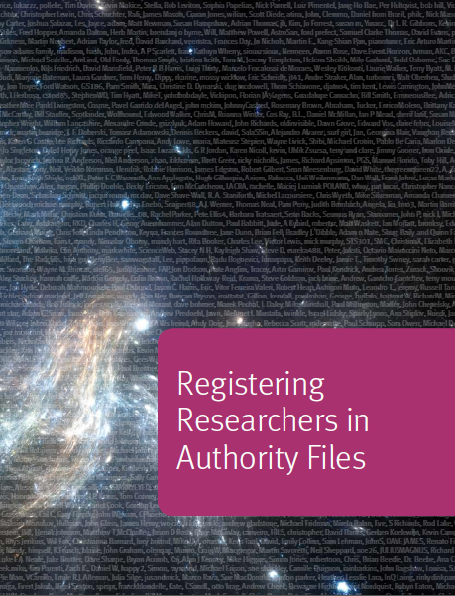
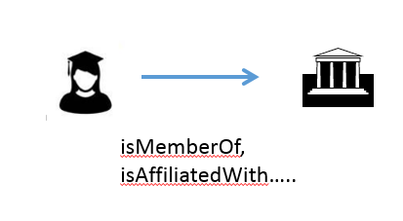
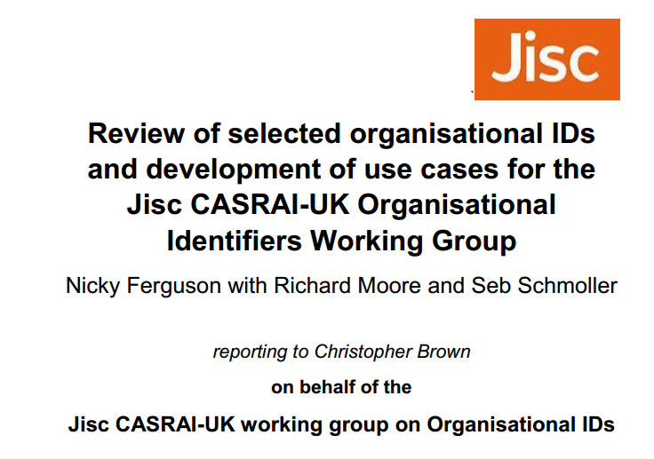
Previous work
Notes:
The current work on organizational identifiers is an outgrowth of the previous work we did with another OCLC Research Library Partners task group on researcher identifiers. That report, Registering Researchers in Authority Files, was published in 2014. In discussing the report with the OCLC Research Library Partnership, it became clear that organizational identifiers were equally important to fulfill some of the needs and use cases, such as better disambiguating names by the researcher’s institutional affiliation. <click>
In the same time frame a Jisc-UK-CASRAI working group was working on organizational identifiers, and we shared our use cases with each other. They were tasked to look at which organizational IDs should be implemented in the UK higher education sector. Its report was published in December 2014. It noted:
“We believe it is useful to separate conceptually the infrastructure element (the provision and maintenance of the orgID itself) and the service element (the services offered both to registrants and to end users of the services).”
“Institutions and others intending or needing to register and/or use orgIDs should use a solution which contains, and contributes to, the minimum data-set curated by ISNI”
Its conclusion:
“The most desirable vision for the future would be for ISNI to emerge as a strong, sustainable and internationally well supported baseline or… ‘bridging’ ID…”
NB: The Consortia Advancing Standards in Research Administration Information (CASRAI) is an international non-profit dedicated to reducing the administrative burden on researchers and improving business intelligence capacity of research institutions and funders.

Slide 4
Identifiers!!!
A unique, persistent and public URI associated with a digital object
Resolvable globally over networks
Unambiguous to use, find and identify the resource.
Examples:
http://id.loc.gov/authorities/names/n79006591
isni.org/isni/0000000123412786
http://viaf.org/viaf/13426768
wikidata.org/entity/Q49108
Identify:
Notes:
Identifiers are a crucial component to make linked data work. We have at our disposal a number of identifiers – the examples here are for the Library of Congress id.loc.gov, the International Standard Name Identifier (ISNI), the Virtual Internal Authority File (VIAF) and Wikidata, the knowledge base operated by the Wikimedia Foundation providing a common source of data that feeds into such projects as different language Wikipedias. <click>
All these identifiers point to the same entity: MIT.

Slide 5
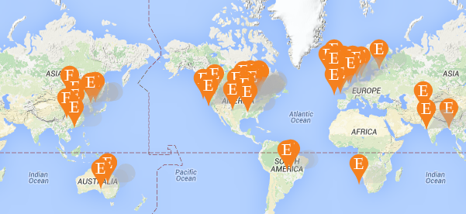
Special challenges with organizations
merges
acquires
Notes:
Here are some of the special challenges presented by organizations. They merge. <click>
They split. <click>
They acquire other organizations or are acquired by them.<click>
They can have branches in multiple locations or countries, and the locations or countries may also change names over time, adding to the complexity.

Slide 6
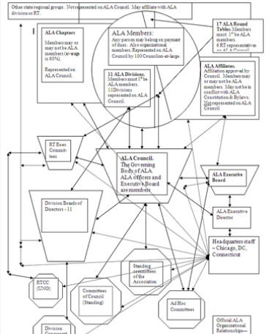
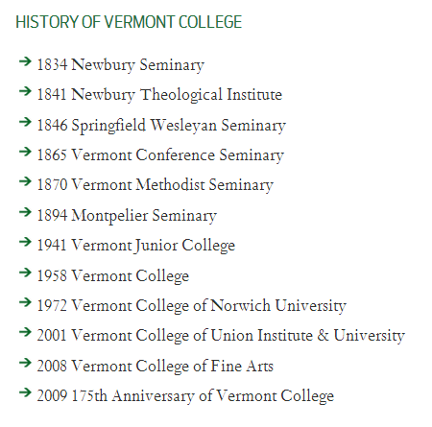
Special challenges with organizations
Notes:
More challenges. Organizations can change names over time and it’s often unclear when a name change represents a new organization. This example for the Vermont College of Fine Arts shows the various name changes it has undergone over its 175 years. <click>
And organizations can have multiple departments or schools, which can also merge, split, or change names. Their hierarchies may change over time and they may have multiple hierarchies. (This is not a real example of an organization chart but what a staff person thought the hierarchy was in practice.)

Slide 7
Different perspectives
Notes:
Different stakeholders can have different perspectives of an organization. For example, publishers tend to focus on the units that subscribe to their publications, which can result in uneven representation of departments or schools within a university.

Slide 8
OCLC Research Task Group on Organisations in ISNI
Karen Smith-Yoshimura OCLC Research (leader)
Grace Agnew Rutgers University
Christopher Brown Jisc (UK)
Kate Byrne University of New South Wales
Matt Carruthers University of Michigan
Peter Fletcher UCLA
Janifer Gatenby OCLC Leiden (ISNI Assignment Agency)
Stephen Hearn University of Minnesota
Xiaoli Li University of California, Davis
Marina Muilwijk University of Utrecht
Chew Chiat Naun Cornell University
Roderick Sadler La Trobe University
John Riemer UCLA
Jing Wang Johns Hopkins University
Glen Wiley University of Miami
Kayla Willey Brigham Young University
With input from Andrew MacEwan, British Library and Anila Angjeli, Bibliothèque nationale de France
Examined 12 use cases; producing sample records for each use case
23 recommendations for the system, for the ISNI-IA, for users
Search guidelines for organisations
Outreach document
Notes:
The OCLC Research task group started meeting in September 2014, and we just published our report. Our focus was on the needs for universities to control their public image and to be correctly linked to their researchers.
We dovetailed our work with the Jisc CASRAI-UK Organisational Identifiers Working Group – the lead, Christopher Brown, is represented on the Task Force. Our report includes examples, use cases, how ISNI addresses the challenges we identified, and an outreach document for academic administrators on the importance of organizational identifiers and the benefits of ISNI membership.

Slide 9
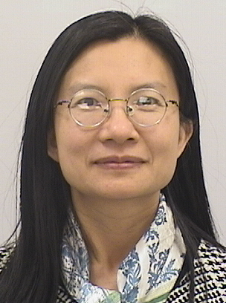
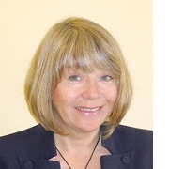
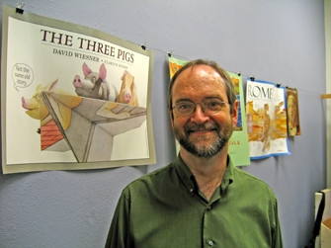
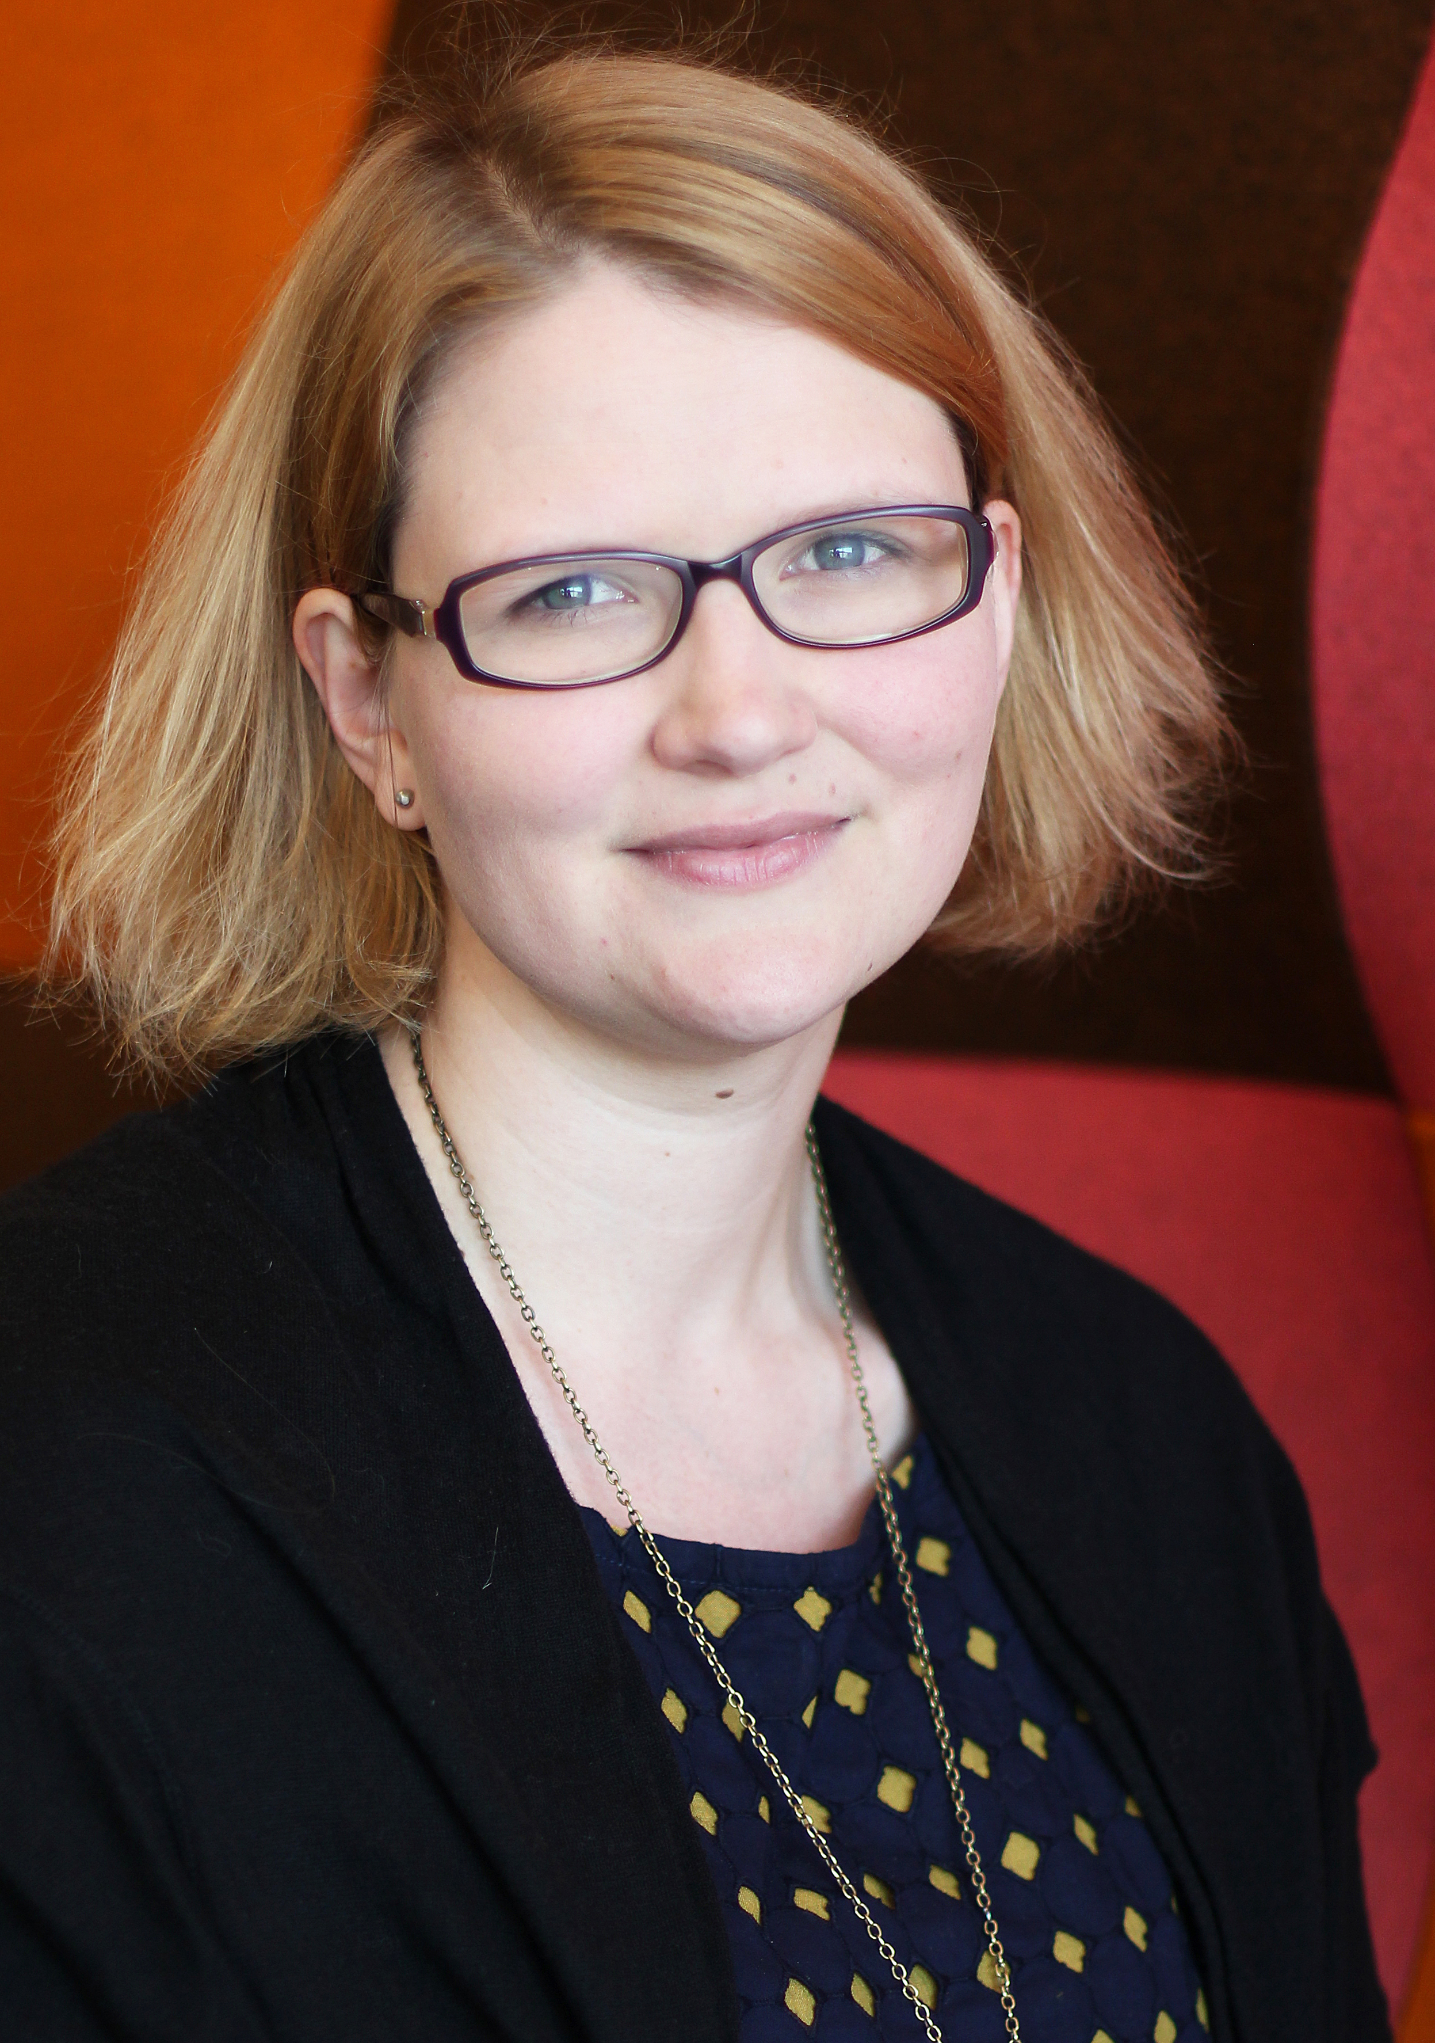
Task group presenters
Jing Wang
Johns Hopkins University
Janifer Gatenby
OCLC
Stephen Hearn
University of Minnesota
Kate Byrne
UNSW Australia
Notes:
Jing Wang is the System Integration Engineer at Johns Hopkins University Libraries and has been working with various library systems including ILS, discovery, and resource sharing systems. She has also worked with the research networking system VIVO for two years. Jing’s involvement with our task group is motivated by the challenge of identity management and entity disambiguation among various independent systems within the research ecosystem. <click>
Janifer Gatenby works on special projects in OCLC’s Leiden office in The Netherlands. Her main project has been establishing the ISNI database and system. During her career at OCLC and previously at library automation organizations, she has contributed to library interoperability standards such as SRU, openURL Request Transfer Message, ISO holdings, ISO data elements, Library Registry (ISO 2146), ISNI, ISCI and Z39.50. <click>
Stephen Hearn is the Metadata Strategist for the University of Minnesota Libraries and has been an advocate for embracing a broader range of sources for registered identifiers for use in cataloging. Library authority files have contributed to the emergence of large clustered ID registries like the Virtual International Authority File and ISNI. Stephen's involvement with the ISNI Task Group is motivated by a desire to understand the relationships between ID registries and their entity representations and to promote the use of identifiers on campus and beyond. <click>
Kate Byrne is the Manager of Research Reporting at UNSW Australia, where she manages its research information management system, Symplectic Elements. Her unit explores how UNSW Australia can implement and integrate emerging research support tools such as Altmetric for Institutions, ORCID and ISNI so that data collected can be reused for many different purposes. She joined the task group to contribute to solving the challenges posed by unclear affiliations data in the 20,000 research publications produced by UNSW researchers each year.

Slide 10
Jing Wang
Use cases

Slide 11
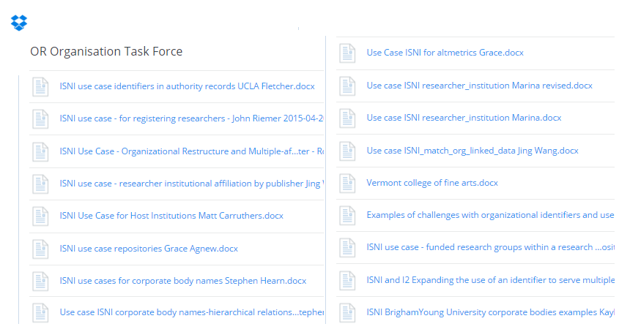
Use cases and examples
Notes:
ISNI serves diverse stakeholders, which can have different perspectives. Understanding the context and identifying use cases were this task group’s first goals. We were charged to develop use cases specific to library and academic needs and then determine how ISNI records could address them.
The task force members examined 12 use cases and provided sample records for these use cases. Use of ISNIs within a linked data environment and different approaches to identifying entities are incorporated within some use cases.

Slide 12
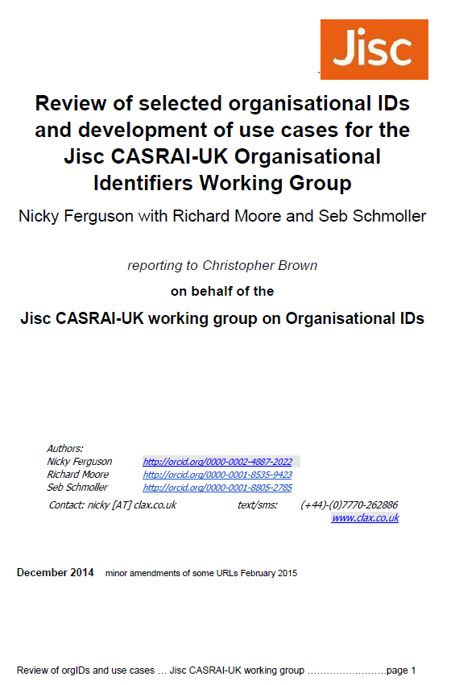
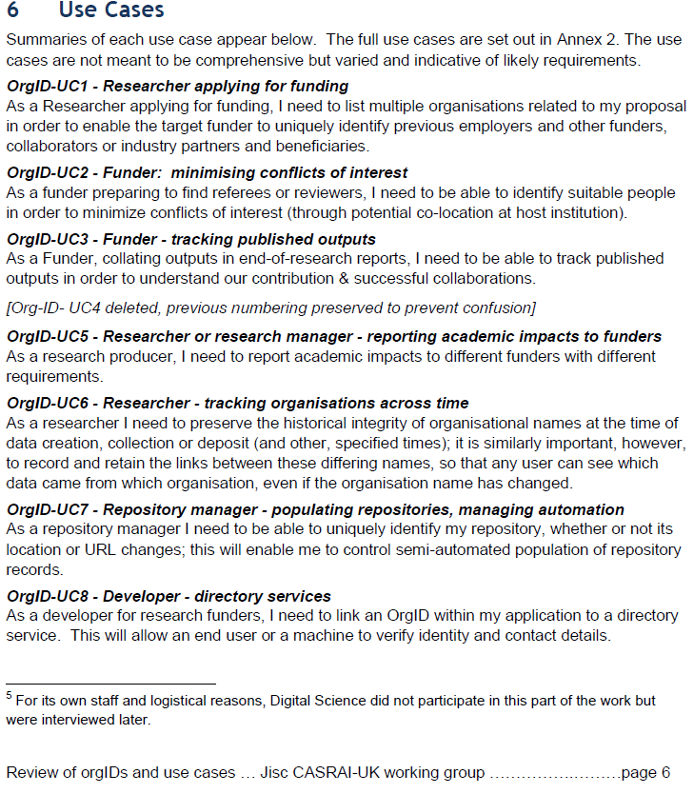
Notes:
The Jisc CASRAI-UK Organisational Identifiers Working Group and our task group worked in parallel on organizational identifier use cases. The Jisc CASRAI-UK Working Group reviewed a core set of organizational identifiers (including ISNI, Ringgold, Digital Science and UKPRN) and developed a set of use cases based on the research lifecycle.

Slide 13
8. Include multiple organizations related to the proposal for funding
9. Populate the repository and manage automation
Researcher group
Repository manager
6. Ensure all my output is accurately attributed to me
11. Match organizations in linked data environment
7. Track organizations across time
Researcher
Software developer
10. Add identifiers to authority records
3. Accurately identify researchers’ affiliation in publication
Metadata curator
Publisher
2. Minimize conflict of interest
1. Diffuse accurate organization description
4. Track published outputs
Funder
5. Aggregate the scholarly output of all my institution and selected subset
Academic Institution
12. Manage rights for the correct organization
Right agency
Notes:
We found much overlap between the two sets of use cases, and consolidated the two sets into this set of twelve, mapped to their respective stakeholders.

Slide 14
8. Include multiple organizations related to the proposal for funding
9. Populate the repository and manage automation
Researcher group
Repository manager
6. Ensure all my output is accurately attributed to me
11. Match organizations in linked data environment
7. Track organizations across time
Researcher
Software developer
10. Add identifiers to authority records
3. Accurately identify researchers’ affiliation in publication
Metadata curator
Publisher
2. Minimize conflict of interest
1. Diffuse accurate organization description
4. Track published outputs
Funder
5. Aggregate the scholarly output of all my institution and selected subset
Academic Institution
12. Manage rights for the correct organization
Right agency
Notes:
Research groups comprised of staff from multiple organizations need to track these organizations in funding proposals so that target funder can identify previous employers, other funders, collaborators, industry partners and beneficiaries.

Slide 15
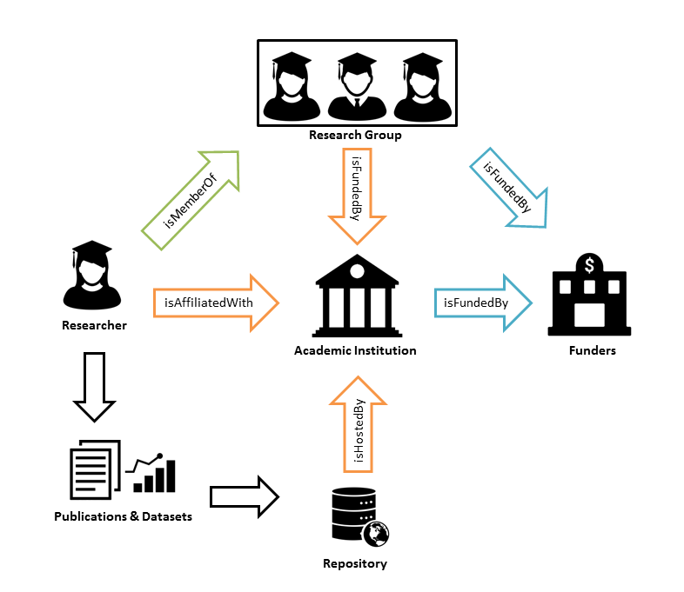
Notes:
We have diagrammed the complex relationships among a research group and its associated academic institutions, repository and funding agency.

Slide 16
8. Include multiple organizations related to the proposal for funding
9. Populate the repository and manage automation
Researcher group
Repository manager
6. Ensure all my output is accurately attributed to me
11. Match organizations in linked data environment
7. Track organizations across time
Researcher
Software developer
10. Add identifiers to authority records
3. Accurately identify researchers’ affiliation in publication
Metadata curator
Publisher
2. Minimize conflict of interest
1. Diffuse accurate organization description
4. Track published outputs
Funder
5. Aggregate the scholarly output of all my institution and selected subset
Academic Institution
12. Manage rights for the correct organization
Right agency
Notes:
A repository manager needs to identify uniquely the institution’s own repository, including its location and URL changes, to maintain ownership and chain of custody for resources that may not belong to the hosting organization. This helps to automate ingesting standardized metadata.

Slide 17
8. Include multiple organizations related to the proposal for funding
9. Populate the repository and manage automation
Researcher group
Repository manager
6. Ensure all my output is accurately attributed to me
11. Match organizations in linked data environment
7. Track organizations across time
Researcher
Software developer
10. Add identifiers to authority records
3. Accurately identify researchers’ affiliation in publication
Metadata curator
Publisher
2. Minimize conflict of interest
1. Diffuse accurate organization description
4. Track published outputs
Funder
5. Aggregate the scholarly output of all my institution and selected subset
Academic Institution
12. Manage rights for the correct organization
Right agency
Notes:
Academic institution administrators want to aggregate the scholarly output of all the institution’s researchers for both internal and external reporting. They want to include output of researchers who are part of multi-institutional research groups. Consistent use of organizational identifiers regardless of the forms of name used will help optimize searching and retrieval from databases and search engines.

Slide 18
8. Include multiple organizations related to the proposal for funding
9. Populate the repository and manage automation
Researcher group
Repository manager
6. Ensure all my output is accurately attributed to me
11. Match organizations in linked data environment
7. Track organizations across time
Researcher
Software developer
10. Add identifiers to authority records
3. Accurately identify researchers’ affiliation in publication
Metadata curator
Publisher
2. Minimize conflict of interest
1. Diffuse accurate organization description
4. Track published outputs
Funder
5. Aggregate the scholarly output of all my institution and selected subset
Academic Institution
12. Manage rights for the correct organization
Right agency
Notes:
Both publishers and funders need to accurately identify researchers’ affiliations, not only for publications, but also to minimize conflicts of interest when finding referees or reviewers.

Slide 19
Research Ecosystem
8. Include multiple organizations related to the proposal for funding
9. Populate the repository and manage automation
Researcher group
Repository
manager
6. Ensure all my output is accurately attributed to me
11. Match organizations in linked data environment
7. Track organizations across time
Researcher
Software developer
3. Accurately identify researchers’ affiliation
10. Add identifiers to authority records
Publisher
2. Minimize conflict of interest
1. Diffuse accurate organization description
Metadata curator
Funder
4. Track published outputs
Academic Institution
5. Aggregate the scholarly output of all my institution and selected subset
Rights agent
12. Manage rights for the correct organization
Notes:
These use cases are inter-connected. The benefit of using organizational identifiers might not be apparent within one system or one institution, but is more apparent when we look at the business process and information flow in the research ecosystem as a whole. Like a natural ecosystem, various systems co-exist in a mutually beneficial relationship. In the inter-connected web of a research ecosystem, a well-maintained organizational identifier is the responsibility of everyone and benefits everyone.

Slide 20
Enterprise directory
D1. Update organizational names and relationships
Metadata curation
C1. 1. Curate organizational data
D2. Get ISNI orgID
ISNI API
D3. update affiliation data
C1.2. Curate affiliation data
P6. Get ISNI orgID
C1. Curate compiled metadata
P1 Update profile
<<Data Flow>>
Curator
Researcher
P2 Submit manuscript
C1.3. Collect publication metadata
<<Data Flow>>
P3. Verify affiliation
Editorial Software
A1. Aggregate data
<<Data Flow>>
<<Data Flow>>
<<Data Flow>>
P4. Publish work
Administrator
Publisher
P5. Publish Metadata
A2. Analyze data
Publishing System
Analytics system
Notes:
Identifiers are needed throughout the workflow from researcher submission of manuscript to the final publication to the subsequent curation of the document and its related metadata and finally the analytics conducted to assess impact. This figure illustrates possible workflows associated with publishing a manuscript and the end-to-end data flows within the research ecosystem, among an enterprise directory, a publishing system, metadata curation and an analytics system. Once a researcher’s affiliated organization is assigned an ISNI identifier either by the institution itself (labelled D2), or by a publisher (labelled P6), the ISNI organizational identifier is captured in the publishing system’s manuscript submission processes (labelled P1, P2 and P3). This will then link the ISNI identifier to the author and the publication in the publication metadata, and included automatically within the existing flow of publication metadata to metadata curation and analytics (labelled P5, C1.3 and A1). Embedding the organizational ISNI into these workflows enable academic administrators to track and analyze the intellectual contribution and the impact of their researchers more accurately, efficiently and comprehensively (labelled A1 and A2). The generation and capture of ISNI organizational identifier can be included in other processes of research lifecycle such as grant submission. The publishing system and activities can be substituted with a grant management system to illustrate the data flow of ISNI organizational identifiers in the context of grant management.

Slide 21
Janifer Gatenby
How ISNI addresses use cases

Slide 22
cross-domain
not for profit
bridging-domains
Text Rights
Trade Sources
Music Rights
Archives and Museums
Encyclopaedias
Libraries
Researchers & Professional
Granting organisations
Professional Societies
Article databases
Theses databases
Notes:
ISNI, the globally recognized and adopted standard approved by ISO for the unique identification of the public identities of persons and organizations across all fields of creative activity.

Slide 23
Quality Team
Registration Agencies (RAGs)
Members
Data Contributors
Partnerships
Notes:
ISNI is a non-profit, community-driven network with contributors representing a broad range of domains such as libraries, rights agencies and publishers. ISNI is managed and curated centrally and offers identifiers that are neutral and international in scope, independent of any single platform. Data collected from cross-domain contributing sources include identifiers contained in local systems. ISNI can serve as a hub to link local and global environments and act as a bridging identifier that connects outputs with their creators across the entire scholarly publishing ecosystem. ISNI’s organizational identifiers are already used to identify organizations within ORCID and are disseminated in Wikidata.
More than 500,000 organizations have public ISNI identifiers in the ISNI database.

Slide 24
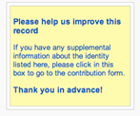
ISNI System
Public
Linked data: Persistent URL
Web enquiry
Request corrections & additions
SRU Enquiry API
View all assigned
Members
Linked data: Persistent URL
Web enquiry
Make corrections, additions & merges
SRU Enquiry API
View all non restricted data
Atom Pub API for requests and replaces
Notes:
The Task Group evaluated the current ISNI system in terms of how easily a specific organization could be retrieved from the ISNI database, how an organization’s structure, history and affiliations could be represented, and how easily the staff of an organization could create and enrich data using the system. The existing system and database offer all the necessary basic components, including online data input, data input via API, batch loading, online search, persistent URI and search via API. The public interface solicits corrections and enrichments via crowd sourcing and this input is monitored and verified by the ISNI Quality Team.
Linked data data dumps approved by ISNI-IA Board, forthcomimg.

Slide 25
Organization metadata
Name
Name variant
Name use
Dates
UN LOCODE
Org. Type
URL
Source of each element
Confidence level
Language of name
Language of identity
Links – Persons,
organisations
Relationship type,
Relationship date
Notes:
ISNI Data Element Values includes established lists for such things as organisation type, name use and relationship type.
The document is currently available on the web site and a machine readable marked up copy has been made for free distribution.

Slide 26
Ohio College Libraries Center 1967 - 1989 Online Computer Library Center 1989- OCLC Incorporated 1989-
Acquisitions
Name variants
0000 0001 1482 1326
 | Name Variant | Acquisition date
Western Library Network | WLN | 1999 | 0000 0001 1703 5400
CAPCON | OCLC Eastern | 2003 | 0000 0001 0443 2618
Fretwell Downing | FDI | 2005 | 0000 0004 0637 162X
Research Libraries Group | RLG | 2006 | 0000 0004 1366 8771
Openly Informatics Inc |  | 2006 | 0000 0004 0588 1257
PICA BV | OCLC PICA, OCLC EMEA | 2007 | 0000 0001 2154 374X
Bond GmbH & Co. KG |  | 2011 | 0000 0004 0480 5455
Acquisitions
(relationship type acquired with link to acquired organisation
Notes:
I am now going to illustrate different scenarios and how they can be represented in ISNI. Starting with an organisation that has grown over time with many acquisitions, using OCLC as an example. OCLC’s primary mission did not change when it acquired other organisations, and so OCLC retains a single ISNI. Each acquired organization merits its own ISNI with a link to the OCLC ISNI as a related name with a relationship type of “acquiredBy”. Similarly, the OCLC record has links to the organizations it acquired. This figure shows some of the acquisitions that would be included in the OCLC record, with some of the individual ISNIs assigned.

Slide 27
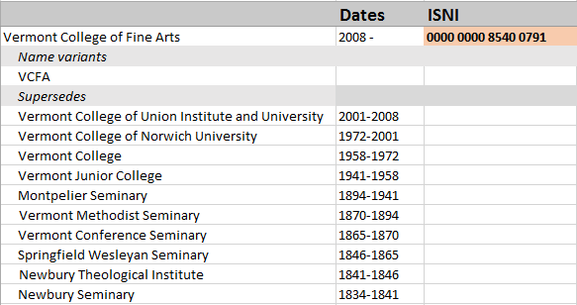
Name Changes, Same Identity
Notes:
You have already seen this example in Karen’s presentation. Vermont College is an example of an organisation that has undergone many name changes. Although the focus of the institution has changed over the years from theology to fine arts, the Vermont College of Fine Arts considers itself to be one identity. Therefore, ISNIs have not been assigned to former names. Adding date attributes in the ISNI record allows the indication of previous names.

Slide 28
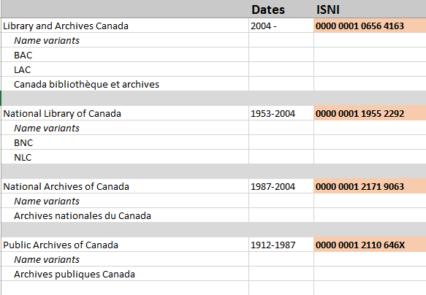
Name Changes, New Identities
Supersedes
Notes:
Library and Archives Canada is an example of two distinct organizations (each with its own ISNI) merging into a new organization with a new ISNI. Each of the previous organizations—the National Library of Canada and the National Archives of Canada—has a “isSupersededBy” relationship with Library and Archives Canada.

Slide 29
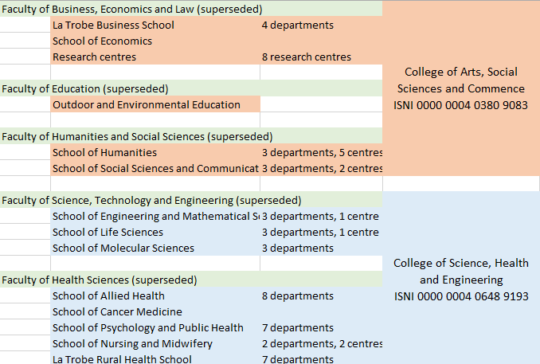
Organisation Hierarchy & Restructure
ISNI 0000 0001 2342 0938
Notes:
La Trobe University provides a current use case of an organization undergoing a major restructuring. The staff stay where they are but their affiliations change around them. In this case, the departments and research centres that were a “UnitOf” a faculty are now a “UnitOf” a new college. Each of the five faculties has a “isSupersededBy” relationship with the new College.

Slide 30
Recommendations: Data Model
Additional values for existing data elements
Organisation type
Name use attributes
Relationship types
Publish as a machine readable ontology
Notes:
The task group assessed the system specifically from the viewpoint of the representation of organizations and concluded that extending the existing data model and defining additional data values would improve the representation of organizations within the database.
A document already exists showing defined data element values. A machine readable ontology will be produced.

Slide 31
Recommendations: Search
SRU API
All non sensitive information for organisations
Exploit “family search” (search extended with links)
More encoding options
N-triples
turtle
Notes:
The SRU API (Search and retrieve via URL http://www.loc.gov/standards/sru/ ) allows access to the ISNI database using multiple access points.
Make sure that all publically available data is available via the API.
Exploit the software’s existing ability to expand a search using links. This will ensure retrieval regardless of the level of granularity in the search term. Stephen will elaborate more on granularity shortly.
SRU outputs XML currently. More encoding options are recommended by the Task Group.

Slide 32
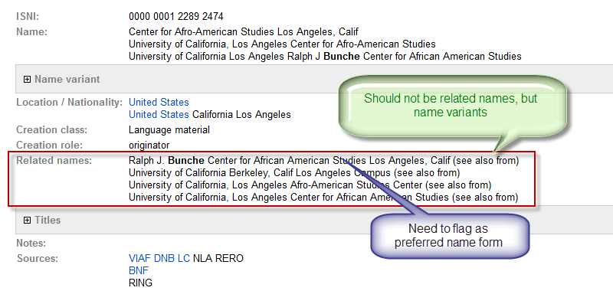
Recommendations: Display Preferred Name
Notes:
ISNI data is amassed from multiple sources, in this case from the German, French and Australian national libraries, the Library of Congress, a Swiss university library network and from Ringgold, a commercial vendor. Each source has different practices for defining a principal name, name variant and related name. This case illustrates the need for the institution itself to flag the preferred name and to normalize the collected data. The source of each line of data is visible under the ISNI system’s tab, “Sources Data”.

Slide 33
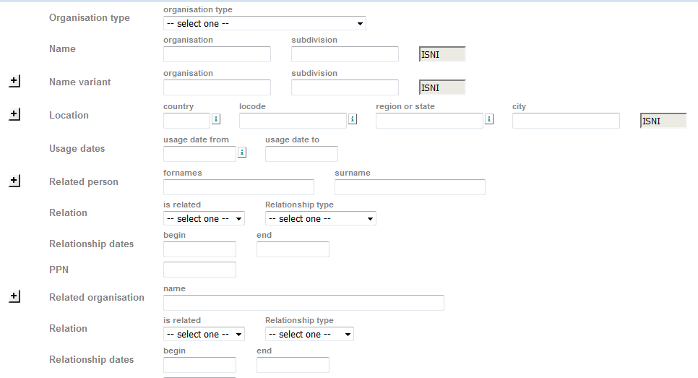
Recommendations: Data Collection
Verified by Organisation
Data Collection form in public interface
Notes:
Recommendation: Allow an organisation to indicate its preferred name form. Obviously this is not mandatory and there may be multiple preferred name forms, e.g. in bi-lingual and multi-lingual countries.
The general public are currently able to input free text comments. More precise input could be encouraged by making a form available as an option.

Slide 34
Interoperability with NACO
NACO requires a new record for each name form
An ISNI will treat them as name variants if the IDENTITY remains unchanged with a name change
Therefore need one ISNI to many NACO
Define new status for associate records linking to an ISNI. Such records are distributed but not used in matching.
Notes:
NACO is a name authority file maintained by the Library of Congress and hundreds of libraries world-wide, including the British Library.
Take the example of Vermont College. There is only one record in ISNI but there are multiple NACO records. The recommendation to accommodate one-to-many relationships will allow, for example, multiple library authority records for name changes to relate to one ISNI correctly.

Slide 35
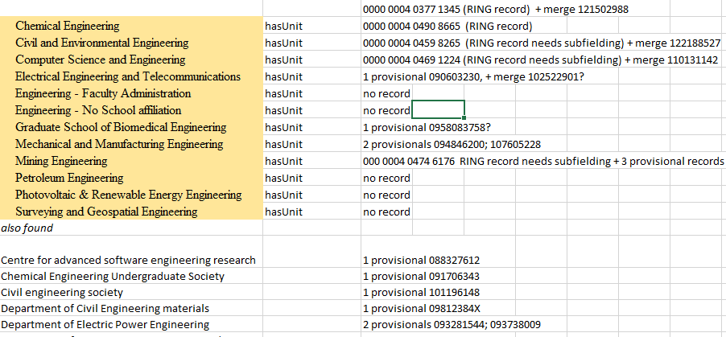
Documentation
More FAQs recommended
Search guidelines
How to Optimize the Representation of an Organisation
Notes:
The Task Group made two technical documents for consideration, organisation search guidelines and a “how to” document for organisations wanting ISNIs for their structure.
In addition a list of topics for which FAQs could be created was offered:
how records can be enriched and linked
explaining the relationship of ISNI and ORCID – pointing to the information under ISNI Community
explaining ISNI for institutions versus ISNI for individuals
explaining NACO/VIAF/ISNI update process.
outlining ISNI’s policy on when there is a new identity and how ISNI treats one-to-many relationships.

Slide 36
Stephen Hearn
Issues

Slide 37
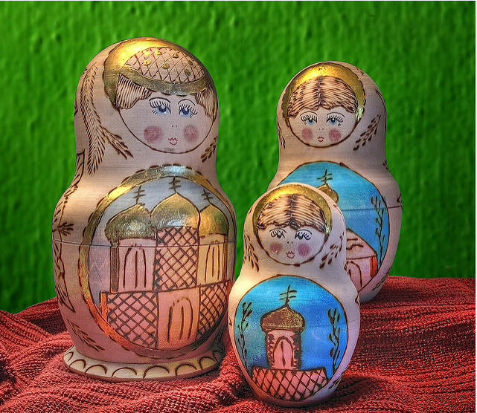
ISNI issues: Same or Different?
Inside Mamuschka / S. Faric, CC-BY license, Flickr
The Three Dolls / Randen Pedersen, CC-BY license, Flickr
Notes:
The ISNI database aggregates entity records from a number of agencies, records which were built to satisfy different business needs. A fundamental question is whether the source files regard two instances as different entities or the same entity? For example, if a body changes its name, is it a different body or the same body? This matters because attribute data that is true for one instance may not be true for another, and may not be true for both together considered as a single entity. Given the volumes of data that ISNI has been merging, case-by-case evaluation was not feasible; but algorithmic process may have made less than ideal choices when aggregating entity representations. ISNI has made good progress in developing ways to represent its source data entities within a holistic framework; but that framework itself may differ from some of the expectations of ISNI users. The task group on ISNIs for organizations in cooperation with the ISNI organization has worked to clarify how the organization can negotiate differences among its source registries and determine a set of policies that best meet its own goals as a bridge ID registry.

Slide 38
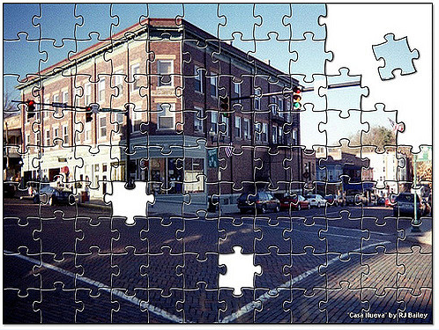
ISNI issues: Incompleteness
Casa Jigsaw / Ron Bailey, CC-BY license, Flickr
Notes:
Another consequence of being built via aggregation is that ISNI may have gaps in its representation. Some of a body’s units may have ISNI records, but not all. Some of a body’s names over time may be represented, but not all. As they contemplate using ISNIs, organizations need to determine whether any entities considered important for identification are omitted from ISNI and need to be registered there.

Slide 39
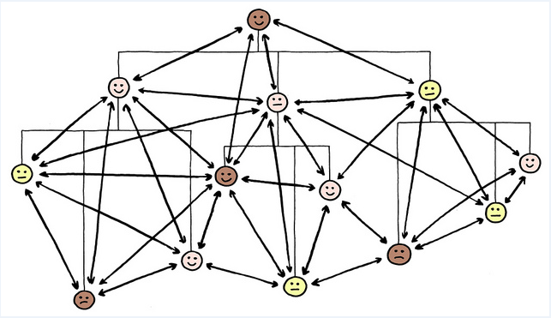
ISNI issue: Hierarchy and connections
Figure 13.9, Both network (for communication) and hierarchy (for authorization) / Jurgen Appelo, CC-BY license, Flickr
Notes:
Corporate bodies can have complex networks of relationships with other entities, networks reflecting corporate hierarchy, sponsorship, funding, affiliation, and other kinds of connection. ISNI is still exploring and developing policies and vocabularies for which types of connection should be represented in ISNI.

Slide 40
ISNI issues: Preferred name
Name cards / Geoffrey Fairchild, CC-BY license, Flickr
Notes:
Organizations typically have a variety of names—a formal name, a legal name, a brief name, a logo name. They may be known by a wider variety of names in different languages or in relation to specific business cases. In ISNI, the ISNI identifier itself is the primary name, intended to uniquely identify that entity; but necessarily the ISNI number must be paired with one or more human-friendly names. ISNI is working on options to ensure that appropriate indications of corporate preference or use context can be associated with the names it lists for corporate entities; but assistance from those entities will be essential to the task.

Slide 41
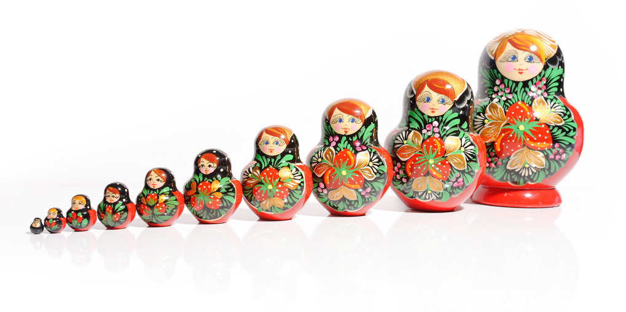
ISNI issues: Granularity
Mamuschka / S. Faric, CC-BY license, Flickr
Notes:
While ISNI by policy prefers to treat many kinds of name changes over time as simple name variants for a single entity, it also accepts representations from its entity data sources that vary widely in granularity. Institutions seeking to use ISNI to aggregate the record of the institution’s publications need to be aware the level of granularity at which an institution’s identity is expressed can determine how easily the aggregate record can be assembled.

Slide 42
How to use ISNI and ISNI identifiers
An identity registry, not a profile service
Serves many users, not primarily the entities named
Engagement with ISNI can ensure a better representation for the institution and its units
Corporate bodies can make policy decisions about:
Which ISNIs to promote through PR and for use by faculty, researchers, corporate units
Which entity relationships to express, inside or outside ISNI
Promoting the use of preferred institutional ISNIs to corporate partners
Cross-registering ISNIs in other identity registries of use to the institution
ISNIs and other identifiers promise more accurate recognition and representation for corporate bodies in the semantic web—but it won’t happen automatically.
Notes:
The task group has prepared a document for those considering why and how to engage with ISNI as part of its goal of increasing awareness and use of ISNIs for organizations.

Slide 43
Kate Byrne
Case study at UNSW Australia

Slide 44
Art & Design, Engineering, Arts &Social Sciences, Law, Medicine, Built Environment, Business School, Science, UNSW Canberra at ADFA
Notes:
UNSW is a large and diverse university like many in the Australian academic community. We have over 53,000 students including over 4000 HDR students, over 9000 staff and research affiliates and over 525 million dollars in research income.
UNSW includes 9 Faculties and within that nearly 200 school, centres and institutes covering a broad range of disciplines and research expertise.
https://unsplash.com/photos/jeV-LUEyJoE

Slide 45
Notes:
UNSW Library manages a number of research systems on behalf of the University including our institutional repository, our research data management planning tool and our research information management system.
As an organisation, we need to ensure our services are both sustainable and scalable and that we are offering a consistent level of service across our community. Due to the size of our organisation, an emphasis is placed on looking at how research systems can be integrated to ensure that whenever possible data is collected once and reused for many different purposes. In addition we work closely with our Division of Research to ensure policy and practice stay closely connected wherever possible.
Our context as a large and diverse institution has played a significant role in shaping our services and systems including our approach to ISNI.

Slide 46
Publication
Sources
eg Scopus, Web of science, PubMed
HR Info
Grants Info
Institutional repository
Symplectic
Elements
Researcher Identifiers
eg ORCID, Scopus, Researcher ID
Google
Researcher Profiles
HERDC Return
Altmetric for Institutions
Faculty or School web pages
UNSW data warehouse
ERA & other reporting
Notes:
At UNSW, we have already put considerable effort into integrating our systems to be able to reuse data where possible.
For UNSW, Symplectic Element’s is the source of truth for publications produced by UNSW researchers – and we predominantly harvest the information about those publications from a number of publication databases. Once collected in Elements, the data is reused in a number of ways downstream within the university – for example researchers can use Elements to upload their publications to the institutional repository to meet open access mandates.
https://unsplash.com/photos/4aQY2CrXsa8

Slide 47
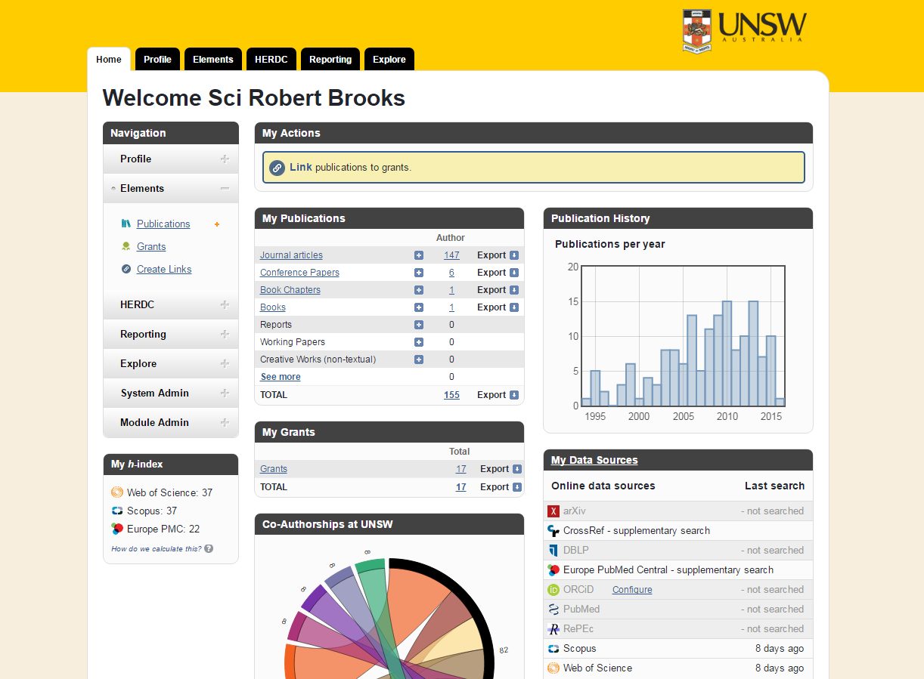
Notes:
Elements harvests publications from data sources like Scopus, Web of Science, PubMed, and Crossref. Each researcher can choose which data sources they feel are most appropriate to their research area.

Slide 48
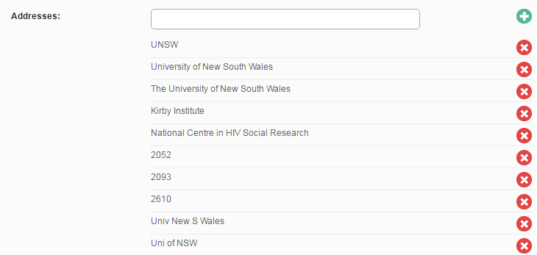
Notes:
The system then uses a number of address settings to search the web for publications with affiliations that match these addresses.
Text searching like this is very challenging as researchers do not always affiliate consistently, and even something as simple as a typo in the affiliation will mean a publication won’t be found by the system.

Slide 49
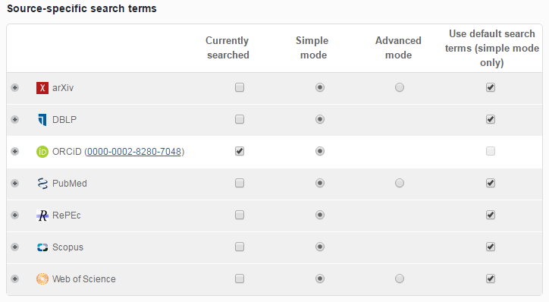
Notes:
Increasingly Elements tackles these issues through the use of researcher identifiers like ORCID, Scopus Author IDs and Researcher IDs which can be added to the system on a researcher by researcher basis.
However we have 15,000 researchers with profiles in our system, so adding them one by one can be a lot of work.
This is what lead to our interest in organisational identifiers like ISNI. If we could replace those text strings with a machine readable identifier for the Organisation, we could not only more effectively collect affiliations – we would be able to analyse that data to find out things like who are our top collaborators much more easily. Plus, we could make information flows between research systems so much easier for everyone.

Slide 50
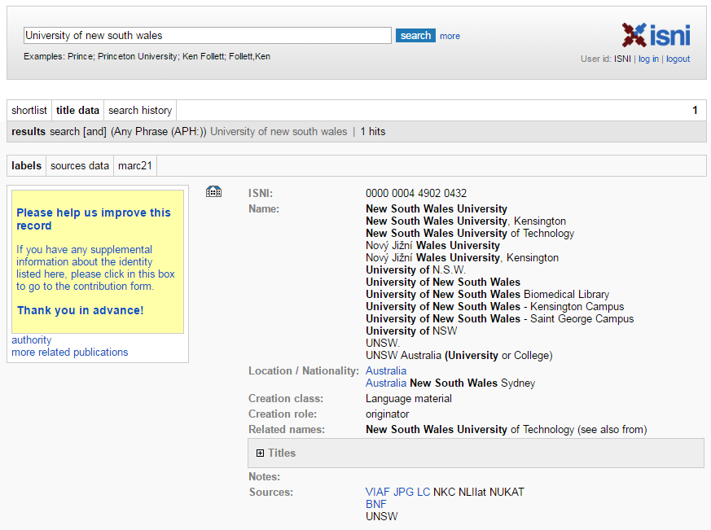
Notes:
In 2015, UNSW Australia became a member of ISNI in order to be able to optimise the representation of our organisation in ISNI.
We started our clean-up by generating a list of the current organisational structure and using this as a basis to search ISNI for possible matches. We located and documented records which matched the existing structure represented former names for existing parts of the structure or represented superseded parts of the structure. Through this process we also identified any gaps in how their existing structure was represented in ISNI.
Using the data we had collected, we developed a structure for the records to represent UNSW within ISNI and a strategy for how we would update the records to reflect this structure.
Stephen mentioned the issue of granularity – and this was an issue we needed to address early on.
As a large university, we needed to make a decision about what degree of granularity we wanted represented in ISNI – as we needed to strike a balance between ensuring there was sufficient granularity to make the representation in ISNI useful and meaningful – but we also need to ensure the records we generated would be sustainable to maintain as the university changed over time.
https://unsplash.com/photos/jR4Zf-riEjI

Slide 51
Notes:
As I mentioned earlier, UNSW has 9 faculties, and nearly 200 schools, centres and institutes. As a result we decided to represent our organisation within ISNI using this record structure:
Each record for both the faculties and the schools within UNSW Australia has an “is unit of” relationship to the UNSW Australia record. In addition, the UNSW Australia record includes “has unit” relationships to each faculty record but not to each school. Each faculty record includes “has unit” relationships to each school.
This was selected as the record structure for a number of reasons. By building the “is unit of” relationship into both the schools and faculties, UNSW Australia is ensuring that if someone locates one of these records, they will be linked back to the top-level UNSW Australia record. However as there is so many schools, centres and institutes, it was decided that the UNSW Australia record would become too convoluted if they included “has unit” links to all of those records.
For former names and superseded units, it was decided to only clean up existing ISNI records and not create new records for missing historical organisational units. New records were only created for missing units from the current organisational structure.
Detailed information about how we worked through the different record types is available in our case study in the document ‘Optimising the representation of an organisational in ISNI’. (See “Deliverables” at http://www.isni.org/content/oclc-research-partners-task-force-representing-organizations-isni)

Slide 52
Notes:
We are keen to use some of the features recommended by the task group – such as being able to indicate our preferred name on a record as Stephen described– so we can further improve these records – which can currently look a little convoluted.
https://unsplash.com/photos/jR4Zf-riEjI

Slide 53
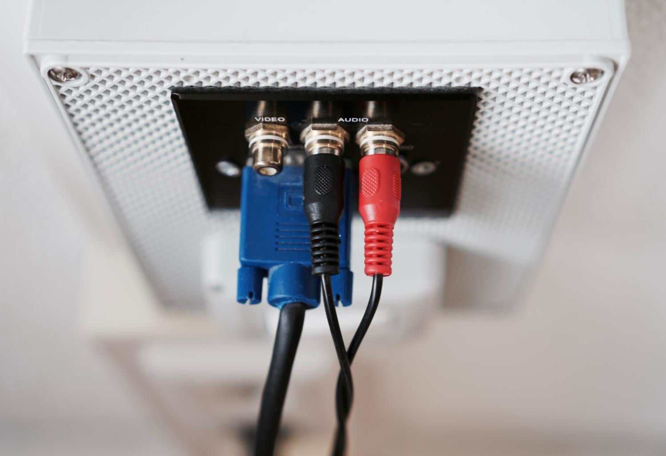
Notes:
We have nearly finished our clean up of UNSW’s records within ISNI, and now we have to wait for more sites to come on board – institutions to help clean up their data and publishers and funders to start using the data.
Infrastructure like ISNI is like any networked system – it only works if both ends of the cable are plugged in.
https://unsplash.com/photos/tFggnfZjhxY

Slide 54
Where to next?
Notes:
As we have been an early member of ISNI, as we have cleaned up our records we have made a number of suggestions to ISNI about how they can continue to refine their system and make it easier to use in the future.
We also contributed to redeveloping the help documentation for representing organisations in ISNI so that others can learn from our experiences.
We plan to undertake an annual review of our records to ensure they stay up to date as UNSW continues to evolve over time.
We look forward to continuing to contribute to this discussion and hopefully helping build some global research infrastructure the world badly needs.
https://unsplash.com/photos/xzZtV9ED5Bs

Slide 55
References
Addressing the Challenges with Organizational Identifiers and ISNI: http://www.oclc.org/content/dam/research/publications/2016/oclcresearch-organizational-identifiers-and-isni-2016.pdf
ISNI: http://isni.org/
Registering Researchers in Authority Files http://www.oclc.org/research/publications/library/2014/oclcresearch-registering-researchers-2014-overview.html
Jisc CASRAI-UK Organisational Identifiers Working Group outputs https://jisccasraipilot.jiscinvolve.org/wp/2015/03/06/organisational-identifiers-working-group-outputs-and-update/
Jisc CASRAI-UK Review of selected organisational IDs and development of use cases for Jisc CASRAI-UK Organisational Identifiers Working Group http://repository.jisc.ac.uk/5853/1/Review-of-orgIDs-usecases-clax.pdf

Slide 56
OCLC Research Webinar, Addressing the Challenges with Organizational Identifiers and ISNI
9 May 2016
Questions?
#orgidreport
Karen Smith-Yoshimura
Janifer Gatenby
Janifer.Gatenby@oclc.org
smithyok@oclc.org
@KarenS_Y
Stephen Hearn
s-hear@umn.edu
Jing Wang
@shearn
jwang40@jhu.edu
Kate Byrne
kate.byrne@unsw.edu.au
@katecbyrne
©2016 OCLC. This work is licensed under a Creative Commons Attribution 4.0 International License. Suggested attribution: “This work uses content from Addressing the Challenges with Organizational Identifiers and ISNI © OCLC, used under a Creative Commons Attribution 4.0 International License: http://creativecommons.org/licenses/by/4.0/.”

