Slide 1
Harnessing the Power of the Crowd:
Crowdsourcing and Community Engagement
at the National Archives
Suzanne Isaacs, Community Manager
National Archives Catalog
suzanne.isaacs@nara.gov
http://www.archives.gov/citizen-archivist/

Slide 2
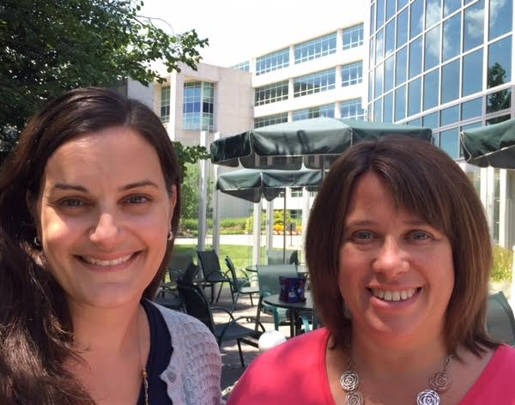
Community Managers
We’re first in line to help customers engage with the Catalog.
We work to create an environment that encourages communication and participation with the records in our catalog.
We get records and information out to users.
We take information in; developing a feedback loop of awareness and engagement that expands the audience for our holdings.
Meredith Doviak & Suzanne Isaacs

Slide 3
Why are We Transcribing and Tagging?
Make Access Happen – Expand access through higher quality information
Connect with Customers – Use engagement to develop a community with anyone interested in our records
Notes:
Indexed on catalog; makes searching better
Allows to interact
Strategic goals

Slide 4
Citizen Archivist Dashboard - National Archives
http://www.archives.gov/citizen-archivist/

Slide 5
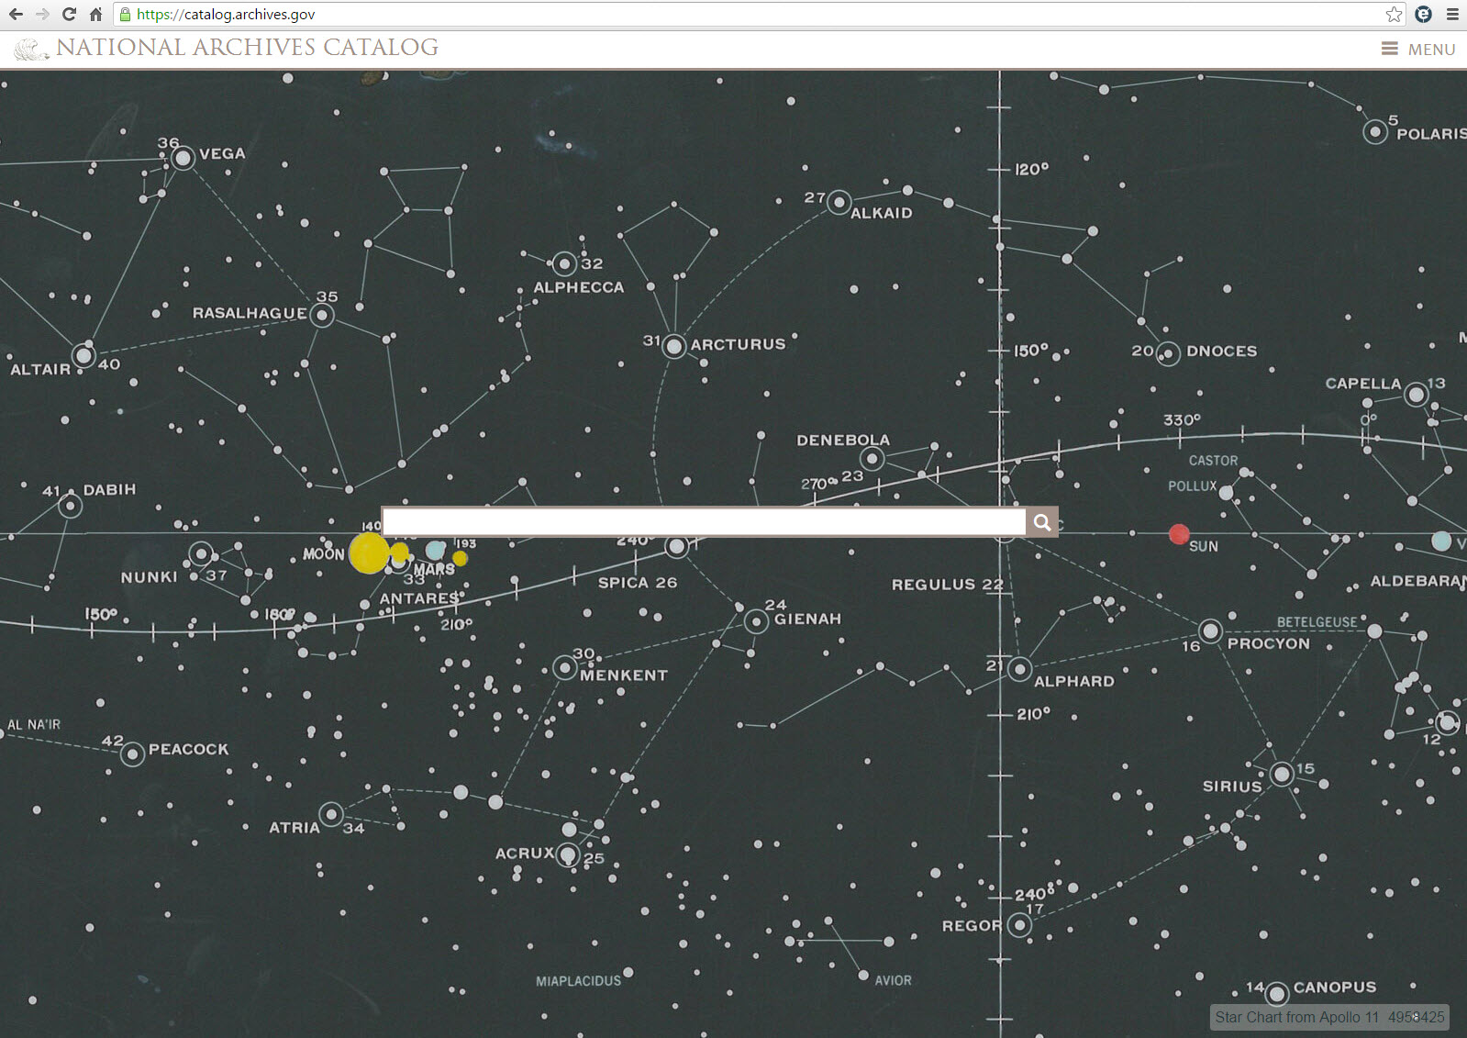

Slide 6
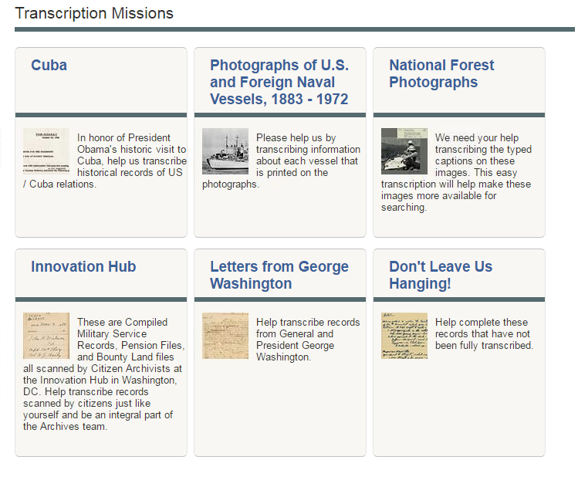
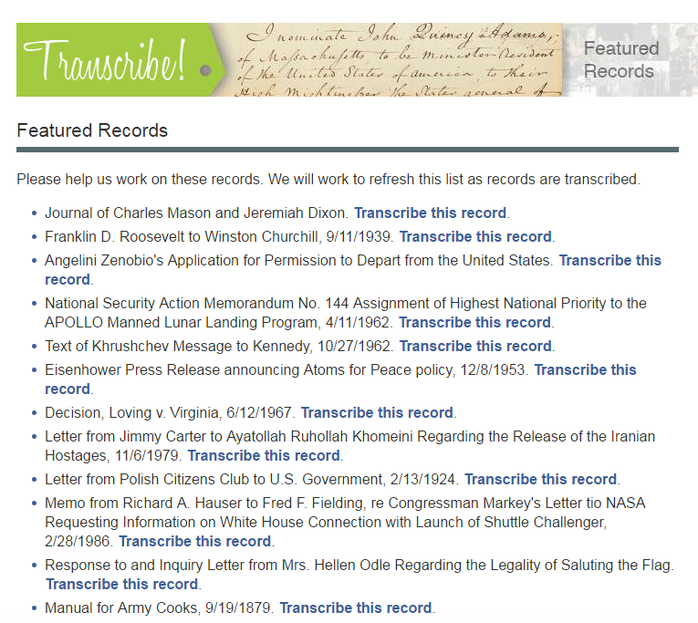
Transcription
http://www.archives.gov/citizen-archivist/transcribe/missions.html

Slide 7
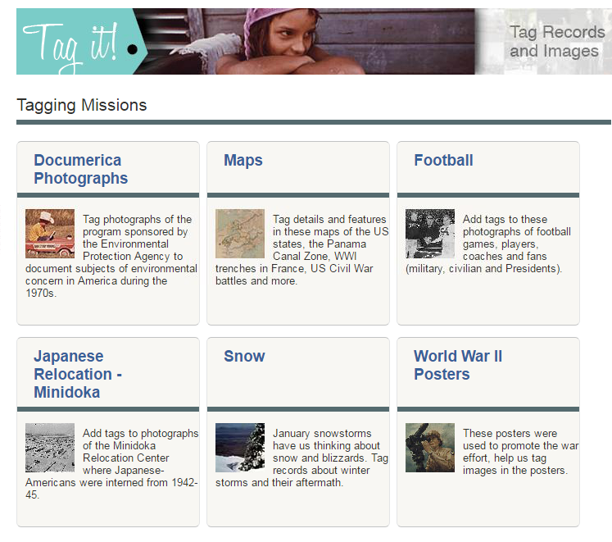
http://www.archives.gov/citizen-archivist/tag/missions.html

Slide 8
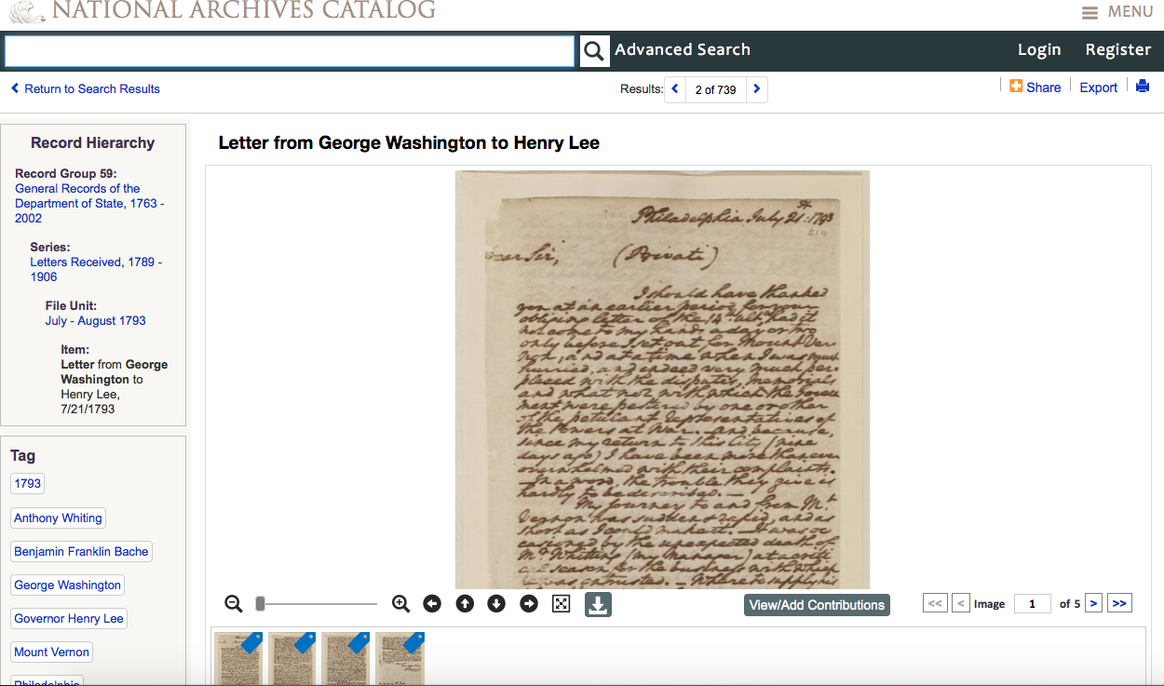

Slide 9
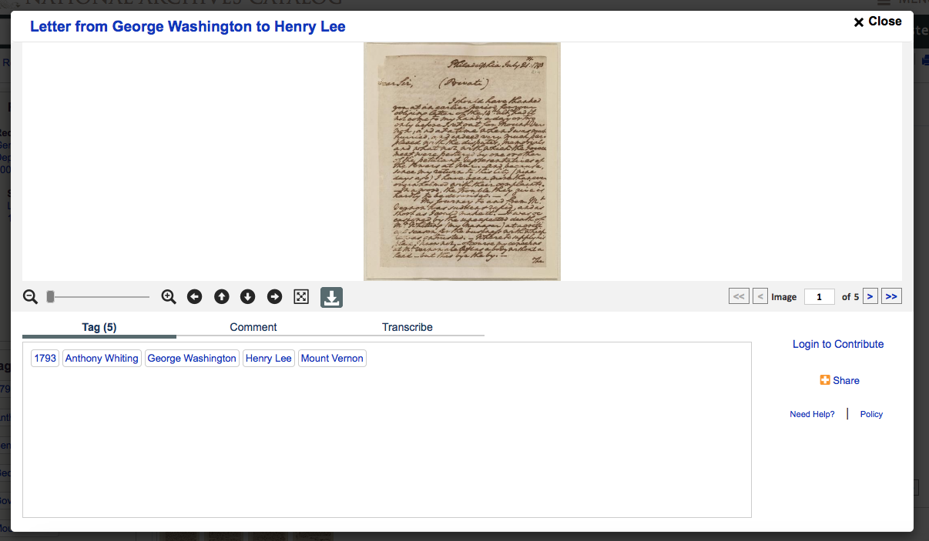

Slide 10
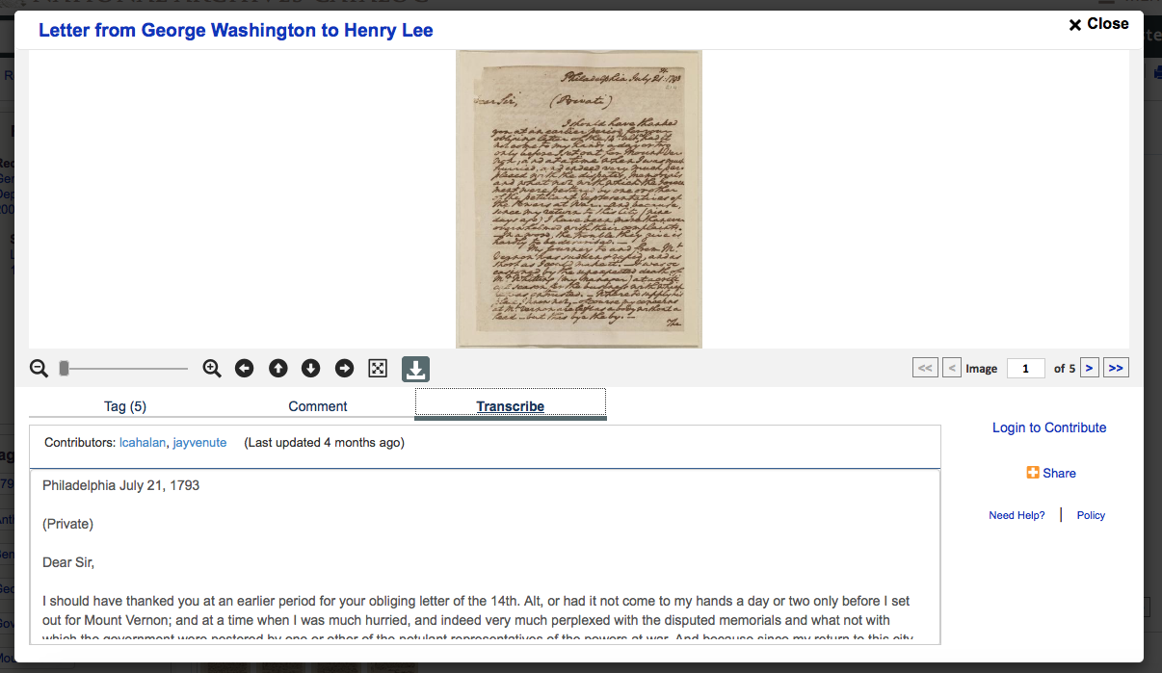

Slide 11
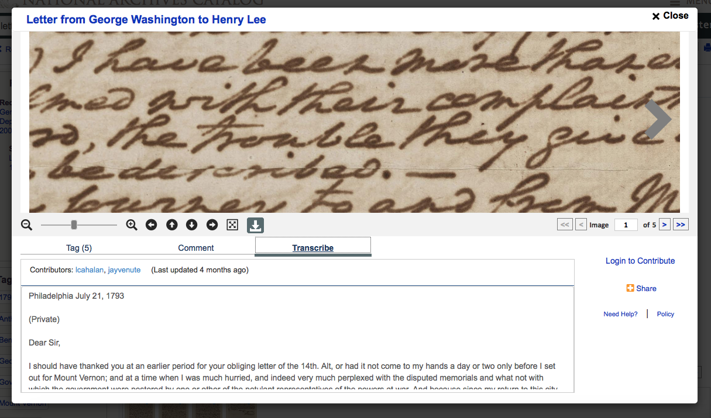

Slide 12
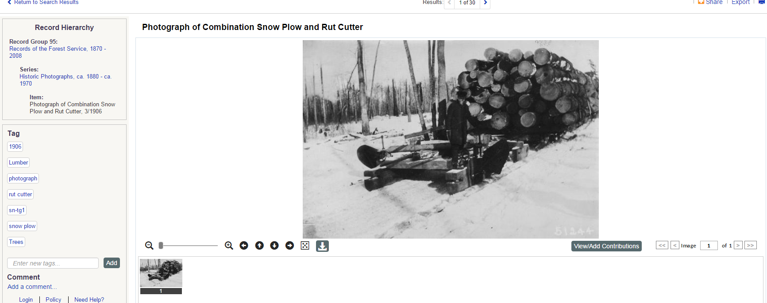
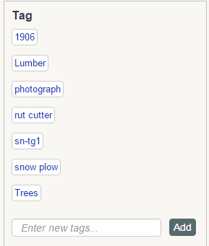

Slide 13
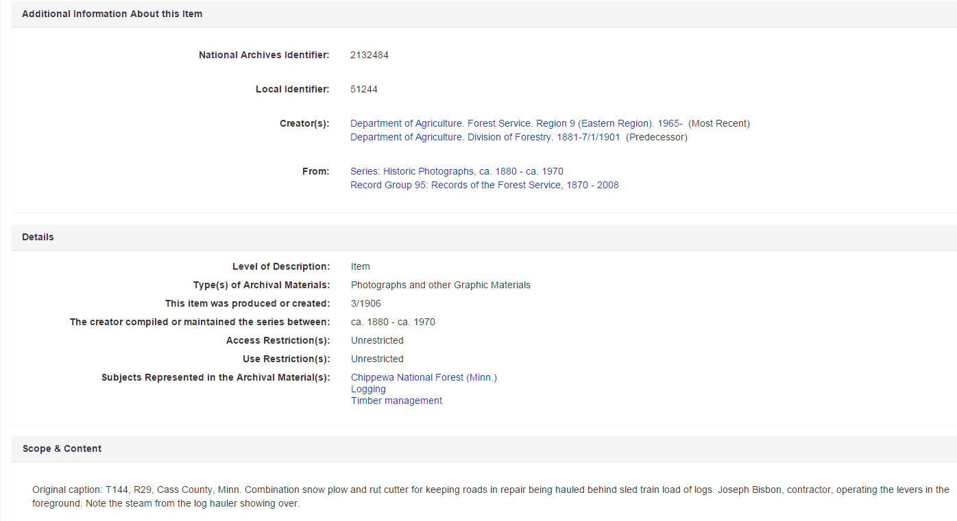

Slide 14
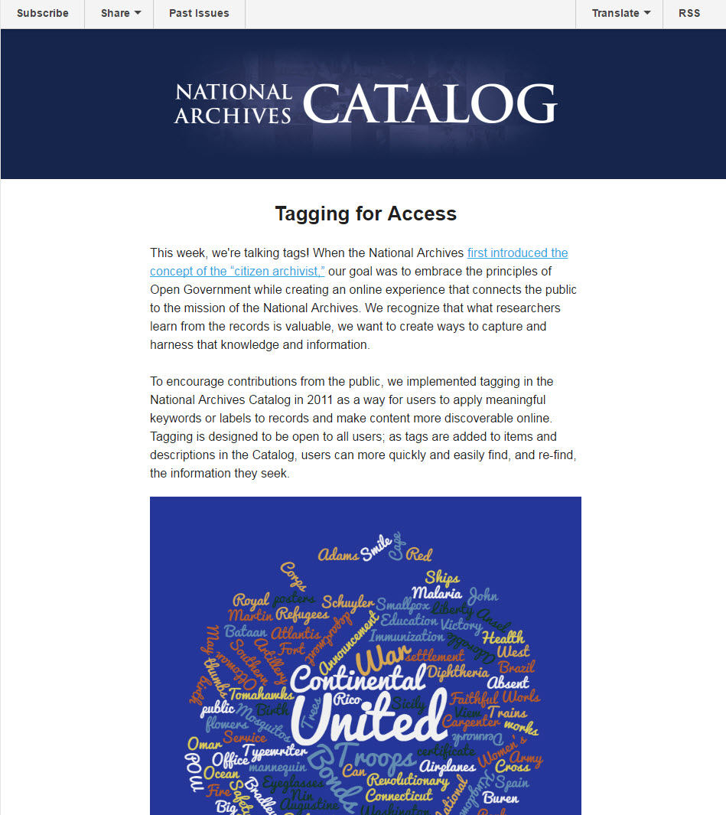
Read this newsletter and subscribe:
http://eepurl.com/b83mb9

Slide 15
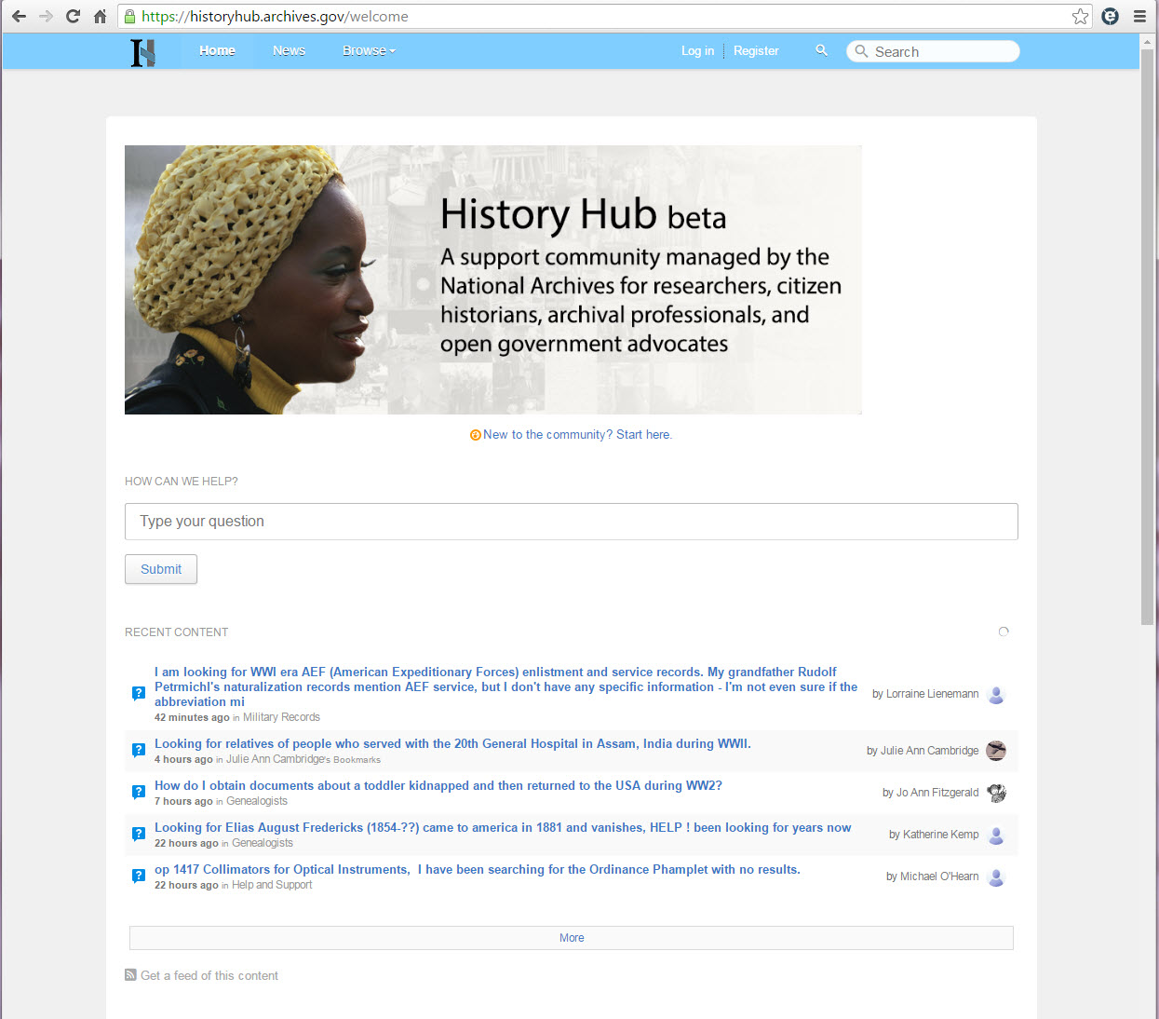
https://historyhub.archives.gov/

Slide 16
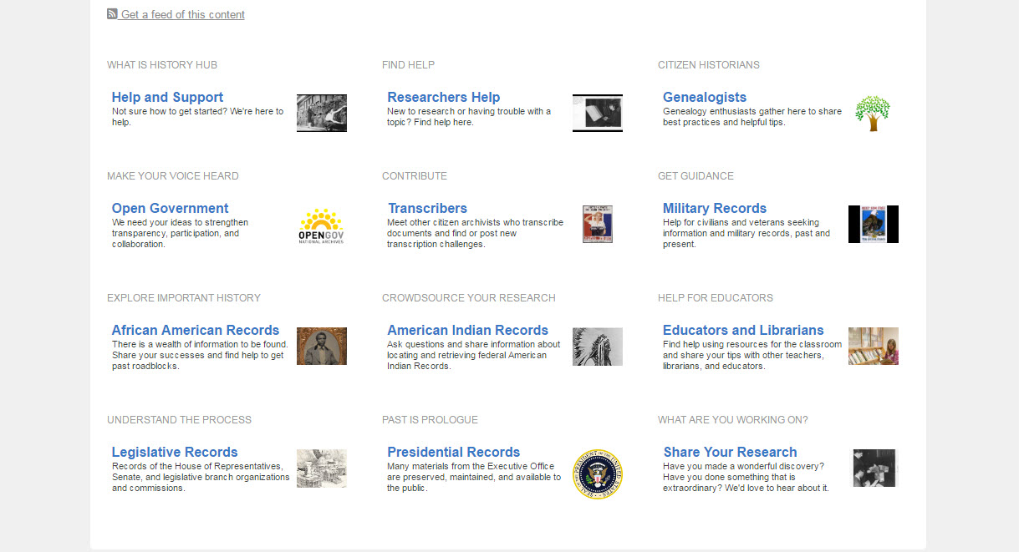

Slide 17
Suzanne Isaacs
suzanne.isaacs@nara.gov

