Slide 1
U. Penn Libraries: OPenn
Doug Emery, emeryr@upenn.edu
Schoenberg Institute for Manuscript Studies
University of Pennsylvania

Slide 2
OPenn philosophy
No mediation — direct access to data
No technical hurdle — no programming required
No legal hurdle — no asking permission

Slide 3
No mediation
Best available digital images and metadata
Accessible via HTTP, anonymous FTP, and anonymous RSYNC

Slide 4
No technical hurdle
No programming knowledge required
Access via:
Web browser
FTP client
Command-line tools: wget & RSYNC

Slide 5
No legal hurdle
Creative Commons (http://creativecommons.org):
Public domain mark
CC0 (CC-zero) — works released into the public domain
CC-BY — Creative Commons Attribution License
CC-BY-SA — Creative Commons Attribution Share Alike
All licenses approved for Free Cultural Works:
https://creativecommons.org/freeworks/

Slide 6
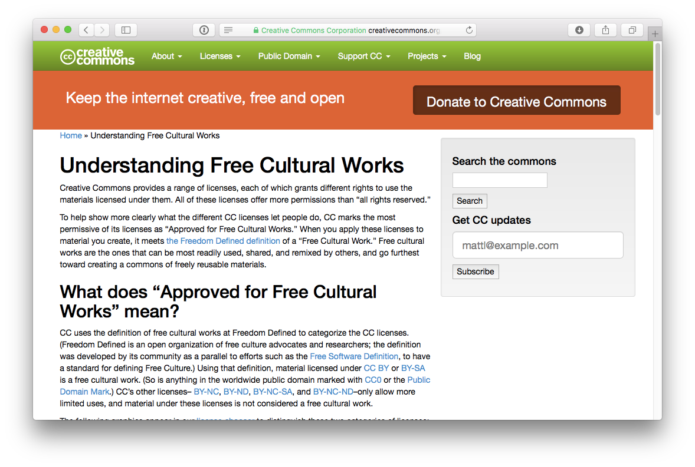

Slide 7
OPenn by the numbers

Slide 8
OPenn by the numbers
18 TB

Slide 9
OPenn by the numbers
18 TB
1677 documents

Slide 10
OPenn by the numbers
18 TB
1677 documents
274,000+ master files (each with 2 derivatives)

Slide 11
OPenn by the numbers
18 TB
1677 documents
274,000+ master files (each with 2 derivatives)
… and growing.

Slide 12
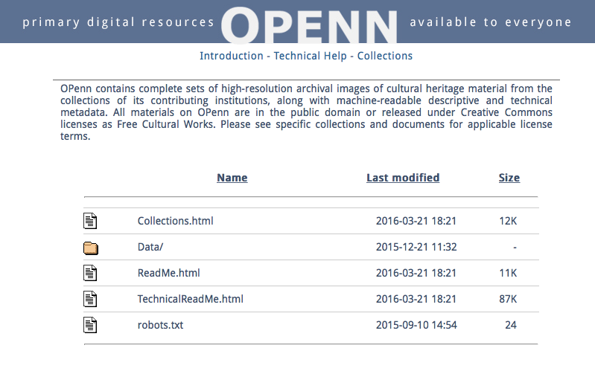
http://openn.library.upenn.edu

Slide 17
OPenn: ReadMe.html
License information
Recommended citation style
Sponsorship
Audiences
Description of site contents
Images
Document descriptions
How to use the data set
HTML Access
Other methods

Slide 19
OPenn: TechnicalReadMe.html
Accessing the Data
HTTP, FTP, RSYNC
File naming conventions
Navigation
Package structure (per document)
Preservation and technical metadata
TEI — descriptive, structural
XMP — technical
Detailed documentation of TEI document description
Standards employed
Appendices — wget, RSYNC

Slide 21
Collections page
Each collection on OPenn
Collection ID (e.g., 0001, 0011)
Metadata type (e.g., TEI)
Brief description

Slide 22
Things to do with OPenn data
ViewShare
http://viewshare.org/views/leoba/openn-and-digital-walters/
Book readers
http://dorpdev.library.upenn.edu/BookReaders/ljs437/index.html#page/1/mode/2up
eBooks
http://repository.upenn.edu/sims_ebooks/69/
The code:
https://github.com/leoba/viewshare
https://github.com/leoba/ebooks

Slide 23
http://openn.library.upenn.edu

