Slide 1
Linked Open Data for Digitized Special Collections
Timothy W. Cole (t-cole3@Illinois.edu)
Myung-Ja K. Han (mhan3@Illinois.edu)
Jacob Jett (jjett2@Illinois.edu)
8 June 2016

Slide 2
Agenda
Project overview, rationale, approach
Mapping legacy special collection metadata to RDF / Linked Open Data
Identifying the entities described
Using (& extending?) schema.org semantics
Testing with the Google Structured Data Tool
Issues encountered (so far)
Preliminary ideas for enhancing UI functionality

Slide 3
Exploring the Benefits for Users of Linked Open Data for Digitized Special Collections
Rationale
Digitized special collections are of growing importance in humanities scholarship and pedagogy.
But beyond digitizing our special collections, what more can we do to maximize the usefulness of these collections?
Supported by 20-month research grant from the Andrew W. Mellon Foundation

Slide 4
Research Questions
What additional challenges are encountered when transforming legacy special collections metadata records into LOD?
Can LOD help libraries get away from siloed collections & better reconnect special and general collections?
Can LOD be leveraged to help contextualize & enrich special collections and identify & establish useful links to both library and non-library information resources?
Can emerging visualization and annotation technologies add a social network view of a special collection that complements traditional bibliocentric perspectives?

Slide 5
Project Team
Principal Investigator: Tim Cole
Co-PIs: Myung-Ja (MJ) Han, Caroline Szylowicz
Project Post-Doc: Peter Organisciak
Lead Developer: M. Janina Sarol
Project Coordinator: Ryan Dubnicek
Project PhD Students: Jacob Jett, Katrina Fenlon
Graduate Assistants: Alex OliviaKinnaman, Melina Zavala

Slide 6
Special Collections for this Experiment
Collections:
Motley Collection of Costume and Theatre Design
Portraits of Actors, 1720 – 1920
Kolb-Proust Archive for Research
Selected because:
Well curated metadata
Encompass both image (CONTENTdm) & text (XTF)
Include people, places, event metadata
Many related, relevant resources on the Web

Slide 7
Tasks
Transform metadata into LOD apply schema.org semantics & identify needed extensions, analyze & remediate legacy metadata, use automated & manual methods to add links & add context, …
Descriptive enrichment & enhanced discovery Improve authority control, add links, search engine- friendly descriptions, support more informative displays, …
Add functionality to User Interface (UI) More context, more interactive, more opportunities to explore and understand the resources we have, … Assess qualitatively with before and after user testing.
Visualizing the social network of Marcel Proust Allow users to annotate the network graph, …

Slide 8
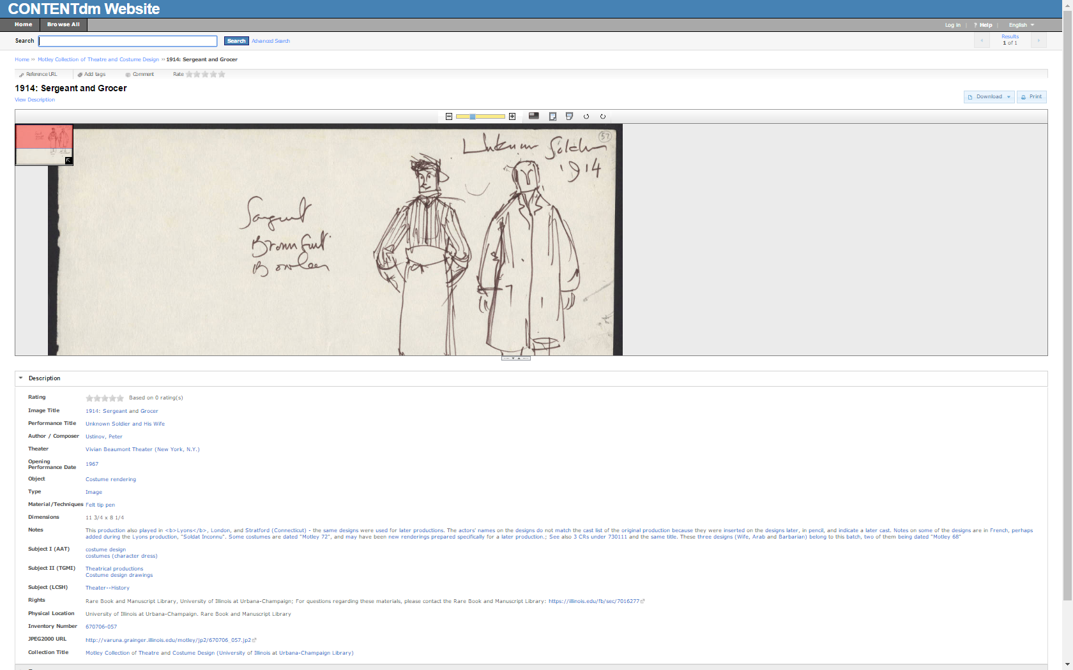
A concrete example from the Motley Collection

Slide 9
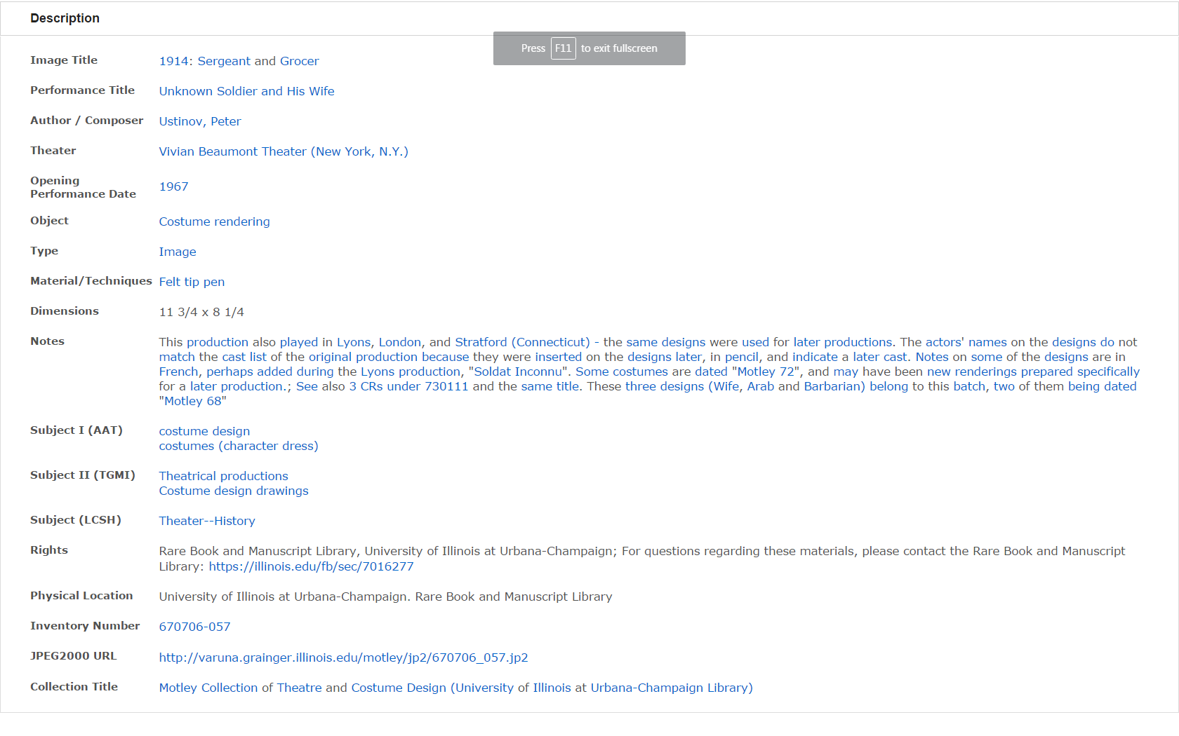

Slide 10
Deep Dive:
Mapping Motley Collection CONTENTdm
metadata to schema.org Linked Open Data
MJ Han
Jacob Jett

Slide 11
Central Design Principles
Linking Metadata to the Web
Migration of flat customized Dublin Core to RDF-based standards
Selection of schema.org vocabulary
Already being used by OCLC and web search engines
Expressive enough to preserve existing metadata
Transformation of strings into URIs
VIAF identifiers for people and organizations
Library of Congress geo-identifiers for places
LCSH SKOS concepts
Getty ATT Linked Open Data Vocabularies
Exercising Good Linked Data Practices
Disambiguate the entities described in the Dublin Core record
Facilitate reuse of metadata in outside contexts

Slide 13
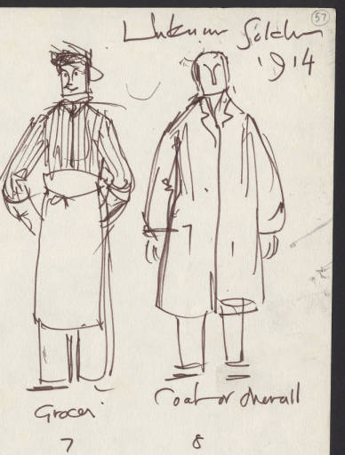
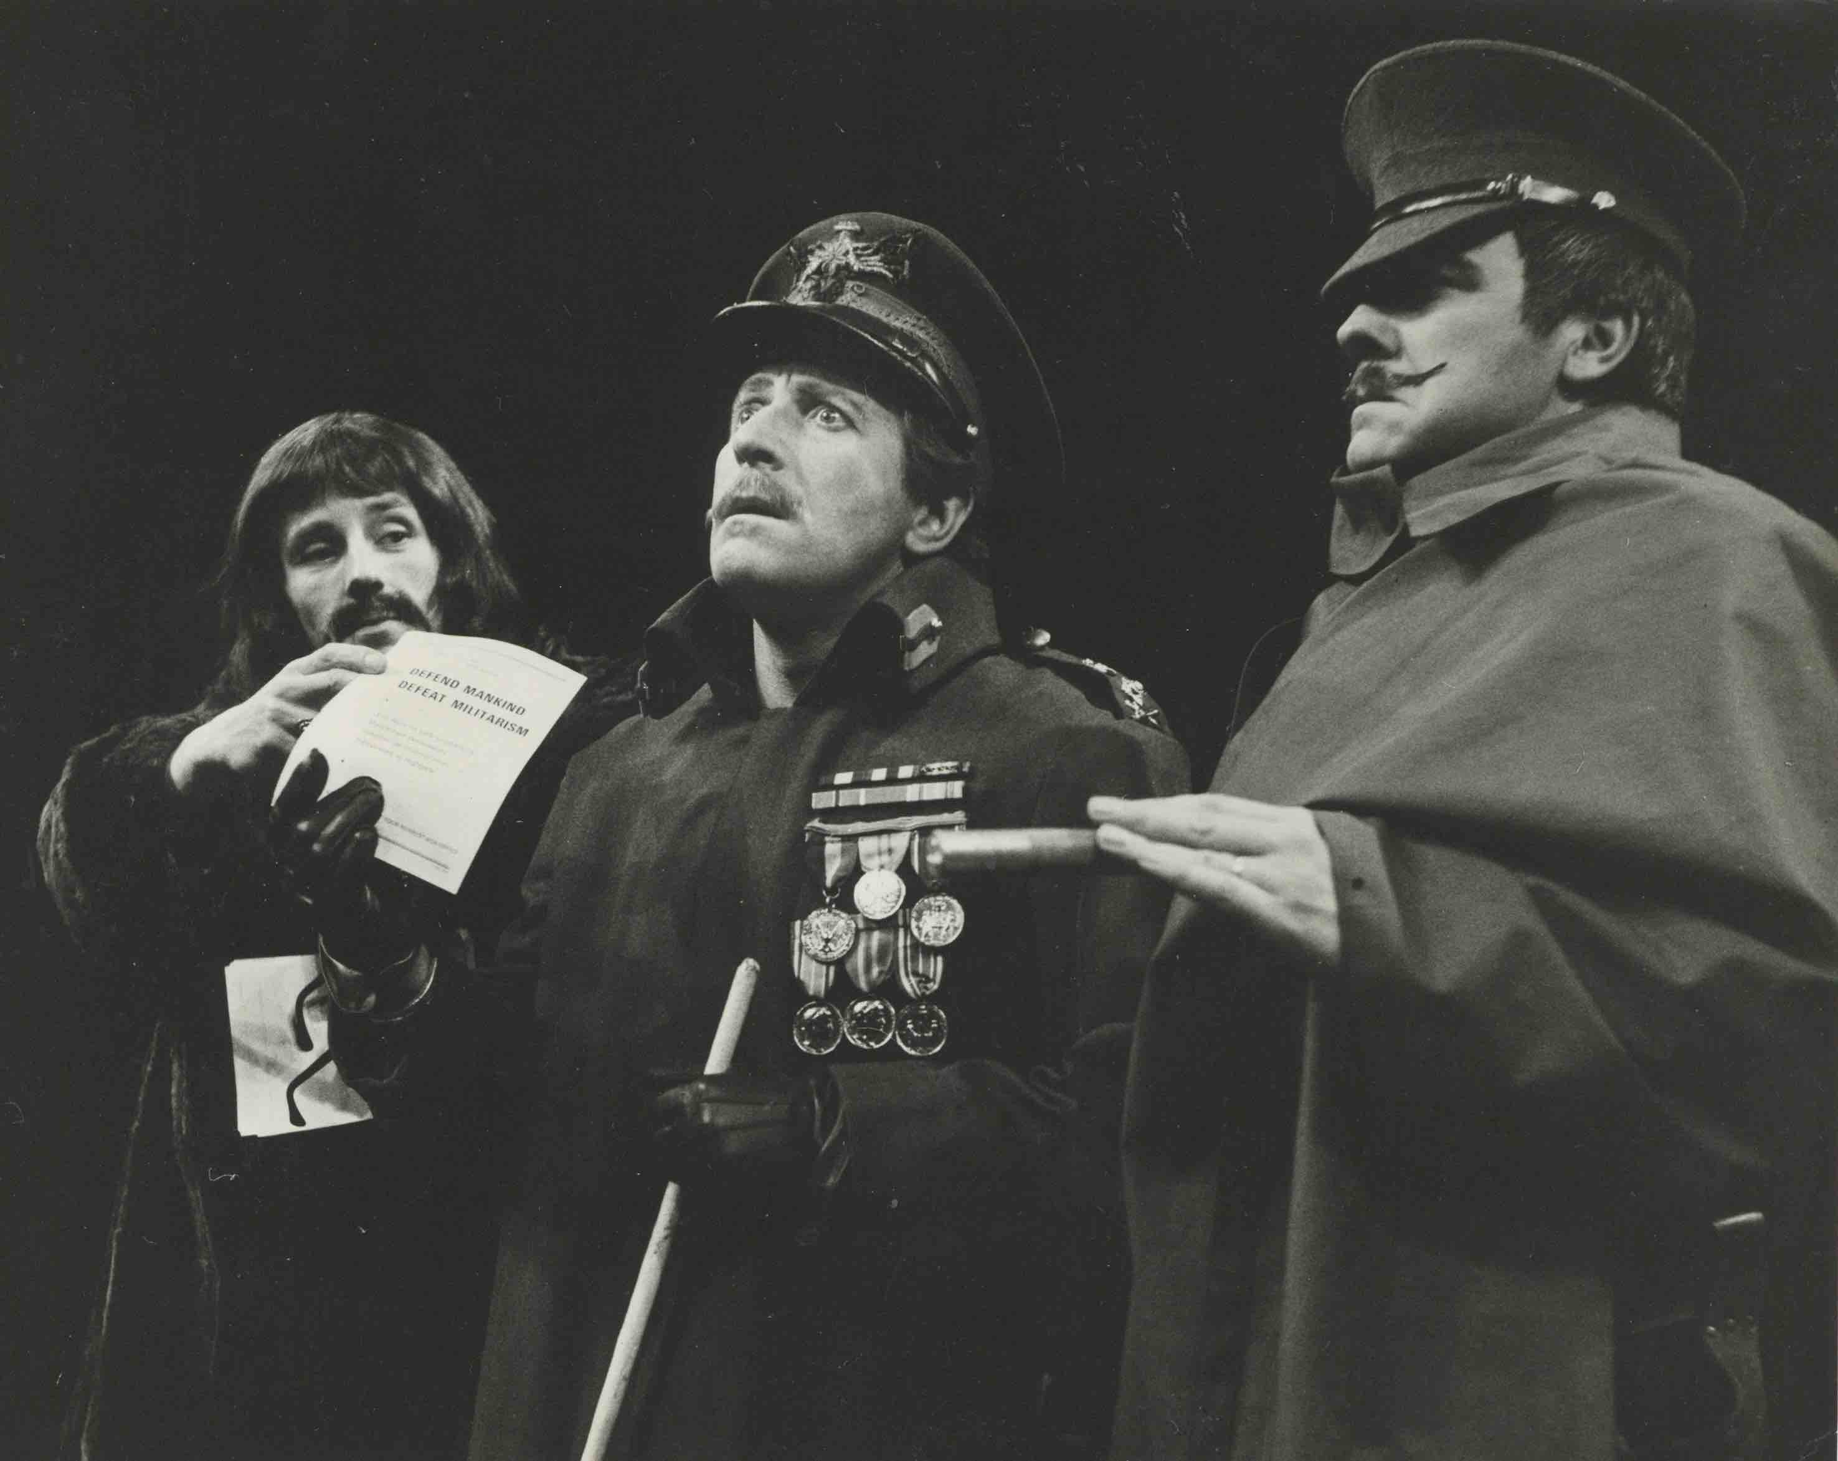
What the CONTENTdm metadata actually describes
Costume design by Motley
Stage production directed by John Dexter
Costume design by Motley?
Linked Data Descriptions
Play by Peter Ustinov

Slide 14
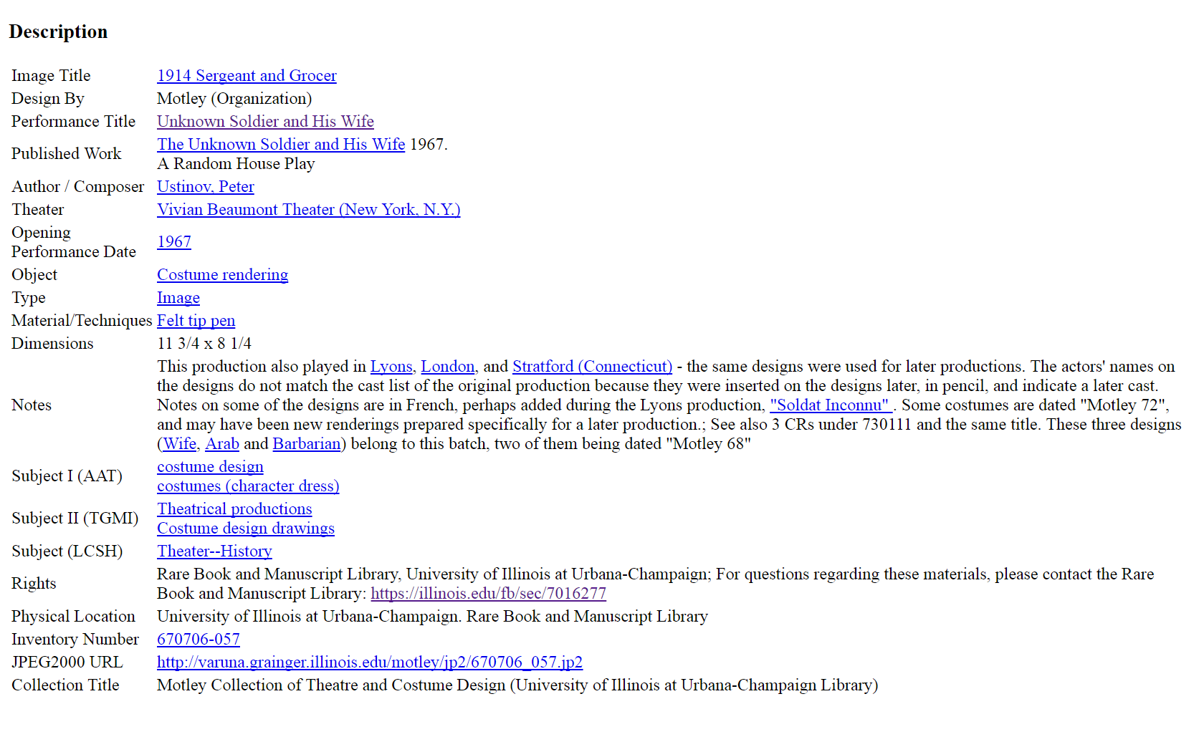
Notes field analyzed and RDFa added (invisible to user)

Slide 15
Costume Sketch Metadata

Slide 16
Field Name | Mapping to schema.org – schema:VisualArtwork
Image Title | schema:name (Text)
Design by | schema:creator (schema:Organization) [always Motley in this case]
Object | schema:genre (Text)
Type | schema:artform (Text or URL)
Material/Techniques | schema:artMedium (Text or URL)
Dimensions | schema:height & schema:width (schema:Distance or schema:QuantitativeValue)
Subject I (AAT) | schema:about (schema:Thing)
Subject II (TGMI) | schema:about (schema:Thing)
Subject III (LCSH) | schema:about (schema:Thing)
Rights | schema:copyrightHolder (schema:Organization or schema:Person)
Physical Location | schema:provider (schema:Organization or schema:Person)
Inventory Number | spc:standardNumber (Text or URL)
JPEG 2000 URL | schema:associatedMedia (schema:CreativeWork)
[is part of Stage Production] | schema:isPartOf (schema:CreativeWork, spc:StageWork)
Collection Title | schema:isPartOf (schema:Collection)

Slide 17
Stage Production Metadata

Slide 18
Field Name | Mapping to schema.org – schema:CreativeWork
[additional type] | schema:additionalType (URL) [spc:StageWork]
Performance Title | schema:name (Text)
Theatre | schema:locationCreated (schema:Place)
Opening Performance Date | schema:dateCreated (Date)
Notes | schema:description (Text)
[production of] | schema:exampleOfWork (schema:Book, fabio:Play)

Slide 19
Play Metadata

Slide 20
Field Name | Mapping to schema.org – schema:Book
[additional type] | schema:additionalType (URL) [http://purl.org/spar/fabio/Play]
Published Work | schema:name (Text)
[publication date] | schema:datePublished (Date)
[part of] | schema:isPartOf (schema:CreativeWorkSeries) [when true]
Author/Composer | schema:author (schema:Person)
[adaptation of] | schema:exampleOfWork (schema:Book or schema:CreativeWork) [when true]

Slide 21
Search Engines can consume schema.org RDFa

Slide 22
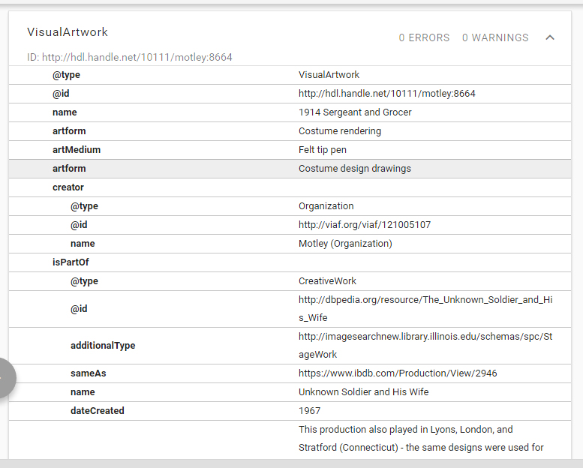

Slide 23
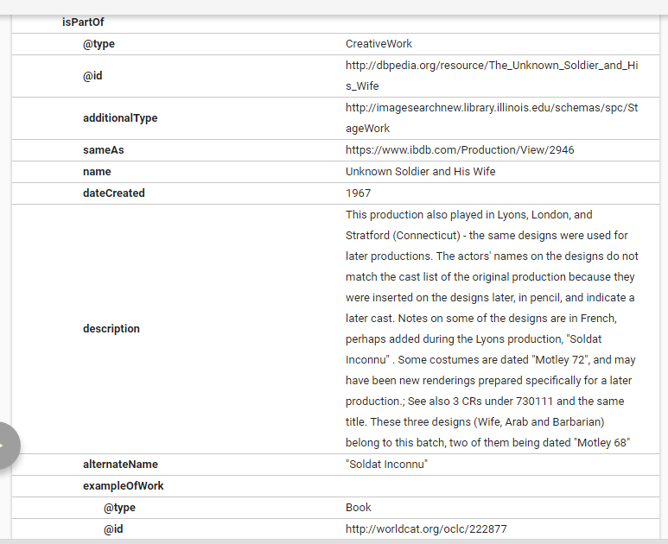

Slide 24
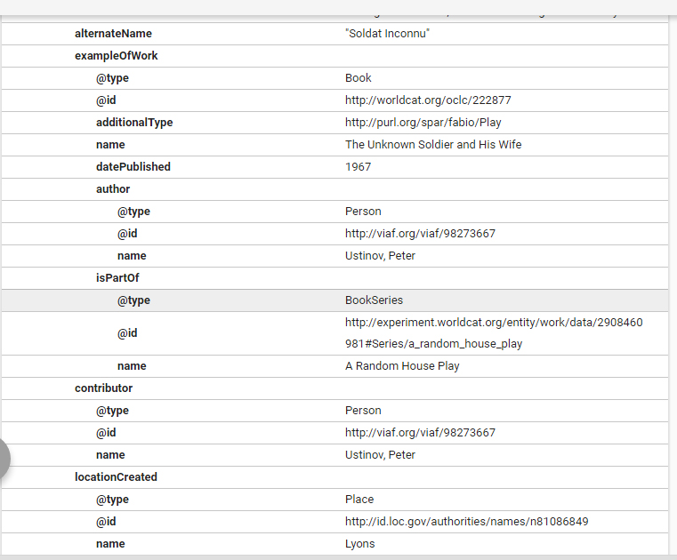

Slide 25
Metadata Issues
Ambiguity of CONTENTdm field names
Some are designed to include two (or more) different kinds of information, e.g., Author/Composer
Changes in personal and theatre names
King’s Theatre in London is now called Her Majesty’s Theatre
Shakespeare Memorial Theatre in Stratford-on-Avon is now called The Royal Shakespeare Theatre
Decision on what to map and what not to map into LOD
Not all metadata is for discovery and access.
Should all metadata fields be mapped to schema.org semantics?
Costume & Set Designs
Particular to Stage Productions (a.k.a. Stage Works)
Shared across multiple performances (aka Theater Events)

Slide 26
Issues on schema.org Semantics
Lack of a new Creative Work type for describing Stage Work
Inconsistency within schema.org vocabulary regarding Theatre Events, Creative Works and (TV) Episodes
Theatre Events are particular performances of Plays
Existing CONTENTdm metadata does not record such fine-grained entities as the individual performances
No actual specific Creative Work sub-class to represent Plays
TV Episode is a kind of Episode which is a kind of a Creative Work
TV Episodes and Stage Productions share many characteristics, e.g.,
Directors,
Actors,
Characters,
Costume & Set Designers,
etc.
Propose StageWork as a new subclass of CreativeWork?

Slide 27
Thinking about UI functionality
preliminary mock-ups
Tim Cole
Peter Organisciak

Slide 28
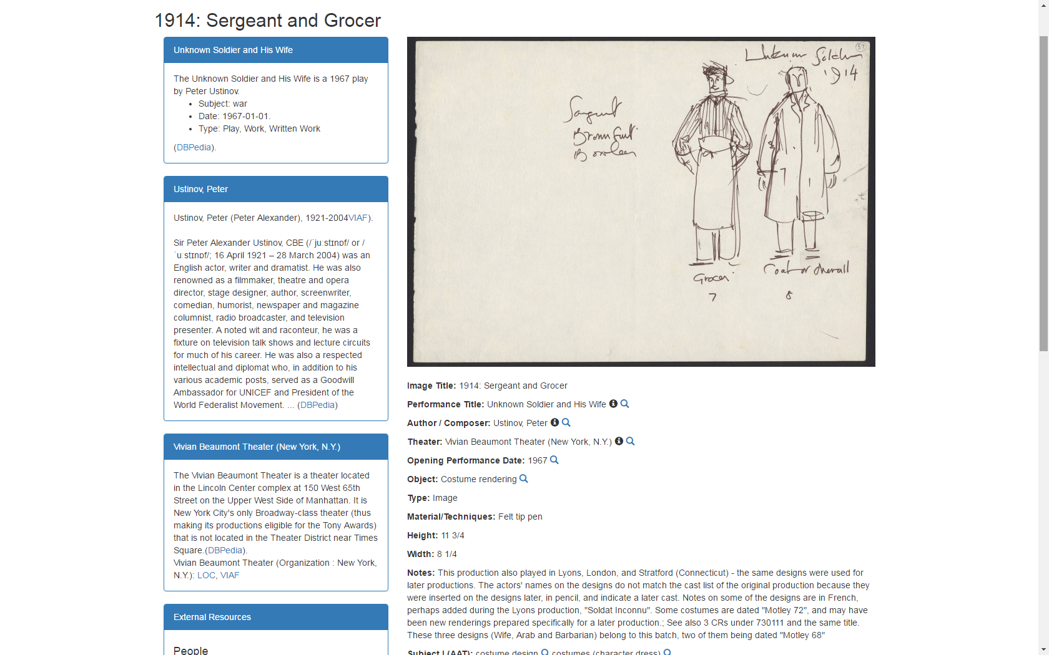

Slide 29
Metadata & links stored locally.

Slide 30
Contextual content added dynamically from linked resources

Slide 31
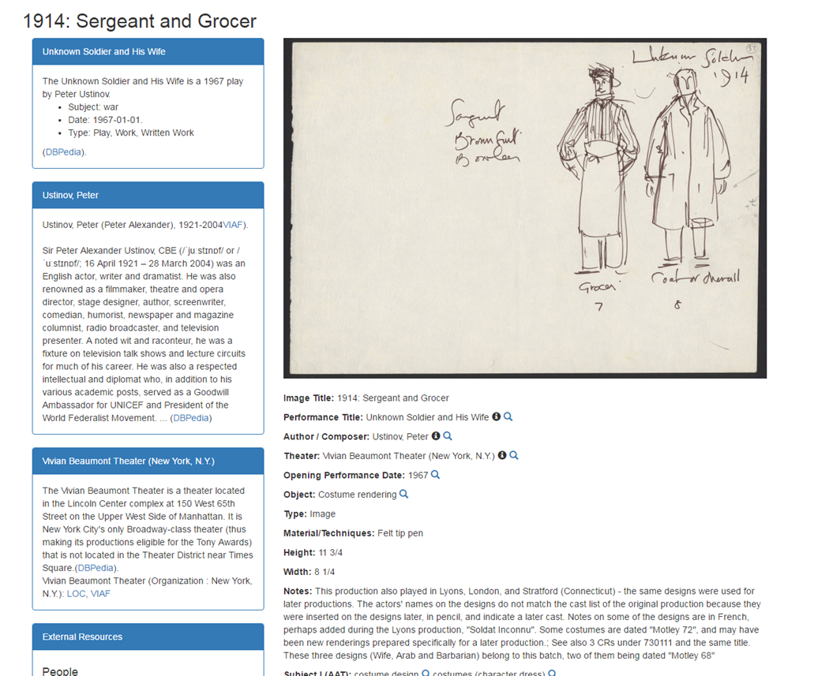

Slide 32
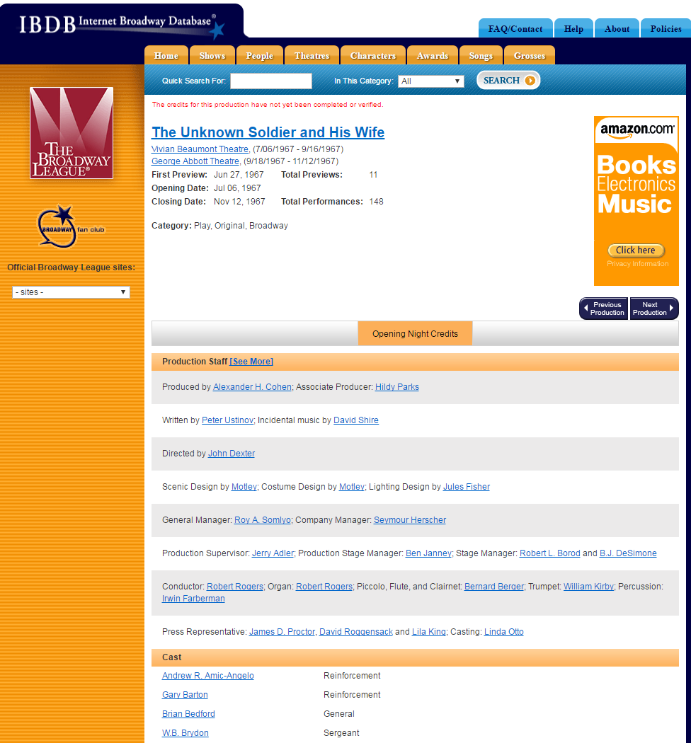

Slide 33
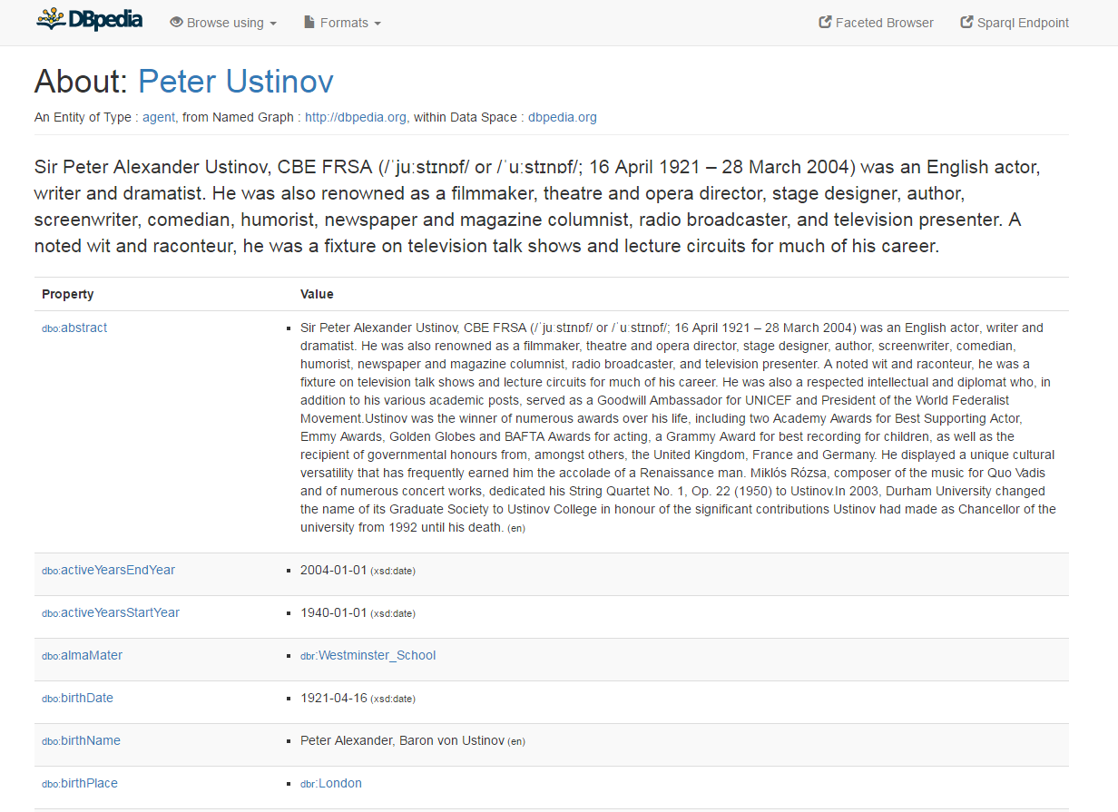

Slide 34
QUESTIONS
For more information & copy of complete proposal, see: http://publish.illinois.edu/linkedspcollections/ , or email:
Ryan Dubnicek: rdubnic2@illinois.edu Tim Cole: t-cole3@Illinois.edu
The research presented is based upon work supported in part by the Andrew W. Mellon Foundation under Award No. 31500650. Any opinions, findings, & conclusions or recommendations expressed in this presentation are those of the presenters and do not necessarily reflect the views of the Mellon Foundation.
Center for Informatics Research in Science and Scholarship

