Slide 1
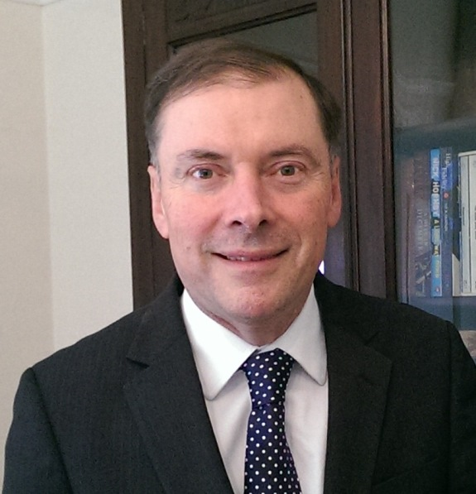
Strategy to Join the Elite
The University of Manchester Experience
Jan Wilkinson
University Librarian & Director of the John Rylands Library
Notes:
Luke
Apology
Topic
Library
Restructured
Resist temptation
Why Manchester (case study)
An interesting story; success story…almost!

Slide 2
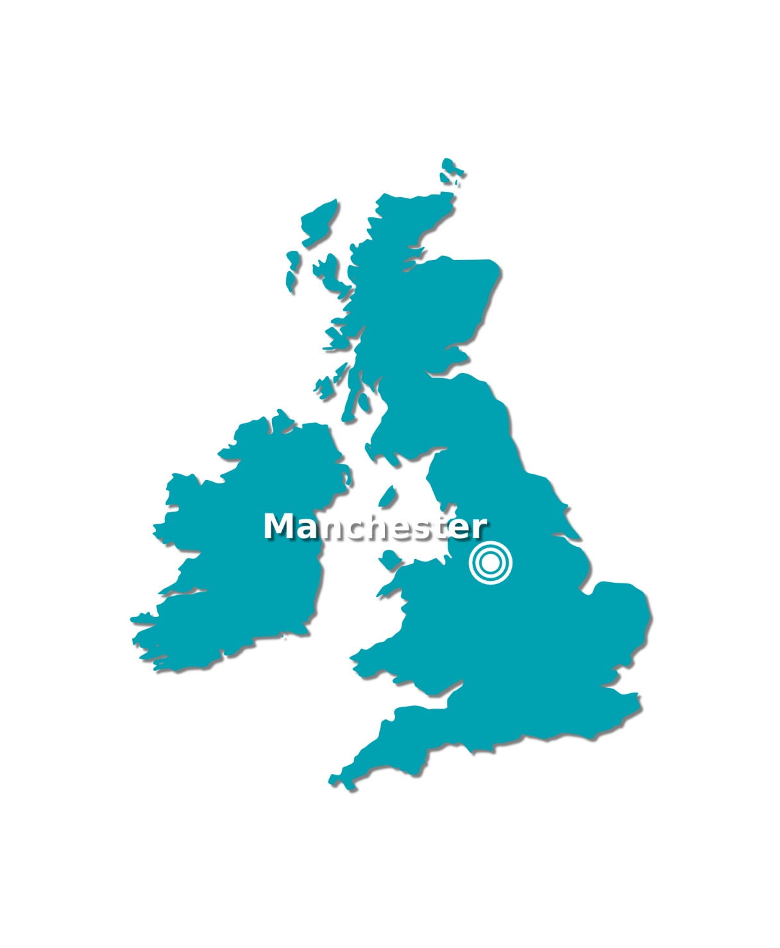
Britain’s 2nd City
Born of the industrial revolution
World’s first industrial city
Cottonopolis
World’s first industrial estate
Britain’s first canal
Cradle of innovation
World’s first computer
Splitting the atom
Home of Graphene
The largest student populations in Europe
Home of culture
Manchester music
Football
Halle Orchestra
International Festival
Media City
Notes:
2nd city - http://www.manchestereveningnews.co.uk/news/greater-manchester-news/manchester-should-uks-second-city-9314530
First industrial estate – Trafford Park
First canal – Bridgewater Canal (first modern artificial waterway – not including Roman stuff!!!)
Baby Computer – 1948 at the University
Atom – Rutherford and his work at the University in the early 20th Century
Graphene – isolated in 2004 at the University
Largest student population – Manchester Uni + Met and Salford = over 100,000 students
Manchester music – Hollies, Herman’s Hermits, 10cc, Sad Café, Buzzcocks, Joy Division, The Smiths, Stone Roses, Simply Red etc etc
Madchester logo – from Happy Mondays EP, designed by Central Station Design Ltd.
EVERYTHING EXCEPT A BEACH
WE DO THINGS DIFFERENTLY HERE!

Slide 3
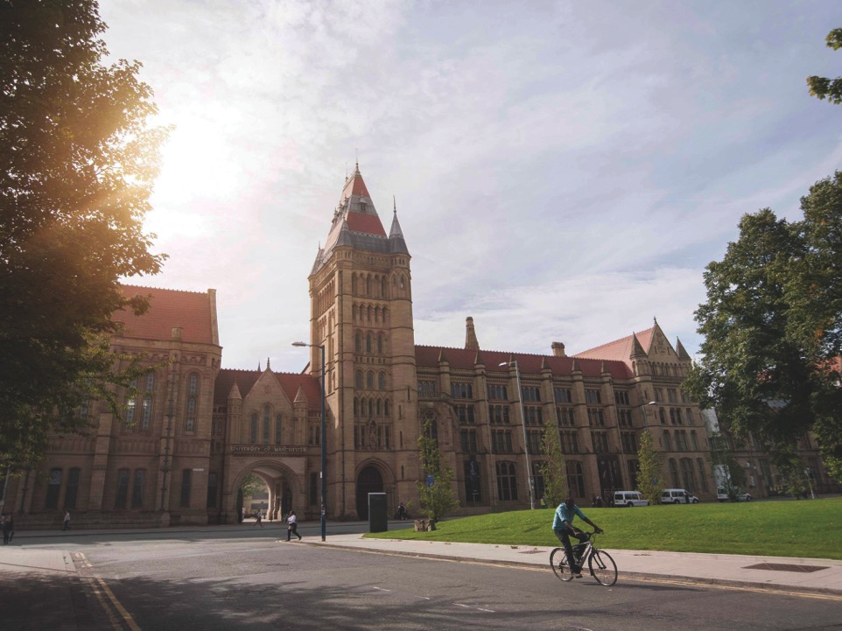
Notes:
Scale – largest UK
40,000 students; highest number of international students (10,000); 1,000+ degree programmes
£890M annual t/o
Distinctive?
Making a difference: Social impact, WP, cultural institutions
Ambitious & strategic
Unpopular? Parvenue!

Slide 4
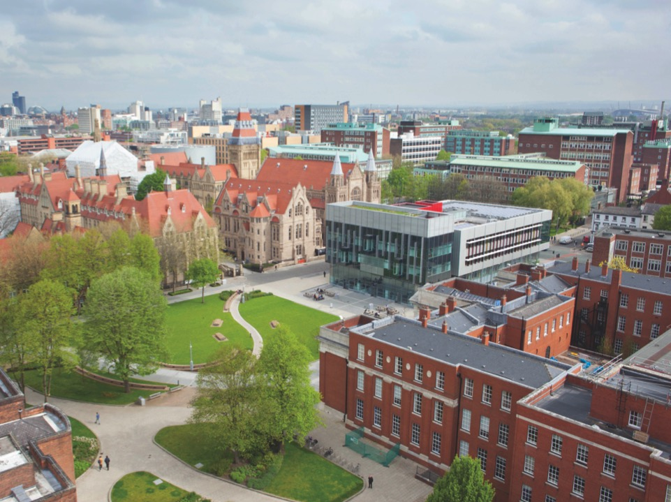

Slide 5
The “new” University of Manchester
2004 merger to form UK’s largest university
2015 Vision for the new institution Manchester 2015
To make the University of Manchester [already an internationally distinguished centre of research, innovation learning and scholarly inquiry] one of the leading universities in the world by 2015.
Distinctive identity that equalled but did not emulate the UK’s “Golden Triangle” or the US Ivy League
Notes:
Logo 1832 display of pedigree disguises much more recent foundation of a new university by Royal charter 1 October 2004. New
Drive towards much higher position in the pantheon of world elite universities than either of its predecessors.
Not to emulate UK golden triangle of Ox/C 2xLondon. Nor the highly endowed US Ivy league.
Merger made possible – 2 contiguous campuses, 2 VC retirement! Post 2001 RAE….
UMIST small & narrow (vulnerable to shocks) tho upward trajectory. VUM high costs, best could do would be to maintain present position. Financial health – student recruitment.
Impetus came from 6 things:
increasing complexity of R problems demanding interdisc. + critical mass+ modern infrastructure
Increasing importance of the K economy & recognision of the role of unis in contribution to bus & community
Student fees & emphasis on Quality
Globalisation of HE, competition for students, top Q staff & R funding
Need to modernise governance/man structures – agile DM
Limited resources
Specific logic - shape of UK economy. Uni-nodal. Concentration in L & SE (Golden Triangle). Other cities have lacked economic dynamism, regional policies failed. Manchester region = success case (regeneration, strategy of local council + local business + local leaders with strong brands) Shift from trad indus to service-based economy. Emphasis on Sci, Tech & Creatives, all that was missing – world class academic institution. Dissolution of 2; creation of new.
OVERALL AIM OF THIS INTEGRATION WOULD BE TO ENHANCE R EXCELLENCE AT INTERNATIONAL LEVEL, incr stud choice & contribute to regional economy
NORTHERN POWER HOUSE – devloved NHS budget, own minister. “What Manchester does today the world does tomorrow” Industrial Rev (confidence)
2015 Agenda & 2020 refresh. Website “Towards 2015”. Represented a blueprint for transformation/step change that Uni was seeking to achieve. (Quote ppt)

Slide 6
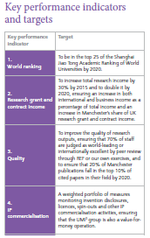
The “2015 Agenda”
Global Standing
World Class Research
3. Outstanding Learning & Student Experience
4. Social Responsibility
Notes:
Process – unqualified success. Next challenge – efforts to create world-class university on a NEW model.
Unusual in having a published research strategy with KPIs.
Website ‘Towards 2015’. The Vision (the agenda itself) – people-centred, research-led, innovative, learning, liberal, independent, international, inclusive, engaging, and A Manchester Instition.
Goals (evolving)
Reputational overarching goal – ‘Global Standing’ – to be recognised as one of top 25 leading Universities in world as measured by position in international league tables that measure elements of R, T, Reputation & Global Reach. BRAND – international excellence.
2. World Ranking Research - To be one of the top 25 research universities in the world according to commonly accepted criteria. Where internationally-leading researchers produce research of highest significance and impact. In SHJT Acad Ranking World Unis international league tables (top 500) with 6 measures of R significance & impact. (staff & alumni nobel prizes; numbers of highly-cited staff; total publications; pubs in Nature & science; and per capital performance with respect to size of institution.) Top 25 not an end in itself. Weakness – favours STEM.
3. Outstanding L & S Experience - The University will provide a superb higher education and learning experience to outstanding students, irrespective of their backgrounds, and will produce graduates distinguished by their intellectual capabilities, employability, leadership qualities, and their ability and ambition to contribute to society. (Have more students from socially deprived neighbourhoods than total golden triangle).
4. Social responsibility - The University will contribute to the social and economic success of the local, national and international community by using our expertise and knowledge to find solutions to the major challenges of the 21st century, and by producing graduates who exercise social leadership and responsibility.

Slide 7
Achievements - World Rankings
Notes:
Immediate beneficial effect 2004 -2005. 78th VUM to 53rd in SHJT ARWU. (Scoring favours scale).
More rapid progress to 2011, then incremental change since 2008. 2014 – 38th. Up 40 places since merger. European ranking – 24th VUM to 6th in 2014.
Downside
Initial push for research gave students impression of neglect and University punished in National Student Survey (of satisfaction)
University launched challenging initiative to re-personalise undergraduate education while gaining efficiency through e-learning and Graduate Teaching Assistants
Promotion tracks available for teaching and knowledge transfer specialist as well as conventional careers
Also 2006 large operating deficit – investment ahead of next RAE

Slide 8
Tracking the Academic Ranking of World Universities
Year | 2004 | 2005 | 2006 | 2007 | 2008 | 2009 | 2010 | 2011 | 2012 | 2013 | 2014
Ranked | 78 | 53 | 50 | 48 | 40 | 41 | 44 | 38 | 40 | 41 | 38
Notes:
This shows the impact of the merger, and then the plateau we are now in. The challenge top 25 – harder as the elite group is approached. Still, Manchester is a distinct mover in a largely static table. Le Monde tracking us as an example for France.

Slide 9
Achievements - Iconics
Notes:
In another dimension of international standing, U fo M is right on track.
Iconic appointments. More nobel prize-winners than any other UK University amongst current/former staff: Joseph Stiglitz (world Poverty) and Sir John Sulston (UK biologist – genomics). Influential Harvard political scientist, Robert Putnam, novelist Martin Amis.
Andre Geim & Konstantin Novoselov 2010 Physics – ground-breaking 2D material Graphene.
Still open to iconic appointments, today focus is on attracting top class academics & students to work under banner ‘World-leading minds’.

Slide 10
Trajectory in Research Awards
Notes:
Research income has been another area of spectacular growth - Includes KT, industry, charities, EU. Excludes government.
Rising from £116M at point of merger to over £200m. 2013 – 37% increase in value of new grants. Always lumpy but 2014-15 another very good year with incr R grants and spin-outs. Eg Nanoco (nanotechnology) £310m market capitalisation. But KT is a priority for UK govt so needs more attn in the future.
Several high-profile strategic partnerships secured with major companies including BP Centre for Advanced Materials, a $100m commitment. Number 1 for R collaboration with UK businesses.
Feedback – ability to assemble interdisciplinary teams has been a key factor in gaining R contracts – attributable at least in part to merger (economies of scope resulted from the wider range of available disciplines, and large multi-disc Schools & Institutes helped create a culture of working from colleagues from many backgrounds.)

Slide 11
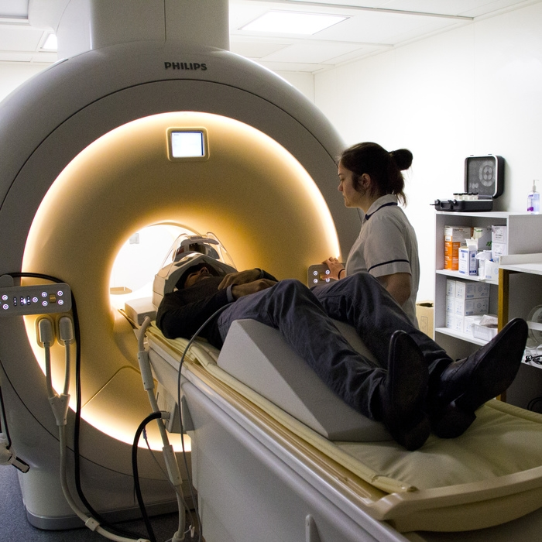
2015?
Comprehensive research excellence with interdisciplinary teams
Driven by explicit strategy
By 2020 we aim to
Be in the world’s top 25
Double our research grant and contract income (since 2010)
Improve quality of research outputs…
Generate over £1bn commercialised IP
¹ Academic Ranking of World Universities
Notes:
2015 too short to achieve all of 2015 goals. Aspirational still.
International Rankings/National Rankings (REF). REF determines R income from Government. REF is the stronger driver = ££. Citations count in both. Reputation does not count in REF, but attracting good researchers does.
More recent Indicator - ‘Improve quality of R outputs, ensuring 90% of staff are judged as producing world-leading or internationally excellent R by peer review through REF, and to ensure that the share of our publications falling into the top 10% of cited papers in their field matches or exceeds that for the top 5 institutions’.

Slide 12
Major University Rankings
Academic Ranking of World Universities produced since 2003 by Shanghai Jiao Tong University (China)
Times Higher Education World University Rankings produced in association with Thomson Reuters since 2010
World University Rankings (QS), produced by Quacquarelli Symonds since 2005
Notes:
Still strong focus on our ranking in the league tables for U of M R strategy (goal 1).
U of M will now focus on these 3, not just bullet 1 from now on.
None are v good, so best to have a basket than rely on 1 eg 1 doesn’t cover hums v well, 3 uses bibliometrics and reputation surveys, 2 is v complex (see later) and pretends to include teaching but not v well.
Important - Which can we influence and which not eg. alumni Nobel laureates. Can influence ‘nearly high-cited Rrs’.

Slide 13
Highly Cited Researchers
Institution | No of Researchers | No of subject areas
Manchester | 8 | 7
Cambridge | 21 | 9
Edinburgh | 7 | 6
Imperial | 19 | 10
Oxford | 30 | 13
UCL | 12 | 6
Notes:
In March 2014, a new version of the Thomson Reuters list of Highly-Cited Researchers became available. This is used in SHJT (ARWU) so is important to us.
In total, over 3,200 highly-cited researchers are included on the list. As previously, citations are based around 21 broad subject categories and researchers are classified as highly-cited.
Highly-cited researchers are those who have a number of publications in the top 1% of articles in the 21 fields, though the number of publications required to be included in the highly-cited list varies according to subject field.
Under the new methodology, the University has 8 highly-cited researchers. However, of our comparator institutions all except Edinburgh have more Highly-Cited Researchers (based on the unverified data circulated). Not doing well enough.
The Library is investigating this further. Identify who these people are based on analysis of their citation count. Also, and importantly, we will be able to provide greater analysis of those Manchester academics who are close to the threshold of highly-cited. However, it is clear that the methodology favours researchers who focus on a relatively defined area of research within the categories above.

Slide 14
And many others…
Performance Ranking of Scientific Papers for World Universities
Research Performance Index (RPI)
Global Universities Ranking (GUR)
Leiden Ranking
SCImago Institutions Rankings (SIR)
Professional Ranking of World Universities
Webometrics Ranking of World Universities
U‐Multirank
Notes:
Other Ranking Tables (need colleague Luke!).
1. 2007 Taiwan Uses 8 bibliometric indicators using data sourced from Thomson Reuters Web of Science.
2. 2010 University of Western Australia based upon 10 years of citation data drawn from Elsevier’s Scopus.
3. 2010 by RatER (Rating of Educational Resources‐ a Russian ‘independent rating agency’) based upon assessment conducted by a pool of ‘experts’ formed by project officials and managers to determine the rating scales for every indicator of performance of the universities in seven areas.
4. The Leiden Ranking, 2008 (Netherlands). Five output‐based ranking tables are provided, each based on a different bibliometric indicator following analysis of data from Web of Science.
5. 2009 by SCImago Research Group (Spain/Portugal) uses the Scopus database to determine five
indicators: output volume, citations per document, internationally collaborative authorship, field‐normalised citation impact and journal outlet prestige.
6. The Professional Ranking of World Universities produced since 2007 by the École Nationale Supérieure des Mines de Paris. Uses a single indicator ‐ the number of alumni holding a post of chief executive officer or equivalent in one of the 500 leading international
companies (Fortune Global 500).
7. The Webometrics Ranking of World Universities, produced since 2004 by the Cybermetrics
Lab (CCHS), a unit of the Spanish National Research Council (CSIC). Based upon four indicators of institutional web presence and impact: size (number of web pages), visibility (number of external links), rich files (number of text files) and scholar (number of
papers and citations from Google Scholar).
8. U‐Multirank - a European Commission supported pilot project.

Slide 15
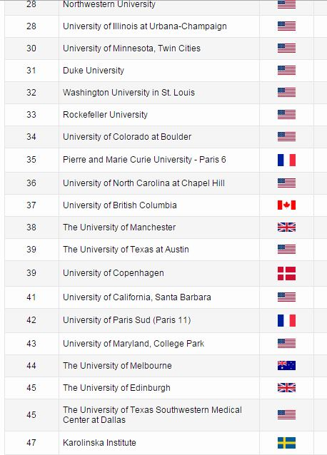
Notes:
Manchester sits differently in each table. Reinforces the need to use a basket, not just one.
Mostly receive criticism but no option but to work with them.
SHJT Academic Ranking of World Universities (ARWU). 38th.
Strengths:
• Most respected table in most countries (first)
• Utilises a range of weighted indicators to reflect different aspects of institutional
performance
• Internationally comprehensible set of indicators, all of which are widely considered to be
reasonable reflections of institutional standing
• Indicators are reasonably simple, objective and transparent
• Ranking outcomes are not notably counter‐intuitive
• Limited year‐on‐year volatility
Weaknesses:
• Based solely on quantitative indicators of research performance and esteem – no indication
of performance in other areas of institutional mission
• No account taken of ‘input indicators’ – research income, research training, diversity of
research population, etc
• Indicators give particular credit to a small number of peaks of exceptional research
performance and, despite per capita measure, to sheer volume of research output
• Highly‐cited researchers indicator is based on a web resource that is updated infrequently
and is frequently challenged as a metric of research impact (it takes no account of author
position and favours activity within the confines of a single subject area)
• By contrast with the transparency of the indicators themselves, the data collection and
manipulation processes are highly opaque with minimal involvement of or responsiveness to
institutions themselves (even when clear errors are discovered)
• Some lack of confidence in the reproducibility of the ranking outcomes6
• Some indicators have apparent anglocentic bias

Slide 16
Notes:
UK Times Higher Education World University Rankings
Manchester 52nd
Indicators
• Citation impact (normalised average citations per paper) (32.5%)
• Research volume (papers per academic – 4.5%), income (scaled – 6%) and reputation (peer
survey – 19.5%)
• Teaching and learning: reputational survey (15%), PhD awards per academic (6%),
undergraduates admitted per academic (4.5%), income per academic (2.25%) and PhD
awards/bachelor awards (2.25%)
• Industry income and innovation – research income from industry per academic (2.5%)
• International mix – ratio of international to domestic staff (3%) and students (2%)
Strengths:
• Diverse range of quantitative and qualitative indicators covering multiple aspects of
institutional mission
• Prominence due to heavy promotion by THE
• Substantial involvement of institutions in data collection and checking for some indicators
• Wide consultation over selection and weighting of indicators
• Intention to overcome previous limitations regarding subject normalisation for bibliometric
data (to remove bias towards institutions with substantial biomedical activity) and
assessment of smaller and monotechnical institutions
Weaknesses:
• Unreliability of reputational survey components – prone to conservatism and anglocentric
bias and open to manipulation. Also unlikely that respondents can discriminate sufficiently
below top choices. Concerns also expressed about fairness of sample group and differential
response rates.
• Income indicators are hard to compare cross‐nationally due to differential contexts for
purchasing power, public vs. private support, indirect costs, etc.
• Substantial bibliometric component has substantial ‘black box’ of complex methodology for
output normalisation and compensation for institution type, national context, etc.
• 2010 rankings contain a number of counter‐intuitive outcomes. These predominantly result
from skewed bibliometric indicators – e.g. placing Alexandria University (Egypt) and Bilkent
University (Turkey) in the upper echelons on the basis of small volumes of highly‐cited work
by as few as one or two member of staff.
• New ranking so year‐on‐year volatility cannot be gauged

Slide 17
Notes:
World University Rankings (QS)
Manchester 30th
Produced by Quacquarelli Symonds since 2005
Indicators:
• Academic peer review via international reputational survey (40%)
• Recruiter review via international reputational survey (10%)
• Faculty (staff):student ratio (20%)
• Citations per faculty – 5 year total citations (from Scopus) divided by total academic staff (20%)
• International orientation – percentage of international staff (5%) and students (5%)
Strengths:
• Range of indicators permit some breadth of coverage of university missions
• Survey attempts to combine qualitative and quantitative measures of performance and standing
• Non survey‐based indicators are reasonably simple and objective
• Good involvement of institutions in data collection and checking
Weaknesses:
• Substantial dispute about merits of reputational survey components
• Very high weighting (50%) for disputed reputational survey components
• High general position of UK universities out of line with other ranking exercises
• Crude bibliometric indicator makes no allowance for natural subject variations in citation practice (thus disadvantaging institutions without substantial biomedical output)
• Unreasonable level of year‐on‐year volatility

Slide 18
General Limitations
Data
Indicators
Aggregation
Governance
Notes:
Whole industry. A very considerable literature now exists discussing the phenomenon of rankings and those who produce them.
Some positive aspects are recognised the tone is overwhelmingly one of criticism of the ways in which ranking tables are produced and to a lesser
extent of the use made of them.
Acknowledge the positives.
Use as an input for benchmarking with the aim of improving an individual institution or even a national system.
There are also benefits to potential students, academics and research collaborators who may find them a convenient way to compare key features of institutions they are contemplating joining or working with. Even a relatively poor performance can stimulate some governments to invest resources to improve their national position.
Why then do rankings have such a negative image, particularly among those working with them? Data, indicators, aggregation/aggregation methods, and
governance.
Data – lack of international comparability, lack of transparency and reproducability (ranking orgs rarely reveal the base data that support their calculations (ARWU) inparticular.
Indicators used:
Most rankings use citation data but problems with accuracy (spellings), bias, treatment of co-authors etc, BUT fact of academic life as part of the assessment environment. (Have to work with them, even if we don’t like them!). Citations don’t measure research quality directly (many reasons for citing a paper) but they do measure impact.
Aggregation – ranking tables include institutions with v diverse missions – not even comparing apples and pears, but apples and arm chairs!
Governance – ranking organisations are self-appointed and the majority use the rankings to support commercial operations for analytical services. Credibility has been diminished by the proliferation of tables and disputes between ranking organisations.

Slide 19
National Rankings: UK REF 2014
Means of allocating university grant for research
Peer assessment of the quality of UK research
36 panels, 190,000 outputs, 7,000 impact cases, 52,000 faculty, 154 institutions…
Assessment based on quantitative indicators, including bibliometrics, and light-touch expert review
3 elements of a “quality profile”:
Research outputs (65%)
Impact indicators (20%)
Research environment (15%)
Notes:
Slide
Means of allocating university grant for research
Peer assessment of the quality of UK universities' research
Assessment based on quantitative indicators, including bibliometrics, and light-touch expert review
3 elements:
Research outputs (65%) – normally 4, publications, materials, IP, performances, etc
Impact indicators (20%) – reach & significance of importance to economy, society, culture (role for libraries: altmetrics, searches, purchasing…)
Research environment (15%) – eg strategies for promoting and developing researchers, equipment, facilities, income, PhD numbers and completions – vitality & sustainability.

Slide 20
Definitions of quality levels
Four star
Quality that is world-leading in terms of originality, significance and rigour.
Three star
Quality that is internationally excellent in terms of originality, significance and rigour but which nonetheless falls short of the highest standards of excellence.
Two star
Quality that is recognised internationally in terms of originality, significance and rigour.
One star
Quality that is recognised nationally in terms of originality, significance and rigour.
Unclassified
Quality that falls below the standard of nationally recognised work. Or work which does not meet the published definition of research for the purposes of this assessment.
Notes:
Used in rankings:
A measure of the average quality of those entered by an institution = GPA of institution
Volume X average quality = Research Power of institution
Another form of ranking comes from the distribution of the QR funds
All units with 4*, 3* or 2* will get funded with a weighting
Ranked in fifth place in terms of “research power”
Research power – quality of R and number of R active faculty in REF.
(Research power is calculated by grade point average (average q of those entered) X number of staff submitted.)
QR funding is the outcome. 3* and above.

Slide 21
Manchester’s REF 2014
83% research activity ‘world-leading’ (4*) or ‘internationally excellent’ (3*)
5th in research power/market share: (from 4th)
4% fall in absolute terms
Rivals increasing (partly due to mergers)
Significant QR implications
staff submitted dropped from 1824 to 1561
UCL increase by 48% to 2566
GPA from 2.12 to 3.17
Russell Group GPA ranking from 6th to 14th
Notes:
154 UK institutions made submissions in 36 subject-based units of assessment
In the most recent Research Excellence Framework (2014), University of Manchester rated fifth in the UK in terms of ‘research power’
Equivalent of 1,289 staff operating at levels of world-leading or international excellence

Slide 22
But not yet good enough – we still need a step change!

Slide 23
Elements of new strategy for research quality
Statement of expectations
Accountability for quality
Developing new talent
Supporting research leaders
Notes:
Slide:
Statement of expectations
Staff with experience at world leading universities report a difference in expectations
All research staff expected to produce minimum of four 3* outputs in REF period and plan for at least one 4*
School targets allow 10% below this to cover teaching/admin, life events etc.
Need to identify which staff below this level can achieve it with support.
Accountability for quality
Internal Research Review will be recalibrated and individual plans/progress assessed annually and against 5 year plan
Impact and business engagement equally valued in portfolio
Each area to identify list of top target journals (can be done using REF data)
Developing new talent
Need to attract and invest in best independent fellows
Substantial part of volume increase in rivals from research fellows who co-author 4* outputs
Expectations should extend to PGRs – theses should support at least one 3* output
Lead supervisors should have at least 3* track record
P&DRs to address research career elements – paper writing skills, conference & social networks, prizes, panel memberships & review experience
Supporting research leaders
Ensuring those producing top level outputs get disproportionate share of research time
Focus support on ‘second decile’ of staff capable of moving to research leadership
Continue to target research leaders for recruitment
All recruitment for staff with research in contract to meet expectations level

Slide 24
We are already on our way…
Major upturn in last two years but too late for REF
Citations in top 10% up from 22% 2008-12 to 24.6% 2009-13
Research income up 7% 2014 and currently up 19% 2015
Research awards to December 80% higher this part year than 2011/12
Manchester share of RCUK awards up from 4.19% 2012/13 to 5.11% 2013/14 (4th in UK)
Major capital awards and Capital Programme give us the environment to attract and excel

Slide 25
References
Strategic vision documents
http://www.manchester.ac.uk/aboutus/facts/vision/
Manchester merger. Georghiou, L. (2009) Strategy to Join the Elite: Merger and the 2015 Agenda at the University of Manchester, in McKelvey, M. and Holmen, M., Learning to Compete in European Universities – from Social Institution to Knowledge Business, Edward Elgar: Cheltenham, pp48-65
University foresight. Georghiou, L. and Cassingena Harper J. (2008) The Higher Education Sector and its Role in Research: Status and impact of International Future-Oriented Technology Analysis, in Cagnin, C.; Keenan, M.; Johnston, R.; Scapolo, F.; Barré, R. (Eds.), Future-Oriented Technology Analysis Strategic Intelligence for an Innovative Economy, Springer
Georghiou L, Strategy to Join the Elite: Merger and the 2015 Agenda at the University of Manchester, in McKelvey M and Holmen M (eds) Learning To Compete In European Universities - From Social Institution to Knowledge Business Edward Elgar 2009

