Slide 1
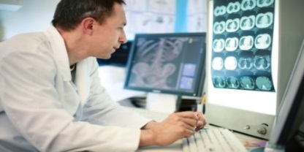
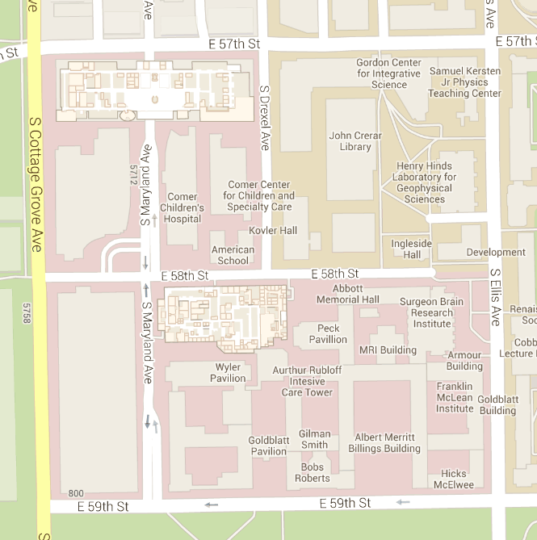
“A Day in the Life” Mapping Project
Andrea Twiss-Brooks
University of Chicago Library
The Library in the Life of the User October 21-22, 2015

Slide 2
Project Goals
Learn how third-year medical students seek and use information in the course of daily activities, especially activities conducted in a clinical setting
Test a particular ethnographic method in multiple institutional settings and determine its viability as a tool for adding to the body of library evidence-based practice

Slide 3
Target Population
Third year medical students aka “fledgling” clinicians
Clerkships or rotations provide exposure to a wide range of clinical activities
Master core clinical medical competencies as well as communication and professionalism competencies
Inpatient and outpatient experiences in various settings
Little use of the physical library facilities

Slide 4
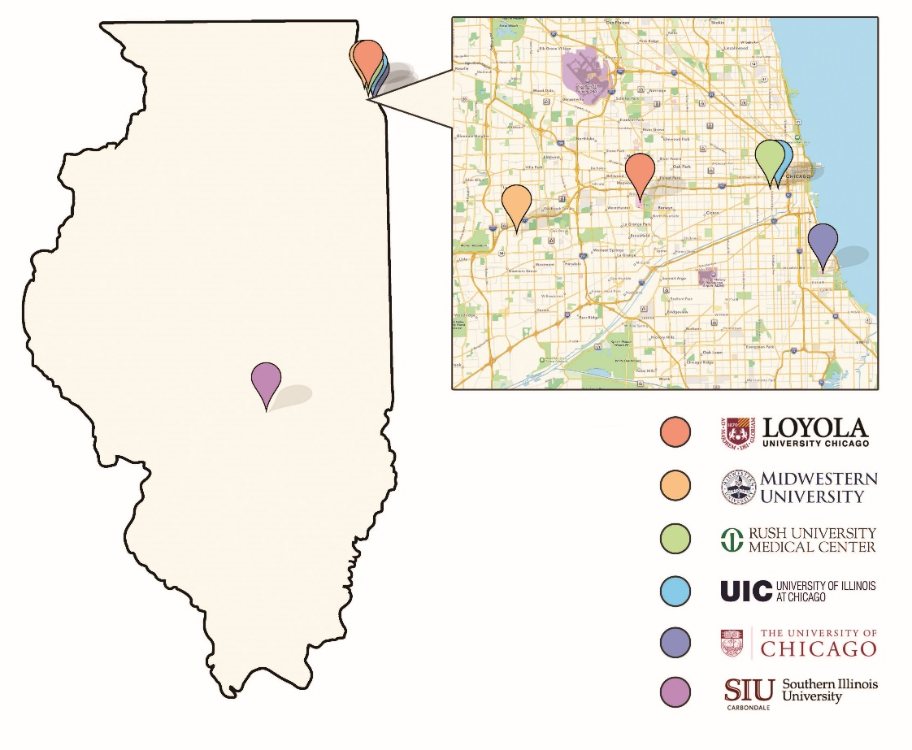

Slide 5
Protocol
Map (or chart) movement for one entire day -- waking up to going to bed
Arrival and departure time at each location noted
Interview on following day using map as prompt
Audio recordings were made – no notes taken during interviews

Slide 6
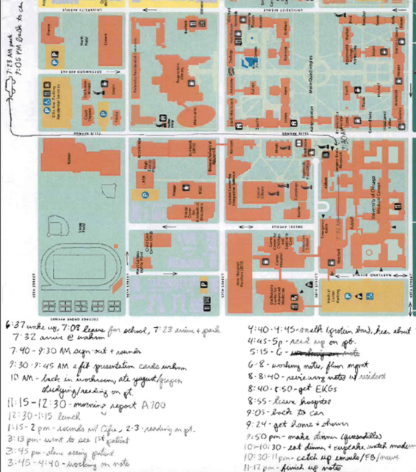
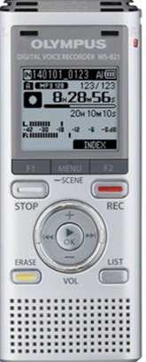
Mapping the day

Slide 7
Coding and Analysis
Student employees transcribed 69 participant interviews
Consultant provided two day workshop on coding and analysis for team members
Each institutional team coded their own transcripts
Analysis using mostly qualitative approaches

Slide 8
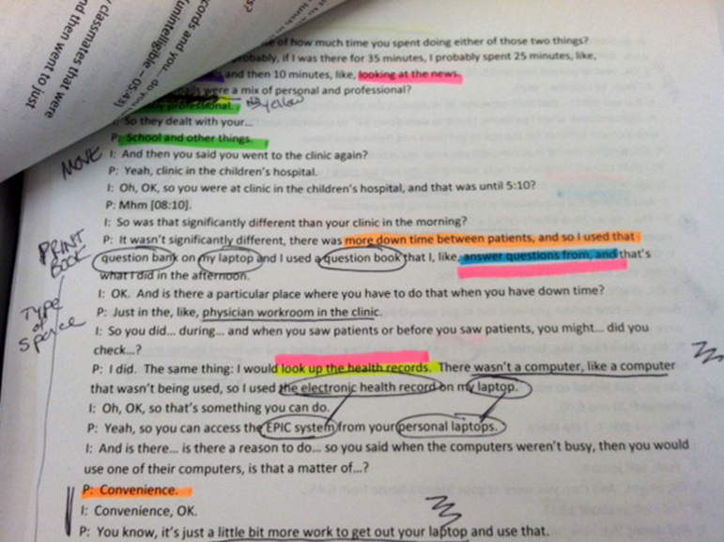
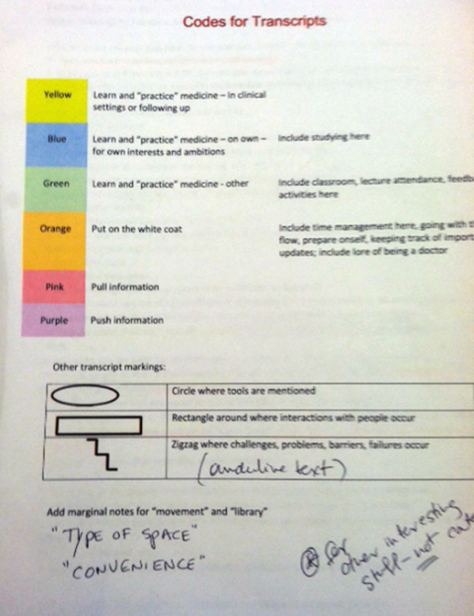
Coding and analysis

Slide 9
Coding and analysis
Learn and practice medicine – clinical setting
Learn and practice medicine – independently
Learn and practice medicine – other
Put on the white coat
Pull information
Push information
Other annotations:
Specific resources or devices; challenges, workarounds or failures; movement; “usually”; awareness of library; personal interactions

Slide 10
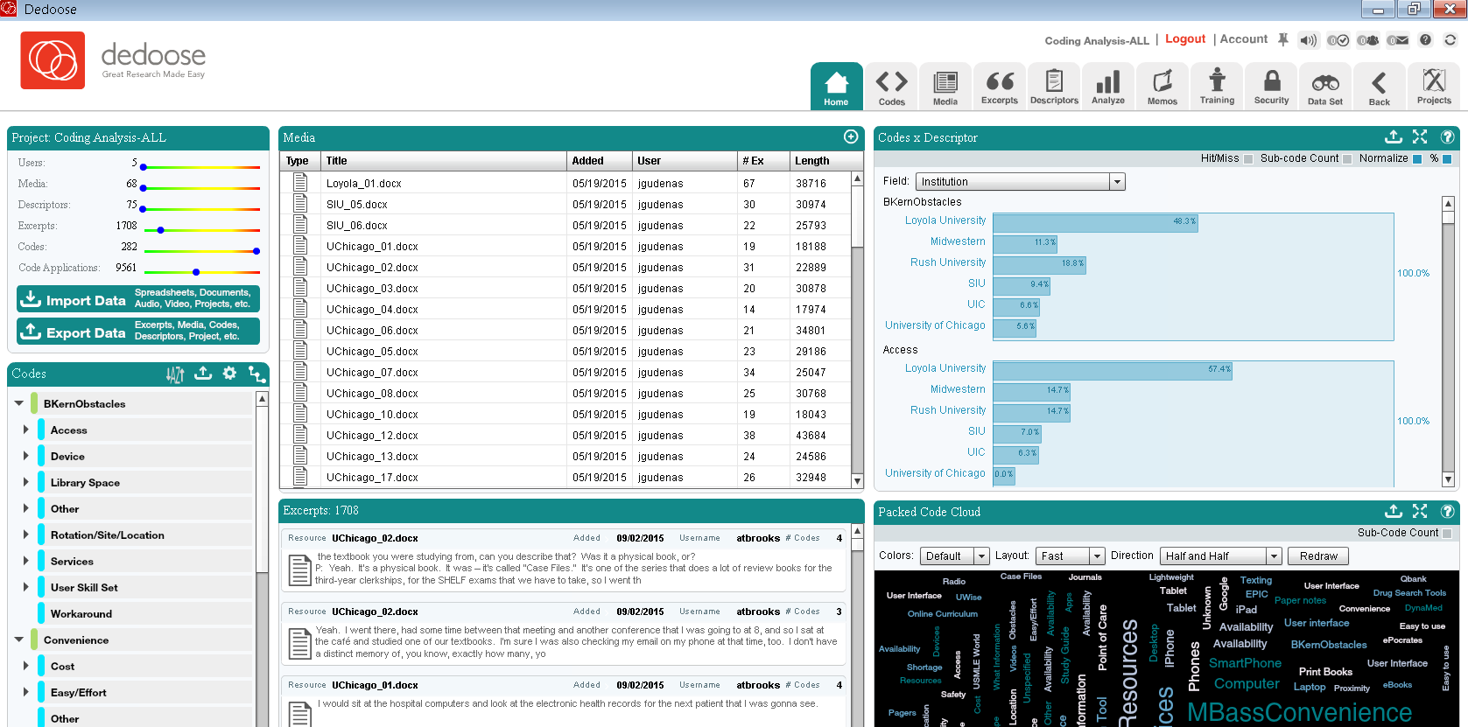
Coding and analysis

Slide 11
Preliminary results
Information seeking “in the wild”
“Information Literacy and Research Practices” by Nancy Fried Foster http://www.sr.ithaka.org/publications/information-literacy-and-research-practices/

Slide 12
Preliminary results
Fast paced clinical answers needed

Slide 13
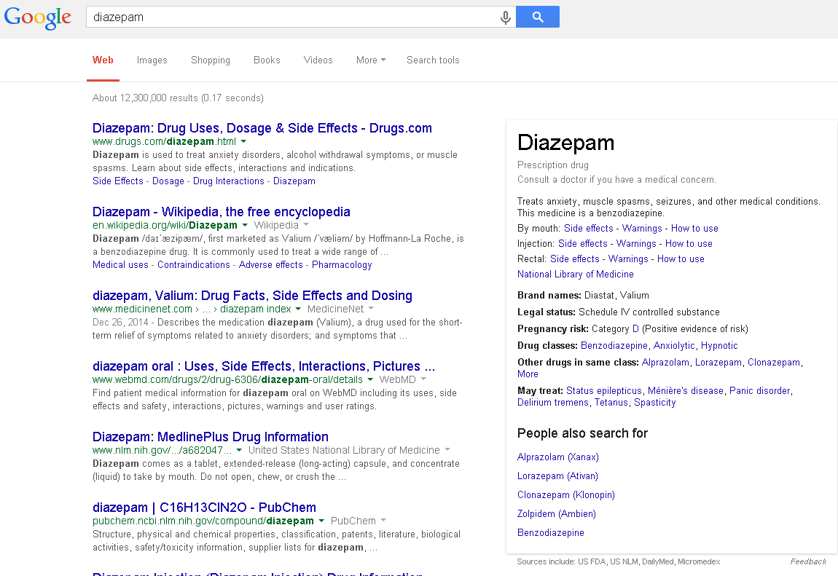

Slide 14
Preliminary results
Fast paced clinical answers needed
When Google/Wikipedia isn’t enough

Slide 15
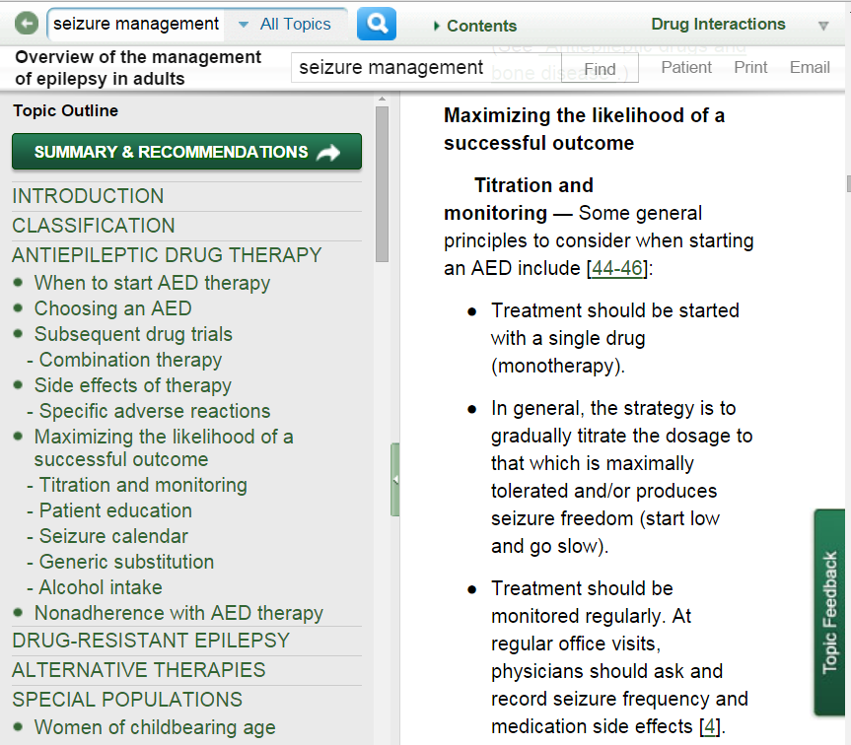
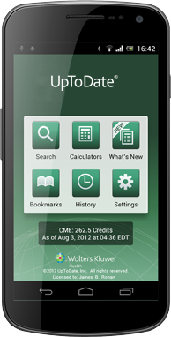

Slide 16
Preliminary results
Fast paced clinical answers needed
When Google/Wikipedia isn’t enough
In depth research and learning

Slide 17
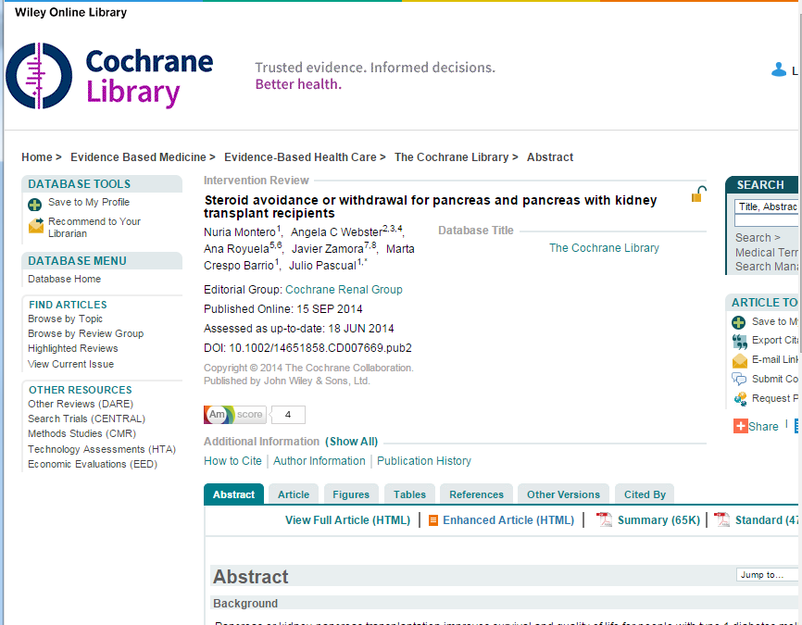
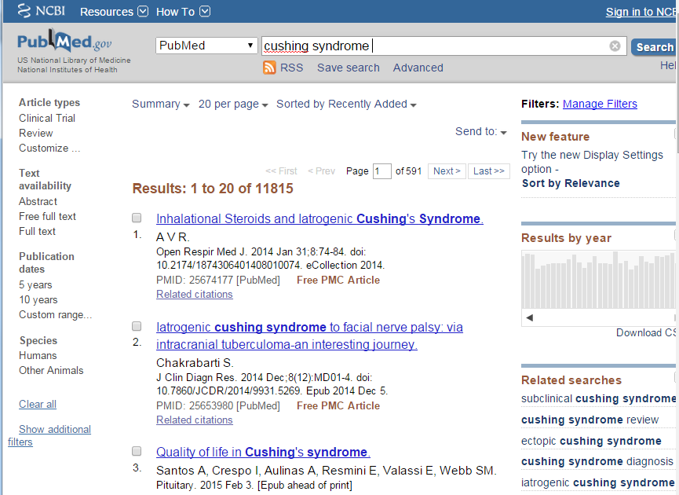

Slide 18
Preliminary results
Fast paced clinical answers needed
When Google/Wikipedia isn’t enough
In depth research and learning
Electronic health records

Slide 19
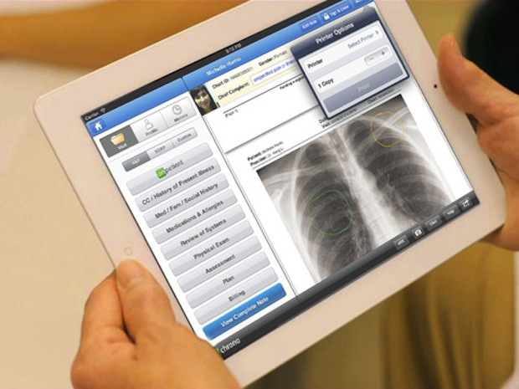

Slide 20
Preliminary results
Fast paced clinical answers needed
When Google/Wikipedia isn’t enough
In depth research and learning
Electronic health records
Print vs e-books

Slide 21
Preliminary results
Fast paced clinical answers needed
When Google/Wikipedia isn’t enough
In depth research and learning
Electronic health records
Print vs e-books
Challenges and obstacles

Slide 22
Applying the results
Renovation projects
Changes to library workstations
Extended borrowing period for iPads
Changed website to faciliate access to UptoDate
Pushing out UptoDate mobile app
Informing librarian rounding pilot program
Changes in collection development projects
Future directions/projects: stronger emphasis on responsive design, support for resources not previously collected, partner with medical school/center to integrate resources into EHR

Slide 23
Lessons learned
Support from the medical school administration was critical
Incentives were important in recruiting participants
Build in extra time for bureaucracy
Having a project leader was essential
Services of a professional consultant were extremely helpful
Use a variety of approaches for project team communication

Slide 24
Acknowledgments
Project Team
Barbara Kern, Deb Werner, Ricardo Andrade (University of Chicago) Kathryn Carpenter, Gwen Gregory, Jay Jurek (University of Illinois at Chicago) Christine Frank, Jonna Peterson, Jeanne Link (Rush University) Gail Hendler, Jean Gudenas, Jeanne Sadlik, Elizabeth Huggins (Loyola University Chicago) Connie Poole (Southern Illinois University) Natalie Reed, Cynthia Snyder, Katy Lencioni (Midwestern University) Nancy Fried Foster (consultant, Ithaka S+R)
Funding
Replicating Rochester: Understanding User Information Needs in the Health Sciences was supported by in part with Federal funds from the Department of Health and Human Services, National Institutes of Health, National Library of Medicine, under Contract No. HHS-N-276-2011-00005C with the University of Illinois Chicago. Project Manager: James Shedlock. Awarded August 2012.
“A Day in the Life” Mapping Project was supported by in part with Federal funds from the Department of Health and Human Services, National Institutes of Health, National Library of Medicine, under Contract No. HHSN-276-2011-00005C with the University of Illinois at Chicago. Project Manager: Andrea Twiss-Brooks. Awarded August 2013.

