Slide 1
OCLC Asia Pacific Regional Council Conference Dec 2015
Moving towards True Multilingualism:
Leveraging Global Cooperation through
WorldCat
Karen Smith-Yoshimura
OCLC Membership and Research

Slide 2
WorldCat today
Resources in nearly all languages
Contributed by more than 20,000 libraries worldwide
More than half the database is for works not in English
Notes:
Thanks to the contributions of all of you and other OCLC members world-wide, we have rich multilingual content in WorldCat that we can leverage. There are more than 350 million records in WorldCat today representing holdings of the world’s libraries. Of the 300 million, more than half are in languages other than English.

Slide 3
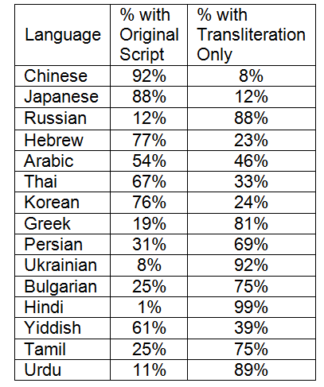
Many languages in WorldCat written in non-Latin scripts
홍길동전
Ιλιάδα
源氏物語
زقاق المدق
Война и миръ
דער בעל-תשובה
紅樓夢
พระอภัยมณี
Notes:
However, many of these non-English languages are written in different character sets. For some of the top languages represented in WorldCat, we have good representation of that language’s writing system such as for Chinese and Japanese. But for others, like Russian and Hindi, the works are represented only by transliterations which can hinder the ability of readers of those languages to find and identify the works they’re interested in.
[Titles displayed in original script:
Korean hangul: Hong Kiltong chŏn or The Story of Hong Gildong
Greek: The Iliad
Arabic: Midaq Alley
Russian: Voyna i mir or War and Peace
Yiddish: Der baʻal-tšwbah or The Penitent (by Isaac Bashevis Singer)
Chinese: Hongloumeng or Dream of the Red Chamber
Thai: Phra Aphai Mani
Japanese (kanji): Genji Monogatari or The Tale of Genji

Slide 4
Present information in the
preferred language and script
of the user
Notes:
OCLC Research has a “Multilingual Bibliographic Structure” project with the goal to present information in the preferred language and script of the user.

Slide 5
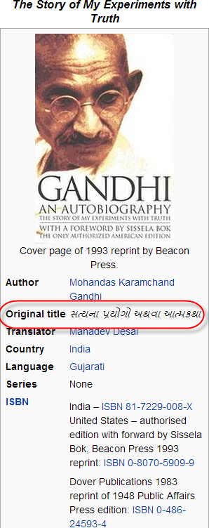
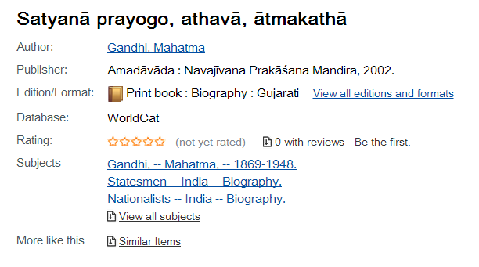
Linked data opportunity
Ingest original script (Gujarati here) for
readers who can read the original
સત્યના પ્રયોગો અથવા આત્મકથા
Notes:
We now have an opportunity to consume linked data. Gandhi wrote his autobiography in Gujarati, but the WorldCat records for his work have only the romanization. But Wikipedia – which is linked to Wikidata – shows the original title in the original script. Rather than trying to add original scripts to the millions of records for languages written in non-Latin scripts but represented only by romanization, wouldn’t it be great if we could link to sources that already have the original script?

Slide 6
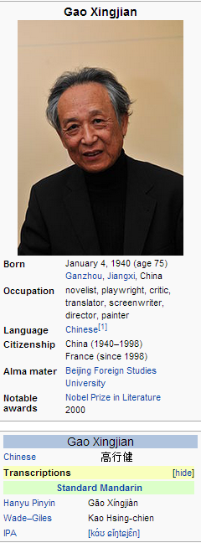
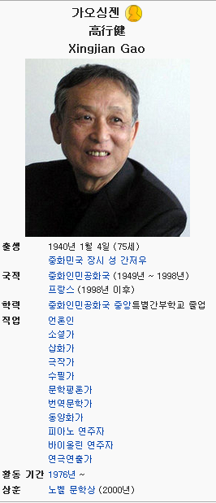
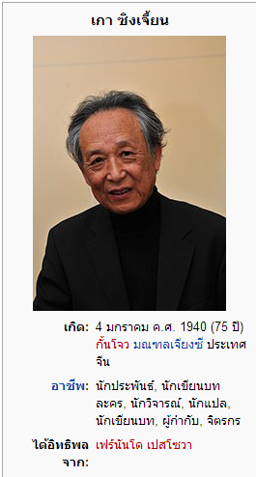
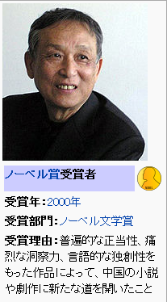
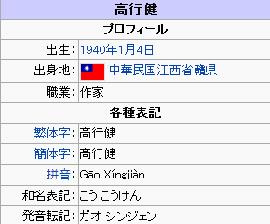
Cues from Wikidata
Notes:
For moving towards true multilingualism, I’d like us to see us take cues from Wikidata – the source of all the different languages of Wikipedia. For persons, it includes links to VIAF as well as other authority files. There’s a separate Wikipedia page for each language. I like that for both the English and Japanese versions, transliterations are an option rather than a default. The Japanese one shows the pronunciation of Gao’s name in Mandarin Chinese (an approximation, as in any transliteration) as well as the pronunciation in Japanese. There are lots of other Wikipedia pages for this Nobel laureate (click) with different information provided.
This works well for the “short head” of the most widely published works and their authors. We can establish “sameAs” relationship links among WorldCat, VIAF and Wikidata as well as other datasets describing the same entities, leveraging the information in each.
WorldCat is a unique resource for representing the “long tail” of the many works and authors not represented in other sources like Wikidata.

Slide 7
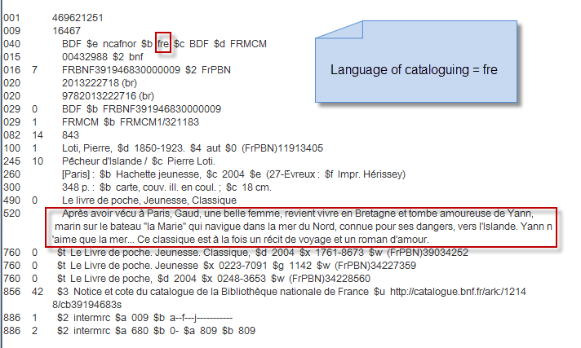
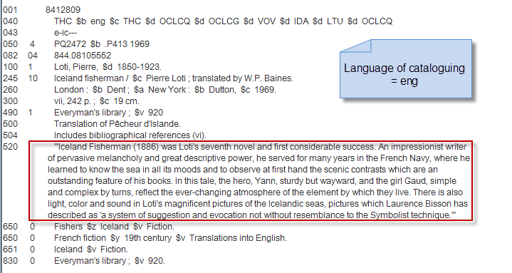
Leveraging language
of cataloging
Notes:
To present information in the preferred language of the user, we need to know the language of the individual data elements, not just the language of the resource being described. The language of cataloging in a record can indicate the language of the free-text fields such as summaries.
Slide from Janifer Gatenby, OCLC

Slide 8
@fr
@en
Notes:
So when we transform these summary text strings into linked data we can provide language tags, allowing us to present information in the preferred language and script of the user.

Slide 9
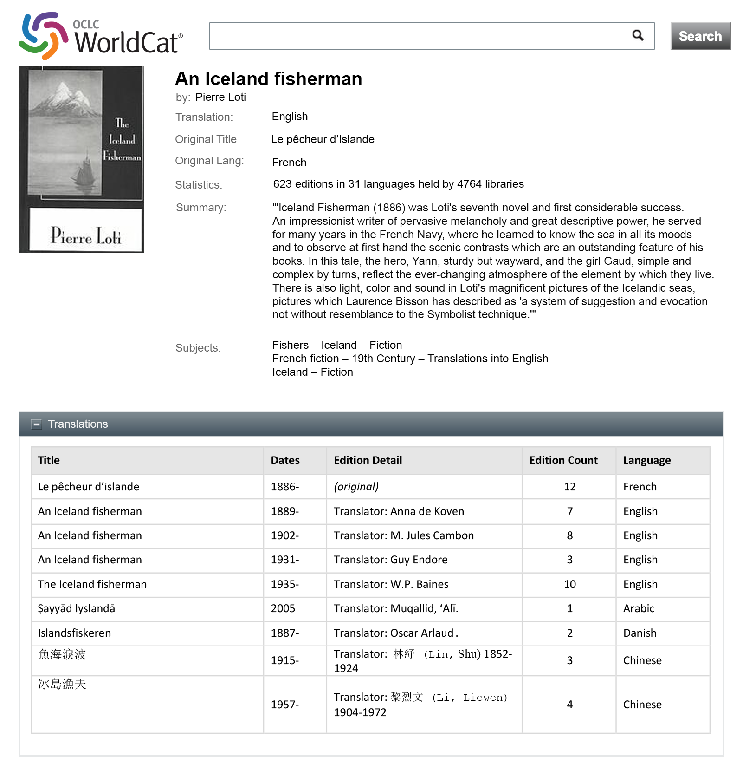
Mockup
Notes:
We have mocked up what a display could look like from the content of WorldCat records. Here, we take advantage that we have an English-tagged summary of An Iceland Fisherman, original in French, displayed in an English interface and with a table of translations and translators of the work.
Mockup designed by JD Shipengrover, OCLC Research

Slide 10
Mockup
Notes:
This is the same record with a Chinese interface. Since we don’t have a Chinese-language summary, none would be shown.
Mockup designed by JD Shipengrover, OCLC Research

Slide 11
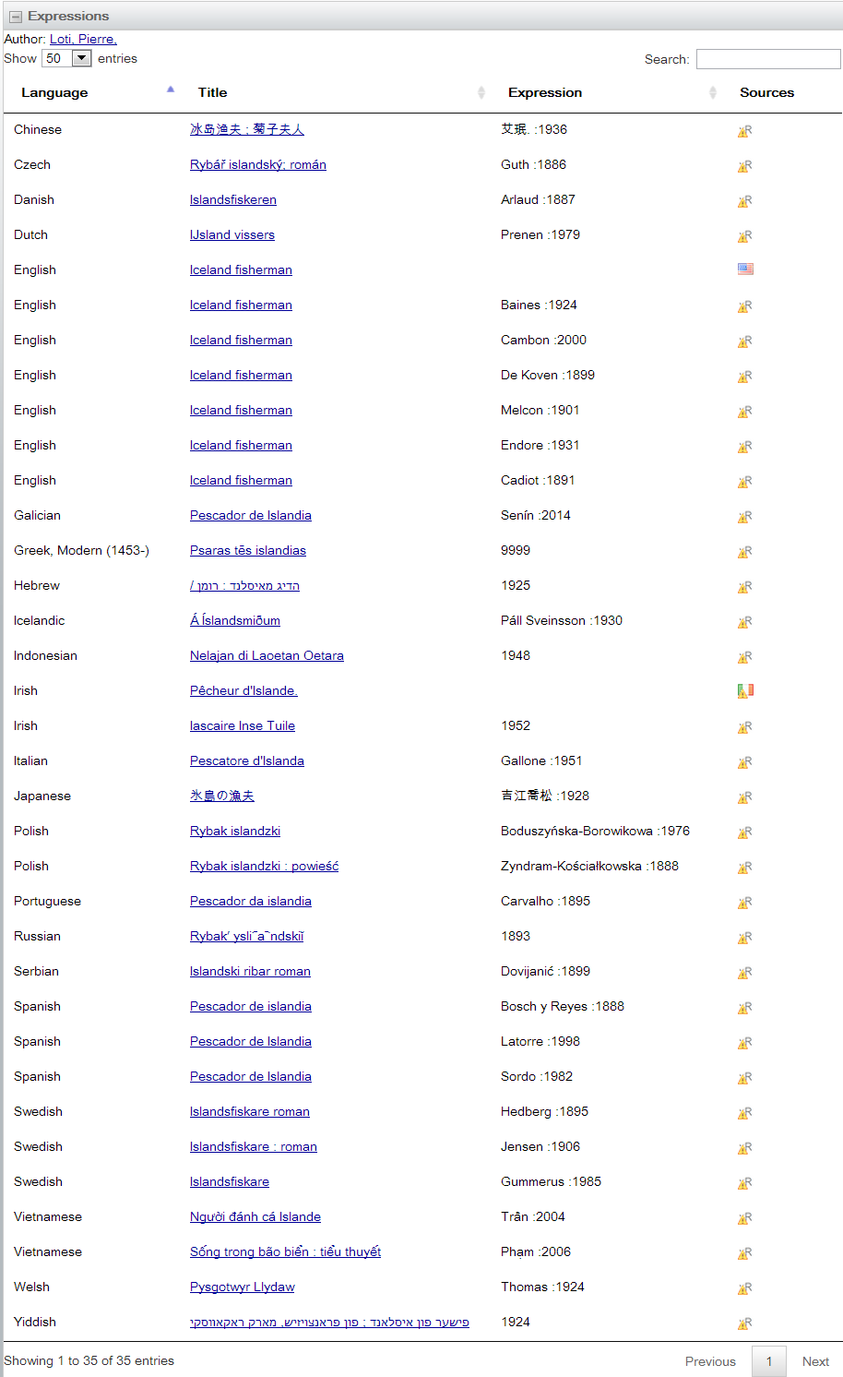
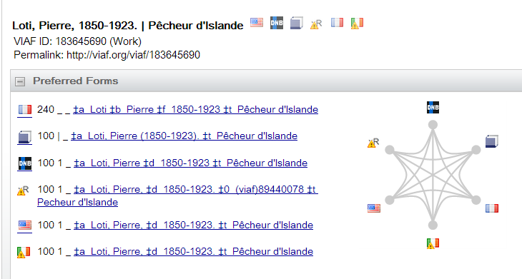
Notes:
We have been datamining WorldCat to generate work-translation ("expression level") records—including the translated title and translator with links to the original work and the author—and adding them to VIAF (Virtual International Authority File). The entries we’ve generated are flagged as "xR". The aim was to generate records from the high quality and detailed WorldCat records that could both improve work clusters and their presentations and be shared as linked data.
This is the current display for the Loti work – We have datamined 33 translations from WorldCat data that are now represented in VIAF, in addition to the two contributed by VIAF contributors. We display only the original script if present along with the translator (if we can parse it out) and the earliest publication date. By comparison, the Unesco Index translationum lists only 9 translations and Wikidata only 5.
We have added 1.4 million of these translation records into VIAF thus far.

Slide 12
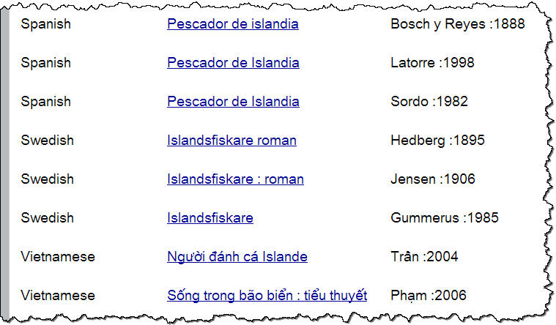
Distinguishing
translations
into same
language
Notes:
Works containing the world’s cultural and knowledge heritage are shared by being translated. The most important works will have multiple translations into the same language. Some translations are better than others and so it is very important to identify the translator of each.
When we datamine WorldCat records, we often have to parse the information in the statement of responsibility to identify the translator. We can then distinguish translations into the same language by translator, as shown in this excerpt from the previous VIAF display for Loti’s Pêcheur d'Islande, with multiple translations into Spanish, Swedish and Vietnamese (the translator is in the column on the right).

Slide 13
Markup for the semantic web
# Original Work (in Chinese)
<http://worldcat.org/entity/work/id/1215997>
a schema:CreativeWork;
schema:creator <http://viaf.org/viaf/102266649> ; # "Gao, Xingjian”
schema:inLanguage "zh";
schema:name "靈山"@zh-hant .
# Translated Work (in English)
<http://worldcat.org/entity/work/id/145209748>
a schema:CreativeWork;
schema:creator <http://viaf.org/viaf/102266649> ; # "Gao, Xingjian“
schema: translator <http://viaf.org/viaf/81663420> ; # "Lee, Mabel"
schema:inLanguage "en";
schema:name "Soul Mountain"@en ;
schema:translationOfWork <http://worldcat.org/entity/work/id/1215997>
Notes:
Machines access VIAF far more than humans. To leverage all the work done by the OCLC cooperative we want to share the relationships we’ve established between original works and their associated translations with the semantic Web. Here is a sample markup of an original Chinese work written by Gao Xingjian, a Chinese Nobel Prize laureate for literature, and one of the translations of his work into English. We marked this up with schema.org; there were two new terms we proposed, since accepted as a bib extension, shown here: translator and translationOfWork. We are also exploring using ISO-defined script differentiators for simplified and traditional Chinese characters, “hant” here for traditional and “hans” for simplified.
The same process contributes to WorldCat descriptions. The relationships we’re establishing in VIAF also flow into WorldCat Works over time.

Slide 14
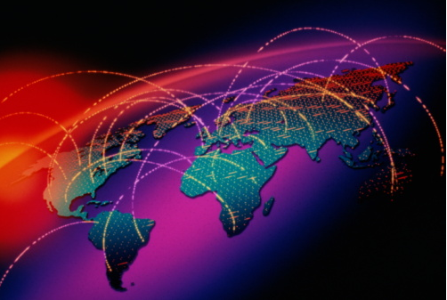
Through global cooperation…
WorldCat has more translations than any other resource.
We can tag data elements from different languages of cataloging.
We can ingest data from other linked data sources to present information in the preferred language and script of the user.

Slide 15
OCLC Asia Pacific Regional Council Dec 2015
Comments?
Karen Smith-Yoshimura
Senior Program Officer
smithyok@oclc.org or @KarenS_Y

