Slide 1
OCLC Research Library Partnership Meeting
Melbourne, Australia
2 December 2015
Working with OCLC Research Library Partners on
Researcher & Organisational Identifiers
Karen Smith-Yoshimura
OCLC Research

Slide 2
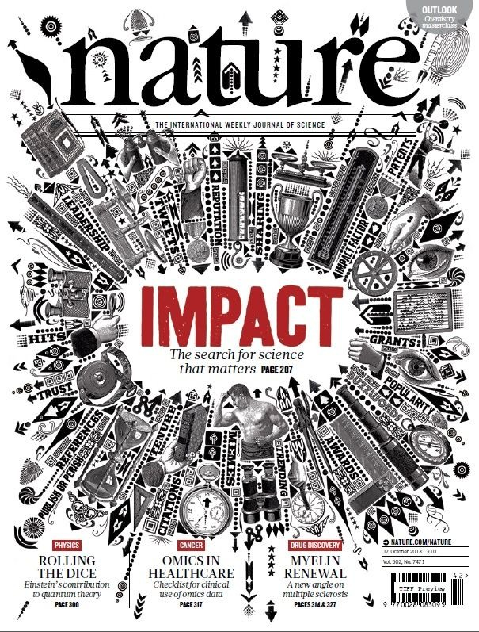
Impact
Funder/government-led initiatives to ensure value for the research that gets funded
Hard to quantify, track and classify
Challenging to get underlying data to map the pathway to impact
Notes:
The new vogue in research evaluation is “impact”…
Slide from Daniel Hook, Symplectic Elements

Slide 3
One indicator of impact
We initially use bibliometric analysis to look at the top institutions, by publications and citation count for the past ten years…
Universities are ranked by several indicators of academic or research performance, including… highly cited researchers…
Citations… are the best understood and most widely accepted measure of research strength.
Notes:
These are three university rankings issued annually, rankings that are of particular importance to research libraries. Some universities even incorporate raising their ranking in their strategic plans. All three use citations as a factor in determining the rankings, and puts added weight to authors of journal articles, which are usually not represented in national authority files.
This type of ranking makes it important to correctly attribute both the authors and their institutional affiliation(s).

Slide 4
Identifiers!!!
A unique, persistent and public URI associated with a digital object
Resolvable globally over networks
Unambiguous to use, find and identify the resource.
Examples:
http://id.loc.gov/authorities/names/n79054099
isni.org/isni/000000012179088X
http://viaf.org/viaf/146316977
wikidata.org/wiki/Q319078
Identify:
Notes:
Identifiers are a crucial component to make linked data work. We have at our disposal a number of identifiers – the examples here are for the Library of Congress id.loc.gov, the International Standard Name Identifier (ISNI), the Virtual Internal Authority File (VIAF) and Wikidata, the knowledge base operated by the Wikimedia Foundation providing a common source of data that feeds into such projects as different language Wikipedias. All these identifiers point to the same entity: University of Melbourne.

Slide 5
Identifiers: Glue for institutions and funder systems
Researchers interact with many internal and external systems
Machine readable data structure and unique identifiers are critical for:
Authentication
Validation
De-duplication
Identifiers enable data to be trusted and re-used at a network scale
Notes:
Modified version of slide from Daniel Hook, Symplectic Elements

Slide 6
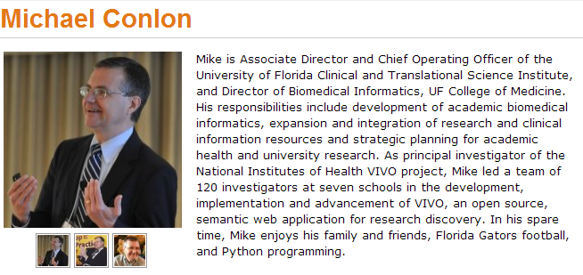
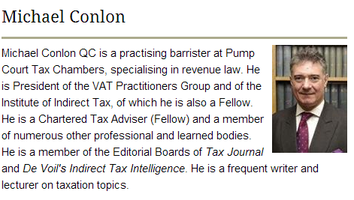
Same name, different people
Conlon, Michael. 1982. Continuously adaptive M-estimation in the linear model. Thesis (Ph. D.)--University of Florida, 1982.
Notes:
Michael Conlon is a member of our task group, an expert in biomedial informatics at the University of Florida. There is another Michael Conlon in the UK who writes articles on European taxes. Obviously two different people. Then there’s an article on microbiota in the Australian journal Microbiology written by a Michael Conlon. The same Michael Conlon as the U. Florida one or a different one based in Australia? Without other metadata, it is difficult to tell. (Turns out, it’s yet another Michael Conlon.)
Michael Conlon is a rather uncommon name. But consider that in China 275 million people have the surname of Li, Wang or Zhang. And that’s not including the millions of overseas Chinese. The chances ethnic Chinese having the same name—especially in the abbreviated form used in journal articles– is high. We need other identifying attributes such as institutional affiliation and discipline (if not photos) to disambiguate names.

Slide 7
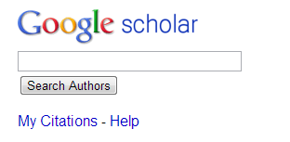
One researcher may have many profiles or identifiers…
(from an email signature block)
Profiles: Academia / Google Scholar / ISNI / Mendeley / MicrosoftAcademic / ORCID / ResearcherID / ResearchGate / Scopus / Slideshare / VIAF / Worldcat
Notes:
Some researchers already have multiple identifiers. This is an example from a signature block in an email. The researcher includes twelve different identifiers or profiles he’s represented in. This also fragments his Web presence.
To recap the problem statement:
Citations are a factor in assessing the impact of scholarship but journal article authors often are not represented in authority files.
A given scholar can be represented by different forms of the name, all of which may not be included in authority files.
Two or more researchers may have the same name, and we need other attributes to disambiguate them.
Some researchers already have multiple identifiers.

Slide 8
Registering Researchers in Authority Files Task Group Members
Micah Altman, MIT - ORCID Board member
Michael Conlon, U. Florida – PI for VIVO
Ana Lupe Cristan, Library of Congress – LC/NACO trainer
Laura Dawson, Bowker – ISNI Board member
Joanne Dunham, U. Leicester
Amanda Hill, U. Manchester – UK Names Project
Daniel Hook, Symplectic Limited
Wolfram Horstmann, U. Oxford
Andrew MacEwan, British Library – ISNI Board member
Philip Schreur, Stanford – Program for Cooperative Cataloging
Laura Smart, Caltech – LC/NACO contributor
Melanie Wacker, Columbia – LC/NACO contributor
Saskia Woutersen, U. Amsterdam
Thom Hickey, OCLC Research – VIAF Council, ORCID Board
Notes:
These are the members of the OCLC Research Registering Researchers in Authority Files Task Group which I facilitate. The members represent different perspectives from three countries – the U.S., The Netherlands, and the UK. We have members who are librarians, those who contribute to the LC/NACO authority file or train others to do so and who are members of the Program for Cooperative Cataloging. We have ORCID and ISNI Board members, and representatives from VIVO, a Current Research Information System (Symplectic), and a publisher (Bowker). My colleague Thom Hickey is the chief scientist responsible for creating the Virtual International Authority File and is on both the VIAF Council and the ORCID Board.

Slide 9
Stakeholders & needs
Researcher | Disseminate research
 | Compile all output
 | Find collaborators
 | Ensure network presence correct
 | Retrieve other’s scholarly output to track a given discipline
Funder | Track funded research outputs
University administrator | Collate intellectual output of their researchers to fulfill funder or national mandates, internal reporting
Librarian | Disambiguate names
Identity management system | Associate metadata, output to researcher
 | Disambiguate names
 | Link researcher's multiple identifiers
 | Disseminate identifiers
Aggregator (includes publishers) | Associate metadata, output to researcher
 | Collate intellectual output of each researcher
 | Disambiguate names
 | Link researcher's multiple identifiers
 | Track history of researcher's affiliations
 | Track & communicate updates
Notes:
The first thing the task group did was write up 18 use case scenarios from the perspective of different actors or stakeholders. I’ve consolidate the needs identified here; some overlap.

Slide 10
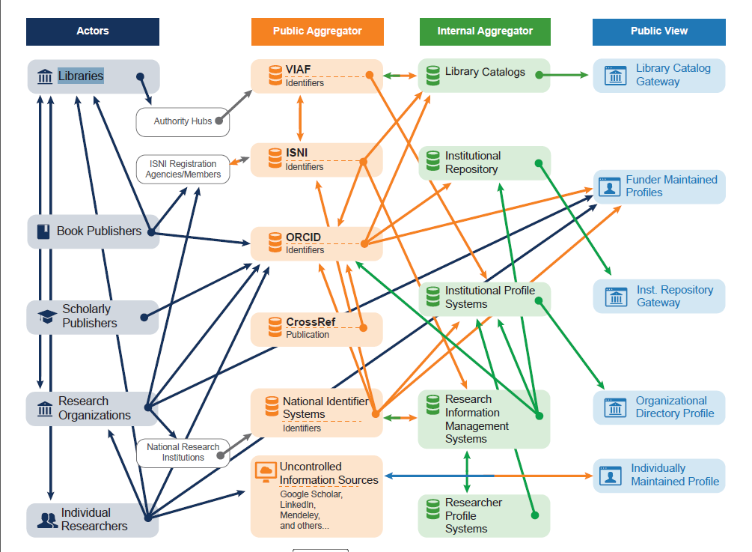
Researcher Identifier Information Flow
Notes:
The same information about a specific researcher may be represented in multiple databases, and only a subset interoperates with each other. We’ve diagrammed the flow of information describing researchers and identified researcher outputs such as publications among classes of actors and systems. Each category of actor is depicted with an icon and a caption. An arrow going from one entity to another is used to indicate that information flows from one entity to the other.
This researcher identifier information flow diagram reveals several patterns:
Information flow is quite complex overall, especially between public aggregators and private aggregators.
Most of the information flow is one way—there are few automatic or systematic channels for corrections or annotations at later stages to flow back up to public aggregator sources, or to the actors providing them. ISNI—which focuses on managing links between member identifier systems and databases—is an exception. It tracks all sources, and corrections are fed back to the source as they are made. The interoperability flows between ISNI and ISNI registration agencies, and between ISNI and VIAF, are indicated in the diagram by bidirectional arrows.
Many actors are contributing to multiple public views of Researcher ID information.
Information provided by the same class of actor may flow through multiple (possible concurrent) paths to internal aggregator systems and public views—suggesting the potential for duplication and inconsistency.
Individual categories of public views seldom represent more than one type of internal aggregator.
A key question is how corrections or updates can be communicated between systems. Researchers are frustrated when they see errors in their profile, works incorrectly assigned to them or works missing. Even if the information is corrected in the local instance, it often is not reflected in the aggregated databases or hubs.
Graphic created by Micah Altman, MIT and JD Shipengrover, OCLC Research

Slide 11
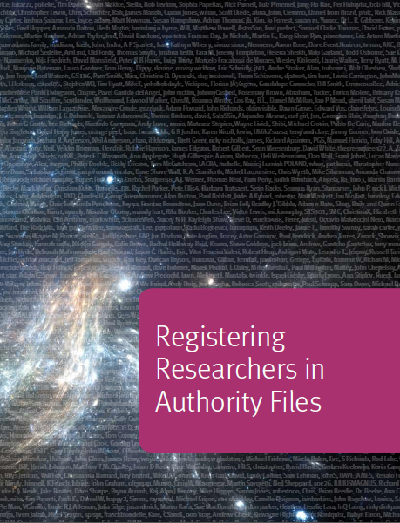
Key recommendations
Researcher: Get persistent identifier (early in career) & use on all external communications
Librarian/University administrator: Advocate benefits and reasons for using and disseminating identifiers
Need for third-party name identifier reconciliation service
http://www.oclc.org/research/publications/library/2014/oclcresearch-registering-researchers-2014-overview.html
Notes:
Our report was published last year, and several task group members joined me in a Webinar explaining our work. We also published supplementary datasets:
Use case scenarios
Functional requirements
Links to 100 researcher networking and identifier systems
Characteristics profiles
Mapping of profiles to functional requirements
Researcher identifier information flow
With a growing “sea” of identifiers, the task group saw a hugh opportunity for a third-party identifier reconciliation service to provide linking among different ID systems rather than have each organization
attempting to construct such a linking system on its own.

Slide 12
Person Entity Lookup Pilot
Link related sets of person identifiers and authorities (e.g., VIAF, ISNI, LC/NACO Authority File)
Surface WorldCat Person entities, and map to identifiers for same person
Seven pilot participants (5 OCLC RLPs):
Cornell University
Harvard University
Library of Congress
National Library of Medicine (US)
National Library of Poland
Stanford University
University of California, Davis
Notes:
Recently begun, to last several months

Slide 13
OCLC Research Task Force on Organisations in ISNI
Karen Smith-Yoshimura OCLC Research (leader)
Grace Agnew Rutgers University
Christopher Brown JISC (UK) (CASRAI)
Kate Byrne University of New South Wales
Matt Carruthers University of Michigan
Naun Chew Cornell University
Peter Fletcher UCLA
Janifer Gatenby OCLC Leiden (ISNI Assignment Agency)
Stephen Hearn University of Minnesota
Xiaoli Li University of California, Davis
Marina Muilwijk University of Utrecht
Roderick Sadler La Trobe University
John Riemer UCLA
Jing Wang Johns Hopkins University
Glen Wiley University of Miami
Kayla Willey Brigham Young University
With input from Andrew MacEwan, British Library and Anila Angjeli, Bibliothèque nationale de France
Examined 13 use cases; producing sample records for each use case
23 recommendations for the system, for the ISNI-IA, for users
Search guidelines for organisations to be produced
Outreach document
Notes:
The OCLC Research task force started meeting in September 2014. We expect to publish our report early in 2016. Our focus is on the needs for universities to control to public image of the university and to be correctly linked to their researchers.
Dovetailing with CASRAI – CASRAI is represented on the Task Force – Examples, use cases, search guidelines.

Slide 14
Organisational IDs: Use cases
Institutions want to track all their scholarly output
Track research groups which may comprise staff from multiple institutions
National assessments reporting
Track funding and validate affiliation
Disambiguate researchers’ names by affiliation
Correctly identify researchers’ affiliations in publications
Many institutions unaware they already have an identifier assigned
Notes:
The current work on organizational identifiers is an outgrowth of the previous work we did with another OCLC Research Library Partners task group on researcher identifiers. That report, Registering Researchers in Authority Files, was published last year. In discussing the report with the Partnership, it became clear that organizational identifiers were equally important to fulfill some of the needs and use cases.
In the same time frame a Jisc-UK-CASRAI working group has also been working on organizational identifiers, and we’ve shared our use cases with each other. The were tasked to look at which organizational IDs should be implemented in the UK higher education sector. Its conclusion:
The most desirable vision for the future would be for ISNI to emerge as a strong, sustainable and internationally well supported baseline or… ‘bridging’ ID…”
The use cases summarized here represent both of our efforts.
NB: The Consortia Advancing Standards in Research Administration Information (CASRAI) is an international non-profit dedicated to reducing the administrative burden on researchers and improving business intelligence capacity of research institutions and funders.

Slide 15
Special challenges with organisations
G
They merge, they split
They acquire/are acquired
They can have multiple departments, schools
Have hierarchies that may change over time
May have multiple hierarchies
Branches in multiple locations or countries
Often unclear when a name change represents a new organisation
Different stakeholders’ perspectives
Notes:
The locations or countries may also change names over time, adding to the complexity.
Publishers tend to focus on the units that subscribe to their publications, which can result in uneven representation of departments or schools within a university.

Slide 16
cross-domain
bridging-domains
Text Rights
Trade Sources
Music Rights
Archives and Museums
Encyclopaedias
Libraries
Researchers & Professional
Granting organisations
Professional Societies
Article databases
Theses databases
Notes:
ISNI is a bridge identifier – linking multiple identifiers for the same personal identity
ISNI covers multiple domains – including cultural and performance. Research is a major domain within ISNI
Universal in scope
Public domain focus
Multiple links
Hub ID – striving to link to all significant existing IDs
Linking among identities, e.g. affiliations, organisation hierarchies
Linking to created resources
Third party input and curation
Organisations can manage their own data, e.g. La Trobe
ISNIs are disseminating links and connections beyond science databases towards publishers and research information systems

Slide 17
ISNI for Organisational Identifiers
Over 500,000 organisations have public ISNIs
ORCID uses ISNIs for organisations
Links to and from Virtual International Authority File (VIAF)
Links in Wikidata
Notes:
In one sense, working with organizational identifiers is easier than researcher IDs, where there are dozens of different identifiers in use. ISNI identifiers are already being diffused across different domains, including Wikidata (from which the identifiers are embedded in many different language Wikipedias.)
In this case, the ISNI identifier in Wikidata for the BnF is also included in <click> the English Wikipedia and the <click> Korean Wikipedia page.

Slide 18
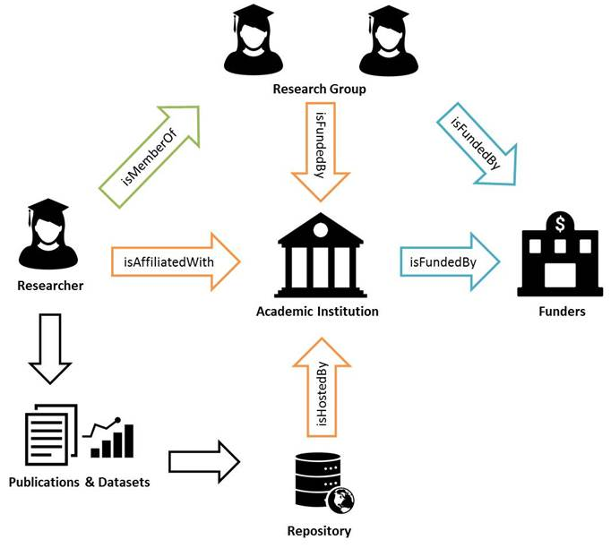
Ex: Relationships for Research Groups
Notes:
Research project (group) is a newly added organisation type, like band, etc. It can have multiple links to both persons and other organisations as well as links to funders.
An example is the Netherlands Graduate School of Linguistics (http://www.lotschool.nl). It publishes a series of dissertations and has an ISNI (0000 0001 0659 950X). However, the people working together in this school are employees of various Dutch universities.
Graphic created by Kate Byrne, U. New South Wales

Slide 19
Recommendations for ISNI
Augment relationship types and display
Indicate organisation’s own preferred form of name
Publish ISNI ontology
Add Turtle, N-Triple, JSON-LD as linked data options
Create end user input form for organisations
Create ISNIs for Organisations outreach document
Engage organisations to maintain their public identity
Encourage organisations to collaborate with ISNI Quality Team to diffuse corrections
Notes:
In addition to research group, OCLC task force has made several recommendations for ISNI org.
Including additional org-org relationships:
“isHostedBy” and “Hosts” (e.g, Hathi Trust)
“Acquired” and “acquired by”
“isGovernedBy”, “governs” (e.g., state-wide repositories)
“isPartneredWith”
Define attributes for names and name variants, including preferred name, current preferred name, language, official form, legal form and common form. Also allow the definition of relationship type for name variants. The use of the attributes is optional and it should be possible to include multiple attributes, e.g. “preferred French name version”.

Slide 20
Using Research Identifiers
An Overview of UNSW’s practice
UNSW Library
Kate Byrne
Manager, Research Reporting
UNSW Library, UNSW Australia
Email: kate.byrne@unsw.edu.au Twitter: @katecbyrne
Notes:
Currently, the research identifier marketplace is still quite fractured. Whilst bridging identifiers like ORCID and international standards like ISNI are on the rise, they do not yet unite research activities consistently across all outputs and disciplines. As a result, UNSW Library aims to support our researchers in making use of a broad range of identifiers so they can pick and choose the IDs needed to best represent their research.
UNSW Library’s activities with research identifiers can be divided into two types, research identifiers for individuals and research identifiers for organisations.

Slide 21
Research Identifiers for Individuals
Support researchers using identifiers including:
Use Symplectic Elements to download publications for researchers based on identifiers and other search settings.
Developing strategies for ORCID integrations with other UNSW systems.
Author ID
Profiles
Notes:
UNSW Library offers advice and assistance to UNSW Researchers who need to create or update their research identifier and associated profiles. The UNSW Library Research Impact Guide (inc case anyone askshttp://subjectguides.library.unsw.edu.au/c.php?g=100225&p=649047) provides a comparison of the common profile tools as an online ‘self-service’ resource and Outreach Librarians are available to provide one on one support to researchers who need it. UNSW Library will not create or update identifers on behalf of researchers as it has been demonstrated that identifers are most successful when then researcher themselves take ownership of the ID and uses it to collate their research.
UNSW Library manages UNSW’s research publication management system, ROS (Research Outputs System). Based on the Symplectic Elements software, ROS searches a range of data sources including Scopus, Web of Science and ORCID and downloads metadata records about publications into the system for UNSW researchers to claim. Identifiers can be added to each researcher’s search settings to improve the accuracy of these search results. Engaging with UNSW researchers by providing assistance editing their ROS profile often proves illuminating in showing researchers how diversely they can be represented online and why identifiers can be useful.
UNSW has expressed interest in joining the Australian ORCID consortium when it is formed in early 2016. This would expand UNSW’s ORCID membership from Basic to Premium and widen the possibilities for system integrations with ORCID. In preparation for the start of the consortium, UNSW Library is leading an effort to develop a strategy for ORCID integrations working with stakeholders from across the university.

Slide 22
Research Identifiers for Organisations
Try to keep UNSW records updated in a range of sources including:
Undertaking a clean up of UNSW’s records in ISNI and documenting this as a case study.
Kate Byrne, Member of OCLC Research Task Force on Representing Organisations in ISNI
Notes:
Identifiers for Organisations is an area that is also still developing. With the rate that organisations change – schools merging, faculties changing name etc. maintaining organisational identifiers can feel a bit like trying to keep water in a bucket with a hole in it. UNSW Library has only been working with organisational identifiers in a significant way for the past 6-12 months and it has been interesting to see the range of organisational identifiers out there. UNSW Library is trying to ensure that they keep records about UNSW reasonably up to date in a range of sources.
GRID is a product that was launched by Digital Science a few weeks ago, when UNSW Library got the press release, they immediately looked themselves up, saw that some of the information in there was out of date and filled out the form to get the information updated.
Cleaning up UNSW’s ISNI records has been a more major undertaking. When UNSW Library became an ISNI member they realised that different parts of UNSW over time had accumulated numerous ISNIs and so they began a project to map and update the existing ISNIs and add any parts of the organisation that are missing. They are not aiming to create a complete historical record, rather trying to ensure it actually resembles UNSW in the current day. UNSW Library are apparently the first organisation to undertake a clean up of this kind, so they are also documenting the process they are following. They will be working with Janifer Gatenby from OCLC /ISNI to document this as a case study.
Kate has been a member of the OCLC Research Task Force on Representing Organisations in ISNI which is putting together recommendations on how to ensure ISNI is up to the complex task of representing institutions. She has found it illuminating to be working both on the theoretical side with the task group and the practical side working with her colleagues to clean up UNSW’s ISNIs.

Slide 23
OCLC Research Library Partnership Meeting , Melbourne
2 December 2015
Thank you!
Contact: Karen Smith-Yoshimura
smithyok@oclc.org
@KarenS-Y
©2015 OCLC. This work is licensed under a Creative Commons Attribution 4.0 International License. Suggested attribution: “This work uses content from How You Can Make the Transition from MARC to Linked Data Easier © OCLC, used under a Creative Commons Attribution 4.0 International License: http://creativecommons.org/licenses/by/4.0/.”

