Slide 1

MANAGING REPUTATION,
MANAGING RISK

Slide 2
Talk Outline
Brief overview of the
University of Illinois at Urbana-Champaign
A look at what a
senior research officer does (and why)
Reputation management
from the research perspective

Slide 3
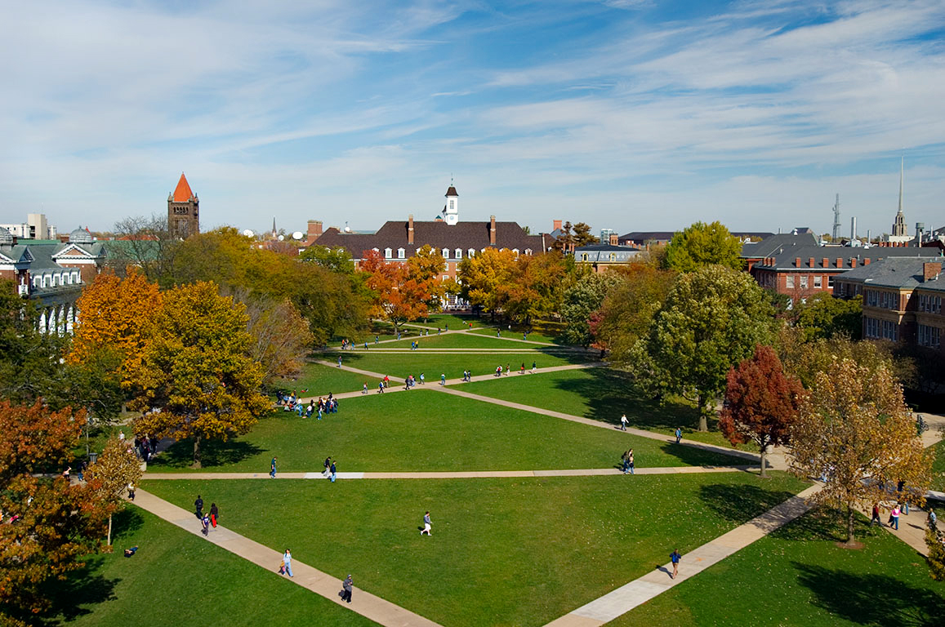
The University of Illinois at Urbana-Champaign
Founded 1867
One of three campuses
Land Grant Institution
Phyllis Wise, Chancellor
“A pre-eminent public research university with a
land grant mission and a global impact”
~ 2013-2016 Campus Strategic Plan

Slide 4
Illinois, by the Numbers
1,848 TENURE TRACK,
872 VISITING FACULTY & INSTRUCTIONAL STAFF

Slide 5
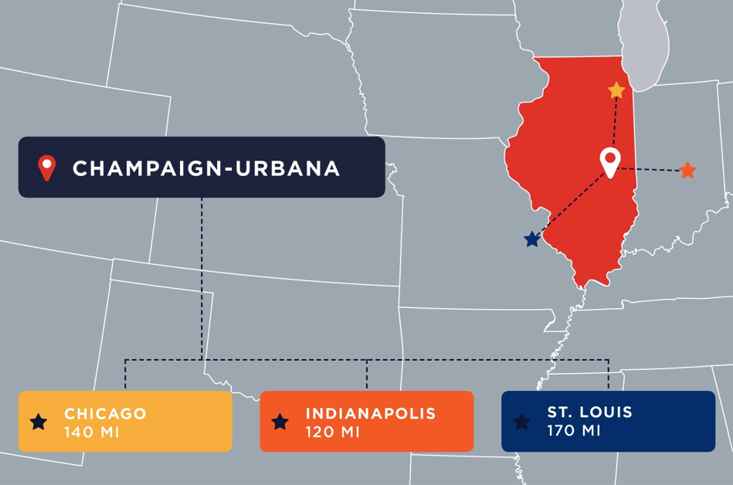

Slide 6


Slide 7
Academic Colleges
16 Colleges and Instructional Units
College of Agricultural, Consumer and Environmental Sciences
College of Applied Health Sciences
College of Business
College of Education
College of Engineering
College of Fine and Applied Arts
Division of General Studies
Graduate College
School of Labor and Employment Relations
College of Law
College of Liberal Arts and Sciences
Graduate School of Library and Information Science
College of Media
College of Medicine at Urbana-Champaign
School of Social Work
College of Veterinary Medicine

Slide 8
Total Research and Development Expenditures
*2013 Expenditures include one-time capital costs for Blue Waters Supercomputer

Slide 9
Research Expenditures FY14

Slide 10
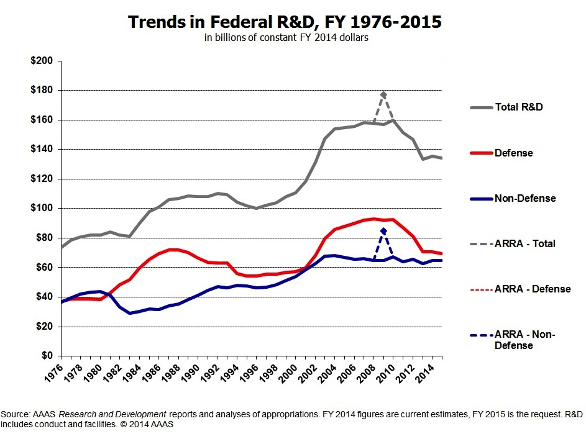
Context: The Pie is not Growing

Slide 11
The Senior Research Officer
The Job Description
The Reality
“….provides leadership for campus-wide interdisciplinary research institutes, promotes new research initiatives, and oversees the administrative and business processes that ensure the productive, safe, and ethical conduct of research at Illinois.”
Represents researchers to campus administration
Responsible for research within campus administration

Slide 12
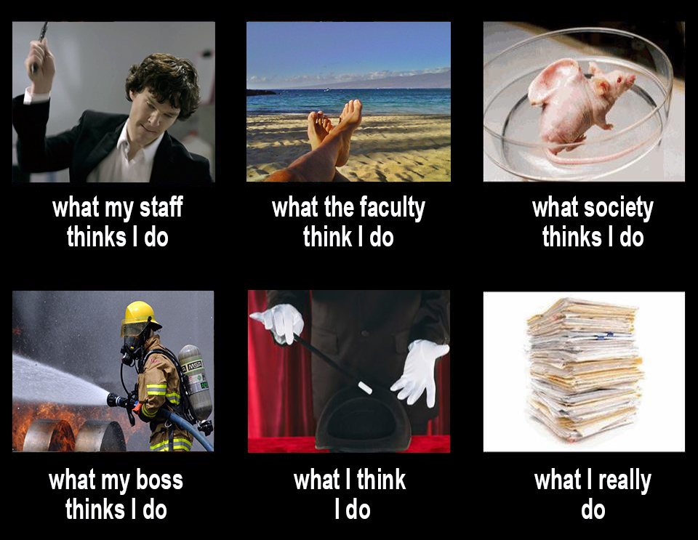
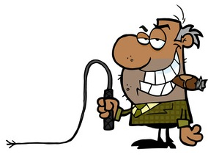
What Does a Senior Research Officer Really Do?

Slide 13
Where Does the Senior Research Officer Fit?
Chancellor
Provost
Vice Chancellor for Research
Vice Chancellor for Student Affairs
Vice Chancellor for Institutional Advancement
College Deans
Research Institutes
Compliance and Support Units

Slide 14
Office of Vice Chancellor for Research Structure
OVCR
(including Central OVCR programs and administrative services)
Administrative
and
Compliance Units
(IACUC, DRS, AACUP, OSP, OPD, OPRS)
Research Institutes
(IGB, Beckman, PRI, NCSA,
iSEE)
Other Units
(Carver Biotech Center, DAR, Center for Advanced Study, IHSI)

Slide 15
Research Compliance Functions:
Keeping Research Safe, Ethical, and Legal
Agricultural Animal Care and Use Program (AACUP)
Division of Research Safety
Institutional Animal Care & Use Committee Office (IACUC)
Research Integrity
Conflict of Interest
Office for the Protection of Research Subjects
Office of Sponsored Programs (OSP)

Slide 16
Research Institutes and Centers
Beckman Institute for Advanced Science and Technology
Carl R. Woese Institute for Genomic Biology
Institute for Sustainability, Energy, and Environment
Interdisciplinary Health Sciences Initiative
National Center for Supercomputing Applications
Prairie Research Institute

Slide 17
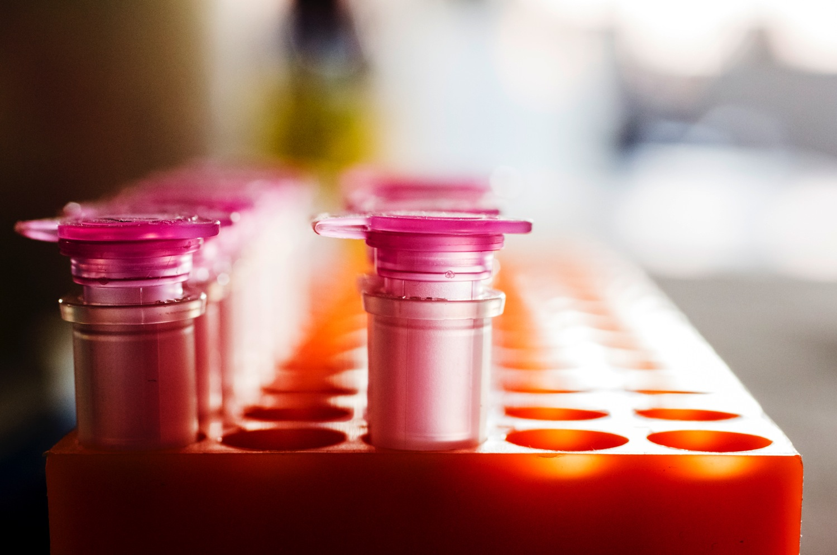
Integrated genomics-based research in energy use and production, the environment, human health, and agriculture
Carl R. Woese Institute for Genomic Biology
Program Areas:
Systems Biology
Cellular and Metabolic Engineering
Genome Technology
Founded: 2003
Funded by a $75 M investment from state of Illinois. Sustained by $217 M in external funding since inception.
igb.illinois.edu

Slide 18
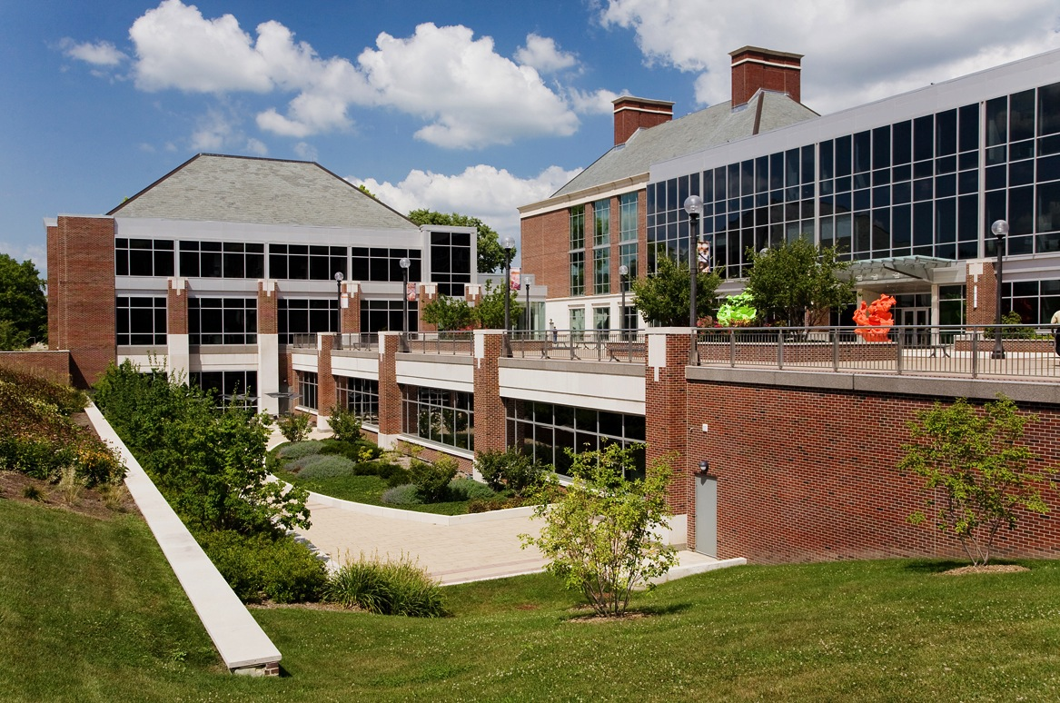
Center for Nutrition, Learning and Memory
KnowEnG
Institute for
Universal Biology
Carl R. Woese Institute for Genomic Biology
Faculty: 57
Affiliates: 67
Graduate Students: 283
Undergraduate Students: 286
Postdocs: 126
Research Staff: 80
Administrative Staff: 46

Slide 19
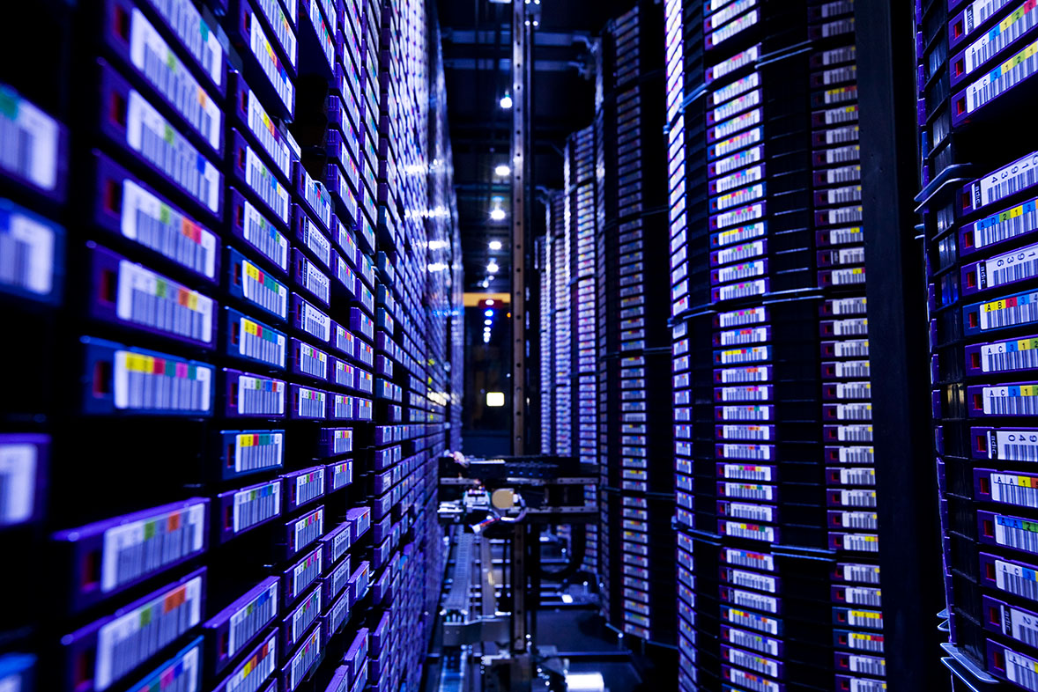
NCSA provides computational power and expertise to develop simulations and study models that cannot be physically created in labs
National Center
for Supercomputing Applications (NCSA)
Research Themes:
Bioinformatics and Health Sciences
Computing and Data Sciences
Culture and Society
Earth and Environment
Materials and Manufacturing
Physics and Astronomy
Founded: 1986
Funded: Originally by the National Science Foundation, the result of an unsolicited proposal sent by visionary faculty who needed more powerful computers to advance their research
ncsa.illinois.edu

Slide 20
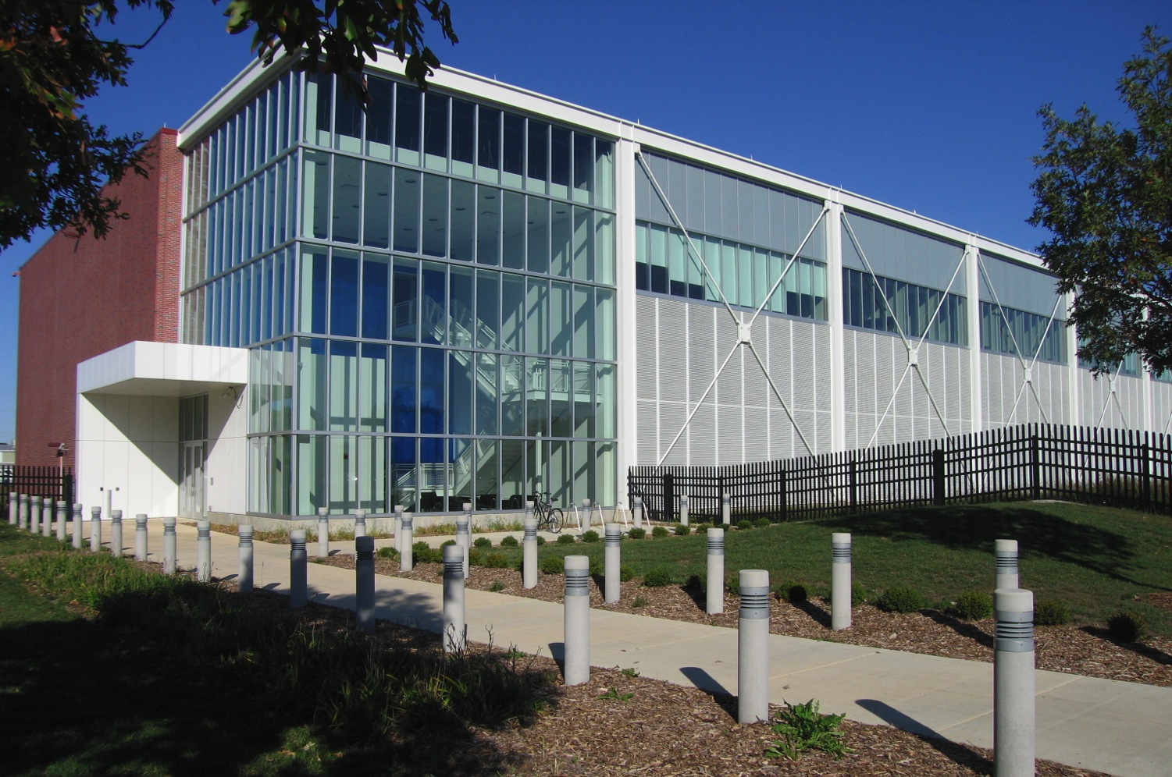
Blue Waters
XSEDE
Private Sector Program
National Center for
Supercomputing Applications
Faculty: 25
Staff: 192
Students: 57

Slide 21
Support Services for the Research Enterprise
Office of Proposal Development
  Support for interdisciplinary “mega-proposals”
  Responsive to grant announcement of strategic importance to the campus
Roy J. Carver Biotechnology Center
  State-of-the-art research infrastructure for investigators
Division of Animal Resources
  Responsible for the safe, humane care of laboratory animals used in research and education

Slide 22
Example of New Support: Research Data Service
The Research Data Service (RDS)
provides the Illinois research community
with the expertise, tools, and infrastructure
necessary to manage and steward research data.

Slide 23
The Problems with Data
I’ve lost two patent claims because we didn’t have complete records in lab notebooks.
I panic every time I try to find my students’ data.
I know I won’t be able to publish anything after my grad student leave because it’s too hard to understand what he/she did.
We don’t have the assay results with substrate X, because I didn’t back-up my computer. And we’re out of substrate X.
The only reason I was able to do the analysis was because on a whim I decided to migrate some of my data off of floppy disks to CDs back in the 90s. I wish I had done all of it.

Slide 24
The Feds Are Taking Notice:
Data Were Collected with Public Money
OSTP MEMO: Increasing Access to the Results of Federally Funded Scientific Research
“requiring researchers to better account for and manage the digital data resulting from federally funded scientific research”
Data management plans will become compulsory
Providing public access to data will become more routine
Publisher expectations get higher as storage gets cheaper
http://www.whitehouse.gov/blog/2013/02/22/expanding-public-access-results-federally-funded-research
Notes:
Aimed at Agencies

Slide 25
Data Management Plans (DMPs)
Plan for: What data are produced, how will the data will be accessible, how will the data be preserved, what access restrictions are expected
Currently required by NSF, DOE, and USGS
Pending requirements
  8 in Oct 2015 (AHRQ, ASPR, CDC, DOD, DOT, FDA, NASA, NIH,* NIST)
  2 in Jan 2016 (USDA, NOAA)
* NIH moving from a single paragraph “Data Sharing Plan” required only from
grants with >$500K direct costs per year to DMP for all research applications

Slide 26
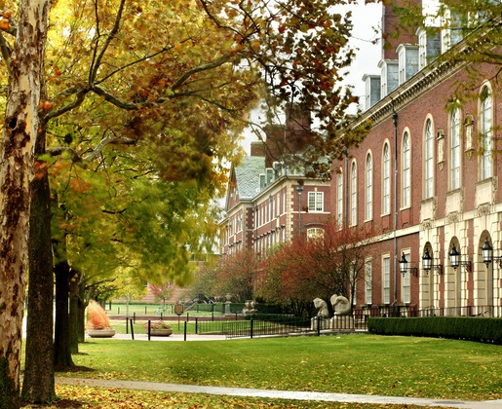
Who on Campus Knows About Storing and Curating Information?
The LIBRARY!
Illinois Library (John Wilkin, Librarian)
Largest at a publicly-funded US university
People: 4.6 M (up approx. 7% from
last year)
Downloads: 5.2 M articles downloaded
by the campus from licensed resources
(up 75%)
Reference: > 100,000 transactions,
either in-person or virtual
Classes: 27,000 students and faculty in librarian-led sessions
Lending: nearly 0.5 M volumes loaned
last year
Notes:
Aimed at Agencies

Slide 27
Research Data Service at Illinois
Part of campus strategic plan: controlled by the Library
Provide experts in data curation and management
Partner with campus VCR, NCSA, Campus IT, GSLIS
Provide storage for datasets to be curated
Goals:
Improve data management
Help researchers comply with agency requirements
Encourage better research

Slide 28

Research Data Service: Data Management Consultation
Advise on entire data management planning process
Help determine what data can or cannot be made accessible
Help determine what data can reasonably be preserved
Identify resources available on campus and elsewhere
https://dmptool.org/
Online wizard for creating a ready-to-use DMPs
Notes:
Not addresses any research techniques – What’s the flux of the data? Volume? What’s the life-time of the data?

Slide 29
Research Data Service: Data Publication at Illinois
IDEALS Institutional Repository
Can accommodate files <2GB, static, flat
Intended long-term preservation
https://www.ideals.illinois.edu/
Illinois Data Bank (in planning)
Ability to mint DOIs for datasets
Medium term commitment (5 year) to online (or near- line) access
Build out preservation capabilities based on collection appraisal
Active Data Storage
Target price of $99/TB-year with disaster recovery

Slide 30
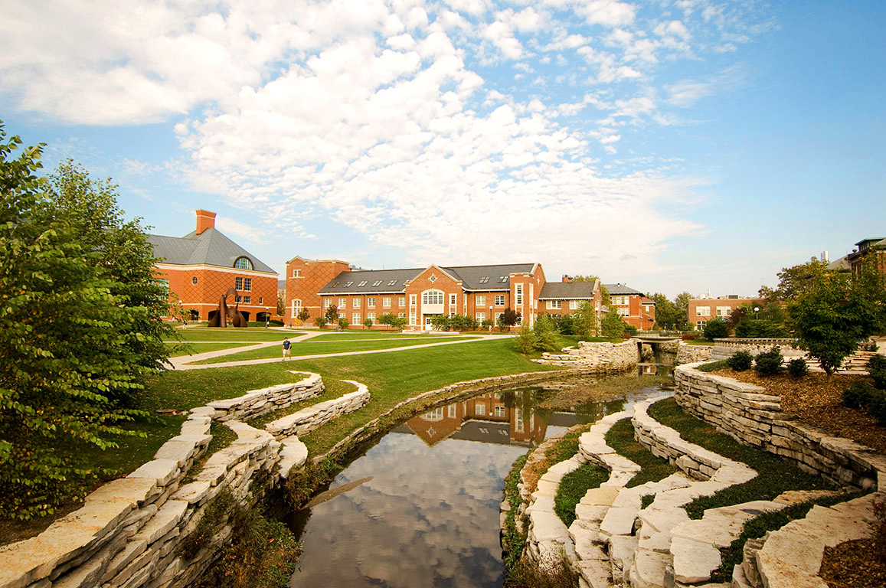
Institutional Reputation: Role of the Senior Research Officer
Why should an SRO care or spend time on reputation?
Better grad students and postdocs will come
Better faculty will come and will stay
More funding will be forthcoming
Allows the institution’s research to have more impact!

Slide 31
Rankings: The (Imperfect) Measure of Reputation
U.S. News & World Report Rankings
In its 2016 rankings, U.S. News & World Report's America's Best Colleges rated Illinois as the number 11 public university and the number 42 national university.
The campus is 1st in undergraduate engineering science and engineering physics, 2nd in graduate civil engineering, 3rd in graduate accounting…
Many other rankings:
None are perfect
All have impact

Slide 32
How to Improve Reputation
Be Excellent!
Hire great staff and faculty
Attract and retain great students
Support them in all activities that are consistent with the institutional mission
Innovate!
Funding, demographics, IT, competition, politics all are changing, and higher education needs to change with them
Communicate Your Excellence!
This can be harder – not in the academic culture
Who to tell, how to tell, what means to use

Slide 33
Communication is both internal and external
Internal
  So members of the university can simply play their roles effectively
  So members of the university can innovate and advance together
  So members of the university can tell their stories
External
  Attract and retain great students
  Attract and retain great faculty and staff
  Inform external stakeholders so that they can be helpful
  (e.g., state legislators)
  Support fundraising efforts
  Help attract external funds
Both add to excellence and reputation

Slide 34
Whose Job is it to Communicate?

Slide 35
Internal Research Communications
  Show up for meetings
    Nothing like being there and talking
    Encourage members of staff to do the same
  Digital Media
    OVCR Website
    Social Media
    Campus Research Calendar
    Mailing lists

Slide 36
Research Communications: Internal Groups
  Campus Research Administrators Working Group (CRAWG)
    Associate deans for research and institute directors
  SPaRC and SPaRC’Ed
    Business staff sharing common practices for sponsored research
    Continued staff training
  Research Safety Council
    Common understanding of safety issues and clear assignment of responsibility
  Research Communications Council
    Information sharing and best practices development

Slide 37
External Research Communications
  At Illinois, efforts are highly decentralized
  Campus Public Affairs
    News stories
    Digital media
    Print media
    Advertising
  Governmental Relations
    Legislative Advocacy
  Individual College and Unit
    Do their own thing (and that is a good thing, as long as the brand is maintained)

Slide 38
Research Communications Problem: What is our Expertise?
  2700+ Faculty (who are continuously innovating)
  Even more research staff, some of whom are nationally leading researchers
  How do we know who is doing what?
    Build collaborative efforts
    Allow external stakeholders (citizens, corporations, legislators, etc.) to join our community, consult our expertise, and support our efforts
  What organization on campus is expert at maintaining information and making it readily available to people who need to find it?
  The Library!

Slide 39
Second Example of Partnering with the Library
Illinois Research Connections
A web portal to find research expertise on the Illinois campus: again arising from campus strategic plan
Examples of similar successful efforts at other universities (Northwestern, Michigan, etc.)

Slide 40
Illinois Research Connections: Project Goals
Showcase Illinois research expertise to external
stakeholders
Connect researchers with potential collaborators,
and encourage interdisciplinary research
Automate publication data collection from
reliable source(s)
Enable units and individuals to make timely
updates to profiles

Slide 41
Project Scope Overview
Overseen by Library in collaboration with Office of Vice Chancellor for Research
Interdisciplinary
  All disciplines, academic colleges and departments
  Research-oriented centers and institutes
Comprehensive
  Up to 2500 individual researchers in first implementation

Slide 42
Project Scope Overview
Data sources
  Elsevier Pure platform pre-populates with Scopus
  Automatic weekly updates from Scopus data
  Faculty may import citations from additional data sources like OCLC WorldCat
  Individuals and proxies can maintain their own records
Campus outreach & training
  Steering & governance committees are providing input
  Training and support for colleges, departments, individual researchers
  Partnering to engage internal and external audiences

Slide 43
PHASE I PRIORITIES: Launch with Publications Data
Pilot with representative units, define policies, and define administrative workflows.
Launch a working system with Elsevier-delivered publications data for current tenure-line faculty, available to campus only
Define communications strategy & begin preparing training and support materials for units & faculty

Slide 44
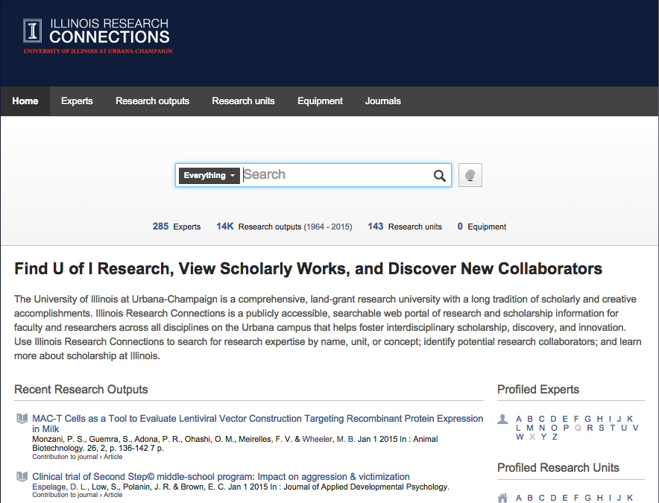

Slide 45
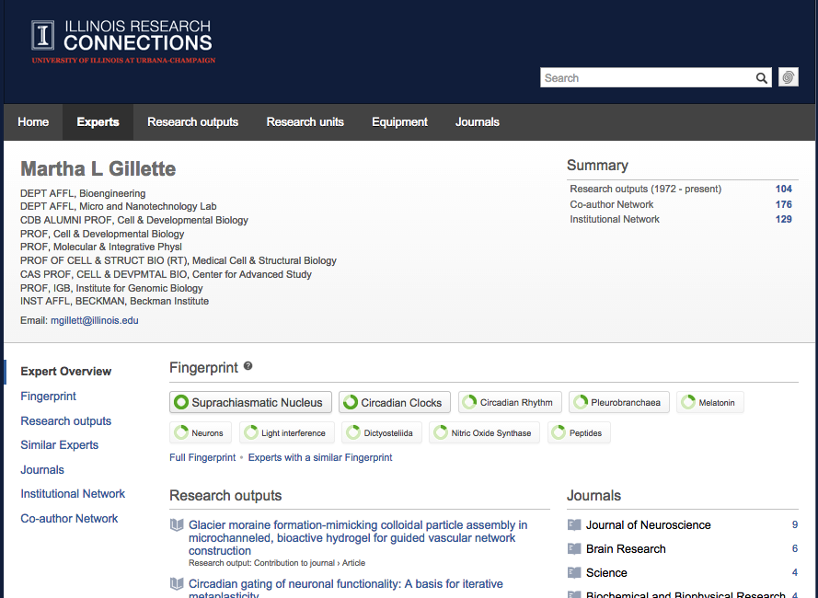

Slide 46
Allocating Profiles
Profiles for up to 2,500 researchers, cost supported by central campus
All tenure-line faculty included (~1,950)
College-level units will be allocated a number of seats in order to select others: emeritus, non-tenure track, staff
Each college-level unit will have a pre-defined number of profiles available
Colleges can purchase additional seats as needed

Slide 47
Profile Updates
Automatic updates from Scopus weekly
Elsevier Pure Experts supports automatic updates from additional data sources, which profile holders control (still testing):
BibTeX import
Manual entry
  OCLC WorldCat
  Web of Science
  arXiv
  CrossRef
  PubMed
Embase
SAO/NASA Astrophysics Data System
CAB Abstracts
Mendeley

Slide 48
PHASE I : Launch
BETA Launch
    Launch a working system with Elsevier-delivered publications data for current tenure-line faculty, available to campus only
    Communications & training
    Early fall 2015
Public
    Public launch will follow about 2-3 months later
    Widespread publicity effort

Slide 49
PHASE II : Improve Scope and System Quality
Training resources for faculty & units
Update system with AY2016 information including addition of emeritus, clinical, research faculty and academic professionals identified by units
Test data export from Pure to campus systems
Begin capturing campus data such as grants

Slide 50
Summarize: Research is a big enterprise, communication is key
The creative process needs support and occasional leadership
Reputation will only come with excellence and its communication
The Library is critical – and not just in traditional roles

Slide 51
Questions
What creative ideas should be added to foster communication?
How can research and the Libary partner
to be even better?

