Slide 1
September 17, 2015
The Evolving Scholarly Record:
Scope, Stakeholders, and Stewardship
Brian Lavoie
Constance Malpas
OCLC Research

Slide 2
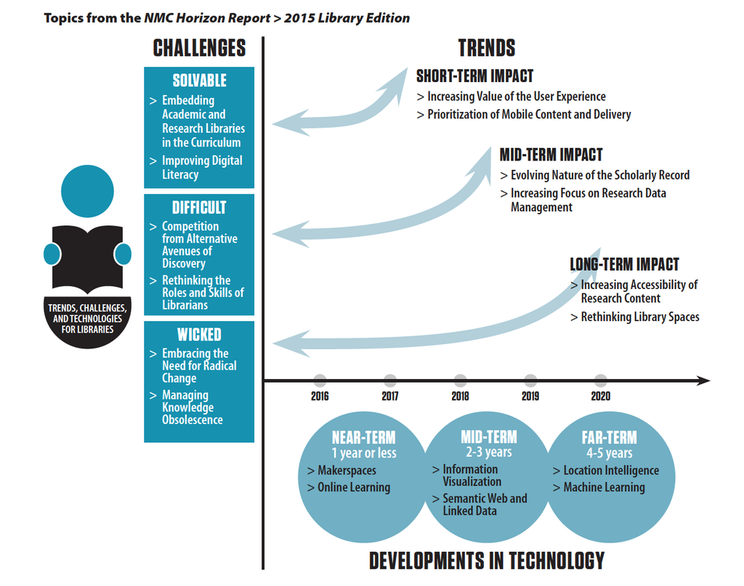
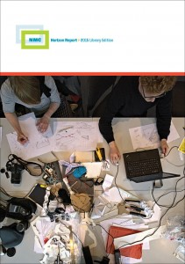

Slide 3
Roadmap
The evolving scholarly record: A challenge for academic libraries
  Background & trends
OCLC Research reports
  The Evolving Scholarly Record
  Stewardship of the Evolving Scholarly Record: From the Invisible Hand to Conscious Coordination
Key issues for academic libraries
Questions & discussion

Slide 4
The evolving scholarly record

Slide 5
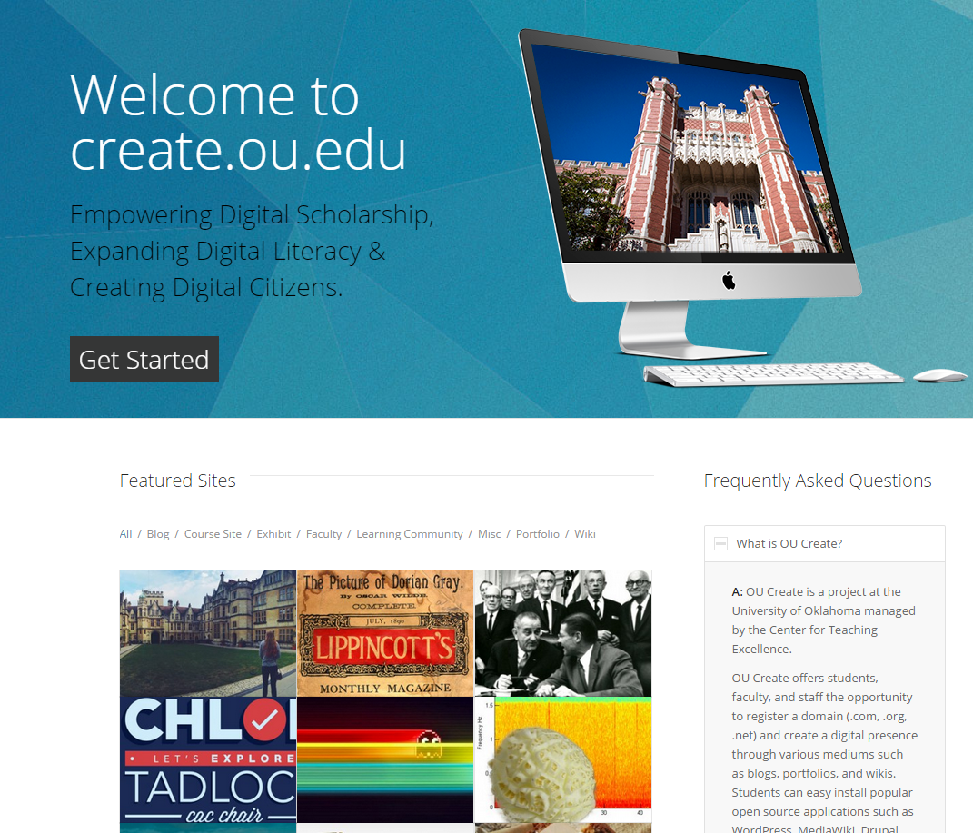
“… Create aims to empower all members of
the OU community to craft and control their
digital narrative through the use of blogs,
portfolios, wikis, and more.”
https://create.ou.edu/

Slide 6
Evolutionary trends …
Formats shifting:
  Print-centric to digital, networked
Boundaries blurring:
  Articles/monographs, but also data, computer models, lab notebooks, blogs, e-mail discussion, e-prints, interactives/executables, visualizations, etc
Characteristics changing:
  Traditionally: static, formal, outcome-focused
  Today: dynamic, blend of formal & informal, more focus on process, replicability, “leveragability”
Stakeholder roles reconfiguring:
  New paths for the scholarly communication “supply chain”

Slide 7
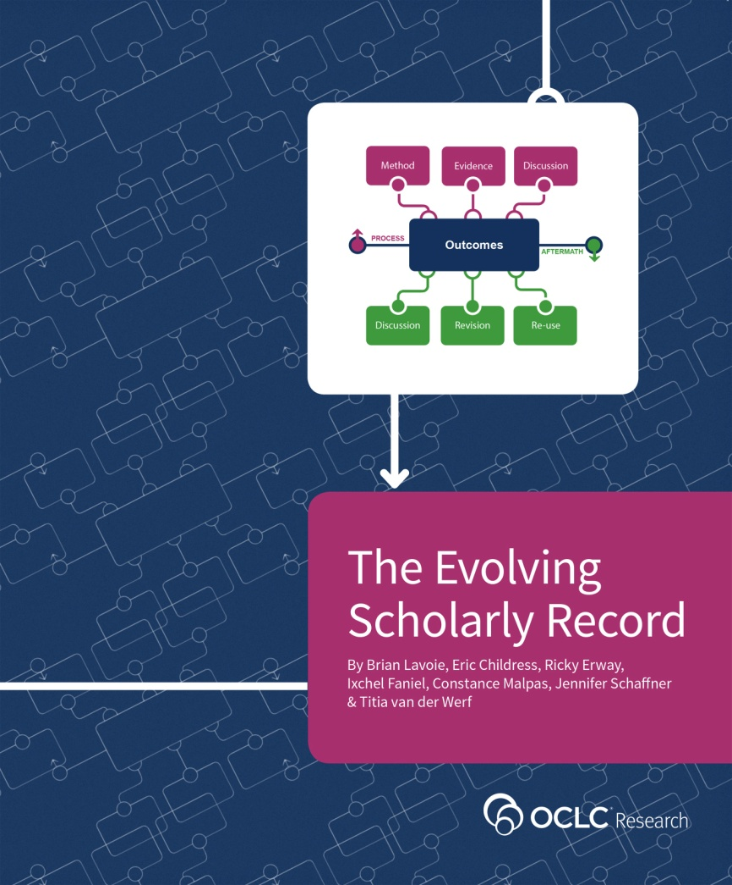
The Evolving Scholarly Record
Develop framework to:
  Organize/support/drive
  discussions about ESR
  “Big picture” view of ESR
  Define key categories of material
  and stakeholder roles
  Common reference point for ESR
  within/across domains
  Support strategic planning by
  libraries, funders, publishers,
  scholarly societies, etc.
http://oc.lc/esr

Slide 8
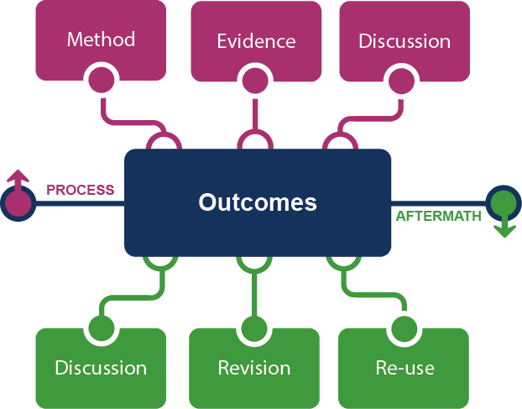
Framing the Scholarly Record …

Slide 9






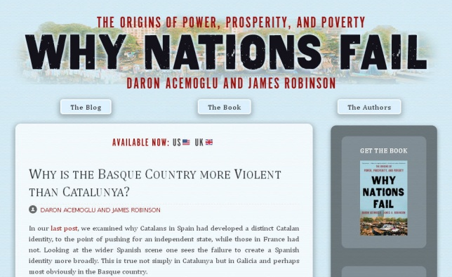



In practice …

Slide 10
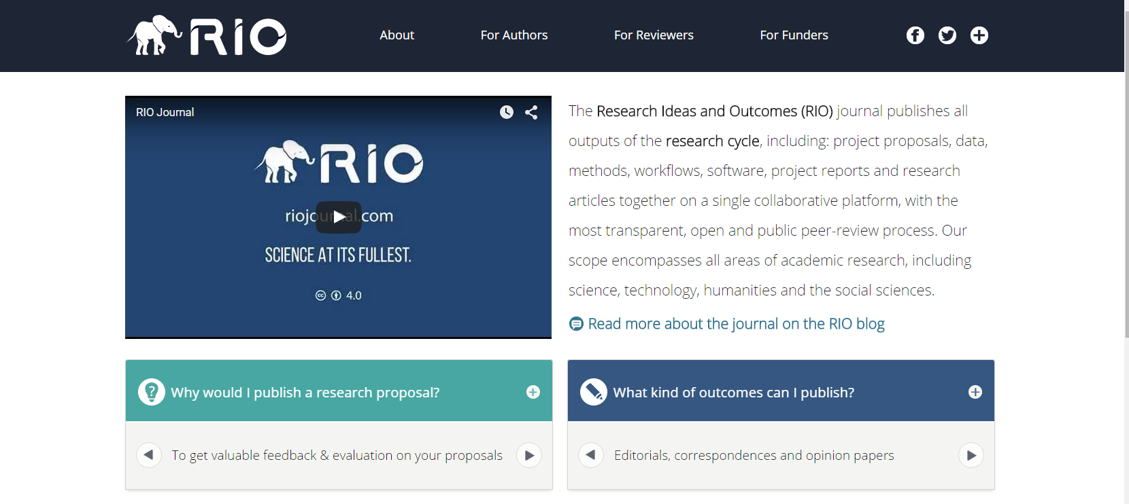
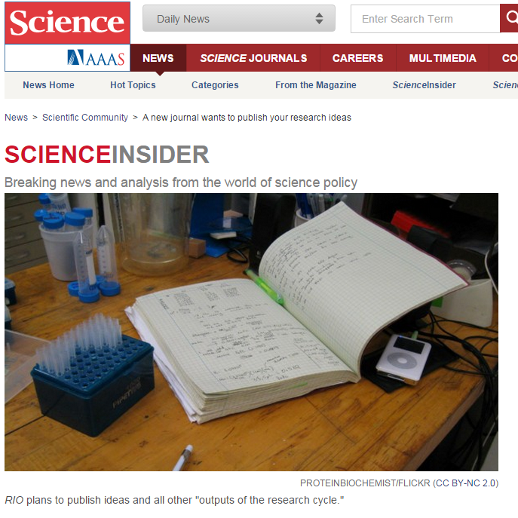
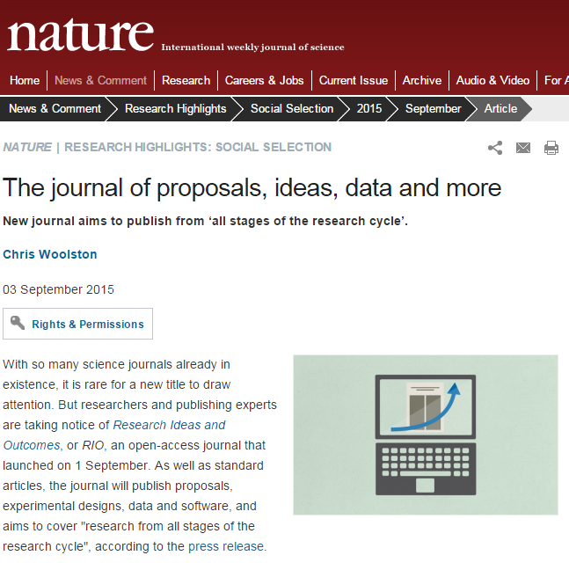
http://riojournal.com/

Slide 11
evolving stewardship models

Slide 12
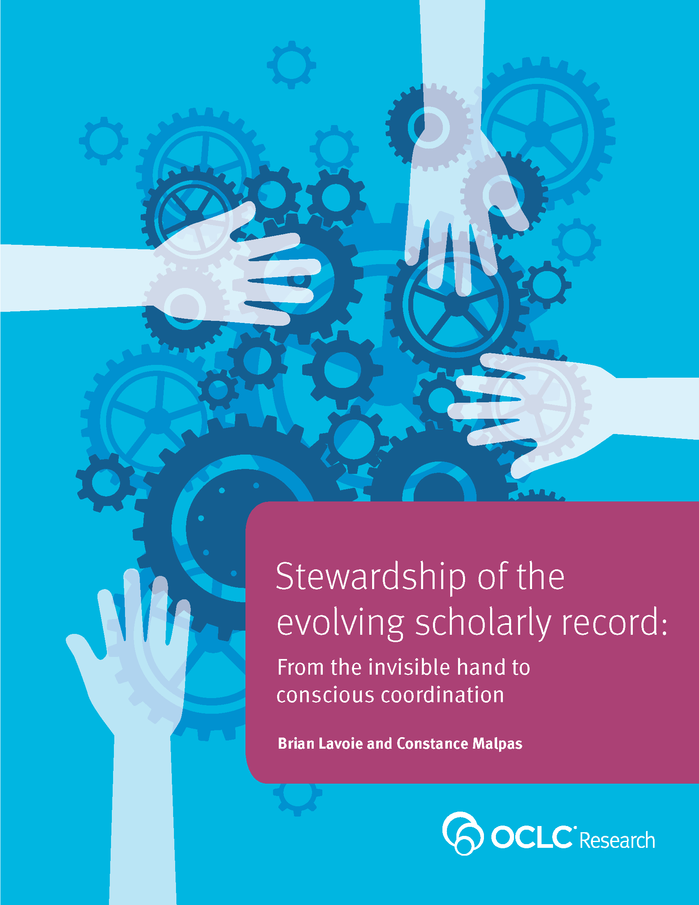
New Report: Stewardship of the Scholarly Record
The scholarly record is evolving, so …
… stewardship models for scholarly record are changing too
“Conscious coordination” key to securing future of scholarly record
http://oc.lc/esr-stewardship

Slide 13
Stewardship … historically
Stewardship of scholarly record was byproduct of uncoordinated, highly distributed, and duplicative process of managing local print collections.
Sum of local stewardship efforts resulted in aggregate library resource that was relatively complete record of published (print) scholarly outputs
“Invisible hand” metaphor: uncoordinated local efforts lead to socially desirable outcome

Slide 14
Stewardship … now
The ‘owned’ collection
The ‘facilitated’ collection
‘borrowed’
‘ESR’
Invisible
Hand
‘licensed’
‘shared print’
Conscious
Coordination
Scholarly record no longer approximated in
academic library collections

Slide 15
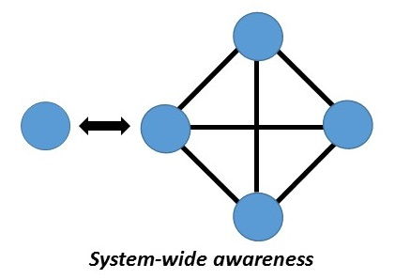
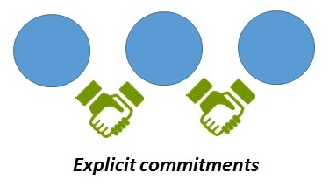
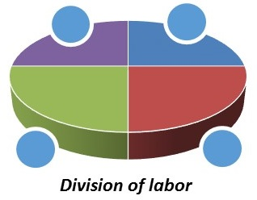
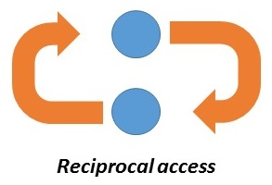
Four elements of conscious coordination
“Align local action with collective effort”
“Move commitments above the institution”
“Collect more of less”
“Curate locally, share globally”

Slide 16







Examples
marc 583

Slide 17
Implications for academic libraries

Slide 18
Academic libraries: key issues
Much of scholarly record not represented in academic library collections
Stakeholder roles are reconfigured
Providing access to scholarly record involves shift from “owned collection” to “facilitated collection”
Stewardship relies on consciously-coordinated networks of collective responsibility
Local collections/services increasingly embedded in cooperative access/stewardship arrangements

Slide 19
Key issues in focus
Much of scholarly record not represented in academic library collections
Stakeholder roles are reconfigured
Providing access to scholarly record involves shift from “owned collection” to “facilitated collection”
Stewardship relies on consciously-coordinated networks of collective responsibility
Local collections/services increasingly embedded in cooperative access/stewardship arrangements

Slide 20
Library coverage: increasingly partial
Growing number and diversity of outputs published in venues outside traditional library supply chain: GitHub, Figshare, ResearchGate, Zenodo etc.
Questions to consider:
Is your institution systematically collecting artifacts of research process and aftermath, as well as traditional outcomes?
How can library expertise in appraisal and selection be applied to curation of materials managed outside the library?

Slide 21
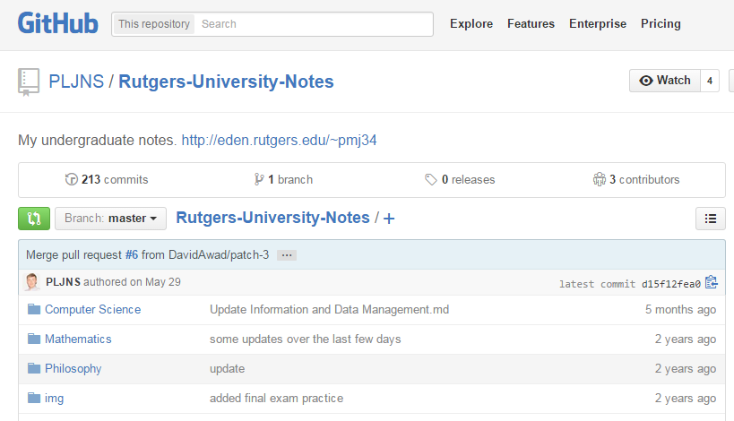
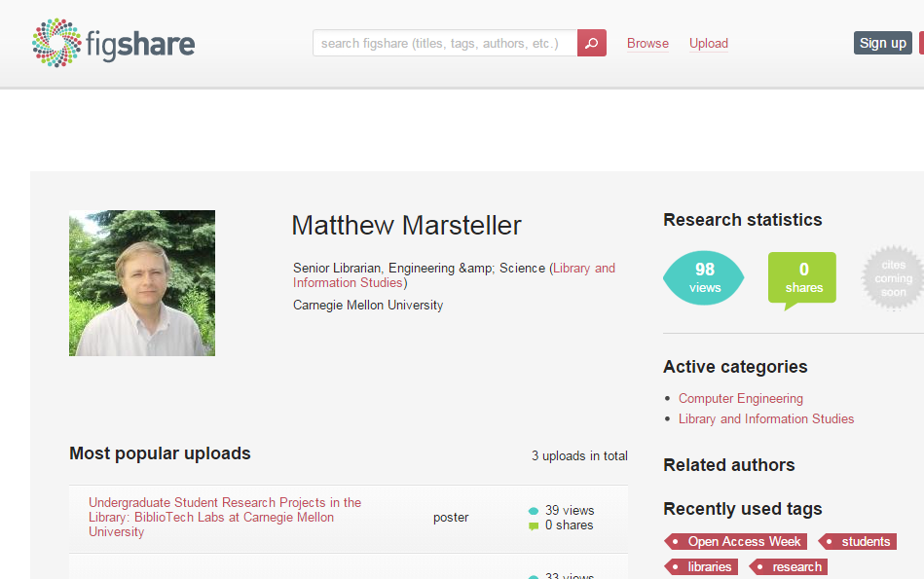
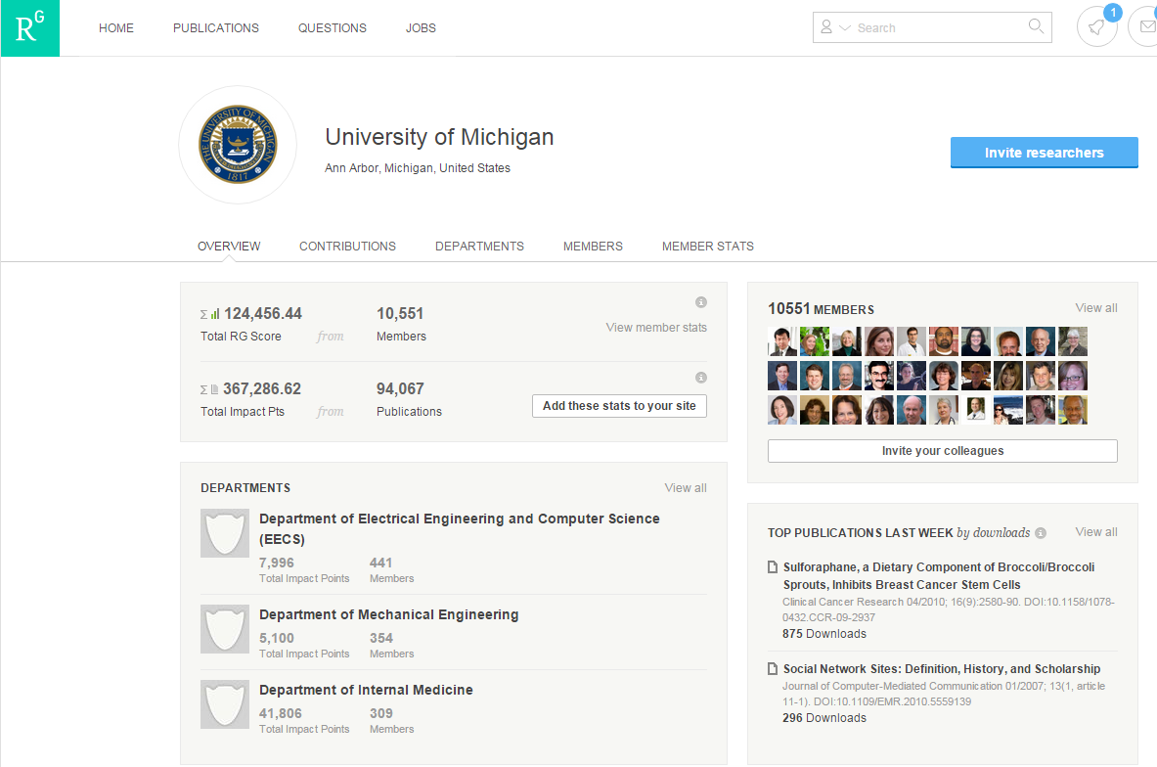
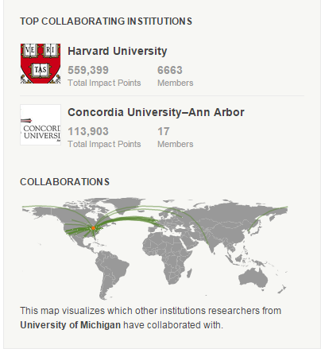
Example: New publication platforms
New forms of scholarly work not fully documented in institutional archives or library collections
Notes:
https://github.com/PLJNS/Rutgers-University-Notes
http://figshare.com/authors/Matthew_Marsteller/542211

Slide 22
Curating ‘facilitated collections’
Demand-driven acquisition profiles; shared print partnerships
Open access resources included in local discovery environment, but not local collection
Institutional repository (content) vs. institutional bibliography (metadata)
Questions to consider:
Does the library track student/faculty use of ‘extra-institutional’ repositories?
Does the library coordinate with other campus units collecting or monitoring research/learning outputs?

Slide 23
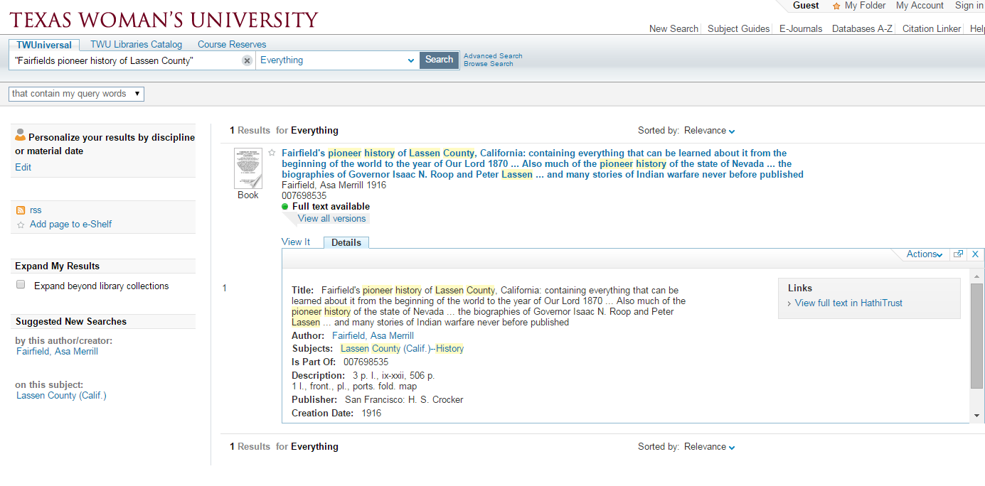
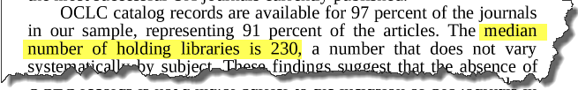
Example: Open access content
Many (non-partner) libraries include HathiTrust content in local discovery environments
Many libraries point to OA journals without participating in preservation schemes
Collins, Cheryl S., and William H. Walters. 2010. "Open Access Journals in College Library Collections". The Serials Librarian. 59 (2): 194-214.
Discoverability and stewardship are decoupled
Notes:
Collins & Walters (2010) found that majority of liberal arts colleges surveyed had large number of OA journals in local OPAC or A-Z List

Slide 24
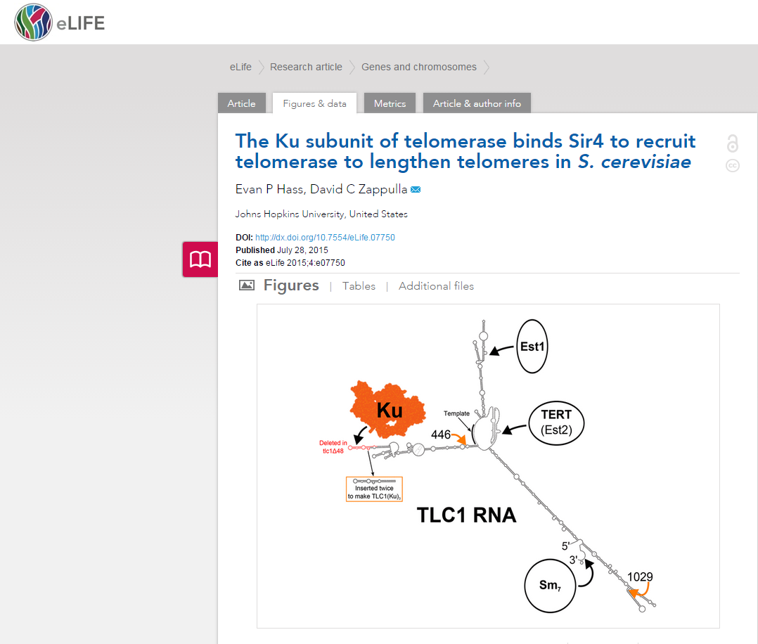
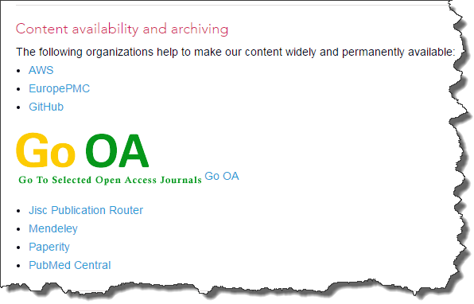
New scholarly publication venues maximize visibility and impact
ISSN: 2050-084X
Established 2012
Held in >125 libraries
http://elifesciences.org/content/4/e07750/article-data

Slide 25
Networks of collective responsibility
Growing attention to governance of ‘above institution’ stewardship -- HathiTrust, UKRR, WEST etc.
Participation rates (and incentives) vary across higher education community – archive holders vs. builders, content contributors vs. capital contributor
Questions to consider:
What is the primary motivation for your library to participate in cooperative stewardship arrangements?
How do you evaluate the robustness of current partnerships? Are you confident they will last?

Slide 26
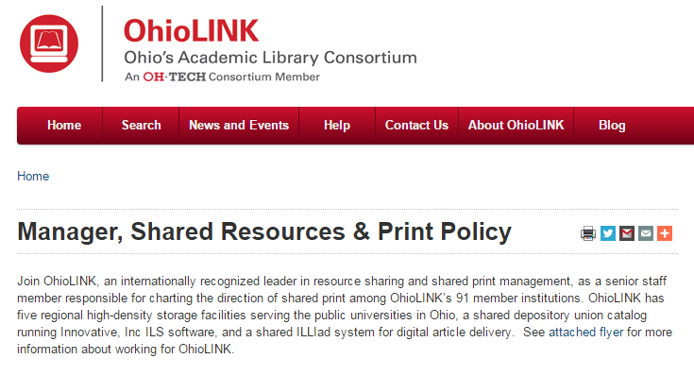
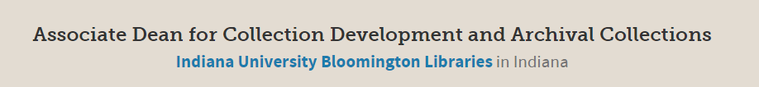
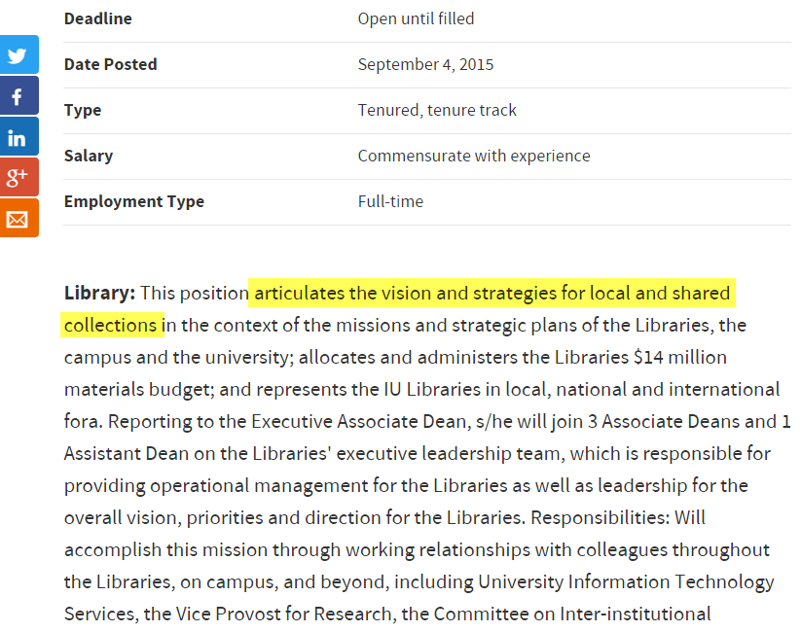
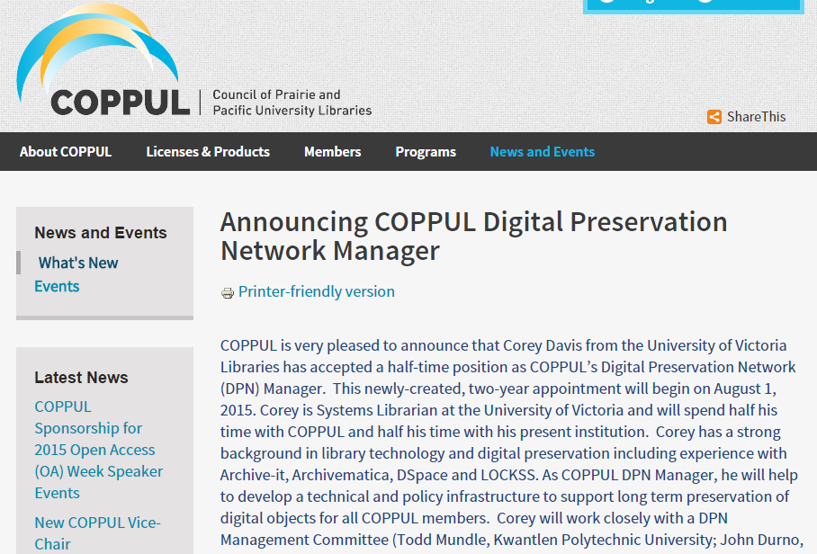
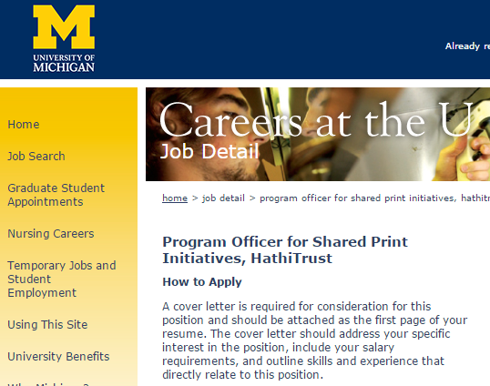
Examples: stewardship at scale
Notes:
Newly created Digital Preservation Network Manager at COPPUL is responsible for managing the consortium’s network of 10 LOCKSS nodes and overseeing the consortium wide implementation of the Archivematica digital preservation software as a service.

Slide 27
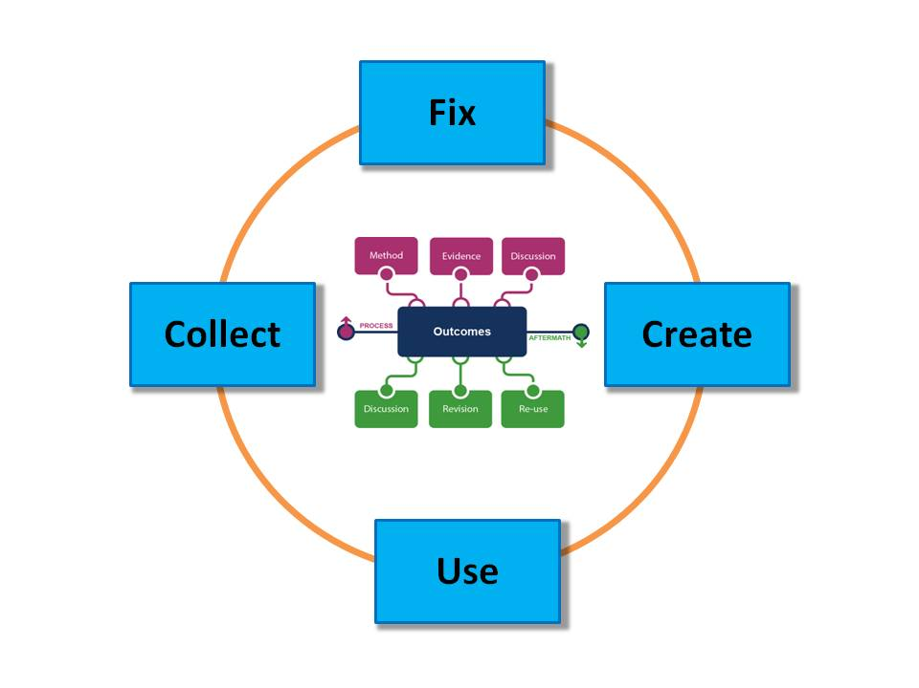
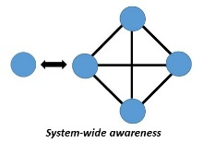



What is the scholarly record?
A selection of
scholarly content …
supported by stable
configurations of
stakeholder roles …
sustained through
conscious coordination
Notes:
Bring this together by posing a simple question: what do we mean by the scholarly record? Given what we’ve discussed, we’d like to propose that the s. r. is a selection of content (defined broadly by our content framework) that places greater emphasis on collecting the materials generated during the process and aftermath phases of scholarly work, and therefore represents a deeper and more complete record of scholarly inquiry…
… that is supported by stable configurations of the roles enumerated in our stakeholder eco-system – in other words, configurations that ensure that scholarly materials are systematically gathered, organized, curated, identified, and made persistently available.
… and finally, that is sustained over the long term through stewardship models characterized by the four elements of conscious coordination.
So these three components – scope, stakeholders, and stewardship – represent our very broad vision of the future of the scholarly record. And as we’ve seen, this vision has important implications for academic libraries as they re-calibrate the infrastructure, coordinating structures, and shared practices needed to sustain the scholarly record in its fullest expression.

Slide 28
Questions & Discussion

Slide 29
Brian Lavoie
lavoie@oclc.org
Constance Malpas
malpasc@oclc.org

