Slide 1
2 February 2015
OCLC Research Update
ALA Midwinter Meeting (Chicago, IL, USA)
ALA “News You Can Use” Series

Slide 2
Agenda
We are OCLC Research
OCLC Shared Print Advisory Council
Is ILL Dying Off?
Data Designed for Discovery

Slide 3
We are OCLC Research
Eric Childress, Consulting Project Manager
OCLC Research Update, ALA-MW
2 February 2015

Slide 4
OCLC Research
Leading research organization devoted to exploration, innovation and community building on behalf of libraries and archives
OCLC Research Library Partnership
Partners include 25 of the top 30 ranked universities in the world
Areas of activity:
Research Collections and Support
Data Science
User Studies
Understanding the System-wide Library
Prototypes, software & algorithms, data mining, surveys, consultation, reports, events, more….

Slide 5
Recent OCLC Research reports
Registering Researchers in Authority Files
Kiwis in the Collection: The New Zealand Presence in the Published Record
Overview of the
researcher identifier
landscape
Identifying things New Zealand in the published record

Slide 6
Other recent work….
Dempsey, Lorcan, Constance Malpas, and Brian Lavoie. 2014. "Collection Directions: The Evolution of Library Collections and Collecting" in portal: Libraries and the Academy 14,3 (July, 2014): 393-423.
Explores evolution of collecting behaviors in a network environment
Inspiration for: ALCTS MW 2015 Symposium
Collection Development Strategies in an Evolving Marketplace
Recent title from ALA
Selected entries from Lorcan Dempsey’s blog
Notes:
Picture of Ray Denenberg from http://www.dlib.org/dlib/may06/authors/05authors.html

Slide 7
New titles
Released 27 January 2015
Joint publication of LoC & OCLC compares & contrasts BIBFRAME & schema.org approaches
Forthcoming title from Morgan & Claypool
Presents OCLC’s experience-informed insights into Linked Data

Slide 8
Upcoming events
Evolving Scholarly Record and the Evolving Stewardship Ecosystem – Workshop Series
Chicago, IL USA
Northwestern Univ.
San Francisco, CA USA
OCLC Research Library Partnership Meeting
3-4 June
San Francisco, CA USA
Landscape and synchronization of research information collection,
Approaches to integration of efforts across the institution,
Where researchers look for and keep information,
The library’s role in managing research information
Sir Francis Drake Hotel
in Union Square
Sir Francis Drake Hotel
in Union Square
Notes:
Previous ESR workshops took place in Amsterdam and Washington DC

Slide 9
OCLC Shared Print Advisory Council
Constance Malpas, Research Scientist
OCLC Research Update, ALA-MW
2 February 2015

Slide 10
Strategic acquisition increases capacity to help libraries develop and implement cooperative print management
Leverages existing OCLC Research on the ‘collective collection’
Builds on successful partnership between OCLC and SCS
Supports our mission to expand library cooperation across
global network
Better together.

Slide 11
OCLC Shared Print Advisory Council
Established August, 2014 to provide expert input on emerging policy and infrastructure needs for shared print management
10 representatives from mature shared print initiatives, service providers and opinion leaders
Co-convenors: Katie Birch, Portfolio Director for Resource Sharing and Analytics, and Constance Malpas, Research Scientist with support from Erin Duncan, Product Marketing Manager

Slide 12
Advisory Council Roster FY2015
Stella Butler, University Librarian, University of Leeds and Chair, Research Libraries UK (RLUK) Board of Directors
Christopher Cole, Manager of Business Development, National Agriculture Library (NAL) *
Bob Kieft, College Librarian, Occidental College and Chair, Shared Print Taskforce, Statewide California Electronic Library Consortium (SCELC)
Rick Lugg, Executive Director, Sustainable Collections Services, OCLC
Jacob Nadal, Executive Director, Research Collections Access & Preservation (RECAP) Consortium
Lizanne Payne, Shared Print Management Consultant
Ben Petersen, Head, Preservation & Collection Management, National Library of Medicine (NLM) *
Stephen Short, Program Planning Specialist, Library of Congress (LC) *
Emily Stambaugh, Shared Print Manager, California Digital Library and Project Manager, Western Regional Storage Trust (WEST)
Amy Wood, Senior Director of Technical Services, Center for Research Libraries (CRL) and Manager of CRL Print Archives Preservation Registry (PAPR)
*Council Members from federal agencies contribute to setting strategic direction but refrain from advising on specific product development priorities, in accordance with agency guidelines.

Slide 13
How we work, what we do
In-person meetings at ALA-MW and ALA Annual
Conference calls as needed (~6 week cycle)
SPAC-L discussion list
Review, refine, prioritize ‘user stories’ for product and service development
Consult on research priorities (e.g., last copy metrics)
Share information on critical timelines, infrastructure needs to improve community coordination

Slide 14
SPAC-L in action … research priorities

Slide 15
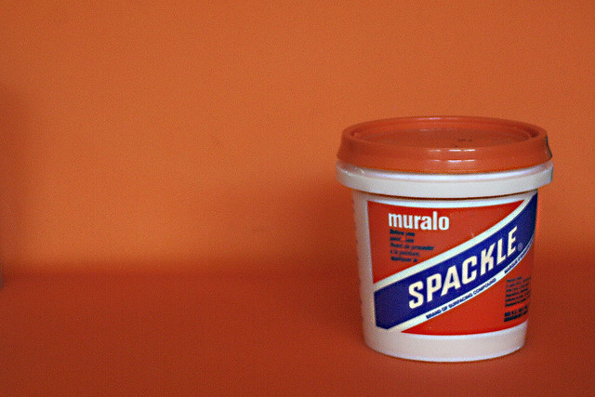
Let’s get to work.
“It's Spackle” photo by CG Hughes
https://www.flickr.com/photos/toolshed4/50677076/

Slide 16
a WORK IN Progress
UNDERSTANDING THE COLLECTIVE SHARED PRINT COLLECTION
Malpas, January 2015

Slide 17
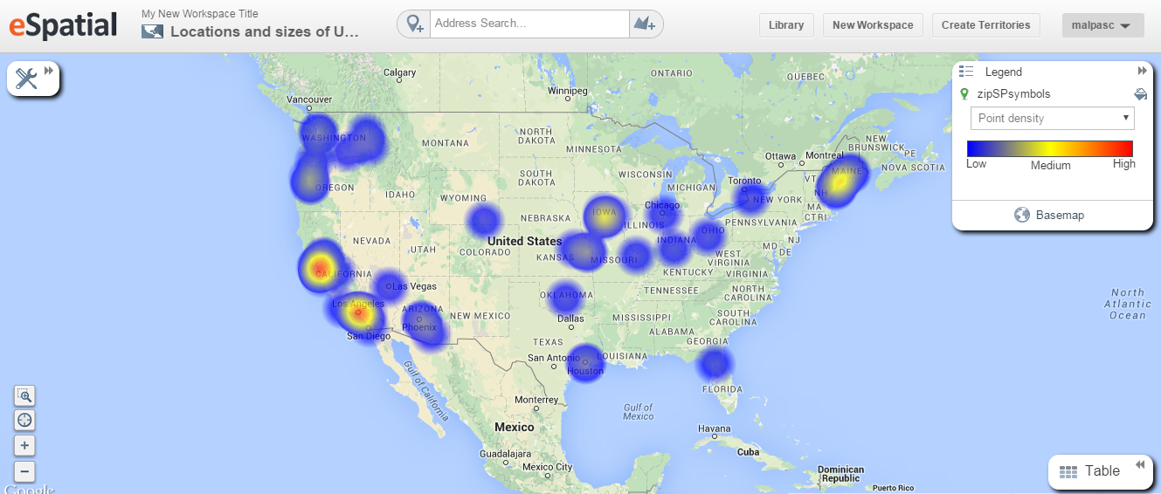
As of December 2014:
63 registered shared print repositories in WorldCat
High concentrations in NorCal, SoCal; other notable concentrations in Cascadia and ChiPitts megaregions

Slide 18
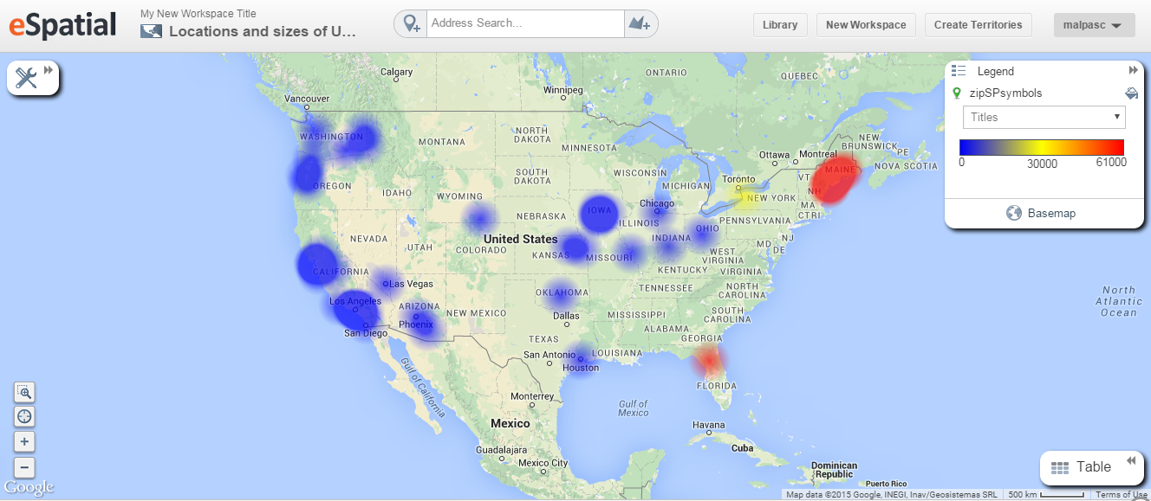
As of December 2014:
1.46 million titles held in shared print repositories
High concentrations in Maine, Florida and New York

Slide 19
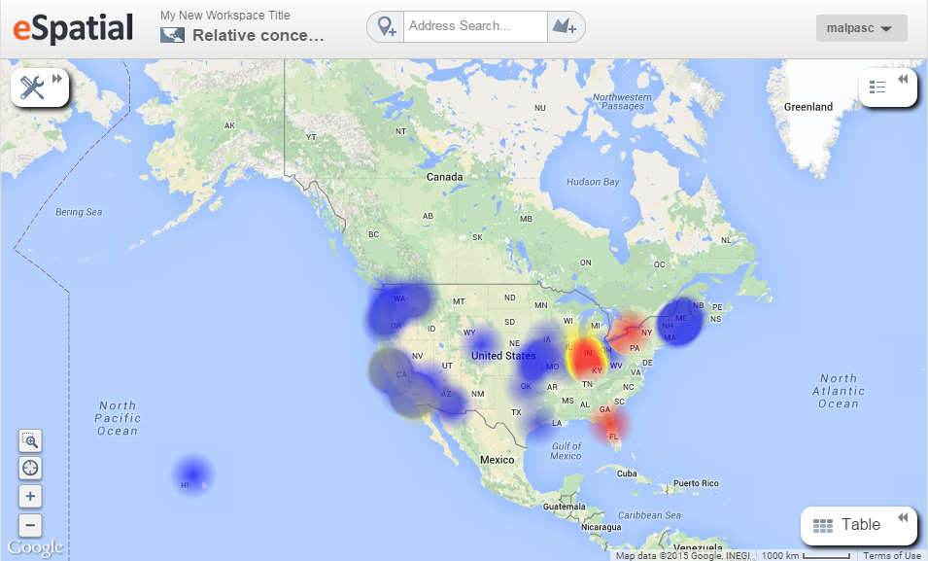
As of December 2014 :
54K serial titles held in shared print repositories
Primarily archived by CIC, CRL-JSTOR, Empire Shared Collections and FLARE programs

Slide 20
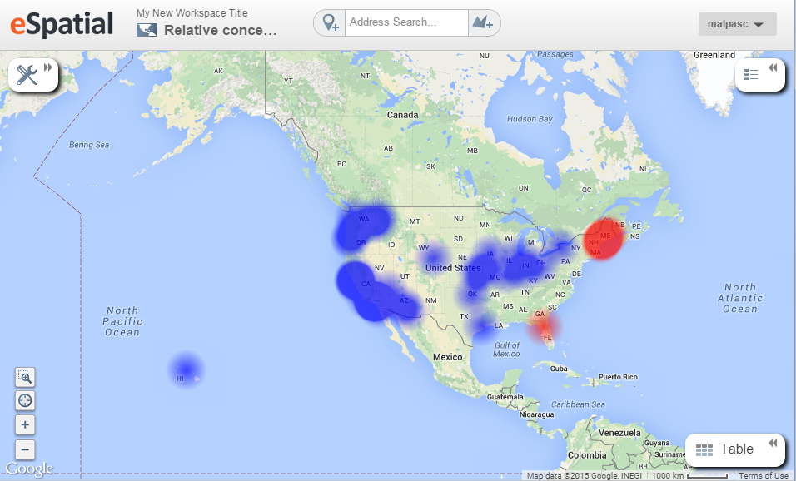
As of December 2014:
1.4 million monographic titles in shared print repositories
Primarily archived by Maine Shared Collections Strategy and FLARE programs

Slide 21
N = 63 repositories
Based on WorldCat data as of December, 2014.

Slide 22
N = 1.92M shared print holdings
Based on WorldCat data as of December 2014.

Slide 23
Bibliographic Diversity of Aggregate Shared Print Resource
as of December 2014
1,297,375 distinct creative works
embodied in 1,468,523 distinct editions/manifestations,
for an average of 1.13 editions per work
Top 5 works by number of archived editions:
Rubaiyat of Omar Khayyam – 243 editions in shared print collections
Longfellow. Poems. – 119 editions in shared print
Hawthorne. The Scarlet Letter. – 85 editions in shared print
Houseman. A Shropshire Lad. – 77 editions in shared print
Homer. The Odyssey. – 66 editions in shared print
91% of archived works represented by a single manifestation

Slide 24
What’s next
In consultation with Advisory Council,
Refine definitions of ‘last copy’ in context of FRBR – last expression, manifestation, item
Develop statistical profile of system-wide print collection and shared print resource, starting with North America
Experimental visualization, maps of materials within and outside of shared print collections; scaled to existing consortia

Slide 25
Is ILL Dying Off?
Some clues from the
Borrow Direct consortium
Dennis Massie, Program Officer
OCLC Research Update, ALA-MW
2 February 2015

Slide 26
Current Interlending Landscape
Fragmented
Many systems in play
Opaque
Statistics reported in gross numbers
Evolving
New models and methods emerging

Slide 27
OCLC ILL statistics
 | FY13 | FY12 | FY11 | FY10 | FY09
ILL requests | 8,858,368 | 9,192,189 | 9,587,429 | 10,248,942 | 10,279,215
Year on year | 4% | 4% | 6% | 0.29%
Between FY09 and FY13, OCLC ILL has seen a 14% reduction in total number of ILL requests.
Anecdotal evidence tells us that US libraries are seeing an ongoing increase in their borrowing.
OCLC wants to learn more about various trends in fulfillment.

Slide 28
The Elusive Big Picture
Is resource sharing activity across the entire library community increasing, decreasing, or staying the same?
Are there similarities among those libraries where activity is decreasing, and among those where it is increasing?
What factors determine the selection of a model or method for each borrowing request?

Slide 29
Made up of 11 institutions with active, sophisticated, innovative resource sharing operations
Some long-established members, some newer members
Involved in all manner of consortial arrangements within and outside the group
Would serve as an excellent illustration of current trends in the research library community

Slide 30
ARL ILL Stats for 11 BD Institutions Filled Requests

Slide 31
Our ILL Stats for 11 BD Institutions Filled Requests

Slide 32
ARL vs Our Study Why might the numbers differ?
Institutions with multiple libraries and with complex ILL set-up’s might not have reported all activity to us.
Both sets of data are self-reported, and possibly compiled by different people.
Potential fiscal/calendar confusion
Overall, study participants reported 75.7% of what was reported to ARL.

Slide 33
Our Borrow Direct Numbers Filled Requests (99.7% agreement)

Slide 34
Our OCLC Numbers Filled Requests

Slide 35
Our RAPID Numbers Filled Requests

Slide 36
Our Docline Numbers Filled Requests

Slide 37
Proportion by Sharing Venue
(Other = Web form, ALA form, email, CCC, other circ-to-circ groups)

Slide 38
BD, OCLC, and RAPID Comparison Filled Requests

Slide 39
C-to-C, OCLC, and RAPID Comparison Filled Requests

Slide 40
C-to-C, OCLC, and RAPID Comparison Filled Requests

Slide 41
C-to-C, OCLC, and RAPID Comparison Filled Requests

Slide 42
C-to-C, OCLC, and RAPID Comparison Filled Requests

Slide 43
C-to-C, OCLC, and RAPID Comparison Filled Requests

Slide 44
Total activity by date joined

Slide 45
Total activity by date joined

Slide 46
Total activity by date joined

Slide 47
Next Steps
More institution-by-institution analysis
Further comparisons by date joined
Look for cause and effect
Break down returnables versus nonreturnables
Track reciprocal interactions via OCLC ILL
Follow-up questions for BD ILL folks
Report out generically
Report to BD cohort in detail

Slide 48
Is ILL Dying Off?

Slide 49
Data Designed for Discovery
Roy Tennant, Senior Program Officer
OCLC Research Update, ALA-MW
2 February 2015
Slides contributed by Bruce Washburn, Richard Wallis, Karen Smith-Yoshimura, Dan Benson, and Mike Teets

Slide 50
The Canonical Entity (of the past)

Slide 51
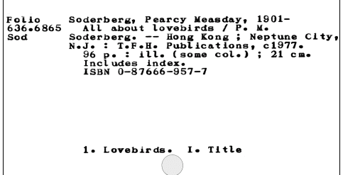
The Canonical Entity (of the present)

Slide 52
Classic Bib Record
A collection of statements…
Taken from the piece itself…
Sometimes “enhanced” with inferred parentheticals (e.g., [1975] )…
Or additional statements not on the piece (e.g., subject headings)
Mostly uncontrolled and only loosely connected to anything else

Slide 53
The Problem….

Slide 54
Actually, A Number of Problems
Identification Problems:
“The Hamlet Problem” (titles aren’t enough)
“The Wang Li Problem” (names aren’t enough)
Linkage Problems:
“The Web Problem” (records aren’t enough, you need links)
“The Language Problem” (surfacing the right translation for a given user is still a problem)

Slide 55
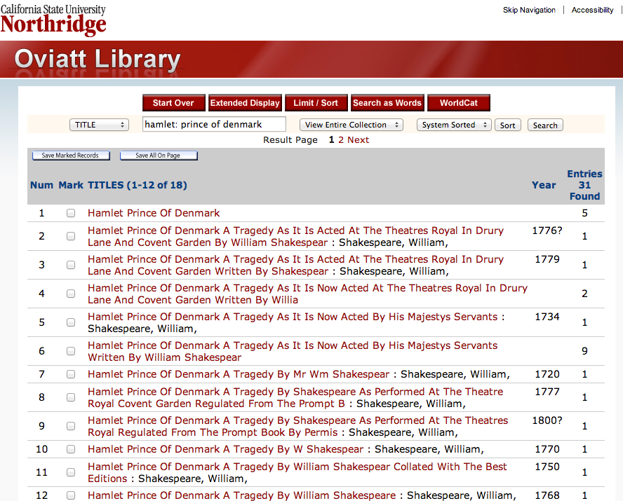

Slide 56
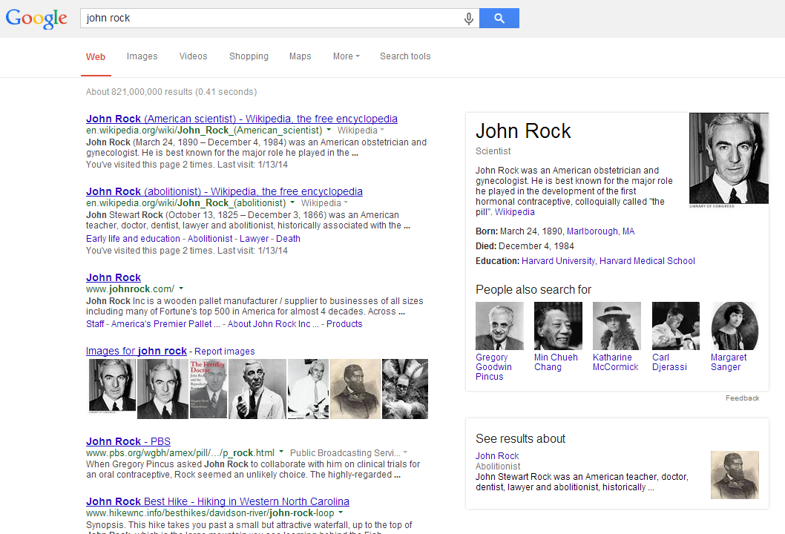
Notes:
Two common words… John Rock. Two very different people. The web now understands!

Slide 57
The Solution

Slide 58
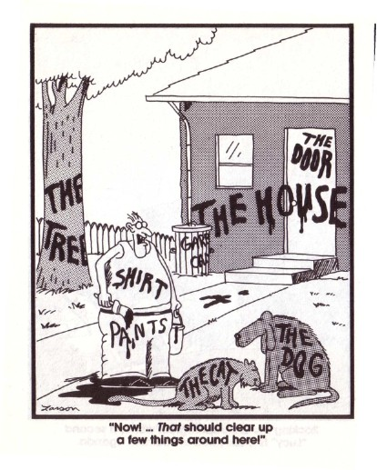
First, define ALL THE THINGS
Notes:
We at OCLC are attacking the problem from two separate directions. These directions may converge in the middle, or may stay separate.
Identify methods that will operate on all text under management
Improve the coverage and quality of formally modeled data
But there is a technology that allows both to co-exist. Triplestores

Slide 59
Then Create Entities of Core Concepts
person
place
object
concept
organization
work

Slide 60
Then Establish Relationships Between Entities
person
place
author
object
concept
item availability
subject
organization
work
Notes:
We, at OCLC, with our major data ingest and processing techniques – Big Data tech
Matching incoming data with what we have
Identifying the entities and associating their role attributes
Woks – not so far very visible in libraries – important on the web

Slide 61
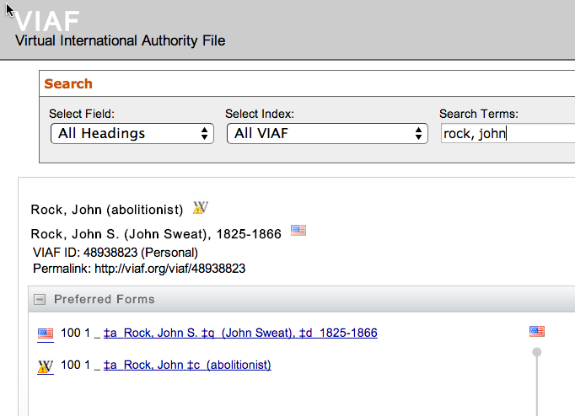
Using
authoritative sources whenever possible

Slide 62
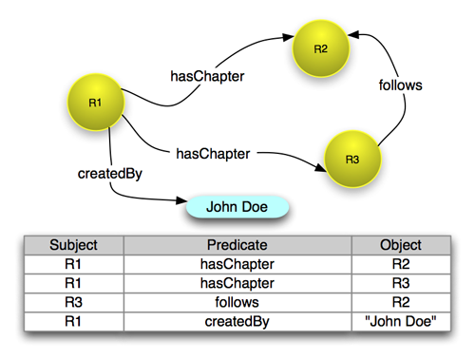
Voila! Linked Relationships Between Entities
Notes:
Store those entities and relationships in a reusable way

Slide 63
OK, but so what?

Slide 64
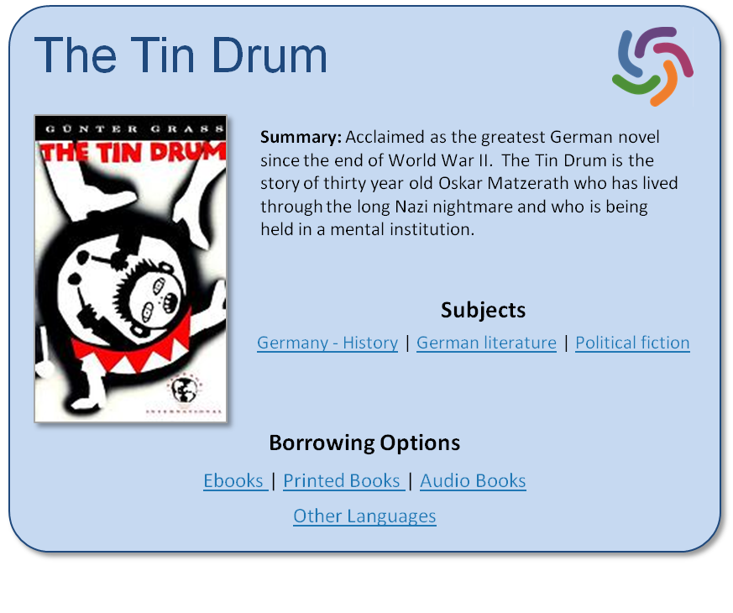
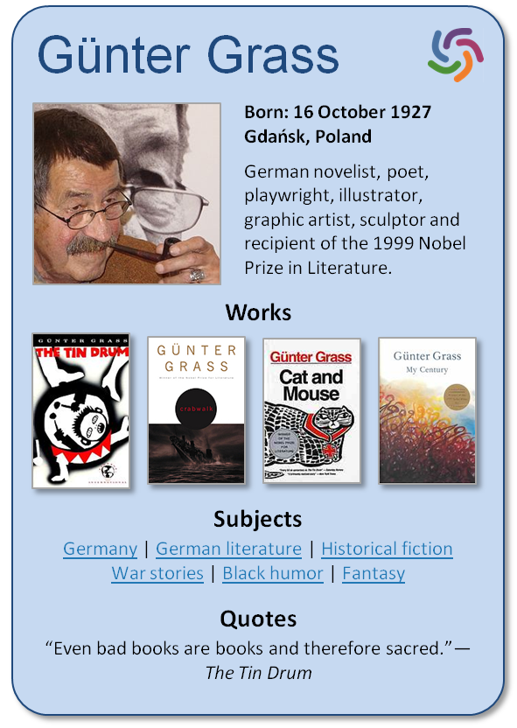
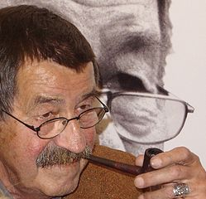
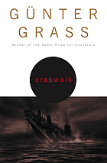
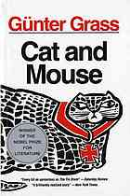
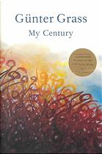
Improving Discovery
Günter Grass
The Tin Drum
Born: 16 October 1927 Gdańsk, Poland
German novelist, poet, playwright, illustrator, graphic artist, sculptor and recipient of the 1999 Nobel Prize in Literature.
Summary: Acclaimed as the greatest German novel since the end of World War II. The Tin Drum is the story of thirty year old Oskar Matzerath who has lived through the long Nazi nightmare and who is being held in a mental institution.
Works
Subjects
Germany - History | German literature | Political fiction
Borrowing Options
Ebooks | Printed Books | Audio Books
Other Languages
Subjects
Germany | German literature | Historical fiction War stories | Black humor | Fantasy
Quotes
“Even bad books are books and therefore sacred.”—The Tin Drum

Slide 65
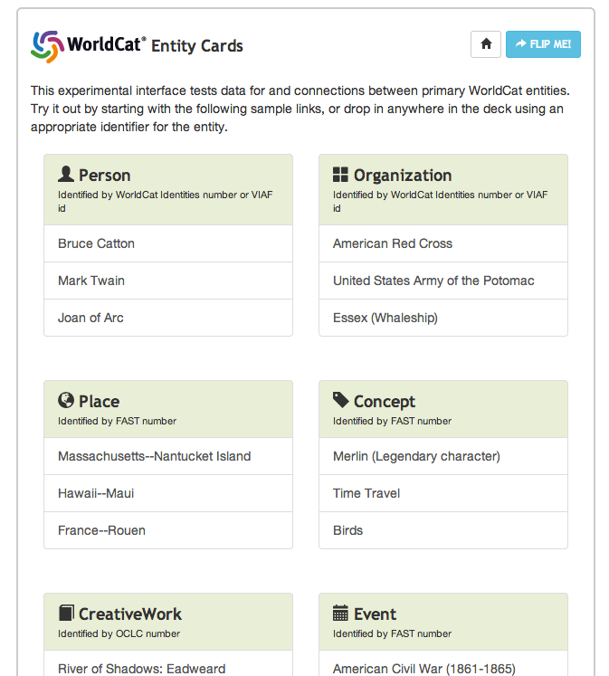
Notes:
This is an example of where it grows up and just becomes useful.

Slide 66
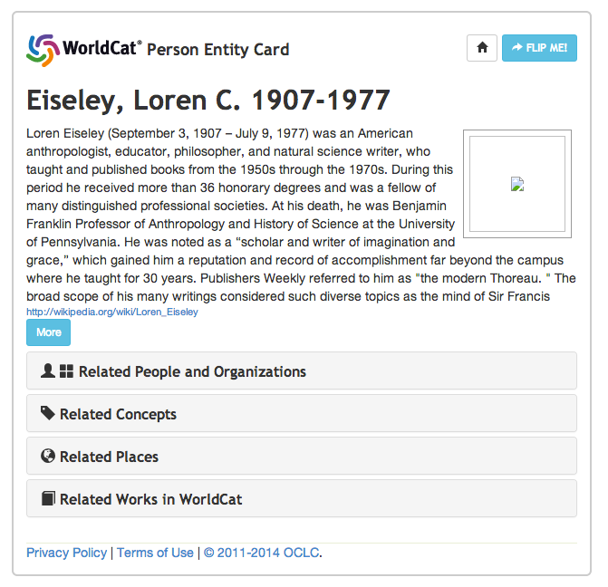
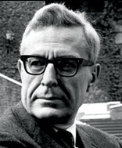

Slide 67
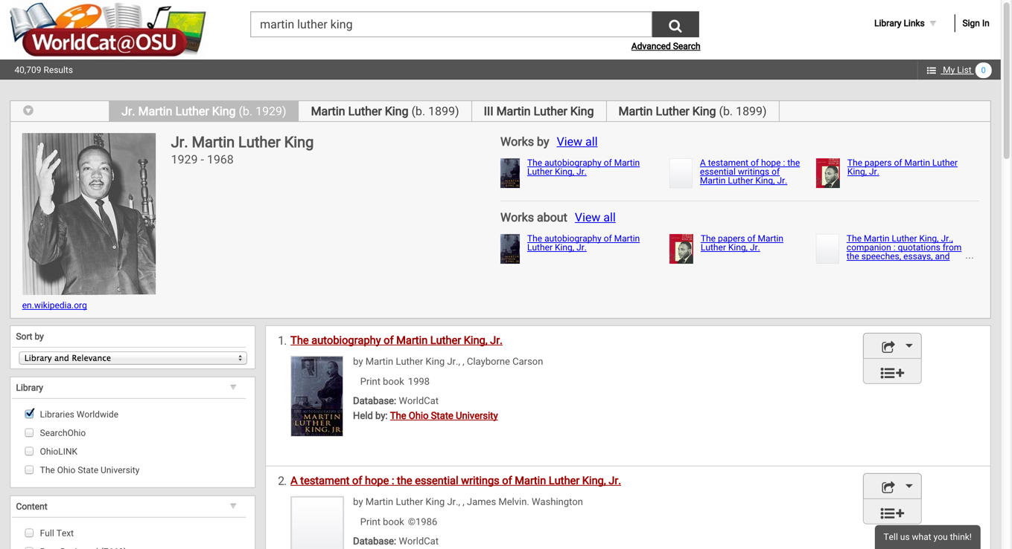

Slide 68
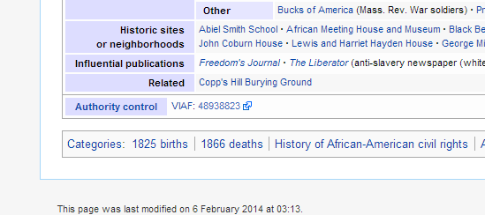
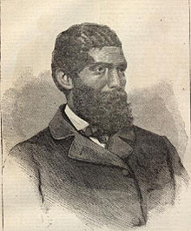
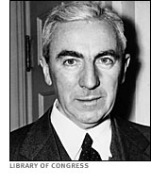
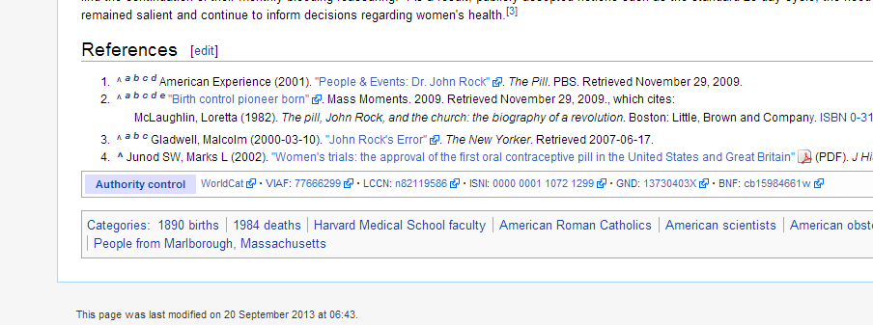
Notes:
VIAF helps!

Slide 69
Title: 西遊記
Language: Chinese
Author: 吳承恩
Created: 1592
HasTranslation:
Title: Journey to the West
Language: English
Translator: Anthony C. Yu
Date: 1977
IsTranslationOf:

Slide 70
Title: 西遊記
Language: Chinese
Author: 吳承恩
Created: 1592
HasTranslation:
Title: Journey to the West
Language: English
Translator: Anthony C. Yu
Date: 1977
IsTranslationOf:
Title: Pilgerfahrt
Language: German
Translator: Georgette Boner Date: 1983
IsTranslationOf:
Title: Journey to the West
Language: English
Translator: W. J. F. Jenner
Date: 1982-1984
IsTranslationOf:
Title: 西遊記
Language: Japanese
Translator: 中野美代子
Date: 1986
IsTranslationOf:
Title: Tây du ký bình khảo
Language: Vietnamese
Translator: Phan Quân
Date: 1980
IsTranslationOf:

Slide 71
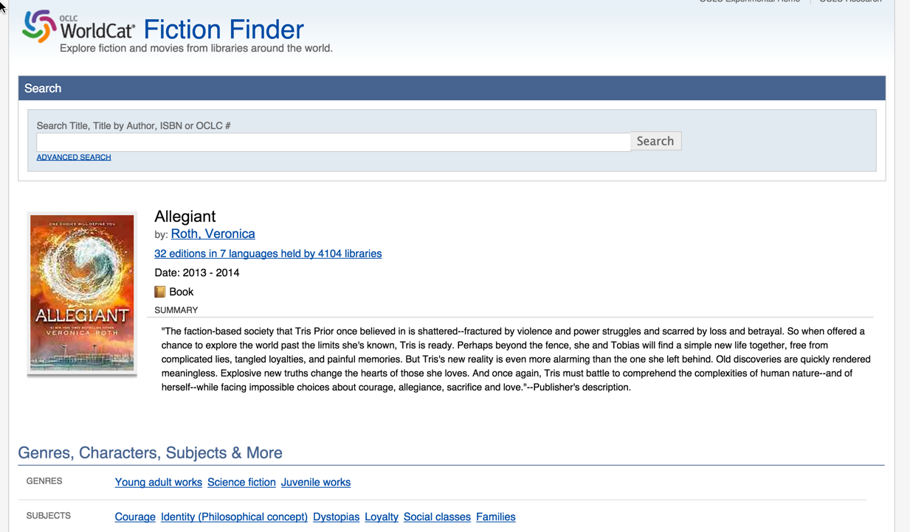

Slide 72
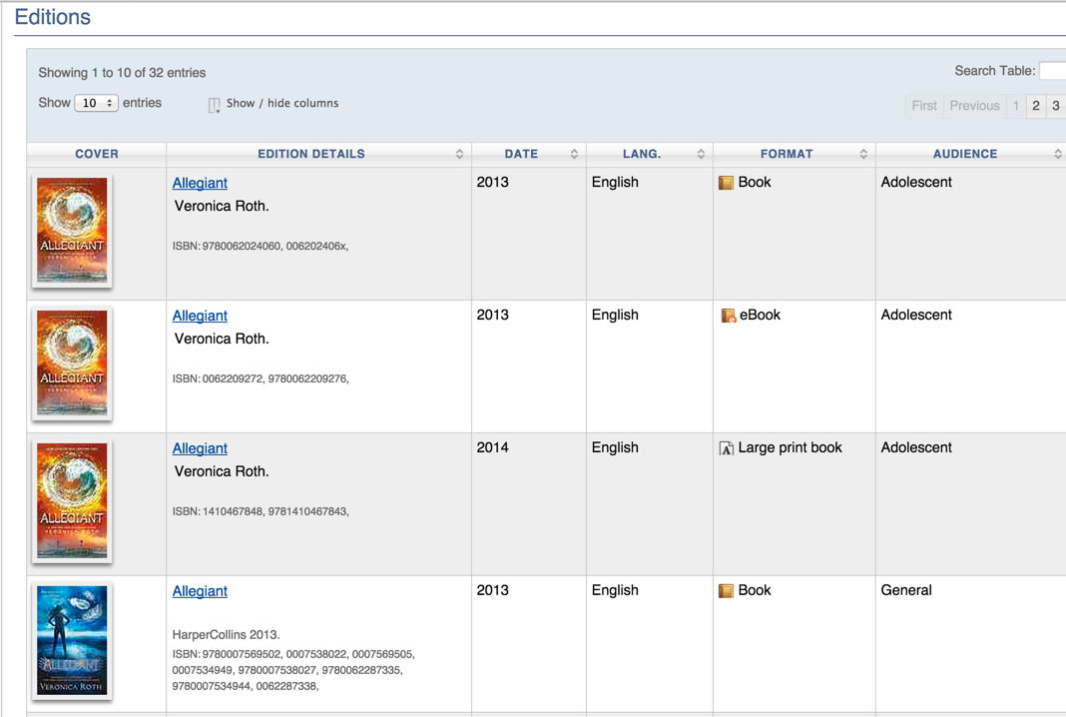

Slide 73
OCLC Production Services
LCSH
Linked Data
Entities
VIAF
Internal OCLC Research Resources
FAST
enhanced
WorldCat
GMGPC
External OCLC Research Systems
WORKS
GSAFD
GTT
Kindred Works
FictionFinder
Identities
MeSH
LCTGM
Cookbook Finder
DDC
Classify

Slide 74
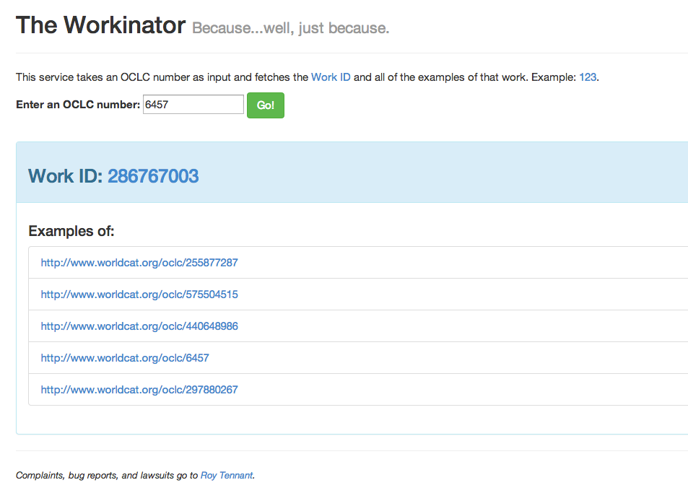
The Workinator

Slide 75
It’s Not the Record, It’s the Linkage
Requires a new kind of thinking: “sets of assertions about something” NOT a “record”
Assertions about an item can be dynamic
Authority control is built-in
Much more than simply translating a record from MARC to a new format

Slide 76
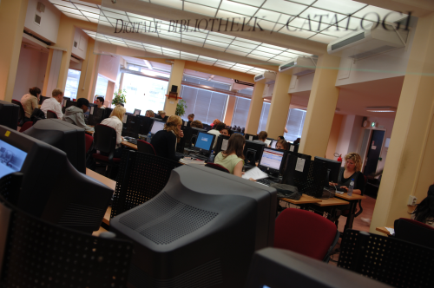
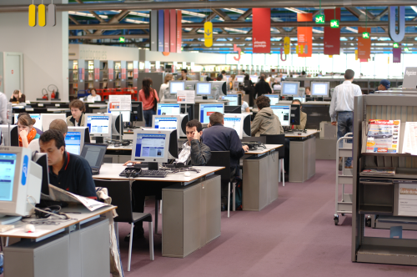
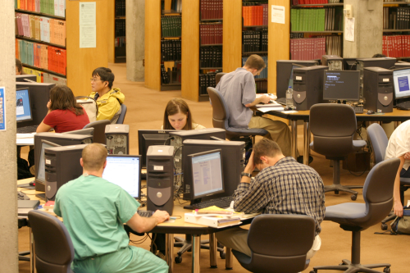
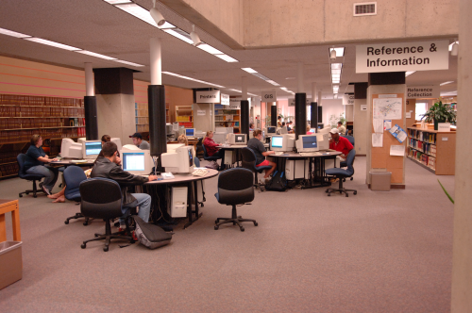
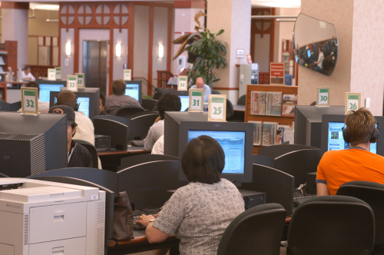
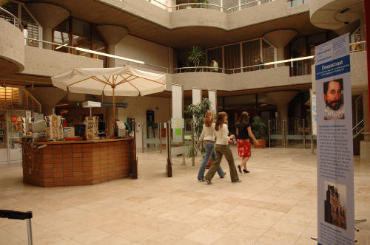
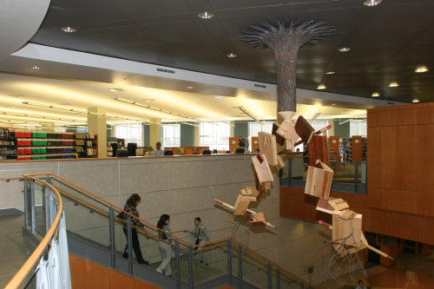
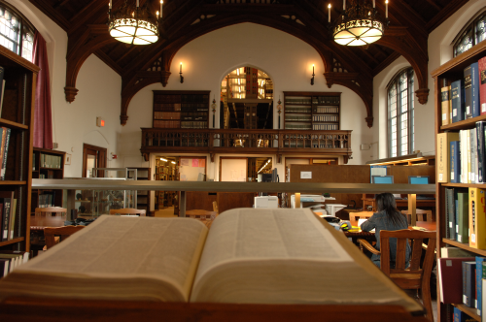
Opportunity
to
connect
users
with
our
resources

Slide 77
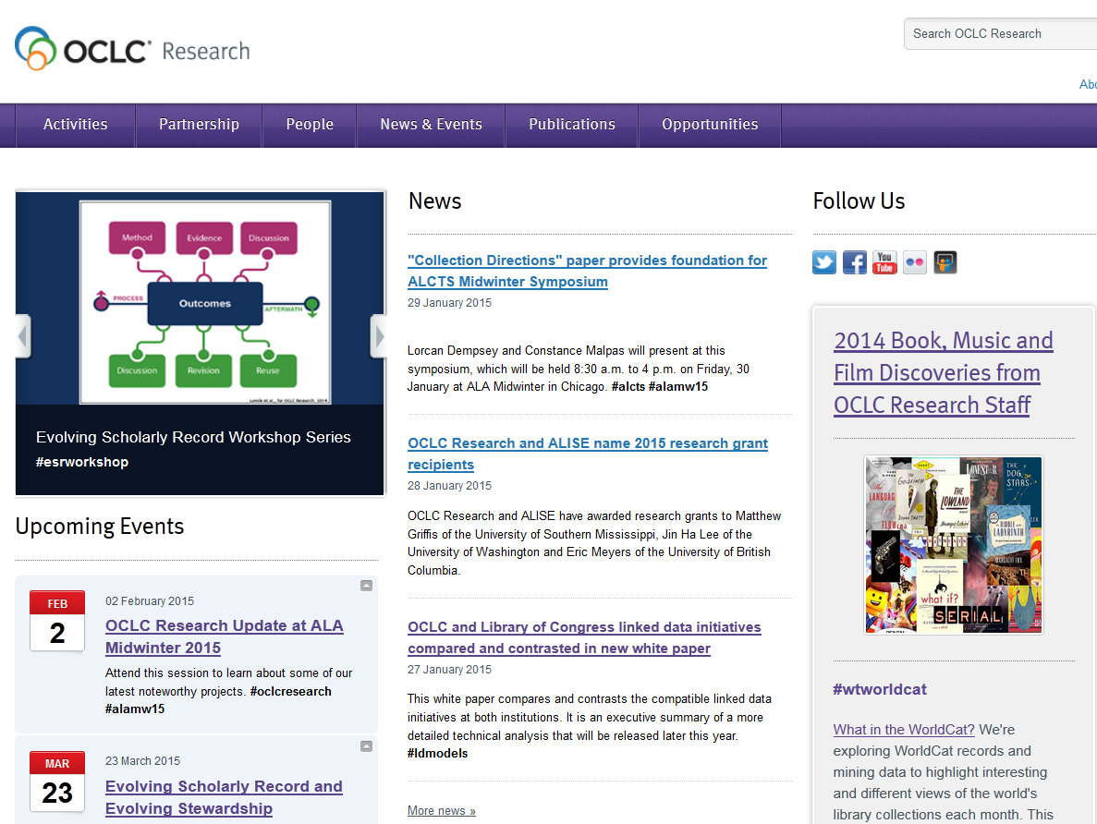
eric_childress@oclc.org
@echildress
malpasc@oclc.org
@ConstanceM
massied@oclc.org
@SHARESGuy
tennantr@oclc.org
@rtennant
http://www.oclc.org/research

Slide 78
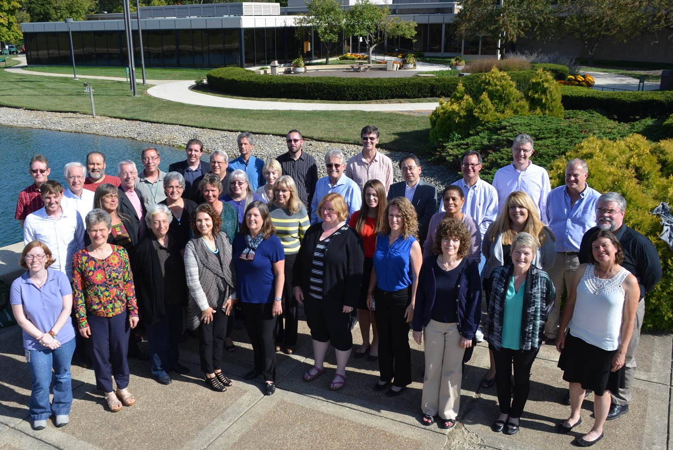
OCLC Research
www.oclc.org/research
Thank you!

