Slide 1
ALA Annual 2015
OCLC Research Update
Merrilee Proffitt, Senior Program Officer
Bruce Washburn, Consulting Software Engineer
Diane Vizine-Goetz, Senior Research Scientist
Roy Tennant, MC and Senior Program Officer

Slide 2
Merrilee Proffitt
Wikipedia and Libraries
Bruce Washburn
On the Linked Data Learning Curve
Diane Vizine-Goetz
FAST (Faceted Application of Subject Terminology)

Slide 3
ALA Annual 2015
OCLC Research in Brief
Roy Tennant
Senior Program Officer

Slide 4
OCLC Research
Explores challenges facing libraries and archives in a rapidly changing information technology environment
Three primary modes of activity:
Community research & development
Advanced development (data mining, prototyping)
Member/Partner engagement
OCLC Research Library Partnership
Work is openly available, e.g.,
Reports
Experimental services

Slide 5
THEMES

Slide 6
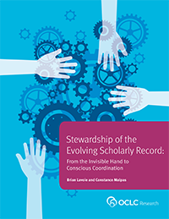
New Report: Stewardship of the Evolving Scholarly Record
The scholarly record is evolving, so …
… stewardship models for scholarly record are changing too
“Conscious coordination” key to securing future of scholarly record
oc.lc/esr-stewardship
Notes:
Also building on our work on the evolving scholarly record, OCLC Research has just published a new report, Stewardship of the Evolving Scholarly Record: From the Invisible Hand to Conscious Coordination.
The focus of this report is on how stewardship models for the scholarly record are evolving in parallel with the evolution of the scholarly record itself. We talk about the concept of “conscious coordination”, which we think will be the driving principle in organizing stewardship arrangements that ensure the scholarly record in its fullest expression is collected and preserved. The report explains what we mean by conscious coordination, contrasts it to traditional approaches to stewardship, and talks about some of the practical implications of building consciously coordinated stewardship activities.
The report is freely available online; we hope you download a copy, and welcome your comments.

Slide 7
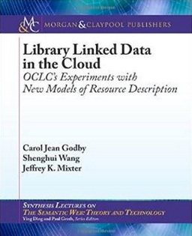
Library Linked Data in the Cloud
Just published
Offers insights gained from OCLC’s innovative work with linked data
Main sections:
Library Standards and the Semantic Web
Modeling Library Authority Files
Modeling and Discovering Creative Works
Entity Identification Through Text Mining
The Library Linked Data Cloud
Technical but approachable
Anyone with a modest background in metadata can read & understand it

Slide 8
ALA Annual 2015
Wikipedia & Libraries
Increasing Library Visibility
Merrilee Proffitt
Senior Program Officer, OCLC Research

Slide 9
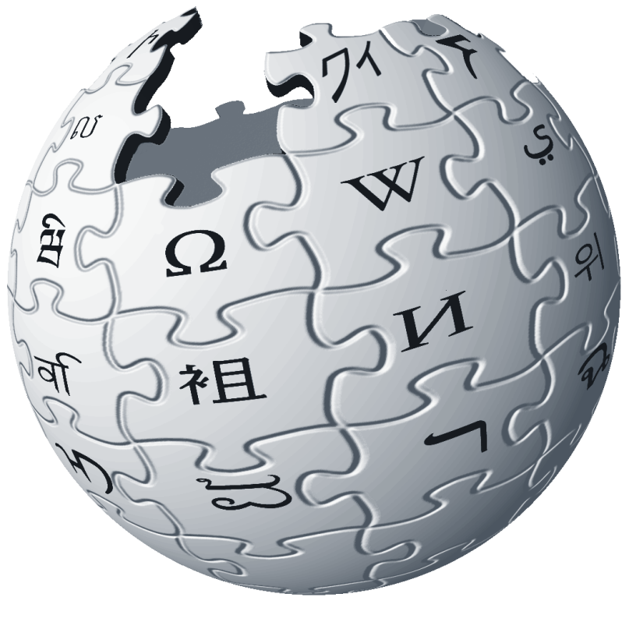
“Discovery happens elsewhere…” Lorcan Dempsey, OCLC Research

Slide 10
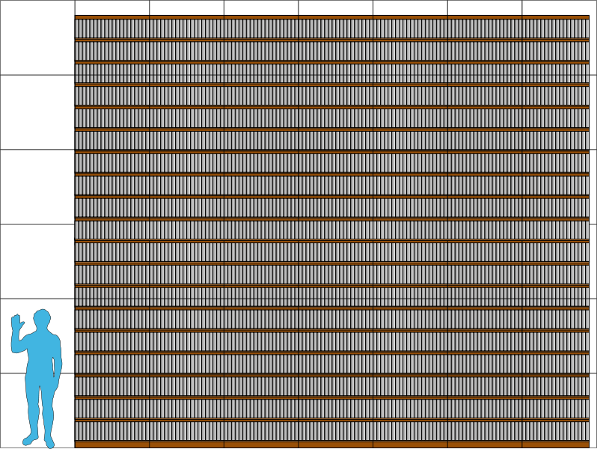
Why Wikipedia?
35 million articles
286 languages
2 billion edits (11 million / month)
8000 views per second
500 million monthly visitors
5th most popular website
2000x larger than Brittanica
Notes:
30 million articles in 286 languages cobbled together by 2 billion edits that are viewed 8000 times per second by 500 million unique visitors per month. The sixth most visited website on the internet is 2000 times larger than Encyclopedia Britannica’s deluxe edition. Wikipedia’s co-founder, Larry Sanger, thought that Wikipedia should be written and reviewed by credentialed experts. So he went off and started his own Wiki called Citizendium. After 12 years, it has 5000 articles. Crowdsourcing works.

Slide 11
Why Wikipedia?
Starting point for research
Learning black market and GWR Google > Wikipedia > References
Ideologically aligned with library mission
Access to knowledge – for free
Shared appreciation of quality sources
Shared appreciation of authority control
Notes:
talk about why Wikipedia is important to libraries (highly ranked, ideologically aligned)

Slide 12
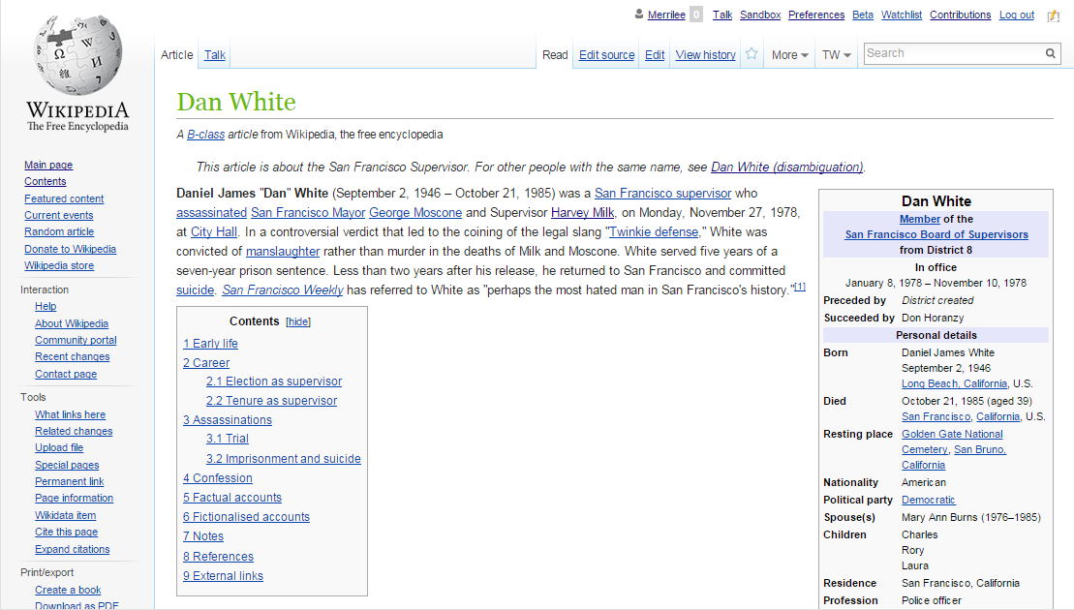
Wikipedia + Libraries

Slide 13
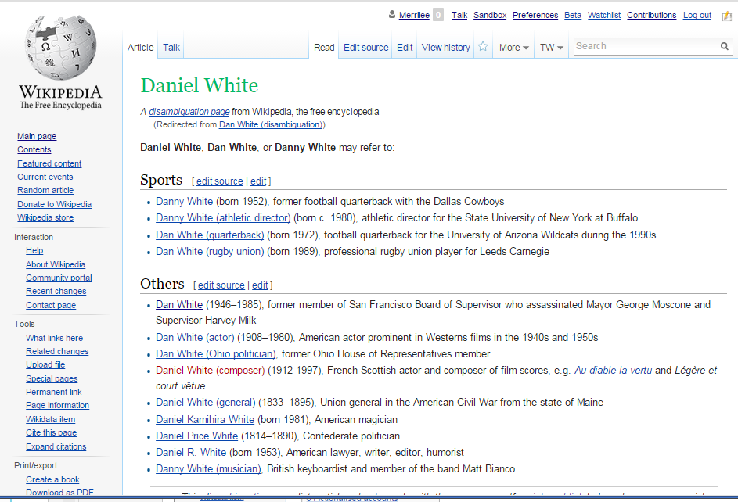
Wikipedia + Libraries

Slide 14
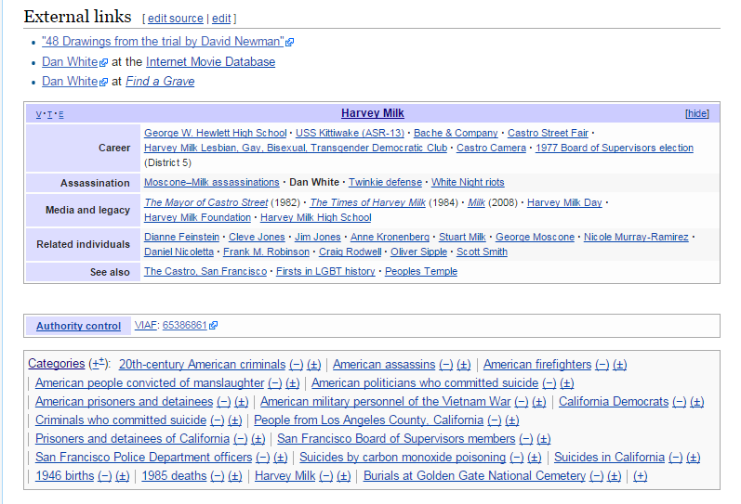
Wikipedia + Libraries

Slide 15
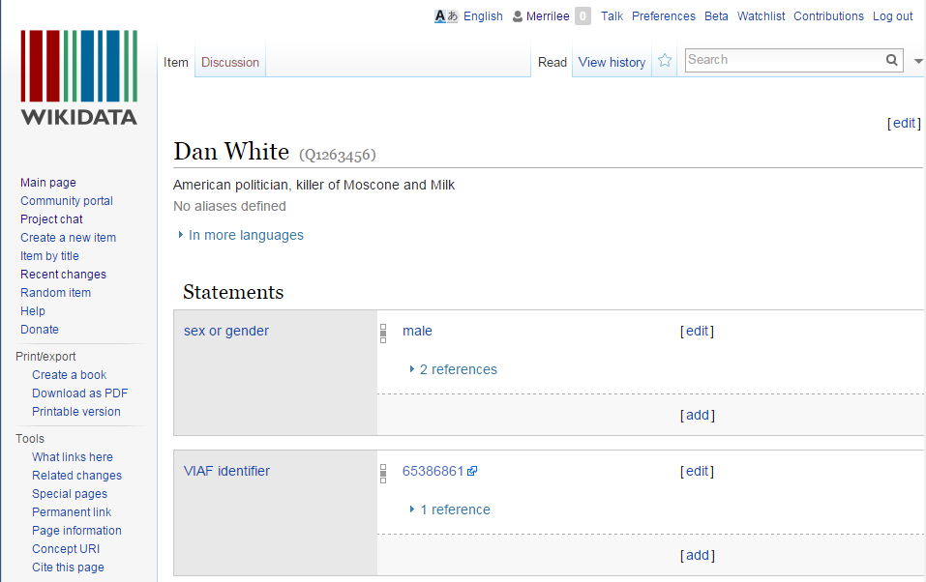
Wikipedia + Libraries

Slide 16
How to engage?
Learn to edit Wikipedia
Attend or host an editing event
Host a Wikipedian in Residence
Host a Wikipedia Visiting Scholar
Consider the unique value that libraries and librarians can bring to Wikipedia
For more information / inspiration
Wiki Libraries
GLAM Wiki
Wikipedia Library
WikiEdu (Wikipedia Education Foundation)

Slide 17
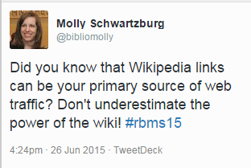

Slide 18
OCLC Research Update, June 29, 2015
On the Linked Data Learning Curve
Current work in OCLC Research
Bruce Washburn
Consulting Software Engineer

Slide 19
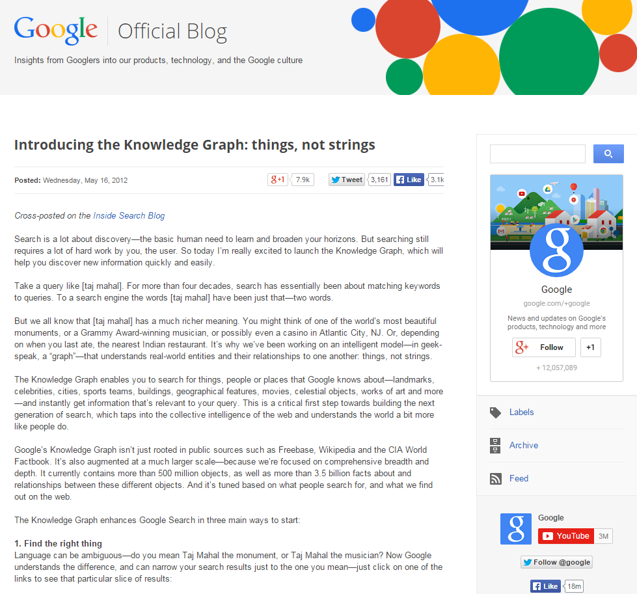
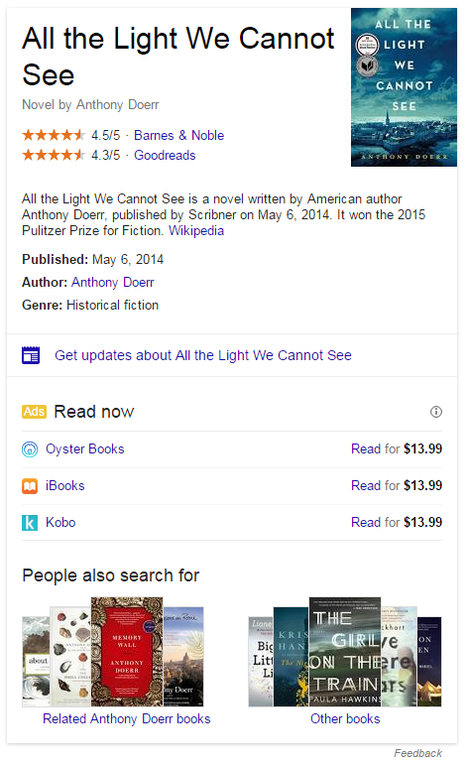
The Knowledge Graph
A Google blog post from 2012 describes the Knowledge Graph that supports searching for the things, people and places that Google knows about and suggestions for relevant related things.
The Graph powers the Google Knowledge Panel in search results
Notes:
The Knowledge Graph that Google began promoting in 2012 is often noted as a model of the power of linked data.
Recently, as Knowledge Panels have appeared with more frequency in search engine results, they have been pointed to as exemplars of that power, with libraries, archives and museums aspiring to be reflected in those highlighted views, and with some library systems emulating that type of focus on working in the data.

Slide 20
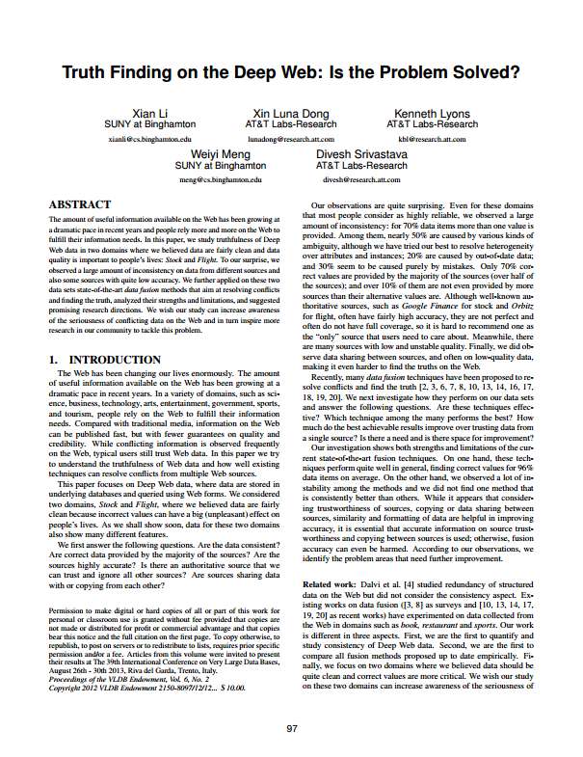
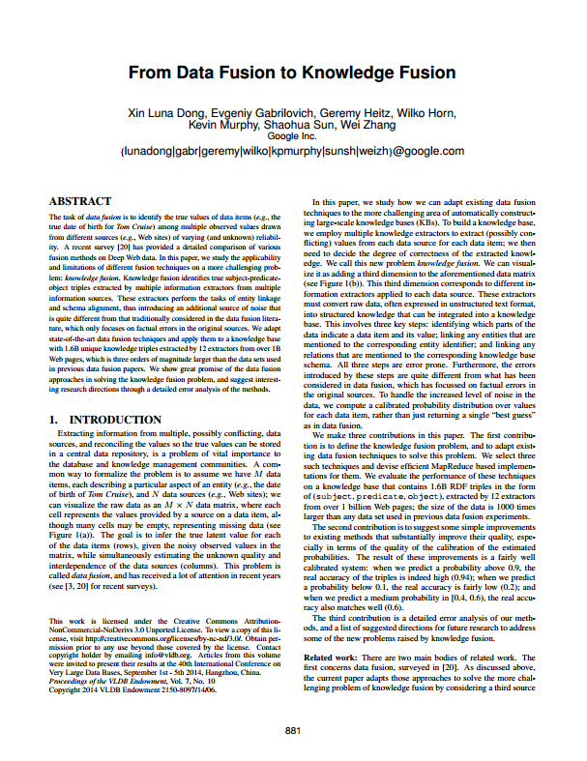
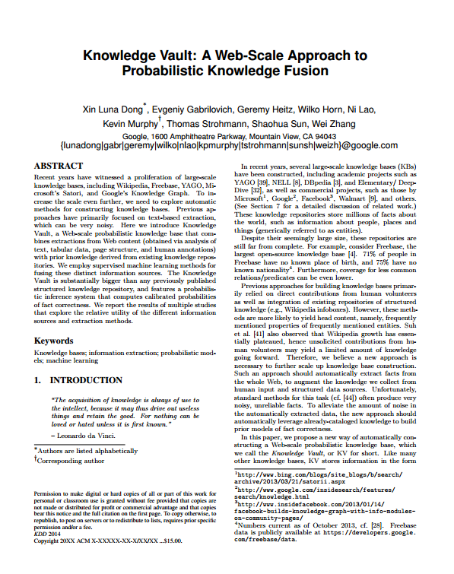
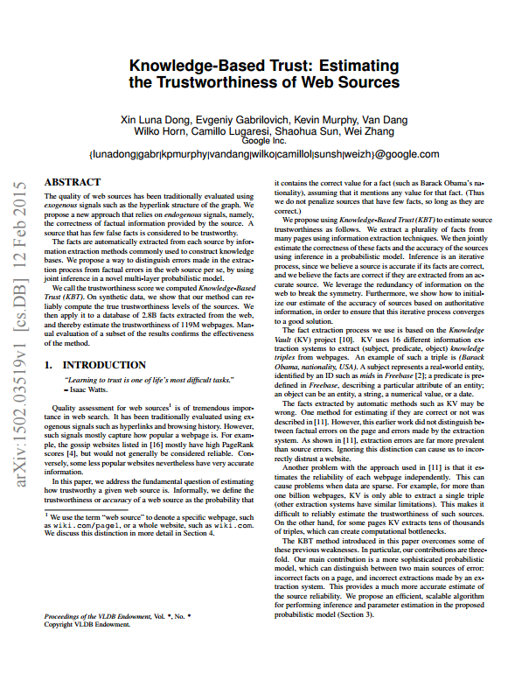
The Google Knowledge Vault
A series of recent Google Research papers describe the use of probabilistic models and machine learning to assess the truth of statements made by multiple sources.
Li, X., Dong, X. L., Lyons, K., Meng, W., Srivastava, D. (2013). Truth Finding on the Deep Web: Is the Problem Solved?
Dong, X. L., Gabrilovich, E., Heitz, G., Horn, W., Murphy, K., Sun, S., Zhang, W. (2013). From Data Fusion to Knowledge Fusion.
Dong, X. L., Murphy, K., Gabrilovich, E., Heitz, G., Horn, W., Lao, N., ... & Zhang, W. (2014). Knowledge Vault: A Web-scale approach to probabilistic knowledge fusion
Dong, X. L., Gabrilovich, E., Murphy, K. Dang, V., Horn, W., … & Zhang, W. (2015). Knowledge-Based Trust: Estimating the Trustworthiness of Web Sources
Notes:
Google researchers have recently published a series of papers describing the theory and mathematics behind related work, to use probabilistic models and machine learning to assess the truth in the statements made about things and their relationships, mined from the web.

Slide 21
A “Knowledge Vault” for Libraries?
OCLC research scientists and software engineers are prototyping a similar model for bibliographic and authority data sources,
in combination with user-contributed content and Linked Data from other providers,
to evaluate a “knowledge vault” for statements about entities and their relationships, including people, groups, places, events, concepts, and works.
Notes:
While recognizing that the web of data that Google is attempting to assess encompasses a much larger set of sources, and represents a higher frequency of competing “claims” of truth about entities and their relationships, we see real potential in applying their approach to the data sources we’ve traditionally worked with.

Slide 22
Library data sources
WorldCat – thousands of libraries, museums and archives contribute to the aggregation. OCLC adds FRBR clustering, algorithmically-deduced connections of strings to Linked Data identifiers, and new entities.
VIAF – 30 or more authority systems contribute, and OCLC merges and links records into new VIAF clusters.
FAST – OCLC transforms Library of Congress subject headings into a new controlled vocabulary, friendly to faceted navigation.
Notes:
We begin by looking at just 3 primary sources of library data, though each is itself an aggregation representing many more contributing sources. WorldCat bibliographic records are contributed by thousands of libraries, museums and archives, the VIAF integrated authority file works with 30 or more contributing authority record sources, and FAST transforms Library of Congress Subject Headings.
The records for these three sources are all available from OCLC as RDF Linked Data with persistent identifiers.

Slide 23
Knowledge Vault data flow
EnhancedWorldCat
Extractor
Knowledge Triples
Scored Triples
VIAF
Extractor
Fusers
FAST
Extractor
Data Sources
Extraction
Collective
Fusion
Knowledge
Vault
Notes:
The first step in the process is extract “triples” from record-oriented data.
Triples are simple statements that describe a relationship between a subject and an object. For example, the creative work Persuasion was created by Jane Austen.
Expressing those simple statements in RDF, the standard model for information interchange on the web, provides a way to aggregate and process triples provided by a wide range of sources.
The “Extractors” produce “Knowledge Triples” which can associate the statement with who produced the statement, when it was produced, and other properties that can be used later on to compare related claims.
The “Fusion” processes apply mathematics to the collective of Knowledge Triples, to produce Scored Triples in the Knowledge Vault.

Slide 24
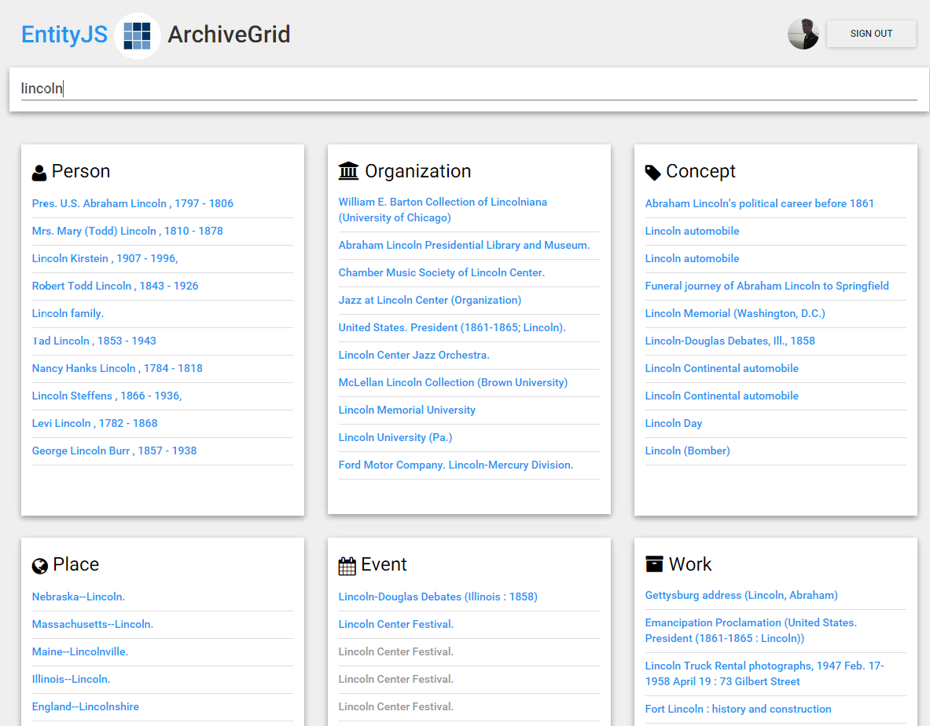
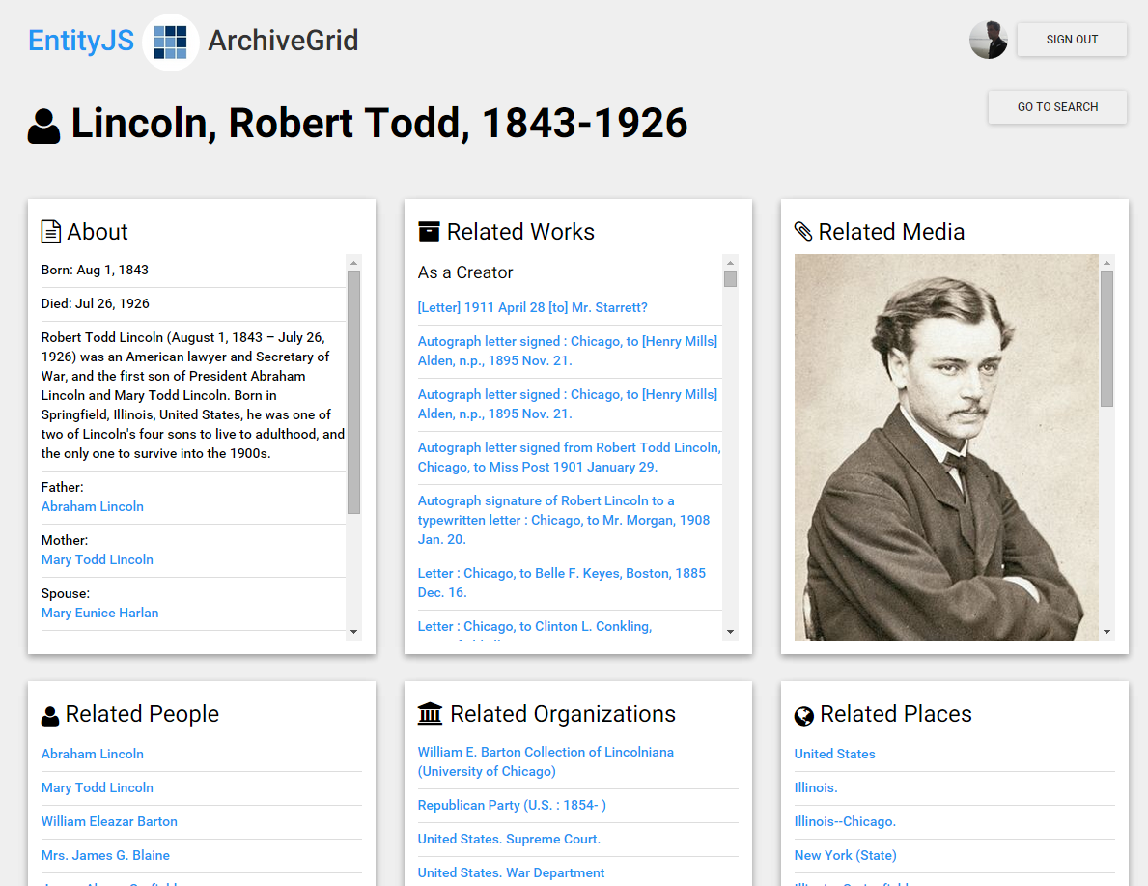
The EntityJS Research Project
Get some real-life RDF experience, test entity refinement and editing, and push triples back to the knowledge vault.
Notes:
Prototype an application that runs in a browser and uses RDF data sources from OCLC and elsewhere
Write as little original code as possible; use existing code libraries
Skip the magic tricks that may hide Linked Data issues
Search across entities
Show relationships of one entity to others
Examine questions around user-contributed improvements to entity relationships
Evaluate how an application like EntityJS could both consume data from and contribute data to the Vault

Slide 25
Testing with a subset of Knowledge
Just the “ArchiveGrid” WorldCat MARC records
Knowledge Triples
Scored Triples
WorldCat
ArchiveGrid
Extractor
Fusers
EntityJS
Extractor
VIAF
FAST
Extractors
Collective
Fusion
Knowledge
Vault
DBPedia
Vault Services
Wikidata
Application Triples
Notes:
To examine the process of transforming bibliographic records to triples and creating a knowledge vault, we’ve extracted a subset of WorldCat records … those that describe the primary source materials that make up the OCLC Research ArchiveGrid discovery system.
Though WorldCat is our only library data source in the testing phase, we’re working with an “enhanced” version of the data provided by WorldCat catalogers, where FAST and VIAF identifiers have been automatically added (where possible) to supplement the strings representing people, groups, places, concepts, and events.
The term “vault” suggests that the triples are valuable (which is true) but also that they are hidden or inaccessible (which is not the intent). We imagine that vault services will be built that ingest and process these triples in various ways. For example, they might be processed into indexes to support fast search and retrieval of specific entities and their relationships
We’ve developed a few services to provide access to the scored triples in the vault. These include MapReduce processes and ElasticSearch indexes for searching, and a triplestore and scripts for canned SPARQL queries.
EntityJS interacts with the Vault services to search across entities, and to view individual entities and their relationships. When viewing a single entity the application connects directly to its RDF source. For example, to initiate the view of a person it retrieves RDF data from VIAF.
EntityJS can also be used to produce new data to flow back into the Knowledge Vault process … and to store temporary versions of that data for immediate use by the EntityJS application.

Slide 26
Search across entities
Notes:
Based on triples in our knowledge vault we built an ElasticSearch engine that helps us quickly search across entities.

Slide 27
Show related entities
Notes:
When an entity is selected, we base the initial view of it on its RDF data source (in this case, a person entity represented by a VIAF record).
We supplement that with information represented by knowledge vault triples, displaying related works and the role this person has associated with that work (creator, contributor, or subject). We also find other related entities and show those that are identified most frequently in the set of ArchiveGrid source records … a kind of “pageRank” to show the most closely related entities first.

Slide 28
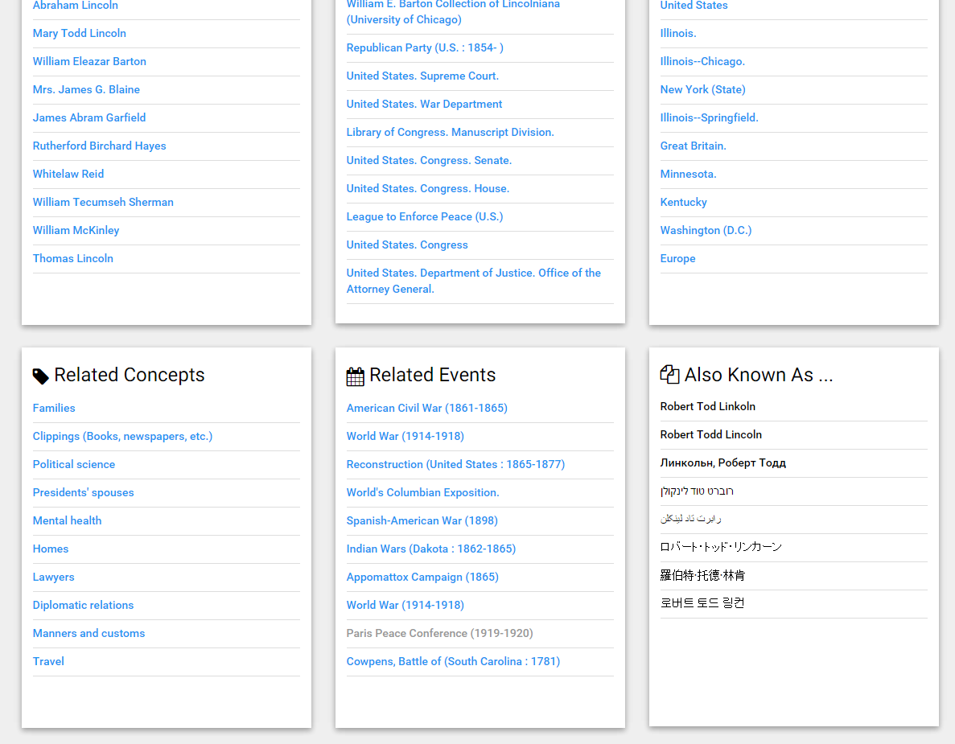
Show related entities
Notes:
Relations to other representations of the entity, as in WikiData, help us supplement the list of alternate names for the person …

Slide 29
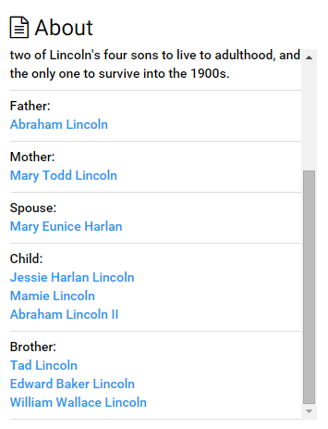
Get more relationships from Wikidata
Notes:
And can identify family relationships to other people, not all of whom would have been otherwise represented in the initial set of ArchiveGrid MARC records. The family relationships from WikiData provide another network layer on top of the relationships in the MARC data.

Slide 30
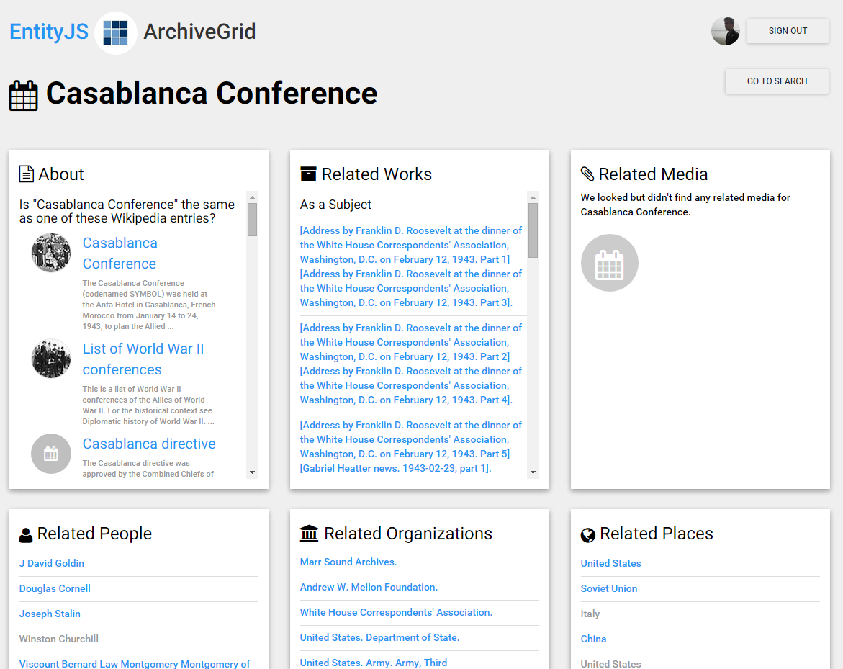
EntityJS users can identify matching entities
Notes:
Not all of our bibliographic or authority records contain connections to related forms. Here is an example of a FAST subject that could benefit from a connection to the corresponding WikiData page.
EntityJS offers a way for users to select from a set of potentially related WikiData/Wikipedia articles for the subject.

Slide 31
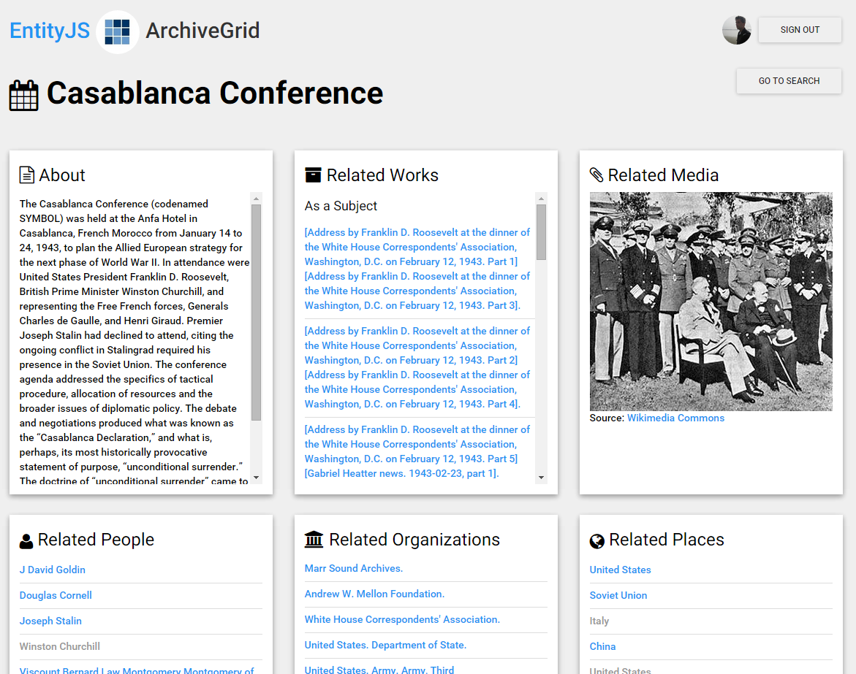
EntityJS users can identify matching entities
Notes:
Selecting a matching subject from the list sends an instruction to the EntityJS knowledge vault services to remember that as a “same as” relationship …
… and the data and related images from Wikidata and Wikipedia can immediately enrich the view in the EntityJS application, while going back into the mix to compete with other factual claims in the process that creates the knowledge vault.

Slide 32
As the EntityJS research project continues …
We will explore other ways to edit and refine entity data
and experiment with using the knowledge vault to support data visualizations

Slide 33
Keeping up with EntityJS
Track initial progress reports on the OCLC Research blog at hangingtogether.org.
We’ll provide project details on the OCLC Research website soon.
Questions or comments?
Bruce Washburn (washburb@oclc.org) or
Jeff Mixter (mixterj@oclc.org)
at OCLC Research

Slide 34
OCLC Research Update, June 29, 2015
FAST (Faceted Application of Subject Terminology)
Diane Vizine-Goetz
Senior Research Scientist

Slide 35
Basics
Enumerative, faceted subject heading vocabulary
Derived primarily from Library of Congress Subject Headings (LCSH), LC NACO file, and LC Genre/Form terms
Retains the vocabulary and reference structure of the source files
Eight categories of terms
Persons
Organizations
Events
Titles of works
Chronological/Time periods
Topics
Places
Form/Genre terms

Slide 36
Why FAST?
Developed to meet a need for a general subject vocabulary that is easy to learn, apply, and control
Modern design
All headings established in authority file
Persistent identifiers for all headings
Obsolete headings deprecated not deleted
Authority file structure facilitates application and automated maintenance of headings
Faceted-navigation friendly

Slide 37
Responsible parties
Began as a collaboration of OCLC Research and the Library of Congress
OCLC Research & advisory groups
WorldCat quality management team
FAST users (e.g., Cornell University, Australian Policy Online, etc.)
ALCTS Faceted Subject Access Interest Group

Slide 38
Facet Counts – 5 June 2015
Facet | Count
Persons | 692,734
Organizations | 360,571
Events | 12,417
Titles of Works | 63,074
Chronological/Time periods | 676
Topics | 406,873
Places | 176,774
Form/Genre | 2,507
Total | 1,715,626

Slide 39
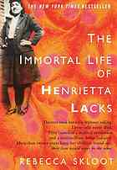
FAST in MARC Bibliographic Records
Headings before conversion
600 10$a Lacks, Henrietta, $d 1920-1951 $x Health.
650 #0$a Cancer $x Patients $z Virginia $v Biography.
650 #0$a African American women $x History.
650 #0$a Human experimentation in medicine $z United States $x History.
650 #0$a HeLa cells.
650 #0$a Cancer $x Research.
650 #0$a Cell culture.
650 #0$a Medical ethics.
FAST headings after conversion
600 17 $a Lacks, Henrietta, $d 1920-1951 $2 fast $0 (OCoLC)fst01914767
650 #7 $a African American women $2 fast $0 (OCoLC)fst00799438
650 #7 $a Cancer $x Patients $2 fast $0 (OCoLC)fst00845411
650 #7 $a Cancer $x Research $2 fast $0 (OCoLC)fst00845497
650 #7 $a Cell culture $2 fast $0 (OCoLC)fst00850172
650 #7 $a Health $2 fast $0 (OCoLC)fst00952743
650 #7 $a HeLa cells $2 fast $0 (OCoLC)fst00952578
650 #7 $a Human experimentation in medicine $2 fast $0 (OCoLC)fst00963042
650 #7 $a Medical ethics $2 fast $0 (OCoLC)fst01014081
651 #7 $a United States $2 fast $0 (OCoLC)fst01204155
651 #7 $a Virginia $2 fast $0 (OCoLC)fst01204597
655 #7 $a Biography $2 fast $0 (OCoLC)fst01423686
655 #7 $a History $2 fast $0 (OCoLC)fst01411628

Slide 40
FAST in MARC Bibliographic Records
Headings before conversion
600 10$a Lacks, Henrietta, $d 1920-1951 $x Health.
650 #0$a Cancer $x Patients $z Virginia $v Biography.
650 #0$a African American women $x History.
650 #0$a Human experimentation in medicine $z United States $x History.
650 #0$a HeLa cells.
650 #0$a Cancer $x Research.
650 #0$a Cell culture.
650 #0$a Medical ethics.
FAST headings after conversion
600 17 $a Lacks, Henrietta, $d 1920-1951 $2 fast $0 (OCoLC)fst01914767
650 #7 $a African American women $2 fast $0 (OCoLC)fst00799438
650 #7 $a Cancer $x Patients $2 fast $0 (OCoLC)fst00845411
650 #7 $a Cancer $x Research $2 fast $0 (OCoLC)fst00845497
650 #7 $a Cell culture $2 fast $0 (OCoLC)fst00850172
650 #7 $a Health $2 fast $0 (OCoLC)fst00952743
650 #7 $a HeLa cells $2 fast $0 (OCoLC)fst00952578
650 #7 $a Human experimentation in medicine $2 fast $0 (OCoLC)fst00963042
650 #7 $a Medical ethics $2 fast $0 (OCoLC)fst01014081
651 #7 $a United States $2 fast $0 (OCoLC)fst01204155
651 #7 $a Virginia $2 fast $0 (OCoLC)fst01204597
655 #7 $a Biography $2 fast $0 (OCoLC)fst01423686
655 #7 $a History $2 fast $0 (OCoLC)fst01411628
http://experimental.worldcat.org/fast/963042/

Slide 41
FAST in MARC Bibliographic Records
Facet
Person……………………………………………
Topic……………………………………………..
Place………………………………………………
Form/Genre………………………………………
FAST headings after conversion
600 17 $a Lacks, Henrietta, $d 1920-1951
650 #7 $a African American women
650 #7 $a Cancer $x Patients
650 #7 $a Cancer $x Research
650 #7 $a Cell culture
650 #7 $a Health
650 #7 $a HeLa cells
650 #7 $a Human experimentation in medicine
650 #7 $a Medical ethics
651 #7 $a United States
651 #7 $a Virginia
655 #7 $a Biography
655 #7 $a History

Slide 42
FAST and Authority Files

Slide 43
Tools for Application and Use
assignFAST
service that automates the manual selection of FAST Subjects based on autosuggest technology
searchFAST
search interface to the FAST authority file that simplifies the process of heading selection
FASTConverter
web application that converts LCSH headings to FAST headings; it helps users become familiar with FAST and see the differences between LCSH and FAST
FAST Linked Data API
Linked Data descriptions expressed using SKOS (Simple Knowledge Organization System) and Schema.org
WorldShare Record Manager
uses assignFAST API in a feature to apply FAST headings

Slide 44
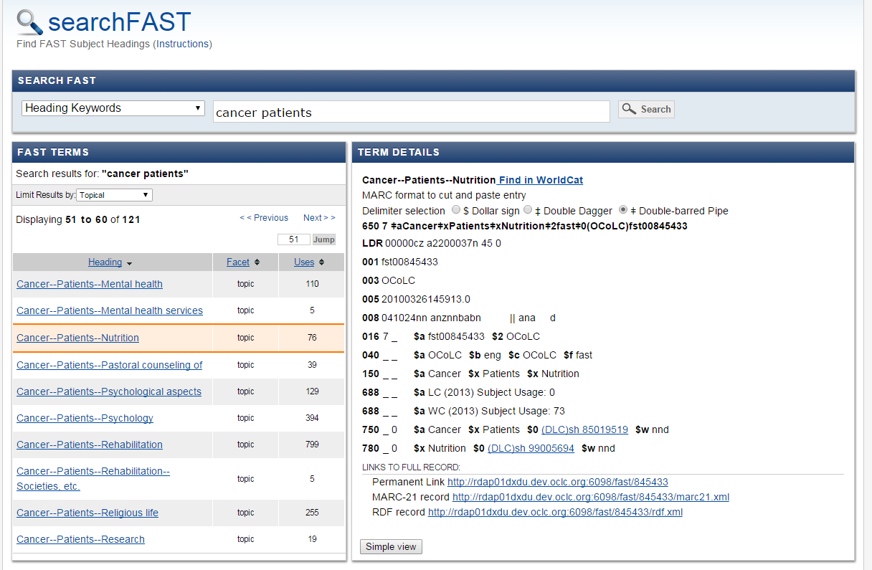
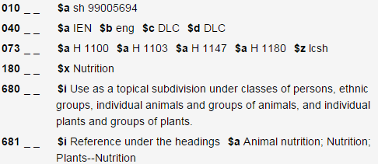

Slide 45
FAST Datasets
Available under Open Data Commons Attribution License (ODC-By)
Bulk downloads updated quarterly
MARC Authority Format in XML
MARC Authority Format in ISO MARC
RDF/XML
Change files published between updates
MARC Authority Format in ISO MARC
Notes:
You are free:
To Share: To copy, distribute and use the database.
To Create: To produce works from the database.
To Adapt: To modify, transform and build upon the database.
As long as you:
Attribute: You must attribute any public use of the database, or works produced from the database, in the manner specified in the license. For any use or redistribution of the database, or works produced from it, you must make clear to others the license of the database and keep intact any notices on the original database.
- See more at: http://opendatacommons.org/licenses/by/summary/#sthash.q2rf8AEz.dpuf

Slide 46
Links to other Files
Authority | Count
Library of Congress Subject Headings* | 299,172
LC NACO File | 1,213,647
VIAF | 1,213,232
DbPedia/Wikipedia | 160,837
Geonames | 85,422
Total geographic coordinates | 120,561
*One-to-One only, not including references to partial or pattern headings

Slide 47
Where FAST is used
Bodleian Libraries, University of Oxford (U.K.)
British Library (U.K., testing FAST)
Chronicling Illinois & The Papers of Abraham Lincoln projects (U.S.A.)
Cornell University Libraries (U.S.A.)
Databib.org (U.S.A.)
National Library of New Zealand (New Zealand)
OCLC (U.S.A.)
RMIT Publishing (Australia)
University of North Dakota (U.S.A.)

Slide 48
FAST at OCLC
WorldCat - January 2015
76 million records enhanced with FAST
WorldCat Entities > WorldCat Works
Experimental WorldCat Linked Data (includes DDC, FAST, VIAF and LCSH URIs)
Experimental applications (OCLC Research)
Classify
WorldCat Identities
mapFAST
…

Slide 49
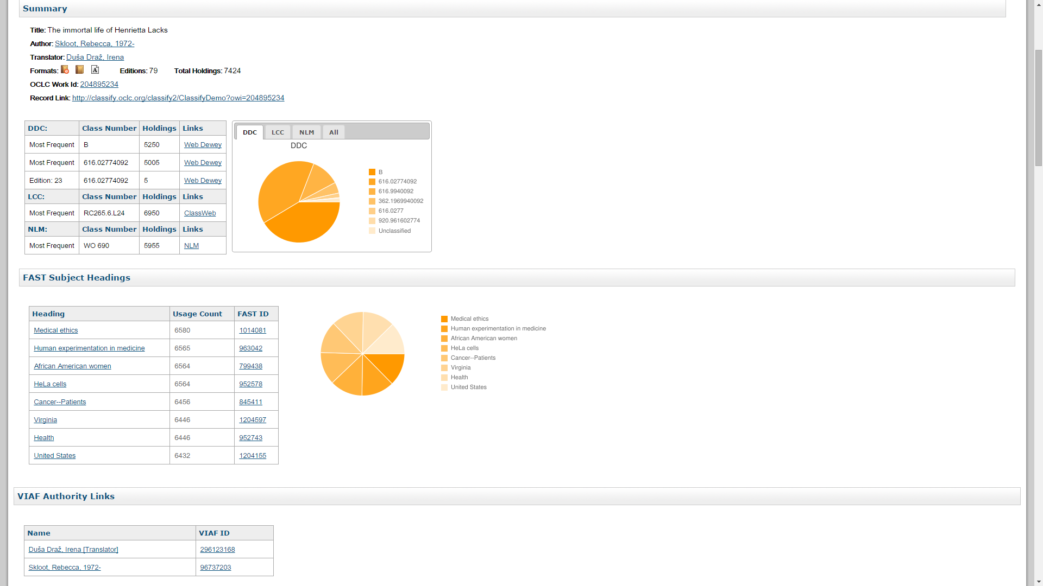
FAST in Classify

Slide 50
What’s new?
FAST geographic headings in VIAF
Synchronizing FAST forms with LCGFT
FAST Changes page
http://fast.oclc.org/fastChanges/

Slide 51
What’s next?
Implementation of Machine-generated Metadata Provenance field (MARC 883) in 6xx headings in WorldCat (expected August 2015)
Preserve user-added FAST headings
Facilitate updating of machine-generated headings
Under consideration/development
User-defined subsets
Support for local authority files
More links to Wikipedia

Slide 52
FAST Team
OCLC Research
Rick Bennett, Eric Childress, Kerre Kammerer, Diane Vizine-Goetz
WorldCat Quality Management
Robert Bremer, Linda Gabel

Slide 53
Links
Project page
http://www.oclc.org/research/themes/data-science/fast.html
Tools
http://fast.oclc.org/searchfast/
http://experimental.worldcat.org/fast/fastconverter/
http://experimental.worldcat.org/fast/assignfast/ (+ API)
http://experimental.worldcat.org/fast/ (+ API)
Datasets
http://www.oclc.org/research/themes/data-science/fast/download.html

Slide 54
ALA Annual 2015
We Welcome Your Engagement
https://twitter.com/OCLC/lists/oclc-research
https://www.facebook.com/OCLCResearch
http://www.slideshare.net/oclcr
http://hangingtogether.org/
http://youtube.com/oclcresearch
http://www.oclc.org/research
News & events
Reports & presentations

