Slide 1
Stewarding NYPL’s Audio and Moving Image Collections into the Future
Evelyn Frangakis, Bill Stingone, Ann Thornton
OCLC Research Webinar April 21, 2015

Slide 2
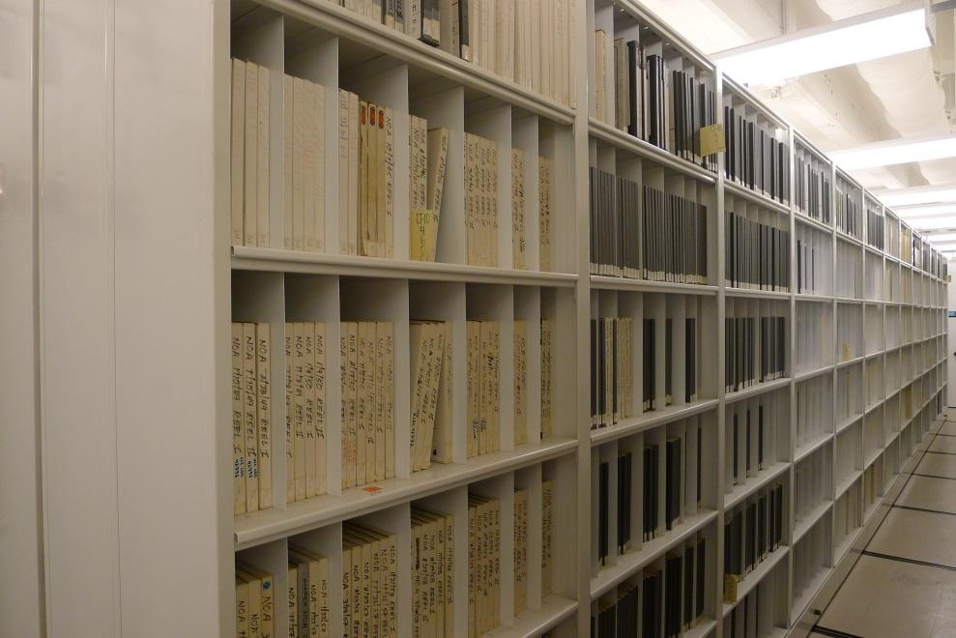
Project Overview
NYPL’s AMI holdings are among the largest and most important in the world
The Andrew W. Mellon Foundation funded a comprehensive preservation assessment
Result: NYPL developed an approach to save the most essential at-risk material

Slide 3
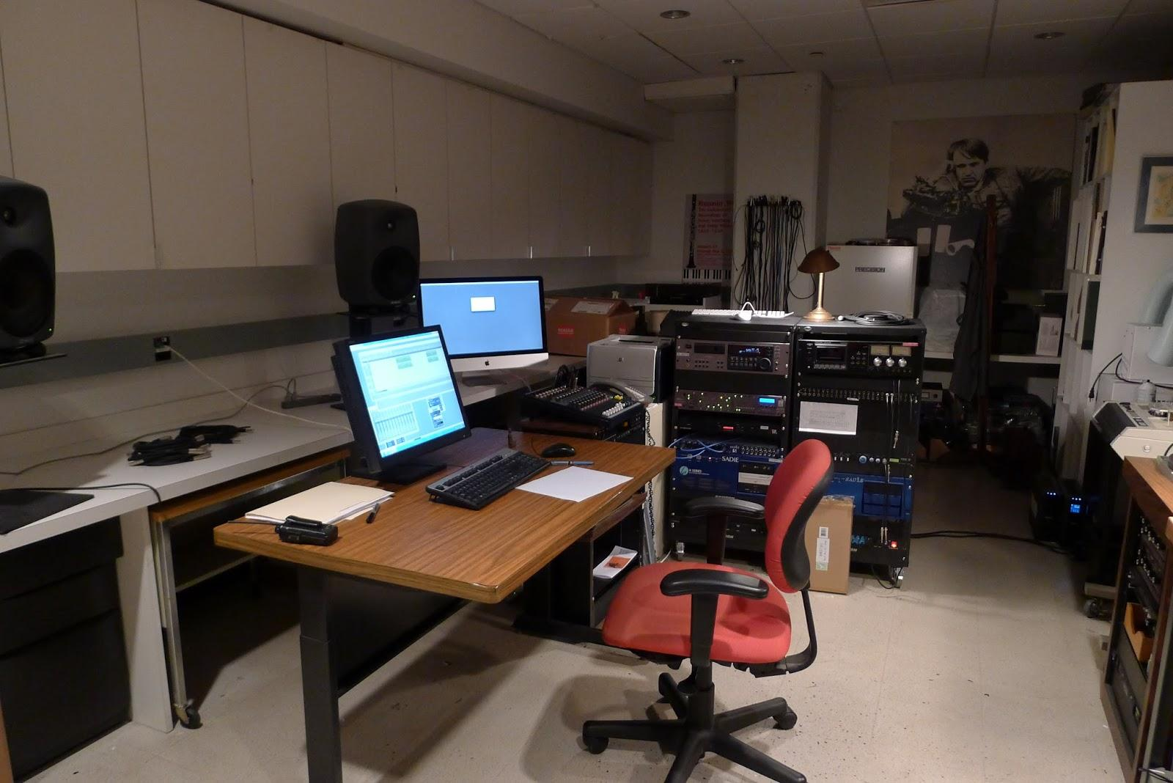
Environmental Scan and Partnerships
Investigated other institutions’ approaches
Modeled our approach on Indiana University’s
Indiana allowed us to beta test MediaScore
Modeled executive sponsorship, AMI Working Group, guiding principles, and project management
BROAD involvement across NYPL with curatorial, administrative, technical, and IT units

Slide 4
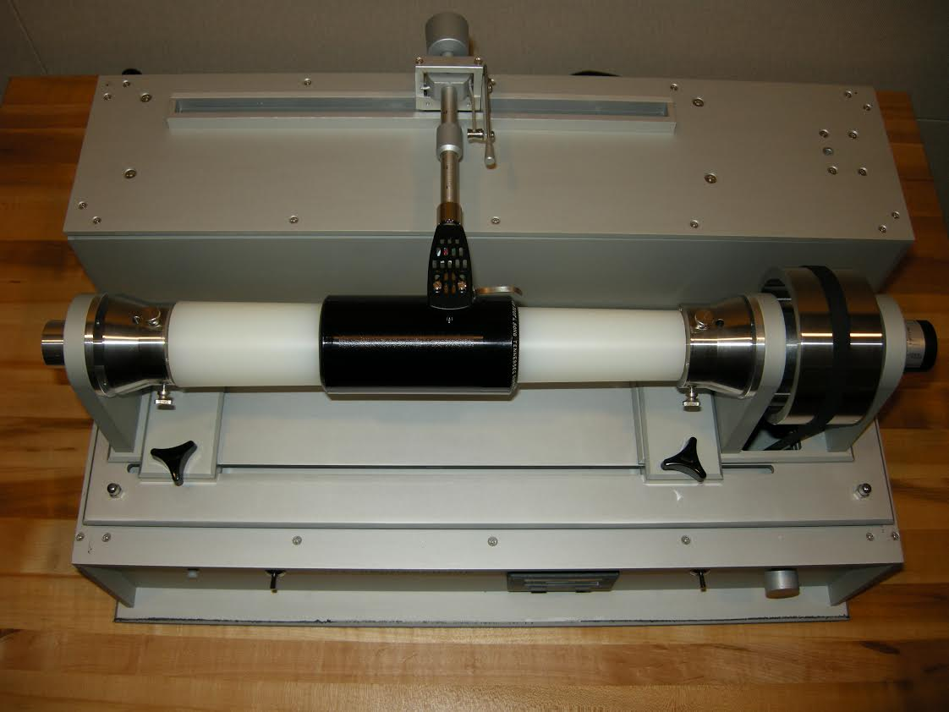
Mellon-Funded Assessment
Compressed to 12-month time frame
Chose AVPreserve as contract partner
Phase 1:
Surveyed curators, individual physical formats, and spaces
Generated format-level inventory of all AMI materials
Phase 2:
Analyzed data and developed recommendations
Phase 3:
Assessed facilities, equipment, and workflows

Slide 5
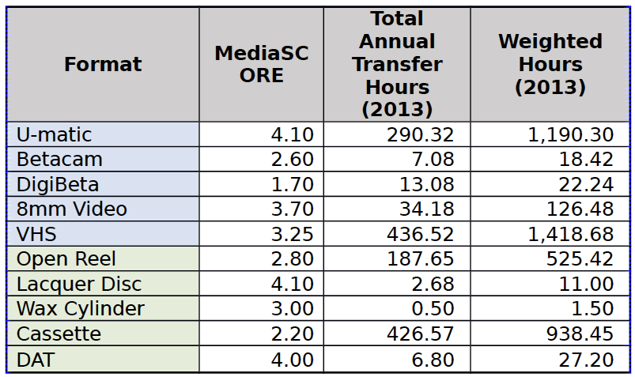
MediaScore

Slide 6
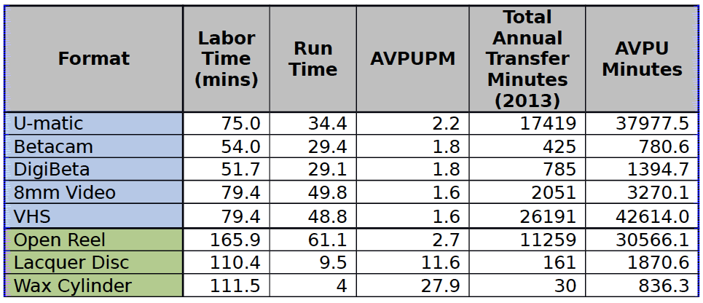
Labor Hours

Slide 7
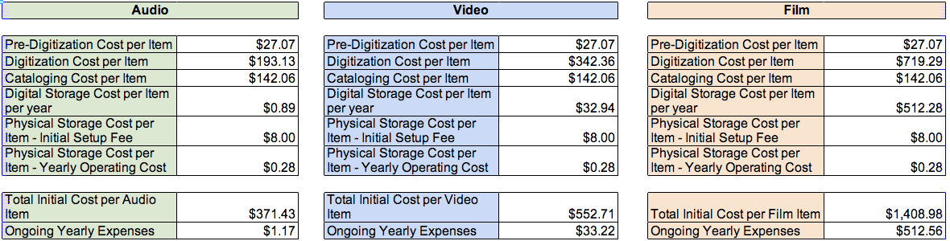
Life-cycle Costs

Slide 8
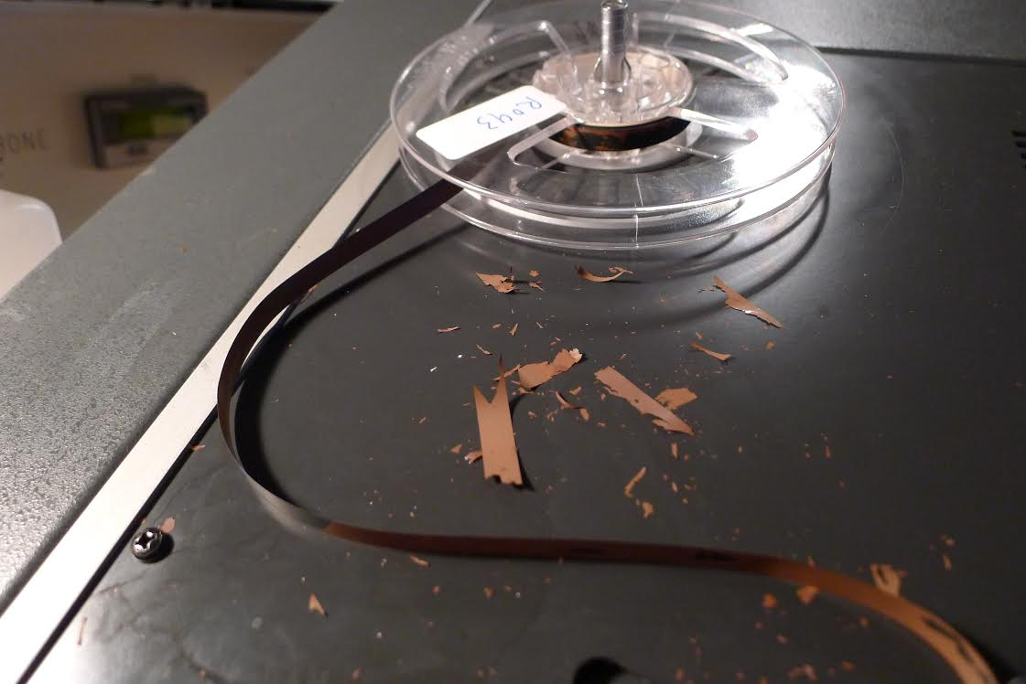
Findings - Collections
More than 800,000 AMI items in 9 curatorial units across 3 of NYPL’s research libraries
60 formats, 4 asset types
1/3 of collection determined high priority for preservation (unique, rare, critical)
Cost of inaction -- a model to help organizations make well-informed decisions about legacy AMI media regarding digitization of legacy physical AMI media
Cost of Inaction (CoI)
https://coi.avpreserve.com

Slide 9
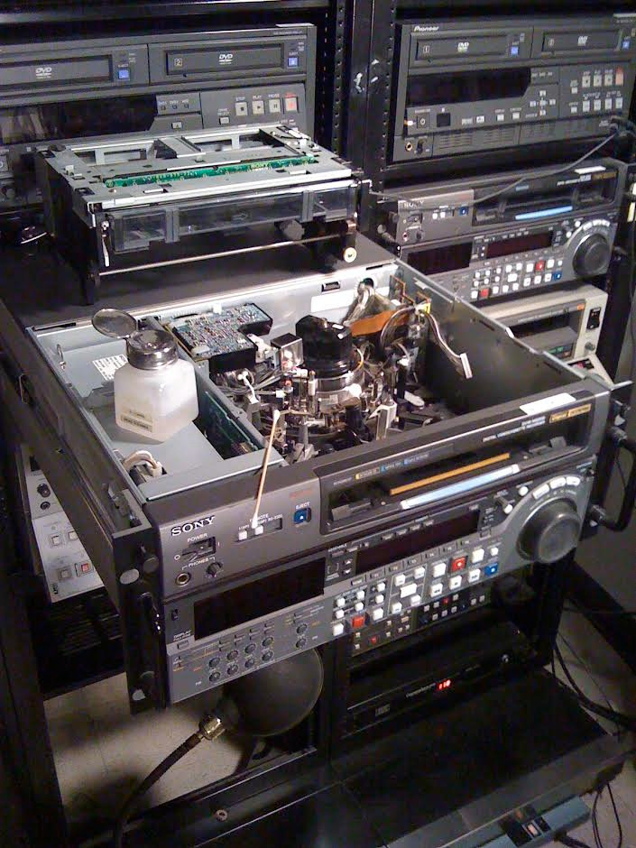
Recommendations
Considered 15-year opportunity window
Four distinct scenarios were developed:
  status quo
  increased outsourcing
  fixed budget
  no loss
Scenarios included costs for:
  Reformatting
  Cataloging
  Physical storage
  Digital storage
Recommendations made for policy changes in acquisitions and life-cycle management

Slide 10
Next Steps – Staffing Capacity
Reallocated vacant library positions to new positions for digital preservation position and AMI preservation, and added capacity through a new audio engineer position and several cataloging/processing positions
Head of Audio and Moving Image Preservation: https://intranet-nypl.icims.com/jobs/8317/head%2c-audio-and-moving-image-preservation/job
Sound Engineer: https://intranet-nypl.icims.com/jobs/8275/sound-engineer/job
Head of Digital Preservation to be posted shortly
Further centralized processing staff to maximize capacity
Adopted rapid inventory approach for most at-risk, least controlled collections
Still to come: further curatorial engagement for deeper prioritization to ensure that collections that need reformatting get into the workflow

Slide 11
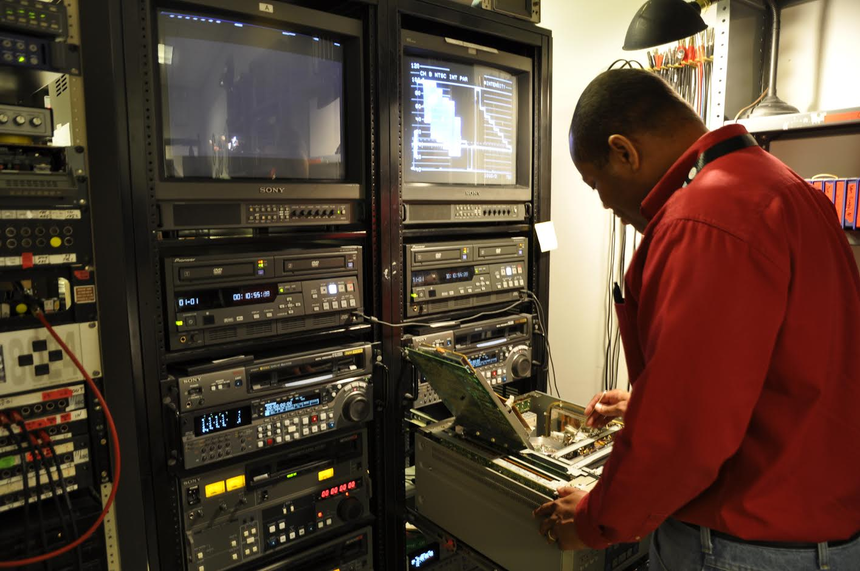
Next Steps – Funding
Reallocating existing budgets to focus on these high priority, high need collections
Increasing internal funding to help ramp up capacity
outsourcing projects
increasing lab capacity (equipment)
Developing focused fundraising strategy
grants in place (MIRS, Wilson)
future grants
other sources

Slide 12
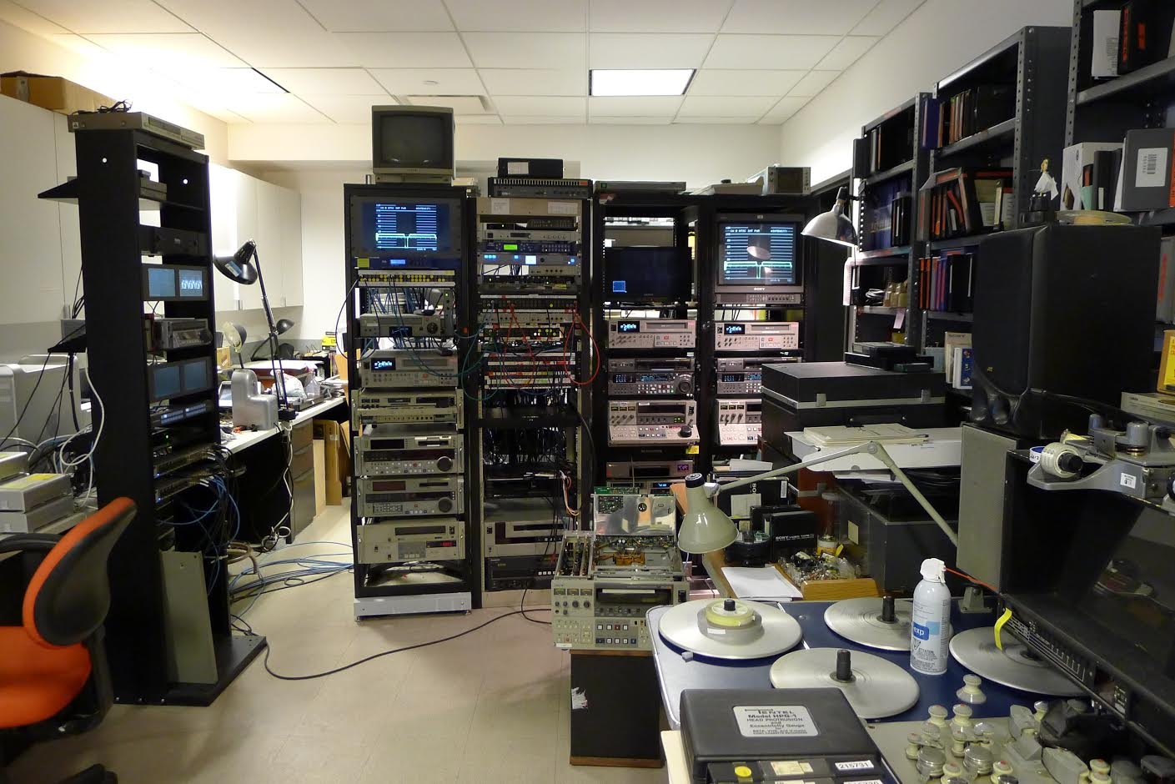
Next Steps – Partnerships
Strategic Partnerships
Accelerated Outsourcing
Public-Private Partnerships
Long-Term Partnerships

Slide 13
Suggested Steps for Others
Come together and address the issue as an institution
Know what and how much you have
Scale is relative, but don’t be overwhelmed by what you have
Use tools that are publicly available (e.g., MediaScore, AVPreserve CoI calculator)
Bring in expertise you need (e.g., collaborations with other organizations, professionals, vendors)
Focus on preservation as the goal for the purpose of saving as much as possible (rather than detailed discovery points)

Slide 14
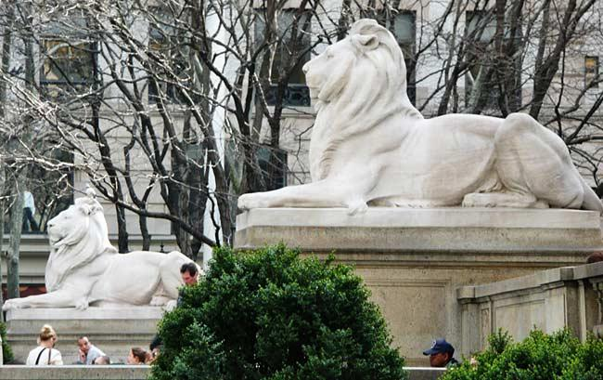
Sharing Approaches and Progress
The tools and methods used for and refined during project can assist other institutions in addressing common needs for AMI collection life-cycle management and preservation
NYPL’s summary report is online
NYPL will continue to share its progress through: http://www.nypl.org/preservation and @NYPLPreserve

Slide 15
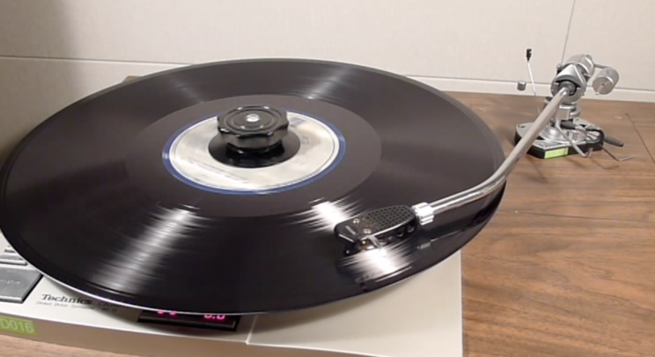
Preservation Week 2014-15
2015 Program of Events: http://www.nypl.org/events/calendar?&series=245107
From 2014: 80 Years of Bizet’s Habanera in one Stunning Rendition
https://www.youtube.com/watch?v=cBy1X4-ul7o&feature=youtu.be

