Slide 1
18 August 2015, Cape Town, South Africa
Managing Derived Entities: Subjects and Names
IFLA World Library and Information Congress, Dynamic Subject Access: Evolution and Transformation, Classification & Indexing section
Thom Hickey, presenter, and Diane Vizine-Goetz
OCLC Research
Notes:
Over the last few years OCLC has invested quite a bit of effort to establish entities and to link bibliographic and authority records to them. While subjects and other ‘entities’ are different in some ways, much of the machine processing we do on them is similar.
Lately I have been involved primarily with VIAF and FRBR, but the boundary between what are considered topical subjects and entities is surprisingly fluid and the techniques needed to deal with subjects and names are converging.
First I am going to talk about subjects, using the FAST system as an example. Then about names that are moving from subjects to personal names, and finish with a little bit about future directions for FAST.

Slide 2
The environment
Hundreds of millions of bibliographic records
  485 languages in 341 million records with more than 2 billion holdings
Records come from a variety of sources created under different rules and practices
  Resulting in duplication, inconsistencies, omissions & errors
Notes:
Over the last decade WorldCat has moved from being a representation of North American libraries to something much closer to a comprehensive bibliographic file. This move towards comprehensiveness in coverage, and even approaching a comprehensive collection of descriptions, has expanded what can be undertaken with machine assistance.
Of course, pulling records from thousands of libraries cataloged in about 100 different languages offers challenges as well as opportunities, but at least duplication and inconsistencies can sometimes become advantages when doing machine processing of the data.

Slide 3
What we want to manage
Works*
Expressions*
People, families, organizations, places
Subjects
Roles, genres, classes
Notes:
For a discussion of managing expressions and works in WorldCat see:
http://elag2015.org/program/managing-work-and-expression-entities-in-worldcat-the-limits-to-existing-authority-files-and-how-data-mining-can-extend-them/
We will only touch on that here, concentrating on the highlighted entities.
We will not be addressing roles or classes in this presentation

Slide 4
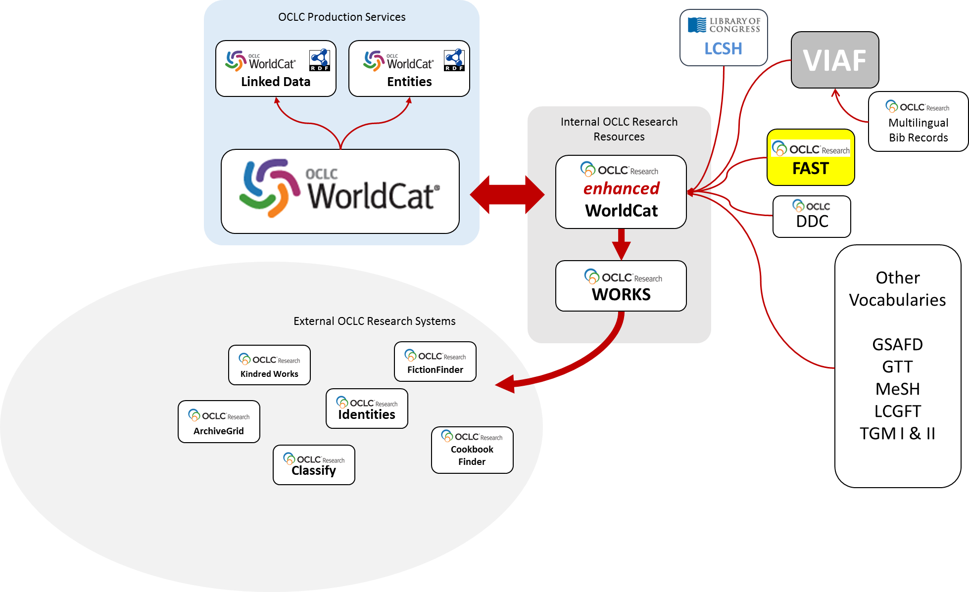
Notes:
This shows an overview of some of the processing done to control headings within WorldCat. Because of our early and continuing work within OCLC Research, Research is still involved in much of this processing.
A linked data view of WorldCat has been available for some time. Just emerging are WorldCat Entities. Both are derived from links in WorldCat, including those added algorithmically. For processing a snapshot is taken of all billion+ rows in the full WorldCat database. Within that we add identifiers and headings primarily to the 350 M records in the cataloging (as opposed to abstracting and indexing) records.
The diagram shows some of the vocabularies involved in these enhancements. We also produce a view of WorldCat organized by FRBR works. This is used to produce several other services, including WorldCat Identities and OCLC Classify.

Slide 5
Managing subjects
Many controlled vocabularies in WorldCat
  FAST (Faceted application of subject terminology)
  LCSH (Library of Congress Subject Headings)
  RAMEAU: répertoire d'authorité de matières encyclopédique unifié
  RVM (Répertoire de vedettes-matière)
  SWD (Schlagwortnormdatei)
Notes:
Ranked by headings
LCSH (Library of Congress Subject Headings)
FAST (Faceted application of subject terminology)
SWD (Schlagwortnormdatei)
RVM (Répertoire de vedettes-matière)
RAMEAU: répertoire d'authorité de matières encyclopédique unifié
In addition some are added ‘behind the scenes’, such as VIAF IDs, including those for FRBR works and expressions.

Slide 6
Links to VIAF & FAST
Notes:
WC=Linkable fields in WC
This chart shows links in WorldCat to VIAF and FAST. For instance, there are over 600 million subject headings in WorldCat, 250 million of which are FAST headings. Since VIAF is used primarily for names, its IDs are attached to many fewer subject fields, but VIAF does cover a substantial portion of creator and contributor headings.

Slide 7
Subject fields links
Notes:
This shows the number of subject headings found in WorldCat records and how many of them have an associated identifier (part of the ‘entification’ that WorldCat is undergoing). Additional effort is underway to link to other controlled vocabularies, for example,
RAMEAU: répertoire d'authorité de matières encyclopédique unifié
RVM (Répertoire de vedettes-matière)
SWD (Schlagwortnormdatei)
FAST can have fewer IDs than LC because of the post coordination. Where $v Fiction may occur in multiple LCSH headings in a single record, it will only occur once as a FAST heading.

Slide 8
FAST as a case study
Faceted vocabulary
All headings established in authority file
  Persistent identifiers for all headings
  Obsolete headings deprecated not deleted
Derived primarily from LCSH, LC NACO file, and LC Genre/Form terms
Notes:
Now a little more explanation of what FAST is.
FAST was developed by OCLC in conjunction with LC as we saw the difficulties in machine processing and control that LCSH presented. We are currently generating FAST headings within WorldCat for bibliographic records that have LCSH headings.
We think FAST is a good example of the type of subject vocabularies we are likely to use in the future (see points above)
OCLC developed FAST in conjunction with the Library of Congress to avoid some of the problems we encountered trying to control and use LCSH in automated ways

Slide 9
Eight categories of terms
Persons
Organizations
Events
Titles of works
Chronological/Time periods
Topics
Places
Form/Genre terms
Notes:
The individual terms in the FAST vocabulary are divided into seven subject facets and a Form/Genre facet. The headings in the subject facets are used to describe what a work is about; the terms in Form/Genre facet are used to represent what a resource or document is, for example, an encyclopedia.

Slide 10
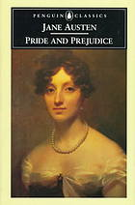
LCSH in MARC Bibliographic Records
Headings before conversion
650 10 Bennet, Elizabeth (Fictitious character) $v Fiction.
650 10 Darcy, Fitzwilliam (Fictitious character) $v Fiction.
650 0 Gentry $z England $v Fiction.
650 0 Social classes $z England $v Fiction.
650 0 Young women $v Fiction.
650 0 Mate selection $v Fiction.
650 0 Courtship $v Fiction.
650 0 Sisters $v Fiction.
651 0 England $x Social life and customs $y 19th century $v Fiction.
Notes:
Note in particular the familiar precoordination of England and Fiction to ‘Social classes’ in LCSH

Slide 11

FAST headings after conversion
FAST headings after conversion
648 7 $a 1800 - 1899 $2 fast
600 7 $a Bennet, Elizabeth $c (Fictitious character) $2 fast $0 (OCoLC)fst00830497
650 7 $a Darcy, Fitzwilliam $c (Fictitious character) $2 fast $0 (OCoLC)fst00887810
600 7 $a Courtship $2 fast $0 (OCoLC)fst00881873
650 7 $a Gentry $2 fast $0 (OCoLC)fst00940300
650 7 $a Manners and customs $2 fast $0 (OCoLC)fst01007815
650 7 $a Mate selection $2 fast $0 (OCoLC)fst01011691
650 7 $a Sisters $2 fast $0 (OCoLC)fst01119758
650 7 $a Social classes $2 fast $0 (OCoLC)fst01122346
650 7 $a Young women $2 fast $0 (OCoLC)fst01183301
651 7 $a England $2 fast $0 (OCoLC)fst01219920
655 7 $a Fiction $2 fast $0 (OCoLC)fst01423787
Notes:
Note that ‘Social classes’ stands on its own (post coordination)
England, Fiction, Social life and customs have been split off
You might think that the lack of precoordination of the headings would lead to less precision in retrieval. Our investigations have shown that the difference is marginal at best, and more than offset by the advantages of having a simpler system to understand, assign, manipulate and search.

Slide 12
Notes:
Here is a labeled view of the FAST subject headings, pulling them out so you can see them better

Slide 13
Facet Counts
Persons | 692,734
Organizations | 360,571
Events | 12,417
Titles of Works | 63,074
Chronological/Time periods | 676
Topics | 406,873
Places | 176,774
Form/Genre | 2,507
Total | 1,715,626
Notes:
Here is a breakdown of how many FAST headings have been established for the different categories. Note that the personal, corporate, and title headings are only established when the name or title is used as a subject heading.

Slide 14
FAST Authority Records
An authority record is created for each FAST heading
Authority records are enhanced in various ways, including
  Geographic area codes, coordinates & feature type information
  WorldCat usage information (literary warrant for heading)
  Links to other vocabularies
Records are available as MARC-21 and RDF with persistent URIs for each heading
Notes:
FAST is algorithmically produced from LCSH using software and some controlling tables.

Slide 15
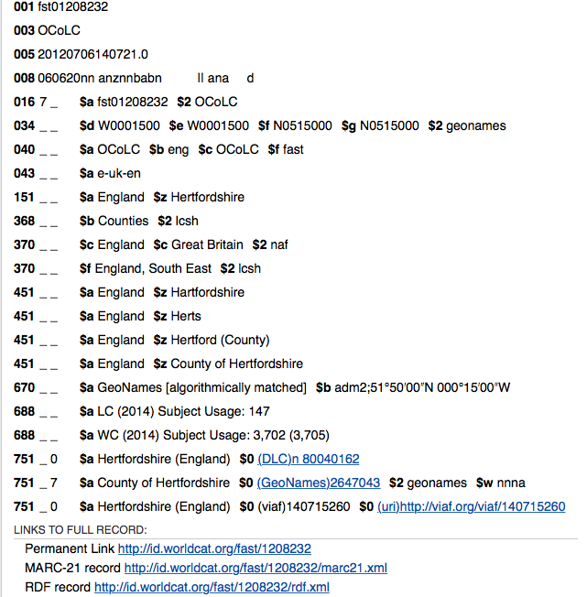
FAST Authority Record England—Hertfordshire
Heading is hierarchal and is based on the MARC Code List for Geographic Areas
Geographic coordinates (040 and 670 fields)
WorldCat usage information (688 fields)
Links to VIAF, LC NACO file and GeoName (751 fields)
All headings have URI based on heading control number
Notes:
Hertfordshire – heart/fəd/shə
The derivation of FAST from LCSH gives us the opportunity to regularize some aspects of the LCSH headings. For example,
in FAST, the structure of geographic names is hierarchal and is based on the MARC Code List for Geographic Areas. The heading begins with the first-level name and may contain two additional levels. First-level names are normally names of countries or larger areas except for Australia, Canada, Great Britain, and the United States. For these areas, second-level entities such as provinces and states are treated as first level names (Texas rather than United States—Texas). “MARC Code Lists for Geographic Areas.” http://www.loc.gov/marc/geoareas/ (accessed March 2015).

Slide 16
Links to other Files
Authority | Count
Library of Congress Subject Headings* | 299,172
LC NACO File | 1,213,647
VIAF | 1,213,232
DbPedia/Wikipedia | 160,837
Geonames | 85,422
Total geographic coordinates | 120,561
*One-to-One only, not including references to partial or pattern headings
Notes:
These are links from FAST.
We are experimenting with adding more links to Wikipedia for topical subjects.

Slide 17
Fictional characters in authority files
Headings of this type are being revised and recoded as personal names.
Persons include persons named in religious works, fictitious and legendary persons, and real or fictitious non-human entities
This change has introduced some inconsistencies in the use of qualifiers associated with names of characters and an opportunity to enhance FAST authority records for fictional characters
Notes:
Here is an example where subjects and names intersect.
It is fair to say that fictional characters are fraught with difficulties. Just identifying them as a separate group is a challenge, but lately the cataloging rules have been changing, giving added complications.
In the past, when cataloging a work attributed to a fictitious character or characters, catalogers were not permitted to create main (100) or added entries (700) for the fictitious creators or contributors
Under RDA, it is possible for a book or other work attributed to a fictitious character to be described with an access point for that character, as well as to assign a subject heading for that character if s/he is treated in the work.
Name access points for fictitious characters are constructed according to the instructions in RDA. RDA treats the phrase “fictitious character” as an “other designation associated with a person” and states that addition of an “other designation” is a required (or core) element of an authorized access point only when needed to distinguish between two otherwise identical names.

Slide 18
100 |  | 1_ |  | Holmes, Sherlock, ‡e author.
245 |  | 14 |  | The autobiography of Sherlock Holmes / ‡c by Sherlock Holmes ; edited by Don Libey, S.H.S.L.
250 |  |  |  | First edition.
264 |  | _1 |  | San Francisco ; ‡a London : ‡b Campbell & Lewis Publishers, ‡c 2012.
264 |  | _4 |  | ‡c ©2012
300 |  |  |  | 132 pages ; ‡c 21 cm
336 |  |  |  | text ‡b txt ‡2 rdacontent
337 |  |  |  | unmediated ‡b n ‡2 rdamedia
338 |  |  |  | volume ‡b nc ‡2 rdacarrier
520 |  |  |  | It is 1929. As Watson has recently died, Sherlock Holmes is determined to set down a "true and accurate summary" of their shared experiences, set in the context of Holmes' life. Born into a prosperous family, Holmes received all the benefits that entailed. In 1874, after his third year at Oxford, Exeter College, Holmes came down to London, and soon found rooms at 47 Montague Street, chosen for its proximity to the British Museum. These were the rooms he later shared with Watson, who disguised the address, which Holmes laid to Watson's "obsession with protecting" [Holmes]. Holmes began creating his practice some six years before he met Dr. Watson, but within a month of Watson's arrival in January of 1881, they were deep in the investigation that was later known as "A Study in Scarlet."
520 |  |  |  | In 2008 a hand-written manuscript with a working title "Montague Notations" was discovered at the bottom of a box of old nineteenth century books offered for sale at a used book stall in England. Along with three first editions by Dickens, the manuscript made its way to the United Sates, purchased by Don Libey, an antiquarian rare book dealer. Over a year later, Libey finally looked at the odd, tattered pen and ink manuscript with blue paper covers -- and the hair on the back of his neck stood up. In his hands was an autobiography dated 1929, and the author was Sherlock Holmes.--Page 4 of cover.
500 |  |  |  | "Copyright 1929 by Sherlock Holmes"--Title page verso.
545 |  |  |  | A member of the Sherlock Holmes Society of London, Don Libey has long nurtured an interest in Sherlock Holmes. He is a specialist in Doyle first editions as well as collectors' editions of other 19th century authors. Additionally, he has written 12 books on direct marketing and is the editor of a newsletter on that topic. ‡u http://www.libey.com/principals/DonaldLibey.html
600 |  | 10 |  | Holmes, Sherlock ‡v Fiction.
650 |  | _0 |  | Watson, John H. (Fictitious character) ‡v Fiction.
600 |  | 10 |  | Doyle, Arthur Conan, ‡d 1859-1930 ‡v Parodies, imitations, etc.
600 |  | 17 |  | Doyle, Arthur Conan, ‡d 1859-1930. ‡2 fast ‡0 (OCoLC)fst01802123
600 |  | 17 |  | Holmes, Sherlock. ‡2 fast ‡0 (OCoLC)fst01906994
650 |  | _7 |  | Watson, John H. (Fictitious character) ‡2 fast ‡0 (OCoLC)fst01172852
655 |  | _7 |  | Fiction. ‡2 fast ‡0 (OCoLC)fst01423787
655 |  | _7 |  | Parodies, imitations, etc. ‡2 fast ‡0 (OCoLC)fst01423840
700 |  | 1_ |  | Libey, Donald R., ‡d 1944- ‡e editor.
Notes:
Here is a MARC record with a couple of fields expanded to show Sherlock Holmes as the author and a note explain his role. As you can see, Holmes is purported to be the author of his autobiography

Slide 19
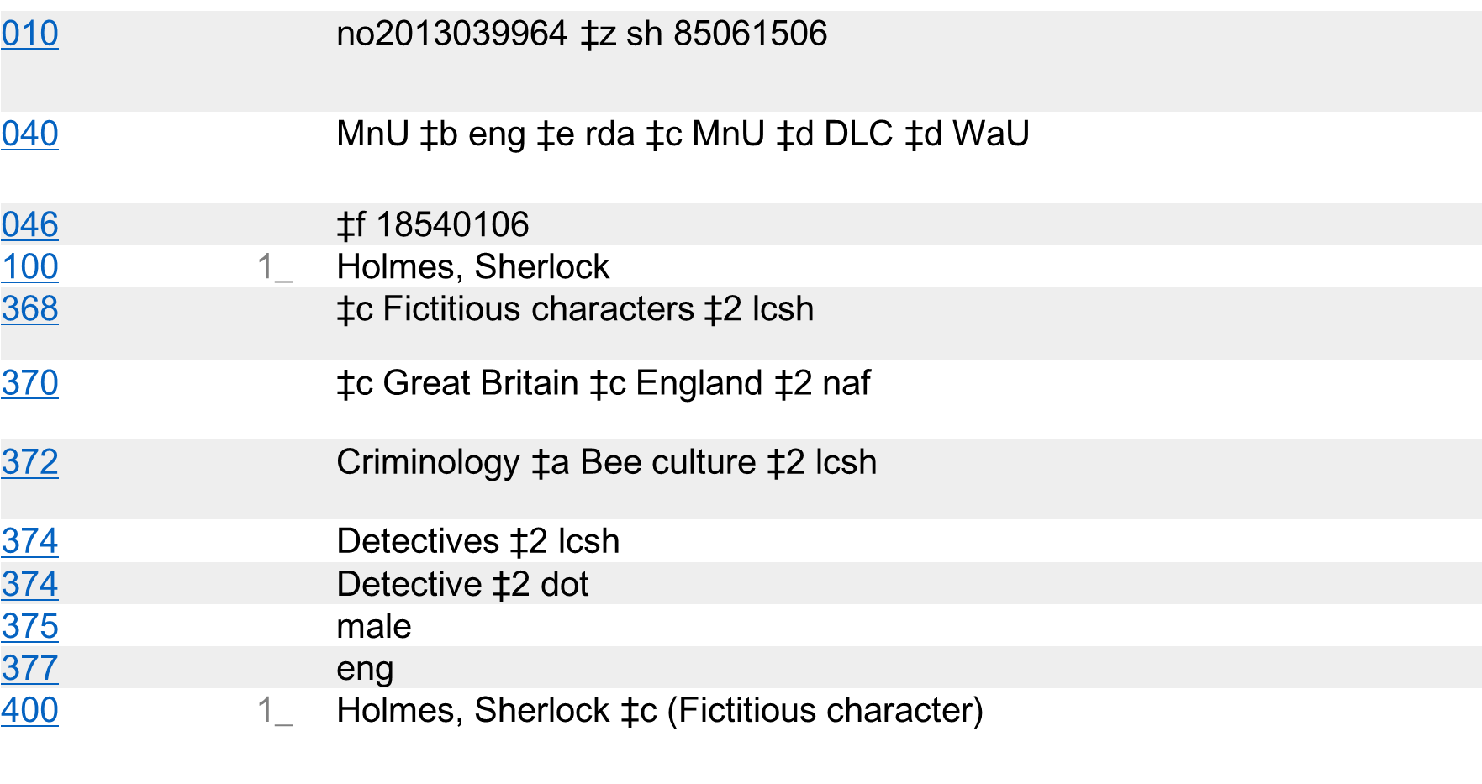
Notes:
Here is the LC authority record for Sherlock Holmes (this used to be a topical subject heading, now it is a personal name)
Not the 37X fields that can be used:
370 - Associated Place (R)
371 - Address (R)
372 - Field of Activity (R)
373 - Associated Group (R)
374 - Occupation (R)
375 - Gender (R)

Slide 20
Search Results
1. Little, John A., ‡d 1945- ‡t Final tales of Sherlock Holmes [100]
2. Watson, Adam, ‡d 1914-2007 [100]
3. Watson, J. H. L. ‡q (John H. L.) [100]
4. Watson, John H. [100]
5. Watson, John H., ‡d 1939- [100]
6. Watson, John H. ‡c (Fictitious character) [100]
7. Watson, John H. ‡c (Fictitious character) ‡x In motion pictures [100]
8. Watson, John H. ‡c (Fictitious character) ‡x On television [100]
Notes:
This is a results list for a search for John Watson. Note the qualifier, fictitious character, was added to differentiate the name from other persons named John Watson.

Slide 21
010 |  |  | no2014068518 ‡z sh 92004671
040 |  |  | WaU ‡b eng ‡e rda ‡c WaU ‡d DLC
046 |  |  | ‡f 1852 ‡v Encyclopædia Britannica online, May 15, 2014
046 |  |  | ‡f 1853~ ‡2 edtf ‡v Wikipedia, May 15, 2014
100 |  | 1_ | Watson, John H. ‡c (Fictitious character)
368 |  |  | ‡c Fictitious characters ‡2 lcsh
372 |  |  | Medicine ‡2 lcsh
374 |  |  | Physicians ‡2 lcsh
375 |  |  | male
377 |  |  | eng
378 |  |  | ‡q John Hamish
400 |  | 1_ | Watson, John H., ‡c M.D.
400 |  | 1_ | Watson, ‡c Dr. (Fictitious character)
400 |  | 0_ | Dr. Watson ‡c (Fictitious character)
400 |  | 1_ | Watson, ‡c Doctor (Fictitious character)
400 |  | 0_ | Doctor Watson ‡c (Fictitious character)
Notes:
As opposed to Holmes, Watson has the $c in the 100, plus the 368 (other attributes)
BUT…

Slide 22
1. Gambari, Ibrahim Sulu [100]
2. Jamalul Kiram ‡b II, ‡c Sultan of Sulu, ‡d approximately 1863-1936 [100]
3. Ogwu, Sulu, ‡d 1948- [100]
4. Sulu [100]
5. Sulu, Elias Aderemi [100]
6. Sulu, Hikaru [100]
7. Sulu, Phill M. ‡q (Phill Manuel), ‡d 1939- [100]
8. Sulu, Reuben [100
Notes:
Searching for Star Trek’s Sulu, it is difficult to pick out the fictitious character in this list! His $c follows the Holmes pattern, since it was not required (or permitted?) in the heading itself because it was not needed for differentiation within the authority file.

Slide 23
 | 010 |  | no2015076346
 | 040 |  | UPB ‡b eng ‡e rda ‡c UPB
 | 100 | 1_ | Sulu, Hikaru
 | 368 |  | ‡c Fictitious characters ‡2 lcsh
 | 372 |  | Outer space--Exploration ‡2 lcsh
 | 374 |  | Space travelers ‡2 lcsh
 | 375 |  | male
 | 400 | 1_ | Sulu, ‡c Captain
 | 670 |  | Star trek (Motion picture : 2009). Star trek, 2009.
 | 670 |  | Memory-alpha wikia, 9 June 2015 ‡b (Hikaru Sulu; human Starfleet officer in the Star Trek universe; born mid 23rd century in San Francisco, California; helmsman of USS Enterprise-A; Captain Sulu)
Notes:
Here is Sulu’s authority record in the LC NAF
We are considering whether we could bring some consistency to this type of heading within FAST. This would be similar to work done earlier on geographic headings, which attempted to regularize the forms and enhance the records with other useful information.

Slide 24
FAST at OCLC
WorldCat - January 2015
  334,000,000 bibliographic records
  98,000,000 records with LCSH
  76,000,000 enhanced with FAST
WorldCat Entities > WorldCat Works
  Experimental WorldCat Linked Data (includes DDC, FAST, VIAF and LCSH URIs)
Experimental applications (OCLC Research)
  Classify
  WorldCat Identities
  mapFAST
  …
Notes:
Here are some more figures about how FAST is used within WorldCat. These are record counts, not the occurrence counts shown earlier.

Slide 25
Future
Under consideration/development
  Regularize name headings for fictitious and legendary characters, e.g., add qualifiers
  Add FAST terms for entity attributes, e.g.,
    372 Exploration of outer space ‡2 fast ‡0 (OCoLC)fst01353078
    372 Space travelers ‡2 fast ‡0 (OCoLC)fst01127948
Experimental
  More links to Wikipedia (next slide)
Notes:
Some future work we are considering

Slide 26
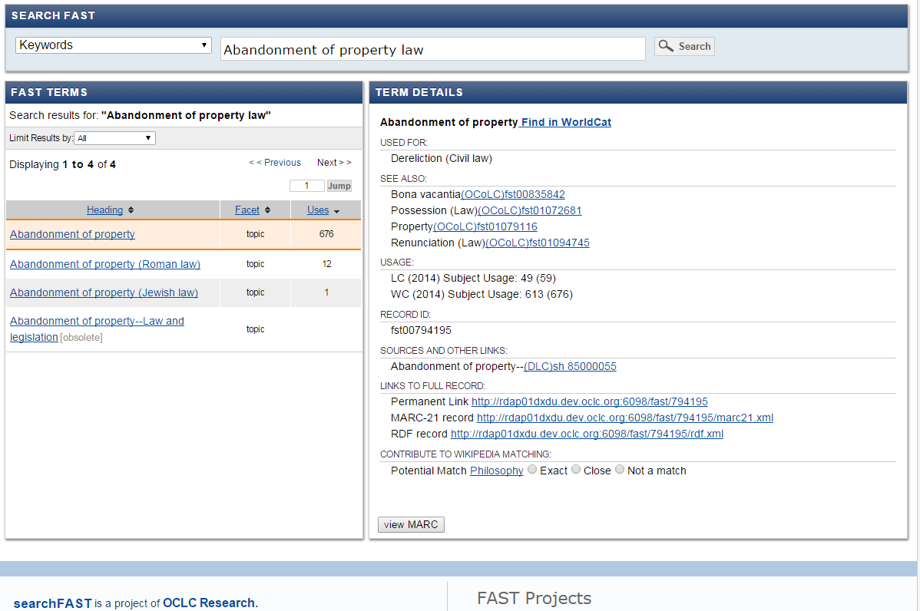
Notes:
While it possible to automatically find relationships between subjects in different vocabularies, it is much harder to evaluate these relationships, and we think human review is needed. This shows how we might solicit feedback from users about relationships suggested between Wikipedia and FAST.
The tooltip has a brief summary, and the full page link to Wikipedia works.
On selection of a radio box, the selection is logged to a file. Each month, the responses are collected and formalized.
Thank you!

Slide 27
IFLA 2015
Thank You

