Slide 1
University of Melbourne • 2 December 2015
Welcome, Partners!
Dennis Massie
Program Officer, OCLC Research
#orlp

Slide 2
OCLC RLP in the Asia Pacific region
1997
National Library of Australia
2002
Keio University
2006
University of Melbourne
2011
La Trobe University
University of Auckland
University of Hong Kong
University of Queensland
2012
University of New South Wales
2014
Australian National University
Deakin University
Macquarie University
Monash University
University of Western Australia
2015
Curtin University
University of Adelaide
University of Sydney

Slide 3
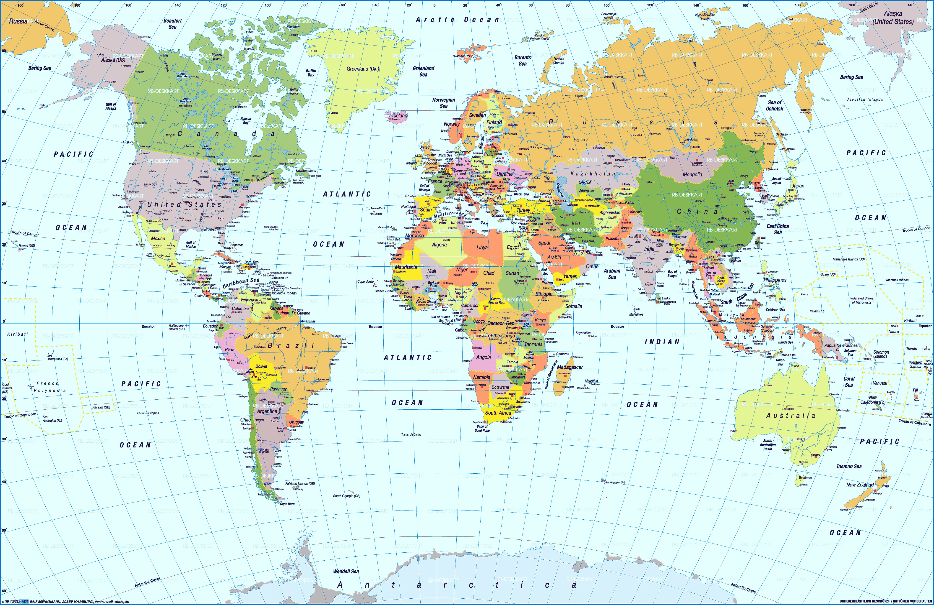

Slide 6
107,903 km

Slide 10
OCLC Research Library Partnership Meeting
The End of the Beginning
Dennis Massie
Program Officer
massied@oclc.org

