Slide 1
University of Melbourne • 2 December 2015
The SHARES Partnership,
Plus Tracking Trends in ILL Cost and Transaction Data
Dennis Massie
Program Officer, OCLC Research

Slide 2
Basic SHARES facts and principles
86 institutions
114 OCLC symbols
9 countries
4 continents
Self-governing
Easy to get started
Academic, museum, law, medical, national, public
SHARES Agreement
  Consider each request
  No blanket restrictions
  Below market rates (via IFM)
  Expedited delivery
  Lending returnables overseas optional
  Reciprocal onsite access

Slide 3
Examples of SHARES engagement opportunities
Advisory or Working Group | People | Institutions | Countries
SHARES Executive Group | 8 | 8 | 2
SHARES Best Practices Working Group | 11 | 10 | 3
SHARES Shipping and Packaging Task Force | 9 | 9 | 3
ILL Cost Calculator Working Group | 3 | 3 | 2
Notes:
Dennis

Slide 4

 | Routine Workflow | Cooperative Workflow | Exceptional Workflow
REVIEW
Request | Via ILL system | Collaboration between Special Collections (SC) and ILL | Directly to SC
Is material held in a special collection? | ILL staff | Collaboration between borrowing and lending institutions | Lending institution
Reference Interview | At borrowing institution—reference desk and ILL staff | Collaboration of ILL and SC staff in both institutions | By lending institution—SC staff
Inter-institutional communication how? | ILL system | ILL system and email/phone | Direct contact between two SC’s
Internal communication how? | ILL system | ILL system and email/phone | Direct contact between SC/ILL staff and other departments
Stipulate for Research Use? | Implicit | Consider emphasizing | Explicit criteria
Reviewing Infrastructure | Written guidelines | Collaboration between borrowing and lending departments | Elaborate decision tree, multiple staff, institutional level decision
Mutual disclosure of ILL and SC facilities | We trust you | Approved checklist | Facilities report
Forms | ILL transaction work form and IFM | Extra insurance and/or forms for special handling | Use agreement, insurance forms, art museums loan agreement, etc.
DECIDE
Decision Maker | ILL staff | ILL and SC consult when necessary | SC staff, curator, possibly director
Original or Surrogate? | Surrogate or predetermined originals | Prefer to lend surrogate, consider original | Case-by-case consideration
Published/unpublished? | Some published and predetermined unpublished material types | Some published OK. Unpublished material on a case-by-case basis | Consider lending published and unpublished materials
Use Rights | Borrower’s responsibility | What any reasonable SC staffer would do | Search, monitor and control thoroughly
Trust and Training | ILL training and expertise | ILL and SC cross-training on handling fragile materials | SC training and experience only
LEND
Oversees loan transaction | ILL staff | Staff in ILL and SC | SC specialists
Quality Control | Usual packager, usual shipper, mailroom or ILL | Special ILL or SC packager | SC/preserv staff prepare special supports and deliver with the material
RETURN
Deliver | Usual shipper, with use/handling conditions | Expedited shipper, extra insurance, special handling instructions | Deliver from SC to SC—call me when you get it

Slide 5
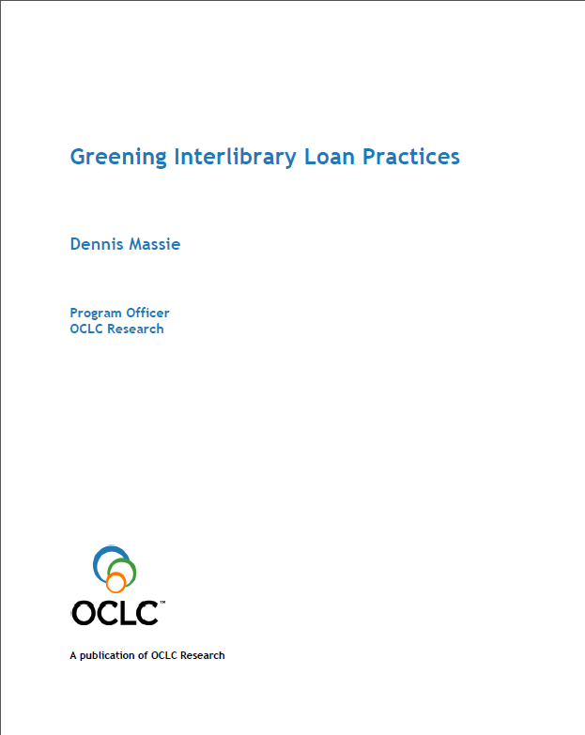
 | Routine Workflow | Cooperative Workflow | Exceptional Workflow
REVIEW
Request | Via ILL system | Collaboration between Special Collections (SC) and ILL | Directly to SC
Is material held in a special collection? | ILL staff | Collaboration between borrowing and lending institutions | Lending institution
Reference Interview | At borrowing institution—reference desk and ILL staff | Collaboration of ILL and SC staff in both institutions | By lending institution—SC staff
Inter-institutional communication how? | ILL system | ILL system and email/phone | Direct contact between two SC’s
Internal communication how? | ILL system | ILL system and email/phone | Direct contact between SC/ILL staff and other departments
Stipulate for Research Use? | Implicit | Consider emphasizing | Explicit criteria
Reviewing Infrastructure | Written guidelines | Collaboration between borrowing and lending departments | Elaborate decision tree, multiple staff, institutional level decision
Mutual disclosure of ILL and SC facilities | We trust you | Approved checklist | Facilities report
Forms | ILL transaction work form and IFM | Extra insurance and/or forms for special handling | Use agreement, insurance forms, art museums loan agreement, etc.
DECIDE
Decision Maker | ILL staff | ILL and SC consult when necessary | SC staff, curator, possibly director
Original or Surrogate? | Surrogate or predetermined originals | Prefer to lend surrogate, consider original | Case-by-case consideration
Published/unpublished? | Some published and predetermined unpublished material types | Some published OK. Unpublished material on a case-by-case basis | Consider lending published and unpublished materials
Use Rights | Borrower’s responsibility | What any reasonable SC staffer would do | Search, monitor and control thoroughly
Trust and Training | ILL training and expertise | ILL and SC cross-training on handling fragile materials | SC training and experience only
LEND
Oversees loan transaction | ILL staff | Staff in ILL and SC | SC specialists
Quality Control | Usual packager, usual shipper, mailroom or ILL | Special ILL or SC packager | SC/preserv staff prepare special supports and deliver with the material
RETURN
Deliver | Usual shipper, with use/handling conditions | Expedited shipper, extra insurance, special handling instructions | Deliver from SC to SC—call me when you get it

Slide 6
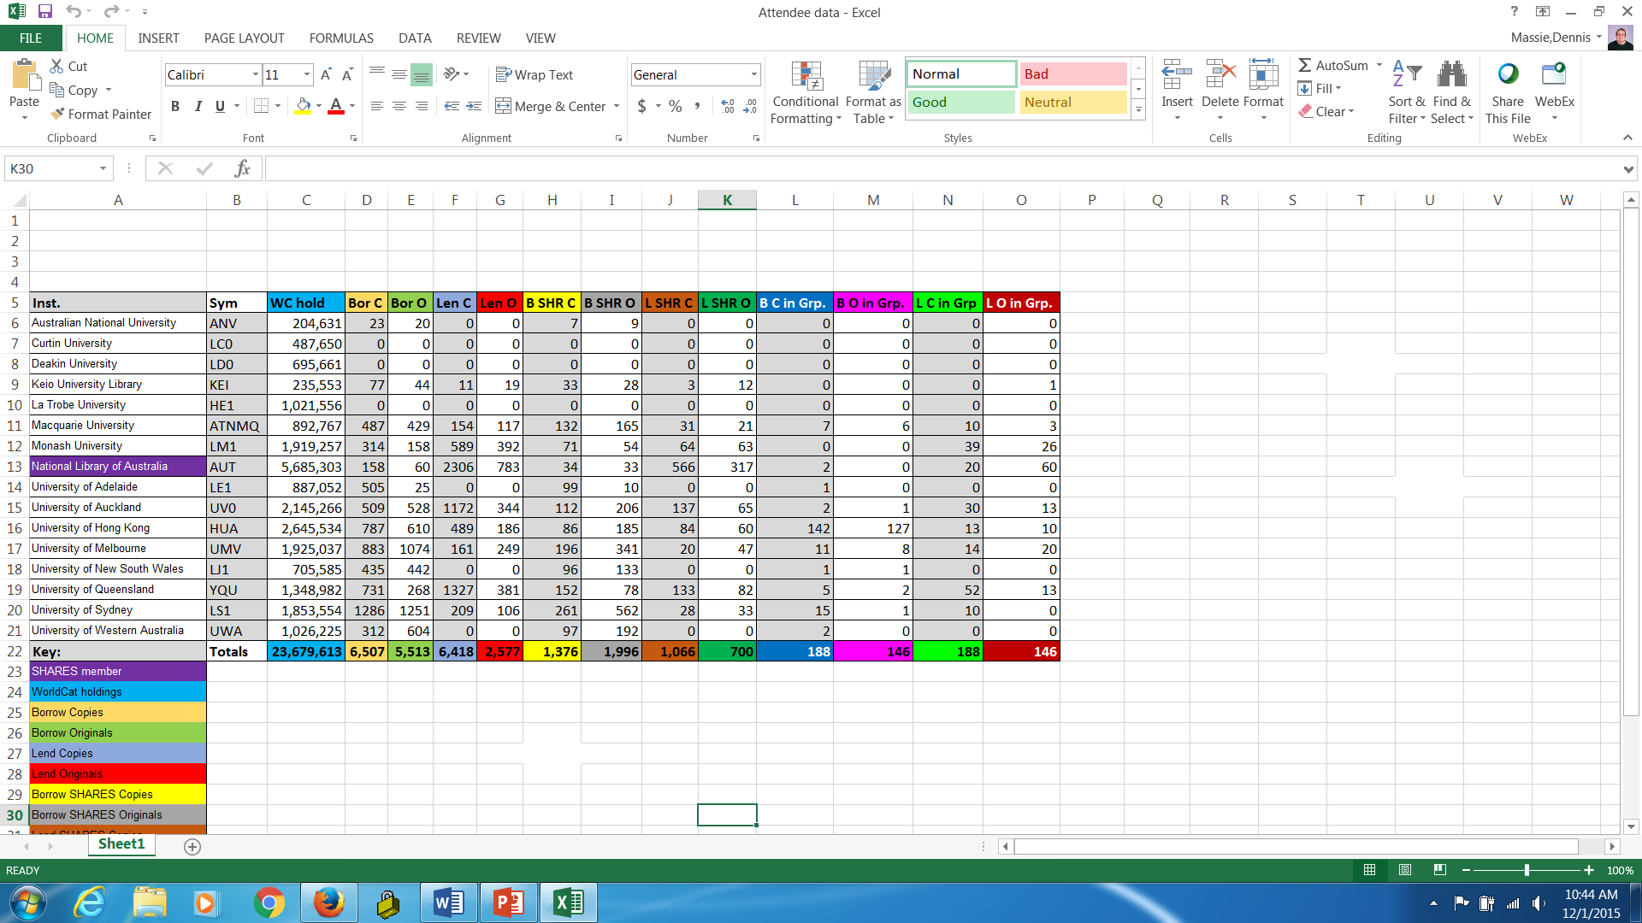
Attendee interactions with OCLC ILL

Slide 7
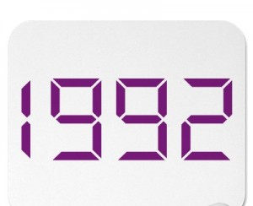







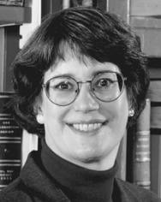
Where is the fresh ILL cost data?
$16.93/$10.56
$17.82/$9.56
$16.46/$8.73
$17.50/$9.27

Slide 8
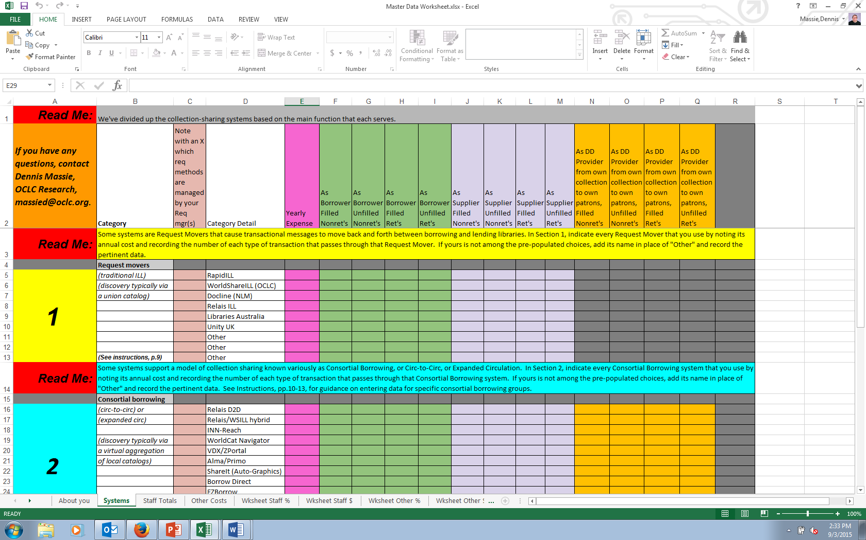
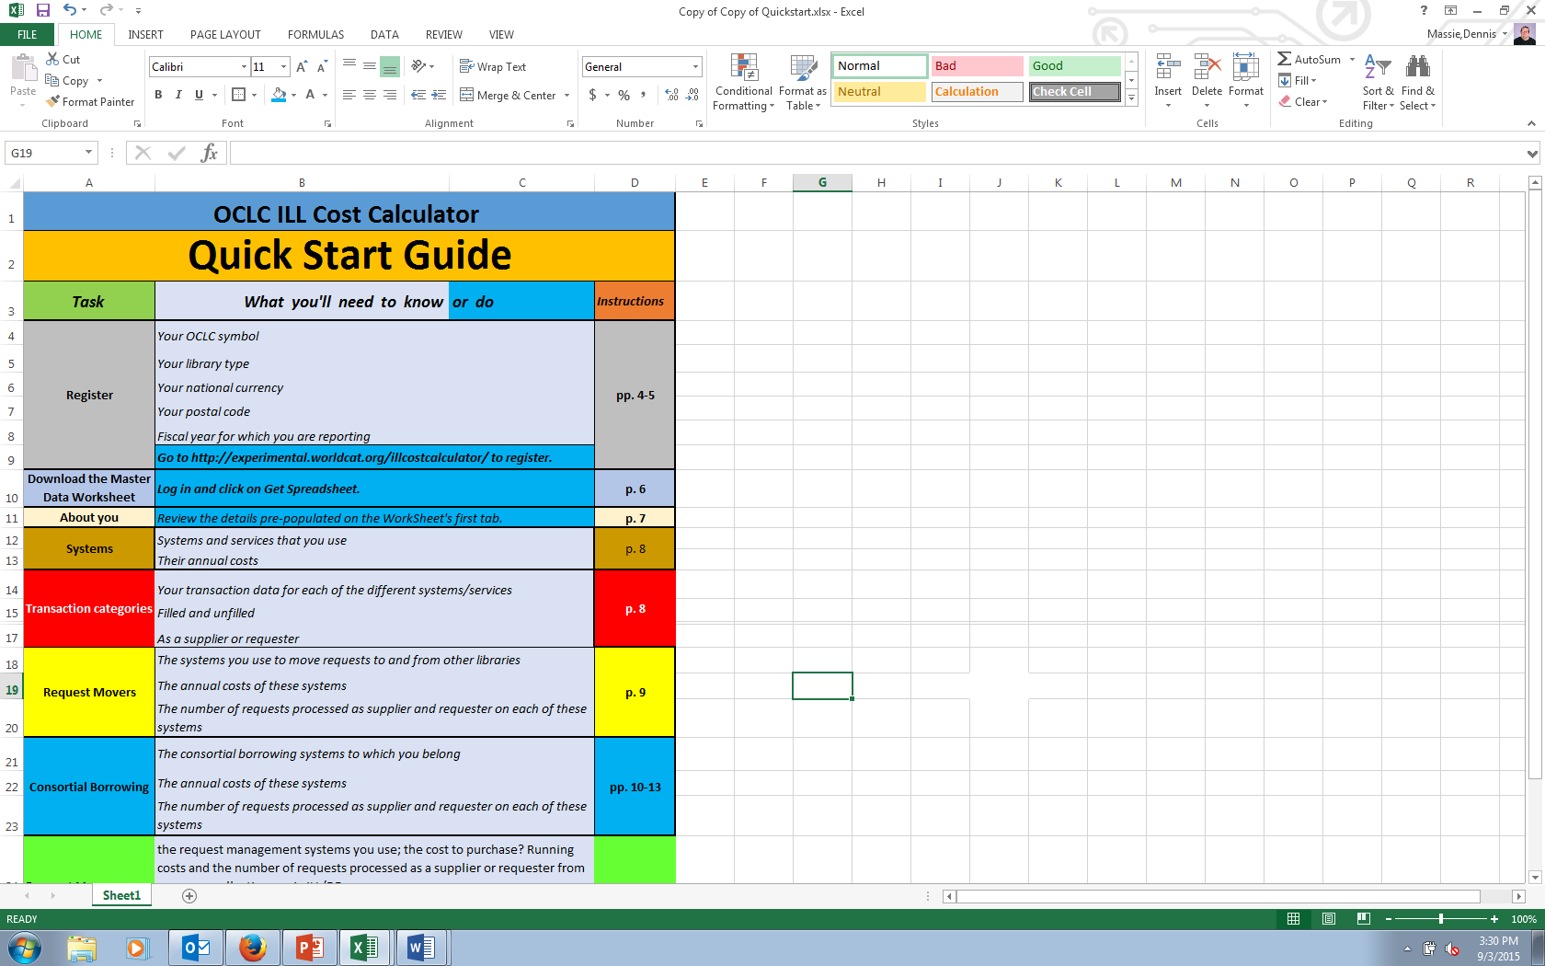
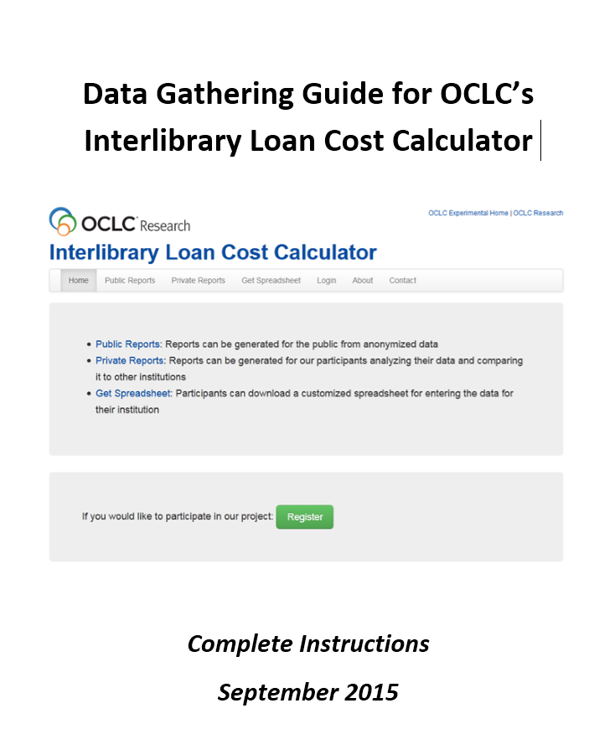
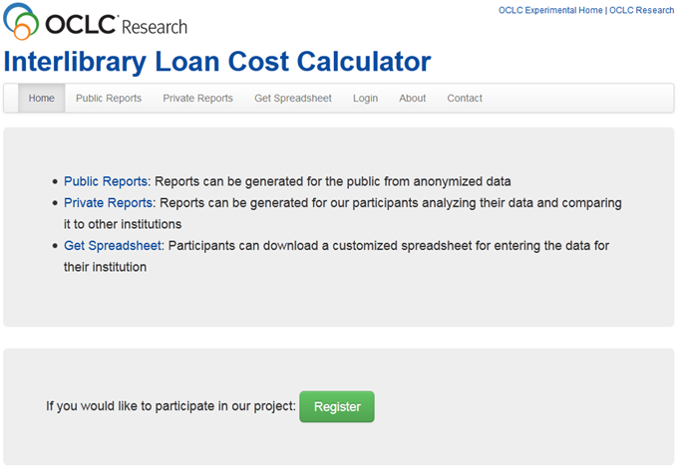
ILL Cost Calculator – now in Beta

Slide 9
Working Group
Megan Gaffney, University of Delaware
Justin Hill, Temple University
Ralph LeVan and JD Shipengrover, OCLC Research
Margarita Moreno, National Library of Australia
Moi!

Slide 10
Our aspirations for the calculator
Provide fresh data about current models
Help establish best practices
Facilitate comparison to anonymized peers
Support evidence-based decision-making

Slide 11
Use Cases
Users want to know:
  Their resource sharing unit costs
  How those costs evolve over time
  How their costs compare with peers
Users would like to project:
  The financial impact of joining a consortium
  Of buying a certain piece of equipment
  Of implementing a new service

Slide 12
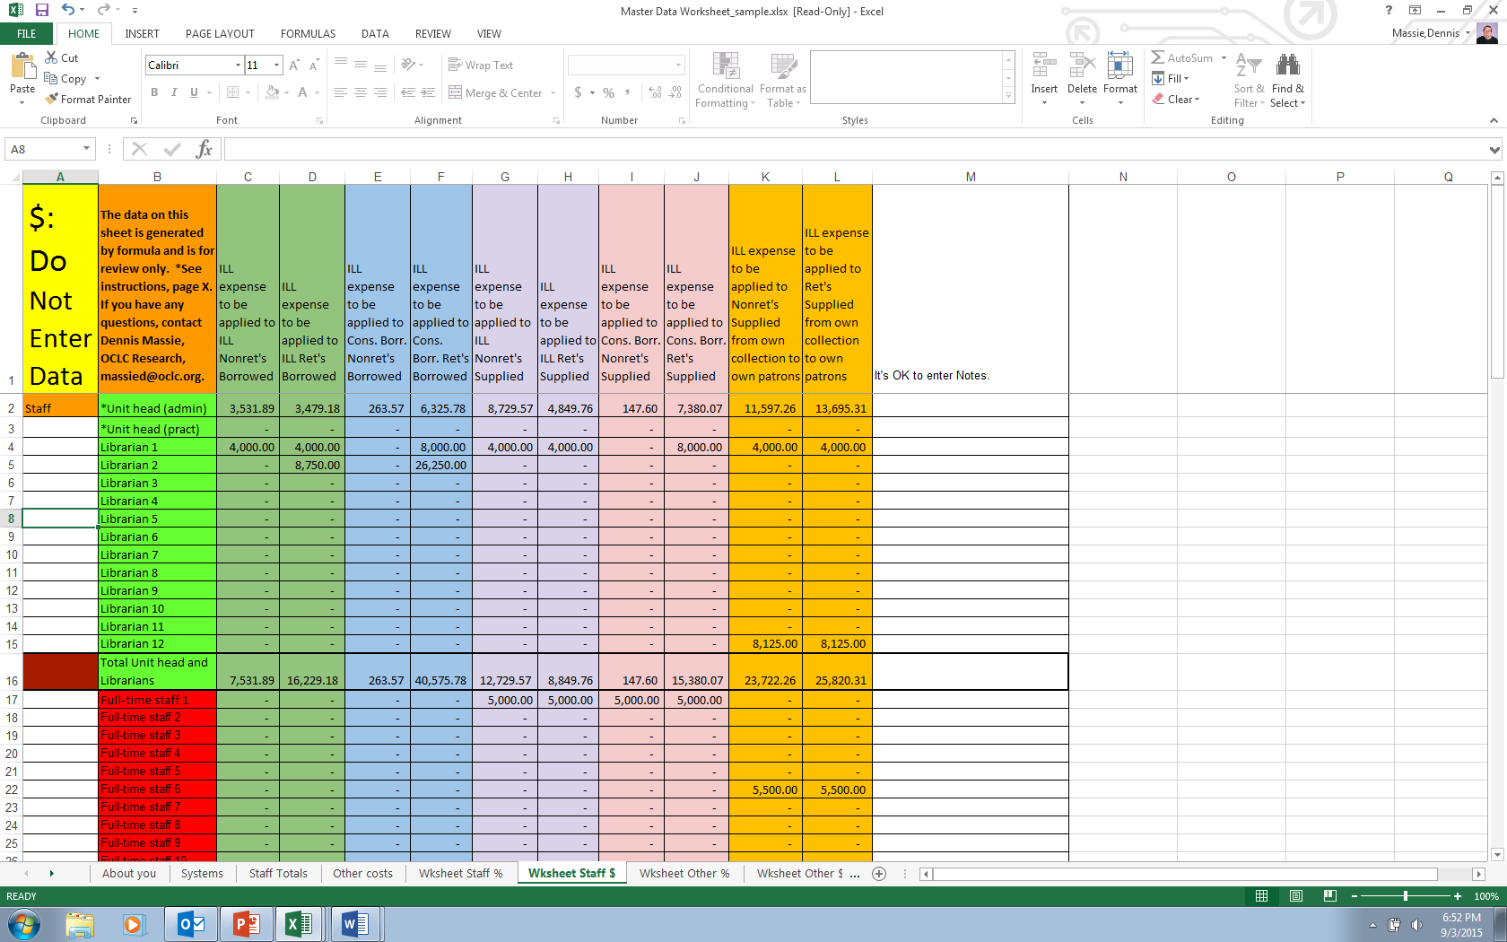
The system calculates Staff costs and reports only totals for each category.
You’ll enter the salary data and review the system-calculated totals on private worksheet tabs that only you will see.

Slide 13
Birthing an ILL Cost Calculator
Next 4 months:
  Beta testers will register and submit their data
  OCLC software engineer will build database and reporting functions
  Beta testers will test reports
Next 6 months:
  “Early interest” folks will be invited to submit data
  We’ll open it up to everyone
  We’ll work with various groups and organizations to encourage use
Google OCLC ILL Calculator for more information.

Slide 14
OCLC ILL statistics
 | FY13 | FY12 | FY11 | FY10 | FY09
ILL requests | 8,858,368 | 9,192,189 | 9,587,429 | 10,248,942 | 10,279,215
Year on year | 4% | 4% | 6% | 0.29%
Between FY09 and FY13, OCLC ILL has seen a 14% reduction in total number of ILL requests.
Anecdotal evidence tells us that US libraries are seeing an ongoing increase in their borrowing.
OCLC wants to learn more about various trends in fulfillment.

Slide 15

As of December 2014:
Made up of 11 institutions with sophisticated, innovative resource sharing operations
Some long-established members, some newer Involved in all manner of consortial arrangements within and outside the group
Would serve as an excellent illustration of current trends in the research library community

Slide 16
OCLC/Borrow Direct ILL Study
What numbers of borrows and loans has each institution executed in each of the various resource sharing venues in the past 5 years?
What factors determine the requesting method or model used for each request?
How/why is all this changing over time?
How will it most likely change in the future?

Slide 17
ARL vs Our Study
Why might the numbers differ?
Institutions with multiple libraries and with complex ILL set-up’s might not have reported all activity to us.
Both sets of data are self-reported, and possibly compiled by different people.
Potential fiscal/calendar confusion
Overall, study participants reported 97.9% of what was reported to ARL.

Slide 18
Circ-to-Circ is where the growth is.

Slide 19
Growth is due to new players.

Slide 20
6 Basic Questions for BD ILLer’s
  What is the strategic thinking behind the groups you join? Technologies you adopt? Workflows you establish?
  What forces are at work driving your choices?
  Who are your users, and what needs do they hope will be met by your collection sharing services?
  What user experience do you offer? What do you aspire to offer?
  What would you like to learn from this data, or any data?
  How will collection sharing evolve over the next 5 years?

Slide 21
Strategic thinking
Automate the routine.
Build in predictability.
Push staff tasks lower in the hierarchy.
Introduce efficiencies, relax restrictive policies.
Partner in concentric circles.

Slide 22
Next steps/further study
Chart OCLC ILL interactions in detail as new members joined Borrow Direct
Isolate returnables and non-returnables
Overlay expenditures and demographics onto collection sharing data
Report out
Repeat study with the CIC

Slide 23


As of December 2015:
Made up of 14 institutions with sophisticated, innovative resource sharing operations
Some long-established members, some newer Involved in all manner of consortial arrangements within and outside the group
Set up their consortial borrowing process to run through ILL rather than Circulation

Slide 24
Per-Student Expenditures, 2012 NECS Survey
IviesPlus
CIC

Slide 25
Total sharing activity is going down.

Slide 26
traffic is way, way up.

Slide 27
Other Consortial Borrowing: Down-ish.

Slide 28
Free online, POD of non-returnables up.

Slide 29
Next steps/further study
Chart OCLC ILL interactions in detail as new members joined Borrow Direct
Isolate returnables and non-returnables
Overlay expenditures and demographics onto collection sharing data
Report out
Repeat study with the CIC
Repeat study with some subset of the Asia Pacific partnership libraries?

Slide 30

OCLC Research Library Partnership Meeting
Questions or comments?
Dennis Massie
Program Officer
massied@oclc.org
©2015 OCLC. This work is licensed under a Creative Commons Attribution 4.0 International License. Suggested attribution: “This work uses content from How You Can Make the Transition from MARC to Linked Data Easier © OCLC, used under a Creative Commons Attribution 4.0 International License: http://creativecommons.org/licenses/by/4.0/.”

