Slide 1
Beyond Ethnography
Joan K. Lippincott, Coalition for Networked Information
OCLC Research Library Partnership Meeting
The Library in the Life of the User
Chicago – October 22, 2015

Slide 2
Beyond Ethnography: What are we missing?
Qualitative research yields rich data
Combining qualitative and quantitative data helps us gain deeper understanding of users
But…
Are we asking the right questions?
Are we looking into the future, not just the present?
Are we aligning our services, spaces, and technologies with the university’s teaching & learning and research aspirations?

Slide 3
Asking good questions
What will you do with this information?
What will you do with this information?
Harvard Libraries
“Are LibGuides serving the research problems our students actually have?”
How many “hits” have we had on our LibGuides?
Which LibGuides are most popular?
How can we judge the usability of our LibGuides?
Will users scroll down the page?
Where do users focus on the page?
http://lj.libraryjournal.com/2015/10/academic-libraries/
harvard-launches-user-research-center/#_

Slide 4
Asking good questions
How can some basic analysis
Lead to next steps in understanding users?
How does the use of our chat service vary over the course of the semester?
Are users satisfied with the answers they receive from our reference chat service?
How does use of “chat” compare to in-person questions?
Can the use of a business-oriented software product that is proactive in reaching users improve the use of our library chat service?

Slide 5
Asking good questions
Study at John Carroll University Library
Employed a “web-shopping customer service model from the business world” (new chat software)
Increased chat transactions from 3% to 21% of reference transactions
70% chats initiated by trigger, not by patron
74% of trigger chats were reference/research chats compared to 57% of patron-initiated chats
Zhang, Jie and Nevin Mayer. “Proactive Chat Reference.” C&RL News, April 2014, pp. 202-5.

Slide 6
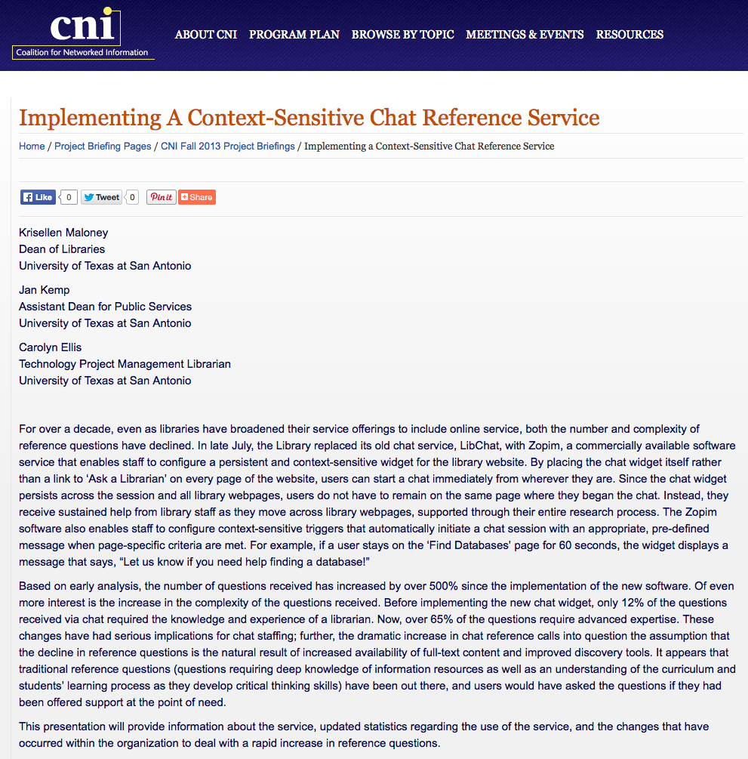
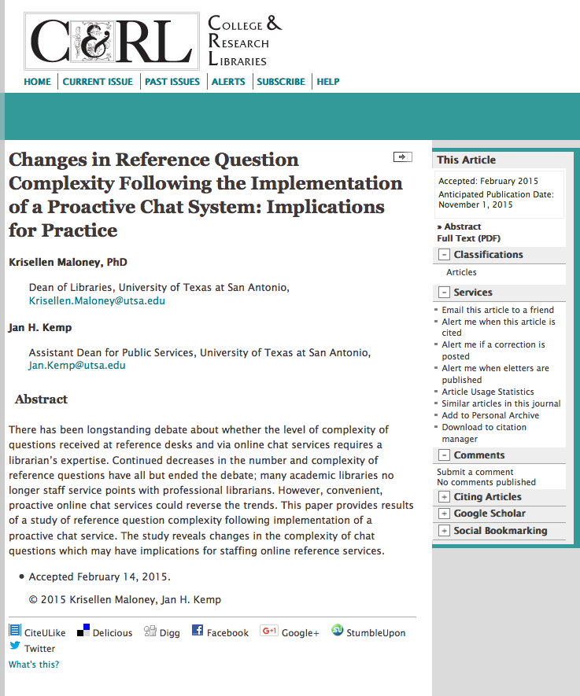
Finding ways to connect librarian expertise to user needs
http://014.cni.org/topics/information-access-retrieval/f13-maloney-implementing/

Slide 7
When planning renovated facilities and services…
Do we ask students about how they like to study?
Alone or in groups?
With or without noise at various levels?
Near windows?
At large or small tables?
Enclosed rooms or open spaces?
With or without someone nearby to provide assistance?

Slide 8
If we asked about how spaces might support their “learning” instead of “studying” would we get different responses?
Quietly studying alone
Deep reading of texts
Studying alongside others
Working on a group project
Solving problems
Finding and reading information for a project
Writing
Collecting and analyzing data
Doing experiments in a lab
Creating in media
Making a physical object
Interviewing or observing

Slide 9
If we asked about the need for services beyond the usual, what responses might we get?
“The Usual”
Thinking more broadly about services
Using databases
Using catalogs
Using primary sources
Finding a good, quiet study spot
Asking for assistance from a librarian
Advice on IP issues
Assistance with developing a poster for a research conference
Creating a video incorporating images from special collections
Developing a data visualization

Slide 10
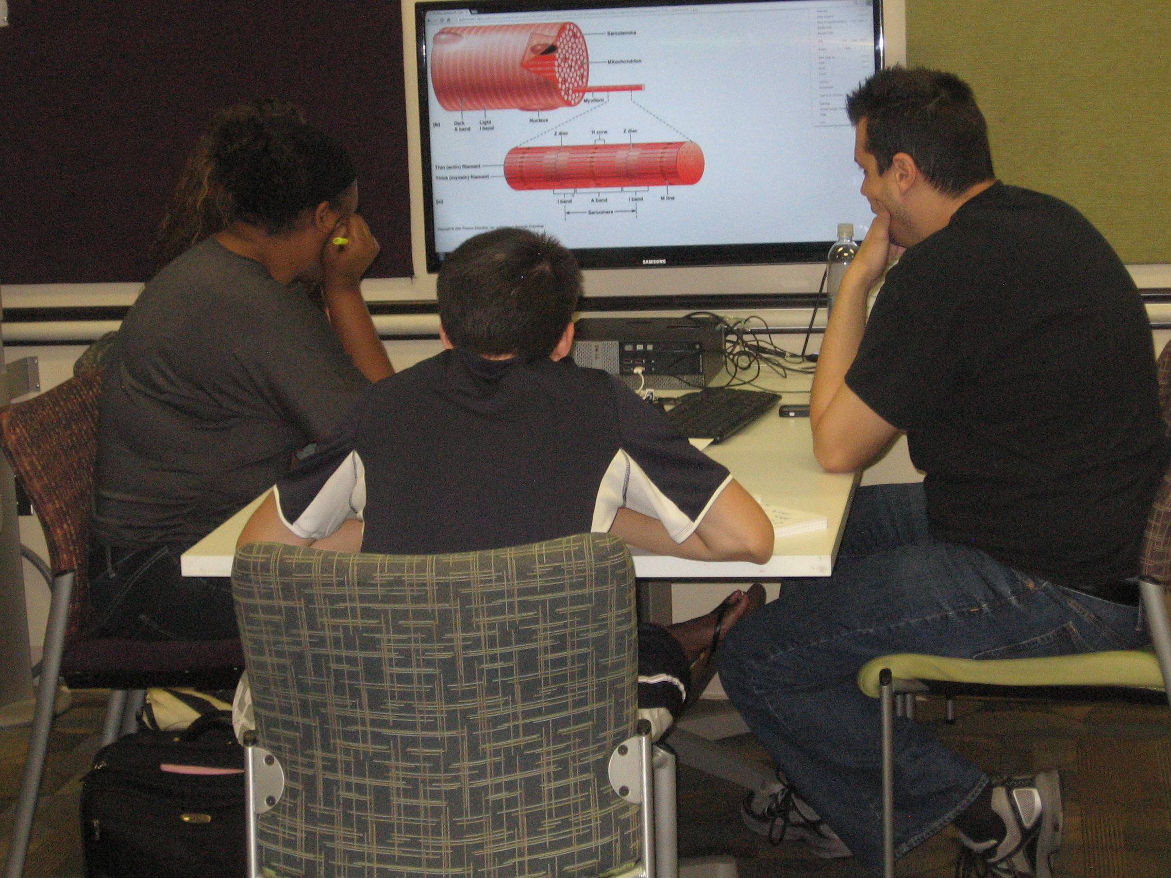
Screens in the life of the user
Have any libraries studied why students are or are not using the large screens in group study areas?
If we just do observations, will we be able to make informed decisions?
U. Central Florida Library

Slide 11
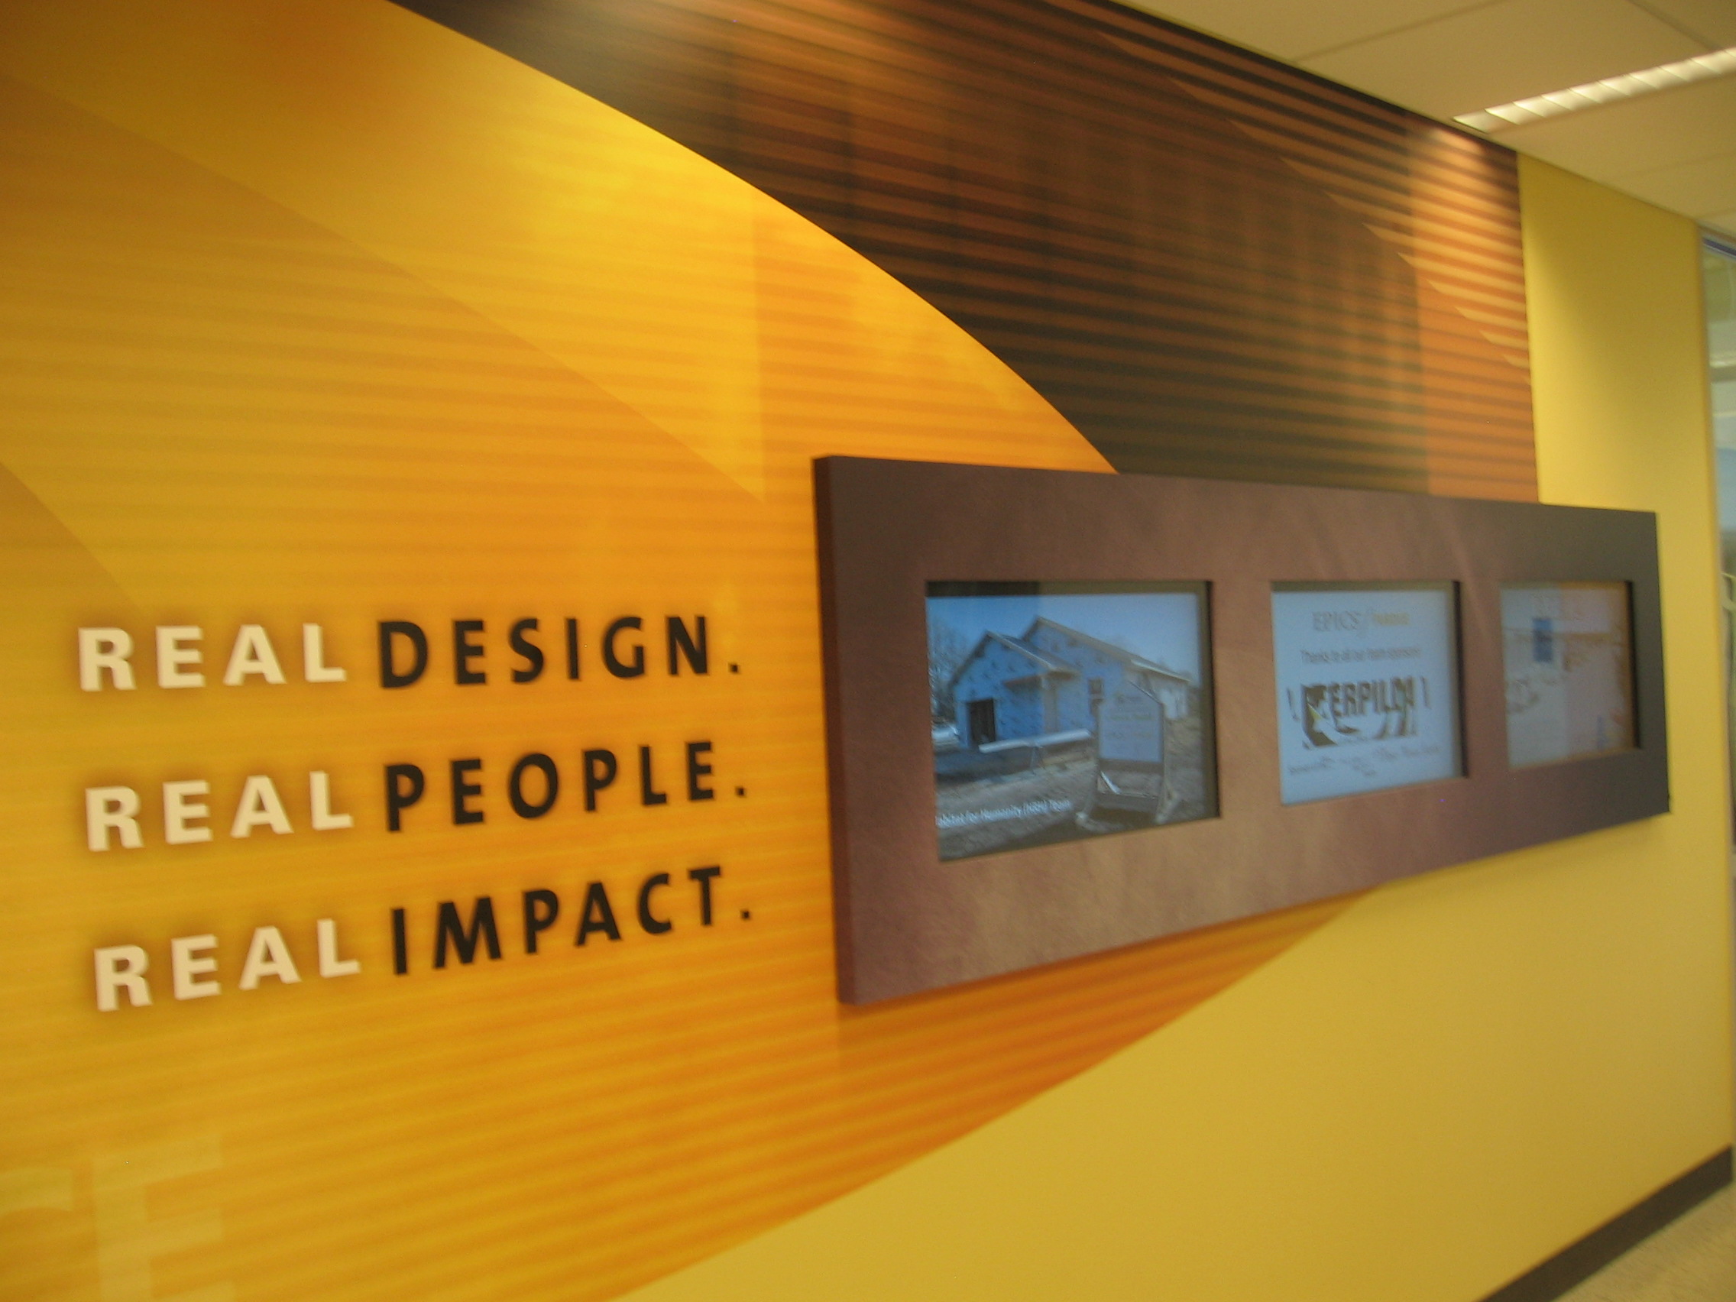
Helping users imagine the future
Purdue U. School of Engineering

Slide 12
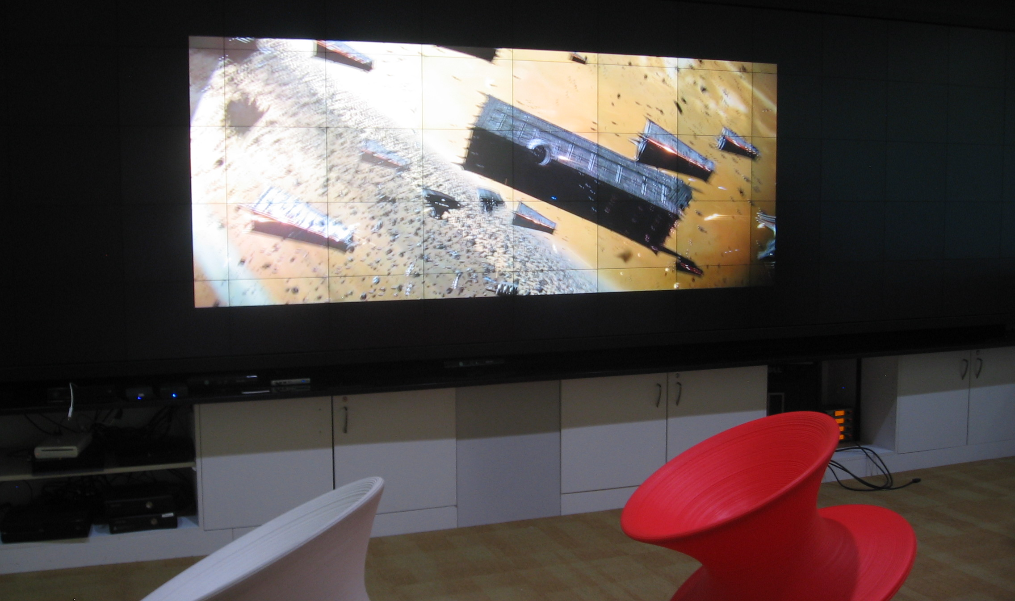
If we showed users examples of what some libraries offer, would they respond differently to our questions?
Game Lab – Hunt Library, NCSU

Slide 13
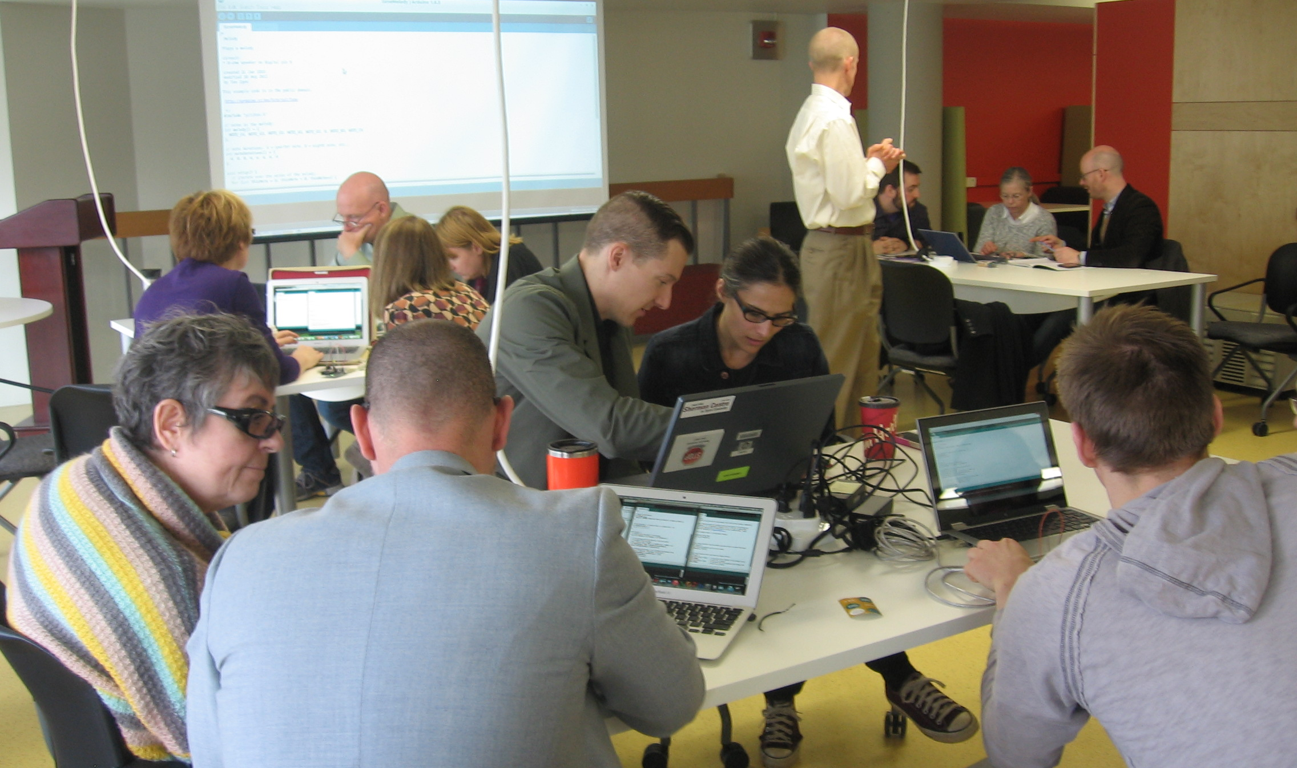
If we showed users examples of what some libraries offer, would they respond differently to our questions?
McMaster U. Library Centre for Digital Scholarship

Slide 14
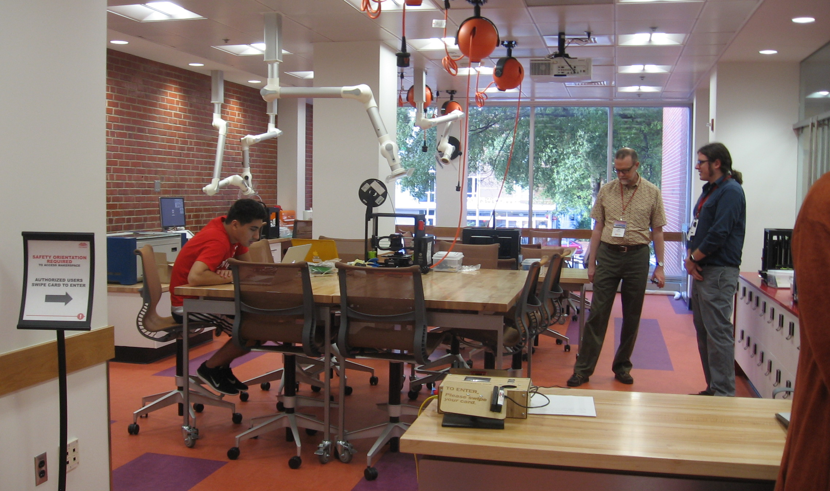
If we showed users examples of what some libraries offer, would they respond differently to our questions?
Makerspace – Hill Library NCSU

Slide 15
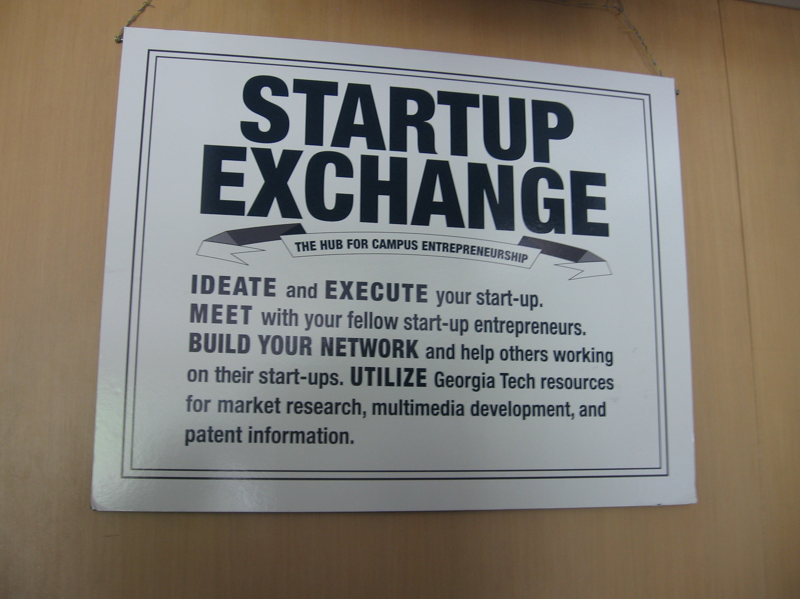
If we showed users examples of what some libraries offer, would they respond differently to our questions?
Georgia Tech Library

Slide 16
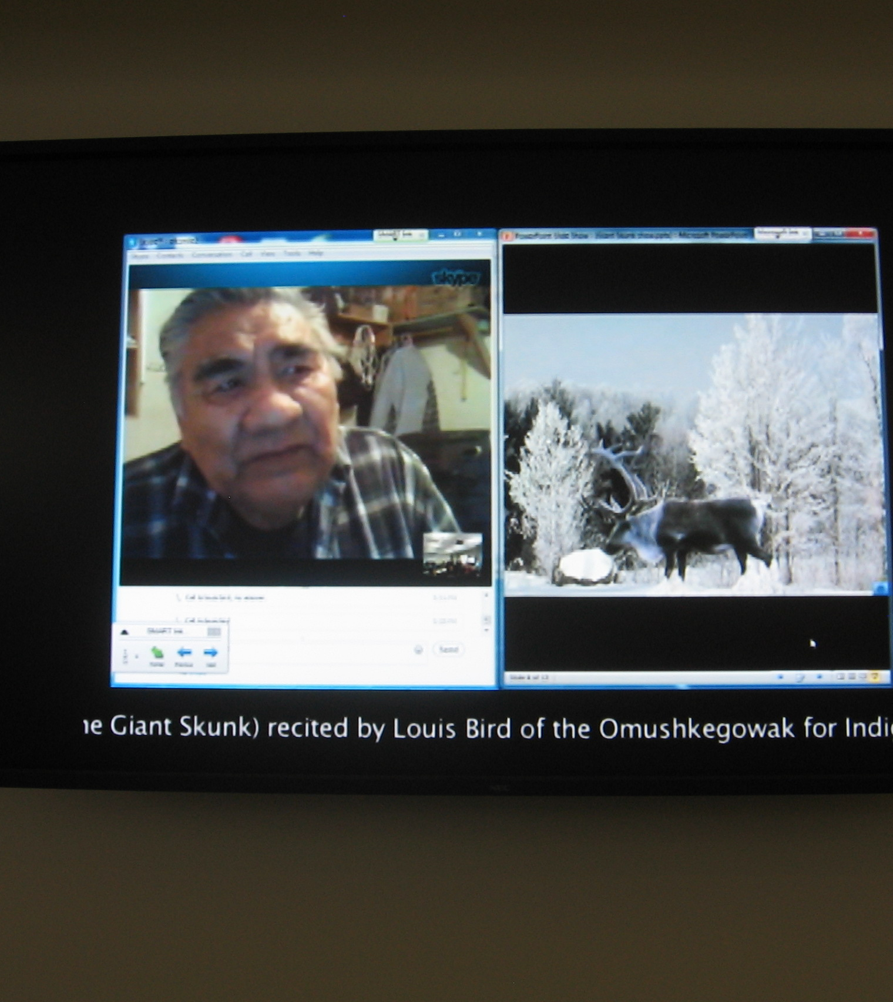
Would some humanities faculty have a better understanding of the potential of digital projects if they heard this story?
“Engaging in and seeking out collaborations and special projects is another way the DMC advocates for advancement in and support of digital media creation. One example of a campus collaboration the DMC was involved with was the Legend of the Giant Skunk.
After attending a DMC workshop on creating image mash-ups, Indigenous Studies instructor Line laplante and Digital Media Commons Manager Dylan Tetrault, with the assistance of student staff in the Digital Media Commons, began work on animating the Cree legend of the Giant Skunk. The project culminated in a multi-media presentation and discussion with the Indigenous Studies class, held in one of the Learning labs on the 4th floor of TFDL over Videoconference with elder Louis Bird of the Omushkego Cree in Peawanuck, Ontario. As Louis told the legend of Misi Sikak (the Giant Skunk) to the class, the visual animation of the story was displayed to the class on the digital displays. It was a moving and powerful experience for all in attendance that evening in the TFDL.”
U. Calgary Taylor Family Digital Library http://library.ucalgary.ca/dmc/louis-bird

Slide 17
Looking to the future
When developing research questions, challenge underlying assumptions!
Your own
Those of your users

Slide 18
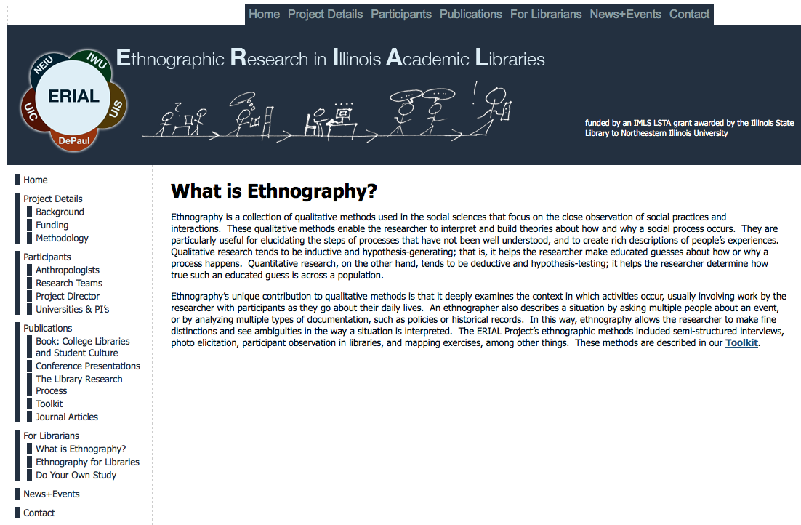
Ethnographic methods
http://www.erialproject.org/for-librarians/what-is-ethnography/

Slide 19
Students and Faculty
Q: “The ERIAL studies refer to teaching faculty as “gatekeepers” and “brokers” between the students and the librarians…Do more substantial librarian-faculty relationships make a difference, encouraging faculty to refer their students to librarians for discipline-related, content-specific help?”
A: …”The fact that faculty are gatekeepers is both good and bad…It’s hard to reach out directly to students and make a big difference, but at least we know to whom our outreach should be directed. Teaching faculty have the power to make the difference libraries need.”
Interview with David Green of the ERIAL Project by Sims Kline. C&RL News, Oct., 2013, p. 489.

Slide 20
How students knew they could schedule research consultations
51% The professor of my class suggested it
37% The librarian talked about it during his/her visit to my class
6% Someone at the reference desk suggested it
4% I read about it on the library website
Magi, Trina J. and Patricia E. Mardeusz. “Why Some Students Continue to Value Individual,
Face-to-face Research Consultations in a Technology-Rich World.” College & Research Libraries
Vol. 74, Nov. 2013, pp. 605-618.

Slide 21
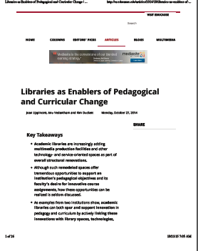
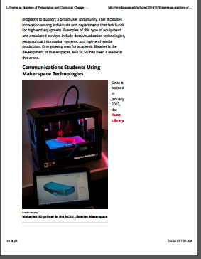
Connecting with faculty and course assignments
http://er.educause.edu/articles/2014/10/libraries-as-enablers-of-pedagogical-and-curricular-change

Slide 22
“Teaching a Different Shakespeare from the One I Love” Stephen Greenblatt, winner of the Pulitzer Prize and National Book Award
But as I have discovered in my teaching, it is a different Shakespeare from the one with whom I first fell in love. Many of my students may have less verbal acuity than in years past, but they often possess highly developed visual, musical and performative skills. They intuitively grasp, in a way I came to understand only slowly, the pervasiveness of songs in Shakespeare’s plays, the strange ways that his scenes flow one into another or the cunning alternation of close-ups and long views. When I ask them to write a 10-page paper analyzing a particular web of metaphors, exploring a complex theme or amassing evidence to support an argument, the results are often wooden; when I ask them to analyze a film clip, perform a scene or make a video, I stand a better chance of receiving something extraordinary…This does not mean that I should abandon the paper assignment; it is an important form of training for a range of very different challenges that lie in their future. But I see that their deep imaginative engagement with Shakespeare, their intoxication, lies elsewhere. (emphases added)
NY Times (The Education Issue), Sept. 11, 2015
http://www.nytimes.com/2015/09/13/magazine/teaching-a-different-shakespeare-than-the-one-i-love.html?_r=0

Slide 23
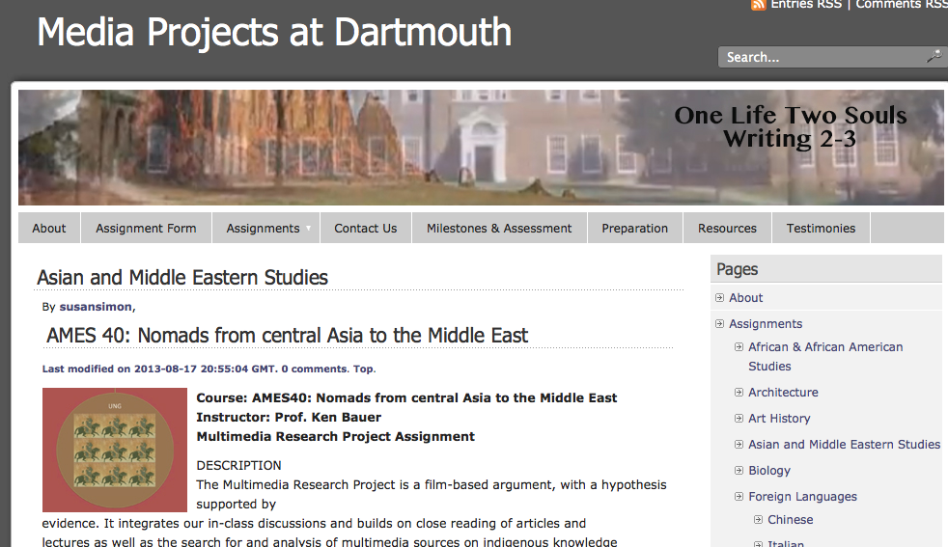
Are faculty/departments interested in new objectives for their curricula?
“Constructs sustained, coherent arguments, narratives or explications of issues, problems or technical issues and processes, in writing and at least one other medium, to general and specific audiences.”
“Negotiates a strategy for group research or performance, documents the strategy so that others may understand it, implements the strategy, and communicates the results.”
http://www.dartmouth.edu/~videoprojects/wp/?page_id=475
Degree Qualifications Profile 2.0 http://www.luminafoundation.org/dqp/

Slide 24
Questions for faculty/departments/programs/schools
Are you planning a significant curriculum revision?
If yes, can the library help achieve some objectives?
Which faculty are developing innovative assignments (or wish to) but due to limitations with currently available facilities/equipment/services are experiencing difficulties or are unable to do so now.

Slide 25
Library in the life of the user
Importance of the affective domain
Importance of a sense of community for students
Ways to de-stress from the pressures of academic life

Slide 26
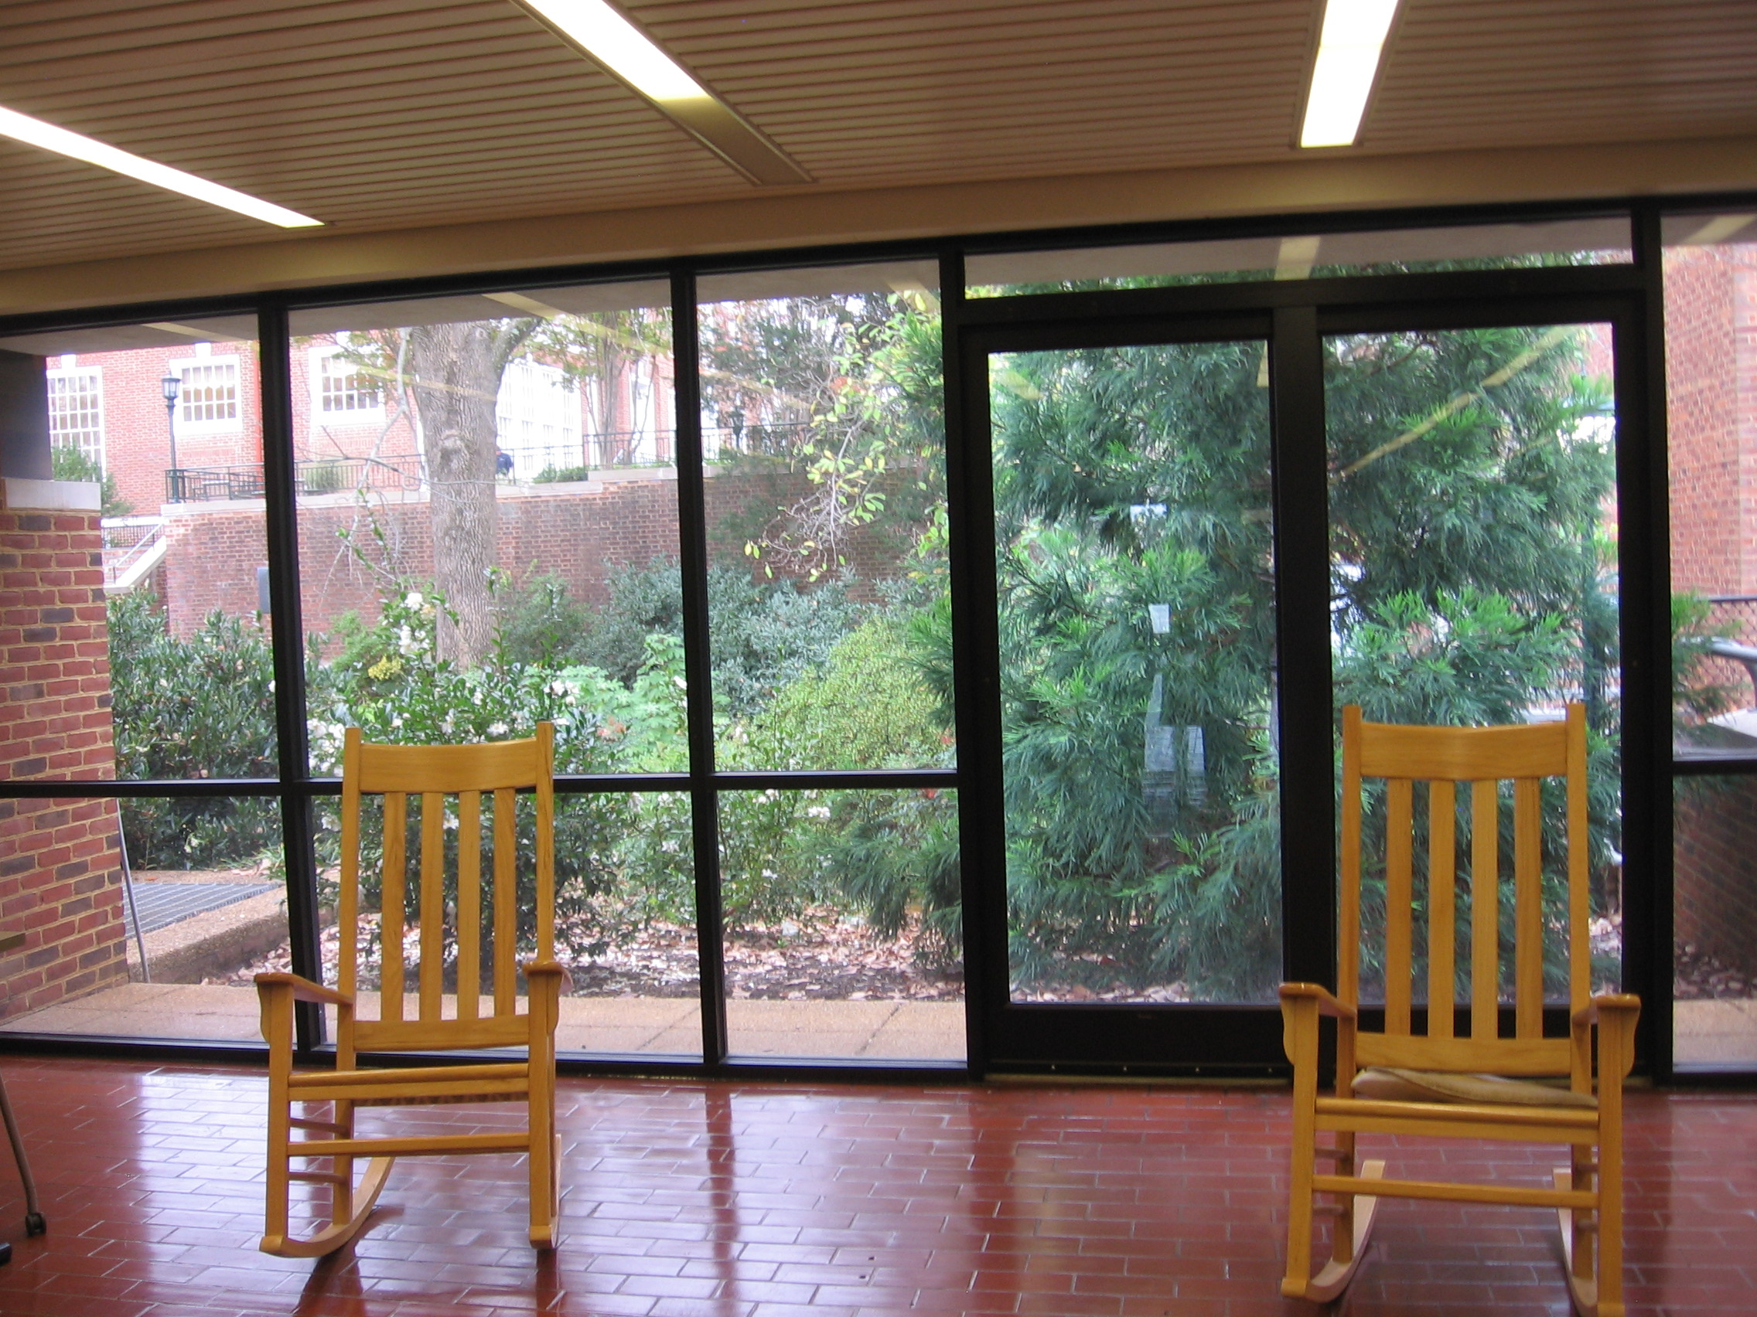
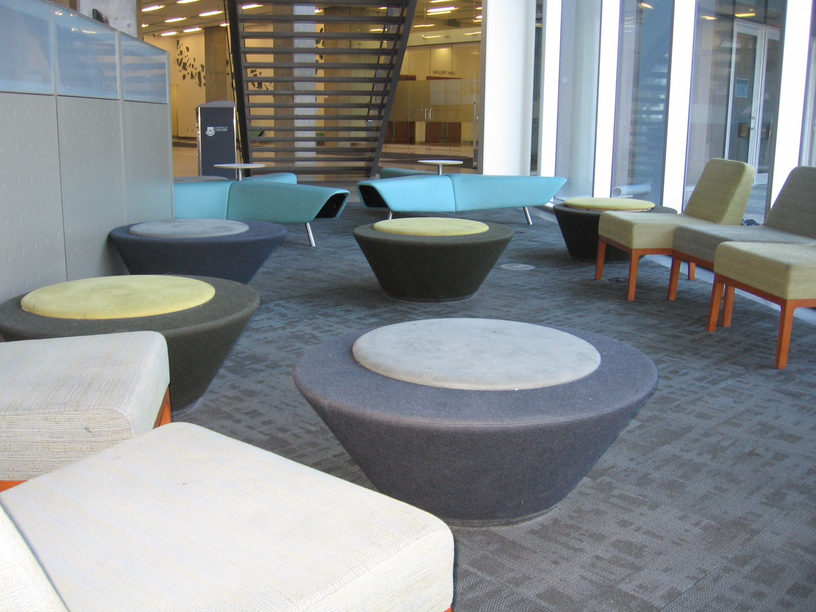
Seating for conversation and relaxation
U. Virginia Library
U. Calgary Library

Slide 27
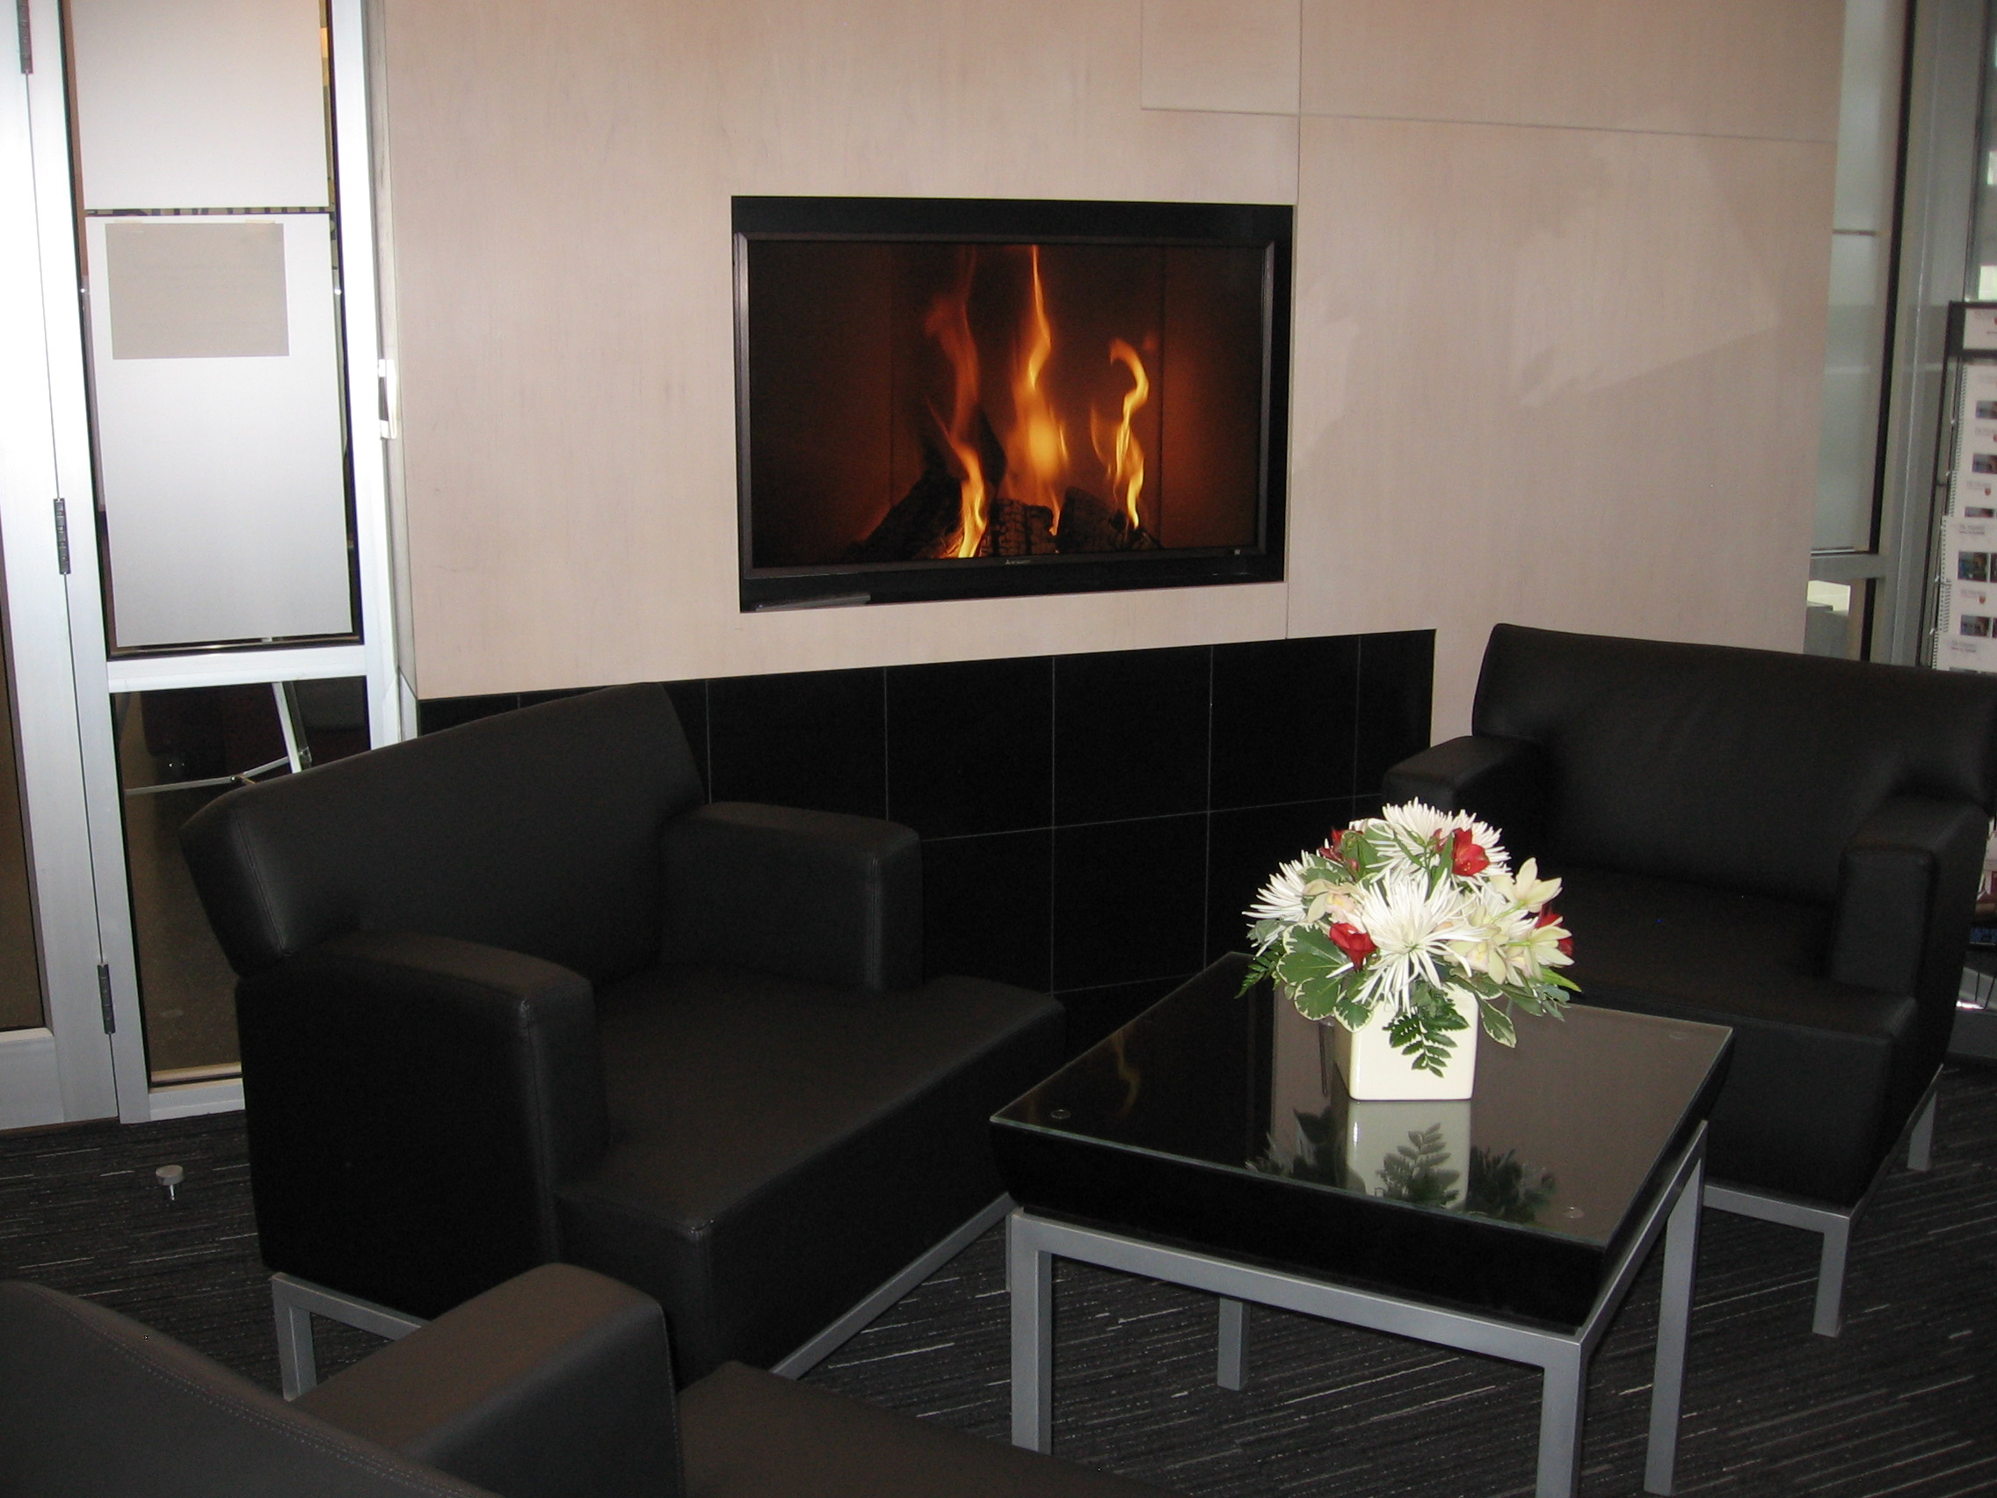
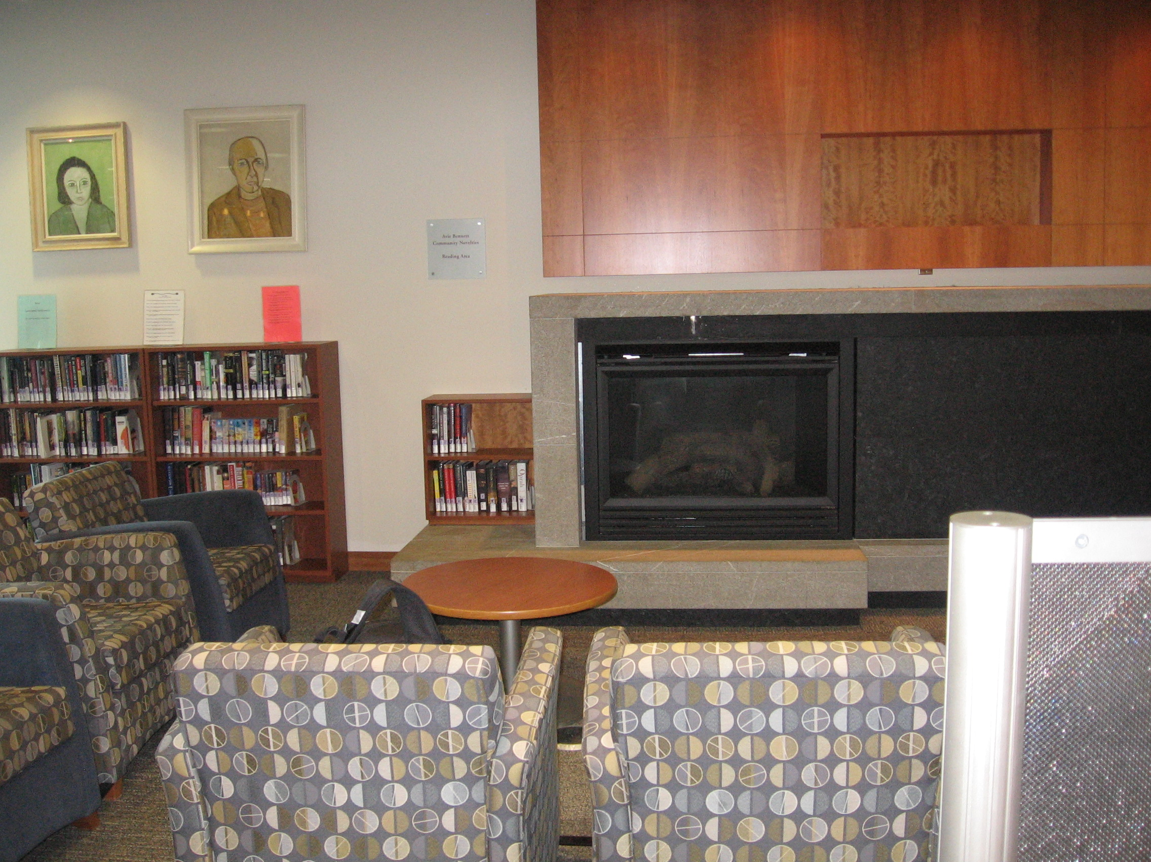
Gathering around a fireplace
McMaster U. Library
U. Toronto Missisauga Library

Slide 28
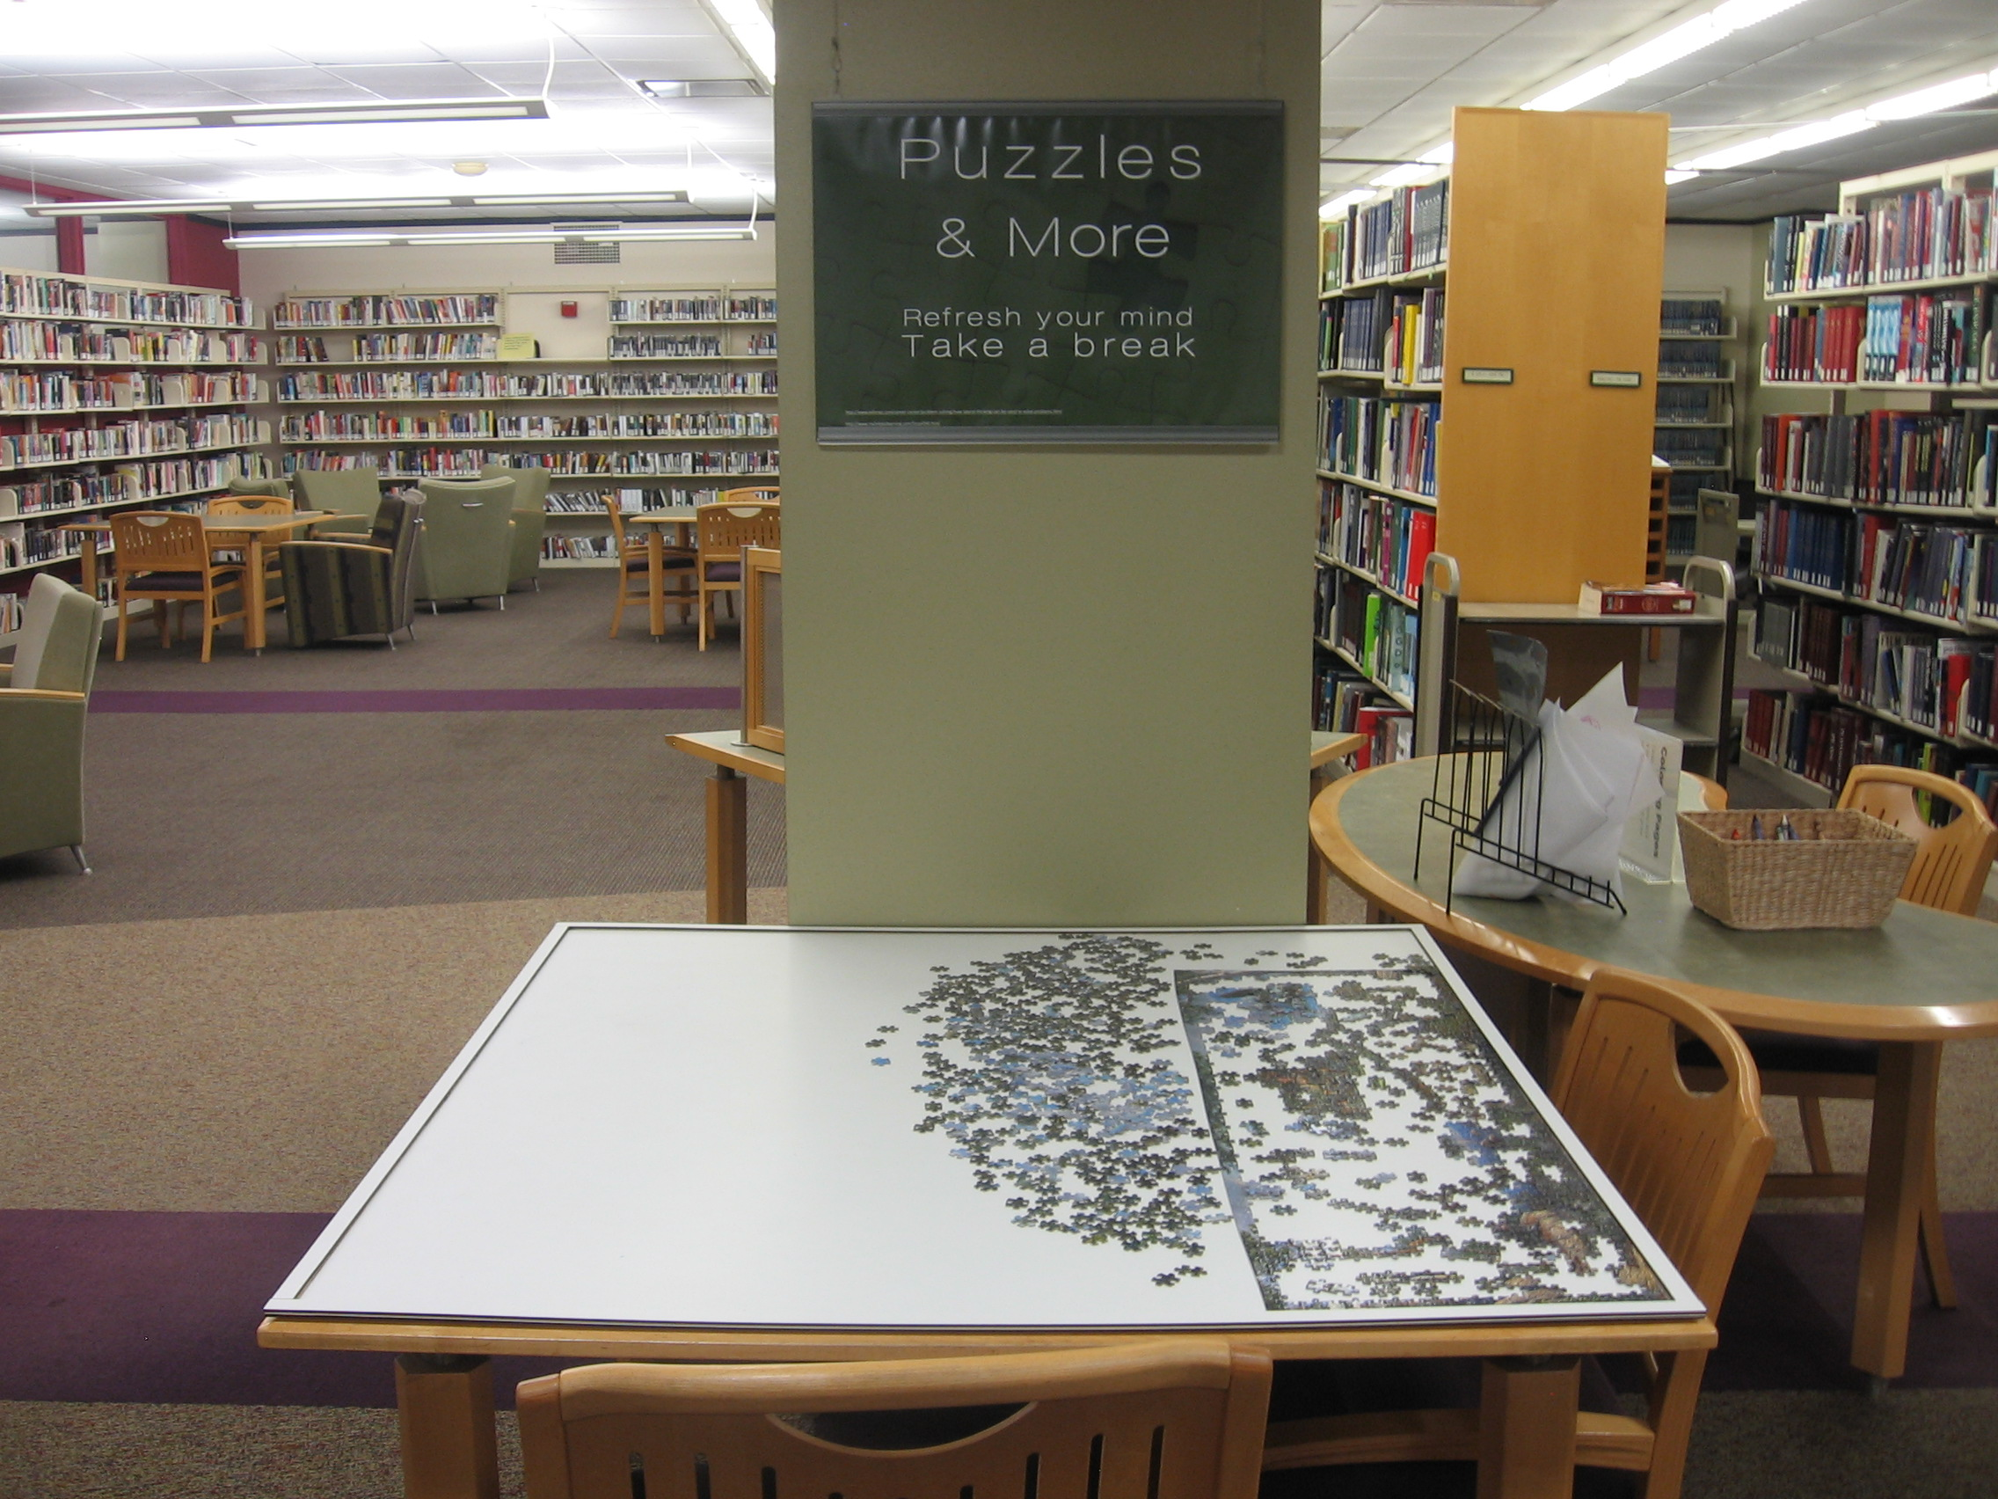
Taking a break/communal activity
Ohio U. Library

Slide 29
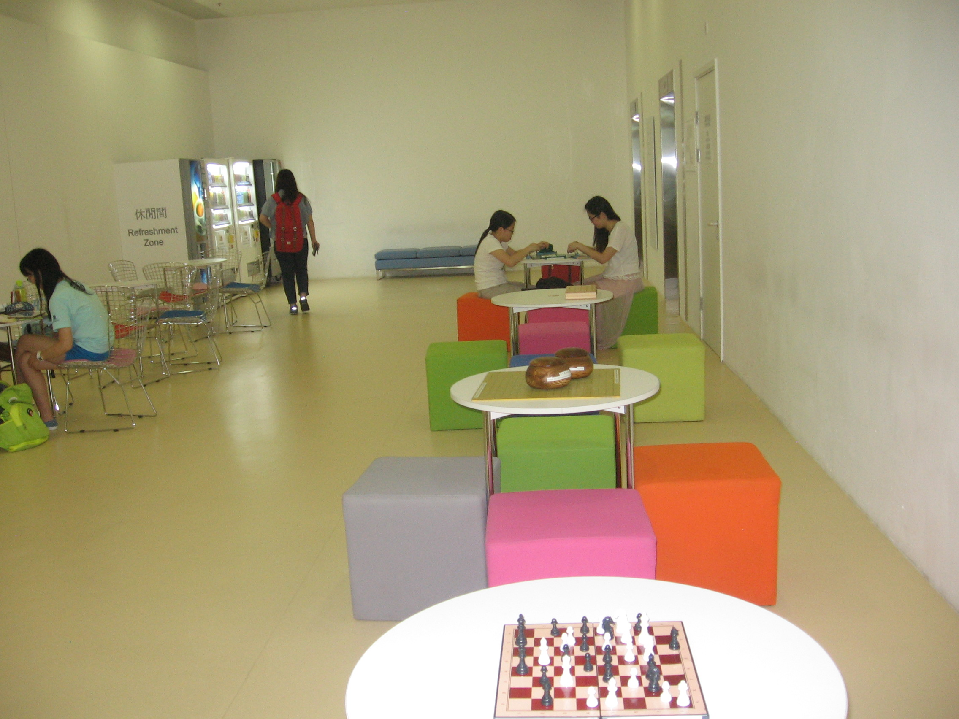
Provide spaces for taking a break
Chinese University of Hong Kong Library

Slide 30
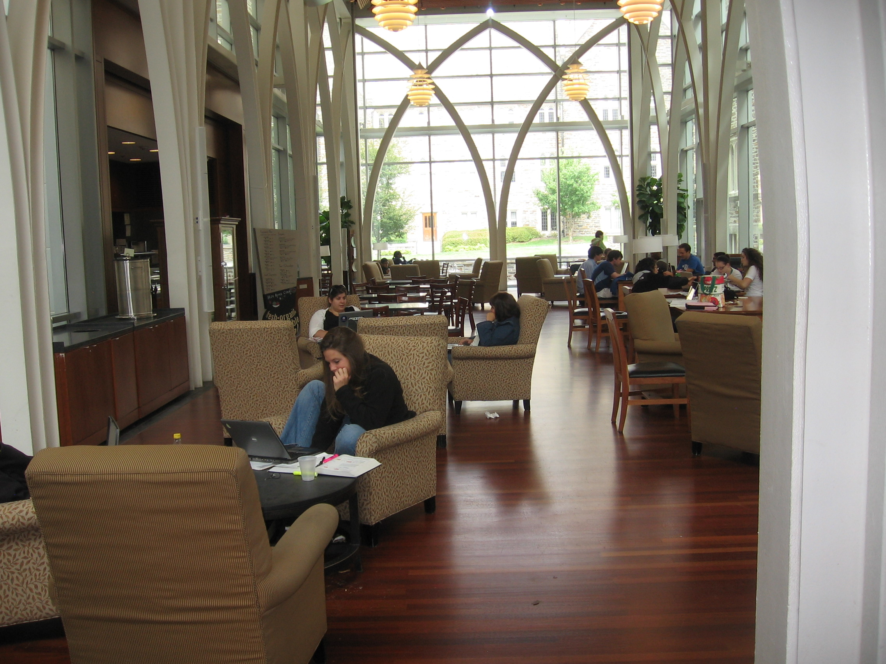
Food and drink in the library
Duke University Library

Slide 31
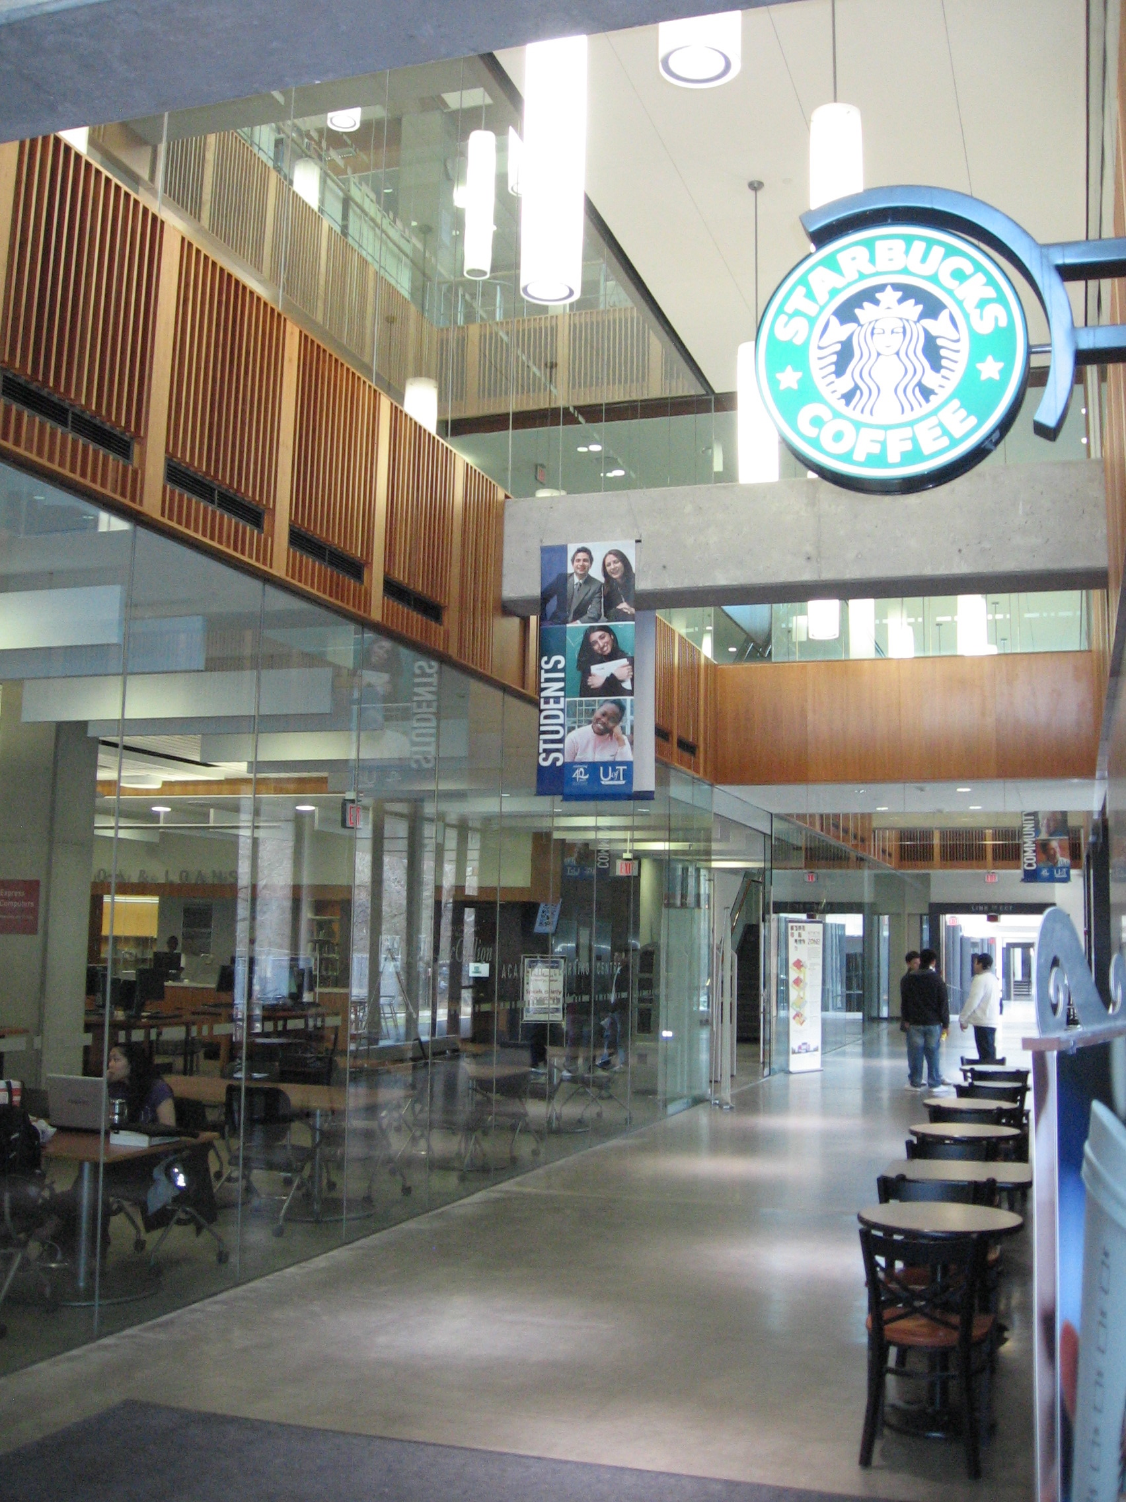
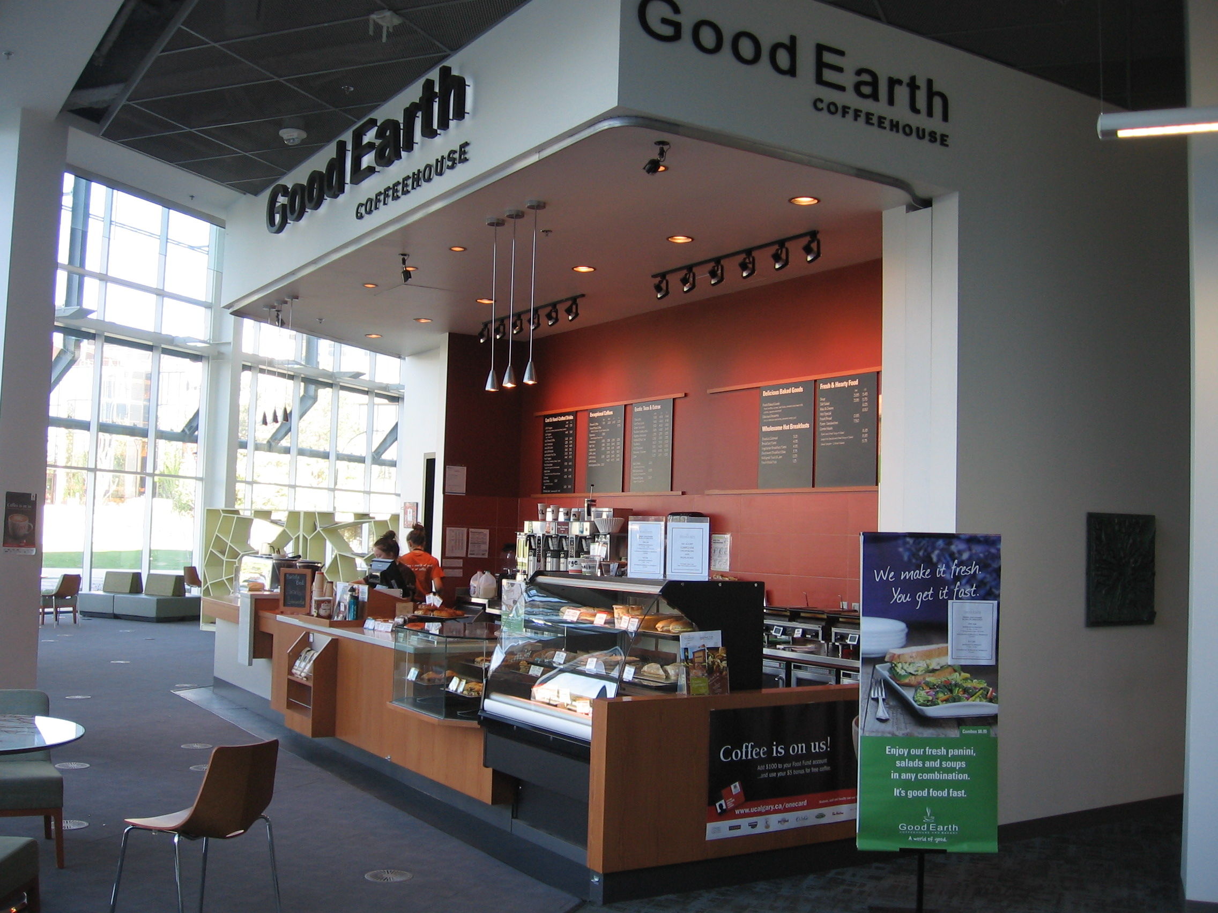
Provide food for students studying many hours
U. Toronto Missisauga
U. Calgary

Slide 32
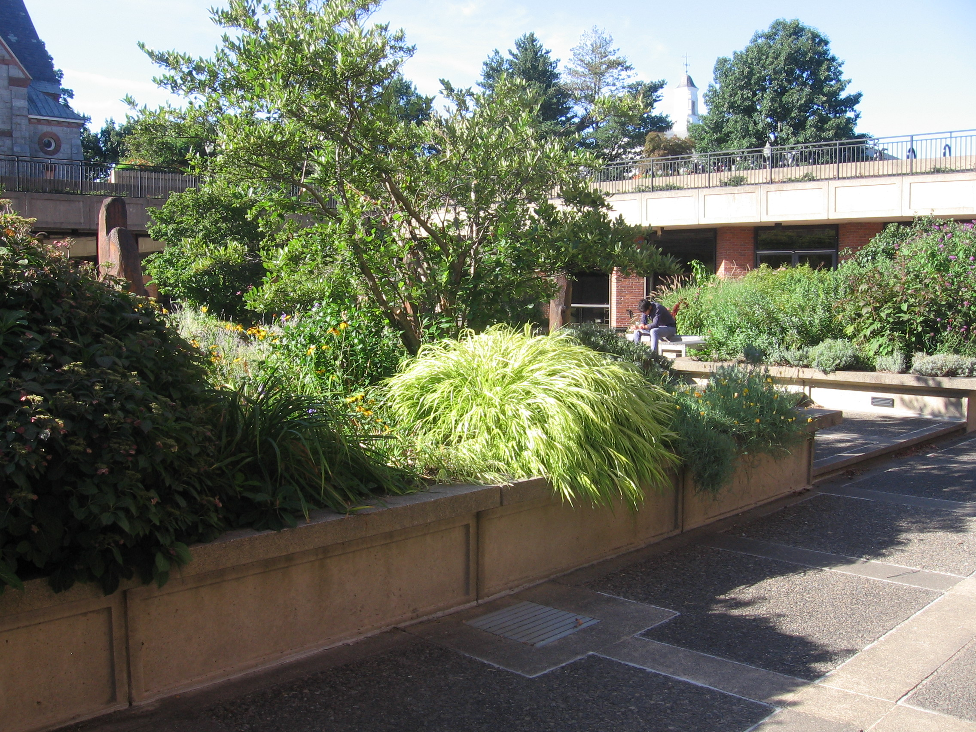
Courtyard Garden Outside Information Commons at U. Mass. Amherst

Slide 33
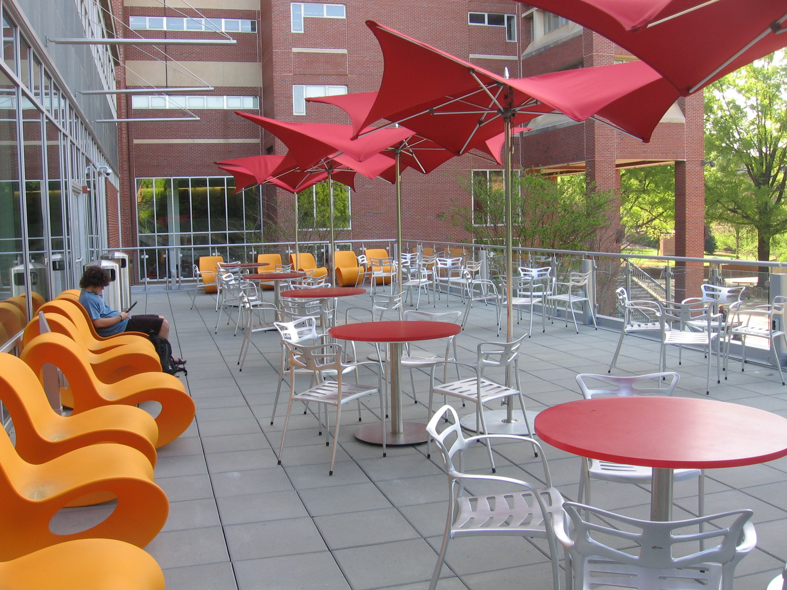
Patio of Hill Library, NCSU

Slide 34
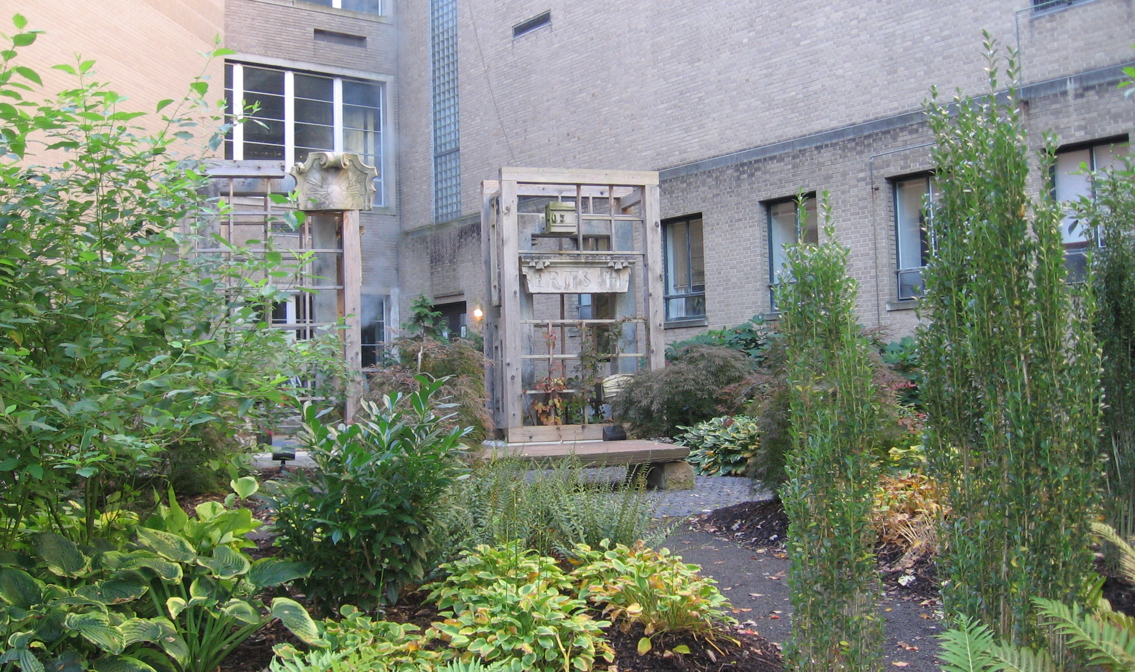
Cornell Mann Library Garden

Slide 35
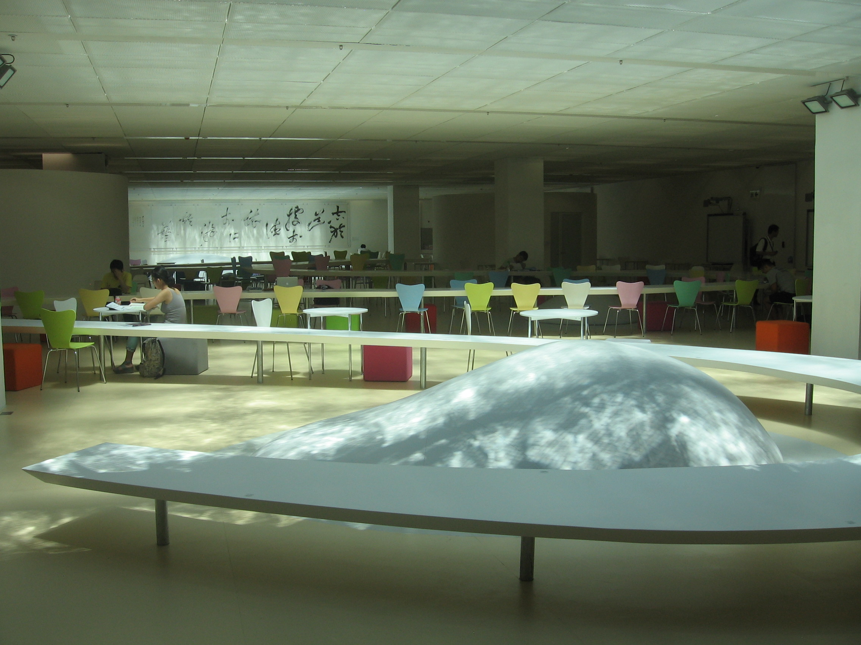
Add artwork to inspire
Chinese U. of Hong Kong Learning Garden

Slide 36
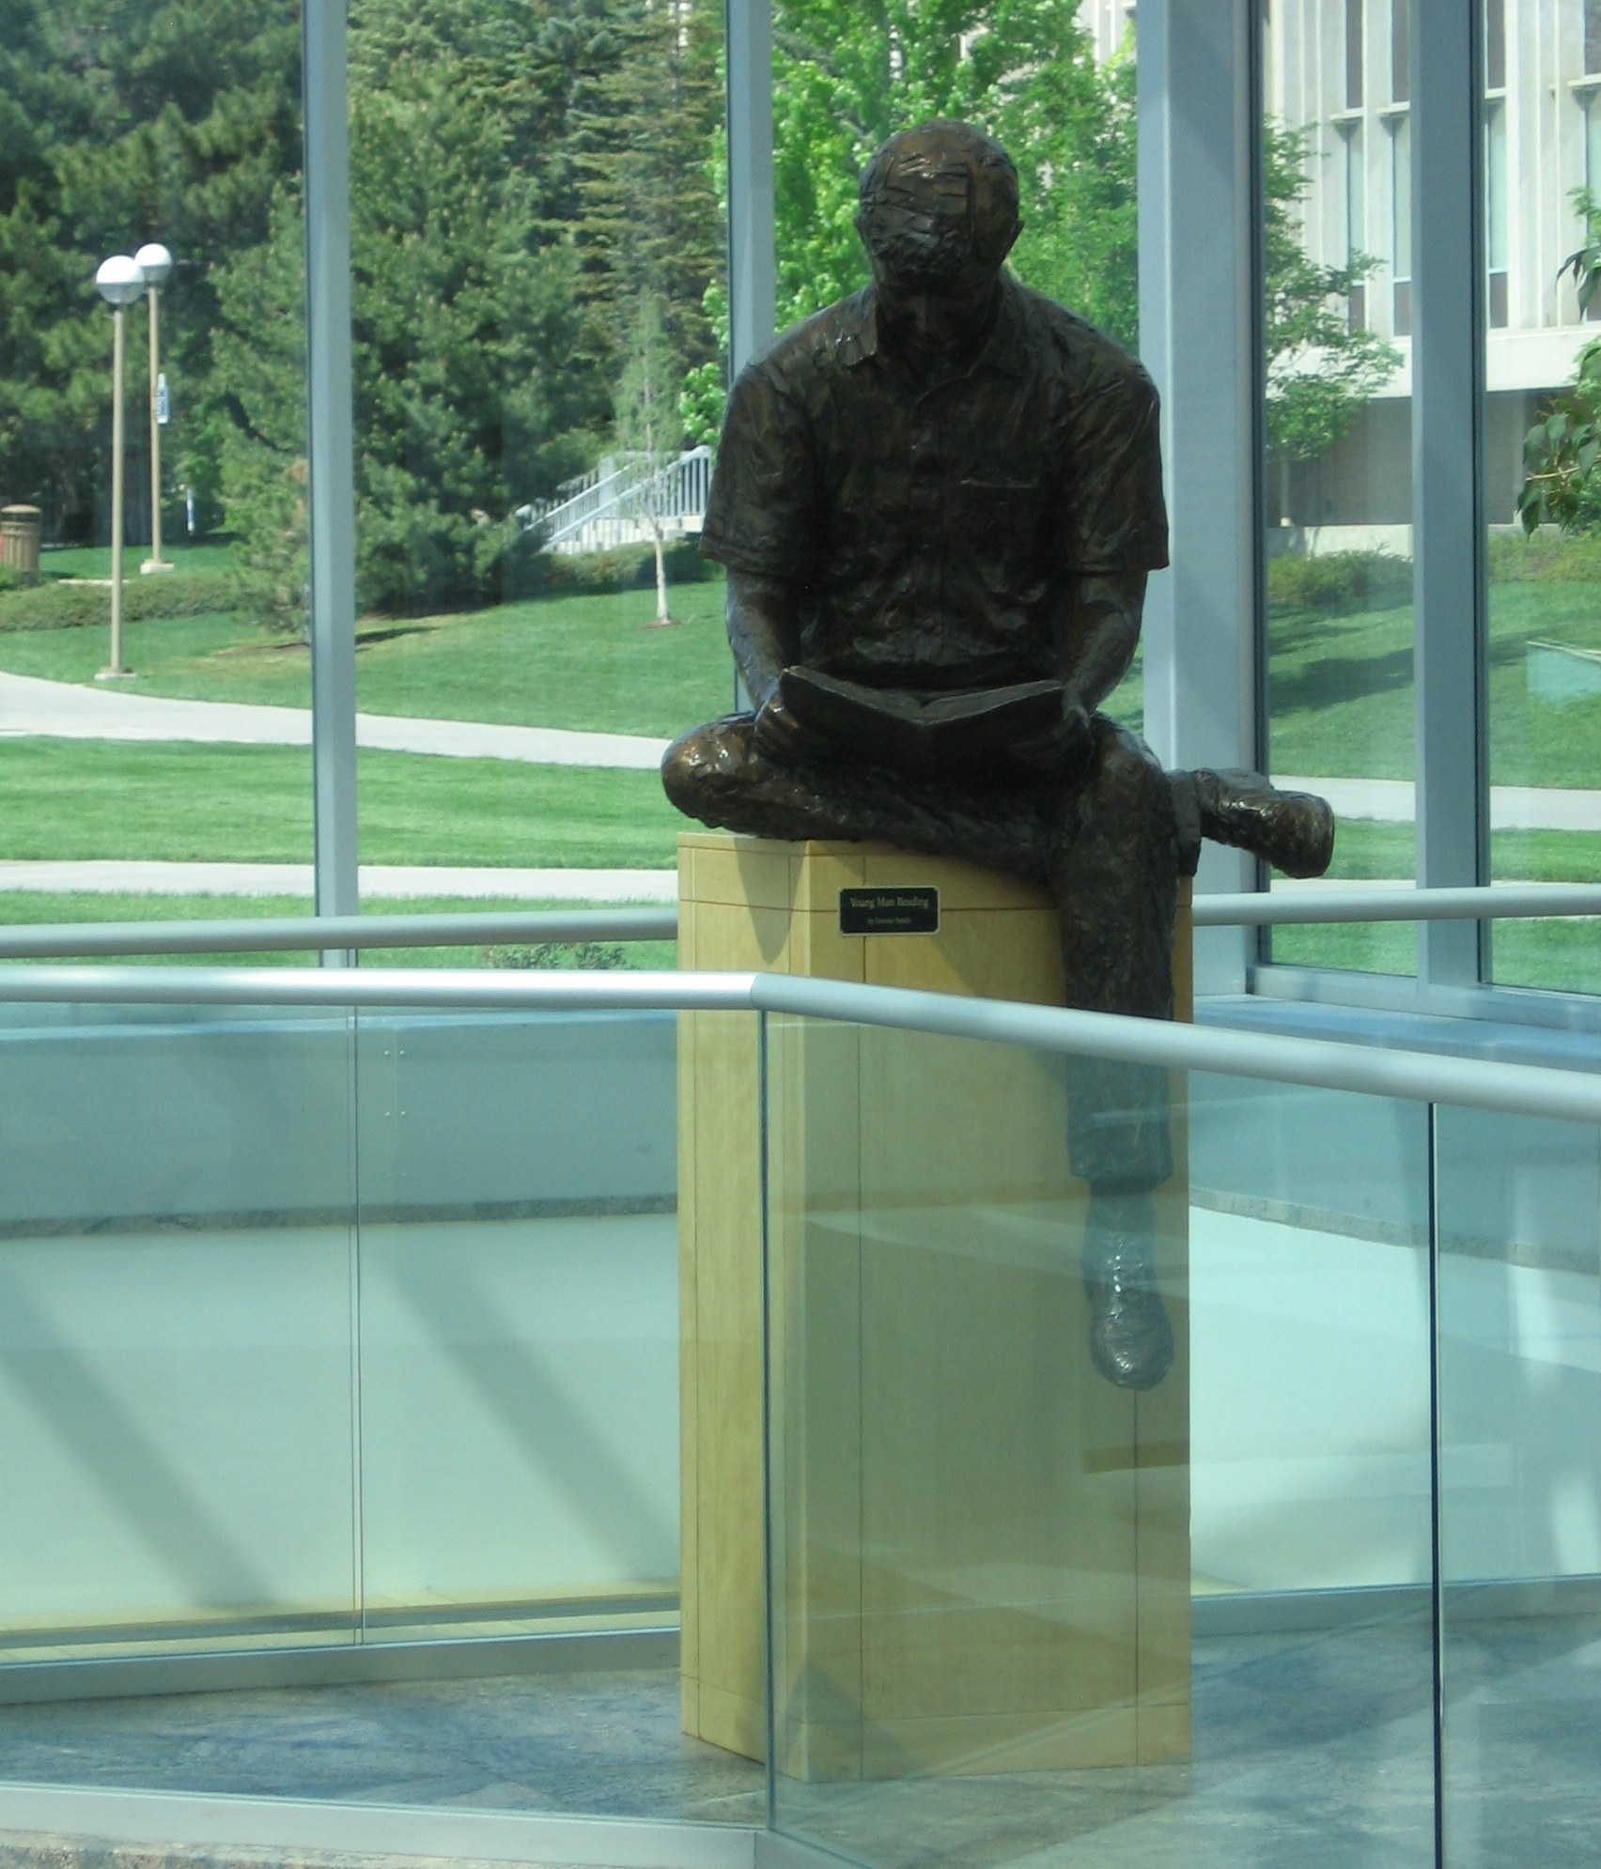
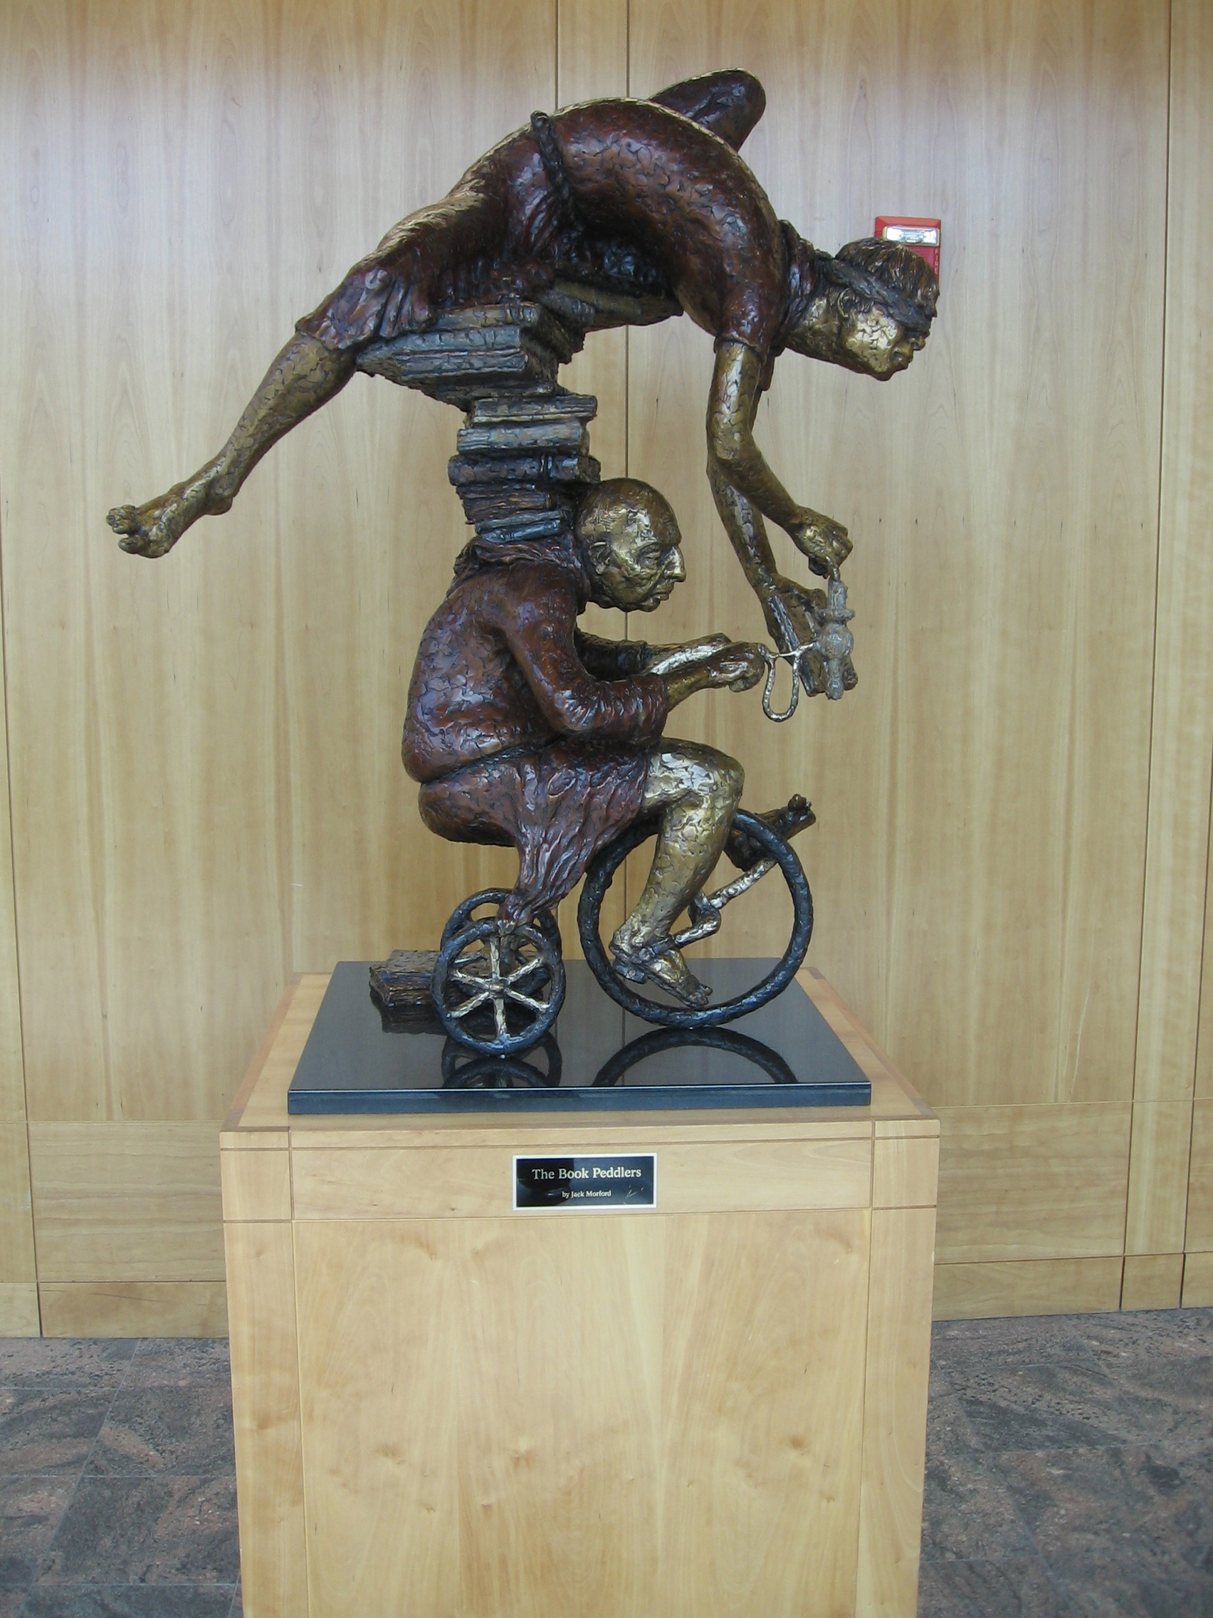
Artwork to set the tone
Brigham Young U. Library

Slide 37
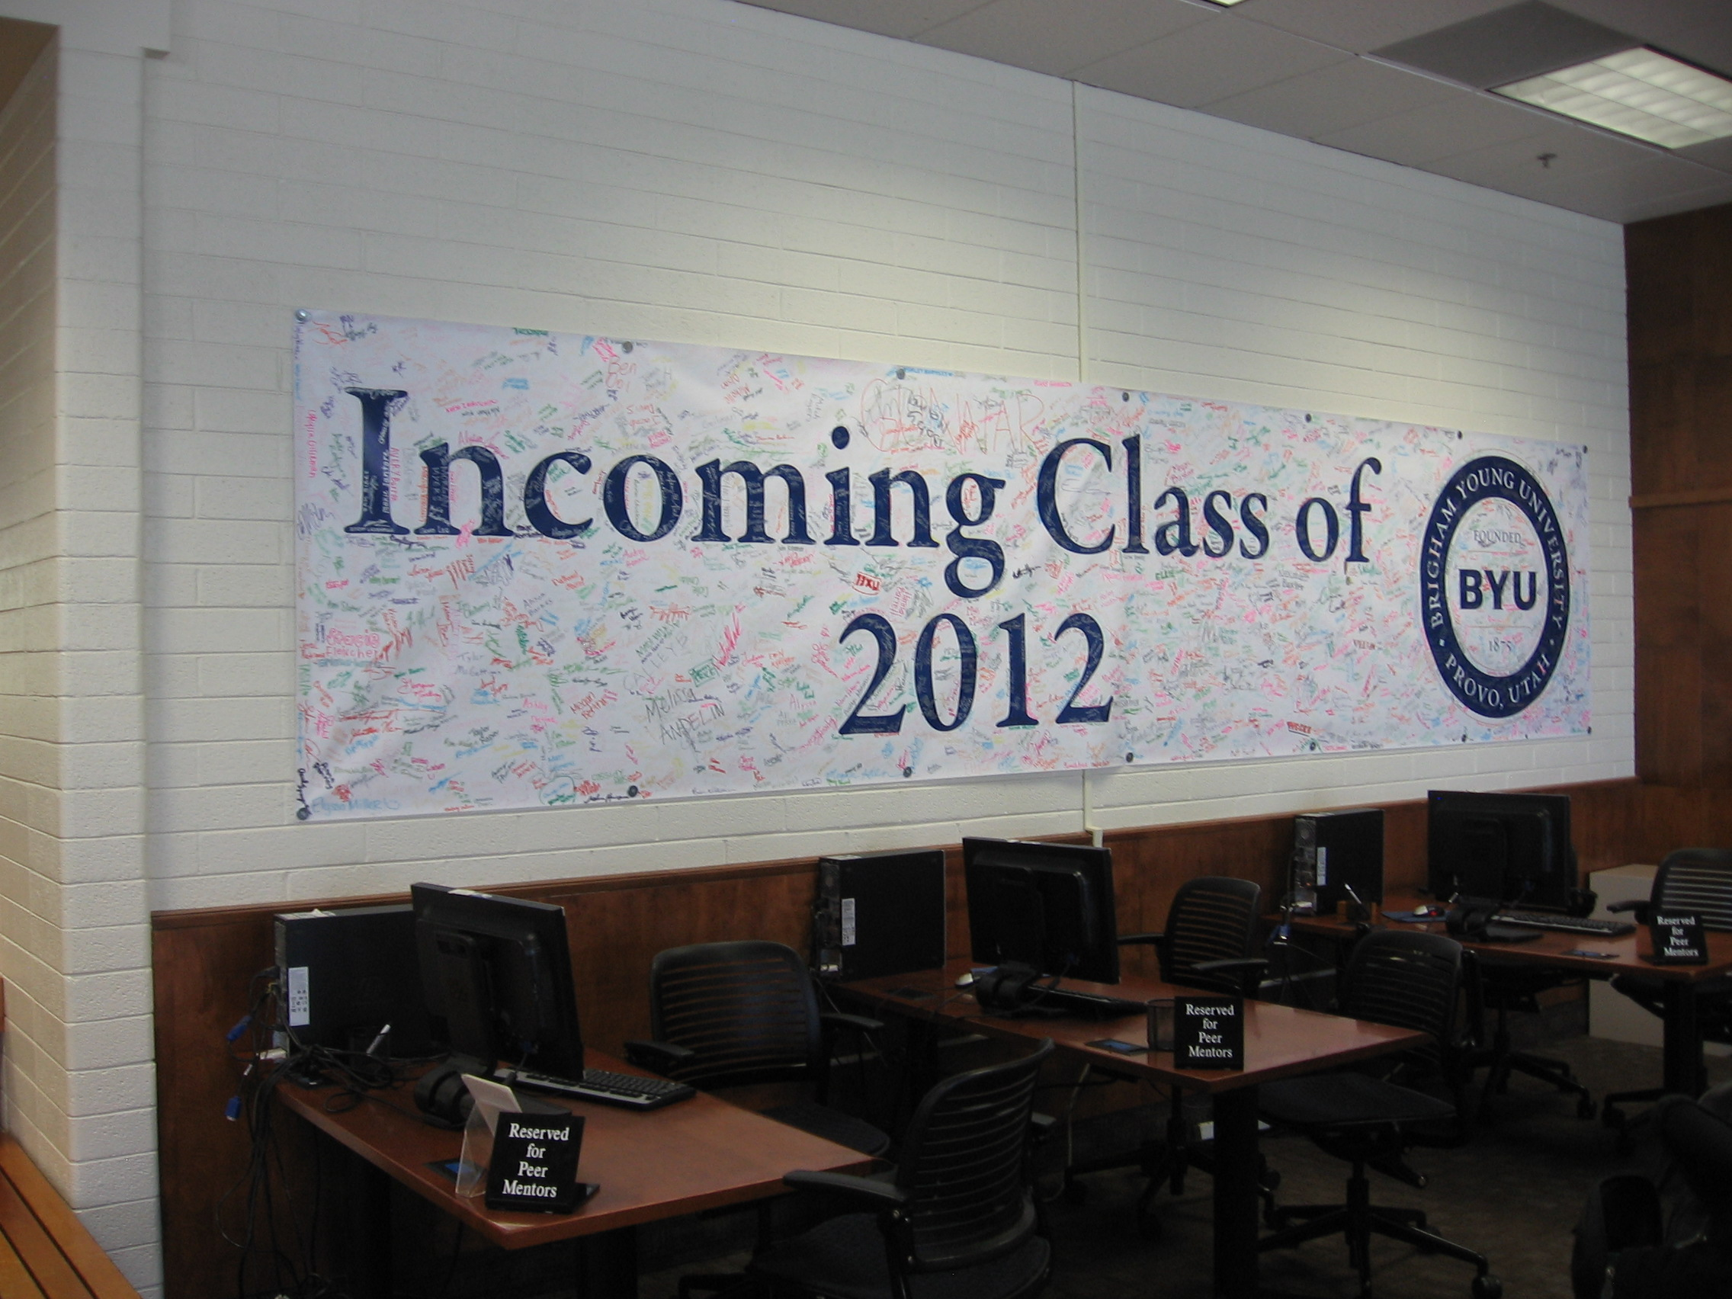
Launch activities that encourage a sense of belonging
Brigham Young U. Library

Slide 38
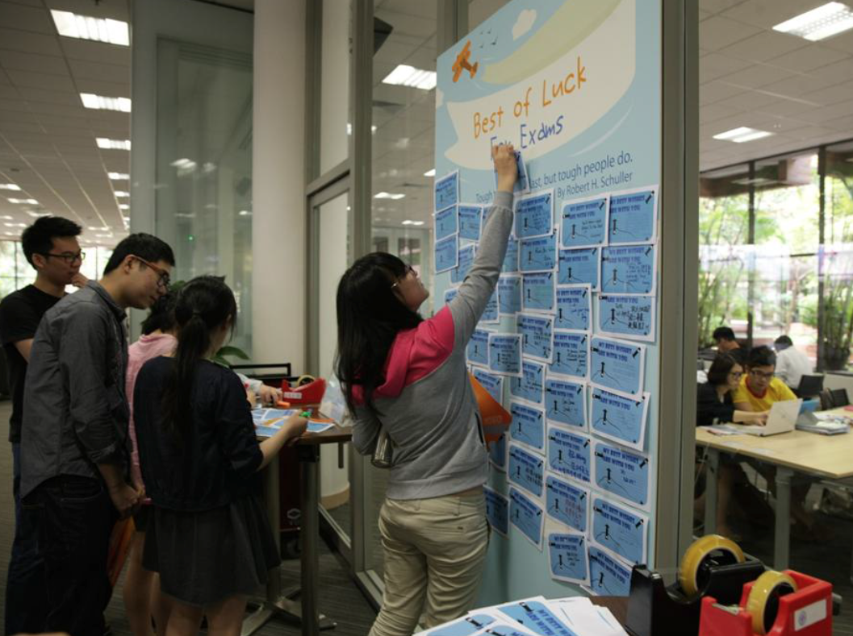
Host opportunities that promote connections among students
Polytechnic University of Hong Kong
Photo courtesy of the Library, Polytechnic U. of Hong Kong

Slide 39
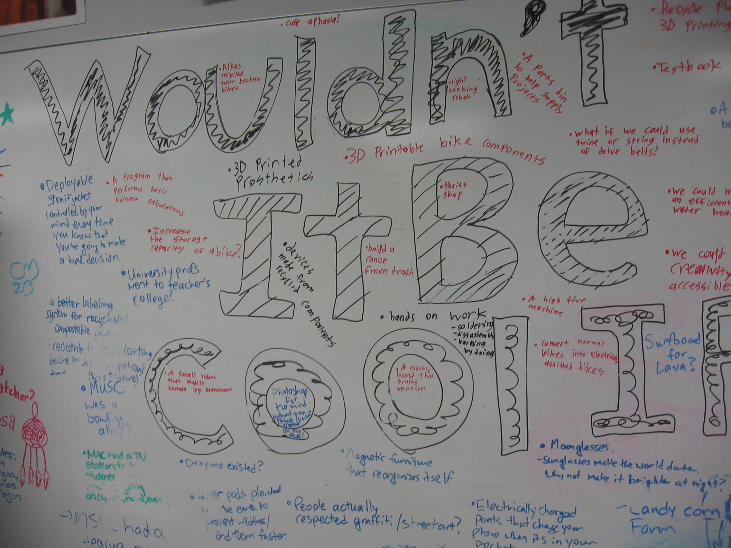
McMaster U. Library

Slide 40
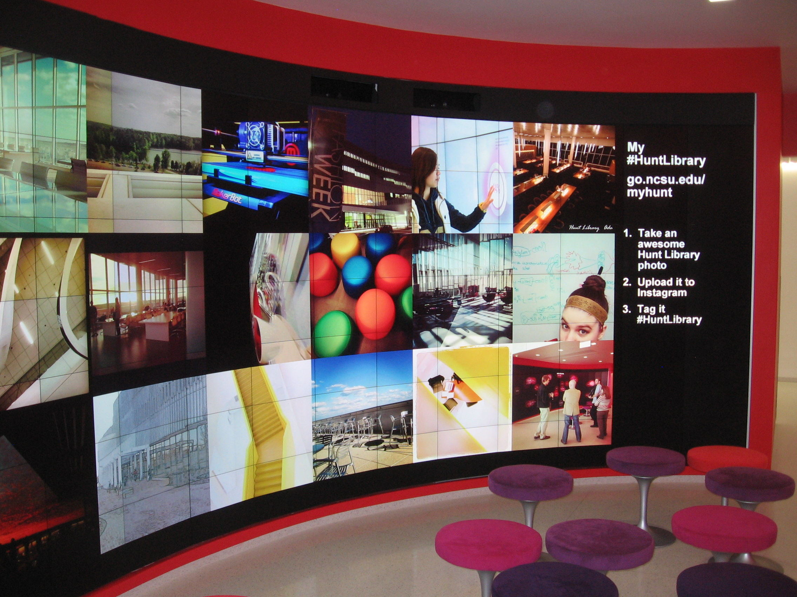
Build community in physical and virtual spaces My #HuntLibrary on Instagram
http://d.lib.ncsu.edu/myhuntlibrary

Slide 41
Moving forward
Ask good questions that will yield meaningful, actionable responses
While studying students who use the library is useful, it provides an incomplete picture
What might students use if they knew about what you offer?
What might students use if you provided different resources from those currently available?
What might student use if you worked with faculty to develop new types of assignments?
Seed conversations with examples (especially visuals) to encourage students and faculty to think into the future

Slide 42
Moving forward – institutional context
Who is monitoring strategic directions within your institution in both research and teaching & learning?
How are you keeping abreast of developments in pedagogy and technology in order to understand the implications for the library?
How could the library become a partner with faculty in some research activities?
How are you helping create a sense of community for your users?

Slide 43
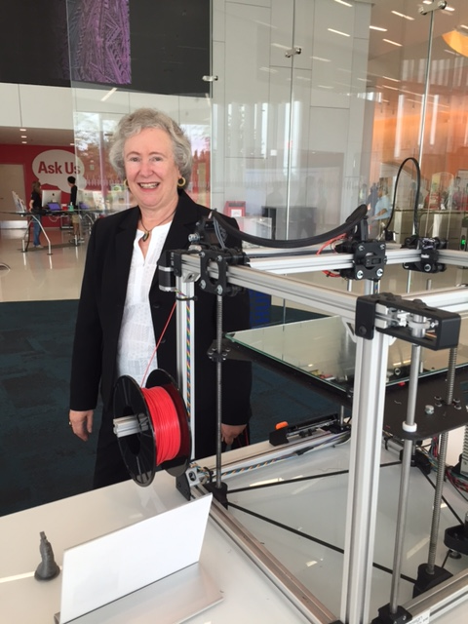
Thank you!
Joan K. Lippincott
joan@cni.org
https://www.cni.org/about-cni/staff/joan-k-lippincott/
All photos are my own unless otherwise indicated
Joan at Hunt Library, NCSU

