Slide 1
OCLC Webinar– 21 May, 2015
Library Linked Data in the Cloud
Carol Jean Godby, Senior Research Scientist
Shenghui Wang, Research Scientist
Jeffrey K. Mixter, Software Engineer

Slide 2
Our collaborators
From OCLC: Jonathan Fausey, Ted Fons, Hugh Jamieson, Tod Matola, Michael Panzer, Stephan Schindehette, Tod Matola, Karen Smith-Yoshimura, Roy Tennant, Richard Wallis, Bruce Washburn, Jeff Young
From Montana State University: Kenning Arlitsch and Patrick OBrien (supported with funding from the Institute of Library and Museum Studies)
Notes:
Since 2013, we have also been working closely with KA and PO on their grant-funded projects that document problems with the visibility of libraries on the Web and offer solutions for improving their SEO. Jeff is a member of their team. But this book is not a formal deliverable from their project.

Slide 3
Library Standards and the Semantic Web

Slide 4
“The Semantic Web isn’t just about putting data on the web. It is about making links, so that a person or machine can explore the web of data.” Tim Berners-Lee, 2006
Notes:
Throughout the book, we wanted to give the sense of people talking. To show that OCLC’s work is embedded in a larger community effort. The text is sprinkled with quotes from published or web-accessible sources. Mostly from librarians, but also from Web standards experts.
Here is a quote from an important blog post, really by Tim Berners-Lee about transforming the web of documents to data. The semantic web is about making links, pure and simple.
In an even earlier publication, TBL and coauthors explain why this transformation matters: the semantic web attempts to make actionable what was once merely displayed. In other words, the first generation of the web delivered documents that you read. The semantic web produces a network of data that does useful things. (Incidentally, one of the coauthors, James Hendler, is the recently retired editor of the series that this book appears in.)
Linked Data is just the current technology for implementing the vision of the Semantic Web.

Slide 5
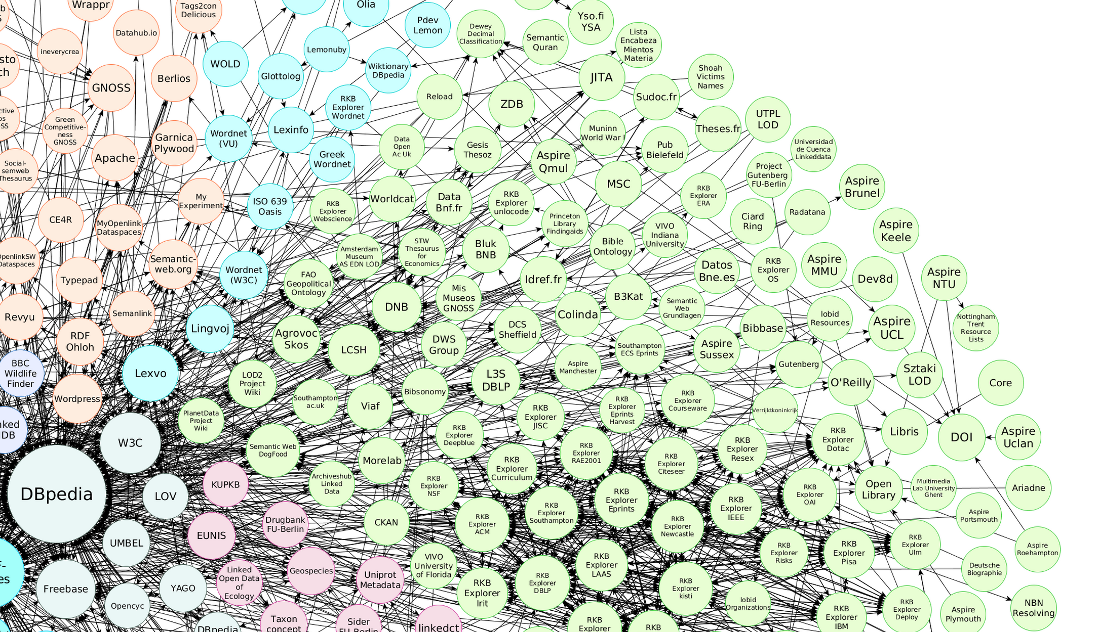
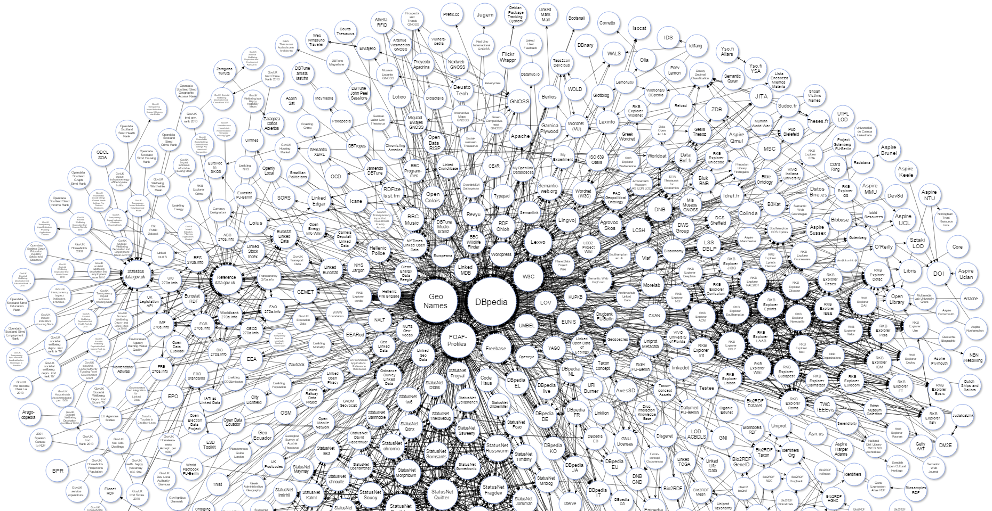
Library linked data in the cloud
Notes:
This the familiar cloud diagram maintained by lod-cloud.net. This is the ‘cloud’ referenced in the title. The circles represent the datasets that have been modeled using linked data principles.
Two important characteristics: the density (number of circles); proximity to the center (most widely referenced).
*At the center are dbpedia (which is mined from Wikipedia and transformed into structured data) and geonames (a geographic db with 8 million place names and is widely becoming a de-facto standard.
*The segment we are interested in contains datasets published by libraries, publishers, and others interested in bibliographic resources and scholarship.
*contributions from European national libraries, Library of Congress, OCLC, and academic research in linguistics and lexicography (Lexvo, WordNet)
What is the status of the linked datasets contributed by libraries…and in particular, OCLC? This is the broad question that this book is about.

Slide 6
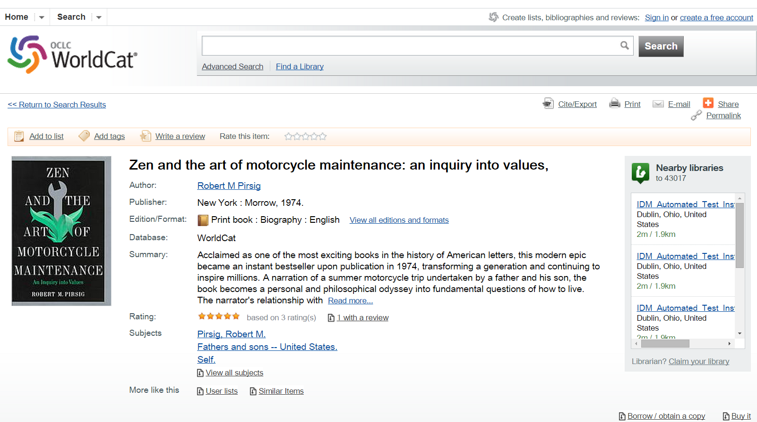
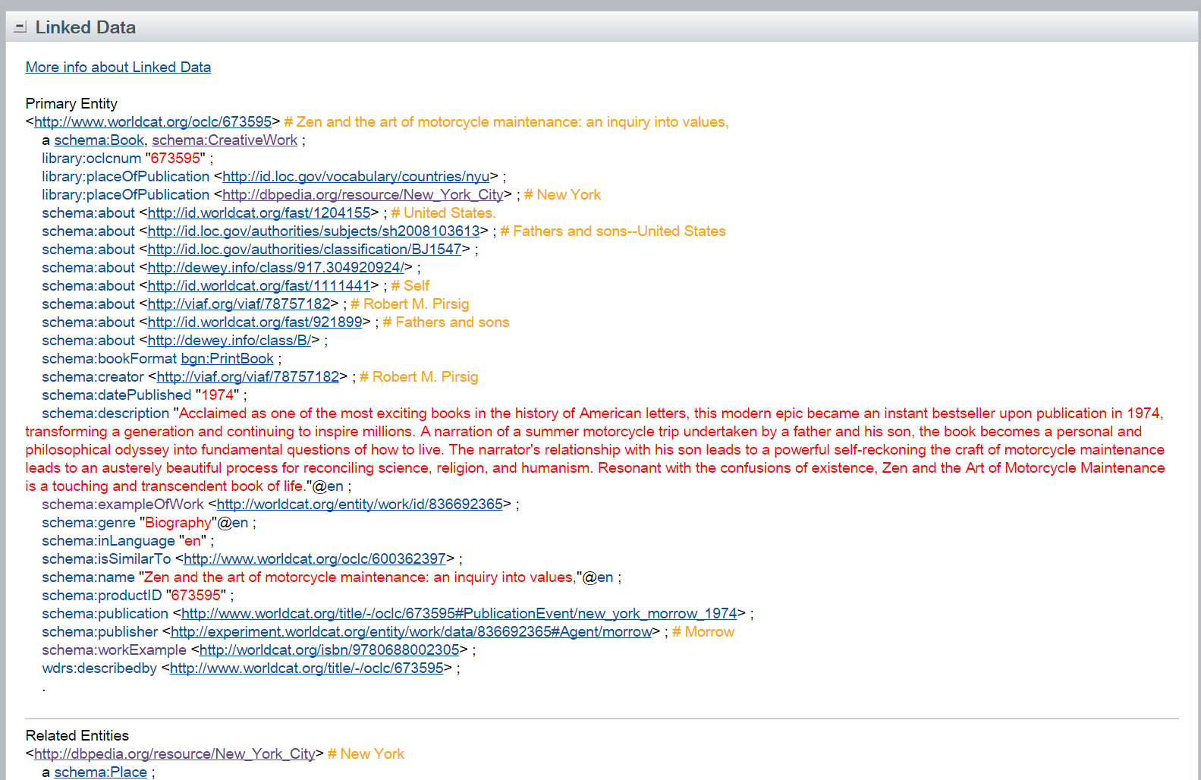
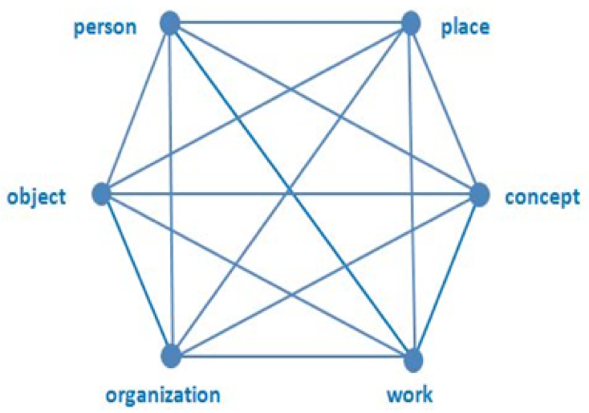
Why we wrote this book
Notes:
Much of the discussion involving linked data can be quite theoretical, we can bring it down to earth with a concrete task. In 2012, OCLC published the first draft of the RDF statements that can be automatically generated from catalog records accessible from WorldCat.org. This was, and still is, the largest linked dataset published by the library community. The main thing we wanted to accomplish in this book is a researcher’s account of this result: where the statements came from, what they say, and what isn’t there yet.
It wasn’t obvious when we started, but we now know that we can get a good running start on the conversion of MARC records to RDF can be restated by distilling it into statements about just six key entities.
* So on one level, the book can be interpreted as the technical underpinning for an image that has appeared in many OCLC presentations on linked data.
More broadly, we wrote this book:
To tell a story representing complex technical ideas and many person-years of innovation
To create a foundation resource from which others can learn, and to spur more sophisticated discussion.

Slide 7
At OCLC: Many interlocking projects
Goals
Develop linked data models of resources managed by libraries using published vocabularies
Discover evidence for the models in legacy library data
Address two primary use cases
Visibility of library resources on the Web
Data aggregation
Scope
Models of key entities: Person, Organization, Concept, Work, Object
Initial draft: key entities represented in library authority files and monographs
Explore issues primarily in the publication (rather than the consumption) of linked data
Notes:
The book aims to tell the larger story that connects many OCLC research projects. The narrative wasn’t outlined in advance, but it grew organically from an intense focus, both on developments in the Web environment and OCLC’s role in the management of library metadata. It builds on a 20-year history of involvement by OCLC researchers in the development of library and Web standards.
Unpack the first two points:
Test the viability of the linked data paradigm.
How good is the match between LD and library metadata?
How compatible is LD to the values of librarianship?
How mature are the tools?
Our development strategy evolved into an Agile design that combines modeling with discovery. Model, then discover. With each iteration, the model gets more detailed.
Use cases
Visibility (classic problem)
Aggregation
More focus :
Create models of descriptive metadata (not technical metadata, not administrative metadata)
So we’re not developing a new standard. We are not competing with others in the library community who are developing standards. Ware conducting experiments and demonstrating proof of concept. And we’re doing it at scale, by working with all of the library metadata we have.

Slide 8
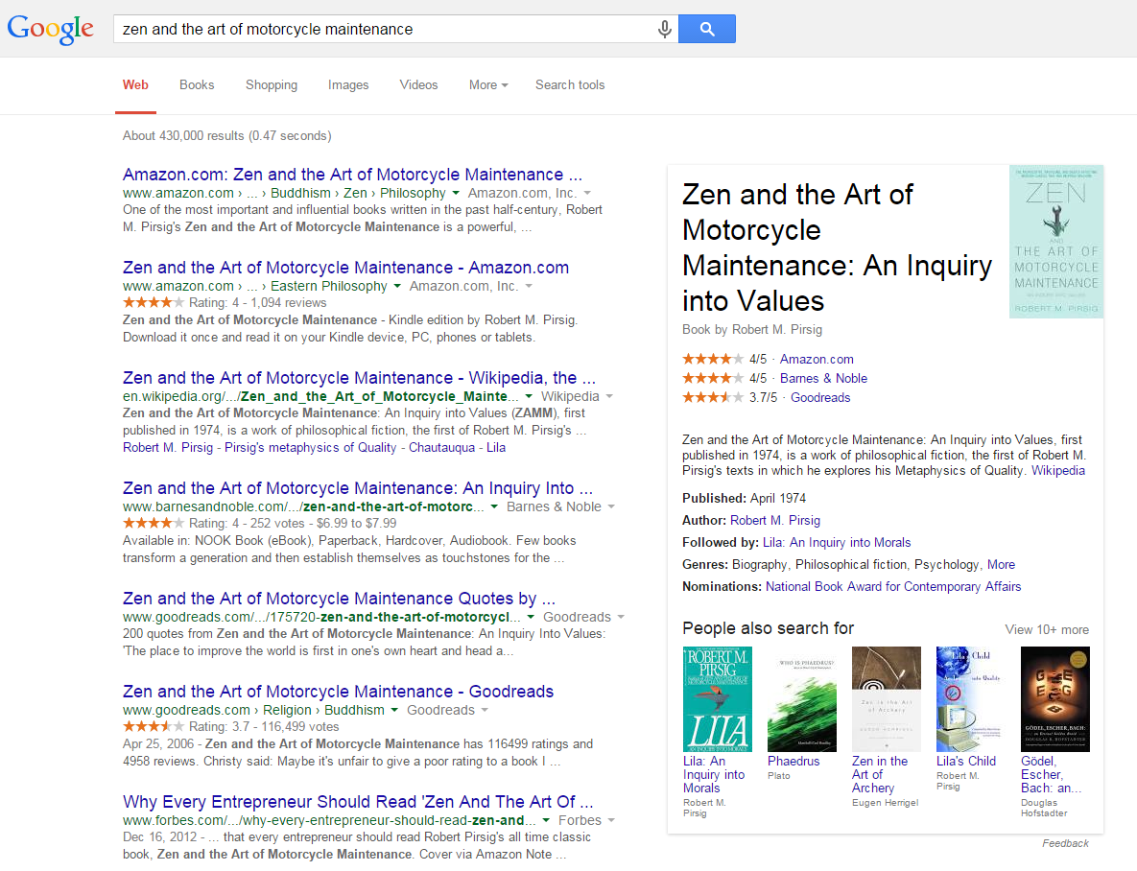
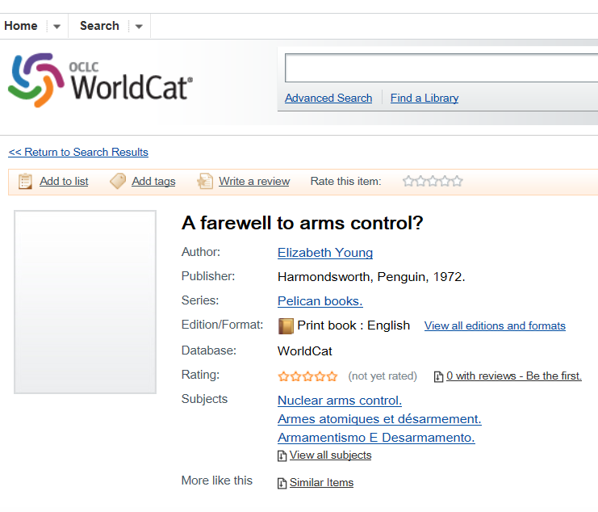
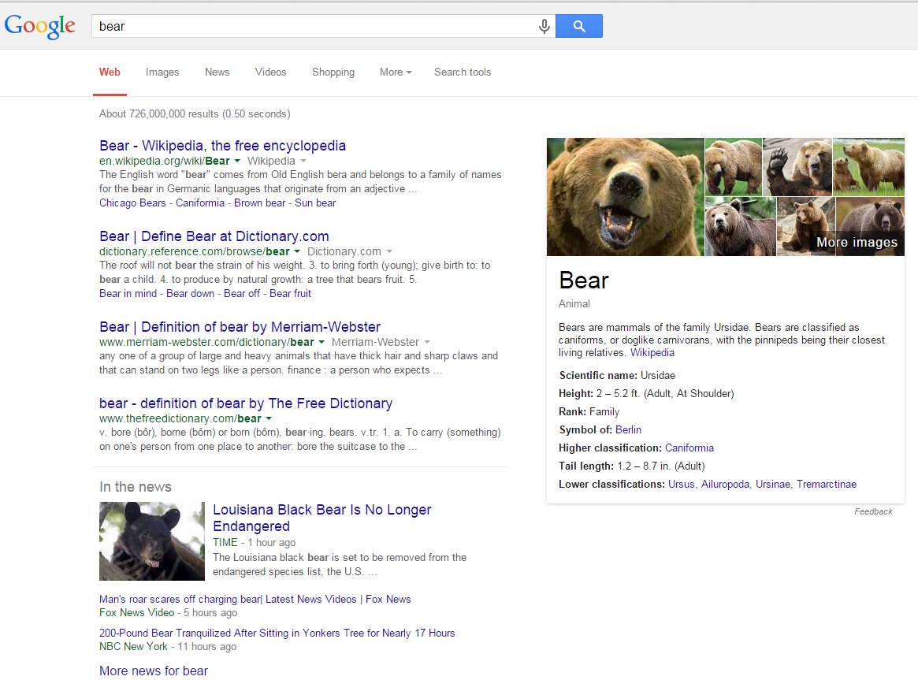
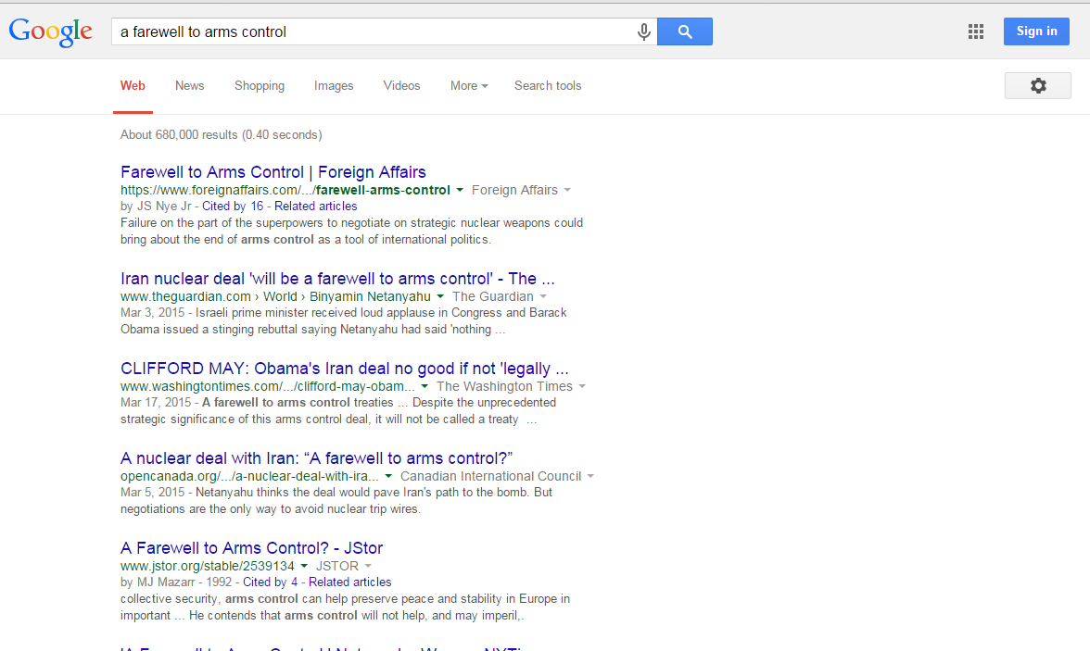
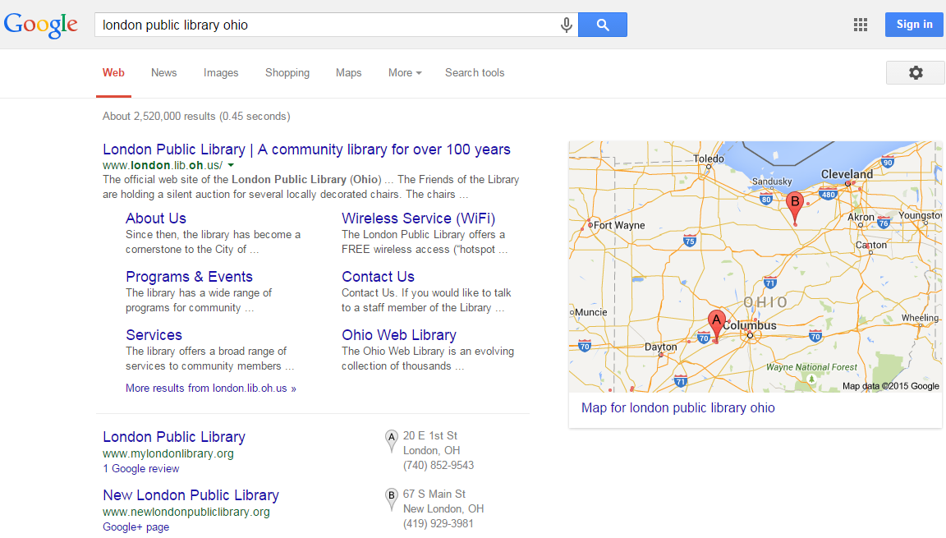
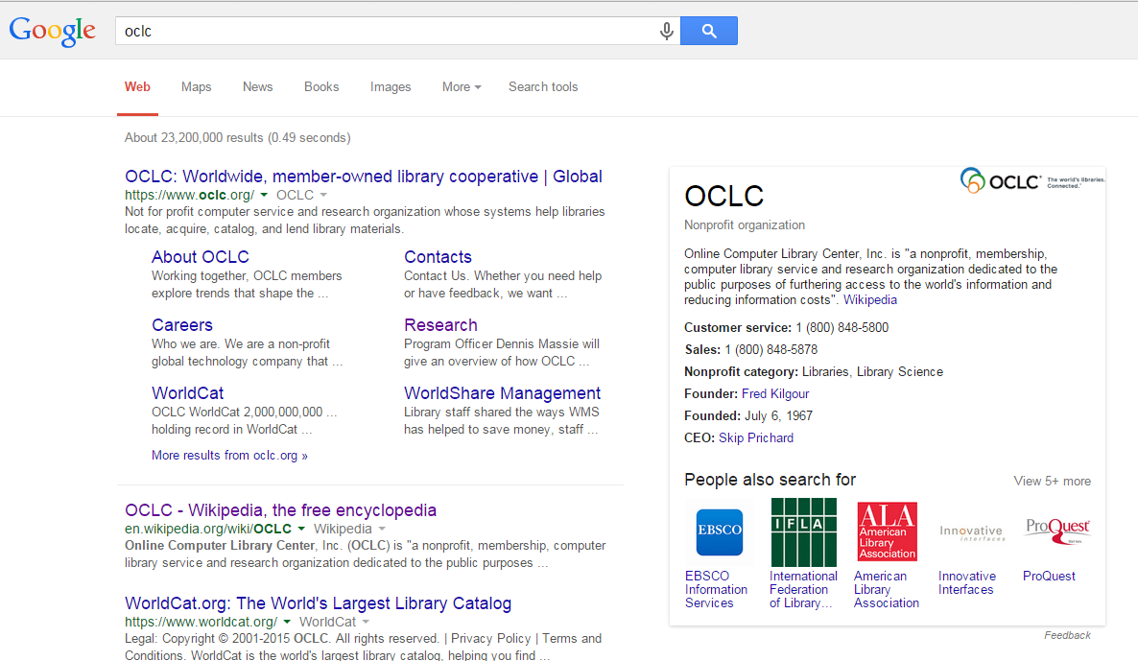
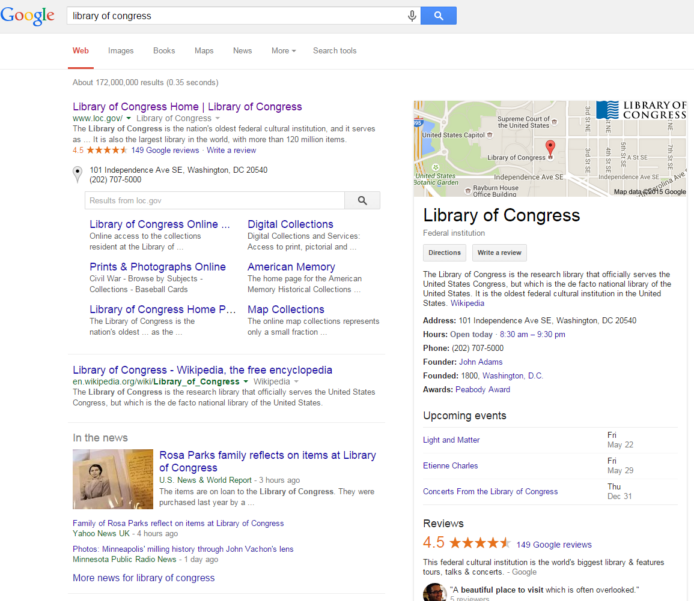
A web of documents
and the Web of Data (about `Things’)
Notes:
So let’s get started. How does the Web of Documents differ from the Web of Things and why does this difference matter?
On the left is a search result from Google for ‘Library of Congress’. It is a list of documents that contain the phrase ‘library of congress.’
On the right is a Google knowledge Card. It is something fundamentally different. It is a description of a ‘thing’ called Library of Congress compiled from a dataset that Google now calls the Knowledge Vault. This is structured data mined from the Web and includes some of the linked datasets shown in the LOD cloud. The result is put into the Knowledge Card we see on the right. It contains attributes that someone might care about. Organization: location on a map, what its building looks like, its hours of operation, etc. This information is present in the web of documents, too, but the user has to dig for it, and often for a long time.
The Google knowledge vault now contains billions of entities and they are available not only for organizations such as Library of Congress, but also for common objects.
*bears. More pictures. ‘Bear’ is ambiguous.
*certain objects found in libraries. Such as ‘Zen’
*following up on observations made by Kenning Arlitsch, Google Knowledge cards for libraries vary in quality. LC looks good, but KC for the London (Ohio) public library is just a location on a map. Kenning’s argues that the KC can be improved by writing a Wikipedia article, which has the effect of generating structured data in Dbpedia. This is mined by Google and other search engines.
*But the problem is deeper because most resources held in libraries do not have KCs. Only the most bestsellers do. ones do. For example: A Farewell to Arms Control written by Elizabeth Young and published in 1972.
In other words, the transformation to the Web of Things changes what it means to publish on the Web. It is no longer good enough to be ‘on’ the web. Libraries and their contents need to be an integral part of the web.

Slide 9
The two views of the Web
Web of Documents
Web pages or other documents
Human-readable text
Independent
Static
Web of ‘Things’ (or Data)
Statements about entities, or ‘Things’
Machine-processable data
Integrated
Actionable
Notes:
So now there are two views of the Web. Why this is important:
1. The KC is a useful application. It saves the reader’s time, which is the first principle in reordered Ranganthan, as our colleagues Lynn Connaway and Ixchel Faniel argued in the book they published last year. And the Web of Data is fertile ground for other good applications.
2. The data produced by LD principles is understandable to others outside our domain. This is what would be required for libraries to be present in the Knowledge Vault

Slide 10
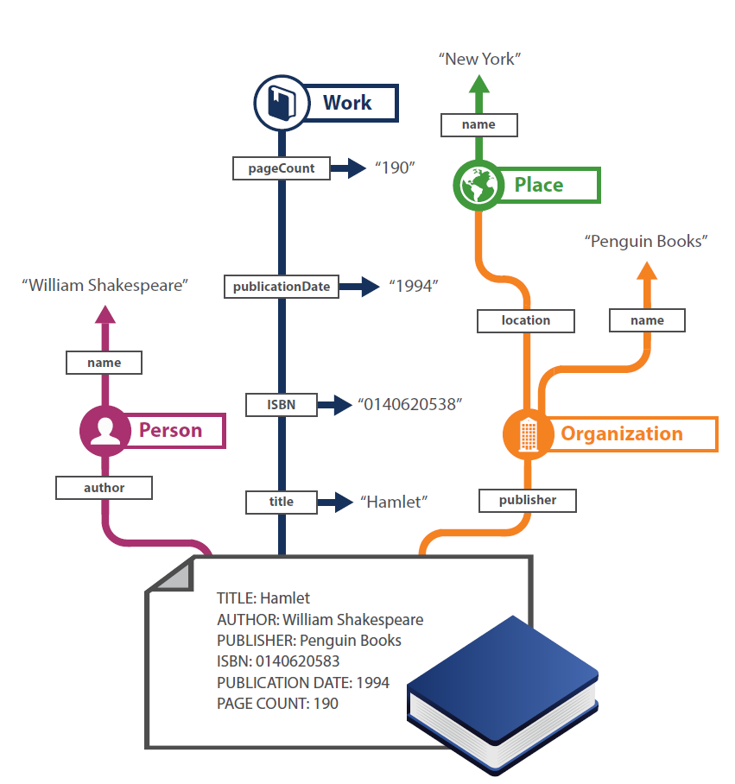
Notes:
So how do we get from documents to entities?
Once solution is an entity-relationship model of the domain of resources managed by libraries. We get there by shredding documents into a set of statements into a simplified form of ‘English’ (or other human language) that a computer can understand. This diagram shows that a bibliographic record about Hamlet can be represented as a set of statements such as ‘William Shakespeare is a person’ Hamlet is a work, ws is the author of hamlet, and so on.
Entity-relationship models like this one have been created for decades. Students learn how to do this in CS 101. It’s an admission that natural-language processing isn’t going to get us where we want to be—not fast enough, anyway.
The linked data paradigm just adds some new requirements:
--use published vocabularies; identify as many links as possible; define entities and relationships that are real– or things in the world that regular people care about – not software objects, database records, or program states that are understood only by me or my project team.
--So this is a big deal. ld is about a shared semantics. It is about a theory of reference that makes the claim that meaning is not just something inside a person’s head, but something much more public. Lots of philosophers have written about that.

Slide 11
“…[P]eople are not the only users of the data we produce in the name of bibliographic control, but so too are machine applications that interact with those data…” Library of Congress On the Record, 2006
“Linked data is about sharing data. [It] provides a strong and well-defined means to communicate library data, one of the main functions requiring attention in
the community’s migration from MARC.”
Kevin Ford, 2012
Notes:
Ch01 gives a rundown of the landscape in which we are working, both in the web standards community and the library community.
The bottom line:
* Linked data is the end result of a long evolutionary path that reaches back before the beginning of the Web as a viable platform for delivering information. And the library community has endorsed those developments.
Some of these sentiments are echoed in publications from the Library of Congress, who have been instrumental in driving the modernization of standards that would be used throughout the world.
Two big conclusions:
Library standards need to be upgraded so machines as well as humans can process library data.
Linked data is aligned with the values of librarianship and the technical requirements of library metadata.

Slide 12
Some big tasks
Transform the description of library resources
Filling the ‘library-shaped’ hole in the Web of Data
Defining more clearly what is meant by ‘machine-readable’ semantics in bibliographic metadata
…using standards, protocols, and best practices developed for the Semantic Web
Notes:
(*point 1) Using the phrase coined by Richard Wallis: Libraries are nearly invisible in this world. But this is where users are. It’s where they begin their search for information.
(*point 2) After all, so was MARC. The definition will change as computing power grows.
(*point 3) this is the linked data paradigm

Slide 13
Modeling and Discovering Entities in Library Metadata

Slide 14
“Computers are dumb. Well, they’re not as smart as us, anyway. Computers think in strings (and numbers), where people think in ‘things.’ Computers think in strings (and numbers) where people think in ‘things.’ If I say ‘Captain Cook,’ we all know I’m talking about a person, and that it’s probably the same person as ‘James Cook.’ The name may immediately evoke dates, concepts around voyages and sailing, exploration or exploitation, locations in both England and Australia …but a computer knows none of that context and by default can only search for the string of characters you’ve given it. It also doesn’t have any idea that ‘Captain Cook’ and ‘James Cook’ might be the same person because the words, when treated as a string of characters, are completely different. But by providing a link …that unambiguously identifies ‘James Cook,’ a computer can ‘understand’ any reference to Captain Cook that also uses that link.” Mia Ridge, 2012

Slide 15
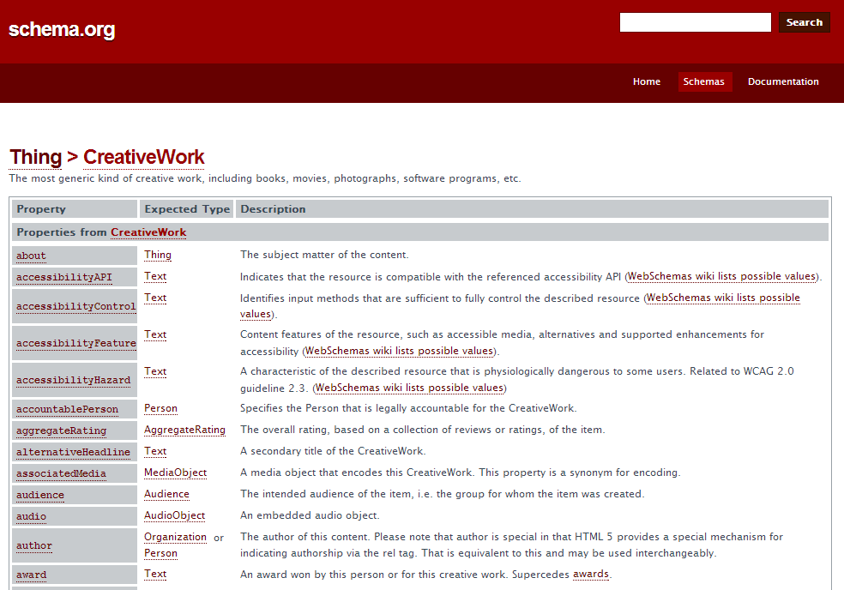
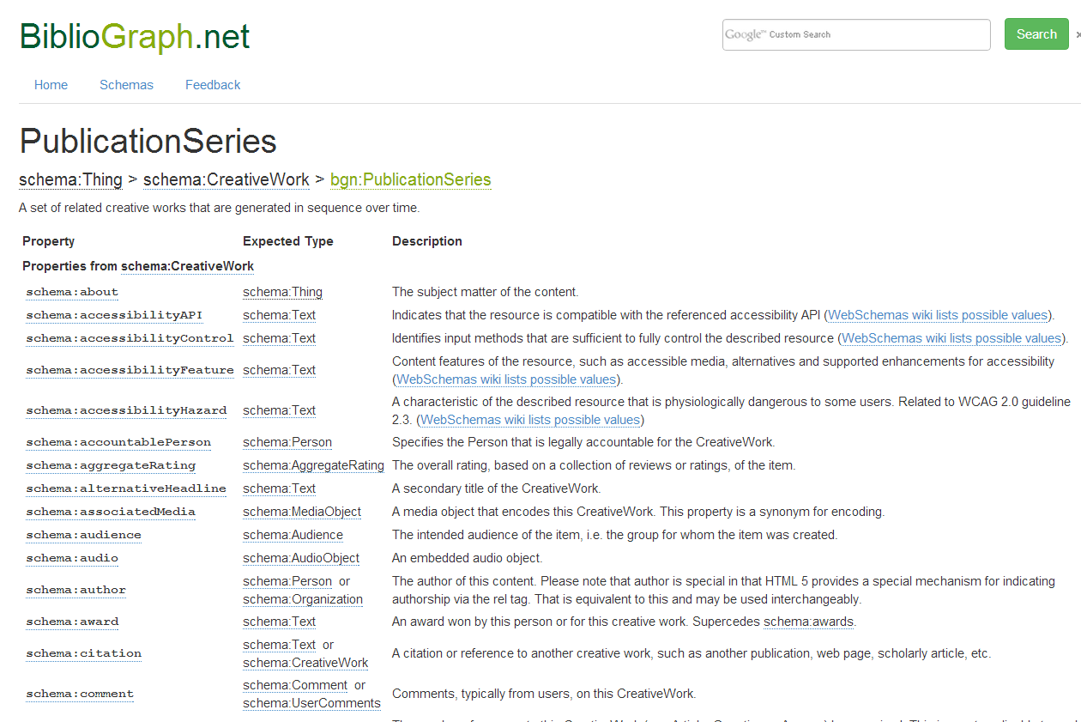
Schema.org and BiblioGraph.net
“Schema.org permits simple things to be simple and
complex things to be possible.”
R.V. Guha (paraphrase) 2014
Notes:
As the cornerstone of our RDF modeling, we chose to use the Schema.org vocabulary. Released in 2011 as part of a collaboration between Google, Bing, Yahoo! And Yandex, it provides a means to describe bibliographic items using vocabulary terms that are consumable and understood by search engines. Since the vocabulary was not specifically designed for bibliographic material, we needed a way to extend Schema.org. BiblioGraph.net is an extension vocabulary that follows the same principles of Schema.org. We use it when we need to describe things with more granularity then is allowed in Schema.org. Since the release of BiblioGraph.net, there has been discussion with the Schema.org community about creating official domain specific extension to the Schema.org vocabulary. The BiblioGraph.net terms are being used as the cornerstone for the bib.schema.org

Slide 16
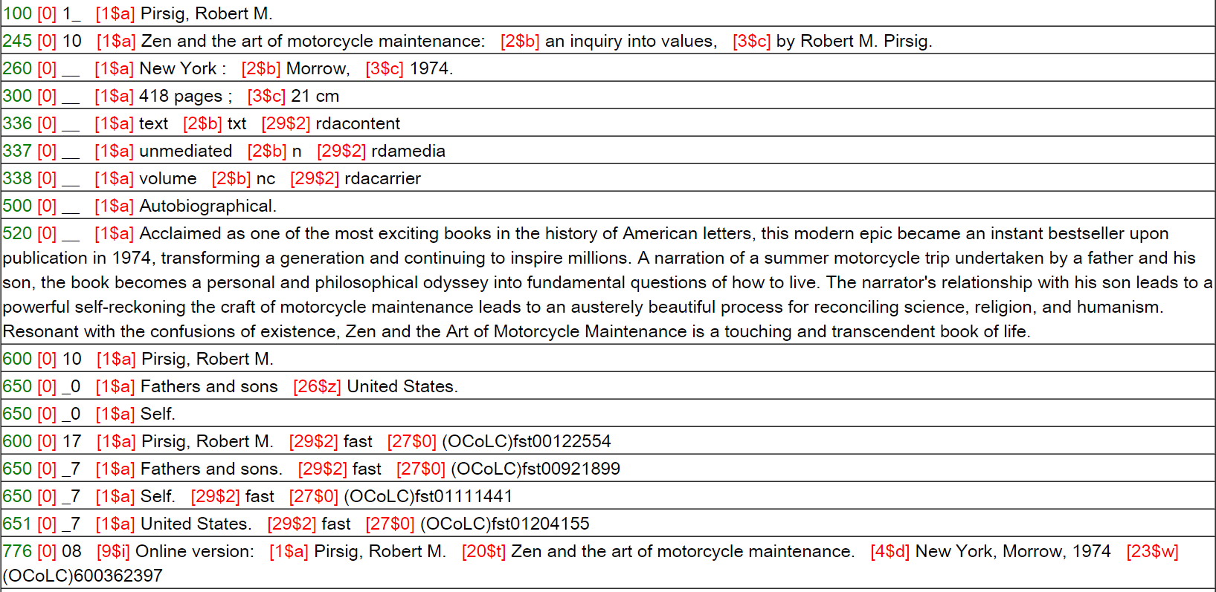
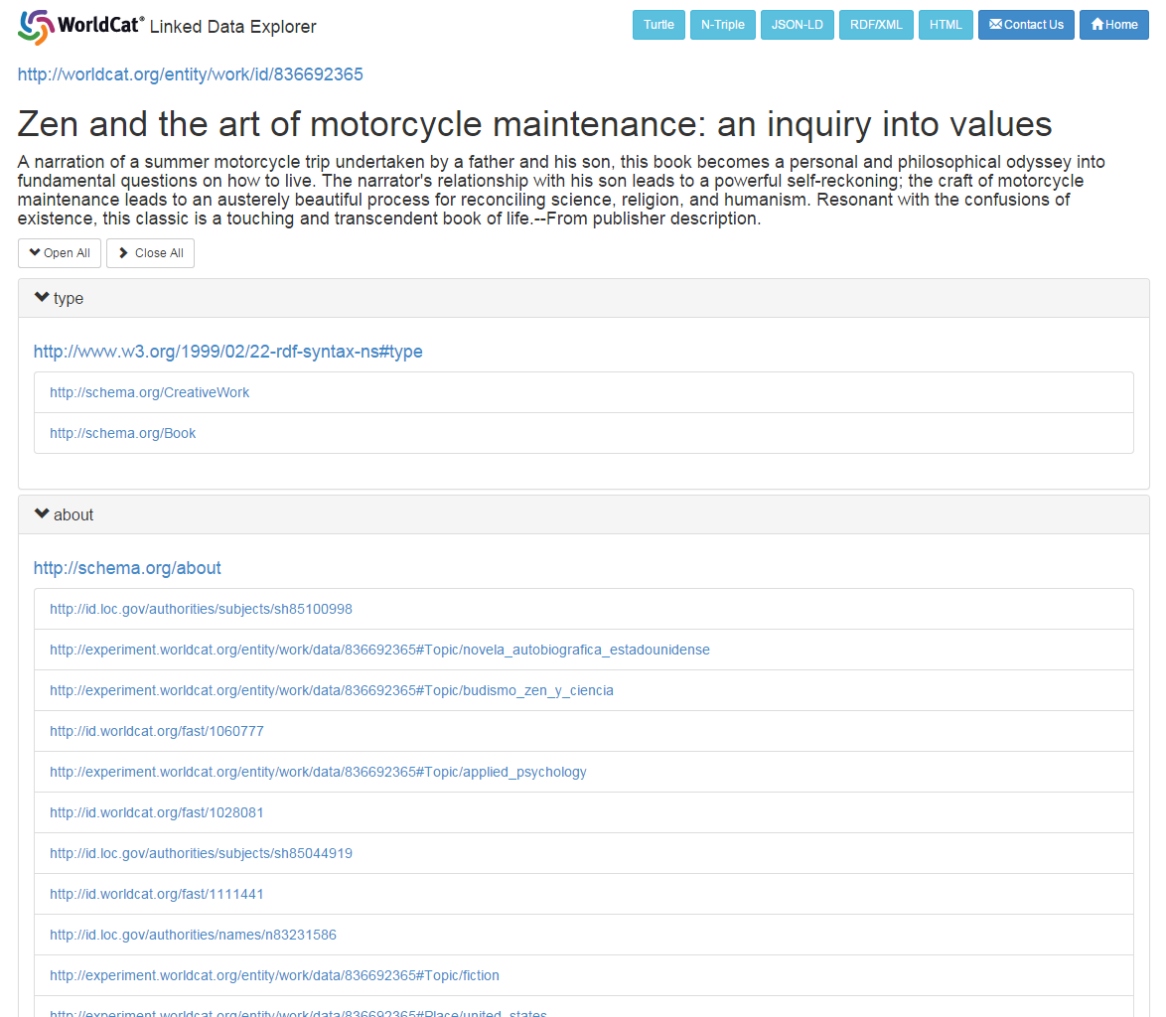
From records to entities: Works
Notes:
We have internal processes that take MARC records serialized as XML and convert them using an XSLT stylesheet into RDF data. This graphic visualizes how we take a MARC records with a $100 Personal Name (Robert Pirsig), a $245 Title (Zen and the art of motorcycle maintenance) and a $650 subject (Fathers and sons) and translate the string values into RDF entities and values. In addition to shredding the MARC record into entities, the other crucial part of this process is clustering WorldCat manifestation-y type records into Work clusters. The resulting image shows you how we are exposing the OCLC Works data right now. With a known Work ID, you can lookup OCLC Works as well as content negotiate for various RDF serializations (NT, JSON-LD, RDF/XML and Turtle).

Slide 17
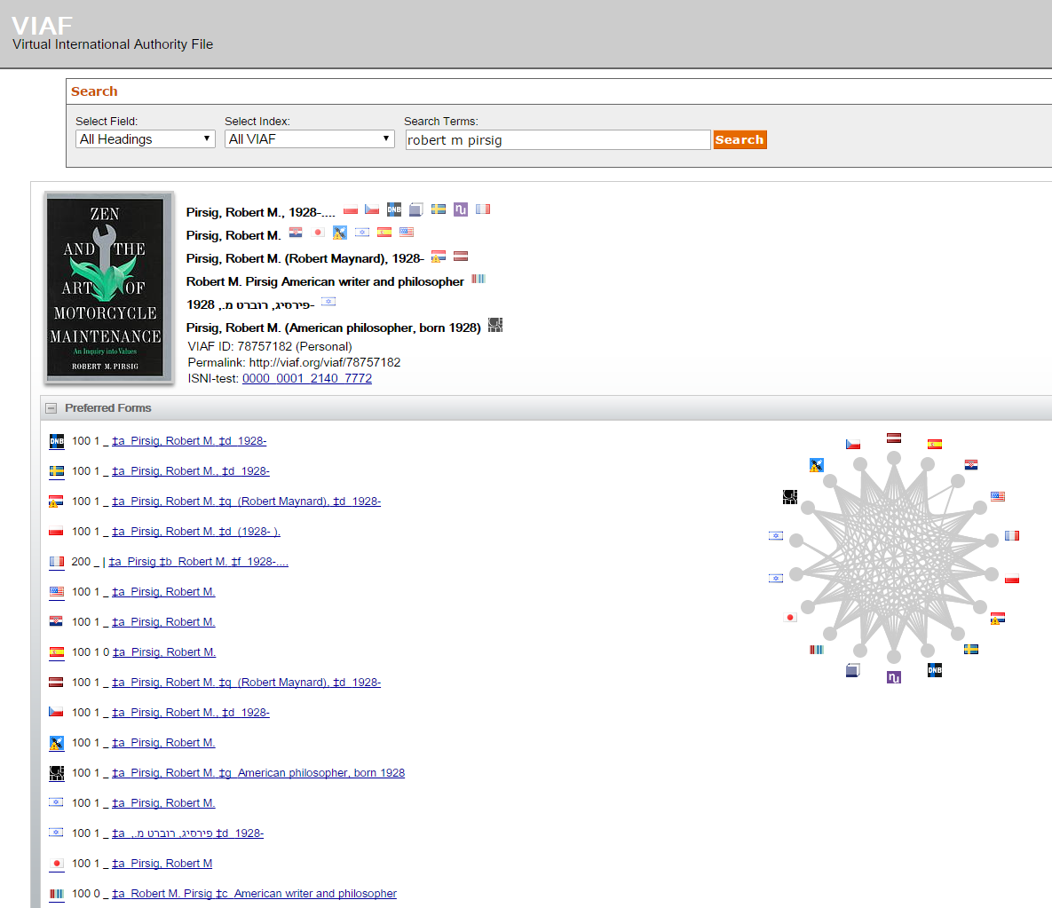
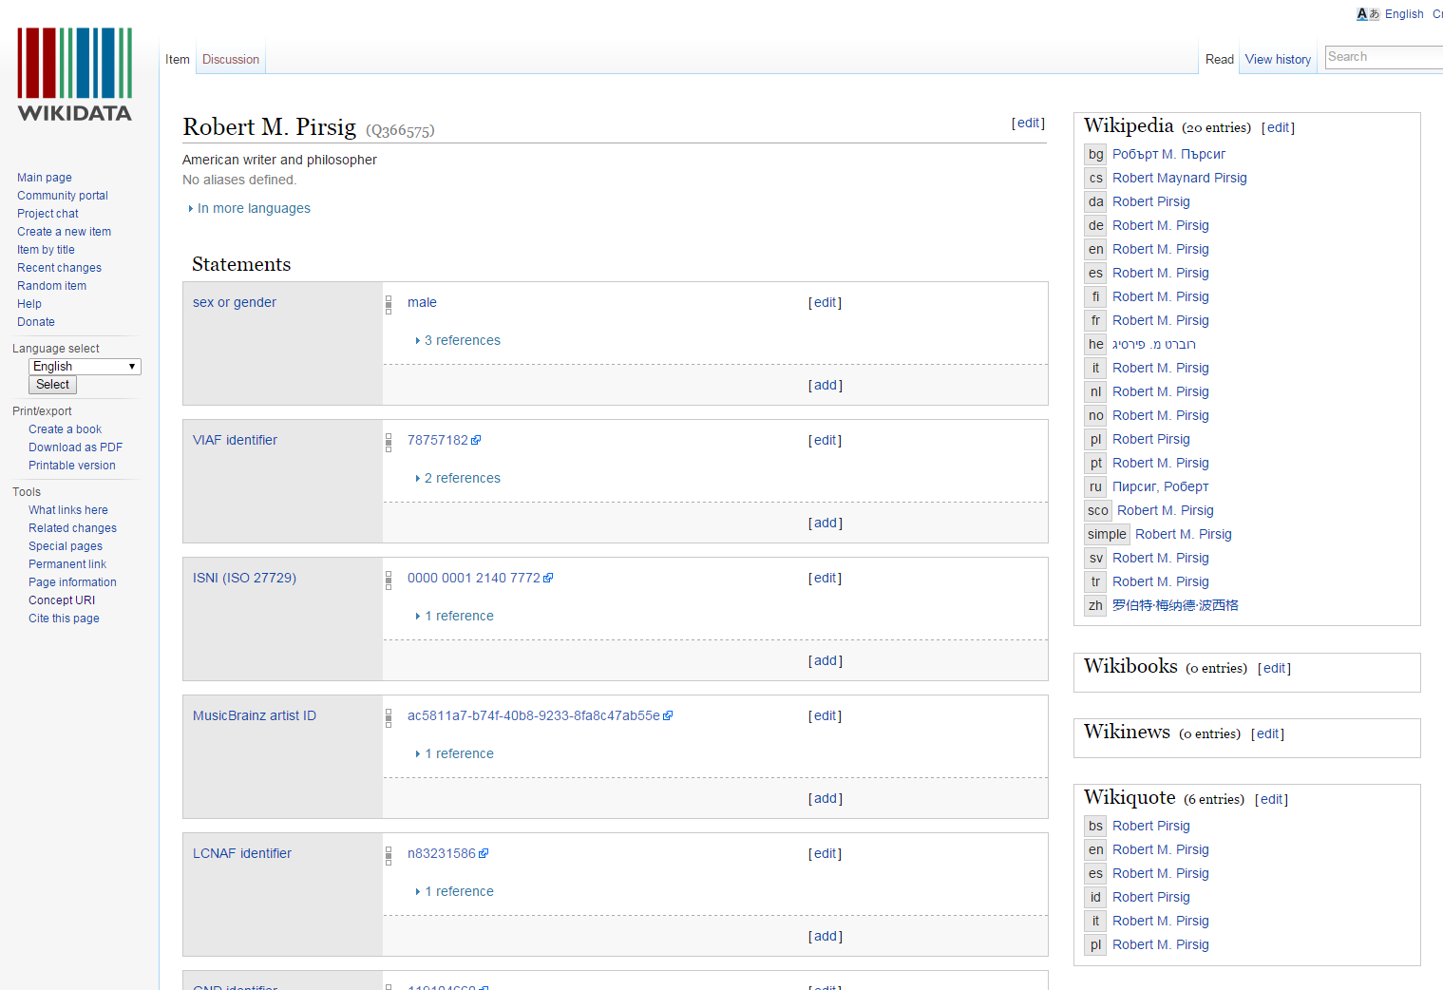
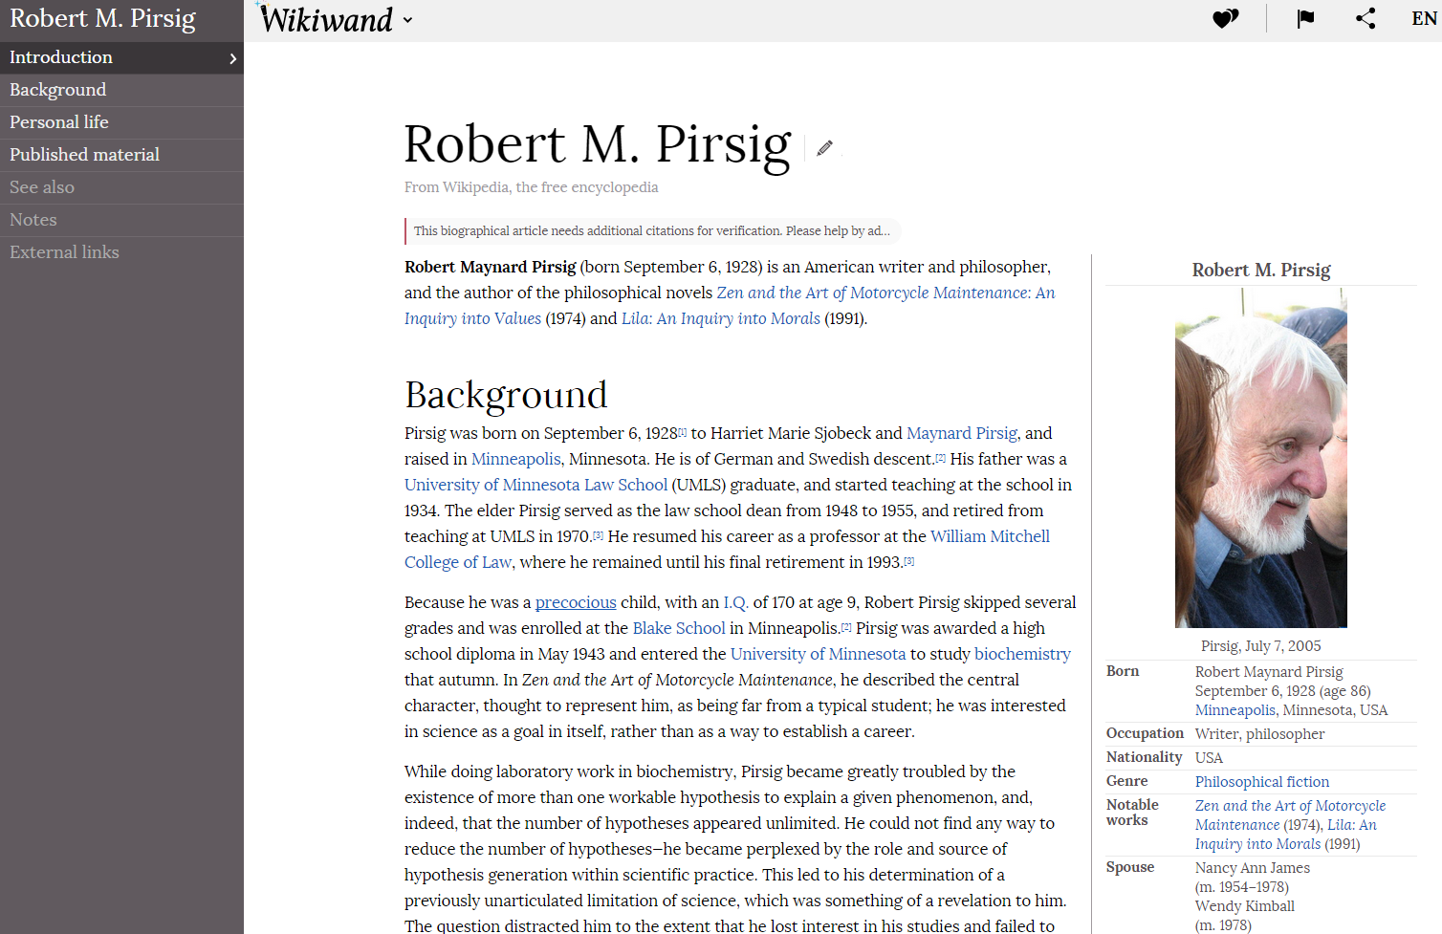
From records to entities: Person
Notes:
We have been able to do the same conversion of personal authority records to Person entities. In doing so, we have been able to not only generate Person entities but more importantly we have begun to connect together, using the schema:sameAs property, individuals across different datasets. This graphic illustrates how we have been able to mine a personal name out of MARC records and connect it to VIAF. From there we have been able to connect the VIAF Person entity for Robert M. Pirsig to both the Wikidata entity for him as well as the Wikipedia entity (Dbpedia). This can help up us greatly expand the number of language specific string values we have as well as help use provide some context and biographical background to our Person entities, which could help drive next generation discovery services.

Slide 18
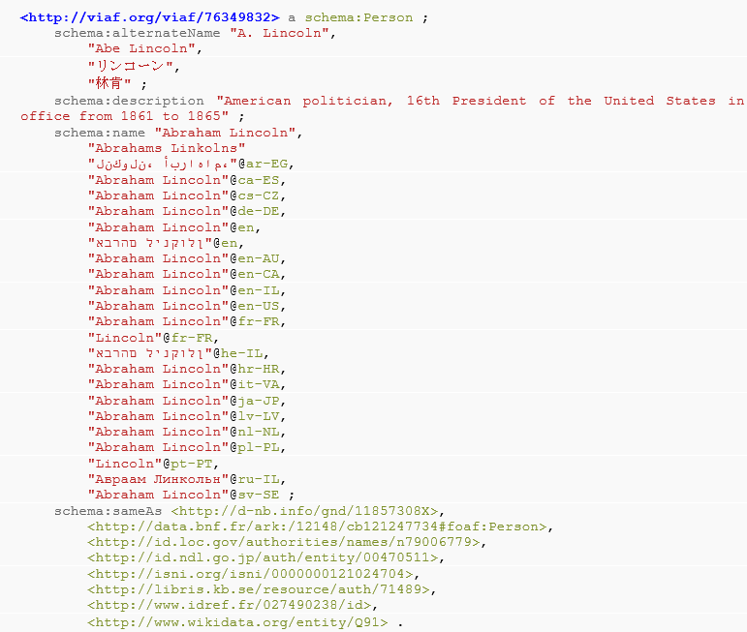
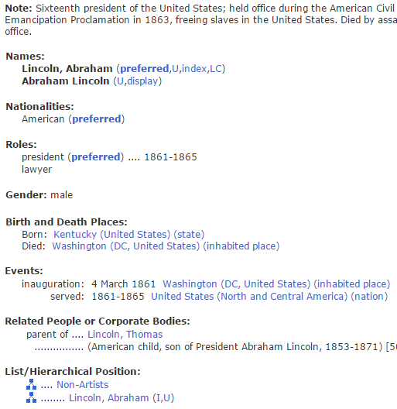
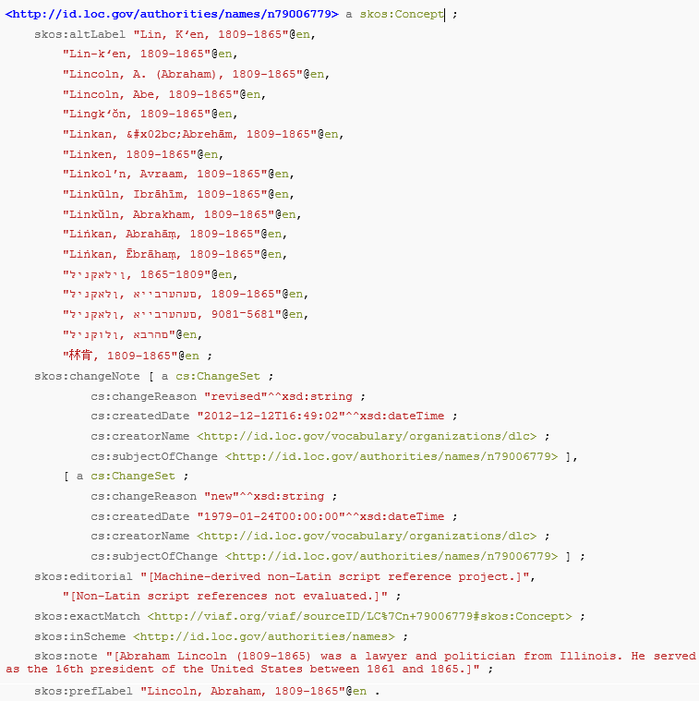
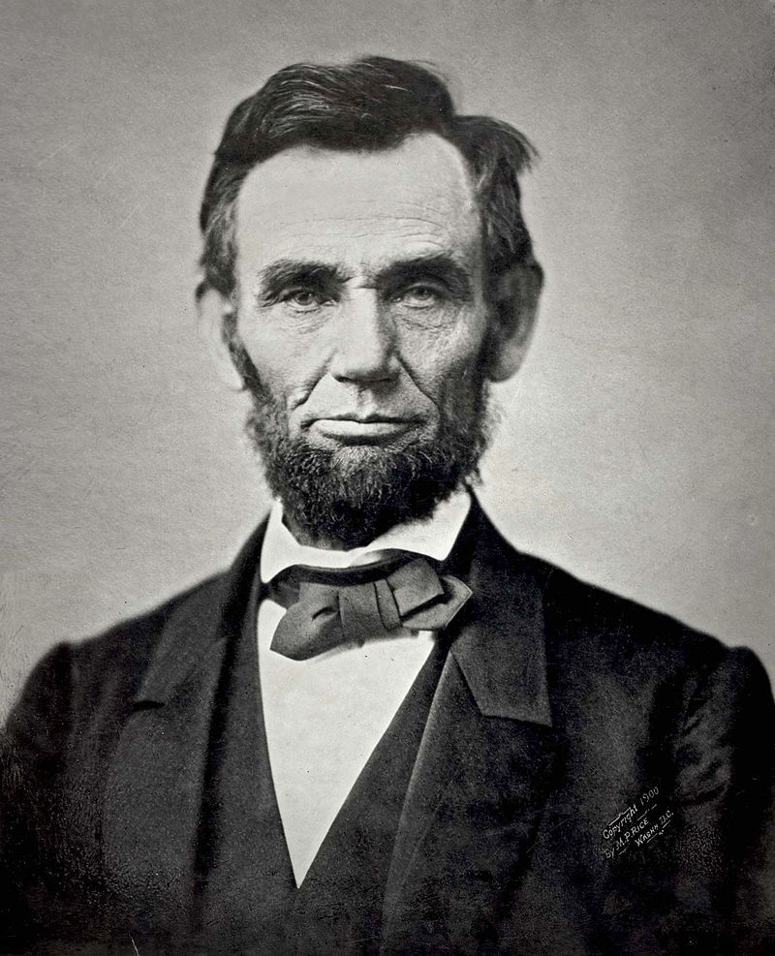
The evolving model of Person
“I am a real person… or was a real person”
Notes:
So in order to create a Person entity we needed to first derive a model for People. Librarians have been managing personal names for quite some time. When the SKOS vocabulary was developed, there was a push to use it to describe resources that were traditional managed in personal name authority files. This first image is a screenshot from the Getty’s ULAN authority file. It looks very much like thesaurus entry, with preferred labels, hierarchical relationships etc. During the early days of RDF development, commonly referred to as ‘SKOSification’ these thesaurus personal name entities were mapped into the SKOS vocabulary, which is used to describe resources found in lists, thesauri, dictionaries etc. As a one to one mapping, this worked very well but there were some logical issues that quickly became apparent, especially to folks working outside of library-land. As we can see here Abraham Lincoln is a real person (or at least was a real person). In SKOS, he was describes as a Concept, following the lineage of controlled vocabularies/authority files. In our modeling of People, we thought it was important model reality which consequently lead to a model in which people are people, places are places, etc. This new view of reality was first implemented in VIAF, originally using FOAF but later using Schema.org. As you can see, this VIAF Thing is classed as a schema:Person and as such has properties associated to it like name, description, birthdate, death date etc. Just to clarify that it is OK to classify Abraham Lincoln as a person here is a snippet of the Person class from the Schema.org vocabulary. You can see that a Person can be alive, dead, undead or fictional – so yes Pinocchio is a real boy (within the reality define in Schema.org).

Slide 19
The evolving model of Person
“The focus property relates a conceptualization of something to the thing itself…” -
http://xmlns.com/foaf/spec/#term_focus
LCNAF
DNB
foaf:focus
foaf:focus
VIAF
foaf:focus
foaf:focus
Getty ULAN
LACNEF
Notes:
The way this new model of Person manifested itself within the VIAF model is that we are able to identify the actual person and then connect them to their respective authority file entries. We have come to refer to this model as the hub and spoke model. At the center is the VIAF entity and around the periphery (the spokes) are various authority file resources. The authority file resources are connected to the VIAF Person via foaf:focus properties. The foaf:focus property is used to connect the conceptualization of something to real-world thing itself. In the example on the previous slide we could connect the LCNAF skos:Concept for Abraham Lincoln (i.e the conceptualization of the Person) to the description of the real-world Person using the foaf:focus property.

Slide 20
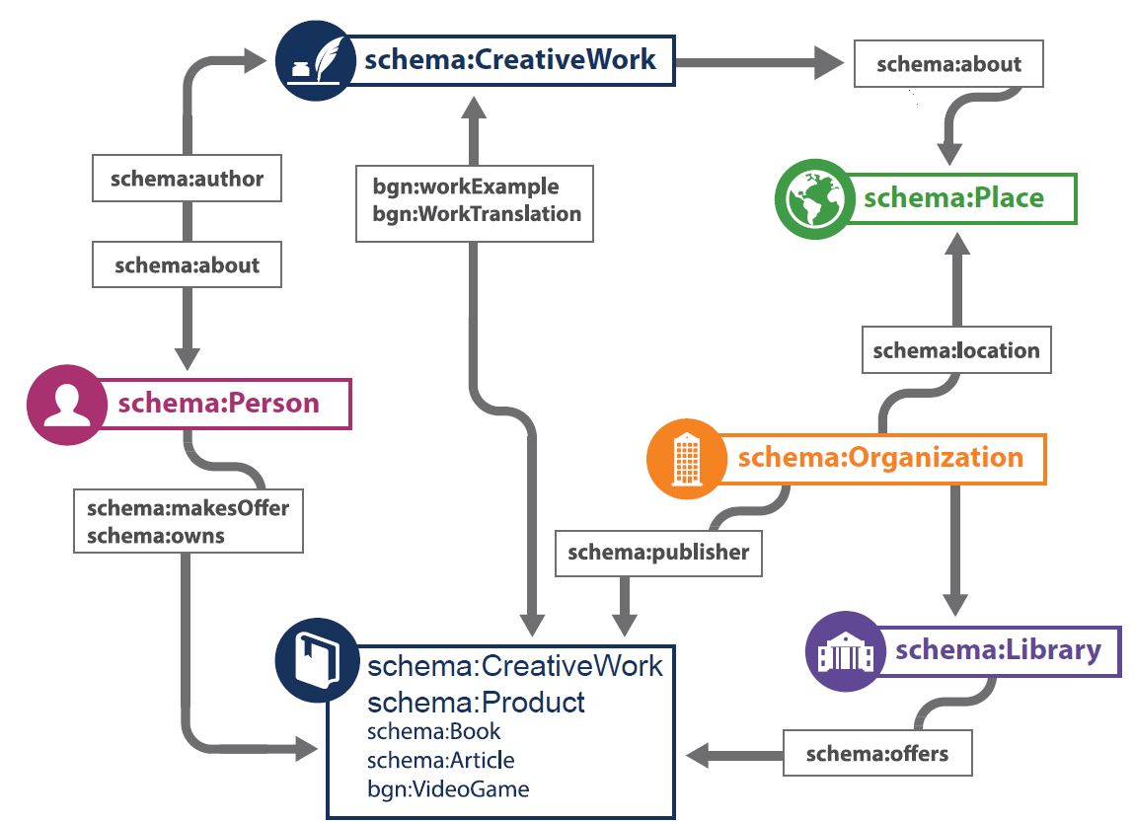
A model of creative works
Notes:
This is the model that we currently use for CreativeWorks. As you can see we have key entities, CreativeWork, Person, Organization, Place etc. The diagram gives a nice overview of our high level entities and how they are connected together.

Slide 21
A sample description
schema:name “Zen and the Art of Motorcycle Maintenance”
schema:about <fast:120755>
schema:name “Montana”
schema:exampleOfWork <wcw:836692365>
schema:name “Robert M. Pirsig”
schema:name “Morrow”
schema:creator <viaf:78757182>
schema:workExample <wc:673595>
schema:publisher <fast:603137>
schema:IndividualProduct
schema:name “Zen and the Art of Motorcycle Maintenance”
Notes:
So this image takes the high level model from the previous slide and adds some instance data to help give some context. You can see we have a person, Robert M. Pirsig, who is the author of this CreativeWork/IndividualProduct, Zen and the art of motorcycle maintenance. The CreativeWork/IndividualProduct has a related publisher, Morrow. The CreativeWork/IndividualProduct also points to a Work Entity which has a related subject (schema:about), Montana.

Slide 22
Some big tasks
Converting string-based descriptions to real-world objects
Representing an actionable view of the domain of library resources and the transactions involving them
Building a foundation for future development

Slide 23
[Text] Mining for Entities and Relationships

Slide 24
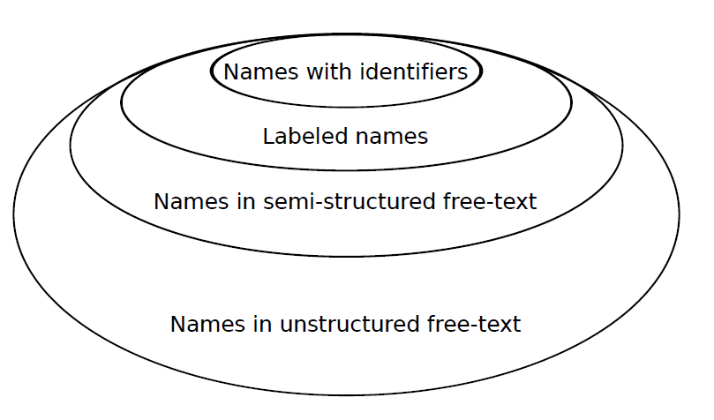
Estimating the size of the problem
16 Million
39 Million
Notes:
So the processes that I just discussed really rely on identifiers that are added to our MARC data through a data enhancement process. This process attempts to match string labels to entities in VIAF, FAST, LCHS and other authority files. Although these processes are very good, there is still a huge corpus of uncontrolled strings that we need to mine and either match to outside entities or create new entities for. To give you a rough idea of where WorldCat is today. There are approximately 16 Million string names that have identifiers. Next out, we have approximately 39 million labeled names with no identifiers. Out from there you get into pure text mining territory. Names in semi-structured fields and unstructured fields. This is where the next phase of entity identification and relation will take place.

Slide 25
Some big tasks
Reaching beyond controlled access points in MARC records
Improving the feedback loop for discovering entities
Clustering and disambiguating – bringing descriptions of the same entity together and separating entities with the same name
Linking to datasets managed outside the library community

Slide 26
Results and Next Steps

Slide 27
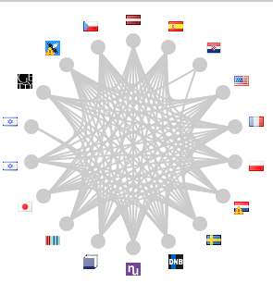
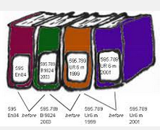
Some outcomes
WorldCat Works: 5 billion RDF triples
FAST:
23 Million
WorldCat Catalog:
15 billion triples
VIAF: 2 billion triples
DDC:
300 million
triples
Notes:
Statistics as of August 2014
KSY’s survey results, September 2014 (72 respondents)
OCLC’s RDF datasets are among the oldest, largest, and most referenced LD stores in the ‘library’ sector of the linked data cloud.
There is international interest in LD
There are many emerging datasets, including WorldCat Works
But:
The cloud is still organizing itself.
Many small datasets, relatively little cross-linking from:
The broader web to the library community
The library community to the broader web
The library community to itself
The survey will be repeated this summer

Slide 28
Next steps
Build on our results
Improve the models of ‘Person,’ ‘Organization,’ and ‘Concept, and ‘Work’
Continue with internationalization effort
Advance long-term goals
Interoperate with other community efforts
Carry out formal studies of linked data’s impact
Access the new datasets from a new generation of services that improve the discovery and delivery of library resources.
Notes:
Near-term goals – Development tasks: refine what we have.
Point 1. So far, the modeling effort has focused primarily on ‘Person.’ The other entities are just getting started. Concept, Topic are ready to develop if modeled in SKOS. The models of Organization, Place, and Work are still in draft form.
Point 2: Right now, we just have a sketch (defining requirements—describe (and ultimately deliver) the work in the user’s language of choice; backward compatibility with MARC.
Point 3: we have enough critical mass to measure impact. Will be done jointly with KA/PO
In other words, the work we have done represents a foundation, or a set of building blocks, that can be used to define a more detailed model. In the book, we focus on models of published monographs. We drop hints about how it can be extended to digitized objects, journal articles, and contents of institutional repositories. We’re already working on those extensions.

Slide 29
The incremental value of the linked data program
Web syndication
Active or actionable data
Data consumed outside the original domain or creation context
Complex data queries without pre-built indexes
Machine-understandable semantics
Cleaner, more normalized data
Notes:
Above the line:
What we’re really after
Below the line:
Accidental benefits that accumulate along the way
The triangle symbolizes where the most effort has been expended and where the results have been achieved.

Slide 30
“If we believe there’s value to making our materials discoverable and usable to a wider audience of people, then we must begin a concerted effort to make our metadata interoperable with Web standards and to publish to platforms that more people use.” Kenning Arlitsch, 2014

Slide 31
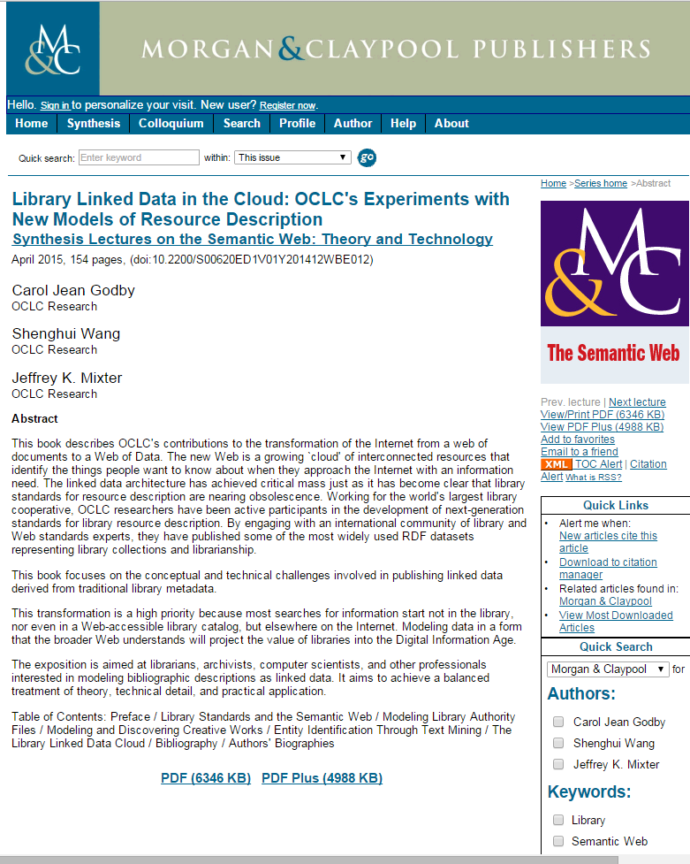
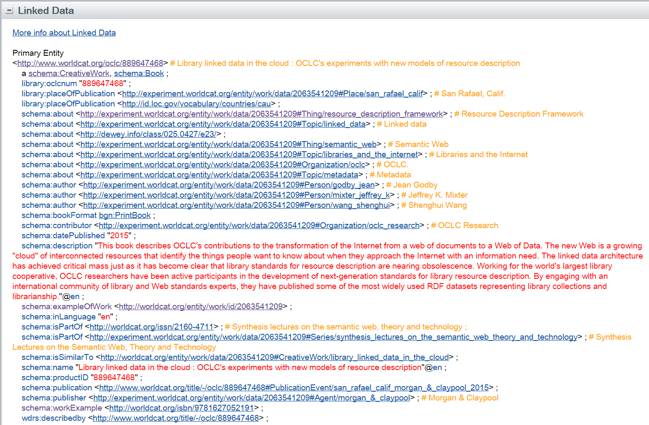
Notes:
This is a fast-moving story and a difficult subject to nail down in a book-length work.
But it’s a living document.

Slide 32
For more information
Carol Jean Godby, Shenghui Wang, and Jeffrey K. Mixter. 2015. Library Linked Data in the Cloud: OCLC's Experiments with New Models of Resource Description. A Publication in the Morgan & Claypool Publishers series Synthesis Lectures on the Semantic Web: Theory and Technology. doi:10.2200/S00620ED1V01Y201412WBE012.
Carol Jean Godby and Ray Denenberg. 2015. “Common Ground: Exploring Compatibilities Between the Linked Data Models of the Library of Congress and OCLC.” http://www.oclc.org/research/publications/2015/oclcresearch-loc-linked-data-2015.html
Carol Jean Godby. 2015. “Is Your Library a ‘Thing’?” https://www.oclc.org/en-CA/publications/nextspace/articles/issue24/isyourlibraryathing.html.

Slide 33
Questions?

Slide 34
Jean Godby
Senior Research Scientist
godby@oclc.org
Shenghui Wang
Research Scientist
wangs@oclc.org
Jeff Mixter
Software Engineer
mjxterj@oclc.org

