Slide 1
OCLC Research Library Partners, Works in Progress Series, 12 August 2015
Looking inside the
Library Knowledge Vault
Bruce Washburn
Consulting Software Engineer, OCLC Research
Jeff Mixter
Software Engineer, OCLC Research

Slide 2
An Overview of Work in Progress
Describing the Google Knowledge Vault
Considering how the Knowledge Vault could apply to Library data
Touring the experimental EntityJS application, for discovery of entities through the Library Knowledge Vault
Summarizing our experimentation to date, and where we’re headed
Notes:
Today we’re going to provide a brief update on some interesting work in progress in OCLC Research
We’ll begin by covering some recent research work at Google that describes the processes they are applying to build a highly-scalable Knowledge Vault, in which competing statements about things described on the web are assessed to determine the level of confidence in the source and the level of certainty about the statement’s truthfulness.
We’ll then talk about how in OCLC Research we’re thinking about that research work, and applying it in experimental ways with Library data.
As part of our work we’ve created an experimental application that we’re calling EntityJS, which can explore data through the Library Knowledge vault. We think it’s an interesting entity-oriented Linked Data discovery app, and would like to get your input on that.
And, as this is a work in progress and still in a somewhat formative stage, we’ll summarize where we are at and where we’re headed next.

Slide 3
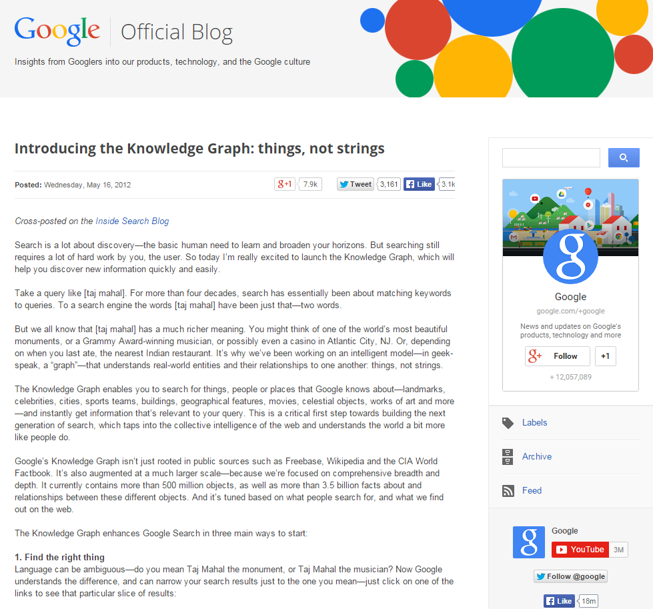
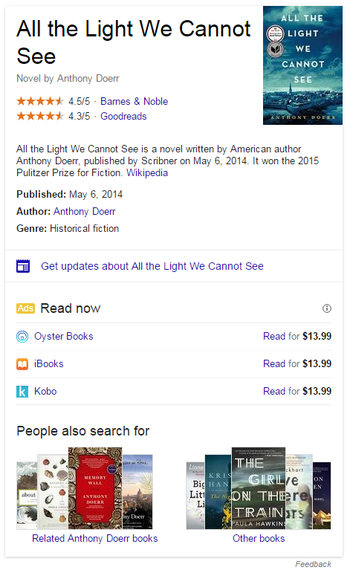
The Knowledge Graph
A Google blog post from 2012 describes the Knowledge Graph that supports searching for the things, people and places that Google knows about and suggestions for relevant related things.
The Graph powers the Google Knowledge Panel in search results
Notes:
The Knowledge Graph that Google began promoting in 2012 is often noted as a model of the power of linked data.
Recently, as Knowledge Panels have appeared with more frequency in search engine results, they have been pointed to as exemplars of that power, with libraries, archives and museums aspiring to be reflected in those highlighted views, and with some library systems emulating that type of focus on working in the data.

Slide 4
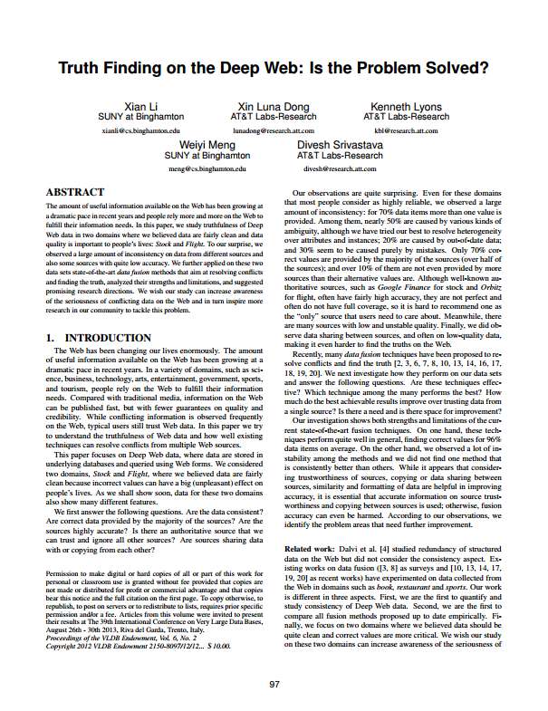
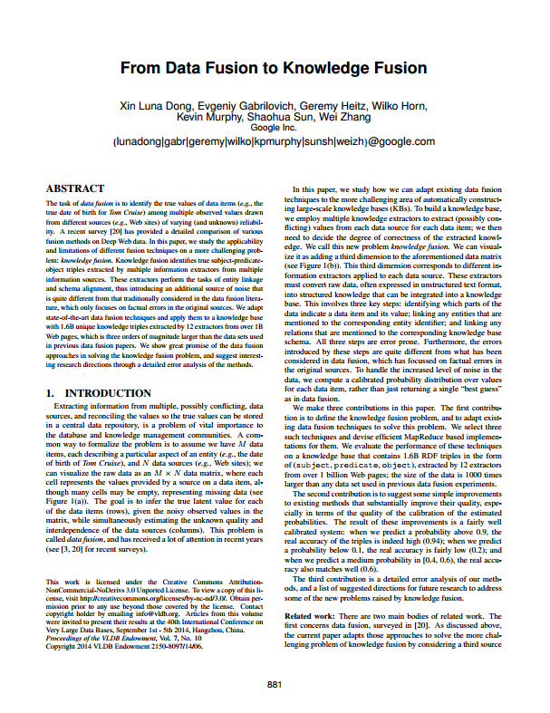
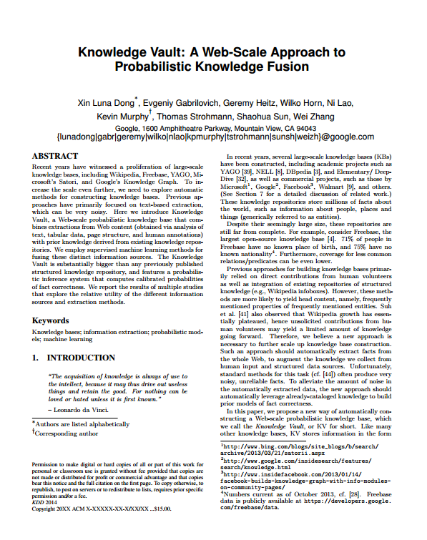
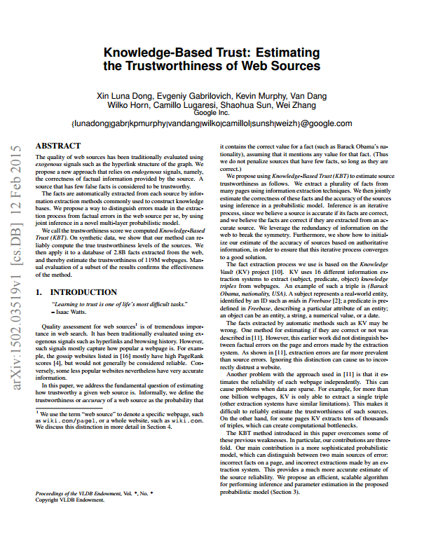
Estimating Trustworthiness and Finding Truth
A series of recent Google Research papers describe the use of probabilistic models and machine learning to assess the truth of statements made by multiple sources.
Li, X., Dong, X. L., Lyons, K., Meng, W., Srivastava, D. (2013). Truth Finding on the Deep Web: Is the Problem Solved?
Dong, X. L., Gabrilovich, E., Heitz, G., Horn, W., Murphy, K., Sun, S., Zhang, W. (2013). From Data Fusion to Knowledge Fusion.
Dong, X. L., Murphy, K., Gabrilovich, E., Heitz, G., Horn, W., Lao, N., ... & Zhang, W. (2014). Knowledge Vault: A Web-scale approach to probabilistic knowledge fusion
Dong, X. L., Gabrilovich, E., Murphy, K. Dang, V., Horn, W., … & Zhang, W. (2015). Knowledge-Based Trust: Estimating the Trustworthiness of Web Sources
Notes:
Google researchers have recently published a series of papers describing how they use probabilistic models and machine learning to assess the truth in the statements made about things and their relationships, mined from the web.
Google researchers refer to this as the Knowledge Vault.
OCLC Research Scientists and engineers have been taking a close look at this work, and thinking about how it may apply to how we aggregate, extract, and fold together bibliographic and authority data from a wide range of sources, as we pursue the work of building linked data representations for the things and the relationships those sources describe.

Slide 5
Understanding “RDF Triples”
A triple is a statement that relates one thing to another, specifying a Subject, Predicate, and Object. RDF triples use URIs for those three elements.
Subject | Predicate | Object
https://viaf.org/viaf/52010985 | https://schema.org/birthPlace | https://id.worldcat.org/fast/1204916
Barack Obama | Was born in | Honolulu, Hawaii
Notes:
Before getting too far ahead of ourselves, let’s contend with some necessary jargon and define an important concept … RDF Triples. We’ll be referring to “triples” a lot in this presentation.
A “Triple” is simply a statement that relates one thing to another. It has 3 parts, a subject, predicate, and object.
When working with large and varied data sources we need a common mechanism for comparing and sifting the aggregated data, and a way to relate one thing to another.
The RDF Triple gives us a common way to do that. RDF stands for Resource Description Framework, a way of modeling data, and an “RDF Triple” is a triple that has identifiers for the subject, predicate, and object.
In this example we see a VIAF identifier for Barack Obama, a schema.org identifier for place of birth, and an OCLC FAST identifier for Honolulu Hawaii, expressing a factual claim about the President’s place of birth.
These identifiers have an important quality of being “dereferenceable” … that is, they can be used with an internet protocol, like HTTP on the web, to look up more information about the thing they represent, and they are language-independent.

Slide 6
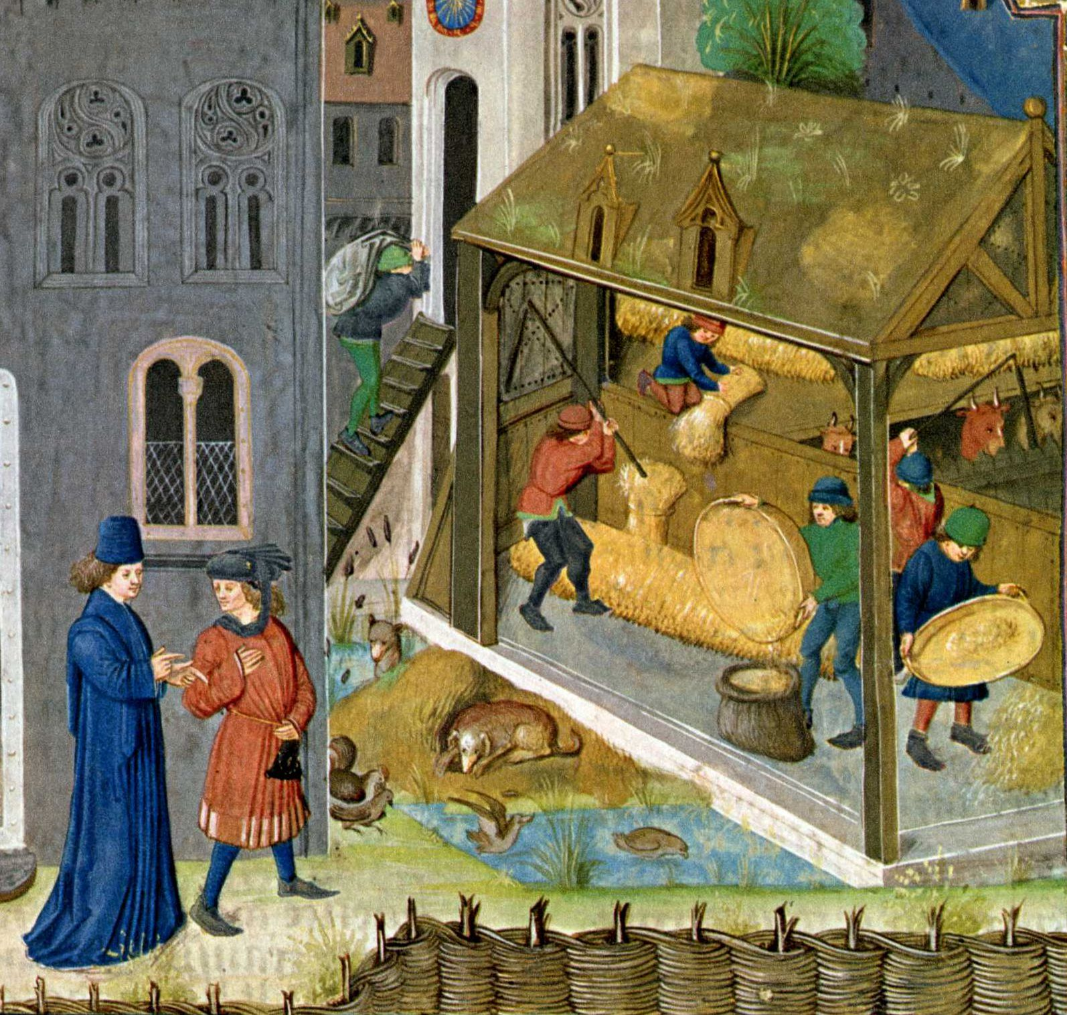
The 3 Main Components of the Google Knowledge Vault
1 -- Extractors
Threshing the Crop, 1480
https://www.flickr.com/photos/marceldouwedekker/7241332380/
Notes:
“Extractor systems extract triples from a huge number of Web sources. Each extractor assigns a confidence score to an extracted triple, representing uncertainty about the identity of the relation and its corresponding arguments.”

Slide 7
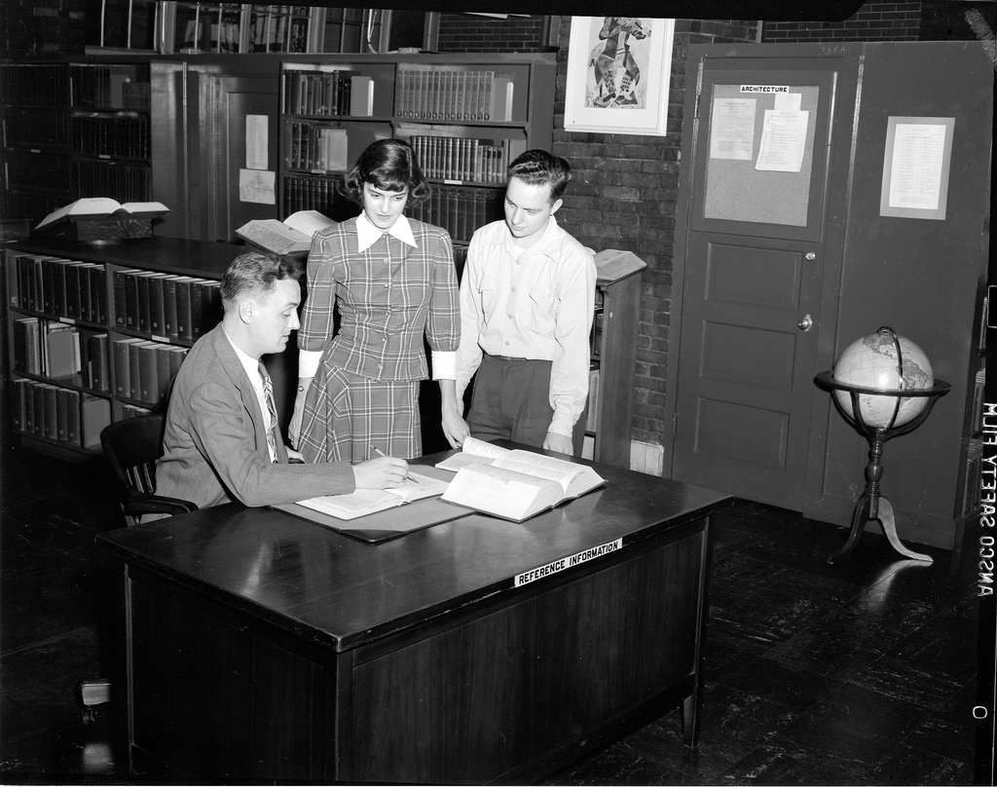
The 3 Main Components of the Google Knowledge Vault
2 – Graph-based Priors
Students at Library reference desk at University of Illinois at Chicago Navy Pier Campus.
https://www.flickr.com/photos/uicdigital/15578872696/
Notes:
“Graph-based Prior systems learn the prior probability of each possible triple, based on triples stored in an existing Knowledge Base.”

Slide 8
The 3 Main Components of the Google Knowledge Vault
3 – Knowledge Fusion
Hollerith Census Machine Dials
https://www.flickr.com/photos/mwichary/2632673143/
Notes:
“The Fusion system computes the probability of a triple being true, based on agreement between different extractors and priors.”

Slide 9
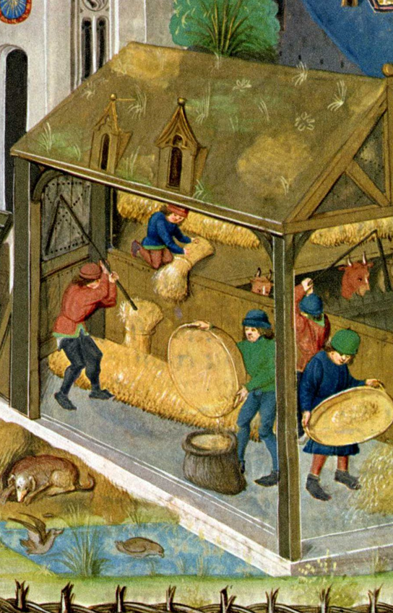
Graph-based Priors
Knowledge Fusion
Extraction
Notes:
Recalling the earlier example of a triple indicating that Barack Obama was born in Honolulu … Based on the many data sources Google consumes, they may find information about Barack Obama that identifies his birthplace as Kenya … perhaps the extraction is actually referring to his father, or perhaps the site is making an factually incorrect claim. Prior information about this fact in existing knowledge bases can be used to determine the level of uncertainty about a new or conflicting claim. And if the knowledge base did not indicate a birth place for the person, it may have other information about the person (in this case, his role as President of the United States) to help determine the level of uncertainty in a new claim.

Slide 10
A “Knowledge Vault” for Libraries?
OCLC research scientists and software engineers are evaluating a similar model for bibliographic and authority data sources,
in combination with user-contributed content and Linked Data from other providers,
to evaluate a “knowledge vault” for statements about entities and their relationships, including people, groups, places, events, concepts, and works.
Notes:
While recognizing that the web of data that Google is attempting to assess encompasses a much larger set of sources, and represents a higher frequency of competing “claims” of truth about entities and their relationships, we see real potential in applying their approach to the data sources we’ve traditionally worked with.

Slide 11
Library data sources
WorldCat – thousands of libraries, museums and archives contribute to the aggregation, and OCLC adds FRBR clustering, algorithmically-deduced connections of strings to Linked Data identifiers, and new work entities.
VIAF – 30 or more authority systems contribute, and OCLC merges and links records into new VIAF clusters.
FAST – OCLC transforms Library of Congress subject headings into a new controlled vocabulary, friendly to faceted navigation.
OCLC produces persistent identifiers and RDF Linked Data for all of these sources.
Notes:
We begin by looking at just 3 primary sources of library data, though each is itself an aggregation representing many more contributing sources. WorldCat bibliographic records are contributed by thousands of libraries, museums and archives, the VIAF integrated authority file works with 30 or more contributing authority record sources, and FAST transforms Library of Congress Subject Headings.
The records for these three sources are all available from OCLC as RDF Linked Data with persistent identifiers.

Slide 12
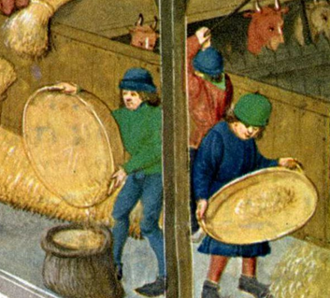
Knowledge Vault data flow
WorldCat
Extractor
VIAF
Extractor
FAST
Extractor
Data Sources
Extraction
Notes:
The first step in the process is extract “triples” from record-oriented data.
Triples are simple statements that describe a relationship between a subject and an object. For example, the creative work Persuasion was created by Jane Austen.
Expressing those simple statements in RDF, the standard model for information interchange on the web, provides a way to aggregate and process triples provided by a wide range of sources.

Slide 13
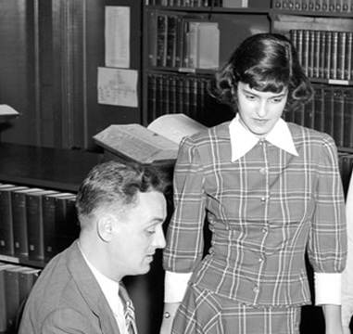
Knowledge Vault data flow
WorldCat
Extractor
Knowledge Triples
VIAF
Extractor
FAST
Extractor
Data Sources
Extraction
Graph-based Priors
Notes:
The “Extractors” produce “Knowledge Triples” which can associate the statement with who produced the statement, when it was produced, and other properties that can be used later on to compare related claims.
While the data sources that serve as input to the extractors can take a wide variety of forms … scraping data from HTML pages, XML documents, JSON documents, etc. … and may reflect a wide range of schemas and ontologies … Dublin Core, MARC, EAD, Wikidata, etc. … the knowledge triples are normalized to adhere to a consistent vocabulary. In our work, that vocabulary is Schema.org. This agreement is not unlike our everyday world, where communication depends upon the agreement to use a shared vocabulary.

Slide 14
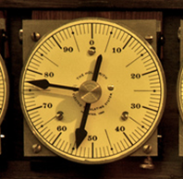
Knowledge Vault data flow
WorldCat
Extractor
Knowledge Triples
Scored Triples
VIAF
Extractor
Fusers
FAST
Extractor
Data Sources
Extraction
Graph-based Priors
Fusion
Knowledge
Vault
Notes:
The “Fusion” processes apply mathematics to the collective of Knowledge Triples, to produce Scored Triples in the Knowledge Vault.
In our current state of development, we’re still just experimenting with the Fusion step … more about that in a bit.

Slide 15
Creating Knowledge Triples from record-oriented data
MARC Records
MARC Record
Enhanced WorldCat MARC Record
FRBR Clustering
String matching with controlled vocabularies
Addition of standard identifiers
Notes:
For our experimental work, we begin with data that is record-oriented. MARC bibliographic and authority data.
As part of the normal operations of OCLC these records are clustered following the FRBR principles, and a significant amount of additional work goes into matching strings representing people, groups, places, events and concepts to corresponding authoritative headings in controlled vocabularies, with identifiers from those vocabularies (LCSH, VIAF, FAST, and others) assigned where possible.

Slide 16
Creating Knowledge Triples from record-oriented data
MARC Records
RDF Entities
MARC Record
Enhanced WorldCat MARC Record
Persons
Organizations
Places
FRBR Clustering
String matching with controlled vocabularies
Addition of standard identifiers
Concepts
Events
Works
Notes:
Our next step is to reconstitute the record-oriented data to represent entities …
OCLC provides Work Entities as Linked Data now, and in our experimentation we’re testing these representations for a total of 6 types of entities.
The entity data is modeled using RDF … The Resource Description Framework … and for users of the data it can then be represented in a variety of Linked Data serializations, including JSON-LD, N-Triples, TTL, or RDF XML.

Slide 17
Creating Knowledge Triples from record-oriented data
MARC Records
RDF Entities
Triples
MARC Record
Enhanced WorldCat MARC Record
Persons
Subject
Predicate
Object
Subject
Predicate
Object
Organizations
Subject
Predicate
Object
Places
Subject
Predicate
Object
FRBR Clustering
String matching with controlled vocabularies
Addition of standard identifiers
Subject
Predicate
Object
Concepts
Subject
Predicate
Object
Subject
Predicate
Object
Events
Subject
Predicate
Object
Works
Subject
Predicate
Object
Subject
Predicate
Object
Notes:
And from those Entities we derive Triples representing the relationships between things that are described in the entity data.
This processing of records into entities and then into triples increases the granularity of the information objects … 4 million records are converted into about 40 million separate entity descriptions, which yield about 400 million triples.
This process includes an action that is similar to the “Graph-based Priors” application of existing Knowledge Bases to validate or extend data Google harvests from the web. The source MARC records include undifferentiated headings for people, places, etc., lacking standard identifiers, and sometimes taking alternative string representations. Using vocabularies like VIAF and FAST as Knowledge Bases, and taking into account other information in the record and related records in a FRBR cluster, these varying strings can be related to the same entity and inherit the richness of that entity description.

Slide 18
Using the Library Knowledge Vault
Triples in a library knowledge vault provide opportunities for applications supporting discovery, editing, visualization, and more
OCLC Research is investigating what it’s like to assemble and work with this kind of data in an experimental discovery system we call “EntityJS”

Slide 19
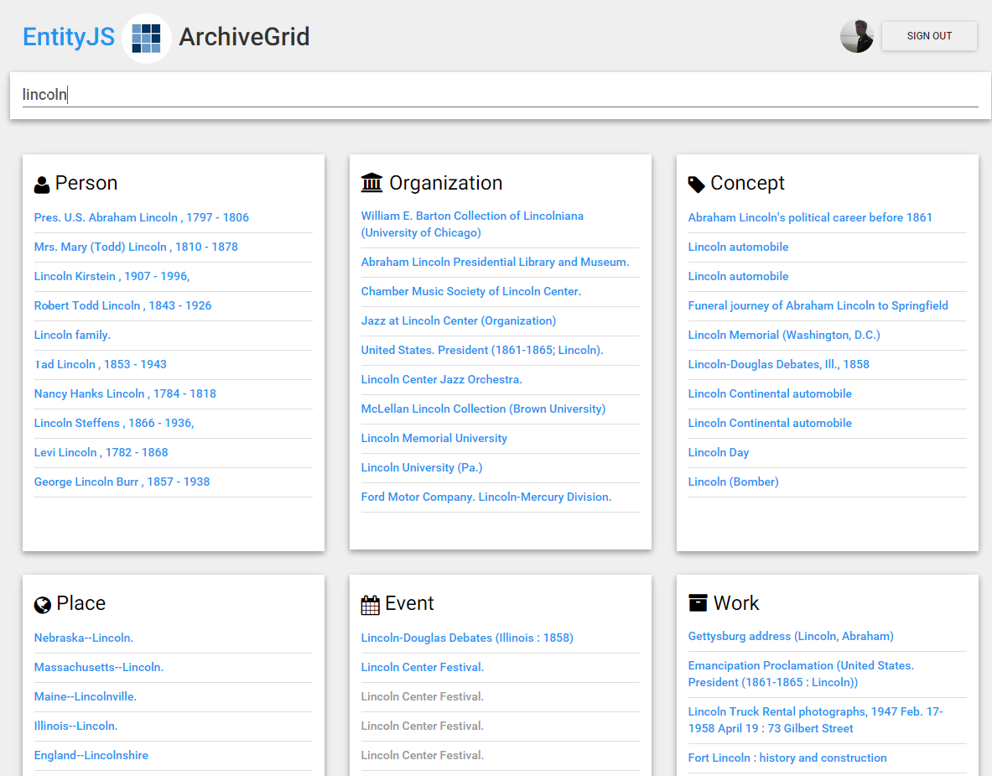
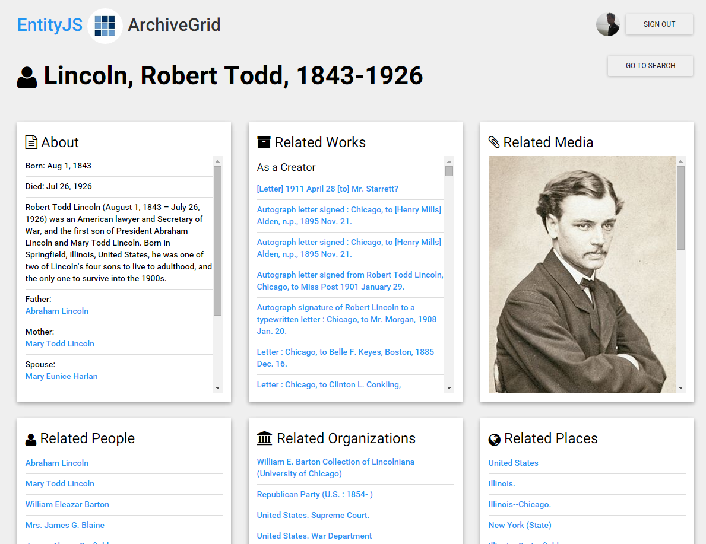
The EntityJS Research Project
Get some real-life experience with using Linked Data, test entity refinement and editing, and push triples back to the knowledge vault.
Notes:
Project Goals
Prototype an application that runs in a browser and uses RDF data sources from OCLC and elsewhere
Write as little original code as possible; use existing code libraries
Skip the magic tricks that may hide Linked Data issues
Search across entities
Show relationships of one entity to others
Examine questions around user-contributed improvements to entity relationships
Evaluate how an application like EntityJS could both consume data from and contribute data to the Vault
Why the name “EntityJS”? We’re thinking about entities, so included that in the name. The “JS” stands for “JavaScript”, the programming language we’re using for our experimental development work. Some common software frameworks we’re using have applied, the “JS” suffix as well … the AngularJS client application software, NodeJS and ExpressJS for server applications … so we’re following that pattern.
Keep in mind that this is just an experimental application, for now, and we just needed a name when referring to it. We’ll probably call it something else, if it grows up to be something more than an experiment.

Slide 20
Testing with a subset of Knowledge
Just the “ArchiveGrid” WorldCat MARC records
WorldCat
ArchiveGrid
Notes:
To examine the process of transforming bibliographic records to triples and creating a knowledge vault, we’ve extracted a subset of WorldCat records … those that describe the primary source materials that make up the OCLC Research ArchiveGrid discovery system.
ArchiveGrid includes about 4 million records from WorldCat describing primary source materials … unpublished letters, diaries, scrapbooks, films, recordings, photographs, etc. … found in the collections of archival institutions and special collections libraries.

Slide 21
Testing with a subset of Knowledge
Just the “ArchiveGrid” WorldCat MARC records
Knowledge Triples
Scored Triples
ArchiveGrid
Extractor
Extraction
Notes:
Though WorldCat is our only library data source in the testing phase, we’re working with an “enhanced” version of the data provided by WorldCat catalogers, where FAST and VIAF identifiers have been automatically added (where possible) to supplement the strings representing people, groups, places, concepts, and events.
The term “vault” suggests that the triples are valuable (which is true) but also that they are hidden or inaccessible (which is not the intent). We imagine that vault services will be built that ingest and process these triples in various ways. For example, they might be processed into indexes to support fast search and retrieval of specific entities and their relationships

Slide 22
Testing with a subset of Knowledge
Just the “ArchiveGrid” WorldCat MARC records
Knowledge Triples
Scored Triples
ArchiveGrid
Extractor
EntityJS
Vault Services
Extraction
Notes:
We’ve developed a few services to provide access to the scored triples in the vault.
We use our Hadoop cluster and MapReduce scripts to convert the triples into data that can be indexed, and use ElasticSearch for supporting that index, so that we can quickly search across the data.
We have also loaded the scored triples into a Triplestore and run server scripts for sending SPARQL queries to that Triplestore, to retrieve unindexed data.
EntityJS interacts with these Vault services to search across entities, and to view individual entities and their relationships.
When viewing a single entity the application connects directly to its RDF source. For example, to initiate the view of a person, the EntityJS client application retrieves RDF XML data from viaf.org.

Slide 23
Testing with a subset of Knowledge
Just the “ArchiveGrid” WorldCat MARC records
Knowledge Triples
Scored Triples
WorldCat
ArchiveGrid
Extractor
VIAF
EntityJS
FAST
DBPedia
Vault Services
Wikidata
Notes:
The EntityJS application makes real-time use of a range of other Linked Data resources, including WorldCat Works, VIAF, FAST, DBPedia, Wikidata, GeoNames and others, to enrich the display.

Slide 24
Testing with a subset of Knowledge
Just the “ArchiveGrid” WorldCat MARC records
Knowledge Triples
Scored Triples
WorldCat
ArchiveGrid
Extractor
VIAF
EntityJS
FAST
DBPedia
Vault Services
Extraction
Wikidata
Application Triples
Notes:
EntityJS can also be used to create new relationships between entities found by searching the knowledge vault, and store temporary versions of that data for immediate use by the EntityJS application.

Slide 25
Testing with a subset of Knowledge
Just the “ArchiveGrid” WorldCat MARC records
Knowledge Triples
Scored Triples
WorldCat
ArchiveGrid
Extractor
Fusers
EntityJS
Extractor
VIAF
FAST
Knowledge
Vault
DBPedia
Vault Services
Extraction
Wikidata
Application Triples
Notes:
EntityJS can also be used to produce new data to flow back into the Knowledge Vault process … this is our opportunity to experiment further with the Knowledge Fusion process, as we can use different confidence scores assigned to the knowledge triples produced by EntityJS than those derived from WorldCat’s ArchiveGrid subset, and test how that affects use of the data in the Knowledge Vault.

Slide 26
Vault Services
Streamline the interaction between the EntityJS client application and the Scored Triples on the server
API to interact with the Triplestore
API to interact with ElasticSearch Index
“PageRank”-like sorting, for entity results

Slide 27
Search across entities
Notes:
Based on triples in our knowledge vault we built an ElasticSearch engine that helps us quickly search across entities.

Slide 28
Show related entities
Notes:
When an entity is selected, we base the initial view of it on its RDF data source (in this case, a person entity represented by a VIAF record).
We supplement that with information represented by knowledge vault triples, displaying related works and the role this person has associated with that work (creator, contributor, or subject). We also find other related entities and show those that are identified most frequently in the set of ArchiveGrid source records … a kind of “PageRank” to show the most closely related entities first.

Slide 29
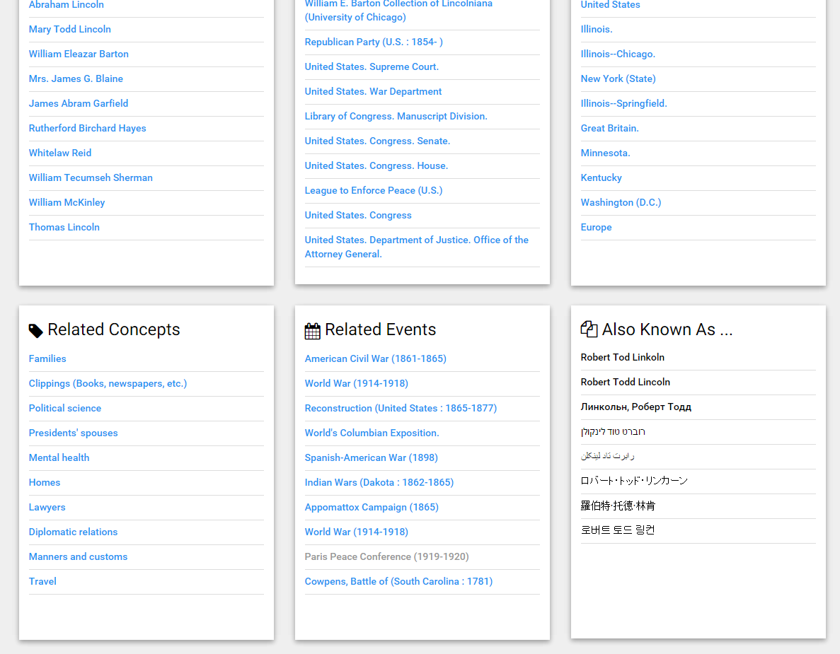
Show related entities
Notes:
Relations to other representations of the entity, as in WikiData, help us supplement the list of alternate names for the person …

Slide 30
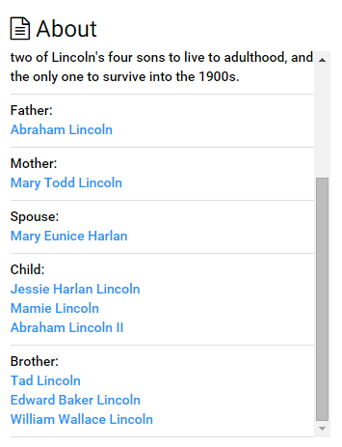
Show related entities
Notes:
And can identify family relationships to other people, not all of whom would have been otherwise represented in the initial set of ArchiveGrid MARC records. The family relationships from WikiData provide another network layer on top of the relationships in the MARC data.

Slide 31
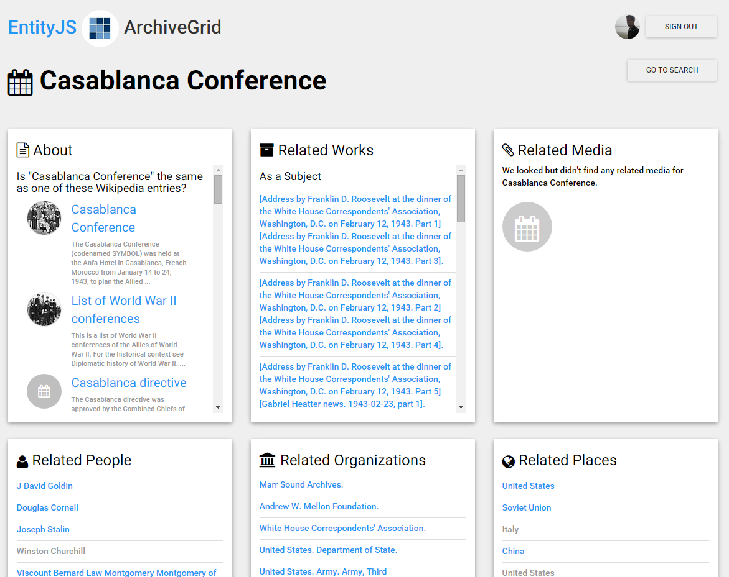
User-contributed “same as” relationships
Notes:
Not all of our bibliographic or authority records contain connections to related forms. Here is an example of a FAST subject that could benefit from a connection to the corresponding WikiData page.
EntityJS offers a way for users to select from a set of potentially related WikiData/Wikipedia articles for the subject.

Slide 32
User-contributed “same as” relationships
INSERT DATA { GRAPH <http://id.worldcat.org/fast/1405559> <http://schema.org/sameAs> <http://www.wikidata.org/data/Q502093>; <http://schema.org/sameAs> <http://dbpedia.org/resource/Casablanca_conference>.}
Notes:
Selecting a matching subject from the list sends an instruction to the EntityJS knowledge vault services to remember that as a “same as” relationship …

Slide 33
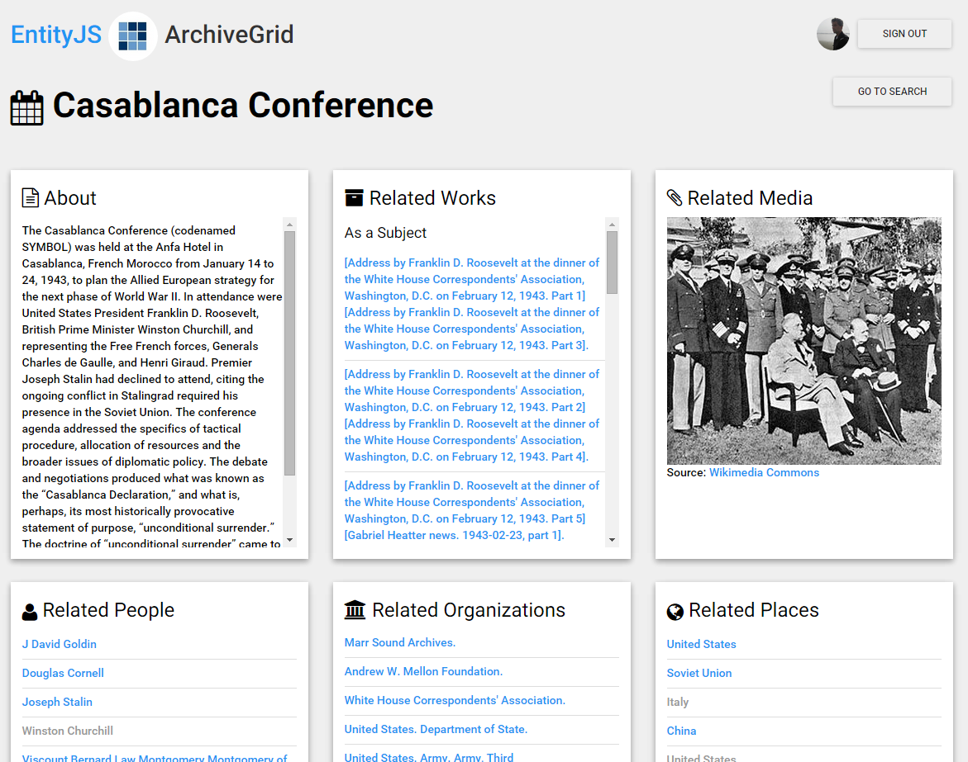
User-contributed “same as” relationships
Notes:
Selecting a matching subject from the list sends an instruction to the EntityJS knowledge vault services to remember that as a “same as” relationship …
… and the data and related images from Wikidata and Wikipedia can immediately enrich the view in the EntityJS application, while going back into the mix to compete with other factual claims in the process that creates the knowledge vault.

Slide 34
An end-to-end test of the
Knowledge Vault
Knowledge Triples
Scored Triples
WorldCat
ArchiveGrid
Extractor
Fusers
EntityJS
Extractor
VIAF
FAST
Extractors
Collective
Fusion
Knowledge
Vault
DBPedia
Vault Services
Wikidata
Application Triples
Notes:
Here’s where the EntityJS application begins to help us further explore the capacity of the knowledge vault … introducing a new set of statements, knowledge triples, that can contend with similar claims from other library data sources and be “fused” through the authority of their sources and their past history in knowledge bases to become a scored triple in the knowledge vault. A full loop through the extraction and fusing process.

Slide 35
Continued Experimentation
Build a way to assign confidence levels to data contributed by EntityJS
Use confidence levels as input to a Fusion process to created Scored Triples
Extend the EntityJS application to incorporate additional Linked Data resources and support further entity relationship refining and editing

Slide 36
Looking inside the Library Knowledge Vault
Contact us
Jeff Mixter
Bruce Washburn
Software Engineer, OCLC Research
Consulting Software Engineer, OCLC Research
mixterj@oclc.org
bruce_washburn@oclc.org

