Slide 1
The Evolving Scholarly Record
Framing the landscape
Brian Lavoie
Research Scientist
OCLC Research
Workshop on the Evolving Scholarly Record
Northwestern University
March 23, 2015

Slide 2
What is scholarly?
“Avoid activities that will distract you from research. Whatever you do, do not start a blog. That will only establish your lack of seriousness as a scholar.”
Greg Mankiw’s Blog [February 24, 2007]
“ … I wanted to officially announce some good news –
Savage Minds is now being archived at the University
of Texas at Austin … SM really has become the blog
of record for the sociocultural anthropological
internetosphere.”
Savage Minds Blog [October 24, 2014]
Content of scholarly record evolving …

Slide 3
What is the scholarly record?
Scholarly Outputs
Scholarly Record
Systematically gathered, organized, curated, identified, and made persistently accessible
Scholarly record’s stakeholder eco-system evolving …
Notes:
Scholarly outputs … amorphous collection of materials , the boundaries of which are somewhat indistinct
New configurations of stakeholder roles are being enacted around the scholarly record

Slide 4
Evolutionary trends …
Formats shifting:
Print-centric to digital, networked
Boundaries blurring/expanding:
Articles/monographs, but also data, computer models, lab notebooks, blogs, e-mail discussion, e-prints, interactives/executables, visualizations, etc
Characteristics changing:
Traditionally: static, formal, outcome-focused
Today: dynamic, blend of formal & informal, more focus on process, replicability, “leveragability”
Stakeholder roles reconfiguring:
New paths for the scholarly communication “supply chain”

Slide 5
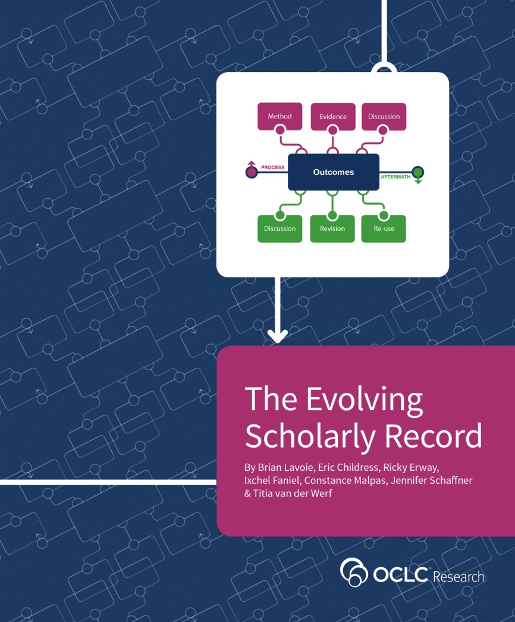
OCLC Research: The Evolving Scholarly Record
Develop framework to:
Organize/support/drive
discussions about ESR
“Big picture” view of ESR
Define key categories of material
and stakeholder roles
High-level; cross-disciplinary
application; practical use
Common reference point for ESR within/across domains
Support strategic planning by libraries, funders, publishers, scholarly societies, etc.
http://oc.lc/esr

Slide 6
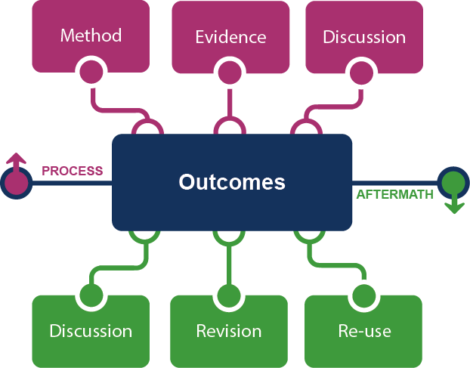
Framing the Scholarly Record …

Slide 7
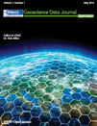
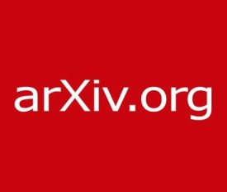
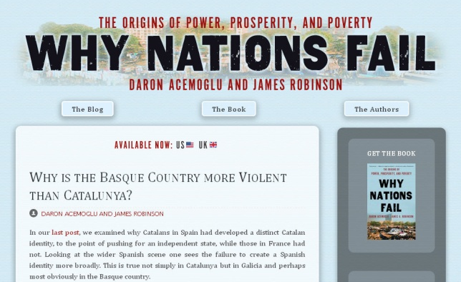
In practice …
Notes:
http://global.oup.com/uk/orc/busecon/economics/carlin/

Slide 8
Framing the stakeholder eco-system …
Fix
Collect
Create
Use

Slide 9
Evolving configurations in the eco-system …
Fix
Create
Social media (blogs, Twitter)
Social storage (SlideShare, YouTube, Flickr)
e-literature
Collect
Use
Notes:
Traditional print configuration
Collection dis-intermediated

Slide 10
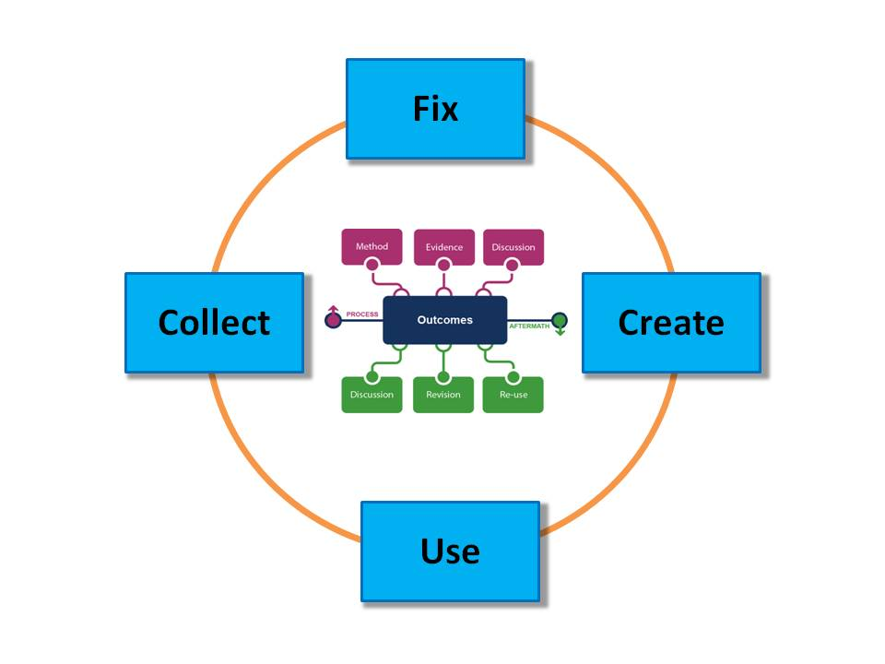
What is the scholarly record? (reprise)
A selection of
scholarly content …
… supported by stable
configurations of
stakeholder roles

Slide 11
Brian Lavoie
OCLC Research
lavoie@oclc.org

