Slide 1
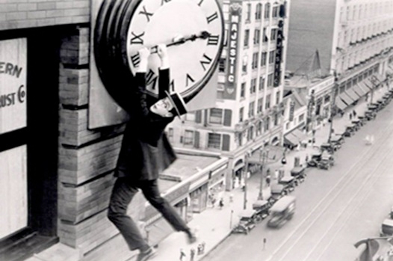
Archiving the Evolving Scholarly Record: A Perspective
Herbert Van de Sompel
@hvdsomp
Los Alamos National Laboratory
Acknowledgments: Andrew Treloar, @atreloar , ANDS

Slide 2
In This Talk
Functions of scholarly communication
Characterizing the future
Archiving the future

Slide 3
Functions of Scholarly Communication
Registration: Allows claims of precedence for a scholarly finding
Certification: Establishes validity of the claim
Awareness: Allows actors in the system to remain aware of new claims
Archiving: Preserves the scholarly record over time
Roosendaal, H, Geurts, C. (1997) Forces and functions in scientific communication
http://www.physik.uni-oldenburg.de/conferences/crisp97/roosendaal.html

Slide 4
System of Journals, Paper Version
Registration: Manuscript submission
Certification: Peer review
Awareness: alerts, library shelf surfing
Archiving: Journals in library stacks

Slide 5
System of Journals, Digital Version
Registration: Manuscript submission
Certification: Peer review
Awareness: Various web discovery services
Archiving: Special purpose archives (e.g. Portico), publishers

Slide 6
In This Talk
Functions of scholarly communication
Characterizing the future
Archiving the future

Slide 7
The Future – Core Observations
The research process, not just its outcome, is becoming visible … on the web
Massive extension of the scholarly record with an enormous variety of novel objects
The objects are heterogeneous, dynamic, compound, inter-related and distributed across the web
The objects are often hosted on common web platforms that are not dedicated to scholarship
Notes:
Also means those platforms don’t share the notion of archival requirement

Slide 8
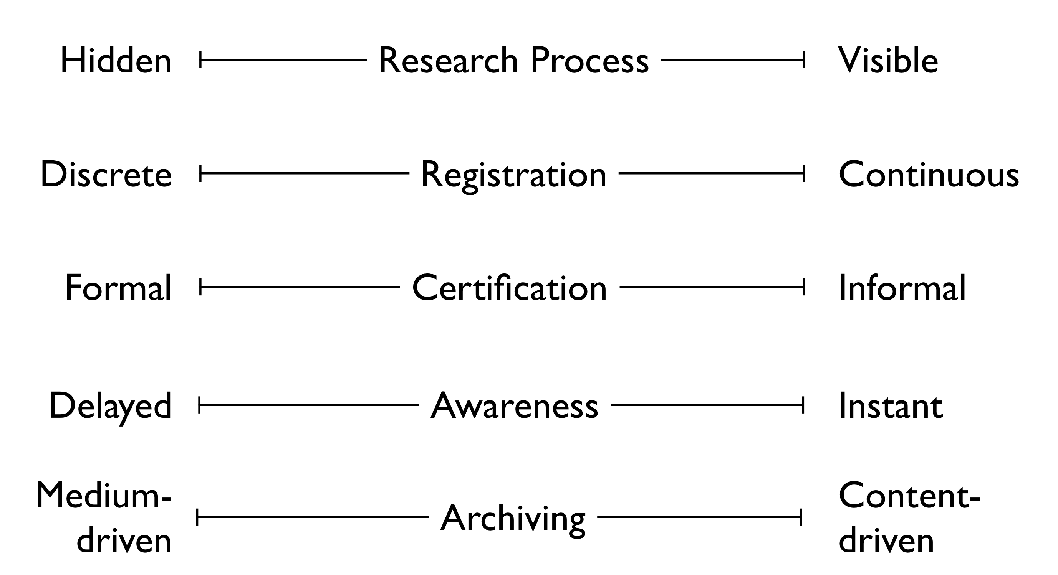
Characterizing the Future – Scholarly Communication

Slide 9
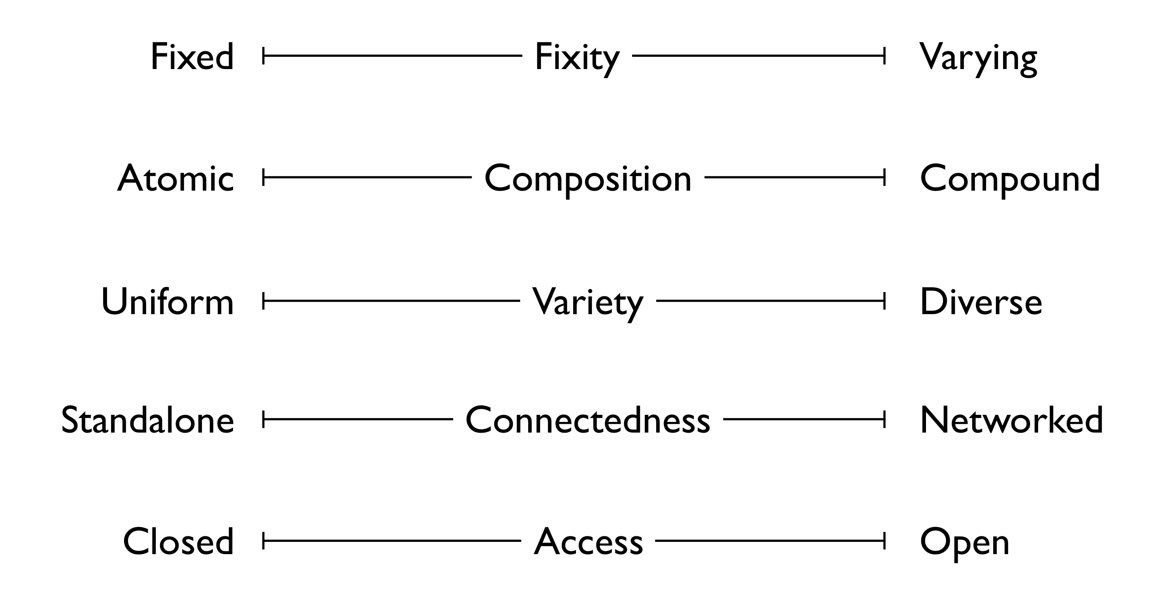
Characterizing the Future – Communicated Objects

Slide 10
In This Talk
Functions of scholarly communication
Characterizing the future
Archiving the future

Slide 11
The Future – Core Observations
The research process, not just its outcome, is becoming visible … on the web
Massive extension of the scholarly record with an enormous variety of novel objects
The objects are heterogeneous, dynamic, compound, inter-related and distributed across the web
The objects are often hosted on common web platforms that are not dedicated to scholarship
The capture/archival paradigm must take these characteristics into account
Notes:
Also means those platforms don’t share the notion of archival requirement

Slide 12
Considerations about Archiving
On the right track?
Capturing paradigms
Pockets of persistence
Recording versus Archiving
A perspective on scholarly infrastructure

Slide 13
Considerations about Archiving
On the right track?
Capturing paradigms
Pockets of persistence
Recording versus Archiving
A perspective on scholarly infrastructure

Slide 14
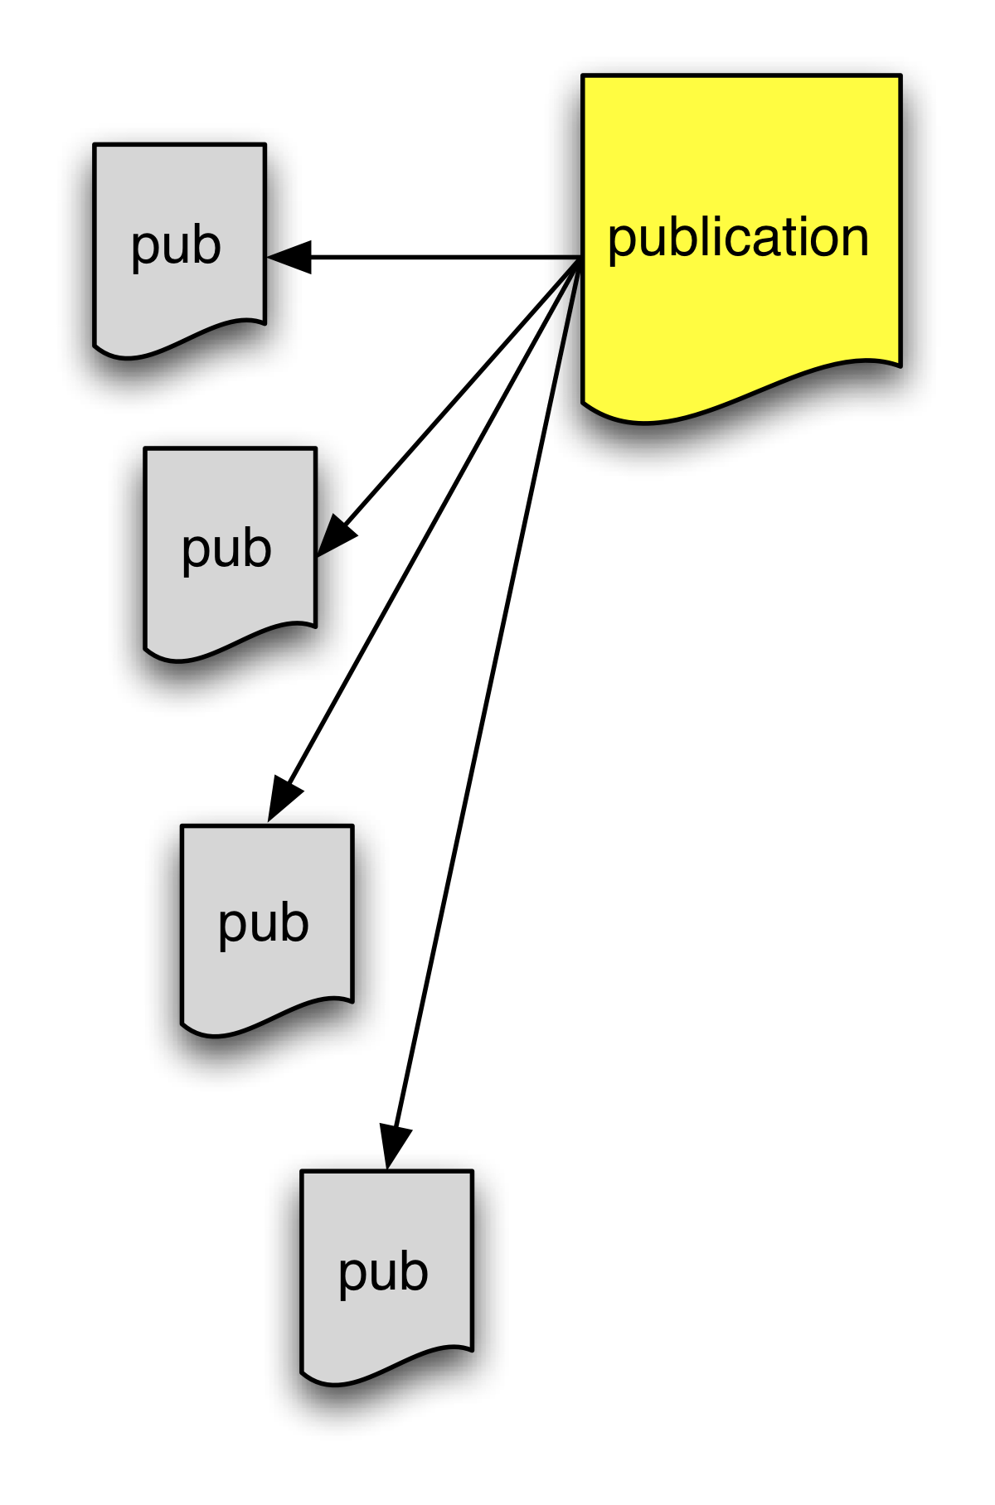
Web-Based Journal System – Links to Articles
Special-purpose archival solutions for articles
Rosenthal finds that what is archived is too few, too healthy, too easy
Attempts with the Keepers Registry to map out what is archived
Based on [ISSN, volume, issue], not on DOI, HTTP URI
David Rosenthal (2013) Patio Perspectives at ANADP II: Preserving the Other Half
http://blog.dshr.org/2013/11/patio-perspectives-at-anadp-ii.html
Notes:
Archiving no longer really with libraries.

Slide 15
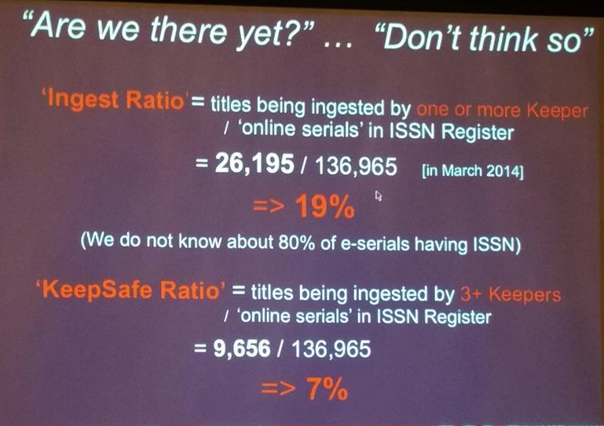
Web-Based Journal System – Links to Articles
Peter Burnhill (2014) Ensuring access to digital back copy
http://www.cni.org/topics/digital-preservation/ensuring-access-to-digital-back-copy/
Notes:
Archiving no longer really with libraries.

Slide 16
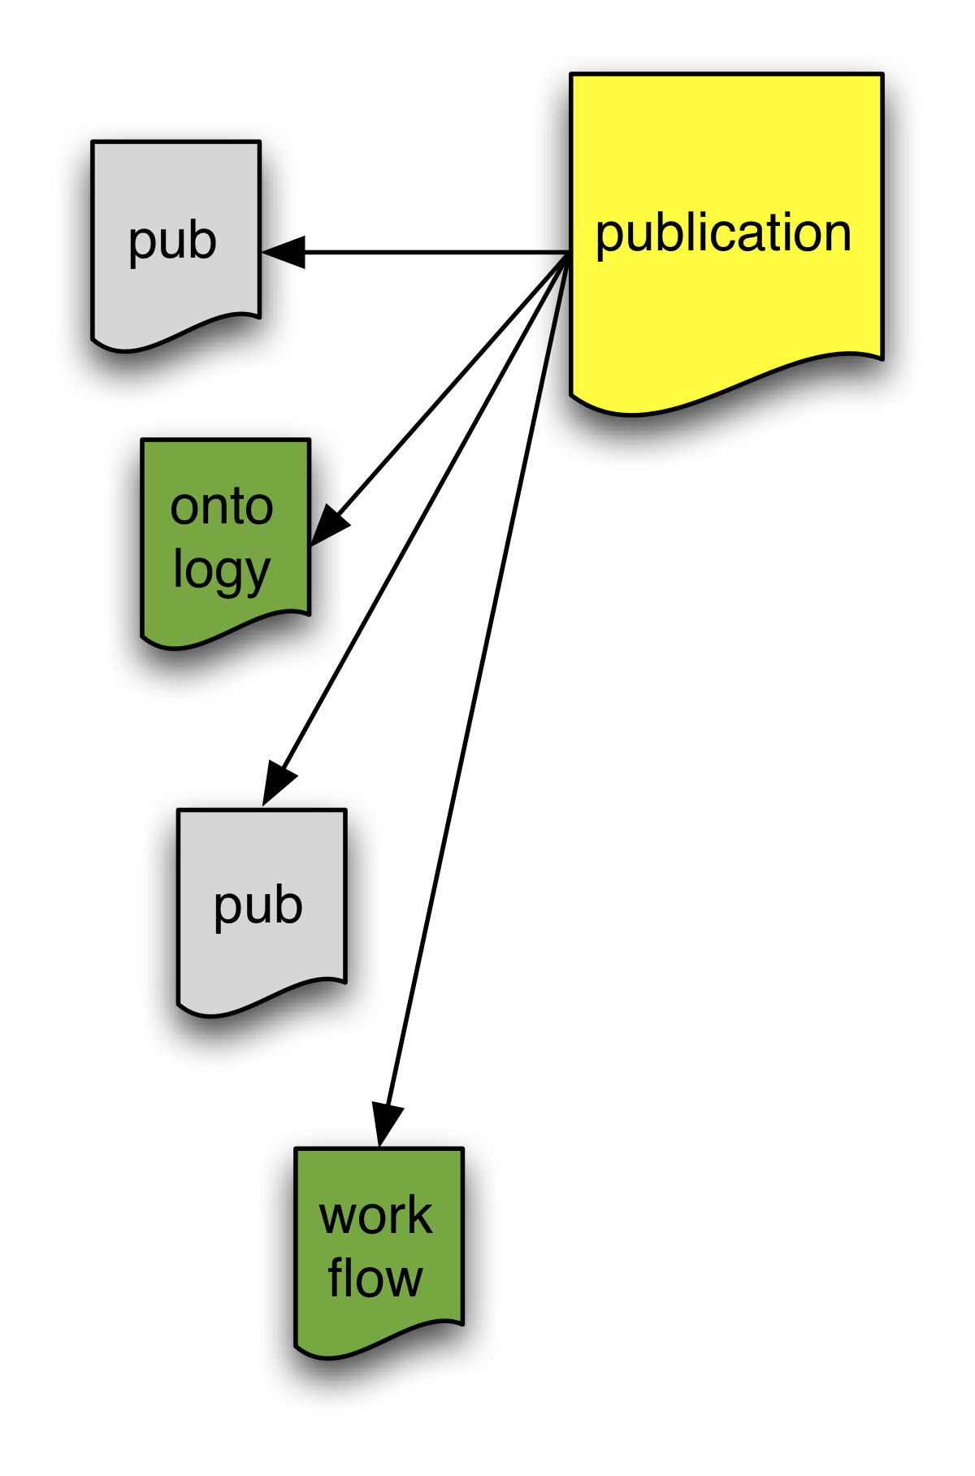

Web-Based Journal System – Links to Web at Large Resources
Web archives contain snapshots, the result of incidental archiving
The Hiberlink project finds that for the large majority of these “Web at Large” resources, no temporally appropriate archived versions exist
Memento infrastructure allows auditing what is globally archived based on HTTP URI
http://hiberlink.org
Notes:
“Web at Large” resources needed or created in research activities e.g. project websites, software, ontologies, workflows, online debate, slides, blogs, videos, etc.

Slide 17
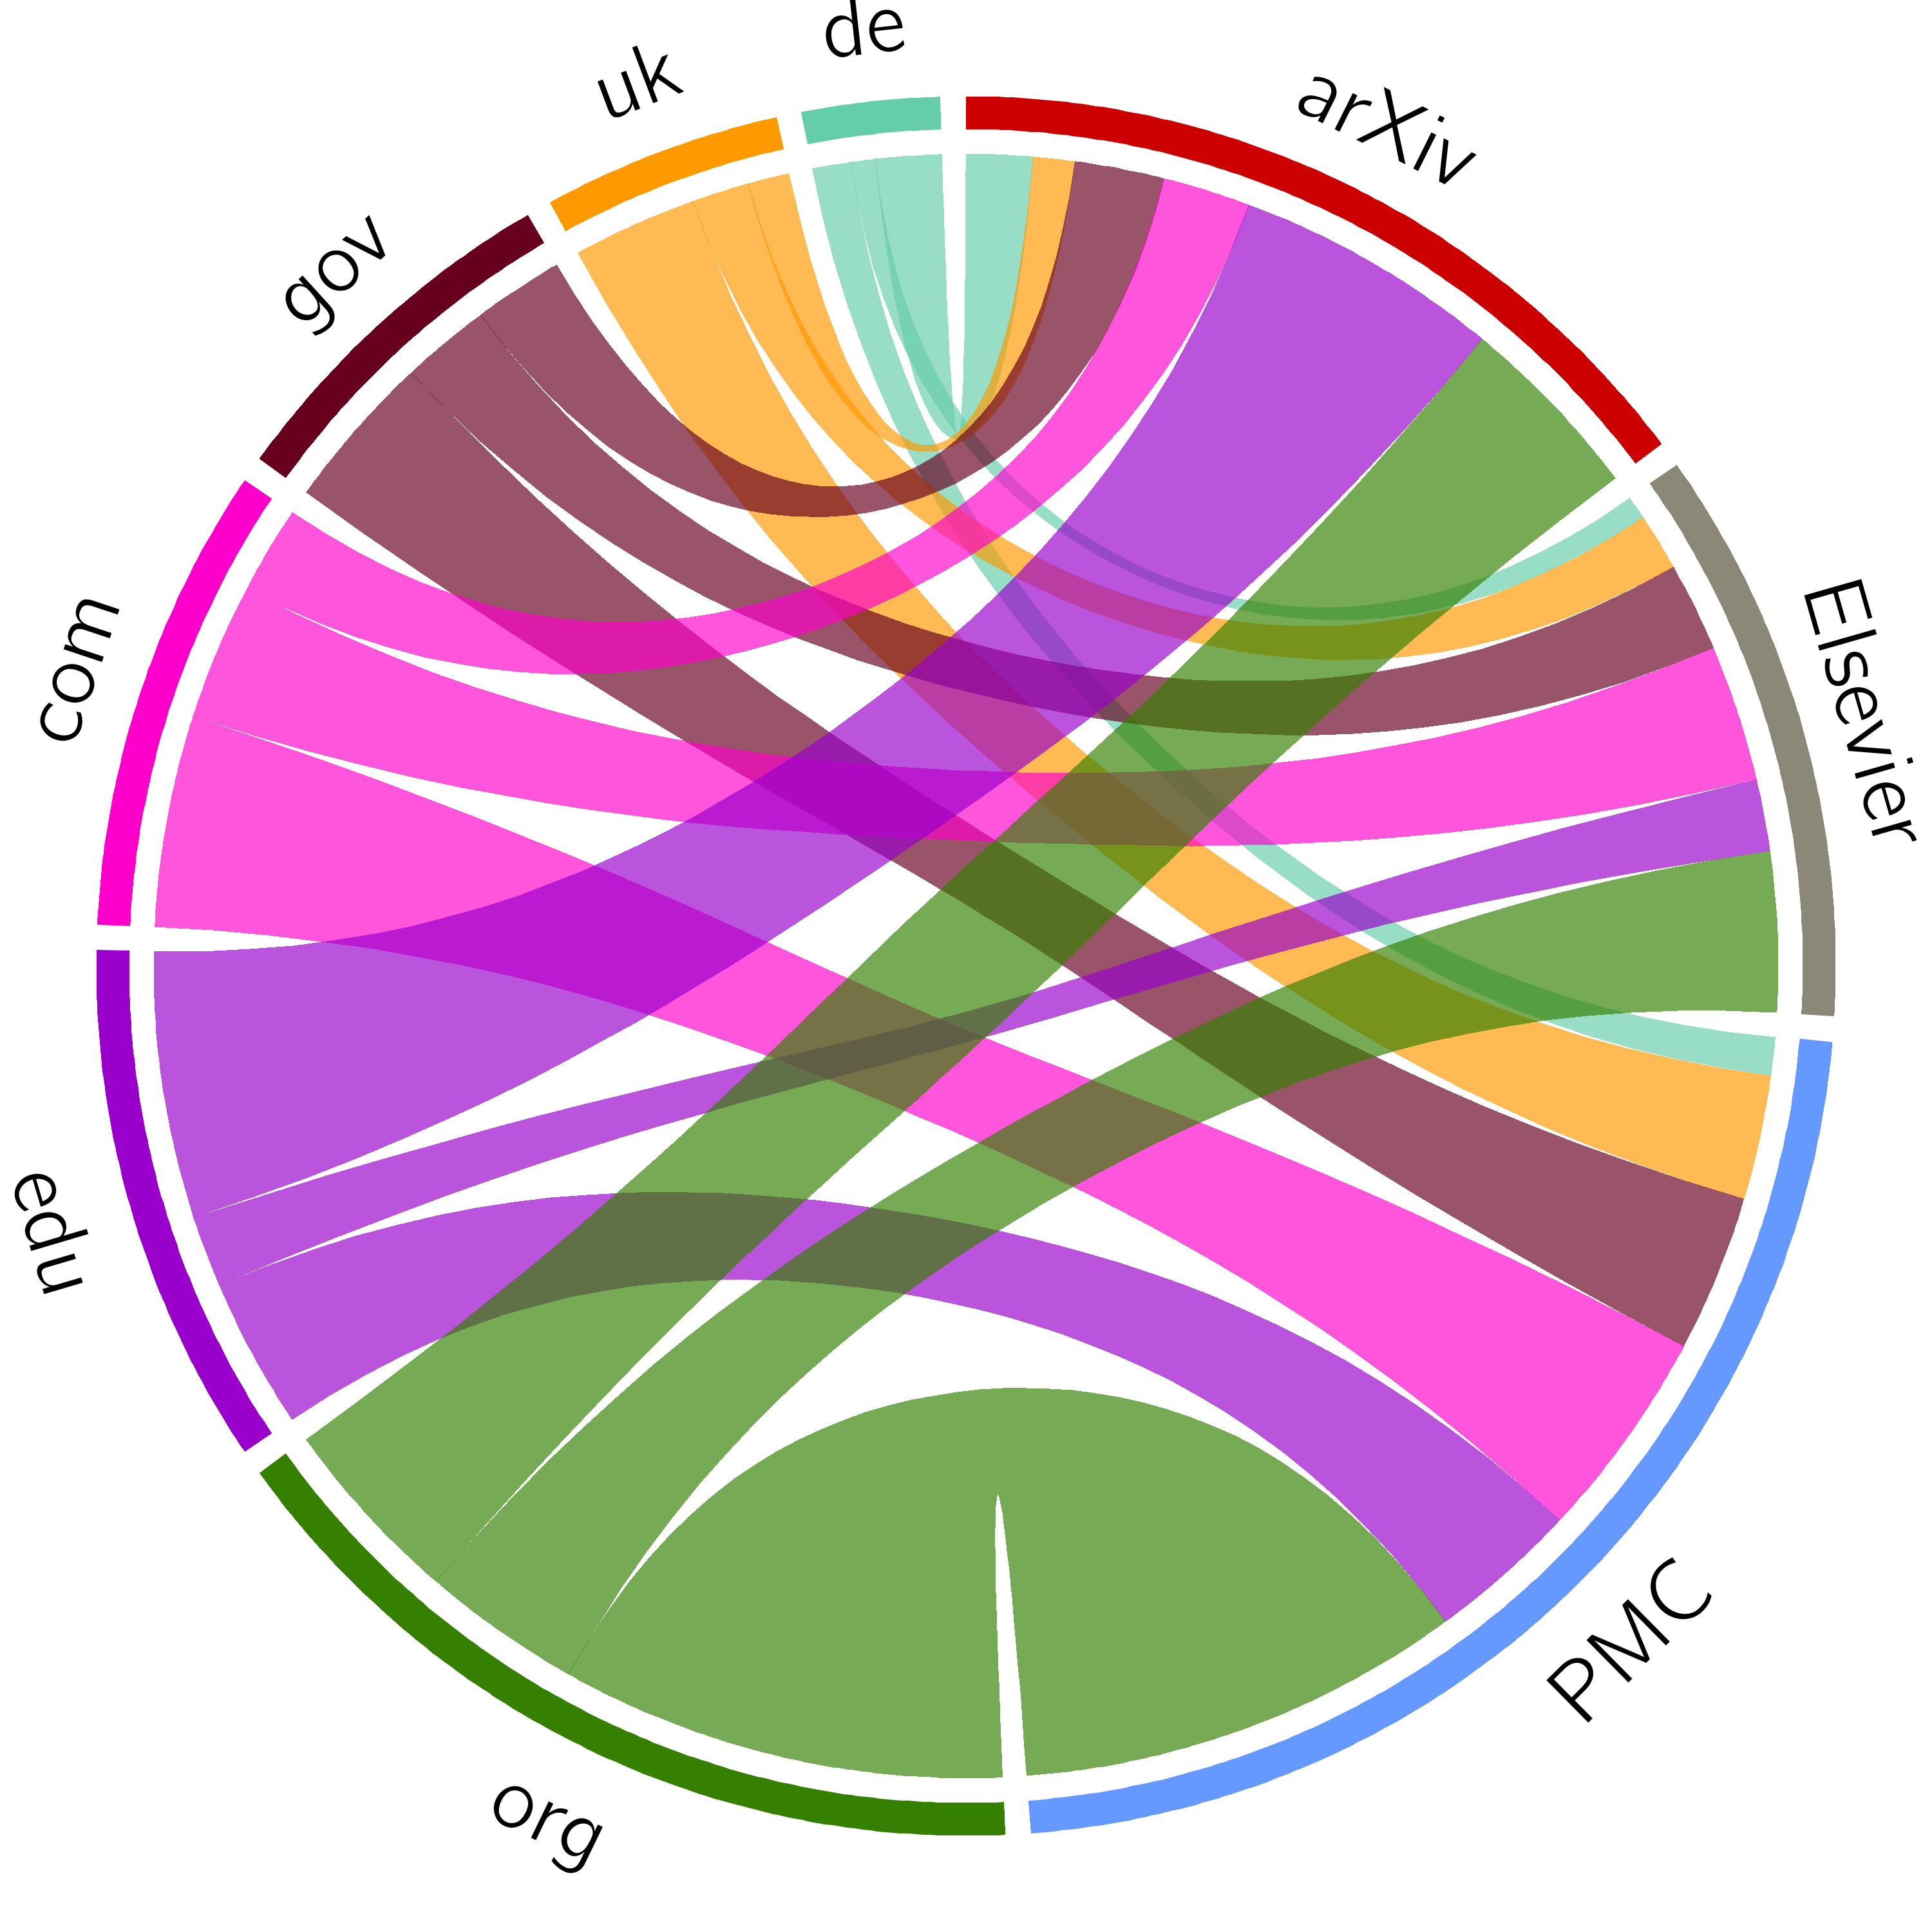
Links Abstracted to Top Level Domain Targets
Martin Klein, Herbert Van de Sompel et al. (2014) Scholarly context not found. In: PLOS ONE
http://dx.doi.org/10.1371/journal.pone.0115253

Slide 18
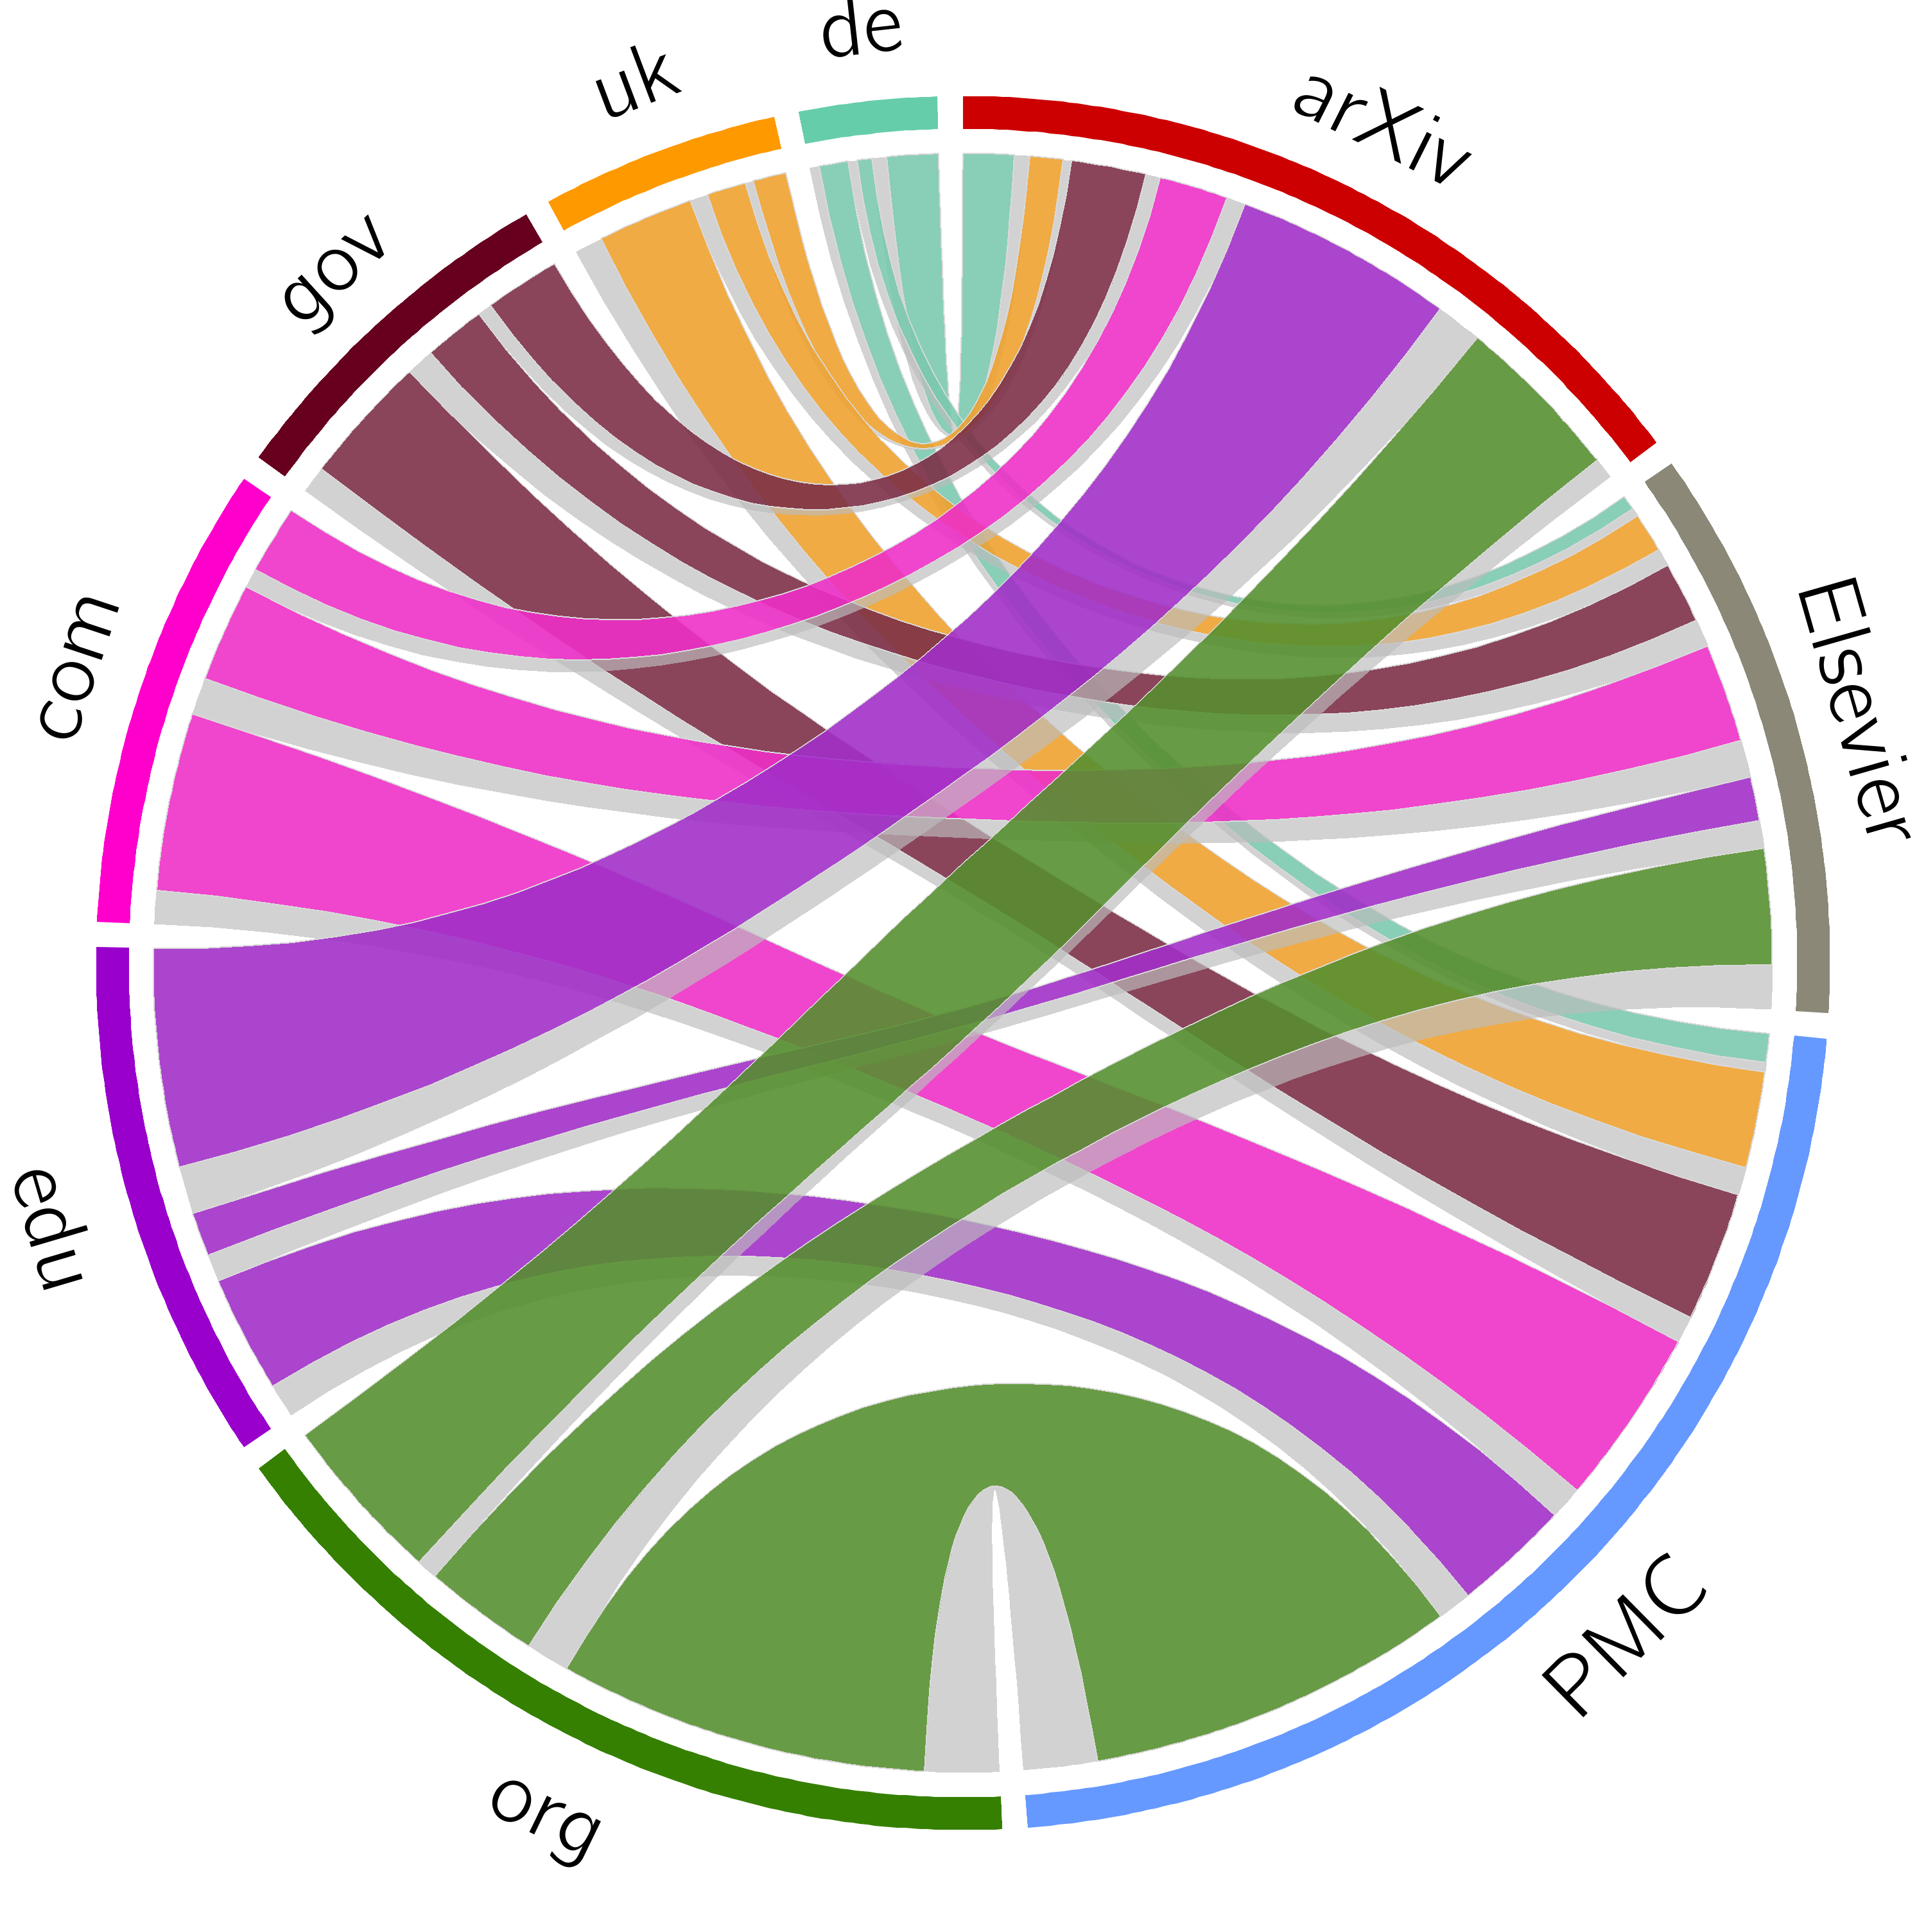
Loss of Current Context – Link Rot
Martin Klein, Herbert Van de Sompel et al. (2014) Scholarly context not found. In: PLOS ONE
http://dx.doi.org/10.1371/journal.pone.0115253
Notes:
Accidental archiving: robots crawl

Slide 19
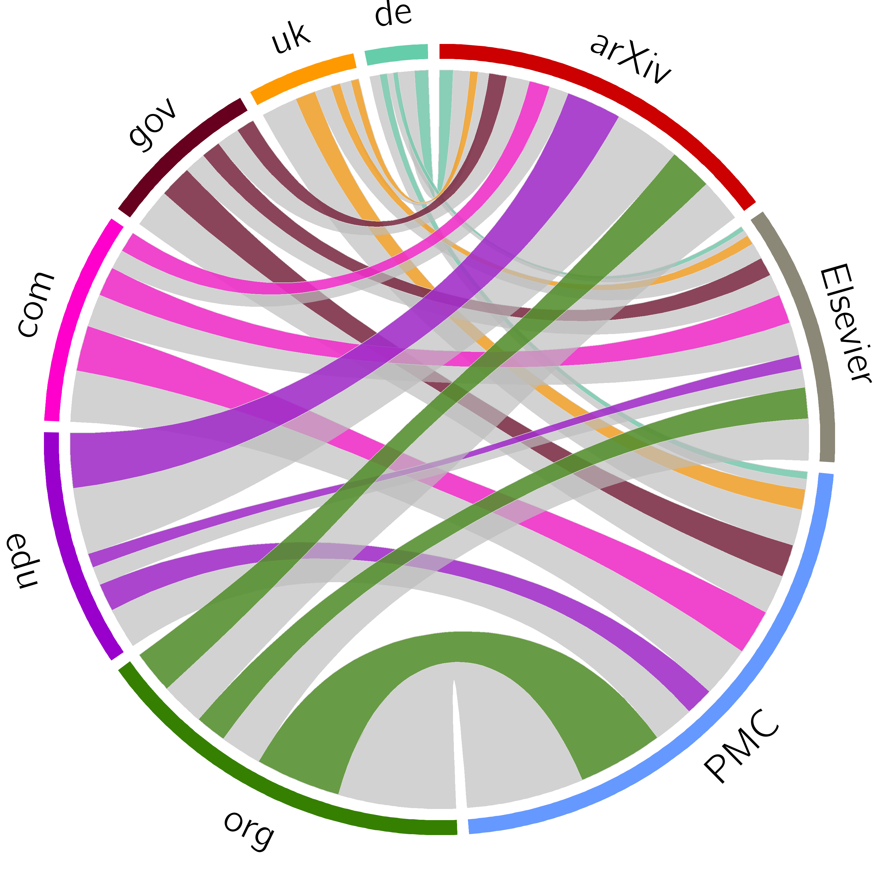
Loss of Past Context – Archival Status (14 day window)
Martin Klein, Herbert Van de Sompel et al. (2014) Scholarly context not found. In: PLOS ONE
http://dx.doi.org/10.1371/journal.pone.0115253
Notes:
Accidental archiving: robots crawl

Slide 20
Considerations about Archiving
On the right track?
Capturing paradigms
Pockets of persistence
Recording versus Archiving
A perspective on scholarly infrastructure

Slide 21
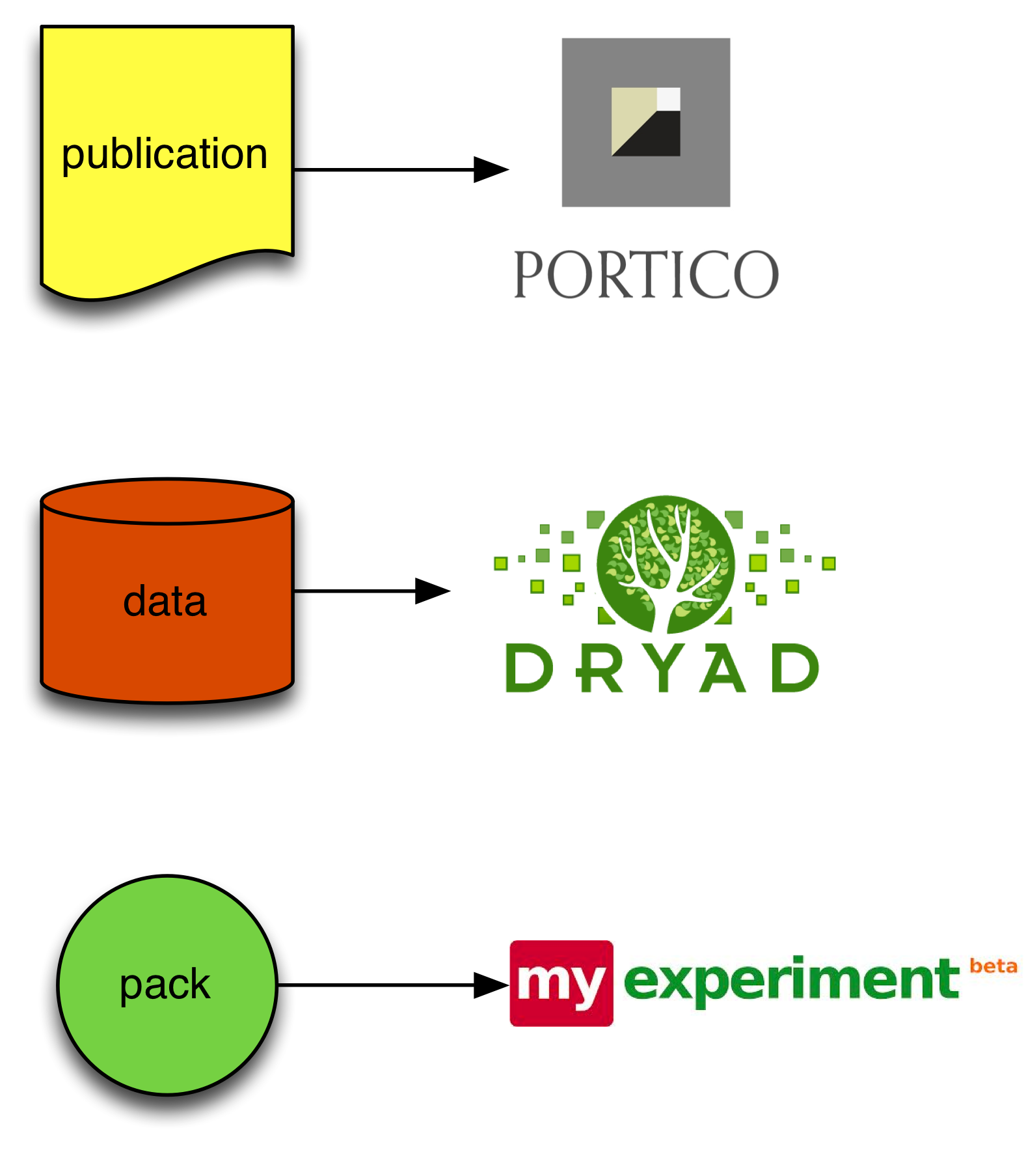
Perspective on “Repository” Capture Paradigm
Atomic object
Finalized object
Removal of context
Perspective on object: file in a file system
Capture request by owner of object
Capture time decided by owner of object

Slide 22
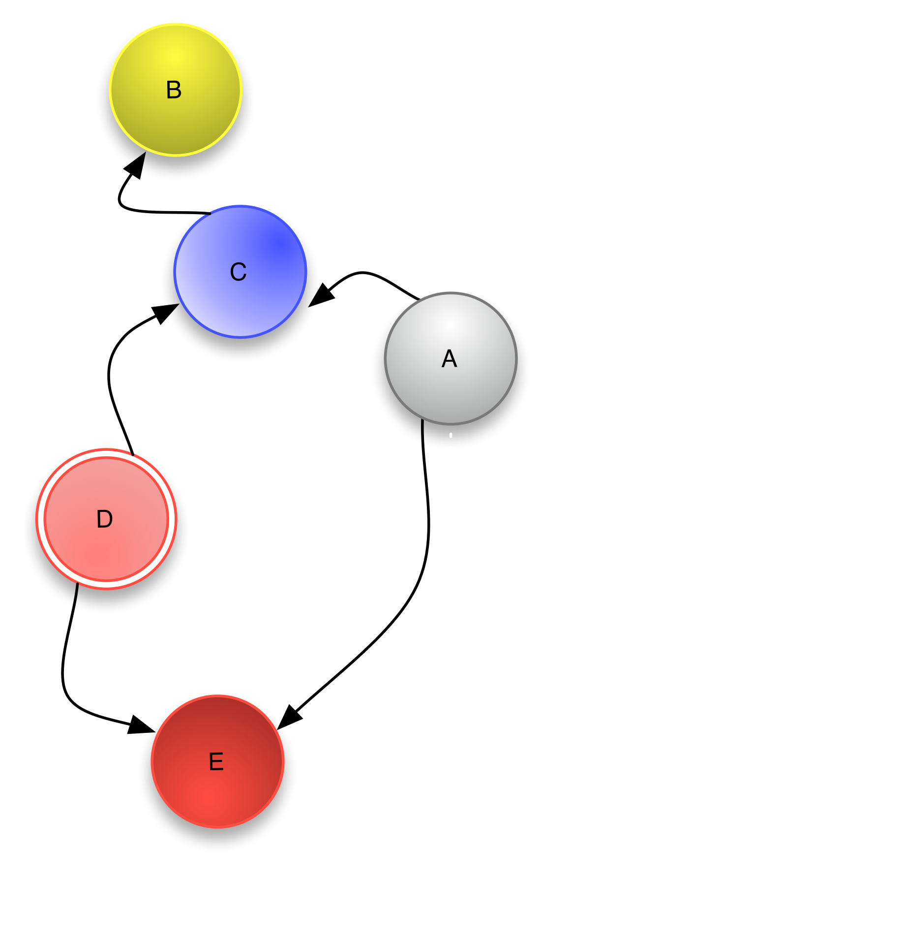
Perspective on “Web” Capture Paradigm
Compound object (context essential)
Constituents of compound object in flux
Perspective on constituents: resources with URIs on the web
Capture request by user of the constituents, owned by self, owned by 3rd parties
Capture time decided by user of the constituents

Slide 23
Considerations about Archiving
On the right track?
Capturing paradigms
Pockets of persistence
Recording versus Archiving
A perspective on scholarly infrastructure

Slide 24
Creating Pockets of Persistence
How to achieve the ability to:
Persistently
Precisely
Seamlessly
revisit the Scholarly Web of the Past and of the Now at some point in the Future
Notes:
I see it as a Web Time Travel problem. Turn the Clock back in time and navigate the web at that time.
Persistently : Keep the ability over time
Precisely: accurately in time
Seamlessly: Like regular web browsing

Slide 25
Creating Pockets of Persistence
How to achieve the ability to:
Persistently
Precisely
Seamlessly
revisit the Scholarly Web of the Past and of the Now at some point in the Future
This challenge exists for the entire web, but some communities actually care about addressing it:
scholarly communication,
legal publications,
journalism,
Wikipedia,
…

Slide 26
Pro-Active Capture for a Seed Collection
Seed Collection - Starting point for capture is a seed collection of interest to communities that care, e.g.
Scholarly literature
Legal documents
On-Line journalism
Wikipedia articles
Lifecycle Events – Intervene at critical moments in the lifecycle of items in these collections to pro-actively capture
Collection items – some solutions in place
Web resources referenced in collection items

Slide 27
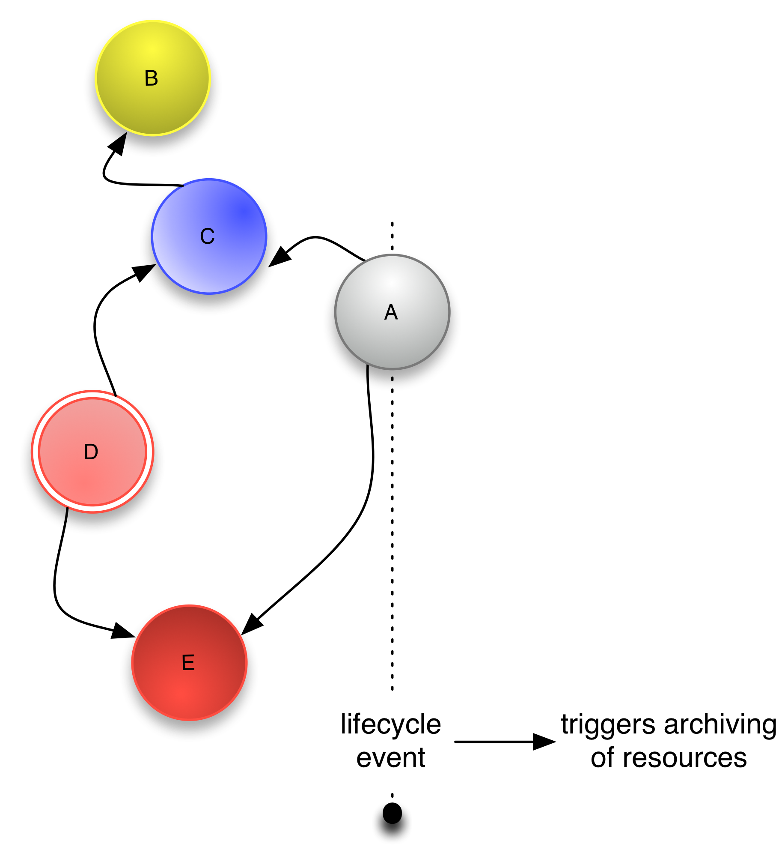
Pro-Active Capture for a Seed Collection
Request by agent (human, machine) interacting with A to capture A, B, C, D, E
Request for capture may result in
In-situ or remote capture
Creation of snapshot or creation of trace
Archival URI, capture datetime
Interoperability for on-demand capture
Orchestration of capture process

Slide 28
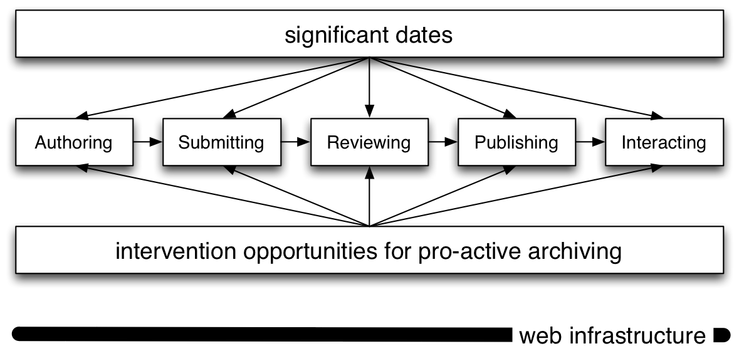
Pro-Active Capture for Seed Collection
Scholarly Literature
What those crucial lifecycle events are may depend on the seed collection type

Slide 29
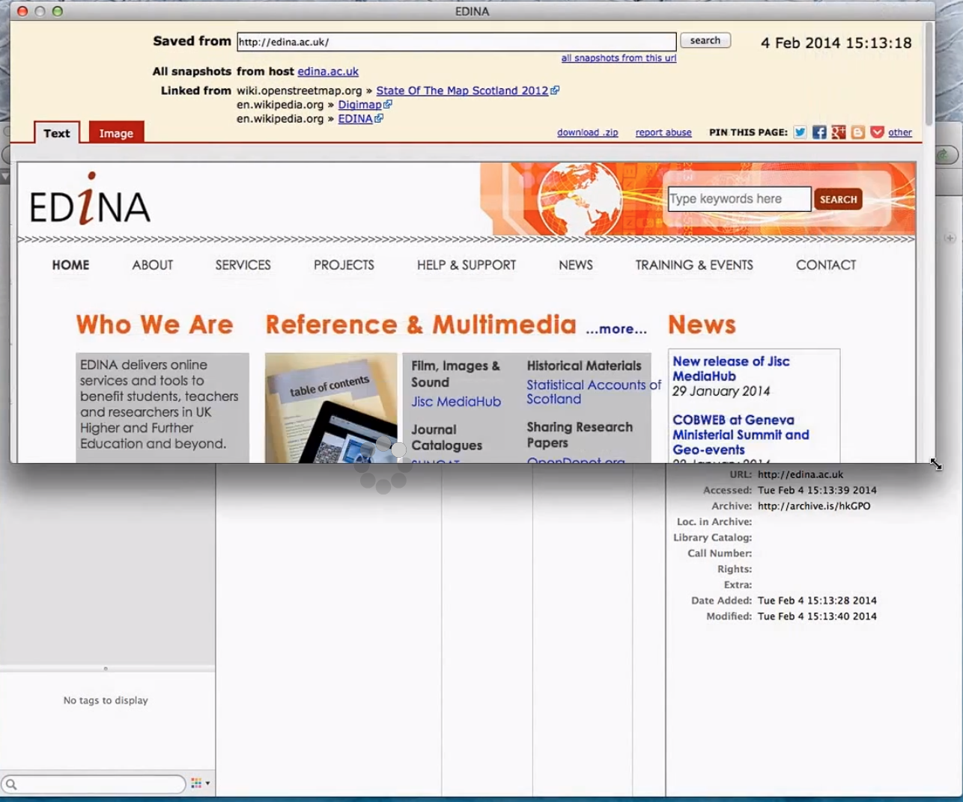
Scholarly Literature: Experimental Zotero Extension
Richard Wincewicz (2014) Prototype Hiberlink plugin for Zotero
https://www.youtube.com/v/ZYmi_Ydr65M%26vq

Slide 30
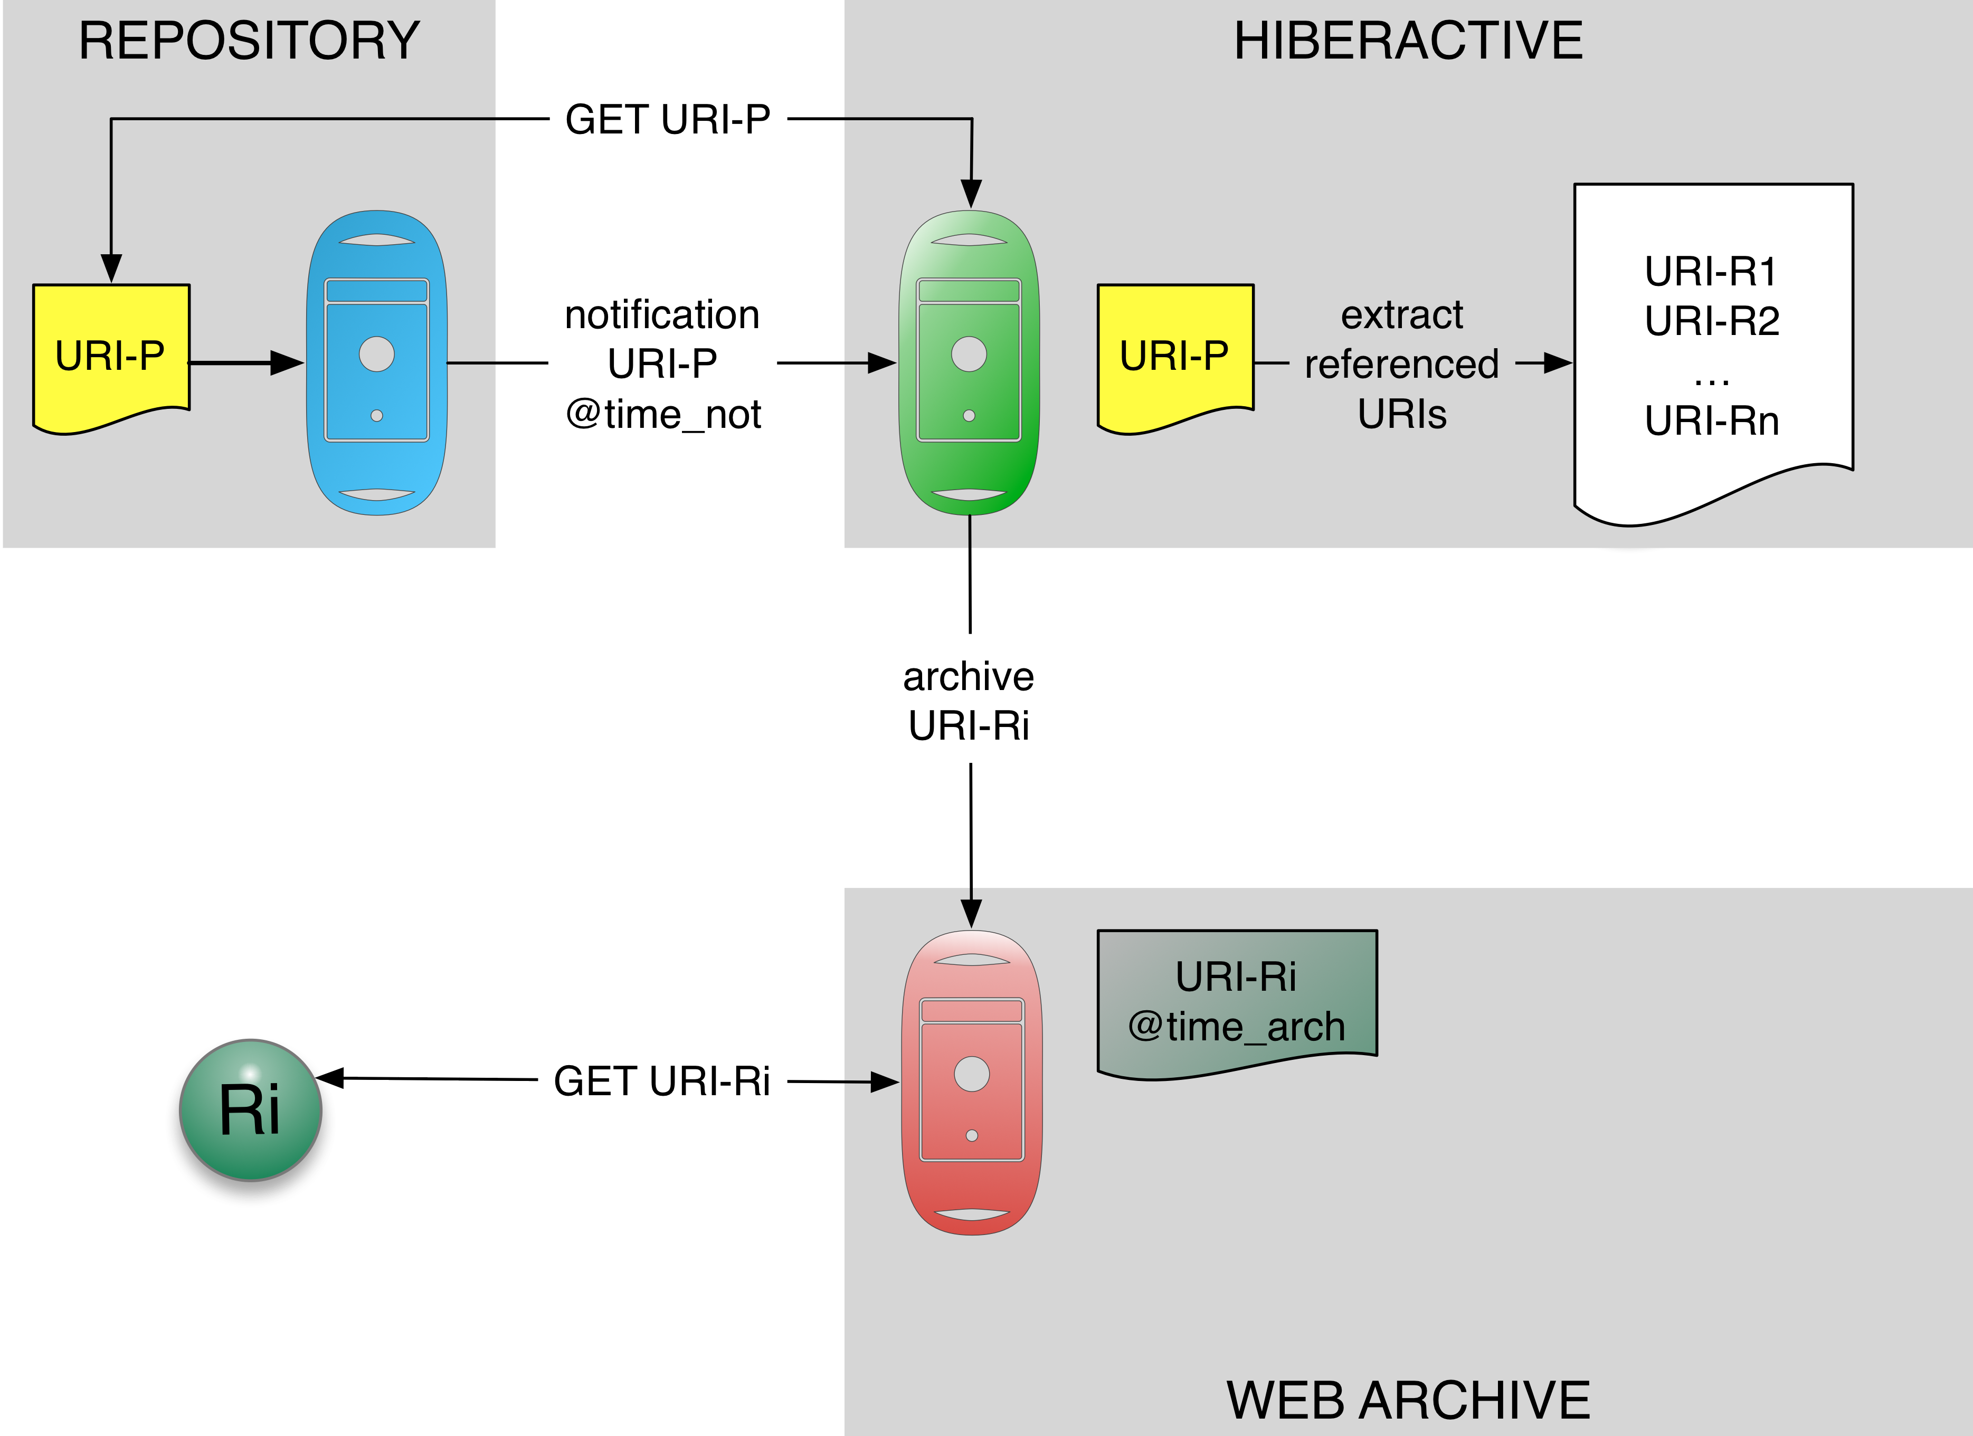
Scholarly Literature: Experimental HiberActive Service
Martin Klein et al. (2014) HiberActive: Pro-Active Archiving of web references
Open Repositories 2014 http://www.slideshare.net/martinklein0815/hiberactive

Slide 31
Considerations about Archiving
On the right track?
Capturing paradigms
Pockets of persistence
Recording versus Archiving
A perspective on scholarly infrastructure

Slide 32
Web Platforms for Scholarship
Increasingly, common web platforms are used for scholarship
GitHub, Wikis, Wordpress, etc.
Many of these platforms have desirable characteristics
Versioning
Time stamping
Social embedding
But, these platforms record rather than archive

Slide 33
Recording is not Archiving
“GitHub reserves the right at any time and from time to time to modify or discontinue, temporarily or permanently, the Service (or any part thereof) with or without notice.”
“GitHub does not warrant that (i) the service will meet your specific requirements, (ii) the service will be uninterrupted, timely, secure, or error-free, (iii) the results that may be obtained from the use of the service will be accurate or reliable, (iv) the quality of any products, services, information, or other material purchased or obtained by you through the service will meet your expectations, and (v) any errors in the Service will be corrected.”
GitHub Terms of Service
http://help.github.com/articles/github-terms-of-service

Slide 34
Recording versus Archiving
Recording | Archiving
Short-term | Longer-term
No guarantees provided | Attempt to provide guarantees
Write many/read many | Write once/Read many
Scholarly process | Scholarly record

Slide 35
Considerations about Archiving
On the right track?
Capturing paradigms
Pockets of persistence
Recording versus Archiving
A perspective on scholarly infrastructure

Slide 36
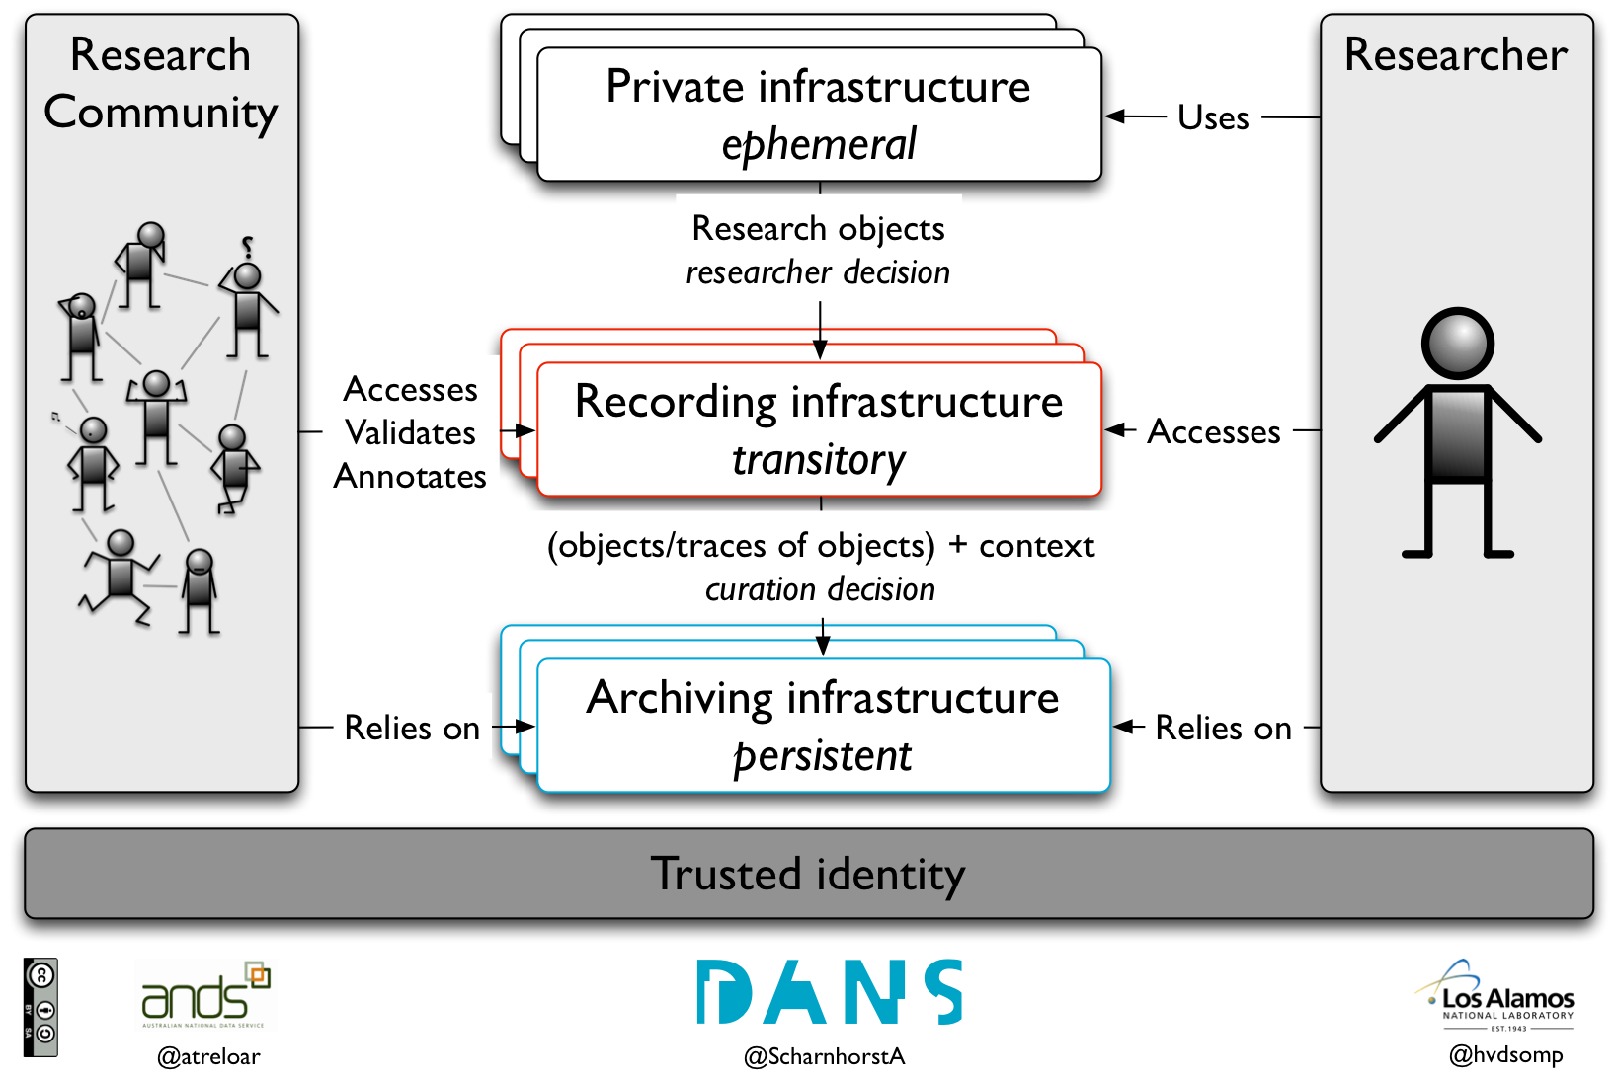

Slide 37
Infrastructure Considerations
Various incentives to move objects from Private to Recording:
Share with self, team, comply with funder requirements
Objects in Recording are network accessible and in global (HTTP) namespace
Within reach of web-scale processes aimed at selectively moving them from Recording to Archiving
Core aspects of these processes include
Ability to snapshot the state of interlinked objects at specific moments in their lifecycle
Transfer of snapshots from Recording platforms to appropriate, distributed Archive platforms (interoperability)
Decisions regarding which objects should be captured

Slide 38
Capture Considerations
What are the criteria involved in deciding (which states of) which objects get captured/archived?
What triggers transition from Recording to Archiving?
On-demand in lifecycle, social status of the object, reference made to object, deliberate randomness for serendipity, …
What to capture/archive?
Snapshot of object or trace of object (metadata, provenance, …) ?
What is the Scholarly Record that requires archiving?
Outcome?
Process and Outcome?

Slide 39
Archiving the Evolving Scholarly Record: A Perspective
Herbert Van de Sompel
@hvdsomp
Los Alamos National Laboratory
Acknowledgments: Andrew Treloar, @atreloar , ANDS

Slide 40
In This Talk
Functions of scholarly communication
Pointers to the future
Characterizing the future
Archiving the future

Slide 41
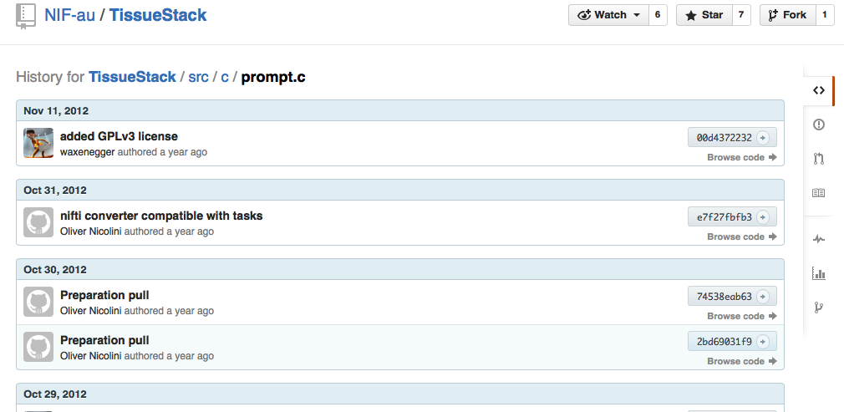
Registration - GitHub
http://github.com

Slide 42
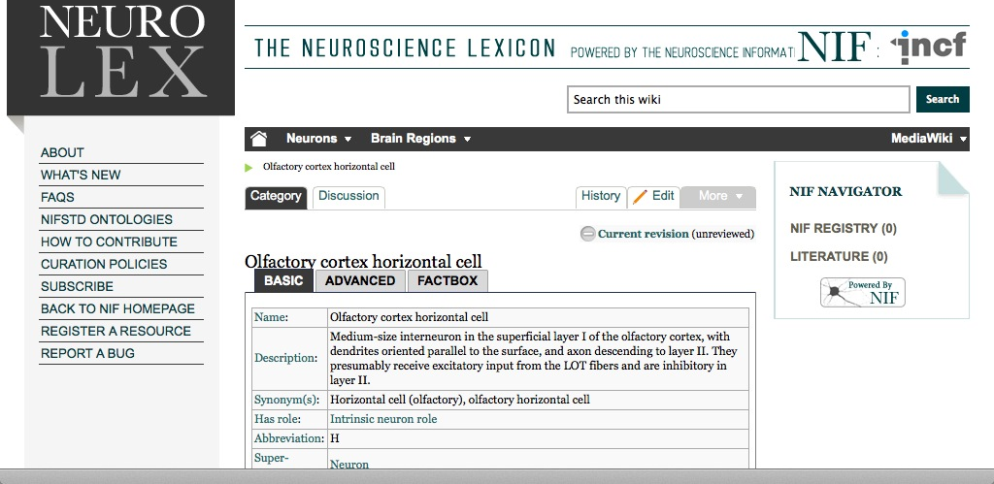
Registration - Neurolex
http://neurolex.org/wiki/Category:Olfactory_cortex_horizontal_cell

Slide 43
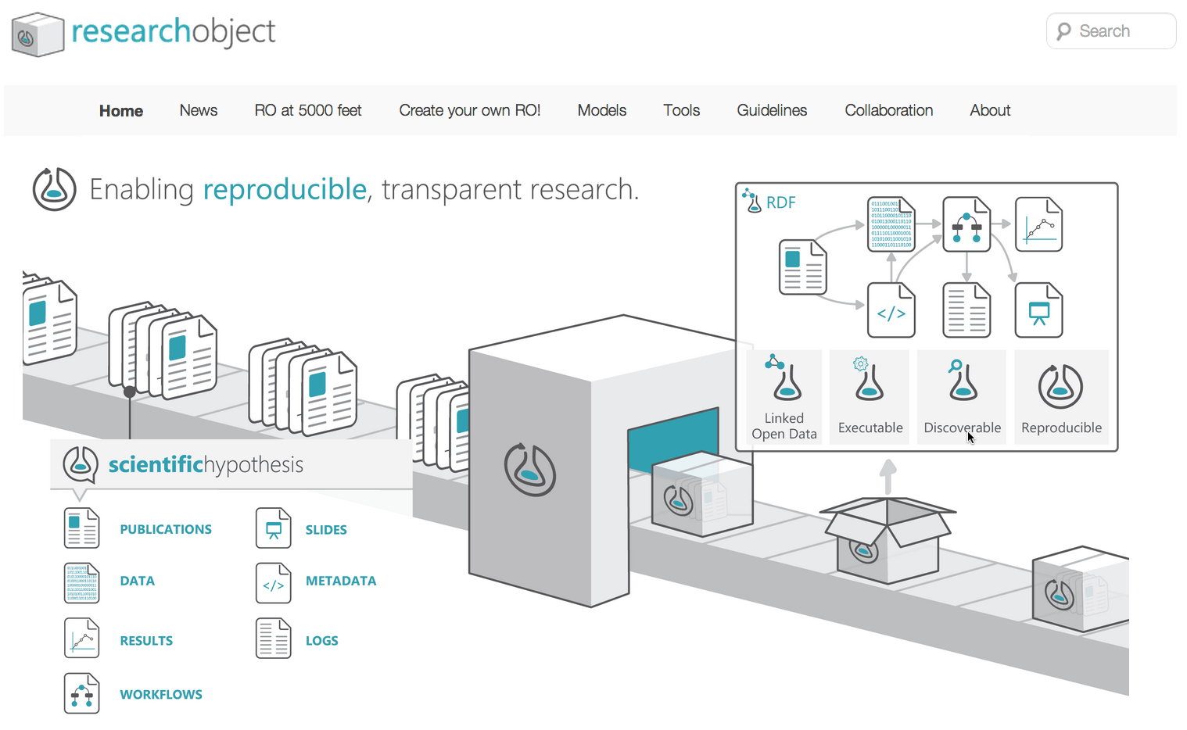
Registration – Research Objects
http://researchobject.org/

Slide 44
Registration - Observations
Registration of wide variety of objects
dynamic, compound, inter-related, distributed across the web
Decoupling registration from certification
Time stamping, versioning

Slide 45
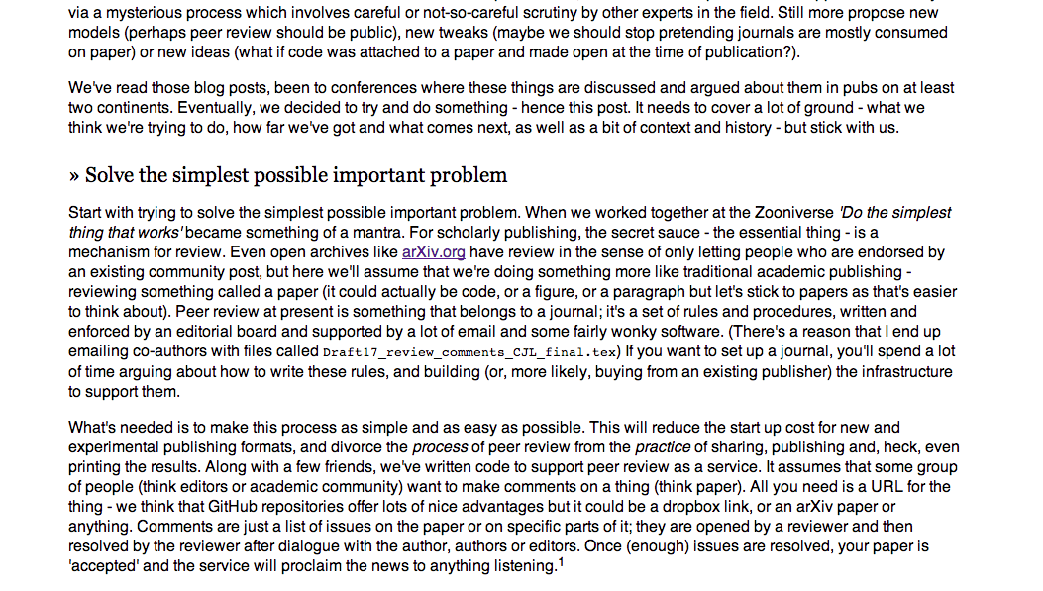
Certification – The Open Journal
http://theoj.org
Notes:
Peer review as an overlay service. Peer review as annotations.

Slide 46
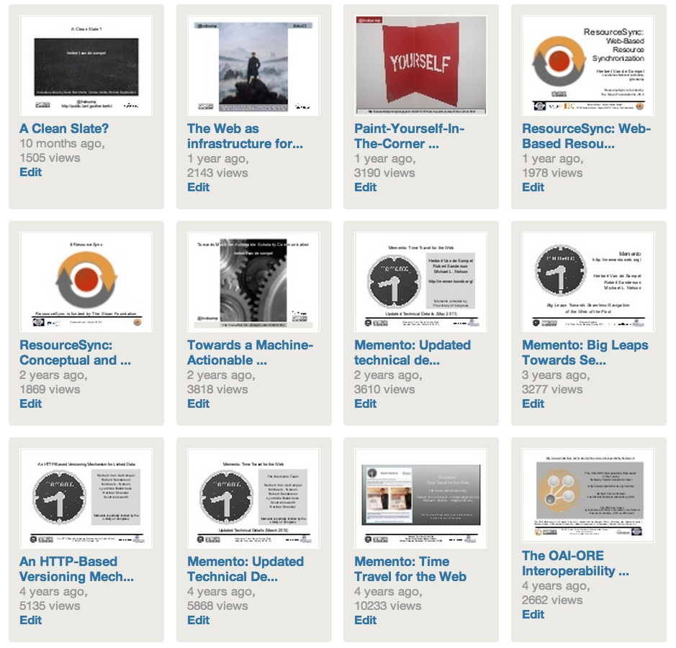
Certification – slideshare
http://www.slideshare.net/hvdsomp/presentations

Slide 47
Certification - Observations
Certification decoupled from registration
Certification of various types of objects
Social interactions validating
Machines validating

Slide 48
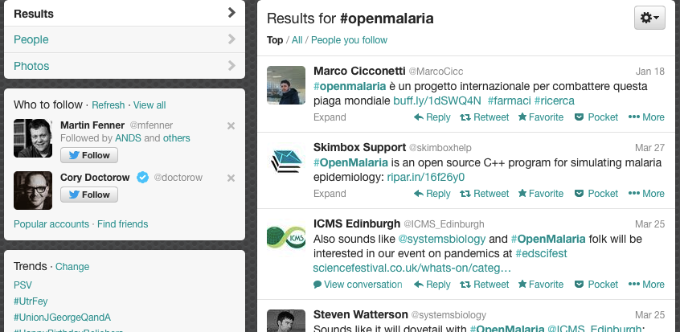
Awareness – Twitter
http://twitter.com
Notes:
Speed & serendipity (Cameron Neylon)

Slide 49
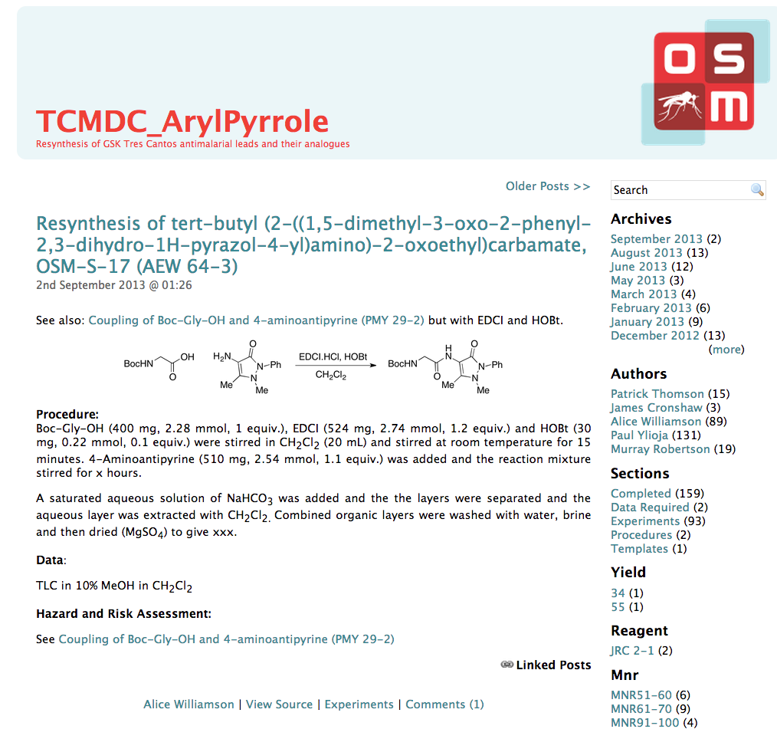
Awareness – eLabNoteBook RSS Feeds
http://malaria.ourexperiment.org/feeds
Notes:
Speed & serendipity (Cameron Neylon)

Slide 50
Awareness - Observations
Awareness for various types of objects
including objects involved in the research process
Real time awareness
Awareness through social media

Slide 51
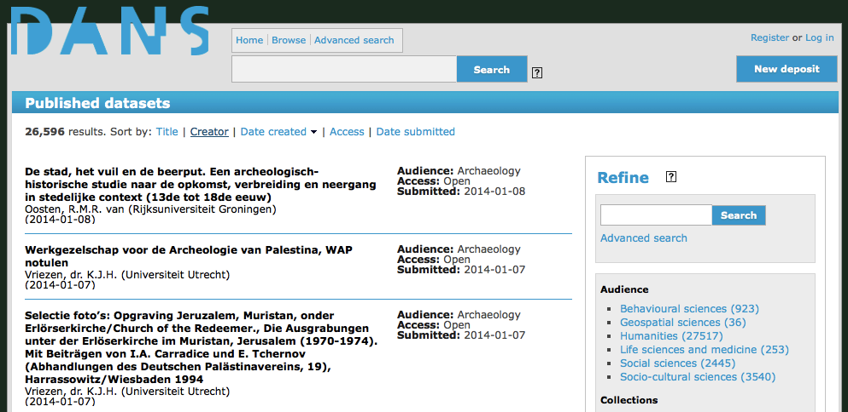
Archiving – DANS Easy
http://easy.dans.knaw.nl/
Notes:
Speed & serendipity (Cameron Neylon)

Slide 52
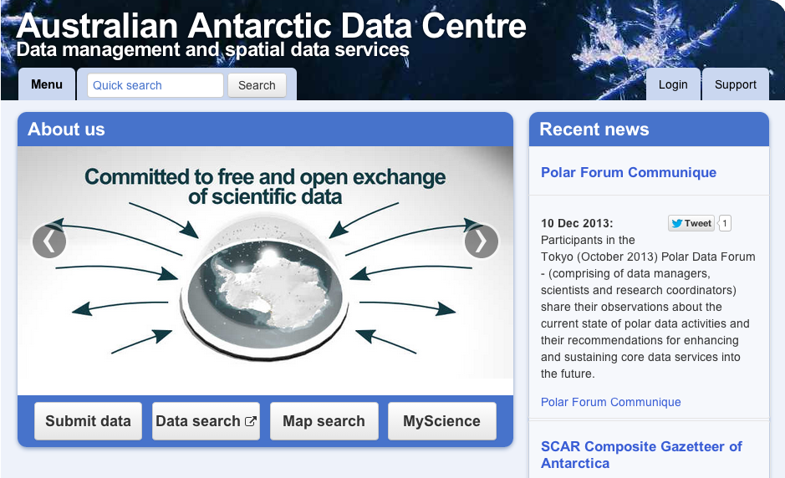
Archiving – Australian Antarctic Data Centre
http://data.aad.gov.au/
Notes:
Regionael, discipline focused

Slide 53
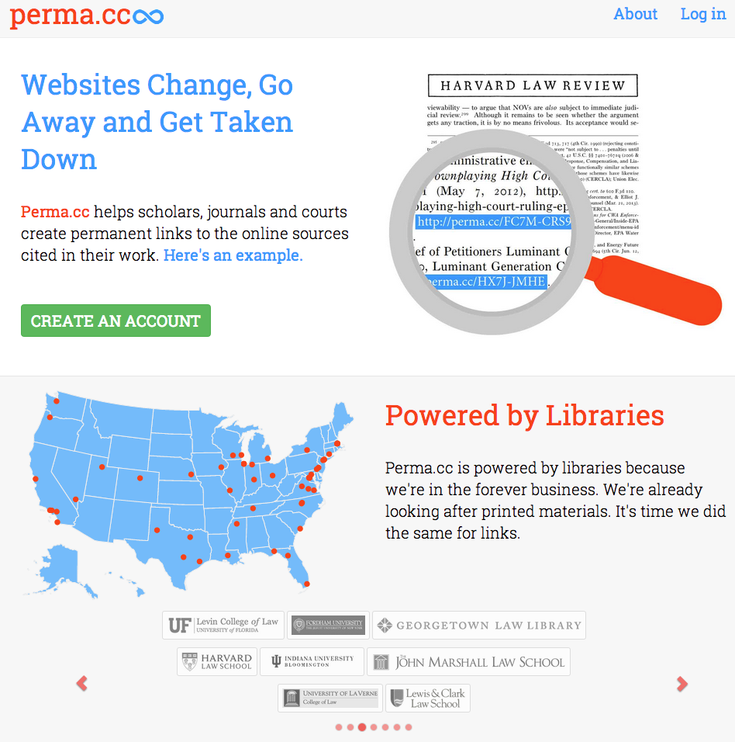
Archiving – perma.cc
http://perma.cc

Slide 54
Archiving - Observations
Archiving/Archives for various types of objects
Distributed archives
Archival consortia
Audit for trustworthiness

