Slide 1
Working with OCLC on ISNI identifiers
Simon Huggard
Deputy Director, Research & Collections, LTU Library
http://isni.org/isni/0000000427541720
http://orcid.org/0000-0002-0365-112X
http://arrow.latrobe.edu.au/Identities/AU-VLU0000078774
Notes:
Identifiers of mine: ISNI, ORCID and MINT (Party infrastructure)

Slide 2
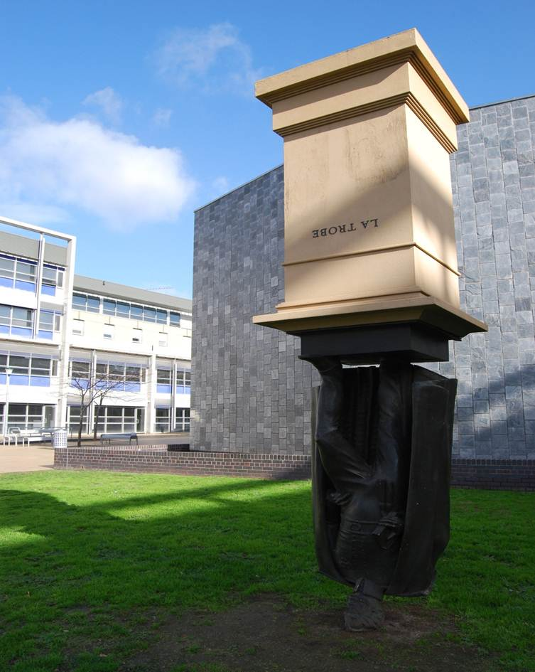
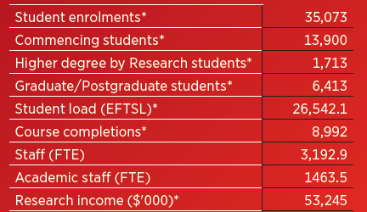
http://www.onlymelbourne.com.au/statue-charles-la-trobe
Notes:
Simon:
Since LTU opened in 1967 as the 3rd University in Victoria, we have grown to more than 30,000 students from over 90 countries with a campus network at Melbourne (Bundoora), Albury-Wodonga, Bendigo, Mildura, Melbourne City and Shepparton.
We are named after Charles Joseph La Trobe, the first Superintendent of the Port Phillip District, and first Lieutenant-Governor of the new colony of Victoria.
The image that you see on screen is a sculpture by Charles Robb, located at the main campus. This sculpture embodies the notion that universities should turn ideas on their heads.
http://www.onlymelbourne.com.au/statue-charles-la-trobe

Slide 3
Research at La Trobe University latrobe.edu.au/research/
1,389 researchers: 339 research staff, 1050 teaching & research staff
1,700 HDR students
32 Research Institutes Centres
2 Research Development Parks
20 Disciplinary Research Programs
5 Research Focus Areas (RFAs):
Building healthy communities
Securing food, water and the environment
Sport exercise and rehabilitation
Transforming human societies
Understanding disease
Notes:
Simon:
To characterise research at La Trobe…

Slide 4
Context
Start of our ISNI journey
Institutional motivations
Library decision making
Researcher behaviour
Notes:
Most institutions are trying to manage publications better
Changing role for the Library
What problem are we trying to solve?
The need for name identifiers
Problems with names that we think ISNIs will resolve
Agreed to work with Janifer Gatenby from OCLC in 2013
Webinar/Discussion with OCLC Sept 2013 – agreed La Trobe would be a pilot
Problems with names that we think ISNIs will help to resolve
Webinar/Discussion with OCLC Sept 2013 – agreed La Trobe would be a pilot
ORCID is gaining momentum rapidly in the academic environment

Slide 5
Why ISNI?
Based on “trusted“ library infrastructure (and many years of library data)
Fills a gap between identifiers in scientific databases (Web of Science, Scopus, etc.) and humanities/mono publishing
The ISNI system is data-driven
Matching against millions of records.
Data comes from many sources into ISNI
Doesn’t rely on the academic to claim anything
Basic nstitutional membership
Notes:
Basic nstitutional membership – 800 Euros (basic institutional membership)

Slide 6
What is the context in Australia?
Big momentum around identifiers
Academics being asked for their ORCID identifier by funders, institutions and publishers
ORCID consortim in Australia
ORCID recently endorsed by: ANDS, ARMS, CAUL, Universities Australia, NHMRC and ARC
Notes:
ARMS Australasian Research Management Society
New consortium with 36 Universities Australia wide. Signing of agreements in November. Work to start in January 2016.
What will happen is that infrastructure will be setup to allow users to login to their own systems at work (eg. CRIS)
And use the AAF to authenticate directly to ORCID. This can then either create an ORCID, update their ORCID record or pull information
From ORCID to update their profile in their CRIS.

Slide 7
ISNI work at La Trobe
ISNI Numbers - initial upload (June 2014)
Assigned: 1021
Provisional: 2530
Non VIAF links: 1563
VIAF links: 1864
Total links: 3427
After unique name assignment (July 2014)
Assigned: 1704
After manual work done (October 2014-early 2015)
Assigned : 2255
1149 current, active researchers with ISNIs, from 1274 current, active University researchers in total (90%)
Working on top 400 identifiers
Notes:
How long did this work take? How much did it cost? Initial work took about 2 weeks full time (one staff member). Later work (manual work) - cost about $8,500 and about 120 hours of work (4 weeks).

Slide 8
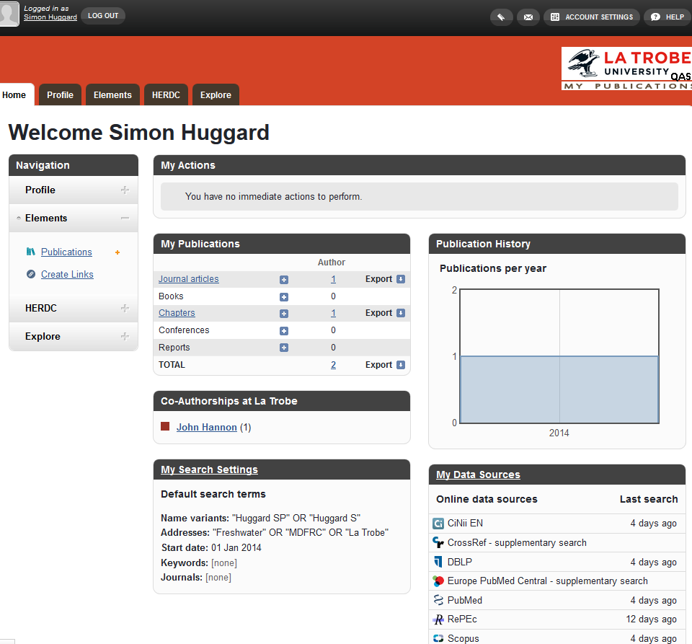
What does this mean for La Trobe?

Slide 9
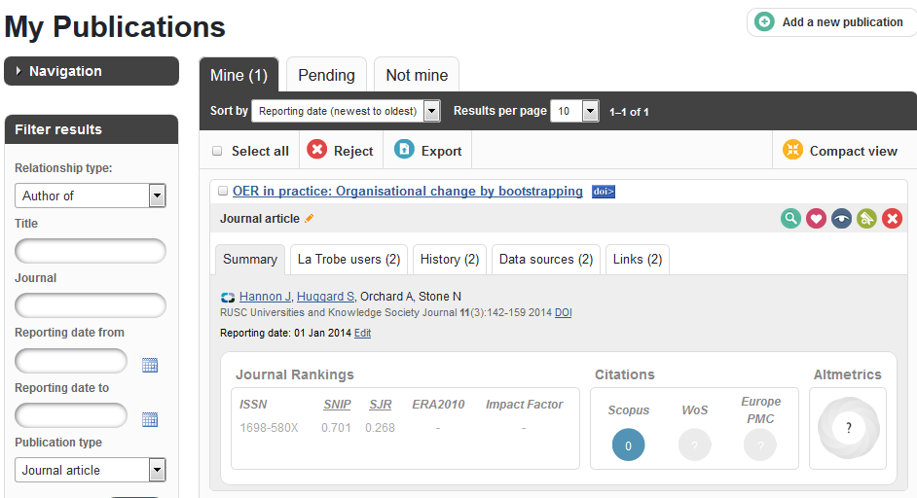

Slide 10
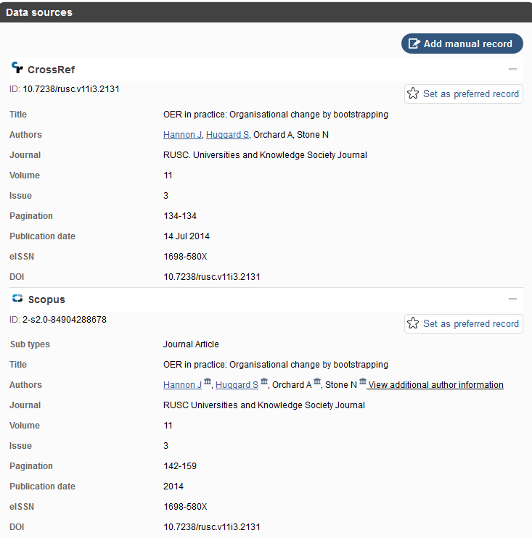
Notes:
CrossRef and Scopus data sources. Have DOI. This finds the item, but not myself necessarily.

Slide 11
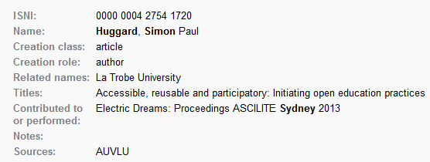
ISNI

Slide 12
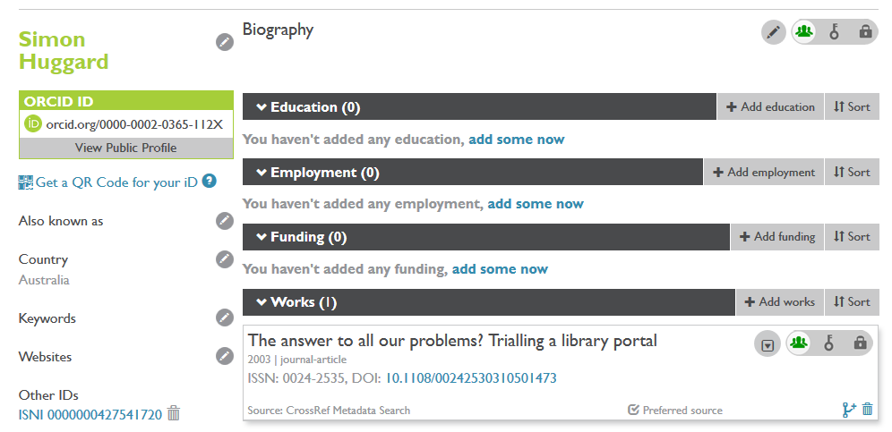
ORCID

Slide 13
ORCID ISNI interoperability
Statement issued April 2013:
https://orcid.org/blog/2013/04/22/orcid-and-isni-issue-joint-statement-interoperation-april-2013
MoU signed January 2014:
http://www.isni.org/content/isni-and-orcid-sign-memo-understanding-2014-01
While ISNI and ORCID have different missions and employ different processes for assigning identifiers …ORCID and ISNI are agreed on the need to aim for interoperation through linking and of sharing public data between the two systems

Slide 14
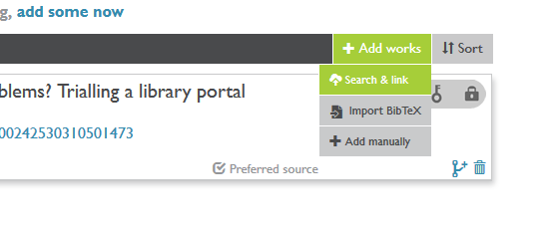
ORCID ISNI interoperability

Slide 15
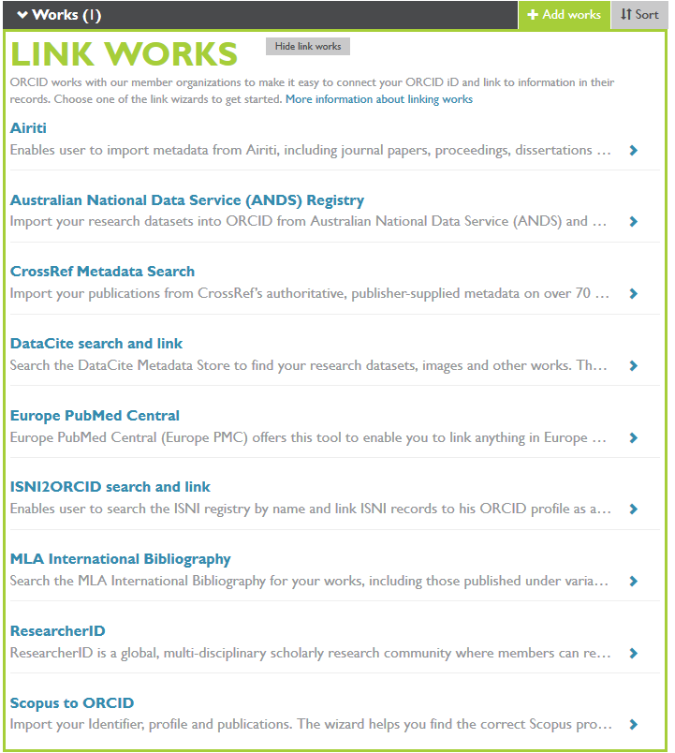
Notes:
Because there are so many places to link up your ORCID with other identifiers – perhaps there is something ISNI can do to help with this?
Use ISNI data source. ISNI can show that 3 ORCiDs are same person.
Discussions with OCLC about testing of the ORCID registration workflow.

Slide 16
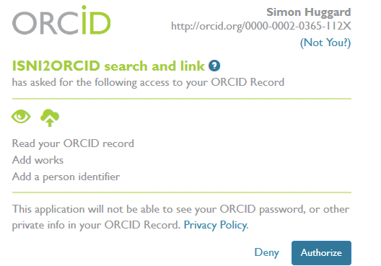
ISNI to ORCID link

Slide 17
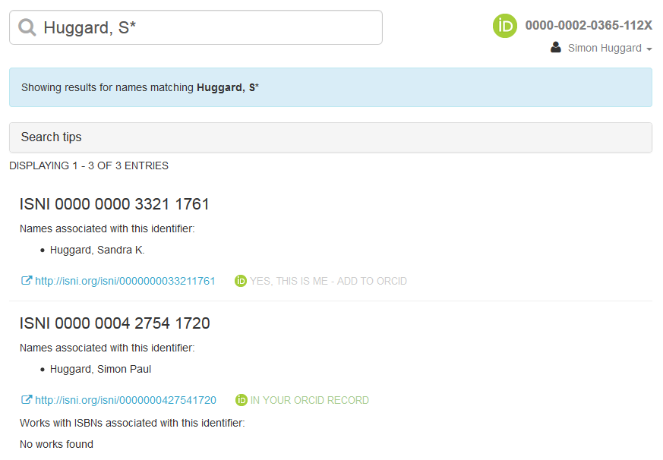

Slide 18
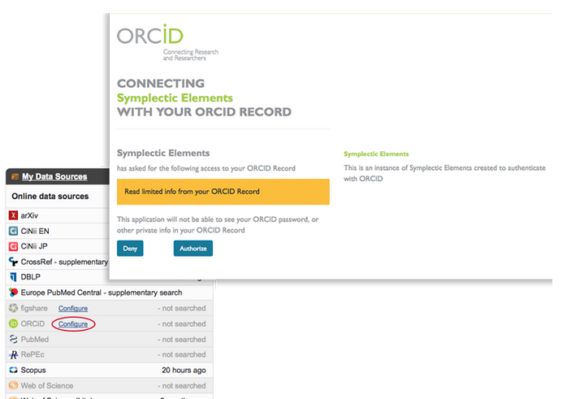
MyPublications – ORCID integration

Slide 19
What next?
Communicate to all researchers that the Library is contributing data to support ISNI identifier assignment and creating ORCIDs on their behalf
Library Research Team will be working with academics and graduate researchers to explain ORCID and ISNI as part of their work to meet with new researchers and support new profiles of academics.
Explain what researchers need to do with their ORCID and ISNI.
Configure our systems to include ORCIDs and ISNIs automatically
Work with OCLC to provide feedback about ISNI registration and ORCID interoperability
Notes:
La Trobe to assess ISNI2ORCID workflow; Provide advice about linked data (b/w organisation to person and back); outreach about ISNI and ORCID;
Investigate ways to improve the ORCID registration process where ISNIs have been assigned; provide advice about maintenance and updating of ORCIDs and ISNIs.

Slide 20
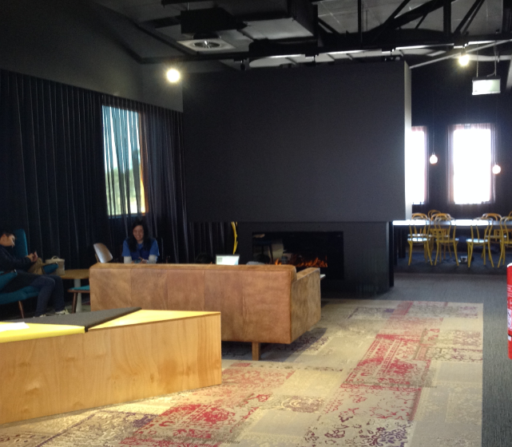
Thank you
Notes:
Picture of the “fire place” in The Learning Commons (opened in July 2015) at La Trobe University Melbourne (Bundoora) campus.

