Slide 1
The Academic Library, Teaching, and Learning: The Bad, Ugly, and Good in Three LibValue Studies
The Library in the Life of the User Chicago, IL October 22, 2015
Rachel A. Fleming-May, M.L.I.S., Ph.D.
Associate Professor, School of Information Sciences
The University of Tennessee
Teresa B. Walker
Associate Dean for Learning, Research, and Engagement University of Tennessee Libraries

Slide 2
LibValue
What?
Value of academic library resources & services in support of teaching , learning, and student success
How?
Instructor Survey: UTK and UNC-W
Three-session Instruction Workshop Series: UTK
Survey of Users (and non-Users) of the UTK Library Commons

Slide 3
Survey @UTK & UNCW: All constituents with instructional responsibilities: Tenured/tenure-track faculty “Clinical” faculty Part-time faculty GTA’s Administrators (e.g., Dean of Students’ Office)
Materials used for teaching support, whether or not provided by Library
Readings, etc., for students, print, electronic, other formats
Reading to support own pedagogical development
Other support provided by UTK Libraries

Slide 4
Differences?
University of Tennessee-Knoxville
University of North Carolina-Wilmington
29,934 FTE Enrollment
RU/VH: Research Universities (very high research activity)
12,924 FTE
Master's L: Master's Colleges and Universities (larger programs)

Slide 5
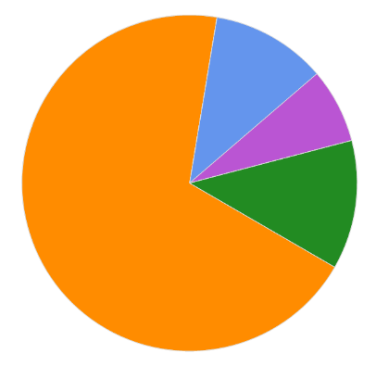
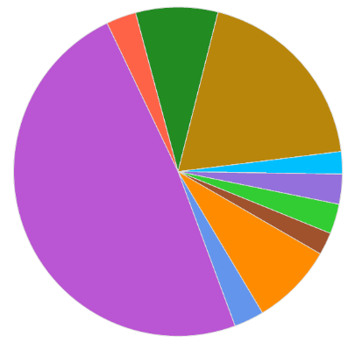
UTK
UNC-W
Communication & Information
Health & Human Services
Education, Health, Human Services
Business
A&S
Education
A&S
Agricultural Sciences & Natural Resources

Slide 6
Services: I have asked my students to…

Slide 7
Services: I have asked a librarian to…

Slide 8
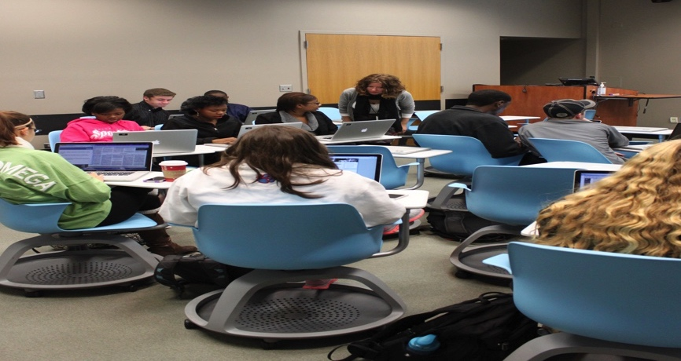
Perceived Benefits, Both Schools:
Savings…
of own time
of own money
of other resources
Improvements…
teaching
course-related materials
student performance

Slide 9
Improved teaching?…

Slide 10
Improved Student Performance?
Notes:
54.4% used e-resources in summer
61.3% used e-resources in fall
“Can work all night with tools needed if can't afford internet at home.”

Slide 11
The Good: UTK
“The primary way I [save money] is by using electronic sources rather than making paper copies.
I am not really sure what the amount total should be…but I know in terms of my own work it is at least 50 dollars a year in savings, and
I would guess is greater than that if you include all the readings that I now provide electronically rather than in paper format.
That savings doesn't include the many, many hours of my time it saves not making copies of supplemental readings that I use fairly regularly in all my classes.”
“Access to electronic journals invaluable in working with and teaching of graduate students.”

Slide 12
…and UNC-W
“Electronic copies of articles reduce clutter and paper usage in the department.
I am embarrassed that I don't utilize the library more.
It's going to be on my list of self-improvements for the coming semesters.
I did not realize the extent of services available through the library.”
“Saving on text book purchases where much of the material is not relevant.
This allows me to tailor the course material and focus the topics more clearly.”
“ feel more confident and see improvements in student performance when I use the library as a resource and refer students to the educators that work there.”

Slide 13
“Would you like to learn more about what the UTK/UNCW Libraries have to offer?”

Slide 14
The “Less Good” (Bad):
“My students have problems figuring out what and how to cite articles and sources –
especially online sources.”
“We need clear help with proper citations,
especially for images.
I am confused about faculty access to image data bases too.”
“Students remain wedded to Wikipedia, no matter what I do. This is the heart of our struggle.”
“Just never thought about [using the library services to support teaching] –
especially with distance education students.”

Slide 15
Instruction: What?
Experimental/Longitudinal Study:
Three-session workshop series
Pre- and post-session assessments
Skills
Awareness
Emotional changes

Slide 16
Designed and Taught By:
UTK Libraries:
Rachel Radom, Assistant Professor and Instructional Services Librarian for Undergraduate Programs
Teresa Walker, Associate Professor and Head, Integrated User Services
Regina Mays
College of Communication and Information:
Rachel Fleming-May

Slide 17
Who?
Piloted Spring 2012 with EN 104 Students (12)
NIH-funded PEER Ph.D. program for students from groups underrepresented in STEM fields, Fall 2012 (13)
UTK-PSCC “Bridge” Program:
Incoming first-year students
Summer 2012 (60+, 43 usable)
Summer 2013

Slide 18
Bridge (before):
Negative Experiences
Small library/ inadequate content
Unhelpful staff
Most:
Had visited UTK’s or another college/university library prior to enrolling
Are “almost always” successful in Google searches
Often need materials from sources other than Google
Sometimes have difficulty finding good information
Often find that researching a topic takes more time than expected
Sometimes or seldom ask a librarian for assistance (59.7% vs. 29.8%-- ‘often’ or ‘almost always’)

Slide 19
Bridge: What was the best part of participating in these workshops?
“I was able to learn how to use the libraries online website and database,
which will be very helpful for me when researching for my papers.”
“This course has really helped me get more used to the library.
I'm definitely more confident.”
“Learning how to work my way around the library.
The citations activity was actually engaging and fun.”
“I learned more about citing and
feel more comfortable about writing my papers.”
“learning how to use the databases correctly.”
CITATION

Slide 20
The Good: "After participating in these three library research workshops, I..."

Slide 21
Follow-up: “After completing the Library Sessions (through my COUN 212 class) . . .”
 | Strongly Disagree | Disagree | Neither Agree nor Disagree | Agree | Strongly Agree
I feel comfortable using the UTK Libraries’ webpage and/or databases for class assignments. | 1 |  | 6 | 25 | 20
I feel comfortable visiting the UTK Library. | 1 |  | 3 | 25 | 23
I used UTK Library resources for my COUN 212 paper(s) and/or my CMST 210/240 speech(es). | 3 | 1 | 6 | 21 | 21

Slide 22

PEER

Slide 23
PEER:
Most:
Almost always begin a project by reviewing literature (62%)
Are “almost always/often” successful searching Google for information (85%)
Seldom or almost never have trouble finding good information (85%)
Negative Experience:
Noisy/not conducive to study
Policies and Procedures
“The database that I was required to use didn't yield the results that I wanted, and it took me a really long time to find what I was looking for.”

Slide 24
The Good: What was the best thing…?
“…most helpful workshops that I have attended since I have entered UTK.”
“The information was presented by knowledgeable staff.”
“The plagiarism workshop I think it was the best, or at least the one that I learn more.
It was really helpful.”
“They were interactive and our questions were answered.”
PLAGIARISM

Slide 25
The Commons Study
Student use of the Learning Commons:
Student-reported usage and affective data
Demographic and PTD data
Goals:
Gain a better understanding of how students use resources and services in the Commons in relation to both coursework and college life
Demonstrate the value of the Commons environment to the University’s efforts in teaching, learning, and student success

Slide 26
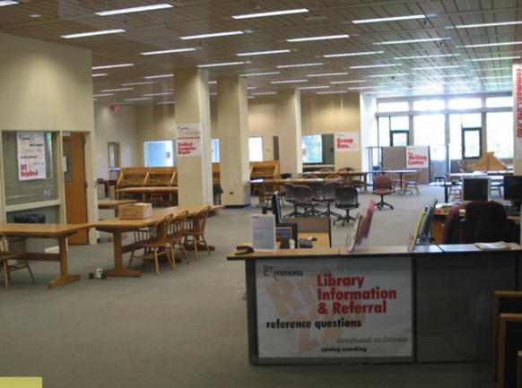
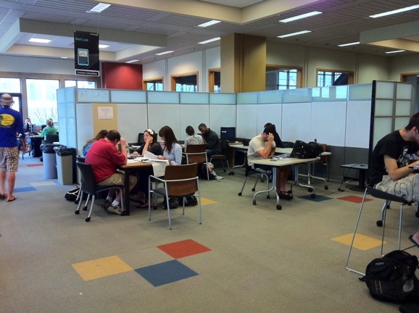
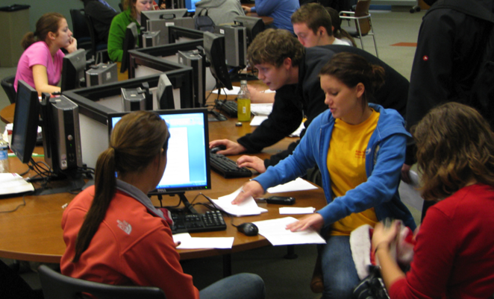
The Commons in Phases

Slide 27
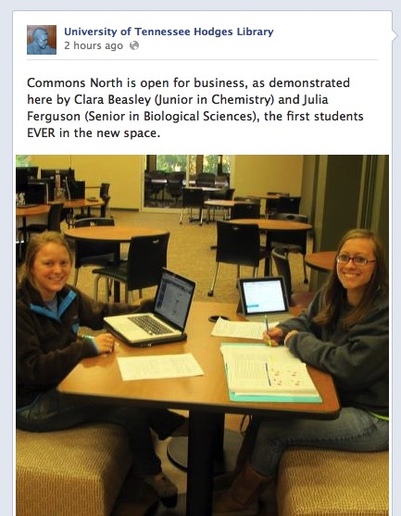
Accidental Grand Opening
Eager students storm the Commons!
We didn’t even have the computers installed but the students decided we were ready!
Notes:
So, these two hooligans, Clara and Julie, if those are their real names, took advantage of a temporary pull back of the caution tape while Rita was giving a tour to SEC schools. What’s done is done. We hadn’t even hooked up the computers, but the students started pouring in as soon as the tape went down.

Slide 28
How do we tell our story?
Existing Data
Needed Data
Automatically collected usage data
Data collected in person by service providers
Demographic data on retention, success, and years to graduation
Student exit surveys
NSSE survey data
Student-reported use of Commons spaces and services
Student-reported value of Commons spaces and services
Augmented university data set including progress toward degree data
Notes:
Discuss the many elements of telling our story to admin and others.

Slide 29
A New Data Set
Admissions/ Demographic Data
Progress Toward Degree Data
Associated Survey ID
Year of birth
Sex
Ethnicity
Year started at UTK
ACT and/SAT or equivalent
Transfer student? (Y or N)
Year and Term of survey
Associated Survey ID
Major
Cumulative GPA
Cumulative Credit Hours
Class Standing
Year and Term of posting
Progress-towards-degree data
Notes:
How did we get permission to use this data? What were the challenges?

Slide 30
Surveys:
In Person
In Class
Distributed in person for one week in Summer and Fall 2011
Focus on services used in the Commons on a typical visit
957 respondents
Taken by Communication Studies 210 and 240 students (Gen Ed)
Use of Commons services and spaces / Feelings about the value of the Commons to their experience at UT
20% response rate from total class enrollment / 146 respondents

Slide 31
Surveys: In Person
Please identify your class standing
Freshman (1st year)
Sophomore (2nd year)
Junior (3rd year)
Senior (4th year)
Graduate

Slide 32
Surveys: In Class
How often do you use the Library Commons for studying in groups
Never
A few times during the semester
Once a month
Once a week
Multiple time a week
Once a day
Multiple times a day

Slide 33
Surveys: In Class
You indicated that you use the Library Commons for studying in groups. Please estimate the amount of time you spend on this activity in a typical visit.
Less than one hour
One to two hours
More than two hours

Slide 34
Surveys: In Class
To what extent does the Library Commons
Categories
Choices
Encourage creativity
Help you do better in class
Make studying more enjoyable
Make you feel more involved in the University
Promote learning
Serve as a place to meet people
Don’t Know
Not at all
Very little
Some
Quite a bit
Very much

Slide 35
What is student success at UT?
Student Retention
I had trouble adjusting personally to UT
I did not feel like I was part of the university
Student Success
Notes:
Exit surveys and NSSE data

Slide 36
The Good: To What Extent Does the Commons

Slide 37
The Great: % of All Respondents vs. Top Students
Notes:
This slide represents a combination of our survey data paired with progress toward degree data for the individual students. It shows that students with a GPA greater than 3.5 make more use of Research Assistance, computer support, and to a lesser degree, tutoring services than other students who took the survey. Conversely, the opposite is true - students with a GPA lower than 3.5 make less use of Research Assistance and computer support than top students. In other words, students who know how to and regularly use the tools of scholarship, research and computing resources, do better academically. It remains to be seen if these students get into major programs sooner or graduate more quickly. We were obviously delighted with these results and to see the role the Commons plays in acculturation to the university community.

Slide 38



More Good: The Commons…
85%
Provides resources
I need for class
90%
Provides help
with assignments
74%
Facilitates group work
95%
Helps me
do better
in class

Slide 39
Using the Data: Improve Learning Spaces
Notes:
We didn’t just learn how valuable we were to students. We learned how we could be more valuable. These charts show how often students visited the Commons for certain kinds of activities. You’ll notice the charts look a lot alike. Students were using the commons regularly for assignments, group work, and individual study. Group study won out only slightly.

Slide 40
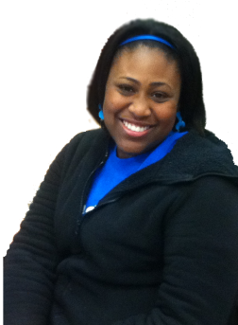
Using the Data: Improve Learning Spaces
We want…
More private study rooms
More computer lab space
More places to plug in laptops
More quiet space
More group space
More practice presentation rooms
More media production
Notes:
They also told us what they wanted. With the same amount of space…give us more of everything!

Slide 41
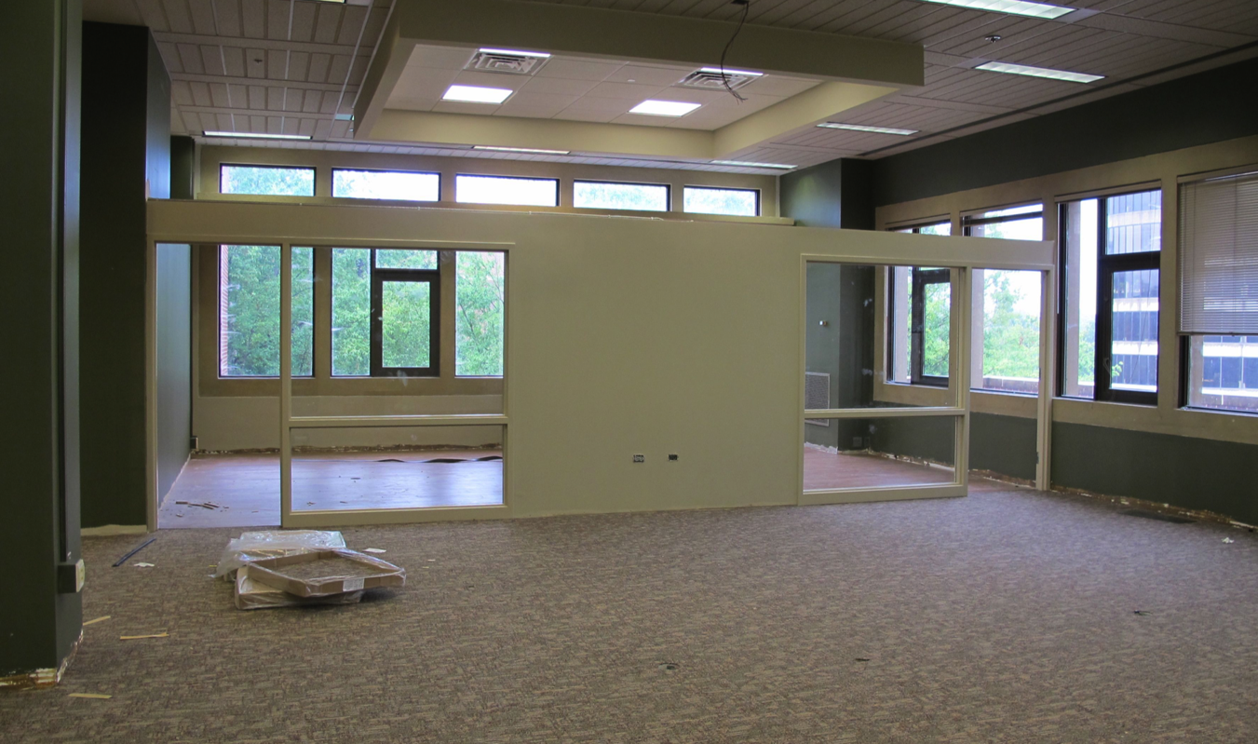
If you can’t build on…build in!
Notes:
These study rooms were added around the perimeter. We intended for them to be the answer to “we want more group space”, but the students used them to solve both problems.

Slide 42
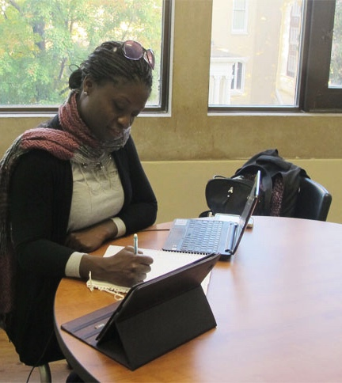
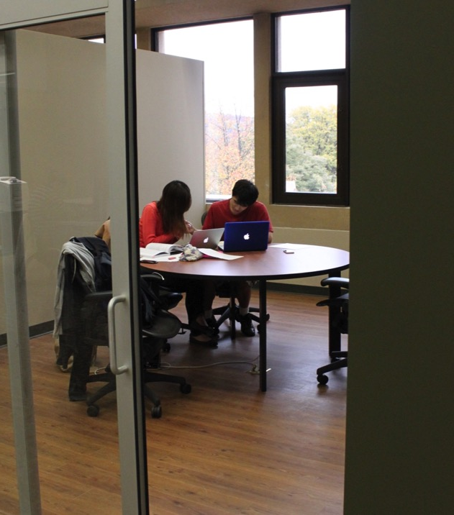
Study Rooms

Slide 43
Using the Data: Improve Engagement
Please identify your class standing:
Fall 2011
Summer 2011
Notes:
Another thing I wanted to mention, and mainly because it surprised us was that the distribution of students using the Commons was quite even by class standing, We had always assumed that most of our customers were lower division undergraduate and mainly freshmen. It was a big surprise to see Seniors representing such a large user base. We were happy to see we were serving the needs of all class ranks and happy to suppose that use of Commons spaces and resources were increasingly important to students as they neared graduation.

Slide 44
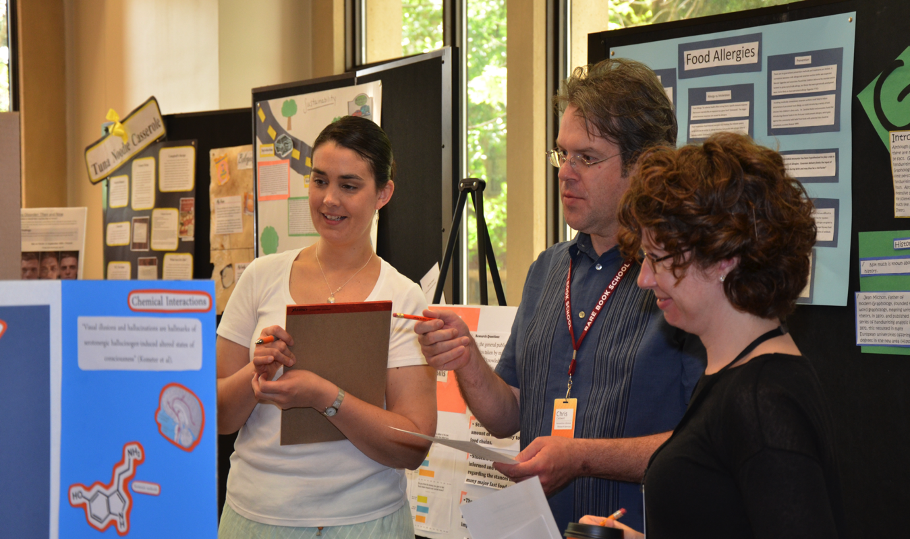
Forum for Student Research
Notes:
Learning that Seniors were a primary demographic told us to expand our engagement activities to account for their interests. This allowed us to strengthen existing partnerships and to build new ones. The English Department had always been a strong partner in providing a forum for student work in the Commons. Extending our activities to include honors and upper division students was a natural progression. An new and fortuitous step was partnering with the, somewhat new, Office of Undergraduate Research and also Career Services.

Slide 45
What happened next? The Changing Landscape of Higher Education
In Tennessee -
Outcomes-based budget
Complete College Act
A Top 25 Mandate
Tennessee Promise, 2015
Notes:
We began our study thinking a lot about changing trends surrounding teaching and learning and issues affecting student success such as retention. The data was able to help us with newer concerns.

Slide 46

Aligning Our Strategic Plan
The Five Top 25 Strategic Priorities
Undergraduate Education
Graduate Education
Research and Creative Activity
Faculty and Staff
Infrastructure and resources
Notes:
The Libraries had been very intentional about aligning its priorities with those of the institution and now we had even more to think about and more ways this data could help us be part of the conversation.

Slide 47
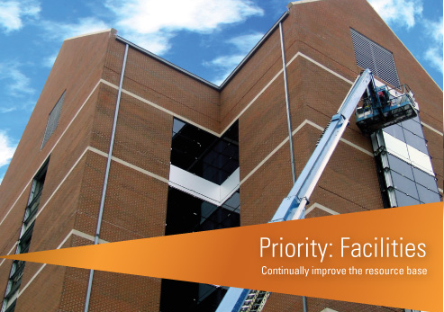
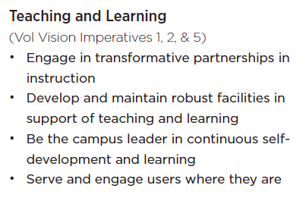
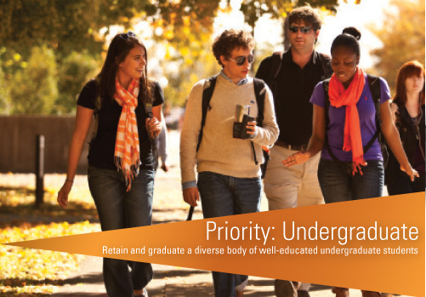
Aligning Our Strategic Plan
Notes:
I will say that with all of these changes, the UT Libraries has not suffered. We were very intentional about aligning our strategic plan with that of the University. Today, I am more focused on Undergraduate Education, Faculty and Staff, Infrastructure and resources, but we completely aligned our plan and short term goals to support that plan with the University’s priorities. We have benefited from that in many ways.

Slide 48
What did that do for us?
74%
It’s my home away from home!
Makes me feel more involved in the University
Notes:
It gave us a story to tell, backed by both data and testimonials, and it was the right story. It was a story that said we were paying attention, focusing on outcomes, and being evidence-based in our decision-making. Not only that, it showed that we were working across the University – with partners in the Commons and with research partners in SIS.

Slide 49
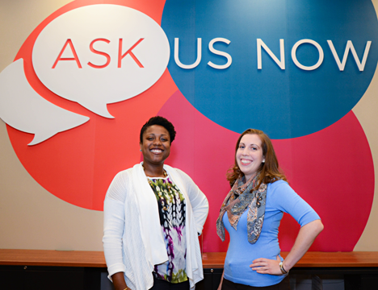
Student Success - New Positions!
“Everyone on campus is talking about it. The Library is actually doing something!”
Notes:
The Chancellor sent out a call for proposals to fund new faculty positions in support of the Top25 Strategic Planning efforts. We proposed a Student Success Librarian, competing with all other colleges and departments at the University. We ended up with two student success librarians.

Slide 50
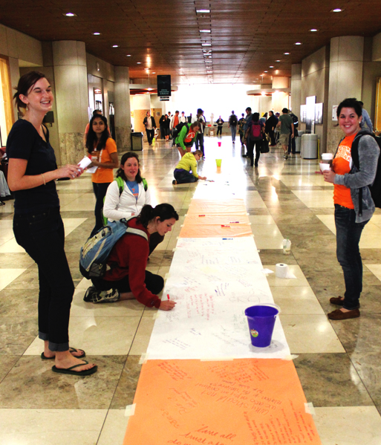
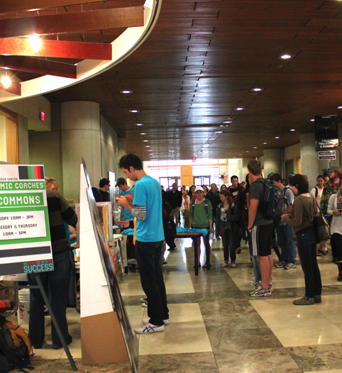
A Rebranding: Main Street!
Notes:
We didn’t think there was any doubt, but just in case…we dubbed the main entry way and galleria Main Street. We call it that and campus tour guides call it that. We take advantage of the traffic and have regular student-centered engagement events.

Slide 51
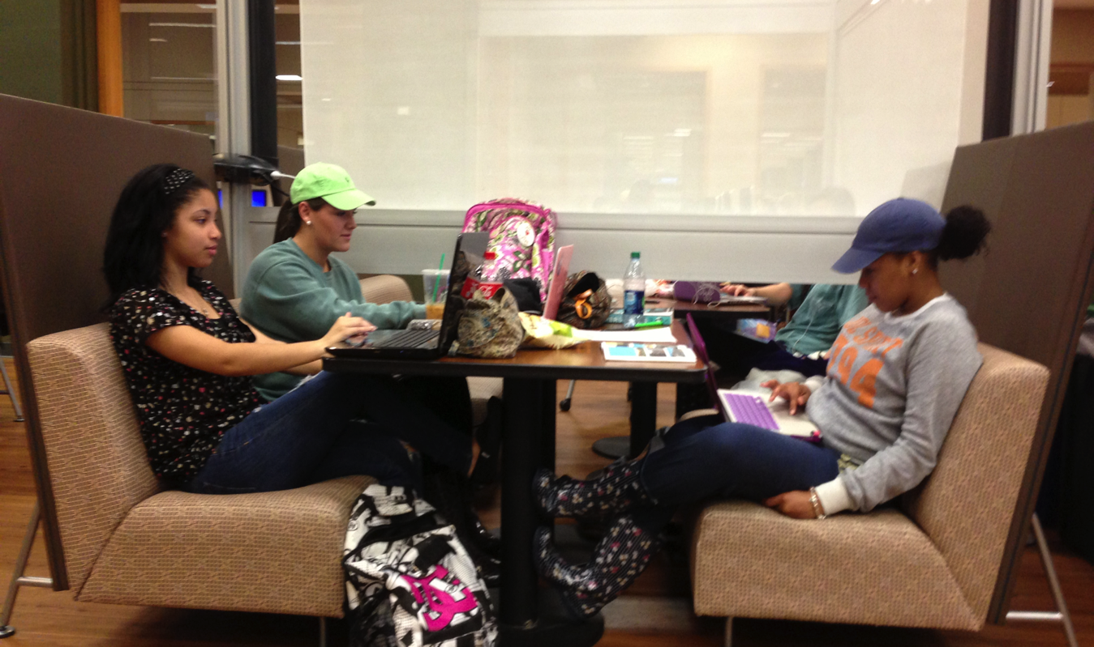
The Commons as Community
Notes:
On a college campus, what might be thought of as a third place is called informal learning space. We created a technology-rich, configurable common area with student-centered resources in one, convenient place. We also had a Starbucks and were open 24 hours.

Slide 52
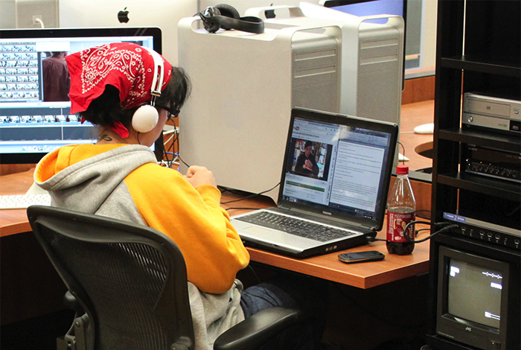
The Commons as Technology Hub
Notes:
We saw in the Commons study that students saw the Commons as a place to use specialized software and technology for completing assignments. In The Studio, in particular, students are creators.

Slide 53
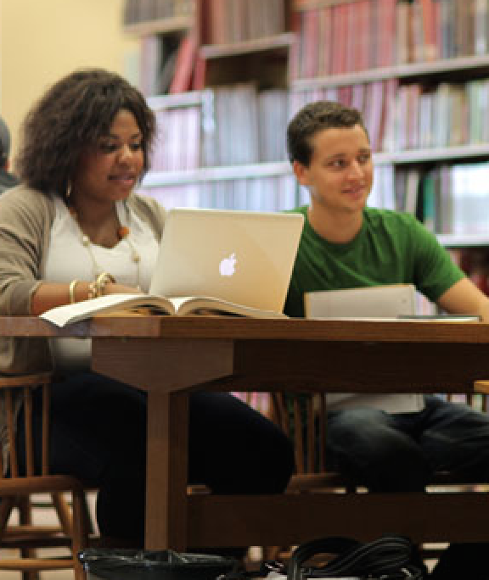
The Commons as Academic Support
Expanded Partnerships
AskUsNow
Student Success Center
Writing Center
Math Tutorial Center
StatLab
The Studio
Supplemental Instruction
More!
Notes:
We saw in the Commons study that students saw the Library as a place to use specialized software and technology and to get help with assignments.

Slide 54
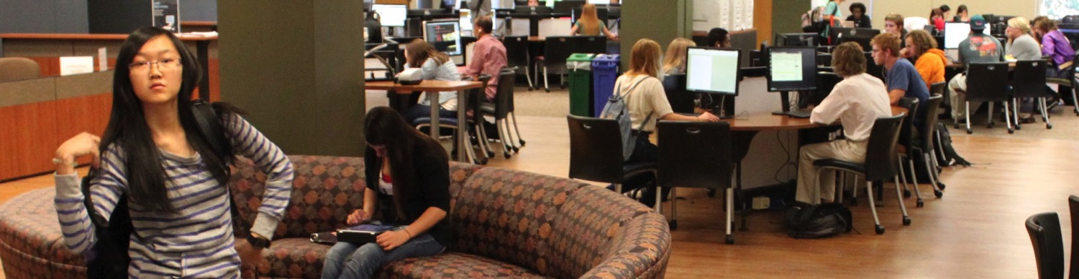
Problems & Opportunities
Take 15, graduate in 4 (years to graduation)
What’s happening to our sophomores?
What about transfer students?
Out Placement
Quality Enhancement Plan – Experiential Learning
Notes:
We got busy capitalizing on our strengths and building on the information we knew, from this study and other assessments and feedback. But the environment was still changing. Observing the students in the changing environment and sitting with this data helped us keep moving forward.

Slide 55
Changes in the Library Environment
Living with students every day in the Libraries is like accidentally conducting an ethnographic study.
The difficulty is remaining open to what you see…

Slide 56
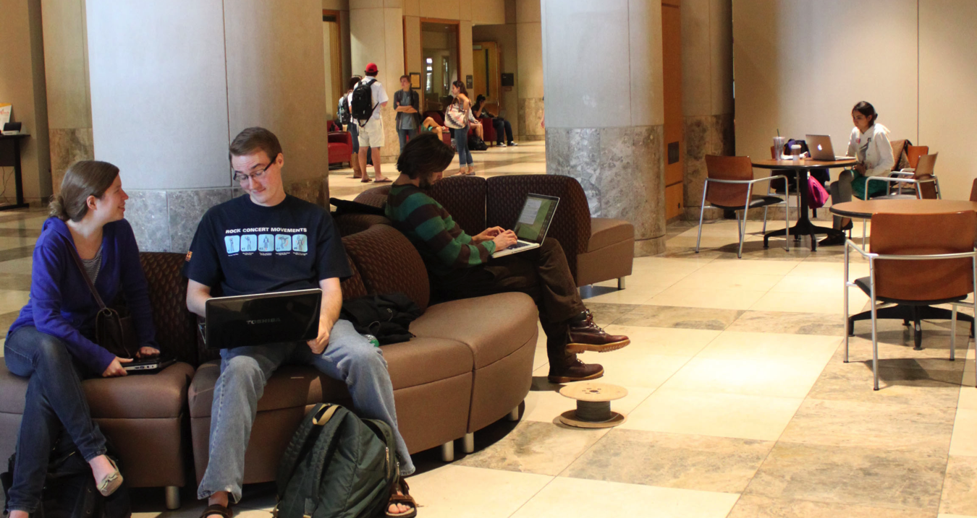
Make Them Comfortable in the Space
Notes:
Students need a space to be themselves…in public. We want them to be at home here and not to feel anxious using our spaces and resources. Part of that is about observing their behavior and responding to it.

Slide 57
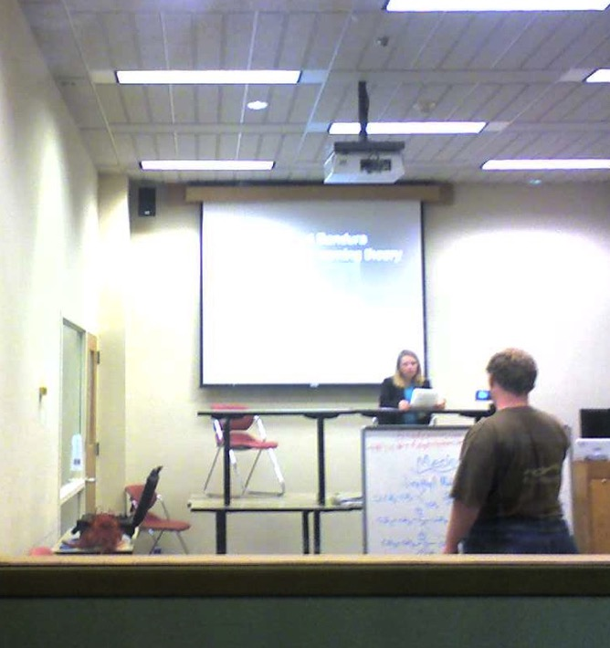
Ingenuity or Scandal?
Journalism students introduce the “green screen” concept in the Commons Phase I.
Capturing the moment introduced angst!
Notes:
This is the picture that put the partnership in peril. I innocently posted this picture to the Commons Partners listserv thinking it proved the Commons was inspiring creativity in our students. The table stacking inspired liability concerns among Commons managers.

Slide 58
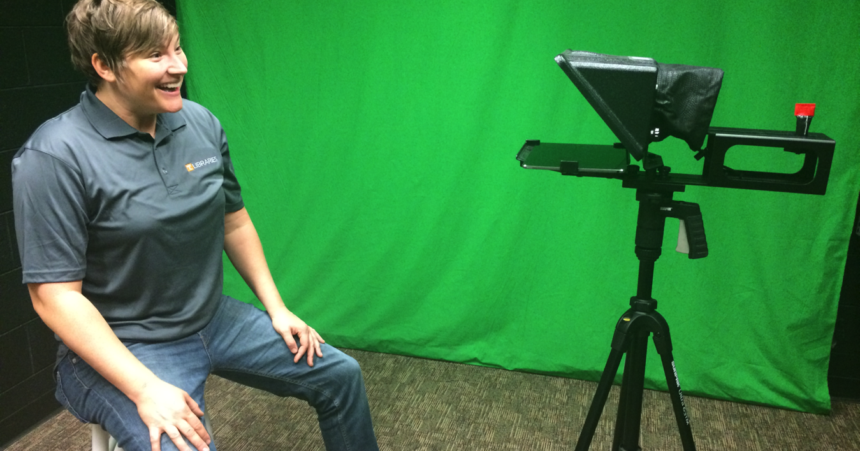
Fast Forward - Changes We’ve Made

Slide 59
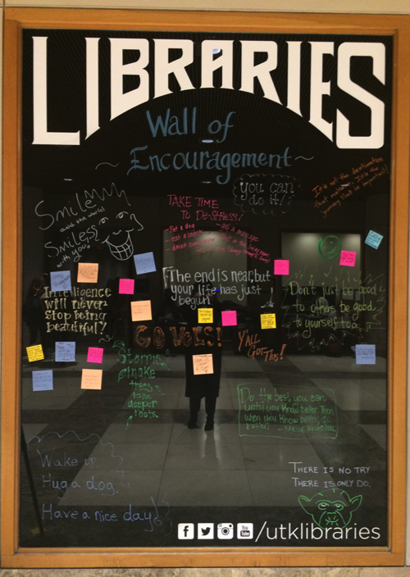
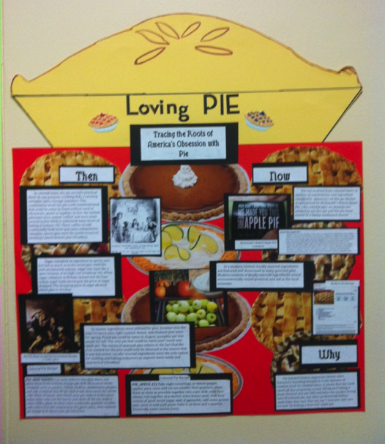
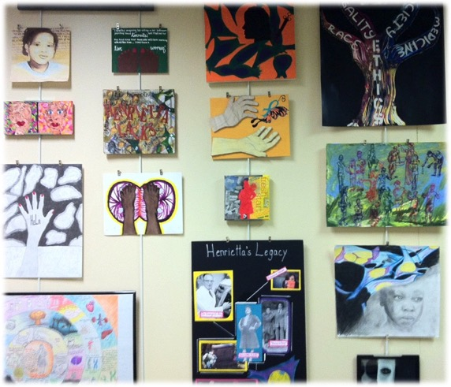
More Opportunities to Interact With the Space

Slide 60
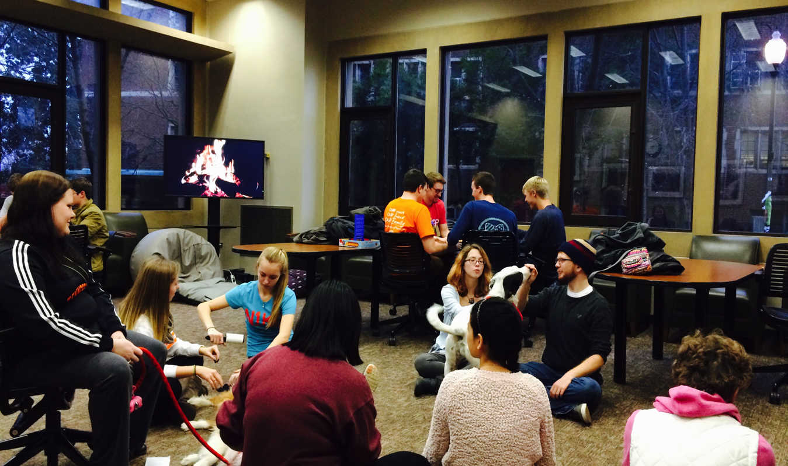
Creating Community: The Family Room

Slide 61
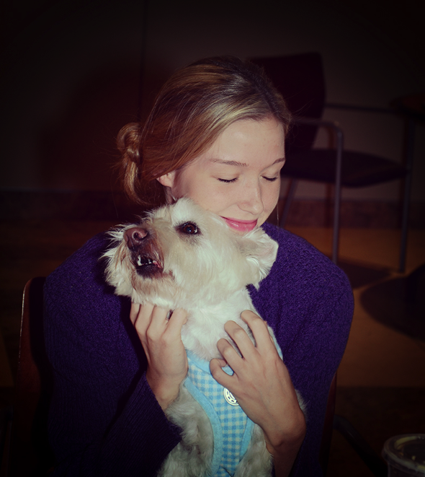
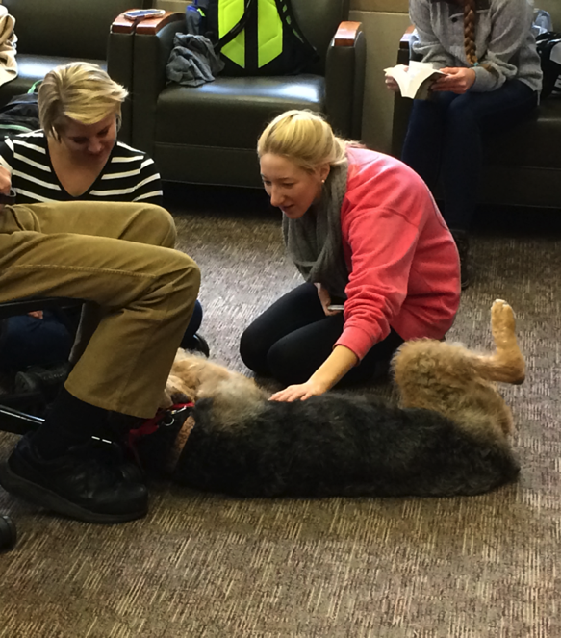
DeStress for Success: Getting a Leg Up On Finals
Notes:
We branded programs we had already begun and invited campus partners and generally put more effort into both the activities and promotion.

Slide 62
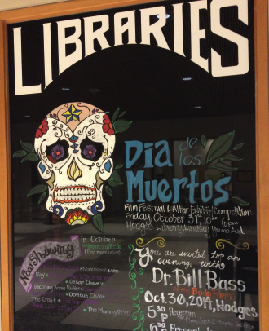

Extending Community
Let us help you
Present your next
Residence Life Program!
UT Libraries
Take Out
Notes:
We looked outward. We developed the Library Take Out program to connect with students in the Residence Halls. The program goes to them but also brings them to the Library and its resources. During finals, we offer support in the dorms. This way, we reach both 1st year, transfer students in the Bridge communities, and strengthen our bonds with campus partners who are dedicated to our same mission.

Slide 63
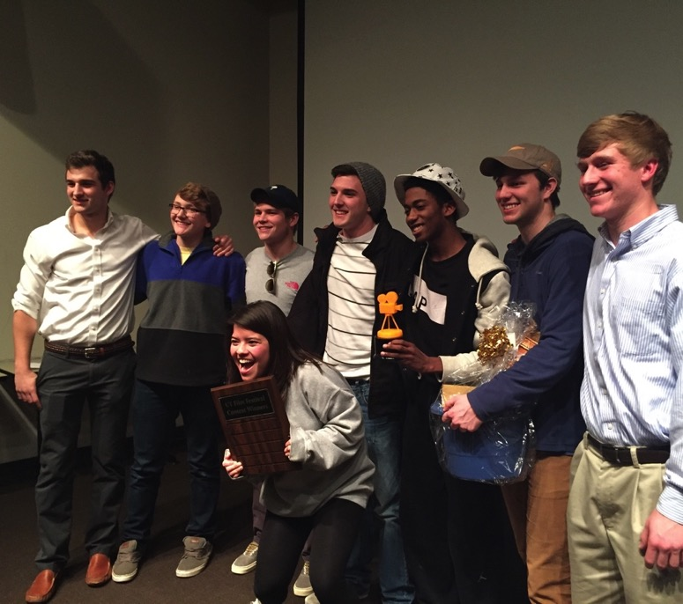
Student Success: Hands on!
I love the
library!
I liked the open learning and speaking environment and the hands on project.
Notes:
Discuss Library Take Out and Instruction
In addition to formative and summative assessment, we have open ended questions about student reactions or things learned.

Slide 64
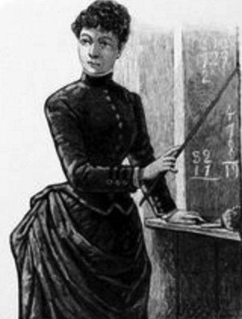
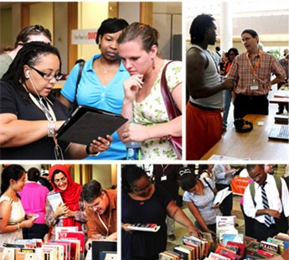
Most Unexpected Change? Our Teaching
Notes:
In thinking about and discussing changes in the environment and the data and assessments we had, it dawned on me…the students who were thriving because they were making the most use of our resources weren’t thriving because we are so awesome. They are thriving because they are practicing using the tools of scholarship. Pairing that with the knowledge that our transfer students were coming in with 2 years of college and still not doing as well as most first year students made us think we had to change some things. We no longer stand in front of the classroom and say “this is how you find a book…this is how you find an article…”
Talk about the STEM Bridge Program Assignment and how we integrated spaces, services, and active engagement.

Slide 65
The Ugly:
What we wish we’d known
What we’d have done differently

Slide 66
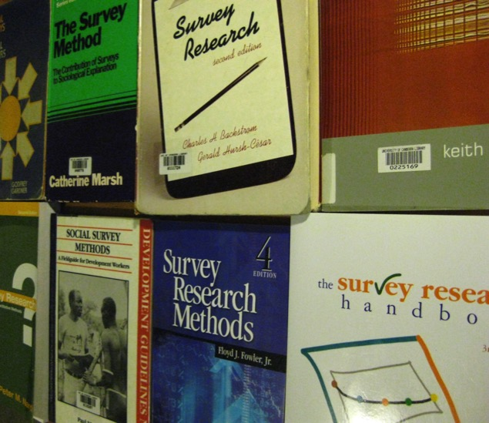
Instructor Survey::
Pre-test, pilot, and pre-test some more!
Be prepared for “backseat driving” about the instrument itself.
Identify a comprehensive distribution strategy
Secure SUPPORT

Slide 67
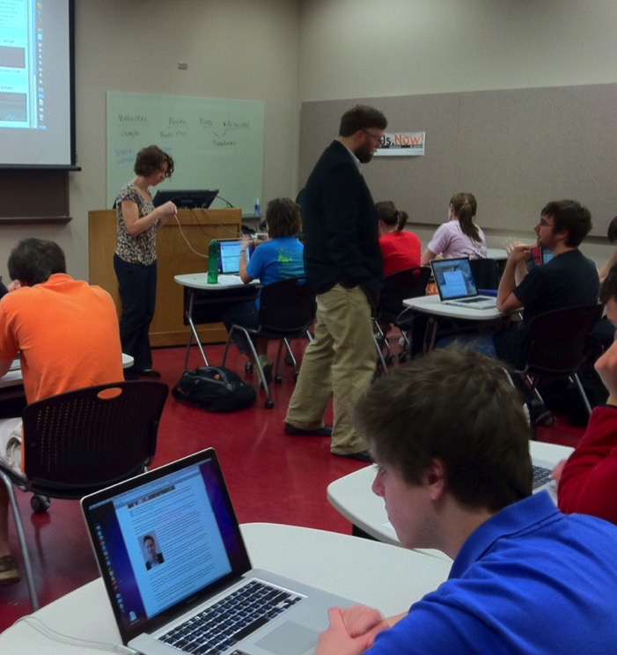
Instruction Series:
Plan on absentees
Develop a plan for collecting data and assigning it to each student
Anonymity
What of someone misses a session?
Carrot or Stick?

Slide 68
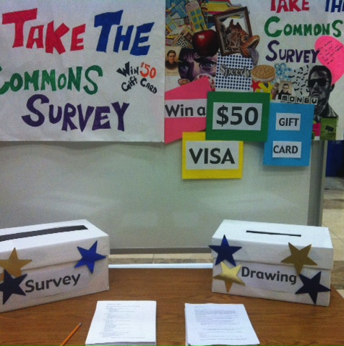
Overcoming Survey Challenges
In Person
In Class
Survey Fatigue
Campus rules on survey distribution
Students don’t read email
Partnership with SIS allowed us to offer the survey in class –
FOR CREDIT
Notes:
We just didn’t know how challenging it would be to give a survey to students. Period. Be creative and find meaningful partnerships.

Slide 69
Overcoming Data Management Challenges
Pretesting can eliminate unnecessary conditional logic
There is more data than you think
You will have to enter some of it manually / SPSS laughs at your question subsets
You have to manage the confidentiality of the data on all sides

Slide 70
More Good!
Research Collaboration
Spending Time With the Data

Slide 71
Sustainability is Mainly About Time
Our questions are still relevant / slight tweaks would yield more useful information
Sitting with existing data for awhile reveals new ideas and informs new challenges

Slide 72
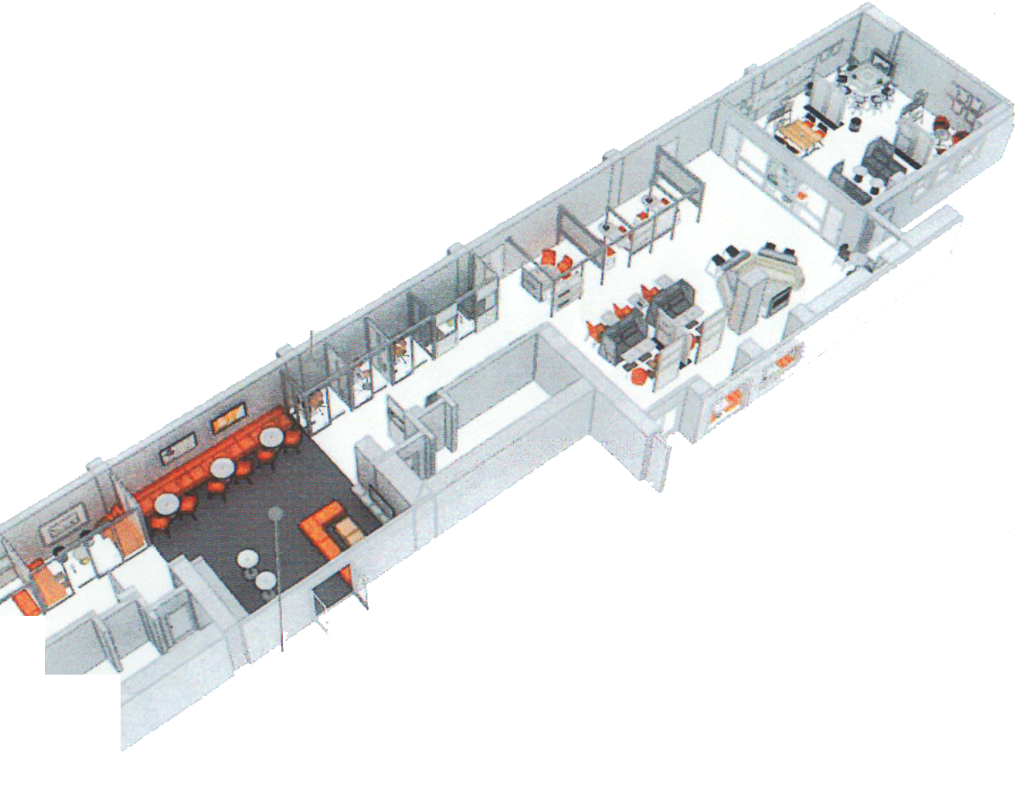
University Showcase | Project Lab
For students, parents,
professors, and
community partners
Solving problems
Creating products
Forming communities
Notes:
The more we’ve told our story, based on the study and based on the things we’ve done since, the more we are seen as a campus community and not just for students. There is something happening in our space that is worth showing off and building upon. We are also looking at the project lab as an answer to the interdisciplinary work going on at our University. It’s not just art, not just STEM.

Slide 73
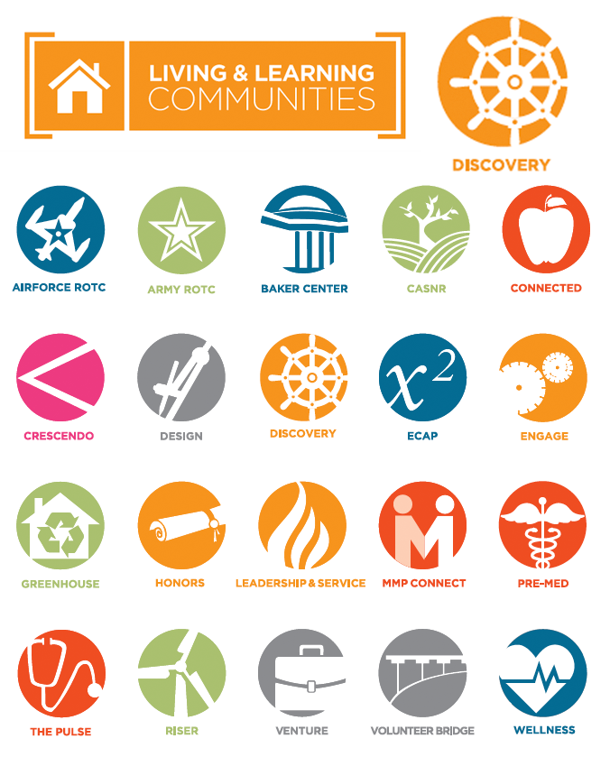
Going to Their Community
Living and Learning Community sponsored by The Libraries,
The Writing Center and the Office of Undergraduate Research
Notes:
Our expanded partnerships bring new opportunities all the time. One of those is a Library-sponsored Living and Learning Community.

Slide 74
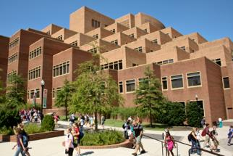
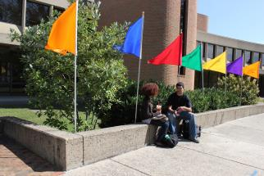
Librarians and LIS Faculty
Alumni Organizations
Research
Informal consulting
Guest lectures
Co-teaching
Accreditation
Committees ☺

Slide 75
Librarians and LIS Faculty
Research

Slide 76
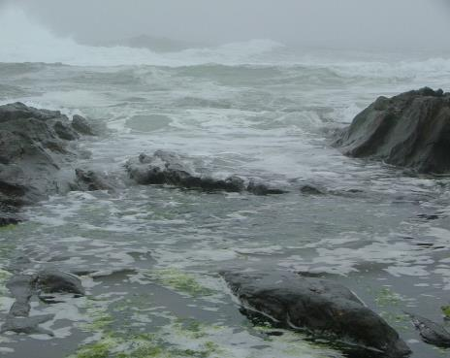
Collaboration, Cooperation
…and the rising tide.

Slide 77
Questions?
Thank You!

