Slide 1

http://www.oztrekk.com/blog/category/australian-law-schools/university-of-melbourne-law-school/page/2/
@LorcanD
Lorcan Dempsey, OCLC
Environmental trends and OCLC Research. RLP meeting, U Melbourne, 2 Dec 2015

Slide 2
Membership and Research
Member
relations
Research
Programs
Research Library Partnership
WebJunction

Slide 3
Themes
OCLC Research

Slide 4
Research Collections & Support
Understanding the System-Wide Library
Data Science
User Studies
Scaling Learning

Slide 5
Knowledge
Plan with confidence
Evidence
Persuade with effect
Models
Make an impact

Slide 6
User studies
OCLC Research

Slide 7
Our traditional model was
one in which we thought of
the user in the life of the library
… but we are now increasingly
thinking about the library
in the life of the user

Slide 8
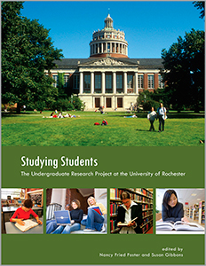
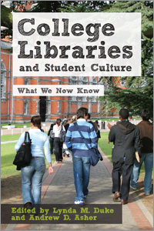


Slide 9
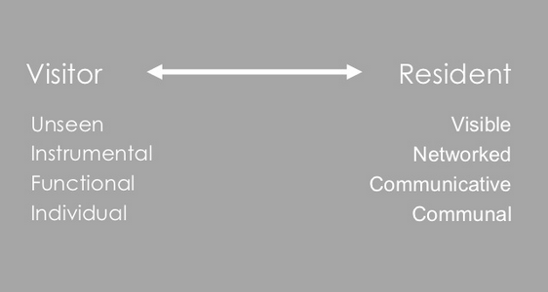
“Google doesn’t judge me” (UKF3)
#vandr

Slide 10

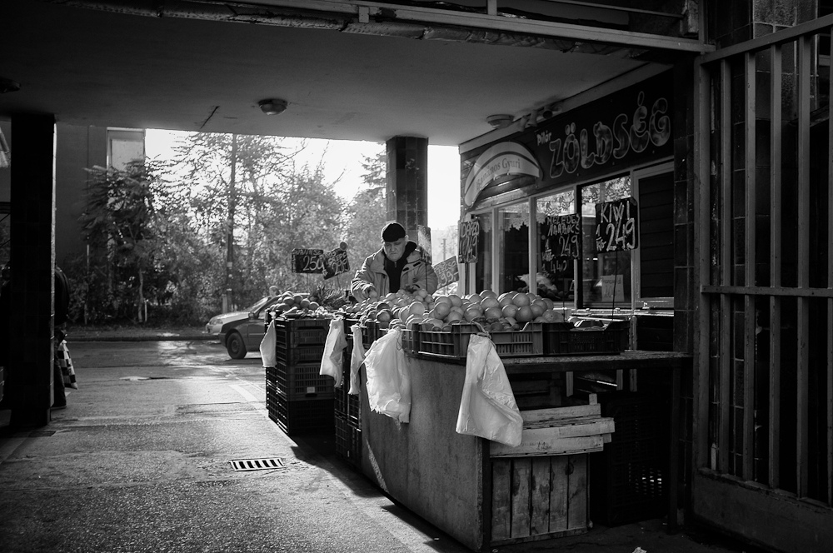
The Learning Black Market
“It’s like a taboo I guess with all teachers, they just all say – you know, when they explain the paper they always say, ‘Don’t use Wikipedia.’”
(USU7, Female, Age 19, Political Science)
Notes:
Image: http://www.deviantart.com/morelikethis/211376699
Covert online study habits
Wikipedia
Don’t cite
Widely used
Guilt
Students & teachers disagree
Quality sources
There is a “Learning Black Market”: learners use non-traditional sources but feel they cannot talk about them in an institutional context. Wikipedia usage is an example of this. (White & Connaway, 2011)
Connaway, Lynn Silipigni, Donna Lanclos, and Erin M. Hood. 2013. “I find Google a lot easier than going to the library website.” Imagine ways to innovate and inspire students to use the academic library. Proceedings of the Association of College & Research Libraries (ACRL) 2013 conference, April 10-13, 2013, Indianapolis, IN. http://www.ala.org/acrl/sites/ala.org.acrl/files/content/conferences/confsandpreconfs/2013/papers/Connaway_Google.pdf.
White, David. 2008. Not “natives’”& “immigrants” but “visitors’ & “residents.” TALL Blog: Online Education with the University of Oxford, April 23, http://tallblog.conted.ox.ac.uk/index.php/2008/07/23/not-natives-immigrants-but-visitors-residents/.
Saunders also found that faculty are “concerned with students’ reliance on Google and Wikipedia for information.” This may help to explain why many of the Emerging stage participants expressed a reluctance to acknowledge or cite Wikipedia in their work for fear of being ridiculed by faculty, or be given a lower grade. This is referred to as the Learning Black Market, which is discussed in more detail in Connaway, Lanclos, and Hood and White’s 2011 blog entry.
Saunders, Laura. 2012. Faculty perspectives on information literacy as a student learning outcome. The Journal of Academic Librarianship 38, no. 4 (2012): 231.

Slide 11
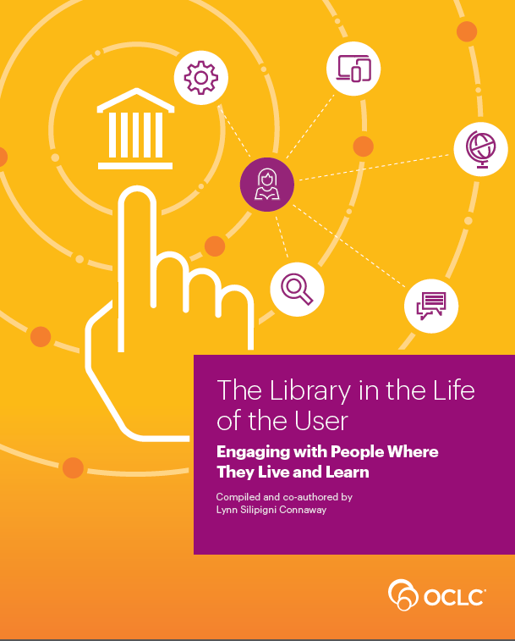

Slide 12
Research collections and support
OCLC Research

Slide 13
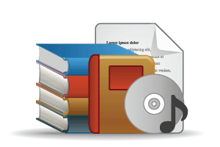

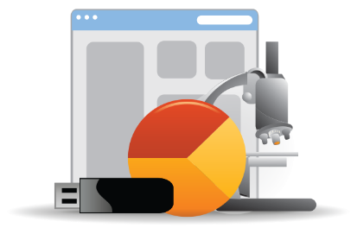
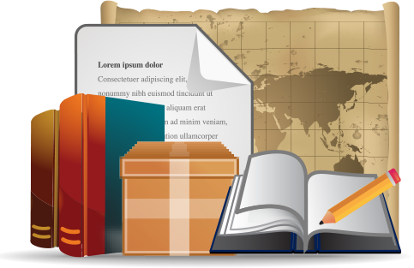
Open Web Resources
‘Published’ materials
In many collections
Licensed
Purchased
Low Stewardship
High Stewardship
Research & Learning Materials
In few collections
Special Collections
Local Digitization
Figure: OCLC Collections Grid.
OCLC Research, 2014

Slide 14
In many collections
Low Stewardship
High Stewardship
Research & Learning Materials
In few collections
Special Collections
Local Digitization
Figure: OCLC Collections Grid.
OCLC Research, 2014

Slide 15
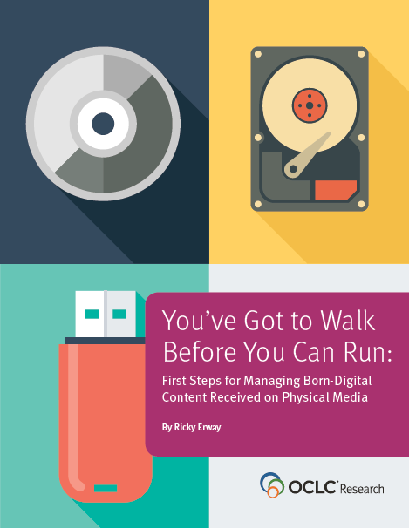
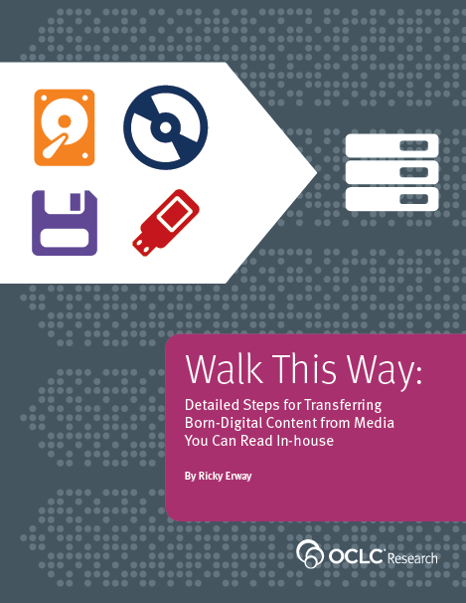

Slide 16
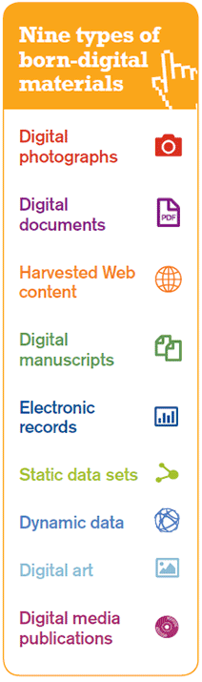
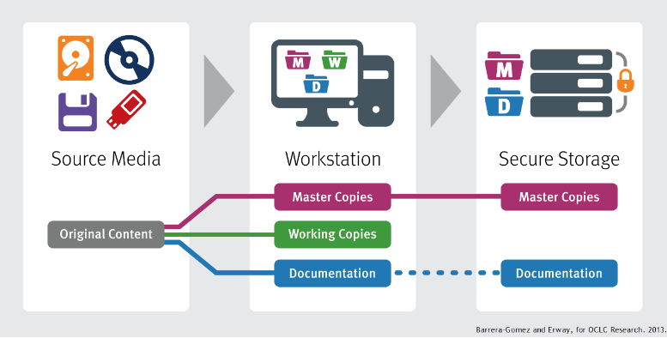

Slide 17
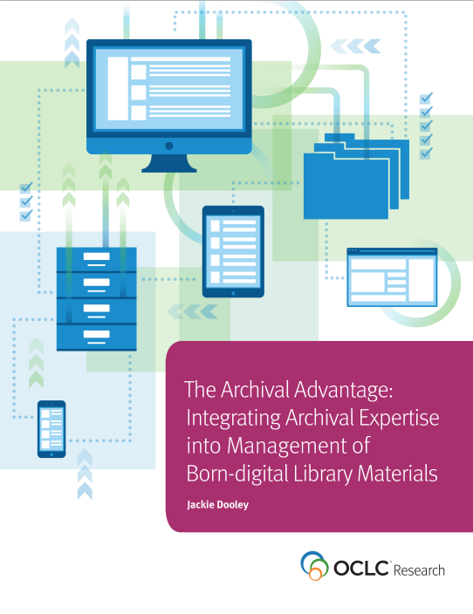
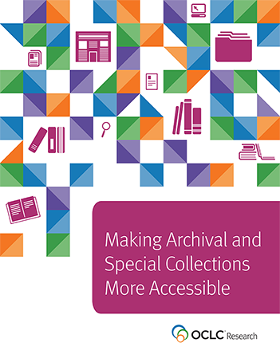

Slide 18
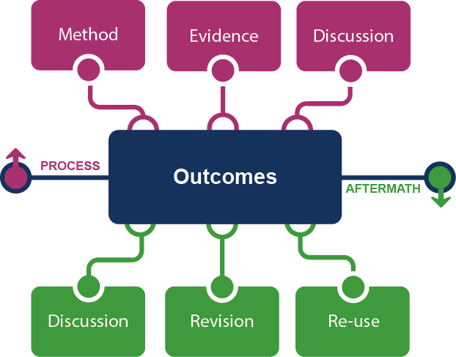
Framing the Scholarly Record …
Figure: Evolving Scholarly Record framework.

Slide 19
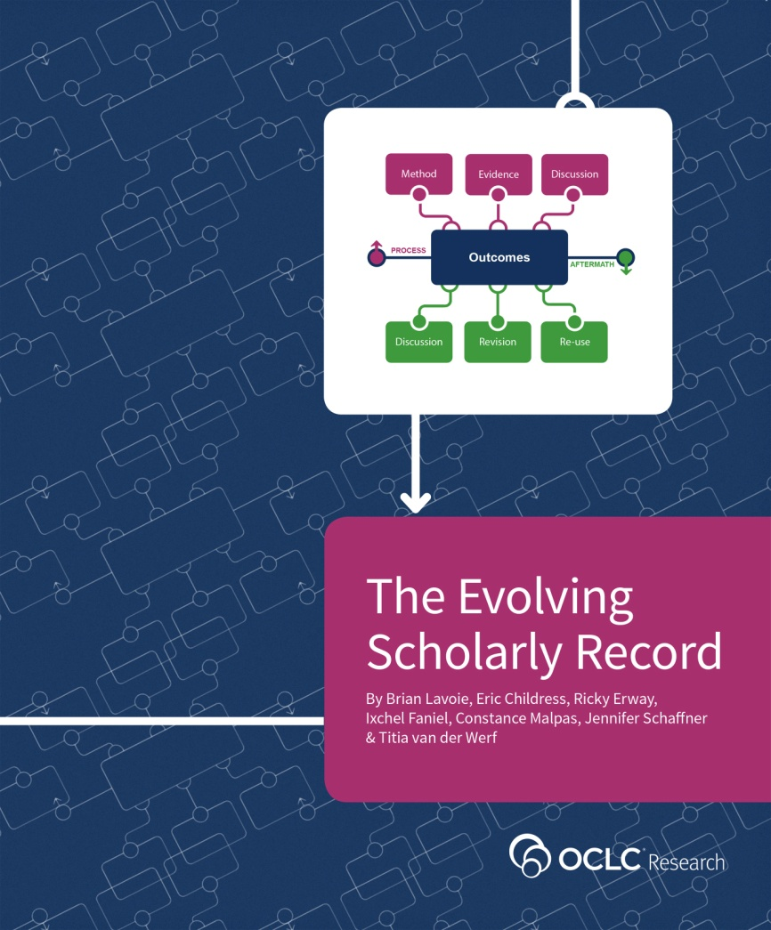
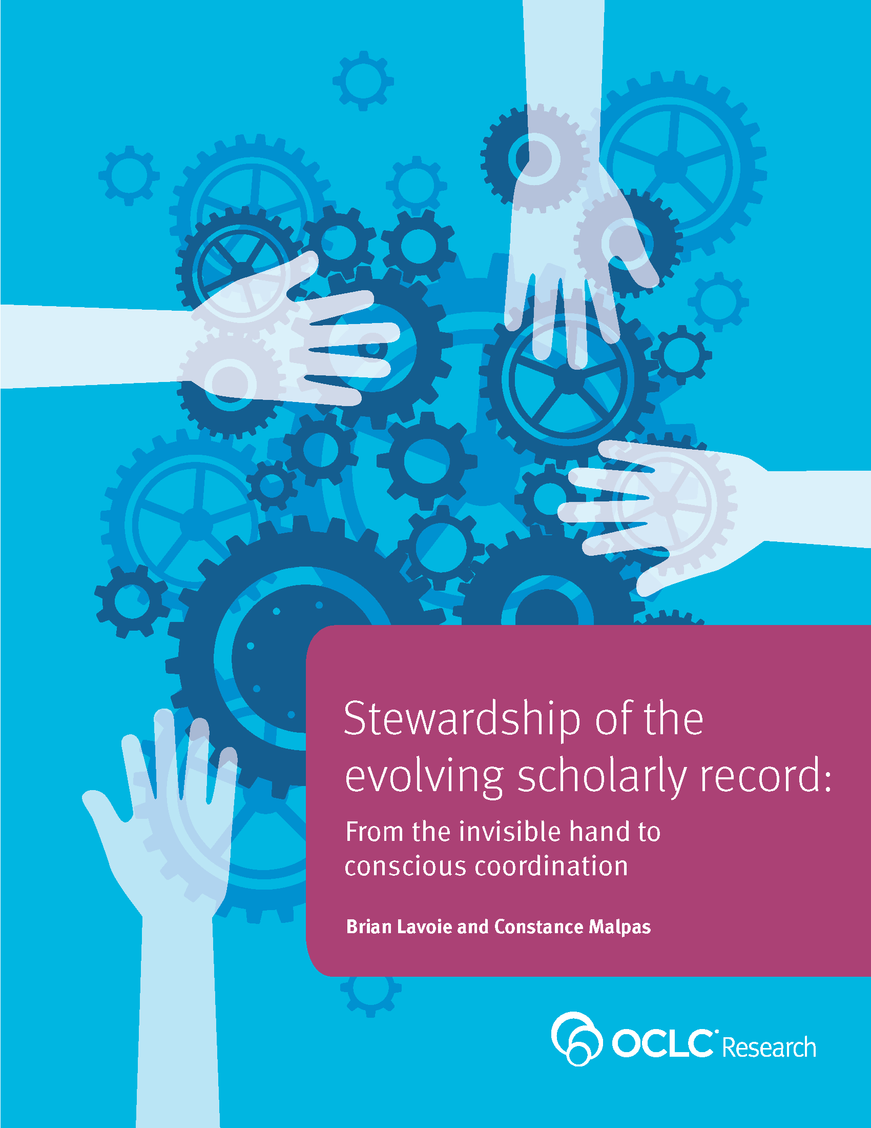

Slide 20
Data science
OCLC Research

Slide 21
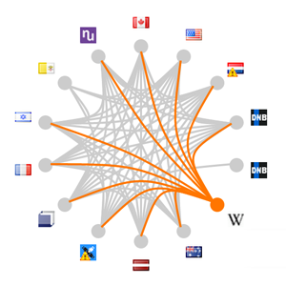
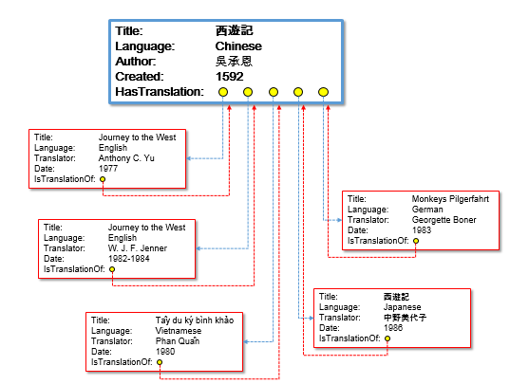
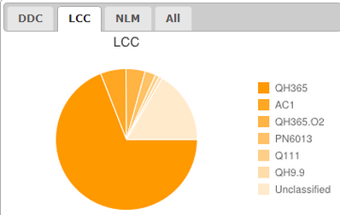
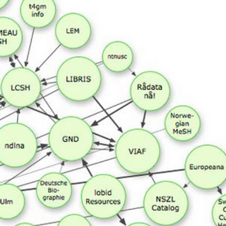
Data Science
Goal: Derive new meaning, insights and services from data-mining WorldCat and other sources for use on the Web.
Aggregate
Enhance
Mine
Expose

Slide 22




OCLC Production Services
LCSH
Linked Data
Entities
VIAF
Internal OCLC Research Resources
Multilingual
Bib Records
enhanced
WorldCat
FAST
GMGPC
External OCLC Research Systems
WORKS
GSAFD
GTT
Kindred Works
FictionFinder
LCTGM
MeSH
ArchiveGrid
Identities
DDC
Cookbook Finder
Classify
Notes:
GMGPC, LCTGM: Thesarus for Graphic Materials
GSAFD: Genre Terms from Guidelines on Subject Access to Individual Works of Fiction, Drama, etc.
GTT: Gemeenschappelijke Trefwoorden Thesaurus, Dutch Joint Subject index

Slide 23


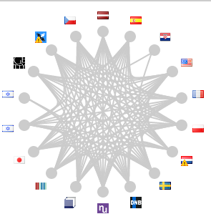
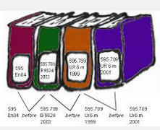
OCLC’s linked data resources
WorldCat Works: 5 billion RDF triples
FAST: 23 Million triples
WorldCat Catalog:
15 billion triples
VIAF: 2 billion triples
DDC:
300 million
triples
Notes:
As of August 2014, we can say that OCLC has published over 20 billion RDF triples extracted MARC records and library authority files.
And from OCLC Research’s survey results, conducted in September 2014 (and now being updated):
OCLC’s RDF datasets are among the oldest, largest, and most referenced LD stores in the ‘library’ sector of the linked data cloud.
There is international interest in linked data
There are many still-emerging datasets. WorldCat Works is in that group.

Slide 24
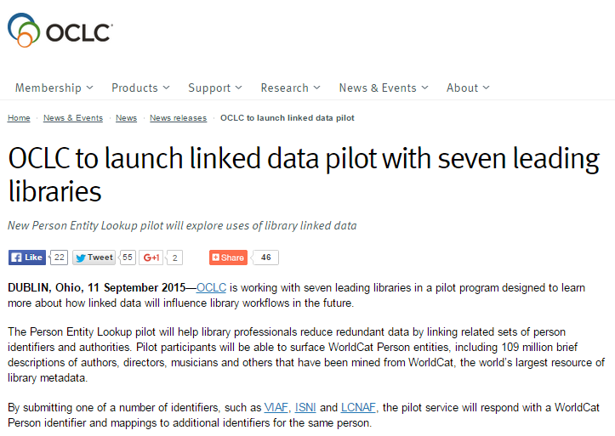

Slide 25
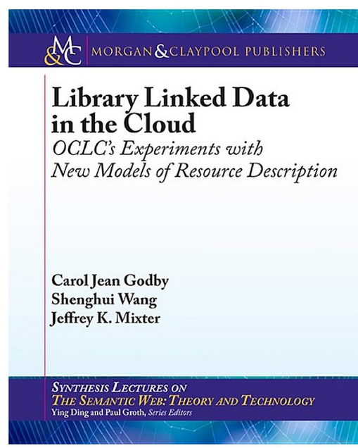
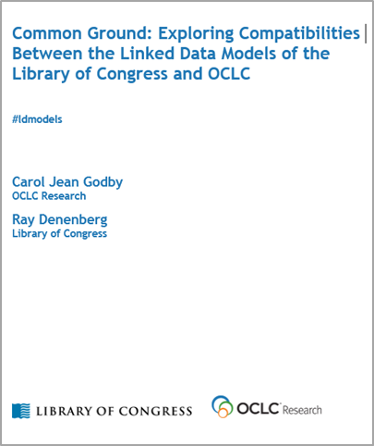

Slide 26
The systemwide library
OCLC Research
Notes:
Picture adapted from: https://pixabay.com/en/classroom-chairs-tables-school-824120/ (license: CC0 https://pixabay.com/en/service/terms/)

Slide 27
The bubble of growth in twentieth-century
printed collections has left … librarians
with a tricky problem.
Barbara Fister
New Roles for the Road Ahead:
Essays commissioned for ACRL’s 75th Birthday

Slide 28
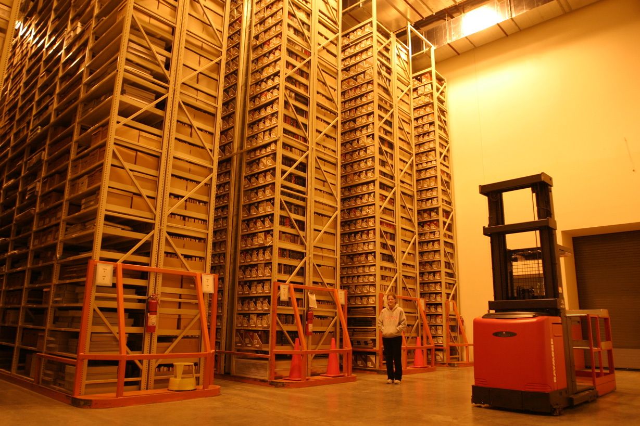
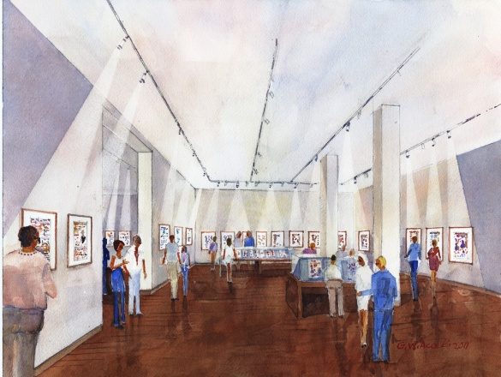
http://library.osu.edu/blogs/cartoons/2012/02/28/blog-launch-and-the-construction-of-our-new-home-in-sullivant-hall/

Slide 29
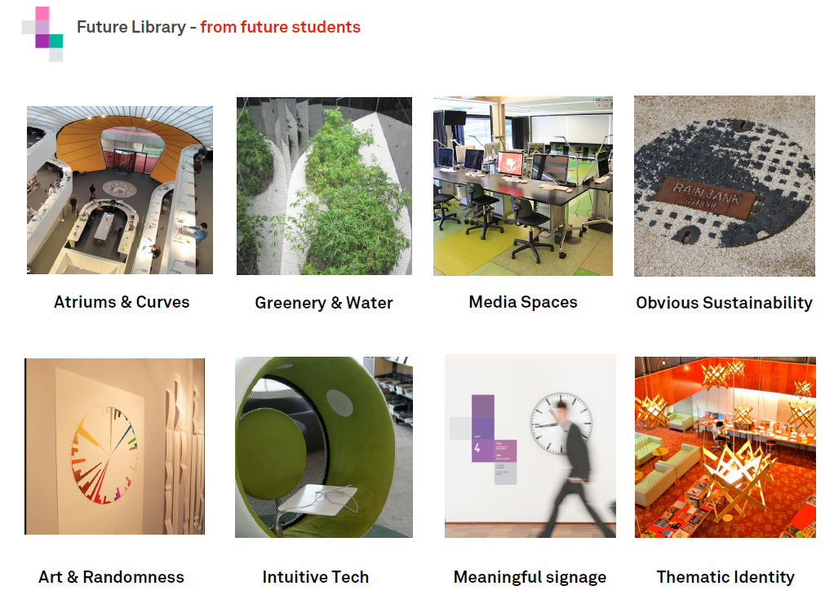
http://www.slideshare.net/malbooth/uts-future-library-more-than-spaces-technology
Mal Booth, UTS Library

Slide 30
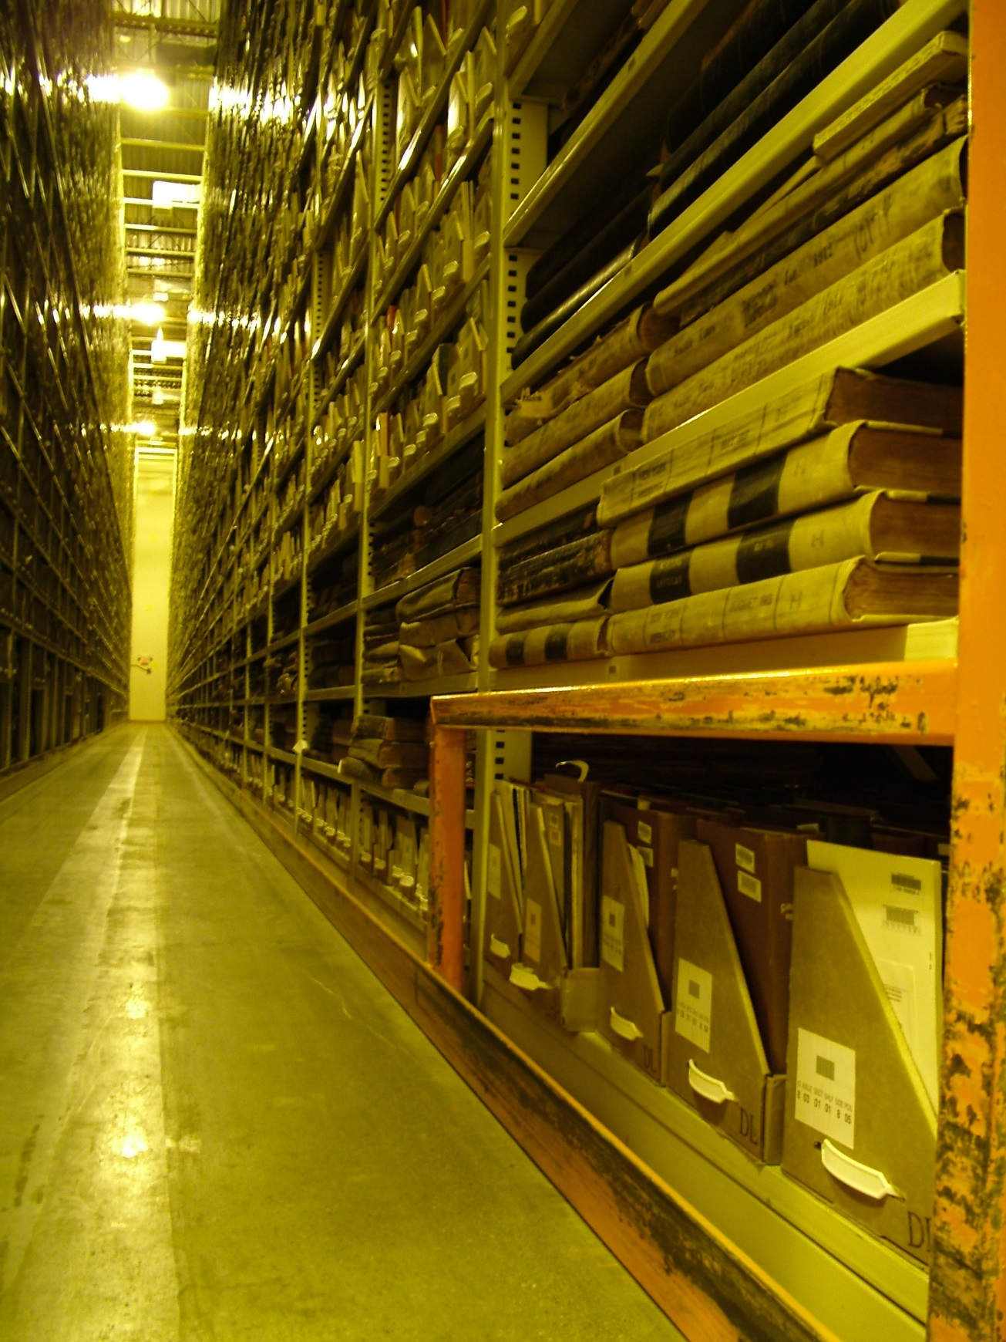

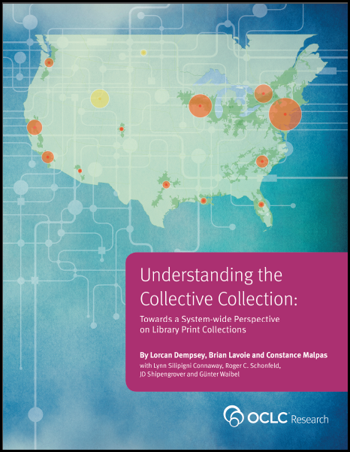
Perhaps the most influential descriptive studies have come from OCLC Research, which has now shared reports outlining both levels of uniqueness as well as duplication among various aggregations of library collections. This growing body of computationally intensive analysis of the collective collection has also begun to clarify geographic distribution and other key characteristics of library collections relevant for decision making around coordinating activities. There is new understanding of collections at scale. Libraries can better assess past successes in coordination and cooperation and surface the outlines of new frontiers for collaborative activities as well as clarify potential efficiencies and opportunities.
Karla Strieb
Ohio State University

Slide 31
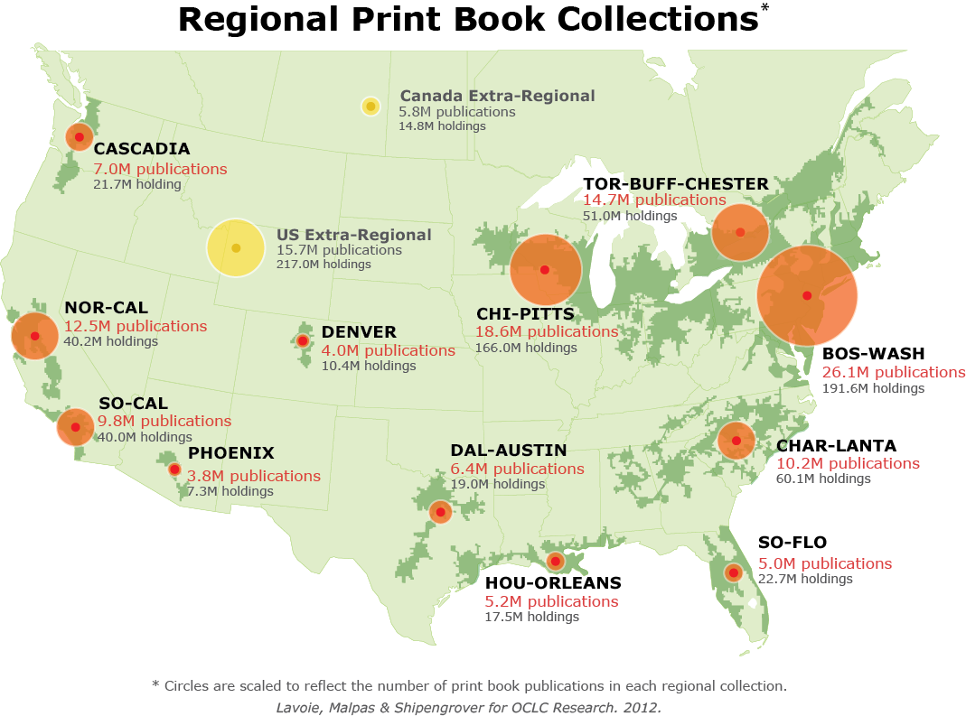
North American print book resource:
45.7 million distinct publications
889.5 million total library holdings

Slide 32
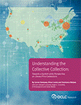
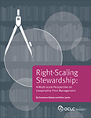
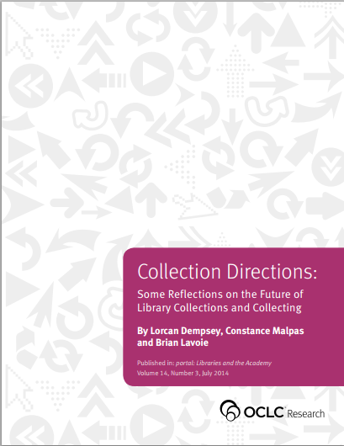
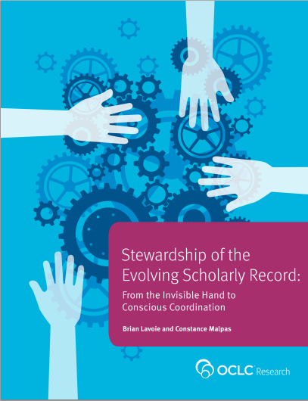
Some outputs

Slide 33





OCLC Research
http://www.oclc.org/research.html
News & events
Reports & presentations
https://twitter.com/OCLC/lists/oclc-research
https://www.facebook.com/OCLCResearch
http://www.slideshare.net/oclcr
http://hangingtogether.org/
http://youtube.com/oclcresearch

