Slide 1
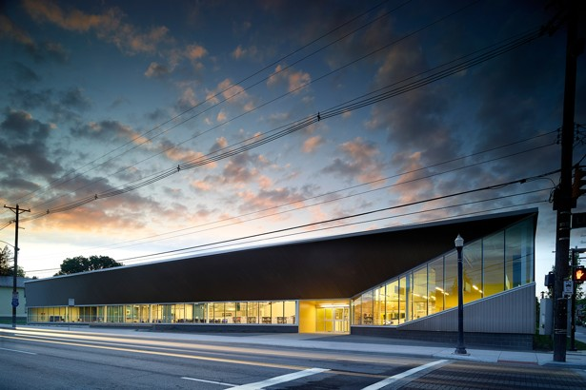
The library in the life of the user, Chicago, 21-22 October 2015
The library in the life
of the user: some contextual remarks
Lorcan Dempsey
@LorcanD
http://www.theatlantic.com/national/archive/2014/10/not-your-mothers-library/381119/

Slide 2
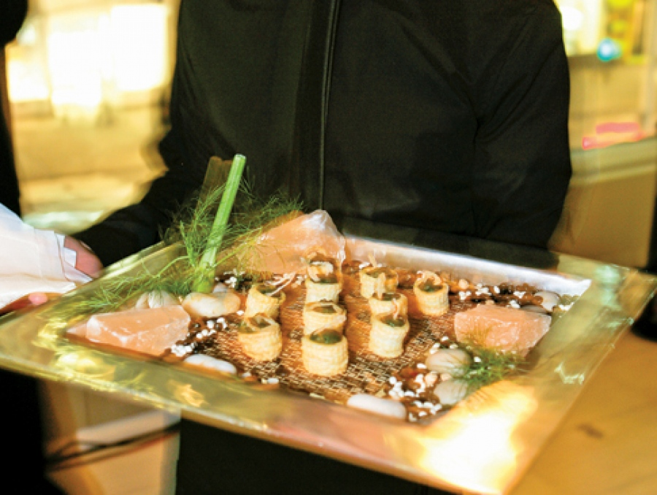
Lacoste http://buff.ly/1jTDw1z

Slide 3
The library in the life of the user
The library in the life of the user

Slide 4
Libraries are not ends in themselves.
They serve the research and learning needs of their universities.
The major long term influence on libraries is how those needs change.
To be effective, libraries need to understand and respond to those changes.

Slide 5
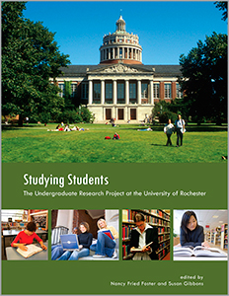
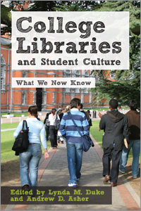


Slide 6
“
First, libraries are changing rapidly, partly in response to ongoing innovations in networked information systems. Furthermore, there is a growing interest in qualitative analyses of the social lives of libraries, and the roles that libraries play in the lives of their users …
Khoo, M., Rozaklis, L., & Hall, C. (2012). A survey of the use of ethnographic methods in the study of libraries and library users. Library and Information Science Research, 34(2), 82-91.

Slide 7
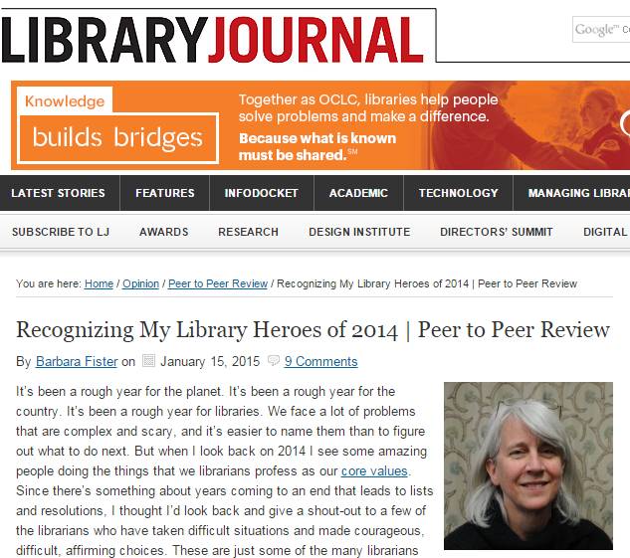
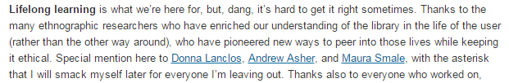
“

Slide 8
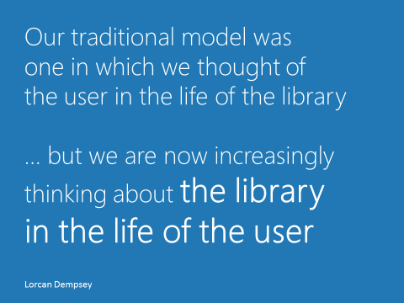

Slide 9
Probably the most persistent limitation of the prior studies [research in libraries] is that researchers have examined the user from the perspective of the library. In effect, they have looked at the user in the life of the library rather than the library in the life of the user. [emphasis in original]
“
Douglas Zweizig
Predicting the amount of library use: An empirical study of the role of the
public library in the life of the adult public. PhD dissertation, Syracuse University, 1973

Slide 10
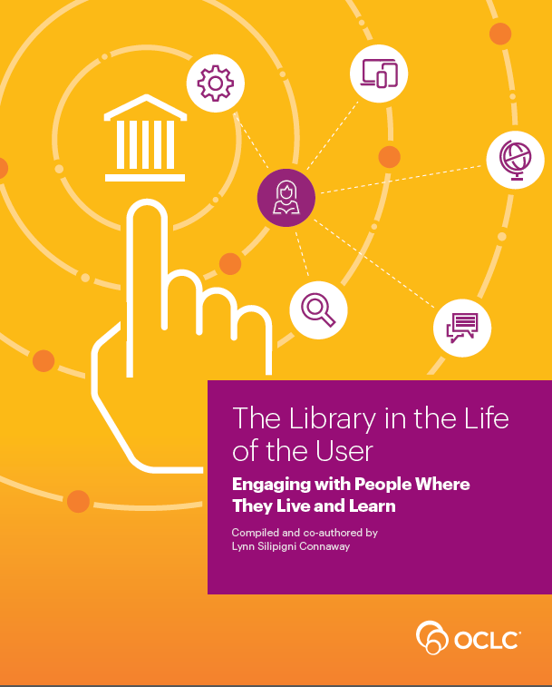

Slide 11
A reset moment - education
The library in the life of the user

Slide 12
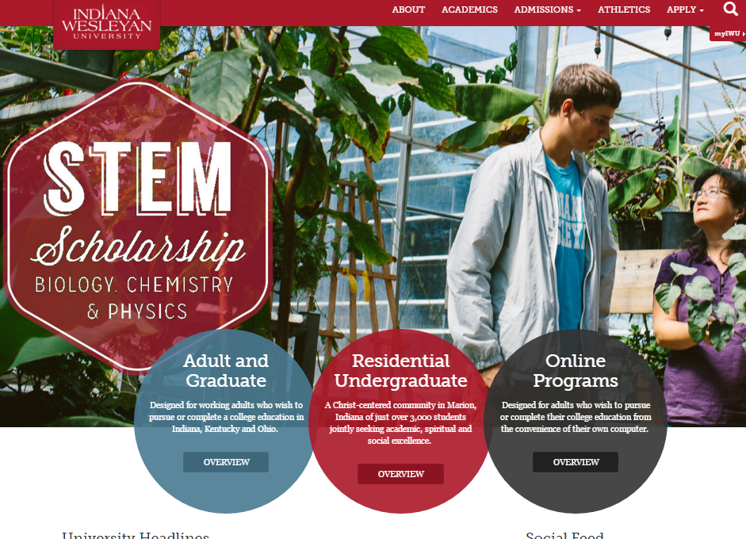

Slide 13
Particularism: defining identity
  Research, Land grant, career, system, …
From bureaucracy to enterprise: making bets
Impact: measuring and responding
  Analytics, assessment, …
  Ranking, reputation, profiling

Slide 14
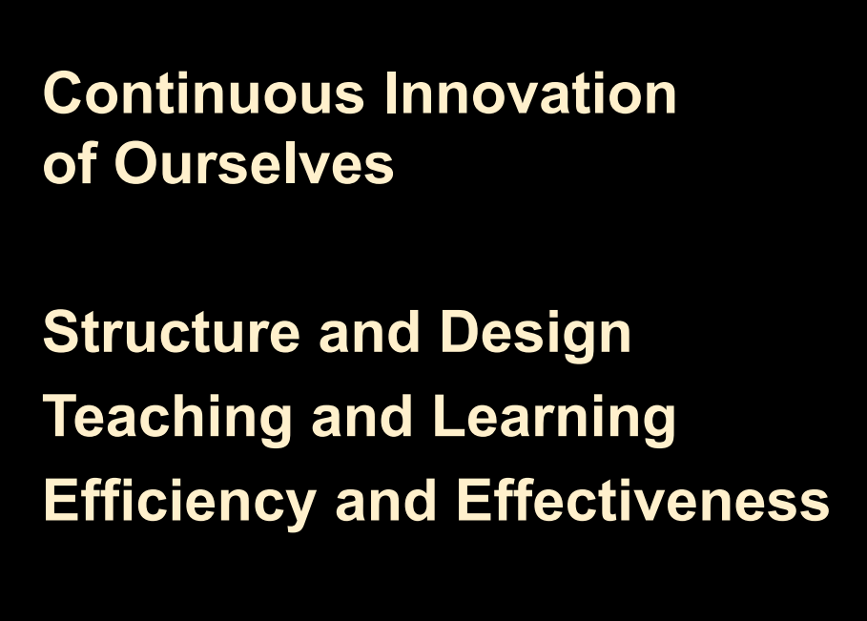

https://president.asu.edu/node/1220

Slide 15
Technology background: behaviors coevolve with technology environments
The library in the life of the user

Slide 16
Research and learning workflows changing
  Flipped classroom, open science, research networks
The network and the personal
    Concentration and diffusion (cloud and mobile)
    The squeezed middle
Scalar choices
  What is the role of the institution?
    E.g. research data:
    Personal, institutional, group, discipline, national
Consumption > curation > creation

Slide 17



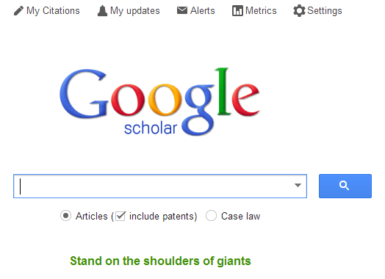

Slide 18
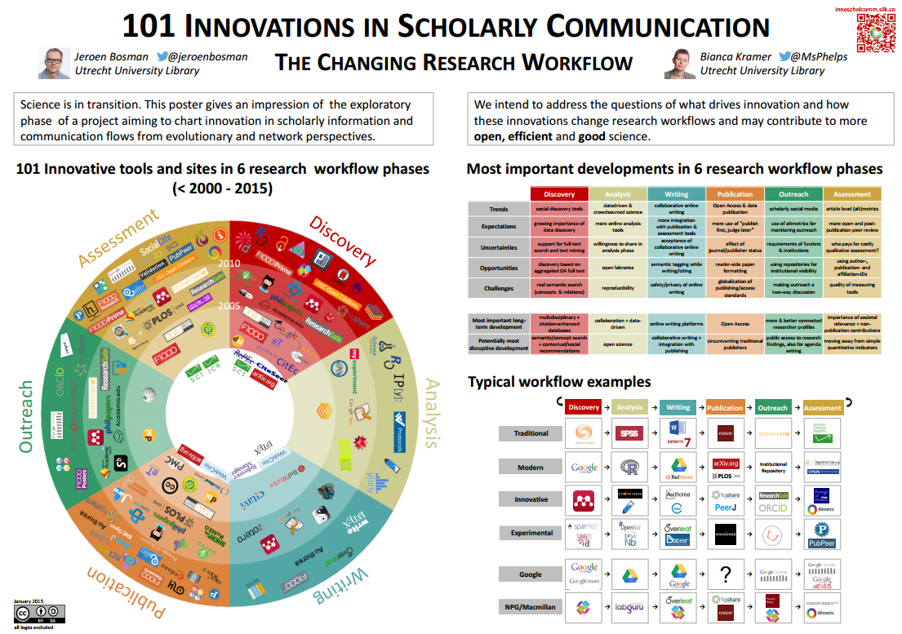
http://innoscholcomm.silk.co/

Slide 19
Organizational diversion
The library in the life of the user

Slide 20
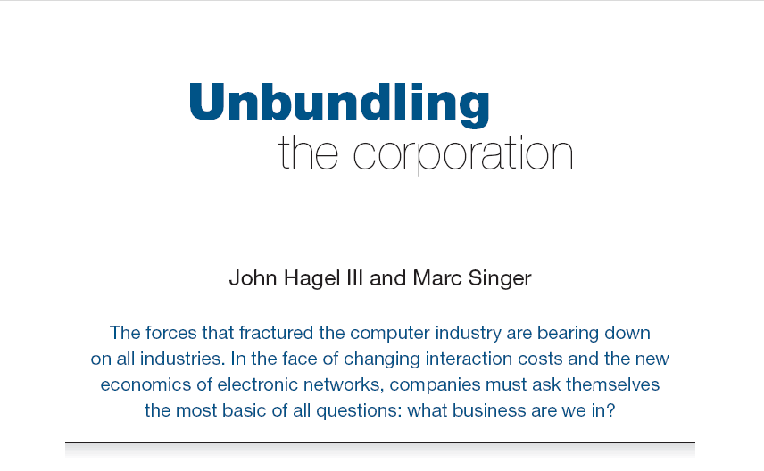
Harvard Business Review (1999)

Slide 21
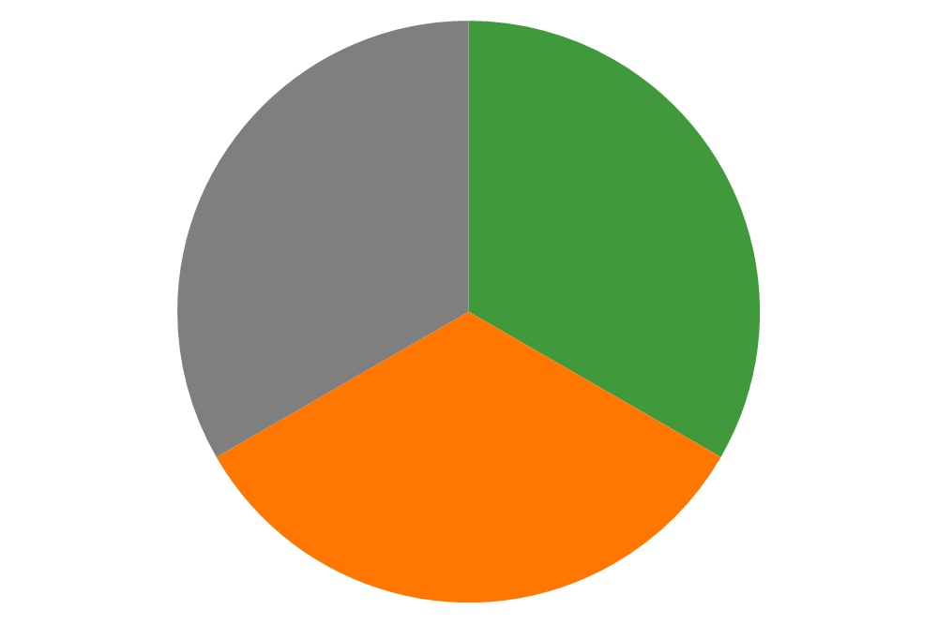
CORE COMPONENTS
OF A FIRM
Attracting and building relationships with customers
“Service-oriented”, customization
Economies of scope important
Develop new products and
services and bring them to
market
Speed/flexibility important
Customer
Relationship
Management
Product Innovation
Infrastructure
Back office capacities that
support day-to-day operations
“Routinized” workflows
Economies of scale important

Slide 22
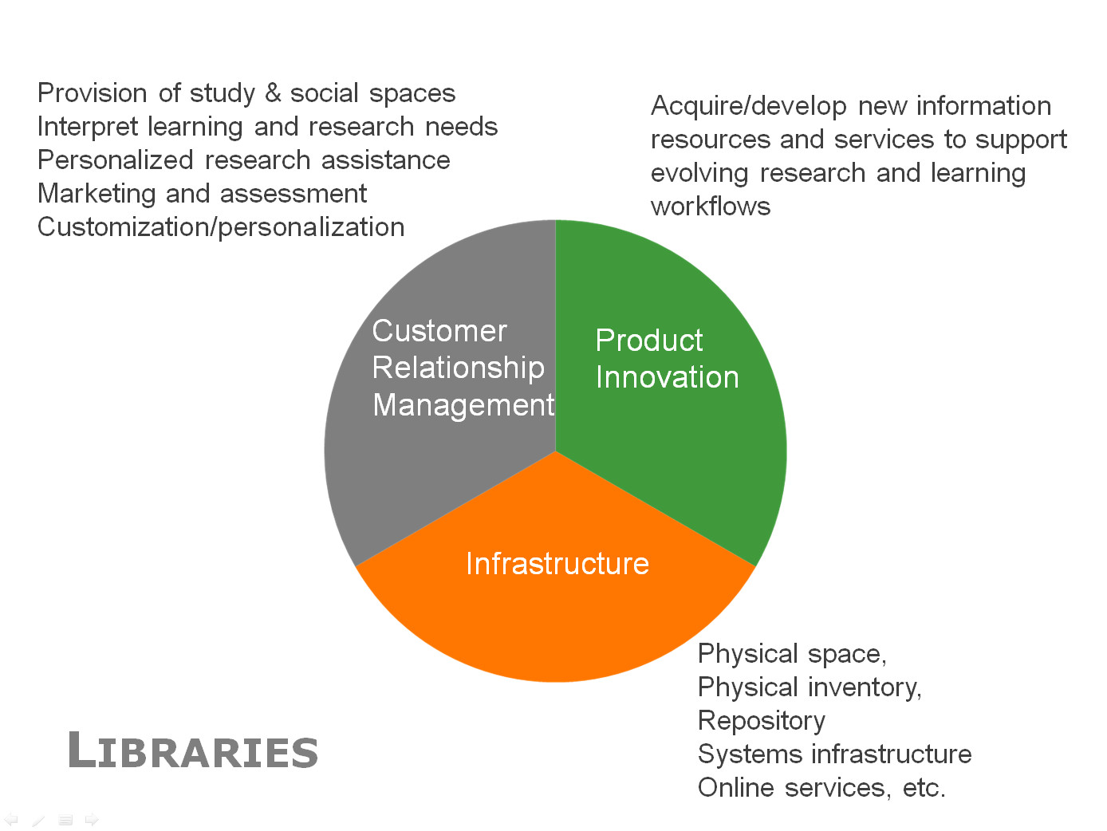

Slide 23
Reconfiguring libraries for the new environment – 3 imperatives
Shift to engagement
Institutional innovation
  Redesign
  Collaboration
  Services
Rightscale infrastructure
  Shared systems – HT, …
  Shared print
  “Groupiness”

Slide 24
An example: Collections and space
The library in the life of the user …

Slide 25
The facilitated collection.
Workflow is the new content supply chain.
From consumption to creation.
Configuring space around user experiences not collections.
Managing down print.

Slide 26
Facilitated collections
Catalog
KB/Discovery
LibGuides, etc
Google, ResearchGate, etc …
Separation of discovery and collection?:
Focus shifts from owned to facilitated (available)?
Focus shifts from collection to other services (creation, …)?
Systemwide thinking becomes stronger?
Owned
Licensed
Available
Global
Figure: Discoverability redefines collection boundaries.
OCLC Research, 2015.

Slide 27
The ‘owned’ collection
The ‘facilitated’ collection
The ‘borrowed’ collection
The ‘demand-driven’ collection
A collections spectrum
The ‘licensed’ collection
The ‘shared print’ collection
Purchased and
physically stored
Pointing people at Google Scholar
Including freely available e-books in the catalog
Creating resource guides for web resources
Figure: A collections spectrum.
OCLC Research, 2015.

Slide 28












Workflow is the new content
arXiv, SSRN, RePEc, PubMed Central (disciplinary repositories that have become important discovery hubs);
Google Scholar, Google Books, Amazon (ubiquitous discovery and fulfillment hubs);
Mendeley, ResearchGate (services for social discovery and scholarly reputation management);
Goodreads, LibraryThing (social description/reading sites);
Wikipedia, Yahoo Answers, Khan Academy (hubs for open research, reference, and teaching materials).
GalaxyZoo, FigShare, OpenRefine (data storage and manipulation tools)
Github (software management)

Slide 29
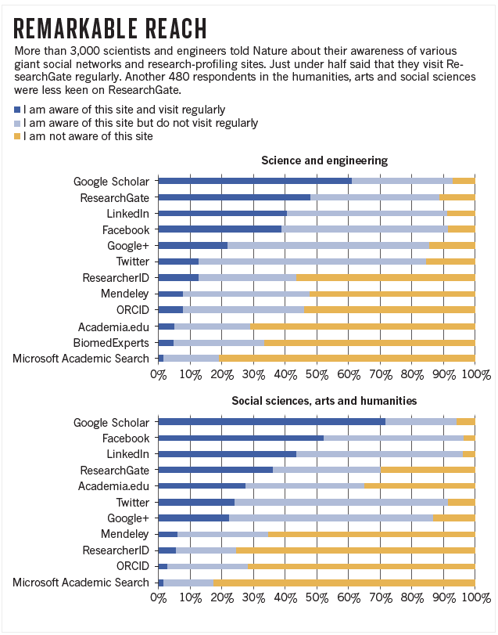
http://www.nature.com/news/online-collaboration-scientists-and-the-social-network-1.15711

Slide 30
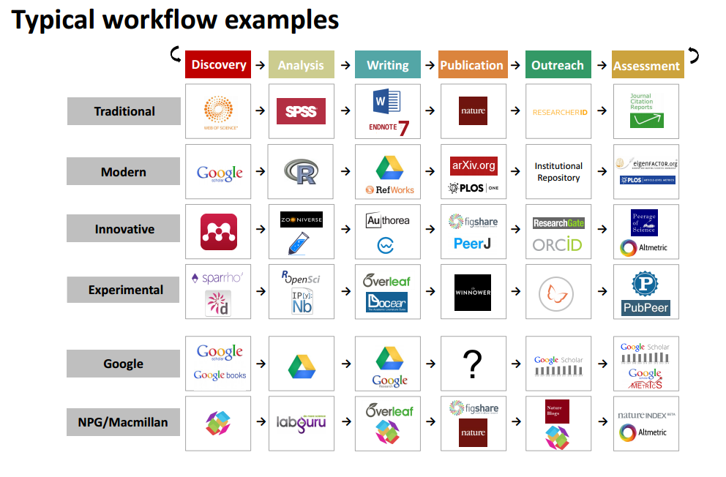
http://innoscholcomm.silk.co/

Slide 31
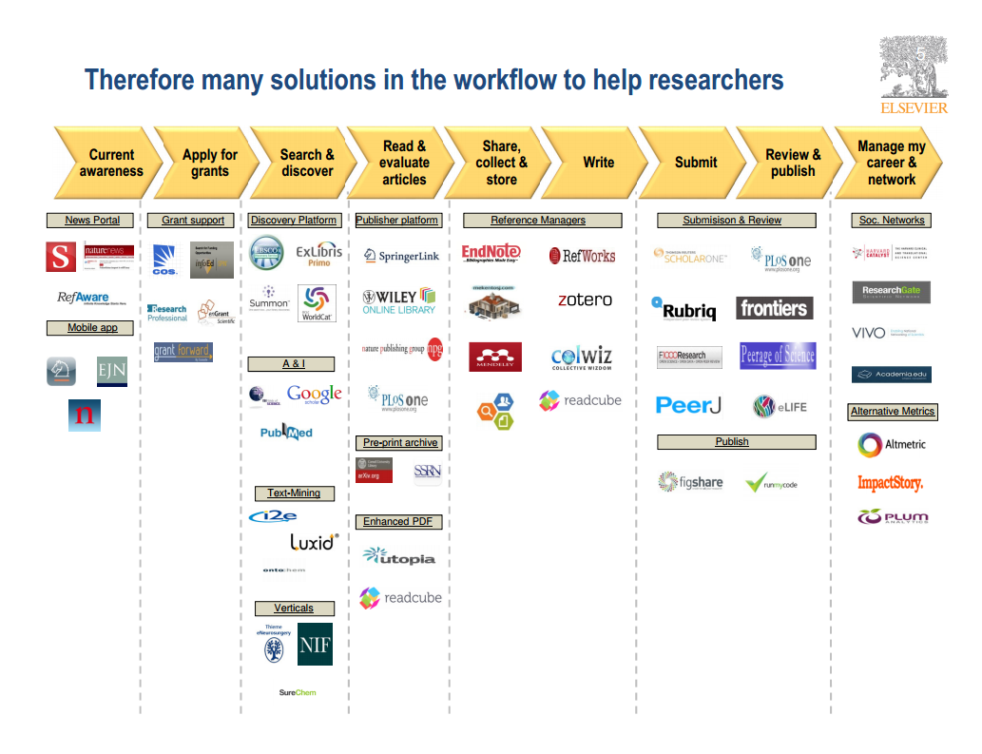
Wouter Haak
Elsevier, VP Product Strategy
LIBER, Riga, 2014

Slide 32
A publisher’s new job description
Her view is that publishers are here to make the scientific research process more effective by helping them keep up to date, find colleagues, plan experiments, and then share their results. After they have published, the processes continues with gaining a reputation, obtaining funds, finding collaborators, and even finding a new job. What can we as publishers do to address some of scientists’ pain points?
Annette Thomas,
CEO of Macmillan
Publishers
(now Chief Scientific Officer
Springer Nature)
http://www.against-the-grain.com/2012/11/a-publishers-new-job-description/

Slide 33
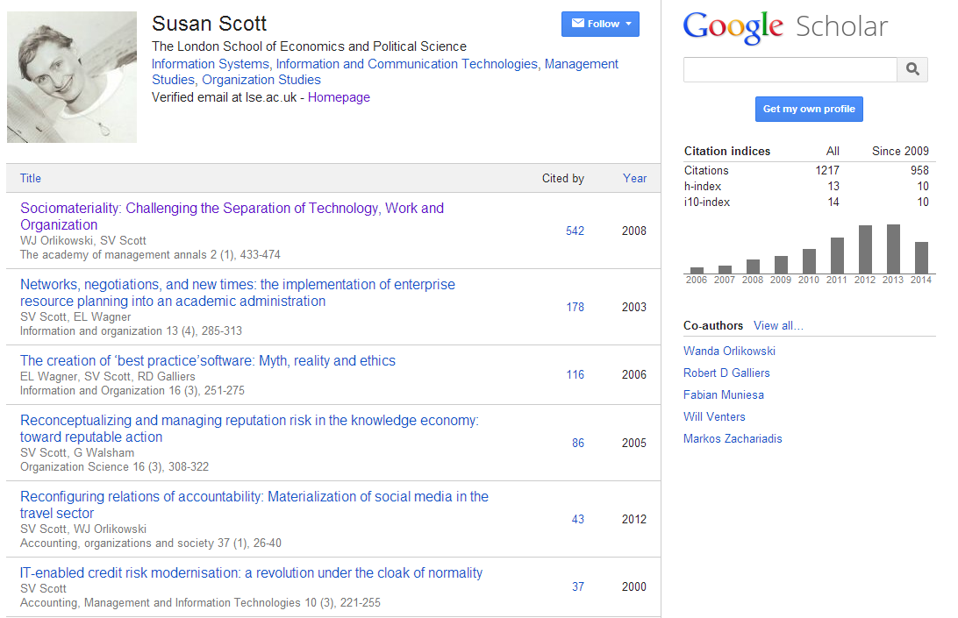
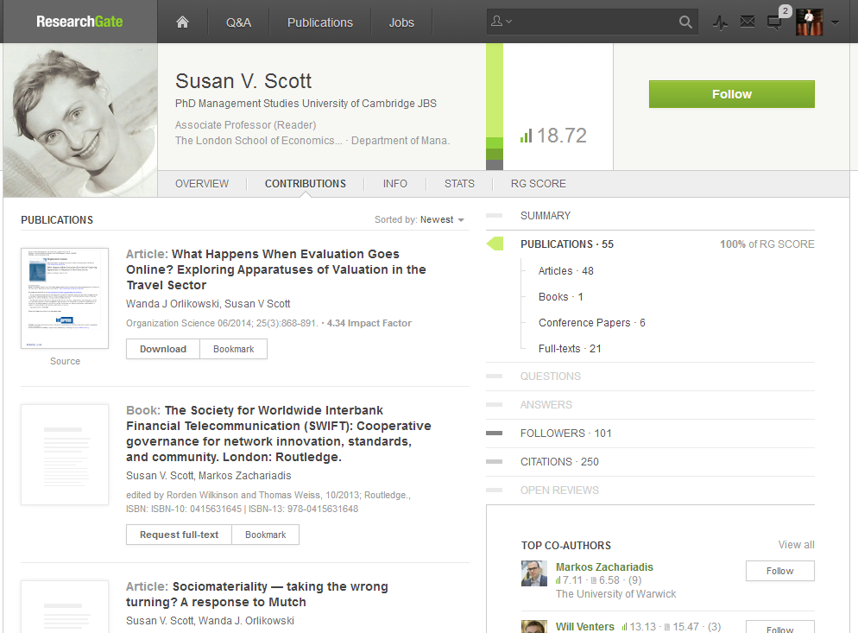

Slide 34
Workflow is the new content (supply chain)
In a print world, researchers and learners organized their workflow around the library.
The library had limited interaction with the full process.
In a digital world, the library needs to organize itself around the workflows of research and learners.
Workflows generate and consume information resources.

Slide 35
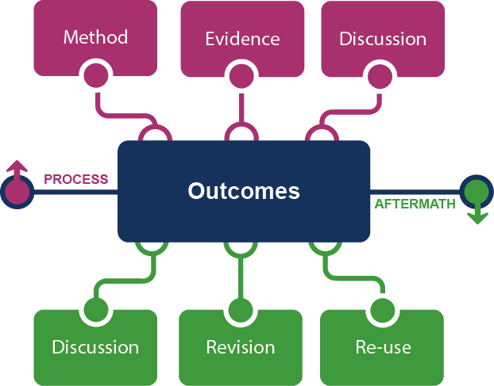
Framing the Scholarly Record …
Creation
Figure: Evolving Scholarly Record framework.
OCLC Research, 2014

Slide 36





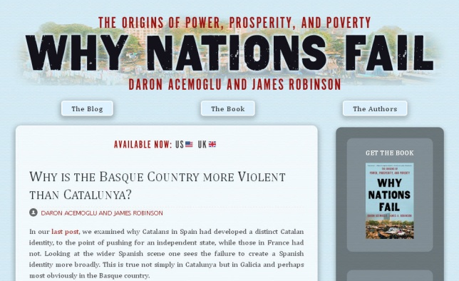


Figure: Evolving Scholarly Record framework, publishing venues.
OCLC Research, 2014

Slide 37
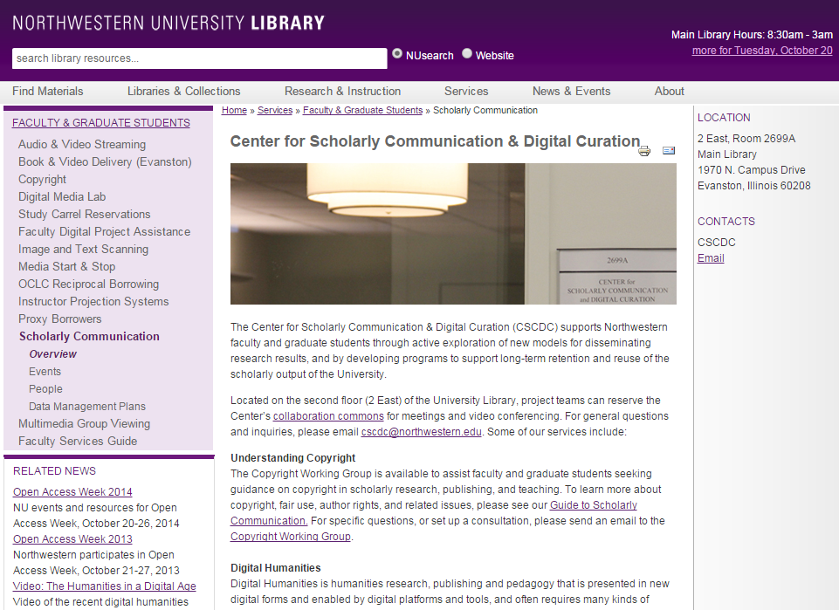

Slide 38
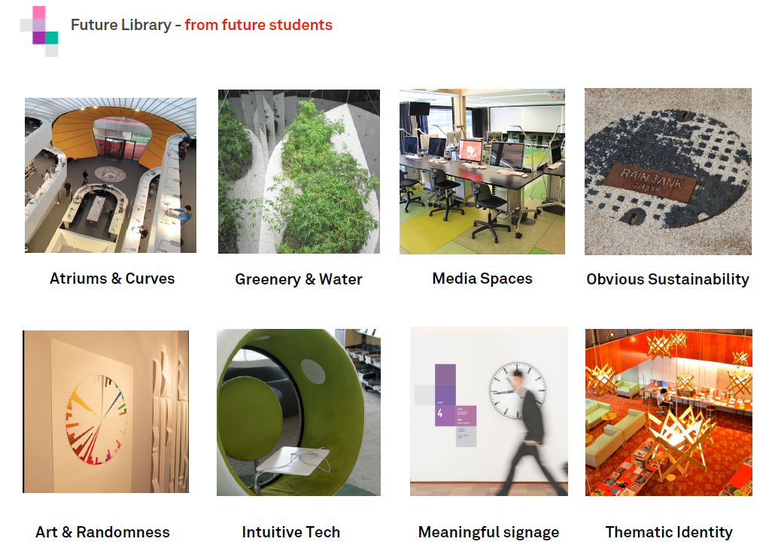
Space and print
http://www.slideshare.net/malbooth/uts-future-library-more-than-spaces-technology Mal Booth, UTS Library

Slide 39
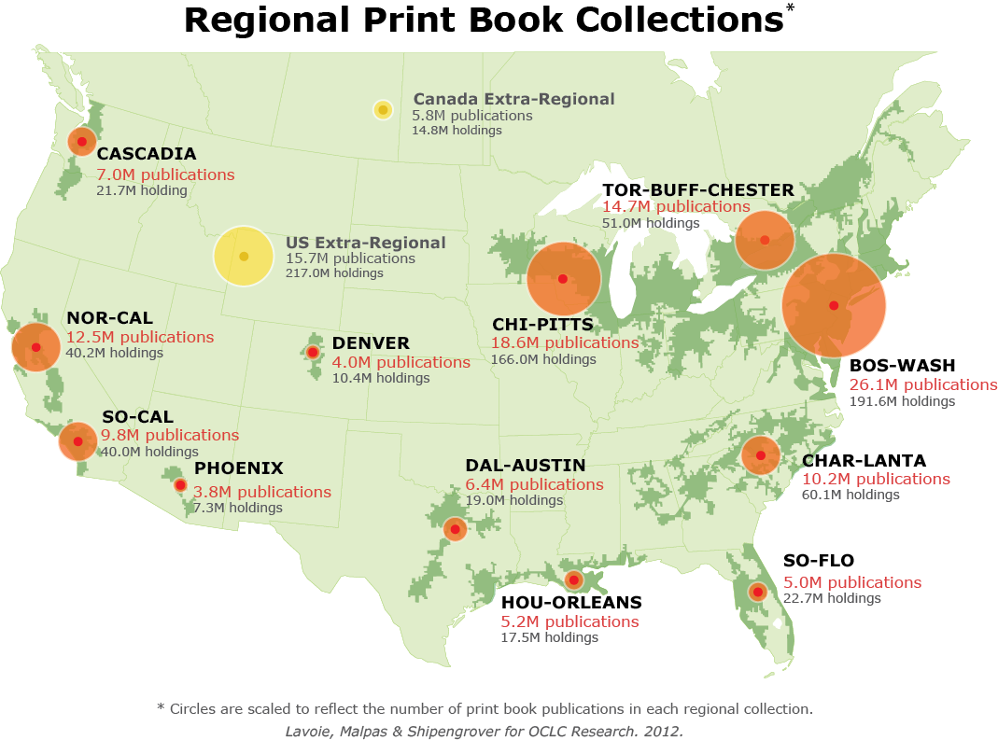
North American print book resource:
45.7 million distinct publications
889.5 million total library holdings
Figure: North American Regional Print Book Collections. OCLC Research, 2013.

Slide 40
The facilitated collection.
Workflow is the new content supply chain.
From consumption to creation.
Configuring space around user experiences not collections.
Managing down print.
The library in the life of the reader, creater, learner, …

Slide 41
Conclusion
The library in the life of the user

Slide 42
Collections | Just in time | Facilitated
Expertise | Subject, process | Partner in research and learning, creation, …
Systems | Back office | Workflow, digital scholarship, shared systems
Space | Configured around collections | Configured around user experiences

Slide 43
Libraries are not ends in themselves.
They serve the research and learning needs of their universities.
The major long term influence on libraries is how those needs change.
To be effective, libraries need to understand and respond to those changes.

Slide 44
“20 years ago I was
in the libraries business.
Today I am in the
Columbus business.”
Pat Losinski, CML
http://www.theatlantic.com/national/archive/2014/10/not-your-mothers-library/381119/

