Slide 1

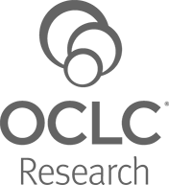
Lorcan Dempsey & Brian Lavoie
OCLC
@LorcanD
Library collections and the evolving scholarly record
Research Library Partners meeting, 2nd December 2015, Woodward Centre, University of Melbourne
http://www.anzcns.org.au/images/ASM4/dreamstime_xxl_857257.jpg

Slide 2
Overview

Slide 3
4 contexts
3 trends
1 project

Slide 4
4 contexts

Slide 5

1
The logic of print distribution influenced library development:
Close to user – multiple library collections.
Big = good.
Just in case.

Slide 6
The bubble of growth in twentieth-century
printed collections has left … librarians
with a tricky problem.
Barbara Fister New Roles for the Road Ahead:
Essays commissioned for ACRL’s 75th Birthday

Slide 7
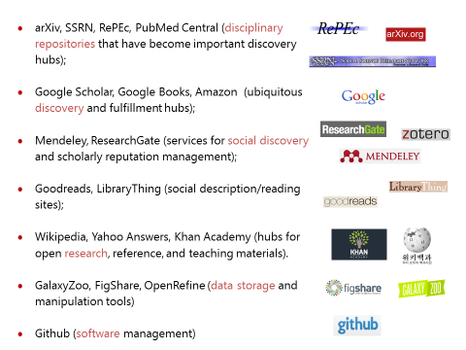
2
An abundance of resources in the network world

Slide 8
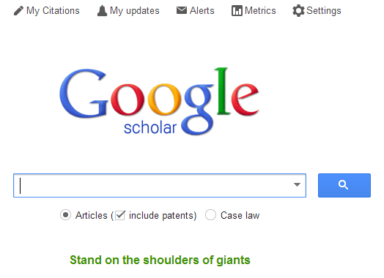




3
Discovery moved to the network level
Peeled away from local collection
“Discovery happens elsewhere”

Slide 9
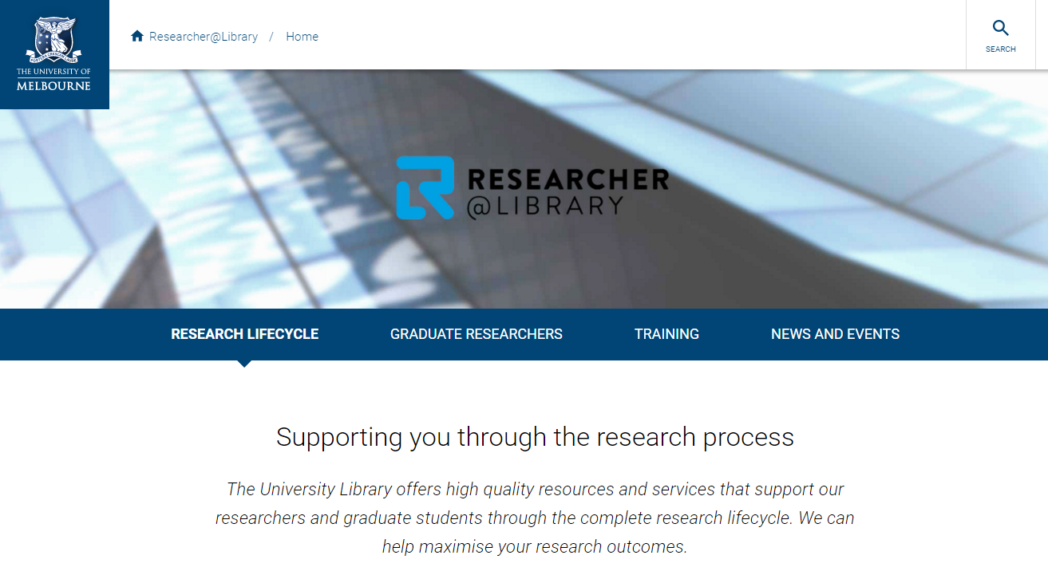
4
From consumption to creation:
Support process as well as product.
Workflow is the new content..
Support for publishing and digital scholarship.
An inside out perspective increasingly important.

Slide 10
http://www.against-the-grain.com/2012/11/a-publishers-new-job-description/
Her view is that publishers are here to make the scientific research process more effective by helping them keep up to date, find colleagues, plan experiments, and then share their results. After they have published, the processes continues with gaining a reputation, obtaining funds, finding collaborators, and even finding a new job. What can we as publishers do to address some of scientists’ pain points?
Annette Thomas,
CEO of Macmillan
Publishers (now Chief Scientific Officer Springer Nature)
A publisher’s new job description

Slide 11
3 trends

Slide 12
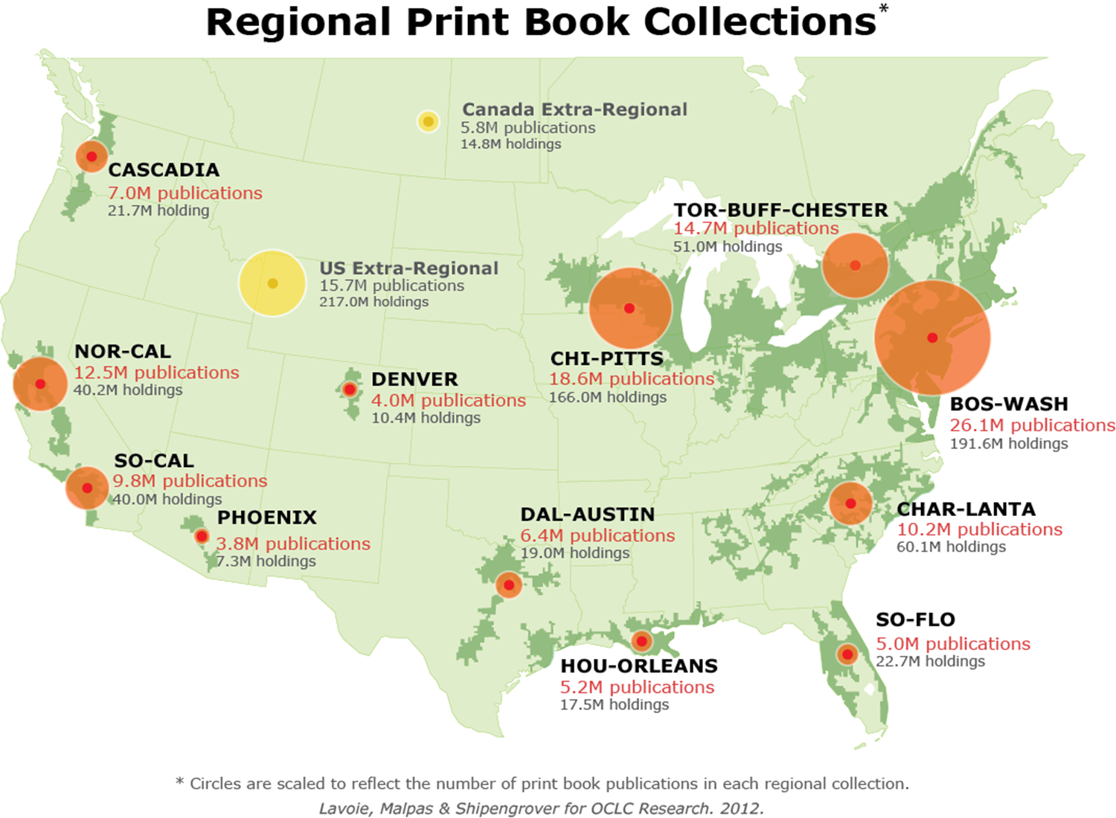
1
Strategic management of the collective print collection
Managing down print.
Emerging shared infrastructure and collective action.
Variable mission to collect/preserve.
Space reconfigured around experiences rather than collections.

Slide 13
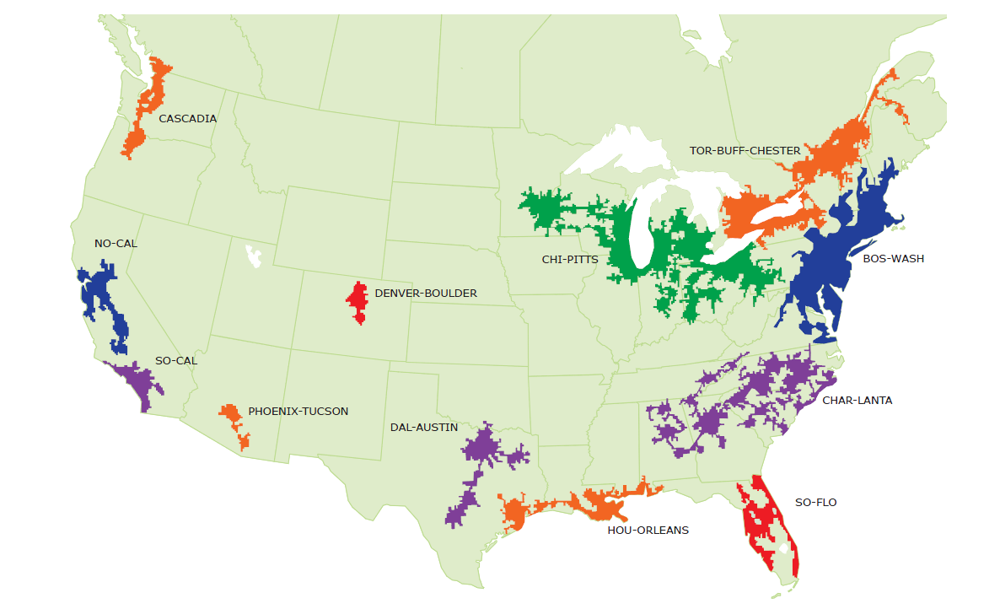
Mega-regions & Shared Print Initiatives
Orbis-Cascade
OCUL
MSCS
WEST
CIC
SCELC
WRLC
GWLA
ASERL
FLARE
We expect that in 5-7 years the larger part of the North American ‘collective collection’ will have moved into shared management.
OCLC Research, 2013

Slide 14

Strategic management of the shared print collection Then: Value relates to depth and breadth of local collection. Now: Value relates to systemwide curation of and access to print collections – ‘rightscaling’.

Slide 15
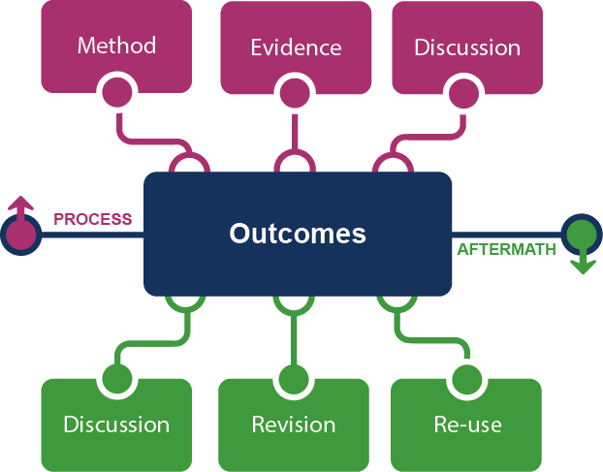
2
From curation to creation
The emerging scholarly record.
Workflow is the new content.
Process and product.

Slide 16
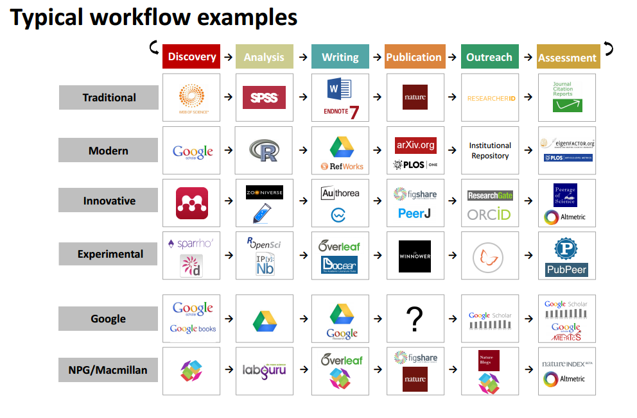


Slide 17
From curation to creation Then: Value relates to management of the ‘products’ of research. Now: Value relates to support of productivity and process of research and learning.

Slide 18
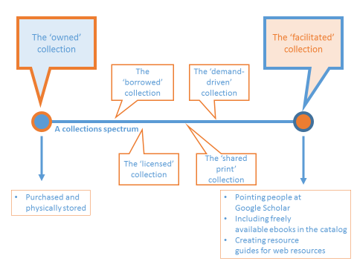
3
From owned/licensed to facilitated.
Organized around user needs
Curation is community oriented?
Inside out vs outside in.

Slide 19
Catalog
KB/Discovery
LibGuides, etc
Google, ResearchGate, etc …
Separation of discovery and collection?:
Focus shifts from owned to facilitated (available)?
More emphasis on making institutional resources discoverable?
Systemwide thinking becomes stronger?
Owned
Licensed
Available
Global
Figure: Discoverability redefines collection boundaries.
OCLC Research, 2015.

Slide 20
Towards facilitated collection Then: Value relates to locally assembled collection. Now: Value relates to ability to efficiently meet a variety of research and learning needs.

Slide 21
1 project

Slide 22
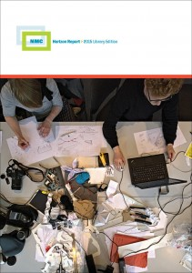
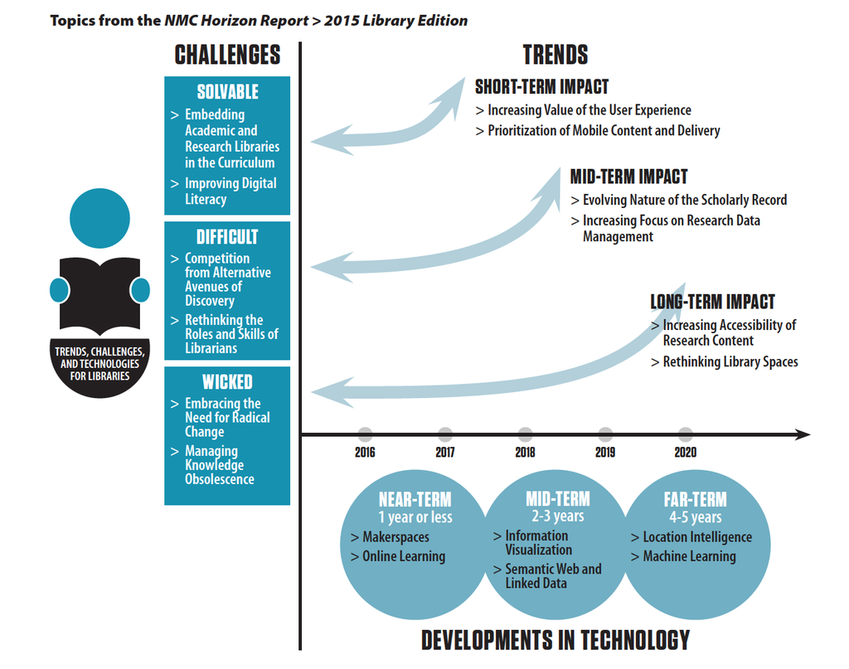
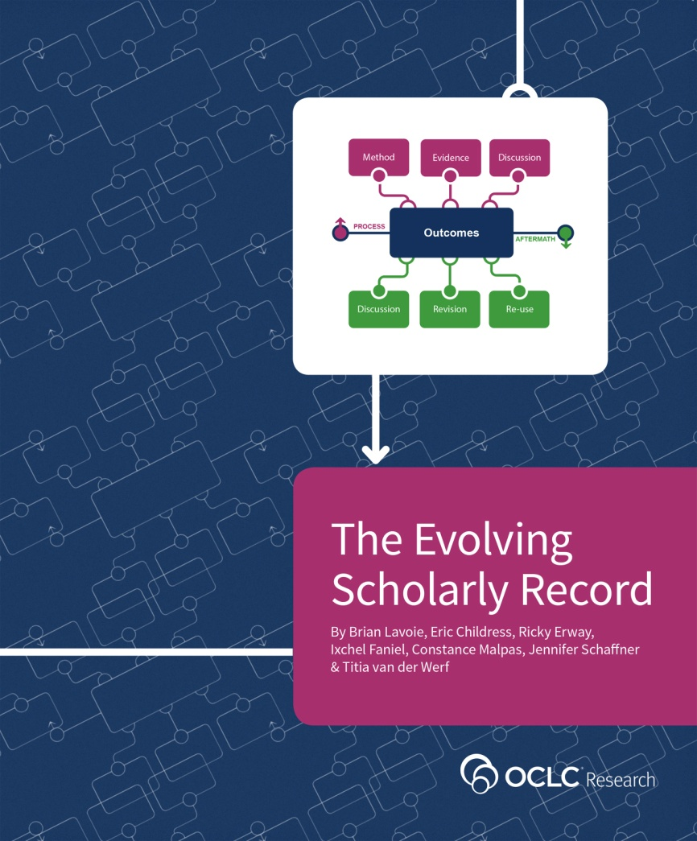
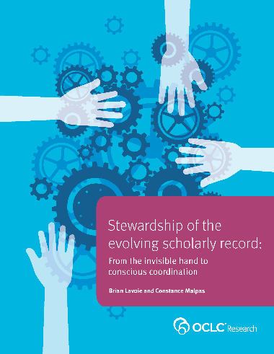
http://oc.lc/esr
http://oc.lc/esr-stewardship
Notes:
Key trend: The scholarly record is evolving, and this has important implications for stewardship of the scholarly record in general, and academic libraries’ role in stewarding the scholarly record in particular.
To reinforce this point, note this picture from the recently published New Media Consortium Horizon report on academic libraries, which looks at some of the key trends, challenges, and technologies impacting academic libraries within the next five years.
The picture indicates that “the “evolving nature of the scholarly record” is expected to be one of two key trends impacting technology adoption in academic libraries over the next three to five years.
This suggests that it’s worthwhile to spend some time unpacking the nature of this trend, and considering its implications for academic libraries as they carry out their mission of gathering, organizing, and curating the scholarly record. OCLC Research has done some work on these topics, summarized in two recently published reports (note report covers/URLs in lower left of slide). In this section of the talk we’ll discuss a few highlights from these reports.

Slide 23
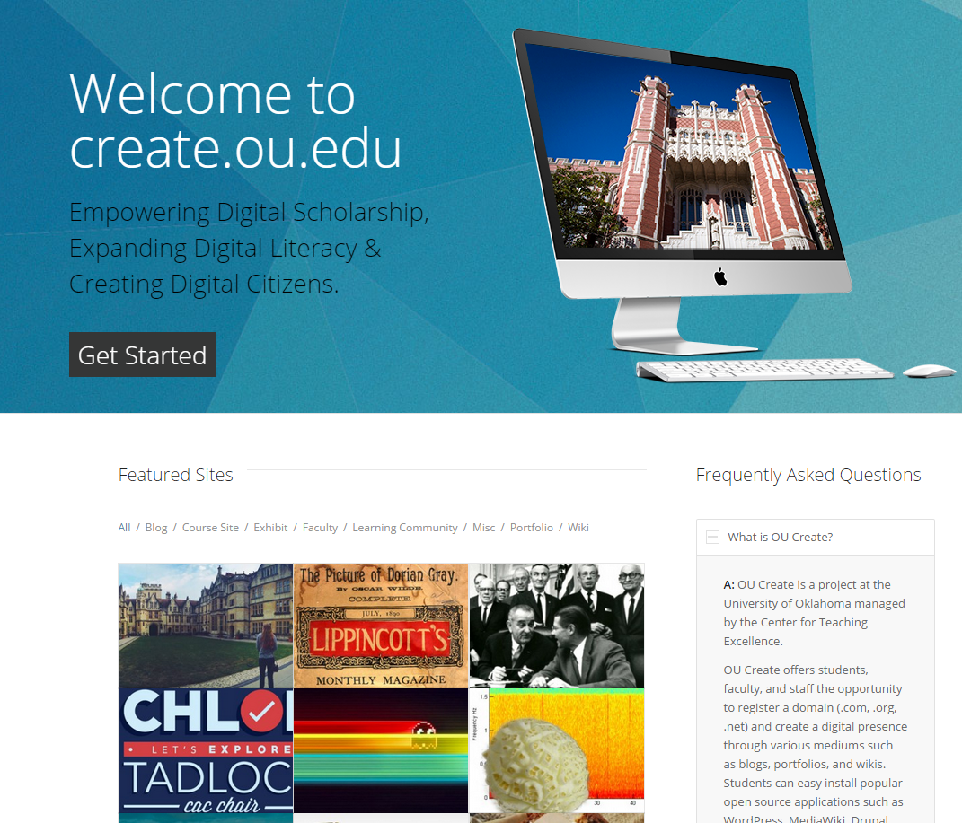
“… Create aims to empower all members of
the OU community to craft and control their
digital narrative through the use of blogs,
portfolios, wikis, and more.”
https://create.ou.edu/
Notes:
To start off, consider this service which is emblematic of the evolution of the scholarly record that we’re witnessing today. OU Create is a program run by the Center for Teaching Excellence at the University of Oklahoma, and its purpose is to offer services to faculty and students to build and maintain a digital identity for themselves and their scholarship. [read quote on slide]
OU Create is an excellent example of how the scholarly record is evolving – in particular, the shift in focus to the digital environment, the adaptation of new channels of scholarly communication, and the notion of a scholarly identity that extends over a diverse range of scholarly outputs.
And the three goals highlighted on the Create home page – empowering digital scholarship, expanding digital literacy, and creating digital citizens – are becoming fundamental services for supporting research and learning in today’s environment.

Slide 24
Evolutionary trends …
Formats shifting:
Print-centric to digital, networked
Boundaries extending:
Articles/monographs, but also data, computer models, lab notebooks, blogs, e-mail discussion, e-prints, interactives/executables, visualizations, etc
Characteristics changing:
Traditionally: static, formal, outcome-focused
Today: dynamic, blend of formal & informal, more focus on documenting full research cycle (replicability, “leveragability”)
Stakeholders reconfiguring:
New paths for the scholarly communication “supply chain”
Notes:
Move from the particular to the general and consider some broad trends shaping the evolution of the scholarly record today.
Massive shift in format from what was traditionally a print-centric scholarly record to one which is increasingly digital and networked.
Boundaries of scholarly record stretching beyond traditional materials like articles and monographs to include wide range of additional scholarly outputs.
Some fundamental characteristics of the scholarly record are changing:
Traditionally: scholarly outputs that went into the scholarly record were static/unchanging (due to print format); most of what entered the scholarly record did so through formal publication channels; and what entered the scholarly record tended to focus on the outcomes of scholarly activity, rather than the full context surrounding that activity.
Today: scholarly outputs much more dynamic/changeable (due to digital format); materials enter the scholarly record through both formal and informal publication channels; much more interest in documenting the scholarly outputs from the full research cycle, not just final outcomes. Reasons: More interest in replicability in many disciplines; higher expectations about being able to leverage past work into new work.
Stakeholder roles reconfiguring: the pathways by which the scholarly record is created, consumed, and managed are shifting into new forms. This involves traditional stakeholders taking on new roles, some dropping out of the picture entirely, and some new stakeholders entering the picture.

Slide 25
Framing the Scholarly Record …
Figure: Evolving Scholarly Record framework.
OCLC Research, 2014
Notes:
Here’s how we framed out the scholarly record in terms of the nature and scope of what it is evolving to include.
Start with final published outcomes: the reporting of final results, conclusions, ideas from a particular scholarly inquiry. Still the coin of the realm for scholarly communication, so they are privileged at the center of the picture;
A lot of these outcomes take the form of familiar text-based materials like books and journal articles, although increasingly supplemented by additional content such as video, graphics, and interactive programs.
Rest of scholarly record divided into two broad areas: process and aftermath
Process: process of scholarly inquiry, or the process by which outcomes are produced. Three key categories of materials generated during the process phase in which there is growing interest in curating them as part of the permanent scholarly record:
Method: materials related to the methodology of scholarly activity (e.g., software, computer models, digital lab notebooks, sampling frames, experimental protocols, instrument calibrations)
Evidence: raw materials/inputs to research (e.g., data sets, survey results, new or enhanced primary source documents, links to findings from other scholarly works);
Discussion: refinement/improvement of research through interactions/discussions with other scholars (e.g., pre-prints, listserv/blog discussions, conference presentations, grant proposals/reviews of grant proposals).
Anchoring outcomes directly to the methods employed, evidence used, and formative discussions conducted during the process of scholarly inquiry helps contextualize and deepen our understanding of these outcomes, facilitate replicability, and leverage results into new research.
Once the outcomes from a research project have been formally published or otherwise made available, scholarly activities surrounding that piece of work may still continue in the “aftermath” phase. Once again, several key categories of materials can be generated:
Discussion: post-publication (through similar channels as those in the process phase, but also post-publication formal reviews and commentary);
Revision: once something has been published, it can be revised in various ways (the work may be enhanced with additional findings; errors may be corrected or clarifications made, etc.)
Re-use: published work may be edited or re-packaged into new forms for new audiences/venues (conference presentations, summaries, blog posts, versions for popular audiences, etc.).
Note: we are not saying that everything discussed here will end up in the scholarly record in every discipline. Better to say that the picture represents the maximal scope and depth of materials regarding which there is increasing interest in systematic collection and curation.
Note that some of the materials in the outlying components might become final outcomes in their own right. Data sets are a good example: in some disciplines the publication of an important data set is now considered a first-class scientific outcome, on a par with a published journal article.

Slide 26


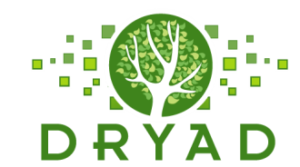


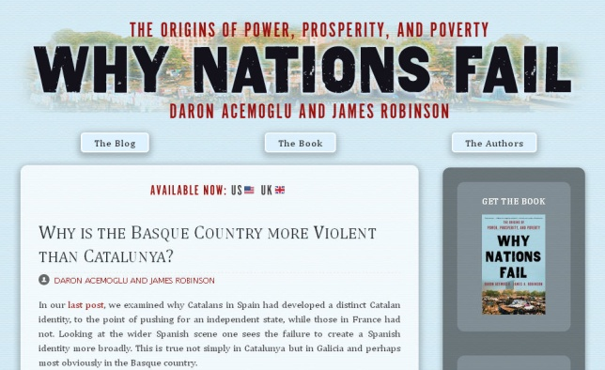


Figure: Evolving Scholarly Record framework, publishing venues.
OCLC Research, 2014
Notes:
MethodsX: journal recently launched by Elsevier that allows researchers to publish details about methodological innovations that may benefit other researchers; “releasing the hidden gems from your lab notebook”
Dryad: repository of data sets associated with published articles in the life sciences.
arXiv: pre-print repository provides an opportunity for scholars to expose their work to peers for discussion and commentary prior to publication.
Why Nations Fail: blog launched simultaneously with publication of book by same name; opportunity for authors to sustain a discussion about ideas presented in their book and apply them to current events.
Figshare: enhance your published work by uploading ancillary materials and making them accessible and citable.
Slideshare: conference presentations are common way of repackaging or re-purposing publications for new audiences and settings. Slideshare provides a means to make presentations discoverable, citable, and consistently accessible.

Slide 27
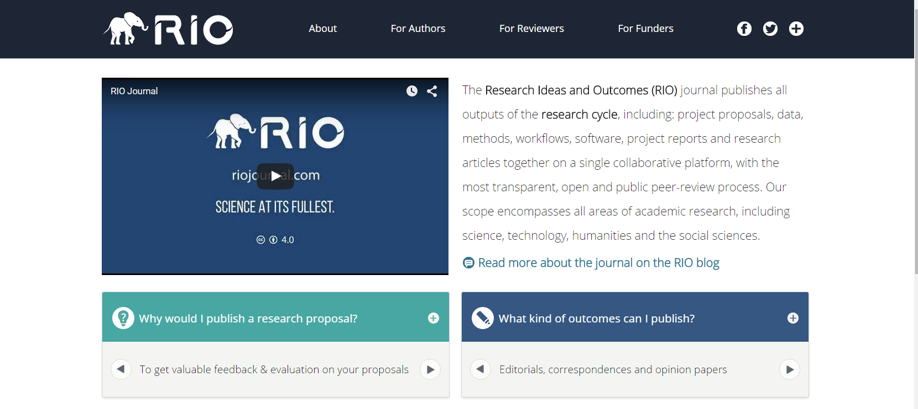
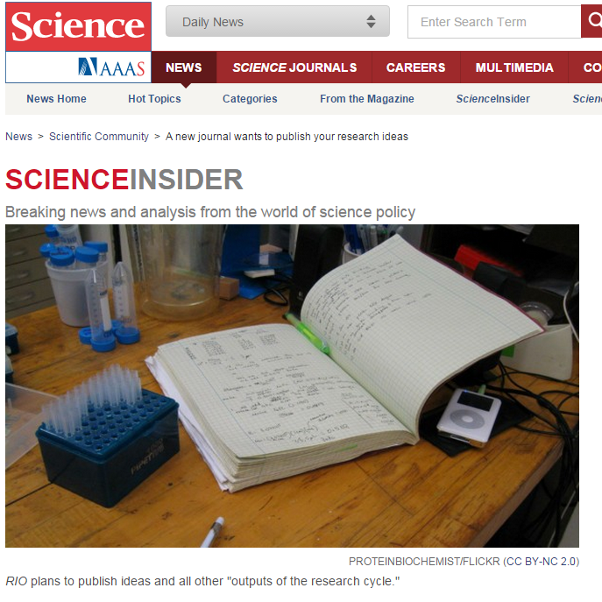
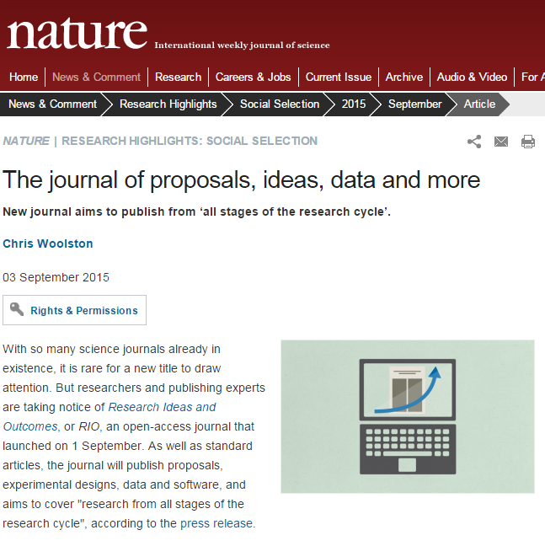
http://riojournal.com/
Notes:
One last example, which is particularly interesting because of the ambition of its scope: the Research Ideas and Outcomes (RIO) Journal: publishes all outputs of the research cycle, anything from project proposals, to data, to methods, to final articles. In other words, it covers pretty much everything represented in our scholarly record picture.
Published by the Bulgarian academic publisher Pensoft. It’s open access, peer-reviewed, and covers all areas of academic research.
Received some press in prestigious places (write-ups in both Science and Nature, as shown on slide).
Remains to be seen if such a journal is viable, but regardless, it is nicely suggestive of the broader patterns that are shaping the scholarly record today. The journal’s slogan is “science at its fullest”, and it aspires to make available a wider variety of research outputs than are traditionally made public. This nicely reflects the nature of the scholarly record itself today.

Slide 28
Evolving scholarly record: Implications
Increasing volume of content
Increasing diversity and
complexity of content
Increasing distribution of custodial
responsibility
Notes:
In thinking about a scholarly record like the one we just discussed, several important implications to consider:
Increasing volume of content: profusion of scholarly outputs poised to enter the scholarly record.
Increasing diversity & complexity: scholarly record moving well beyond text-based materials, encompassing wide range of scholarly outputs, many of which are in technically complex formats.
Increasing distribution of custodial responsibility: scholarly outputs that we might want to include in the permanent scholarly record are scattered all over the network in many custodial hands, including many non-library/non-cultural heritage organizations.
All of this leads to a scholarly record exhibiting characteristics far different from the traditional print-based scholarly record that so many library collections services, and infrastructure are built around. And this creates challenges for the traditional library-based stewardship model.

Slide 29
Evolving library collections … and stewardship models
The ‘owned’ collection
The ‘facilitated’ collection
‘borrowed’
‘ESR’
Locally-focused
Stewardship
‘licensed’
‘shared print’
Conscious
Coordination
Scholarly record no longer approximated in
academic library collections
Notes:
Traditional approaches to stewardship, which center around managing collections as relatively autonomous units, with little coordinated action across institutions, are inadequate for today’s scholarly record.
And that’s because the evolution of the scholarly record is part of a fundamental transformation of academic library collections. We can see this in the picture on the slide.
Start on the left with “owned collection”: traditional library collection model; materials purchased, brought into library; accessed/used within library’s physical space
Over the years, library collections have evolved, moving along a continuum toward the second endpoint on the right. We’ve seen things like the emergence of
Borrowed collection: emergence of sophisticated resource sharing networks to support/complement local collections.
Licensed collection: instead of purchasing and taking custody, libraries license access to materials that are managed elsewhere.
Shared print: print management moved from a local activity to one that is done above the institution within cooperative arrangements.
Evolving Scholarly Record: now we see the emergence of a scholarly record that is increasingly digital and networked, and where an array of diverse and technically complex scholarly outputs are poised to enter the scholarly record. And these scholarly outputs are characterized by a highly distributed pattern of custodial responsibility – in other words, they are scattered all over the network, and many (most?) of them are not in the collections of academic libraries.
So the scholarly record is now imperfectly approximated in academic library collections, or even in the aggregate library resource, because libraries are not collecting – and lack the resources to collect – the full range of scholarly outputs that now comprise the evolving scholarly record.
So what we are moving toward is the endpoint on the right: the facilitated collection, where providing local access to scholarly record less about accumulating large, representative local collections, and more about facilitating access to scholarly resources distributed across the network.
In thinking about transition from owned collection to facilitated collection, we think there will be a parallel shift in stewardship strategies as well: from relatively autonomous, locally-focused stewardship efforts, to what we call conscious coordination.

Slide 30
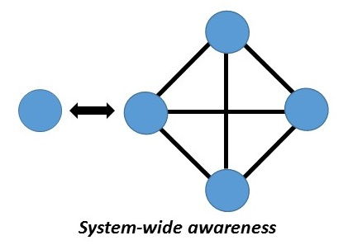
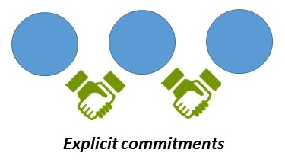
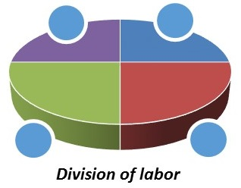
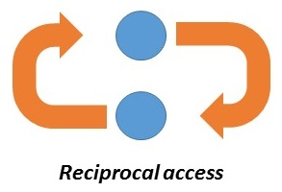
Four elements of conscious coordination
“Align local action with collective effort”
“Move commitments above the institution”
“Collect more of less”
“Curate locally, share globally”
Notes:
What is conscious coordination? We say in our report that consciously coordinated stewardship of the scholarly record is characterized by four principles:
System-wide awareness: local decisions about stewardship are taken with a broader awareness of the system-wide stewardship context – who is collecting what, what commitments have been made elsewhere in terms of stewarding various portions of the scholarly record, and how the local collection fits into the broader system-wide stewardship effort.
Explicit commitments: declarations of explicit stewardship commitments around portions of the local collection. Collecting institutions acknowledge, accept, and undertake to fulfill explicit responsibilities in regard to collecting, curating, and making available certain types of materials. Fulfillment of these responsibilities is seen as a commitment not only to local faculty and students, but also to a broader external stakeholder community
Division of labor: emergence of divisions of labor within cooperative arrangements. Rather than attempting to collect some of everything, greater emphasis will be placed on specialization in collection building. So collecting institutions will seek to collect more of less: investing more intensively in a narrower range of materials, within the context of cooperative arrangements in which different institutions specialize in collecting different portions of the scholarly record.
Reciprocal access: Stewardship strategies characterized by a greater degree of specialization in collecting activity must be accompanied by robust resource sharing arrangements that ensure relatively frictionless access to all parts of the scholarly record: i.e., mutual assurance that materials collected by one institution will be made available to other partners, and vice versa.
We discuss all of these in more detail in the report, but the basic idea is that we expect stewardship models of the evolving scholarly record to exhibit these characteristics in one form or another.

Slide 31








Examples
marc 583
Notes:
Some examples where elements of conscious coordination are starting to manifest in current stewardship efforts/services:
SWA:
Hathi Trust: takes pains to measure the overlap between its member libraries print collections and the digital surrogates in the Hathi shared repository.
Sustainable Collection Services: allows comparison of local print holdings to print holdings in the library system as a whole.
Both services place local collections in a broader system-wide context.
EC:
MARC 583 field: allows you to register local preservation commitments in group catalogs to help coordinate cooperative collection management activities
UKRR: centralized registry of retained print holdings in the UK, which institutions can use to inform local print retention decisions based on commitments articulated in the registry.
DOL:
Specialized or thematic collecting activity becoming more central to collection building strategy.
Columbia University’s Contemporary Composers Web archive: a unique asset not duplicated elsewhere in the library system.
Dryad: specializes in curating data sets associated with published articles in the life sciences literature; that is the “niche” of the scholarly record they serve.
RA:
See this with efforts to reduce frictions in traditional ILL networks, like BorrowDirect, but also new initiatives like SHARE that aim to improve discoverability and accessibility to digital scholarly outputs that are widely distributed across the network.
These examples show that the elements of conscious coordination are starting to spread into stewardship activities related to both traditional and emerging forms of scholarly outputs, and we think that we’ll continue to see more of this going forward.

Slide 32
Conclusion

Slide 33
Key Takeaways
Scholarly record evolving into deeper, more comprehensive record of scholarly activity.
Scholarly record highly distributed across the network – beyond academic library collections.
For libraries, stewardship often happens elsewhere
Academic libraries increasingly embedded in/reliant on consciously-coordinated networks of collective responsibility to the scholarly record
Notes:
Some key takeaways to highlight from the previous discussion:
The scholarly record is evolving to capture scholarly outputs from all phases of the research cycle, not just final outcomes.
Many of these scholarly outputs are not in the custodial care of academic libraries, which disrupts the traditional library-based stewardship model.
As a result, there is a growing gap between the scholarly record in its fullest expression (and what libraries make discoverable/point to in their catalogs), and what libraries are actually stewarding themselves.
Increasingly, we are moving to a model of collective stewardship responsibility to the scholarly record, where scholarly outputs are gathered, curated, and made accessible through networks of consciously coordinated stewardship activity. Academic libraries will both participate in these networks (through contribution of stewardship effort) and rely on them for ongoing access to the full scope of the scholarly record.

Slide 34
Next Steps
Focus on Research Data Management
Key part of ESR for academic libraries
Clarify the landscape in this area:
What are libraries’ pressing needs for RDM? How has this need been incorporated into strategy statements?
What are the demand-side expectations? What are scholars’ requirements for long-term data management?
What is the state-of-play for supply-side solutions? What system-wide arrangements have emerged to meet RDM needs?
Beyond Libraries: Other Stakeholder Perspectives
Focus on publishers’ role in consciously-coordinated networks of collective responsibility to scholarly record
Notes:
Some next steps for our ESR work:
In general, we want to move beyond concepts and frameworks and think more deeply about practical implications of ESR, especially in terms of operational and system-wide impact.
For example:
We’d like to focus some effort on looking in detail at research data management, which is a key part of the evolving scholarly record – and an area of pressing need – for academic libraries. So we would like to look at questions like:
How have plans for developing RDM capacities been articulated in academic library strategy statements?
What are the general requirements for RDM that scholars are articulating? Where do libraries fit in the broader eco-system of providers who will meet those requirements?
What is the state of play of RDM solutions today? What sorts of system-wide arrangements have emerged for meeting RDM needs (e.g., institutional repositories, Dryad, Figshare …)?
We would also like to do some thinking about the role of other stakeholders besides libraries in stewarding the scholarly record. Stewardship of important scholarly outputs often happens external to the library, and therefore libraries are becoming increasingly dependent on complex networks of non-library stakeholders to ensure long-term access to, and preservation of, the scholarly record.
So we are planning to produce an article that takes a closer look at how publishers fit into emerging networks of consciously-coordinated, collective stewardship responsibility to the scholarly record.
In summary: The evolving nature of the scholarly record, and the emergence of stewardship arrangements based on conscious coordination, are going to have important consequences for libraries, in terms of operational impact and new kinds of sourcing and scaling decisions. Our future work in the area of the evolving scholarly record will address these issues.

Slide 35
Further resources
http://www.oclc.org/content/dam/research/publications/library/2014/oclcresearch-collection-directions-preprint-2014.pdf
http://oc.lc/esr
http://oc.lc/esr-stewardship

