Slide 1

OCLC Research Library Partners
Chicago, IL October 22-23, 2015
Findings from the
Visitors and Residents Project
Lynn Silipigni Connaway, PhD
Senior Research Scientist
connawal@oclc.org
@LynnConnaway

Slide 2

Participant Interview Questions
Selected Questions
2. Think of the ways you have used technology and the web for your studies. Describe a typical week.
4. Think of a time when you had a situation where you needed answers or solutions and you did a quick search and made do with it. You knew there were other sources but you decided not to use them. Please include sources such as friends, family, teachers, coaches, etc.
(White and Connaway 2011-2014)
Notes:
Image: https://www.flickr.com/photos/3ammo/12490957864/
1. Describe the things you enjoy doing with technology and the web each week.
2. Think of the ways you have used technology and the web for your studies. Describe a typical week.
3. Think about the next stage of your education. Tell me what you think this will be like.
4. Think of a time when you had a situation where you needed answers or solutions and you did a quick search and made do with it. You knew there were other sources but you decided not to use them. Please include sources such as friends, family, teachers, coaches, etc.
5. Have there been times when you were told to use a library or virtual learning environment (or learning platform), and used other source(s) instead?
6. If you had a magic wand, what would your ideal way of getting information be? How would you go about using the systems and services? When? Where? How?
White, David S., and Lynn Silipigni Connaway. 2011-2014. Visitors & Residents: What Motivates Engagement with the Digital Information Environment. Funded by JISC, OCLC, and Oxford University. http://www.oclc.org/research/activities/vandr/.

Slide 3

Diarist Monthly Interview Questions
Selected Questions
2. Think of a time fairly recently when you struggled to find appropriate resources to help you complete an ACADEMIC assignment. What happened?
3. Explain a time in the past month when you were successful in getting what you needed in a PERSONAL situation. What steps did you take?
(White and Connaway 2011-2014)
Notes:
Image: https://www.flickr.com/photos/couragextoxlive/3054488331/
Explain a time in the past month when you were SUCCESSFUL in completing an ACADEMIC assignment. What steps did you take?
Think of a time fairly recently when you struggled to find appropriate resources to help you complete an ACADEMIC assignment. What happened?
Explain a time in the past month when you were successful in getting what you needed in a PERSONAL situation. What steps did you take?
Explain a time in the past month when you were NOT successful in getting what you needed in a PERSONAL situation. What steps did you take?
Tell me something interesting that has happened in the past month in the social media that you used for ACADEMIC purposes.
Tell me something interesting that has happened in the past month in the social media that you used for PERSONAL situations.
What do you have to add to our discussion today about how you got information in the past month for both PERSONAL and ACADEMIC situations?
White, David S., and Lynn Silipigni Connaway. 2011-2014. Visitors & Residents: What Motivates Engagement with the Digital Information Environment. Funded by JISC, OCLC, and Oxford University. http://www.oclc.org/research/activities/vandr/.

Slide 4

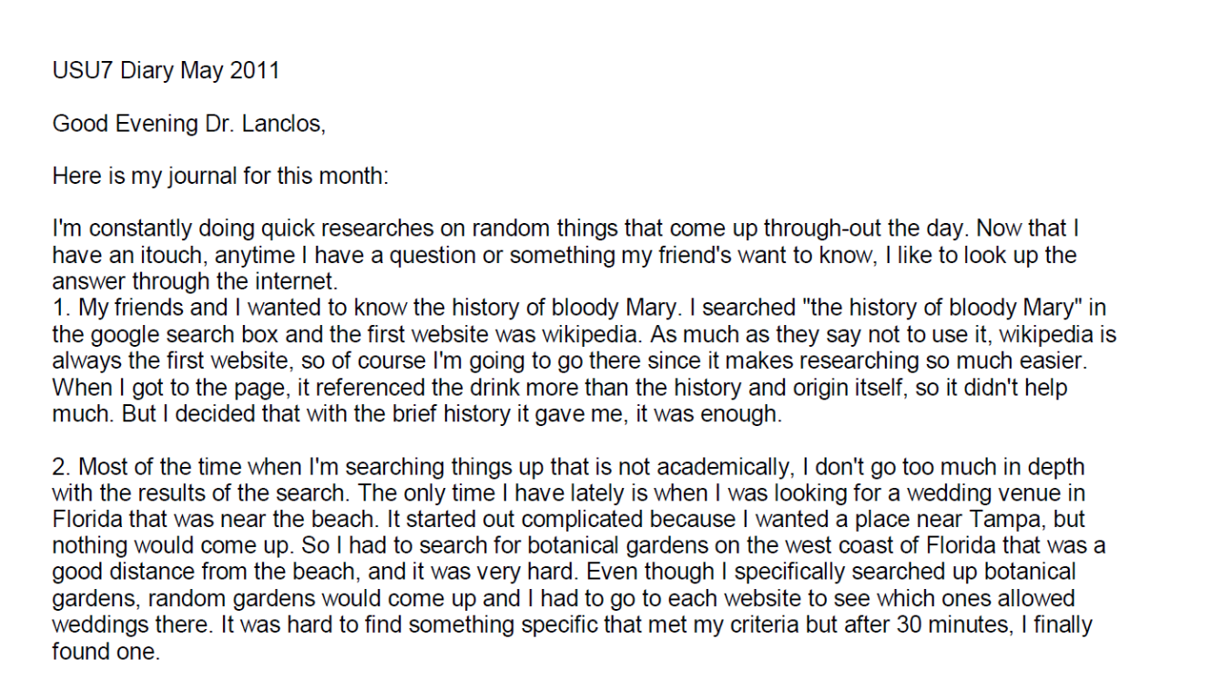
Diary Submission Example
(White and Connaway 2011-2014)
Notes:
Image: https://www.flickr.com/photos/limeflyphotography/14352660977/
Screenshot: USU7 Emg Dry1 Ph1 (Digital Visitors and Residents, USU7, Female, Age 19, Political Science)
“March was a little more serious. We’re nearing election time and all that jazz, and this is the first election I’ll be able to vote in, so I’ve been doing a bit of reading on a few of the candidates (not much, mind you). As a side note, I’m kind of debating whether or not I should actually vote in this election since I have such little knowledge on the candidates.” (Digital Visitors and Residents, USU12, Male, Age 19) USU12 Est Dry2 Ph2
“Um they do have a search box but I didn’t—I didn’t use that. Um I pretty much just, I pretty much just clicked links.” (Digital Visitors and Residents, USU12, Male, Age 19, 30:37) USU12 Est Follup Int1 Ph3
White, David S., and Lynn Silipigni Connaway. 2011-2014. Visitors & Residents: What Motivates Engagement with the Digital Information Environment. Funded by JISC, OCLC, and Oxford University. http://www.oclc.org/research/activities/vandr/.

Slide 5

Participant Online Survey Questions
Selected Questions
Think of a time in the past month when you *struggled* to find appropriate resources to help you complete an ACADEMIC/PROFESSIONAL assignment. Please include sources such as friends, family, teachers, teaching assistants, tutors, coaches, colleagues, professors, etc. Please answer each of the following questions.
17. What steps did you take and why?
18. What resources did you choose to use?
19. What made you choose these resources instead of others?
20. What made these resources easy or difficult to use?
Notes:
Image: http://www.flickr.com/photos/73582860@N00/5064328494
Think of a time in the past month when you *struggled* to find appropriate resources to help you complete an ACADEMIC/PROFESSIONAL assignment. Please include sources such as friends, family, teachers, teaching assistants, tutors,
coaches, colleagues, professors, etc. Please answer each of the following questions.
17. What steps did you take and why?
18. What resources did you choose to use?
19. What made you choose these resources instead of others?
20. What made these resources easy or difficult to use?

Slide 6
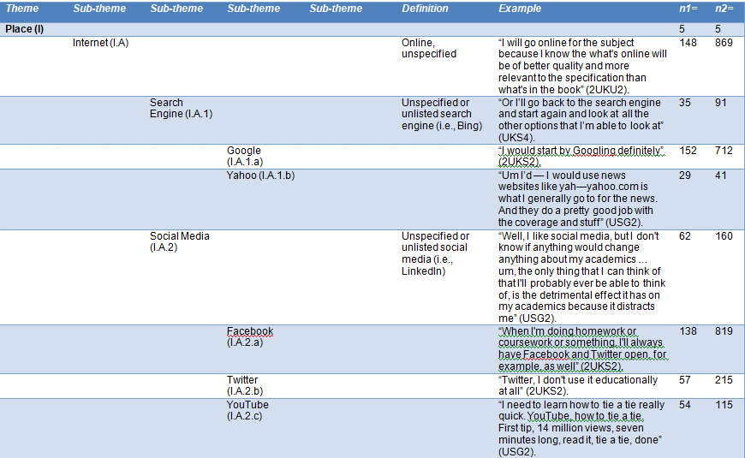
Digital Visitors & Residents Codebook Sample
Notes:
Image: V&R Expanded Codebook
Note: the n-values do not include the online surveys but do include the initial interviews, follow-up interviews, and diaries
n1= Sources/Transcripts
n2=Unique References
N=192 Unique Sources/Transcripts and 73 Unique Individuals
White, David S., and Lynn Silipigni Connaway. 2011-2014. Visitors & Residents: What Motivates Engagement with the Digital Information Environment. Funded by JISC, OCLC, and Oxford University. http://www.oclc.org/research/activities/vandr/.

Slide 7
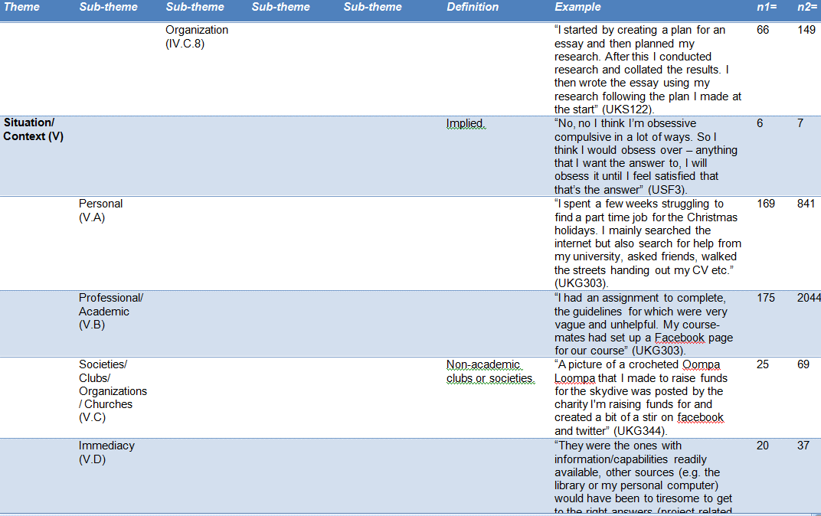
Notes:
Image: V&R Expanded Codebook
Note: the n-values do not include the online surveysbut do include the initial interviews, follow-up interviews, and diaries
n1= Sources/Transcripts
n2=Unique References
N=192 Unique Sources/Transcripts and 73 Unique Individuals
How we used the codebook:
First: the 3 researchers and research assistant coded the same two transcripts, one US and one UK (both secondary school).
We met and re-met and coded and re-coded until there was agreement.
THEN we went our separate ways to code. BUT we still communicate with each other in our coding processes, because of the remote nature of our collaboration.
Coding is done on paper, for the most part, and then the codes are entered into word, or scanned and sent to research assistants, who enter the coding into NVivo9. When the research assistants are entering the coding, they notice discrepancies, document them, and generate a discussion about what was intended, and what should the final coding be.
This continuous communication provides more consistency in coding across the researchers.
When Inter-coder Reliability was calculated between all five coders it was found to be an average of 0.6380 for Kappa and an Agreement Percentage of 98%.
White, David S., and Lynn Silipigni Connaway. 2011-2014. Visitors & Residents: What Motivates Engagement with the Digital Information Environment. Funded by JISC, OCLC, and Oxford University. http://www.oclc.org/research/activities/vandr/.

Slide 8
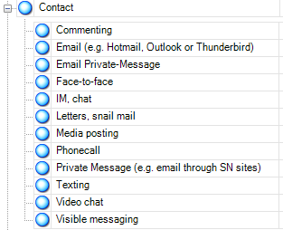
Data Analysis: Digital Visitors & Residents
I. Place
A. Internet
1. Search engine
a. Google
b. Yahoo
2. Social Media
a. FaceBook
b. Twitter
c. You Tube
d. Flickr/image sharing
e. Blogging
B. Library
1. Academic
2. Public
3. School (K-12)
C. Home
D. School, classroom, computer lab
E. Other
Codebook
Nvivo 10
(White and Connaway 2011-2014)
Notes:
Screenshot of Digital Visitors and Residents codebook in NVivo 10
White, David S., and Lynn Silipigni Connaway. 2011-2014. Visitors & Residents: What Motivates Engagement with the Digital Information Environment. Funded by JISC, OCLC, and Oxford University. http://www.oclc.org/research/activities/vandr/.
QSR International. 2011. NVivo 9: Getting started. http://download.qsrinternational.com/Document/NVivo9/NVivo9-Getting-Started-Guide.pdf.
Nvivo10:
Qualitative research software
Upload documents, PDFs, & videos
Create nodes & code transcripts
Merge files
Queries
Reports
Models

Slide 9
Phases 1-4 Demographics
Ages of Interview, Diary, and Follow-up Interview Participants Compared to Ages of Online Survey Participants
 | 12-18 |  | 19-25 |  | 26-34 |  | 35-44 |  | 45-54 |  | 55-64 |  | 64+
Demographic Age Band | Interview, Diary, Follow-up | Online Survey | Interview, Diary, Follow-up | Online Survey | Interview, Diary, Follow-up | Online Survey | Interview, Diary, Follow-up | Online Survey | Interview, Diary, Follow-up | Online Survey | Interview, Diary, Follow-up | Online Survey | Interview, Diary, Follow-up | Online Survey
Emerging | 25 | 23 | 14 | 15 | 2 | 0 | 1 | 4 | 0 | 0 | 1 | 0 | 0 | 0
Establishing | 1 | 1 | 5 | 38 | 3 | 2 | 1 | 1 | 0 | 0 | 0 | 0 | 0 | 0
Embedding | 0 | 0 | 6 | 15 | 1 | 18 | 0 | 5 | 3 | 1 | 0 | 2 | 0 | 1
Experiencing | 0 | 0 | 0 | 0 | 0 | 3 | 3 | 7 | 5 | 6 | 2 | 6 | 0 | 2
(White and Connaway 2011-2014)
Notes:
73 Interview, Diary, and Follow-up Participants
150 Online Survey Participants
Age of Interview, Diary, and Follow-up Participants
26 12-18 years old (12 UK/14 US)
25 19-25 years old (11 UK/14 US)
6 26-34 years old (3 UK/3 US)
5 35-44 years old (4 UK/1 US)
8 45-54 years old (3 UK/5 US)
3 55-64 years old (3 UK/0 US)
Age of Online Survey Participants
24 12-18 years old (14 UK/10 US)
68 19-25 years old (28 UK/40 US)
23 26-34 years old (10 UK/13 US)
17 35-44 years old (7 UK/10 US)
7 45-54 years old (1 UK/6 US)
8 55-64 years old (0 UK/8 US)
64+ years old (0 UK/3 US)
White, David S., and Lynn Silipigni Connaway. 2011-2014. Visitors & Residents: What Motivates Engagement with the Digital Information Environment. Funded by JISC, OCLC, and Oxford University. http://www.oclc.org/research/activities/vandr/.
Age groups and academic disciplines seem to be significantly different between the two samples, but the other factors are not significantly different. (The usual caveats about statistical power should be considered.)

Slide 10
Phases 1-4 Demographics
Academic Disciplines of Interview, Diary, and Follow-up Interview Participants Compared to Academic Disciplines of Online Survey Participants
Discipline Type | Interview, Diary, Follow-up | Online Survey
Secondary/ High School | 21 | 15
Sciences | 22 | 86
Arts/ Humanities | 12 | 23
Social Sciences | 16 | 26
Undeclared | 2 | 0
(White and Connaway 2011-2014)
Notes:
Academic Discipline of Interview and Diary Participants
21 secondary/high school students, 22 Sciences, 12 Arts/Humanities, 16 Social Sciences, 2 Undeclared
Academic Discipline of Online Survey Participants
15 High School (11 UK/4 US), 46 Professions & Applied Sciences (16 UK/30 US), 28 Formal Sciences (20 UK/8 US), 12 Natural Sciences (3 UK/9 US), 26 Social Sciences (5 UK/21 US), 23 Humanities (5 UK/18 US)
White, D. S., & Connaway, L. S. (2011-2014). Visitors & Residents: What motivates engagement with the digital information environment. Funded by JISC, OCLC, and Oxford University. Available: http://www.oclc.org/research/activities/vandr/.
Age groups and academic disciplines seem to be significantly different between the two samples, but the other factors are not significantly different. (The usual caveats about statistical power should be considered.)

Slide 11

“Convenient” Isn’t Always Simple
Convenience trumps all other reasons for selecting and using a source
(Connaway, Lanclos, and Hood 2013)
Notes:
Image: http://www.organiclifestylemagazine.com/green/images/issue-6/convenience.jpg
Convenience:
Wikipedia is described not just as effective, but also as “convenient,” and convenience is a key reason expressed for the choices that people make about technology, and about the information and other resources they end up using.
Digging down into the interviews allows us to talk about convenience in complicated ways—convenience is contextual, and is not the same for all people, or even for the same person in different situations.
It can be, for instance, about available time.
It can be about usability, perceptions of how easy resources are to use.
It can be about what is familiar, most physically convenient, too, even if it takes more time to use/access.
The fact is, perceptions of convenience, and about what is involved in effective searches for information and resources include digital as well as physical places now. It is easy to find information online, and it is easier than ever to produce content and put it on line. Resident modes of practice, engagement with social media, open practices like blogging, are already transforming notions not just of convenience, but also of authority, of what constitutes legitimate scholarly modes of communication, and the sorts of places in which such communication can and should take place.
Connaway, Lynn Silipigni, Donna Lanclos, and Erin M. Hood. 2013. “’I always stick with the first thing that comes up on Google…’ Where People Go for Information, What They Use, and Why.” EDUCAUSE Review Online (December 6), http://www.educause.edu/ero/article/i-always-stick-first-thing-comes-google-where-people-go-information-what-they-use-and-why.

Slide 12
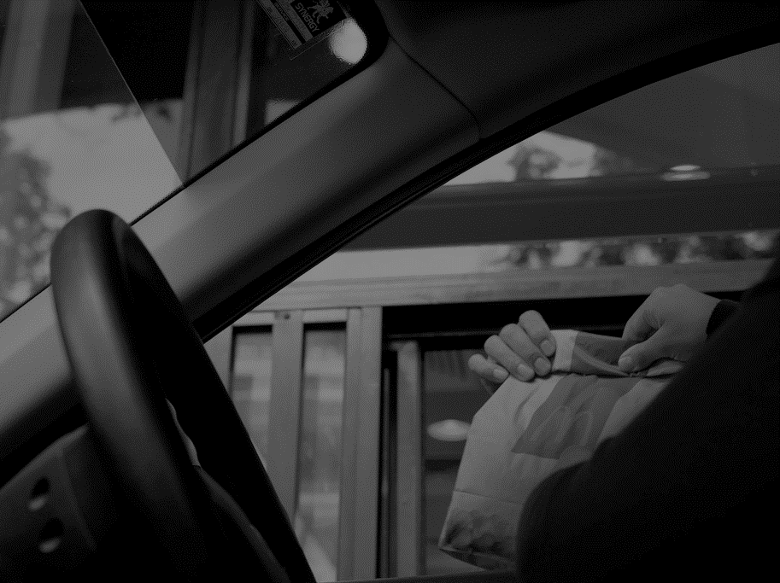
“Well I probably actually use these things on emails because it’s an incredibly easy and quick way of getting information.”
(Digital Visitors and Residents, UKS8, Female, Age 16, Secondary School Student)
Notes:
Image: http://www.flickr.com/photos/56712180@N02/10237757246
Interviewer: “Is there anything techno-wise that you would find it difficult to live without?”
Respondent: “Well I probably actually use these things on emails because it’s an incredibly easy and quick way of getting information.” (Digital Visitors and Residents, UKS8, Female, Age 16, Secondary School Student) (Emerging)

Slide 13
Interview & Survey: Decision, Choice: Convenience
(White and Connaway 2011-2014)
Notes:
Decision, Choice and Educational Stages Non-Aggregated: Online Surveys (Questions 4-6)
Convenience: Emerging 37, 88%, Establishing 38, 90%, Embedding 32, 76%, Experiencing 20, 83%
Decision Choice AND Educational Stages Non-Aggregated: Interviews
Convenience: Emerging 39, 91%, Establishing 10, 100%, Embedding 10, 100%, Experiencing 9, 90%
White, David S., and Lynn Silipigni Connaway. 2011-2014. Visitors & Residents: What Motivates Engagement with the Digital Information Environment. Funded by JISC, OCLC, and Oxford University. http://www.oclc.org/research/activities/vandr/.

Slide 14
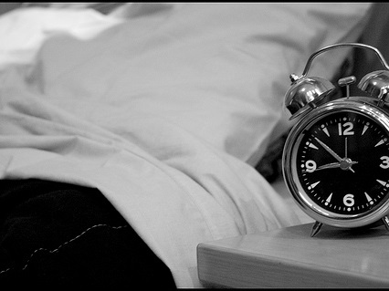
“…convenience, I needed the answer, my maths, I was doing an exercise, I got stuck on a question, I still had the rest of the exercise to go and I had like an hour to do it and I just wanted the formula and the quickest way to do it was to type it into Google and it came up.”
(Digital Visitors and Residents, UKS2, Female, Age 17, Secondary School Student)
Notes:
Image: http://www.flickr.com/photos/76103695@N00/3929606859
“But, yes, convenience, I needed the answer, my maths, I was doing an exercise, I got stuck on a question, I still had the rest of the exercise to go and I had like an hour to do it and I just wanted the formula and the quickest way to do it was to type it into Google and it came up. So, yes, it’s definitely a convenience thing I think.” (Digital Visitors and Residents, UKS2, Female, Age 17, Secondary School Student) (Emerging)
“And since a lot of my academic work is done at night, later hours, it’s much more convenient to do so within the home rather than to go to a library and seek out a computer there.” (Digital Visitors and Residents, UKG2, Female, Age 22, Learning and Technology) (Embedding)

Slide 15
Interview & Survey: Decision, Choice: Available Time
Notes:
Decision, Choice and Educational Stages Non-Aggregated: Online Surveys (Questions 4-6)
Available Time: Emerging 4, 10%, Establishing 5, 12%, Embedding 7, 17%, Experiencing 2, 8%
Decision Choice AND Educational Stages Non-Aggregated: Interviews
Available Time: Emerging 17, 40%, Establishing 4, 40%, Embedding 5, 50%, Experiencing 5, 50%
White, David S., and Lynn Silipigni Connaway. 2011-2014. Visitors & Residents: What Motivates Engagement with the Digital Information Environment. Funded by JISC, OCLC, and Oxford University. http://www.oclc.org/research/activities/vandr/.

Slide 16
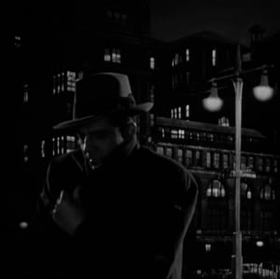
The Learning Black Market
“It’s like a taboo I guess with all teachers, they just all say – you know, when they explain the paper they always say, ‘Don’t use Wikipedia.’”
(Digital Visitors and Residents, USU7, Female, Age 19, Political Science)
Notes:
Image: http://s695.photobucket.com/user/TheForbiddenDonut/media/sidewalk.jpg.html
According to Alexa (2014), a Web site that tracks commercial Web traffic, Wikipedia is the 7th-most visited site in the world and the 6th most-visited site in the US. It should come as no surprise to librarians and faculty that Wikiipeida is one of the most visible and tempting information sources for college students.
Alexa, 2015. “Site overview: Wikipedia.org,” http://www.alexa.com/siteinfo/wikipedia.org
White, David S., and Lynn Silipigni Connaway. 2011-2014. Visitors & Residents: What Motivates Engagement with the Digital Information Environment. Funded by JISC, OCLC, and Oxford University. http://www.oclc.org/research/activities/vandr/.

Slide 17

“I just don’t – I really don’t understand why Wikipedia is so taboo because – I mean, I do understand that anyone can add information on there but then again anyone can make a website, anyone can make a journal, it doesn’t make it like an educational source.”
(Digital Visitors and Residents, USU7, Emerging, Female, Age 19, Political Science)
Notes:
Image by Jermyu, https://flic.kr/p/93xd5g
Wikipedia
No that’s fine. Wikipedia’s okay for some things because it’s like if they’re formalized theories about things then the people who check them will be people who know about these theories. But at the same time it’s freely editable and people might read something, not quite understand it and think that they know better than whoever wrote the article. And again whoever wrote the article might have just mis, sort of mis-worded something or said it slightly wrong. And so if you just want a sort of like a quick facts check, if you want to make sure that you’re making sense of this particular part to this particular theory and applying it properly then it can be useful just to quickly check it. And then if it agrees with what you were doing then you know you’re on sort of the right track. (Digital Visitors and Residents, UKU4, Emerging, Male, Age 19, Chemical Biology)
I just don’t – I really don’t understand why Wikipedia is so taboo because – I mean, I do understand that anyone can add information on there but then again anyone can make a website, anyone can make a journal, it doesn’t make it like an educational source. (Digital Visitors and Residents, USU7, Emerging, Female, Age 19, Political Science)
I go to Wikipedia. (Laughter) I mean I do actually trust the kind of wisdom of crowds, the notion that if people are keeping an eye on that site for wrong information and there’s somebody out there doing that there’s no better **. Whereas something that’s published can get through the vetting process with just one or two reviewers and have mistakes in it. (Digital Visitors and Residents, USF5, Experiencing, Male, Age 51, Theater)
White, David S., and Lynn Silipigni Connaway. 2011-2014. Digital Visitors and Residents: What Motivates Engagement with the Digital Information Environment? Funded by JISC, OCLC, and Oxford University. http://www.oclc.org/research/activities/vandr/.

Slide 18

“The problem with Wikipedia is it’s too easy…you don’t actually learn anything, you just get an answer.”
(Digital Visitors and Residents, USU6, Male, Age 28, Electrical Engineering)
Notes:
Image: http://www.flickr.com/photos/10506540@N07/4839938374
“The problem with Wikipedia is it’s too easy. You can go to Wikipedia, you can get an answer, you don’t actually learn anything, you just get an answer.”
(Digital Visitors and Residents, USU6, Male, Age 28, Electrical Engineering, quoting a teacher) (Emerging)
“They don’t fail you but you get ridiculed in front of everyone for sourcing Wikipedia…No, I just don’t even use it. Because I can find the information I need to on other sites. But looking at the author, I try to use a lot of college websites. Or the university databases. They really like those websites because they’re legitimate.” (Digital Visitors and Residents, USS3, Female, Age 17, High School Student) (Emerging)
“Erm, well I guess a lot of the times teachers say don’t use .com or don’t use Wikipedia, they like hate when we use Wikipedia. But Wikipedia is always right, so I always use that.” (Digital Visitors and Residents, USS6, Female, Age 17, High School Student) (Emerging)
Wikipedia is always really helpful. Obviously I’ll search on Google, but yes, Wikipedia has got a lot of things on there that are helpful, so yes, I use that a lot. (Digital Visitors and Residents, UKS1, Emerging, Male, Age 18, Secondary School Student)
“I think they say don’t trust every word it says, because obviously it can’t definitely be factually correct. But if you are just looking for more information it’s good, I think, just to find out about things.” (Digital Visitors and Residents, UKS1, Male, Age 18, Secondary School Student) (Emerging)

Slide 19
Interview: Place
(White and Connaway 2011-2014)
Notes:
Place AND Educational Stages: Interviews
Facebook: Emerging 95%, Establishing 100%, Embedding 100%, Experiencing 90%
Twitter: Emerging 21%, Establishing 50%, Embedding 50%, Experiencing 70%
YouTube: Emerging 33%, Establishing 50%, Embedding 30%, Experiencing 40%
Wikipedia: Emerging 81%, Establishing 90%, Embedding 70%, Experiencing 50%
White, David S., and Lynn Silipigni Connaway. 2011-2014. Visitors & Residents: What Motivates Engagement with the Digital Information Environment. Funded by JISC, OCLC, and Oxford University. http://www.oclc.org/research/activities/vandr/.
61% of current Facebook users say that at one time or another in the past they have voluntarily taken a break from using Facebook for a period of several weeks or more.
Rainie, Lee, Aaron Smith, and Maeve Duggan. 2013. “Coming and Going on Facebook.” Pew Research Center (February 5). http://www.pewinternet.org/2013/02/05/coming-and-going-on-facebook/.
Facebook popular social media site with 72% of online adults using it.
Next, Pinterest with 31%. Instagram with 28%, Twitter with 23%
Duggan, Maeve. 2015. “Mobile Messaging and Social Media 2015.” Pew Research Center (August 19). http://www.pewinternet.org/2015/08/19/mobile-messaging-and-social-media-2015/.

Slide 20
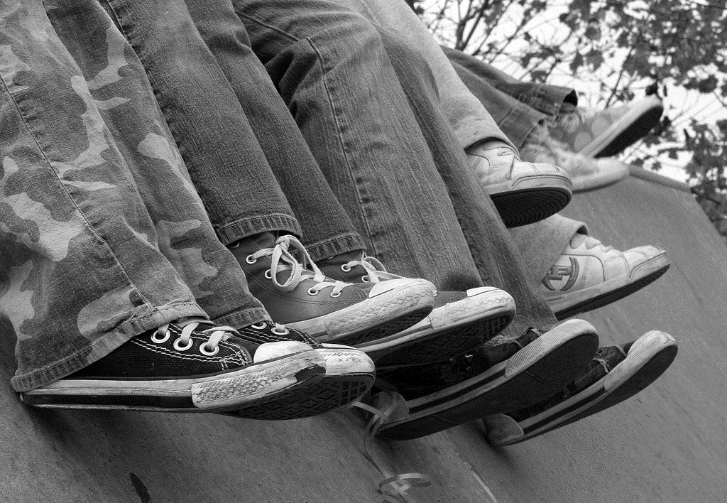
“I always stick with the first thing that comes up on Google because I think that’s the most popular site which means that’s the most correct.”
(Digital Visitors and Residents, USS1, Female, Age 17, High School Student)
Notes:
Image: http://www.flickr.com/photos/pinksherbet/2001899627/
“I always stick with the first thing that comes up on Google because I think that’s the most popular site which means that’s the most correct.” (Digital Visitors and Residents, USS1, Female, Age 17, High School Student)
White, David S., and Lynn Silipigni Connaway. 2011-2014. Visitors & Residents: What Motivates Engagement with the Digital Information Environment. Funded by JISC, OCLC, and Oxford University. http://www.oclc.org/research/activities/vandr/.
Google is the #1 most used site in the world and in the US.
Alexa, 2015. “Site overview: google.org,” http://www.alexa.com/siteinfo/google.com

Slide 21

“So Google has a good algorithm for that too. I think I know how to search, which helps a lot. I know what words to put in, I know to put in journal / report / study / research. Those are words that tend to bring the correct results quickly to the top and I think that’s because I’ve been searching on Google for so long, as long as I can remember...”
(Digital Visitors and Residents, UKG2, Embedding, Female, Age 22, Learning and Technology)
Notes:
Image by aesop, https://flic.kr/p/6qWNPy
Reliability
Yes, yes, yes. But other than that… Yes. Other than that, I find Google very helpful and I think that partially because I’m able to discern which links quickly are the ones that I wouldn’t want to click on versus not. So Google has a good algorithm for that too. I think I know how to search, which helps a lot. I know what words to put in, I know to put in journal / report / study / research. Those are words that tend to bring the correct results quickly to the top and I think that’s because I’ve been searching on Google for so long, as long as I can remember - middle school, fifth or sixth grade – that I’ve quickly developed those skills implicitly from doing research for as long as I have. (Digital Visitors and Residents, UKG2, Embedding, Female, Age 22, Learning and Technology)
White, David S., and Lynn Silipigni Connaway. 2011-2014. Digital Visitors and Residents: What Motivates Engagement with the Digital Information Environment? Funded by JISC, OCLC, and Oxford University. http://www.oclc.org/research/activities/vandr/.

Slide 22

“Sometimes I just use Google and that will get me started… Sometimes I’ll do a more extensive search through library databases like PsychINFO, things like that, or Academic Premier...”
(Digital Visitors and Residents, USF5, Experiencing, Male, Age 51, Theater)
Notes:
Image by Robert Scoble, https://flic.kr/p/7twZcy
Google
Yes. It’s like for our extended project we have like tutorial sessions, and they gave us this website that you go on to like try and find useful resources, but I just think it’s too complicated and it’s limited, that I just carried on going on Google. (Digital Visitors and Residents, UKS6, Emerging, Female, Age 16, Secondary School Student)
Yes. My teacher, she had told me to go on the internet and look up some statistics for my SAP and I really couldn’t find them. But when I went to the library, I found books and stuff that had more information than what Google or Wikipedia or anybody else had. (Digital and Visitors and Residents, USS1, Emerging, Female, Age 17, High School Student)
White, David S., and Lynn Silipigni Connaway. 2011-2014. Digital Visitors and Residents: What Motivates Engagement with the Digital Information Environment? Funded by JISC, OCLC, and Oxford University. http://www.oclc.org/research/activities/vandr/.

Slide 23
Interview & Survey Place: Search Engine
(White and Connaway 2011-2014)
Notes:
Place and Educational Stages Aggregated Results: Online Surveys (Questions 4-6)
Search Engine (Aggregated): Emerging 16, 38%, Establishing 25, 60%, Embedding 19, 45%, Experiencing 15, 63%
Place and Educational Stages Aggregated Results: Interviews
Search Engine (Aggregated): Emerging 38, 88%, Establishing 10, 100%, Embedding 10, 100%, 9, 90%
Search Engine is Aggregated of Search Engine, Google, and Yahoo.
Online Survey Prompt: Think of a time in the past month when you had either a Personal or Academic/Professional situation where you needed answers or solutions and you did a quick search and made do with it. You knew there were other resources but you decided not to use them. Please include all sources, including human sources, such as friends, family, teachers, teaching assistants, tutors, coaches, colleagues, professors, etc. and answer the following questions.
4. What resources did you use?
5. What made you choose these resources instead of others?
6. What made these resources easy or difficult to use?
White, David S., and Lynn Silipigni Connaway. 2011-2014. Visitors & Residents: What Motivates Engagement with the Digital Information Environment. Funded by JISC, OCLC, and Oxford University. http://www.oclc.org/research/activities/vandr/.

Slide 24

“Probably the biggest thing is email. I live on my email and Facebook also, which I’m not as proud of. Just because it’s a time vortex.”
(Digital Visitors and Residents, USS3, Female, Age 17, High School Student)
Notes:
Image: http://www.flickr.com/photos/125401673@N05/18625524680
“Probably the biggest thing is email. I live on my email and Facebook also, which I’m not as proud of. Just because it’s a time vortex.” (Digital Visitors and Residents, USS3, Female, Age 17, High School Student) (Emerging)

Slide 25

“Oh my goodness when I was starting my academic life everything was in the library and you could go in to these libraries at your university which were such fascinating places. …So I miss that – the old fashioned library.”
(Digital Visitors and Residents, UKF2, Female, Age 51, Marketing)
Notes:
Image: http://www.flickr.com/photos/99532761@N00/14154338759
“I haven’t called them, I don’t think I’ve ever talked to the librarians here since I’m not in the building much.” (Digital Visitors and Residents, USU4, 0:45:50, Male, Age 19, Mechanical Engineering) (Emerging)
“There’s been some times where it’s not available online but I can walk up to the library and get a photocopy or take the book itself or something.” (Digital Visitors and Residents, USG2, Male, Age 25, Biology) (Embedding)
“I think I probably have to come to the library more as a college student as opposed to when I was in high school I probably just looked something up offline. There are more restrictions now, at least for me, with the sort of resources that you can use as far as internet sources and things like that. In high school it was generally if you had a project they kind of just, I guess, expected that you’d go online. So I didn’t have any book requirements or things like that.” (Digital Visitors and Residents, USG3, Female, Age 23, History) (Embedding)

Slide 26
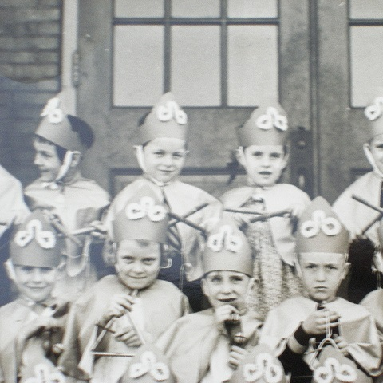
“And so like my parents will always go, ‘Well look it up in a book, go to the library.’ And I’ll go, ‘Well there’s the internet just there.’”
(Digital Visitors and Residents, UKU5, Emerging, Female, Age 19, Chemistry)
Notes:
Image: http://goo.gl/owsfzE/
“And so like my parents will always go, ‘Well look it up in a book, go to the library.’ And I’ll go, ‘Well there’s the internet just there.’” (Digital Visitors and Residents, UKU5, Emerging, Female, Age 19, Chemistry)
White, David S., and Lynn Silipigni Connaway. 2011-2014. Visitors & Residents: What Motivates Engagement with the Digital Information Environment. Funded by JISC, OCLC, and Oxford University. http://www.oclc.org/research/activities/vandr/.

Slide 27
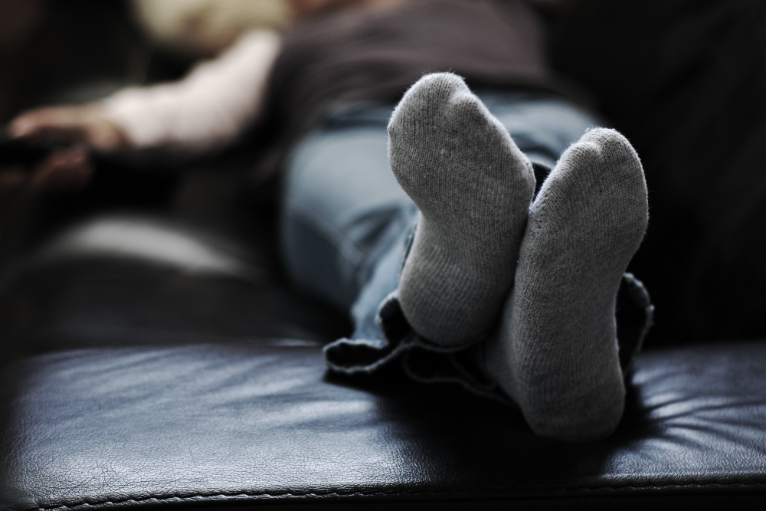
“Frequently when I’m working from home, it does feel a bit onerous to come all the way … to use the library when I’m immediately probably going to go home afterwards.”
(Digital Visitors and Residents, UKG2, Embedding, Female, Age 22, Learning and Technology)
Notes:
Image by John Watson, https://flic.kr/p/4EegSM
Reliability
Frequently when I’m working from home, it does feel a bit onerous to come all the way, which is about two miles away on bike, to use the library when I’m immediately probably going to go home afterwards. I find working from home very comfortable. I’d like – it feels also very private, it’s easy for me to concentrate without other people within the library space. So all of those reasons influenced my decision to take the easier route rather than physically having to move to get information. (Digital Visitors and Residents, UKG2, Embedding, Female, Age 22, Learning and Technology)
White, David S., and Lynn Silipigni Connaway. 2011-2014. Digital Visitors and Residents: What Motivates Engagement with the Digital Information Environment? Funded by JISC, OCLC, and Oxford University. http://www.oclc.org/research/activities/vandr/.

Slide 28
Interview & Survey Place: Library
Notes:
Place and Educational Stages Aggregated Results: Online Surveys (Questions 4-6)
Library (Aggregated): Emerging 5, 12%, Establishing 2, 5%, Embedding 9, 21%, Experiencing 0, 0%
Place and Educational Stages Aggregated Results: Interviews
Library (Aggregated): Emerging 32, 74%, Establishing 8, 80%, Embedding 10, 100%, Experiencing 6, 60%
Library is Aggregated of Library, Academic Library, Public Library, and School Library.
Online Survey Prompt: Think of a time in the past month when you had either a Personal or Academic/Professional situation where you needed answers or solutions and you did a quick search and made do with it. You knew there were other resources but you decided not to use them. Please include all sources, including human sources, such as friends, family, teachers, teaching assistants, tutors, coaches, colleagues, professors, etc. and answer the following questions.
4. What resources did you use?
5. What made you choose these resources instead of others?
6. What made these resources easy or difficult to use?
White, David S., and Lynn Silipigni Connaway. 2011-2014. Visitors & Residents: What Motivates Engagement with the Digital Information Environment. Funded by JISC, OCLC, and Oxford University. http://www.oclc.org/research/activities/vandr/.

Slide 29
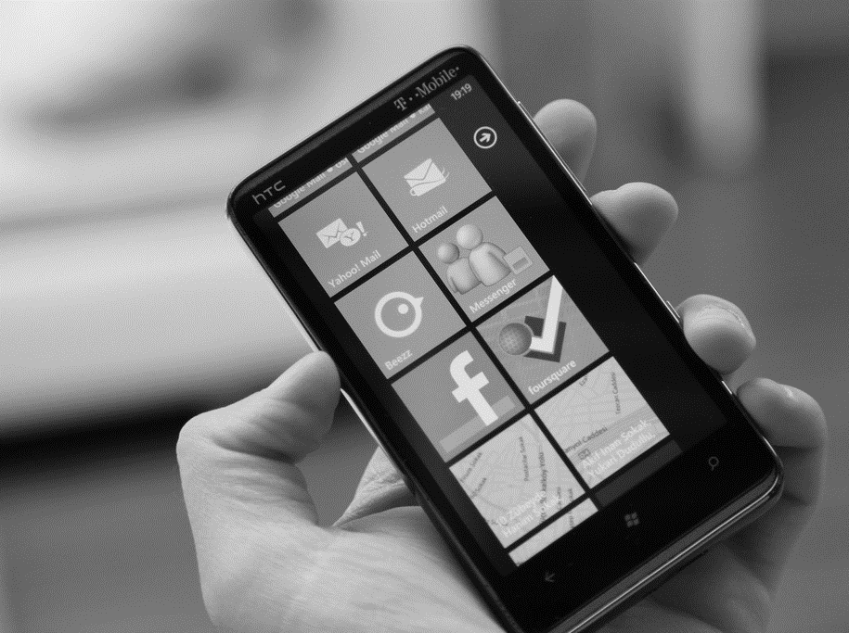
“I tend to check my emails to see whether tutors have emailed me or assignment dates or if anything important like that has changed.”
(Digital Visitors and Residents, UKU6, Female, Age 19, History)
Notes:
Image: http://www.flickr.com/photos/23455580@N03/5566562232
“…just send an email, because calling, they’re not there, you leave a message, they call you back, they’re not there, new message, come back and forth.” (Digital Visitors and Residents, USF4, Male, Age 54, Biology) (Experiencing)
“I’m not huge on the whole “Let’s just talk forever online.” As I said I’m more of a people person. I like interacting. I like face to face, if worse comes to the worse and we use technology we talk on the phone. I don’t want to text, you’re not getting a sense of who they really are by texting. You need to talk to them to understand who it is. Emailing I completely understand because it’s necessary to get in touch with business and get in touch with resources and all those kinds of things. But I think we do rely on the internet and technology way too much though.” (Digital Visitors and Residents, USS5, Male, Age 18, High School Student) (Emerging)
“Cell phone is probably the biggest thing. I think I’m on that 24/7 but that’s also like my lifeline to the fraternity so it’s got a bit of a valid reason. So, cell phone is the biggest thing from texting. I get my emails on there and I can surf the web on it, so that kind of all in one thing. My computer I’ll really only use that for school reports, school homework, maybe Facebook.” (Digital Visitors and Residents, USU3, Male, Age 19, Mechanical Engineering) (Emerging)
Rule of 3 – “In a conversation among 5 or 6 people at dinner, you have to check that 3 or more people are paying attention – heads up – before you give yourself permission to look down at your phone. So conversation proceeds, but with different people having their heads up at different times. The effect is hwat you would expect: Conversation is kept relatively light, on topics where people feel they can drop in and out.”
Sherry Turkle, Stop Googling. Let’s Talk. http://www.nytimes.com/2015/09/27/opinion/sunday/stop-googling-lets-talk.html

Slide 30
Interview: Means of Contact
(White and Connaway 2011-2014)
Notes:
Contact and Educational Stages: Interviews
Email: Emerging 81%, Establishing 100%, Embedding 100%, Experiencing 100%
Face-to-Face: Emerging 60%, Establishing 60%, Embedding 40%, Experiencing 70%
Phone Call: Emerging 77%, Establishing 90%, Embedding 70%, Experiencing 70%
White, David S., and Lynn Silipigni Connaway. 2011-2014. Visitors & Residents: What Motivates Engagement with the Digital Information Environment. Funded by JISC, OCLC, and Oxford University. http://www.oclc.org/research/activities/vandr/.

Slide 31
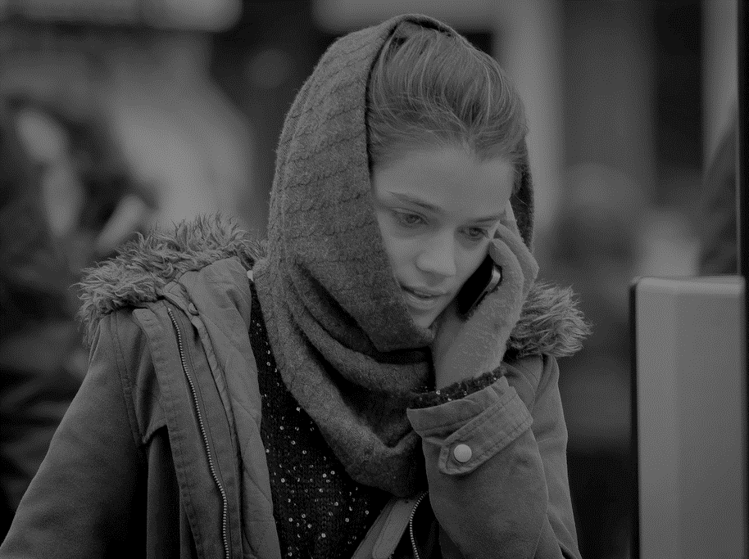
“I do, like I’ll call home and ask my dad a question about something or another, or like my grandparents.”
(Digital Visitors and Residents, USU4, Male, Age 19, Mechanical Engineering)
Notes:
Image: http://www.flickr.com/photos/67430875@N03/8652281135
“I do, like I’ll call home and ask my dad a question about something or another, or like my grandparents. My grandpa took like a bunch of high level math stuff, so I’ve asked him periodically but if I could I’d just as soon know everything automatically, that’d just be easy.” (Digital Visitors and Residents, USU4, Male, Age 19, Mechanical Engineering) (Emerging)

Slide 32
Interview Sources: Human
(White and Connaway 2011-2014)
Notes:
Source and Educational Stages: Interviews
Father: Emerging 49%, Establishing 50%, Embedding 40%, Experiencing 10%
Mother: Emerging 58%, Establishing 50%, Embedding 40%, Experiencing 10%
Extended Family (Siblings, Cousins, Relatives, Children, Spouses): Emerging 53%, Establishing 50%, Embedding 30%, Experiencing 20%
White, David S., and Lynn Silipigni Connaway. 2011-2014. Visitors & Residents: What Motivates Engagement with the Digital Information Environment. Funded by JISC, OCLC, and Oxford University. http://www.oclc.org/research/activities/vandr/.

Slide 33
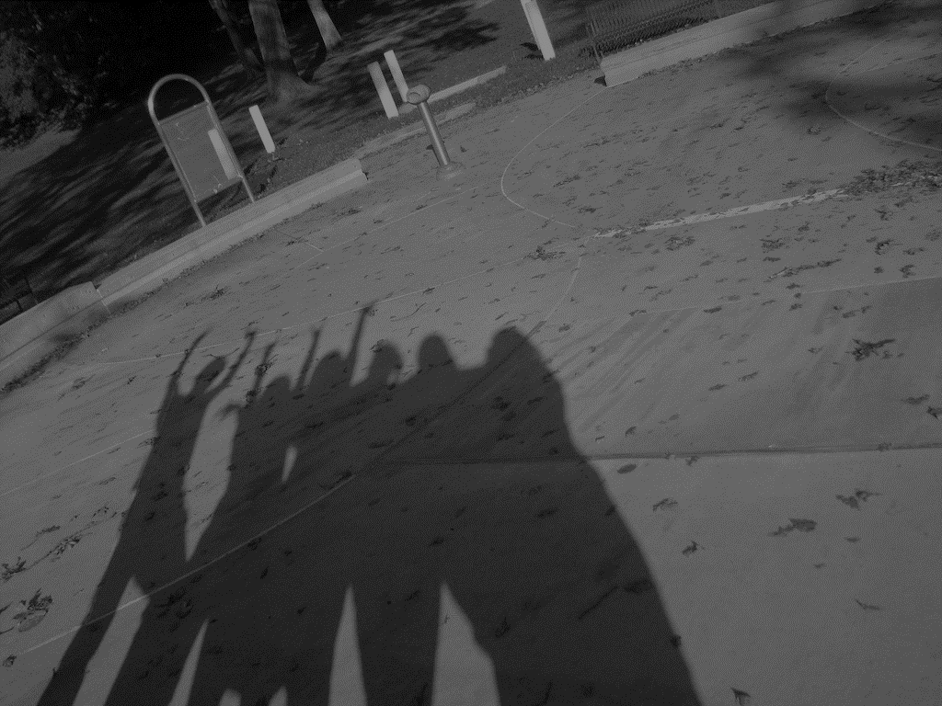
“Just because all my friends have it, it’s just an easy way to catch up and then, especially if I need some work to hand in for tomorrow, go and find out on Facebook, ask all my friends.”
(Digital Visitors and Residents, UKS1, Male, Age 18, Secondary School Student)
Notes:
Image: http://www.flickr.com/photos/38434991@N08/5091242386
“Just because all my friends have it, it’s just an easy way to catch up and then, especially if I need some work to hand in for tomorrow, go and find out on Facebook, ask all my friends.” (Digital Visitors and Residents, UKS1, Male, Age 18, Secondary School Student) (Emerging)
“I have friends, people I know from my classes, that are on Facebook, but it’s not what I’ve used. For example, there’s a girl in my liberal studies class that’s going to help me with an assignment we have due Monday, but I’m probably going to send her a text message to ask her when she wants to come here and meet up and do it, or stuff. So, like I said, Facebook is mostly social.” (Digital Visitors and Residents, USU13, Male, Age 18, Undeclared) (Emerging)

Slide 34
Interview Sources: Human
(White and Connaway 2011-2014)
Notes:
Source and Educational Stages: Interviews
Friends/Colleagues: Emerging 77%, Establishing 70%, Embedding 40%, Experiencing 40%
Peers: Emerging 51%, Establishing 60%, Embedding 40%, Experiencing 50%
Other: Emerging 21%, Establishing 40%, Embedding 30%, Experiencing 60%
Other: emailing online journal personnel to get access, associate pastor, graduation coordinator, undergrads, volunteer coordinator, girlfriend’s sister, the Head of the school, thank you cards to people who had given graduation gifts, people at the HelpDesk, semi-girlfriend.
White, David S., and Lynn Silipigni Connaway. 2011-2014. Visitors & Residents: What Motivates Engagement with the Digital Information Environment. Funded by JISC, OCLC, and Oxford University. http://www.oclc.org/research/activities/vandr/.

Slide 35
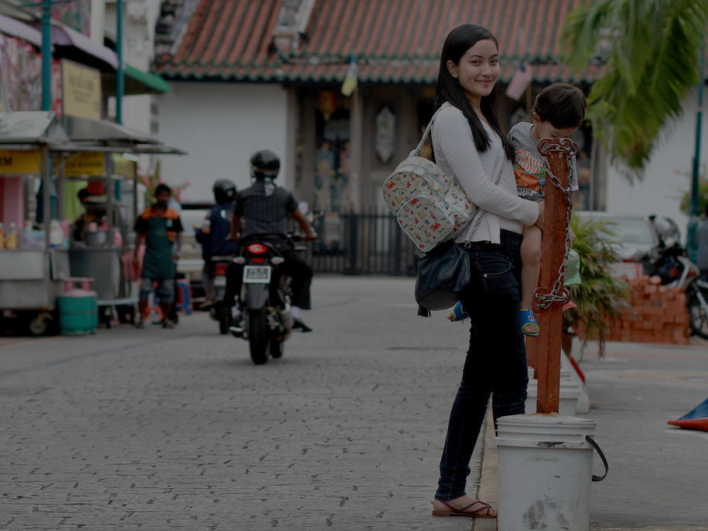
“One of my favorite ways of getting information is by asking people.”
(Digital Visitors and Residents, UKU3, Female, Age 19, French and Italian)
Notes:
Image: http://www.flickr.com/photos/17868205@N00/21748694620
“One of my favorite ways of getting information is by asking people. Instead of Googling the whole time I mostly have faith in the fact that people are actually learning, if I can go to a tutor and ask them something.” (Digital Visitors and Residents, UKU3, Female, Age 19, French and Italian) (Emerging)

Slide 36
Interview Sources: Human
(White and Connaway 2011-2014)
Notes:
Source and Educational Stages: Interviews
Experts/Professionals: Emerging 30%, Establishing 20%, Embedding 30%, Experiencing 20%
Librarians: Emerging 12%, Establishing 0%, Embedding 10%, Experiencing 20%
Teachers/Professors: Emerging 37%, Establishing 90%, Embedding 60%, Experiencing 20%
White, David S., and Lynn Silipigni Connaway. 2011-2014. Visitors & Residents: What Motivates Engagement with the Digital Information Environment. Funded by JISC, OCLC, and Oxford University. http://www.oclc.org/research/activities/vandr/.

Slide 37
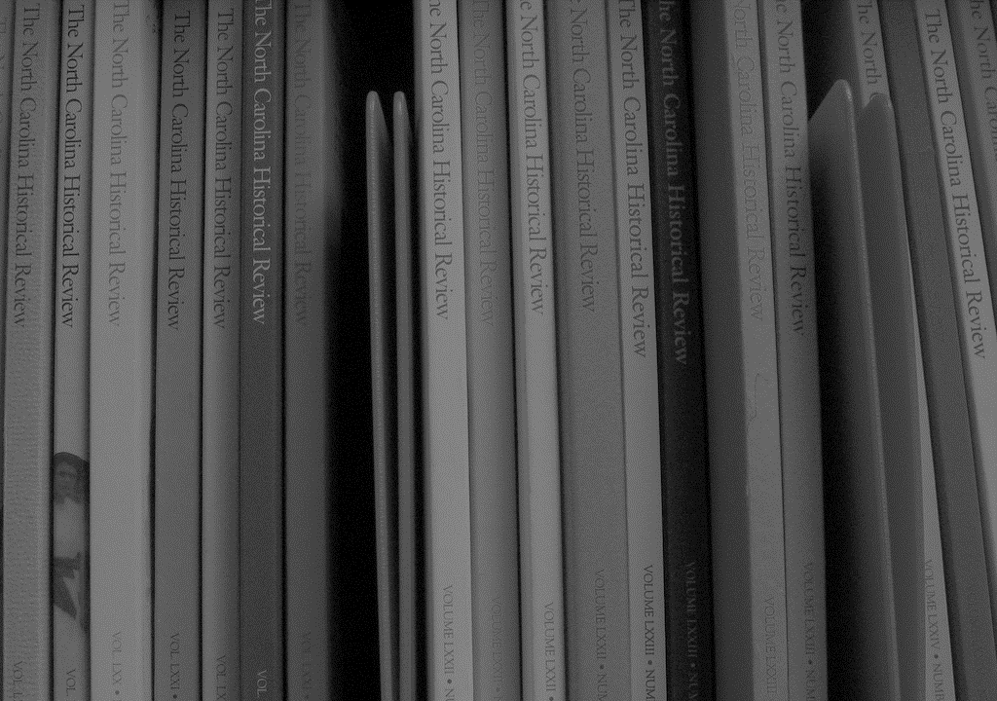
“Well, I do think the kind of – I mean, the library system’s very good, the way you can renew books, the way you can search for publications, e-journals… That is amazing really, the way you can do those kind of searches.”
(Digital Visitors and Residents, UKG3, Male, Age 51, Practical Theology)
Notes:
Image: http://www.flickr.com/photos/14247749@N00/8801814428
“Well, I do think the kind of – I mean, the library system’s very good, the way you can renew books, the way you can search for publications, e-journals… That is amazing really, the way you can do those kind of searches.” (Digital Visitors and Residents, UKG3, Male, Age 51, Practical Theology) (Embedding)

Slide 38
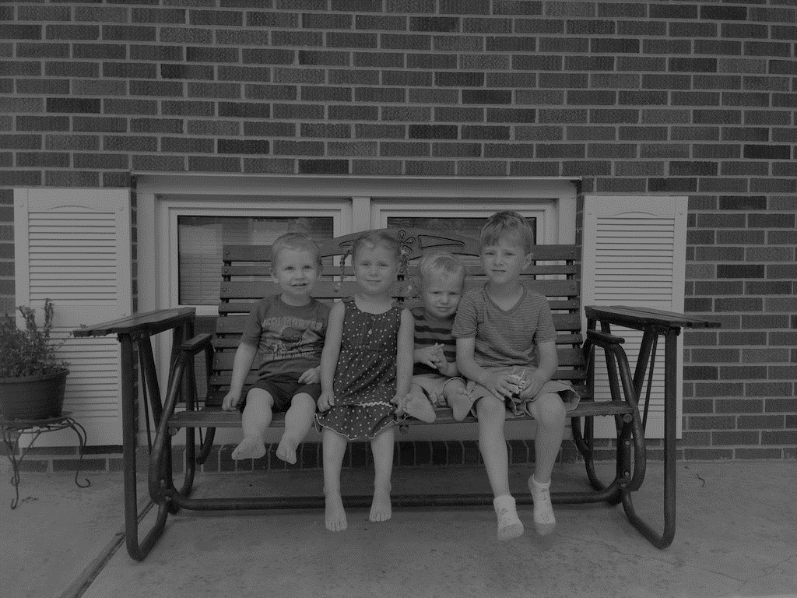
“If it were- if I had a question about history or some sort of discussion based thing I would probably call my dad or my grandfather or my sister beforehand.”
(Digital Visitors and Residents, UKU12, Female, Age 21, Mathematical Physics)
Notes:
Image: http://www.flickr.com/photos/79016591@N07/21703644279
“If it were- if I had a question about history or some sort of discussion based thing I would probably call my dad or my grandfather or my sister beforehand. Something that requires some sort of interpretation – if I’m reading something like Wikipedia the facts might be correct but unless you’ve got the right context in mind or unless you understand more information around the subject it’s not always that reliable.” (Digital Visitors and Residents, UKU12, Female, Age 21, Mathematical Physics) (Establishing)

Slide 39
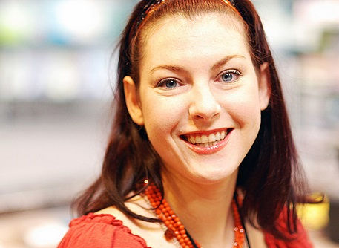
The word “librarian” never mentioned in original interviews by Emerging Stage participants as a source of information
One participant referred to “a lady in the library who helps you find things”
(Digital Visitors and Residents, USU5, Male, Age 19, Systems Engineering)
Notes:
Image: http://www.flickr.com/photos/domesticat/2438570563/
“– there’s a lady in the library who helps you find things.” (Digital Visitors and Residents, USU5, Systems Engineering, Male, Age 19, Systems Engineering) (Emerging)
White, David S., and Lynn Silipigni Connaway. 2011-2014. Visitors & Residents: What Motivates Engagement with the Digital Information Environment. Funded by JISC, OCLC, and Oxford University. http://www.oclc.org/research/activities/vandr/.

Slide 40
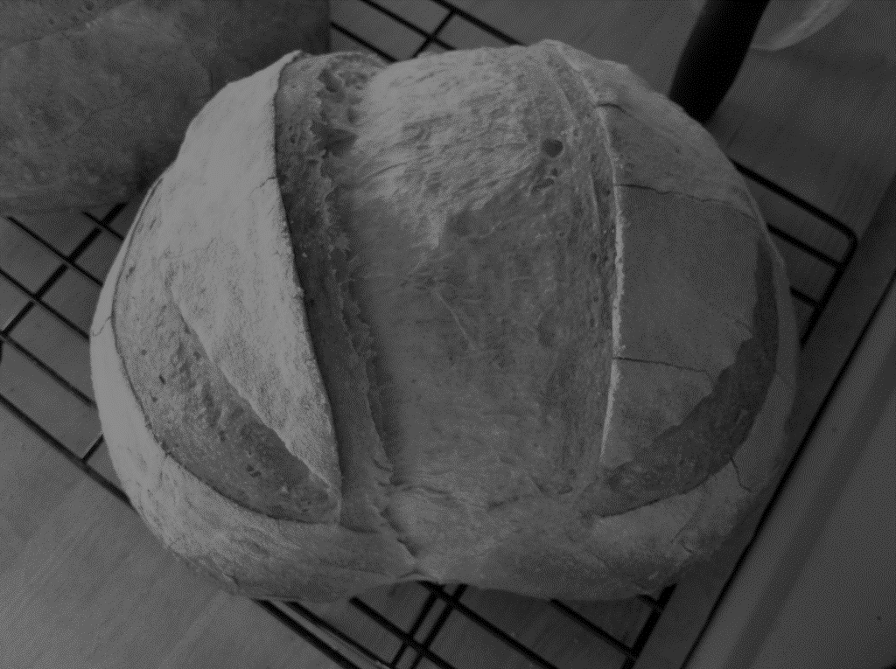
“This morning I was looking for a homemade bread recipe that I could use to bake and then blog about…At first I started looking online, and it was a little bit overwhelming…I ended up reaching into my mom’s cupboard and using a recipe that I found in one of her old cookbooks. The recipe was just what I was looking for: it was a simple homemade white bread.”
(Digital Visitors and Residents, USS3, Female, Age 17, High School Student)
Notes:
Image: http://www.flickr.com/photos/20218973@N00/5212750348
“This morning I was looking for a homemade bread recipe that I could use to bake and then blog about. (I just started my own food blog: gritsgonegreen.wordpress.com). At first I started looking online, and it was a little bit overwhelming. There were so many different recipes with different flavors and crazy combinations. The one thing that was good about looking at the online recipes was viewing the user comments and seeing how people liked or disliked each recipe. I ended up reaching into my mom’s cupboard and using a recipe that I found in one of her old cookbooks. The recipe was just what I was looking for: it was a simple homemade white bread. I was about to search on the internet how to knead and punch bread, but I flipped the page, and there was a whole glossary of bread making terms. I must admit, I was a little bit surprised by the amount of information and instruction found in the cookbook. I thought I was going to have to look up an instructional video online.” (Digital Visitors and Residents, USS3, Female, Age 17, High School Student) (Emerging)

Slide 41
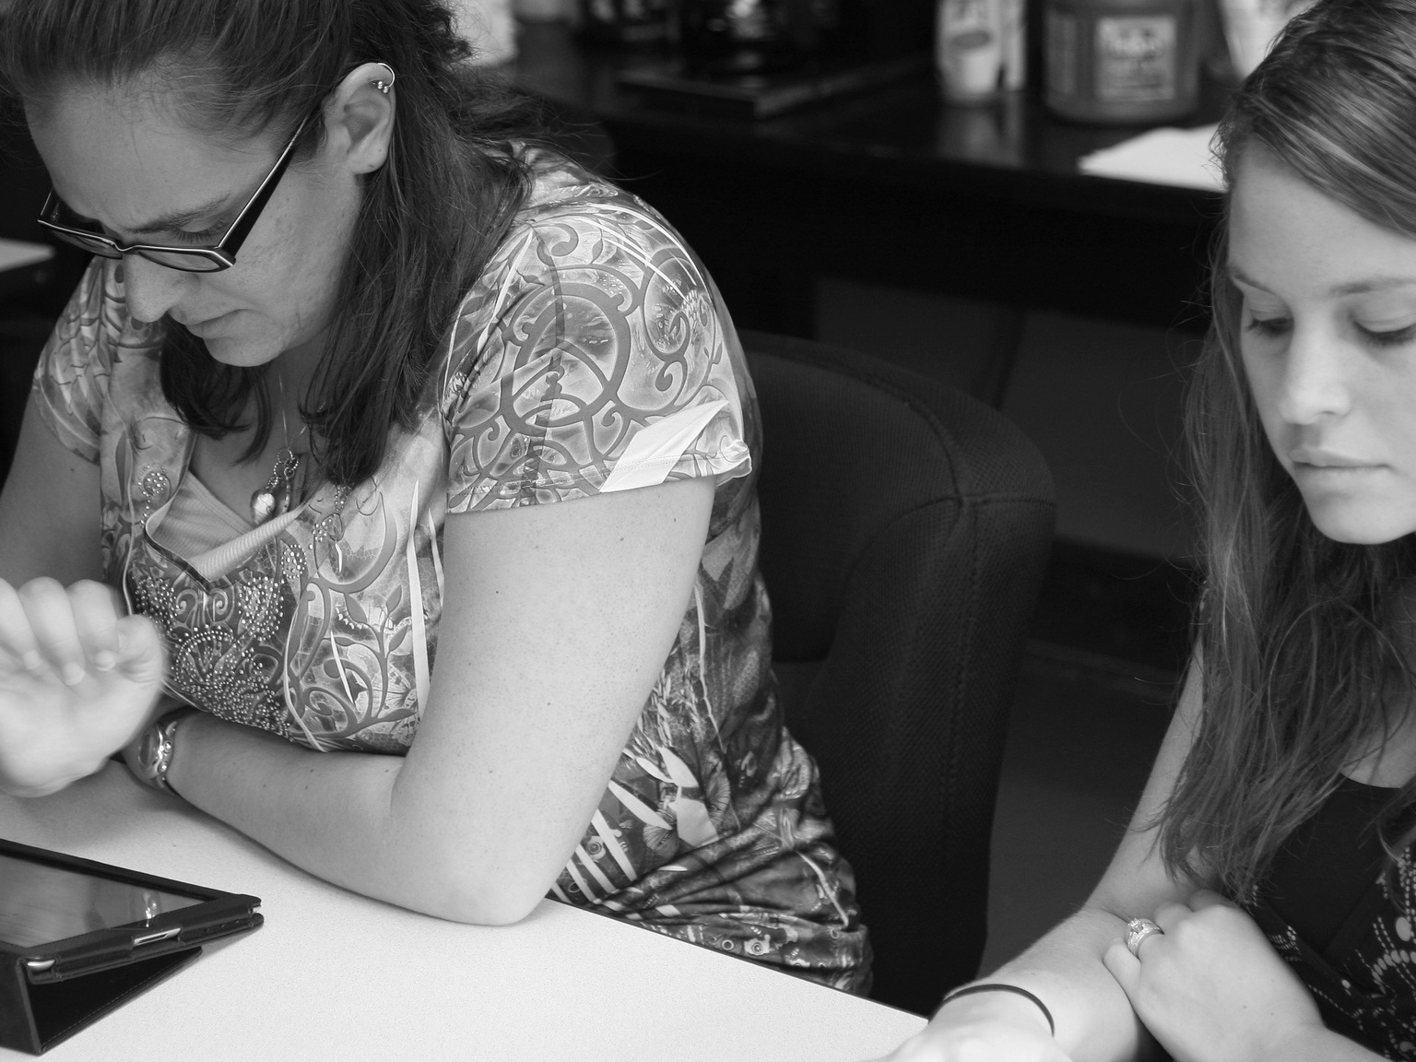

Assessing Non-Traditional Sources:
Determining Credibility and Authority
“I look at the organization. Usually I would look at the link, the actual link URL. That usually tells you if it’s an edu if it’s with a university, if it’s…”
(Digital Visitors and Residents, UKG2, Embedding, Female, Age 22, Learning and Technology)
“Like, if two of them say the same thing then that must be right.”
(Digital Visitors and Residents, USS4, Male, Age 17, High School Student)
Notes:
Image by Matt Brown, https://flic.kr/p/pZAx8Z
Credibility
“I look at the organization. Usually I would look at the link, the actual link URL. That usually tells you if it’s an edu if it’s with a university, if it’s… Frequently, you’ll get a result from Spotify or a website that just mentions something but is not actually a valid resource, so I would look at the source through the URL to distinguish which one I want. Newspapers, it’s fairly easy to tell. I mean, Google does sort the news items usually, separately from the rest of the items, so it’s very easy to distinguish what’s research or scholarly or what’s the news item.” (Digital Visitors and Residents, UKG2, Embedding, Female, Age 22, Learning and Technology)
“Well in high school I don’t think it’s nearly as strict. You know, in high school I think the teachers are just trying to get by everyone. Like “Okay, yes, yes, that’s fine, you use that,” just because they’re trying to encourage everyone to complete things for one thing. So I think it was much more open. And then once you get into the college the first rule that you learn in you English one-on-one class is don’t use Wikipedia to cite anything. That kind of attitude of “If you don’t know where that source came from doesn’t use it.” And if it’s something credible that you can easily defend, you know, it’s a memo from the Defence Department or it’s something from an organisation that you can trust, then that’s okay to use, but other than that don’t use that.” (Digital Visitors and Residents, USG4, Embedding, Female, Age 23, Latin American Studies)
“I hardly use Wikipedia for school related stuff because it is not a credible source, but for simple information like a list of the presidents, it is fine to look at. It gave me a simple and easy to look at list of the presidents, and I quickly got the information that I needed.” (Digital Visitors and Residents, USS3, Female, Age 17, High School Student)
White, David S., and Lynn Silipigni Connaway. 2011-2014. Digital Visitors and Residents: What Motivates Engagement with the Digital Information Environment? Funded by JISC, OCLC, and Oxford University. http://www.oclc.org/research/activities/vandr/.

Slide 42
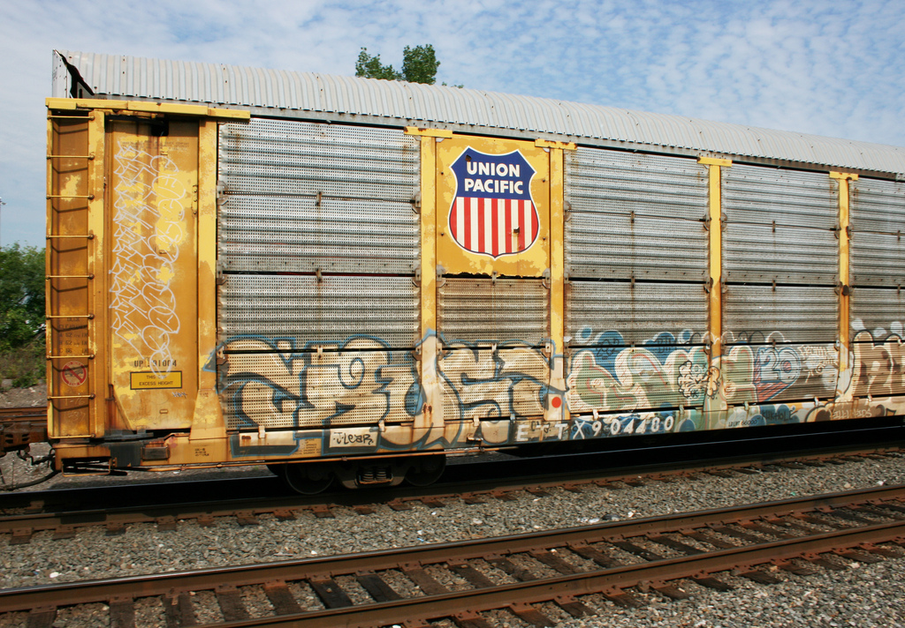
“And I liked using a lot of official websites, so if a company had given me – I did mine on premature babies so I got a parent help book that was given to parents who had premature babies and it had a list of like trusted websites in it and things like that. I knew that they were good content because otherwise I wouldn’t have been given them.”
(Digital Visitors and Residents, UKS2, Emerging, Female, Age 17, Secondary School Student)
Notes:
Image by carnagenyc, https://flic.kr/p/adBVAJ
Authority
Well, as I say, I did my EPQ and I did a lot of comparing websites and getting numerous websites and checking that they said the same thing and looking at who wrote them and whether they’re not qualified to be talking about them and stuff. And I liked using a lot of official websites, so if a company had given me – I did mine on premature babies so I got a parent help book that was given to parents who had premature babies and it had a list of like trusted websites in it and things like that. I knew that they were good content because otherwise I wouldn’t have been given them. So things like that, yes, so. (Digital Visitors and Residents, UKS2, Emerging, Female, Age 17, Secondary School Student)
Yes, stuff like that. And then so looking at the websites what I’ll do is if it’s a web MD or anything that has some sort of authoritative type of knowledge, something that we’ve commonly accepted as a population then that’s okay, yes. Or I will branch out and if it’s like some sort of homeopathic, I’ll just go ahead and click. But if I know that there’re are these sites that have attached super ads on them, like “Know how to know,” or something like that. Or sites where I know that it’s going to be just like wishy-washy or whatever, then I don’t click on them because I know that I’m going to get ad pop-ups and that just gets me a little bit annoyed. (Digital Visitors and Residents, USG5, Embedding, Female, Age 30, Latin American Studies)
I knew that the best place to look was CNN since I know that the carry news on all over the world. I went to CNN, went under the US section, and under some other news, I found the news I was looking for. CNN is probably the sire I trust the most for news I wasn't to know more about or maybe it doesn't come up on the Yahoo homepage. (Digital Visitors and Residents, USU7, Emerging, Female, Age 19, Political Science)
White, David S., and Lynn Silipigni Connaway. 2011-2014. Digital Visitors and Residents: What Motivates Engagement with the Digital Information Environment? Funded by JISC, OCLC, and Oxford University. http://www.oclc.org/research/activities/vandr/.

Slide 43
All Survey Questions
Emerging + Establishing | Embedding + Experiencing
1. Agency\Decision, choice\Convenience, ease of use, accessibility | 1. Agency\Decision, choice\Convenience, ease of use, accessibility
2. Sources\Human | 2. Sources\Digital
3. Situation, context\Professional, academic | 3. Agency\Decision, choice\Searching
4. Agency\Decision, choice\Searching | 4. Sources\Human
5. Sources\Digital | 5. Situation, context\Professional, academic
6. Place\Internet | 6. Sources\Digital\Websites
7. Sources\Digital\Websites | 7. Agency\Evaluation\Accept
8. Agency\Evaluation\Accept | 8. Situation, context\Personal
9. Situation, context\Personal | 9. Place\Internet\Search engine
10. Place\Internet\Search engine | 10. Agency\Motivation\Extrinsic (externally motivated)
Notes:
For each group of questions, calculated histograms, histogram contrasts, support vector machine weights, and did statistical hypothesis testing to address the following two research questions.
“What are the most significant factors for novice and experienced researchers in choosing their modes of engagement with the information environment?”
To answer this question, we can look at the histogram of codewords assigned to (Emerging+Establishing) responses and compare/contrast with the histogram of codewords assigned to (Embedding+Experiencing) responses.
“Histograms – [Question Set].xlsx”: These files contain codeword histograms for Emerging, Establishing, Embedding, Experiencing, (Emerging+Establishing), (Embedding+Experiencing), and all four stages combined.
“Histogram Contrasts – [Question Set].xlsx”: These files compare histograms of pairs of educational stage groups to illustrate what is different between them.
“Support Vector Analysis – [Question Set].xlsx”: I took raw survey data and used the RFE algorithm (typically used for gene selection in bioinformatics) to assign weights to codeword in terms of a variety of educational stage classification tasks. Specifically, I trained a support vector machine to recognize the difference between two groups of educational stages (let’s call them “ES1” and “ES2”). The end result is that each codeword is given a (signed) weight. The magnitude of the weight indicates how important that codeword is in differentiating between ES1 and ES2. The sign of the weight indicates which of the two educational stage groups the codeword better represents. For example, a negative weight (by convention) indicates that its codeword better represents ES1, and a positive weight indicates that its codeword better represents ES2.
Another way to understand what the weights mean is as follows. For a given survey response, gather up all of its assigned codewords. Look up the weights of those codewords and sum them up. If the sum is negative, then it is likely that the survey response was written by someone whose educational stage is in ES1. Otherwise, it is likely that the survey response was written by someone whose educational stage is in ES2.
“Do individuals develop personal engagement strategies which evolve over time and for specific needs and goals, or are the educational contexts (or in the context of this study, “educational stages”) the primary influence on their engagement strategies?”
Each hypothesis test compares the histogram of responses in one educational stage group with the histogram of responses from the other group. Chi-squared tests are used (albeit indirectly, as Monte-Carlo sampling is used instead of explicit calculation) to determine if the two histograms are statistically significantly different. We are doing a very large number of hypothesis tests, so the Benjamini-Hochberg procedure is used to deflate p-values to control the false discovery rate.
Factor analysis: Selected 2 dependent variables and then put all of the independent variables in the cage (like when selecting lottery winners) and identified the highest occurrences of the independent variables.

Slide 44
Think of a time in the past month when you had either a Personal or Academic/Professional situation where you needed answers or solutions and you did a quick search and made do with it.
Emerging + Establishing | Embedding + Experiencing
1. Agency\Decision, choice\Convenience, ease of use, accessibility | 1. Agency\Decision, choice\Convenience, ease of use, accessibility
2. Situation, context\Professional, academic | 2. Sources\Digital
3. Sources\Digital | 3. Sources\Digital\Websites
4. Agency\Decision, choice\Searching | 4. Situation, context\Professional, academic
5. Sources\Digital\Websites | 5. Agency\Decision, choice\Searching
6. Sources\Human | 6. Place\Internet\Search engine
7. Place\Internet\Search engine | 7. Place\Internet\Search engine\Google
8. Place\Internet\Search engine\Google | 8. Sources\Human
9. Place\Internet | 9. Agency\Motivation\Extrinsic (externally motivated)
10. Agency\Decision, choice\Speed Convenience, ease of use, accessibility | 10. Agency\Evaluation\Accept
Notes:
You knew there were other resources but you decided not to use them. Please include all sources, including human sources, such as friends, family, teachers, teaching assistants, tutors, coaches, colleagues, professors, etc. and answer the following questions.
4. What resources did you use?
5. What made you choose these resources instead of others?
6. What made these resources easy or difficult to use?

Slide 45
Think of a time in the past month when you were successful in completing an Academic/Professional assignment.
Emerging + Establishing | Embedding + Experiencing
1. Situation, context\Professional, academic | 1. Situation, context\Professional, academic
2. Agency\Decision, choice\Convenience, ease of use, accessibility | 2. Sources\Digital
3. Agency\Decision, choice\Searching | 3. Agency\Decision, choice\Convenience, ease of use, accessibility
4. Sources\Digital | 4. Agency\Motivation\Extrinsic (externally motivated)
5. Sources\Human | 5. Agency\Decision, choice\Searching
6. Sources\Physical | 6. Sources\Human
7. Place\Internet | 7. Sources\Digital\Websites
8. Agency\Motivation\Extrinsic (externally motivated) | 8. Agency\Evaluation\Accept
9. Sources\Digital\Websites | 9. Sources\Physical
10. Sources\Physical\Books | 10. Sources\Physical\Books
Notes:
Please answer each of the following questions.
10. What steps did you take and why?
11. What resources did you choose to use?
12. What made you choose these resources instead of others?
13. What made these resources easy or difficult to use?

Slide 46
Think of a time in the past month when you struggled to find appropriate resources to help you complete an Academic/Professional assignment.
Emerging + Establishing | Embedding + Experiencing
1. Situation, context\Professional, academic | 1. Situation, context\Professional, academic
2. Agency\Decision, choice\Searching | 2. Agency\Motivation\Extrinsic (externally motivated)
3. Agency\Decision, choice\Convenience, ease of use, accessibility | 3. Sources\Digital
4. Sources\Human | 4. Sources\Human
5. Agency\Motivation\Extrinsic (externally motivated) | 5. Agency\Decision, choice\Convenience, ease of use, accessibility
6. Place\Internet | 6. Agency\Decision, choice\Searching
7. Sources\Digital | 7. Sources\Digital\Websites
8. Agency\Evaluation\Accept | 8. Agency\Evaluation\Accept
9. Sources\Physical | 9. Place\Internet\Search engine
10. Agency\Decision, choice\Relevance | 10. Place\Internet\Search engine\Google
Notes:
Please include sources such as friends, family, teachers, teaching assistants, tutors, coaches, colleagues, professors, etc. Please answer each of the following questions.
17. What steps did you take and why?
18. What resources did you choose to use?
19. What made you choose these resources instead of others?
20. What made these resources easy or difficult to use?

Slide 47
Think of a time in the past month when you were successful in getting what you needed in a Personal situation.
Emerging + Establishing | Embedding + Experiencing
1. Sources\Human | 1. Agency\Decision, choice\Convenience, ease of use, accessibility
2. Situation, context\Personal | 2. Situation, context\Personal
3. Agency\Decision, choice\Convenience, ease of use, accessibility | 3. Agency\Motivation\Intrinsic (internal, self motivated)
4. Sources\Human\Friends, colleagues | 4. Sources\Human
5. Agency\Motivation\Intrinsic (internal, self motivated) | 5. Agency\Decision, choice\Searching
6. Agency\Evaluation\Accept | 6. Sources\Digital
7. Agency\Decision, choice\Searching | 7. Agency\Evaluation\Accept
8. Agency\Decision, choice\Reliability | 8. Sources\Digital\Websites
9. Sources\Human\Mother | 9. Place\Internet\Search engine
10. Agency\Decision, choice\Familiarity | 10. Place\Internet\Search engine\Google
Notes:
Please include sources such as friends, family, teachers, teaching assistants, tutors, coaches, colleagues, professors, etc.
21. What steps did you take and why?
22. What resources did you choose to use?
23. What made you choose these resources instead of others?
24. What made these resources easy or difficult to use?

Slide 48
Think of a time in the past month when you struggled to find what you needed in a Personal situation.
Emerging + Establishing | Embedding + Experiencing
1. Sources\Human | 1. Situation, context\Personal
2. Situation, context\Personal | 2. Agency\Motivation\Intrinsic (internal, self motivated)
3. Agency\Decision, choice\Convenience, ease of use, accessibility | 3. Sources\Human
4. Agency\Decision, choice\Searching | 4. Agency\Decision, choice\Searching
5. Sources\Human\Friends, colleagues | 5. Sources\Digital
6. Agency\Motivation\Intrinsic (internal, self motivated) | 6. Sources\Digital\Websites
7. Place\Internet | 7. Agency\Decision, choice\Convenience, ease of use, accessibility
8. Agency\Evaluation\Accept | 8. Sources\Human\Friends, colleagues
9. Agency\Decision, choice\Relevance | 9. Place\Internet\Search engine
10. Sources\Digital | 10. Place\Internet\Search engine
Notes:
Please answer each of the following questions.
25. What steps did you take and why?
26. What resources did you choose to use?
27. What made you choose these resources instead?
28. What made these resources a good choice in this situation?

Slide 49
infoKit
What is it?
    Contains advice on evaluating digital/online services within the broader context of traditional services.
Why did we create it?
    To understand the contexts surrounding individual engagement with digital resources, spaces and tools.
Who will use it?
    Librarians and information technology staff
(White, Connaway, Lanclos, Hood, and Vass 2014)
Notes:
Image: Microsoft Clip Art
contains advice on evaluating the services offered
focus primarily is on digital/online services
set within the broader context of traditional services
lead to more effective engagement between individuals and institutions
identifying how individuals engage with technology
how they acquire their information
why they make the choices that they do
designed to help practitioners generate their own qualitative inquiries
to inform their own policy needs
to frame the organisation and its services within the institutional agendas surrounding student experience and engagement.
White, David, Lynn Silipigni Connaway, Donna Lanclos, Erin M. Hood, and Carrie Vass. 2014. Evaluating Digital Services: A Visitors and Residents Approach. http://www.jiscinfonet.ac.uk/infokits/evaluating-services/.

Slide 50
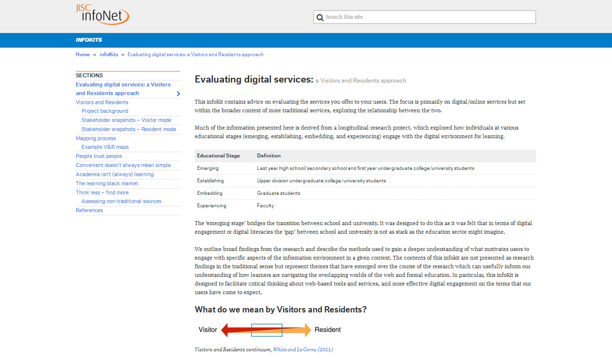
Infokit
http://bit.ly/evaldigservs-infokit
Notes:
White, David, Lynn Silipigni Connaway, Donna Lanclos, Erin M. Hood, and Carrie Vass. 2014. Evaluating Digital Services: A Visitors and Residents Approach. http://www.jiscinfonet.ac.uk/infokits/evaluating-services/.

Slide 51
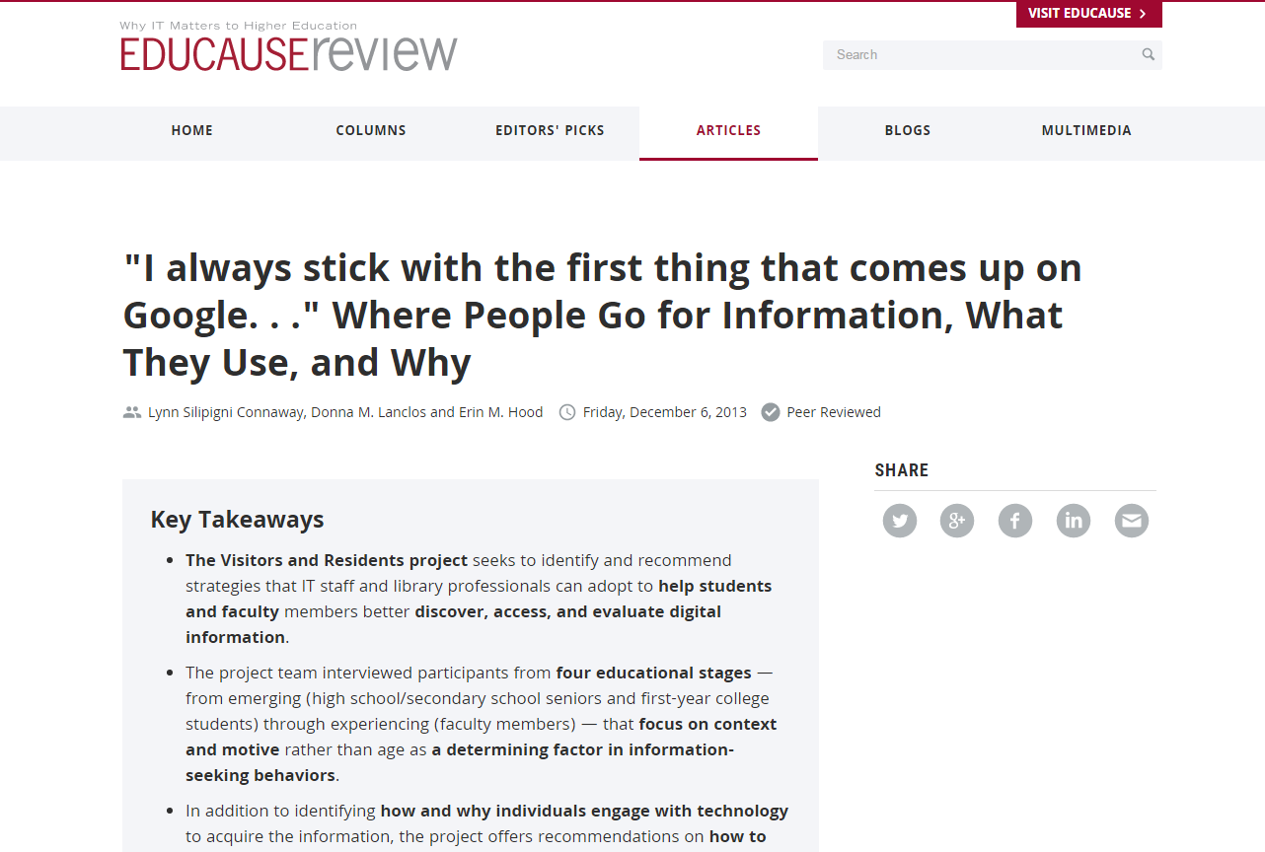
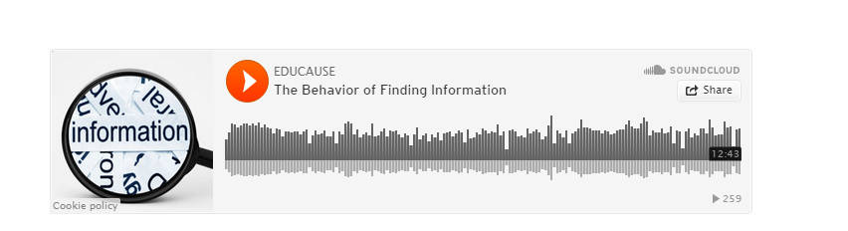
Notes:
Connaway, Lynn Silipigni, Donna Lanclos, and Erin M. Hood. 2013. “’I always stick with the first thing that comes up on Google…’ Where People Go for Information, What They Use, and Why.” EDUCAUSE Review Online (December 6), http://www.educause.edu/ero/article/i-always-stick-first-thing-comes-google-where-people-go-information-what-they-use-and-why.

Slide 52
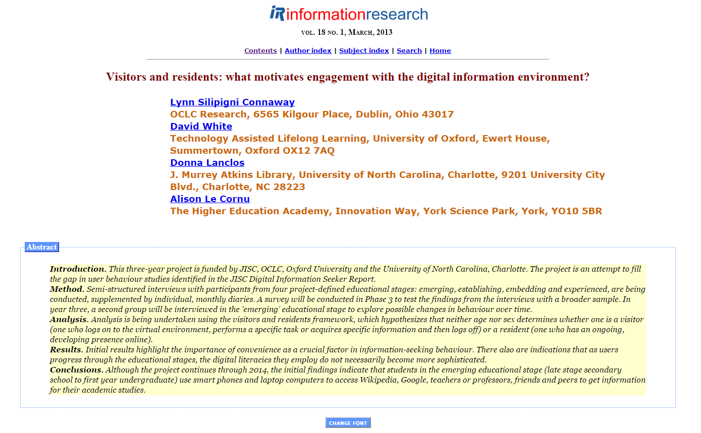
Notes:
Connaway, Lynn Silipigni, David White, Donna Lanclos, and Alison Le Cornu. 2013. Visitors and Residents: What Motivates Engagement with the Digital Information Environment? Information Research 18, no. 1, http://informationr.net/ir/18-1/infres181.html.

Slide 53

Implications
Spend less time on unproven strategies
Accelerate learning in a time of change
Find better ways of scaling learning and innovation
(Dempsey, 2015)
Notes:
Image: http://www.flickr.com/photos/7843389@N02/2300190277
Dempsey, L. (2015). From infrastructure to engagement: Thinking about the library in the life of the user. Keynote presented at Minitex 24th Annual Interlibrary Loan Conference, St. Paul, May 12. Available: http://www.slideshare.net/lisld/from-local-infrastructure-to-engagement-thinking-about-the-library-in-the-life-of-the-user.

Slide 54

Know Your Community
Mobile
Easy, Elegant, & Engaging
Content
Curation
Physical & Online
  Presence
(Roskill 2014)
Notes:
Image: http://www.winxnetcommunity.com/portals/2/images/community-people.jpg
Mobile
Easy, Elegant, & Engaging
Like Amazon, Google, and Apple
Content
Curation
Physical Presence
Special events to promote services
Become Whole Foods – Know and cater to your community – offer what they want in inviting environment (both physical and online)
Roskill, Andrew. 2014. “Get a Read on This: Libraries Bridging the Digital Divide: Andrew Roskill at TEDxCharleston.” YouTube. http://www.youtube.com/watch?v=J198u5HK0pY.
“The survey of more than 1,900 U.S. adults finds that these apps are particularly popular among young adults—49% of smartphone owners ages 18-29 use messaging apps, and 41% say they use apps that automatically delete sent messages.“ Duggan, Maeve. 2015. “Mobile Messaging and Social Media 2015.” Pew Research Center (August 19). http://www.pewinternet.org/2015/08/19/mobile-messaging-and-social-media-2015/.
McDiarmid (1940), a sociologist at the University of Chicago, stated, “ an important part of an
effective library survey is a study of the community itself (11).”
McDiarmid, E. W. 1940. The Library Survey: Problems and Methods. Chicago, IL: American
Library Association.

Slide 55

A colleague posted on Facebook:
“ I showed my 12-year-old son an old floppy disk.
He said, ‘Wow….Cool! You 3d printed the save icon.’”

Slide 56

“Our traditional model was one in which we thought of the user in the life of the library…but we are now increasingly thinking about the library in the life of the user.”
(Dempsey 2015)
Notes:
Image: http://www.flickr.com/photos/8264582@N06/7800724256
Dempsey, Lorcan. 2015. “From Infrastructure to Engagement: Thinking About the Library in the Life of the User.” Keynote presented at Minitex 24th Annual Interlibrary Loan Conference, St. Paul, May 12. http://www.slideshare.net/lisld/from-local-infrastructure-to-engagement-thinking-about-the-library-in-the-life-of-the-user
Observe. Not just in your library, but on campus, on trains, in restaurants, shops, etc.
Ranganathan (1931) said, “Perhaps the most convenient method of studying the consequences of this law will be to follow the reader from the moment he enters the library to the moment he leaves it…” (337).
Ranganathan, Shiyali Ramamrita. 1931. The Five Laws of Library Science. London: Edward
Goldston, Ltd.

Slide 57
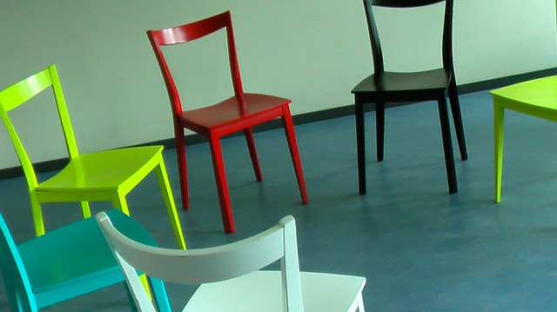
Questions and Discussion
Lynn Silipigni Connaway
connawal@oclc.org
@LynnConnaway
Notes:
Image: Pixaby

Slide 58
References
    Alexa, 2015. “Site overview: Wikipedia.org,” http://www.alexa.com/siteinfo.
    Connaway, Lynn Silipigni, Donna Lanclos, and Erin M. Hood. 2013. “’I always stick with the first thing that comes up on Google…’ Where People Go for Information, What They Use, and Why.” EDUCAUSE Review Online (December 6), http://www.educause.edu/ero/article/i-always-stick-first-thing-comes-google-where-people-go-information-what-they-use-and-why.
    Connaway, Lynn S., David White, and Donna Lanclos. 2011. “Visitors and Residents: What motivates engagement with the digital information environment?” Proceedings of the 74th ASIS&T Annual Meeting 48: 1-7.
    Connaway, Lynn Silipigni, David White, Donna Lanclos, and Alison Le Cornu. 2013. Visitors and Residents: What Motivates Engagement with the Digital Information Environment? Information Research 18, no. 1, http://informationr.net/ir/18-1/infres181.html.
    Dempsey, Lorcan. 2012. “Thirteen Ways of Looking at Libraries, Discovery, and the Catalog: Scale, Workflow, Attention.” EDUCAUSE Review Online, http://www.educause.edu/ero/article/thirteen-ways-looking-libraries-discovery-and-catalog-scale-workflow-attention.

Slide 59
References
    De Santis, Nick. 2012. “On Facebook, Librarian Brings 2 Students from the Early 1900s to Life.” Chronicle of Higher Education (January 6), http://chronicle.com/blogs/wiredcampus/on-facebook-librarian-brings-two-students-from-the-early-1900s-to-life/34845.
    Duggan, Maeve. 2015. “Mobile Messaging and Social Media 2015.” Pew Research Center (August 19). http://www.pewinternet.org/2015/08/19/mobile-messaging-and-social-media-2015/.
    McDiarmid, E. W. 1940. The Library Survey: Problems and Methods. Chicago: American Library Association.
    QSR International. 2011. NVivo 9: Getting started. http://download.qsrinternational.com/Document/NVivo9/NVivo9-Getting-Started-Guide.pdf.
    Rainie, Lee, Aaron Smith, and Maeve Duggan. 2013. “Coming and Going on Facebook.” Pew Research Center (February 5). http://www.pewinternet.org/2013/02/05/coming-and-going-on-facebook/.
    Ranganathan, Shiyali Ramamrita. 1931. The Five Laws of Library Science. London: Edward, Goldston, Ltd.

Slide 60
References
    Roskill, Andrew. 2014. “Get a Read on This: Libraries Bridging the Digital Divide: Andrew Roskill at TEDxCharleston.” YouTube. http://www.youtube.com/watch?v=J198u5HK0pY.
    Turkle, Sherry. 2015. Stop Googling. Let’s Talk. New York Times, Opinion. http://www.nytimes.com/2015/09/27/opinion/sunday/stop-googling-lets-talk.html.
    White, David S., and Alison Le Cornu. 2011. “Visitors and Residents: A New Typology for Online Engagement.” First Monday 16, no. 9. http://firstmonday.org/ojs/index.php/fm/article/view/3171/3049.
    White, David S., and Lynn Silipigni Connaway. 2011-2014. Visitors & Residents: What Motivates Engagement with the Digital Information Environment. Funded by JISC, OCLC, and Oxford University. http://www.oclc.org/research/activities/vandr/.
White, David, Lynn Silipigni Connaway, Donna Lanclos, Erin M. Hood, and Carrie Vass. 2014. Evaluating Digital Services: A Visitors and Residents Approach. http://www.jiscinfonet.ac.uk/infokits/evaluating-services/.
Zickuhr, Kathryn, Lee Rainie, and Kristen Purcell. 2013. Library Services in the Digital Age. Washington, DC: Pew Research Center’s Internet & American Life Project.

