Slide 1
Chicago October 22, 2015
Visitors and Residents:
A Mapping Exercise
Lynn Silipigni Connaway, PhD
Senior Research Scientist
William Harvey, PhD
Consulting Software Engineer

Slide 2
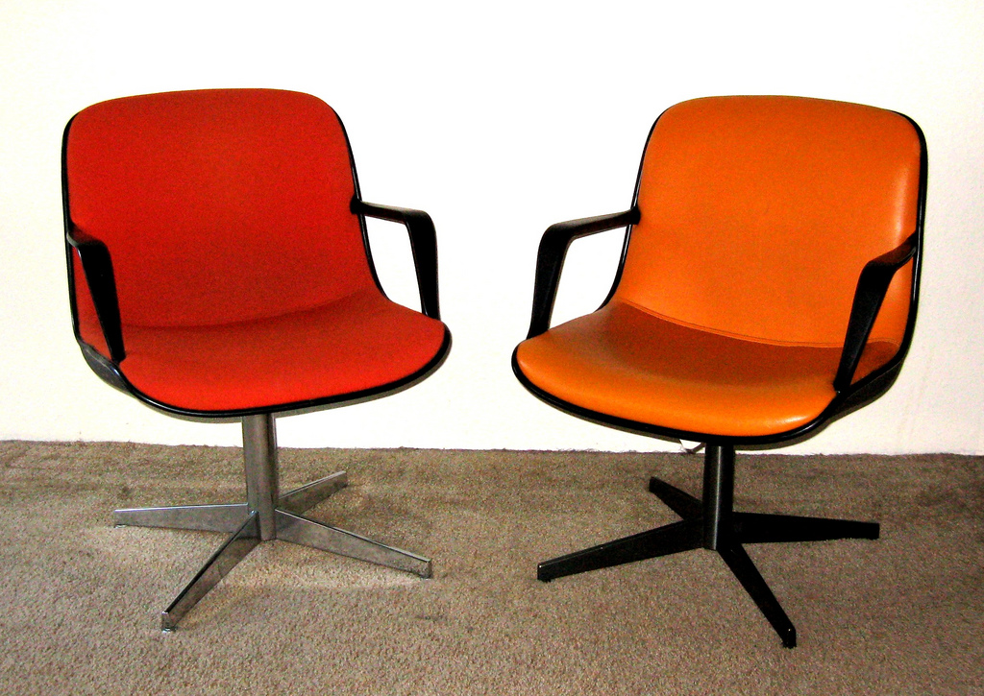
Overview
Notes:
Image: http://www.flickr.com/photos/toddmecklem/2730613340/

Slide 3
Visitors and Residents: What motivates engagement with the digital information environment?
Partners
JISC (UK funding body)
OCLC
Lynn Silipigni Connaway, Ph.D.
Erin M. Hood, M.L.I.S.
Oxford University
David White
Alison Le Cornu, Ph.D.
University of North Carolina, Charlotte
Donna Lanclos, Ph.D.
Notes:
Image: http://www.flickr.com/photos/myxi/712710373/
The Digital Visitors and Residents (V&R) project is a US/UK collaborative project, funded by JISC, OCLC Online Computer Library Center, Inc., Oxford University, and the University of North Carolina, Charlotte.
“This paper reports the initial findings of a three-year longitudinal study to identify how late-stage secondary school and first-year undergraduate students in the US and UK, referred to here as members of the “Emerging” educational stage, engage with technology and information sources. The assumptions embedded in traditional academic library services and systems and the existing disconnect between the everyday information-seeking behaviors of members of the Emerging stage (last year high school/secondary school or first year college/university) are examined. Initial results highlight the importance of convenience as a crucial factor in information-seeking behavior. There also are indications that as users progress through the educational stages, the digital and information literacies they employ do not necessarily become more sophisticated.” (Connaway, Lanclos, and Hood, 2013)
Connaway, Lynn Silipigni, Donna Lanclos, and Erin M. Hood. “‘I find Google a lot easier than going to the library website.’ Imagine Ways to Innovate and Inspire Students to Use the Academic Library.” Proceedings of the Association of College & Research Libraries (ACRL) 2013 conference, April 10-13, 2013, Indianapolis, IN, 2013, http://www.ala.org/acrl/sites/ala.org.acrl/files/content/conferences/confsandpreconfs/2013/papers/Connaway_Google.pdf.
White, David S., and Lynn Silipigni Connaway. 2011-2014. Visitors & Residents: What Motivates Engagement with the Digital Information Environment. Funded by JISC, OCLC, and Oxford University. http://www.oclc.org/research/activities/vandr/.

Slide 4
About Digital Visitors and Residents
Identify individuals’ modes of engagement
How they acquire their information
Why they make their choices
(White, Connaway, Lanclos, Hood, and Vass 2014)
Notes:
Image: https://www.flickr.com/photos/ameteorshower/7003279005/
V&R project
identify how individuals engage with technology and sources
how they acquire their information
why they make the choices that they do.
Understand the contexts that surround engagement with digital resources, spaces, and tools
(InfoKit Intro)
White, David S., and Lynn Silipigni Connaway. 2011-2014. Visitors & Residents: What Motivates Engagement with the Digital Information Environment. Funded by JISC, OCLC, and Oxford University. http://www.oclc.org/research/activities/vandr/.
White, David, Lynn Silipigni Connaway, Donna Lanclos, Erin M. Hood, and Carrie Vass. 2014. Evaluating Digital Services: A Visitors and Residents Approach. http://www.jiscinfonet.ac.uk/infokits/evaluating-services/.

Slide 5
V&R Framework
#vandr
Visitors and Residents resources http://goo.gl/vxUMRD
(White and Le Cornu 2011)
Notes:
This is a continuum and individuals may be display visitor or resident characteristics in different contexts and situations.
Visitors
functional use of technology
often linked to formal need
less visible/more passive online presence
more likely to favor face- to- face interactions
Residents
significant online presence and usage
high level of collaborative activity online
contributions to the online environment in the form of uploading materials, photos, videos.
White, David S., and Lynn Silipigni Connaway. 2011-2014. Visitors & Residents: What Motivates Engagement with the Digital Information Environment. Funded by JISC, OCLC, and Oxford University. http://www.oclc.org/research/activities/vandr/.

Slide 6
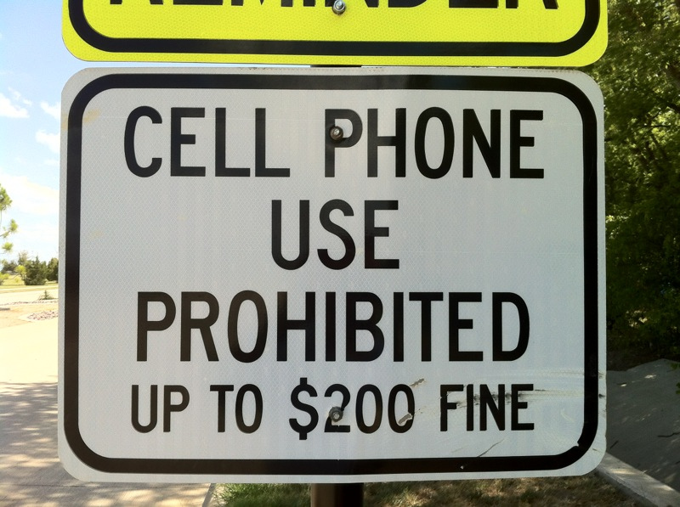
Visitor Mode
Functional use of technology
Formal need
Invisible online presence
Internet is a toolbox
(White and Connaway 2011-2014)
Notes:
Image: http://www.flickr.com/photos/31442459@N00/7648151218
Visitors: functional use of technology, often linked to formal need (such as use of software for specific coursework, or organising meetings through email contact); less visible/more passive online presence, more likely to favor face- to- face interactions (even as they use the internet to organize/schedule those interactions)
White, David S., and Lynn Silipigni Connaway. 2011-2014. Visitors & Residents: What Motivates Engagement with the Digital Information Environment. Funded by JISC, OCLC, and Oxford University. http://www.oclc.org/research/activities/vandr/.

Slide 7
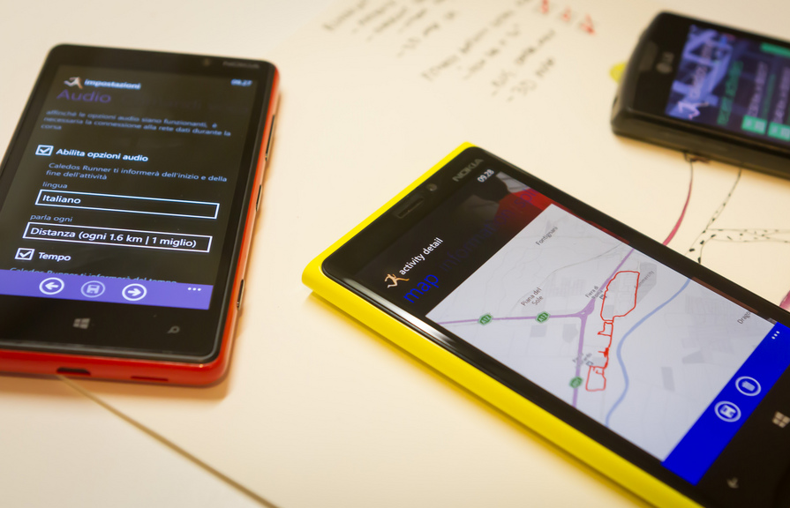
Resident Mode
Visible and persistent online presence
Collaborative activity online
Contribute online
Internet is a place
(White and Connaway 2011-2014)
Notes:
Image: http://www.flickr.com/photos/15216811@N06/8521338394
Residents: significant online presence and usage; high level of collaborative activity online; contributions to the online environment in the form of uploading materials, photos, videos.
White, David S., and Lynn Silipigni Connaway. 2011-2014. Visitors & Residents: What Motivates Engagement with the Digital Information Environment. Funded by JISC, OCLC, and Oxford University. http://www.oclc.org/research/activities/vandr/.

Slide 8
Educational Stages
(Connaway, White, and Lanclos 2011)
Notes:
1. Emerging (Late stage secondary school/First year undergraduate);
2. Establishing (Second/third or third/fourth year undergraduate);
3. Embedding (Postgraduates, PhD students);
4. Experienced (Scholars).
Connaway, Lynn S., David White, and Donna Lanclos. 2011. “Visitors and Residents: What motivates engagement with the digital information environment?” Proceedings of the 74th ASIS&T Annual Meeting 48: 1-7.
White, David S., and Lynn Silipigni Connaway. 2011-2014. Visitors & Residents: What Motivates Engagement with the Digital Information Environment. Funded by JISC, OCLC, and Oxford University. http://www.oclc.org/research/activities/vandr/.

Slide 9
Data Collection Tools
4 Project Phases
Semi-structured interviews
Diaries/monthly semi-structured interviews
Written
Video
Skype or telephone
Second group of semi-structured interviews
Online survey
(White and Connaway 2011-2014)
Notes:
Image: https://www.flickr.com/photos/colorblindpicaso/3399410617/
Data Collection Tools
Semi-structured interviews (initial interviews)
Diaries/monthly semi-structured interviews by Skype or telephone
Online survey (on-going)
White, David S., and Lynn Silipigni Connaway. 2011-2014. Visitors & Residents: What Motivates Engagement with the Digital Information Environment. Funded by JISC, OCLC, and Oxford University. http://www.oclc.org/research/activities/vandr/.

Slide 10
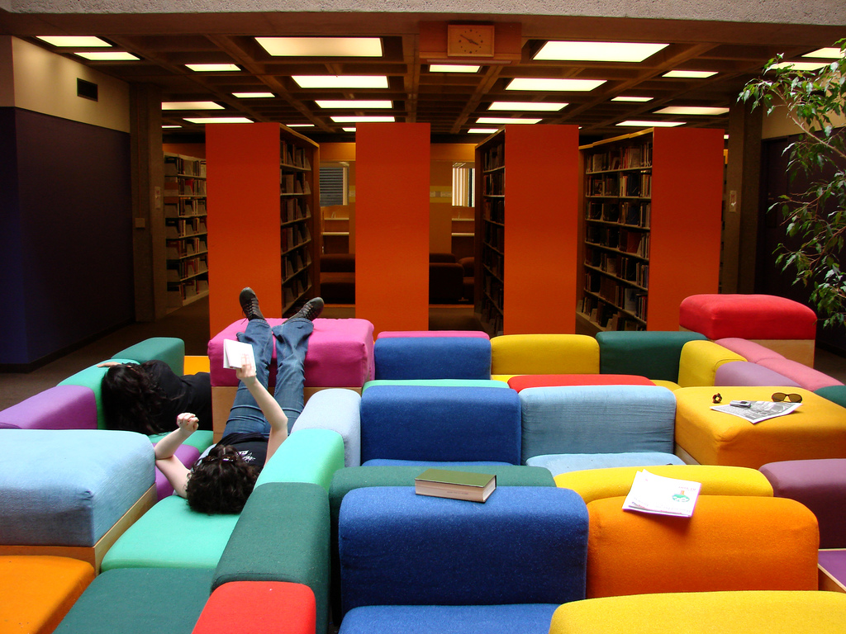
Project Phases
Phase 1: Interviews
31 (16 US/15 UK) Emerging (Last year of secondary/high school & first year of university)
10 (5 US, 5 UK) Establishing (2nd-3rd year undergraduates)
10 (5 US, 5 UK) Embedding (Postgraduates, PhD students)
10 (5 US, 5 UK) Experiencing (scholars)
Some Phase 1 participants agreed to submit monthly diaries
(White and Connaway 2011-2014)
Notes:
Image: https://www.flickr.com/photos/istolethetv/519756811/
Phase 1
Individual Interviews
Emerging (secondary school/1st year undergraduates: 31 (16 US, 15 UK)
Establishing (2nd-3rd year undergraduates): 10 (5 US, 5 UK)
Embedding (postgraduates, PhD students): 10 (5 US, 5 UK)
Experiencing (scholars): 10 (5 US, 5 UK)
Phases 1 & 2: Participant Demographics
61 participants: 15 secondary students/46 university students & faculty
34 females/27 males
38 Caucasian/5 African-American/2 Multi-racial/1 Asian/2 Hispanic/13 Unidentified
White, David S., and Lynn Silipigni Connaway. 2011-2014. Visitors & Residents: What Motivates Engagement with the Digital Information Environment. Funded by JISC, OCLC, and Oxford University. http://www.oclc.org/research/activities/vandr/.

Slide 11
Diarists
Phase 2: Diaries & Follow-Up Interviews
22 Diarists (10 UK/12 US):
66 diaries collected
53 follow-up diarist interviews conducted
Conducted and collected from April 2011 through October 2013
(White and Connaway 2011-2014)
Notes:
Image: https://www.flickr.com/photos/nalbertini/6317803326/
22 Diarists (10 UK/12 US)
Initially, email and Google Docs. Vague lists were returned.
More structure/better information:
Semi-structured interviews by Skype and phone or explicit questions to be addressed in the written diaries.
66 Diaries Collected
51 self-conducted diaries
5 written diary forms
6 Google diaries
4 video diaries
53 Follow-up Diarist Interviews Conducted
Conducted and collected from April 2011 through October 2013
White, David S., and Lynn Silipigni Connaway. 2011-2014. Visitors & Residents: What Motivates Engagement with the Digital Information Environment. Funded by JISC, OCLC, and Oxford University. http://www.oclc.org/research/activities/vandr/.

Slide 12
Project Phases
Phase 3
Interviews of second group of 12 Emerging stage students (6 US/6 UK)
Phase 4
In-depth online survey
150 participants representing each educational stage (90 US/60 UK)
(White and Connaway 2011-2014)
Notes:
Image: https://www.flickr.com/photos/hjl/7623844908/
Phase 3
Interviewed second group of 12 (6 US/6 UK) students in the Emerging stage
This will help to determine if methods of engagement are changing over time
Phase 4
In-depth online survey
150 participants representing each educational stage in both US & UK (90 US/60 UK)
White, David S., and Lynn Silipigni Connaway. 2011-2014. Visitors & Residents: What Motivates Engagement with the Digital Information Environment. Funded by JISC, OCLC, and Oxford University. http://www.oclc.org/research/activities/vandr/.

Slide 13
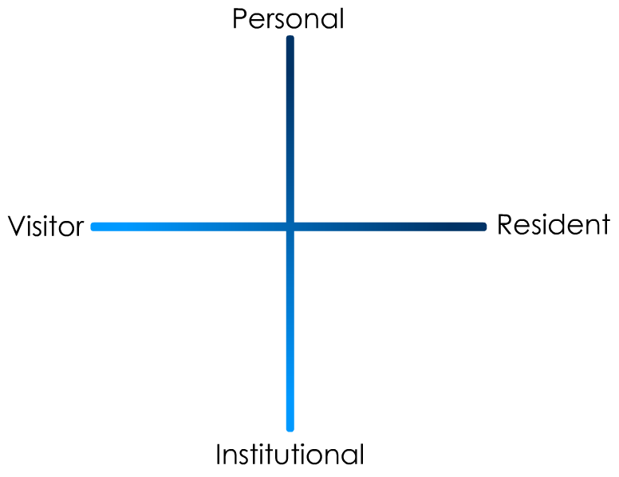
(Connaway and White for OCLC Research 2012)
Notes:
“In simple terms the Visitors see the web as a series of tools. They decide what they want to achieve, chose an appropriate online tool to do the job, then log-off. They leave no social trace of themselves online. The Residents live a proportion of their lives online. They see the web as a place where they can express themselves and spend time with people. Residents will have a profile on a social networking platform and aspects of their persona, or digital identity, maintaining presence even when they are not online. The premise of V&R is presented as a continuum whereby individuals’ modes of engagement will be more Visitor or Resident depending on their personal motivations and the context and situation at the time.” (Connaway, Lanclos, and Hood 2013)
Connaway, Lynn Silipigni, Donna Lanclos, and Erin M. Hood. 2013. “‘I find Google a lot easier than going to the library website.’ Imagine Ways to Innovate and Inspire Students to Use the Academic Library.” Proceedings of the Association of College & Research Libraries (ACRL) 2013 conference, April 10-13, 2013, Indianapolis, IN. http://www.ala.org/acrl/sites/ala.org.acrl/files/content/conferences/confsandpreconfs/2013/papers/Connaway_Google.pdf.
First Monday Paper: http://is.gd/vandrpaper
Video: http://is.gd/vandrvideo

Slide 14
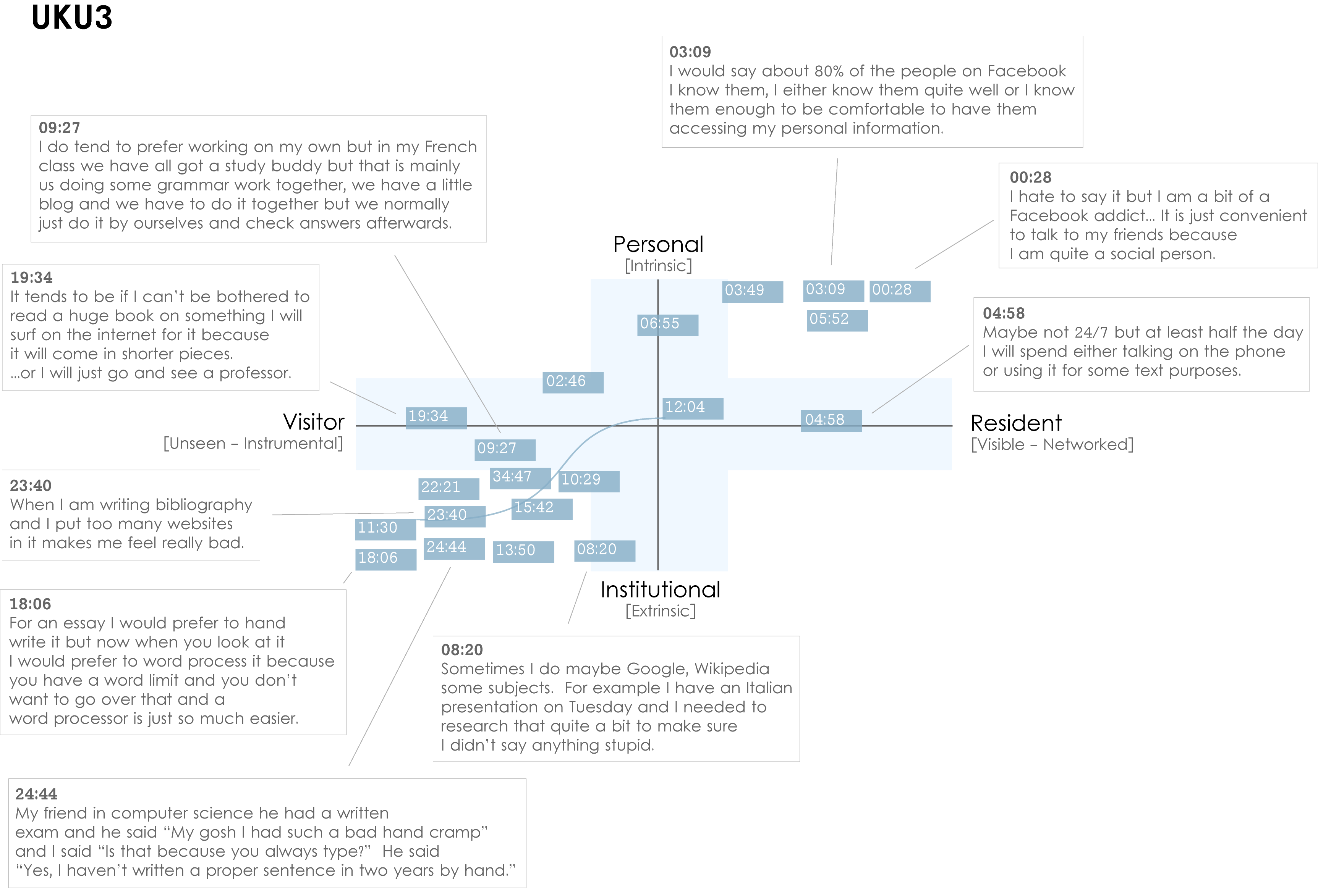
Notes:
UKU3 (UK 1st year undergraduate)
This participant has a clear demarcation between Resident modes of engagement in her personal life and Visitor modes of engagement for study.
The map is a mode of engagement landscape onto which individuals can be plotted. The limits of the map have been defined by the four major framing concepts of the project: V&R – Personal and Institutional. The Personal end of the axis encompasses an individual’s private life, and the Institutional is their professional and/or academic life.
The data from the Emerging educational stage seem to suggest that individuals were engaging with systems and materials not provided by their institutions to do institutional work (e.g., consulting Wikipedia to write an essay). Such user-owned literacies, when mapped as below, take a prominent role in the academic work of many of our research subjects. Given the effect that the internet is having on collapsing the relationship between certain modes of activity and specific physical spaces, it is important not to tie notions of the intuitional and the personal to ideas of “school/university/library” and “home” as buildings.

Slide 15
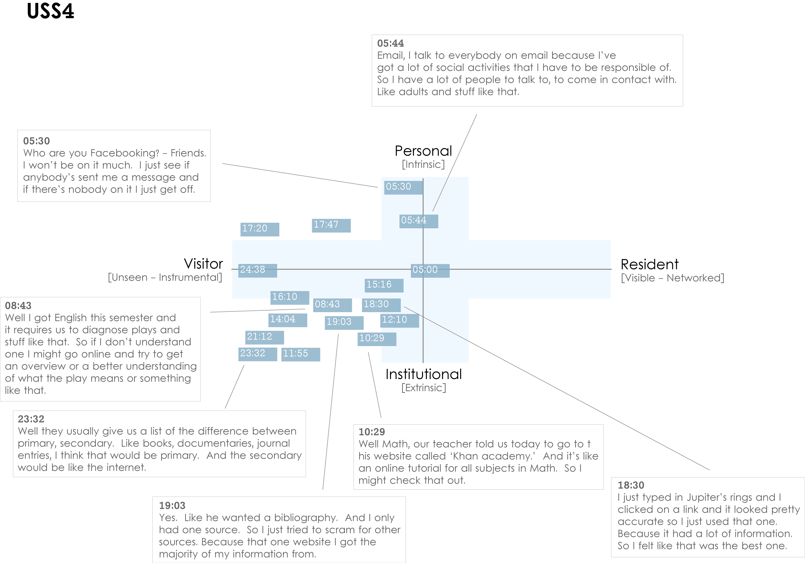
Notes:
USS4 (US high-school student)
This is an example of a participant who is predominantly engaging in a Visitor mode. The quotes illustrate that he does use the web regularly for his studies, but is not interested in being “visible” online.
The distinction between internal and external motivation can quickly become complicated. However, attempting to define why individuals engage with particular kinds of information can help identify substantive and relevant issues. For instance, the difference between the personal and the institutional diminishes as individuals become increasingly embedded in academic contexts. This convergence would be representative of the process of “becoming” an expert in a given discipline, and in the shift from predominantly consuming to constructing knowledge. The numbers on the dark blue blocks represent the time-code point in the interview at which the participant discussed an activity or approach.

Slide 16
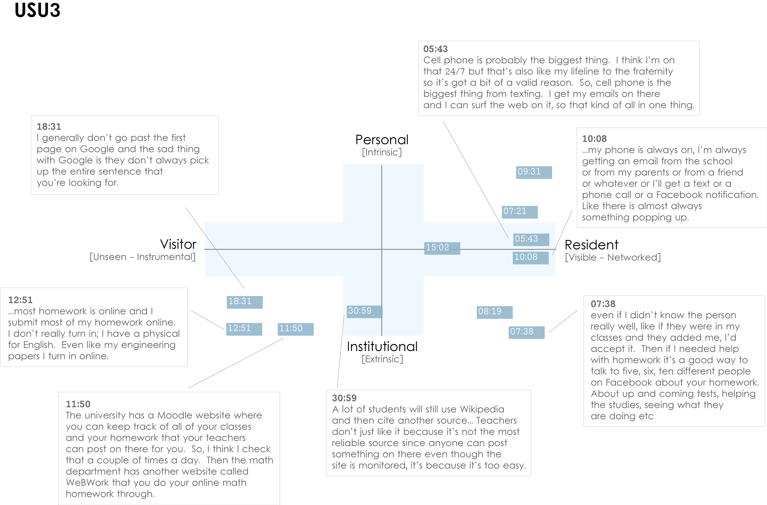
Notes:
USU3 (US 1st year undergraduate) This participant is highly Resident, connected to friends, family and study related matters “24/7” via a smartphone. His willingness to “friend” fellow students with a view to discussing assignments in Facebook is the main form of activity that takes place in the Resident/Institutional quadrant. This tends to be the only activity that takes place in this quadrant amongst participants from the Emerging educational-stage.
It should be possible to plot our code book onto the map, which would provide the ability to automatically plot coded data from individuals or groups. For example, Extrinsic and Intrinsic motives have been coded in NVivo, which map directly to the vertical axis (Personal/Institutional). Other codes can be identified as more Resident in nature: “Visible messaging,” “Media posting,” “Connection: sharing with others;” or as more Visitor in nature: “Searching,” “Email,” “Word processing.”

Slide 17
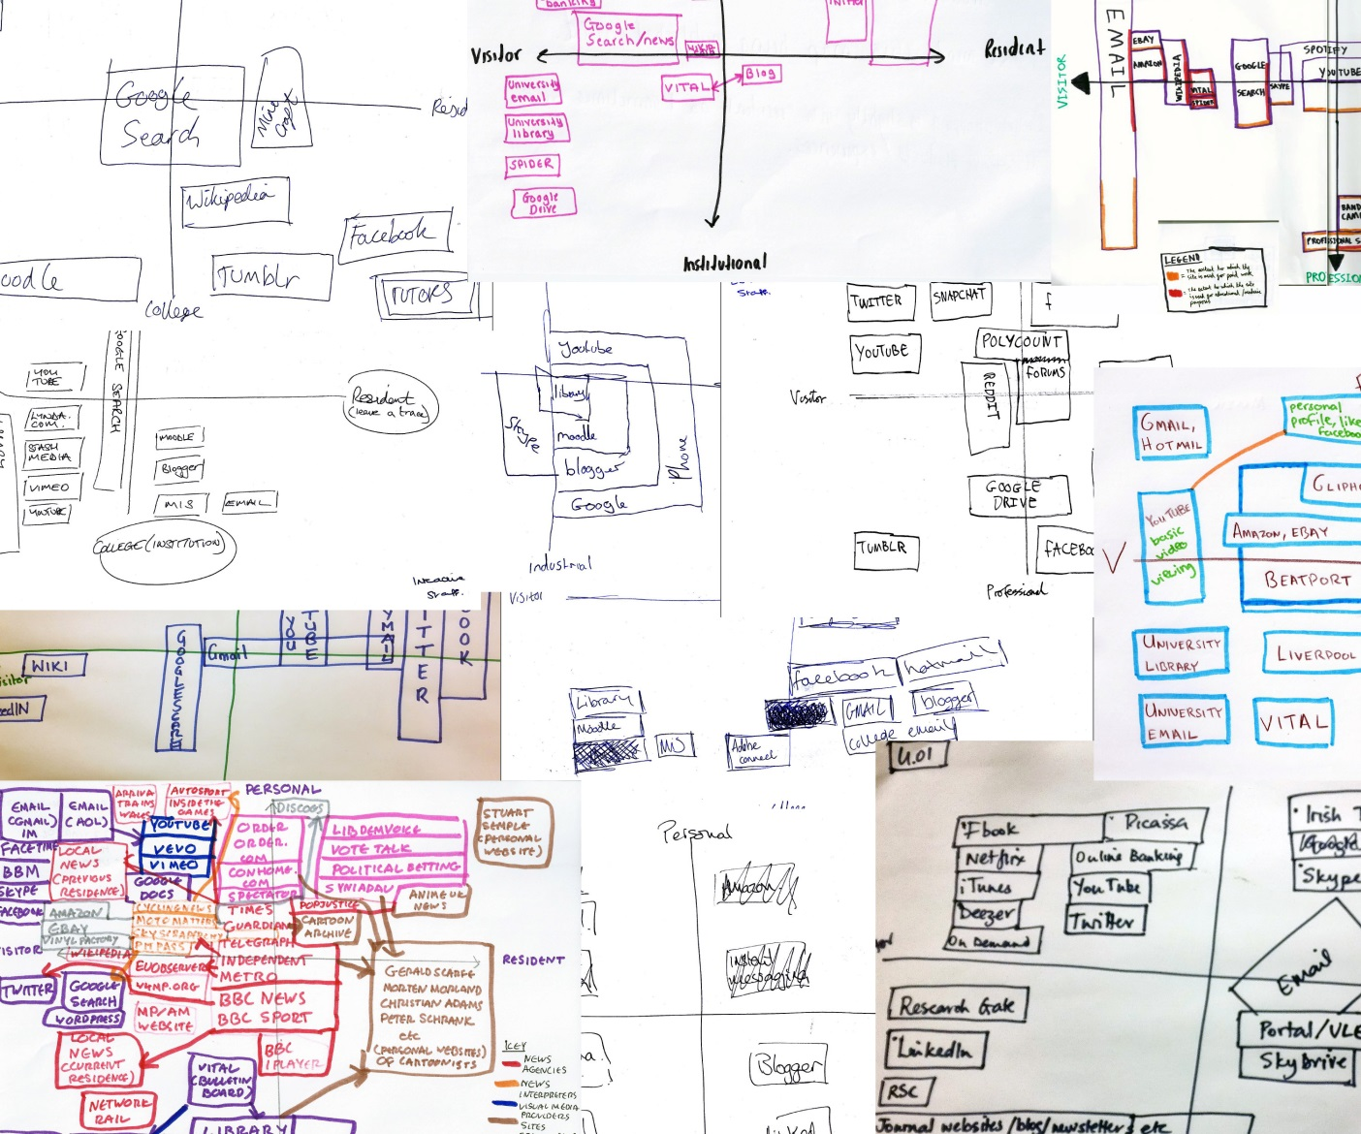
Mapping

Slide 18
Notes:
Low Residency

Slide 19
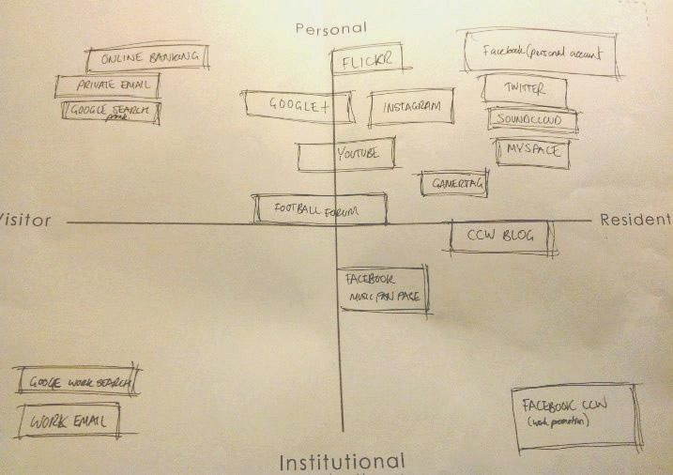
Notes:
Compartmentalized - Professional and personal FB accounts

Slide 20
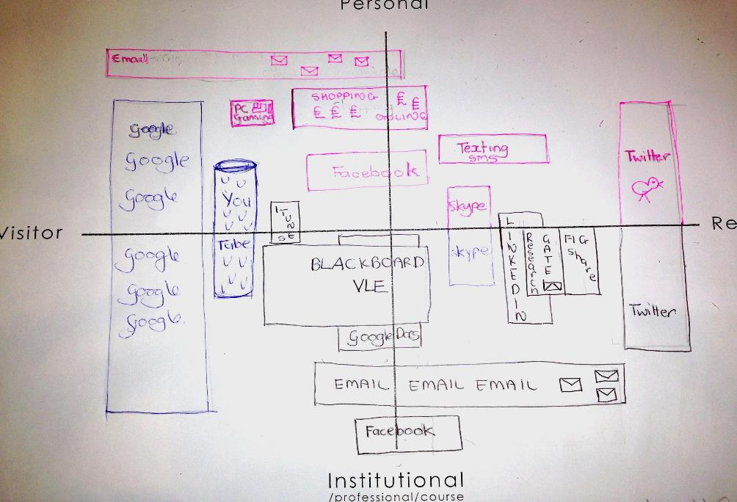
Notes:
Google – disappearing into use – Post-digital

Slide 21
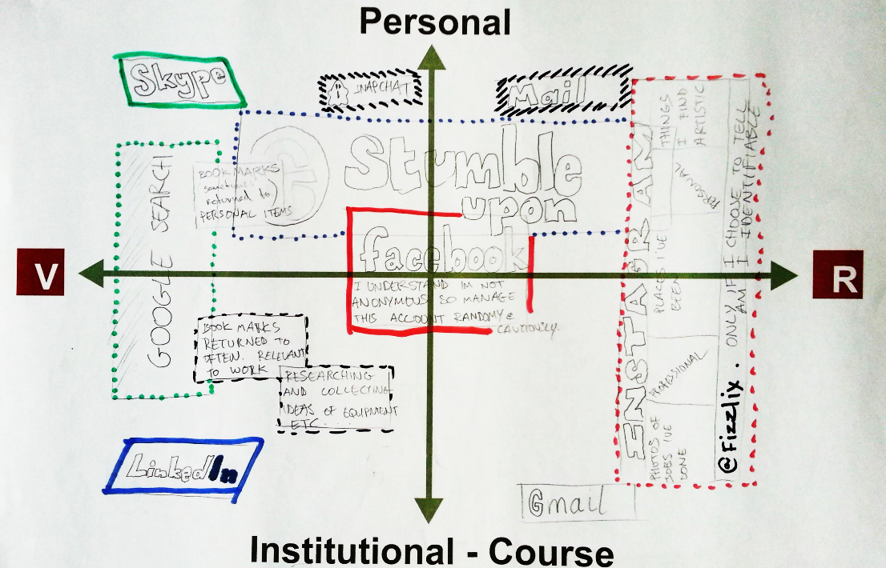
Notes:
Ideal - Annotations

Slide 22
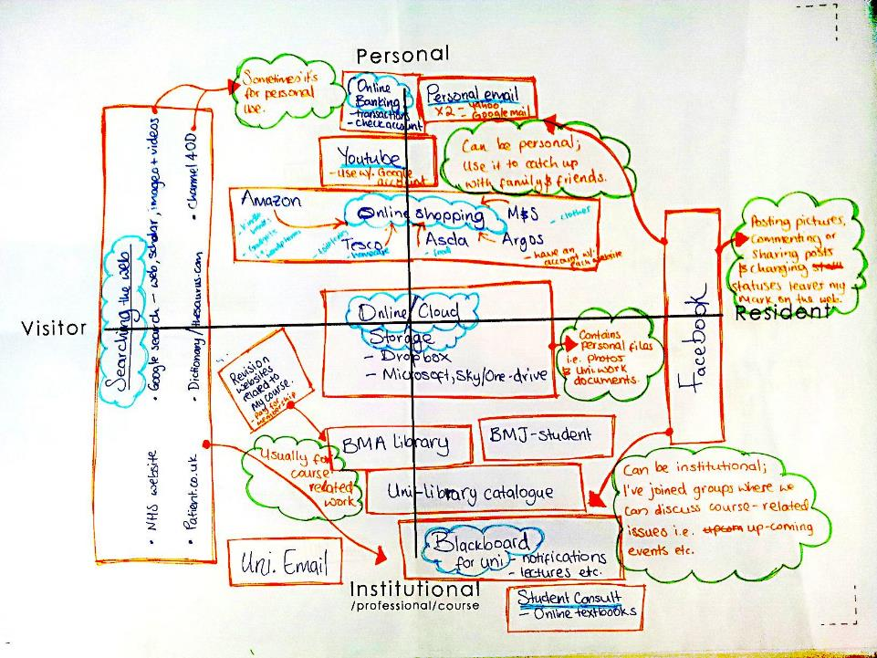
Notes:
Ideal - Annotations

Slide 23
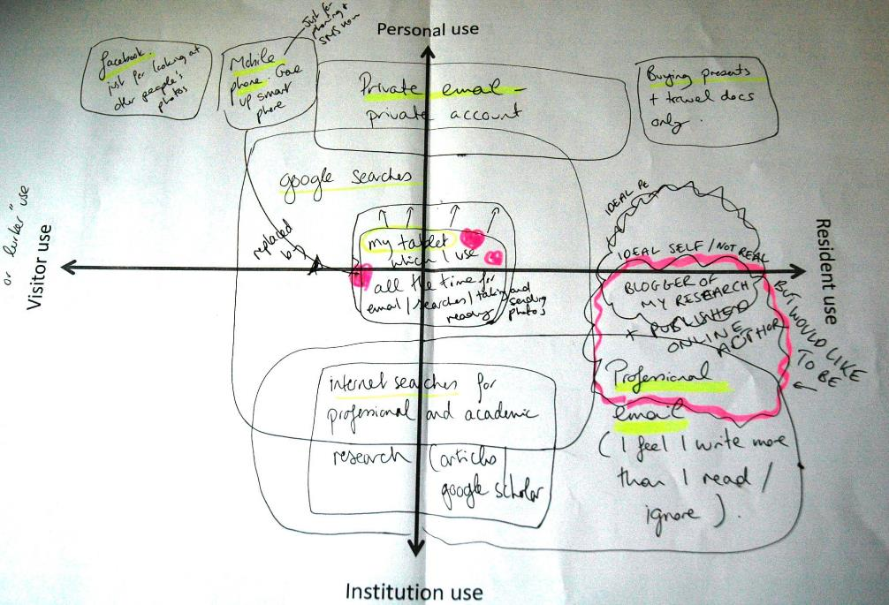
Notes:
Ideal - Annotations

Slide 24
Let’s Make a Map
Okay, here we go!

Slide 25
Let’s Make a Map
Okay, here we go!
Our friend Clippy will guide us along the way.

Slide 26
It looks like you’re trying to create a Visitors and Residents map. Would you like help?

Slide 27
Step 1: Draw horizontal and vertical axes.

Slide 29
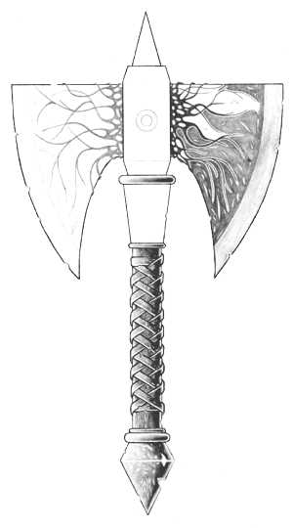

Slide 33
Write “Visitor” on the left, and “Resident” on the right.

Slide 34
Visitor
Resident

Slide 35
Write “Personal” at the top, and “Institutional” at the bottom.
Visitor
Resident

Slide 36
Personal
Visitor
Resident
Institutional

Slide 37
Personal
Now think really hard about your engagement with the Web. Making a list can be helpful.
Visitor
Resident
Institutional

Slide 38
My Engagement with the Web
Google search
Github
Journal articles
Computer science blogs
Email
Personal website
Google Groups
Gitter.im
Hacker News
YouTube
Shopping/Purchasing/Bills

Slide 39
Personal
Try to think about how you use each service. Plot your modes of engagement using one or more boxes or regions.
Visitor
Resident
Institutional

Slide 40
Personal
Google Search
Visitor
Resident
Institutional

Slide 41
Personal
Google Search
Email
Visitor
Resident
Institutional

Slide 42
Personal
Google Search
Email
Journal Articles
Visitor
Resident
Institutional

Slide 43
Personal
Google Search
It looks like you have two different modes of engagement here.
Email
Journal Articles
Github (Personal)
Visitor
Resident
Github (Work-related)
Institutional

Slide 44
Personal
Google Search
Comp. Sci. Blogs
Email
Journal Articles
Github (Personal)
Visitor
Resident
Github (Work-related)
Institutional

Slide 45
Personal
Google Search
Comp. Sci. Blogs
Email
Journal Articles
Github (Personal)
Visitor
Resident
Github (Work-related)
Gitter.im
Institutional

Slide 46
Personal
Google Search
Comp. Sci. Blogs
Email
Journal Articles
Github (Personal)
Visitor
Resident
Github (Work-related)
Google Groups
Gitter.im
Institutional

Slide 47
Personal
Google Search
Hacker News
Comp. Sci. Blogs
Email
Journal Articles
Github (Personal)
Visitor
Resident
Github (Work-related)
Google Groups
Gitter.im
Institutional

Slide 48
Personal
Google Search
Hacker News
Personal Website
Comp. Sci. Blogs
Email
Journal Articles
Github (Personal)
Visitor
Resident
Github (Work-related)
Google Groups
Linkedin
Gitter.im
Institutional

Slide 49
Personal
Google Search
YouTube
Hacker News
Personal Website
Comp. Sci. Blogs
Email
Journal Articles
Github (Personal)
Visitor
Resident
Github (Work-related)
Google Groups
Linkedin
Gitter.im
Institutional

Slide 50
Personal
Google Search
Shopping/Bills
YouTube
Hacker News
Personal Website
Comp. Sci. Blogs
Email
Journal Articles
Github (Personal)
Visitor
Resident
Github (Work-related)
Google Groups
Linkedin
Gitter.im
Institutional

Slide 51
Personal
Google Search
Shopping/Bills
YouTube
Yaaay! You did it!
Hacker News
Personal Website
Comp. Sci. Blogs
Email
Journal Articles
Github (Personal)
Visitor
Resident
Github (Work-related)
Google Groups
Linkedin
Gitter.im
Institutional

Slide 52
How to Share
Take a photo and email it to:
oclc.vandr@gmail.com
For attribution, include in the email body:
Name (First, Last)
Title/Position
Employer/University
Age
12-18 19-25 26-34 35-44 45-54 55-64 65+
Highest Education Level
HS Diploma Bachelor’s Master’s Ph.D.
Notes:
The dropbox email address is oclc_vandr_b7de@sendtodropbox.com.

Slide 53
Discussion of Personal Mapping
Notes:
Image: http://www.flickr.com/photos/ejpphoto/6307523224/

Slide 54
Beyond This Analysis
We can learn about how we engage
personally,
professionally,
individually, &
collectively
We can better understand our identity & dynamics
Notes:
Lynn

Slide 55
So What?
Identify how target audiences
Engage with technology
Discover & access information
Modify & develop services & systems
Notes:
Lynn

Slide 56
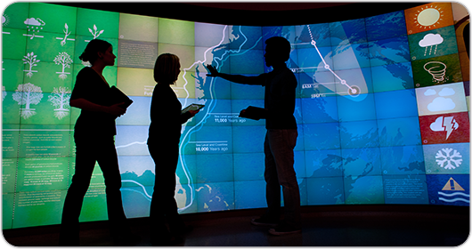
The Library in the life
of the user
Notes:
Lynn
Image: https://www.google.com/url?sa=i&rct=j&q=&esrc=s&source=images&cd=&cad=rja&uact=8&ved=0CAcQjRxqFQoTCLWE45XBiMgCFY2kiAodHkcAGw&url=http%3A%2F%2Fwww.christiedigital.com%2Fen-us%2Fnews-room%2Fpress-releases%2Fpages%2Fchristie-helps-nc-state-build-research-library.aspx&psig=AFQjCNHsAocoyaTQLyzXjLzslitKWDbUnQ&ust=1442938024202771I
Working on an app to create and submit maps
It’s possible to create and submit on personal computers/laptops
Testing on tablets and smart phones
This will give OCLC the ability to collect maps and analyze, using William’s analysis tools to influence product development, services, and systems.

Slide 57
Questions and Discussion
#vandr
Notes:
Image: Microsoft Clip Art

Slide 58
References
Connaway, Lynn Silipigni, Donna Lanclos, and Erin M. Hood. 2013. “‘I find Google a lot easier than going to the library website.’ Imagine Ways to Innovate and Inspire Students to Use the Academic Library.” Proceedings of the Association of College & Research Libraries (ACRL) 2013 conference, April 10-13, Indianapolis, IN, http://www.ala.org/acrl/sites/ala.org.acrl/files/content/conferences/confsandpreconfs/2013/papers/Connaway_Google.pdf.
Connaway, Lynn S., David White, and Donna Lanclos. 2011. “Visitors and Residents: What motivates engagement with the digital information environment?” Proceedings of the 74th ASIS&T Annual Meeting 48: 1-7.
White, David S., and Alison Le Cornu. 2011. “Visitors and Residents: A New Typology for Online Engagement.” First Monday 16, no. 9, http://firstmonday.org/ojs/index.php/fm/article/view/3171/3049.
White, David S., and Lynn Silipigni Connaway. 2011-2014. Visitors & Residents: What Motivates Engagement with the Digital Information Environment. Funded by JISC, OCLC, and Oxford University. http://www.oclc.org/research/activities/vandr/.
White, David, Lynn Silipigni Connaway, Donna Lanclos, Erin M. Hood, and Carrie Vass. 2014. Evaluating Digital Services: A Visitors and Residents Approach. http://www.jiscinfonet.ac.uk/infokits/evaluating-services/.

