Slide 1
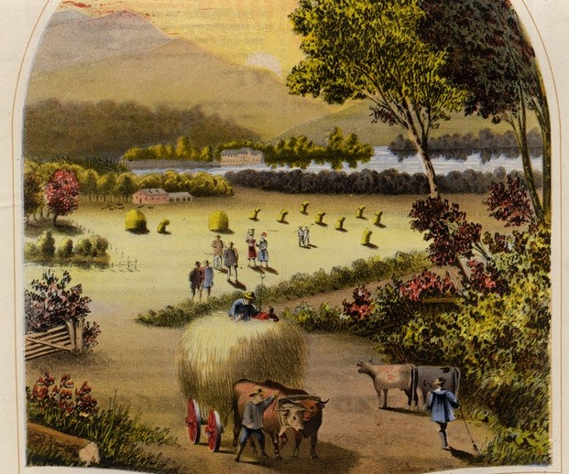

Getting to Know You: Tales from the Field
Margaret Burri
Sheridan Libraries
Johns Hopkins University
Notes:
Thanks to OCLC Research Partners for giving me the chance to share with you some stories about how we got to know our faculty and students better. Hence the word “tales”: user centered inquiry helps us find different ways to hear our users stories. We’re in the middle of planning for the renovation of our main campus library—the Milton S. Eisenhower Library—and the work that we’ve done over the last 4 years using user centered inquiry has put us in a good place to plan a space that puts users front and center.

Slide 2

Notes:
So what’s up with the pig? I chose this photo because it’s a reminder of a couple of things that you need to remember when doing user-centered design. First, expect the unexpected. Who knew that pigs could swim? And second, you never know when you’re going to get a chance to learn something new.

Slide 3

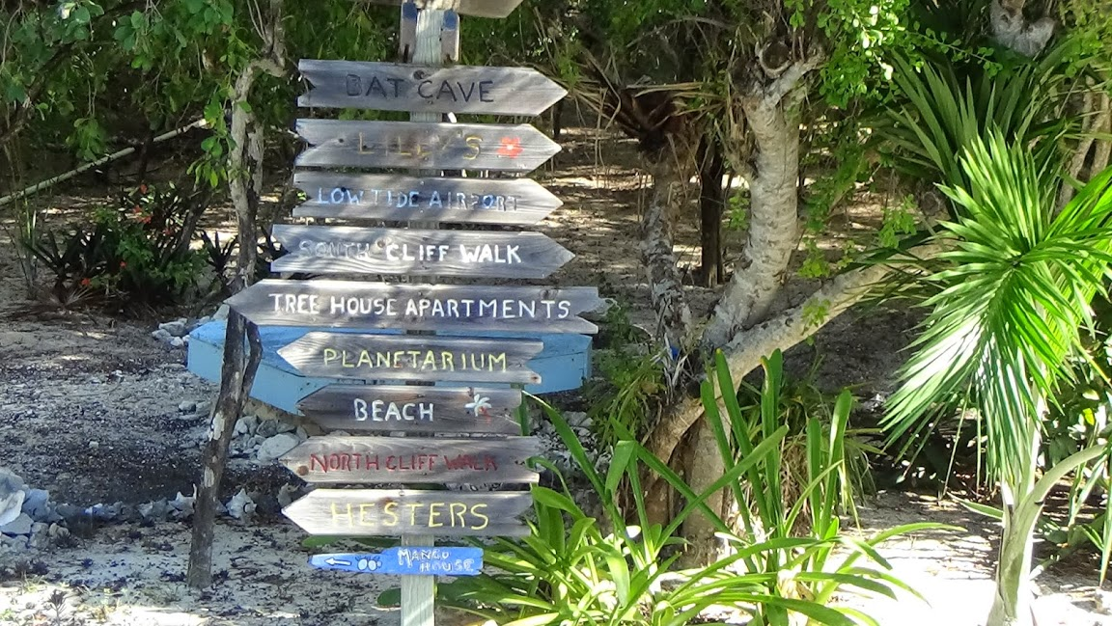

Reading the Signs
Notes:
As hard as it is to admit it, sometimes we think that all users are alike. Or, barring that, that we know best about how they should be using the library and its resources. We need to be more attuned to variation, and be open to reading the signs that there are a myriad of directions that users want to go in.

Slide 4
Background
DKC in the 1990s: use cases
2010: Colleague proposes UX Director position
2011: Hire UX Director
Notes:
A little history. Before I knew what UX or user centered design was, my colleagues in the Digital Knowledge Center, the precursor to our Digital Research and Curation center, worked with us to craft use cases for digital projects. They wanted us to describe what a user might do with content from, for example, the Lester S. Levy Sheet Music Collection, a collection of popular American sheet music that was the library’s first foray into creating a digital collection. They challenged us to describe the casual, scholarly, and musical users. It was a different way of thinking, and went beyond “if you put it up they will come.”
Fast forward to 2010: a forward looking colleague of mine, Deborah Slingluff, proposed hiring a UX director. We were in the throes of building the Brody Learning Commons, and it became clear to Deborah that having someone with UX experience would be invaluable. Steven Heslip, our UX director, started in the fall of 2011. He’s an urban anthropologist, not a librarian, and that’s brought a fresh perspective. I have to be honest and say that some people were skeptical, and I can’t count the number of times he took a colleague out for lunch or coffee, but he overcame the initial resistance, and came away with a good understanding of our culture. It was an ethnographic study in miniature.

Slide 5
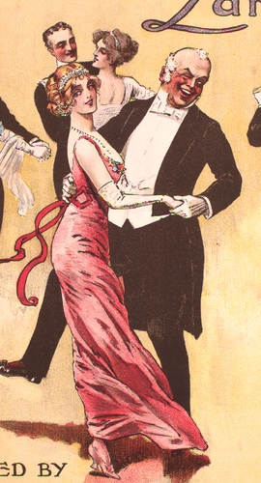
A Whirlwind of Activity
Catalyst Facet Architecture and Design
Top Ph.D. Research
Undergraduate Experience Photo Journal
Borrow Direct Integration
ULC Services Inquiry
Library as Research and Study Space
Student Web Design Program
Describing Research Processes and Information Seeking Behavior
MSEL Use Study
BLC Use Study
Library Services Process Audits
Coding Reference Analytics
Seeking the Monograph Mapping
Notes:
And it’s been a whirlwind of activity since. This is just a sample of the projects that we’ve worked on over the last 4 year. They’ve run the gamut from the fox trot to the waltz; or, more accurately, from digital to physical projects, and from hard core analytics to softer qualitative data.

Slide 6
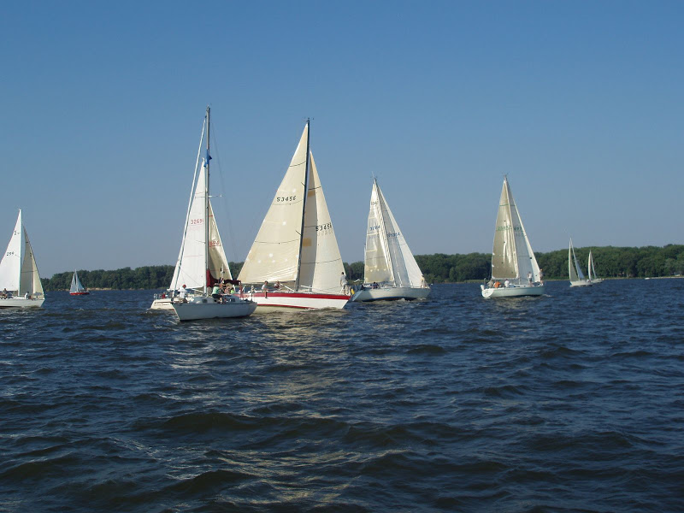
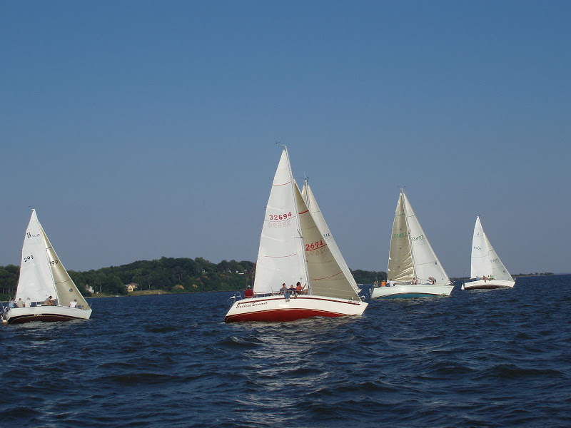
What It Took
Notes:
So what did it take to make this happen? We weren’t too far off, but we needed guidance and expertise to get us moving in the same direction. We had to reconcile “the user comes first” with “we know best.” We also had to take advantage of available people resources: Steven recruited a great group of students, with majors ranging from IR, to Comp Sci to psychology, and worked closely with a couple of the liaison librarians on projects to bring them up to speed. Resources are scarce for all of us so we leveraged what we had.

Slide 7
A Bit of Everyone
FY14 Liaison Activities
Study & Research Space Survey
Top PhD
Research Hub/Data Life Cycle
Humanities Research Needs
Engineering Design Teams
MSE Use Study
Participatory Design Activities
Photo journals
Focus Groups
Notes:
We’ve worked hard to be sure that our users are representative and that we don’t favor one over the other. During the course of our most recent work, requirements gathering for the renovation of the MSE library, I was challenged by my colleagues about the range of users that we’d worked with over the years. I put this slide together as an overview. We have an almost equal distribution of user types, and a fairly broad representation by discipline.
These numbers reflect only the inquiry that we had done to date that give us information for the renovation; if I were to systematically go through every other project we’d done, I suspect the distributions would hold up.
One outcome of working on a variety of projects is that we’re building a diverse and rich set of inquiries that we can continue to mine.

Slide 8
Examples
MSEL Use Study: qualitative and quantitative
Student Web Redesign: participatory design
Top Ph.D: guided ethnographic study
Notes:
Now that you know how we get to where we are, I want to briefly run through three projects, each of which used a different user-centered approach.

Slide 9
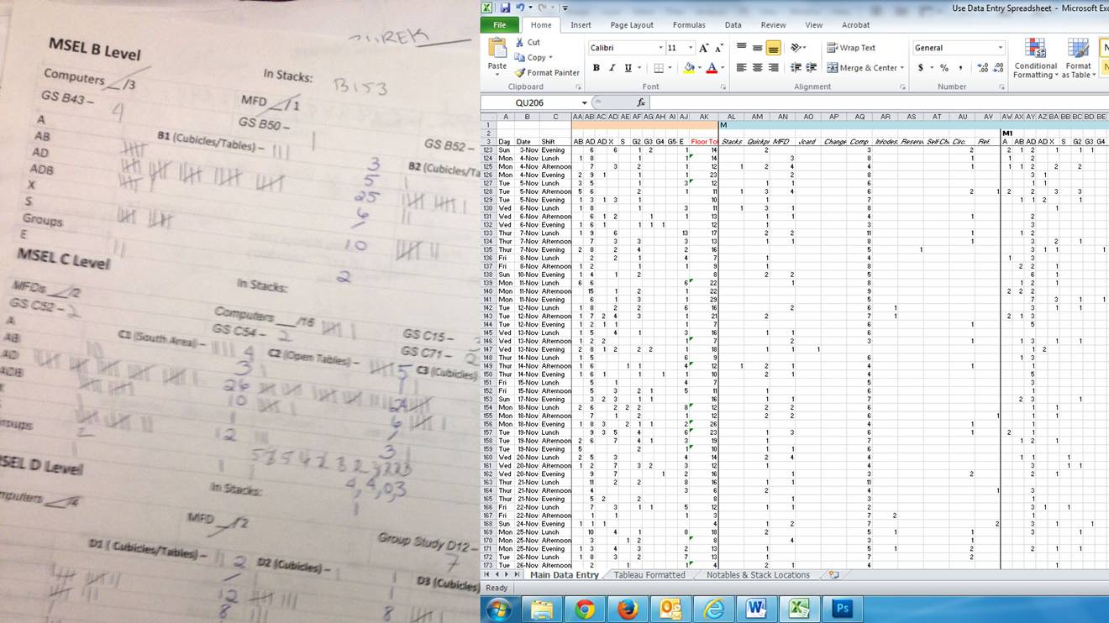
MSEL Use Study
Notes:
The MSEL Use Study used both quantitative and qualitative data to help us develop evidence-based understandings of MSEL facility throughout the academic year.
Our goals were to:
Identify needs that are not being met, especially during times of peak use
Understand user needs and desires, including why they choose to use parts of the library and not others
Characterize use of different parts of the library based upon evidence collected
The quantitative side was a series of daily observations that documented various behaviors throughout the library. Behaviors were coded: for example, active or engaged with a book, active or engaged with a device, active with both, and my personal favorite, an “x” for sleeping or not engaged.
The coding schema was adopted from a hand-out distributed by Nancy Fried-Foster at a participatory design workshop that she conducted at JHU. The students made observations 3 times a day, and recorded 400 sets of counts over the academic year. They were extremely conscientious—they only missed three times.
The data was loaded into a spreadsheet for analysis using Tableau.

Slide 10

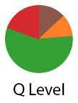
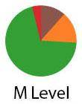
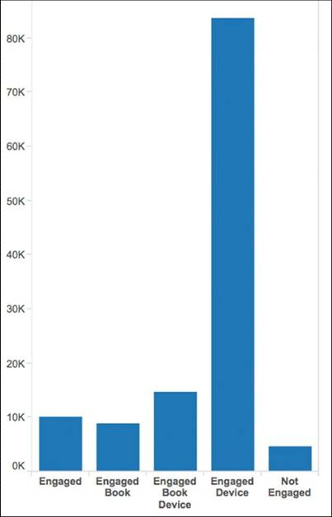
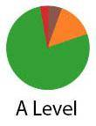
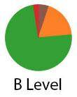
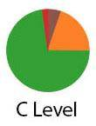
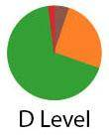
MSEL Use Study
Notes:
And the final product: from hash marks to Tableau to charts.

Slide 11
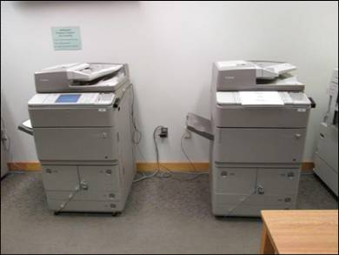
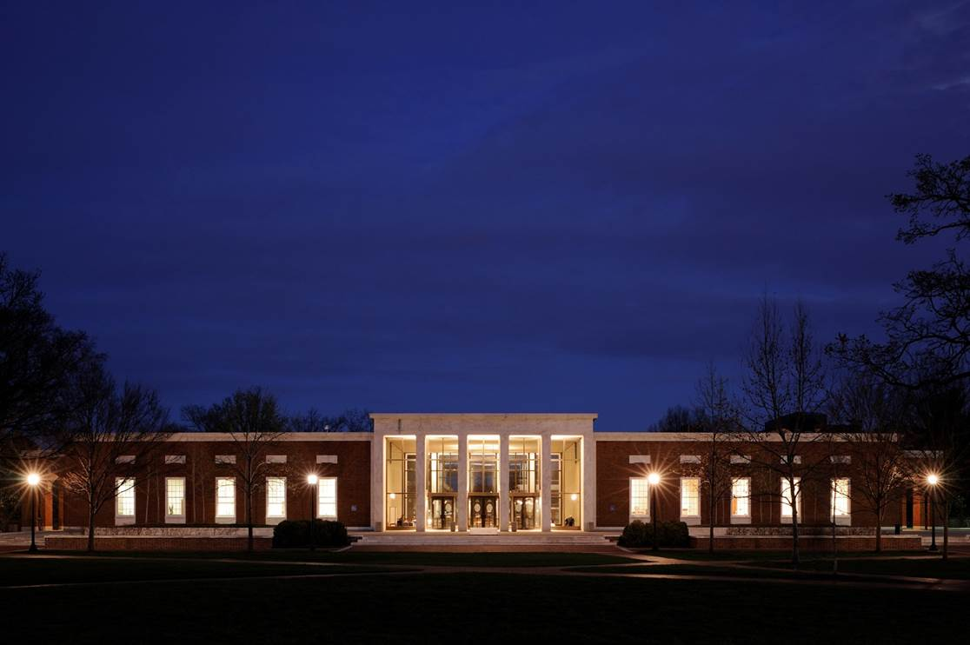
MSEL Use Study
Photo Surveys: Technology & After Dark
Notes:
And now for the qualitative part. Why use photo surveys? Because when you debrief the photographers, you get things that you never would have asked about. We did two for the use study: technology use and the library after dark. And we did indeed find out things that we never would have expected or asked about. I’m going to focus on the “after dark” part. There were more surprises there than in the technology part.
Briden, J. (2007). Photo surveys: eliciting more than you knew to ask for. In N.F. Foster & S. Gibbons (Eds.), Studying students: the undergraduate research project at the University of Rochester (40-47). Chicago: ACRL.

Slide 12
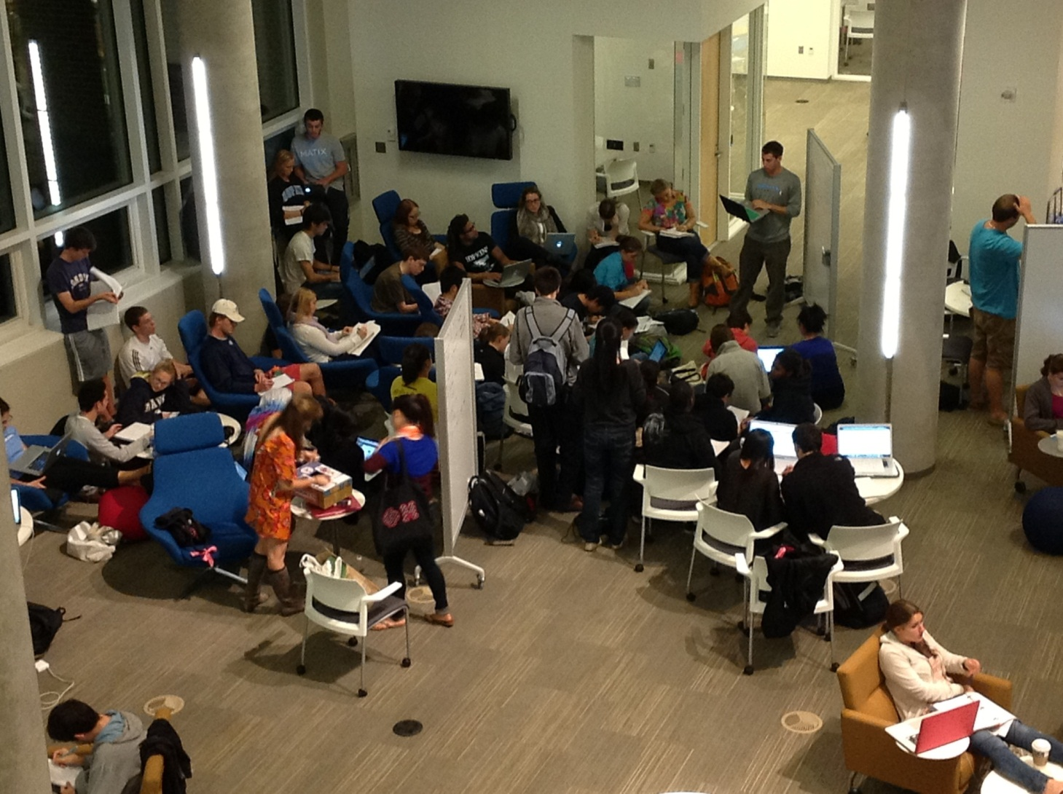
They’re Doing What?
Notes:
We learned that any library space is fair game for an impromptu review session. The students here are from an upper-level chemistry class. There was a particularly difficult question in the review set, and via social media word spread that someone had solved it. So they met at the library, commandeered some moveable white boards, and they were on their way.

Slide 13
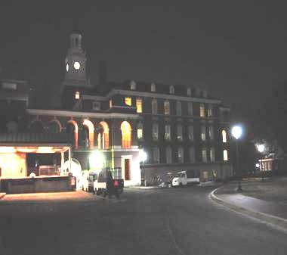
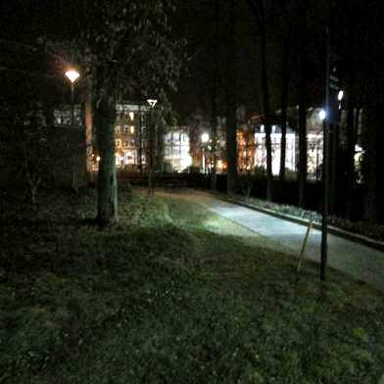
Getting There
“No one passes from there [Mattin Center], though I don’t feel that uncomfortable or unsafe, someone has to walk from this road or other road, which is kind of deserted. No one is using it.” – Security Informatics, Masters Student
“I feel uncomfortable or unsafe at night because it is dark in here [Mattin Center]. There is not enough lighting.” – International Studies, Junior
Notes:
We also found out that certain ways to walk to the library were problematic. We shared this with security and student life. The lighting has improved somewhat, and it reinforced that the Mattin Center, which sits just south of the library, is not a user friendly space.

Slide 14
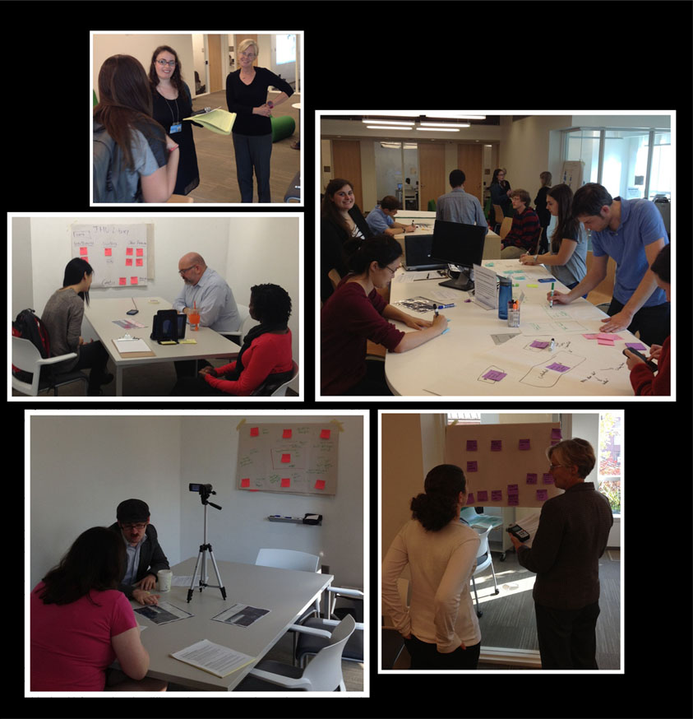

Student Web Design
Notes:
Moving from the physical to the digital, our website was long overdue for an overhaul, so we ran a participatory design exercise with students. We asked them to design their ideal website, and then had them walk us through their design. Some takeaways that we incorporated into the final design was that there was too much jargon, students wanted to know what they were searching, they wanted someplace that highlighted our Special Collections material, and they really didn’t care about seeing social media on the site. This project was done hand-in-hand with our student workers, and they did the bulk of the recruitment, analysis and the initial wire framing of the revised site.

Slide 15
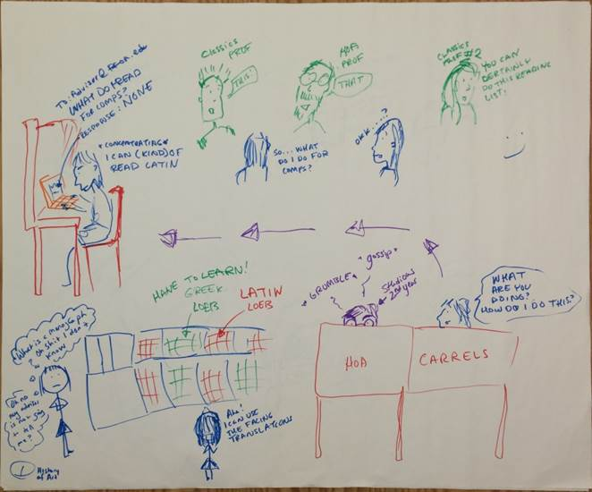
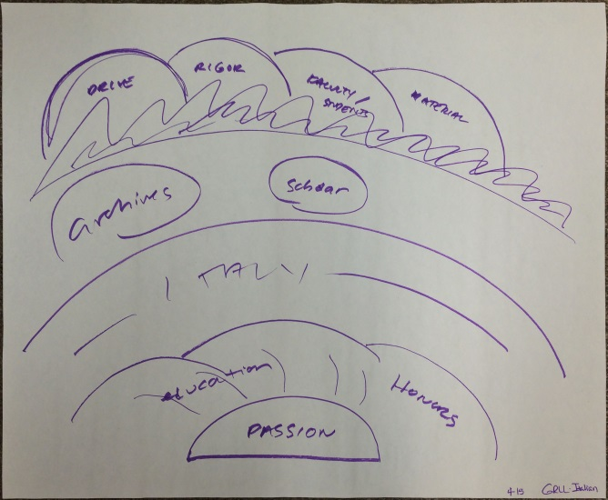
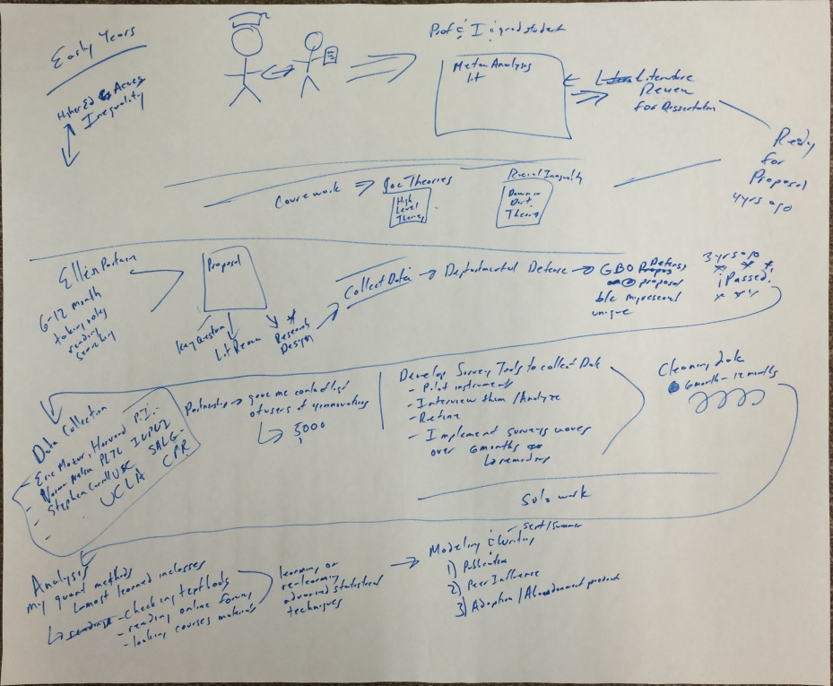
Top PhD
Notes:
Semi Structured interviews. One of the goals of the university’s strategic plan is to ensure that at least 2/3s of Hopkins’s PhD programs stand in the top 20. Since the library’s strategic plan cascades from the university’s, several of the liaison librarians worked with Steven to conduct a series of semi-structured interviews that asked grad students to illustrate how they do their research. These were done by students in history of art, sociology, and German and Romance Languages and Literature. It was while working on this project that we began to realize the importance to moving away from focusing on what we wanted them to do and really listening to what they wanted and needed to do.
Some of the insights gleaned from this inquiry were confirmed this past spring when we did a survey and focus groups on the library as research and study space. Just as the History of Art student illustrated her need for community while in the library, we heard this echoed numerous times.

Slide 16
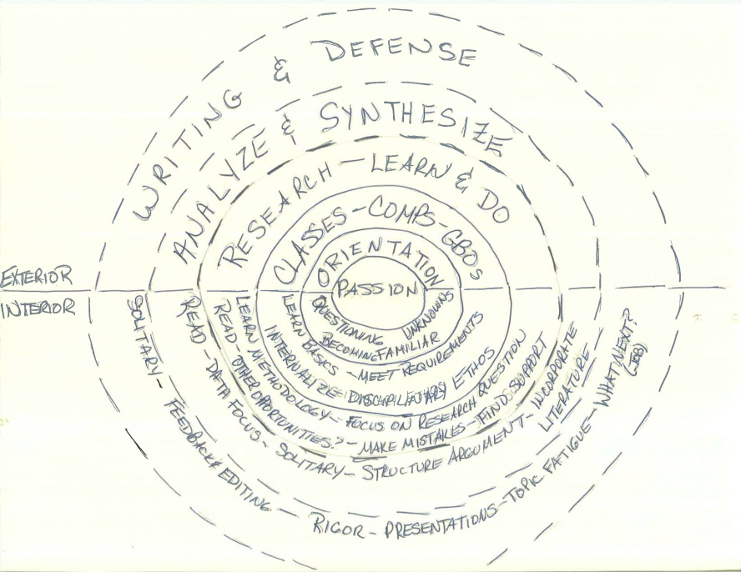
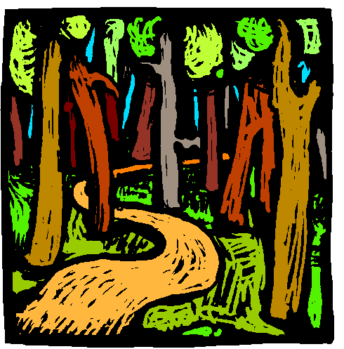
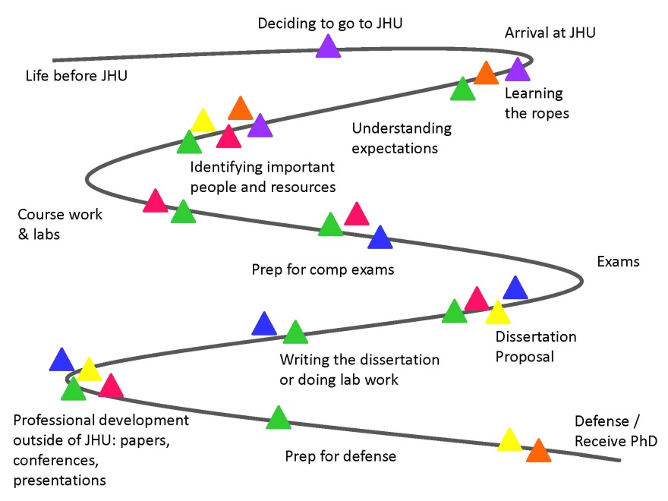
Top PhD
Notes:
The coolest thing about putting the user first is that it helps us look at things differently. These images were done by the three liaison librarians who worked on the project, and illustrate their understanding of our graduate students’ research process. I’d like to share with you how the librarian described the one on the right:
“It’s clear from all the interviews that the research process follows the trajectory or path of a classic quest, or hero’s journey. The shape of the journey is not a circle, but a definite linear path from Point A to Point Z, with detours, obstacles and trials along the way.”
The more we know about these detours, obstacles and trials, the better we can design spaces and workflows that support our users on their journey.

Slide 17
Sources
Images:
Photo survey participants: slides 11-13
Top Ph.D. participants: slide 15
Robin Sinn, Don Juedes, and Sue Waterman: slide 16
Steven Heslip: slide 14
Lester S. Levy Sheet Music Collection, http://levysheetmusic.mse.jhu.edu/ : slides 1 and 5
Social Media Image (slide 14): http://www.onlinerepmanagement.com/wp-content/uploads/2012/04/Social-Media-Liability-e1334847608175.png
Alan J. Weiss, M.D.: slides 2, 3, and 6
Reading:
Briden, J. (2007). Photo surveys: eliciting more than you knew to ask for. In N.F. Foster & S. Gibbons (Eds.), Studying students: the undergraduate research project at the University of Rochester (40-47). Chicago: ACRL.

