Slide 1
Beyond authorship: an introduction to the CRediT taxonomy
Amy Brand, PhD
OCLC Research Library Partnership Meeting
San Francisco, June 4 2015
Notes:
Good morning! Thanks to Constance, Ricky, and others at OCLC. It’s a tremendous honor to be here. I’m Amy Brand of Digital Science

Slide 2
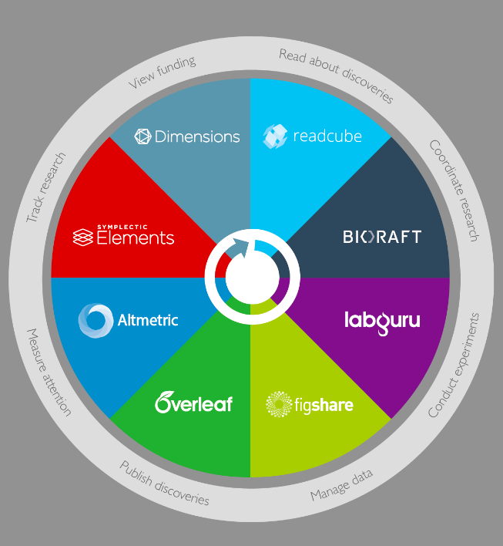

Notes:
For those of you who aren’t familiar with Digital Science, we invest in and incubate academic start ups that share a mission to address researcher painpoints and make research smarter at various stages of the workcycle, beginning in the lab and going all the way through to publication and reputation management.
Many of the companies in our portfolio fit squarely in that reputation management space. Symplectic elements helps researchers and institutions manage their record of scholarship. figshare, our repository solution, is being used widely to post and share, preserve research data and other scholarly outputs.
And Altmetric tracks a range of social media and other indicators of the downstream attention paid to published research – blogs, tweets, downloads, news coverage, etc.

Slide 3

Notes:
But today I am going to talk about a different kind of reputation management painpoint for researchers – the pain of not receiving appropriate credit for their contributions to collaborative research because of our longstanding authorship and attribution practices.
what does it mean to SHARE authorship and credit from the researcher’s perspective? What role do the politics of the lab play, for example? And how can we devise a better, fairer attribution system?
Now this work is somewhat independent of Digital Science and its portfolio companies, but Digital Science nonetheless supports it because of its potential to improve scholarly communication and lay the foundation for new kinds of research metrics based on being able to track – within science publications -- individual contributions to published research

Slide 4
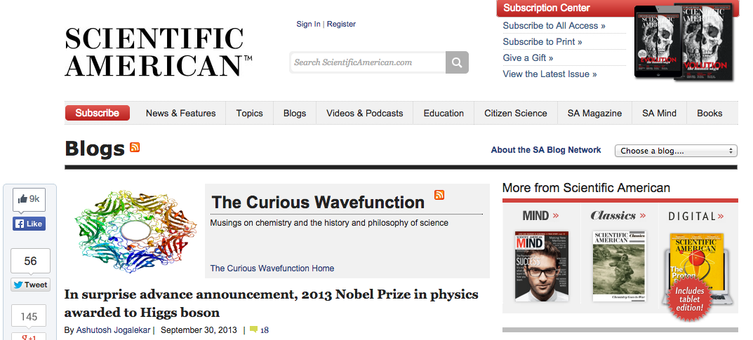
Notes:
Before the announcement of the 2013 Nobel Prize in Physics, there was a satirical posting in SciAm’s blog reporting that Stockholm had announced that the award for the Higgs Boston discovery would go to the particle itself because it wasn’t clear which of 6000 people involved in the project deserved credit for its discovery.
Our current authorship practices are simply not up to the task of representing today’s large-scale team science collaborations

Slide 5
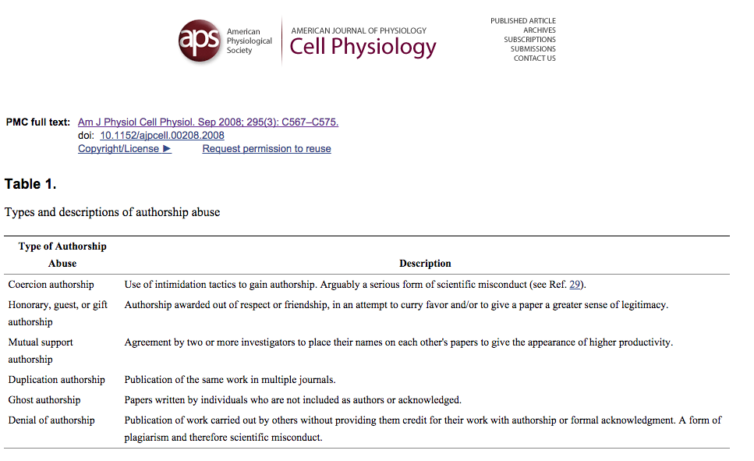
Notes:
But co-authorship has always been ripe for abuse. Most researchers who have co-authored articles for publication, whether with one collaborator or twenty, have a story about wrangling over the order in which author names appear in the byline. And every journal publisher deals with cases of authorship dispute.
READ CATALOG None of which would arise in the case of sole authorship of course, but multi-authorship, especially in the sciences, is increasingly the norm, and the number of authors per paper is growing.
(MY STORY WITH VIVIAN – first high profile linguistics journal article as a grad student at MIT. I somewhat naively decided it would be fun to work with another grad student in my dept on the paper, but it was clearly my project, However, her last name began with a letter earlier in the alphabet – she was a D and I was a P at the time – and the journal we published in had a policy that authors be listed in alphabetical order. It sounds trivial but I was heartbroken at the time not to be first author on my own paper.)

Slide 6
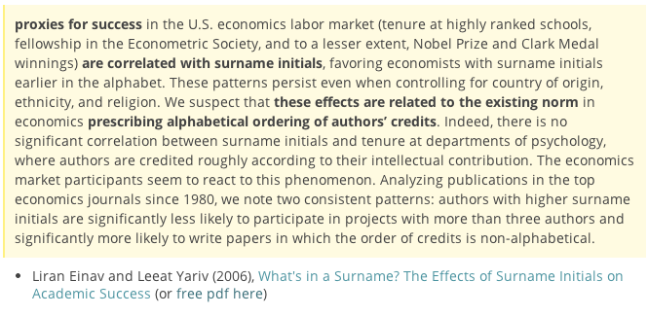

Name order effects in economics
Notes:
Turns out I had good reason to be upset.
In fields, like mathematics and economics, in which author name order is always alphabetical, and therefore all contributions are presumeably considered equal, it has actually been observed that you are more likely to get tenure in an elite department or to win a Nobel prize if your surname begins with a letter earlier in the alphabet. Professor Altman is more likely to be a star as an academic economist than Professor Zalaznick simply because of this alphabetical authorship practice.
This stuff really matters, especially for younger scholars and scientists, especially as the number of authors on research papers is growing across all disciplines.

Slide 7
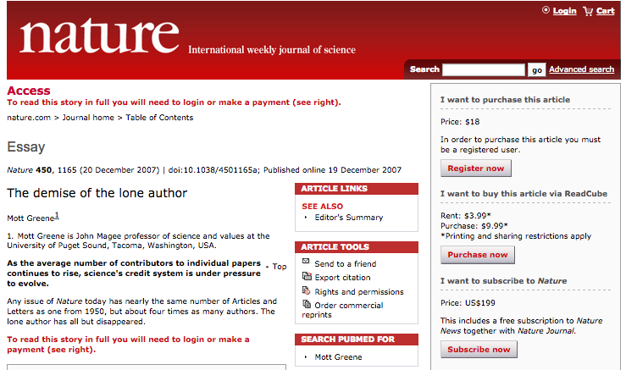
Notes:
If you were to do a google search on a term like “author inflation” for example it would reveal for you several recent articles with titles like this one, “the demise of the lone author.”
Sole authorship was the norm until about the 1920s. From the 30s through the 70s, publications with two authors were more common than lone author papers. Author numbers started to creep up in the 70s, and By 2000, the average number of authors in articles published in high-ranking medical journals was seven.

Slide 8
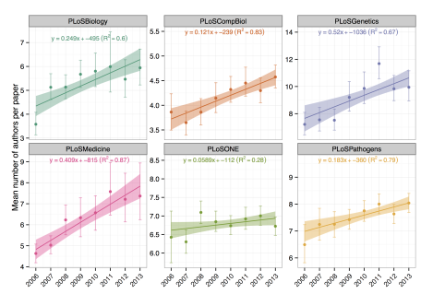

Notes:
Consider the increase in mean number of authors per paper between 2006 and 2013, as charted here in these 6 PLoS journals. In PLoS medicine for example -- the lower left graph in pink --we see the average number of authors during that timespan going from just under 5 to just under 8.

Slide 9
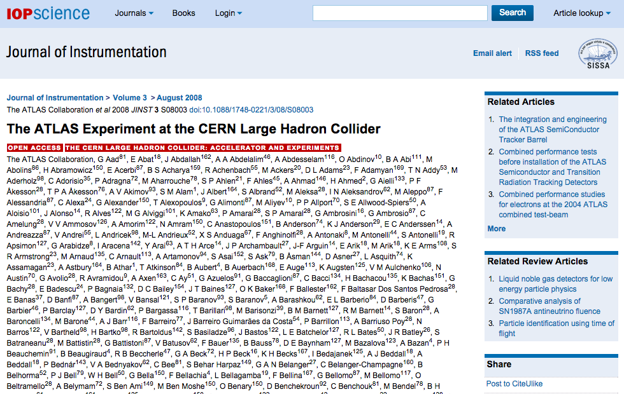
2,926 authors from
169 research institutions!
Notes:
And today it is not all that unusual for scientific publications to list hundreds or even thousands of authors, as you well know.
Consider publications in particle physics like this one about the Atlas experiment at CERN, with almost 3000 authors.
Now, whether you are author number 1 or author number 1500 on this paper, you can claim this paper in your CV and the citations it garners via your personal h-index. But if you are coming up for appt review, applying for a job, or submitting a grant proposal, there is a big difference between being first author and an obscure middle author.

Slide 10
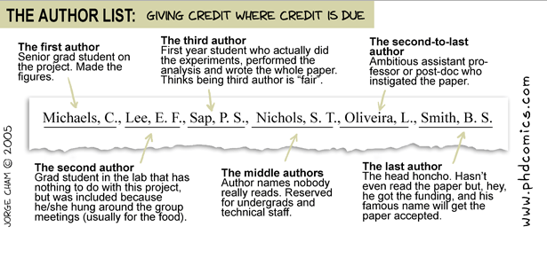
Notes:
Does authorship actually “give credit where credit is due”?
I assume you’ve all seen PHD comics before? This is a good one. The first author made the figures. the third author is the student who actually did all the work and to whom it doesn’t even occur it may not be fair to be listed in middle author position – the names that no one even reads; the last author is the lab head who hasn’t even read the paper. Funny only because it is absolutely realistic; this is what usually happens.
The order of authorship in the case of multi-authored works has no generally agreed upon truth or meaning, and typically does not clarify the contribution to the research in question…. with the result that credit is, in fact, often not given where credit is due.

Slide 11
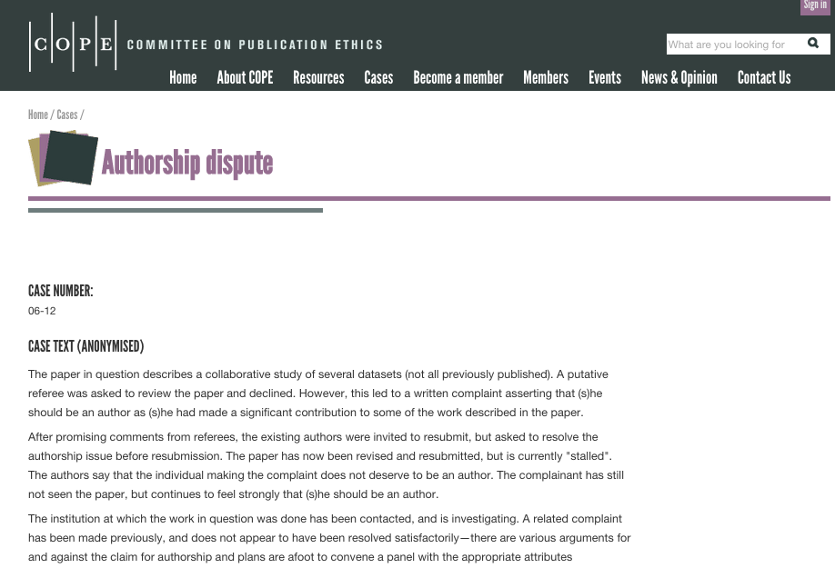
Notes:
And yet who gets credit for research and discovery has a huge impact on people’s lives. And so why do we persist with a system in which the incentives and conventions for authorship, citation, attribution, and credit are so dysfunctional and easily gamed?
Authorship disputes abound. The Committee on Publication Ethics in the UK advises editors and publishers on all aspects of publication ethics as well as cases of dispute or misconduct. This particular case, which is fairly representative, concerns an individual asserting rights to authorship that the other authors don’t agree with. READ

Slide 12
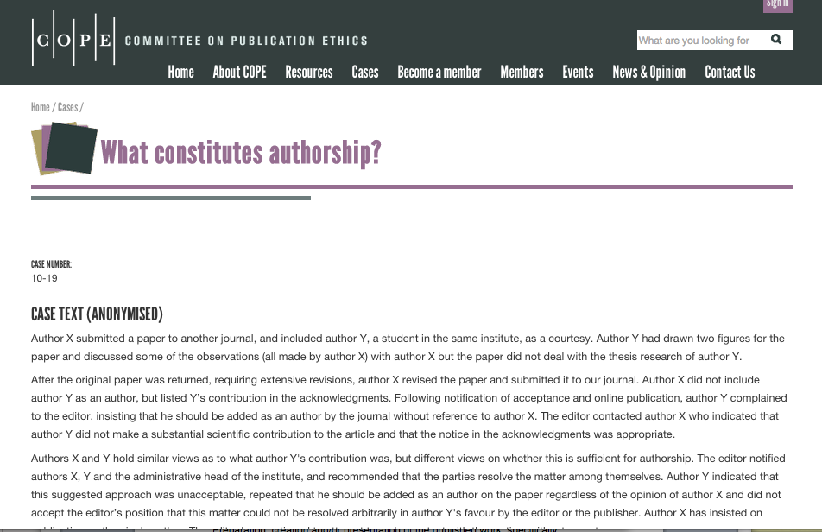
Notes:
READ Or in this example, we see authors agreeing on who did what but diverging on whether someone should be counted as an author. READ. Note this underscores an important point that defining what constitutes authorship is different from defining types of contribution. A point I will come back to.

Slide 13
The system of authorship, while appropriate for articles with only one author, has become inappropriate as the average number of authors of an article has increased; as the work of coauthors has become more specialized and relationships between them have become more complex; and as both credit and, even more, responsibility have become obscured and diluted.
Rennie, Yank , Emanuel, 1997
Notes:
There is a long history of work in the medical publishing arena devoted to capturing contribution in relation to accountability – which you can imagine is really important in medical science when people’s lives are at stack
A Long-time JAMA editor named Drummond Rennie is the name most publicly associated with this work, and back in 1997 Drummond wrote…

Slide 14
The International Committee of Medical Journal Editors recommends that authorship be based on the following four criteria:
Substantial contributions to the conception or design of the work; or the acquisition, analysis, or interpretation of data for the work; AND
Drafting the work or revising it critically for important intellectual content; AND
Final approval of the version to be published; AND
Agreement to be accountable for all aspects of the work in ensuring that questions related to the accuracy or integrity of any part of the work are appropriately investigated and resolved.
All those designated as authors should meet all four criteria for authorship, and all who meet the four criteria should be identified as authors.
Notes:
The ICMJE recommendations usually come to the fore when this topic is being discussed. Many publishers refer to them in their author policies and perhaps think that they have thereby addressed the contributorship issue. But note that these recommendations only define the criteria for authorship, READ. Anyone who contributed to the work but does not meet all four criteria gets labeled a contributor rather than an author.
But these recommendations fall short of providing a comprehensive description of standard contribution types or roles, because that’s not what they were intended to do. So authorship and contributorship are distinct constructs, and yet enforcing transparency around contribution will, I believe, go a long way toward mitigating the types of authorship abuse we talked about earlier.

Slide 15
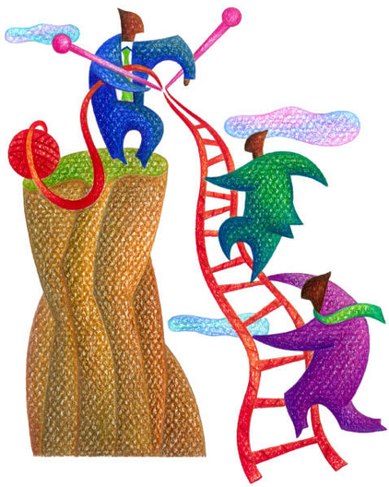
Notes:
I first became interested in this issue while working on promotion and tenure at Harvard a few years back.
I was reviewing a biostatistician’s tenure dossier and was struck by the different views of his scholarship as portrayed in the assessments of his peers, who argued that he was an outstanding scientist and the leading methodologist in his field, as compared with his publication record, which included exclusively multi-authored articles on which he was almost always a middle author. I had seen this pattern before and knew that this would be a difficult case for the presidential tenure committee to adjudicate. (And this at a place like Harvard, which has the luxury of being more qualitative than quantitative in its tenure review practices).

Slide 16
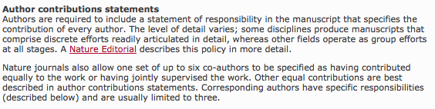
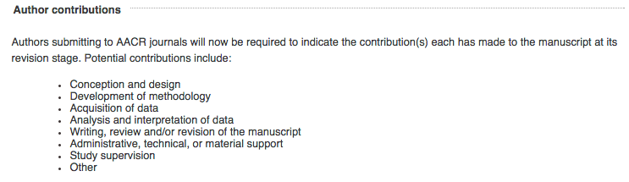
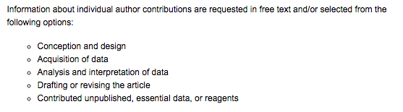
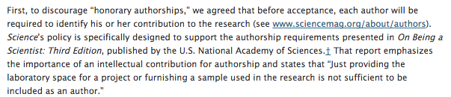
Notes:
What I wished for on his behalf was that his formal publication record somehow captured the fact that he was the lead contributor when it came to statistical methodology, on all of his papers.
In surveying the author policies of various journals, I found that several, especially on the biomedical side, were beginning to capture contribution in free-text form, and a few were even providing controlled vocabularies for contribution type (READ).
It occurred to me if that we could get publishers to converge on a standard set of contribution tags, since it seemed like there was already so much alignment, we could spread the practice of capturing contribution and actually turn it into machine readable information (in other words, metadata).

Slide 17
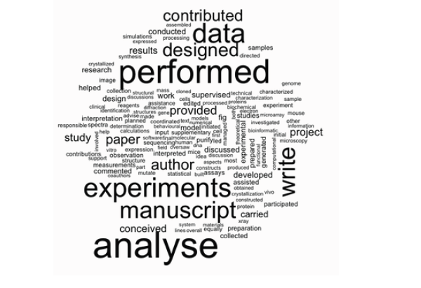
Micah Altman, MIT Libraries
Nature – 5 years
Notes:
I discovered, too, that several of my colleagues involved in helping launch ORCID were interested in topic.. We held a workshop at Harvard back in May of 2012, funded by the Wellcome Trust, and decided there to embark on the long project of creating a taxonomy.
The first step was analyzing free-text acknowledgement sections and author contribution statements.

Slide 18
supervised
synthesis
microarray
reagents
mouse
design
initial
interpretation
microscopy
discussed
developed
calculations
assisted
model
participated
statistical
collected
Micah Altman, MIT Libraries
conceived
Notes:
Some of the less frequent terms:
Grey – type of contribution:
blue – experiment specific or analytic
green – stage of the experiment
Other things that appear in this analysis:
(4) Degree of contribution – equal, contribute, supervise

Slide 19
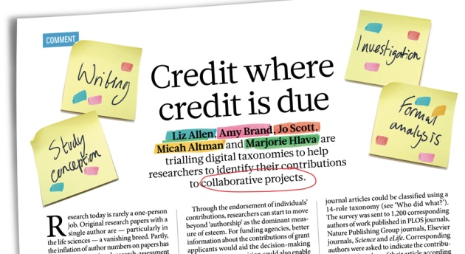
Harvard – Wellcome Trust effort
Nature 508, 312–313 (17 April 2014) doi:10.1038/508312a
Notes:
We used this and other data to draft a strawman taxonomy and ran a pilot with several publishers in which we had authors of 200 recently published papers from Nature, Elsevier, and PLoS use the taxonomy and report back on their experience. The results were largely positive. We published them as a Nature commentary about a year ago, and decided to embark on a more formal standards setting process.

Slide 20
Formalising the process is a good idea (n=5)
“I think formalizing this process is an excellent idea.” (eLife)
“The exercise is excellent and shall be done by all authors each time we have a scientific paper to submit.” (Nature)
“I think that using the taxonomy as part of the submission is an excellent idea!” (Nature)
All contributors should be recognised for the work they do (n=2)
“I think there is an unstated belief in Biology that only the person acquiring the funding should be the corresponding author. However, the students and postdocs who contribute to the conceptual design of the project could be considered corresponding authors also, should they so desire.” (eLife)
“It was easy because we have collectively agreed that this process is open to abuse by senior authors and made sure that all authors contributed equally to the project and paper.” (Nature)
Lead/supporting division is good (n=1)
“I think the division into leading and supporting role is a good one...” (eLife)
Please use this space to provide any comments to explain the rating you have given above.
(How easy or difficult did you find it to assign the contributions of the authors on '^f('publicationname')^' using the taxonomy in the previous questions?)
Base: n=72
Notes:
Now, I don’t have time in this presentation to go into all the results of that first survey but I wanted to show you a couple of statements that authors made in response to underscore how important this is to researchers --

Slide 21
Project CRediT working group
Liz Allen (Chair), Wellcome Trust
Amy Brand (Chair), Digital Science
Micah Altman, MIT Libraries
Helen Atkins, PLoS
Monica Bradford, Science/AAAS
Todd Carpenter, National Information Standards Organization
Jon Corson-Rikert, Cornell University
Jeffrey Doyle, Cornell University
Melissa Haendel, Oregon Health & Science University
Daniel Katz, National Science Foundation
Veronique Kiermer, Nature Publishing Group
Nettie Lagace, National Information Standards Organization
Emilie Marcus, Elsevier Inc
Walter Schaffer, National Institutes of Health
Jo Scott, Wellcome Trust
Gene Sprouse, American Physical Society
Victoria Stodden, Columbia University
Notes:
Emboldened to broaden our efforts, we created a multi-constituent working group that includes funders, publishers, standards bodies, institutions, and researchers. You can see the core members listed here. READ – Nature, Science, PLoS, Elsevier, NIH, NSF
Our project is being run under the joint auspices of NISO and CASRAI (Consortia Advancing Standards in Research Administration Information).

Slide 22
Term | Definition
Conceptualization | Ideas; formulation or evolution of overarching research goals and aims.
Methodology | Development or design of methodology; creation of models.
Software | Programming, software development; designing computer programs; implementation of the computer code and supporting algorithms; testing of existing code components.
Validation | Verification, whether as a part of the activity or separate, of the overall replication/reproducibility of results/experiments and other research outputs.
Formal Analysis | Application of statistical, mathematical, computational, or other formal techniques to analyse or synthesize study data.
Investigation | Conducting a research and investigation process, specifically performing the experiments, or data/evidence collection.
Resources | Provision of study materials, reagents, materials, patients, laboratory samples, animals, instrumentation, computing resources, or other analysis tools.
Data Curation | Management activities to annotate (produce metadata), scrub data and maintain research data (including software code, where it is necessary for interpreting the data itself) for initial use and later re-use.
Writing – Original Draft | Preparation, creation and/or presentation of the published work, specifically writing the initial draft (including substantive translation).
Writing – Review & Editing | Preparation, creation and/or presentation of the published work by those from the original research group, specifically critical review, commentary or revision – including pre- or post-publication stages.
Visualization | Preparation, creation and/or presentation of the published work, specifically visualization/data presentation.
Supervision | Oversight and leadership responsibility for the research activity planning and execution, including mentorship external to the core team.
Project Administration | Management and coordination responsibility for the research activity planning and execution.
Funding Acquisition | Acquisition of the financial support for the project leading to this publication.
Notes:
Through a process of broad community consultation, we have arrived at a 14-term tag set or vocabulary that is intended to capture high level contributor roles that function across the sciences. READ SOME ALOUD. All available at projectcredit.net.
Data curation – could be a library role
Funding acquisition as an interesting one. We’re not trying to say here that someone who acquires funding for a project should necessarily be included as an author, or what position he or she might have in the author list, but we’re saying that if that’s all you did – as with the case of many lab heads included as author – it should be transparent to readers that that’s all that you did. Make sense?

Slide 23
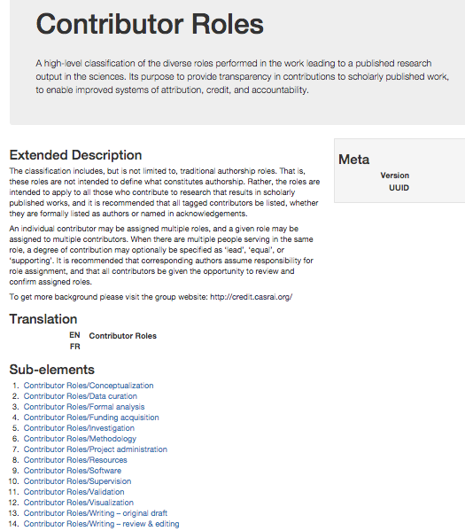
Notes:
Earlier this year, the taxonomy was published to the CASRAI data dictionary, as a first step towards standardization.
CASRAI can be viewed as a kind of front end to the more formal and technical standards process.

Slide 24
Header - Contributor Roles
The classification includes, but is not limited to, traditional authorship roles. That is, these roles are not intended to define what constitutes authorship. Rather, the roles are intended to apply to all those who contribute to research that results in scholarly published works, and it is recommended that all tagged contributors be listed, whether they are formally listed as authors or named in acknowledgements.
Notes:
Note that the header information for the taxonomy clarifies that we envision these roles being called out whether someone is listed as an author or only in the acknowledgements. We recognize that different journals and communities have different practices wrt authorship and at the same time we want to encourage recognition of non traditional contributions such as data curation and software
Our theory is that if we begin to recognize, in this way, roles that haven’t traditionally been authorship roles, we can begin to shift academic values about scholarly merit.

Slide 25
Header - Contributor Roles
An individual contributor may be assigned multiple roles, and a given role may be assigned to multiple contributors. When there are multiple people serving in the same role, a degree of contribution may optionally be specified as ‘lead’, ‘equal’, or ‘supporting’. It is recommended that corresponding authors assume responsibility for role assignment, and that all contributors be given the opportunity to review and confirm assigned roles.
Notes:
In addition, for the purposes of providing some authority control around role assignment, we specify that roles should be declared by corresponding authors, and affirmed by all contributors. The hope is that this attempt at transparency will eventually result in fewer authorship disputes.

Slide 26
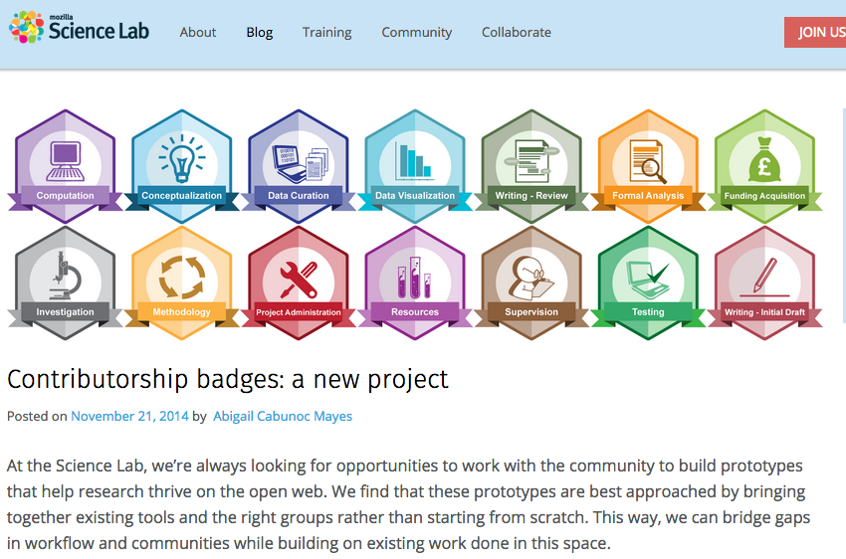
Notes:
We now have several initiatives embarking on early implementations of the credit taxonomy.
Mozilla Science Labs, in partnership with Biomedcentral, has jumped on board to create a set of badges based on the taxonomy. As I understand it, the badges reside in the browser when you’re accessing an article, but the data still has to be provided by the publisher.

Slide 27
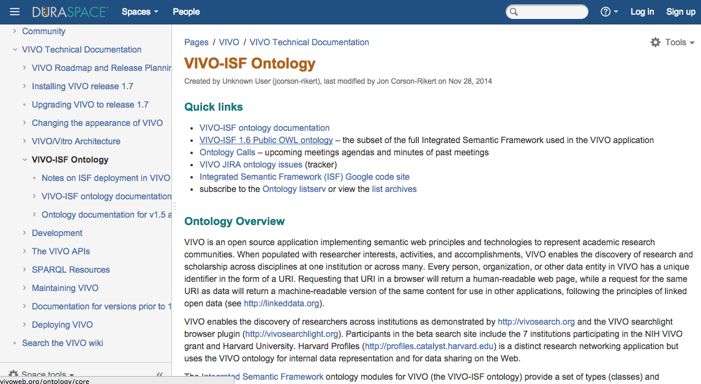
Notes:
There are plans underway to integrate the credit taxonomy into VIVO-ISF ontology, VIVO being the open source research networking platform now in use at many universities. Imagine this information, for example, enriching the kinds of expertise search that research networking platforms enable. Several speakers yesterday talked about profile and expertise systems. Contribution could be another data type that adds intelligence to this search functionality.

Slide 28
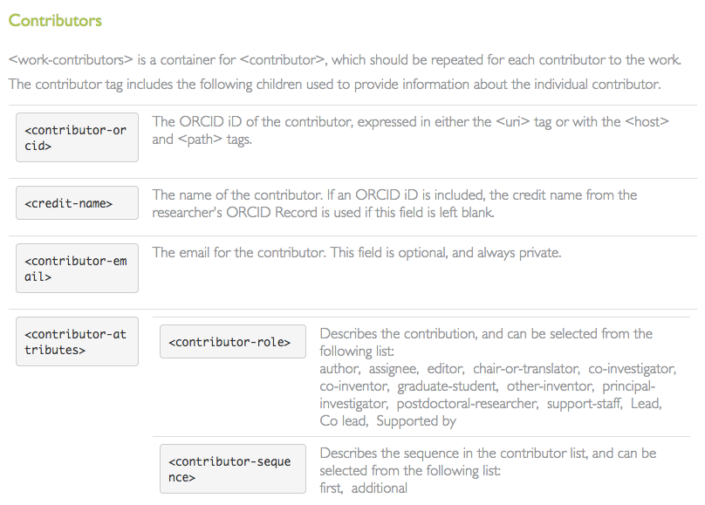
Notes:
And ORCID itself allows researchers to specify contribution roles for any work they add to their ORCID profile, and will be moving from the current set of terms, which is more geared toward job roles than contribution types, to the credit taxonomy shortly.
CrossRef and Symplectic Elements are both planning pilots.
These are very positive steps, but the self-declared approach here, falls short of the vision of having these tags truly integrated into the publishing metadata ecosystem.

Slide 29
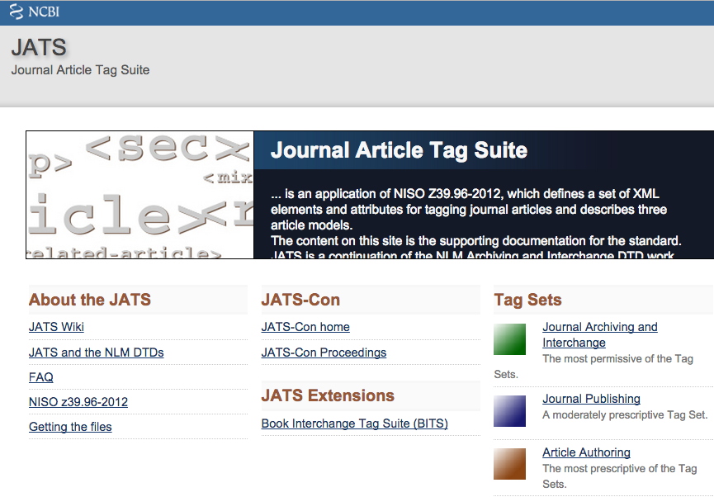
Notes:
In order for that to happen, one important step is having the tags integrated into the NISO-NCBI journal article tag suite, or JATS, and that is work that is now also getting underway (thanks to Margy Hlava). Manuscript tracking vendors are now starting to get on board, -- Aries, for example, is planning to incorporate the CRedIT taxonomy in version 13.0 for authors and co-authors and expects to make a formal announcement about this in coming weeks. The Electronic Journals Press, ejPress, is considering adding it to their author submission platform.
Several publishers, including PLoS, Science, Cell, and Nature, are committed to being early adopters.

Slide 30
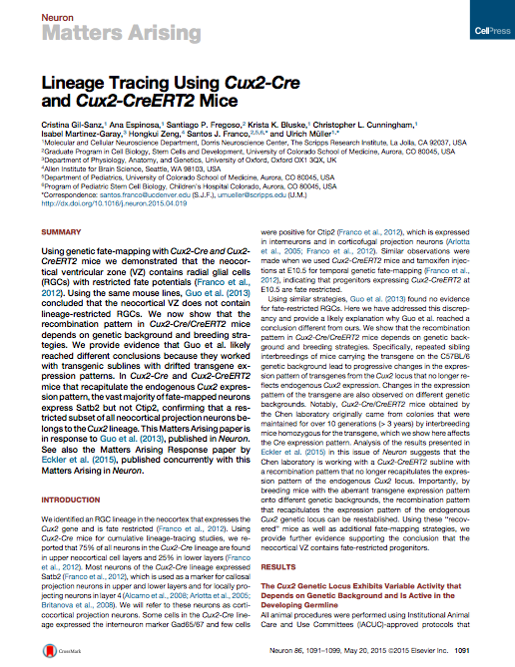
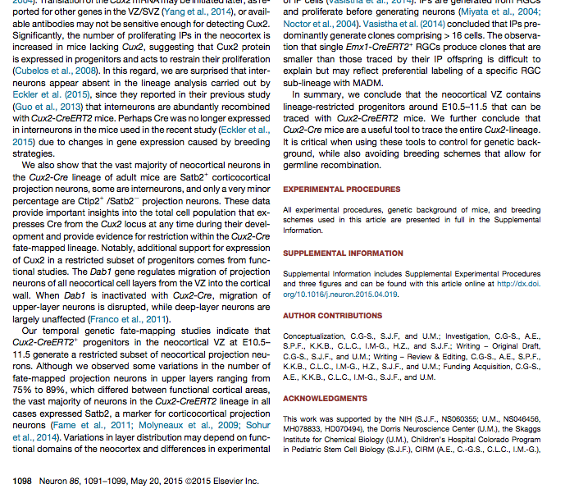
Notes:
Here you can see an example of a recently published Cell Press article with an author contributions section based on the CRediT taxonomy

Slide 31
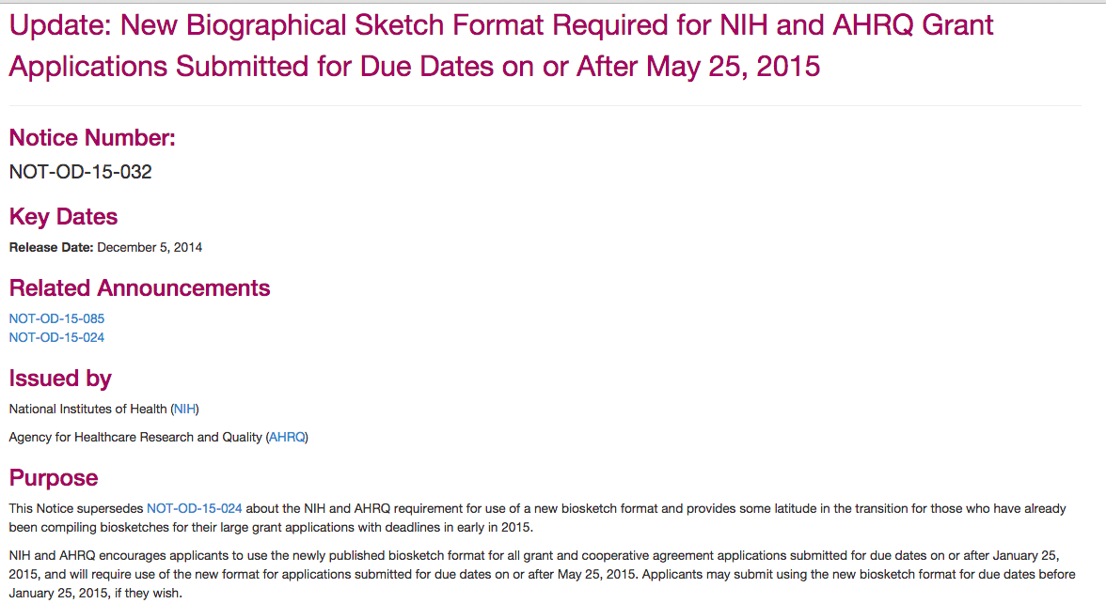
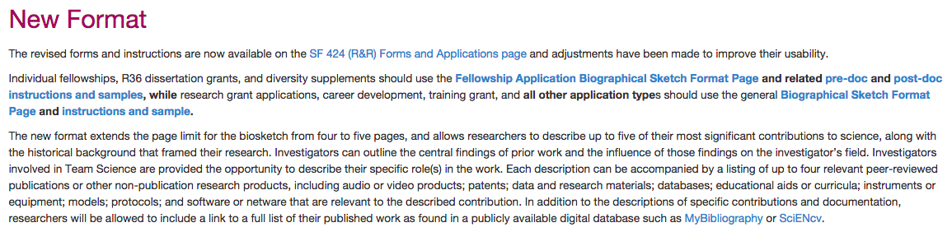
Notes:
…tomorrow, session at Scits meeting at NIH devoted to this topic

Slide 32



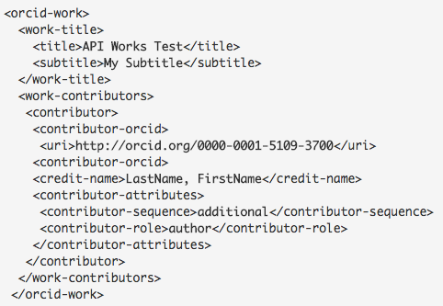


contrib
PUBLISHERS
Contribution
report
Notes:
The longer term vision here is Machine readability. How many of you are familiar with fundref?
Imagine Contributor role metadata collected by publishers via the article submission tracking process and deposited with CrossRef (similar to FundRef, I’m calling it contribref, although I am sure there is a more clever label to be had)
ORCID, which already pulls metadata from CrossRef, can then link CRs to ORCIDs, which means the orcid system is queriable for not only “which dois did this particular orcid have a role in creating” but also, then “what contributiion did this orcid make to this particular doi?” ORCID is really at the center of this.
Effectively, an evaluation committee could then pull an individual’s authoritative contribution report from ORCID; this would greatly facilitate the kinds of tenure decisions I talked about earlier.

Slide 33
projectcredit.net
Notes:
So that’s my vision. We’re not there yet, but we’re on the path. Libraries can play a key role by encouraging researchers to adopt ORCID, as many of you already are, and become smarter about curating their own record of scholarly impact. Library rationale for their role in these RIM and RRR efforts can include helping researchers and the institution get credit for their scholarly output.
If we can all work together to make this happen, we can have a positive impact on the accuracy of the scholarly record going forward and on the culture of research itself. Think fewer author disputes; think happier, better recognized graduate students.
And think of institutions, ultimately, having access to a more nuanced picture of their own research contributions and activities.
More info at the website you see listed here. Happy to take any questions.

