Slide 1
Why Ethnography?
Andrew Asher, PhD
University Libraries & Dept. of Anthropology
@aasher
asherand@Indiana.edu

Slide 2
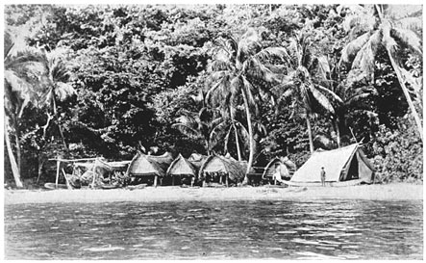
“Imagine yourself suddenly set down surrounded by all your gear, alone on a tropical beach close to a native village, while the launch or dinghy which has brought you sails away out of sight.”
Bronisław Malinowski
Argonauts of the Western Pacific (1922)

Slide 3
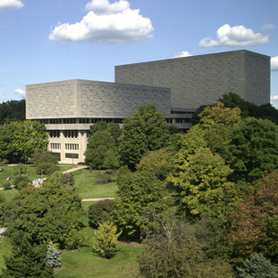
Herman B. Wells Library
Indiana University Bloomington

Slide 4
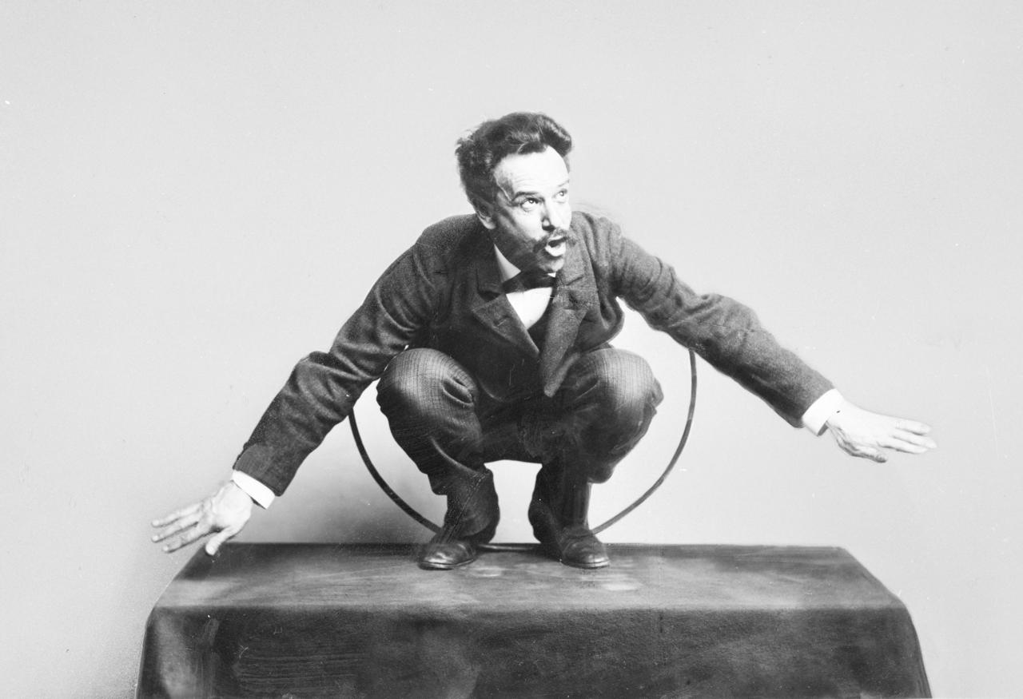
Image: Franz Boas posing for the Hamat’sa life group figures, US National Musuem, 1895 (Negs. #8293-8304 [Photos 16:76-77, 95-104]; NMNH Dept. of Anthropology: Photographs of artifacts; Box 6; Album 16; NAA).

Slide 5

What are Libraries?

Slide 6
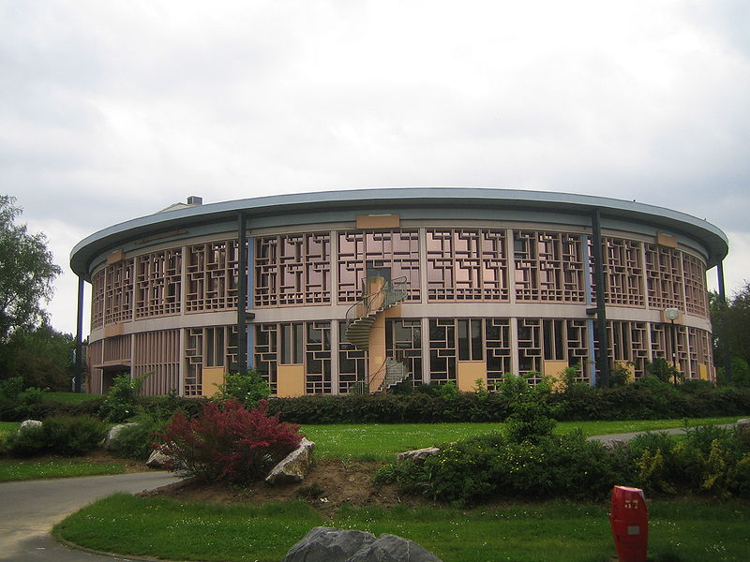
Lille University Library
“Asked about what they were doing in the Library on the day of our survey, 38 percent said they were completing an assignment for which they had used none of the tools supplied by the Library”
Pierre Bourdieu & Monique de Saint Martin, 1965
Image: Jiel Beaumadier (http://jiel.b.free.fr) (Own work) [CC-BY-SA-3.0], via Wikimedia Commons
Libraries are social institutions

Slide 7
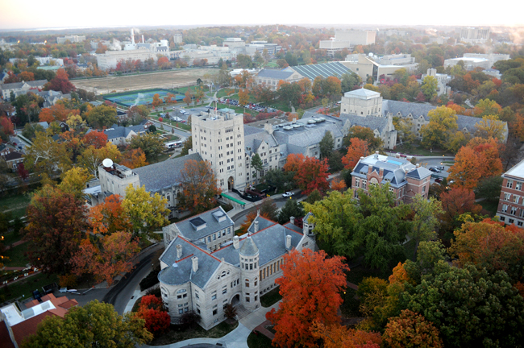
Libraries are social relations

Slide 8
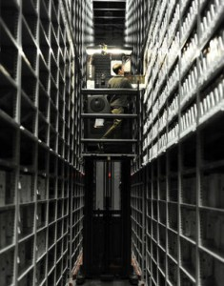
Image: Ruth Lilly Auxiliary Library Facility
https://blogs.libraries.indiana.edu/craiglab/2015/08/11/how-costs-factor-into-the-preservation-of-library-collections/
Libraries are
technologies.

Slide 9

Libraries are symbols
& symbolic systems
Image: Herman B Wells Library, https://blogs.libraries.indiana.edu/craiglab/files/2015/08/stacksWells-1.jpg

Slide 10
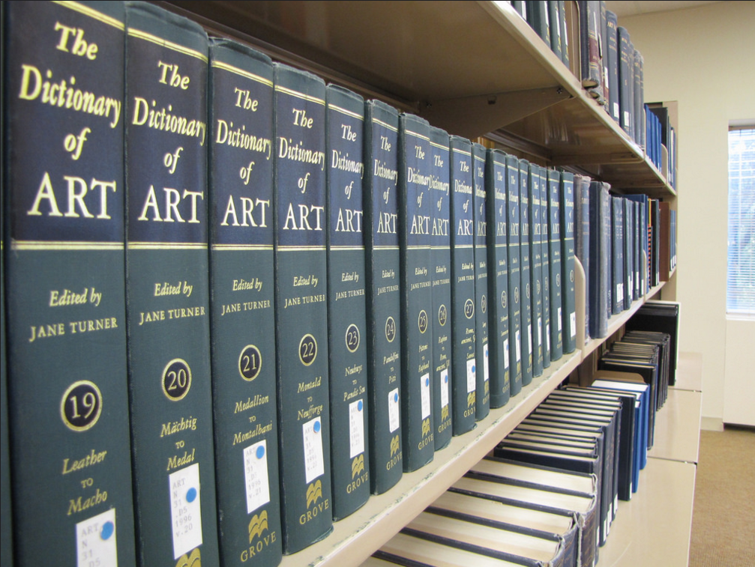
Libraries are beliefs

Slide 11

Libraries are practices

Slide 12
Culture
Social Relations|Technologies|Symbols|Beliefs|Practices

Slide 13
Ethnography
The art and science of describing a group, culture, or social process.

Slide 14
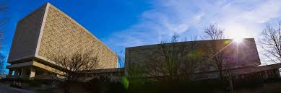

Slide 15
Empirical data
Real people in real situations

Slide 16
Why? & How?

Slide 17
Ethnography
&
Ethnographic

Slide 18

Ethnographic Toolkit
http://www.erialproject.org/publications/toolkit/
Image: https://thenounproject.com/term/toolbox/154266/ by Brian Ejar

Slide 19
Observational
Interviewing
Mapping/Visual

Slide 20

Observation

Slide 21
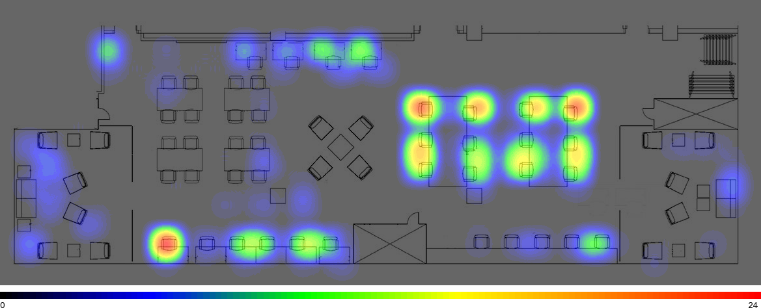
Graduate Commons- Indiana University

Slide 22
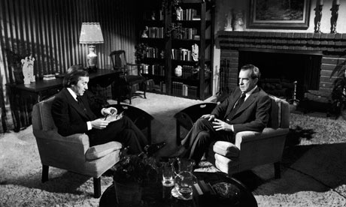
Interviewing
Image: http://www.theguardian.com/media/2011/jun/22/david-frost-nixon-bbc2

Slide 23
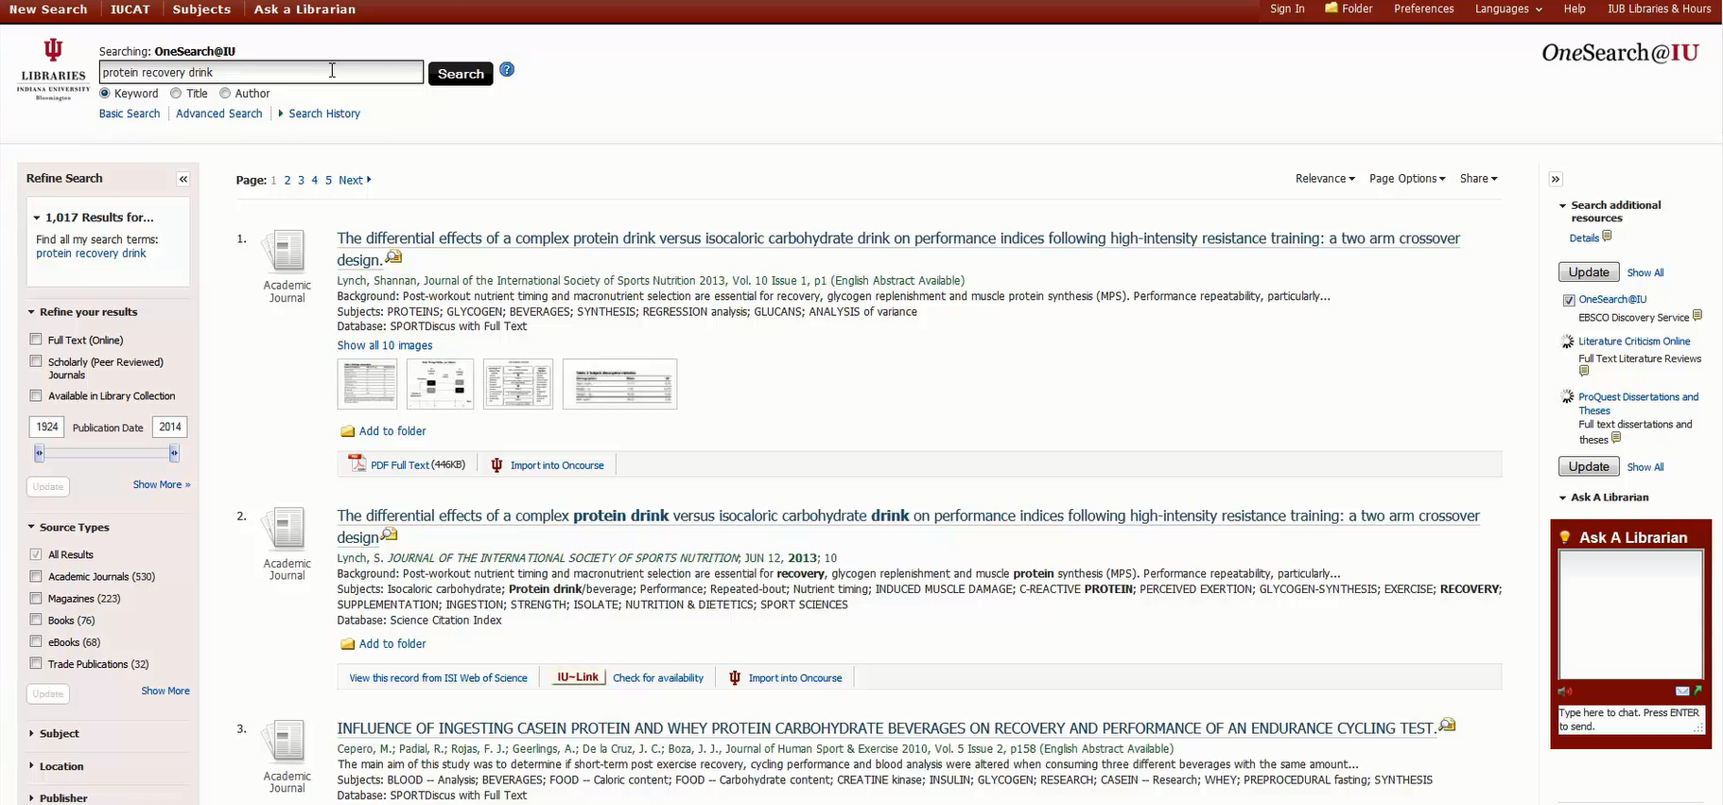
Research Practice Interviews

Slide 24
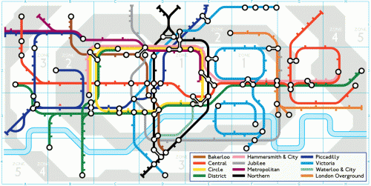
How do people find information?
How do they know its true?
Image Credit: http://www.google.com/doodles/150th-anniversary-of-the-tube
Notes:
During the ERIAL project I became fascinated with Search as a process and concept– especially with the questions of How people find information they need, and [even more importantly, how do they know this information is reliable, or true? These aren’t just questions that are important to understanding how students do research and write papers, but are also really fundamental anthropological questions about how people navigate the world. And as I observed students search, I began to think very critically about how tools and technologies mediate the discovery of information and how search algorithms in particular express a form of power that profoundly shapes the way people acquire knowledge.

Slide 25
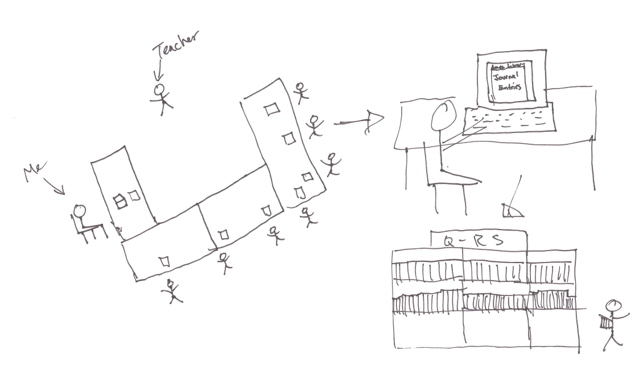
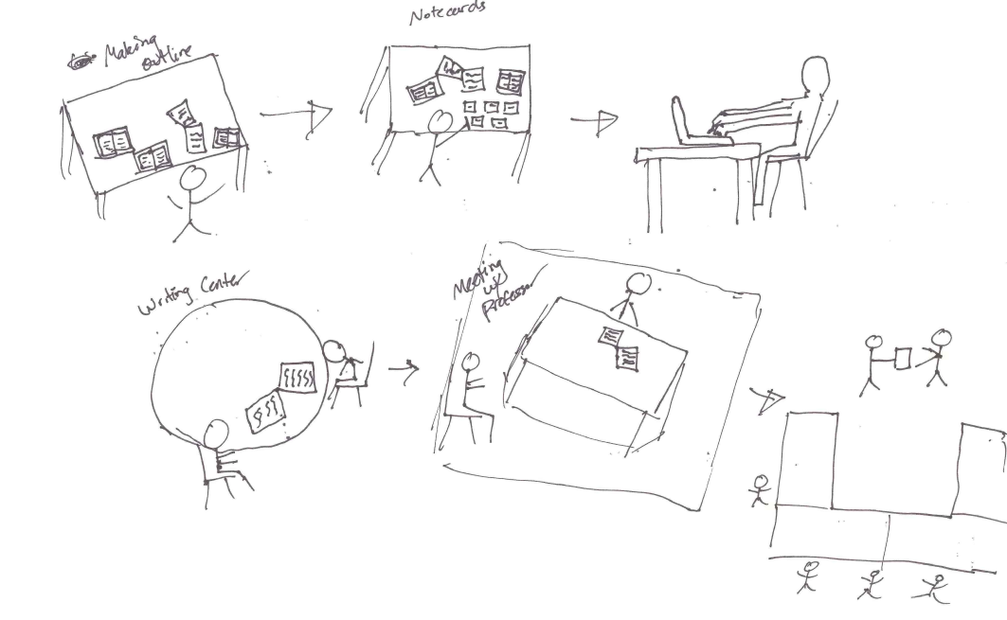
Retrospective Research Interviews
Evaluation
Assignment
Getting Help
Search and Discovery

Slide 26
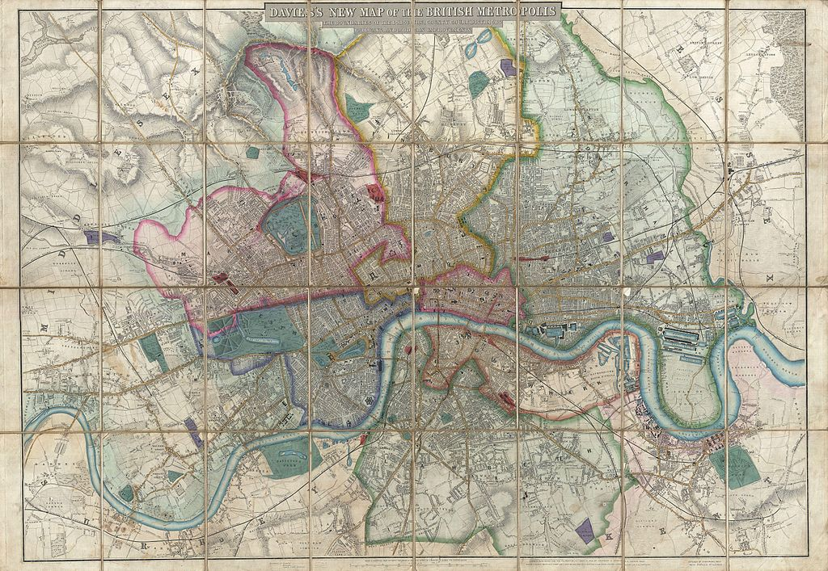
Mapping
Image: http://commons.wikimedia.org/wiki/File:1852_Davies_Case_Map_or_Pocket_Map_of_London,_England_-_Geographicus_-_London-davies-1852.jpg

Slide 27
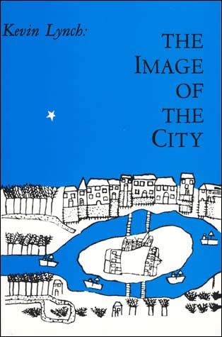
Cognitive Maps
(Sketch Maps)
Image: http://mitpress.mit.edu/sites/default/files/9780262620017.jpg

Slide 28
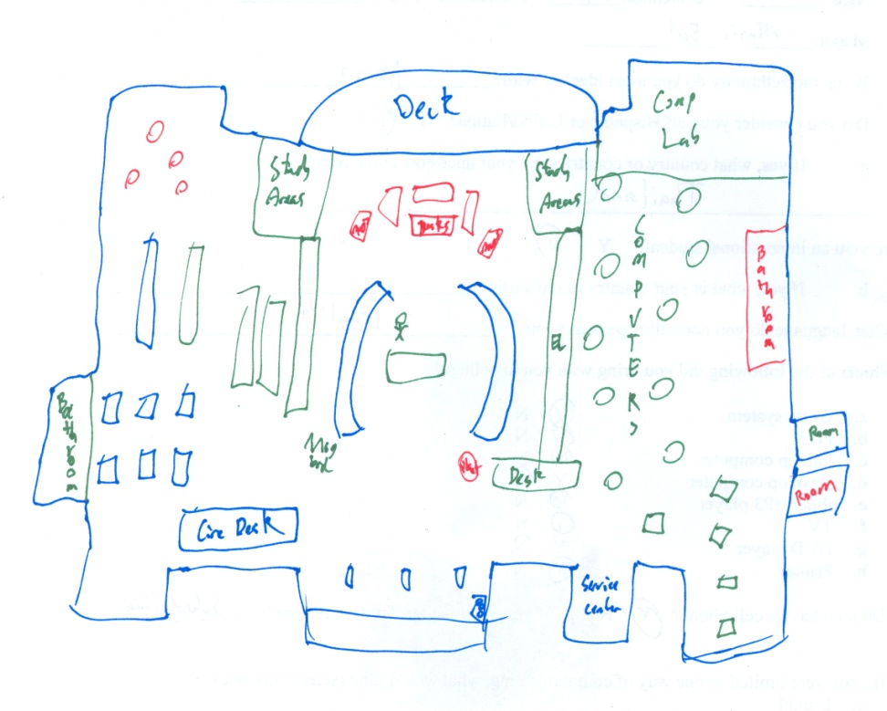
Notes:
Draw maps of the library, so we could see what things they associated with the library as a space or place

Slide 29
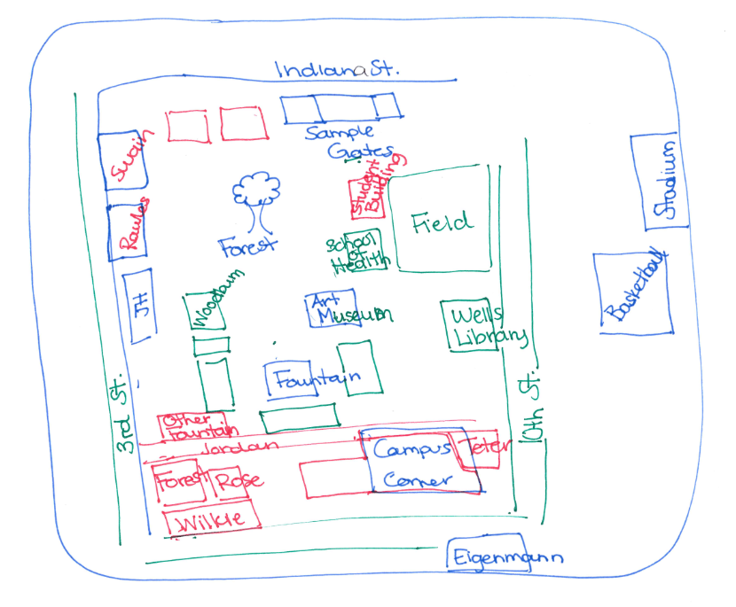

Slide 31
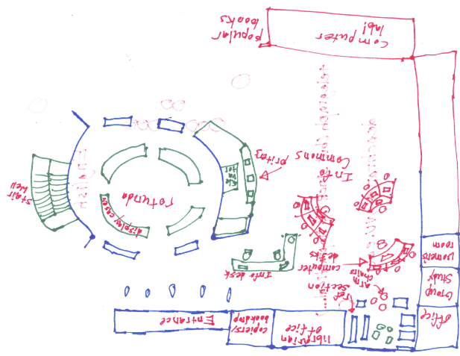

Slide 32
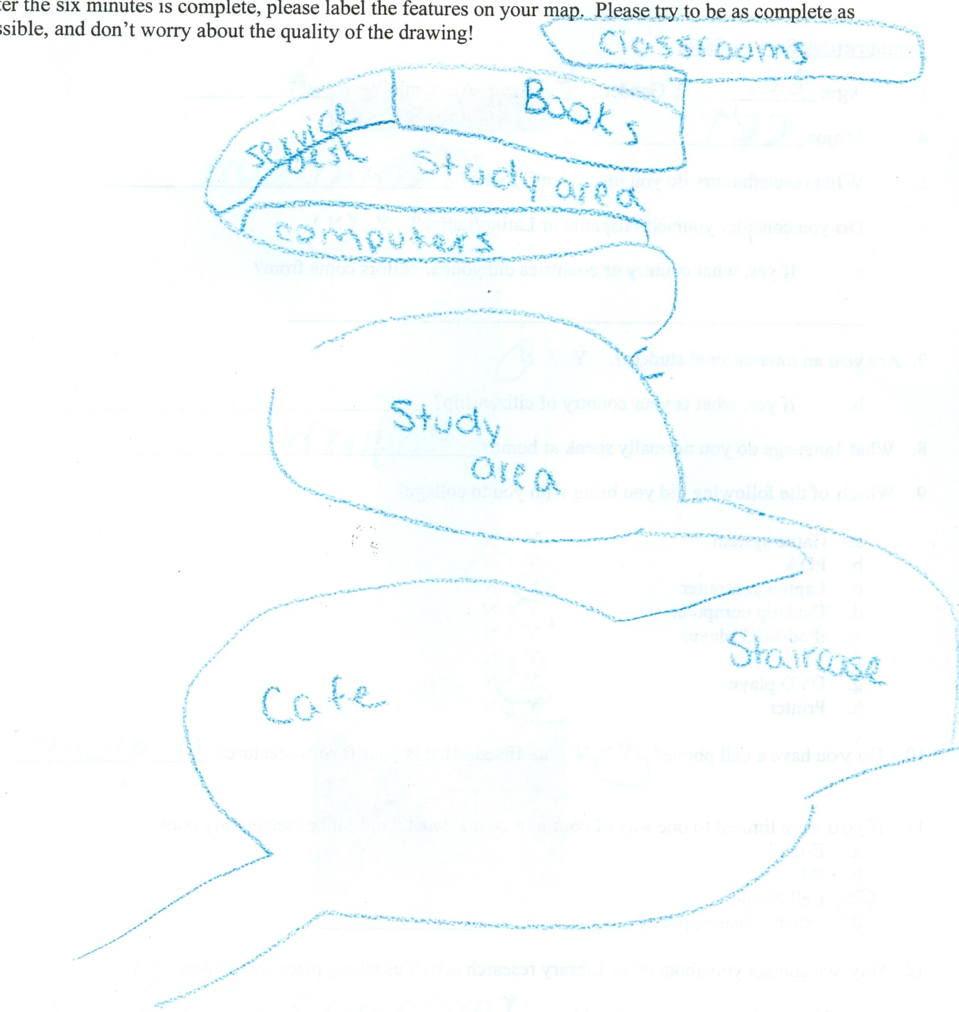

Slide 33
High Identification:
Reference/Circulation Desks
Computers
Study Areas/Labs
Low Identification:
Librarian Offices
Journals
Notes:
Read slide

Slide 34
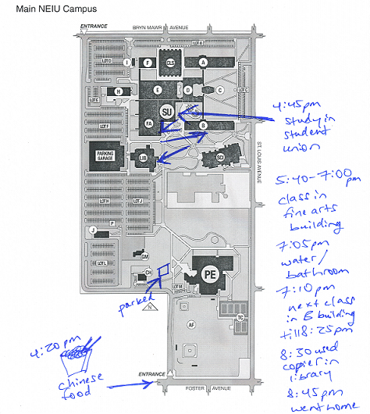
Day Maps

Slide 36
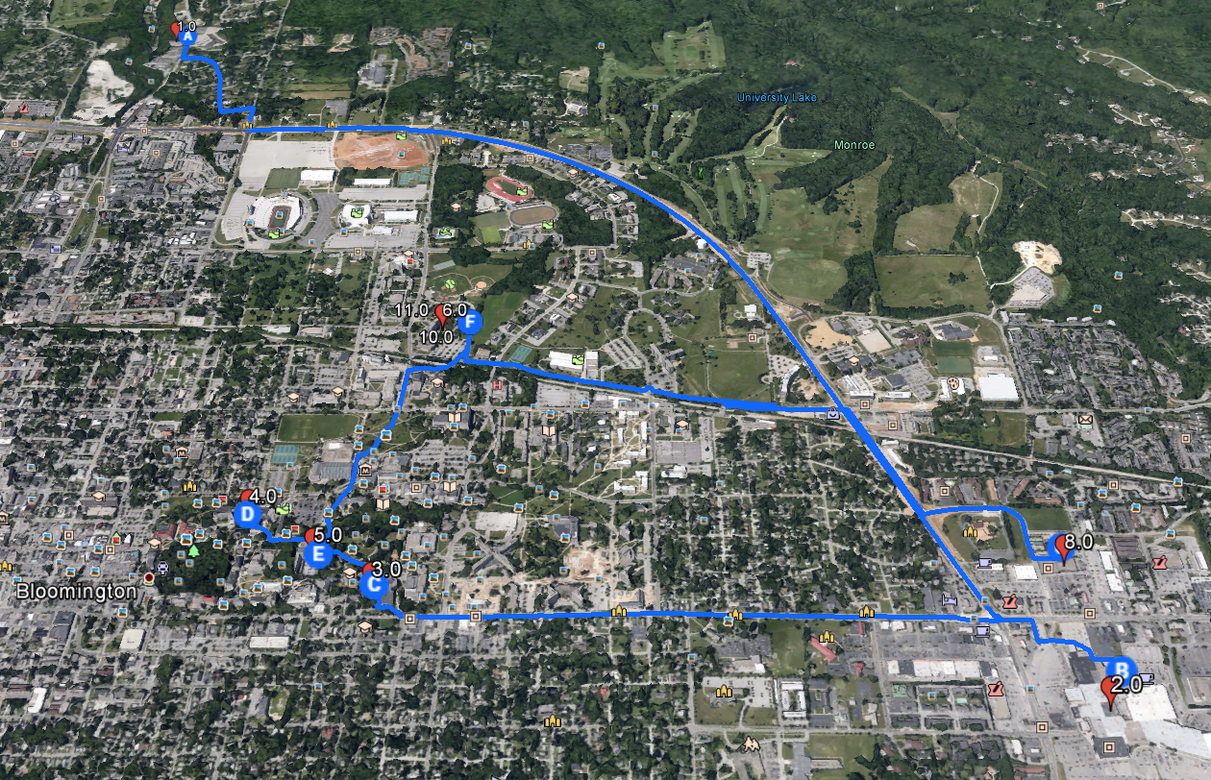

Slide 37
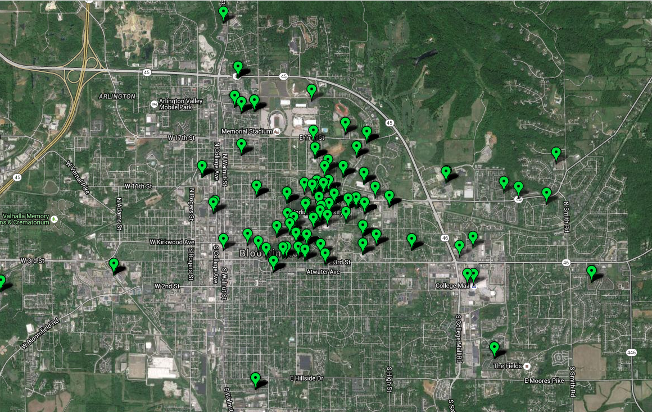

Slide 38
Comparative | Longitudinal
Library Ethnology

Slide 39

asherand@Indiana.edu
@aasher
Image: (Public Domain), http://thenounproject.com/term/information/22/

