Slide 1
OCLC Research Webinar - 11 August 2015
The Archival Advantage
Integrating Archival Expertise Into Management of Born-Digital Library Materials
Jackie Dooley
Program Officer
OCLC Research
#archival-advantage

Slide 2
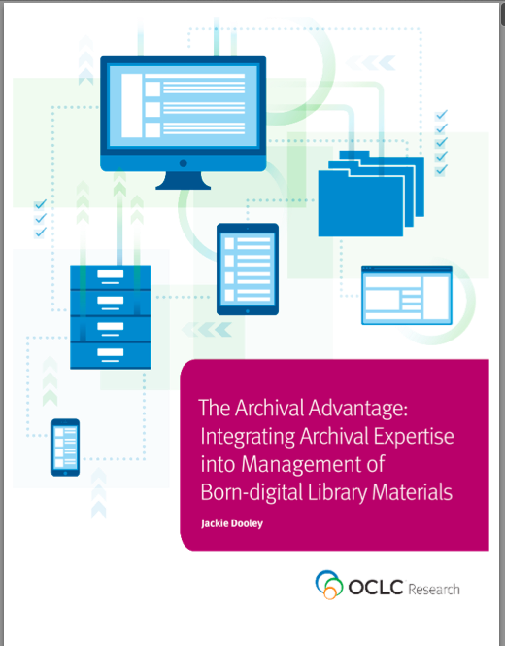
overview
Impetus for the work
Audience
External reviewers
Characteristics of Archival Materials
Characteristics of Born-digital Materials
Ten Areas of Archival Expertise

Slide 3

Impetus for the work

Slide 4
Why this essay?
Leverage archivists’ traditional skills and expertise to enhance digital library planning and management
Integrate archivists into the research library “mainstream”
Include archivists in planning for born-digital materials not in the custody of the archives

Slide 5

external reviewers

Slide 6
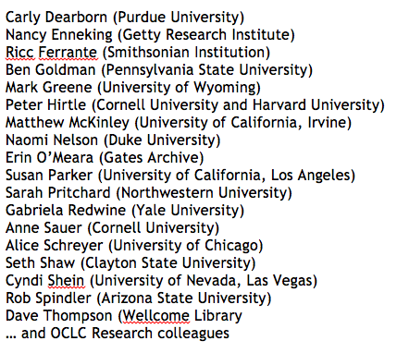
Who were our reviewers?
Demystifying Born Digital advisory group
Library directors
Heads of special collections
IT professionals

Slide 7
Reviewers’ big debate!
Is it “born digital” or “digital”?

Slide 8
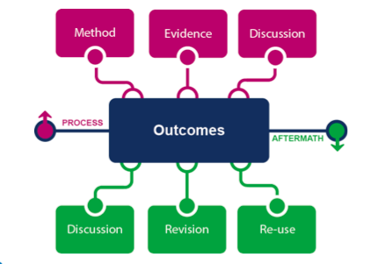
first, A tip of the hat to …
The Evolving Scholarly Record

Slide 9

“Much of what was considered “grey literature” in the print context is now digital. The scholarly and cultural records are becoming more complex as evidence, methodology, and discussion join more traditional outputs.”
--The Archival Advantage

Slide 10
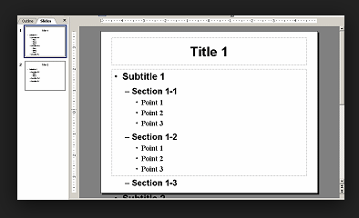
Report structure

Slide 11
Intro and audience
Characteristics of Archival Materials
Characteristics of Born-digital Materials
Ten Areas of Archival Expertise

Slide 12
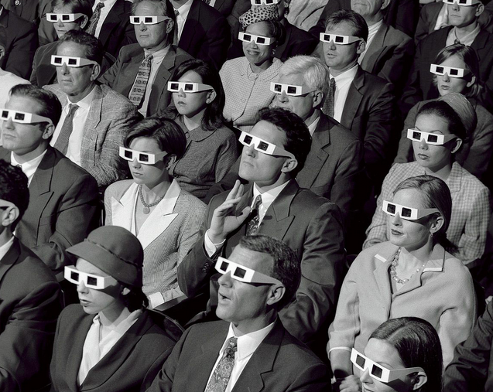
A. Audience

Slide 13
Primary Audience: The Library
“… the wide variety of library specialists who may be involved in digital programs and projects, particularly library directors and other managers who set the vision and direction for digital initiatives.
Others include technology specialists who manage systems and services in areas such as repository design, hardware and software management, digitization, and website development; data curation experts; preservationists who contribute their understanding of the functional and technical requirements for reliable long-term protection of content; liaison librarians who have close relationships with researchers and knowledge of research methods; and metadata specialists. Some of these actors may have expertise that overlaps with that of archivists.”

Slide 14
Secondary Audience: Archivists
  Arguments for becoming involved
  Areas of expertise described for a non-archivist audience
  Sample questions that may arise in the born-digital context
  Be the evangelists!

Slide 15
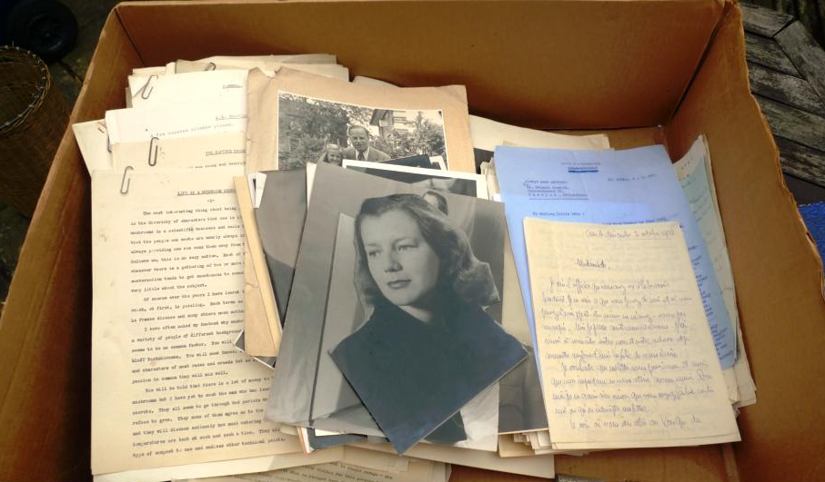
B. Characteristics of archival materials

Slide 16
Archival materials are …
Unique, unpublished, “originals”
Not publicly accessible until acquired
Small percentage warrant acquisition
Limited meaning without context
A discrete collection may be enormous and grow over time
Nonstandard IP considerations, must be actively managed
Privacy issues
Restrictions may be imposed by donor or library
Permanent retention is the norm; deaccession possible
Secure conditions for storage and use
Custodian is uniquely responsible for preservation
Standard descriptive elements often not present
Prevalence of collection-level metadata

Slide 17
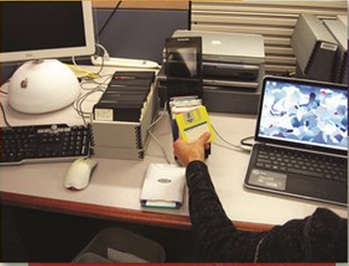
c. Characteristics of born-digital materials

Slide 18
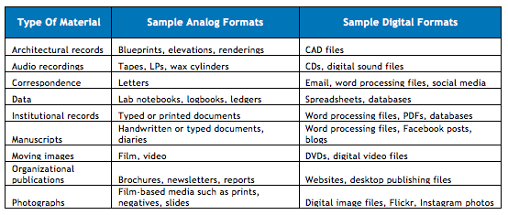
Sample analog-to-digital formats

Slide 19
Correlation with archival materials
All of these sample digital formats have “archival” characteristics
  The exception: formally published materials such as music CDs or commercial films
Any could be managed by either the archives or the broader library in e-environments such as …
  Institutional repositories
  Data repositories
  Web archives…

Slide 20
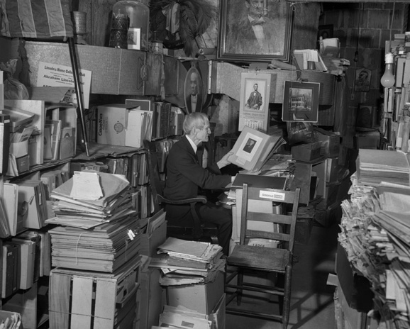
d. Ten areas of archival expertise

Slide 21
The ten areas
Ownership
Donor Relations
Intellectual Property
Appraisal
Context of Creation and Use
Authenticity
Restrictions on Access and Use
Transfer of Ownership
Permanence
Collection-Level Metadata

Slide 22
1. Ownership
  The issue: Legal ownership of the digital property
  Description: Almost everything is owned by someone (person or organization), but who that is may not be apparent. It is paramount to ascertain that the person offering the material has the right to do so.
  Sample question: What does “ownership” mean when it’s so easy to make identical copies of digital files?

Slide 23
2. Donor relations
  The issue: Factors to address when working with donors of digital content.
  Description: Issues may be sensitive, donors may be emotional, relationships can be long and must be actively stewarded
  Sample question: Do we have to ask the donor before we recover deleted files?

Slide 24
3. Intellectual property
  The issue: Legal ownership of the intellectual property rights.
  Description: IP rights are completely distinct from ownership of the property per se. Many people don’t realize they own any rights, let alone which ones.
  Sample question: What happens if the donor doesn’t know who holds copyright?

Slide 25
4. Appraisal
  The issue: Significance of the material in the context of the institution’s collecting mission.
  Description: The content must be sufficiently significant to warrant the costs of acquisition, preservation, access, and all other considerations. It must also have strong potential to attract users.
  Sample question: Should we consider the high cost of processing materials in obsolete digital formats as part of the appraisal decision?

Slide 26
5. Context of creation and use
  The issue: The circumstances under which the materials were produced and their relationship to the creator’s overall output.
  Description: The circumstances surrounding creation, ownership, custody, and intended use inform understanding of the material so that its full significance can be determined.
  Sample question: What sort of contextual information is needed for a website?

Slide 27
6. Authenticity
  The issue: Factors that help determine whether the materials can serve as an accurate, reliable record of the creator’s output.
  Description: An authentic document is one that is complete and unchanged since it left the custody of its creator.
  Sample question: Are the copies that we make for digital processing and preservation considered authentic?

Slide 28
7. Restrictions on access and use
  The issue: Limitations on access to or use of the materials.
  Description: Some materials must be held inaccessible due to the requirements of U.S. or State statutes, donor requirements, privacy issues, or intellectual property.
  Sample question: Are there issues associated with providing digital access to papers written by students as course assignments? What about letters of recommendation for students?

Slide 29
8. Transfer of ownership
  The issue: Terms and conditions to be discussed at the time of transferring ownership to the institution.
  Description: A formal deed of gift is necessary to avoid any future questions regarding whether the gift was legally made, as well as the terms that were specified.
  Sample question: Is a deed of gift necessary for a professor’s research data?

Slide 30
9. Permanence
  The issue: Preservation of the authentic materials into the foreseeable future.
  Description: Questions may arise about continuing to devote server space to material that has seen little or no use several years after being acquired.
  Sample question: If standard back-up systems aren’t sufficient for preserving files over the long term, what type of environment meets digital preservation standards?

Slide 31
10. Collection-level metadata
  The issue: Efficient creation of contextual and descriptive data for discovery and access.
  Description: Collection-level description is the archival norm. The usual identifying elements (author, title, extent, etc.) usually must be determined by the archivist because they don’t explicitly appear on the material.
  Sample question: Is one metadata record sufficient for this complex website?

Slide 32
The ten areas, redux
Ownership
Donor Relations
Intellectual Property
Appraisal
Context of Creation and Use
Authenticity
Restrictions on Access and Use
Transfer of Ownership
Permanence
Collection-Level Metadata

Slide 33
Read the report!
The Archival Advantage:
Integrating Archival Expertise into
Management of Born-digital Library Materials.
2015. Dublin, Ohio: OCLC Research.
    oc.lc/archadv

Slide 34
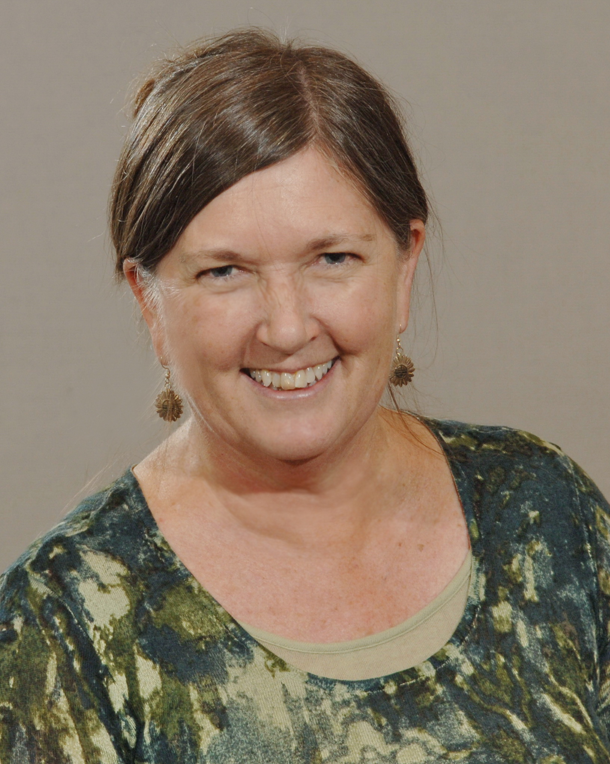
The Archival Advantage
Questions?
Jackie Dooley
Program Officer, OCLC Research
dooleyj@oclc.org
@minniedw

