Slide 1
New roles for research libraries in performance measurement?
OCLC Changing support/supporting change, 10-12 June 2014, Amsterdam
Paul Wouters, Centre for Science and Technology Studies (CWTS)
Notes:
[Onszelf voorstellen]

Slide 2

CWTS Profile
Innovative Contract Research Organization
Research Performance- and Benchmark studies
Tailor-made solutions
Input for strategic decision making
Based in Leiden, the Netherlands

Slide 3
Backbone: the Center for Science and Technology Studies (CWTS) of Leiden University
Recognised leader in the field for more than 20 years: bibliometrics, scientometrics, and research evaluation
Strong expertise: science and technology indicators & network analyses and mapping

Slide 4
Clients face key questions
How should we monitor our research?
How can we profile ourselves to attract the right students and staff?
How should we divide funds?
What is our scientific- and societal impact?
What is our area of expertise?
How is our research trans-disciplinary connected?

Slide 5
Products and Services
CWTS B.V. Monitoring & Evaluation
Performance Analysis
Leiden Ranking
Benchmark Reports
Researcher Profiles
Journal Profiles & Indicators

Slide 6
Products and Services
CWTS B.V. Advanced Analytics
Tailor-made analysis based on network analysis, text mining and visualisation techniques
Research strengths analysis
Find blind spots/hot spots
Identification of partners/potential new staff
Enhanced collaborative network analysis

Slide 7
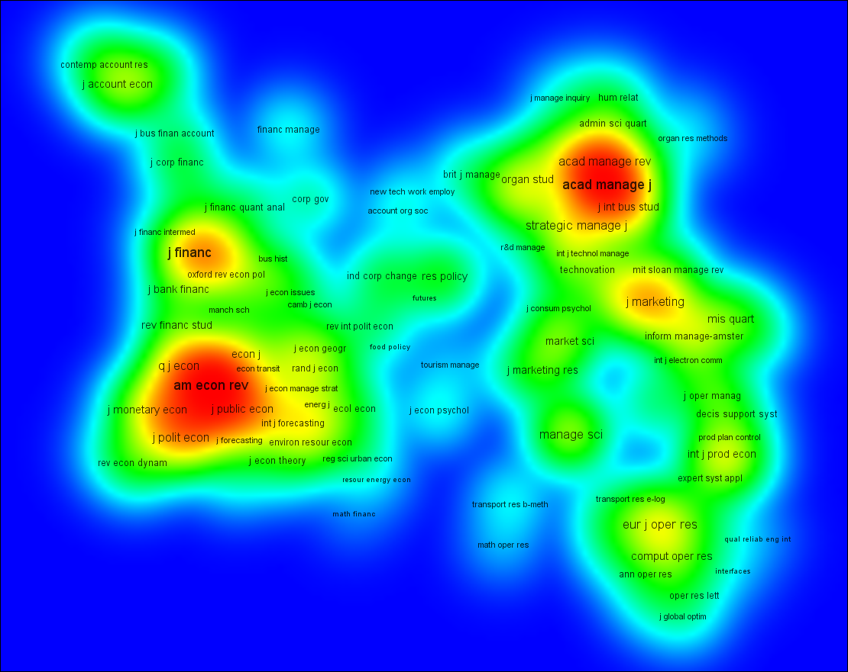
Products and Services
CWTS B.V. Advanced Analytics
Mapping & Network Analysis
VOSviewer 1.5.5
Readily available via www.vosviewer.com

Slide 8
Products and Services
CWTS B.V. Training & Education
CWTS Course 'Measuring Science and Research Performance'

Slide 9
New roles for research libraries
Increased bibliometric services at university level available through databases
Increased self-assessment via “gratis bibliometrics” on the web (h-index; publish or perish; etc.)
Emergence of altmetrics
Increased demand for bibliometrics at the level of the individual researcher
Societal impact measurements required
Career advice – where to publish?

Slide 10
Altmetrics projects

Slide 11
Promise and potential
Overcome limitations peer review
Be faster than citation analysis (“real-time”)
Be able to capture non-traditional influence and activity
Various projects at CWTS:
Open Access Laboratory (eg editorial board membership indicators)
Usage, readership, and download analysis (eg Mendeley)
What do altmetrics indicators signify or represent?
Google Scholar for SSH

Slide 12
Extensive comparison of altmetric indicators with citations (Costas, Zahedi, Wouters, 2014 – with Altmetric.com)
15%-24% of the publications present some altmetric activity

Slide 14
Extensive comparison of altmetric indicators with citations (Costas, Zahedi, Wouters, 2014 – with Altmetric.com)
15%-24% of the publications present some altmetric activity
Most active: social sciences, humanities and the medical/life sciences
Positive correlations but relatively weak correlations with citations
Altmetrics do not reflect the same concept of impact as citations

Slide 16
The ACUMEN project

Slide 17


Academic Careers Understood through Measurements and Norms
European 7th Framework collaborative project
Capacities, Science in Society 2010
Grant Agreement: 266632
9 institutional partners, in 7 countries

Slide 18


ACUMEN research
assessment of scientometric indicators in performance evaluation
Common Data Strategy
15 European countries
assessment of webometric (and altmetric) indicators
Bulgaria
Czech Republic
Denmark
Estonia
Finland
France
Germany
Hungary
Israel
Italy
Netherlands
Poland
Slovenia
Spain
United Kingdom
comparative analysis of peer review systems in Europe
4 Academic Disciplines
analysis of gender dimension in researcher evaluation
astronomy and astrophysics
public and occupational health
environmental engineering
philosophy (including history and philosophy of science)
ethnographic study of
important evaluation events
Tatum & Wouters | 14 November 2013

Slide 19

portfolio
aim is to give researchers a voice in evaluation
evidence based arguments
shift to dialog orientation
selection of indicators
narrative component
Good Evaluation Practices
envisioned as web service
expertise
output
narrative
influence

Slide 20
ACUMEN Portfolio
Career Narrative Links expertise, output, and influence together in an evidence-based argument; included content is negotiated with evaluator and tailored to the particular evaluation
Evaluation Guidelines
aimed at both researchers and evaluators
development of evidence based arguments (what counts as evidence?)
expanded list of research output
establishing provenance
taxonomy of indicators: bibliometric, webometric, altmetric
guidance on use of indicators
contextual considerations, such as: stage of career, discipline, and country of residence
Expertise
- scientific/scholarly
- technological
- communication
- organizational
- knowledge transfer
- educational
Output
- publications
- public media
- teaching
- web/social media
- data sets
- software/tools
- infrastructure
- grant proposals
Influence - on science
- on society
- on economy
- on teaching
Tatum & Wouters | 14 November 2013

Slide 23
Portfolio & Guidelines
Instrument for empowering researchers in the processes of evaluation
Taking in to consideration all academic disciplines
Suitable for other uses (e.g. career planning)
Able to integrate into different evaluation systems
©2014 Paul Wouters. This work is licensed under a Creative Commons Attribution 3.0 Unported License. Suggested attribution: “This work uses content from "New roles for research libraries in performance measurement?" © Paul Wouters, used under a Creative Commons Attribution license: http://creativecommons.org/licenses/by/3.0/”
Tatum & Wouters | 14 November 2013

