Slide 1
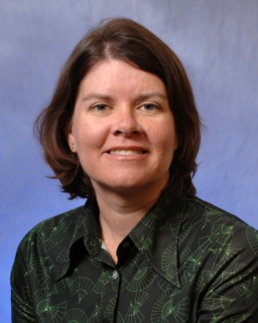
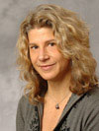
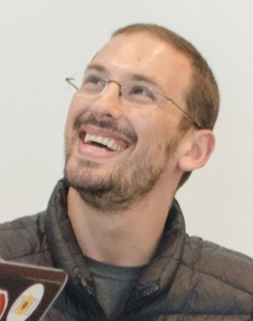
Wikipedia Library Project and OCLC full-text delivery
Merrilee Proffitt
Senior Program Officer
OCLC Research
Cindy Cunningham
Director, Partner Program
OCLC
Jake Orlowitz
Wikipedian
25 February 2014

Slide 2
“Discovery happens elsewhere…”

Slide 3
Why Wikipedia?
Highly ranked (#6 in global traffic via Alexa)
Starting point for research
Learning black market and GWR Google > Wikipedia > References
Ideologically aligned with library mission
Access to knowledge – for free
Shared appreciation of quality sources
Notes:
talk about why Wikipedia is important to libraries (highly ranked, ideologically aligned)

Slide 4
http://webempires.org/wikirank/top/
Notes:
Further challenges – library resources are pretty invisible, even to the earnest community of Wikipedia editors. Despite preference for free sources of information, it’s easy to link to free sites.
Worldcat comes in at #81 on this list, Hathi Trust not even in top 100.

Slide 5
Special challenges
In order to collaborate, negotiate with… who?
Community of editors is
Distributed and virtual
Pulled in by heterogeneous interests
Culture of combating “link spam”
Notes:
But there are challenges for working with such a dispersed, heterogeneous (in terms of interests) and virtual communities
Sarah will mention link spam challenges

Slide 6
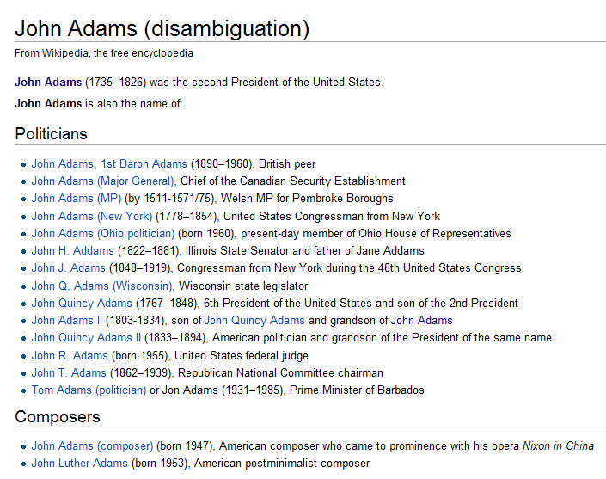
Shared challenges!
Disambiguation is important!
Wikipedia articles utilize Authority Control
Notes:
Whenever I talked to someone who was involved with Wikipedia, it turned out that disambiguation, for names in particular, is really important. Just as it is for libraries. There was is a growing recognition of the importance of library name authorities, and some Wikipedia articles have started incorporating authority control into articles. Not surprisingly, the German language Wikipedia had already started to add in authority control, and xxx articles has name authority data. But the English language Wikipedia has only 4k articles with authority data (on perhaps 1m articles about people – kind of difficult to tell).

Slide 7
Wikipedia’s mission
Imagine a world in which every person on the planet shares in the sum of all human knowledge. That is what we’re doing.
(for free, in the language of their choice)
Notes:
JAKE STARTS HERE wales and sanger, citizendium vs. wikipedia. bold, radical, awesome, inspiring. it is happening.
https://en.wikipedia.org/wiki/Wikipedia

Slide 8
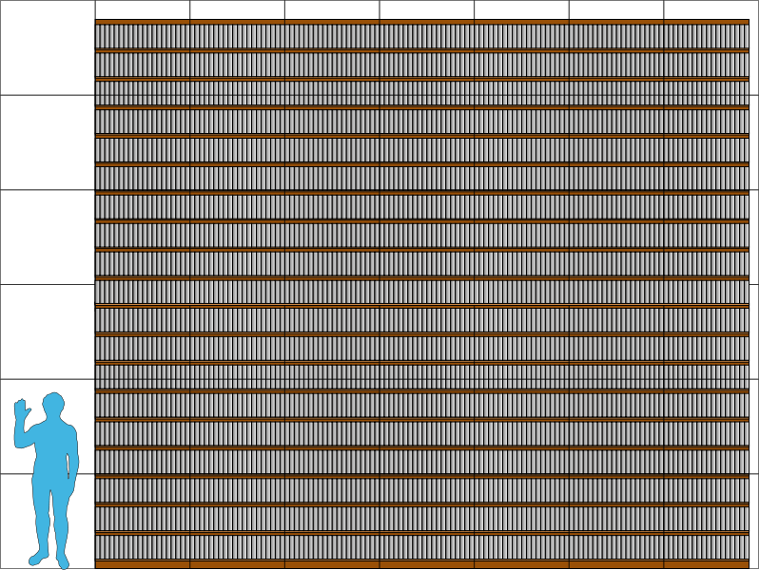
Wikipedia’s scale
30m articles, 4m English
16 million images
8000 views per second
500 million unique visitors per month
3.7 billion monthly mobile pageviews
2.1 billion edits, 700 million English
Notes:
5th largest website, 2000 times as large as encyclopedia britannica’s deluxe edition.

Slide 9
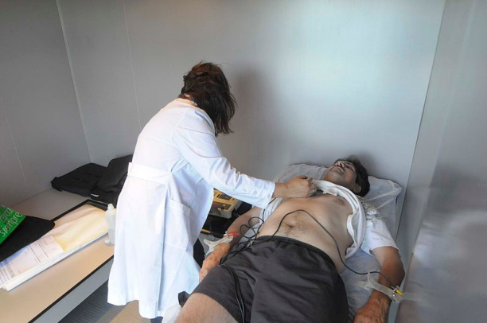
Ubiquitous usage
50% to 90% of physicians
35 to 70% of pharmacists
94% of medical students use Wikipedia
Notes:
Even doctors! A survey of clinical docs found that 90% looked up clinical info on WP, and the 10% who denied usage, stated they used it for background information--they were using it too.
http://www.slideshare.net/JakeOcaasi/wikipedia-and-medicine-keys-to-success

Slide 10
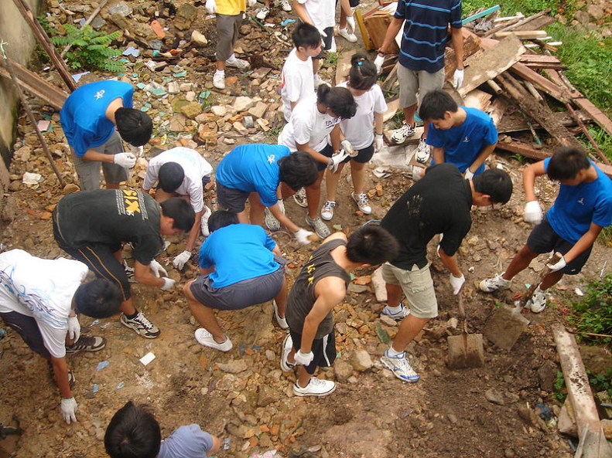
Wikipedia’s volunteers
20 million registered users
120,000 active editors
1,400 administrators
… working for free, with no central control
Notes:
crowdsourced collaboration, enwikipedia alone
https://en.wikipedia.org/wiki/Special:Statistics

Slide 11
Wikipedia’s pillars
Neutral point of view
Verifiability
Consensus
Civility
Open copyright
Notes:
*** describe don’t engage, reliable source, not a democracy, discourse, free culture https://en.wikipedia.org/wiki/Wikipedia:PILLARS

Slide 12
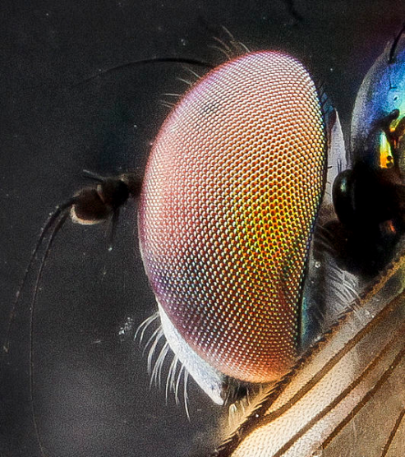
Wikipedia’s reliability
As accurate as Britannica
Errors fixed quickly over time
“Many eyeballs make all bugs shallow”
Virtual filter
Teaches information literacy
Notes:
*** Want students, professionals, and the public to read critically. At any given moment there could be an error, and we admit that. but what happens to an error in a traditional volume compared to on wikipedia?
https://en.wikipedia.org/wiki/Reliability_of_Wikipedia

Slide 13
Pedagogical benefit
Engaged students, global audience, realworld purpose
Unique assignment, peer feedback, cool and different
Media literacy, identify bias, evaluate credibility
Constructing knowledge, content gaps
Discourse, collaboration, community of practice
Expository writing, literature review, citation
Critical thinking, process reflection
Plagiarism, close paraphrasing, copyright
Digital citizenship, online etiquette, wiki code
Notes:
More motivated, interested, self-aware, thoughtful, capable researchers

Slide 14
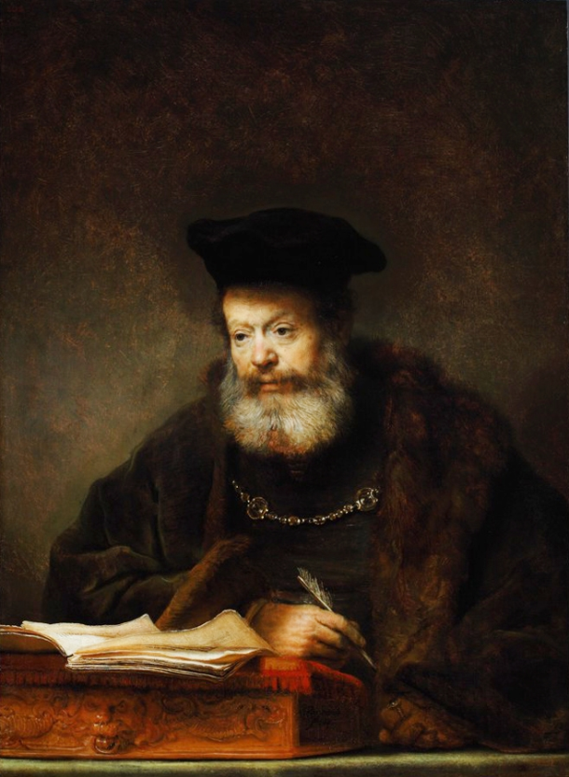
Wikipedia Visiting Scholars
Academic tradition
Research affiliates
Unpaid, remote positions
Full access to collections
Liason to Wikipedia’s community
Notes:
WVS, research affiliate + WIR (peter suber)

Slide 15
Wikipedia Visiting Scholars
What if every library or research institution had
one Wikipedia on staff to access their
collections and add to the encyclopedia?

Slide 16
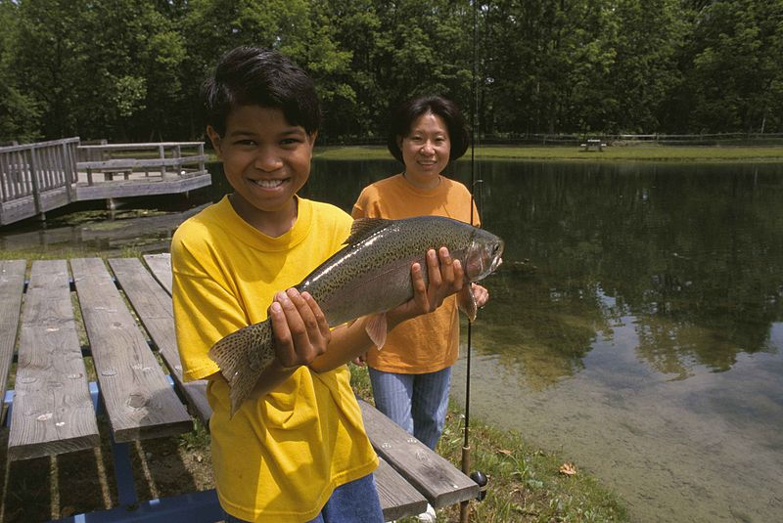
Fulfillment tool
OCLC Pilot
IP affiliation
Open URL
Proxy Resolver
University initiative

Slide 17
Fulfillment tool
What if every reference in a Wikipedia article
had the link to the full text source next to it?

Slide 18
OCLC Pilot Project using library digital collections
Deploying OCLC’s KnowledgeBase API on Wikipedia pages, using a downloadable script:
Provides authenticated users with direct access to full-text licensed by libraries
Improves workflows to support research and editing Wikipedia pages
Supports Wikipedia Loves Libraries program, by demonstrating the value-add that editors bring to libraries by highlighting library-hosted materials.

Slide 19
Access to electronic collections
An end user can be affiliated with
an institution via IP address
Glen Heights College
(a fictitious school)
”E” collections
Get full text

Slide 20
How the WCKB can work with Wikipedia pages
4. Via WorldCat KB API, Wikipedia displays link(s)
to full text content to editors on campus
Glen Heights College
Get full text

Slide 21
OCLC KnowledgeBase opportunity based on E-collection registration:
Participating institutions have registered ‘E’ in WorldCat
Electronic
X
1
X
8
X
441

Slide 22
Requirements for library participation:
Libraries must be full cataloging members of OCLC and subscribe to FirstSearch, which provides libraries with Discovery features.
Register your library’s e-collection:
Go to service config www.worldcat.org/config and register your collection manually by identifying all the collections to which your library subscribes. Or, start here to find the registration form to begin: http://www.oclc.org/knowledge-base/start.en.html, OR
Sign up for the PubGet service—your credentials are shared with OCLC which is authorized to harvest your holdings from content providers. Details of the PubGet service are here: http://www.oclc.org/knowledge-base/start.en.html

Slide 23
More options for registering your collection:
Output your library’s KnowlegeBase file from your resolver, and OCLC will process it for its WCKB. (SerialsSolutions, PBNet and Ebsco all allow sharing of their KBs.) Click here to learn how to export your KB: http://www.oclc.org/content/dam/support/knowledge-base/kb_tree.pdf
OCLC has agreements with EBL and Ebrary, where they will automatically send holdings information to OCLC as libraries buy their content, as authorized by the library. Libraries need to contact EBL and Ebrary to indicate that they wish their holdings to be sent OCLC. If they have no existing profile they need to begin with ‘Getting Started’ link http://www.oclc.org/knowledge-base/start.en.html and submit the KB request form for OCLC profiling http://www.oclc.org/content/forms/worldwide/en/wckb-request.html

Slide 24
Pilot Project outcomes:
Using the WorldCatKB will allow the library to see:
Total number of full-text article requests via the WCKB API,
Number of requests from a Wikipedia script to the WCKB API,
Number of times a full-text link is clicked through on the Wikipedia script.

Slide 25
What’s next, if you want to join us:
Notify Cindy Cunningham (cunningc@oclc.org), Merrilee Proffitt (proffittm@oclc.org) or Jake Orlowitz (jorlowitz@gmail.com) of your interest.
Be prepared to have your e-collection fully represented on the WCKB.
Have the support of your institution, if needed, to create a visiting status for the Wikipedia editor.
:Pilot for using the WCKB API will run March-May, 2014.

Slide 26
Merrilee Profffitt proffitm@oclc.org
Cindy Cunningham cunningc@oclc.org
Jake Orlowitz jorlowitz@gmail.com

