Slide 1
SUPPORTING CHANGE CHANGING SUPPORT
introducing the theme
Titia van der Werf
Senior Program Officer
Wednesday 11 June
ORLP meeting Amsterdam 2014

Slide 3
OCLC Research Library Partnership
like-minded institutions
focus on 1) efficient operations and 2) shaping new scholarly services
directly engaging senior managers
supported by OCLC Research

Slide 4
OCLC Research Library Partners – March 2014

Slide 5
Territory size of scientific papers published in 2001

Slide 6
Territory size of extra scientific papers published in 2001 compared with 1990

Slide 7
shifts leading to changes

Slide 8
the hype-curve of buzz words

Slide 9
following technology trends …

Slide 10
or … understanding

Slide 11
understanding how libraries are changing in the light of …
Shifting boundaries of the scholarly record and the stewardship ecosystem
Evolved understanding of researcher needs
Identify needs of scholars and researchers for the management of their scientific data and information in order to:
recommend strategies for library data management services
identify the knowledge and skills needed for effective data librarians.
Reusing collections for digital scholarship
Demonstrate ways in which the data describing unique collections can be used as the raw material of new forms of digital scholarship.
New ways of thinking about library metadata
Reconcile authority files and enrich them with authors of journal articles and links to all works published by an author, in order to facilitate identity management and position research libraries as partners in the organization of institutional researcher information.
How to make it easier for researchers and institutions to more accurately measure their scholarly output?

Slide 12
SUPPORTING CHANGE / CHANGING SUPPORT
research
libraries
universities

Slide 13
research
support
libraries
support
universities

Slide 14
Discipline-based RIs
VRE’s
e-collab
research
Text Mining
Centre
DH Centre
support
Library Networks
WorldCat
Local Discovery
Hathi Trust
libraries
universities

Slide 15
research
Library Networks
VIAF
Research and HE-Networks
DMP
CRIS
euroCRIS
libraries
support
universities
Repository
Research Assessment
OpenAIRE
eduroam

Slide 16
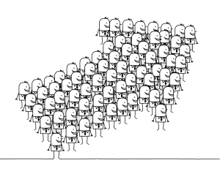
research
support
libraries
support
universities

Slide 17
Discipline-based RIs
VRE’s
e-collab
research
Text Mining
Centre
DH Centre
Library Networks
VIAF
Research and HE-Networks
Local Discovery
CRIS
euroCRIS
libraries
universities
Repository
Research Assessment
OpenAIRE
eduroam

Slide 18
Discipline-based RIs
VRE’s
e-collab
research
Text Mining
Centre
DH Centre
Library Networks
Research and HE-Networks
VIAF
euroCRIS
CRIS
Local
Discovery
libraries
universities
Research Assessment
Repository
eduroam
OpenAIRE

Slide 19
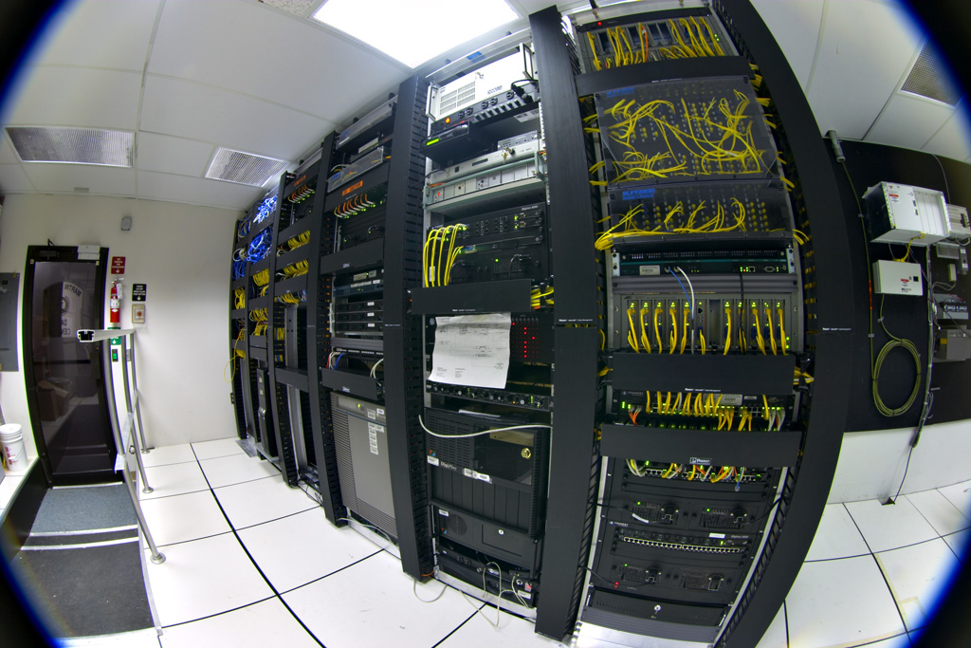

Slide 20
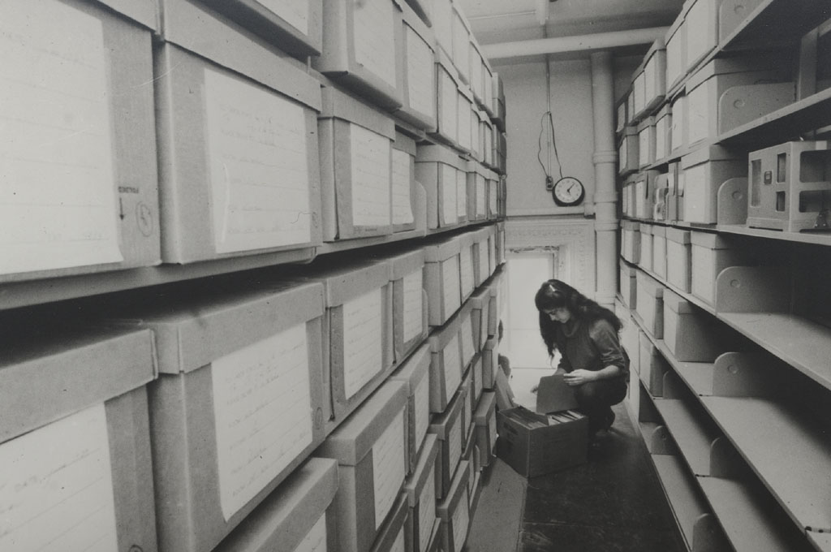

Slide 21
Titia van der Werf
titia.vanderwerf@oclc.org

