Slide 1
Our Format Transitions
Roger C. Schonfeld
@rschon
rcs@ithaka.org

Slide 2
Journals

Slide 3
Collecting format
Faculty Members: “If my library cancelled the current issues of a print version of a journal but continued to make them available electronically, that would be fine with me.”
Notes:
Design Notes:
You can use this as the question page template.

Slide 4
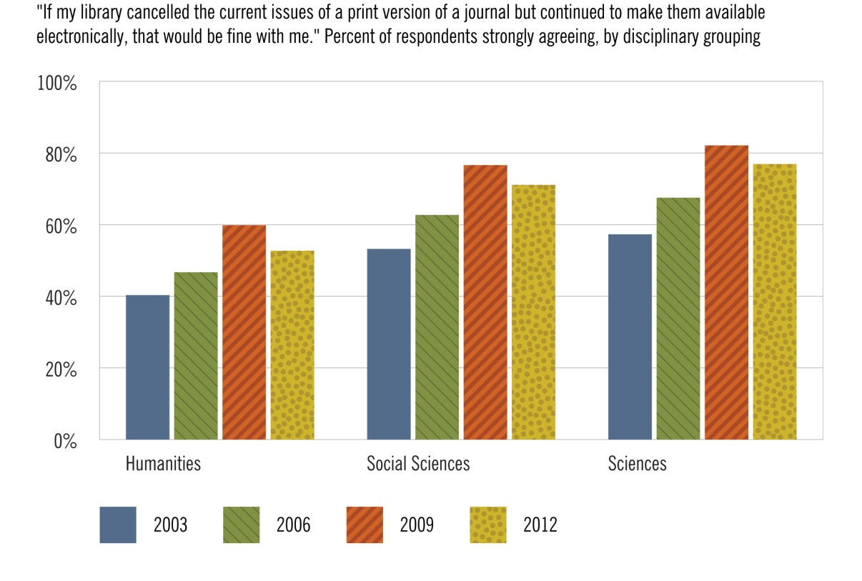
Source: Ithaka S+R US Faculty Survey 2012
Notes:
Faculty members have become moderately less comfortable with libraries cancelling current issues of print journals.

Slide 5
Publication format
Faculty members: “I am completely comfortable with journals I use regularly ceasing their print versions and publishing in electronic-only form”
Academic library directors: “I am completely comfortable with journals my library subscribes to ceasing their print versions and publishing in electronic-only form.”

Slide 6
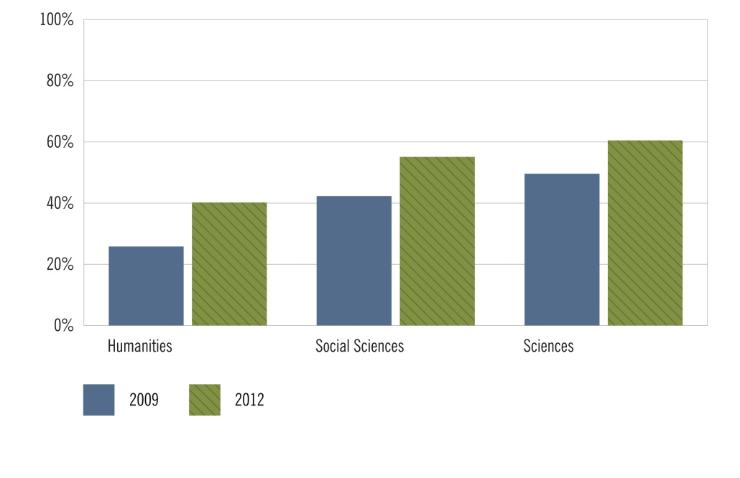
Source: Ithaka S+R US Faculty Survey 2012
Notes:
Faculty members are becoming more comfortable with journals ceasing their print versions.

Slide 7
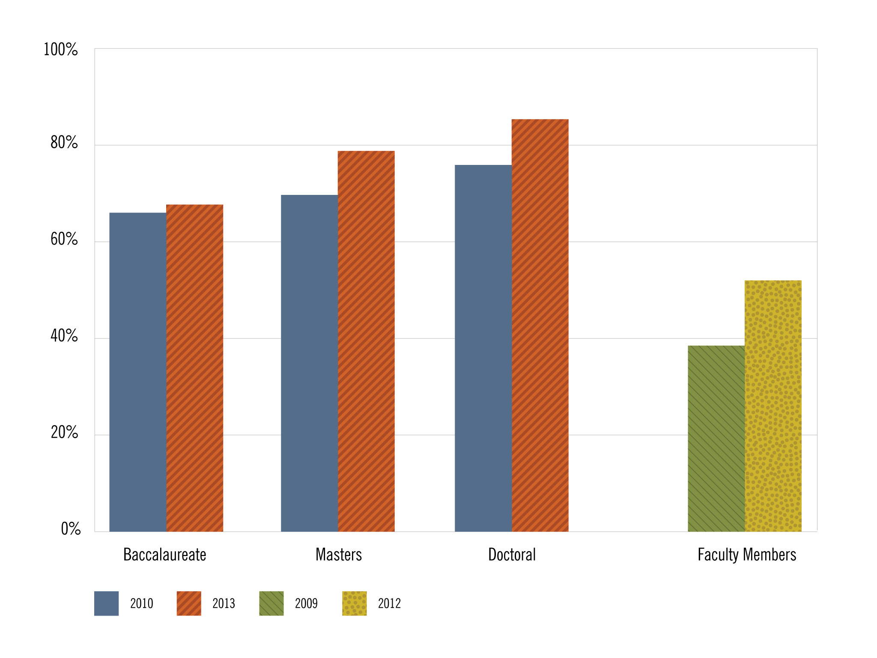
Source: Ithaka S+R US Library Survey 2013; Ithaka S+R US Faculty Survey 2012
Notes:
Design Notes:
Please remove figure number and put question on new slide preceding chart. Can be text in PPT, not an image.

Slide 8
Collections Management
Academic Library Directors: “Within the next five years, the use of online or digitized journals will be so prevalent among faculty and students that it will not be necessary to maintain library collections of hard-copy journals.”
Notes:
Design Notes:
You can use this as the question page template.

Slide 9
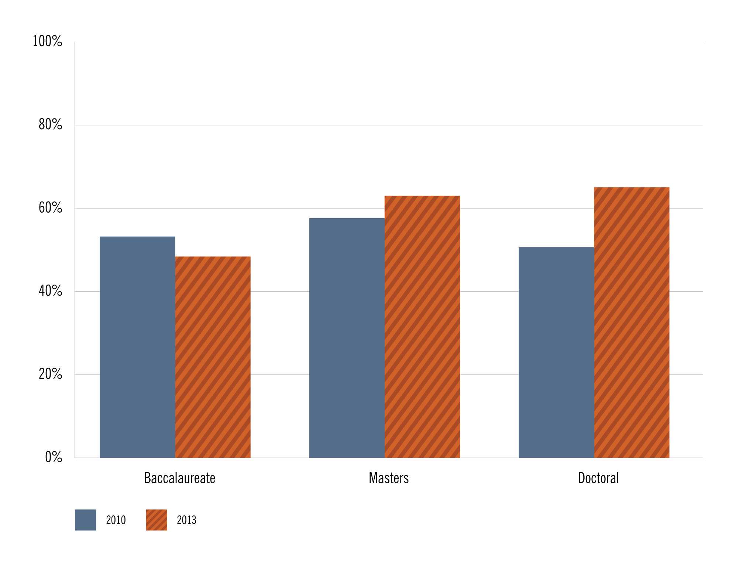
Source: Ithaka S+R US Library Survey 2013
Notes:
Design Notes:
Please remove figure number and put question on new slide preceding chart. Can be text in PPT, not an image.

Slide 10
Backfiles Format
Faculty Members and Academic Library Directors:
“Assuming that electronic versions of journals are proven to work well, I would be happy to see hard copy collections discarded and replaced entirely by electronic collections.”

Slide 11
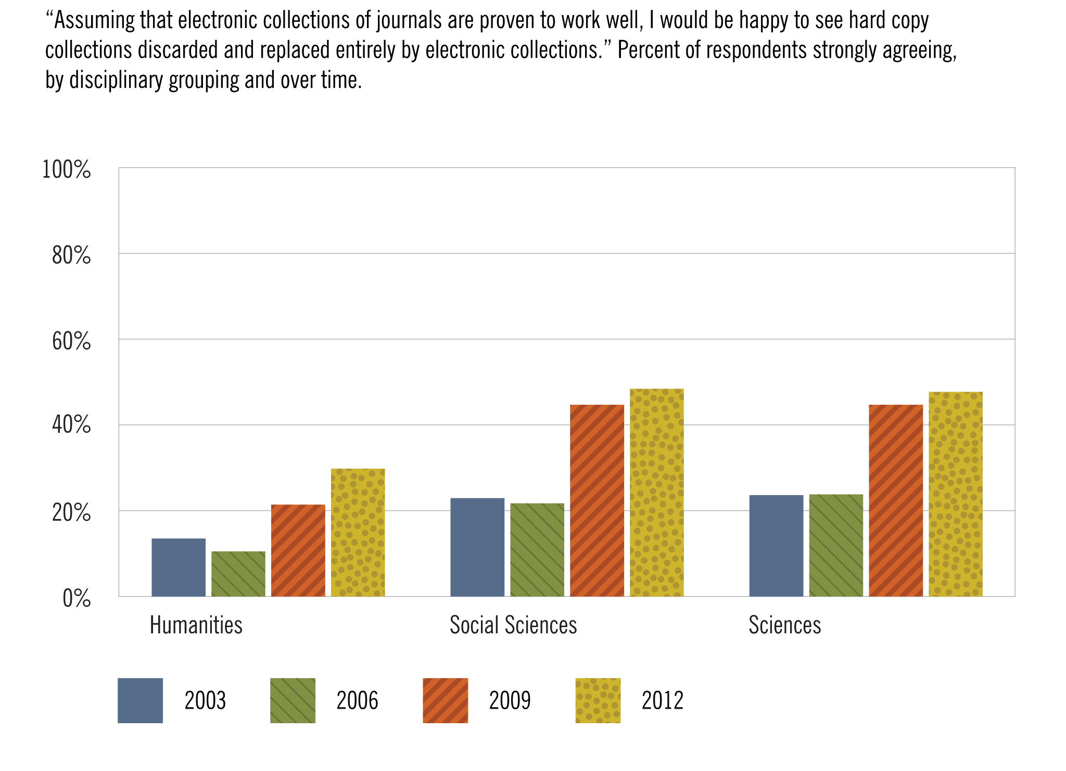
Source: Ithaka S+R US Faculty Survey 2012

Slide 12
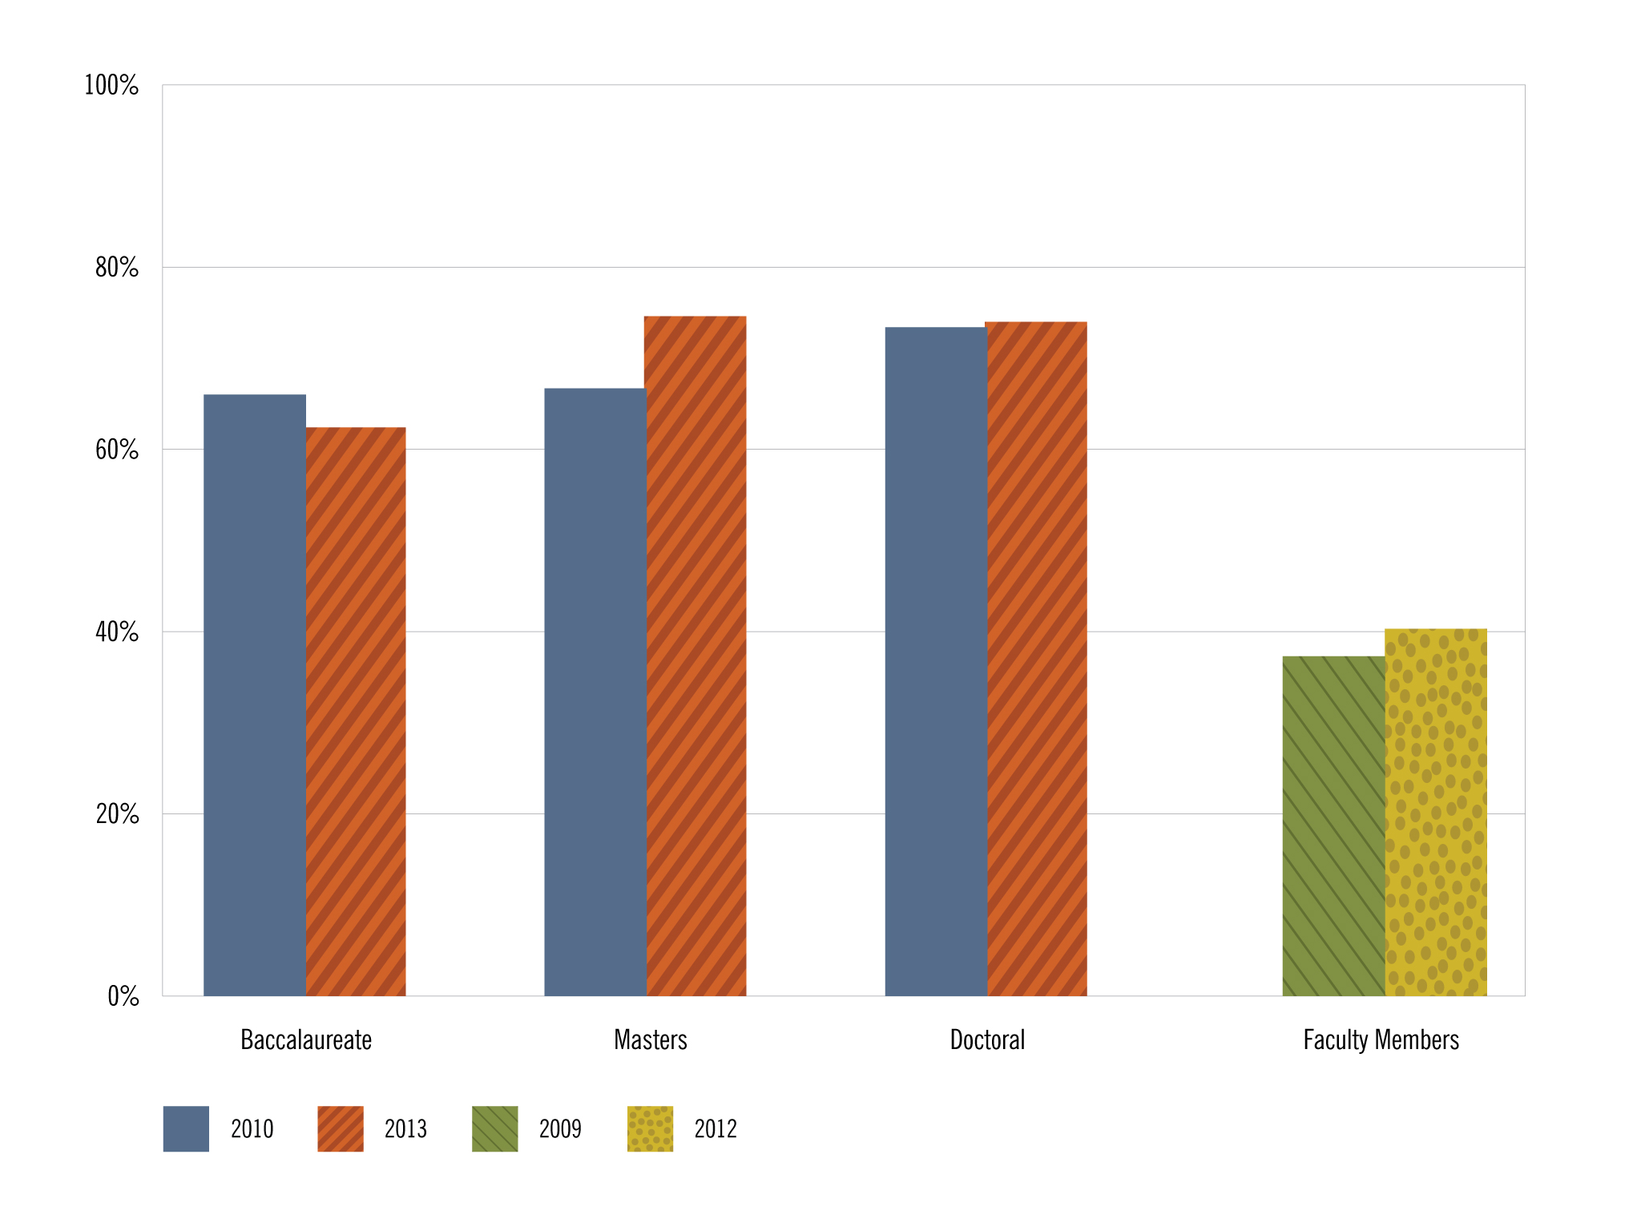
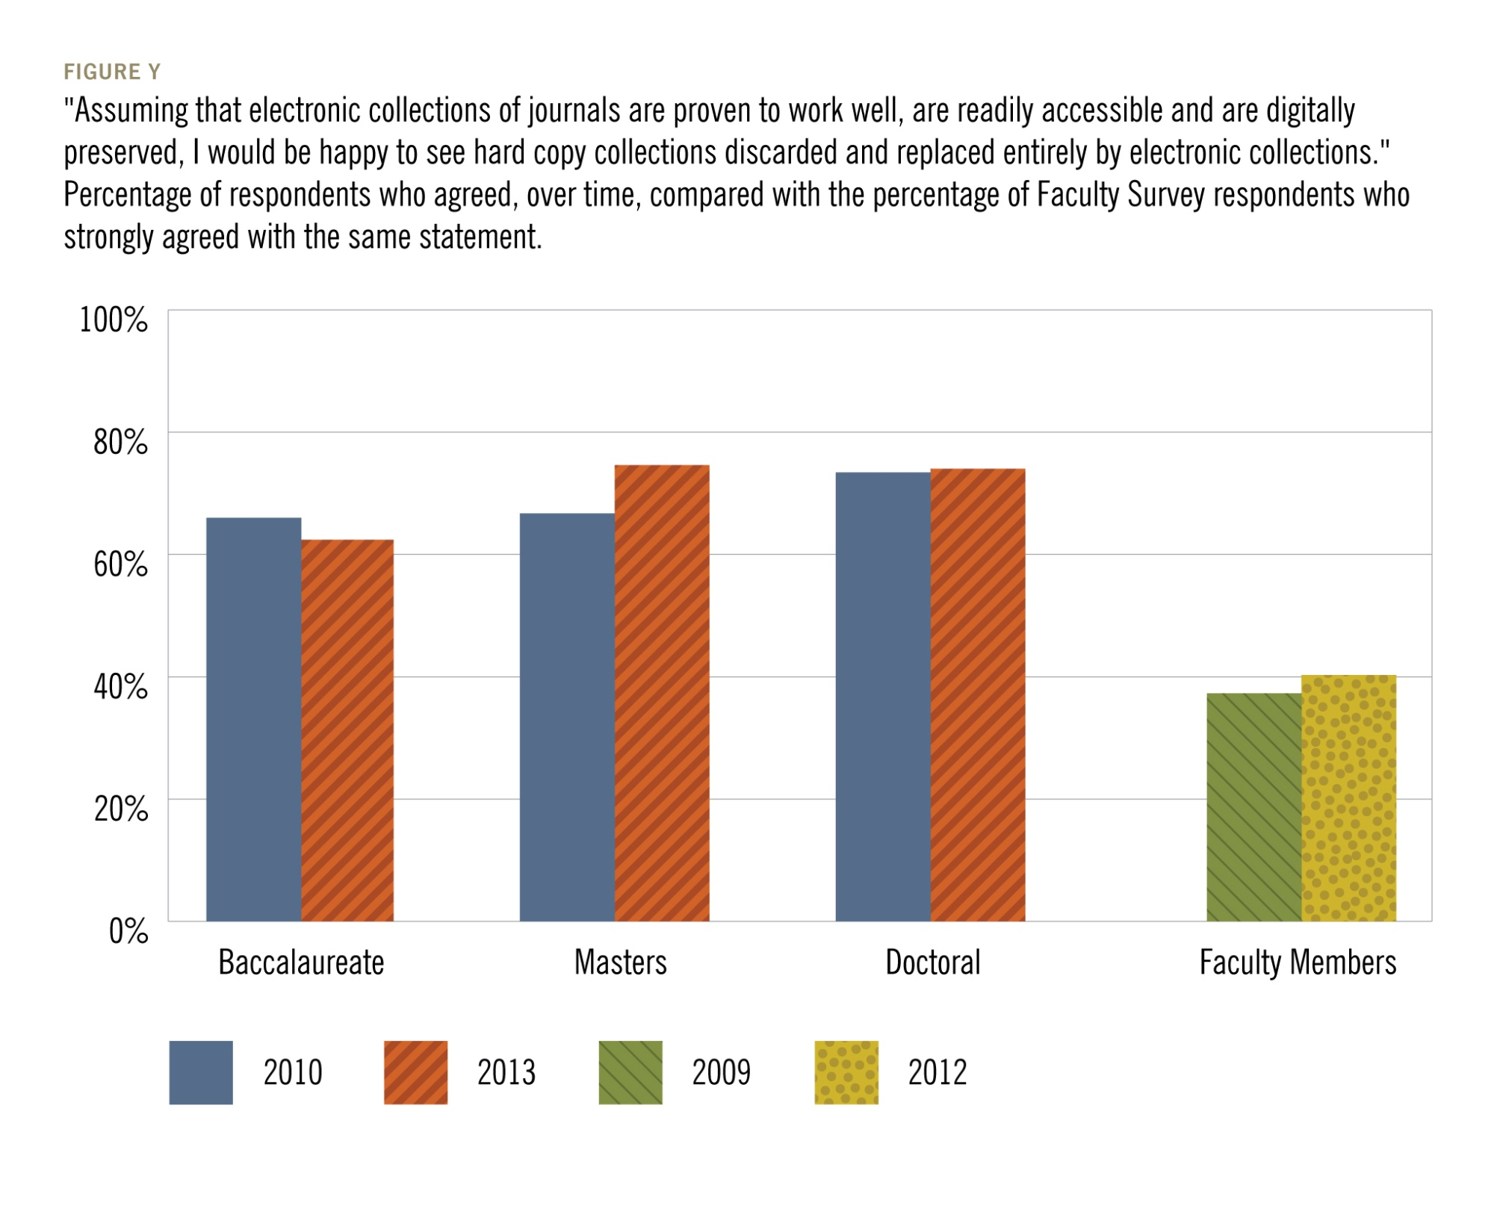
Source: Ithaka S+R US Library Survey 2013; Ithaka S+R US Faculty Survey 2012
Notes:
Design Notes:
Please remove figure number and put question on new slide preceding chart. Can be text in PPT, not an image.

Slide 13
Books

Slide 14
De-Accessioning to Date
Academic Library Directors: “What percentage of your print book collection has your library de-accessioned because you have access to those books in an electronic format?”
Notes:
Design Notes:
You can use this as the question page template.

Slide 15
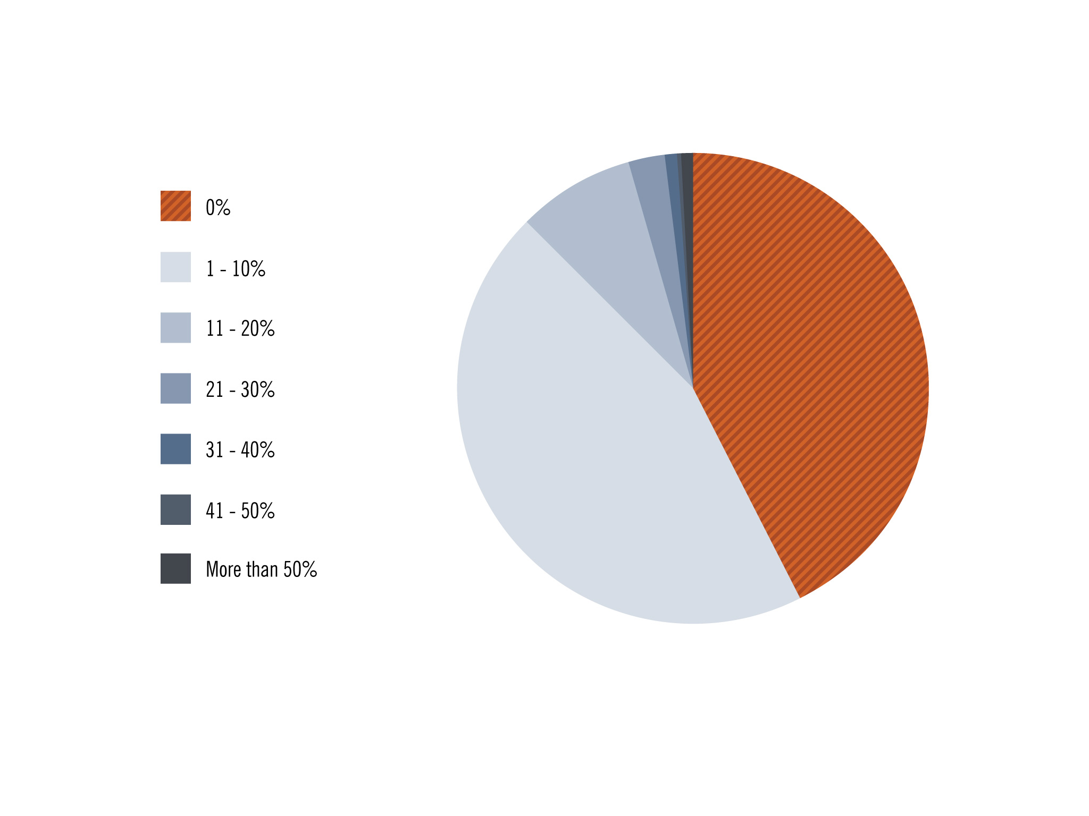
Source: Ithaka S+R US Library Survey 2013
Notes:
Design Notes:
Please remove figure number and put question on new slide preceding chart. Can be text in PPT, not an image.

Slide 16
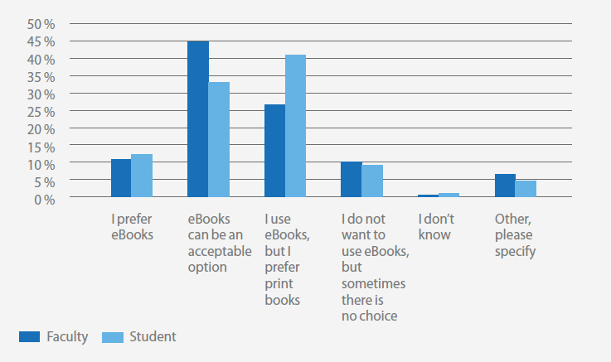
How do you feel about ebooks?
Source: Springer eBooks: eBook Use and Acceptance in an Undergraduate Institution

Slide 17
Frequency of Use
Faculty Members: “You may have had the opportunity to read scholarly monographs in electronic format, either through a library subscription database or standalone e-books. How often have you used scholarly monographs in digital form in the past six months – often, occasionally, rarely, or never?”

Slide 18
Source: Ithaka S+R US Faculty Survey 2012
Notes:
Monographs are perhaps more widely used by scholars in e-format than is sometimes thought

Slide 19
Importance
Faculty Members: “Electronic versions of scholarly monographs play an important role in my research and teaching.”
Academic Library Directors: “Electronic versions of scholarly monographs play an important role in the research and teaching of faculty members at my institution.”
Notes:
Design Notes:
You can use this as the question page template.

Slide 20
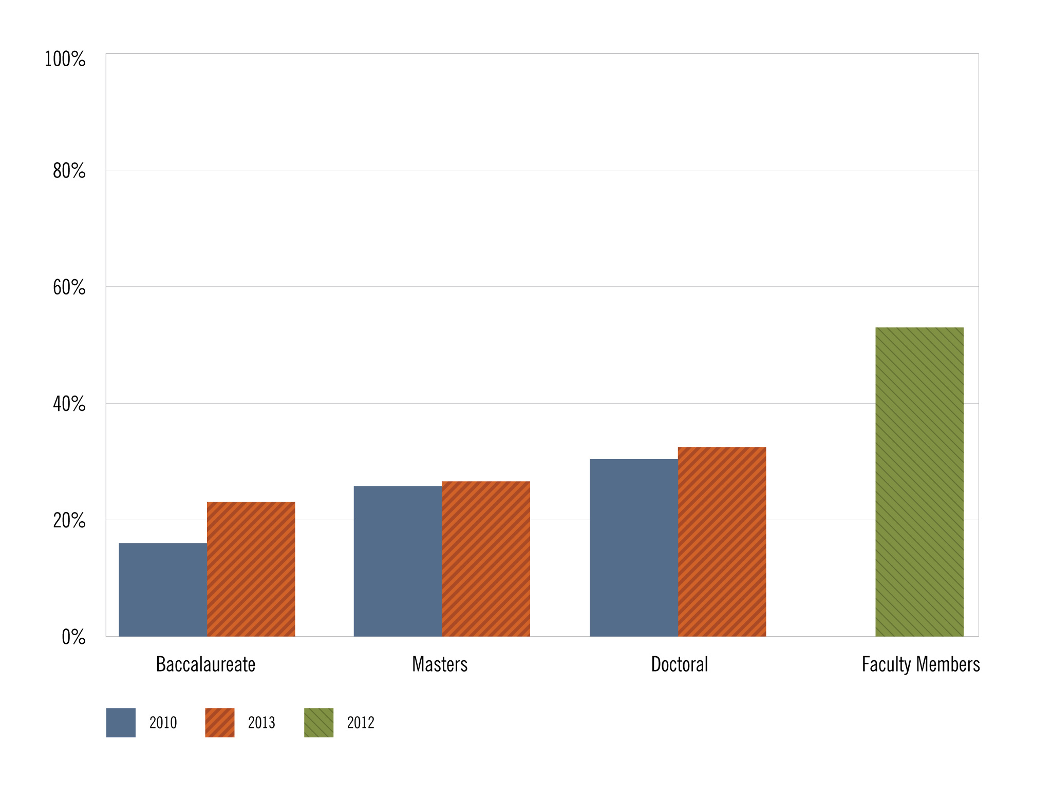
Source: Ithaka S+R US Library Survey 2013; Ithaka S+R US Faculty Survey 2012
Notes:
Design Notes:
Please remove figure number and put question on new slide preceding chart. Can be text in PPT, not an image.
The footnote can also be removed.

Slide 21
Use Cases
Faculty Members:
“Below is a list of ways you may use a scholarly monograph. Please think about doing each of these things with a scholarly monograph in print format or in digital format and… indicate how much easier or harder it is to perform each activity in print or digital format.”
Reading cover to cover in depth
Reading a section in depth
Comparing treatment of ideas between monographs
Skimming in whole or in part
Exploring references
Searching for a particular topic

Slide 22
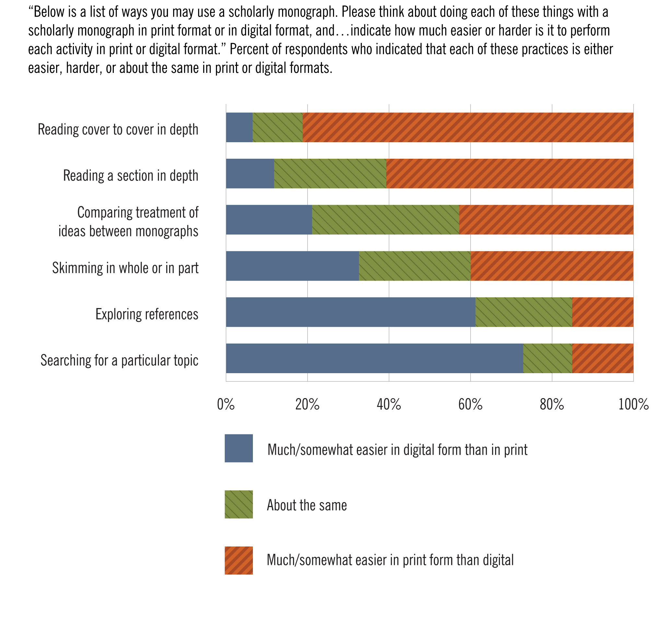
Monograph use cases (US)
Reading cover to cover
Reading a section
Comparing monographs
Skimming
Exploring references
Searching for a topic
Source: Ithaka S+R US Faculty Survey 2012
Notes:
Clearly there are some use cases for which print monographs remain preferred. Long form engagement differs tremendously from field to field. The importance of indices, tables of contents, figures, and images, and the images and plates themselves in monographs cannot be overemphasized. For some fields, the codex may have enduring value for long-form engagement with a narrative, while in other cases there may be an opportunity or perhaps even a need to reconceive the nature of the monograph for a post-codex environment.

Slide 23
Academic Library Directors and Faculty Members:
“Within the next five years, the use of e-books will be so prevalent among faculty and students that it will not be necessary to maintain library collections of hard copy books.”
© 2014 Roger C. Schonfeld. This work is licensed under a Creative Commons Attribution-NonCommercial 3.0 Unported License. Suggested attribution: “This work uses content from “Our Format Transitions” © Roger C. Schonfeld, used under a Creative Commons Attribution-NonCommercial license: http://creativecommons.org/licenses/by-nc/3.0/us/”
Notes:
Design Notes:
You can use this as the question page template.

Slide 24
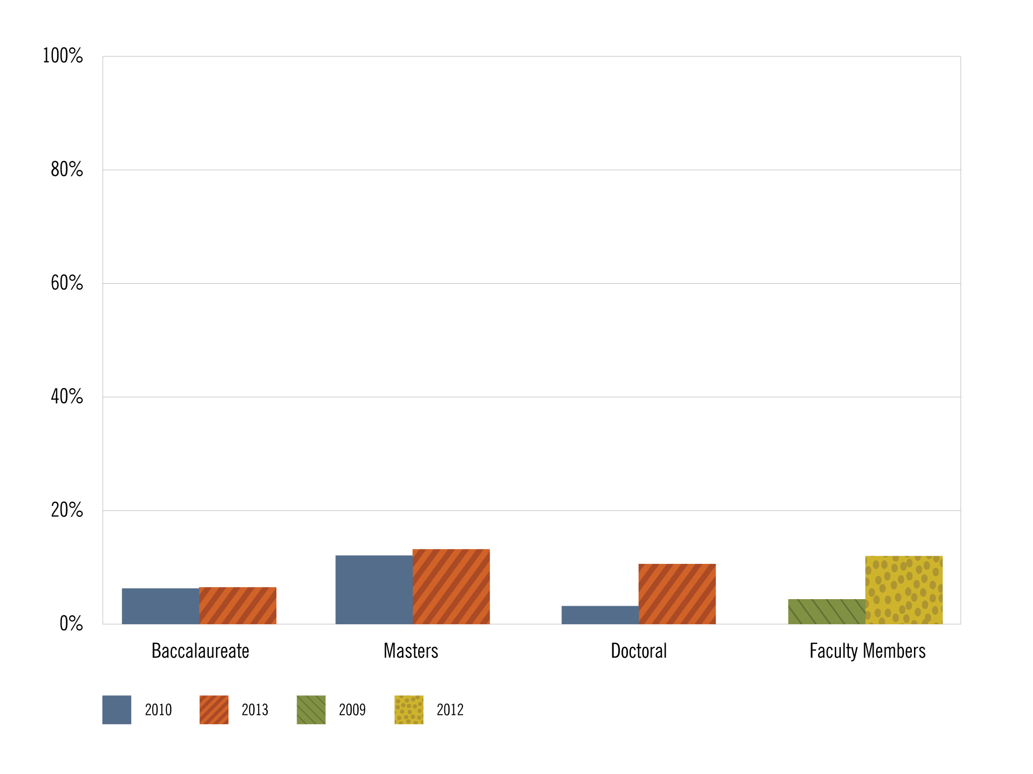
Source: Ithaka S+R US Library Survey 2013; Ithaka S+R US Faculty Survey 2012
Notes:
Design Notes:
Please remove figure number and put question on new slide preceding chart. Can be text in PPT, not an image.
The footnote can also be removed.

