Slide 1
The Library’s role in research data management
An Edinburgh Case Study
Dr John Scally, Director of Library & University Collections
OCLC Research Library Partnership meeting, 10-12 June 2014, Amsterdam

Slide 2
UK Context Edinburgh Context (structure and culture) Library’s role: making RDM palatable Where we’re at … 5 lessons Learned & 1 question

Slide 3
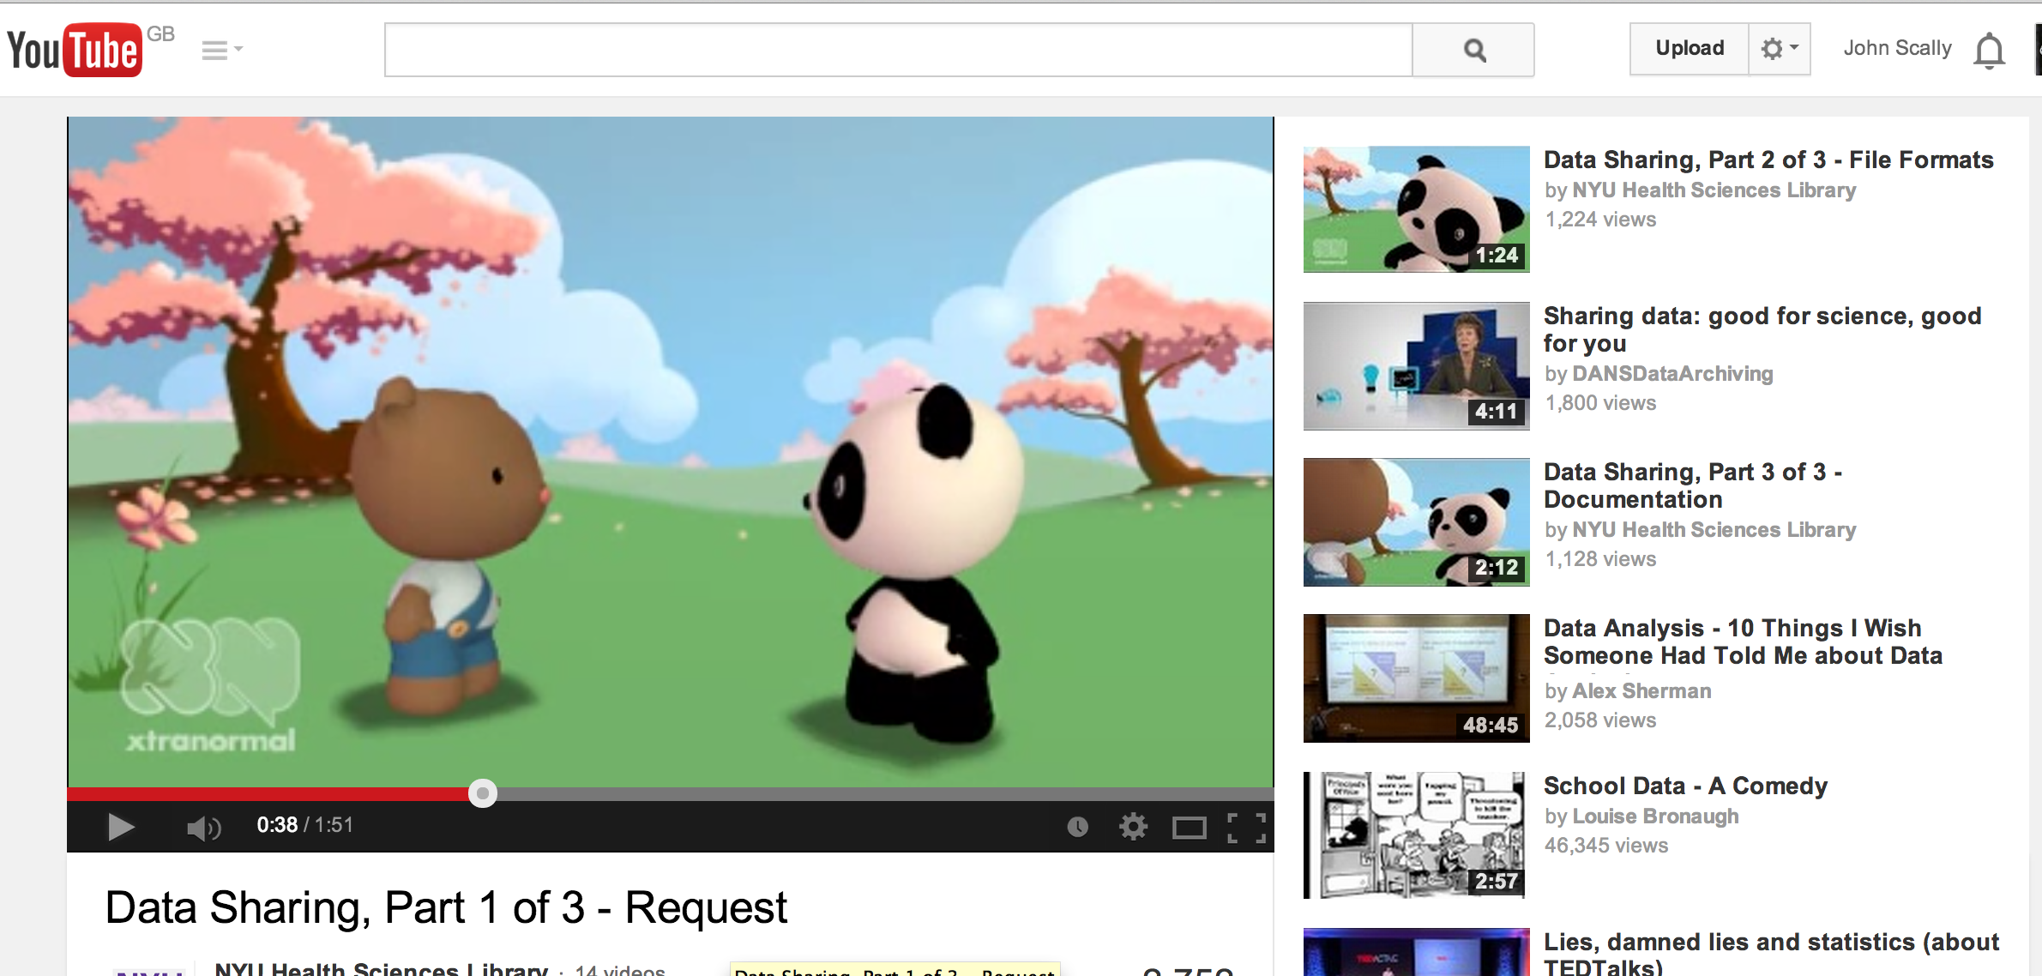
Explaining the problem, rather than waving the big stick (compliance)
NYU Health Sciences Libraries
Data Sharing Stories, 1 Request 2 Data Sharing and 3 Documentation
1. https://www.youtube.com/watch?v=RVZbk3GEVSw
2. https://www.youtube.com/watch?v=RtSv0gSbCP8
3. https://www.youtube.com/watch?v=-MIH8PkuUo4

Slide 4
"What could be done in respect of storage services, facilities
and policies to make your research at Edinburgh easier,
better, more competitive or more successful?"
RDSWG, 2010
Research Computing Consultation 2007
Research Data Audit 2009
Good practice, Bad Practice, Best Practice, Data discs, floppy discs, flash drives,
network storage, subject repositories, no backup, multiple backup …
Research Data Storage Working Group Report 2010
Research Data Management Policy 2011
Notes:
Research Data Storage Working Group Report (2010): The group is primarily tasked with developing recommendations for research data storage. The remit is taken directly from the document constituting the working groups:
Review current practice within the University of Edinburgh;
Review what is known about current practice within the peer universities internationally;
Review current national and international developments that seek to influence or provide services in the field;
Develop, with suitable consultation, options with appraisal of their cost and feasibility, with a risk analysis of actions or inactions in this field.

Slide 5
Research Councils UK 2011 statement:
Common Principles on Data Policy. Overarching Framework, http://www.rcuk.ac.uk/research/datapolicy/
OCLC, Amsterdam June 2014
Notes:
Publicly funded research data are a public good, produced in the public interest, which should be made openly available with as few restrictions as possible in a timely and responsible manner that does not harm intellectual property.
http://www.rcuk.ac.uk/research/datapolicy/

Slide 6
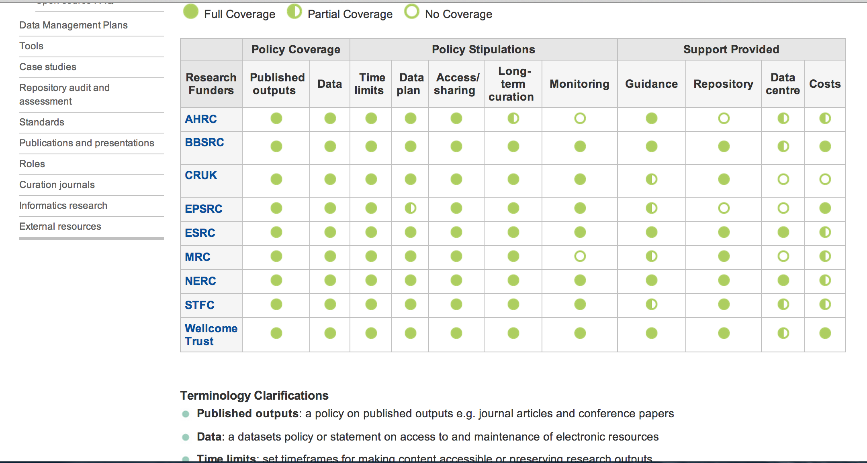
Understanding (and remembering) Funders Data Policies Requirements
Notes:
Wellcome, Cancer UK, MRC, ESRC have just issued a report from their Expert Advisory Group on Data Acccess calling for serious culture change in making data available
http://www.wellcome.ac.uk/stellent/groups/corporatesite/@msh_peda/documents/web_document/wtp056495.pdf

Slide 7
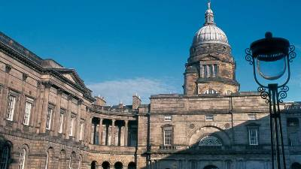
2013-14: 32,500 students. Academic Staff FTE 6,150/Headcount 9,229
IT: 50% done centrally, 50% locally.
Multi-campus. 3 Colleges. 22 Schools. 22 different cultures.
Significant discipline differences.
From Edinburgh College of Art to Physicists at CERN.
Academic Year, 2012-13
Research Applications Submitted = 2,222
Research Grants Awarded = 934
Value of Awards = £301M
[Most collaborative internally – research teams
Many collaborative externally, often internationally]

Slide 8
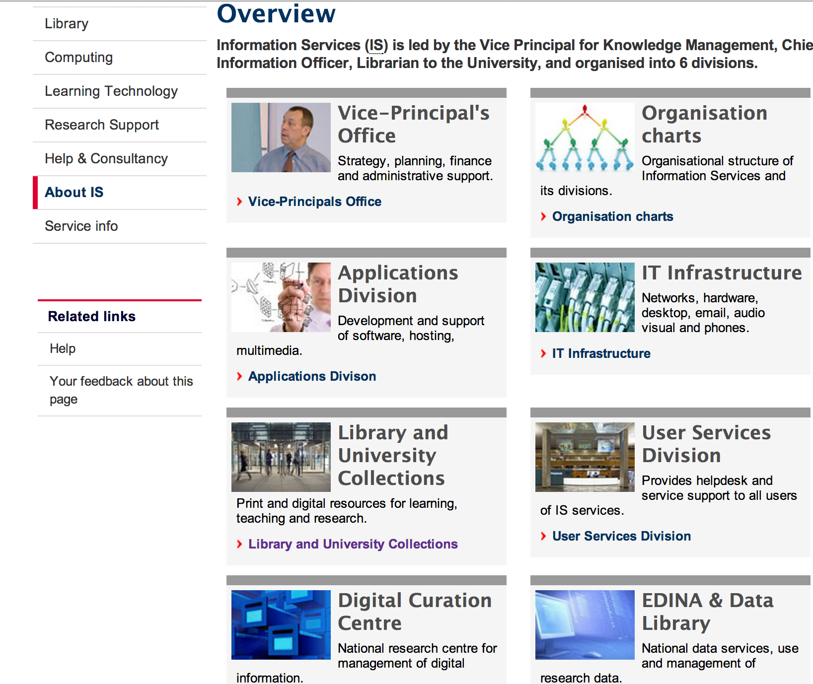
Information Services – Convergence of IT & Library Services

Slide 9
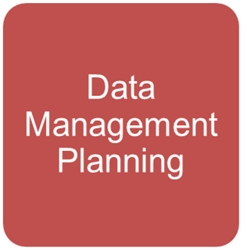
Quick Win …
…. but this is much more difficult
Notes:
Aspirational policy … but expectation that it should be delivered.

Slide 10
Library’s Role
Director of Library Lead, July 2012 – VP step back
Historical progression in curation and management of content – back to 1580 at Edinburgh
Library - a trusted brand in the Academy
Know how to manage stuff: physical and e-content, pubn repositories; CRIS; Special Collections …
Recent reputation in Open Access – Library is solving, even the sceptics are being convinced …
Service at the core of the Library ethos
‘Past is a great source for future knowledge’
DANSData Archiving video, 18 Aug 2013
Notes:
Not just looking for new activity to pull on board – crisis of identity / land grab
Special Collections is choc a block with research data

Slide 11
Programme Management at Edinburgh
RDM Programme in 3 phases:
Phase 0: August 2012 – August 2013: Planning phase, with some pilot activity.
Phase 1: September 2013 – May 2014: Initial rollout of primary services.
Phase 2: June 2014 – May 2015: Continued rollout; maturation of services.
Full details of the programme is available at: http://edin.ac/1eE3sav
11
Notes:
Also a detailed Workplan. Monthly Reports. Steering Board. RDM Action Group.

Slide 12
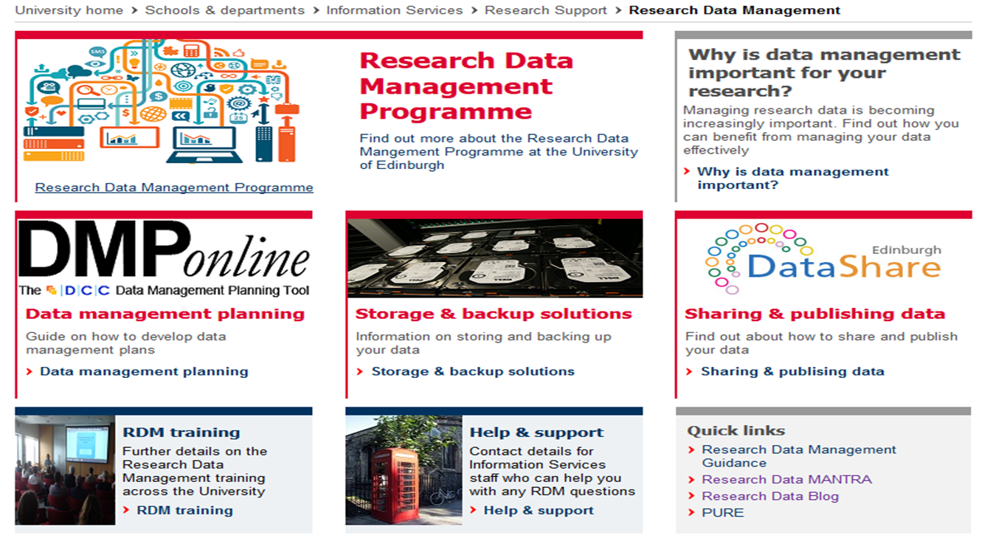
Notes:
DMPonline: Free and open web-based tool to help researchers write plans: https://dmponline.dcc.ac.uk/
It features:
Templates based on different requirements
Tailored guidance (disciplinary, funder etc.)
Customised exports to a variety of formats
Ability to share DMPs with others

Slide 13
Data Management Lifecycle
Awareness Raising and Advocacy
Planning
Active Research
Data Management Planning
Resource planning and costing
Active Data Store
Data Stewardship
Data Vault
Data Asset Register
DataShare
Generic University Policy
Specific Funder policies
Collaborative and other tools
De-allocation
Retention
External data repository services
Data collection and (file) management
Data analysis
Good practice
DMP creation
Data Description
Data anonymisation
National and international RDM initiatives
Data licensing
Data Appraisal
Data manipulation (incl. normalisation)
Data publication/citation
Data documentation and metadata
Data visualisation
Data Security
Notes:
Software in the last two

Slide 14
Where are we now?
0.5TB to every active researcher (9,000+)
1.6PB DataStore (with 1PB in reserve)
£250,000 staffing and operating costs
Large uptake in training; big push on awareness raising
DMP online customisation; Research Office active
DataStore / DataShare both LIVE
Data Asset Register and DataVault at spec stage
RDM being blended into our business: Helpdesk, Liaison, IT Support, PG training, Induction of staff … beginning to join up
Notes:
Before offering some concluding points, share now some visuals of early thoughts on DAR and DataVault. Moving everyone over to this new infrastructure: Colleges willing to pay for non researchers to be placed on it, so bringing in income.

Slide 15
TINY
DEPOSIT
DOI
REDIRECT
?
EPSRC
AGGREGATE
RCUK
COLLECTIONS
CRUD
LOG
ITEMS
UI
IDENTIFY
SHARE
DISCOVER
FUNCTIONS
SERVICES
DESCRIPTION
Data Asset Register

Slide 16
AUTO VERSIONING
KEY ENCRYPTION
FIREWALL
SECURE
WRITE ONCE
DATA VAULT
RETENTON/REVIEW
HIERARCHICIAL
FIXITY
SPEED
ASSURANCE
MULTIPLE COPIES
TAPE

Slide 17
METADATA & FULL TEXT
CRIS
Online Researcher Profiles
METADATA
Data Asset Register
PRIVATE
PUBLIC
Internal Data Repository
Store
Deposit
Data Vault
Link
External Data Repositories
RESEARCH DATA
Notes:
CRIS system )Current Research Information System. What we are thinking around here. What it might look finally 1 Version. Tools and services to make this all join up. Possibly use the CRIS system PURE to be the DAR? These are evolving thoughts.

Slide 18
5 lessons learned … 1 question
Make sure everyone knows who has overall lead for the Policy, Strategy, Governance and Implementation.
Ensure the money is available for capital and revenue aspects. It’s about the service, not the tin.
Institutional policy on RDM is a baby step on the way. Early message is good research practice and support; later message is policy/compliance.
Use the RDM initiative to reboot your Support Structures.
Tie into Open Access and its role in Research Support: RCUK Gold OA, Green OA and Repositories filling up (18,000 papers in 2 years since Finch)
Question: Does all of this signal a renaissance for research support in the Library?
Notes:
Is RDM, Open Access and other forms of Research support pointing to a renaissance in research support in the Library? (after the google fear of a few years ago; writing our own obituaries etc)

Slide 19
Thanks to the RDM team at Edinburgh
Pete Clarke
Cuna Ekmekcioglu
Jeff Haywood
Stuart Lewis
Kerry Miller
Stuart McFarlane
Robin Rice
Orlando Richards
Tony Weir
john.scally@ed.ac.uk
@scallyjj
©2014 John Scally. This work is licensed under a Creative Commons Attribution 3.0 Unported License. Suggested attribution: “This work uses content from "The Library’s role in research data management: An Edinburgh Case Study" © John Scally, used under a Creative Commons Attribution license: http://creativecommons.org/licenses/by/3.0/”

