Slide 1
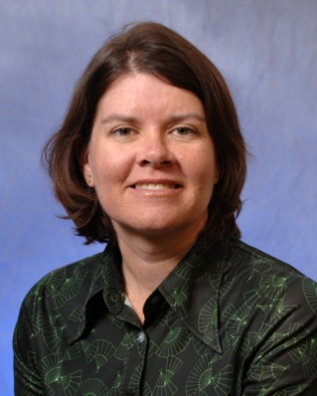
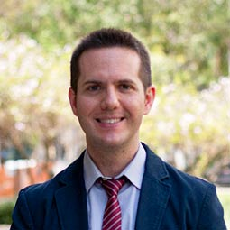
Beyond EAD
9 January 2014
OCLC TAI-CHI webinar series
#oclcr
Tools for Creating and Editing EAC-CPF Records and "Remixing" Archival Metadata
Merrilee Proffitt
OCLC Research
Ethan Gruber
American Numismatic
Society
Tim Thompson
University of Miami
Libraries
Allison Jai O’Dell
University of Miami
Libraries

Slide 2
Beyond EAD
Tools for Creating and Editing EAC-CPF Records and "Remixing" Archival Metadata
Merrilee Proffitt
Senior Program Officer, OCLC Research
9 January 2013
OCLC TAI-CHI webinar series
#oclcr

Slide 3
Companion to Encoded Archival Description (EAD)
Based on International Standard Archival Authority Record for Corporate Bodies, Persons and Families (ISAAR-CPF)
Emphasis on relations…
With other resources
With other corporate bodies, persons, families
With functions
Compatible with library authorities and structures (LCSH, MODS, etc.)
Offers flexibility for alternate names, variant forms, local implementations
Notes:
EAC-CPF: Encoded Archival Context – Corporate Bodies, Persons, Families
XML schema
Based on International Standard Archival Authority Record for Corporate Bodies, Persons and Families (ISAAR-CPF) which is a data content standard issued by the International Council on Archives
EAC-CPF was adopted by the Society of American Archivists in 2011 as a standard for encoding archival authority data – EAC is used not just in the US but globally – in France, Germany Sweden, the Netherlands, and Australia for example.
Emphasis on relations
With other resources
With other corporate bodies, persons, families
With functions

Slide 4
Merrilee Proffitt
OCLC Research
Ethan Gruber
American Numismatic
Society
Tim Thompson
University of Miami
Libraries
Allison Jai O’Dell
University of Miami
Libraries

