Slide 1
Beyond EAD: Tools for Creating and Editing EAC-CPF Records and “Remixing” Archival Metadata
Remixing Archival Metadata Project (RAMP) editor
9 January 2014
Allison Jai O’Dell (@AllisonJaiODell)
Timothy A. Thompson (@timathom)
University of Miami Libraries

Slide 2
Outline
Overview of RAMP
EAC-CPF and name authority work
RAMP demo, part 1: VIAF and WorldCat Identities
RAMP demo, part 2: contributing to Wikipedia
Closing thoughts

Slide 3
Overview of the RAMP editor

Slide 4
OVERVIEW OF THE RAMP EDITOR
RAMP: what it is
A browser-based tool…
For deriving, creating, and enhancing EAC-CPF records
Pulling in external data from OCLC APIs:
VIAF
WorldCat Identities
And transforming those records into wiki markup for direct publication to Wikipedia through its API

Slide 5
OVERVIEW OF THE RAMP EDITOR
The RAMP stack is a LAMP stack
To run RAMP, you need…
MySQL 5.1.5+ (with permission for stored procedures)
PHP 5+ (with php_xsl and php_curl extensions)
Apache
Mozilla Firefox or Google Chrome web browsers. RAMP is not currently compatible with Internet Explorer.

Slide 6
OVERVIEW OF THE RAMP EDITOR
RAMP: what it isn’t
A robust management system for EAC-CPF records
No event tracking after importing records
Implements a subset of the EAC-CPF schema (most common elements and attributes). Cannot automatically generate a <multipleIdentities> wrapper, for example
Focus on EAC-CPF as a data exchange format

Slide 7
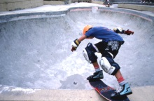
OVERVIEW OF THE RAMP EDITOR
RAMP is more than just metadata…
State Archives of Florida, Florida Memory, http://floridamemory.com/items/show/123385
It’s a lifestyle.

Slide 8
Conclusion

Slide 9
CONCLUSION
Wikipedia: the benefits
Increase in Web traffic to digital collections and finding aids
Archivists have a rich tradition of contextual description: why not expand its reach?

Slide 10
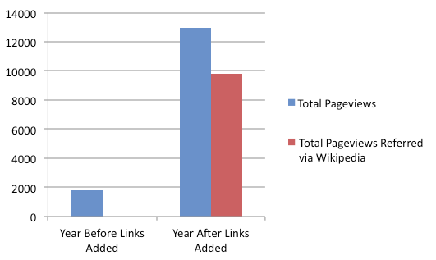
CONCLUSION
Wikipedia: the benefits
“Using Wikipedia to Enhance the Visibility of Digitized Archival Assets” (Szajewski 2013)
http://www.dlib.org/dlib/march13/szajewski/03szajewski.html

Slide 11
CONCLUSION
Wikipedia: the caveats
Wikipedia participation can challenge librarians and archivists to critically evaluate their own descriptive practices
It also means getting used to a new set of community norms and terms, like “Notability” and “No Original Research”

Slide 12
CONCLUSION
RAMP: the rationale
From unique collections…
To unique people
If you haven’t already, try looking up your finding aid or digital collections URL in a Wikipedia “external links search”: https://en.wikipedia.org/wiki/Special:LinkSearch

Slide 13
CONCLUSION
Credits
University of Miami Libraries
Cataloging & Metadata Services
Web & Emerging Technologies
Cuban Heritage Collection, Special Collections Division, University Archives
GLAM-Wiki community
Dorothy Howard (Wikipedian-in-Residence, Metro NY Library Council)
Matthew Flaschen (Wikimedia Foundation)
Sven Manguard (Wikipedia editor)

Slide 14
Thank you!
Allison Jai O’Dell
a.odell@miami.edu
Tim Thompson
t.thompson5@miami.edu

