Slide 1
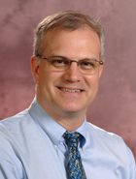
OCLC Research Update
ALA Midwinter (Philadelphia, PA, USA) 2014-01-27
Eric Childress
Notes:
A special thanks to the American Library Association for inviting OCLC Research to present this update.

Slide 2
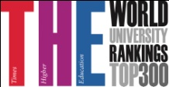
OCLC Research
Innovation Lab
Leading research group devoted exclusively to exploring the challenges facing libraries & archives
Advances OCLC’s public mission through…
Advanced Development
Community R&D
Member/Partner Engagement
Experiment with new processes, software, systems
Identify challenges, evaluate responses, survey, investigate, analyze, report, prototype, data work…
Convene, connect, shape, influence
Incl. 22 of Top
25 Universities
OCLC Research
Library Partnership
Notes:
Partnership - 162 Partner Institutions
125 in North America, 28 in Europe, 9 in Asia
22 of the top 25 universities in The Times Higher Education World Ranking

Slide 3
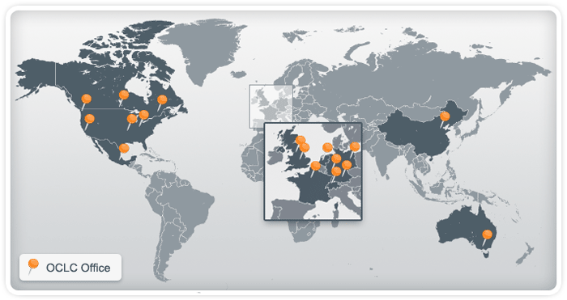
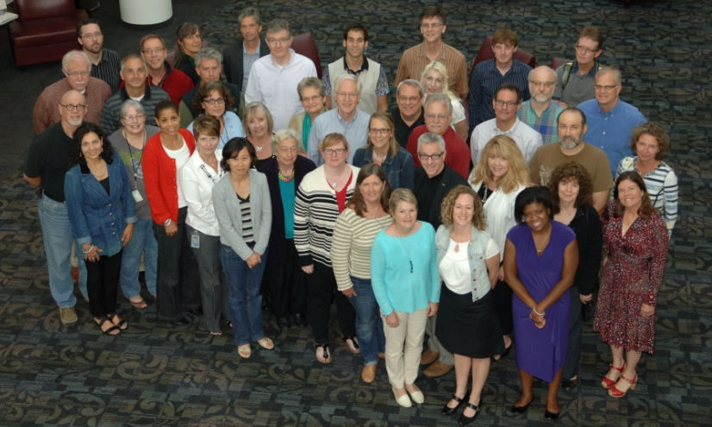
OCLC Research
Dublin, Ohio
30
Leiden, Netherlands
San Mateo, California
3
12

Slide 4
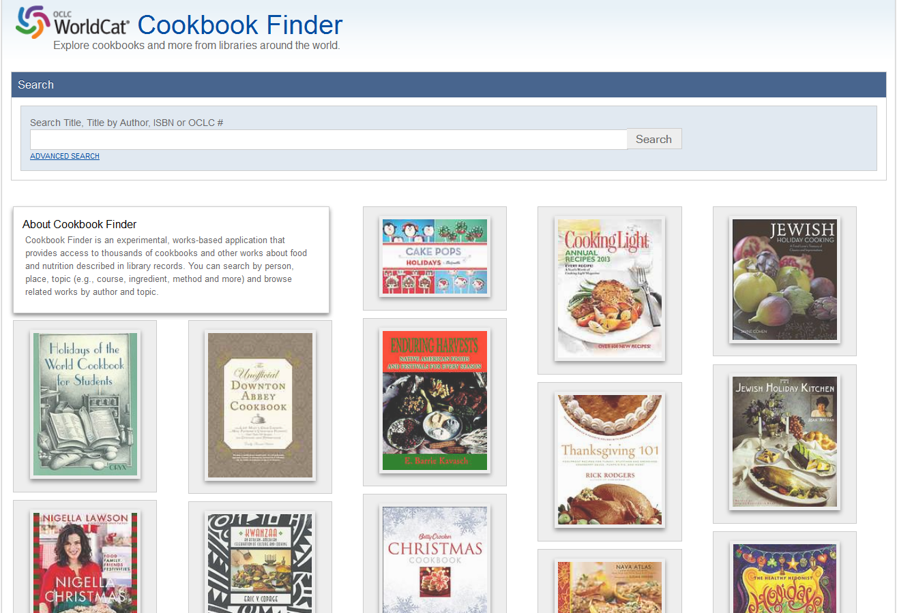
Cookbook Finder
http://experimental.worldcat.org/xfinder/cookbookfinder.html
Notes:
Cookbook Finder provides access to thousands of cookbooks and other works about food and nutrition described in library records. You can search by person, place, topic (e.g., course, ingredient, method, and more) and browse related works by author and topic ((supplied by the Kindred Works/Recommender API.
Cookbook Finder bookmarks will be available at the OCLC booth, at the OCLC Research Update session and at the Dewey Breakfast.

Slide 5
Lidia's Italy in America

Slide 6
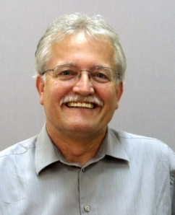
Most used title words
http://www.theatlantic.com/technology/archive/2014/01/in-books-movies-and-media-the-most-popular-title-word-is-new/282921/

Slide 7
Understanding the Collective Collection
Collection of articles and reports (222 p.)
Explores “collective collection” / managing down print / shift to digital
Available:
Online ($0): http://www.oclc.org/research/publications/ library/2013/2013-09r.html
Order hardcopy ($32): OCLC Online Service Center
A sample report will be on display at the OCLC booth

Slide 8
OCLC Research
http://oclc.org/research.html
2014 Partnership Meeting:
Amsterdam, Netherlands (10-12 June)

Slide 9
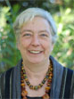
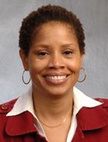
Presentations
Karen
Smith-Yoshimura
Lynn
Silipigni
Connaway
Ixchel
Faniel

Slide 10
Scholars’ Contributions to VIAF
Karen Smith-Yoshimura
OCLC Research
OCLC Research Update, Midwinter ALA Philadelphia
27 January 2014
Notes:
I’m Karen Smith-Yoshimura, program officer in OCLC Research in our San Mateo office in California. Today I will be summarizing two activities: Scholar’s contributions to the Virtual International Authority File (VIAF) and Registering Researchers in Authority Files. I and my colleagues work with a transnational group of 162 research libraries—the OCLC Research Libraries Partnership—on issues of common concern, forming working groups as needed.

Slide 11
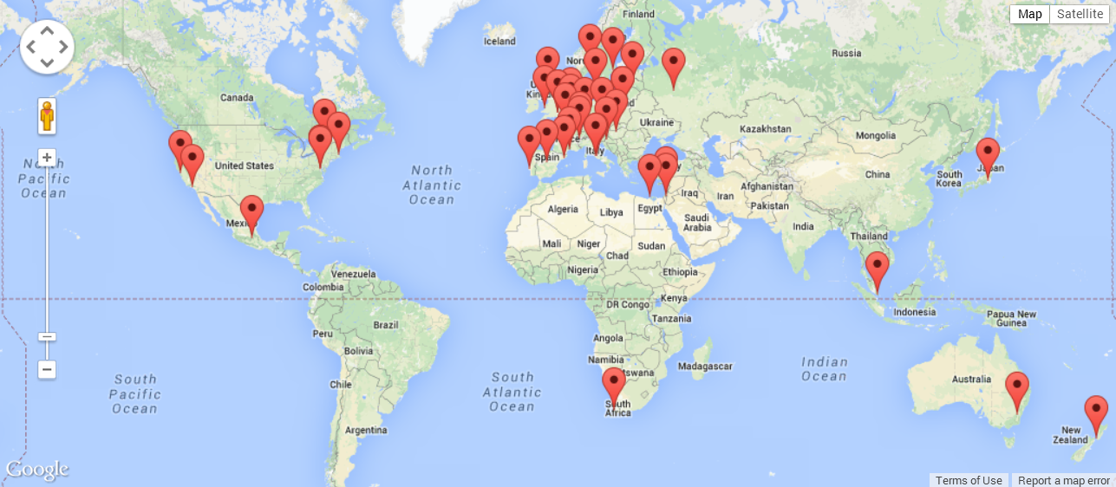
VIAF™ (Virtual International Authority File)
Notes:
Currently the Virtual International Authority File comprises authority records from 35 organizations or agencies, mostly from national libraries or library agencies, marked on this map. It currently includes over 30 million personal names, plus smaller numbers of corporate/conference names, geographic names, and titles. OCLC Research has been collaborating with scholars to enrich VIAF clusters with new names and additional script forms of names already represented.

Slide 12
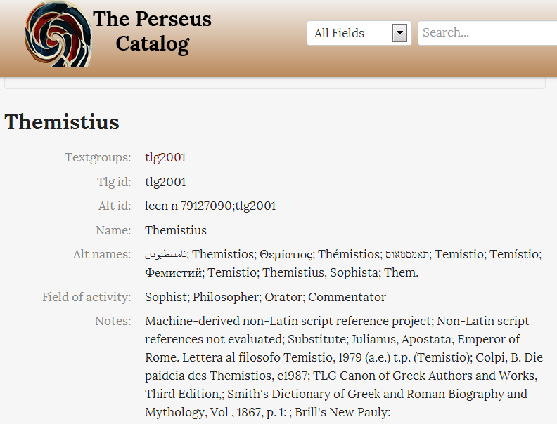
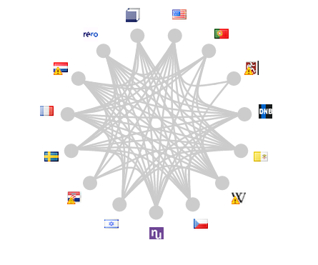
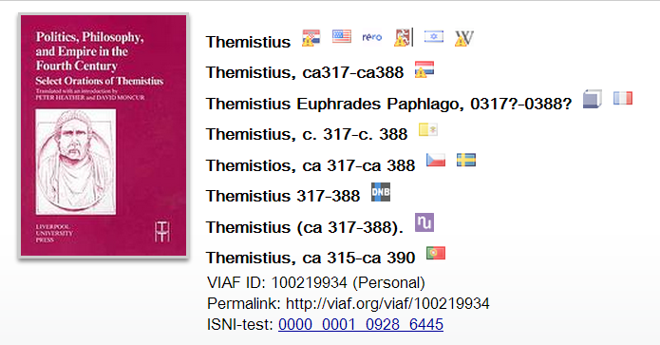
Notes:
The Perseus Catalog is the first source for scholarly data added to VIAF. The Perseus Catalog, hosted by Tufts University, an OCLC Research Library Partner, aims to provide access to at least one online edition of every major Greek and Latin author from antiquity to 600 CE. Here the VIAF cluster for Themistius is enriched with the Greek and ancient Greek representations from the Perseus catalog (click) under “Alternate name forms.”

Slide 13
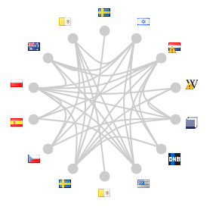
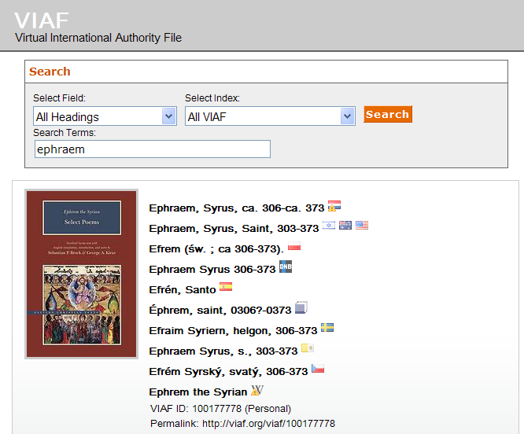
Notes:
We have also been working with a group of Syriac studies scholars to add Syriac script to existing names and adding new ones. Syriac is a dialect of Aramaic, developed in the kingdom of Mesopotamia in the first century A.D. It flourished in the Persian and Roman Empires, and Syriac texts comprise the third largest surviving corpus of literature from the fourth through seventh centuries, after Greek and Latin. The Syriac reference portal in development includes not only the Syriac script form of the name, but other script variations as well, including Arabic.
A number of Syriac names are already represented in VIAF, as in this example. (click) Note that although Ephram has been contributed by 14 different sources, none includes the Syriac script that Ephram wrote in. When we load the Syriac records, expected soon, the Syriac-script form of the name will appear within the VIAF cluster, with its own icon. (click) The other multiple forms of Syriac and other script forms will be included under “Alternate names”.
For scholars, VIAF represents a resource for disseminating their research on names beyond their own communities. Scholars benefit by receiving VIAF URIs as persistent identifiers for the names they contribute that they can then use in their own databases, linked data applications, scholarly discourse, and name disambiguation in multinational collaborations often undertaken outside the traditional library domain. We’re widening both the user and contribution VIAF base beyond libraries to scholarly communities. Both scholarly societies and libraries benefit because VIAF is enriched by name authority data which would not otherwise be contributed by national libraries.

Slide 14
Registering Researchers in Authority Files
Karen Smith-Yoshimura
OCLC Research
OCLC Research Update, Midwinter ALA Philadelphia
27 January 2014
Notes:
I will now summarize work over the past year on registering researchers in authority files. This is still “work in progress”.

Slide 15
Scholarly output impacts the reputation and ranking of the institution
We initially use bibliometric analysis to look at the top institutions, by publications and citation count for the past ten years…
Universities are ranked by several indicators of academic or research performance, including… highly cited researchers…
Citations… are the best understood and most widely accepted measure of research strength.
Notes:
First, some background and the problem statement. These are three university rankings issued annually, rankings that are of particular importance to research libraries. Some universities even incorporate raising their ranking in their strategic plans. All three use citations as a factor in determining the rankings, which skews the results towards universities focusing on the sciences rather than the humanities. It also puts added weight to authors of journal articles, which are usually not represented in national authority files.

Slide 16
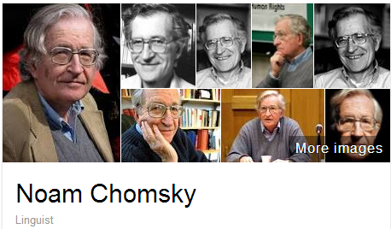
A scholar may be published under many forms of names
Works translated into 50 languages
(WorldCat)
Νόαμ Τσόμσκι
নোম চম্‌স্কি
ནམ་ཆོམ་སི་ཀེ།
નોઆમ ચોમ્સ્કી
नोआम चाम्सकी
Նոամ Չոմսկի
ノーム・チョムスキー
ნოამ ჩომსკი
Ноам Чомски
ನೋಅಮ್ ಚಾಮ್ಸ್ಕೀ
노엄 촘스키
നോം ചോംസ്കി
ਨੌਮ ਚੌਮਸਕੀ
Ноам Хомский
诺姆·乔姆斯基
Also published as:
Avram Noam Chomsky
N. Chomsky
نعوم تشومسكي
נועם חומסקי
Journal articles
Notes:
Noam Chomsky is a scholar widely translated. WorldCat has records for his works in fifty languages. But only some of the forms of his name are represented as “preferred forms” in national authority files (shown on the left). The forms on the right are from wikidata. The Library of Congress/NACO authority file can support only a few of the scripts shown, representing these scripts with romanizations.
Note that the “N. Chomsky” form used in journal articles is generally not included in national authority files. Chomsky happens to have a rather unique name, but for many others it would be a challenge to match up the abbreviated journal citation form with the fuller forms of name. This illustrates the futility of relying on text string matching to determine if two authors represent the same person or not.

Slide 17
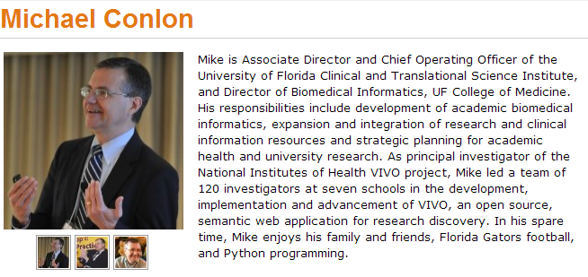
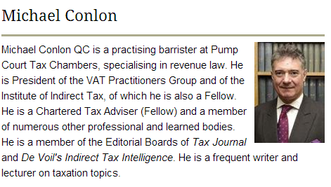
Same name, different people
Conlon, Michael. 1982. Continuously adaptive M-estimation in the linear model. Thesis (Ph. D.)--University of Florida, 1982.
Notes:
Michael Conlon is a member of our task group, an expert in biomedial informatics at the University of Florida. There is another Michael Conlon in the UK who writes articles on European taxes. Obviously two different people. Then there’s an article on microbiota in the Australian journal Microbiology written by a Michael Conlon. The same Michael Conlon as the U. Florida one or a different one based in Australia? Without other metadata, it is difficult to tell.
Michael Conlon is a rather uncommon name. But consider that in China 275 million people have the surname of Li, Wang or Zhang. And that’s not including the millions of overseas Chinese. The chances ethnic Chinese having the same name—especially in the abbreviated form used in journal articles– is high. We need other identifying attributes such as institutional affiliation and discipline (if not photos) to disambiguate names.

Slide 18
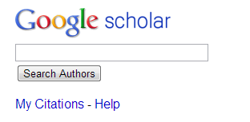
One researcher may have many profiles or identifiers…
(from an email signature block)
Profiles: Academia / Google Scholar / ISNI / Mendeley / MicrosoftAcademic / ORCID / ResearcherID / ResearchGate / Scopus / Slideshare / VIAF / Worldcat
Notes:
Some researchers already have multiple identifiers. This is an example from a signature block in an email. The researcher includes twelve different identifiers or profiles he’s represented in. This also fragments his Web presence.
To recap the problem statement:
Citations are a factor in assessing the impact of scholarship but journal article authors often are not represented in authority files.
A given scholar can be represented by different forms of the name, all of which may not be included in authority files.
Two or more researchers may have the same name, and we need other attributes to disambiguate them.
Some researchers already have multiple identifiers.

Slide 19
Registering Researchers in Authority Files Task Group
How to make it easier for researchers and institutions to more accurately measure their scholarly output?
Challenges to integrate author identification
Approaches to reconcile data from multiple sources
Models, workflows to register and maintain integrated researcher information

Slide 20
Registering Researchers in Authority Files Task Group Members
Micah Altman, MIT - ORCID Board member
Michael Conlon, U. Florida – PI for VIVO
Ana Lupe Cristan, Library of Congress – LC/NACO trainer
Laura Dawson, Bowker – ISNI Board member
Joanne Dunham, U. Leicester
Amanda Hill, U. Manchester – UK Names Project
Daniel Hook, Symplectic Limited
Wolfram Horstmann, U. Oxford
Andrew MacEwan, British Library – ISNI Board member
Philip Schreur, Stanford – Program for Cooperative Cataloging
Laura Smart, Caltech – LC/NACO contributor
Melanie Wacker, Columbia – LC/NACO contributor
Saskia Woutersen, U. Amsterdam
Thom Hickey, OCLC Research – VIAF Council, ORCID Board
Notes:
These are the members of the OCLC Research Registering Researchers in Authority Files Task Group which I facilitate. The members represent different perspectives from three countries – the U.S., The Netherlands, and the UK. We have members who are librarians, those who contribute to the LC/NACO authority file or train others to do so and who are members of the Program for Cooperative Cataloging. We have ORCID and ISNI Board members, and representatives from VIVO, a Current Research Information System (Symplectic), and a publisher (Bowker). My colleague Thom Hickey is the chief scientist responsible for creating the Virtual International Authority File and is on both the VIAF Council and the ORCID Board.

Slide 21
Stakeholders & needs
Researcher | Disseminate research
 | Compile all output
 | Find collaborators
 | Ensure network presence correct
Funder | Track research outputs for grants
University administrator | Collate intellectual output of their researchers
Journalist | Retrieve all output of a specific researcher
Librarian | Uniquely identify each author
Identity management system | Associate metadata, output to researcher
 | Disambiguate names
 | Link researcher's multiple identifiers
 | Disseminate identifiers
Aggregator (includes publishers) | Associate metadata, output to researcher
 | Collate intellectual output of each researcher
 | Disambiguate names
 | Link researcher's multiple identifiers
 | Track history of researcher's affiliations
 | Track & communicate updates
Notes:
The first thing the task group did was write up 18 use case scenarios from the perspective of different actors or stakeholders. I’ve consolidate the needs identified here; some overlap.

Slide 22
Some functional requirements
Librarian as a stakeholder
Create consistent and robust metadata
Associate metadata for a researcher’s output with the correct identifier
Disambiguate similar results
Merge entities that represent the same researcher and split entities that represent different researchers
Notes:
From the use case scenarios we derived functional requirements, again linked to the stakeholders. These are the functional requirements for librarians – we need consistent and robust metadata to allow for successful integration with other researcher’s output and various types of sorting.

Slide 23
More functional requirements
Researcher & university administrator as a stakeholder
Link multiple identifiers a researcher might have to collate output
Associate metadata with a researcher’s identifier that resolves to the researcher’s intellectual output.
Verify a researcher/work related to a researcher is represented
Register a researcher who does not yet have a persistent identifier
Funder and university administrator as a stakeholder
Link metadata for a researcher’s output to grant funder’s data
Notes:
These are some functional requirements for the researcher, university administrator and funder. Other requirements are targeted for other stakeholders.

Slide 24
Systems profiled (20)
Authority hubs:
Digital Author Identifier (DAI)
Lattes Platform
LC/NACO Authority File
Names Project
Open Researcher and Contributor ID (ORCID)
ResearcherID
Virtual International Authority File (VIAF)
Current Research Information System (CRIS): Symplectic
Identifier hub: International Standard Name Identifier
National research portal: National Academic Research and Collaborations Information
System (NARCIS)
Notes:
We started with a list of over 100 different research information/identifier systems. Criteria used to select systems to profile: 1) have significant mind-share/take-up by researchers and 2) researchers are represented by a persistent, unique, and publicly accessible URI. We wanted to end up with a representative sample of different research information/identifier systems. For some system types we profiled only one system to represent a category.

Slide 25
Systems profiled (20)
Online encyclopedia: Wikipedia
Reference management:
Research & collaboration hub: nanoHUB
Researcher profile systems:
Community of Scholars
Google Scholar
LinkedIn
SciENcv
VIVO
Subject author identifier system:
Subject repository: arXiv

Slide 26
Partial overview: Authority & identifier hubs
Digital Author Identifier | Researchers in all Dutch CRIS & library catalogs | 66K
Lattes Platform | Brazilian researchers and research institutions | 2M people, 4K inst.
ISNI | Data from libraries, open source resource files, commercial aggregators, rights management organizations. Includes performers, artists, producers, publishers | 7M total; 720 K researchers
LC/NACO Authority File | Persons, organizations, conferences, place names, works | 9M total; ? researchers
ORCID | Individual researchers plus data from CrossRef/Scopus, institutions, publishers | 200K
ResearcherID | Researchers in any field, in any country | 250K
VIAF | Library authority files for persons, organizations, conferences, place names, works | 26M people; ? researchers
Notes:
Each profile contains many characteristics; I’m showing only a partial overview, of the scope and size, for the systems characterized as authority or identifier hubs. Some focus only on researchers, while others are broad with millions of people represented. It is often impossible to tell how many researchers are represented in these larger databases.
The Lattes Platform is the largest of the researcher-only databases; it includes Brazilian researchers in all disciplines plus those outside Brazil who work with them.
ISNI’s focus is to consolidate the data from multiple sources and assign then diffuse identifiers to support machine matching and disambiguation of name identities. ISNI can be assigned to all individuals and organisations that create, perform, produce, manage, distribute or feature in creative content including natural, legal, or fictional identities. Note that ISNI is a VIAF contributor and Digital Author Identifiers are being loaded into ISNI.

Slide 27
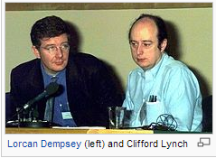
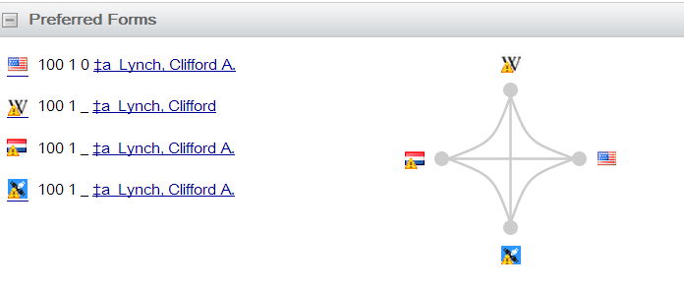
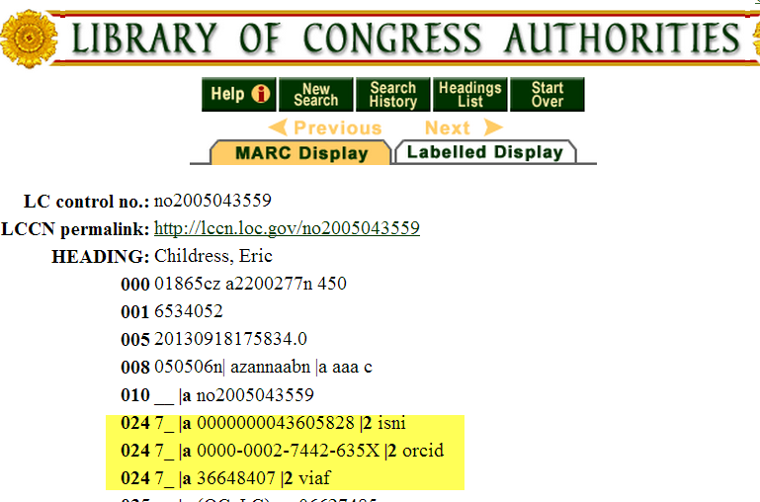
Some overlaps
Notes:
There are overlaps. Here, Cliff Lynch’s VIAF cluster shows he is represented by a Wikipedia article, and is also in the ISNI database as well as the LC/NACO and Dutch national authority files. My OCLC colleague Eric Childress has an authority record with his ISNI, ORCID, and VIAF identifiers.

Slide 28
How are differences in data models , provenance – maintained ?
LinkedIn
Mendeley
How do corrections, annotations, and conflicting assertions on public profile presentation propagate back ?
Aggregator: (Content Type)
Scope
Overlap among members of group actor types?
Google Scholar
Libraries
Aggregator: Internal/Private
Individually Maintained Profile
NACO
VIAF (Identifiers)
Individuals,
Pseudonyms, Organizations, Uniform titles, Fictional Names
Controlled
Information
Source
RERO
Book Publishers
GNL
…
Library Catalogs
Library Catalog
Gateway
Uncontrolled
Information
Source
Ringold (Org Names)
ISNI
Registration
Agencies/Members
ISNI (Identifiers) Individuals, Pseudonyms, & Organizations
Anonymous Pull
Bowker
Funder Maintained Profiles (e.g. ScienceCV)
Authenticated Pull
Authenticated Push
Individual
Researchers
ORCID: (Identifiers & Researcher outputs) Living Researchers
Actor Type
ORCID Member Research Orgs
Institutional Repository Catalogs
Institutional Repository
Gateway
CrossRef: (Publication) Journal Authors
Scholarly Publishers
Specific Actor
CRIS Instances
E.g. Symplectic, METIS
Organizational Directory Profile
National Research Institutions
National Identifier Systems
(Identifier)
E.g. DAI
Public View
Harvard Profiles/Other Institutionally Deployed Profile systems
VIVO
Member Research Orgs
VIVO: (Researcher Outputs) Researchers from Member Institutions
Question?
CAP
Notes:
Micah Altman (MIT) diagramed this Researcher ID information flow which demonstrates the complexity of the current researcher information workflow ecosystem. The ovals on the left show the various stakeholders: libraries, publishers, individual reserachers, ISNI registration agencies, ORCID and VIVO members, national research institutions. The dotted lines show the information flow among them, for example, book publishers provide information to libraries. The drums in the centers represent various types of aggregated databases: Virtual International Authority File, ISNI, ORCID, CrossRef, National platforms, VIVO. The lower right represents institutional-based databases such as Harvard Profiles, Stanford’s Community Academic Profiles, an institution’s CRIS or Institutional repository. Note that these operate separately from the libraries’ work on authority records on the top left. The information flows to either controlled information sources on the far right, or uncontrolled information sources on the Internet shown on the top (Google Scholar, LinkedIn, Mendeley).
A key question is how corrections or updates can be communicated between systems. Researchers are frustrated when they see errors in their profile or works incorrectly assigned to them, or works missing. Even if the information is corrected in the local instance, it often does not get reflected in the aggregated databases or hubs.

Slide 29
Some possibly emerging trends
Widespread acknowledgement that persistent identifiers for researchers is needed
Registration files rather than authority files for researcher identification
Universities assigning identifiers to researchers
Assigning ORCIDs to authors when submitting electronic
dissertations in institutional repositories
Pilot to automatically generate preliminary authority records
from publisher files (Harvard U. press, one other)
Assigning ISNI identifiers to their researchers.
Assigning local identifiers to researchers who don’t have one.
Using UUIDs (Universally Unique identifiers) to map to other identifiers like ORCID.
Notes:
We have started identifying some “possibly emerging trends”. The field is changing so quickly it is hard to tell whether a couple of examples are isolated occurrences or indicative of an emerging trend.
Note that the four universities shown here are taking five different approaches to assigning identifiers to researchers.

Slide 30
Nascent recommendations
Criteria for stakeholders to select identifier for the context or domain of applicability.
Researcher: Obtain persistent identifier before submitting any output.
Disseminate your persistent identifiers on all external communications
Librarian/university administrator/aggregator: Assign persistent identifiers to authors at point of submission if don’t already have one
Electronic dissertations in institutional repositories
Papers, datasets to research websites
Articles to journal aggregators
Notes:
The task group has just started to put together its recommendations. We propose to target the recommendations to a particular audience or stakeholder and suggest the criteria to select which identifier to use for a particular domain of applicability.

Slide 31
More nascent recommendations
Hub/aggregator:
Establish maintenance mechanism to:
Correct information about a researcher
Merge entities representing same person
Split entities representing different researchers.
Establish protocols to communicate changes to original source
Create framework to identify privacy & rights issues
Address interoperability of standards for both formats and data elements
Notes:
Publishers and rights management agencies in particular are very concerned about privacy & rights issues they may have. It’s important to have some agreement that data that may be considered private, like birth dates, can be used for matching but not for sharing.

Slide 32
smithyok@oclc.org
@KarenS_Y
viaf.org/viaf/72868513
http://www.oclc.org/research/activities/viaf-scholars.html
http://www.oclc.org/research/activities/registering-researchers.html

Slide 33
Reordering Ranganathan: Shifting User Behaviors, Shifting Priorities
ALA Midwinter, January 27, 2014
OCLC Research Update
Lynn Silipigni Connaway, Ph.D.
Ixchel M. Faniel, Ph.D.
Senior Research Scientist OCLC
connawal@oclc.org
@LynnConnaway
Associate Research Scientist OCLC
fanieli@oclc.org

Slide 34
Same Laws, New Lens

Slide 35
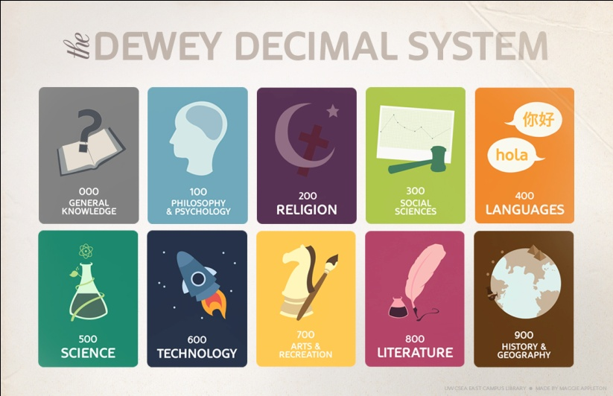
Ranganathan and Dewey
S.R. Ranganathan
1892-1972
Mathematician and librarian
Five Laws of Library
Science
M. Dewey
1851-1931
Librarian and educator
Dewey Decimal Classification (DDC) System
Notes:
Five Laws Image: http://babel.hathitrust.org/cgi/pt?id=uc1.$b99721;view=1up;seq=13
DDC Image: http://www.flickr.com/photos/33302583@N00/5907672591

Slide 36
 | Ranganathan’s Original Conception | New Conception in the Current Environment
First Law | Books are for use. | E-books are for reading. | Netflix is for watching. | Blackboard is for studying.
Second Law | Every person his or her book. | Every listener her iTunes. | Every artist his Photoshop. | Every student her EasyBib.
Third Law | Every book its reader. | Every blog its reader. | Every Google Map its traveler. | Every digital repository its researcher.
Fourth Law | Save the time of the reader. | Save the time of the listener. | Save the time of the traveler. | Save the time of the researcher.
Fifth Law | A library is a growing organism.

Slide 37
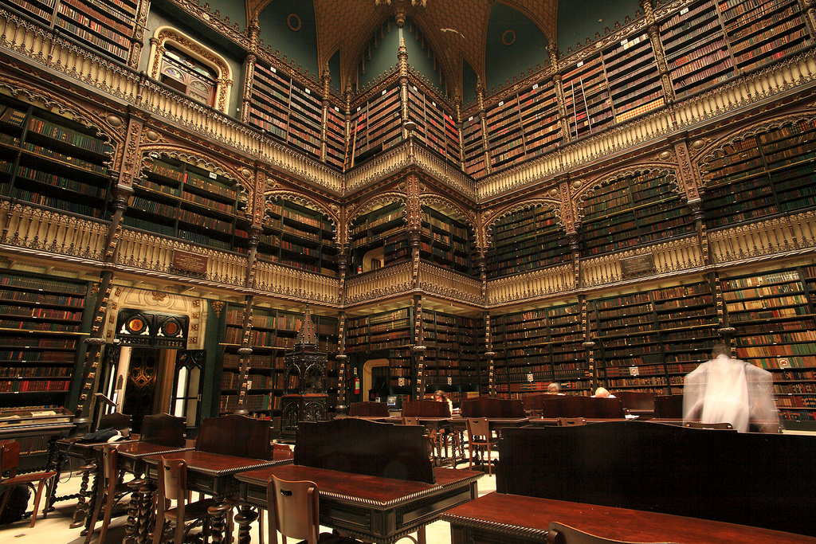
“Perhaps the most convenient method of studying the consequences of this law will be to follow the reader from the moment he enters the library to the moment he leaves it…”
(Ranganathan 1931, 337)
Notes:
Image: http://www.flickr.com/photos/mathieustruck/6551303327/

Slide 38
Three Aspects of Time
Time as simply time
Time as a shorthand for convenience
Time as stand-in for the entire service experience
Notes:
Image: http://www.flickr.com/photos/condadoconde/3456239301/

Slide 39
Time as Time
Seekers
Overwhelmed by information
No tolerance for delays
(Alves 2013; Connaway, Dickey, and Radford 2011; Fast and Campbell 2004; Sweeney 2006)
Notes:
Image: http://www.flickr.com/photos/katiew/320161805/

Slide 40
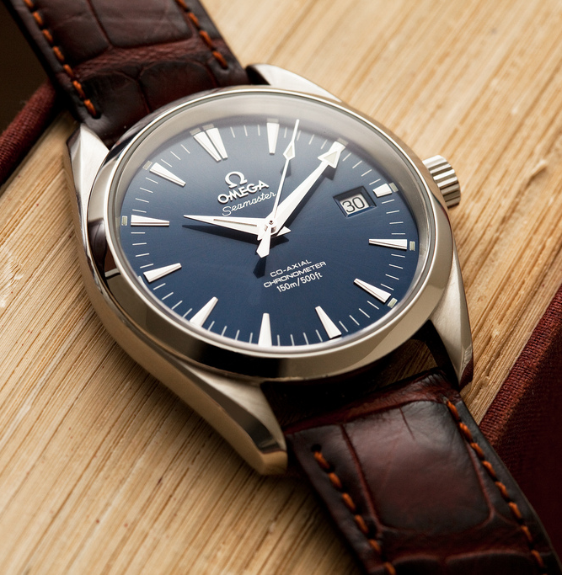
Time as Time
Contributors
Time and resource constraints
Delayed contributions
Time
(Connaway and Dickey 2010b; Faniel 2009)
Notes:
Image: http://www.flickr.com/photos/shanelin/6950430281/

Slide 41
Convenience: (1) fitness or suitability for performing an action or fulfilling a requirement; and (2) something (as an appliance, device, service) conducive to comfort or ease
(Merriam-Webster.com)
Notes:
Image: http://www.flickr.com/photos/18378305@N00/8583120909/

Slide 42
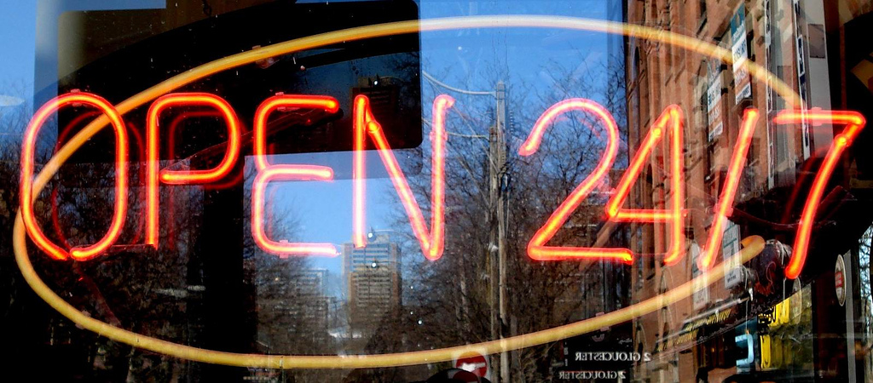
Time as Convenience
Libraries
Limited hours
Long travel distances
Time intensive
Search Engines
Fast and easy
Cost-effective
Available
(Connaway, Dickey, and Radford 2011; Connaway 2013b; Connaway, Lanclos, and Hood 2013; Connaway, Lanclos, White, Le Cornu, and Hood 2013; Pullinger 1999; De Rosa 2005)
Notes:
Image: http://www.flickr.com/photos/mag3737/452838421/

Slide 43
Time as User Experience
Discovery
Quick and convenient
Familiar
Rated, reviewed, and ranked by relevancy
(Calhoun, Cantrell, Gallagher, and Hawk 2009; Connaway 2013b; Connaway, Dickey, and Radford 2011; Connaway, Lanclos, and Hood 2013; Connaway, Lanclos, White, Le Cornu, and Hood 2013; Connaway and Radford 2011; Connaway, White, Lanclos, and Le Cornu 2013; Dempsey 2012; Head and Eisenberg 2009; Purcell, Rainie, Heaps, Buchanan, Friedrich, Jacklin, Chen, and Zickuhr 2012)

Slide 44
Our Interpretation of the Law

Slide 45
Save the time of the reader
=
Embed library systems and services into users’ existing workflows
Notes:
Image: http://www.flickr.com/photos/tonivc/2283676770/

Slide 46
Recommendations
Inform Users
Market and promote library services
Provide a broad range of tools
Remove the barriers between discovering and accessing information
(Connaway, Dickey, and Radford 2013)
Notes:
Image: Microsoft Clip Art

Slide 47
Being Seamless
= Efficiency
+ Knowledge of external and internal systems
+ Knowledge of user-centered services
(Connaway and Dickey 2010a)

Slide 48
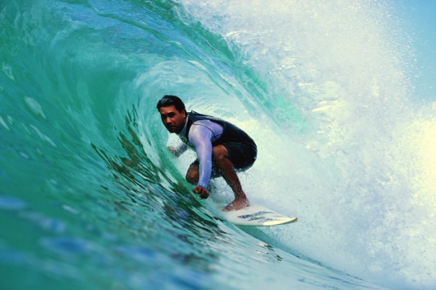
Recommendations
Be Proactive
Sense and respond to challenges
Be bold
Be inventive
Take risks
(Faniel 2009)
Notes:
Image: Microsoft Clip Art

Slide 49
Recommendations
Look Upstream
Are students using a particular service?
Is there a way to apply the technology?
Meet them
Notes:
Image: http://www.flickr.com/photos/obikani/11289244226/

Slide 50
Save the time of the reader
Notes:
Image: http://www.flickr.com/photos/kimota/105783011/

Slide 51
Selected Bibliography
Alves, Julio. 2013. Unintentional knowledge: What we find when we’re not looking. The Chronicle of Higher Education: The Chronicle Review (June 23), http://chronicle.com/article/Unintentional-Knowledge/139891/?cid=cr&utm_source=cr&utm_medium=en.
Calhoun, Karen, Joanne Cantrell, Peggy Gallagher, and Janet Hawk. 2009. Online catalogs: What users and librarians want: An OCLC report. Dublin, OH: OCLC.
Case, Donald Owen. 2012. Looking for information: A survey of research on information seeking, needs and behavior. Bingley, UK: Emerald Group.
Connaway, Lynn Silipigni. 2013a. Findings from user behavior studies: A user’s world. Presented at ALA Midwinter Meeting and Exhibits, January 28, 2013, in Seattle, Washington.
Connaway, Lynn Silipigni. 2013b. Why the internet is more attractive than the library. The Serials Librarian 64, no. 1-4: 41-56.
Connaway, Lynn Silipigni, and Timothy J. Dickey. 2010a. The digital information seeker: Report of findings from selected OCLC, RIN, and JISC user behavior projects. http://www.jisc.ac.uk/media/documents/publications/reports/2010/digitalinformationseekerreport.pdf.
Connaway, Lynn Silipigni, and Timothy J. Dickey. 2010b. Towards a profile of the researcher of today: What can we learn from JISC Projects? Common themes identified in an analysis of JISC virtual research environment and digital repository projects. http://ie-repository.jisc.ac.uk/418/2/VirtualScholar_themesFromProjects_revised.pdf.
Connaway, Lynn Silipigni, Timothy J. Dickey, and Marie L. Radford. 2011. “If it is too inconvenient I’m not going after it:” Convenience as a critical factor in information-seeking behaviors. Library & Information Science Research 33, no. 3: 179-190. http://www.oclc.org/content/dam/research/publications/library/2011/connaway-lisr.pdf.
Connaway, Lynn Silipigni, Donna Lanclos, and Erin M. Hood. 2013. “I find Google a lot easier than going to the library website.” Imagine ways to innovate and inspire students to use the academic library. Proceedings of the Association of College & Research Libraries (ACRL) 2013 conference, April 10-13, 2013, Indianapolis, IN. http://www.ala.org/acrl/sites/ala.org.acrl/files/content/conferences/confsandpreconfs/2013/papers/Connaway_Google.pdf.

Slide 52
Selected Bibliography
Connaway, Lynn Silipigni, Donna Lanclos, David White, Alison Le Cornu, and Erin M. Hood. 2013. User-centered decision making: A new model for developing academic library services and systems. IFLA Journal 39, no. 1: 30-36.
Connaway, Lynn Silipigni, and Marie L. Radford. 2011. Seeking synchronicity: Revelations and recommendations for virtual reference. Dublin, OH: OCLC Research. http://www.oclc.org/reports/synchronicity/full.pdf.
Connaway, Lynn Silipigni, Marie L. Radford, Timothy J. Dickey, Jocelyn De Angelis Williams, and Patrick Confer. 2008. Sense-making and synchronicity: Information-seeking behaviors of Millennials and Baby Boomers. Libri 58, no. 2: 123-135. http://www.oclc.org/resources/research/publications/library/2008/connaway-libri.pdf.
Connaway, Lynn Silipigni, David White, Donna Lanclos, and Alison Le Cornu. 2013. Visitors and Residents: What motivates engagement with the digital information environment? Information Research 18, no. 1, http://informationr.net/ir/18-1/infres181.html.
Dempsey, Lorcan. 2008. Always on: Libraries in a world of permanent connectivity. First Monday 14, no. 1, http://www.firstmonday.org/htbin/cgiwrap/bin/ojs/index.php/fm/article/view/2291/207.
Dempsey, Lorcan. 2012. Thirteen ways of looking at libraries, discovery, and the catalog: Scale, workflow, attention. EDUCAUSE Review Online (December 10), http://www.educause.edu/ero/article/thirteen-ways-looking-libraries-discovery-and-catalog-scale-workflow-attention.
De Rosa, Cathy. 2005. Perceptions of libraries and information resources: A report to the OCLC Membership. Dublin, OH: OCLC Online Computer Library Center.
Faniel, Ixchel M. 2009. Unrealized potential: The socio-technical challenges of a large scale cyberinfrastructure initiative. Arlington, VA: National Science Foundation. http://hdl.handle.net/2027.42/61845.
Fast, Karl V., and D. Grant Campbell. 2004. “I still like Google:” University student perceptions of searching OPACs and the web. Proceedings of the ASIS&T Annual Meeting 41: 138-146.

Slide 53
Selected Bibliography
Head, Alison J., and Michael B. Eisenberg. 2009. Lessons learned: How college students seek information in the digital age. Project Information Literacy Progress Report, The Information School, University of Washington.
Merriam-Webster.com. 2013. Convenience. Accessed December 12, http://www.merriam
webster.com/dictionary/convenience.
Pullinger, David. 1999. Academics and the new information environment: The impact of local factors on use of electronic journals. Journal of Information Science 25, no. 2: 164-172.
Purcell, Kristen, Lee Rainie, Alan Heaps, Judy Buchanan, Linda Friedrich, Amanda Jacklin, Clara Chen, and Kathryn Zickuhr. 2012. How teens do research in the digital world. Washington DC: PEW Internet & American Life Project. http://pewinternet.org/Reports/2012/Student-Research.aspx.
Ranganathan, Shiyali Ramamrita. 1931. The five laws of library science. London: Edward Goldston, Ltd.
Savolainen, Reijo. 1993. The sense-making theory: Reviewing the interests of a user-centered approach to information seeking and use. Information Processing & Management 29, no. 1, 13-28.
Sweeney, Richard. 2006. Millennial behaviors & demographics. http://certi.mst.edu/media/adminstrative/certi/documents /Article-Millennial-Behaviors.pdf.
Talja, Sanna, Heidi Keso, and Tarja Pietilainen. 1999. The production of “context” in information seeking research: A metatheoretical view. Information Processing & Management 35, no. 6, 751-763.
White, David, Lynn Silipigni Connaway, Donna Lanclos, Alison Le Cornu, and Erin Hood. 2012. Digital Visitors and Residents: Progress report. Report submitted to JISC, June 2012. http://www.jisc.ac.uk/media/documents/projects/visitorsandresidentsinterim%20report.pdf.

Slide 54
Thank you!
Lynn Silipigni Connaway connawal@oclc.org
@LynnConnaway
Ixchel M. Faniel fanieli@oclc.org

Slide 55
Questions

Slide 56
http://www.oclc.org/research.html

