Slide 1
Research Records and Artifact Ecologies
The Evolving Scholarly Record and the Evolving Stewardship Ecosystem
OCLC Workshop, Amsterdam
10 June, 2014
Natasa Milic-Frayling
Principal Researcher
Microsoft Research Cambridge, UK

Slide 2
Supporting Scientific Work
  How to support reuse of scientific data, tools, and resources to facilitate new scientific discoveries?

Slide 3
Research on Scientific Practices (1)
Process of scientific discovery and ‘universalizing knowledge’ is an inherently social enterprise
  Van House, N. A., Butler, M. H., and Schiff, L. R. 1998. Cooperative knowledge work and practices of trust: sharing environmental planning data sets. In Proc. of CSCW '98. ACM Press (1998), 335-343
Ways of gathering and validating shared data bind the researchers into distinct communities of practice
Birnholtz, J. P., and Bietz, M. J. Data at work: supporting sharing in science and engineering. In Proc. of GROUP '03. ACM Press (2003), 339-348.

Slide 4
Research on Scientific Practices (2)
Gathering and propagation of scientific information
  Difference between the scientific work conducted in the labs and reports communicated to the scientific community.
  Data passes through a complex, multi-stage social journey, from the laboratory experiments to the written paper.
  Latour, B. Science in Action, Harvard University Press, Cambridge MA, 1998.
Scientific records stands as an intermediary between the raw data and the formal scientific paper
  More ‘annotation, augmentation, deletion and imposed structure’ are added to raw data, the more data moves towards record.
  Shankar, K.,Order from chaos: The poetics and pragmatics of scientific recordkeeping. J. Am. Soc. Inf. Sci. Technol. (2007) 58, 10, 1457-1466.

Slide 5
Research on Scientific Practices (3)
Collaboratories―enable teams of distributed scientists to collaborate on scientific problems using tools for shared data access, data analysis, and communication.
Olson et al. studied 10 major collaboratories and see them as ‘a challenge to human organizational practices’.
  Pre-specifying data sharing rules and having a clear understanding of the common benefits, are essential for the success of a collaboratory.
Olson, G. M., Teasley, S., Bietz, M. J., and Cogburn, D. L. Collaboratories to support distributed science: the example of international HIV/AIDS research. In Proc. of SAICSIT ‘02 (2002), 44-51.

Slide 6
Research on Scientific Practices (4)
Ownership of data and sharing
  Bly [4] shows that scientists can be reluctant to share data for fear of losing their ‘monopoly rent’ on that data.
  Vertesi and Dourish found that the methods of producing and acquiring data in the scientific collaboration influence the manner in which the data is shared.
    In collaborative and inter-dependent research, there is sense of group ownership of data.
    In more independent research, competing for equipment, time, and resources, there is a feeling that data is personally earned and owned by individuals.
Bly, S. Special section on collaboratories, Interactions. ACM Press (1998), 5, 3, 31.
Vertesi, J. and Dourish, P. The value of data: considering the context of production in data economies. In Proc. of CSCW '11, ACM Press (2011), 533-542.

Slide 7
Observations
Research has dealt with important factors:
  Technical infrastructure (data repositories, tools)
  Collaborative practices (sharing rules, adopting tools, etc.)
  Information artifacts (scientific records including metadata that contextualizes data, lab books, publications).
What is the inter-relationship of technologies, practices, and artifacts that emerge as part of the scientific activities.

Slide 8
Approach
Adopt the ecology metaphor, inspired by the information ecology, introduced in 1999 by Nardi and O’Day
Nardi B. A., and O'Day, V. L. Information ecologies: Using technology with heart. (1999) MIT Press.
“Information Ecology is a system of people, practices, values and technologies in a particular local environment”.

Slide 9
Research Objectives
Study artifacts ecology of a successful collaborative scientific environment
Understand the interdependencies of the technologies, practices, and artifacts within the scientific discovery
  Identify advantages and drawbacks of the observed technologies and practices
  Consider enhancements
  Inform the design of the support required for collaborative scientific work.

Slide 10
user observation study
Scientific Discovery in the Nano-Technology Lab

Slide 11
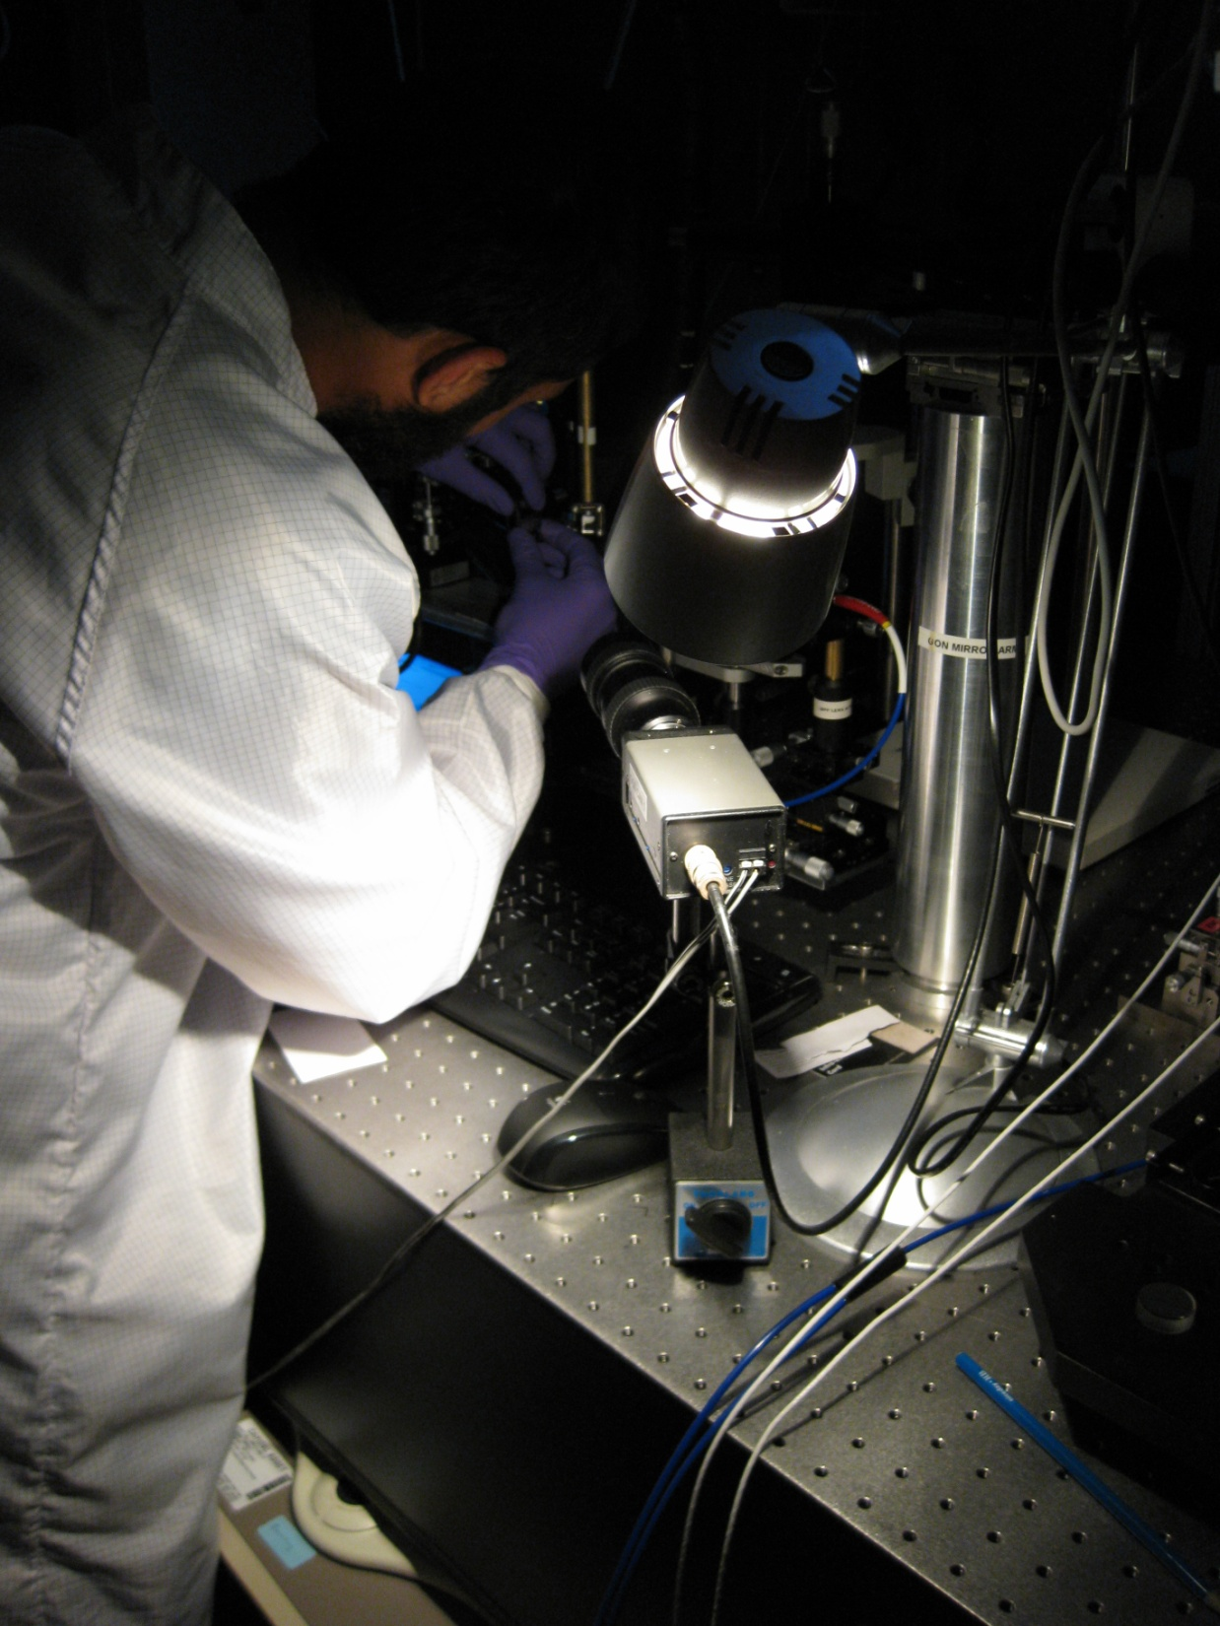
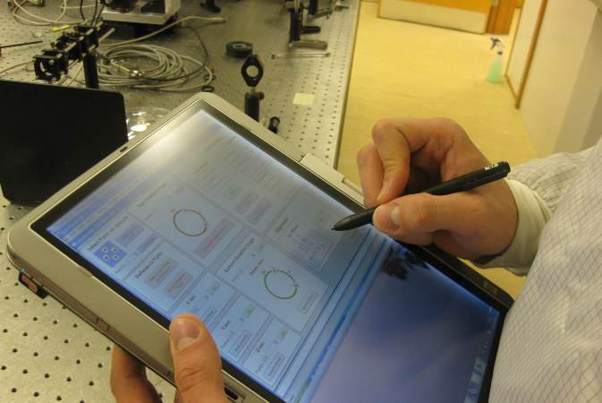
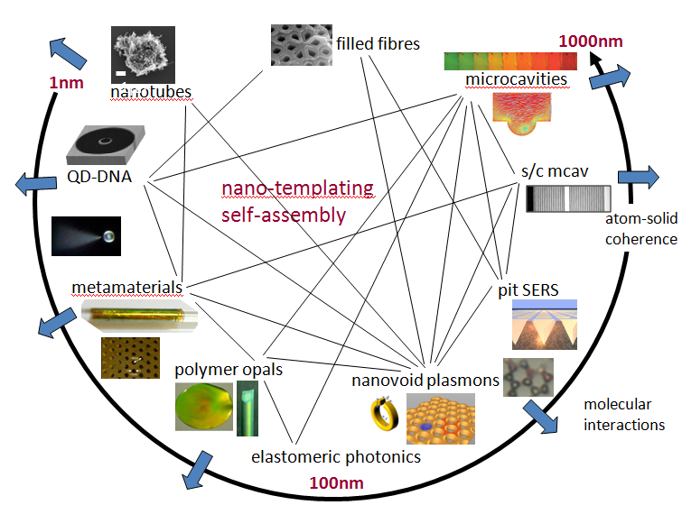



University NanoPhotonics Research Centre
Complex and dynamic research environment
Internationally recognized within the highly competitive area
Technologically highly advanced

Slide 12
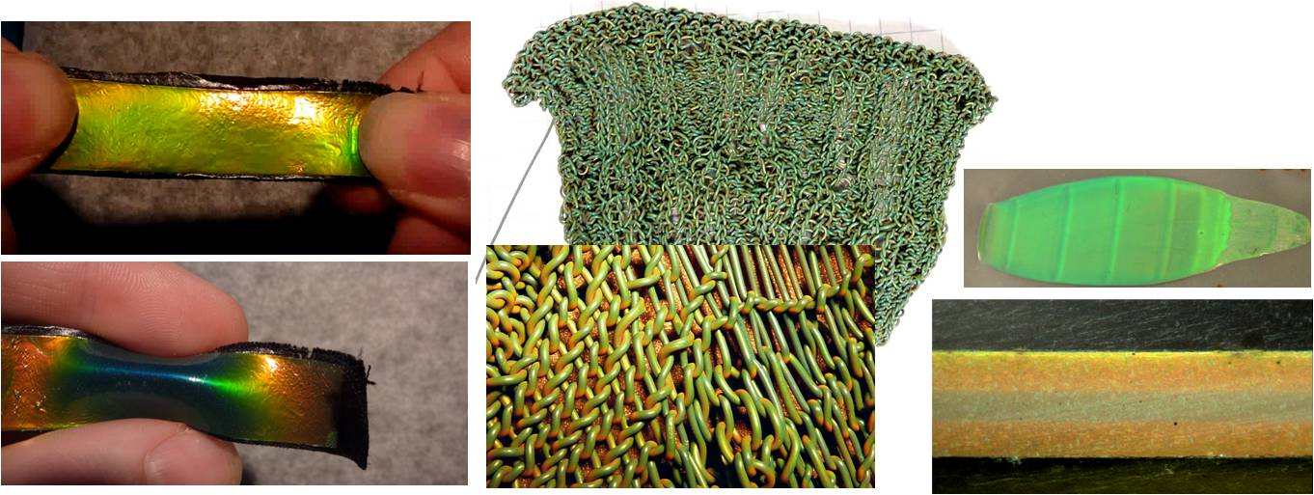
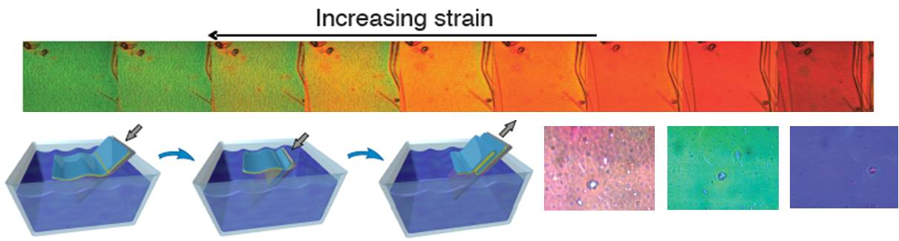
Research in Optical Properties of Materials
Notes:
The Nano-photonics Research Centre (NPRC) engages in the science of nano-photonics, exploring how new materials can be created in which the interaction between light and matter is fundamentally altered to produce useful new effects. This image depicts an output of Nanophotonics research… [explain this material and the science behind it]

Slide 13
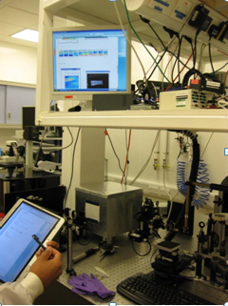
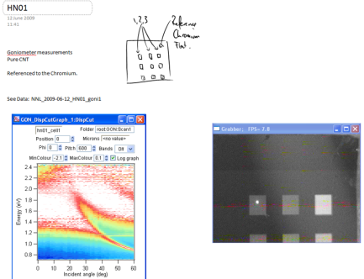
Research Environment
Electronic Lab Book: HP Tablets and MS OneNote
Sophisticated lab environment
Software:
  OneNote
  Office production tools
  Igor analysis tool
  Groove data sharing

Slide 14
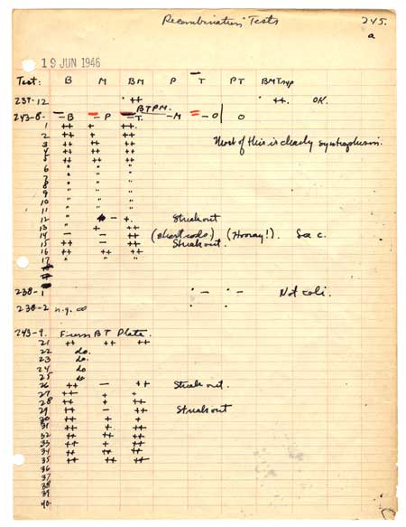
Physical vs. Electronic Lab Book
Laboratory Notebook, Yale University, 1946-1947, p. 245 (June 19, 1946).
Notes:
Contrast of the physical (rigid and prescriptive) lab books vs electronic lab books, facilitated by OneNote.

Slide 15
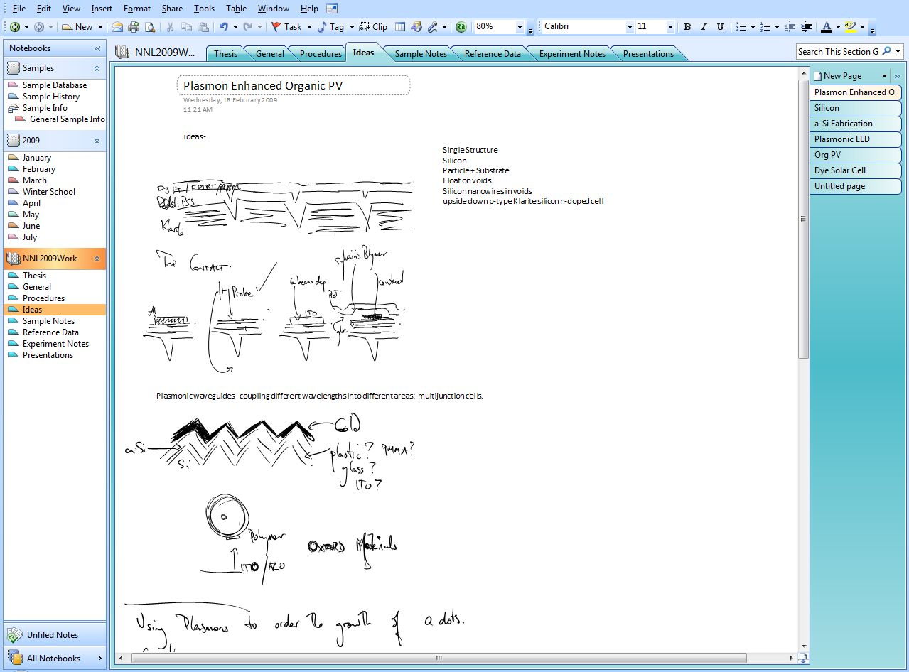
Physical vs. Electronic Lab Book

Slide 16
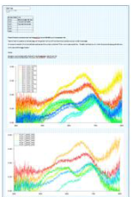



Observed Practices
Experiments and data collection
Analysis and synthesis
Interpretation and validation
Shared notebook
Lab notebook
Summary
Work practices optimised for rapid sharing of data and information with the research leader and the group
Diverse digital artefact ecology, comprising material samples, data, notes, and summaries
Issues: bridge information silos, bridge the gap between individual and collective record keeping.

Slide 17
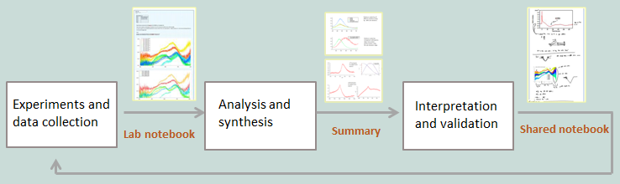
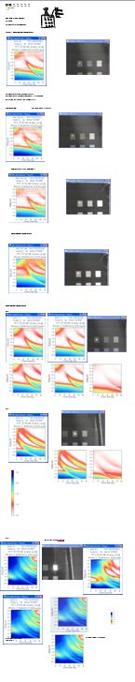
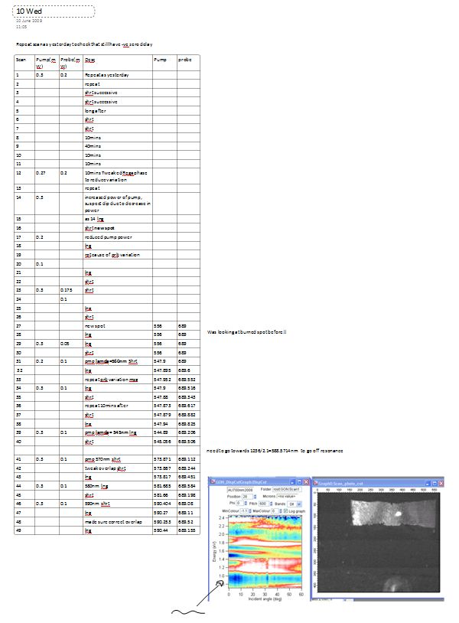
Data Collection
Lab books
(OneNote Notebook)

Slide 18
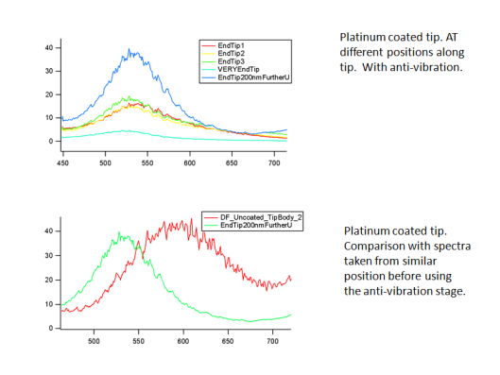
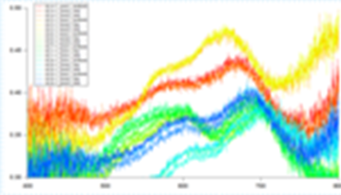
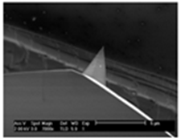
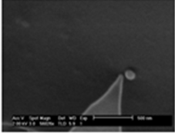
Distillation―From Notes to Summaries
Individual researcher notes
(OneNote Notebook)
Summary of findings (PowerPoint slide)

Slide 19
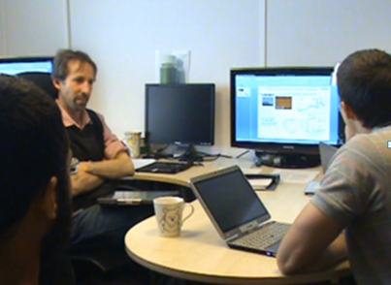
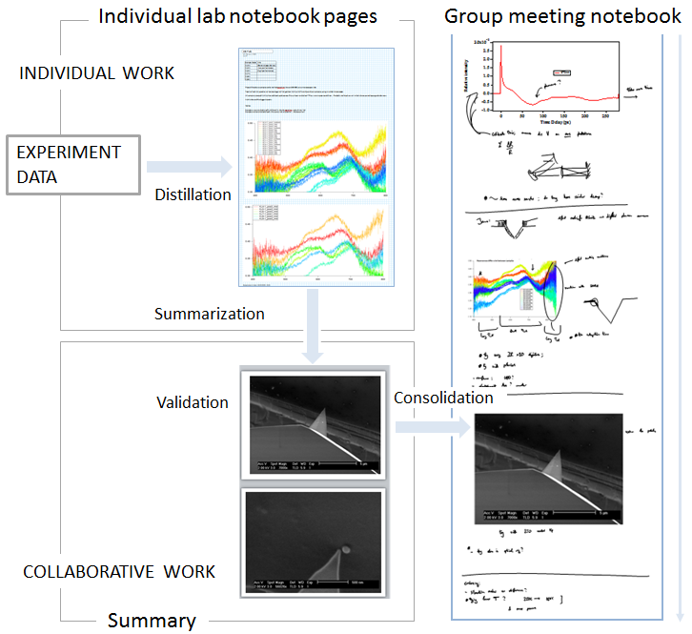
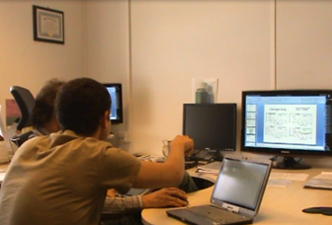
Interpretation and Validation
Gaining collective insights and establishing common ground

Slide 20
Evolution of Knowledge & Digital Artefacts

Slide 21
Inter-weaving of Digital Artifacts
Uncovered complex nature of the artefact ecology
Scientific work produces a chain of interrelated and complementary artifacts to enable interpretation of scientific data
Artifacts are interrelated
  Lab notes taken during experiments give context to the data
  Summarise, from the notes, synthesize intermediary findings
  During meetings, content from summaries (e.g., images) are embedded into meeting notes.
  Graphs and images are used and reused from one artefact to another, contextualized in new ways as new interpretations emerge.

Slide 22
What does this all mean?
Providing access to data is a pre-requisite but not sufficient to support successful reuse of scientific data.
We need to design rich environments that can give rise to artifacts that facilitate interaction and crystalization of experimental data and insights.
We need to maintain and share not only the data but the artifact ecology that supports scientific work.

Slide 23
technology probe
Representation of research projects

Slide 24
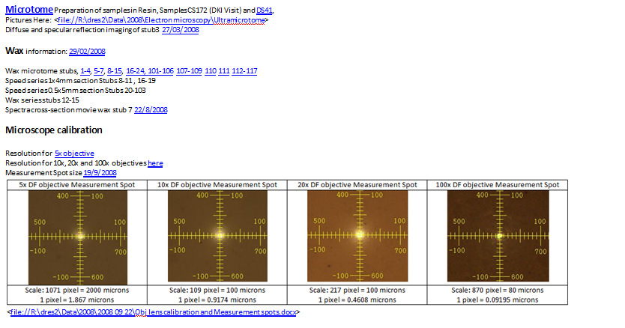
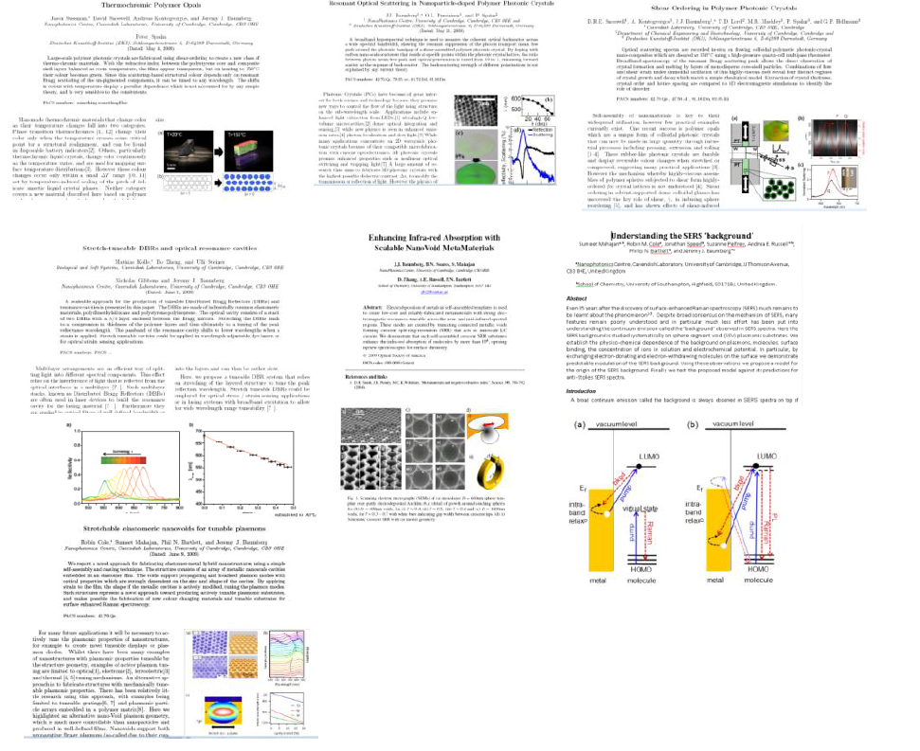
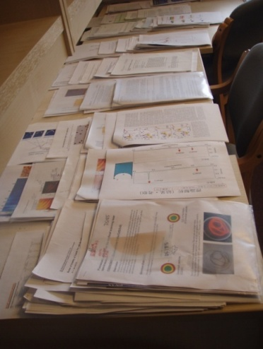
How to Create Overviews of Projects?
Linking artefacts
Overcome the limitations of physical interaction

Slide 25
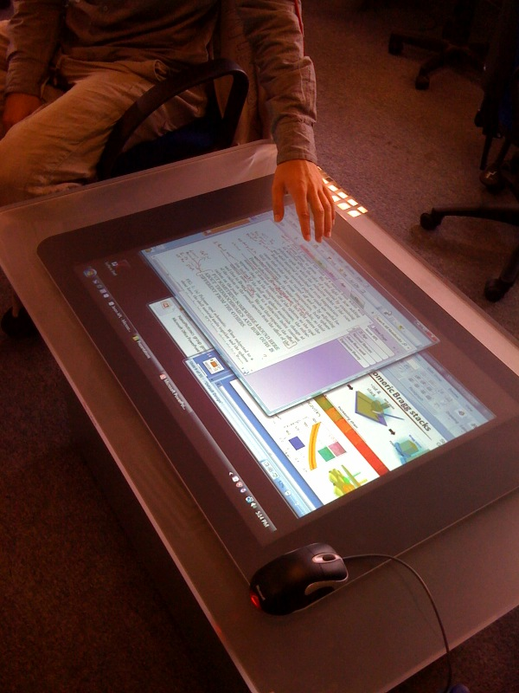
Meta Surfacing
Replace piles of papers with iconic and digital representations
Enable search and data mining
Create conceptual maps for individual topic, project, and researcher, linking relevant artefacts.
Enable rich interaction and real time manipulation of maps and objects.

Slide 26
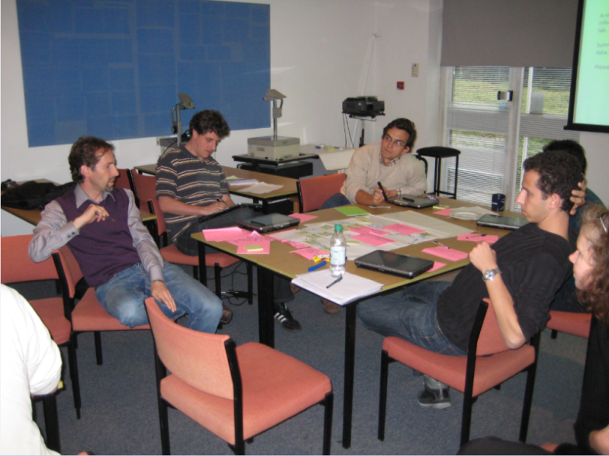
Co-design Workshop
Representing information and data in shared resource maps

Slide 27
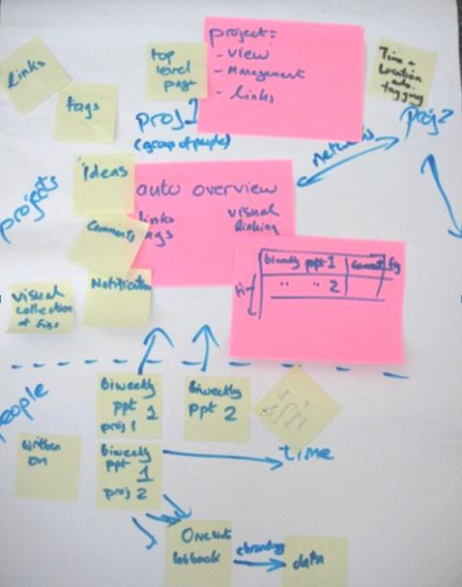
Co-design Workshop
Desire for improved information linking
  Space for viewing, arranging, annotating and creating new links between data sources
  Collaborative space for making connections between projects.

Slide 28
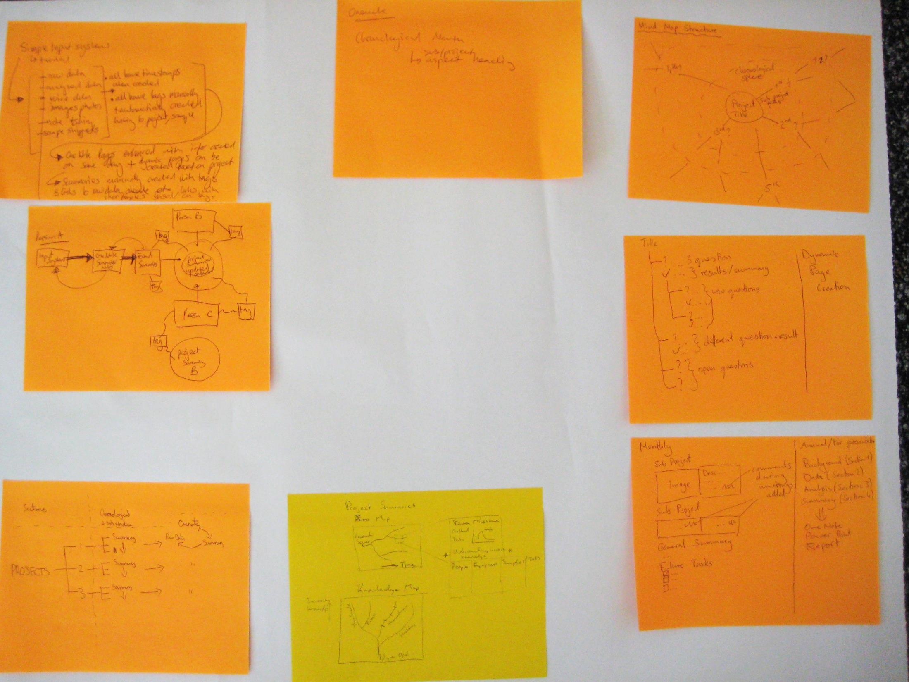
Co-design Workshop
Desire for visual project spaces
  Enable drill down from presentations and summaries to raw data
  Support tagging and automatic data collection and association

Slide 29
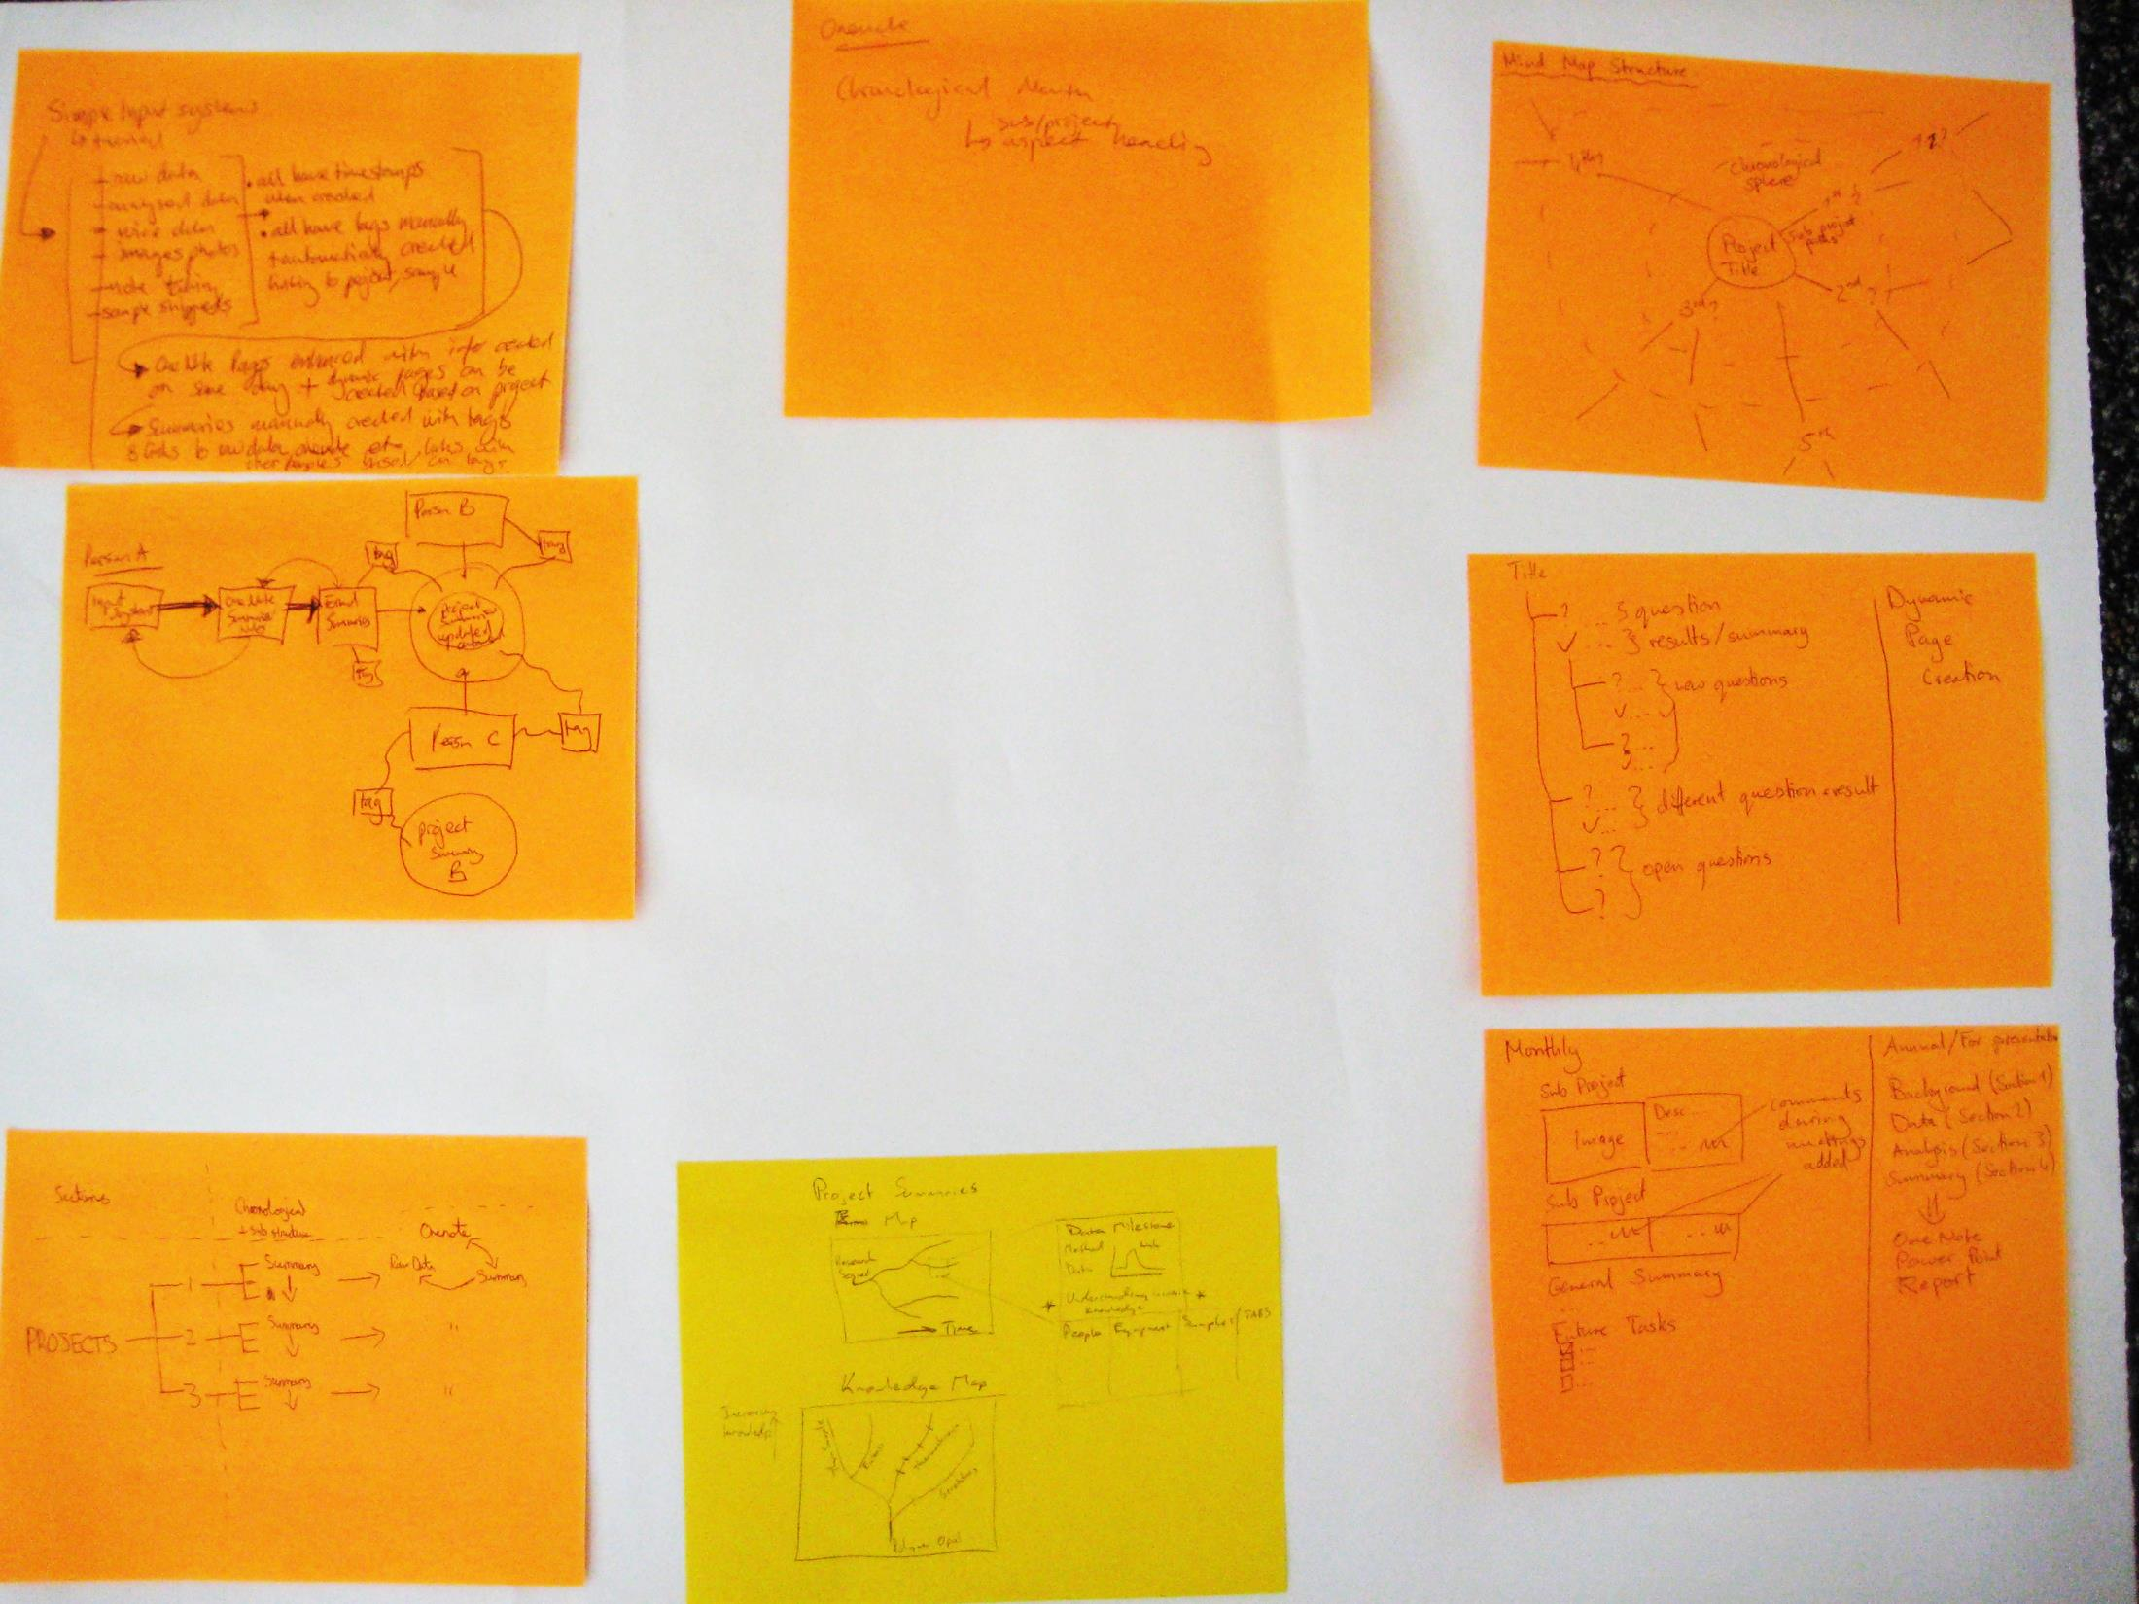
Visualization Ideas

Slide 30
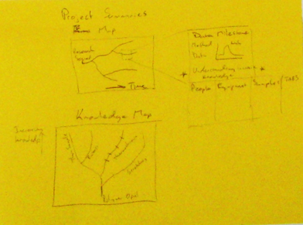
Visualization Ideas

Slide 31
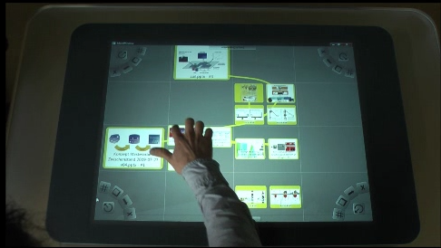
Support for Linking and Sense Making
Key functions
Import any information type
Enables annotation
Enables linking of resources
Link back to original file and folder place
Platform
Microsoft Surface to help enable collaboration
Synchronisation between tablet and Surface to support current practices

Slide 32
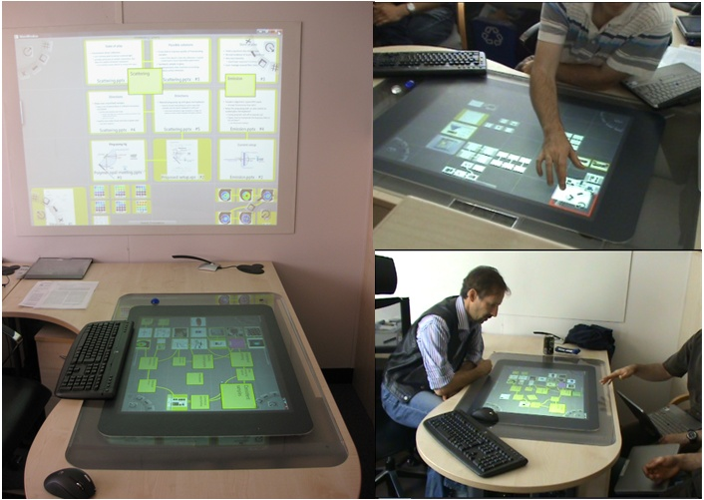
User Tasks
Sessions 1,2,3
Session 4
Session 5
Individual knowledge crystallisation
Collaborative knowledge crystallisation
Active review

Slide 33
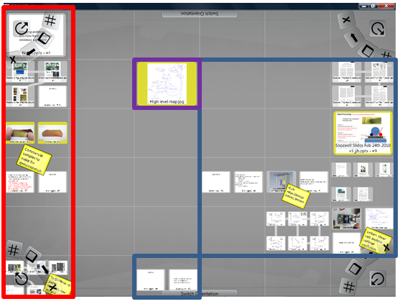
Spatial Chunking of Maps
Sessions 1, S1
High level map
Commercial work
Scientific work
Progress
Most recent data
Separate scientific work

Slide 34
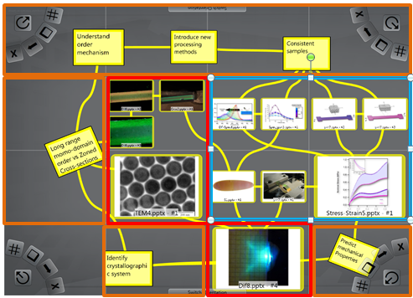
Spatial Chunking and Linking within Maps
Sessions 2, S2
Blue – the results of experiments on stretched samples. Well understood area.
Red – areas of uncertainty. Nano-chasms and sample cross sections are incongruous. Results of diffraction experiment not understood. Solutions needed.
Orange. Notes show illustrate the interconnection and dependencies between different areas of the graph.

Slide 35
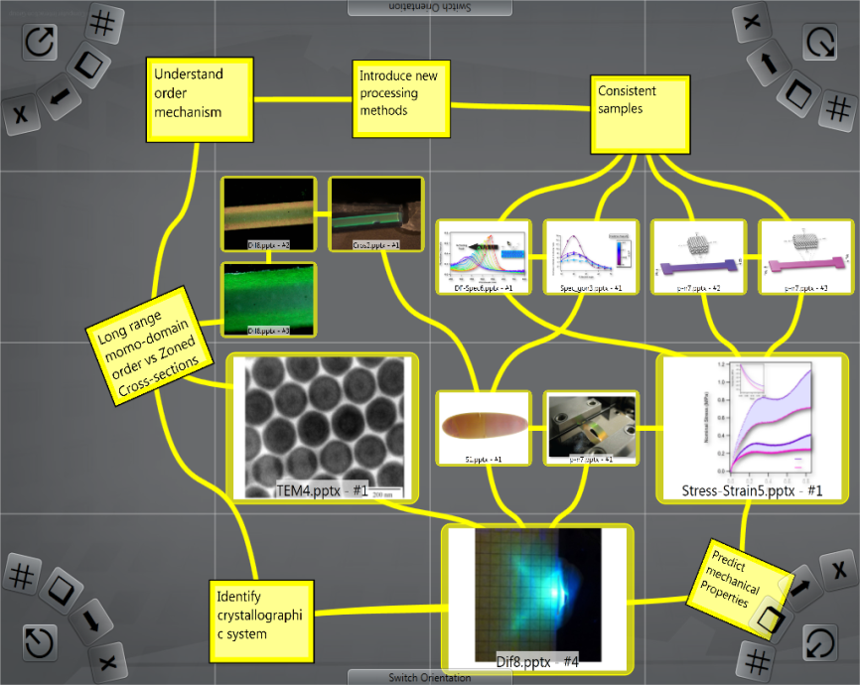
Project Maps

Slide 36
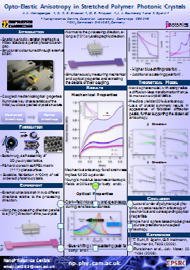
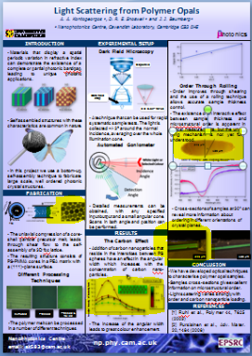
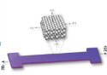

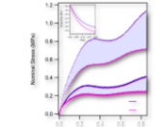
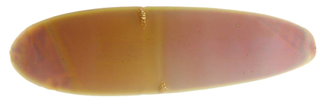

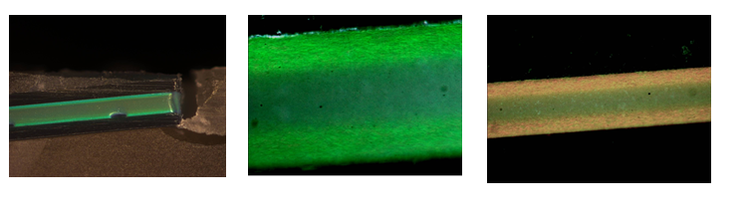
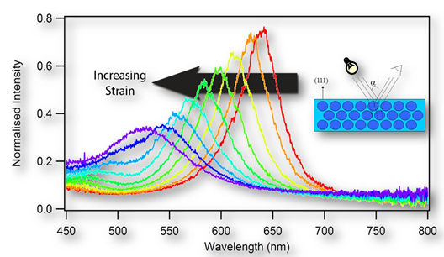

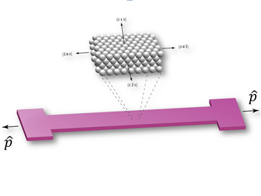
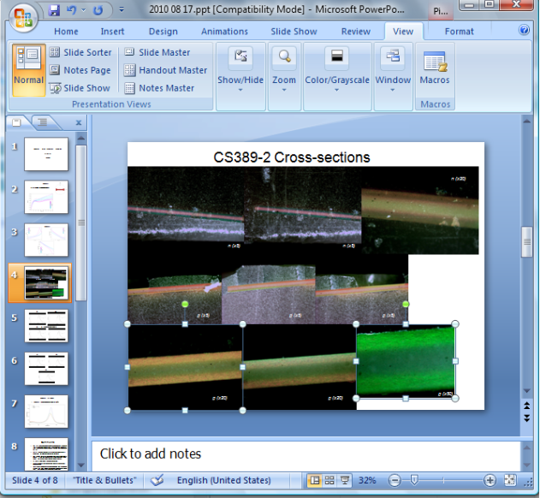
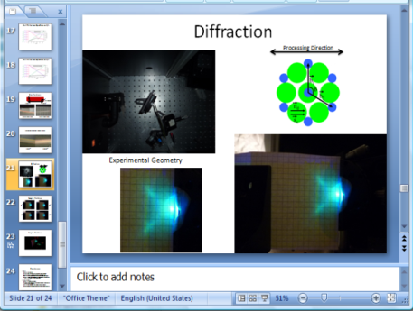
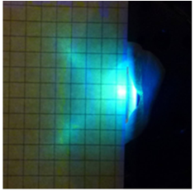
Project Maps

Slide 37
Learnings: Decoupling information units from documents
Participants imported sub-parts of the documents.
Extracting content was not fully supported across file types; participants used workarounds such as cut&paste
The document file is too course grain for creating project maps.
We require content extraction and format transformation services

Slide 38
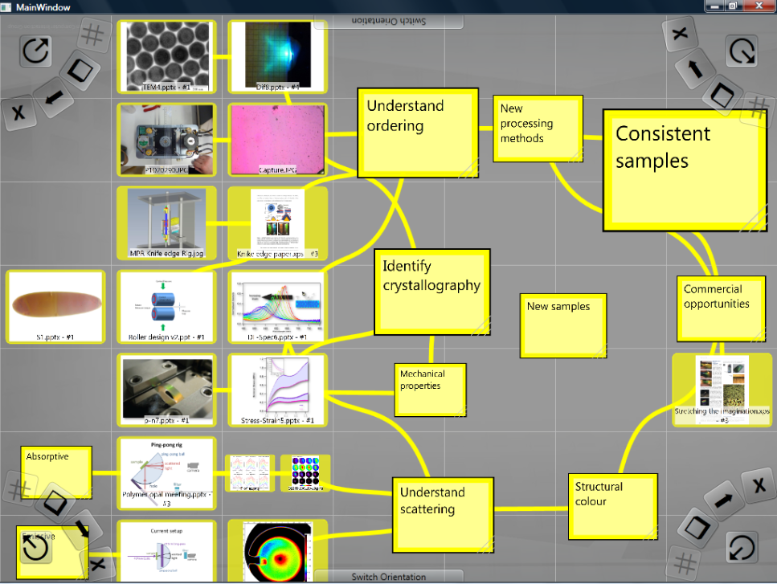
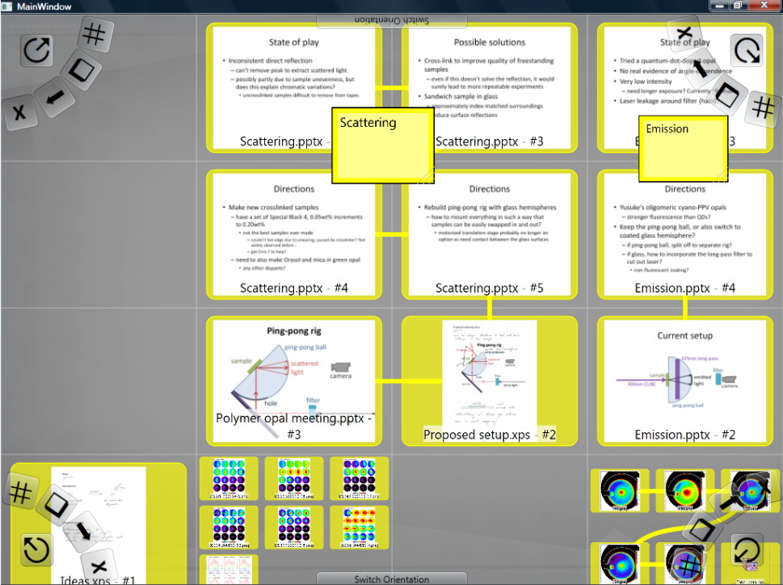
Learnings: Spatial and explicit linking
The participants used space, links, and annotations to express relationships among information items in the map.
The semantic regions within the map could be ambiguous to third parties without a digital trace of interaction that led to the map
We require rich linking and referencing services.
Complementary information about interaction may need to be recorded.

Slide 39
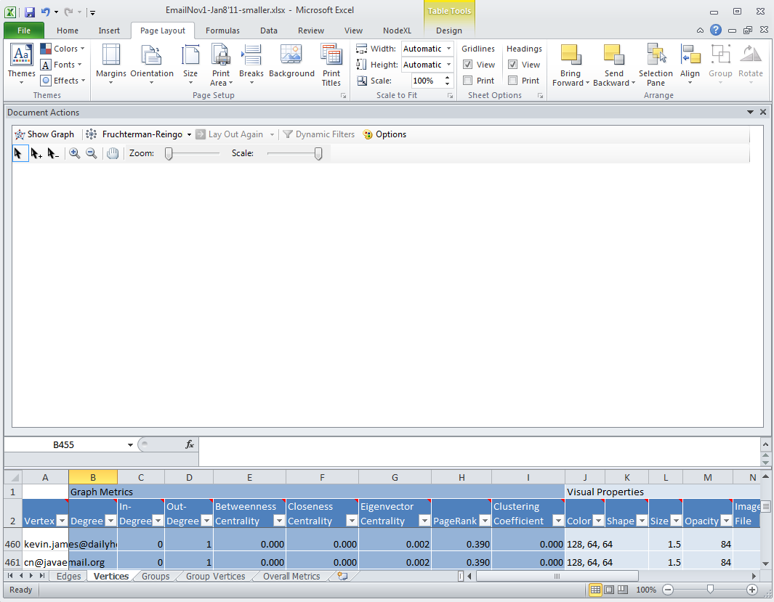
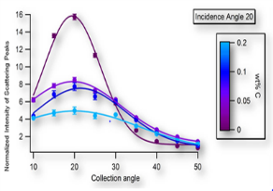
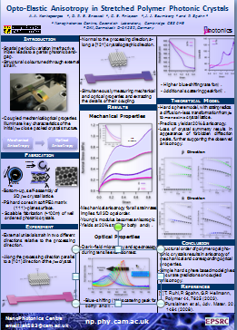








Information Architecture
COMPOSITION
REFERENCES
COLLECTIONS

Slide 40




Information Architecture
Documents
Sub-documents
Compositions
COMPOSITION
Linking among
extracts
References to the files
REFERENCES
COLLECTIONS

Slide 41
long term access to digital
Representation of research projects

Slide 42



FILE
APPLICATION
DIGITAL CONTENT/
EXPERIENCE
Persisted
Ephemeral
PRESERVATION = Persistence + Connection with the contemporary ecosystem.
DIGITAL ARTEFACT
SOFTWARE – decoder
FILE – digital object
Hardware to process and DISPLAY
Persisted part of the digital artefact

Slide 43
Paradox: we are concerned about storage, yet
Digital is inherently about processing bits, not about storing bits

Slide 44
Symbiosis of Files and Applications
Objective of preservation is to ensure that the persisted digital content and applications remain connected with the contemporary computing ecosystem.
PRESERVATION = Persistence + Connection with the contemporary ecosystem.
FILE
APPLICATION
DIGITAL CONTENT
Persisted
Ephemeral

Slide 45
What do you want to keep ‘unchanged’?
FILE
APPLICATION
DIGITAL CONTENT
If application is not running in the contemporary environment

Slide 46
What do you want to keep ‘unchanged’?
FILE
APPLICATION
DIGITAL CONTENT
If application is not running in the contemporary environment
  Migrate files and run with a contemporary software
  (give up on both the original files and the application)

Slide 47
What do you want to keep ‘unchanged’?
FILE
APPLICATION
DIGITAL CONTENT
If application is not running in the contemporary environment
  Retain the files and port the application to the new environment
  (retain content files by give up on the application, at least partially)

Slide 48
What do you want to keep ‘unchanged’?
FILE
APPLICATION
DIGITAL CONTENT
If application is not running in the contemporary environment
  Create a virtual machine with the old computing stack and run the original files and software.
  (retain original files and original application; maintain scaffolding)

Slide 49

Computational Cradles
Sustain and increase the value of digtial through
Virtualization of legacy software + Bridging Services
Individual computational ‘cells’ for different generations of software stacks
VM-Gen4
VM-Gen3
Contemporary Computing Ecosystem
VM-Gen2
Bridging services: format translators, content extractors, etc.
VM-Gen1

Slide 50
Connecting Legacy with
Contemporary Ecosystem
VM-Gen4
VM-Gen3
Contemporary Computing Ecosystem
Digital artifact always requires (some software) computation.
No need to give up on the original software!
VM-Gen2
VM-Gen1
Bridging Technologies and Methods
ICT: SOFTWARE AND HARDWARE INNOVATION
Contemporary Ecosystem

Slide 51
preserving computation
Virtualization of Legacy Software

Slide 52

Virtual Machine with Windows 2000 (left) and Windows XP (right), running on Microsoft Cloud (Azure)

Slide 53

Start menus for Windows 2000 (left) and Windows XP (right),

Slide 54

MS Map Point application running on Windows 2000 (left) and MS Money 2003 running on Windows XP (right),

Slide 55
Increasing value of legacy content
format transformation

Slide 56


Word document shown in Microsoft Word 2.0 (from 1992)
Running in the Virtual Machine with Windows XP

Slide 57

Word document in MS Word 2.0 (from 1992) and converted to Open XML format, shown in Office 2007 (right)

Slide 58


Word Perfect document, shown in WordPerfect 5.2 (from 1994)
Running in the Virtual Machine with Windows XP

Slide 59

Word Perfect document in WordPerfect 5.2 (from 1994) and converted to Open XML format, shown in Office 2007 (right)

Slide 60
Concluding Remarks
Research results in a complex ecology of digital artefacts
  This includes a computing infrastructure, software, and digital artefacts
Snapshots of scientific research records can be preserved through virtualization of the artefact ecology
  That ensures that all the original artefacts can be accessed.
Services around research ecology snapshots can provide added value.
  These include curation services, beyond the project descriptions provided by the specialist as part of research practices.

Slide 61
Thank you
Natasa Milic-Frayling
natasamf@microsoft.com
Integrated Systems
Microsoft Research Cambridge UK

