Slide 1
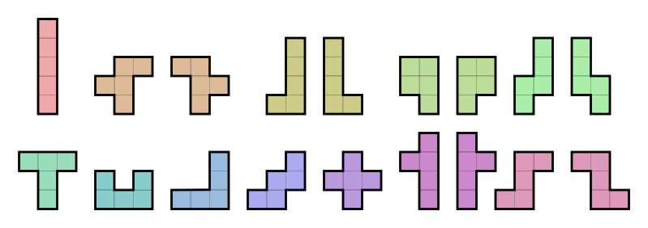
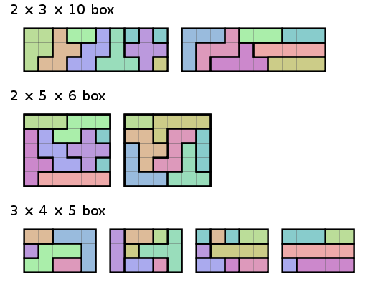
Restructuring
Research Libraries:
Strategy and Value
http://commons.wikimedia.org/wiki/File:All_18_Pentominoes.svg
Jim Michalko
OCLC Research
Libraries and Research: Supporting Change/Changing Support
12 June 2014

Slide 2
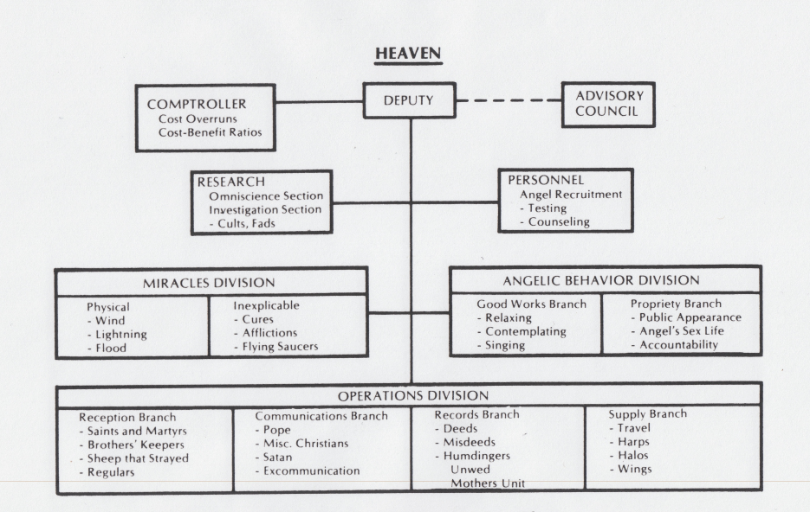
Charts, Structure, Organization

Slide 3
Reorganized? Restructured?
radical, novel, innovative
  organization structures
  senior management portfolios
Notes:
“We’re seeing some striking new combinations of managerial and organisational responsibilities… We think these new organisational structures are evidence of the way research libraries are evolving to match the contours of their institution. ”
(UNSW and Melbourne responded to Jim’s call, also Auckland, several in the UK and Canada, and one in the Netherlands)
Goal: international library leadership finds shared understanding and becomes less risk-averse to novel assignments:
radically shift library structures and plan to adjust to changes in research and higher education
restructure library functions to be (again) built to purpose
capitalize on turnover at the top; “musical chairs” and “fresh horses”
remedy gap in array of management skills to fit evolving system dynamics
change library culture
(an example of a work-in-process:)
Jim’s call: “Do you self-identify as a research library leader who has recently reorganised or is about to change the administrative structure of your organization? OCLC Research is searching internationally for directors, deans or other senior managers who have changed their organisation’s structure or made new assignments to:
align with changes in research and education,
more closely align with university directions or
ensure the library is responsive to the changed expectations of the constituencies served by the library.
“What have you decided? We’re seeing some striking new combinations of managerial and organisational responsibilities such as:
digital scholarship, digital preservation, digitization, and special collections
metadata services, IT, systems and digital humanities
university press, institutional repository and preservation/conservation
“We think these new organisational structures are evidence of the way research libraries are evolving to match the contours of their institution. We’d like to understand more in order to synthesise and characterize these emerging strategies and structures.”
Problem: insufficient flexibility to respond to changing external economic and political demands, including:
funding cuts that will not be reversed
scale and pace of changes to research library system dynamics
structural unknowns in research and the “crisis in higher education”
irrelevance and disintermediation of research libraries
evolving scholarly record flips collecting mission from local/private to public good; paired with need for shared services
legacy staff and legacy culture
What we (OCLC Research) do: quickest path to a synthesis will be:
identify institutions that have redesigned and made assignments
Jim send call for directors to self-identify to share drivers for organizational restructuring
invite that cohort of directors or appropriate senior leadership to structured interviews about their reasoning
identify emerging strategies and structures

Slide 4
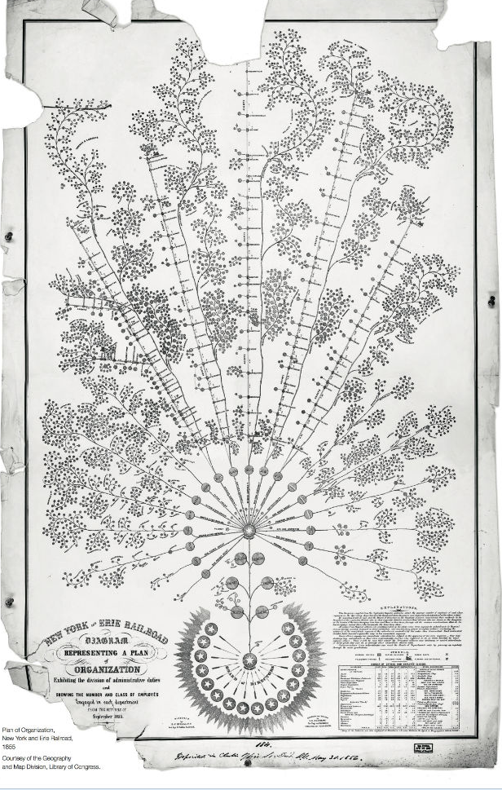
Charts,
Structure,
Organization
http://www.wired.com/2014/03/stunningly-complex-organization-chart-19th-century/

Slide 5
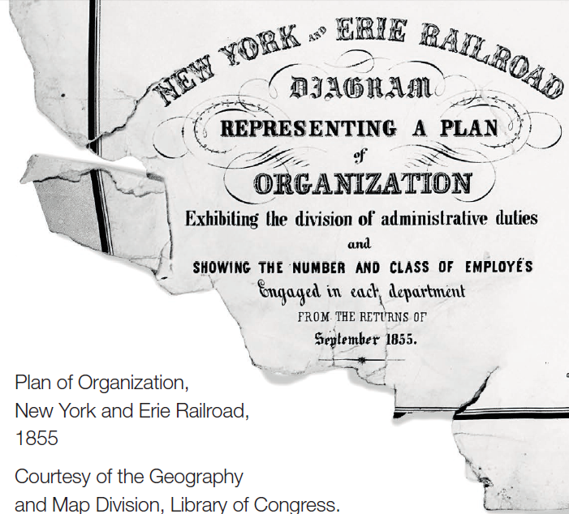

Slide 6
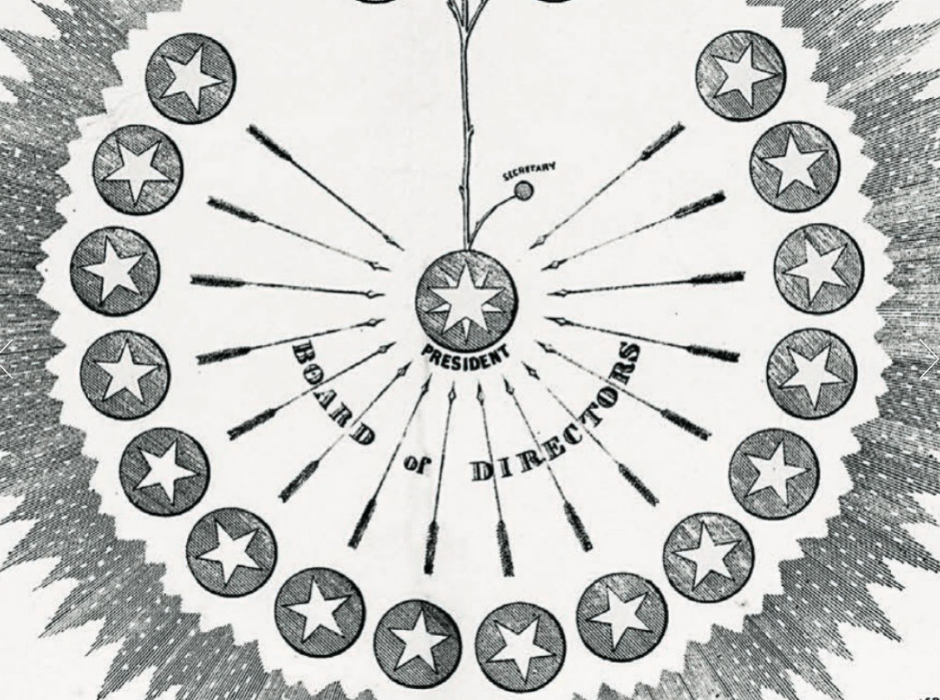

Slide 7
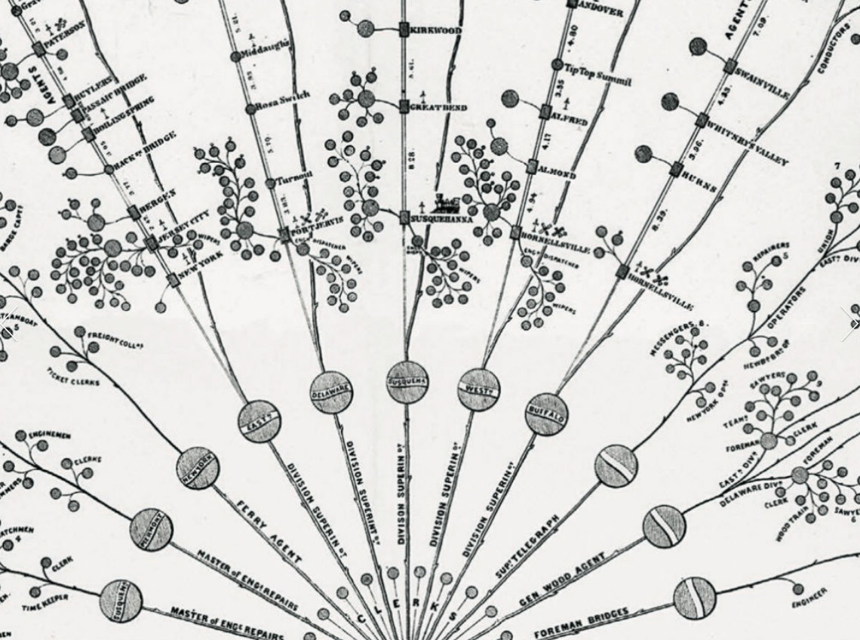

Slide 8
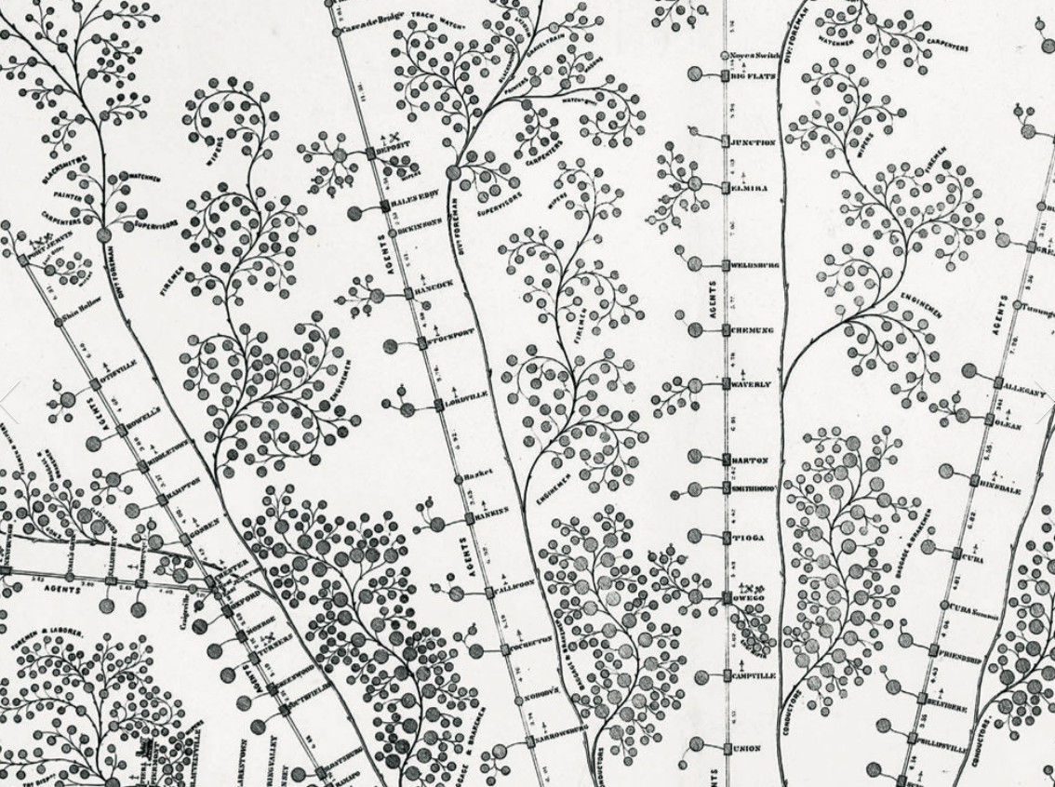

Slide 9
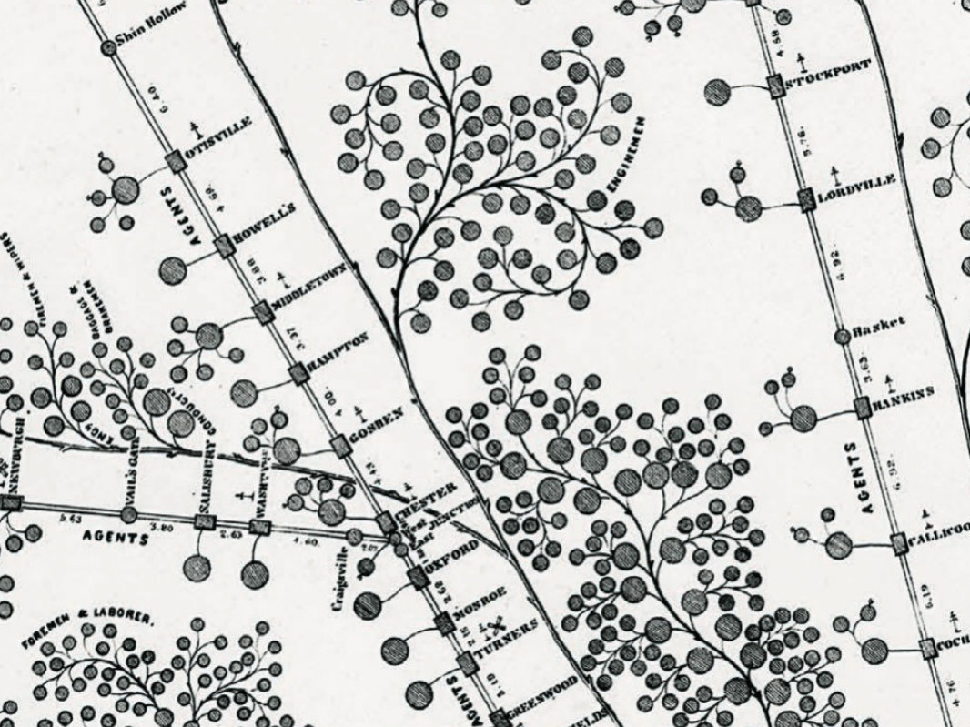

Slide 10
Reorganized? Restructured?
radical, novel, innovative
  organization structures
  senior management portfolios
Structure
following
Strategy?
Notes:
“We’re seeing some striking new combinations of managerial and organisational responsibilities… We think these new organisational structures are evidence of the way research libraries are evolving to match the contours of their institution. ”
(UNSW and Melbourne responded to Jim’s call, also Auckland, several in the UK and Canada, and one in the Netherlands)
Goal: international library leadership finds shared understanding and becomes less risk-averse to novel assignments:
radically shift library structures and plan to adjust to changes in research and higher education
restructure library functions to be (again) built to purpose
capitalize on turnover at the top; “musical chairs” and “fresh horses”
remedy gap in array of management skills to fit evolving system dynamics
change library culture
(an example of a work-in-process:)
Jim’s call: “Do you self-identify as a research library leader who has recently reorganised or is about to change the administrative structure of your organization? OCLC Research is searching internationally for directors, deans or other senior managers who have changed their organisation’s structure or made new assignments to:
align with changes in research and education,
more closely align with university directions or
ensure the library is responsive to the changed expectations of the constituencies served by the library.
“What have you decided? We’re seeing some striking new combinations of managerial and organisational responsibilities such as:
digital scholarship, digital preservation, digitization, and special collections
metadata services, IT, systems and digital humanities
university press, institutional repository and preservation/conservation
“We think these new organisational structures are evidence of the way research libraries are evolving to match the contours of their institution. We’d like to understand more in order to synthesise and characterize these emerging strategies and structures.”
Problem: insufficient flexibility to respond to changing external economic and political demands, including:
funding cuts that will not be reversed
scale and pace of changes to research library system dynamics
structural unknowns in research and the “crisis in higher education”
irrelevance and disintermediation of research libraries
evolving scholarly record flips collecting mission from local/private to public good; paired with need for shared services
legacy staff and legacy culture
What we (OCLC Research) do: quickest path to a synthesis will be:
identify institutions that have redesigned and made assignments
Jim send call for directors to self-identify to share drivers for organizational restructuring
invite that cohort of directors or appropriate senior leadership to structured interviews about their reasoning
identify emerging strategies and structures

Slide 11
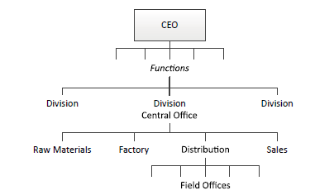
Structure follows strategy
“and that the most complex type of structure is the result of the concatenation of several basic strategies”
Chandler AD. 1962 Strategy and Structure, MIT Press, Cambridge, MA.
GALBRAITH, Jay R.. The Evolution of Enterprise Organization Designs. Journal of Organization Design

Slide 12
Complexity
Growth
  Volume
  Markets
  Adjacent business
Law of Requisite Variety
  Outside entities proliferate
  Inside entities respond
    e.g. Marketing
GALBRAITH, Jay R.. The Evolution of Enterprise Organization Designs. Journal of Organization Design

Slide 13
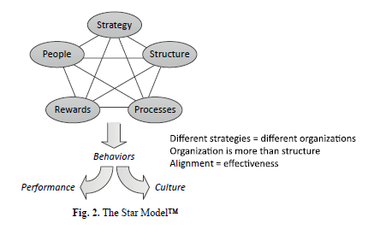
Structure is not organization
Galbraith, J. 1977 Organization Design, Addison-Wesley, Reading, MA

Slide 14
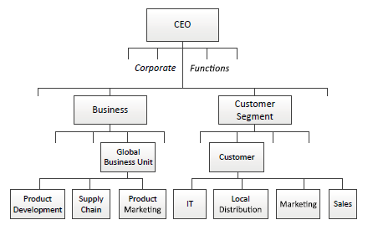
Customer
Front to Back
GALBRAITH, Jay R.. The Evolution of Enterprise Organization Designs. Journal of Organization Design

Slide 15
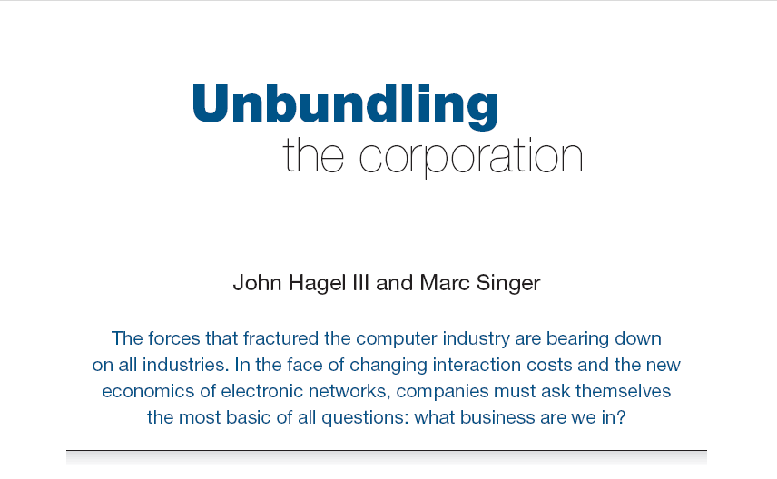
Harvard Business Review (1999)

Slide 16
CORE COMPONENTS
OF A FIRM
Attracting and building relationships with customers
“Service-oriented”, customization
Economies of scope important
Develop new products and
services and bring them to
market
Speed/flexibility important
Customer
Relationship
Management
Product Innovation
Infrastructure
Back office capacities that
support day-to-day operations
“Routinized” workflows
Economies of scale important

Slide 17
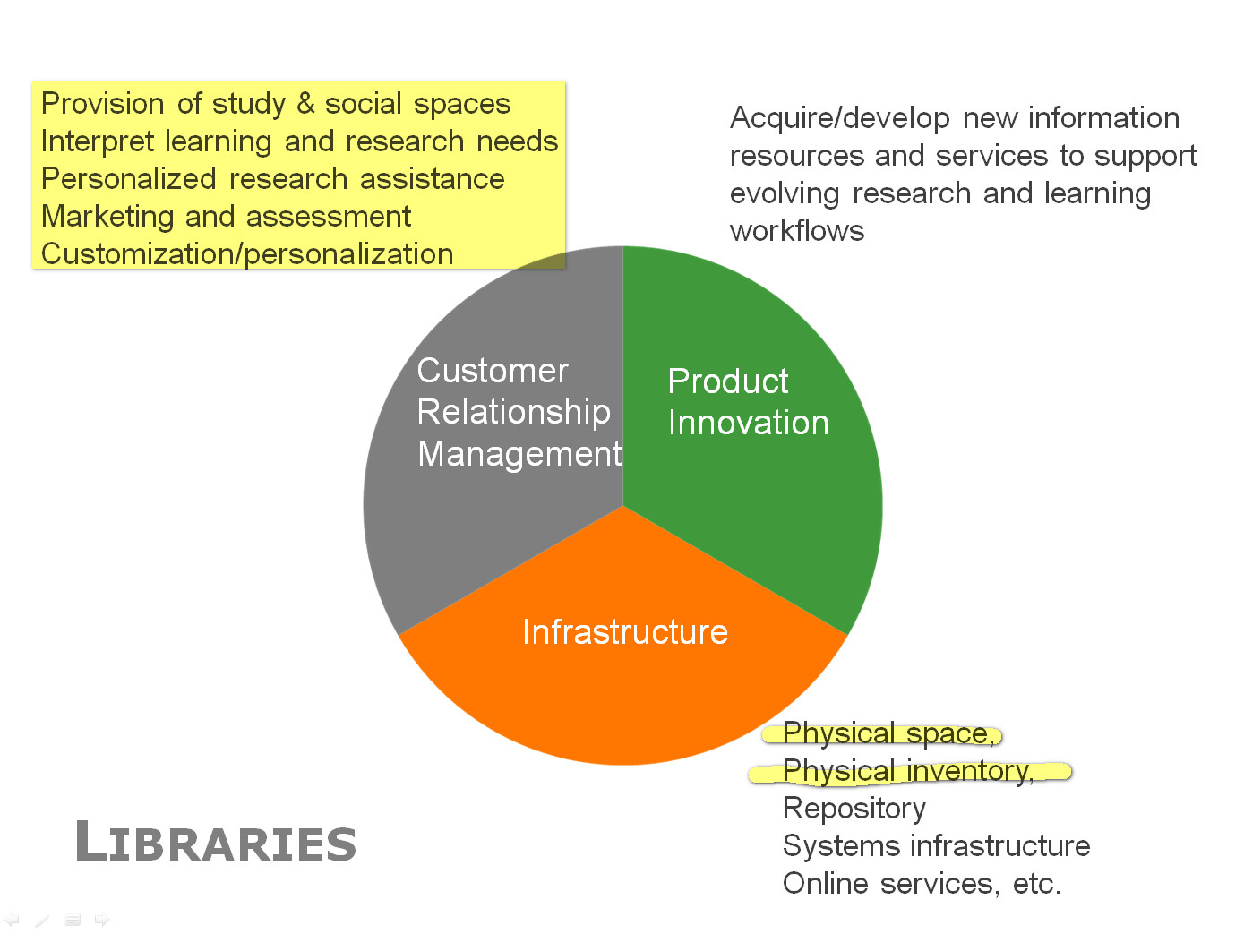

Slide 18
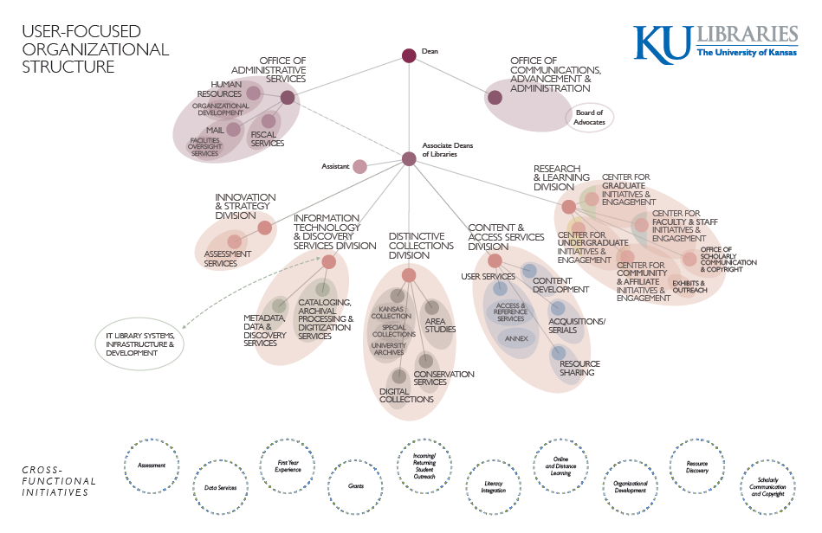

Slide 19

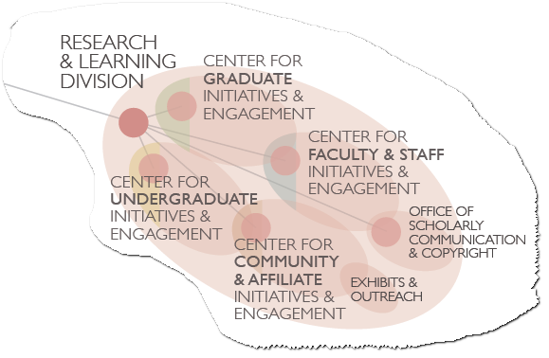
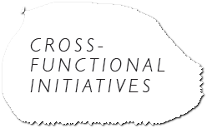

Slide 20
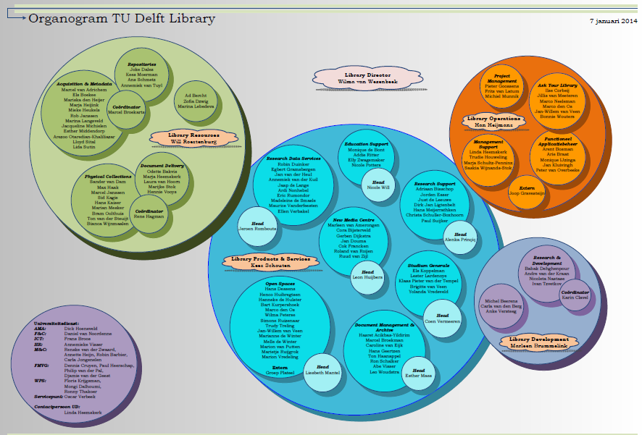

Slide 21
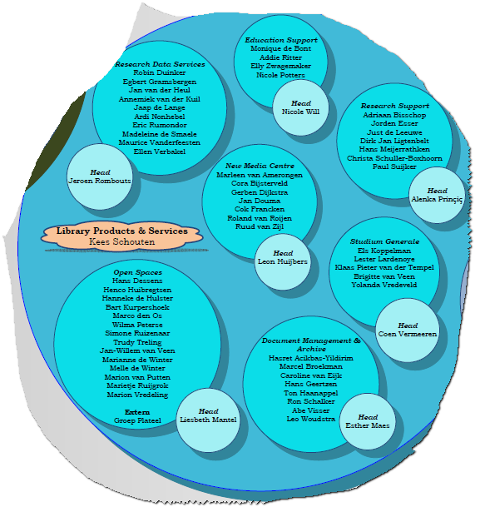
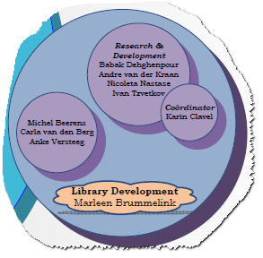

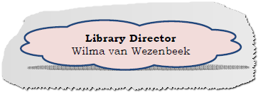

Slide 22
Observations
Structure to support strategy
Event(s)
Opportunity
User-centered
University alignment
Extra-library
skill sets
Shared Services

Slide 23
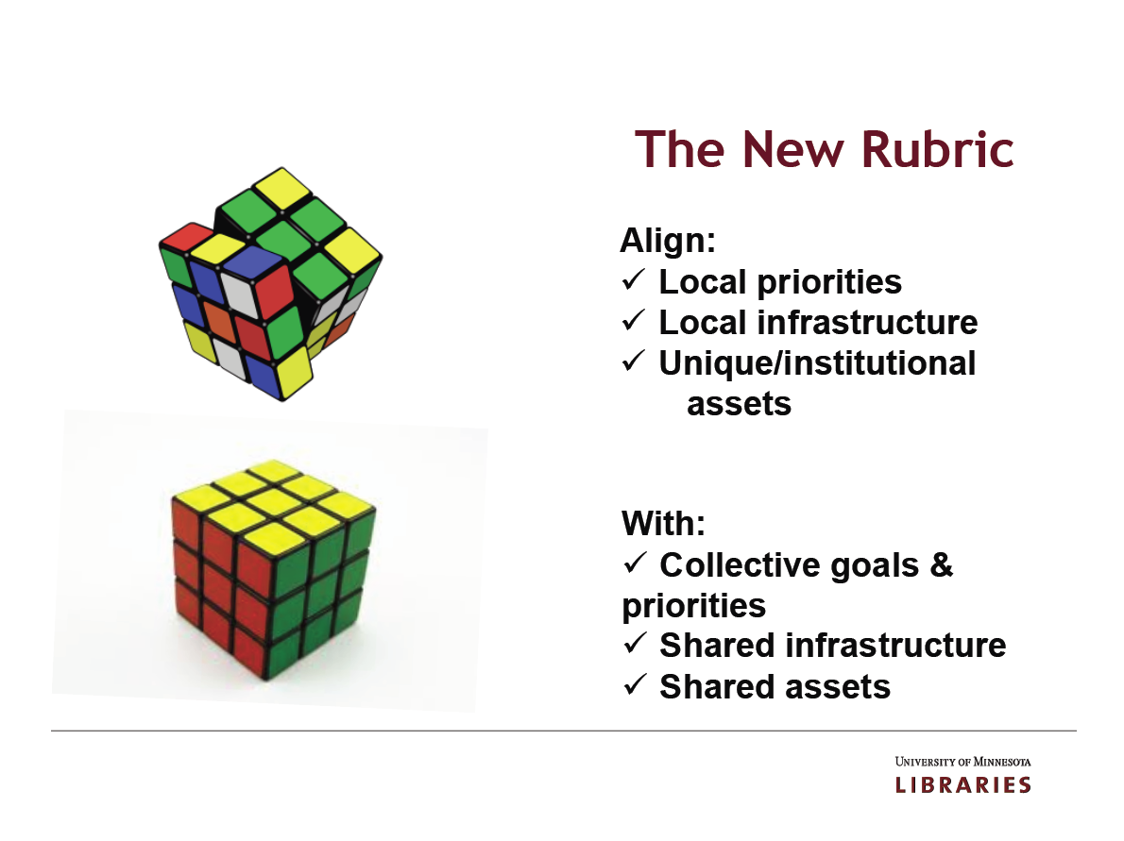
The new rules
http://www.arl.org/resources/pubs/mmproceedings/160mm-proceedings.shtml#colls
Wendy Lougee at the 4 May 2012 ARL Membership Meeting Chicago, IL
Notes:
Wendy Lougee called this the new rubric which means a kind of general prescription. In this case she is prescribing the shape of the future library. She believes that the 21st century library will align itself closely to the local priorities of its institution. It will manage some local infrastructure and will provide services that respond to unique institutional assets which includes areas of research or teaching distinction.
However that local alignment will be supported by collective goals and priorities understood by the community of research libraries. These local operations will depend on shared infrastructure (like data management and preservation facilities) and on shared assets (like print collections jointly owned by many institutions).
This kind of alignment of the local with collective shared structures will define the 21st century library.
Note to myself: An established custom; a set of rules, an injunction; a general prescription.

Slide 24
Observations
Structure to support strategy
Event(s)
Opportunity
User-centered
University alignment
Extra-library
skill sets
Shared Services
Specific gravity
of services
Community of
Practice
Success essentials
Principles
Advance management
Communication
Master space plan

Slide 25
Reorganized? Restructured?
radical, novel, innovative
  organization structures
  senior management portfolios
in order to…
align with changes in research and education
align with university directions
ensure the library is responsive to expectations and constituencies
Structure
following
Strategy?
Notes:
“We’re seeing some striking new combinations of managerial and organisational responsibilities… We think these new organisational structures are evidence of the way research libraries are evolving to match the contours of their institution. ”
(UNSW and Melbourne responded to Jim’s call, also Auckland, several in the UK and Canada, and one in the Netherlands)
Goal: international library leadership finds shared understanding and becomes less risk-averse to novel assignments:
radically shift library structures and plan to adjust to changes in research and higher education
restructure library functions to be (again) built to purpose
capitalize on turnover at the top; “musical chairs” and “fresh horses”
remedy gap in array of management skills to fit evolving system dynamics
change library culture
(an example of a work-in-process:)
Jim’s call: “Do you self-identify as a research library leader who has recently reorganised or is about to change the administrative structure of your organization? OCLC Research is searching internationally for directors, deans or other senior managers who have changed their organisation’s structure or made new assignments to:
align with changes in research and education,
more closely align with university directions or
ensure the library is responsive to the changed expectations of the constituencies served by the library.
“What have you decided? We’re seeing some striking new combinations of managerial and organisational responsibilities such as:
digital scholarship, digital preservation, digitization, and special collections
metadata services, IT, systems and digital humanities
university press, institutional repository and preservation/conservation
“We think these new organisational structures are evidence of the way research libraries are evolving to match the contours of their institution. We’d like to understand more in order to synthesise and characterize these emerging strategies and structures.”
Problem: insufficient flexibility to respond to changing external economic and political demands, including:
funding cuts that will not be reversed
scale and pace of changes to research library system dynamics
structural unknowns in research and the “crisis in higher education”
irrelevance and disintermediation of research libraries
evolving scholarly record flips collecting mission from local/private to public good; paired with need for shared services
legacy staff and legacy culture
What we (OCLC Research) do: quickest path to a synthesis will be:
identify institutions that have redesigned and made assignments
Jim send call for directors to self-identify to share drivers for organizational restructuring
invite that cohort of directors or appropriate senior leadership to structured interviews about their reasoning
identify emerging strategies and structures

Slide 26
Full citation:
GALBRAITH, Jay R.. The Evolution of Enterprise Organization Designs. Journal of Organization Design, [S.l.], v. 1, n. 2, p. 1-13, aug. 2012. ISSN 2245-408X. Available at: <http://www.jorgdesign.net/article/view/6342/6045>.. doi:10.7146/jod.6342.

