Slide 1
Right-scaling Stewardship
A multi-dimensional perspective on OSU & CIC print collections
Brian Lavoie
Constance Malpas
27 March 2014
Regional Print Management: Right-scaling Solutions
Dublin, Ohio USA
#regionalprint

Slide 2
Roadmap
Background
The print book landscape
Ohio State print book collection & CIC collective print book resource
Profiles of rare and core print book assets
“Centers of distinction” & network demand
Key insights

Slide 3
Background: OSU/CIC print book study
Explore regional-scale cooperative print strategy
From an institutional (OSU) perspective
From a consortial (CIC) perspective
Based on shared, centrally managed collection, and network of local collections
Analysis: WorldCat bibliographic & holdings data
Findings intended to inform, not prescribe
Do not necessarily reflect intentions of OSU or CIC
Not making recommendations, but an evidence base to inform strategic planning
Specific to OSU/CIC; patterns of analysis of broader interest

Slide 4
The print book landscape

Slide 5
Print books: Distinct publications*
World:
157.4m
N. America:
49.8m
CHI-PITTS:
19.0m
12.4m
2.7m
*As represented in
January 2013

Slide 6
OSU print book collection & CIC print book resource

Slide 7
Size (distinct print book publications)
2.7 million
12.4 million

Slide 8
Bilateral overlap
% of OSU’s print book collection
also held by comparison institution
% of comparison institution book collection also held by OSU
OSU vis-à-vis CIC
MICHIGAN 49
ILLINOIS 49
CHICAGO 46
WISCONSIN 44
INDIANA 43
MINNESOTA 41
IOWA 37
PENN STATE 37
MICH STATE 35
NORTHWESTERN 32
NEBRASKA 26
PURDUE 20
CIC vis-à-vis OSU
PURDUE 59
NEBRASKA 58
PENN STATE 48
MICH STATE 48
IOWA 47
NORTHWESTERN 42
INDIANA 39
MINNESOTA 39
ILLINOIS 35
MICHIGAN 34
WISCONSIN 34
CHICAGO 31

Slide 9
Comparison to CIC collective print book resource
% of local collection held by at least 1 other CIC member
# of Books Overlap w/CIC
PURDUE 0.9m 0.93
NEBRASKA 1.2m 0.93
IOWA 2.1m 0.89
MICH STATE 2.0m 0.88
PENN STATE 2.1m 0.85
NORTHWESTERN 2.0m 0.83
OHIO STATE 2.7m 0.83
INDIANA 3.0m 0.83
MINNESOTA 2.9m 0.81
WISCONSIN 3.9m 0.80
ILLINOIS 3.8m 0.79
MICHIGAN 3.9m 0.76
CHICAGO 4.1m 0.76

Slide 10
OSU: Rare & core print book assets
OSU’s
“core” print book asset
(~400K books)
More than 10:
14%
3 or less:
38%
8 to 10:
18%
OSU’s
“rare” print book
asset
(~1 m books)
Total # of CIC holdings
4 to 7:
30%
Percent of OSU collection

Slide 11
CIC: Rare & core print book assets
CIC’s
“core” print book asset
(~400K books)
8 to 10:
5%
More than 10:
3%
4 to 7:
16%
3 or less:
76%
Total # of CIC holdings
CIC’s
“rare” print book
asset
(~9.4 m books)
Percent of CIC collective collection

Slide 12
CIC rare & core: Language
Rare
458 distinct languages
Core
67 distinct languages

Slide 13
CIC rare & core: Age
Rare:
27% published pre-1950
Core:
9% published pre-1950

Slide 14
CIC rare & core: Subject
STEM: 15%
Rare
Humanities: 63%
Social Sciences: 22%
Humanities: 50%
STEM: 20%
Core
Social Sciences: 30%

Slide 15
Takeaways …
Scale is key
No CIC member accounts for half of OSU’s collection; CIC accounts for 83%
“Rareness is common”
38% of OSU print book collection “rare”; 14% “core”
76% of CIC collective collection “rare”; 3% “core”
Emerging profiles …
CIC collecting activity exhibits of shared investment & diversity
CIC members’ print book collections differ significantly
More than 75% of CIC collective print book resource “rare”
But: matching local and consortial profiles of rare & core
Rare print book:
Highly likely to be non-English
Highly likely to be humanities
Probably older than average
Core print book: Almost certainly English Even chance: humanities or social sciences/STEM Probably more recent than average

Slide 16
“Centers of distinction”

Slide 17
C
enters
reveal patterns in local investment
institutional priorities
singular strengths
Many related titles
C
omps
reflect scope of local holdings
coverage of global literature
cooperative synergies
Many representative works
More information:
http://outgoing.typepad.com/outgoing/2013/05/centers-and-coverage.html

Slide 18
Centers of Distinction
FAST | Coverage compared to WorldCat | Heading | OSU Rank compared to other CIC libraries | OSU Rank compared to other WorldCat libraries
fst01008312 | 67.20% | Manuscripts, Church Slavic | 1 | 1
fst00848081 | 61.20% | Cartoonists | 1 | 1
fst00980348 | 59.80% | Israeli poetry | 1 | 4
fst00807464 | 43.80% | American wit and humor, Pictorial | 1 | 1
fst00954398 | 36.80% | Hebrew poetry | 1 | 13
fst01205076 | 33.10% | Ohio—Columbus | 1 | 1
fst00812274 | 30.30% | Arabic fiction | 2 | 10
fst01108635 | 26.90% | Science fiction, American | 1 | 11
fst00812533 | 23.70% | Arabic poetry | 2 | 13
fst00869145 | 20.40% | Comic books, strips, etc. | 1 | 1

Slide 19
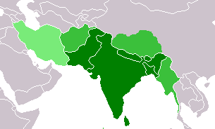
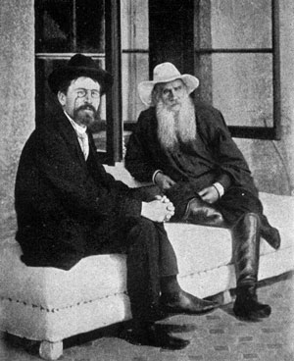
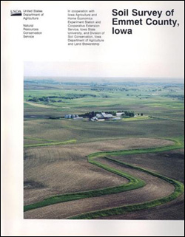
Shared Centers
South Asia: Chicago & Wisconsin
Russian Literature: Indiana, Michigan,
Northwestern, Ohio State
Soil Surveys: Iowa, Illinois, Minnesota,
Penn State, Wisconsin
Opportunities to deepen collaboration

Slide 20
Takeaways …
Institutionally distinctive centers may be important differentiators for libraries
Local management priority
Shared centers represent areas of shared investment that can be leveraged as collective asset
Candidates for ‘above the institution’ management
Even the largest collections are far from comprehensive; no institution is an island
Preserving scope of collective resource is a shared responsibility

Slide 21
Optimizing supply & demand

Slide 22
CIC Inter-lending Activity
Borrowing
1,215,831 requests
801,700 titles borrowed
84% books
5,160 libraries (symbols) filled requests from 29 CIC libraries
Avg. requests per title: 1.45
Avg. holdings per title: 138 (median = 44)
Lending
1,330,831 requests
888,996 titles loaned
90% books
29 CIC libraries (symbols) filled requests from 5,266 libraries
Avg. requests per title: 1.43
Avg. holdings per title: 128 (median = 43)
Analysis based on all returnable CIC borrows/loans placed 1 Jan 2006-10 May 2013

Slide 23
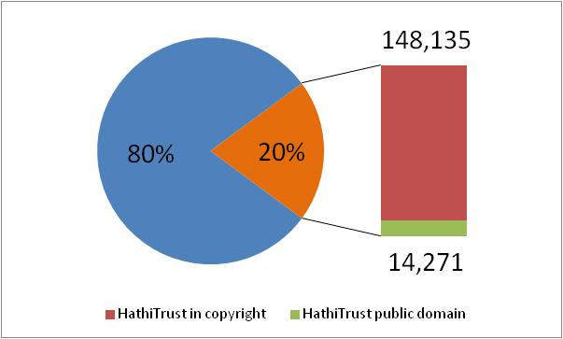
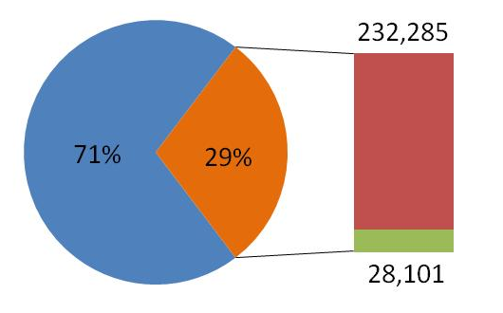
Alternative Supply Chain: HathiTrust
Titles Borrowed by CIC Libraries
Public domain digital surrogates available for 2-3% of titles borrowed & loaned by CIC
Titles Loaned by CIC Libraries

Slide 24
Takeaways …
Removing frictions in discovery/delivery of collective CIC resource may increase its value
Network demand relatively low compared to total size of CIC collective print book resource; UBorrow impact is positive
Institution and CIC-scale decisions about print retention will affect larger library system
Aggregate CIC print book resource is rich and varied; supports thousands of libraries across North America
Strong incentives to coordinate CIC shared print strategy with HathiTrust shared monographs strategy
CIC libraries: 30% of titles loaned, 20% of titles borrowed, duplicated by HathiTrust; ~3% available as public domain

Slide 25
Key insights and implications

Slide 26
Key Insights
Scale adds scope and depth
Collective CIC resource offers great breadth and diversity while exhibiting patterns of internal coherence and complementarity
Uniqueness/scarcity is relative
Titles that appear scarce at CIC-scale are comparatively abundant in larger library system
Coverage requires cooperation
Even the largest institutional collections are far from comprehensive; preserving the collective resource will require coordination on a large scale

Slide 27
“
If there is one principle that warrants special emphasis, it is that scale impacts nearly all the fundamental characteristics of a collective print resource and the cooperation needed to sustain it... “right-scaling” stewardship of the collective print investment becomes the central question of any shared print strategy.
”
B. Lavoie, C. Malpas 2014, page 51

Slide 28
Questions and feedback welcome.
lavoie@oclc.org
malpasc@oclc.org

Slide 29
Symposium Roadmap
Right-scaling stewardship: print monographs
What determines the appropriate scale of collaboration?
Selecting for sustainability
How will stewardship of print monographs be distributed? How will it be supported?
Making it work: service models and operations
How do we mobilize distributed resources as a collective asset? How can we coordinate across consortia?
The Future of Print Books: what to withdraw (and what to retain)
Research Libraries & Shared Print Stewardship: the director’s cut
*
*

