Slide 1

New uses for old content
Dr Adam Farquhar
Head of Digital Scholarship
The British Library
#bldigital
http://britishlibrary.typepad.co.uk/digital-scholarship

Slide 2
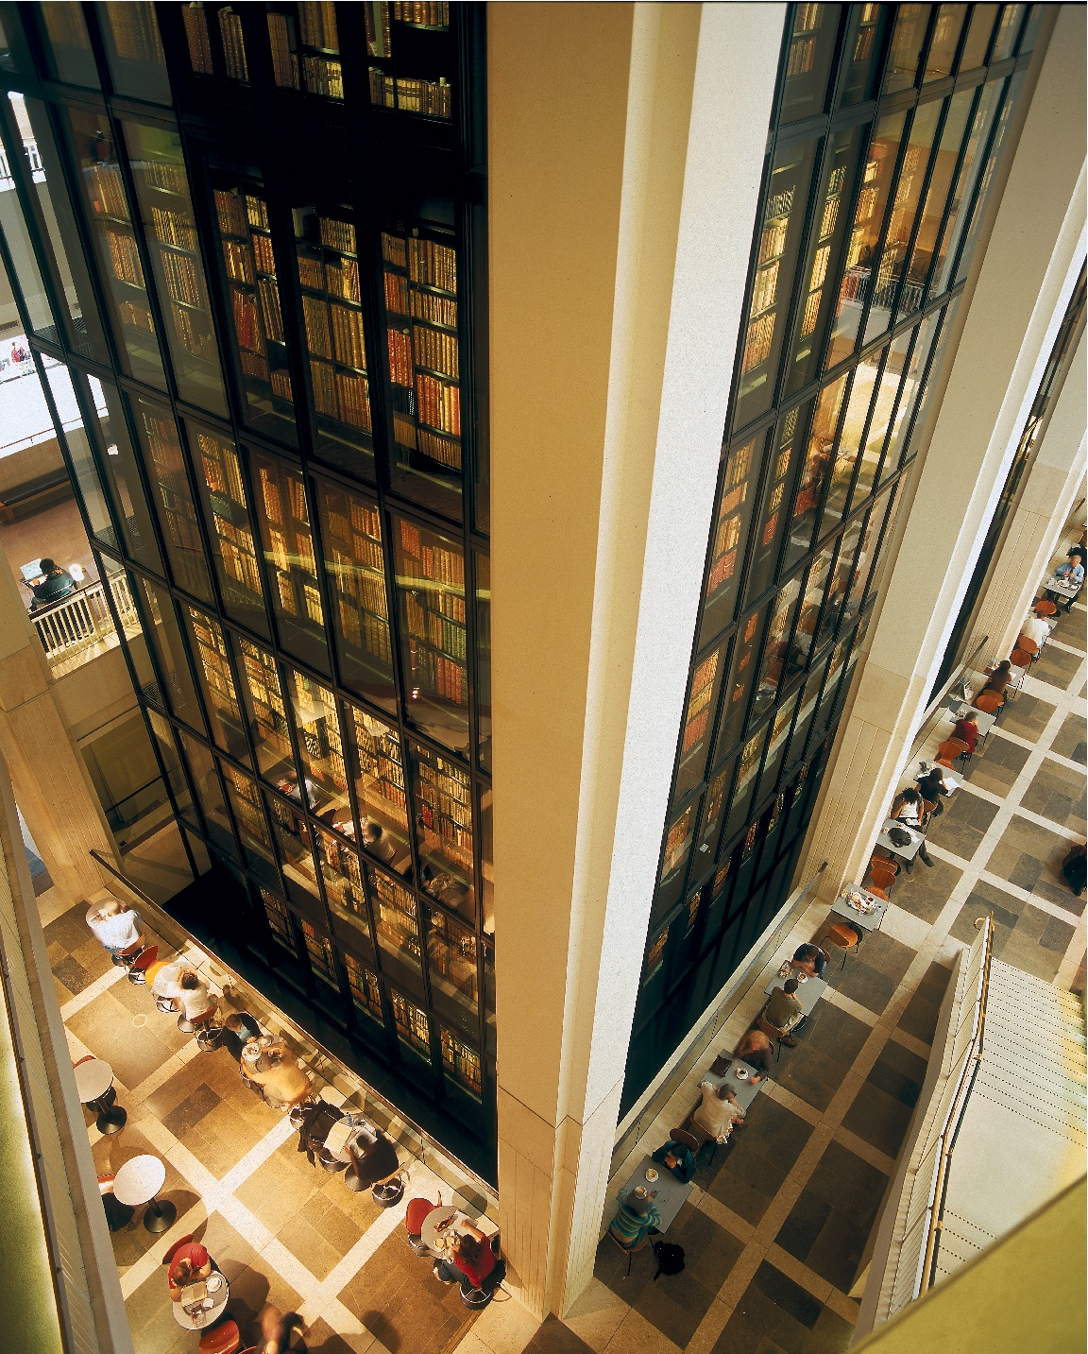
150 Million Items
Notes:
First a bit of background. The British Library in London is the national library of the UK and by many counts one of the largest research libraries in the world. Once a department of the British Museum it eventually grew into its own as national library in 1973 and moved to a new purpose built building in 1997 which can sit 1,200 researchers at any one time across 5 reading rooms.
The collections are enormous, we currently estimate them to exceed 150 million items, representing every age of written civilisation. While we acquire items through purchase or gifts, much of the collection has been built up through legal deposit. That is, by law, a copy of every UK and Ireland print publication must be given to the British Library by its publishers. This is a concept which has been part of English law since 1662.
And now, in 2013, legal deposit has been extended to cover non-print material which means by law we take in digitally published items as well, which means regular mass crawls of the entire UK web domain as well as ebooks, ejournals and the like.

Slide 3
Digital Content

Slide 4
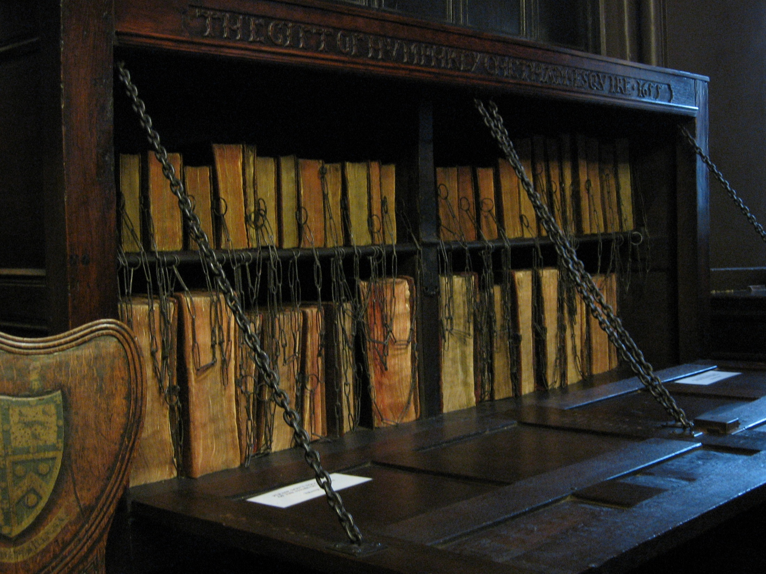
But still chained

Slide 5
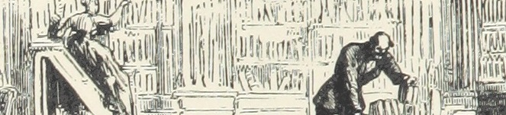
“Literary scholars and historians have in the past been limited in their analyses of print culture by the constraints of physical archives and human capacity. A lone scholar cannot read, much less make sense of, millions of newspaper pages. With the aid of computational linguistics tools and digitized corpora, however, we are working toward a large-scale, systemic understanding of how texts were valued and transmitted during this period”
    David A. Smith, Ryan Cordell, and Elizabeth Maddock Dillon, ‘Infectious Texts: Modeling Text Reuse in Nineteenth-Century Newspapers’ (2013) http://www.ccs.neu.edu/home/dasmith/infect-bighum-2013.pdf

Slide 6
“Reading individual works is as irrelevant as describing the architecture of a building from a single brick, or the layout of a city from a single church”
    Franco Moretti, Stanford

Slide 7
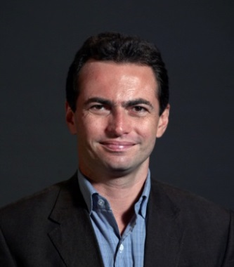
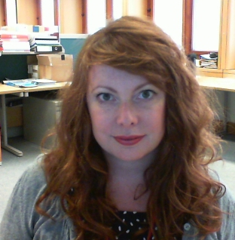
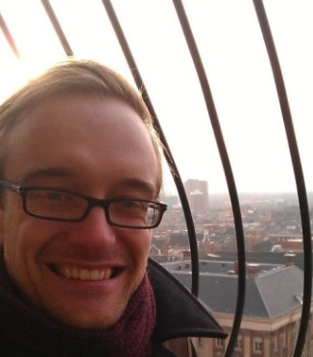
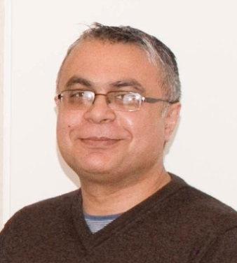
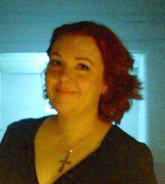
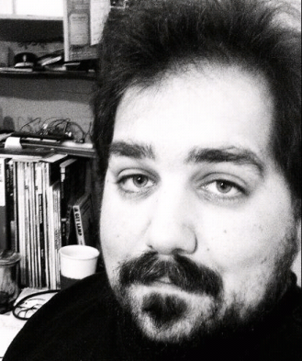
Digital Research Team
Cross-disciplinary mix of curators, librarians and programmers
Support innovative use of our digital collections
Explore how digital technologies are re/shaping research and how this informs how the library does its business
Encourage and support colleagues & scholars to work with and across the library’s digital content

Slide 8
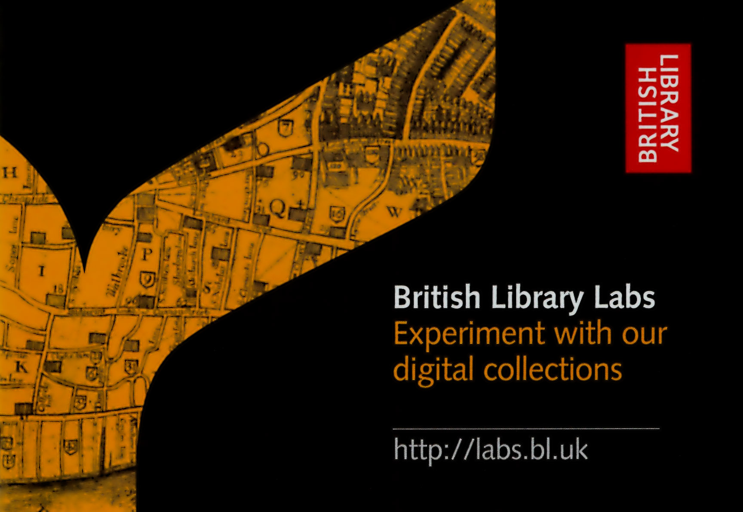
Notes:
One way is through the British Library Labs project and the Digital Curator team which make up the Digital Research Team. The aim of the lab is to encourage scholars to experiment at scale with our digital collections and data. The team holds competitions, events, and creates the space in which to engage with scholars working in this realm. Through the labs we’re learning how to better support scholars and build new services.

Slide 9
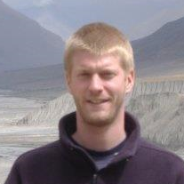
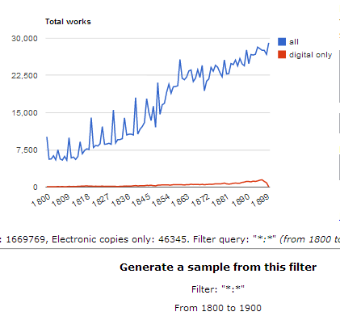
Labs 2013 Competition Winner
Pieter Francois - postdoctoral researcher at the University of Oxford
Focus on European travel in the 19th Century
Uses statistical methods to support text analysis
Tool produces representative samples of texts based on search criteria
http://samplegenerator.cloudapp.net

Slide 10
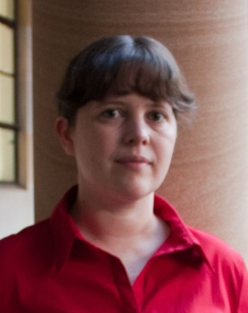
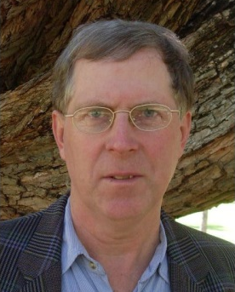
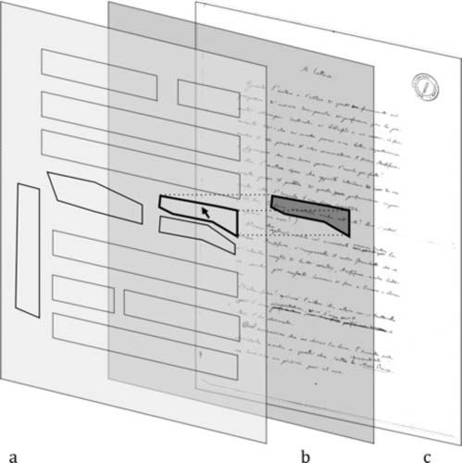
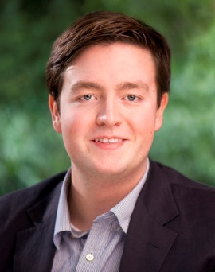
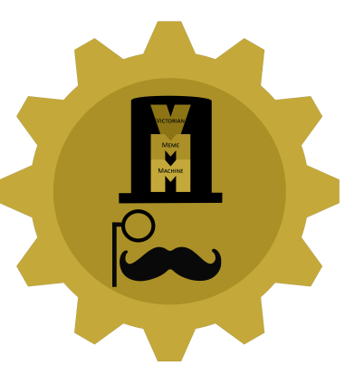
Labs 2014 Competition Winners
Desmond Schmidt and Anna Gerber of the University of Queensland
For: Text to Image Linking Tool
Links transcriptions to manuscript regions
Bob Nicholson of Edge Hill University
For: Victorian Meme Machine
What would make a Victorian joke funny again?

Slide 11
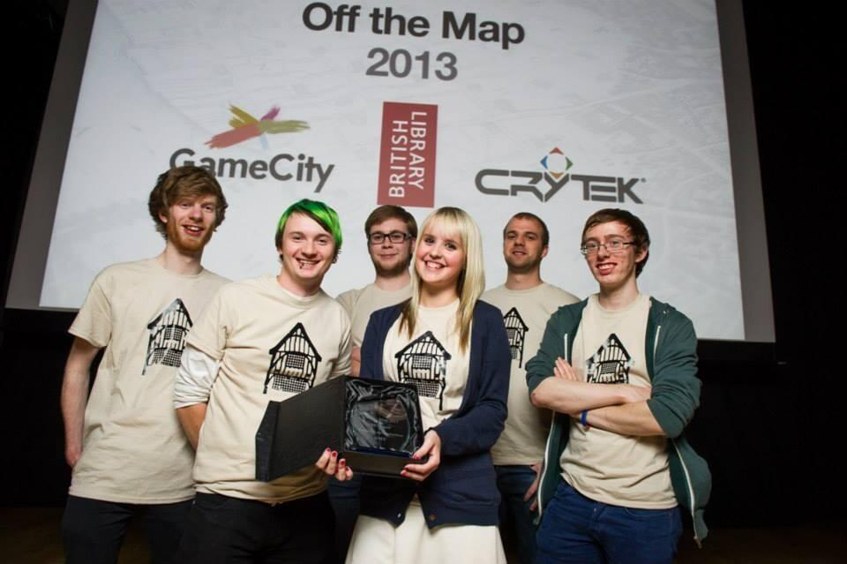
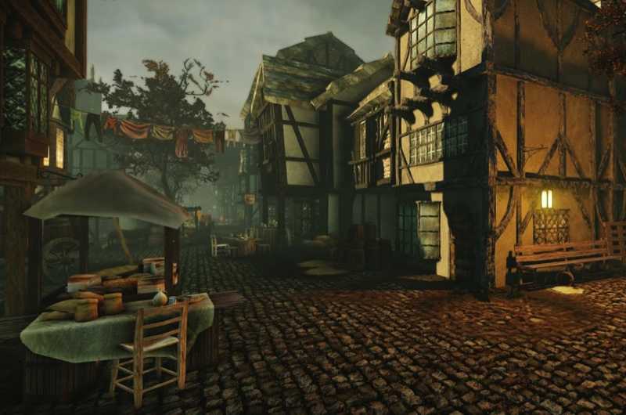
Off the Map Competition 2013
A challenge for videogame design students to turn historic maps and engravings from the British Library collections into a 3D environment using Crytek's CRYENGINE software.
Pudding Lane Productions, a team of six second-year students from De Montfort University, Leicester, won first prize.
Their work was showcased at GameCity, an annual festival of videogame culture.
http://youtu.be/SPY-hr-8-M0 (Flythrough starts at 0:50)

Slide 12
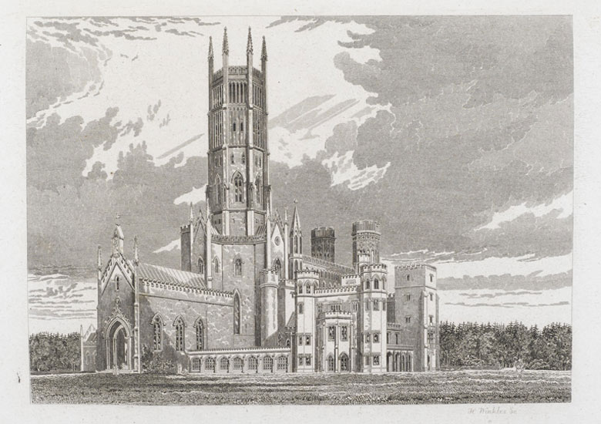
Off The Map Competition 2014
Terror and Wonder: The Gothic Imagination
Exhibition opens October 2014
  Fonthill Abbey, home of William Beckford, author of Vathek
  Edgar Allan Poe’s Masque of the Red Death
  Whitby and its association with Bram Stoker’s novel Dracula
Images from Delineations of Fonthill and its Abbey, John Rutter, 1823

Slide 13
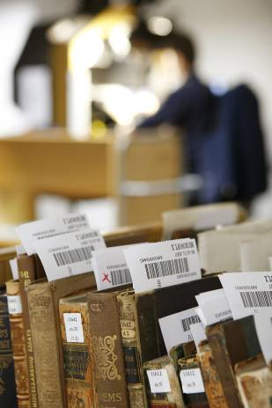
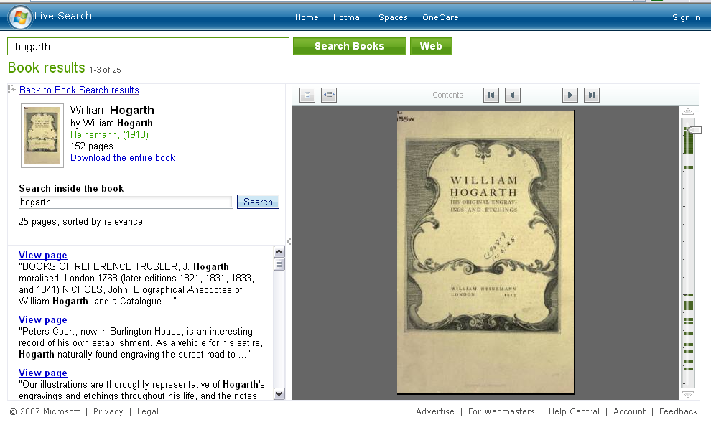
Microsoft Live Search
early foray into mass digitisation
Digitised 65,000 out of copyright books from the 19th Century from 2006 – 2008
In the public domain!

Slide 14
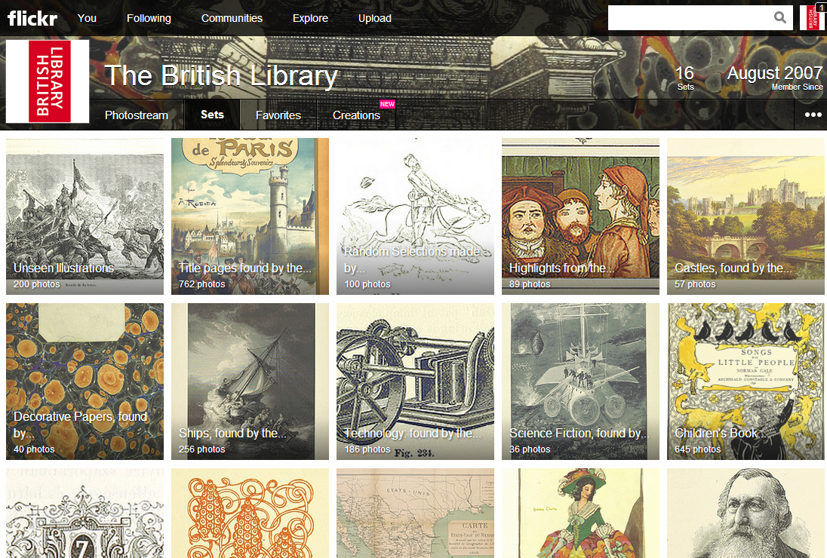

Slide 15
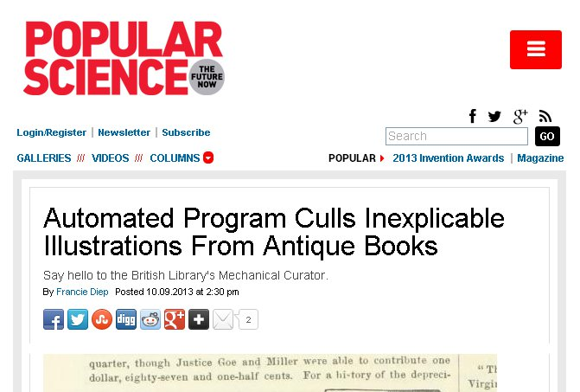

Slide 16
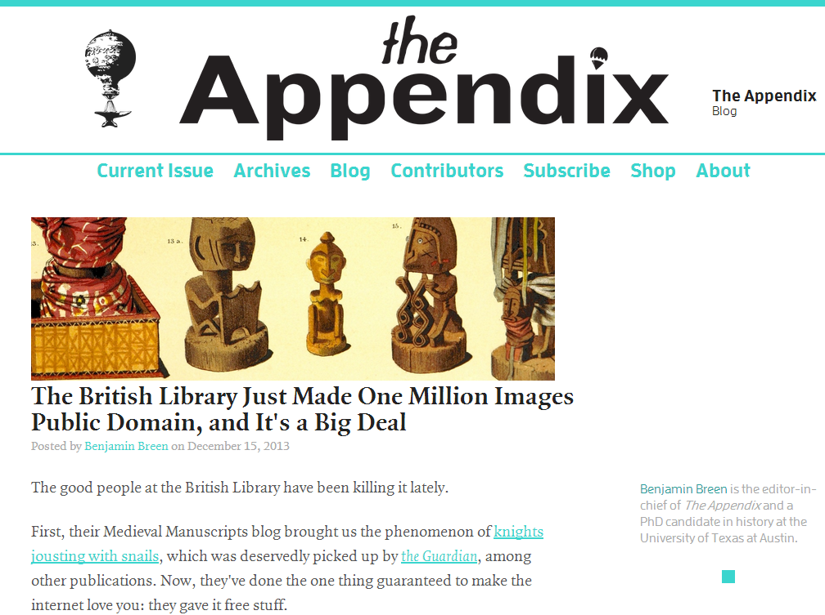

Slide 17
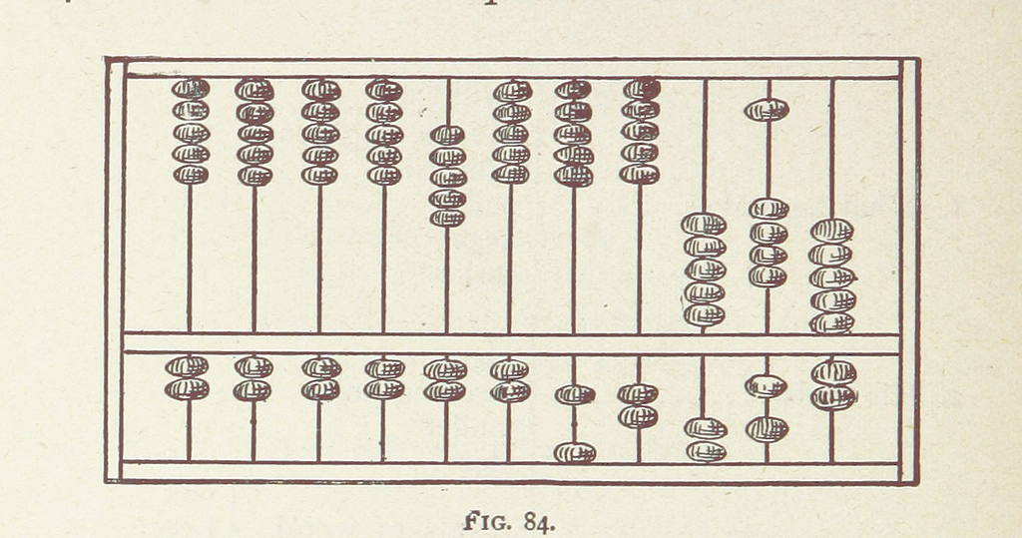
By the numbers
Launched December 13th, 2013
Over 160 million image views
Over 90,000 unique tags added; 4000 portraits, 3000 maps, 600 music
Top tagger a story of Machine (15K) vs. Man (30K)!
Notes:
See:
http://britishlibrary.typepad.co.uk/digital-scholarship/2013/12/a-million-first-steps.html
https://www.flickr.com/photos/britishlibrary/sets/
http://mechanicalcurator.tumblr.com/
http://blpublicdomain.wikispaces.com/

Slide 18
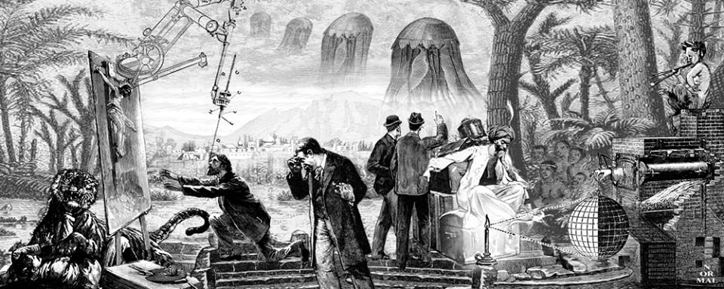
Creative Uses
David Normal installation at Burning Man Festival
“Moments” by Joe Bell
Colouring-in Pages for Children

Slide 19
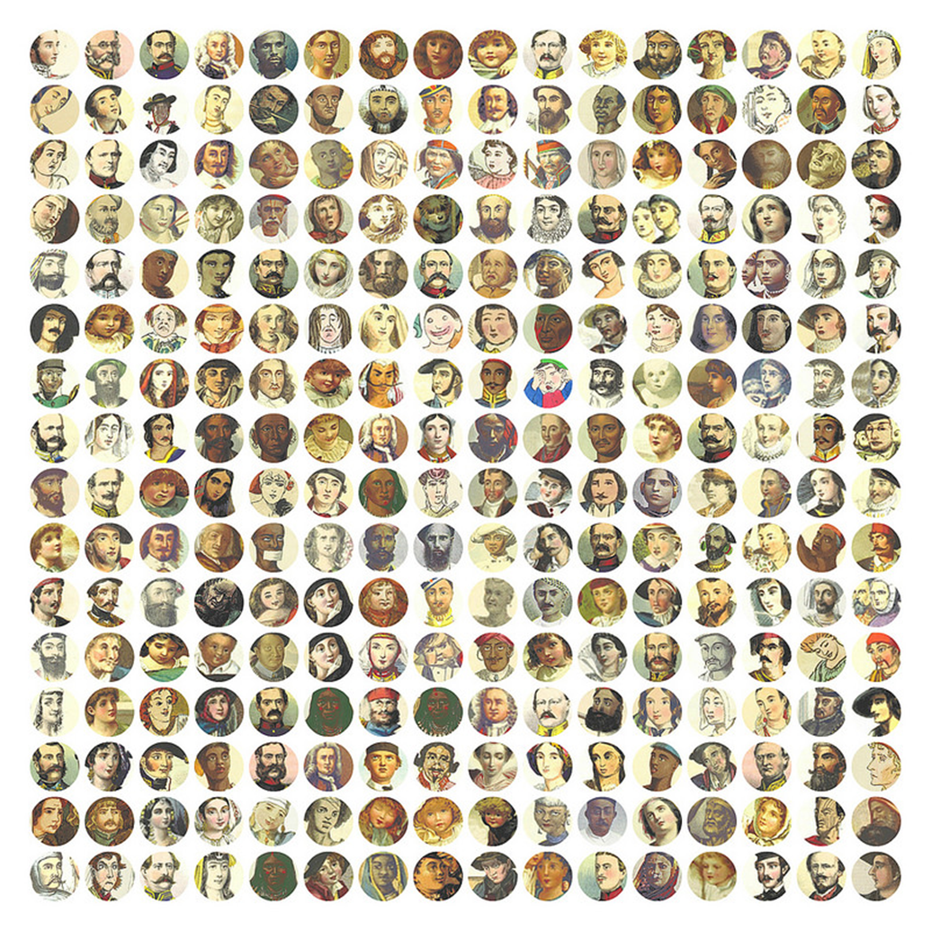
Research
Mario Klingemann Pattern Recognition Software
Lost Visions: retrieving the visual element of printed books from the nineteenth century’ Julia Thomas, Cardiff University
Collaborative PhD ‘A History of the Printed Image 1750-1850: Applying Data Science Techniques to Printed Book Illustration’
And more…
TSB Digital Innovation Contest - tracking Public Domain in the Wild

Slide 20
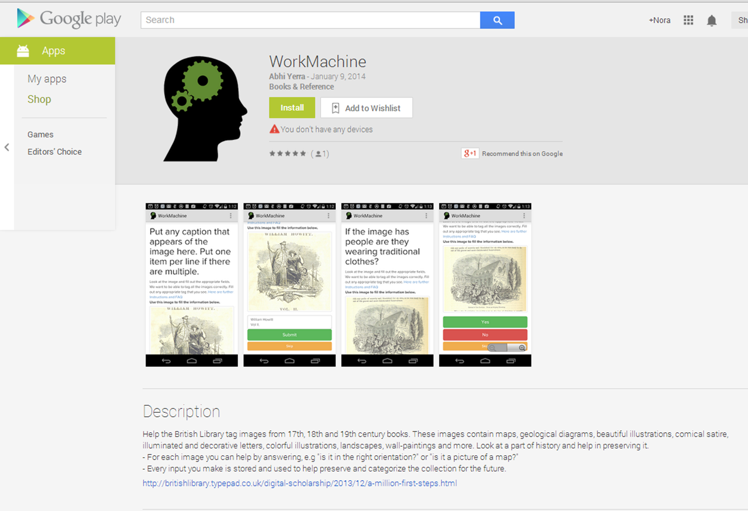
Crowdsourcing & Apps
Metadata Games
Wikipedia Synoptic Index

Slide 21
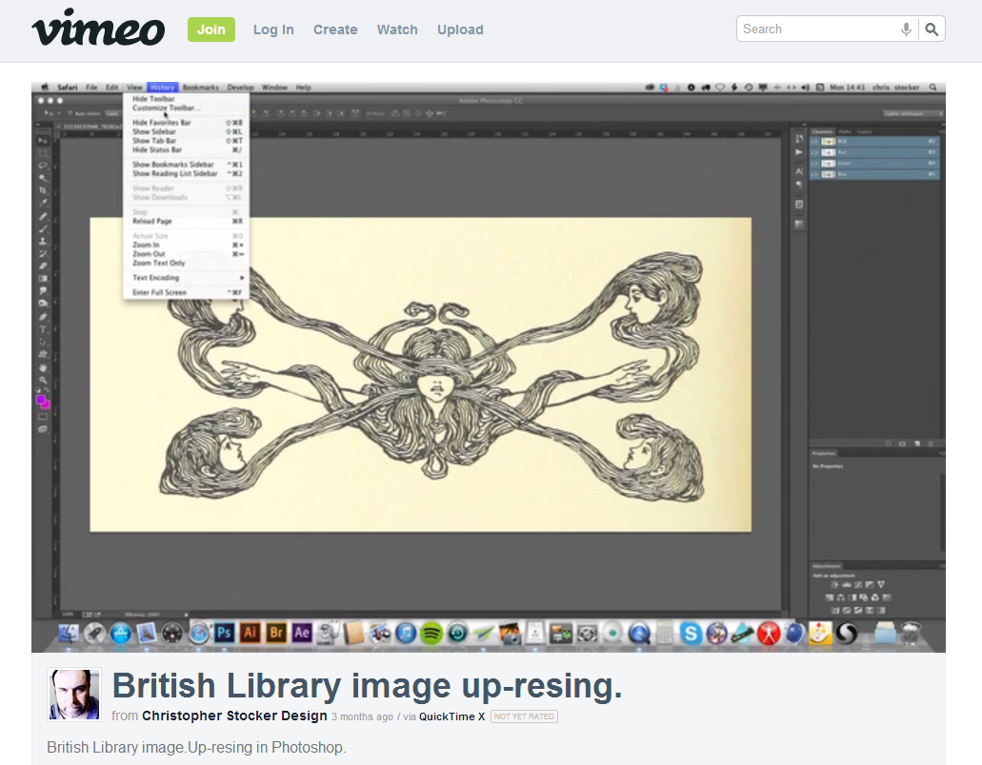
Tutorials
Using Photoshop to Up-res images
Converting images to vector graphics

Slide 22
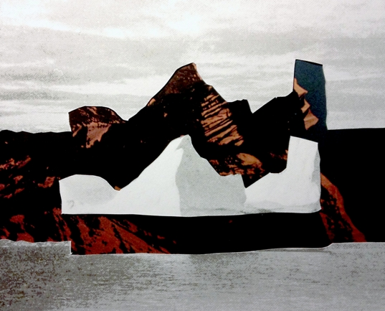
Collaborations with Colleagues
Inspired by Flickr, a Sound Archive series
Maps will be fed into the next phase of the Georeferencer

Slide 23
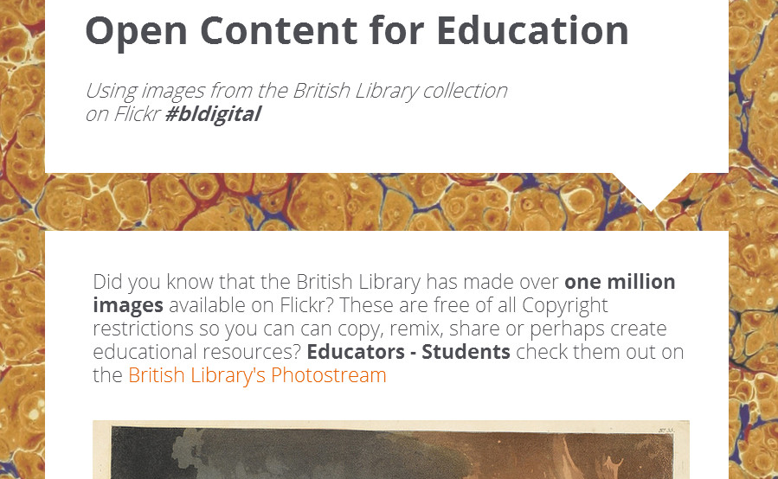
Education
Images included in Wikipedia Articles
University of Minnesota English Literature Course Exercise on Tagging
Art Therapy Courses

Slide 24
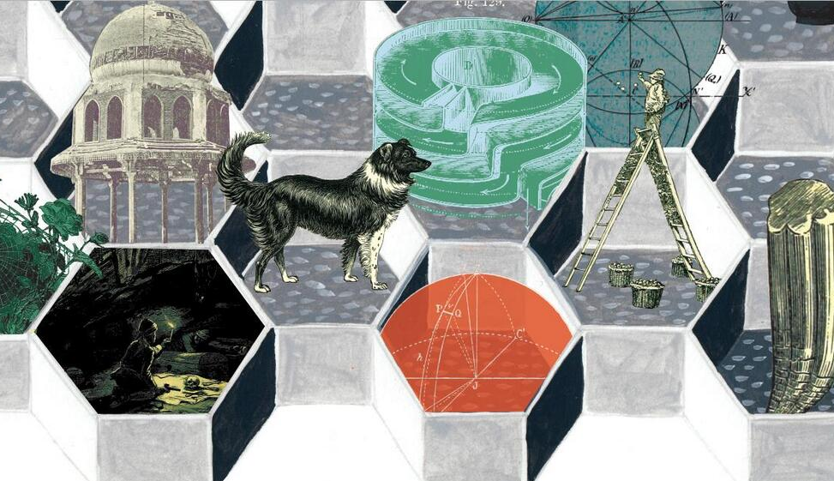
Commerce
Possible tie-in with British Library Shop.
Skateboard on Zazzle by Jon Voss, HistoryPin

Slide 25
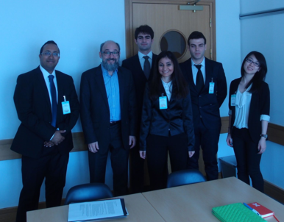
Big Data Experiment
Joint project with UCL, Microsoft and the BL
UCL Computing MSc students will develop experimental platforms to interrogate public domain digital collections
  Use Microsoft Azure cloud infrastructure
  Learn about research patterns in the arts and humanities
  Grapple with public domain digital collections
  Implement researcher tools and services in Azure
  Image recognition, machine learning, statistics
  More at http://bit.ly/1kZ0oKv

Slide 26
Thank you
#bldigital
http://britishlibrary.typepad.co.uk/digital-scholarship
©2014 Adam Farquhar. This work is licensed under a Creative Commons Attribution 3.0 Unported License. Suggested attribution: “This work uses content from "New uses for old content" © Adam Farquhar, used under a Creative Commons Attribution license: http://creativecommons.org/licenses/by/3.0/”

