Slide 1
A Framework for the Evolving Scholarly Record
Providing a common understanding and shared terminology for the day’s conversations
Ricky Erway
Senior Program Officer
OCLC Research
10 June 2014
Evolving Scholarly Record and Evolving Stewardship Ecosystem Workshop
Amsterdam
Notes:
The boundaries of the scholarly record are always evolving
But a confluence of trends is accelerating the evolutionary process
-----
The framework I’ll be sharing with you will help us communicate as we discuss our evolving stewardship roles in the broader ecosystem.

Slide 2
OCLC Research and The Evolving Scholarly Record
Common reference point
High-level view; reduce fragmentation
Facilitate discussions
Equip stakeholders with a resource for strategic planning
It’s about the stuff
Notes:
But first, why did OCLC jump into this fray? Our motivations were many.
We wanted a common reference point for concepts and terms, which could be used like the OAIS reference model, which really facilitated community discussions about digital preservation.
While many have addressed aspects of this topic for particular audiences, we wanted to reduce fragmentation and minimize parts being examined in isolation. The framework encompasses the big picture view of the scholarly record, with general categories of material and high-level stakeholder roles.
We hoped it would be of practical use in cross-disciplinary and cross-domain conversations, to help organize, support, and even drive discussions about the evolving scholarly record.
We aspired to equip libraries, scholars, funders, publishers, scholarly societies, and so on, with a resource for strategic planning
That’s a lot of aspirations. One of the outcomes of thid workshop will be getting a sense of how useful it is.
I want to be clear that this work does not attempt to describe scholarly processes nor encompass scholarly communication; there is substantial work in these areas, including that by Ross Atkinson, Brian Schottlaender, and our own Herbert Van de Sompel. *The framework focuses on the “stuff” or the units of communication that become part of the record -- and, for our purposes, how that stuff will be stewarded going forward.

Slide 3
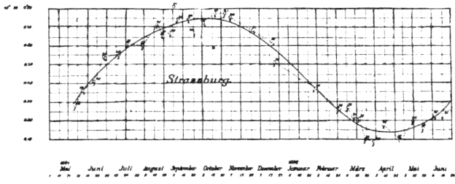
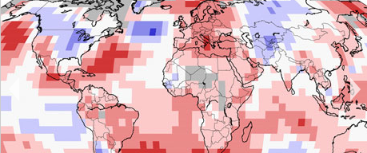
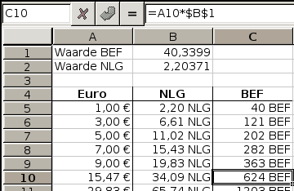
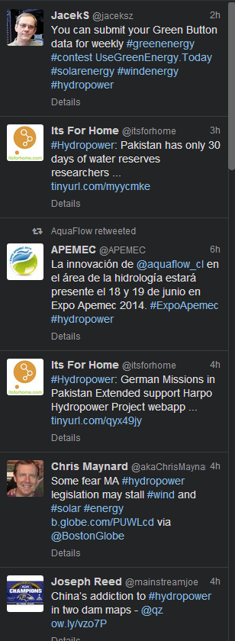
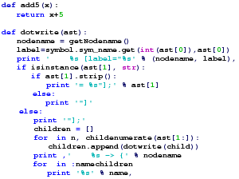
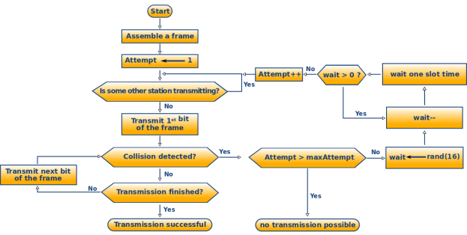
Notes:
[animated] What does the scholarly record look like? The majority to date has looked like this, but increasingly we’re seeing *data and *presentations and *social media and *blogs and *human observations and *sensor data and *code and *algorithms and *visualizations.
http://www.istockphoto.com/stock-illustration-16163206-books-and-magazines.php?st=34928b1
http://commons.wikimedia.org/wiki/File:Screenshot-spreadsheet.png GNU GPL
http://commons.wikimedia.org/wiki/File:Very-active-users-article-count-ratio.png PD
http://commons.wikimedia.org/wiki/File:EPICA_delta_D_plot.svg PD
http://commons.wikimedia.org/wiki/File:PSM_V75_D424_Astronomical_observations_broken_down_to_quantity_and_number_of_days.png PD
http://commons.wikimedia.org/wiki/File:Python.png PD
http://commons.wikimedia.org/wiki/File:CSMACD-Algorithm.svg PD
http://commons.wikimedia.org/wiki/File:US_Navy_040605-N-6633C-002_Commander_Naval_Reserve_Force,_Vice_Adm._John_G._Cotton,_is_silhouetted_in_front_of_a_Powerpoint_slide_mapping_out_the_Naval_Reserve_Force%27s_future.jpg PD
http://www.ncdc.noaa.gov/ PD
http://upload.wikimedia.org/wikipedia/commons/7/70/A_screenshot_of_the_front_page_of_the_Marshall_Center%27s_Techne_blog_is_taken_in_Garmisch-Partenkirchen%2C_Germany%2C_June_2%2C_2013_130602-D-SK857-724.jpg PD

Slide 4
Perspective & content
Researchers: what is necessary to validate & build on current literature
Academics: what establishes credentials
Publishers: what is “published”
Librarians: what we’ve traditionally tended +++
Notes:
Those viewing the scholarly record will see the portions pertinent to their purpose.
For Researchers: The scholarly record likely includes data and tools
For certain Faculty: The scholarly record might be limited to peer-reviewed, high impact journals
For some Publishers: The scholarly record might be fairly traditional: books and journal articles, though they are increasingly electronic
For Librarians and archivists: The scholarly record is what we’ve tended in the past and are grappling with now -- and the relations needed to be built with myriad other stakeholders

Slide 5
Evolutionary trends
Formats shifting
Boundaries blurring
Characteristics changing
Stakeholder roles reconfiguring
Notes:
In all cases, it is clear that
Formats are shifting – from print-based to digital and networked
Boundaries are blurring – it’s not just articles and monographs, but it’s also data, computer models, blogs, and so on.
The characteristics are changing – from being static, formal, and outcome-focused to being dynamic, and blending formal & informal, with more focus on process, replicability, and “leveragability”
Stakeholder roles are reconfiguring – generating new paths in the scholarly “supply chain”
These are not incremental changes and they require more than an incremental response

Slide 6
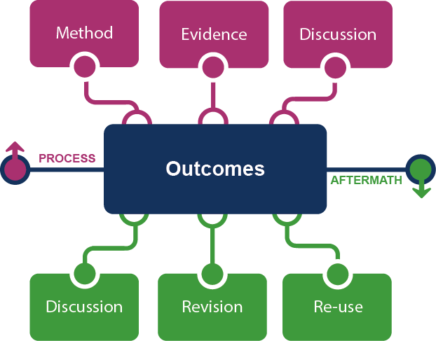
Evolving Scholarly Record Framework
Notes:
Here is the heart of the framework – and at the center is what has traditionally been the payload, research outcomes.
The framework conceptualizes the new scholarly record as having greater emphasis on context (process & aftermath), not just focused on outcomes. It is a deeper and more complete record of scholarly inquiry.
[Walk around the framework]
Upper/Process Method – lab notebooks, computer models, protocols
Evidence – datasets, primary source documents, survey results
Discussion – proposal reviews, preprints, conference presentations
Outcomes still include articles and monographs, but also simulations, performances, and a growing variety of other “end products”
Lower/Aftermath We see Discussion again – this time after the fact: reviews, commentary, online exchanges
Revision – can include the provision of additional findings, corrections, and clarifications
Reuse – might involve summaries, conference presentations, and popular media versions,
Nothing is fixed. For example, in some fields, a conference presentation may be the outcome, in others it is used to inform the outcome, and in others it may amplify the outcome to reach new audiences.
These framework components are not new nor are they “suddenly important” but they have yet to be formalized into the scholarly record through systematic collection, referenceability, and accessibility.
As ever, prior work is the foundation of future inquiry. The scholarly record itself is input to new research

Slide 7
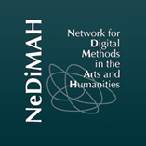
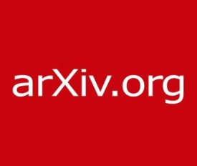
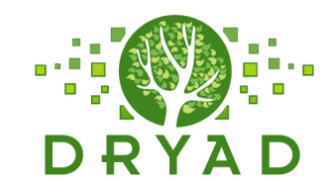
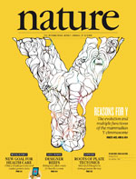
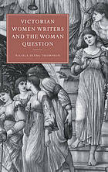
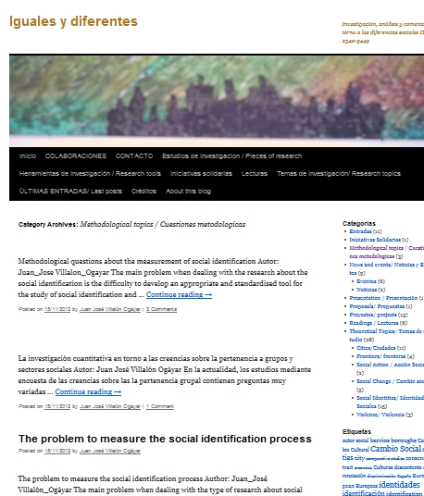
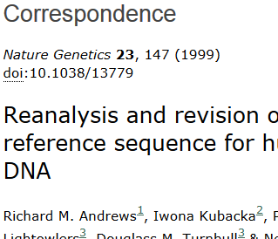
Notes:
There will be different examples for different people -- and the same examples can occur in different parts of the framework, depending on who is using it and for what purpose.
Many of these examples represent places rather than the stuff. Some places are part of the research workflow and others may be about access – and they are certainly not all offering preservation. How do we sort out who are the serious stewards? What kinds of relationships do we need with those who are? AND perhaps more importantly, with those who are not.

Slide 8
Framing the stakeholder eco-system …
Fix
Collect
Create
Use
Notes:
Let’s take a look at the stakeholder roles in this evolving ecosystem

Slide 9
Traditional configuration
Fix
Create
Collect
Use
Notes:
The traditional print configuration had well-defined roles and flow:
Researchers or authors create. Publishers fix the outcomes intellectually, physically, and legally. Libraries and archives select, organize, preserve and provide access to the outcomes. Researchers, faculty, and students use the outcomes.

Slide 10
Evolving configurations in the eco-system …
Fix
Create
e-publications
Collect
Use
Notes:
Now we see collecting being dis-intermediated. This has been happening for some time with the licensing of electronic journals and eBooks.
Now of most the roles are fulfilled external to the library [though we have the pleasure of paying for it]

Slide 11
Evolving configurations in the eco-system …
Fix
Create
Social media (blogs, Twitter)
Social storage (SlideShare, YouTube, Flickr)
Collect
Use
Notes:
With social media, both collecting and fixing are taken on by the creators and users.
Libraries are taking some of the collecting back, for instance the participants in the International Internet Preservation Consortium capture blogs as part of their web harvesting activities and the Library of Congress is archiving Twitter.

Slide 12
Notes:
Stakeholders and roles are being combined in new ways.
When a library publishes open access articles in its institutional repository it is taking on the fixity role as well as collection.
In some cases we have scientists creating a platform in which they use, create, share, preserve, and provide access to their data – taking on all four roles.

Slide 13
Evolving stewardship model …
System-wide stewardship of ESR
Distributed
Specialised
Conscious coordination
Collecting responsibilities
Coordination & cooperation
Reliance on external sources
Collecting for the public interest
“Inside-out”
Notes:
The system-wide view of the scholarly record is
More distributed (going beyond traditional collecting institutions)
More specialized (in the sense that not everyone can collect everything)
We see a need for conscious coordination
Requiring more explicit collecting responsibilities
More attention to coordination & cooperation because we are now
More reliant on external sources for access; and we need to build trust networks for preservation
The very nature of what we are collecting is changing. Research libraries used to try to collect comprehensively (or at least extensively) for a local audience. More and more they are realizing that the ecosystem as a whole will collect comprehensively and only they can collect and share with the scholarly community the things unique to their institution (the research output of the institution and unique collections). This is the transition Lorcan Dempsey describes as changing from an outside-in approach to a more focused inside-out approach.

Slide 14
Library roles
promote data literacy
select
help discover external resources
ensure appropriate metadata
encourage reuse
preserve
provide access
coordinate
manage rights
create policy
connect to related resources
collaborate
provide persistent identifier
Notes:
*Libraries continue to provide traditional services
*There are some newer user-facing roles
*Some familiar processes have become more complex
*and we have new roles in the larger ecosystem
Some key characteristics impacting our role as stewards are the
Increasing volume of content
Increasing diversity and complexity of content, not to mention the challenges in versioning and citeability and
Finding our way in the increasingly distributed ecosystem of custodial responsibility
We’ll discuss these and more throughout the workshop.

Slide 15
Notes:
This is the picture I’d like you to fix into your minds for the day: The evolving array of stuff to be curated; the various combinations of stakeholders and roles, responsibilities, and relationships; and the opportunity to create a whole that is more than the sum of the parts.

Slide 16
Reviewers
Natasa Miliç-Frayling
Roger Schonfeld
Kathleen Fitzpatrick
Cliff Lynch
Brian Schottlaender
Birgit Schmidt
Don Waters
OCLC Research team
Brian Lavoie
Constance Malpas
Ricky Erway
Jennifer Schaffner
Titia van der Werf
Ixchel Faniel
Eric Childress
Ricky Erway
OCLC Research
erwayr@oclc.org
Notes:
I want to acknowledge the valuable input of the expert reviewers who provided feedback on an earlier version <thanks Natasa>
And to credit Brian Lavoie, who led this work in OCLC Research, is the primary author, and allowed me to poach some of his slides.

