Slide 1
Digital Humanities and Libraries
A Constellation of Engagement
Ricky Erway
Senior Program Officer, OCLC Research
11 June 2014, Amsterdam
Libraries and Research: Supporting Change/Changing Support
#orlp

Slide 2
“Do something about digital humanities”
Notes:
When our colleagues at OCLC Research Library Partner institutions were asked for topics that they’d like to see addressed, they kept saying, “Do something about Digital Humanities,” but they didn’t say what needed doing. When we said at staff meetings, “We should do something about Digital Humanities,” we were asked what exactly and demurred.
Then Jim came back from a meeting where library directors were asking him what we were doing about DH. So we decided to do something. But what?
What did we have to contribute? We realized that a lot has been written by librarians about DH and libraries, and librarians often go to meetings to talk to other librarians about DH. We decided to try to steep ourselves in DH from the researchers’ perspective and see what might come of it.

Slide 3







Immersion
“Beyond the Text”
Continuous Access To Cultural Heritage (CATCH)
CATCH in Context
CATCH WebArt
Notes:
We set out to familiarize ourselves with the scholars’ point of view—about their processes, their issues, and their needs. We followed online discussions, attended conferences, and took advantage of opportunities to talk to scholars about what they do, how they do it, and where they would like assistance.
In informal focus groups, we asked DH scholars questions such as:
•Remembering a recent piece of work you did, what kinds of sources did you use? What made locating them easy or hard?
•How do you publish or share the outcomes of your research? What will happen to tools, new versions of your source material, or other byproducts of your work?
•What skills do you wish you had on your research team?
We synthesized what we heard and shared it with our colleagues. We thought it would be most useful to library directors who are not already in the thick of DH.
Images from http://thatcamp.org/

Slide 4
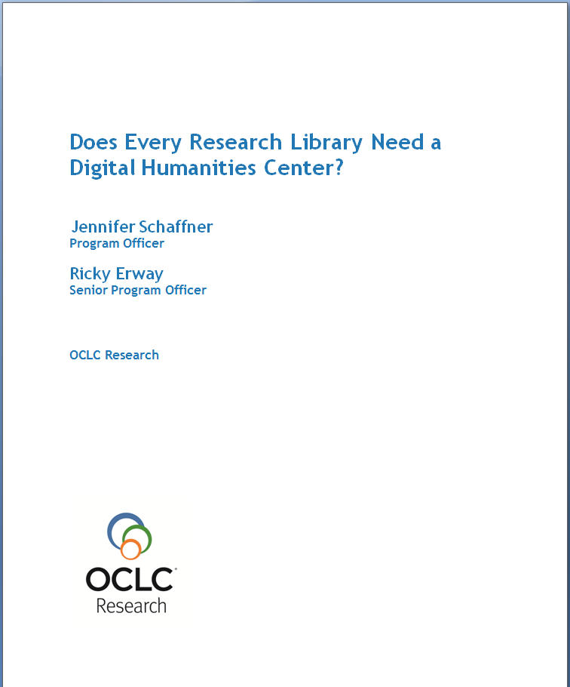
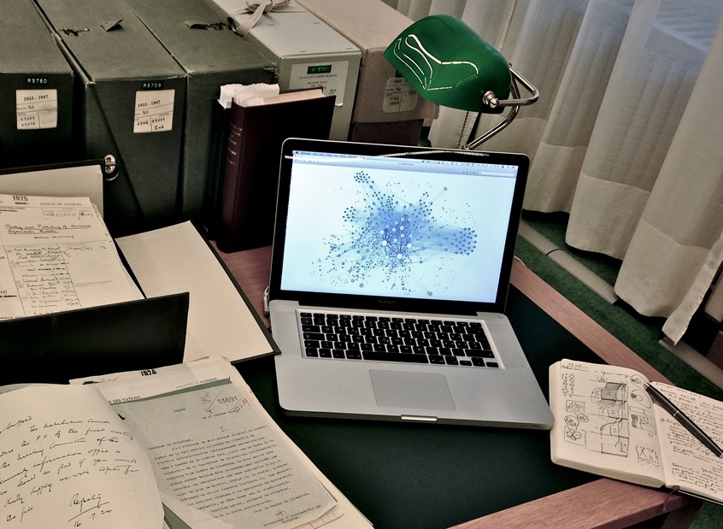
Not always
It depends…
Humanités Numériques [crop] Calvinius CC BY-SA 3.0
Notes:
Accordingly, our essay addressed the subset of library directors who were deciding how to engage with the digital humanities.
We discuss specific concerns of scholars engaged in DH and tie these to decisions that might be made by directors, hoping to bridge the gap between how library directors and DH researchers think.
Hitting the title question head on, we said, * Well, it depends.
A DH center will not always meet the needs of researchers. When a DH center is warranted, it is not necessarily best located in the library. There are many models that demonstrate successful collaborations with digital humanists. In most settings, the best decision is to observe what local academics are already doing and then take appropriate action.
Humanités Numériques [crop] Calvinius CC BY-SA 3.0

Slide 5
Suggestions
Learn from the DH researchers
Consider other local resources
Consider cross-institutional, interdisciplinary, national, or international resources
Find out what researchers cherish
Find out what researchers lack
Find out what matters to researchers
Then engage
Notes:
In order to learn about local DH research, consider a survey or a faculty advisory group. Having library staff serve as liaisons to departments or centers is a good way to get familiar with researchers’ work.
Learn what local resources are available to DH researchers – such as university technology support, project management, support they may have in their departments…
External resources might offer support for discovery, or provide tools or preservation services.
Find out what they cherish – right near the top are digital sources and metadata!
Find out what they lack – often technical skills (statistics, programming, or interface design)
Find out what matters to them – they often mention discoverability and preservation
Once you’ve opened up the lines of communication, you’ll know better how to proceed. If you can identify a training need, that might be a great opportunity to train your staff with researchers, to break the ice, exchange information, and create some lasting synergy.
Ultimately the boundaries may blur to the point where you have library staff working as DH team members and have DH researchers on the library staff.
There are many roles for libraries in DH - We suggest a…

Slide 6



Omicron² du Cygne. Photo Serge Corrotte, Egres73 [adapted] CC BY-SA
Notes:
Constellation of ways to engage.
*In some cases, there may be a single service or entry point into DH
*In other cases a few services might meet the needs of DH scholars
*In others an array of services and points of engagement might be offered
*And every so often, yes, a full-blown DH center is born.
http://commons.wikimedia.org/wiki/File:32_cyg_.jpg
Omicron² du Cygne. Photo Serge Corrotte, Egres73 CC BY-SA

Slide 7

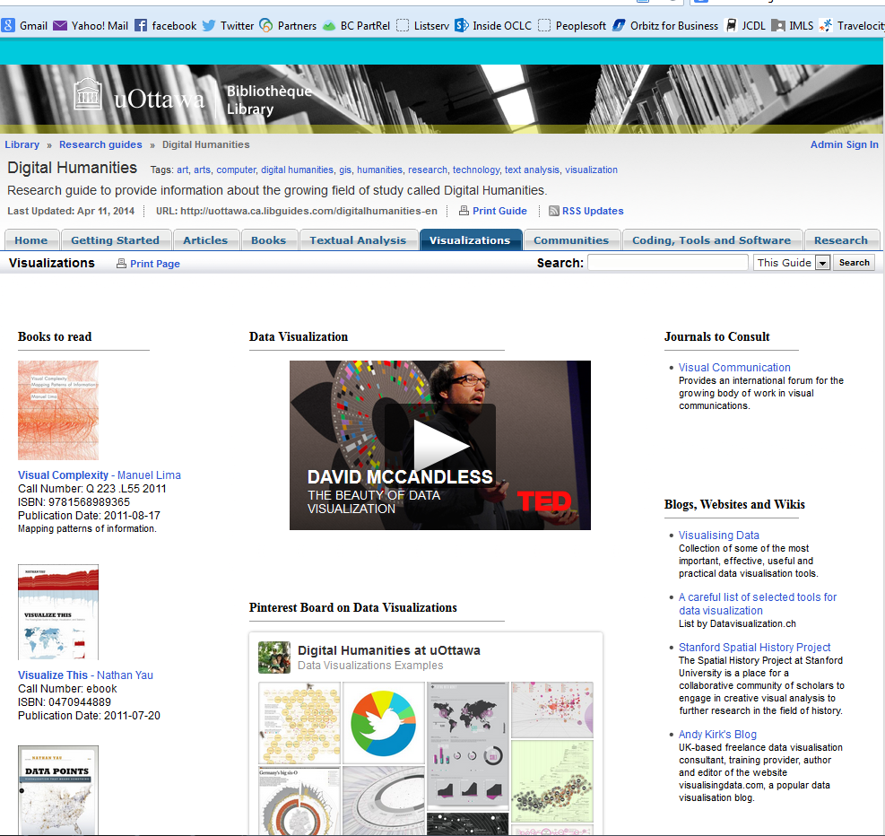
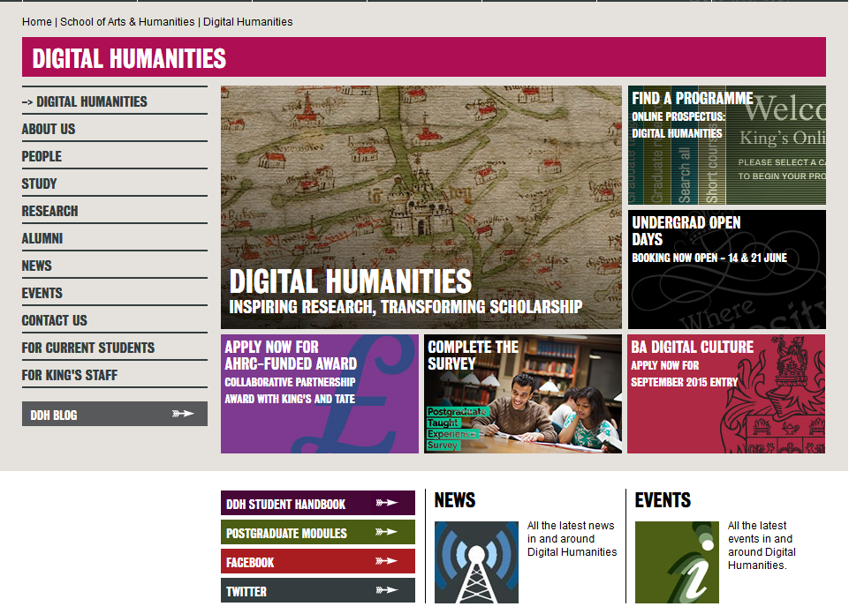
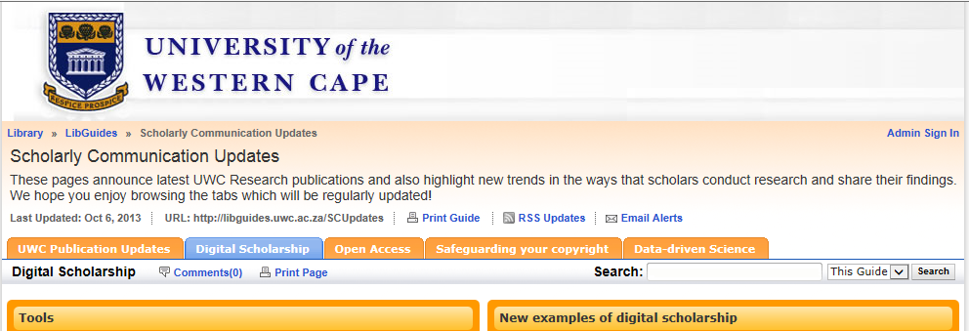
Virtual DH centers
Notes:
One of the easiest ways to begin is to look at what the library already offers and make sure digital humanities scholars are aware of it.
DH Libguides and websites – are one way to package existing services and resources that may not be reaching researchers and offer them as a “virtual DH center”
This is a low-overhead opportunity to promote tools, training, and the assistance you have to offer with offer with curating data or creating metadata … even as you explore other needs.

Slide 8
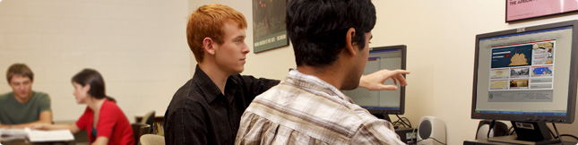
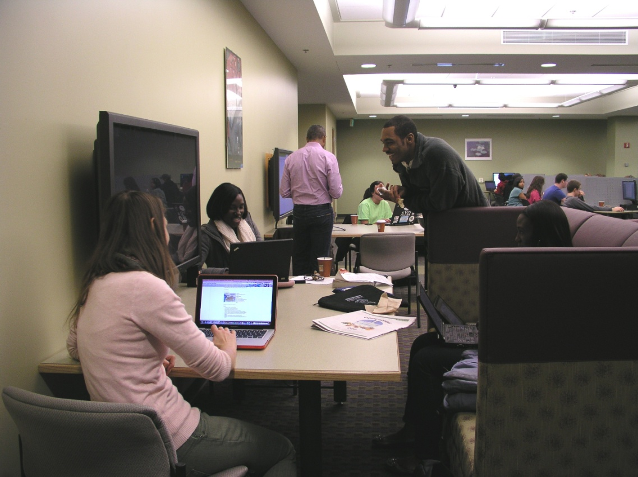
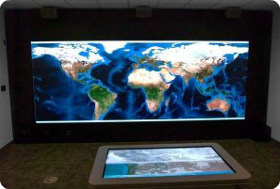
From virtual to tangible
Notes:
Another successful example is offering space and equipment not otherwise available to them.
Collaboration space is often hard to come by at a university
Specific software and hardware may exceed their project budget, but be affordable as a centralized resource
Server space is another offer that may be most welcome.
http://library.ucalgary.ca/visualization-studio
http://its.unc.edu/teachingandlearning/teaching-and-learning/computer-labs/
http://president.richmond.edu/ayers/scholarship/digital-scholarship.html

Slide 9
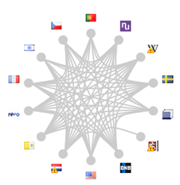


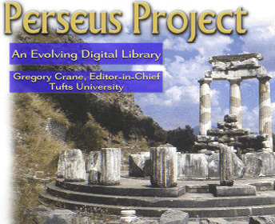
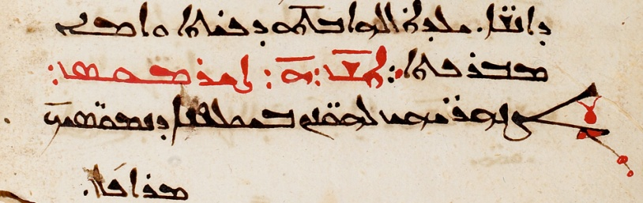

Metadata
Notes:
We were surprised how dominantly metadata figured in scholars’ descriptions of their work. As we were learning about their metadata desires, colleagues back at OCLC were enriching VI-AF (the Virtual International Authority File) with names from Perseus and the Syraic Portal.
The scholars behind the Perseus Catalog aim to provide access to online editions of every major Latin and Greek author from antiquity to 600 CE.
The other collaborative digital reference project researches texts in Syriac, which comprises the third largest surviving corpus of literature from the Roman Empire.
Scholarly contributions can enrich existing VIAF clusters by adding script forms of names that previously lacked them, as well as by adding new names.
Scholars benefit from using VIAF persistent identifiers for the names in their own databases, linked data applications, and scholarly discourse. They also appreciate using VIAF as a means to disseminate their research on names beyond their own communities.
http://llt.msu.edu/vol4num1/onthenet/default.html
http://syriac.ua.edu/about.html

Slide 10
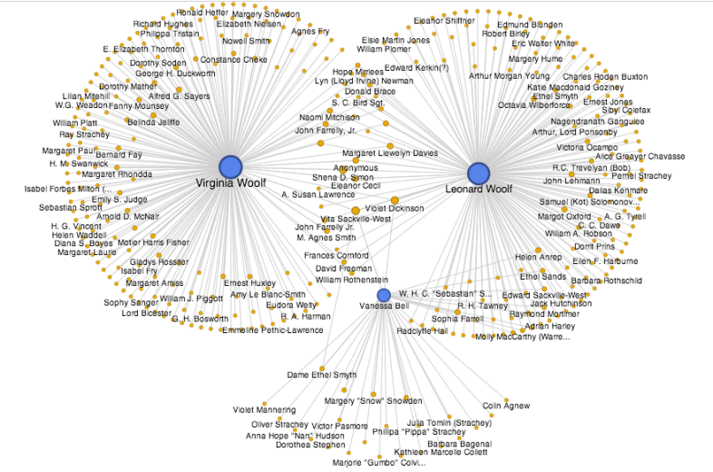
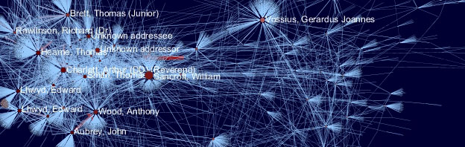
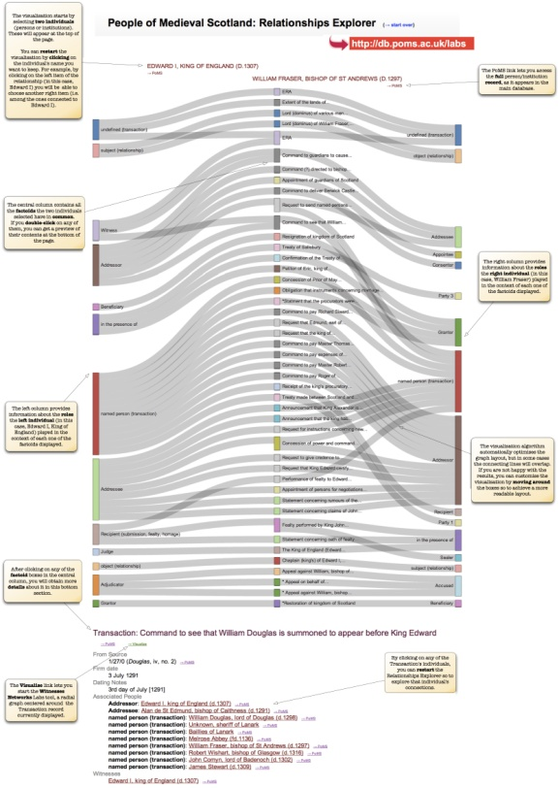
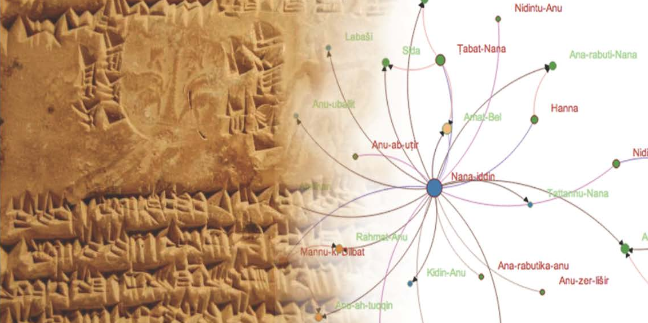
Visualization
Notes:
ProsoPOGraphy accounts for much of the interest in VIAF and authority work. Researchers establish disambiguated names in a manner that lends itself to visualization in order to draw connections within groups of literary characters and within groups of historical figures.
http://www.culturesofknowledge.org/?author=5
http://www.modmaps.net/tcllp/wp-content/uploads/2013/07/Woolf-Letters-Graph-Network.png
http://berkeleypros.files.wordpress.com/2013/09/doceng2013-title-slide.jpg
http://wip.cch.kcl.ac.uk/2012/09/14/people-of-medieval-scotland/

Slide 11
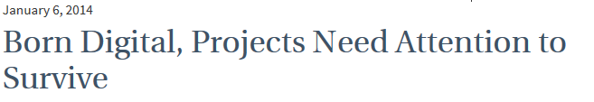
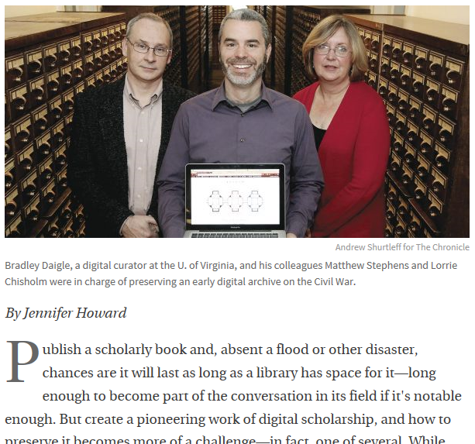
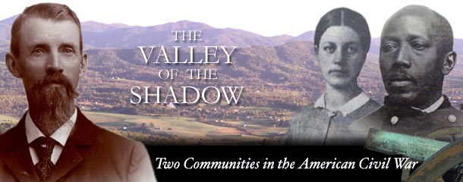
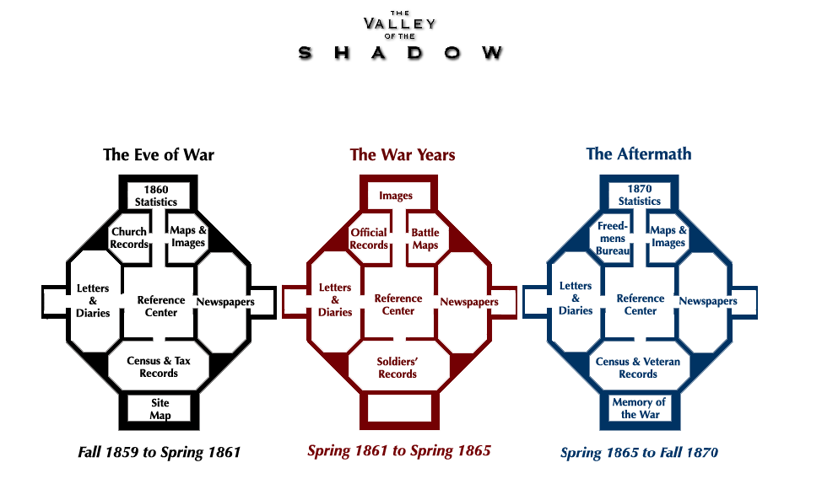
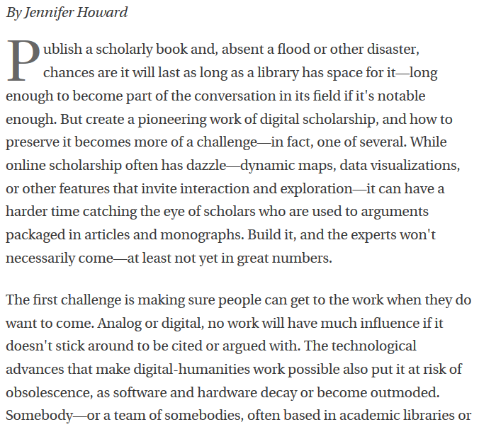
Preservation
Notes:
Sometimes the library is consulted after the fact. In one case, a collection developed over a period of 14 years by faculty members and grad students quickly became technologically out of date. A couple of years after the project was finished, the library stepped in and reformatted files and rebuilt the web presentation. The library now suggests that long term archiving strategies be put in place early on – and the library is eager to help with that. They refer to it as the “DH path to production” in which creativity flows into sustainability.

Slide 12

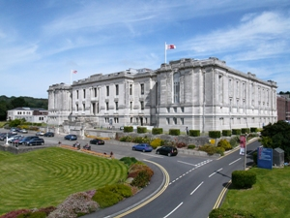

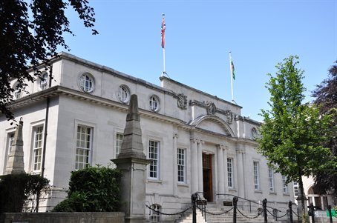
Uniting collections and researchers
Notes:
A mutually beneficial relationship can be developed by lighting a path to special collections.
The National Library of Wales has a digital humanities research program. They partnered with academics to integrate their digital content into research. The University of Wales funded an academic research Chair to set up the initiative. The National Library’s goal is to make the library’s digital collections more sustainable by supporting their use for scholarship, so they are situating the digital collections as an essential part of the scholarly research infrastructure. In a few moments, Adam Farquhar will share how the British Library is connecting collections and scholars.
http://www.visitmidwales.co.uk/Aberystwyth-National-Library-of-Wales/details/?dms=3&venue=1024485
http://www.wales.ac.uk/en/AboutUs/AboutUs.aspx

Slide 13

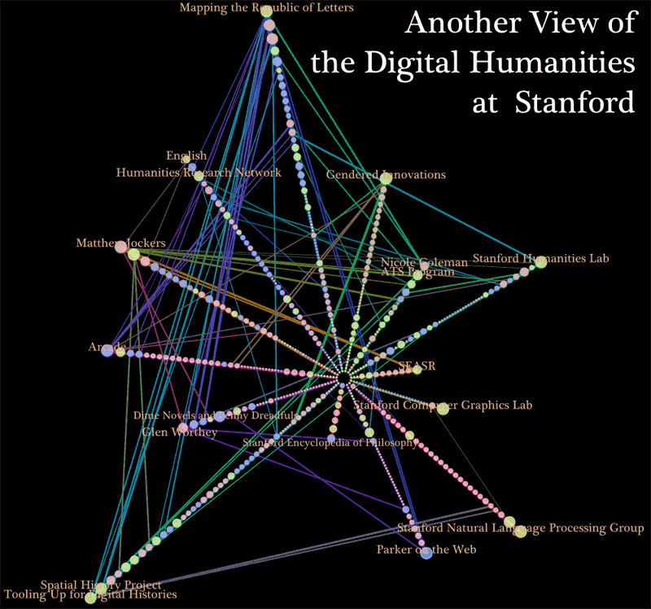

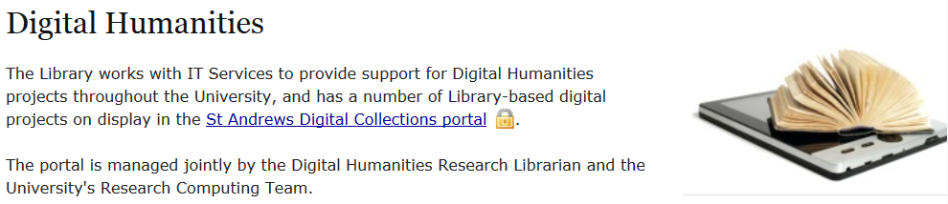



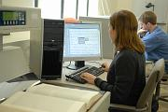
Staffing
Notes:
Whether or not a library has one staff member, several, or a center devoted to DH is largely a local issue.
For example, the University of St Andrews is fortunate to have a DH-skilled librarian and gave her autonomy to work in partnership with Research Computing. She launches DH projects based on the Library’s Special Collections and provides support to researchers initiating their own projects.
The Maryland Institute of Technology in the Humanities is jointly supported by the College of Arts and Humanities and the University Libraries. They have representation in the directorship from academic departments and from the libraries to solidify those ties. They’ve run a Digital Humanities Incubator to help introduce Library staff to digital humanities through a series of workshops, tutorials, and project consultations.
Stanford has been successful taking a “loose collective” approach to Digital Humanities. The program has no hierarchy and is distributed: in the Spatial History Lab, the Literary Lab, Center for Textual Analysis, the Music Department’s Center for Computer Research, and other department-based groups; as well as in the Stanford Humanities Center and in various units of the Libraries. They call it “a robust connective tissue of base-funded positions …that have been supporting digital humanities scholarship since before it was called that.” (Elijah Meeks)
Columbia’s Digital Humanities Center is an example of a Center developed by and in the library. The staff of two full time professionals and six graduate consultants, under the guidance of a steering committee of four, offers a wide array of resources and services.

Slide 14
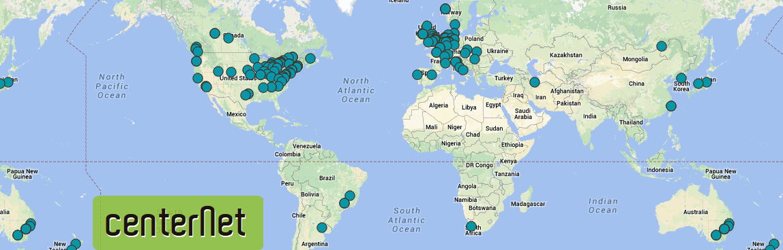
So is it about DH centers?
Sometimes…
Notes:
Do you need to put a center on the map? Not necessarily
If a center is the right thing for your university, should it be in the library? Not necessarily.
In fact it might not even be in your institution.
Collaborations spawn some of the most successful centers…

Slide 15








Collaborative centers
Notes:
The University of Amsterdam has launched an initiative with the Royal Netherlands Academy of Arts and Sciences and the Free University to create a joint Center for Digital Humanities to incubate humanities projects with support from private partners. And I’ve just read that they are now entering into a significant new partnership, the Center for Humanities and Technology
The Göttingen Centre for Digital Humanities (GCDH) is a collaboratory that cooperates with five other research institutions to coordinate and carry out DH research, teaching, and infrastructure.
At a larger scale are the national or EU-scale centers
The e-Humanities Group in the Netherlands brings together expertise and research in the development and use of digital technologies in the humanities and social sciences.
Australia’s Humanities Networked Infrastructure is a national ‘virtual laboratory’ that aggregates data and tools to provide access to Australia’s cultural datasets in a wider context.
CLARIN is a distributed research data infrastructure, with sites at universities, research institutions, and libraries all over Europe. They provide access to language data collections and the tools to work with them.
The Digital Research Infrastructure for the Arts and Humanities facilitates long-term access to European Arts and Humanities research data.

Slide 16
Reaction to the essay
Librarians “have the right and responsibility to structure initiatives and shift resources not just in response to faculty requests, but in considered anticipation of them.”
Bethany Nowviskie
Director of Digital Research & Scholarship
University of Virginia
Notes:
Bethany Nowviskie said, in response to our essay, Librarians “have the right and responsibility to structure initiatives and shift resources not just in response to faculty requests, but in considered anticipation of them.”

Slide 17
Other voices
Where a library begins is not at all where they might end up
There simply aren’t enough qualified people out there
Don’t take a "build it and they will come" approach
A center is never the best response unless you want to be relevant as a research library
The essay picked up on many of the issues I have experienced in the front lines
We’re looking at the virtual option but faculty members want a physical place they can go
It is an unhelpful “us/them,” differentiating between “DH academics” and “librarians.”
The report reinforces the notion that a one-size-fits-all approach never fits all.
It offers lots of ideas for people at smaller institutions about how to do DH without a "Center"
Think of “Stone Soup” -- you may simply be the one bringing the stone
Notes:
That kicked off a spirited discussion about the variety of ways libraries engage with the digital humanities. I hope it will continue in our discussions today.
Here are a few other voices.
For years we’ve all been increasingly competing over the same, barely growing pool of qualified candidates. The only way a new center can find plausible people is to hire them away from somewhere [else] and there simply aren’t enough qualified people out there.
I would agree that a center is never the only or likely best response to perceived need for digital humanities support, as long as it’s amended to add, “...unless they want to be relevant as a research library.”
I forwarded the essay to my dean. We’re looking at the virtual option to begin with, although most of the faculty members I’ve spoken with would like a physical place they can go.
The chief value of the report is in its clear reinforcement of the notion that a one-size-fits-all approach to digital scholarship support never fits all.
We don’t all have to do the same thing, we simply have to find where we fit, or make a place for us to fit. … Think of “Stone Soup” and you may simply be the one bringing the stone.
There was an animated back-and-forth on Twitter and in blog posts – and the discussion of the essay blended into the ongoing DH discourse.

Slide 18
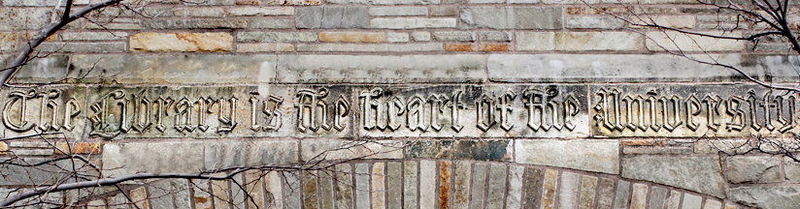
Push and Pull
When to support – when to collaborate – when to lead
Changes in the discipline / changes in the academy
eScholarship ➔ scholarship
Notes:
One of the themes of the essay, and the subsequent discussion, was when to support – when to collaborate – and when to lead
The answer is often very local and related to shifts and changes in the research process. Changes in research aren’t evenly distributed. Some universities will have a cadre of vanguard researchers, while another might have a single DH scholar. Libraries can also be vanguards (or outliers) in their engagement.
When change is more broad-based it’s clearer to see the appropriate response. We need to calibrate by what we learn and what happens as we try different things.
Digital humanities are at a crossroads, challenged by traditional academic structures, values, and incentives. Boutique projects will eventually give way to disciplinary changes, which will in turn effect change in the academy. As changes are embraced by the academy, e-scholarship will be seen simply as scholarship. We need to ensure that libraries are attuned, * in order to retain their position as the heart of the university.
http://yaleuniversity.tumblr.com/post/43108995561/the-library-is-the-heart-of-the-university

Slide 19
OCLC Research team
Jennifer Schaffner
Ricky Erway
Titia van der Werf
Merrilee Proffitt
Ricky Erway
erwayr@oclc.org
Does Every Library Need a Digital Humanities Center?
Jennifer Schaffner and Ricky Erway, 2014
http://oc.lc/k9JACG
Notes:
I want to especially acknowledge Jennifer Schaffner, who ventured into the digital humanities milieu with me and is lead author of the essay.

Slide 20
Image Sources
http://thatcamp.org/
http://commons.wikimedia.org/wiki/File:Humanit%C3%A9s_Num%C3%A9riques.JPG
http://commons.wikimedia.org/wiki/File:32_cyg.jpg
http://library.ucalgary.ca/visualization-studio
http://its.unc.edu/teachingandlearning/teaching-and-learning/computer-labs/
http://president.richmond.edu/ayers/scholarship/digital-scholarship.html
http://llt.msu.edu/vol4num1/onthenet/default.html
http://syriac.ua.edu/about.html
http://www.culturesofknowledge.org/?author=5
http://www.modmaps.net/tcllp/wp-content/uploads/2013/07/Woolf-Letters-Graph-Network.png
http://berkeleypros.files.wordpress.com/2013/09/doceng2013-title-slide.jpg
http://wip.cch.kcl.ac.uk/2012/09/14/people-of-medieval-scotland/
http://valley.lib.virginia.edu/ and http://valley.lib.virginia.edu/VoS/choosepart.html
http://chronicle.com/article/Born-Digital-Projects-Need/143799/
http://www.visitmidwales.co.uk/Aberystwyth-National-Library-of-Wales/details/?dms=3&venue=1024485
http://www.wales.ac.uk/en/AboutUs/AboutUs.aspx
https://dhs.stanford.edu/digital-humanities-at-stanford/
http://mith.umd.edu/about/
http://digitalhumanities.org/centernet/
http://yaleuniversity.tumblr.com/post/43108995561/the-library-is-the-heart-of-the-university

Slide 21
A range of possible ways to engage
package existing services as a “virtual DH center”
advocate coordinated DH support across the institution
help scholars plan for preservation needs
extend the institutional repository to accommodate DH digital objects
work internationally to spur co-investment in DH across institutions
create avenues for scholarly use and enhancement of metadata
consult DH scholars at the beginning of digitization projects
get involved in DH project planning for sustainability from the beginning
commit to a DH center
Notes:
package existing services as a “virtual DH center”
advocate coordinated DH support across the institution
help scholars plan for preservation needs
extend the institutional repository to accommodate DH digital objects
work internationally to spur co-investment in DH across institutions
create avenues for scholarly use and enhancement of metadata
consult DH scholars at the beginning of digitization projects
get involved in DH project planning for sustainability from the beginning
commit to a DH center

Slide 22



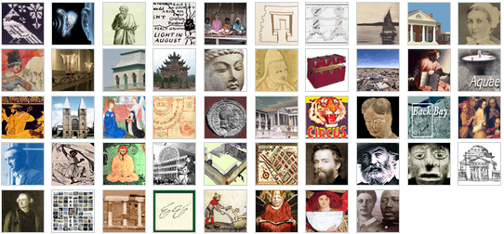


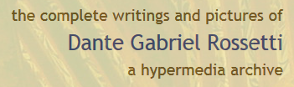



Beyond the ordinary
Notes:
And every so often there’s a time and a place to create a true center of excellence.
The University of Virginia, a highly decentralized institution, has managed to integrate the expertise of scholars, librarians, and technologists to achieve leadership in the digital humanities.
The Institute for Advanced Technology in the Humanities (IATH) develops information technology for scholarly humanities research. It is a unique collaboration between humanities and computer science research faculty, computer professionals, and the library.
The library-based Scholars’ Lab is where researchers across the disciplines partner on digital projects and benefit from expert consultation and teaching.
The Virginia Center for Digital History (VCDH) in the school of arts and sciences advances historical scholarship and facilitates active dialog between scholars, researchers and educators.
The Digital Media Lab focuses on areas involving the convergence of media and technology, with a team of knowledgeable media professionals.
The University of Virginia let a thousand flowers bloom and the library has served as founder, catalyst, or home for many of the initiatives.
Bethany Nowviskie (Director of Digital Research & Scholarship at UVA) said, in response to our essay, Librarians “have the right and responsibility to structure initiatives and shift resources not just in response to faculty requests, but in considered anticipation of them.”

Slide 23
  “Collaboration with the university library is the only realistic option for long-term sustainability of digital humanities projects … If digital humanities projects stand still, they will indeed die, and the library is the only part of our institutional structure that can keep them moving enough to save them.”
                --Kretzschmar and Potter
Notes:
Quote from http://www.slideshare.net/viroviacum/designing-the-digital-humanities-library-lab-leuven-dh3l?qid=a0fa1735-6326-4493-859f-6095fa5a8a7c&v=default&b=&from_search=4

Slide 24
“Libraries and digital humanities have the same goals. Stop asking if the library has a role, or what it is, and start getting involved in digital projects that are already happening. … Become producers/creators in collaboration with scholars rather than servants to them.” -- Micah Vandegrift
Notes:
http://www.inthelibrarywiththeleadpipe.org/editorial-board/micah-vandegrift/
http://www.inthelibrarywiththeleadpipe.org/2012/dhandthelib/

