Slide 1
What Comes Next?
Closing plenary
Oclc/cic/osu
Regional print symposium
March 27-28, 2014
Carol pitts diedrichs
Vice provost and Director of university libraries
The Ohio State University
Notes:
Good afternoon. I’m delighted to have the chance to wrap up our couple of days together talking about a topic I’m very interested in. First I want to talk about three key opportunities that are before us

Slide 2


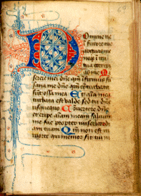
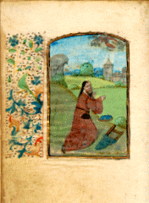
To Secure Special and Distinctive Collections
Notes:
The first is the opportunity to secure special and distinctive collections

Slide 3
To Deduplicate Low Use Content and Redirect Resources
Notes:
The second to deduplicate low use content and redirect resources

Slide 4
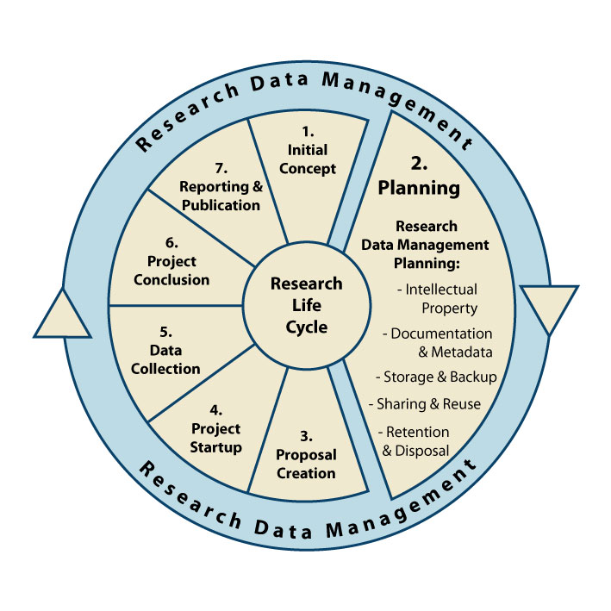

To Rethink User Services as Expectations and Behaviors Change
Research Life Cycle
University of Western Australia, 2012
Notes:
And third, to rethink user services as expectations and behaviors change

Slide 5
Key Insights
Rare and Core Collections do not cleanly correspond to our preconceived notions
Notes:
From our time together the last couple of days as well as previous attention to this issue, I have some key insights to share. The first is that rare and core collections do not cleanly correspond to our preconceived notions

Slide 6



Print books: Distinct manifestations*
World:
157.4m
N. America:
49.8m
CHI-PITTS:
19.0m
12.4m
2.7m
*As represented in
January 2013
Notes:
You’ll remember some of these slides from the presentation by Constance and Brian about the OSU collection in the context of the CIC, the CHI-PITT region, in North America and in the world
We often talk about a collection size of 7+ million volumes at OSU – but in this context we have identified 2.7 million distinct manifestations of print books – in essence the starting corpus for use to consider

Slide 7
OSU: Rare and core
OSU’s
“core” print book asset
(~400K books)
More than 10:
14%
3 or less:
38%
8 to 10:
18%
OSU’s
“rare” print book
asset
(~1 m books)
Total # of CIC holdings
4 to 7:
30%
Percent of OSU collection
Notes:
Again to remind you about the breakdown an that many of OSU’s “rare” collections are
in English,
were published since 1960, and
are in the social sciences and STEM.
Many of them are also
in foreign languages,
published before 1950 and
in humanities subject areas
So this isn’t entirely surprising to me as we have long been known for our popular American fiction collection, our area studies collections, and very strong humanities culture while also being very STEM driven

Slide 8
OSU rare & core: Age
Rare:
23% published pre-1950
Core:
9% published pre-1950
Notes:
And another visual that speaks to the rare and core parts of the OSU collection based on age range
The work that OCLC Research has done is important because it allows us to move beyond our anecdotal impressions of the rare and core portions of our collections to a more data driven analysis that can be acted upon

Slide 9
OSU Core Collections
The widely held parts of our collections are relatively small and may be duplicated because they are also heavily used. We do actually need many copies of Plato’s Republic to support users’ needs.
Karla Strieb, Associate Director,
for Collections, Technical Services and Scholarly Communication
Notes:
We also come away from this analysis with this insight about our core collection – that the widely held parts of our collections are relatively small and may be duplicated because they are also heavily used. We do actually need many copies of Plato’s Republic to support users’ needs.

Slide 10
Key Insights
Monographs require a different strategy than serials
Notes:
This insight is probably at this stage pretty obvious to most of us – that monographs are going to require a different strategy than serials

Slide 11

OSU Centers and Comps
“Coverage requires cooperation”
FAST | Coverage compared to WorldCat | Heading | OSU Rank compared to other WorldCat libraries | OSU Rank compared to other CIC libraries
fst01008312 | 67.20% | Manuscripts, Church Slavic | 1 | 1
fst00848081 | 61.20% | Cartoonists | 1 | 1
fst00980348 | 59.80% | Israeli poetry | 4 | 1
fst00807464 | 43.80% | American wit and humor, Pictorial | 1 | 1
fst00954398 | 36.80% | Hebrew poetry | 13 | 1
fst01205076 | 33.10% | Ohio—Columbus | 1 | 1
fst00812274 | 30.30% | Arabic fiction | 10 | 2
fst01108635 | 26.90% | Science fiction, American | 11 | 1
fst00812533 | 23.70% | Arabic poetry | 13 | 2
fst00869145 | 20.40% | Comic books, strips, etc. | 1 | 1
Notes:
Again some of OCLC’s work to draw out OSU’s strengths in comparison to all of WorldCat and within the CIC is useful to begin to think about strategies we might employ going forward. And actually, given my long history at OSU and my previous role as AD for Collections and Technical Services, these don’t surprise me at all. If we were harkening back to the old Conspectus work where you were to identify areas where you collected “comprehensively”, these would be exactly the areas that OSU would have pointed to – Slavic manuscripts from our Hilandar collection, cartoons from the BICLM, popular American fiction, science fiction, middle east and Judaic collections.
What’s fascinating about this chart to me – and to OCLC’s point – is that OSU holds the #1 rank for holdings about cartoonists but that represents only 67.20% of the coverage in WorldCat. To ensure a comprehensive collection, we’ll surely have to collaborate with someone else.
And particularly for cartoons, fiction and area studies, this material is largely print books. And given that these collections all already reside in our special collections, won’t be weeded, and are in secure storage, these make ideal candidates for declaration as intention to retain for the long term.

Slide 12
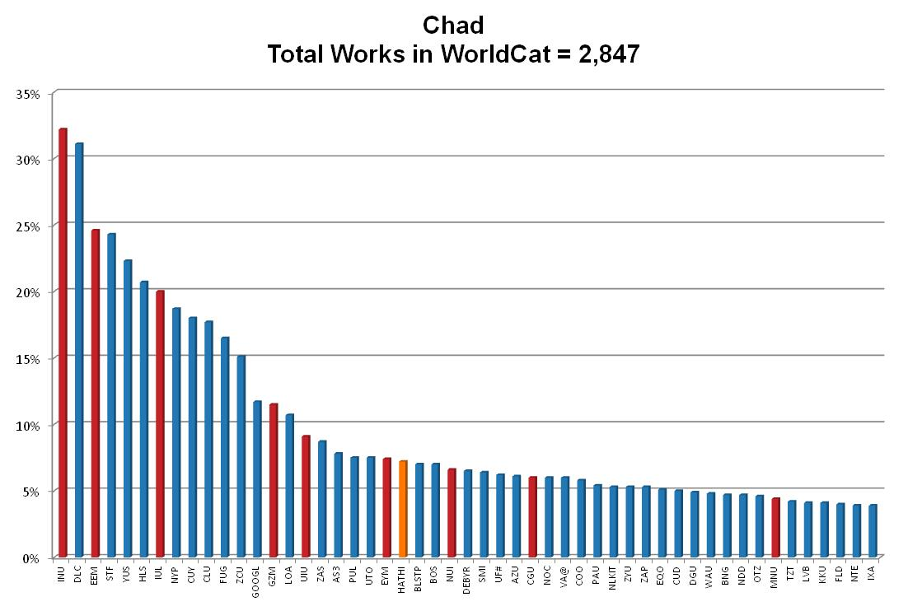

9 of the 50 most comprehensive collections related to Chad are held by CIC institutions
Coverage
CIC
HathiTrust
Holding Libraries (OCLC symbols)
Notes:
Let me close this section with this last insight from OCLC’s work that identifies works related to Chad and the strength of collections held in the CIC – perhaps another area for concerted effort to retain and preserve the existing corpus.
Again this data now provides us with some specific ways of thinking about how to structure shared print projects for distinctive collections

Slide 13
Key Insights
Opportunities to Develop and align regional collections which overlap across varying geographies are both promising and challenging!
Notes:
The next insight – that developing and aligning regional collections which overlap across varying geographies are both promising and challenging. At OSU we’ve lived in this world for a long time holding membership in two very robust and active consortial groups – the CIC and OhioLINK

Slide 14
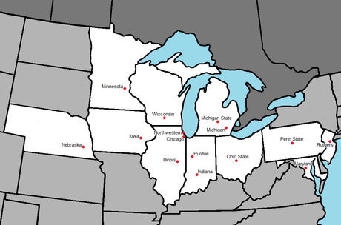
CIC
Notes:
This is a great visual of the regional scale and scope of the CIC/Big Ten consortium as it stands today ranging from Nebraska to New Jersey. Partnerships across the CIC are important to us, but we also have important partnerships in our state.
Decision-making between and among those partners is both promising and challenging. For example, our CIC colleagues have similar concerns to OSU about what they need to retain and how their faculty will react to that. But CIC libraries also want to repurpose space for users and transform their physical spaces.
Many of our OhioLINK colleagues are certainly concerned about their collections, but probably are more concerned about the potential duplication among our state depositories, and an urgent need to make more user spaces.
So how do we proceed with shared print projects that address both of our consortial responsibilities? Serials have been less problematic in this area, but monographs will create much greater demand than we expect for serial volumes for which we have robust, long term electronic access.

Slide 15
Key Insights
Distributed
Versus
Centralized?
Or both?
Notes:
A key question for us about shared print management is whether our strategies should be distributed, centralized or perhaps both.

Slide 16

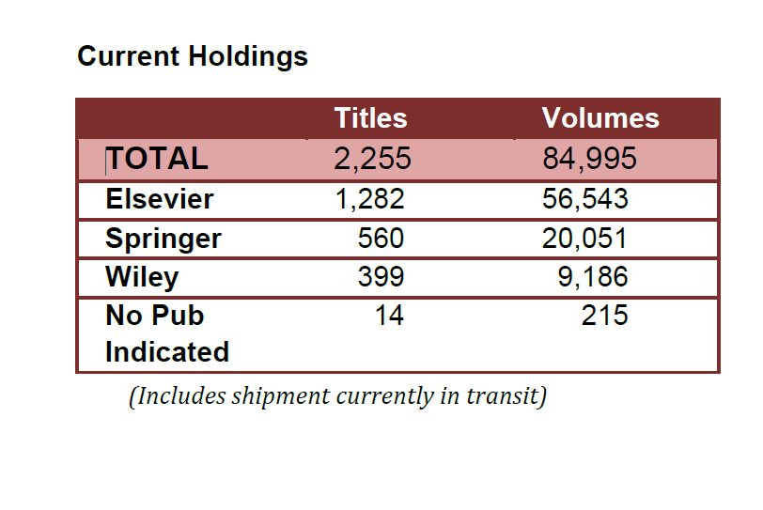
http://www.cic.net/Home.aspx
Centralized shared print journal storage project
Notes:
The decision made by the CIC for shared print journals was a centralized model. In that case, you might ask “why”?
Several reasons:
Availability of a module at IU
Widespread electronic access including local load of content in Ohio
Little demand for print use so materials leaving campus were without issues
Ability to save local shelf space
A centralized decision made good sense for the CIC for shared print journals.

Slide 17
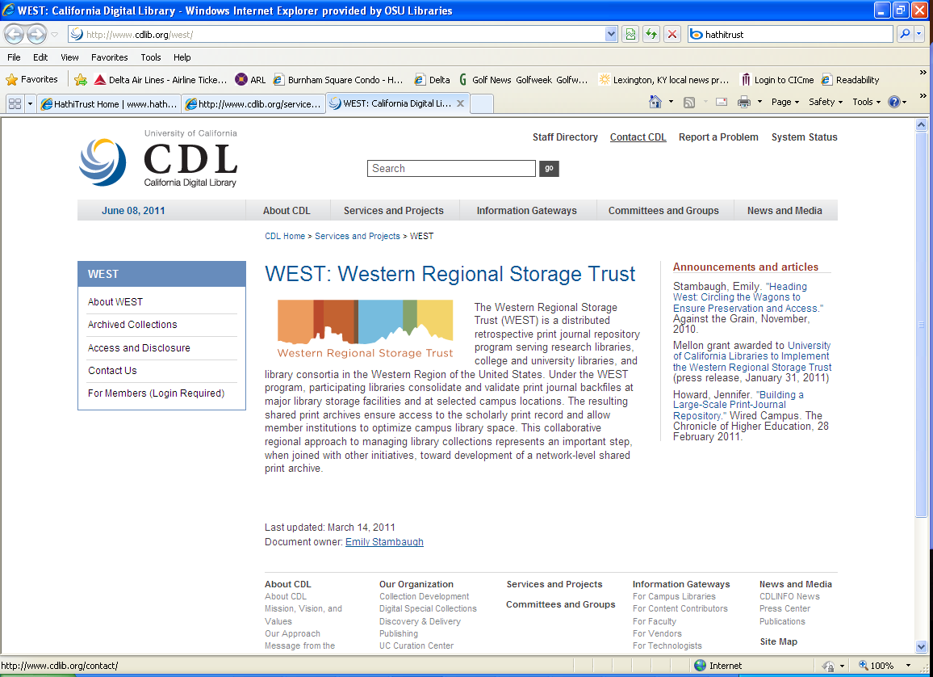
http://www.cdlib.org/services/west/docs/WEST_Orientation.pdf
A Distributed Model
http://www.cdlib.org/west/
Notes:
The Western Regional Storage Trust (WEST) is a good exemplar for a distributed retrospective print journal repository program serving research libraries in the western region of the United States.

Slide 18
And many other potential partners
Washington Research Libraries Consortium
Connect
New York
MI-SPI – Michigan Shared Print Initiative
PALCI
Maine Shared Collection Strategy
Scholar’s Trust
partnership between Association of Southeast Research Libraries (ASERL) and Washington Research Library Consortium (WRLC)
www.scholarstrust.org
Virtual Library of Virginia (VIVA)
California Digital Library
MedPrint
National Library of Medicine and its associated medical library partners
Notes:
And there are many other projects around the country that are experimenting with serial and monograph projects
And you will also have heard from Illinois and Tom Teper earlier about their last copy policy in Illinois where their partners who intend to withdraw a last copy will do so and then send it to Illinois
I think the right answer at this point is likely – both decentralized and centralized as appropriate to the project and region
So again, no “right” answer as to whether repositories should be centralized or decentralized but I think we’d all agree that we are reaching thes tage where we need some coordination of action.

Slide 19
Key Insights
Readiness to provide user services varies widely
Notes:
It’s one thing to talk about sharing print monographs and quite another to provide ready and easy access to those items. It starts with discovery – how does a user know that an item is available to them? Can they request it simply – patron initiated or are there more hurdles and barriers? Once requested, how does it get delivered to the user and how does it get returned?
An insight that I believe is extremely pressing – what is our readiness to provide user services in support of shared print? And we believe that readiness varies widely across the country. We probably easily know how to do this for serials – scan an article and send it electronically to the user. Print books pose a much bigger issue for us.

Slide 20
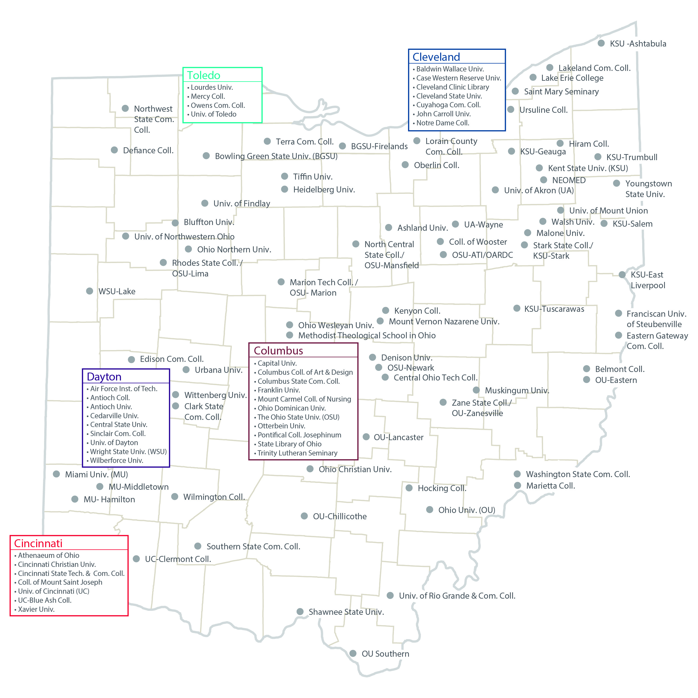
Map of 91
OhioLINK
Member Institutions
Notes:
I realize that you can’t read this well but it is a map of Ohio with the 91 OhioLINK members noted. One advantage for us in Ohio is that it only takes about 5 hours to get from one end of the state to the other – perhaps further as you travel off the freeway system. But nothing compared to state with a larger physical geography. That’s one thing that works in our favor.

Slide 21
OhioLINK’s Readiness
User Services Needed
OhioLINK assessment
Discovery
Patron Request
Transportation
Delivery options
OhioLINK Central Catalog
Patron initiated requests directly from the central catalog
Statewide courier service that delivers to each location
Pickup at user’s home location or any OhioLINK institution
Notes:
So when I think about what we must do to share print effectively, I ask these questions and find good answers here in Ohio:
Discovery
Patron Request
Transportation
Delivery Options
We’ve been doing this effectively for more than 20 years and “OhioLINK” is a definable service to our users who know to expect delivery within 2-3 days.
I could tell you lots of stories from the early days of OhioLINK’s creation which would reveal the fear and angst across the state about whether this would work. But today it’s simply seen as a service that effectively meets the needs of faculty and students on a daily basis.
So in Ohio, I think we have a state of readiness that positions us well to build on our existing services for shared print.
Other places might not yet be in the same state of preparedness.

Slide 22
Key Insights
Expected changes in the demand curve
Notes:
So we realize that changes in demand will occur over the next 25 years
As Mark noted yesterday that’s precisely the reason that the CIC project guarantees access for 25 years – and then if not before, we expect to review where things stand and what is the right solution for that point in time

Slide 23
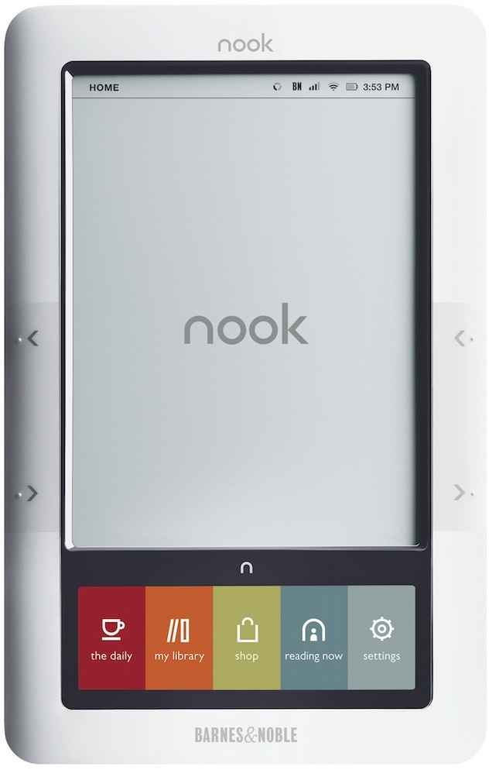

Format preferences
Notes:
The only given I see about devices and e-reading is that they are going to keep getting better. New tools will develop that will resolve issues that inhibit use for scholarly work such as printing etc. I’m not sure on what time frame but I expect that people will continue to migrate their reading to online format.

Slide 24



Preferences for format based on particular activity at hand
Roger C. Schonfeld
Stop the presses: is the monograph headed toward an e-only future?
Ithaka S+R, 2013
http://www.sr.ithaka.org/blog-individual/stop-presses-monograph-headed-toward-e-only-future
Notes:
At the same time, I think the findings from the Ithaka study – Stop the Presses – are right on target in one of its conclusions that preferences for format are based on the particular activity at hand.

Slide 25
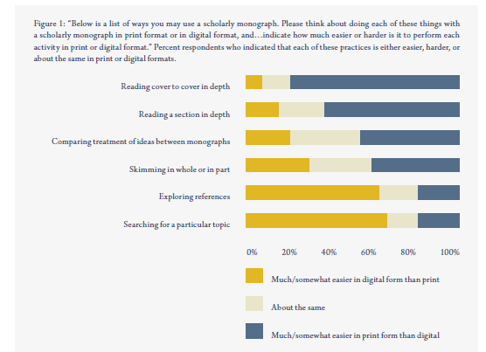
Roger C. Schonfeld. Stop the presses: is the monograph headed toward an e-only future? Ithaka S+R, 2013, p. 6
http://www.sr.ithaka.org/blog-individual/stop-presses-monograph-headed-toward-e-only-future
Notes:
I would refer you to this chart in the manuscript which shows where people now prefer to use the print and when they prefer the electronic – p. 6

Slide 26


Personal Options
Plane trip to Australia
10 days in Australia
Read, discard, requires no charging
To heavy to carry enough print books for 10 days
Perfect for carrying enough books for 10 days
Requires electricity; flying coach
Notes:
And then I think about my own preferences which are neither completely all electronic or all print
I recently took a trip to Australia and made different choices:
For the plane trip over, I wanted a paperback book that I owned that I could throw away after I read it
Because I was flying coach, I would have reduced ability to recharge my devices
But for the 10 days in Australia, I wanted several books on my ipad so that I could limit the amount of things I had to carry
And I would note that I looked forward to my flight home for which I was flying business class with the knowledge that I would have a way to charge my device for the entire trip home
Except that the charger at my seat was broken …. Thank goodness for a completely charged Mophie device that closed the gap

Slide 27
Notes:
And of course there is always going to be the question or what is the proper format for reading in the bathtub!

Slide 28



What are regionally significant established collaborative/
cooperative groups doing now?
Possible
Next
Steps
Notes:
So, let me wrap up with a few thoughts on possible next steps
Some good progress is being made already by regional, collaborative groups

Slide 29
HathiTrust Print Monographs Archive Planning Task Force
Ballot Initiative passed in 2011
Current Status
To develop a Distributed Print Monographs Archive corresponding to volumes represented within HathiTrust
HathiTrust Governing Board has just approved the appointment of a task force to begin the process of implementation of this initiative
Notes:
As Matthew talked about yesterday, just this past week, the HathiTrust Board of Governors approved the charge for a task force on print monographs archiving which stems from a ballot initiative from the constitutional convention in October 2011
This distributed archive would correspond to the volumes represented digitally in HT

Slide 30
Terms of Ballot Initiative
H
A
T
H
I
T
R
U
S
T
A print archive founded on formal agreements with the print repositories of member institutions or their affiliated agents
Agreements would establish retention commitments to ensure continuing availability of the archived holdings to HathiTrust members
Notes:
Here’s what the ballot initiative actually called for back in 2011 – a print archive founded on formal agreements with the print repositories of member institutions and agreements which would establish retention commitments

Slide 31
Terms of Ballot Initiative
H
A
T
H
I
T
R
U
S
T
Provide financial support to the designated repositories sufficient to secure and maintain these agreements
Initiate and carry out a formal planning process by which necessary policies, operational plans, and business models required would be established to sustain a distributed archive
Notes:
The ballot initiative also spoke to the need to provide financial support and that HT would initiate and carry out a formal planning process focused on policies, operational plans and business models

Slide 32
Task Force Charge
Reporting to the HathiTrust Program Steering Committee, the Print Monographs Archive Planning Task Force is charged to develop plans for a distributed Print Monographs Archive on behalf of HathiTrust, including the requisite policies, operational plans, and business model.
Notes:
This is the charge to the task force and a call for volunteers from member institutions will be forthcoming

Slide 33
Issues to be Addressed
Exploration of the model needed to identify and preserve print resources
Qualifications of participating repositories
Analysis and identification of appropriate content for inclusion
Additional criteria for participation such as geographic distribution, repository type, breath of contribution, institutional commitment
Retention periods
Discovery, access policies and service models
Business and financial model
Roles and relationships among HathiTrust and other libraries and organizations engaged in collaborative management of print collections
Notes:
And finally here are the key issues that the task force will address

Slide 34

CIC Status
Shared print repository for journals at Indiana
OCLC/OSU study of the CHI-PITT mega-region and its relationship to the OSU collection and the CIC collective collection
Next steps?
Notes:
Within the CIC, we have our shared print repository for print journals
We have the recent OCLC/OSU/CIC study which provides us with valuable data
And now we need to decide about next steps
I’m sure we’re going to be closely involved with the HT initiative in this area

Slide 35
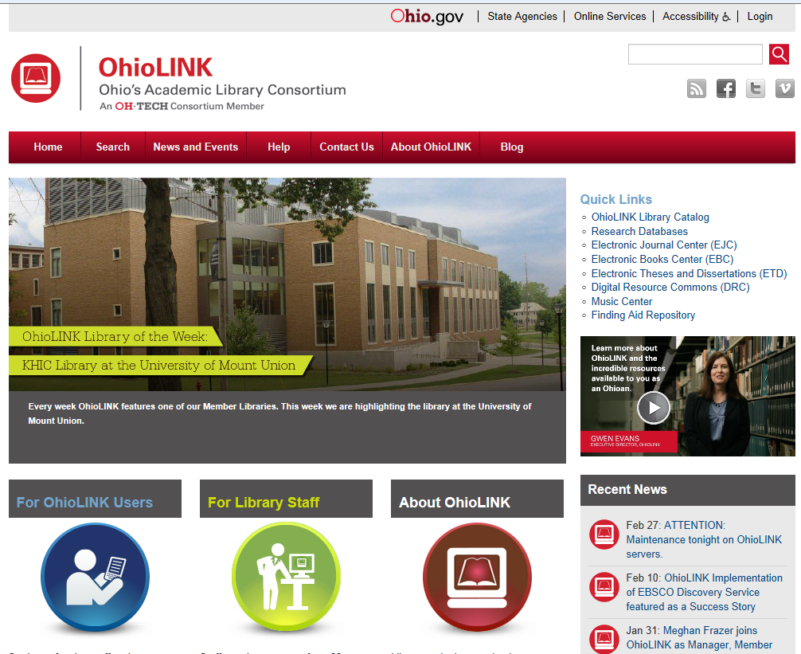
5 shared repositories build in the 1990s as part of original concept of OhioLINK
Current focus on securing journal content
Hiring a new employee to provide staff support for shared print and depository activities
Conversations underway about possible pilot for shared print monographs
Notes:
As Scott noted, OhioLINK has 5 shared repositories located around the state
Recent projects have focused on securing journal content
A new employee is being added to the OhioLINK staff to support these activities
And discussions are underway about a possible pilot for print monographs
So this is a great example of one of the issues discussed earlier about overlap between consortial groups and their members. OSU usually placed its first priority on its relationship with OhioLINK and then its other partnerships. But when it came to shared print for journals which are held in the OhioLINK EJC – a largely locally loaded set of content held on computers here in Ohio – we opted to work with CIC to secure our journal content in the very conveniently located Indiana storage module
However, when we begin to think about shared print for monographs and the clear priority that our OSU faculty place on ease of access. Our thoughts are turning quickly to how we might serve – as the flagship – as a shared print repository for Ohio.

Slide 36
Discussions between collaborative groups
  Is the CIC Shared Print Repository considering participation beyond the CIC?
  Could OhioLINK (very close geographically) buy-in to the CIC SPR for print journal retention?
  How might the shared depositories in OhioLINK relate to other efforts such as the Michigan, Maine, Connect NY, PALCI, WRLC, ASERL, CDL
  Role of new HathiTrust Shared Print Monographs Archive Task Force
Possible
Next
Steps
Notes:
With the variety of projects underway, another possible next step is the discussion that need to happen between collaborative groups. As my OhioLINK colleagues already know, I often talk about whether we should be talking to the CIC about “buying in” to their journal repository there since it is so conveniently located to us
So clearly this is a next advance that we need to make

Slide 37


Rick Lugg
SCS
  Archive copies
  In addition to secure, full-text digital surrogates in HathiTrust, some number of print copies must be retained and maintained, as a failsafe for technological disaster, to correct errors in digitization, and as original artifacts
Three categories of low use monographs
http://sustainablecollections.com/weed-feed/2013/5/8/collection-security-surplus-copies.html
Notes:
I’ve also been intrigued by some of the work that SCS and Rick Lugg have been doing. We talked often very generically about shared print for monographs but not as often about what we mean by securing that content. Are these dark archives, are they light archives, can they be loaned to users?
One useful construct that Rick has advanced in his blog is the concept of three categories of low use monographs. The first is Archive copies:
Archive Copies: in addition to secure, full-text digital surrogates in HathiTrust, some number of print copies must be retained and maintained, as a failsafe for technological disaster, to correct errors in digitization, and as original artifacts.

Slide 38
Rick Lugg
SCS
  Service copies
  Additional copies are needed to lend or scan on behalf of users. The number of copies required here may vary, depending on historical use, availability as eBooks or on the used book market, and other factors.
Three categories of low use monographs
http://sustainablecollections.com/weed-feed/2013/5/8/collection-security-surplus-copies.html
Notes:
Service Copies: Once archiving requirements have been satisfied, additional copies are needed to lend or scan on behalf of users. The number of copies required here may vary, depending on historical use, availability as eBooks or on the used book market, and other factors.

Slide 39
Rick Lugg
SCS
  Surplus copies
This is the area where withdrawal, storage, and sharing begin to make sense, … At least some of these volumes can be safely removed, provided that attention is paid to holdings in the state/province, region, or country, and to the presence of a secure digital version in HathiTrust or another certified repository.
Three categories of low use monographs
http://sustainablecollections.com/weed-feed/2013/5/8/collection-security-surplus-copies.html
Notes:
Surplus Copies: This is the area where withdrawal, storage, and sharing begin to make sense, especially for titles that have not circulated in 20 or more years. Most libraries have a surprising amount of material in this category. At least some of these volumes can be safely removed, provided that attention is paid to holdings in the state/province, region, or country, and to the presence of a secure digital version in HathiTrust or another certified repository.

Slide 40

Western Regional Storage Trust
Selection criteria based on risk management principles
http://www.cdlib.org/services/west/docs/WEST_Orientation.pdf
Notes:
So now I come back to some of the work that WEST has done with their selection criteria around the concept of risk management and risk profiles. What that means is that titles with moderate or high duplication in their region are good candidates for shared storage.

Slide 41
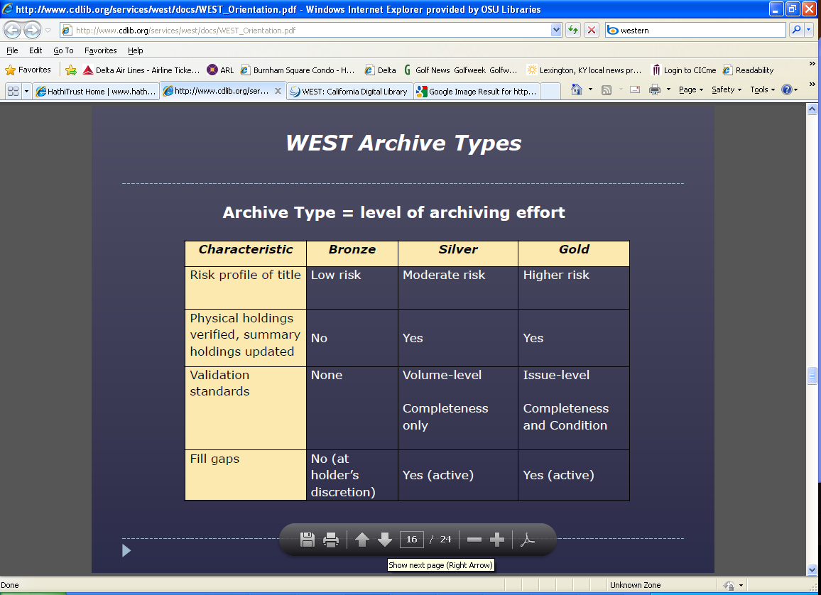
Notes:
I’m intrigued by how these theoretical construct – with modifications could be applied in the monograph area
Based on the risk of the particular title, the journal title is assigned a level of bronze, silver or gold. The higher the risk, the more attention is given to the tasks performed as the material is moved into the shared storage archive. For example, titles that are not widely held will be carefully checked page by page to ensure their completeness before any other volumes are discarded.
I think it would be very interesting work to marry the concepts from Rick Lugg about service and archive copies with risk profiles.

Slide 42
Secure more distinctive collections
  How will we define distinctiveness at regional level?
  Within a regional only or in relationship to other regional repositories?
  Identify qualifying collections
  Develop strategies to secure and publicize secured collections for use
  Develop policies and service parameters
Possible
Next
Steps
Notes:
We must also begin to secure actual collections – most likely the lowest hanging fruit is me is our distinctive collections
As we discussed yesterday, you can count on me to keep all that content about cartoonists – but you’re right that I’m only going to let you come and use it on site in a controlled environment, or possible scan small portions for you
And I’m intrigued to know who has that remaining 33%

Slide 43
Availability of data to make needed assessments
  Value of OCLC Research/CIC/OSU study to understand duplication and relative scarcity across and between research collections
  Resources such as Sustainable Collections Services
  Need for tools to bring together the information on duplication and likelihood of use
  Use data is largely available only locally
Possible
Next
Steps
Notes:
And finally, the reality that we continue to need robust data to make these needed assessments.
The work that OCLC has done, the work that SCS is doing for individual libraries
The need for tools to bring that information on duplication and likelihood of use together
And the fact that use data is largely available only locally

Slide 44

Acknowledgements
Karla Strieb
Associate Director for
Collections, Technical Services &
Scholarly Communications
Strieb.2@osu.edu
614-292-6840
Notes:
And I’d like to close with a thank you to my colleague, Karla Strieb, who provided many valuable insights and discussions about this topic with me

Slide 45
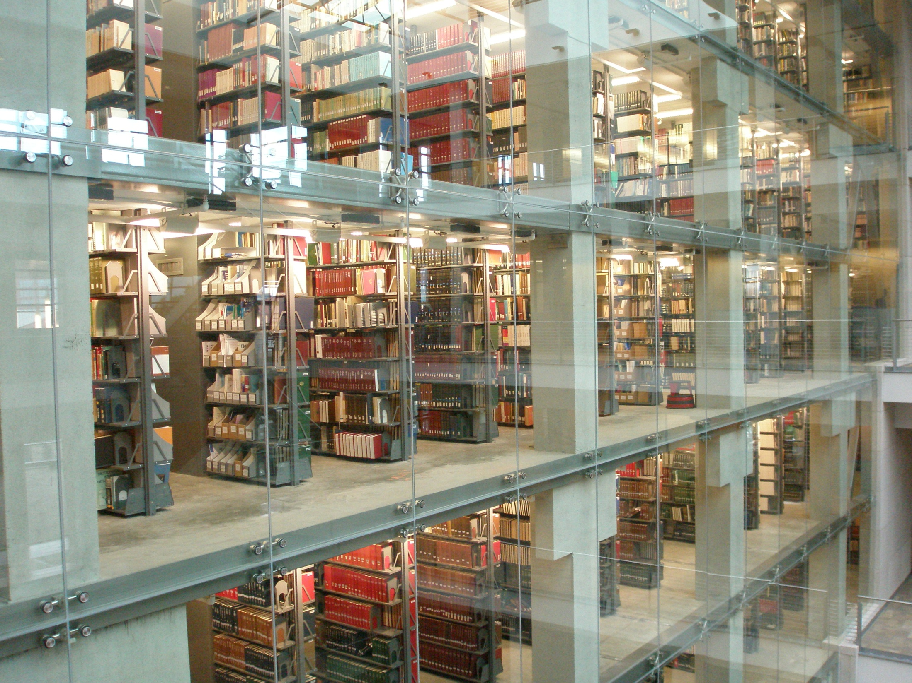



Questions?
library.osu.edu
© 2014 Carol Pitts Diedrichs. This work is licensed under a Creative Commons Attribution 3.0 Unported License. Suggested attribution: “This work uses content from “What Comes Next?” © Carol Pitts Diedrichs, used under a Creative Commons Attribution license: http://creativecommons.org/licenses/by/3.0/”

