Slide 1
The Importance of an Engagement-Centered Approach to Library Services
Lynn Silipigni Connaway, Ph.D.
Senior Research Scientist
OCLC
Chair of Excellence
Departmento de Biblioteconomía y Documentación UniversidadCarlos III de Madrid
@LynnConnaway
connawal@oclc.org
12 June 2014
Libraries and Research: Supporting Change/Changing Support
#orlp
Notes:
Lynn Silipigni Connaway will discuss the results of several studies that identify user-centered approaches for the development of library services and systems that encourage community engagement.

Slide 2

“… Is the library gonna die? How do we stay relevant, and actually, being engaged?…and more engaged… And not just…the preservation and dissemination of the documents, but actually the data is a way for the library to stay relevant and engaged in scholarship…”
(Libraries and Data Management, Focus Group 1 Participant)
Notes:
Image: http://whokilledjamesnorris.com/blog/wp-content/uploads/2012/01/puzzle.jpg
Faniel, I.M., Connaway, L.S. & Parson, K. (2014). Building Relationships for the Effective Development and Delivery of Research Data Services. RUSA ALA Annual Conference 2014.

Slide 3
Americans who have visited a library website (past 12 months)
30%
13%
Those who used a handheld device to access library website
(Zickuhr, Rainie, & Purcell, 2013)
(Raine, 2014)
This work is licensed under a Creative Commons Attribution 3.0 Unported License. http://creativecommons.org/licenses/by/3.0/
Notes:
In the past 12 months, 30% of Americans (16 and older) visited a library website (Rainie, 2014) 13% used a handheld device to access a library website (Zickuhr, Rainie & Purcell, 2013).
Rainie, L. (2014). Libraries in communities. Washington, DC: Pew Research Center’s Internet & American Life Project.
Zickuhr, K., Rainie, L., & Purcell, K. (2013). Library services in the digital age. Washington, DC: Pew Research Center’s Internet & American Life Project.

Slide 4
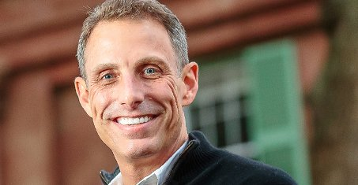
“95% of the population values libraries while only 52% are using them.”
( Roskill, 2014)
Notes:
Image from: http://tedxcharleston.org/speakers-2014/
95% of the population values libraries, only 52% are using them. -Andrew Roskill, CEO of BiblioLabs
A serial entrepreneur and a digital community advocate, who is founder and CEO of BiblioLabs, a software and media company focused on helping libraries provide cool and engaging digital products.
Roskill, A. (2014 May). Get a Read on This: Libraries Bridging the Digital Divide: Andrew Roskill at TEDxCharleston. YouTube. Retrieved May 22, 2014, from http://www.youtube.com/watch?v=J198u5HK0pY

Slide 5






Why?
Notes:
Image
Facebook: https://encrypted-tbn2.gstatic.com/images?q=tbn:ANd9GcSW_YQ0SQXbuERWgHjsRXl9OSEcJKKTNF1tPOLMm831NuhqLpDzdi2ys4eV
Wikipedia: http://www.better-ears.com/de/images/iphone/retina/wikipedia-icon.jpg
Google: http://www.conceptcupboard.com/blog/wp-content/uploads/2013/09/google.jpg
Amazon: http://launchdfw.com/wp-content/uploads/2014/05/amazon-1.png
Apple: https://encrypted-tbn0.gstatic.com/images?q=tbn:ANd9GcTvMHlAbrfxFfaPaA-pvPxMeQ8a2s_rTVafQq-cVh7pFyS8f_Y13m9W2hZo
Twitter: https://pbs.twimg.com/profile_images/2284174758/v65oai7fxn47qv9nectx.png

Slide 6
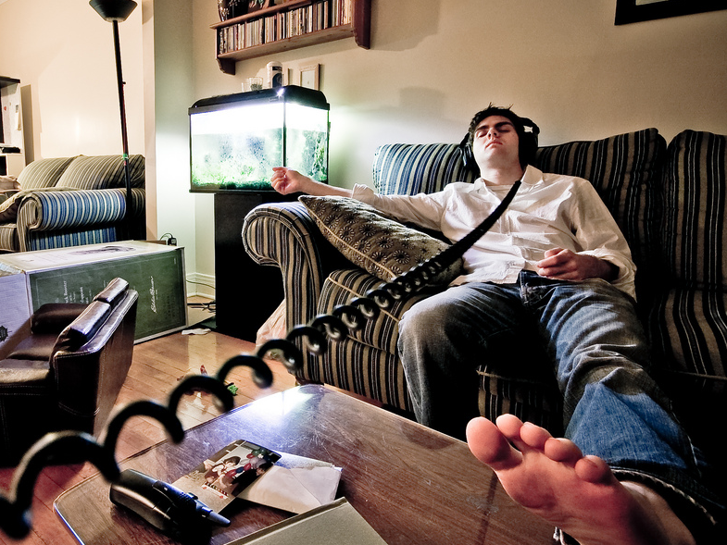
“I don't know how to access computer library service. When I need to look something [sic] up I use google.”
(Seeking Synchronicity, NOS-61939, Male, Age 46-55)
Notes:
Image: http://www.flickr.com/photos/alexnormand/2241169614/
“I don"t know how to access computer library service. When I need to look somthing up I use google.” (Seeking Synchronicity, NOS-61939, Male, Age 46-55)
Radford, M. L., & Connaway, L. S. (2005-2007). Seeking Synchronicity: Evaluating virtual reference services from user, non-user, and librarian perspectives. Funded by the Institute for Museums and Library Services (IMLS). Retrieved from http://www.oclc.org/research/activities/synchronicity/default.htm

Slide 7
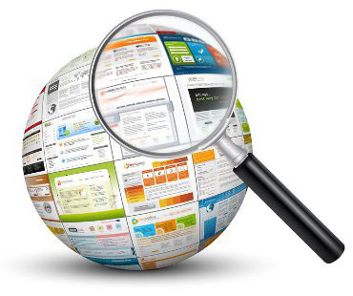
Tools Used: Students
Undergraduate Students
  Google, Wikipedia
  Also use library website & e-journals
  Human resources
    Other students/classmates
    Family & relatives
    Friends
Graduate students
  Professors, advisors, mentors
  Electronic databases
(Connaway & Dickey, 2010)
(De Rosa, 2010)
Notes:
Image:http://emarketingcreative.com/wp-content/uploads/2013/04/search-engine-optimization.jpg
“One of my favourite ways of getting information is by asking people. Instead of Googling the whole time I mostly have faith in the fact that people are actually learning, if I can go to a tutor and ask them something.” (Digital Visitors and Residents, UKU3, 0:19:34, Female, Age 19, French and Italian)
“Like usually with homework I usually can do it myself. But like, like sometimes I will just like IM my friend on Facebook and will be like, “Hey do you know how to do this?” That is usually how I will do it or I will text somebody but for the most part if I can’t figure it out then I just kind of star that question because there is usually just one or two questions. Or I will just go to my parents or my Grandma or something.” (Digital Visitors and Residents, USS6, 0:17:08, Female, Age 17, High School Student)
“And then if I’m requiring more information I’ll go over to the library website and use the JSTOR. And what I find easier for me to look for the JSTOR link is actually going through what I used as an undergraduate and going into the anthropology field, because I know that they have the JSTOR and Project MUSE and all of these search engines that I already see if I click on that.” (Digital Visitors and Residents, USG5, 0:01:10, Female, Age 30, Latin American Studies).
Information studies students: (Bertot, et al., 2012, p. 213), 28% use OPAC daily or weekly, 86% use Google daily or weekly
Bertot, J. C., Berube, K., Devereaux, P., Dhakal, K., Powers, S., & Ray, J. (2012). Assessing the usability of WorldCat Local: Findings and considerations. The Library Quarterly, 82(2), 207-221.
Connaway, L.S., & Dickey, T.J. (2010). Digital information seekers: Report of findings from selected OCLC, RIN, and JISC user behavior projects. http://www.jisc.ac.uk/media/documents/publications/reports/2010/digitalinformationseekerreport.pdf (p. 39).
De Rosa, C. (2010). Perceptions of libraries: A report to the OCLC membership. Dublin, OH: OCLC Online Computer Library Center.
White, D., & Connaway, L. S. (2011-2014). Visitors and residents: What motivates engagement with the digital information environment. Funded by JISC, OCLC, and Oxford University. Retrieved from http://www.oclc.org/research/activities/vandr/

Slide 8

Tools Used: Researchers
  Online resources
    99.5% use journals as primary resource
    Google, Web of Science, PubMed, Science Direct, JSTOR
  Human resources
    90% mention expertise of individuals as important resource
      Coworkers
      Colleagues
      Other professionals
(Research Information Network, 2006)
(Connaway & Dickey, 2010)
Notes:
Image: Microsoft ClipArt
Google, Web of Science, PubMed, Science Direct, JSTOR (p.27)
Increasingly important to research process at all levels (p.4)
Articles are central type of resource for researchers (p.34-35)
99.5% say journals are primary resource (p. 34-35)
71% rank journals in their top three resources (p. 34-35)
90% mention expertise of individuals as important resource (pp.7, 34-35)
Connaway, L. S., & Dickey, T. J. (2010). Digital information seekers: Report of findings from selected OCLC, RIN, and JISC user behavior projects. http://www.jisc.ac.uk/media/documents/publications/reports/2010/digitalinformationseekerreport.pdf (p.4).
Research Information Network. (2006). Researchers and discovery services: Behaviour, perceptions and needs. London: Research Information Network (p. 27, p. 34-35).

Slide 9
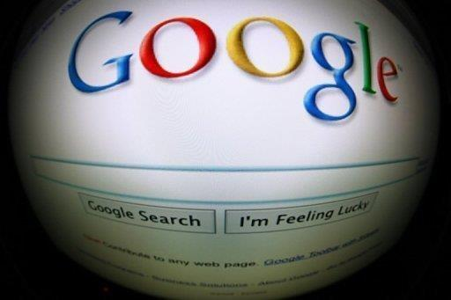
“I find Google a lot easier [than library catalog]…so many journals come up and when you look at the first ten and they just don’t make any sense. I, kind of, give up.”
(Digital Visitors and Residents, USU7, Emerging, Female, Age 19, Political Science)
Notes:
Image: http://cdn.phys.org/newman/gfx/news/hires/googleappsin.jpg
White, D., & Connaway, L. S. (2011). Visitors and residents: What motivates engagement with the digital information environment. Funded by JISC, OCLC, and Oxford University. Retrieved from http://www.oclc.org/research/activities/vandr/

Slide 10
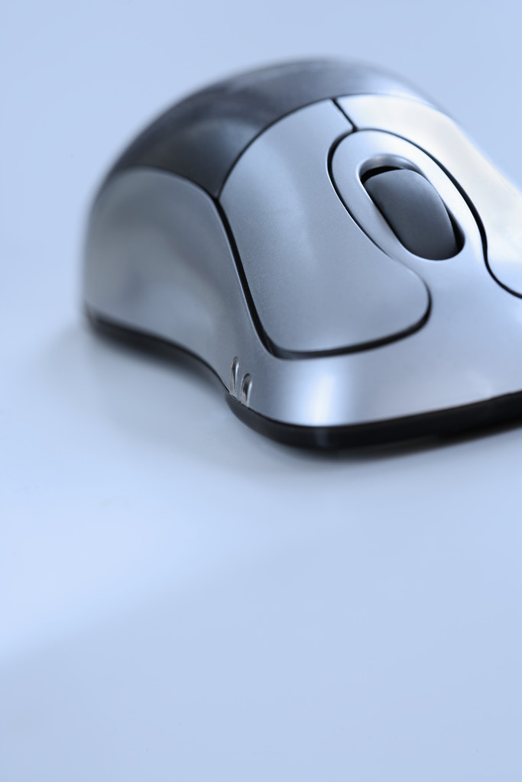
Journals & Databases
  Journals
    Access more important than discovery
    Want full text, online versions
    Expect seamless Discovery-to-Delivery
    Back files difficult to access
    Content often discovered through Google
    Visit only a few minutes
  Databases
    Electronic databases not perceived as library sources
    Frustration locating & accessing full-text copies
(Research Information Network, 2006)
Notes:
Image: Microsoft Clip Art
Logins, password, and authentication interferes with access to sources
“…the first thing I did was, before I came to the library to use the MLA database, I did a Google search and it turns out that there is a professor at Berkeley who keeps a really, really nice and fully updated [unclear – words] page with bibliographic references, all kinds of links, you know, it's just awfully good, and I mean it just gets you really off and running on a lot his information and more novels. And I used it quite a bit, and then I did finally come up with and supplement that with an MLA search, which yielded some articles that were not on that page.” (Focus Group Interview 01, Faculty, Sense-making the Information Confluence)
Connaway, L. S., & Dickey, T. J. (2010). Digital information seekers: Report of findings from selected OCLC, RIN, and JISC user behavior projects. http://www.jisc.ac.uk/media/documents/publications/reports/2010/digitalinformationseekerreport.pdf (p.4).
Dervin, B., Connaway, L. S., & Prabha, C. (2003-2006). Sense-making the information confluence: The whys and hows of college and university user satisficing of information needs. Funded by the Institute of Museum and Library Services (IMLS). Retrieved from http://imlsosuoclcproject.jcomm.ohio-state.edu/
Research Information Network. (2006). Researchers and discovery services: Behaviour, perceptions and needs. London: Research Information Network
Backfiles difficult to access
Wong, W., Stelmaszewska, H., Bhimani, N., Barn, S., & Barn, B. (2009). User behaviour in resource discovery: Final report. Retrieved from http://www.jisc.ac.uk/whatwedo/programmes/inf11/userbehaviourbusandecon.aspx
“And have all the breakdowns, because the database, although you would assume that it would be easier for me to go through the database mode it’s actually even worse because you’ve got to filter through all these other like alphabetical… Well I mean they’re in alphabetical order so… And so for me that’s not… I just go ahead and I stick to what I know. I like the layout of that and I just go bing, bing, and then I go and look into articles.” (Digital Visitors and Residents, USG5, 0:02:58, Female, Age 30, Latin American Studies).
White, D., & Connaway, L. S. (2011-2014). Visitors and residents: What motivates engagement with the digital information environment. Funded by JISC, OCLC, and Oxford University. Retrieved from http://www.oclc.org/research/activities/vandr/

Slide 11
Digital Visitors & Residents:
Digital Sources
Notes:
Interestingly, we can see that university database and website usage increases through the first three educational stages.
Digital Sources and Educational Sources: Interviews
Databases: Emerging 19%, Establishing 50%, Embedding 80%, Experiencing 80%
University Databases: Emerging 33%, Establishing 30%, Embedding 70%, Experiencing 40%
University Websites: Emerging 28%, Establishing 40%, Embedding 50%, Experiencing 30%
White, D., & Connaway, L. S. (2011-2014). Visitors and residents: What motivates engagement with the digital information environment. Funded by JISC, OCLC, and Oxford University. Retrieved from http://www.oclc.org/research/activities/vandr/

Slide 12
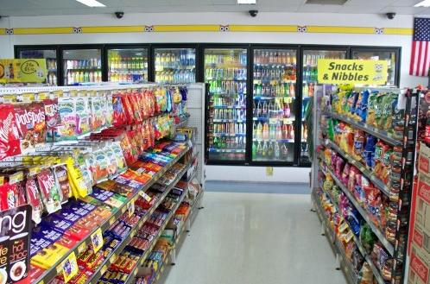
Convenience
Convenience trumps all other reasons for selecting and using a source
(Connaway, Lanclos, & Hood, 2013)
Notes:
Image: http://www.eqmoorepark.com.au/uploadedImages/EntertainmentQuarter/Content/Stores/CityConvenienceStoreinsideshot.jpg
Convenience:
-Finding information online is not directly equated with the quality of that information.
-Time is related to convenience which is a recurring theme in information-seeking behavior research.
Connaway, L. S., Dickey, T. J., & Radford, M. L. (2011). “If it is too inconvenient I’m not going after it:” Convenience as a critical factor in information-seeking behaviors. Library & Information Science Research, 33(3), 179-190.
Connaway, L. S., White, D., Lanclos, D., & Le Cornu, A. (2013). Visitors and residents: What motivates engagement with the digital information environment? Information Research, 18(1). Retrieved from http://informationr.net/ir/18-1/infres181.html
Connaway, L. S, Lanclos, D., & Hood, E. M. (2013b). “I find Google a lot easier than going to the library website.” Imagine ways to innovate and inspire students to use the academic library. Proceedings of the Association of College & Research Libraries (ACRL) 2013 conference, April 10-13, 2013, Indianapolis, IN, 2013. Retrieved from http://www.ala.org/acrl/sites/ala.org.acrl/files/content/conferences/confsandpreconfs/2013/papers/Connaway_Google.pdf
-Convenience can be either physical or virtual, based on the context and situation at the time of need.
-“Convenience is a situational criterion in people’s choices and actions during all stages of the information-seeking process.”
-The concept of convenience can include their choice of an information source (including physical and electronic formats), their satisfaction with the source and its ease of use, and their time horizon in information seeking.
Case, D. O. (2012). Looking for information: A survey of research on information seeking, needs, and behavior. Bingley: Emerald.
“…convenience/ease of use were frequently mentioned by participants in all educational stages, authority/legitimacy is consistently discussed by last year high school/secondary school and first-year college/university student (Emerging stage) participants, decreasing for the third- and fourth-year college and university student (Establishing stage) participants, then increasing with the graduate/postgraduate and doctoral student (Embedding stage) and faculty, scholars, and life-long learner (Experiencing stage) participants” (Connaway, Lanclos, Hood 2013a, 12).
Connaway, L. S, Lanclos, D. M., & Hood, E. M. (2013a). “I always stick with the first thing that comes up on Google…” Where people go for information, what they use, and why. EDUCAUSE Review Online (December 6). Retrieved from http://www.educause.edu/ero/article/i-always-stick-first-thing-comes-google-where-people-go-information-what-they-use-and-why

Slide 13
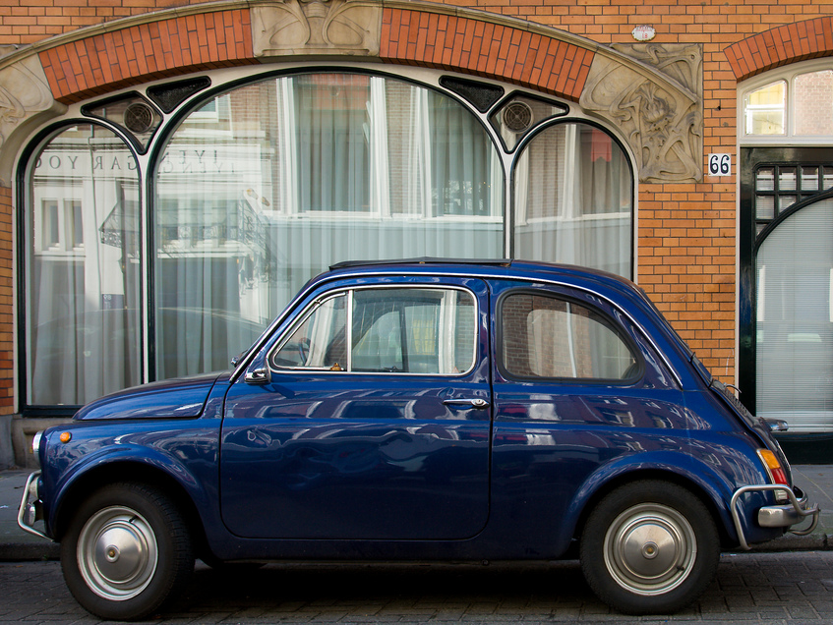
“Last semester I was writing a paper on Brazil and there was a book in the library that I just did not want to leave my house to go to. It is a 50 minute drive, I didn’t want to do that, but I was writing my paper and so I used Google books instead and really they only had a section of the book available but that was the section I used. So, you know, doing that instead of coming here physically and going to get the whole book. And it saved time, it saved gas, I got what I needed and it wasn’t a big deal.”
(Digital Visitors and Residents, USG4, Female, Age 23, Latin/American Studies)
Notes:
Image: http://www.flickr.com/photos/haagsuitburo/2315233844/
Lazy (No Motivation) OR Satisficing
Laziness levels appear to not be a true indicator of actual laziness, but perception. Not surprisingly Emerging participants indicated higher levels of laziness as they are unmotivated by their work at this stage. Considering how many required core classes are required along with high school classes, they have lower levels of interest in their classes at this point. Establishing and Embedding participants spoke of laziness as being that they don’t want to travel all the way back to campus to the library, especially late at night, and not going above and beyond in their work. These students are not necessarily lazy, though they speak of themselves that way, rather most of us would speak of these participants as busy and trying to manage their time.
Emerging: Participants do not want to take the time to do the actual task. Want to find shortcuts/quickest way to complete the task or how to avoid doing it at all. Often do not want to leave their computer. Recognize laziness in themselves/find themselves to not be motivated. I don’t see a response difference between First Round and Second Round.
Establishing: Only two participants, one speaking of professors, not themselves. The other speaks of not going above and beyond, just doing the minimum.
Embedding participants: Do not live on campus and do not want to travel just to go to the library.
Experiencing: One participant, teacher discussing student’s laziness versus their own. They would not be as lazy, but understand that the students are overwhelmed.
“I mean may be sometimes when I have to do research like I guess with the assignment last night once I’d found that website I didn’t continue to see what else I could find. So it’s kind of I guess a lazy approach to it – not going above and beyond, once I get there I just kind of stop.” (Digital Visitors and Residents, USU9, Female, Age 21, Sociology/Gerontology) Establishing
“I live about two miles away from here on bike, which is not that far, but when you’re writing a paper and don’t feel like getting out of your pajamas… Frequently when I’m working from home, it does feel a bit onerous to come all the way, which is about two miles away on bike, to use the library when I’m immediately probably going to go home afterwards. I find working from home very comfortable. I’d like – it feels also very private, it’s easy for me to concentrate without other people within the library space. So all of those reasons influenced my decision to take the easier route rather than physically having to move to get information.” (Digital Visitors and Residents, UKG2, Female, Age 22, Learning and Technology) Embedding

Slide 14
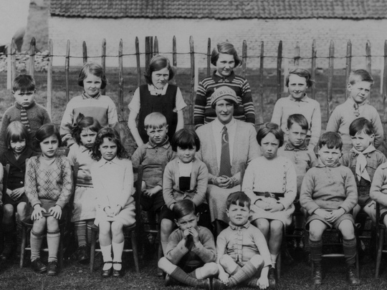
“And so like my parents will always go, ‘Well look it up in a book, go to the library.’ And I’ll go, ‘Well there’s the internet just there.’”
(Digital Visitors and Residents, UKU5, Female, Age 19, Chemistry)
Notes:
Image: http://www.flickr.com/photos/22326055@N06/6732616879/
White, D., & Connaway, L. S. (2011-2014). Visitors and Residents: What motivates engagement with the digital information environment. Funded by JISC, OCLC, and Oxford University. Retrieved from http://www.oclc.org/research/activities/vandr/

Slide 15
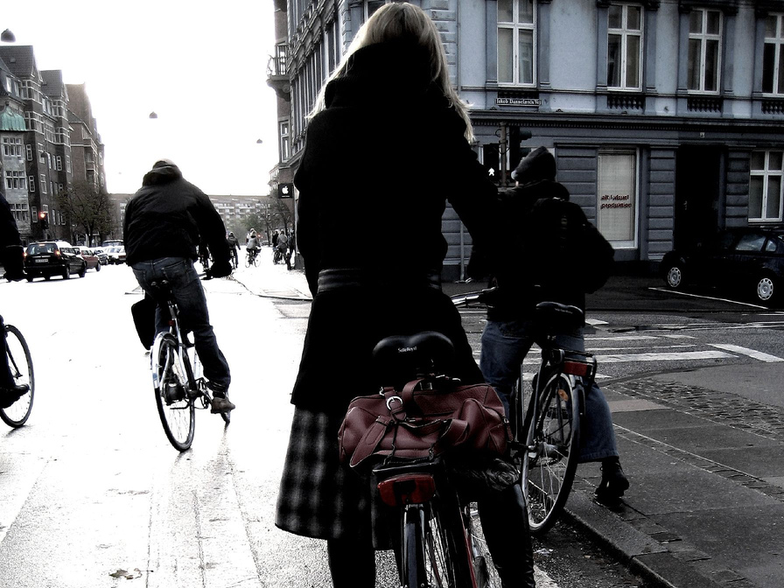
“This year I don’t think I have ever picked up a book out of the library to do any research, all I have used is my computer.”
(Digital Visitors and Residents, USU1, Female, Age 19, Undeclared)
Notes:
Image: http://www.flickr.com/photos/16nine/297307637/
“This year I don’t think I have ever picked up a book out of the library to do any research, all I have used is my computer.” (Digital Visitors and Residents, USU1, 0:15:16, Female, Age 19, Undeclared)
White, D., & Connaway, L. S. (2011-2014). Visitors and Residents: What motivates engagement with the digital information environment. Funded by JISC, OCLC, and Oxford University. Retrieved from http://www.oclc.org/research/activities/vandr/

Slide 16
Place and Educational Stages
Notes:
Place AND Educational Stages: Interviews
Facebook: Emerging 95%, Establishing 100%, Embedding 100%, Experiencing 90%
Twitter: Emerging 21%, Establishing 50%, Embedding 50%, Experiencing 70%
YouTube: Emerging 33%, Establishing 50%, Embedding 30%, Experiencing 40%
Wikipedia: Emerging 81%, Establishing 90%, Embedding 70%, Experiencing 50%
White, D., & Connaway, L. S. (2011-2014). Visitors and Residents: What motivates engagement with the digital information environment. Funded by JISC, OCLC, and Oxford University. Retrieved from http://www.oclc.org/research/activities/vandr/

Slide 17


The Learning Black Market
“It’s like a taboo I guess with all teachers, they just all say – you know, when they explain the paper they always say, ‘Don’t use Wikipedia.’”
(Digital Visitors and Residents, USU7, Female, Age 19, Political Science)
Notes:
Image: http://www.deviantart.com/morelikethis/211376699
Covert online study habits
Wikipedia
Don’t cite
Widely used
Guilt
Students & teachers disagree
Quality sources
There is a “Learning Black Market”: learners use non-traditional sources but feel they cannot talk about them in an institutional context. Wikipedia usage is an example of this. (White & Connaway, 2011)
Saunders also found that faculty are “concerned with students’ reliance on Google and Wikipedia for information.” This may help to explain why many of the Emerging stage participants expressed a reluctance to acknowledge or cite Wikipedia in their work for fear of being ridiculed by faculty, or be given a lower grade. This is referred to as the Learning Black Market, which is discussed in more detail in Connaway, Lanclos, and Hood and White’s 2011 blog entry.
Saunders, L. (2012). Faculty perspectives on information literacy as a student learning outcome. The Journal of Academic Librarianship ,38(4), 231.

Slide 18
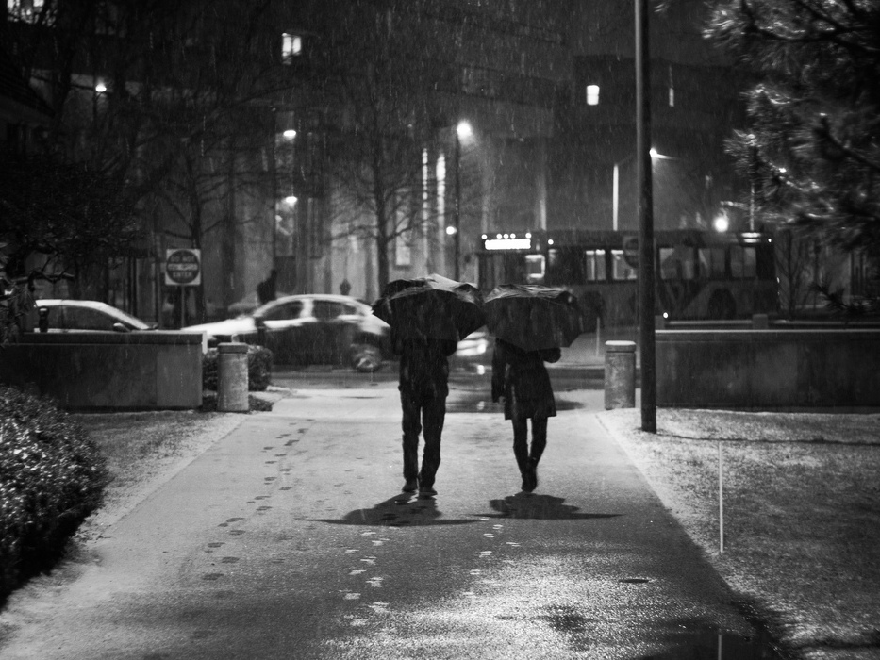
“I use Facebook for organizing my life basically, with friends and stuff. ...I also use that in education to talk to my friends about an equation, the things I don't understand and it works quite well.”
(Digital Visitors and Residents, 2UKS2, Male, Age 18, Computing/ Biology/ History)
Notes:
Image: http://www.flickr.com/photos/sackton/6799330916/
“I use Facebook for organizing my life basically, with friends and stuff. ...I also use that in education to talk to my friends about an equation, the things I don't understand and it works quite well.”
(Digital Visitors and Residents, 2UKS2, Emerging, Male, Age 18, Secondary School Student)
White, D., & Connaway, L. S. (2011-2014). Visitors and Residents: What motivates engagement with the digital information environment. Funded by JISC, OCLC, and Oxford University. Retrieved from http://www.oclc.org/research/activities/vandr/

Slide 19
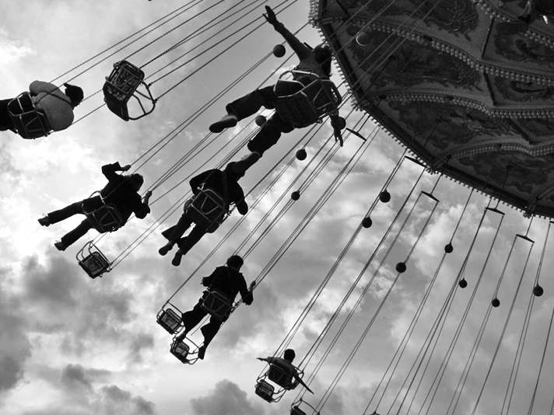
“I get on Twitter a whole bunch. It’s Twitter or Facebook are what I usually use the most to talk to my friends.”
(Digital Visitors and Residents, USS1, Female, Age 17, High School Student)
Notes:
Image: http://www.flickr.com/photos/auro/230377281/
“I get on Twitter a whole bunch. It’s Twitter or Facebook are what I usually use the most to talk to my friends.” (Digital Visitors and Residents, USS1, Emerging, Female, Age 17, High School Student)
Twitter
Emerging: Of the eight second round participants, two said they don’t use Twitter (one stating that Twitter is “stupid”), and the other six said they use Twitter. They had various reasons for using it, some to communicate with friends and family members, others to follow celebs. Only one First Round Emerging participant was coded for Twitter. They said they use it for communicating with friends.
Establishing: Of the five Establishing participants coded for Twitter, four said they don’t use it, and one said they do. Of the four who don’t use it, three indicated their negative opinions of it, one calling it a “bit bizarre.”
Embedding: Of the five participants coded, 4 said they use Twitter, one said they don’t because of the “negative connotation with Twitter.”
Experiencing: Of the seven Experiencing participants who were coded for Twitter, four said they don’t use Twitter, and three said they do.
“Well so Facebook is basically a combination of family, old high school friends and friends that I interact with now. But the primary ones that I interact with on Facebook and Twitter are pretty much the same thing, however if we’re getting specific, I use Twitter to interact with mainly friends that I have at my church.” (Digital Visitors and Residents, USG2, Male, Age 25, Biology) Embedding
“I’m on Twitter but like I don’t really post anything. I just like scroll through news and see people complaining about life.” (Digital Visitors and Residents, 2USU1, Male, Age 18, Electrical Engineering and Math) Emerging
“No, no. I think Twitter’s a bit bizarre because it seems to be people just declaring what they think rather than socializing really with other people. I mean you can choose to comment upon what other people are saying but in general it’s sort of like a declaration of your status and I don’t really see why it’s- well I see why it’s so popular but it’s not for me I don’t think.” (Digital Visitors and Residents, UKU12, Female, Age 21, Physics) Establishing
“It’s something I find… yes, I’m not… although I’m very open with everyone, I don’t see the point of telling people that I’m going to the loo or I’m going somewhere, I don’t know, I just find very weird. So I don’t know, I find weird.” (Digital Visitors and Residents, UKF5, Female, Age 41, Urban Design) Experiencing
White, D., & Connaway, L. S. (2011-2014). Visitors and Residents: What motivates engagement with the digital information environment. Funded by JISC, OCLC, and Oxford University. Retrieved from http://www.oclc.org/research/activities/vandr/

Slide 20
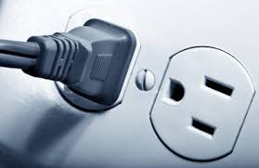
“…Having that engagement to talk about what the library can do with data management makes all of the constituents on campus think again about what else the library might be able to do for them.”
“And so they're a lot more likely to come and say, "What do you know about this?" or just try to see if we can provide a service that we might not know if we can or can't, but it keeps us more engaged.”
(Libraries and Data Management, Focus Group 2 Participant)
Notes:
Image: https://encrypted-tbn2.gstatic.com/images?q=tbn:ANd9GcTCBCzlqCj2CwT9pBrw8qGNenD51SmztLNLJwUwEJKHp0amPQqjUg
This quote was coded in L&DM at “Builds Relationship.”
Faniel, I.M., Connaway, L.S. & Parson, K. (2014). Building Relationships for the Effective Development and Delivery of Research Data Services. RUSA ALA Annual Conference 2014.

Slide 21
VRS Potential User Online Survey
Notes:
21
FtF is Preferred by VRS Potential Users Net Gens (N=122)
“I most enjoy using”
49% enjoyed using FtF interaction more than email, telephone, or text messaging
FtF 49.18% N=60
Phone 11.48% N=14
Email 27.05% N=33
Text Messaging 12.30% N=15
“I believe the face-to-face format helped my experience to be successful. This is because the interaction was far more personal, I was able to clearly state my question and get immediate feedback or answers. She was able to clarify what it was that I was looking for and was there waiting for me to come back if I had any trouble finding what I needed once she had given me the locations of what I was looking for.” (Seeking Synchronicity, NOS-56406, Female, Age 19-28)
“I have no problem using the chat reference services, but when I'm using the library I like to be there in person. I usually don't have a problem browsing the site online but I'm sure if I did email would work well. As previously stated, face to face interaction allows me to better communicate my ideas with a librarian and they usually tend to help me very well.” (Seeking Synchronicity, NOS-92990, Male, Age 19-28)
“I have nothing truly against chat reference services, so I may use it in the future, but I will probably always rely on the face-to-face services as my main form of information seeking.” (Seeking Synchronicity, NOS-69073, Female, Age 19-28)
Radford, M. L., & Connaway, L. S. (2005-2007). Seeking Synchronicity: Evaluating virtual reference services from user, non-user, and librarian perspectives. Funded by the Institute for Museums and Library Services (IMLS). Retrieved from http://www.oclc.org/research/activities/synchronicity/default.htm

Slide 22
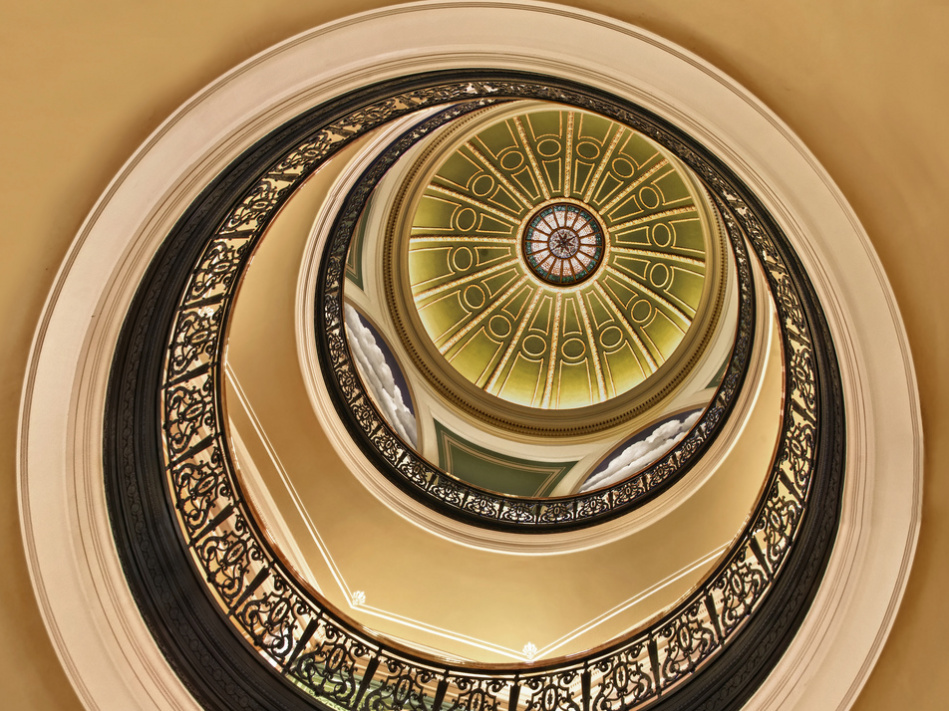
“The response time, the response rate, the politeness of the librarians, their information, you know, their knowledge. That's what I value.”
(Cyber Synergy, VS43, Male, Age 19-25, Student)
Notes:
Image: http://www.flickr.com/photos/w4nd3rl0st/6613621143
“The response time, the response rate, the politeness of the librarians, their information, you know, their knowledge. That's what I value.” (Cyber Synergy, VS43, 6:14, Male, Age 19-25, Student) (In response to “What do you value in VRS?”)
“I think the immediacy as well as the convenience.” (Cyber Synergy, VS22, 6:14, Female, Age 19-25, Student) (In response to “What do you value in VRS?”)
“I value that they're there to help people in their search and who need information. I value that the librarian is there to help in my search.” (Cyber Synergy, VS50, 9:13, Gender Unknown, Age Unknown, Author) (In response to “What do you value in VRS?”)
Radford, M. L., Connaway, L. S., & Shah, C. (2011-2013). Cyber Synergy: Seeking Sustainability through Collaboration between Virtual Reference and Social Q&A Sites. Funded by the Institute of Museum and Library Services (IMLS), Rutgers University, and OCLC. Retrieved from http://www.oclc.org/research/activities/synergy/default.htm

Slide 23

Human Sources Mean Frequency
3.53 Teachers, Professors
3.07 Friends, Colleagues
1.36 Mother
1.23 Peers
1.22 Extended Family
1.10 Father
1.08 Other Human Source
0.59 Experts, Professionals
0.22 Librarians
N=73, All Interview Participants
Notes:
Image: http://www.flickr.com/photos/cybrarian77/6284181389/
Mean calculations of Human Sources from Interviews only, all educational levels combined. The mean (or average) was calculated by the sum of the total participant mentions divided by the number (or count) of participants.

Slide 24
Human Sources and Educational Stages
Notes:
Human Sources and Educational Stages: Interviews
Librarians: Emerging 12%, Establishing 0%, Embedding 10%, Experiencing 20%
Peers: Emerging 51%, Establishing 60%, Embedding 40%, Experiencing 50%
Teachers, Professors: Emerging 86%, Establishing 90%, Embedding 60%, Experiencing 20%
Experts, Professionals: Emerging 30%, Establishing 20%, Embedding 30%, Experiencing 20%
White, D., & Connaway, L. S. (2011-2014). Visitors and residents: What motivates engagement with the digital information environment. Funded by JISC, OCLC, and Oxford University. Retrieved from http://www.oclc.org/research/activities/vandr/

Slide 25
Human Sources and Educational Stages
Notes:
Human Sources and Educational Stages: Interviews
Mother: Emerging 58%, Establishing 50%, Embedding 40%, Experiencing 10%
Father: Emerging 49%, Establishing 50%, Embedding 40%, Experiencing 10%
Extended Family: Emerging 53%, Establishing 50%, Embedding 30%, Experiencing 20%
Friends, Colleagues: Emerging 77%, Establishing 70%, Embedding 40%, Experiencing 40%
White, D., & Connaway, L. S. (2011-2014). Visitors and residents: What motivates engagement with the digital information environment. Funded by JISC, OCLC, and Oxford University. Retrieved from http://www.oclc.org/research/activities/vandr/

Slide 26
Place (Type of Library) and Educational Stage
Notes:
(Place referring to what type of library is mentioned when they speak of libraries in any context (going to study, going to get sources, going to for classes, etc. ). These mentions were coded as their academic/university library, their local public library, or their high school library. If they do not specify what type of library it is, then it was coded as just library).
Place AND Educational Stage: Interviews
Academic: Emerging 60%, Establishing 60%, Embedding 90%, Experiencing 50%
Public: Emerging 12%, Establishing 10%, Embedding 0%, Experiencing 0%
School (K-12): Emerging 14%, Establishing 10%, Embedding 0%, Experiencing 0%
Library (General): Emerging 28%, Establishing 40%, Embedding 60%, Experiencing 40%
White, D., & Connaway, L. S. (2011-2014). Visitors and residents: What motivates engagement with the digital information environment. Funded by JISC, OCLC, and Oxford University. Retrieved from http://www.oclc.org/research/activities/vandr/

Slide 27

“Well now we have the opportunity to actually get involved in the research project where we're onboard at day one helping the researcher even, you know, manage their data.”
(Libraries and Data Management, L10)
Notes:
Image from http://www.vumc.com/27576/7086114/7086164/Homepagecarroussel-research1.jpg
Quote from L&DM source, L10_int_4Jan2013 (full quote below):
L10: Well, I think that this is a real direction for libraries in general. Really at the end of the day you catalog books, through OCLC, and most of it copy cataloging. What you're really focusing on and adding value to is that unique research and unique collections that you have here locally that you're trying to make available digitally outside the walls of the university. I see the whole library profession doing more than just, and I don't want to say that in a negative manner, it's in the past we sort of did collection development based on what researchers wanted. We purchased those materials and we put them in our building. Well now we have the opportunity to actually get involved in the research project where we're onboard at day one helping the researcher even, you know, manage their data. So I really see... I think the future's bright for libraries in that regard. I've read a lot of articles saying well libraries are passe, they're not...you know… Since everything is now digital--well everything isn't digital--their importance has lessened. But I see a bright future for the library profession it's just gonna be looking a lot different over time. It's changed in a huge way in the time that I've been graduated with my degree in librarianship and information management in '86, and today. (Reference 1, L10) (On Builds Relationships).
Faniel, I.M., Connaway, L.S. & Parson, K. (2014). Building Relationships for the Effective Development and Delivery of Research Data Services. RUSA ALA Annual Conference 2014.

Slide 28
What Facilitates Data Services Provision?
N=36
Notes:
L&DM Node: What Facilitates Data Services Provision? (N=36, 10 Interviews & 3 Focus Groups)
Resources 47
Communication, Coordination, Collaboration with others within & outside the library 44
Training or Experience 41
Leadership Support 18
Acknowledgement of the Diverse Data Services Models Available 8
Other 1
Note: This is raw data. It does not account for perhaps the same person mentioning, for example, resources as what facilitates data services provision multiple times.
Faniel, I.M., Connaway, L.S. & Parson, K. (2014). Building Relationships for the Effective Development and Delivery of Research Data Services. RUSA ALA Annual Conference 2014.

Slide 29
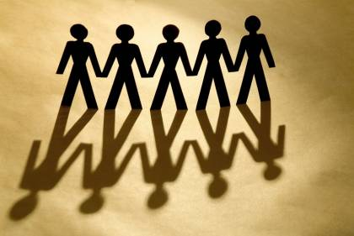
“I think we're all in agreement at [University Name] … that developing personal relationships with faculty members is a way to enhance the library's abilities to serve faculty members and graduate students … developing these personal relationships, they’re both critical.”
(Libraries and Data Management, L02)
Notes:
Image from http://nextstopsuccess.net/wp-content/uploads/2014/01/relationship1.jpg
“… Maybe I'm probably egotistical but I feel like, well, it benefits me, too, because then, my faculty, as a liaison librarian view me as relevant to their research process and come to me or send their students to me more frequently, more readily, I would say. Because they see us as a resource for research and support, in a way that maybe they hadn't connected before. I mean, when I first started--I'm also new. [chuckle] Not even two years in the profession.--But when I first started, the head faculty was like, "Oh, I mean I knew you bought books." [laughter/crosstalk] And so now, getting that message out, it's just proving value, I think, and that personally is very gratifying, so…” (Focus Group 1 Participant).
Faniel, I.M., Connaway, L.S. & Parson, K. (2014). Building Relationships for the Effective Development and Delivery of Research Data Services. RUSA ALA Annual Conference 2014.

Slide 30
N=36
Notes:
Libraries and Data Management
Challenges with Infrastructure 43
Challenges with Researchers 28
Librarian Challenges 38
Other Challenges 3
Note: This is raw data. It does not account for perhaps the same person mentioning, for example, resources as what facilitates data services provision multiple times.
Faniel, I.M., Connaway, L.S. & Parson, K. (2014). Building Relationships for the Effective Development and Delivery of Research Data Services. RUSA ALA Annual Conference 2014.

Slide 31

Know Your Community
Mobile
Easy, Elegant, & Engaging
Content
Curation
Physical Presence
(Roskill, 2014)
Notes:
Image: http://www.drba.net/Portals/0/Images/community_two.jpg
o Mobile
o Easy, Elegant, & Engaging
§ Like Amazon, Google, and Apple
o Content
o Curation
o Physical Presence
§ Special events to promote services
o Become Whole Foods – Know and cater to your community – offer what they want in inviting environment (both physical and online)
Roskill, A. (2014 May). Get a Read on This: Libraries Bridging the Digital Divide: Andrew Roskill at TEDxCharleston. YouTube. Retrieved May 22, 2014, from http://www.youtube.com/watch?v=J198u5HK0pY

Slide 32
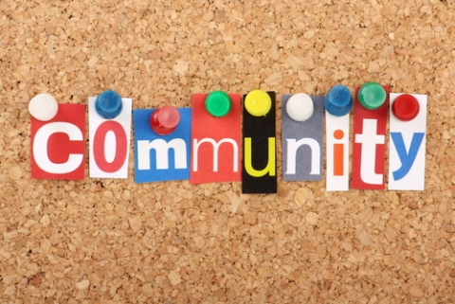
Community is Content
Social networks formed around social objects
  Music, photos, videos, links
  Reviewing
  Tagging
  Commenting
  Rating
Refines interaction with resources
(Dempsey, 2012)
Notes:
Image: http://www.bluewolf.com/sites/default/files/SalesforceCommunities.jpg
Dempsey, L. (2012). Thirteen ways of looking at libraries, discovery, and the catalog: Scale, workflow, attention. EDUCAUSE Review Online. Retrieved from http://www.educause.edu/ero/article/thirteen-ways-looking-libraries-discovery-and-catalog-scale-workflow-attention
The interaction of community and resources — in terms of discussion, recommendation, reviews, ratings and so on — is evident in some form in most of the major network services we use (Amazon, iTunes, Netflix, Flickr). Indeed, this is now so much a part of our experience that sites without this experience can seem bleached somehow, like black and white television in a color world.
What about the catalog in this context? Some catalogs have experimented with collecting tags and reviews but it does not seem that the catalog has the centrality, scale, or personal connection to crystallize social activity on its own. There is some activity at the aggregate level (e.g., Worldcat, BiblioCommons) and there is some syndication of social data from commercial social collecting/reading sites (e.g., LibraryThing). Similarly, catalogs have not generally mobilized usage data to rank, relate or recommend, and again this seems like something that might best be done at the aggregate level, and syndicated locally (as with the Bx service from Ex Libris, for example).
There are some places where catalog data gets used — reading lists and resource guides, for example — which seem to be especially appropriate for such attention. The choices involved in this additional layer of curation could be aggregated to provide useful intelligence. What items occur frequently on reading lists, for example? Would it be useful to provide an environment where students rate, review or comment on assigned readings? Is there enough commonality across institutions to make it useful to aggregate this data?
Our web experiences are now actively shaped by ranking, relating and recommending approaches based on social and usage data. For library services this is a major organizational challenge, as supra-institutional approaches may be required to generate appropriate scale (Dempsey, 2012).

Slide 33

What can we do?
Advertise resources, brand, & value
Provide search help at time of need
    Chat & IM
    Mobile technology
Model services on popular/familiar services
Design all of our systems with users in mind
  User-centered
  Engagement
Notes:
Image: http://www.digitalmarketing1.com/images/inkcolors.jpg
Zickuhr, K., Rainie, L., & Purcell, K. (2013). Library services in the digital age. Washington, DC: Pew Research Center’s Internet & American Life Project.
Advertise resources, brand, value: One aspect mentioned very often, both in focus groups and in qualitative work from previous research, is that people wish they were more aware of the full range of services offered by their libraries. One focus group member loved her local library and rated it highly in all areas—except communication; “there’s so much good stuff going on but no one tells anybody.” Another said, “they do so many fabulous things, [but] they have horrible marketing” (Zickuhr, Rainie, & Purcell, p. 38)
However, focus group members say that having resources and events listed on their library’s website wasn’t enough—as several participants pointed out, they probably weren’t going to go to the website to look for events (or even to sign up for email newsletters) unless they already knew that the library had those events (Zickuhr, Rainie, & Purcell, p. 38)
Help at time of need: When asked, “What do you value in VRS?”, one participant said “Instantaneous help. Sometimes if you're looking for something and you can't find it, it takes forever. Since you have someone there that can respond to you live, you have the comfort that someone is there” (Cyber Synergy, VS47, Male, Age 26-34, Sales Account Manager)
Another was able to receive searching help in a database, “I would say it was my freshman year and I was doing an English paper for my expository writing class and I was looking for something in JSTOR and I used the "Ask a Librarian" to do more advanced searches in JSTOR as to what keywords to put in, and it really helped me. One, her quickness and response, and two, the simplicity of her instructions as to the key title words to put in really helped me and made it successful” (Cyber Synergy, VS17, Female, Age 19-25, Social Work)
St. Louis University library provided pop-up help when OPAC displayed 0 retrievals. Within the first hour, 20 individuals used the pop-up, chat help.
Users in Mind: One size fits none – design services for those who use them – Boutique libraries (Priestner, A., & Tilley, E. (2012). Personalising library services in higher education: The boutique approach. Farnham, Surrey, England: Ashgate).
Embedded librarians
Familiar formats
Something clean, simple, streamlined and user friendly, but also credible sources (Cyber Synergy, VS 23, Female, Age 26-34, Stay-at-Home-Mom).
“In college, and especially grad school, I’m not afraid to go to the library anymore because we have a very good [assist 0:45:56] and we have a very good website.” (Digital Visitors and Residents, USG2, 0:45:28, Male, Age 25, Biology)

Slide 34

infoKit
What is it?
Contains advice on evaluating digital/online services within the broader context of traditional services.
Why did we create it?
To understand the contexts surrounding individual engagement with digital resources, spaces and tools.
Who will use it?
Librarians and information technology staff
(White, Connaway, Lanclos, Hood & Vass, 2014)
Notes:
Image: Microsoft Clip Art
The infoKit contains advice on evaluating the services offered. The focus primarily is on digital/online services but set within the broader context of more traditional services, exploring the relationship between the two. Much of the information presented is derived from a longitudinal research project, the Digital Visitors & Residents project, which explored how individuals at various educational stages (emerging, establishing, embedding, and experiencing) engage with the digital environment for learning.
Paying attention to which services people adopt can lead to more effective engagement between individuals and institutions, and the resources/services therein. It’s not just about identifying how individuals engage with technology and how they acquire their information but also why they make the choices that they do. We need to understand the larger, more complex contexts that surround individual engagement with digital resources, spaces, and tools before we can think constructively about how to (if, indeed in some cases, we should) provide institutionally-based digital resources and services. This is also important when considering how institutional systems interface, or overlap, with the environment and culture of the wider web.
The infoKit is designed to help practitioners generate their own qualitative inquiries, to inform their own policy needs and to frame the organisation (corporate, department, faculty) and its services within the institutional agendas surrounding student experience and engagement.
White, D., Connaway, L. S., Lanclos, D., Hood, E. M., & Vass, C. (2014). Evaluating digital services: A Visitors and Residents approach. Retrieved from http://www.jiscinfonet.ac.uk/infokits/evaluating-services/

Slide 35

“By focusing on relationship building instead of service excellence, organizations can uncover new needs and be in position to make a stronger impact.”
(Matthews, 2012)
Notes:
Image: http://zadroweb.com/wp-content/uploads/2013/04/relationship-building-300x200.jpg
Mathews, B. (2012). Think like a startup: A white paper to inspire library entrepreneurialism [White paper]. Retrieved from http://chronicle.com/blognetwork/theubiquitouslibrarian/2012/04/04/think-like-a-startup-a-white-paper/
Users do not know they can ask librarians (Kolowich, Seeking synchronicity: Revelations and recommendations for virtual reference)
Example: Seeking Synchronicity
Librarians identified successful VR encounters as those where they were able to offer instruction and specialized knowledge, the user had a positive attitude
Users identified successful VR encounters as those providing convenience, an accurate answer, and they were comfortable with the service
Connaway, L. S., & Radford, M. L. (2011). Seeking synchronicity: Revelations and recommendations for virtual reference. Dublin, OH: OCLC Research. Retrieved from http://www.oclc.org/reports/synchronicity/full.pdf
Kolowich, S. (2011, August 22). Study: College students rarely use librarians’ expertise. USA Today. Retrieved from http://www.usatoday.com/news/education/story/2011-08-22/Study-College-students-rarely-use-librarians-expertise/50094086/1

Slide 36
Funding
Cyber Synergy: Seeking Sustainability through Collaboration between Virtual Reference and Social Q&A Sites project is funded by IMLS, OCLC, & Rutgers http://www.oclc.org/research/activities/synergy.html
The Digital Visitors and Residents project is funded by JISC, Oxford University, and OCLC, in partnership with the University of North Carolina, Charlotte
http://www.oclc.org/research/activities/vandr.html
Seeking Synchronicity: Evaluating Virtual Reference Services from User, Non-User and Librarian Perspectives is an IMLS-funded project
http://oclc.org/research/activities/synchronicity.html
Sense-making the Information Confluence: The Hows and the Whys of College and University User Satisficing of Information Needs, Institute for Museums and Library Services Research Grant, 2003-2005, Ohio State University & OCLC Research http://www.oclc.org/research/activities/imls.html

Slide 37
References
Bertot, J. C., Berube, K., Devereaux, P., Dhakal, K., Powers, S., & Ray, J. (2012). Assessing the usability of WorldCat Local: Findings and considerations. The Library Quarterly, 82(2), 207-221.
Case, D. O. (2012). Looking for information: A survey of research on information seeking, needs, and behavior. Bingley: Emerald.
Connaway, L. S., & Dickey, T. J. (2010). Digital information seekers: Report of findings from selected OCLC, RIN, and JISC user behavior projects. http://www.jisc.ac.uk/media/documents/publications/reports/2010/digitalinformationseekerreport.pdf
Connaway, L. S., Dickey, T. J., & Radford, M. L. (2011). “If it is too inconvenient I’m not going after it:” Convenience as a critical factor in information-seeking behaviors. Library & Information Science Research, 33(3), 179-190.
Connaway, L. S, Lanclos, D. M., & Hood, E. M. (2013a). “I always stick with the first thing that comes up on Google…” Where people go for information, what they use, and why. EDUCAUSE Review Online (December 6). Retrieved from http://www.educause.edu/ero/article/i-always-stick-first-thing-comes-google-where-people-go-information-what-they-use-and-why
Connaway, L. S, Lanclos, D., & Hood, E. M. (2013b). “I find Google a lot easier than going to the library website.” Imagine ways to innovate and inspire students to use the academic library. Proceedings of the Association of College & Research Libraries (ACRL) 2013 conference, April 10-13, 2013, Indianapolis, IN, 2013. Retrieved from http://www.ala.org/acrl/sites/ala.org.acrl/files/content/conferences/confsandpreconfs/2013/papers/Connaway_Google.pdf
Connaway, L. S., & Radford, M. L. (2011). Seeking synchronicity: Revelations and recommendations for virtual reference. Dublin, OH: OCLC Research. Retrieved from http://www.oclc.org/reports/synchronicity/full.pdf
Connaway, L. S., White, D., Lanclos, D., & Le Cornu, A. (2013). Visitors and residents: What motivates engagement with the digital information environment? Information Research, 18(1). Retrieved from http://informationr.net/ir/18-1/infres181.html
Dempsey, L. (2008). Always on: Libraries in a world of permanent connectivity. First Monday, 14(1). Retrieved from http://www.firstmonday.org/htbin/cgiwrap/bin/ojs/index.php/fm/article/view/2291/207
Dempsey, L. (2012). Thirteen ways of looking at libraries, discovery, and the catalog: Scale, workflow, attention. EDUCAUSE Review Online. Retrieved from http://www.educause.edu/ero/article/thirteen-ways-looking-libraries-discovery-and-catalog-scale-workflow-attention

Slide 38
References
Dempsey, L. (2013, January 23). The inside out library: Scale, learning, engagement. Presented at Hacettepe University, Beytepe, Ankara (Turkey).
De Rosa, C. (2010). Perceptions of libraries: A report to the OCLC membership. Dublin, OH: OCLC Online Computer Library Center.
Dervin, B., Connaway, L. S., & Prabha, C. (2003-2006). Sense-making the information confluence: The whys and hows of college and university user satisficing of information needs. Funded by the Institute of Museum and Library Services (IMLS). Retrieved from http://imlsosuoclcproject.jcomm.ohio-state.edu/
De Santis, N. (2012, January 6). On Facebook, librarian brings 2 students from the early 1900s to life. Chronicle of Higher Education. Retrieved from http://chronicle.com/blogs/wiredcampus/on-facebook-librarian-brings-two-students-from-the-early-1900s-to-life/34845
Faniel, I.M., Connaway, L.S. & Parson, K. (2014). Building Relationships for the Effective Development and Delivery of Research Data Services. RUSA ALA Annual Conference 2014.
Kolowich, S. (2011, August 22). Study: College students rarely use librarians’ expertise. USA Today. Retrieved from http://www.usatoday.com/news/education/story/2011-08-22/Study-College-students-rarely-use-librarians-expertise/50094086/1
Mathews, B. (2012). Think like a startup: A white paper to inspire library entrepreneurialism [White paper]. Retrieved from http://chronicle.com/blognetwork/theubiquitouslibrarian/2012/04/04/think-like-a-startup-a-white-paper/
Radford, M. L., & Connaway, L. S. (2005-2007). Seeking Synchronicity: Evaluating virtual reference services from user, non-user, and librarian perspectives. Funded by the Institute for Museums and Library Services (IMLS). Retrieved from http://www.oclc.org/research/activities/synchronicity/default.htm
Radford, M. L., Connaway, L. S., & Shah, C. (2011-2013). Cyber Synergy: Seeking Sustainability through Collaboration between Virtual Reference and Social Q&A Sites. Funded by the Institute of Museum and Library Services (IMLS), Rutgers University, and OCLC. Retrieved from http://www.oclc.org/research/activities/synergy/default.htm
Rainie, L. (2014). Libraries in communities. Washington, DC: Pew Research Center’s Internet & American Life Project.

Slide 39
References
Research Information Network. (2006). Researchers and discovery services: Behaviour, perceptions and needs. London: Research Information Network
Roskill, A. (2014 May). Get a Read on This: Libraries Bridging the Digital Divide: Andrew Roskill at TEDxCharleston. YouTube. Retrieved May 22, 2014, from http://www.youtube.com/watch?v=J198u5HK0pY
Saunders, L. (2012). Faculty perspectives on information literacy as a student learning outcome. The Journal of Academic Librarianship ,38(4), 231.
Wasserman, S. (2012, June 18). The Amazon effect. The Nation. Retrieved from http://www.thenation.com/article/168125/amazon-effect
Wikipedian in residence. (2014, May 21). Wikipedia. Retrieved May 22, 2014, from http://en.wikipedia.org/wiki/Wikipedian_in_residence
Wong, W., Stelmaszewska, H., Bhimani, N., Barn, S., & Barn, B. (2009). User behaviour in resource discovery: Final report. Retrieved from http://www.jisc.ac.uk/whatwedo/programmes/inf11/userbehaviourbusandecon.aspx
White, D., & Connaway, L. S. (2011-2014). Visitors and Residents: What motivates engagement with the digital information environment. Funded by JISC, OCLC, and Oxford University. Retrieved from http://www.oclc.org/research/activities/vandr/
White, D., Connaway, L. S., Lanclos, D., Hood, E. M., & Vass, C. (2014). Evaluating digital services: A Visitors and Residents approach. Retrieved from http://www.jiscinfonet.ac.uk/infokits/evaluating-services/
Zickuhr, K., Rainie, L., & Purcell, K. (2013). Library services in the digital age. Washington, DC: Pew Research Center’s Internet & American Life Project.

Slide 40
Lynn Silipigni Connaway, Ph.D.
connawal@oclc.org
@LynnConnaway
Notes:
Discussion Questions:
When considering user-centered services at my institution, the top three challenges we face are ____, ______, and ______.
Our top strength for being able to articulate how the academic library contributes to the institution’s mission and goals is _________.
I would describe/define data management as ________.
When planning data management services, I recommend _____, ______, and ____.
My biggest weakness/challenge in regards to planning and developing data management services is________.

