Slide 1
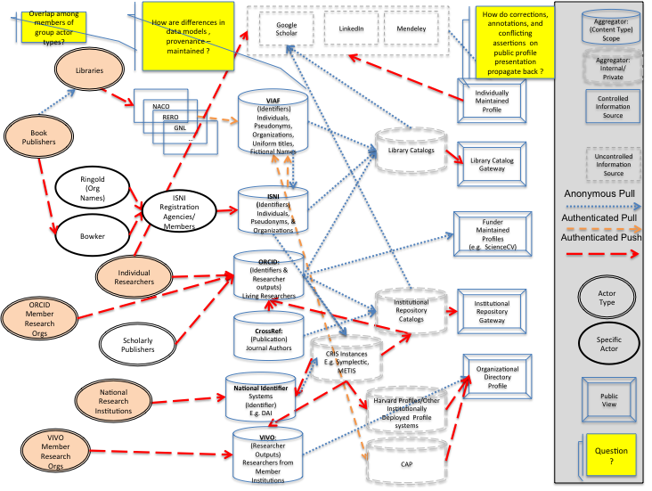
Integrating Researcher Identifiers into the Scholarly Record
Prepared for
Libraries and Research: Supporting Change/Changing Support -- OCLC Research Library Partnership Meeting
June2014
Presented by:
Micah Altman, escience@mit.edu Director of Research, MIT Libraries Non-Resident Senior Fellow, Brookings Institution

Slide 2
Related Work
K. Smith-Yoshimura, et al., 2014, Registering Researchers in Authority Files, OCLC Research.
Liz Allen, Jo Scott, Amy Brand, Marjorie M.K. Hlava, Micah Altman 2014, Beyond authorship: recognising the contributions to research; Nature.
Data Synthesis Task Group. 2014. Joint Principles for Data Citation.

Slide 3
DISCLAIMER
These opinions are our own, they are not the opinions of MIT, Brookings, OCLC, any of the project funders, nor (with the exception of co-authored previously published work) my collaborators
Secondary disclaimer:
“It’s tough to make predictions, especially about the future!”
-- Attributed to Woody Allen, Yogi Berra, Niels Bohr, Vint Cerf, Winston Churchill, Confucius, Disreali [sic], Freeman Dyson, Cecil B. Demille, Albert Einstein, Enrico Fermi, Edgar R. Fiedler, Bob Fourer, Sam Goldwyn, Allan Lamport, Groucho Marx, Dan Quayle, George Bernard Shaw, Casey Stengel, Will Rogers, M. Taub, Mark Twain, Kerr L. White, etc.
Notes:
Scholarly publishers, research funders, universities, and the media, are increasingly scrutinizing research outputs. Of major concern is the integrity, reliability, and extensibility of the evidence on which published findings are based. A flood of new funder mandates, journal policies, university efforts, and professional society initiatives aim to make this data verifiable, reliable, and reusable: If "data is the new oil", we need data management to prevent 'fires', ensure 'high-octane', and enable 'recycling'.
In this presentation we provide an overview of the major categories of new initiatives to promote research reproducibility, reliability, and reuse. We then examine the state of the art in informatics methods for managing data in support of reproducibility, reliability, and reuse -- and we examine the state of the practice -- how publishers, universities, libraries, and archives, can support these goals while under the practical constraints of time, budget, legal requirements for data protection.

Slide 4
Collaborators & Co-Conspirators
Registering Researchers in Authority Files Task Group Members
Micah Altman, MIT - ORCID Board member
Michael Conlon, U. Florida – PI for VIVO
Ana Lupe Cristan, Library of Congress – LC/NACO trainer
Laura Dawson, Bowker – ISNI Board member
Joanne Dunham, U. Leicester
Amanda Hill, U. Manchester – UK Names Project
Daniel Hook, Symplectic Limited
Wolfram Horstmann, U. Oxford
Andrew MacEwan, British Library – ISNI Board member
Philip Schreur, Stanford – Program for Cooperative Cataloging
Laura Smart, Caltech – LC/NACO contributor
Melanie Wacker, Columbia – LC/NACO contributor
Saskia Woutersen, U. Amsterdam
K. Smith-Yoshimura, OCLC Research
Thom Hickey, OCLC Research – VIAF Council, ORCID Board
Contributor Roles Project
Amy Brand, Digital Science
Liz Allen, Wellcome Trust
Marjorie M.K. Hlava, Access Innovations
Jo Scott, Wellcome Trust
Research Support
Wellcome Trust; Digital Science; OCLC Research

Slide 5
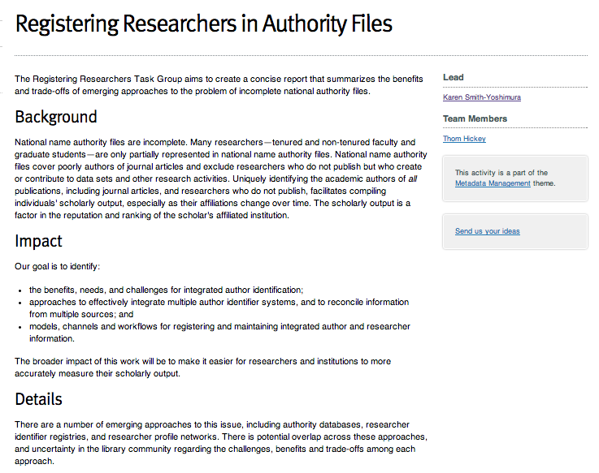
Notes:
One of OCLC Research’s missions is to act as a community resource for shared Research and Development (R&D). And we collaborate with the institutions affiliated with the OCLC Research Library Partnership on issues of common cern.

Slide 6
Preview
* Motivations *
* State of the Practice *
* Observations & Recommendations *

Slide 7
What’s the problem? (more)
Notes:
5 Minutes

Slide 8
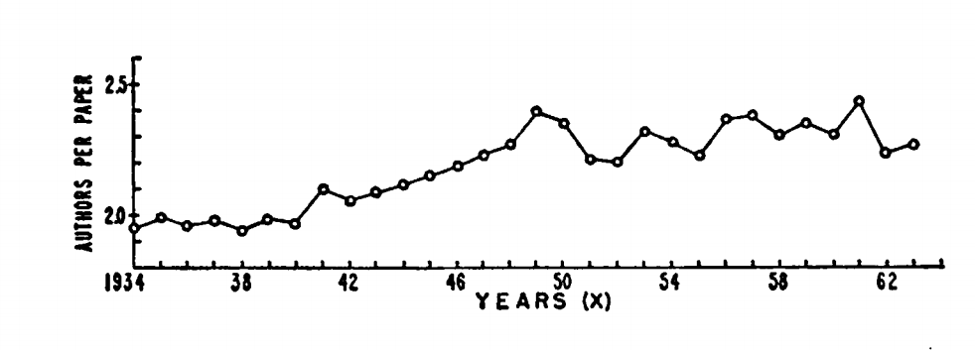
Then
Clarke, Beverly L. "Multiple authorship trends in scientific papers." Science 143.3608 (1964): 822-824.

Slide 9
Later
By 1980, average number of authors in high-ranked medical journals was 4.5
By 2000, average number of authors was 6.9
[Weeks et al. 2004]

Slide 10


Now

Slide 11
Now is More

Slide 12
Authorship Trends, Issues, & Questions
Trend | Potential Authorship Issues | Questions
Increase in number of coauthors | ‘honorary’ authorship ‘ghost’ authorship disputes | How to disambiguate author names? How to communicate attribution in citation? How to describe contributions to work? How to evaluate and predict impact? Who is responsible?
Shift from academic publishing in books to journals | loss of sole-author-book as a evaluation measure | How to integrate name authority and researcher identifier systems?
Decreasing granularity of publications | persistence of “nano” publication vs. authorship | How to document authorship over substructure of work?
Dynamic documents | version misattribution | How to document authorship over time?
Increasing diversity in citable scholarly outputs | citation cannibalization, overrcounting | How to cite data, software, presentations(?), blogs (?), tweets (?)

Slide 13
Potential improved analytics…
Reduce error in standard analytics -- impact factors, citation indices
New measures become feasible -- collaboration analysis
Measures including new research objects -- grants, datasets, software
Measure of new populations -- graduate students, postdocs, citizen scientists
Measures of new connections -- new maps of science, revealing “dark matter”

Slide 14
The State of the Practice in Researcher Identification
Notes:
5 Minutes

Slide 15



Scholarly output impacts the reputation and ranking of the institution
We initially use bibliometric analysis to look at the top institutions, by publications and citation count for the past ten years…
Universities are ranked by several indicators of academic or research performance, including… highly cited researchers…
Citations… are the best understood and most widely accepted measure of research strength.
Notes:
First, some background and the problem statement. These are three university rankings issued annually, rankings that are of particular importance to research libraries. Some universities even incorporate raising their ranking in their strategic plans. All three use citations as a factor in determining the rankings, which skews the results towards universities focusing on the sciences rather than the humanities. It also puts added weight to authors of journal articles, which are usually not represented in national authority files.

Slide 16
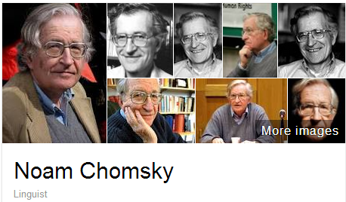
A scholar may be published under many forms of names
Works translated into 50 languages
(WorldCat)
Νόαμ Τσόμσκι
নোম চম্‌স্কি
ནམ་ཆོམ་སི་ཀེ།
નોઆમ ચોમ્સ્કી
नोआम चाम्सकी
Նոամ Չոմսկի
ノーム・チョムスキー
ნოამ ჩომსკი
Ноам Чомски
ನೋಅಮ್ ಚಾಮ್ಸ್ಕೀ
노엄 촘스키
നോം ചോംസ്കി
ਨੌਮ ਚੌਮਸਕੀ
Ноам Хомский
诺姆·乔姆斯基
Also published as:
Avram Noam Chomsky
N. Chomsky
نعوم تشومسكي
נועם חומסקי
Journal articles
Notes:
Noam Chomsky is a scholar widely translated. WorldCat has records for his works in fifty languages. But only some of the forms of his name are represented as “preferred forms” in national authority files (shown on the left). The forms on the right are from wikidata. The Library of Congress/NACO authority file can support only a few of the scripts shown, representing these scripts with romanizations.
Note that the “N. Chomsky” form used in journal articles is generally not included in national authority files. Chomsky happens to have a rather unique name, but for many others it would be a challenge to match up the abbreviated journal citation form with the fuller forms of name. This illustrates the futility of relying on text string matching to determine if two authors represent the same person or not.

Slide 17
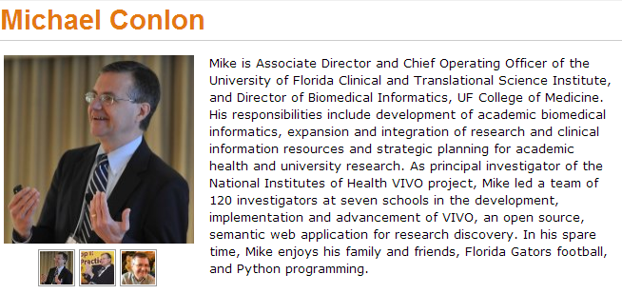



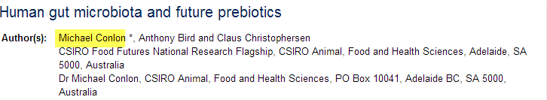
Same name, different people
Conlon, Michael. 1982. Continuously adaptive M-estimation in the linear model. Thesis (Ph. D.)--University of Florida, 1982.
Notes:
Michael Conlon is a member of our task group, an expert in biomedial informatics at the University of Florida. There is another Michael Conlon in the UK who writes articles on European taxes. Obviously two different people. Then there’s an article on microbiota in the Australian journal Microbiology written by a Michael Conlon. The same Michael Conlon as the U. Florida one or a different one based in Australia? Without other metadata, it is difficult to tell.
Michael Conlon is a rather uncommon name. But consider that in China 275 million people have the surname of Li, Wang or Zhang. And that’s not including the millions of overseas Chinese. The chances ethnic Chinese having the same name—especially in the abbreviated form used in journal articles– is high. We need other identifying attributes such as institutional affiliation and discipline (if not photos) to disambiguate names.

Slide 18

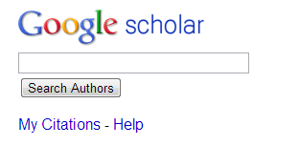











One researcher may have many profiles or identifiers…
(from an email signature block)
Profiles: Academia / Google Scholar / ISNI / Mendeley / MicrosoftAcademic / ORCID / ResearcherID / ResearchGate / Scopus / Slideshare / VIAF / Worldcat
Notes:
Some researchers already have multiple identifiers. This is an example from a signature block in an email. The researcher includes twelve different identifiers or profiles he’s represented in. This also fragments his Web presence.
To recap the problem statement:
Citations are a factor in assessing the impact of scholarship but journal article authors often are not represented in authority files.
A given scholar can be represented by different forms of the name, all of which may not be included in authority files.
Two or more researchers may have the same name, and we need other attributes to disambiguate them.
Some researchers already have multiple identifiers.

Slide 19
Registering Researchers in Authority Files Task Group
How to make it easier for researchers and institutions to more accurately measure their scholarly output?
Challenges to integrate author identification
Approaches to reconcile data from multiple sources
Models, workflows to register and maintain integrated researcher information

Slide 20
Stakeholders & needs
Researcher | Disseminate research
 | Compile all output
 | Find collaborators
 | Ensure network presence correct
Funder | Track research outputs for grants
University administrator | Collate intellectual output of their researchers
Journalist | Retrieve all output of a specific researcher
Librarian | Uniquely identify each author
Identity management system | Associate metadata, output to researcher
 | Disambiguate names
 | Link researcher's multiple identifiers
 | Disseminate identifiers
Aggregator (includes publishers) | Associate metadata, output to researcher
 | Collate intellectual output of each researcher
 | Disambiguate names
 | Link researcher's multiple identifiers
 | Track history of researcher's affiliations
 | Track & communicate updates
Notes:
The first thing the task group did was write up 18 use case scenarios from the perspective of different actors or stakeholders. I’ve consolidate the needs identified here; some overlap.

Slide 21
Some functional requirements
Librarian as a stakeholder
Create consistent and robust metadata
Associate metadata for a researcher’s output with the correct identifier
Disambiguate similar results
Merge entities that represent the same researcher and split entities that represent different researchers
Notes:
From the use case scenarios we derived functional requirements, again linked to the stakeholders. These are the functional requirements for librarians – we need consistent and robust metadata to allow for successful integration with other researcher’s output and various types of sorting.

Slide 22
More functional requirements
Researcher & university administrator as a stakeholder
Link multiple identifiers a researcher might have to collate output
Associate metadata with a researcher’s identifier that resolves to the researcher’s intellectual output.
Verify a researcher/work related to a researcher is represented
Register a researcher who does not yet have a persistent identifier
Funder and university administrator as a stakeholder
Link metadata for a researcher’s output to grant funder’s data
Notes:
These are some functional requirements for the researcher, university administrator and funder. Other requirements are targeted for other stakeholders.

Slide 23





Systems profiled (20)
Authority hubs:
Digital Author Identifier (DAI)
Lattes Platform
LC/NACO Authority File
Names Project
Open Researcher and Contributor ID (ORCID)
ResearcherID
Virtual International Authority File (VIAF)
Current Research Information System (CRIS): Symplectic
Identifier hub: International Standard Name Identifier
National research portal: National Academic Research and Collaborations Information
System (NARCIS)
Notes:
We started with a list of over 100 different research information/identifier systems. Criteria used to select systems to profile: 1) have significant mind-share/take-up by researchers and 2) researchers are represented by a persistent, unique, and publicly accessible URI. We wanted to end up with a representative sample of different research information/identifier systems. For some system types we profiled only one system to represent a category.

Slide 24







Systems profiled (20)
Online encyclopedia: Wikipedia
Reference management:
Research & collaboration hub: nanoHUB
Researcher profile systems:
Community of Scholars
Google Scholar
LinkedIn
SciENcv
VIVO
Subject author identifier system:
Subject repository: arXiv

Slide 25
Partial overview: Authority & identifier hubs
Digital Author Identifier | Researchers in all Dutch CRIS & library catalogs | 66K
Lattes Platform | Brazilian researchers and research institutions | 2M people, 4K inst.
ISNI | Data from libraries, open source resource files, commercial aggregators, rights management organizations. Includes performers, artists, producers, publishers | 7M total; 720 K researchers
LC/NACO Authority File | Persons, organizations, conferences, place names, works | 9M total; ? researchers
ORCID | Individual researchers plus data from CrossRef/Scopus, institutions, publishers | 200K
ResearcherID | Researchers in any field, in any country | 250K
VIAF | Library authority files for persons, organizations, conferences, place names, works | 26M people; ? researchers
Notes:
Each profile contains many characteristics; I’m showing only a partial overview, of the scope and size, for the systems characterized as authority or identifier hubs. Some focus only on researchers, while others are broad with millions of people represented. It is often impossible to tell how many researchers are represented in these larger databases.
The Lattes Platform is the largest of the researcher-only databases; it includes Brazilian researchers in all disciplines plus those outside Brazil who work with them.
ISNI’s focus is to consolidate the data from multiple sources and assign then diffuse identifiers to support machine matching and disambiguation of name identities. ISNI can be assigned to all individuals and organisations that create, perform, produce, manage, distribute or feature in creative content including natural, legal, or fictional identities. Note that ISNI is a VIAF contributor and Digital Author Identifiers are being loaded into ISNI.

Slide 26
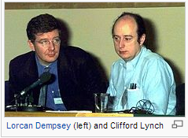
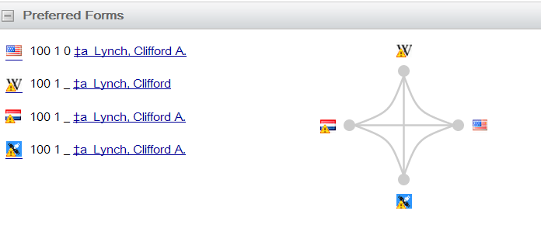
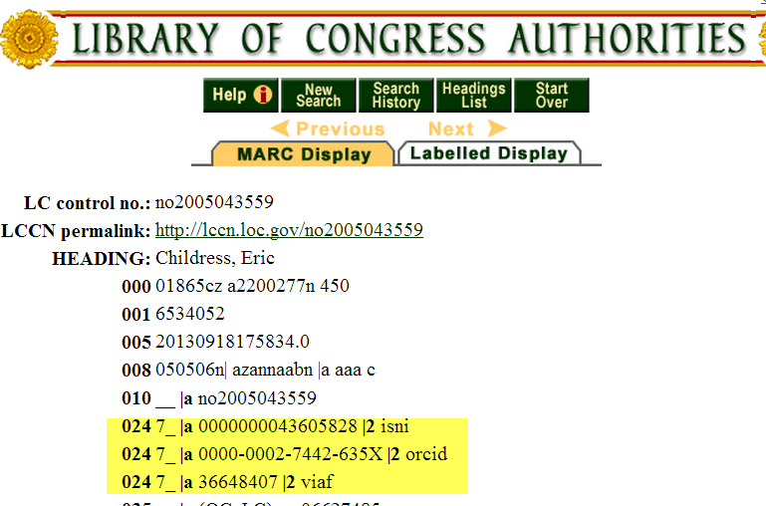
Some overlaps
Notes:
There are overlaps. Here, Cliff Lynch’s VIAF cluster shows he is represented by a Wikipedia article, and is also in the ISNI database as well as the LC/NACO and Dutch national authority files. My OCLC colleague Eric Childress has an authority record with his ISNI, ORCID, and VIAF identifiers.

Slide 27
Observations
Notes:
5 Minutes

Slide 28
Where is Everyone?

Slide 29
Where are researchers?
W.A.G.’s

Slide 30


Changing Scholarly Landscape … Books vs. Journals
 | Books | Journals
Read by | All disciplines | Most Disciplines
Tenure & promotion driver | Humanities, some Social Sciences (e.g. Political Science) | Some Humanities, Social Sciences, Life Sciences, Physical Sciences
Robust system of name and subject | Yes | No
Robust system of citation tracking | No | Yes
Robust system of full-text indexing | No | Yes, although fragmented
Notes:
We have started identifying some “possibly emerging trends”. The field is changing so quickly it is hard to tell whether a couple of examples are isolated occurrences or indicative of an emerging trend.
Note that the four universities shown here are taking five different approaches to assigning identifiers to researchers.

Slide 31


Researcher Identifier ≠ Name Authorities
(Example) | Traditional Name Authorities | Researcher Identifier Systems
Primary Stakeholders | Research Libraries | Publishers, Researchers, Funders, Libraries
Internal standardization/integration | Standardized and well integrated within libraries | Fragmented. Some well-integrated communities of practice.
Organization | Primarily top-down, careful controlled entry from participating organizations | Varies: top down, bottom-up, middle out; often individual contributors
External integration | Very limited: High barriers to entry, few simple API’s | Varies, but more open. Some services offer simple open API’s; integration with web 2.0 protocols (e.g. OpenId)
Works Covered | Primarily Books & other works traditionally catalogued by libraries | Journal articles; Grants; Datasets
People covered | Authors of works published in or about a single country* | Authors of research articles, fundees, members of research institutions – international;
Key record criterion | Complete record of work. | Persistent and unambiguous identifier for an individual contributor
Notes:
We have started identifying some “possibly emerging trends”. The field is changing so quickly it is hard to tell whether a couple of examples are isolated occurrences or indicative of an emerging trend.
Note that the four universities shown here are taking five different approaches to assigning identifiers to researchers.

Slide 32
Complex Environment
Types of Systems
Authority hubs: providing a centralized location of records for multiple institutions
Current Research Information System (CRIS): stores and manages data about research conducted at an institution and integrates it with data from external sources:
Identifier hubs: providing a centralized registry of identifiers
National research portal: providing access to all research data stored in a nation’s network of repositories
Online encyclopedia: a compendium of information divided into articles which includes references to the works by scholars
Reference management: a system to help scholars organize their research, collaborate with others, and discover the latest research
Research and collaboration hub: a centralized portal where scholars in a particular discipline can work together
Researcher profile systems: networks that facilitate professional networking among scholars
Subject author identifier system: a registration service to link scholars with the records about the works they have written
Subject repository: a discipline-based centralized repository to facilitate scholarly exchanged in the fields covered
Roles
Systems overlap – Google Scholar combines reference management, profiles, ids
Systems can have both producers and consumers relationships with each other
Institutional members/maintainers overlap systems, but do not necessarily coordinate
How disputed information is resolved is often unclear

Slide 33
How are differences in data models , provenance – maintained ?
LinkedIn
Mendeley
How do corrections, annotations, and conflicting assertions on public profile presentation propagate back ?
Aggregator: (Content Type)
Scope
Overlap among members of group actor types?
Google Scholar
Libraries
Aggregator: Internal/Private
Individually Maintained Profile
NACO
VIAF (Identifiers)
Individuals,
Pseudonyms, Organizations, Uniform titles, Fictional Names
Controlled
Information
Source
RERO
Book Publishers
GNL
…
Library Catalogs
Library Catalog
Gateway
Uncontrolled
Information
Source
Ringold (Org Names)
ISNI
Registration
Agencies/Members
ISNI (Identifiers) Individuals, Pseudonyms, & Organizations
Anonymous Pull
Bowker
Funder Maintained Profiles (e.g. ScienceCV)
Authenticated Pull
Authenticated Push
Individual
Researchers
ORCID: (Identifiers & Researcher outputs) Living Researchers
Actor Type
ORCID Member Research Orgs
Institutional Repository Catalogs
Institutional Repository
Gateway
CrossRef: (Publication) Journal Authors
Scholarly Publishers
Specific Actor
CRIS Instances
E.g. Symplectic, METIS
Organizational Directory Profile
National Research Institutions
National Identifier Systems
(Identifier)
E.g. DAI
Public View
Harvard Profiles/Other Institutionally Deployed Profile systems
VIVO
Member Research Orgs
VIVO: (Researcher Outputs) Researchers from Member Institutions
Question?
CAP
Notes:
Micah Altman (MIT) diagramed this Researcher ID information flow which demonstrates the complexity of the current researcher information workflow ecosystem. The ovals on the left show the various stakeholders: libraries, publishers, individual reserachers, ISNI registration agencies, ORCID and VIVO members, national research institutions. The dotted lines show the information flow among them, for example, book publishers provide information to libraries. The drums in the centers represent various types of aggregated databases: Virtual International Authority File, ISNI, ORCID, CrossRef, National platforms, VIVO. The lower right represents institutional-based databases such as Harvard Profiles, Stanford’s Community Academic Profiles, an institution’s CRIS or Institutional repository. Note that these operate separately from the libraries’ work on authority records on the top left. The information flows to either controlled information sources on the far right, or uncontrolled information sources on the Internet shown on the top (Google Scholar, LinkedIn, Mendeley).
A key question is how corrections or updates can be communicated between systems. Researchers are frustrated when they see errors in their profile or works incorrectly assigned to them, or works missing. Even if the information is corrected in the local instance, it often does not get reflected in the aggregated databases or hubs.

Slide 34
Some Emerging trends:
Widespread recognition that persistent identifiers for researchers are needed
Registration services rather than authority files as a solution for researcher identification
Interoperability between systems is increasing:
ISNI & VIAF interoperability.
ORCID and ISNI coordination
CRIS system integration with ORCID, ISNI, VIVO
Adoption trends …
Notes:
We have started identifying some “possibly emerging trends”. The field is changing so quickly it is hard to tell whether a couple of examples are isolated occurrences or indicative of an emerging trend.
Note that the four universities shown here are taking five different approaches to assigning identifiers to researchers.

Slide 35
Adoption Trends: Publishers -- Early Adopters
Most major scholarly journal publishers with US presence now integrate ORCIDs (ACM, Elsevier, Hindawi, IEEE, NPG, PLOS, Springer, Taylor & Francis, Thomson Reuters, Wiley)
Widespread integration of ORCIDs with manuscript subscription systems
MacMillan integrating ISNIs in Digital Science family of systems
Integration of ORCIDs with CrossRef platform for DOI indexing and interlinking services
Notes:
We have started identifying some “possibly emerging trends”. The field is changing so quickly it is hard to tell whether a couple of examples are isolated occurrences or indicative of an emerging trend.
Note that the four universities shown here are taking five different approaches to assigning identifiers to researchers.

Slide 36
Adoption Trends: Funders -- National Adoption & Beyond
FCT, the Portuguese national funder, requires ORCIDS for their national evaluation system
DAI, the Netherlands national funder, has created ISNIs for each researcher
SNSF, the Swiss national funder, has created ISNIs for each researcher
Wellcome Trust has integrated ORCIDs into grant submission and evaluation.
NIH integrated ORCIDs into the inter-agency biosketch platform SciENcv.
U.S. D.O.E. integrated ORCIDs into grant submission
Notes:
We have started identifying some “possibly emerging trends”. The field is changing so quickly it is hard to tell whether a couple of examples are isolated occurrences or indicative of an emerging trend.
Note that the four universities shown here are taking five different approaches to assigning identifiers to researchers.

Slide 37





Adoption trends: Increasing number of Universities assigning identifiers to researchers
Assigning ORCIDs to authors when submitting electronic
dissertations in institutional repositories
Pilot to automatically generate preliminary authority records
from publisher files (Harvard U. press, one other)
Assigning ISNI identifiers to their researchers.
Assigning local identifiers to researchers who don’t have one.
Using UUIDs (Universally Unique identifiers) to map to other identifiers like ORCID.
Notes:
We have started identifying some “possibly emerging trends”. The field is changing so quickly it is hard to tell whether a couple of examples are isolated occurrences or indicative of an emerging trend.
Note that the four universities shown here are taking five different approaches to assigning identifiers to researchers.

Slide 38
(But wait, there’s more! …)
New universities now systematically creating ORCID’s for their researchers: Boston University (medical school), Chalmers Institute of Technology, Hong Kong University, La Universidad de Zaragoza, National Taiwan University, Texas A&M, and University of Michigan (in progress)
University efforts to integrate ORCID’s and software Infrastructure
BU is integrating ORCID into the Profiles research profile platform (used by 30+ institutions)
Cornell University, is integrating ORCID into the VIVO open source researcher profiling system, used by over a hundred institutions
University of Notre Dame, is integrating ORCID identifiers into their Institutional Repository and into the Hydra open source IR tool.
Purdue University, is integrating ORCID identifiers into their data management platform, and the HUBzero open source platform for supporting research collaboration.
Texas A&M University is integrating ORCID identifiers into the open source Vireo electronic theses and dissertations (ETD) workflow
University of Colorado, is integrating ORCID identifiers into their Faculty information System (FIS).
University of Missouri, is integrating ORCID identifiers into DSpace.
Notes:
We have started identifying some “possibly emerging trends”. The field is changing so quickly it is hard to tell whether a couple of examples are isolated occurrences or indicative of an emerging trend.
Note that the four universities shown here are taking five different approaches to assigning identifiers to researchers.

Slide 39
Building on Identifiers
-- Outputs
Notes:
5 Minutes

Slide 40
Joint Principles for Data Citation
Importance. Data should be considered legitimate, citable products of research. Data citations should be accorded the same importance in the scholarly record as citations of other research objects, such as publications[1].
Credit and attribution. Data citations should facilitate giving scholarly credit and normative and legal attribution to all contributors to the data, recognizing that a single style or mechanism of attribution may not be applicable to all data[2].
Evidence. In scholarly literature, whenever and wherever a claim relies upon data, the corresponding data should be cited [3].
Unique Identification. A data citation should include a persistent method for identification that is machine-actionable, globally unique, and widely used by a community[4].
Access. Data citations should facilitate access to the data themselves and to such associated metadata, documentation, code, and other materials, as are necessary for both humans and machines to make informed use of the referenced data[5].
Persistence. Unique identifiers, and metadata describing the data and its disposition, should persist -- even beyond the lifespan of the data they describe[6].
Specificity and verifiability. Data citations should facilitate identification of, access to, and verification of the specific data that support a claim. Citations or citation metadata should include information about provenance and fixity sufficient to facilitate verifying that the specific timeslice, version and/or granular portion of data retrieved subsequently is the same as was originally cited[7].
Interoperability and flexibility. Data citation methods should be sufficiently flexible to accommodate the variant practices among communities, but should not differ so much that they compromise interoperability of data citation practices across communities[8].
http://www.force11.org/node/4769

Slide 41
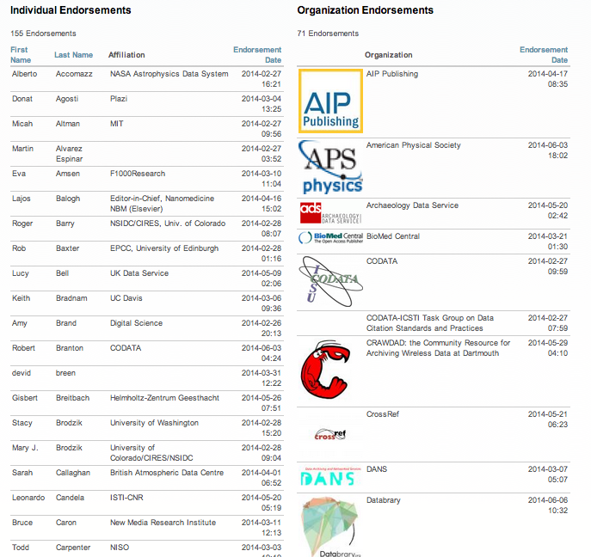

Slide 42

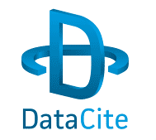

Current Data Citation Indexing & Linking
Data Citation Index
Commercial Service (Thomson Reuters)
Indexes many large repositories (e.g. Data-PASS)
Beginning to extract citations from TR publications
DataCite
DOI registry service (DOI provider)
Data DOI metadata indexing service (parallel to CrossRef)
Not-for-profit membership Organization
Collaborating with ORCID-EU to embed ORCIDs
SciDirect Linking
DOI, entity, and application linking
Limited number of repositories
Elsevier jorunals
http://www.dlib.org/dlib/january11/aalbersberg/01aalbersberg.html

Slide 43


Community Implementation Efforts
Research Data Alliance
Data Citation Working Group
Overlaps with synthesis group
Focuses on dynamic data citation
Early-mid stage
Lead by Andreas Rauber
rd-alliance.org/working-groups/data-citation-wg.html
Joint Data Citation Implementation Group
Overlaps with citation synthesis group
Focuses on broad range of implementation
Early stages
Lead by Tim Clark
www.force11.org/datacitationimplementation

Slide 44
Building on Identifiers
-- Roles
Notes:
5 Minutes

Slide 45
Author Roles Remain Ambigous
Citation is ambiguous
meaning of first author?
meaning of last author?
collective authorship?
corresponding author?
(semi-) alphabetical ordering
Acknowledgements ≠ Authorships
sometimes honorary
sometimes strategic
sometimes non-intellectual contribution
Authorship Statements
typically qualitative
rarely published
motivation is often on misconduct, not scholarly
Authorship Norms Vary by Journal, even within same field…
PNAS: “Authorship must be limited to those who have contributed substantially to the work.”
Harvard Medical School: “Everyone who has made substantial intellectual contributions to the work should be an author. Everyone who has made other substantial contributions should be acknowledged.”
ICMJE: “Substantial contributions to the conception or design of the work; or the acquisition, analysis, or interpretation of data for the work; AND Drafting the work or revising it critically for important intellectual content; AND Final approval of the version to be published; AND Agreement to be accountable for all aspects of the work in ensuring that questions related to the accuracy or integrity of any part of the work are appropriately investigated and resolved.”
[Sadler 2011]

Slide 46
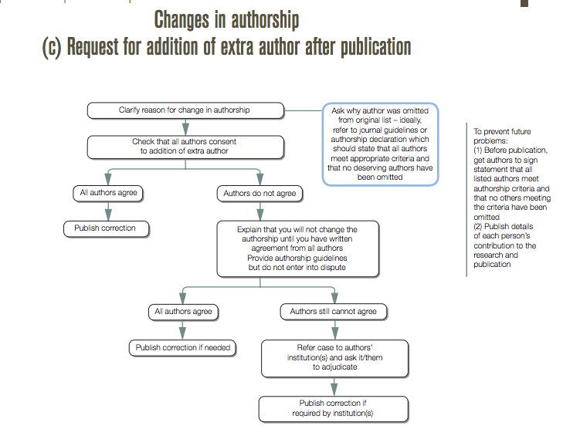
Authorship Guidelines & Best Practices
Typically created by publisher community
Many to choose from
Oriented to BioMedical disciplines
Primarily proscriptive, not descriptive/empirical
Even when author statements are collected, they are typically not published/available (and never in structured form)
Notable examples:
Wager & Kleiner 2011 (Committee on Publication Ethics)
ICMJE 2013
[COPE Flowcharts http://publicationethics.org/resources/flowcharts ]

Slide 47
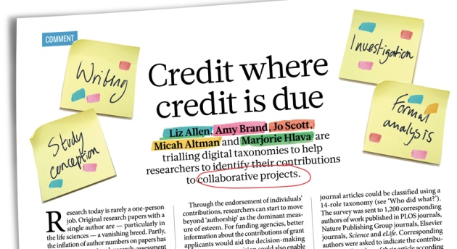
Developing a Taxonomy of Contributor Roles
Nature 508, 312–313 (17 April 2014) doi:10.1038/508312a

Slide 48
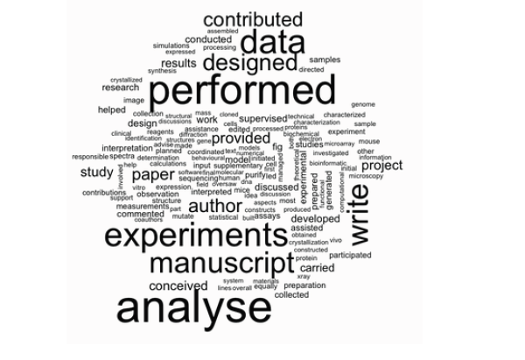
supervised
synthesis
microarray
reagents
mouse
design
initial
interpretation
microscopy
discussed
developed
calculations
assisted
model
participated
statistical
collected
Micah Altman, MIT Libraries
conceived
Notes:
Some of the less frequent terms:
Grey – type of contribution:
blue – experiment specific or analytic
green – stage of the experiment
Other things that appear in this analysis:
(4) Degree of contribution – equal, contribute, supervise

Slide 49
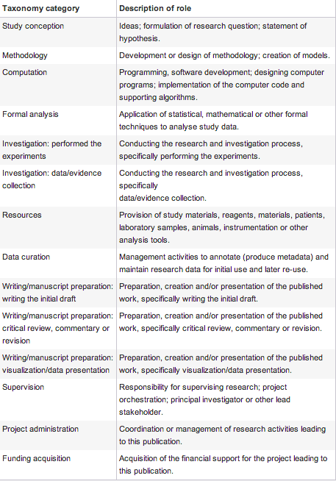
Prototype Taxonomy
Prototype Harvard-Wellcome taxonomy described in Nature
CASRAI/NISO Working Group to develop formal recommendations
Community workshop at CNI 2014 winter meeting

Slide 50
Recommendations
for Universities
Notes:
5 Minutes

Slide 51
Prepare to Engage
Adoption of researcher identifiers has been rapid within scholarly publishing
Funders see clear benefits, and are engaged
It is time for many universities to transition from watchful waiting to and engagement
Starting to engage…
Develop outreach and educational materials for researchers, stakeholders
Future-proof systems:
Authors are not a string
Identifiers are multi-valued, with multiple authorities
Demand more than PDF’s …
Many publishers are already associating each article with:
Multi-valued author list
Identifiers – author, funder, institution
Contribution/COI statements
Prepare for more complex measurement & reporting of usage

Slide 52
Choosing Identifiers
Broad Researcher Identifiers: Compare ORCID & ISNI
National mandates
Capabilities
Usage patterns
Retain traditional identifiers: VIAF, NACO
Well supported in library systems
Primarily describe authors of books and similar works
Be aware of community identifiers for local integration (e.g. ArXiV )

Slide 53
Manage Risks
Environment is evolving
Funder mandates and policies are incomplete
No dominant business model
Incomplete adoption, no single comprehensive data source
Integration between classic and new name authority is lacking
Researchers …
will not drive change alone;
are sensitive to who controls their profile, and how information can be “corrected”;
Incentive mechanisms, well-timed nudges, setting norms with junior scholars, and establishing information feedback loops are critical.

Slide 54
Additional References
Haak, Laurel L., et al. "ORCID: a system to uniquely identify researchers." Learned Publishing 25.4 (2012).
VIAF Presentations and Publications http://oclc.org/research/activities/viaf.html
Jones, Richard, et al. "Researcher Identifiers Technical interoperability report." (2011).
Clarke, Beverly L. "Multiple authorship trends in scientific papers." Science 143.3608 (1964): 822-824.
Weeks, William B., Amy E. Wallace, and B. C. Kimberly. "Changes in authorship patterns in prestigious US medical journals." Social science & medicine 59.9 (2004): 1949-1954.
Papatheodorou, Stefania I., Thomas A. Trikalinos, and John Ioannidis. "Inflated numbers of authors over time have not been just due to increasing research complexity." Journal of clinical epidemiology 61.6 (2008): 546-551.
Sadler, Theodore R. "Publishing in Academia: Woes of Authorship, Figures, and Peer Review." Drug Information Journal 45.2 (2011): 145-150.
Wager E & Kleinert S (2011) Responsible research publication: international standards for authors. A position statement developed at the 2nd World Conference on Research Integrity, Singapore, July 22-24, 2010. Chapter 50 in: Mayer T & Steneck N (eds) Promoting Research Integrity in a Global Environment. Imperial College Press / World Scientific Publishing, Singapore (pp 309-16). (ISBN 978-981-4340-97-7)
ICMJE, 2013. Recommendations for the Conduct, Reporting, Editing, and Publication of Scholarly Work in Medical Journals, http://www.icmje.org/recommendations

Slide 55
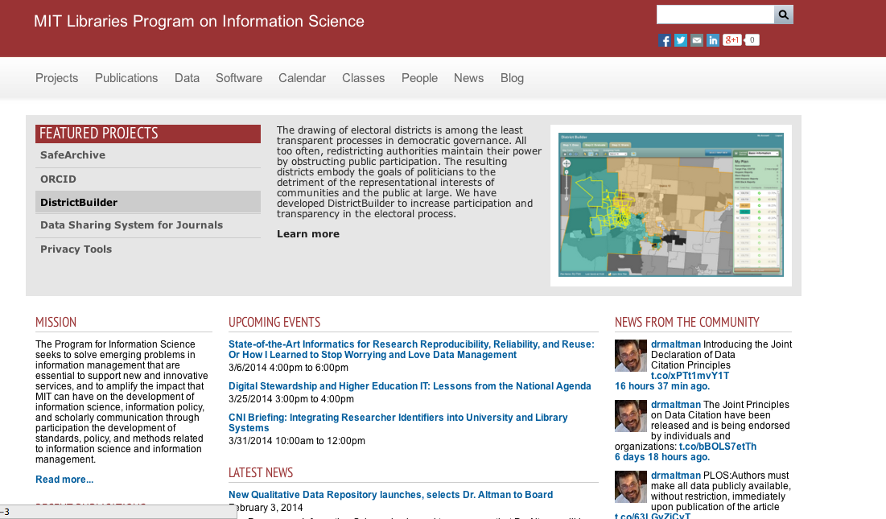

Questions?
Micah Altman
E-mail: escience@mit.edu
Twitter: @drmaltman
Web: informatics.mit.edu
AC: ORCID:0000-0001-7382-6960
Karen Smith-Yoshimura
E-mail: smithyok@oclc.org
Twitter: @KarenS_Y
Web: oclc.org/research/people/smith-yoshimura.html
AC: viaf.org/viaf/72868513
©2014 Micah Altman. This work is licensed under a Creative Commons Attribution 3.0 Unported License. Suggested attribution: “This work uses content from "Integrating Researcher Identifiers into the Scholarly Record" © Micah Altman, used under a Creative Commons Attribution license: http://creativecommons.org/licenses/by/3.0/”

