Slide 1
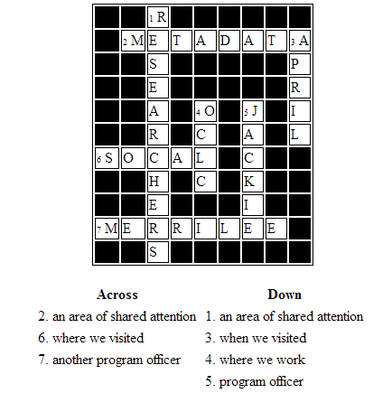

Slide 2
Briefing - OCLC Research Library Partnership
April 2013
Southern California
Merrilee Proffitt & Jackie Dooley
Program Officers OCLC
With thanks to Roy Tennant, Karen Smith-Yoshimura, Constance Malpas,
Ixchel Faniel, and Ricky Erway for contributions!

Slide 3
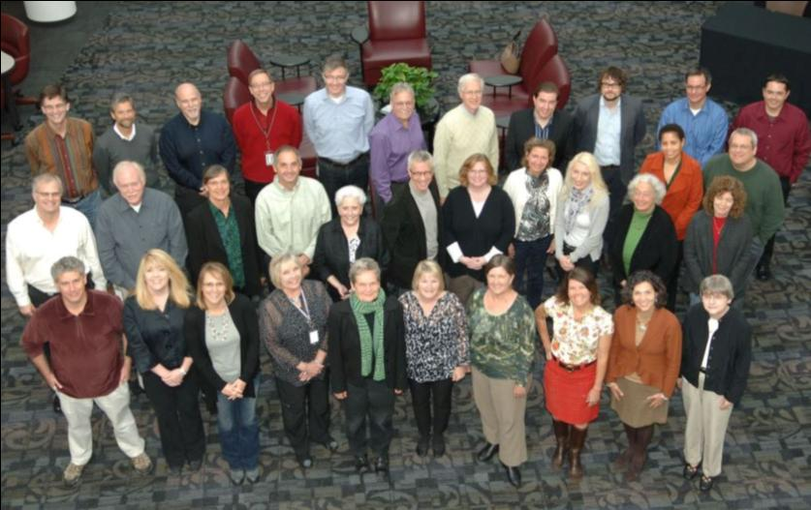
Who we are
OCLC Research Library Partnership
transnational
heterogeneous
Surrounded by smart people
Your photo here….

Slide 4
Composition of the Partnership (4/2013)
Notes:
*Included CIC and University of California in the OCLC RLP column, because there significant representation from both in the Partnership

Slide 5
Composition of the Partnership (4/2013)
25 of the top 30 universities in The Times Higher Education World Ranking
57% of Research Libraries UK
61% of Hathi Trust Partners
50% of ARL Members
60% of Google Books Partners*
Notes:
*Included CIC and University of California in the OCLC RLP column, because there significant representation from both in the Partnership

Slide 6
More about Partners
In SoCal
Cal Tech
Getty
Huntington
San Diego State University
UCI
UCLA
UCSD
USC
Newest Partners
Occidental College (July 1)
University of Wisconsin
Memorial Sloan-Kettering Cancer Center Library
Fordham University

Slide 7
Motivations for our work
New ways of thinking about library metadata
Renewing our understanding of researcher needs
Rethinking collections

Slide 8
MARC usage in WorldCat - why?
We have a huge legacy of structured and semi-structured information
It is locked up in a standard that has accreted changes for the last 40-50 years without a systemic overhaul
To give it a systemic overhaul, we MUST know what we have to work with

Slide 9
Why Now?
2007: LC Working Group on the Future of Bibliographic Control
2011: First RDA Vocabularies Published
2011: LC Bibliographic Framework Initiative
2012: BIBRAME Primer document released
2013: BIBFRAME.org site released

Slide 10
Prior work…
2003: 420,000 MARC Records

Slide 11
Prior work
2006: 54 Million WorldCat Records

Slide 12
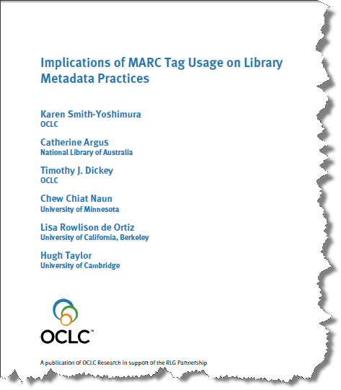
Prior work
What is “good enough” cataloging?

Slide 13
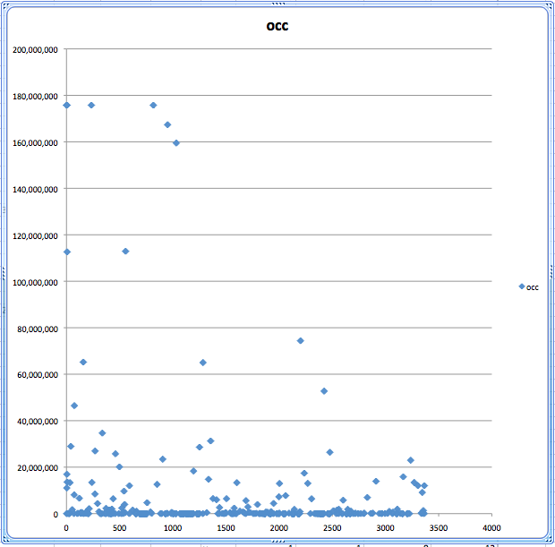
245 Title Statement
260 Publication Statement
300 Physical Description
Discovery
Evaluation
100 Personal Name
Identifiers
500 Notes
650 Subject
700 Personal Name

Slide 14
The Project
To provide actual evidence of how MARC has been used over the last 40+ years
Report over the course of one year in quarterly snapshots
Expose some fields immediately, but also take requests
Provide particular feedback to WorldCat Quality Control and the Library of Congress’ BIBFRAME initiative

Slide 15
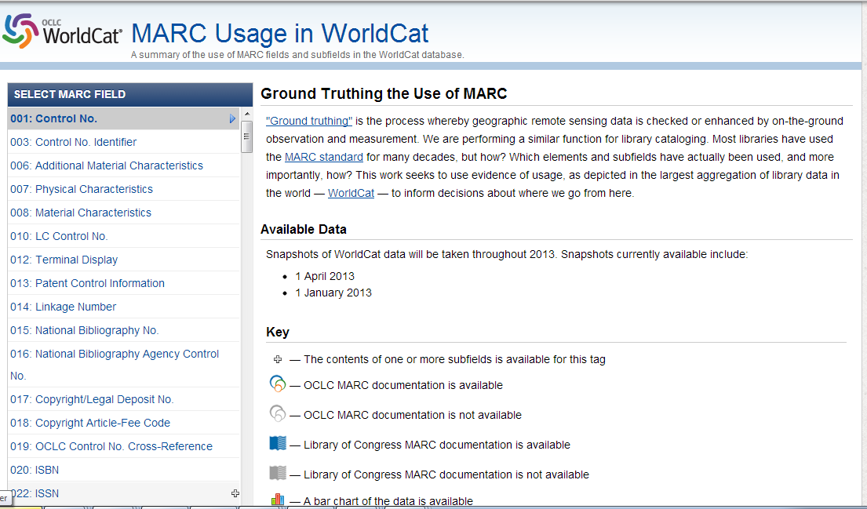
See for yourself
http://experimental.worldcat.org/marcusage/
Notes:
Work led by Roy Tennant

Slide 16
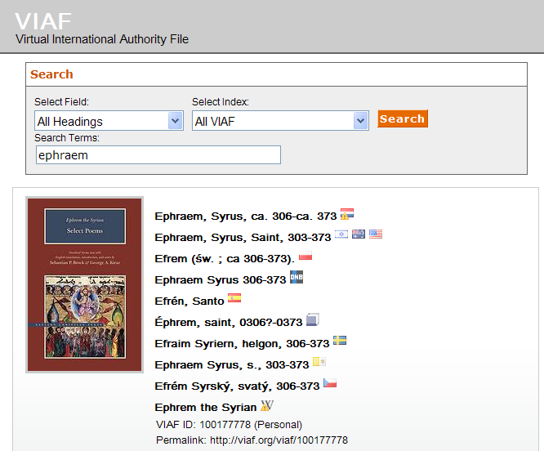
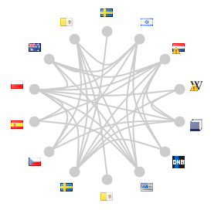
Notes:
Over the past year OCLC Research has been working with a group of Syriac studies scholars with the goal of tapping their expertise to enrich the Virtual International Authority File (VIAF), by adding Syriac script to existing names and adding new ones. Syriac is a dialect of Aramaic, developed in the kingdom of Mesopotamia in the first century A.D. It flourished in the Persian and Roman Empires, and Syriac texts comprise the third largest surviving corpus of literature from the fourth through seventh centuries, after Greek and Latin.
A number of Syriac names are already represented in VIAF, as in this example Note that although Ephram has been contributed 14 different sources, (click) none includes the Syriac script that Ephram wrote in. The Syriac reference portal in development (click) includes not only the Syriac script form of the name, but other script variations as well, including Arabic. It also includes (click) a short biographical note.

Slide 17
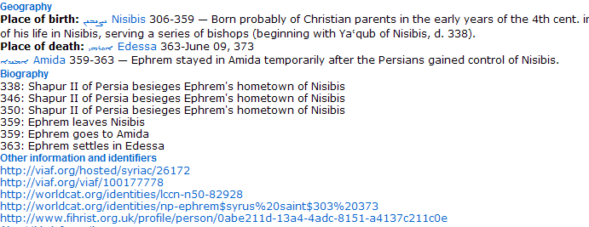
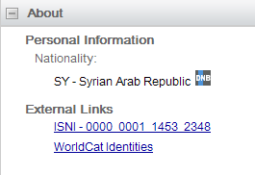
Notes:
VIAF includes only a few data elements about a personal name – in this case, only the nationality (using modern nomenclature) and external links, if present, to ISNI (International Standard Name Identifier) and WorldCat Identities. The Syriac scholars (click) include place of birth and death, as known at the time the person lived there – with links to a map. A short biography lists life milestones, and it also includes external links – to VIAF, WorldCat Identities, and Fihrist, the union catalog of Islamic Manuscripts based in the UK, which is also interested in contributing its Arabic names to VIAF.

Slide 18
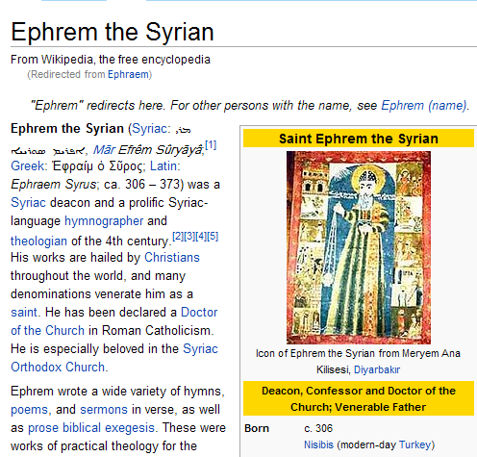
Notes:
How would this work? Imagine that the Syriac-script form of the name will appear within the VIAF cluster, with its own icon. The other script forms found in the Syriac reference portal would be included under “Alternate names”. Just as now when you click on the “Wikipedia” link in a VIAF cluster you are brought to the Wikipedia article (click), we expect scholars interested in more detail will click on the Syriac-scholar link.

Slide 19
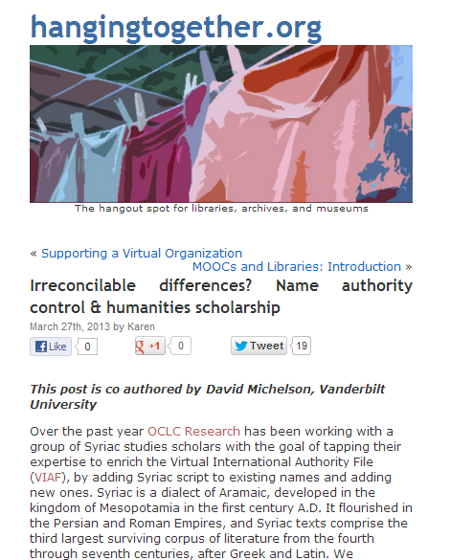
Summary on
HangingTogether
Notes:
http://hangingtogether.org/?p=2621

Slide 20
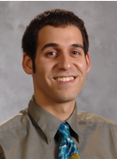
OCLC Wikipedian in Residence
Opportunities with library data
Education and outreach for librarians
Max Klein!

Slide 21
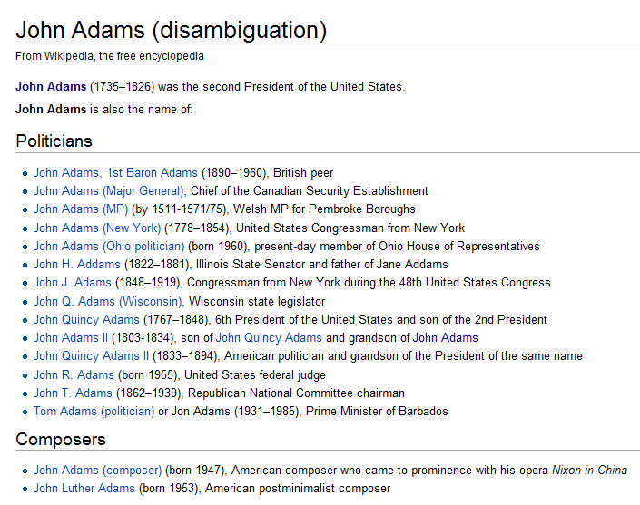
VIAFbot - Purpose
Disambiguation is important!
Wikipedia articles utilize Authority Control
Notes:
Whenever I talked to someone who was invovled with Wikipedia, it turned out that disambiguation, for names in particular, is really important. Just as it is for libraries. There was is a growing recognition of the importance of library name authorities, and some Wikipedia articles have started incorporating authority control into articles. Not surprisingly, the German language Wikipedia had already started to add in authority control. But the English language Wikipedia has only 4k articles with authority data (on perhaps 1m articles about people – kind of difficult to tell).

Slide 22
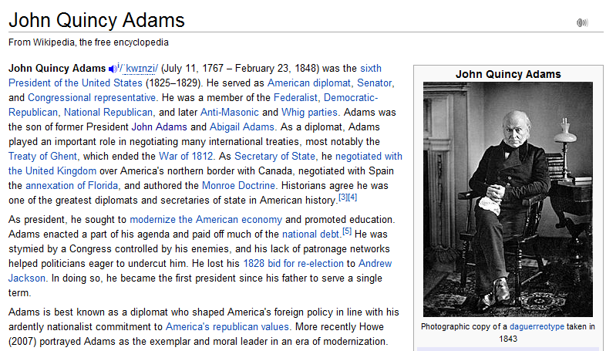

Slide 23
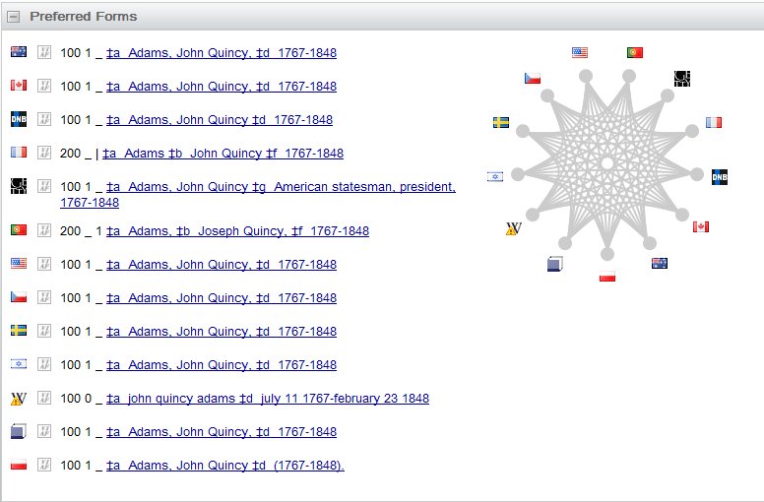

Slide 24
VIAFbot - Progress
250,000 + articles now have authority data, and links to VIAF
…out of roughly 1 million articles about “people” on WP:EN

Slide 25
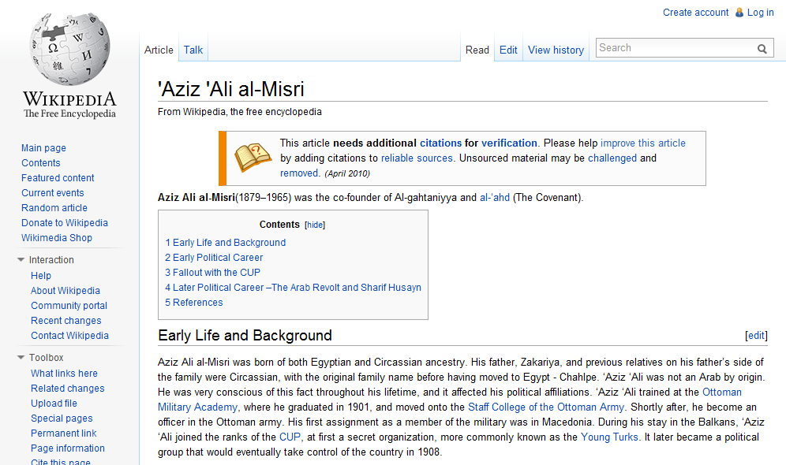
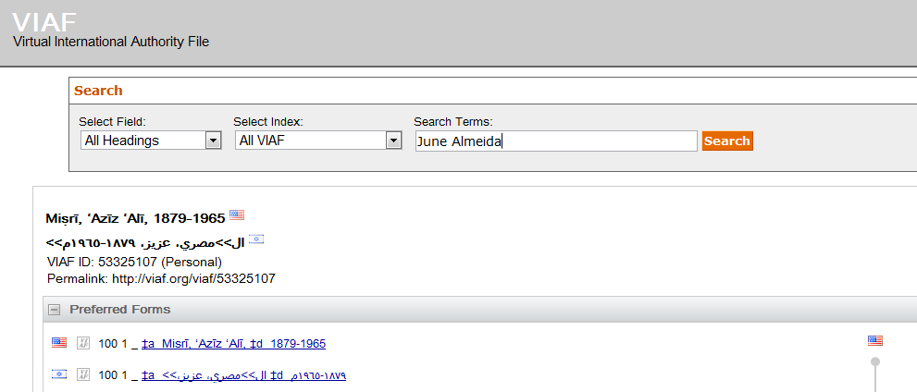
A heartwarming story from a cataloger
Added by VIAFbot 9 October 2012
Notes:
Cataloger John Myers from Union College in Schenectady NY wrote to us last week to report, “I had an Arabic name to enter into a record as part of a note, and I wasn’t confident about the diacritics. So, I look in the authority file to temporarily download it, copy the form of the name, and then move on. [I] Couldn’t find the name in OCLC. [I looked] in Wikipedia under his common name – bingo. Even better, Wikipedia has a link to VIAF, double bingo! With the authorized form from VIAF, I could readily find the record in OCLC …The miracles of an interconnected bibliographic dataverse!...Thank you for your efforts! It made my work in my catalog possible!!

Slide 26
Next up….WikiData
Notes:
A good example of a rich Wikidata record: https://www.wikidata.org/wiki/Q1394

Slide 27
And you?
Opportunities or challenges for working with metadata?

Slide 28
Advancing the Research Mission
Partner email discussion forum for identifying areas of need. Subgroups then take on a topic and develop something of use to the community.
Notes:
Contact Ricky Erway for more information

Slide 29
Advancing the Research Mission
Encouraging campus-wide data management planning. This group is identifying topics for libraries to raise to other stakeholders on campus (IT, Office of Research, Academic departments) about the advantages of a campus-wide policy.
Dan Tsang, chair (University of California, Irvine); Allan Bell (University of British Columbia); Anna Clements (University of St. Andrews); Joy Davidson (DCC, University of Glasgow ); Mike Furlough (Pennsylvania State University); Chuck Humphrey (University of Alberta); Amy Nurnberger (Columbia University); Claire Stewart (Northwestern University); Beth Warner (Ohio State University); Perry Willett (California Digital Library)

Slide 30
Advancing the Research Mission
Selecting datasets for preservation and access. This group is exploring issues related to deciding which datasets merit long term curation, how to handle deposit agreements (use restrictions, duration, service levels), and what to do when a dataset is decommissioned.
Ann Lally, chair (University of Washington ); Brian Clifford (University of Leeds; Joy Davidson (DCC, University of Glasgow ); Chuck Humphrey (University of Alberta); Harrison W. Inefuku (Iowa State University); Rachael Kotarski (British Library); Ron Nakao (Stanford University); Barbara Rockenbach (Columbia University); Sally Rumsey (University of Oxford); Anna Shadbolt (University of Melbourne)

Slide 31
Institute for Museum and Library Services (IMLS) funded project led by Drs. Ixchel Faniel (PI) & Elizabeth Yakel (co-PI)
Studying the intersection between data reuse and digital preservation in three academic disciplines to identify how contextual information about the data that supports reuse can best be created and preserved.
Focuses on research data produced and used by quantitative social scientists, archaeologists, and zoologists.
The intended audiences of this project are researchers who use secondary data and the digital curators, digital repository managers, data center staff, and others who collect, manage, and store digital information.
For more information, please visit http://www.dipir.org

Slide 32
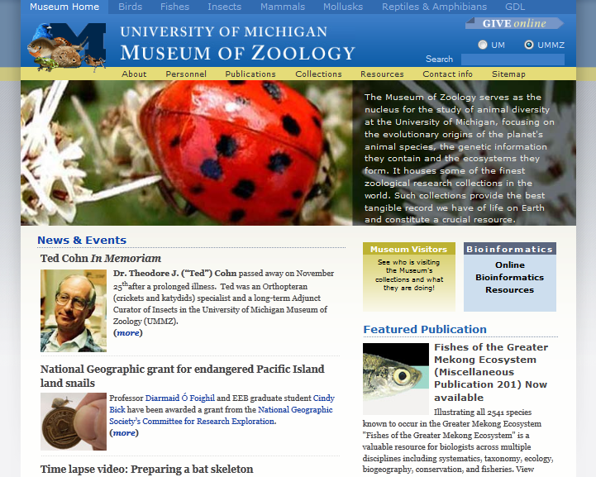

Slide 33
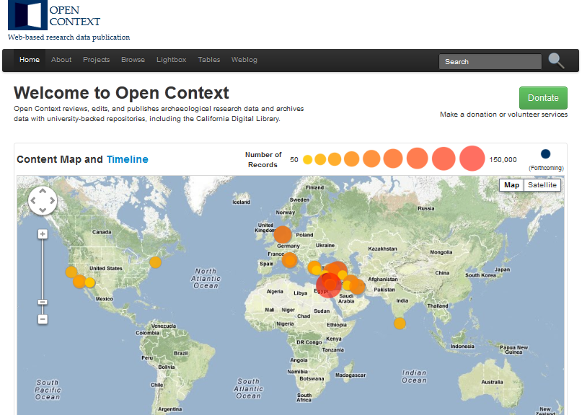

Slide 35
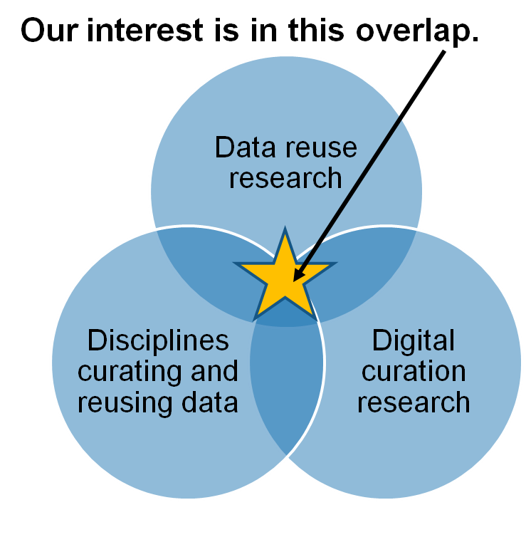
Research Motivations & Questions
What are the significant properties of quantitative social science, archaeological, and zoological data that facilitate reuse?
2. How can these significant properties be expressed as representation information to ensure the preservation of meaning and enable data reuse?
Faniel & Yakel 2011

Slide 36
ICPSR Survey of Data Reusers – Part 1 (The Conceptual Model)
Data Producer Reputation
Data Ease of Operation
+
Data Credibility
+
+
+
Data Accessibility
Data Reuse Satisfaction
+
Data Completeness
+
+
Data Relevancy
Documentation Quality

Slide 37
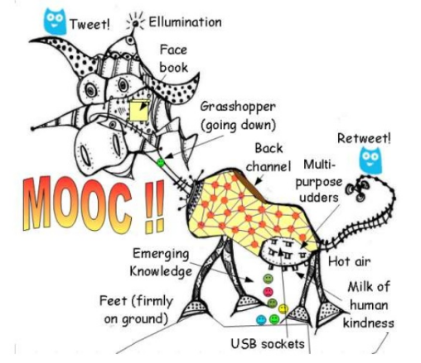
http://www.downes.ca/presentation/304

Slide 38
MOOCs and Libraries
Contacted institutional partners represented in the OCLC Research Library Partnership
Coursera – 20 of 32 (now 62)
edX - 2 of 6 (now 12)
FutureLearn - 4 of 12 (now 17 plus the British Library)
Conversations with Public Libraries
Notes:
I started our investigation by attempting to make contact with librarians who are already involved in MOOCs, or who work at institutions who are engaged in partnership with the three main MOOC providers. To give you a sense of how quickly this space is moving, when I started this investigation in December, there were…. In the middle of my investigation, FutureLearn was launched by the Open University in the UK, and in February both Coursera and edX increased their numbers substantially. I also visited the Coursera offices in Mountain View.
Most of what I learned has been from the edX and Coursera cohort. FutureLearn was still getting underway, but those institutions were delighted that we are doing work in this area, and hope to be able to learn how libraries are already engaged with MOOCs, so this was a useful interaction (Gill Needham attending). I also learned that the edX group has a self-assembled group of librarians. There is nothing similar within the Coursera group.
I was also part of conversations with a handful of public libraries together with my colleague Chrystie Hill. These conversations were real eye openers for me – while many academic institutions at this point are concerned with issues around MOOC production, many public libraries are thinking creatively about MOOC consumption and how MOOCs may fit into the learning lives of the broad and diverse audience that public libraries serve, including home schoolers, those returning to college, and how MOOCs may fit into a broad portfolio of materials provided to support a variety of learning objectives.
I also visited the Coursera offices in Mountain View, very close to the office I work out of in San Mateo California.

Slide 39
MOOCs and Libraries: March 18-19 University of Pennsylvania
Themes for meeting
Copyright
Production
New opportunities for librarians
Audience
Summaries on HangingTogether.org
http://hangingtogether.org/?cat=58
Video and slides on OCLC Research website
http://www.oclc.org/research/events/2013/03-18.html

Slide 40
And you?
Opportunities or challenges for new ways of working with faculty/scholars?

Slide 41
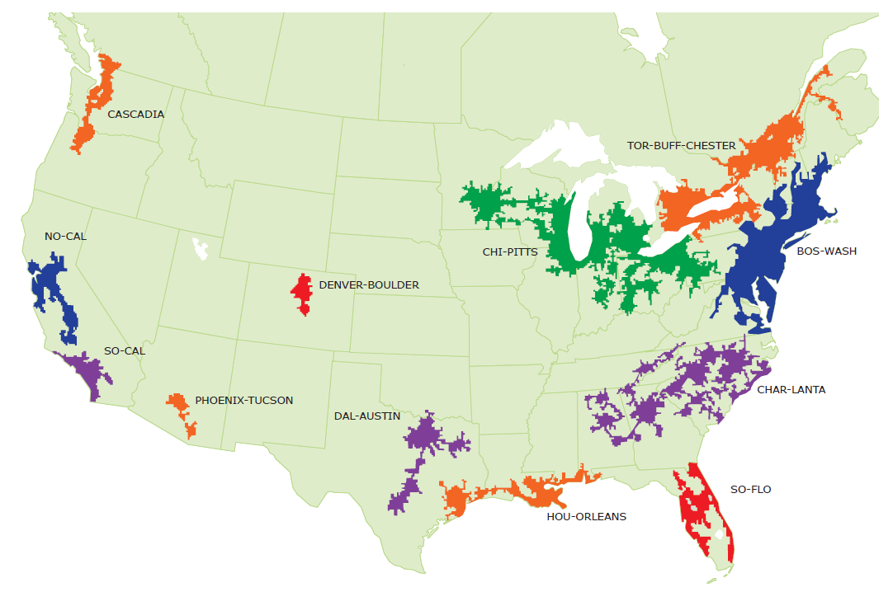
A mega-regional perspective on print books in Southern California libraries
SoCal
Constance Malpas
OCLC Research
malpasc@oclc.org
Shared Print Collections Southern California Mega-Region Meeting
14 December 2012 - UCLA - Bob Kieft, convener

Slide 42
What we mean by ‘mega-region’
Geographic area defined by high level of economic integration underpinned by robust supporting infrastructure (transportation, logistics, etc.)
Anchored by one or more urban agglomerations
High concentration of educational and cultural organizations, a center of gravity for the ‘creative class’

Slide 43
Mega-regions and print management
An empirically derived framework (Richard Florida, et al.) based on regional economic activity; mega-regions are a ‘natural unit’ for analysis
Helps situate print management within broader networks of economic exchange; builds on existing organizational infrastructure and institutional interests
Shared print management efforts being undertaken at variable (and overlapping) scale; we have no objective benchmarks for establishing appropriate scale of action
For monographic literature especially, we believe a model based on economic ‘flows’ is an appropriate choice
Notes:
Mega-region framework not prescriptive – simply one model among others for how to organize a regional approach to print management.

Slide 44
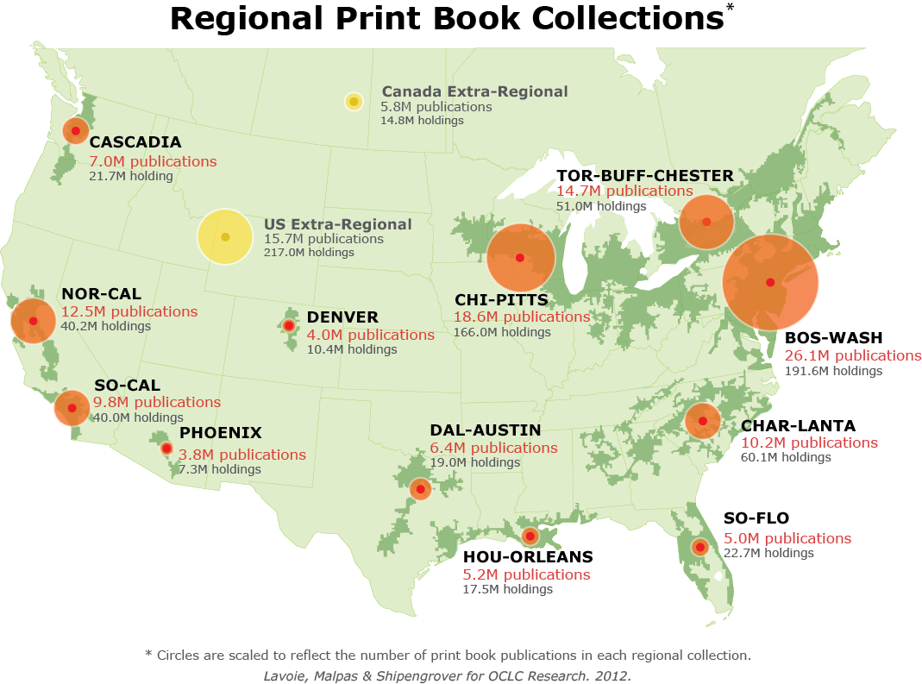
OCLC Research, 2012
Notes:
Here to talk about SoCal print book resource, but useful to put it in context of other NA mega regions.

Slide 45
‘Density’ of print book holdings in SoCal
SoCal
Majority of titles held by <5 libraries in region
OCLC Research, 2012
Notes:
So this necessarily raises the question of ‘how much is enough’ and the degree to which SoCal institutions must rely on extra-regional partners to supplement intra-regional preservation infrastructure.

Slide 46
Distribution of SoCal Print Books by Holding Library Type
SoCal
Majority of titles held by academic libraries
N = 40M holdings
OCLC Research, 2012
Notes:
About 2/3rds of the regional print book collection (holdings) is held by academic libraries. So as academic sector changes, we can anticipate potentially major impact on SoCal print book collection.

Slide 47
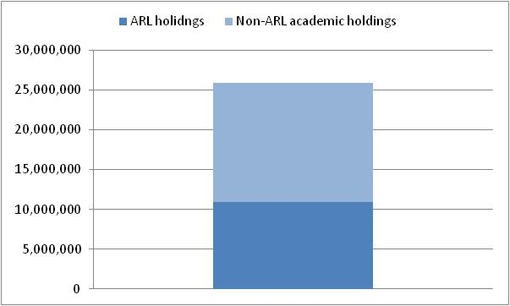
Distribution of SoCal Print Books in Academic Libraries
SoCal
… mostly non-ARL libraries
37%
of SoCal holdings
27%
of SoCal holdings
N = 26M holdings in SoCal academic libraries; 40M holdings in all SoCal libraries
OCLC Research, 2012
Notes:
About 2/3rds of the regional print book collection (holdings) is held by academic libraries. So as academic sector changes, we can anticipate potentially major impact on SoCal print book collection. A significant part of the regional inventory is held by institutions that are likely to shed low-use print materials.

Slide 48
In sum: institutional stewardship
Evidence
2/3rds of SoCal print book collection is held by academic libraries
Most of these held by non-ARL institutions with limited preservation capacity or mandate
OPINION
As mid-tier HEI seek to adapt to competitive e-learning environment, local investment in print management is likely to decline; external cooperative or commercial strategies will be increasingly attractive to academic administrators

Slide 49
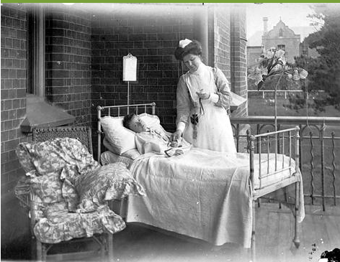
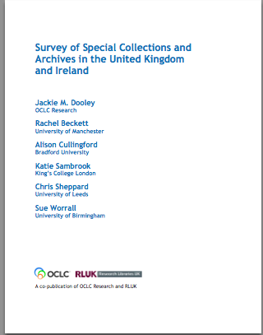
Taking Our Pulse(s)
Notes:
A 2009 survey of special collections and archives in the US and Canada shows that digitization of special collections and increasing user access to those collections are of critical importance to research libraries.
The survey was a follow up to the 1998 ARL survey led directly to many high-profile initiatives to "expose hidden collections.“
We updated ARL’s survey instrument and extended the subject population to encompass the 275 libraries in the following five overlapping membership organizations:
• Association of Research Libraries (124 universities and others)
• Canadian Academic and Research Libraries (30 universities and others)
• Independent Research Libraries Association (19 private research libraries)
• Oberlin Group (80 liberal arts colleges)
• RLG Partnership, U.S. and Canadian members (85 research institutions)
The rate of response was 61% (169 responses).
http://commons.wikimedia.org/wiki/File:Stethoscope_1.jpg
Stethoscope. Public domain.

Slide 50
Key Findings
“Most challenging issues”
Space
Born Digital
Digitization
Tough economy renders “business as usual” impossible
User demand for digitized collections is insatiable
Management of born-digital materials is in its infancy
Notes:
The OCLC report reveals, despite the efforts to uncover hidden collections, much rare and unique material remains undiscoverable, and monetary resources are shrinking at the same time that user demand is growing. The balance sheet is both encouraging and sobering:
• The size of ARL collections has grown dramatically, up to 300% for some formats
• Use of all types of material has increased across the board
• Half of archival collection descriptions have no online presence
• While many backlogs have decreased (compared to the 1998 survey), almost as many continue to grow
• User demand for digitized collections is insatiable
• Management of born-digital archival materials is still in its infancy
• 75% of general library budgets have been reduced
• Staffing is generally stable, but has grown for digital services
• The current tough economy renders “business as usual” impossible
The top three “most challenging issues” in managing special collections were space (105 respondents), born-digital materials, and digitization.

Slide 51
Recommendations
Digitization
Develop models for large scale digitization
User services
Promote policies that facilitate (rather than inhibit) access
Born-digital archival materials
Create a no-expertise-needed program for management
Notes:
Focused on issues that warrant shared action
Assessment
--Develop and promulgate metrics that enable standardized measurement of key aspects of special collections use and management.
Collections
--Identify barriers that limit collaborative collection development.
--Take collective action to share resources for cost-effective preservation of at-risk audiovisual materials.
User Services
--Develop and liberally implement exemplary policies to facilitate rather than inhibit access to and interlibrary loan of rare and unique materials.
Cataloging and Metadata
--Compile, disseminate, and adopt a slate of replicable, sustainable methodologies for cataloging and processing to facilitate exposure of materials that remain hidden and stop the growth of backlogs.
--Develop shared capacities to create metadata for published
--Convert legacy finding aids using affordable methodologies to
Digitization
--Develop models for large-scale digitization of special collections,
--Determine the scope of the existing corpus of digitized rare books,
Born-Digital Archival Materials
--Define the characteristics of born-digital materials that warrant their
management as “special collections.”
--Define a reasonable set of basic steps for initiating an institutional program for responsibly managing born-digital archival materials.
--Develop use cases and cost models for selection, management, and preservation of born-digital archival materials.
Staffing
--Confirm high-priority areas in which education and training

Slide 52
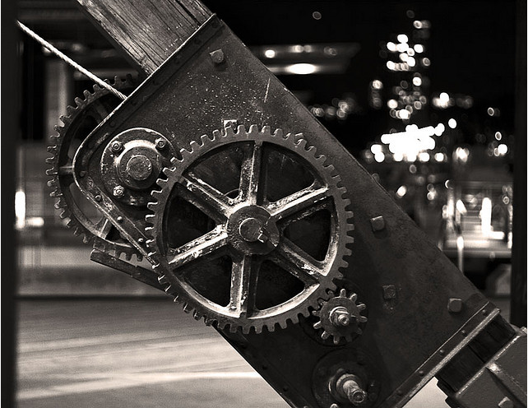
Shifting Gears: Moving up to large-scale digitization
Notes:
So let’s take each of these in turn, starting with digitizition and what institutions can do
Our paper “Shifting Gears,” was written following a partner event called “Digitization Matters” where we invited speakers to talk about what they were or should be doing to increase scale of special collections digitization. The paper tales off from the event and argues for scaling up the digitization of special collections, encouraging more radically accessible collections, with a particular focus on adopting a “just do it” attitude towards digitization.
Recommendations are intended to help special collections keep pace with mass digitization of books. We can hide those treasures in our backlogs or behind custom portals -- or we can push them out into the light of day.
Cogs And Gears At Pier In Sydney
http://www.flickr.com/photos/greenputty/168099505/

Slide 53
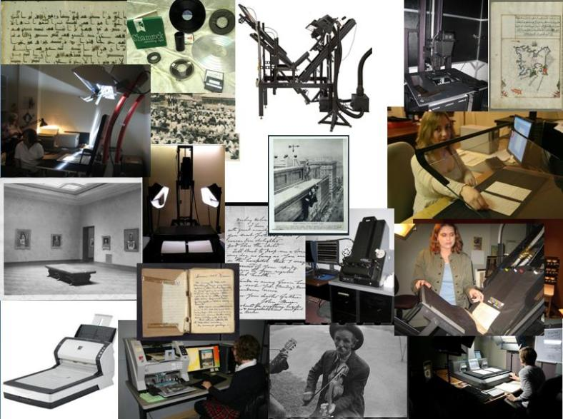
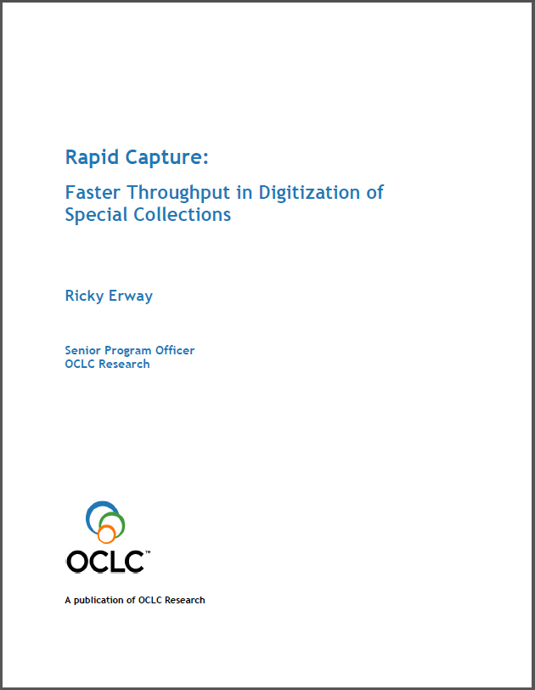
Rapid Capture: Faster throughput
Notes:
As institutions begin programmatically digitizing collections, they will want to incorporate innovative approaches. "Rapid Capture” looks at the moment of actual digitization of a variety of formats and highlights approaches that capture at scale.
We identified some innovative ways to accelerate throughput.
There are 9 vignettes + 2 bonus stories. They describe quite succinctly: What they did, how they did it, and the result.

Slide 54
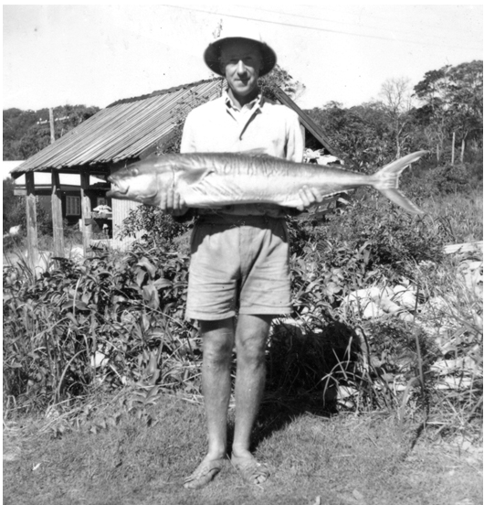
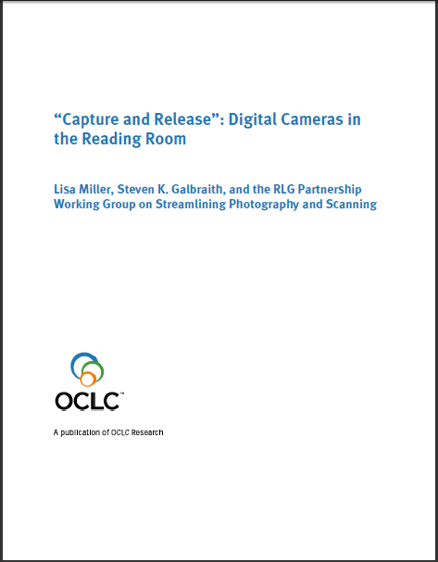
Capture and Release: DIY reading room photography
Notes:
There are other ways we can make special collections more accessible. The 2010 "Capture and Release”⁸ argues for allowing, if not encouraging, cameras in the Reading Rooms, and was written in response to something we heard repeatedly in the OCLC Research Library partnership – should I, or should I not allow the use of camera in the reading room. ⁸ www.oclc.org/research/publications/library/2010/2010-05.pdf
Ray Madsen with a prize catch, Noosa Heads, ca 1950 [picture]
https://sunshinecoast.spydus.com/cgi-bin/spydus.exe/FULL/PIC/BIBENQ/55304388/30126892,1?FMT=IMG&IMGNUM=1

Slide 55
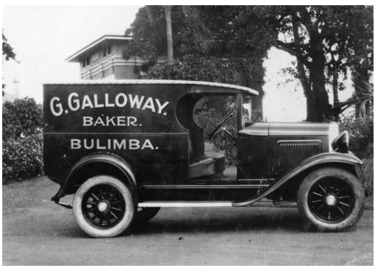
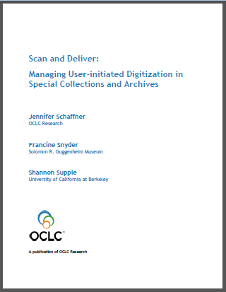
Scan and Deliver: User-initiated digitization
Notes:
"Scan and Deliver: Managing User Initiated Digitization in Special Collections and Archives"⁹investigates policy issues related to patron-initiated digitization of materials.
⁹
Steps in user-initiated digitization – review, decide, scan, and deliver – have a spectrum of tracks for workflow.

Slide 56
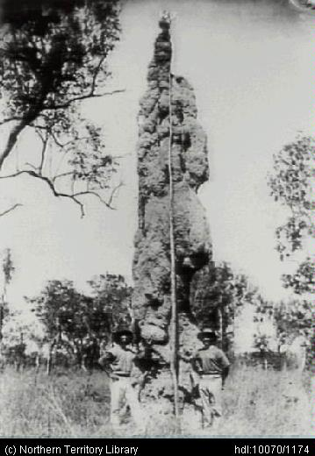
Archival collections assessment: How to prioritize?
Notes:
I’m not going to talk about our work to define and provide models for archival collections assessment, the collection of qualitative and quantitative data which can help you prioritize important archival management functions including appraisal, processing, digitization, conservation, and collection management.

Slide 57
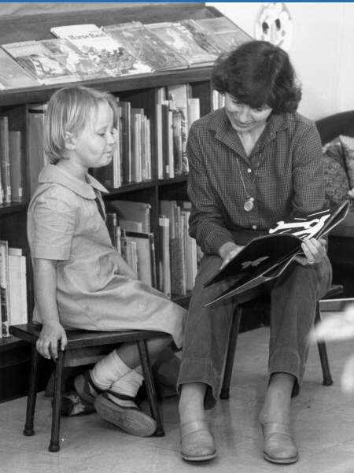
Sharing special collections: “Treasures on trucks”!
Advisory group made up of special collections and ILL staff
Streamlining workflows for requests
Checklist to ensure trust
Notes:
Finally, I’m not talking about how we are working to help make researchers lives easier by sharing special collections via interlibrary loan. This in controversial in the US and almost unheard of in the UK and Ireland, but we hope to establish some models for experimentation and implementation.
The Sharing Special Collections Advisory Group is made up of special collections specialists and interlibrary lending staff, in several cases teams from the same institution.
Two main tasks have been identified during preliminary discussions: streamlining work flows when handling ILL requests for rare and unique materials, and exploring how best to go about building trust between two institutions sufficient to allow the physical lending of special collections materials.
A subset of the interlibrary loan practitioners will draft recommended work flows for handling external requests for special collections items, which will be submitted for review to the entire group.
Another subset of the group will explore the idea of creating a checklist for facility, staffing, policy and procedural standards that must be met to ensure “trustworthy” handling of another library's special materials on loan.
ImagesACT
ACT Heritage Library Images ACT
backReference #: 002651Sharing stories at the public library
http://www.basis.act.gov.au/DUSLibrary/ImagesACT.nsf/3506a89b45287c52ca256abc000c49a8/6a1b1a321a2feb924a256ca70016fed1!OpenDocument

Slide 58
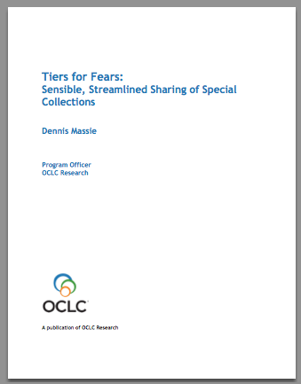
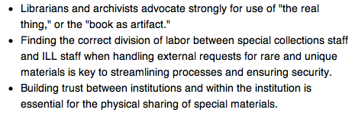
Sharing special collections
Coming spring 2013!

Slide 59
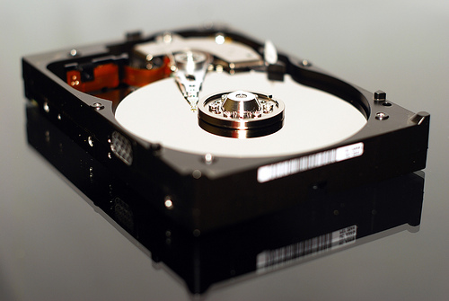
Demystifying Born Digital
Notes:
Program of work inspired by findings from our survey of special collections, which identified this not only as an area of concern, but an area where our partners and others have been paralyzed and have made very little progress. This program area focussed on enhancing effective management of born-digital materials as they intersect with special collections and archives in research libraries.
Working with a number of advisors (who are themselves largely learning as they go, rather than experts in digital preservation), break down what seems to be a giant problem into a number of smaller problems.
photo credit: <a href="http://www.flickr.com/photos/gatiuss/4053789290/">Gatis Gribusts</a> via <a href="http://photopin.com">photopin</a> <a href="http://creativecommons.org/licenses/by-nc/2.0/">cc</a>

Slide 60
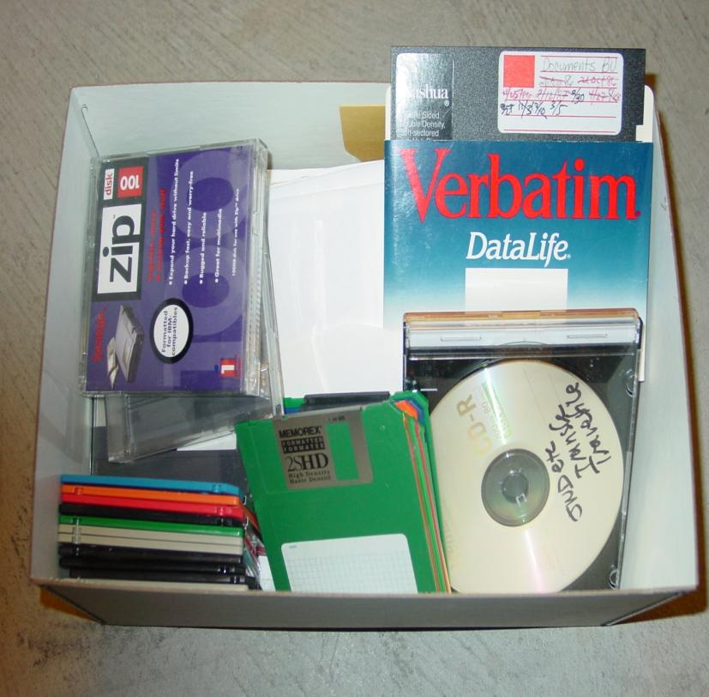
Born-digital materials are …
Undercollected
Undercounted
Undermanaged
Unpreserved
Inaccessible
American Heritage Center

Slide 61
Suite of “reportlets”
Outline first steps to begin managing removable physical media (1st & 3rd reports)
Advocate for collaboration in converting obsolete media (2nd)
Articulate the relevant skills and expertise of archivists (4th)
Describe how these pertain to various types of born-digital material and how special collections and archives intersect with “born digital” (5th)

Slide 62
Target audiences
Research library directors and institutional administration
Archivists and special collections librarians
Other specialists
Collection development
Curatorial
Digital library
Information technology
Metadata
Records management

Slide 63
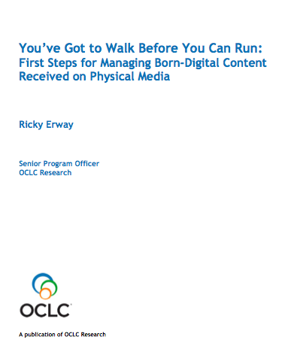
First Steps for Managing Born-Digital Physical Media (Published August 2012)

Slide 64
Intent of First Steps
Seek confidence building rather than overwhelming novices with complex information and procedures.
Knowing what you have (i.e., do an inventory) and taking some simple technical steps can allay the fear factor.
Archivist may have to begin alone without help from IT staff.
Having taken first steps, it’s then easier to continue learning.

Slide 65
Part 1: Collections management first steps
Inventory what you have
Types & quantities of physical media
File formats
Estimated number of gigabytes
Prioritize materials for processing
Anticipated level/nature of use
Level of significance/uniqueness
Potential loss due to age or type of media
Unique content not replicated elsewhere

Slide 66
Part 2: Technical steps for readable media
1. Use a “clean” computer.
2. Use a write blocker.
3. Insert source media. Do not attempt to open any files.
4. Create a disk directory.
5. Copy files from media to the directory. Consider copying as a disk image.
6. Generate a copy of the directory.
7. Generate and record a checksum.
8. Create a readme file.
9. Copy the directory to trustworthy archival storage.
10. Return the original physical media to storage.
11. Create or update any associated descriptive tool(s).

Slide 67
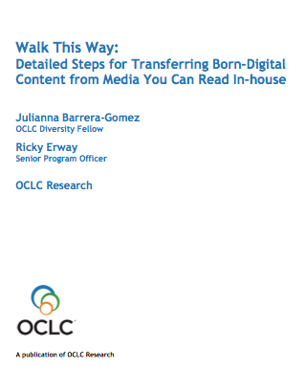
Detailed Steps
for Managing Born-Digital Physical Media
Coming spring 2013!

Slide 68
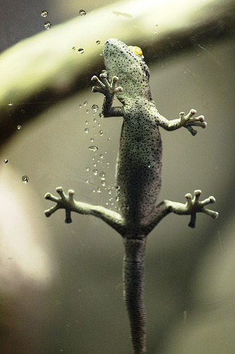
Swatting the Long Tail of obsolete media
Notes:
The second report, Swatting the Long Tail of Digital Media: A Call for Collaboration, urges a collaborative approach for conversion of content on various types of digital media. As with First Steps, the document refers only to born-digital material on physical media. This essay is intended for managers who are making decisions on where to invest their born-digital time and money. It should help them understand that any expectations that local staff will be able to handle everything are probably impractical. We hope it’ll also help archivists (and others) in the trenches breathe a sigh of relief to think that perhaps they won’t have to deal with an array of obsolete media all on their own.

Slide 69
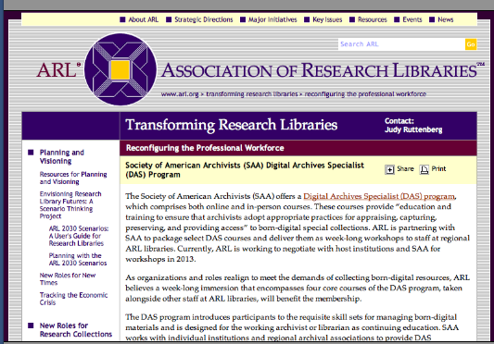
DAS comes to ARL libraries!

Slide 70
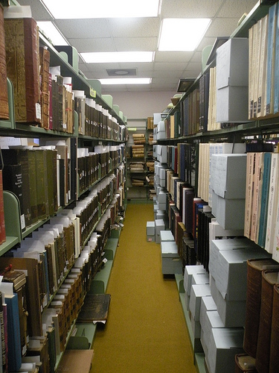
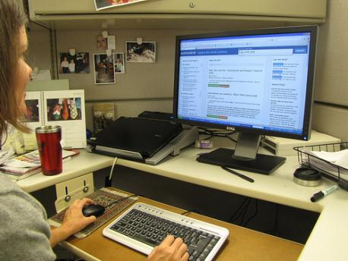
ArchiveGrid, connecting researchers to primary source materials …
http://beta.worldcat.org/archivegrid/
Notes:
I’m also not going to talk about ArchiveGrid, which is a free service that brings together 1.7 million archival collection descriptions to help researchers discover collections of interest and connect with archives.
“Current Archives” is copyright (c) 2011 Carmichael Library and made available under a Attribution 2.0 license: http://creativecommons.org/licenses/by/2.0/deed.en

Slide 71
